Slide 1
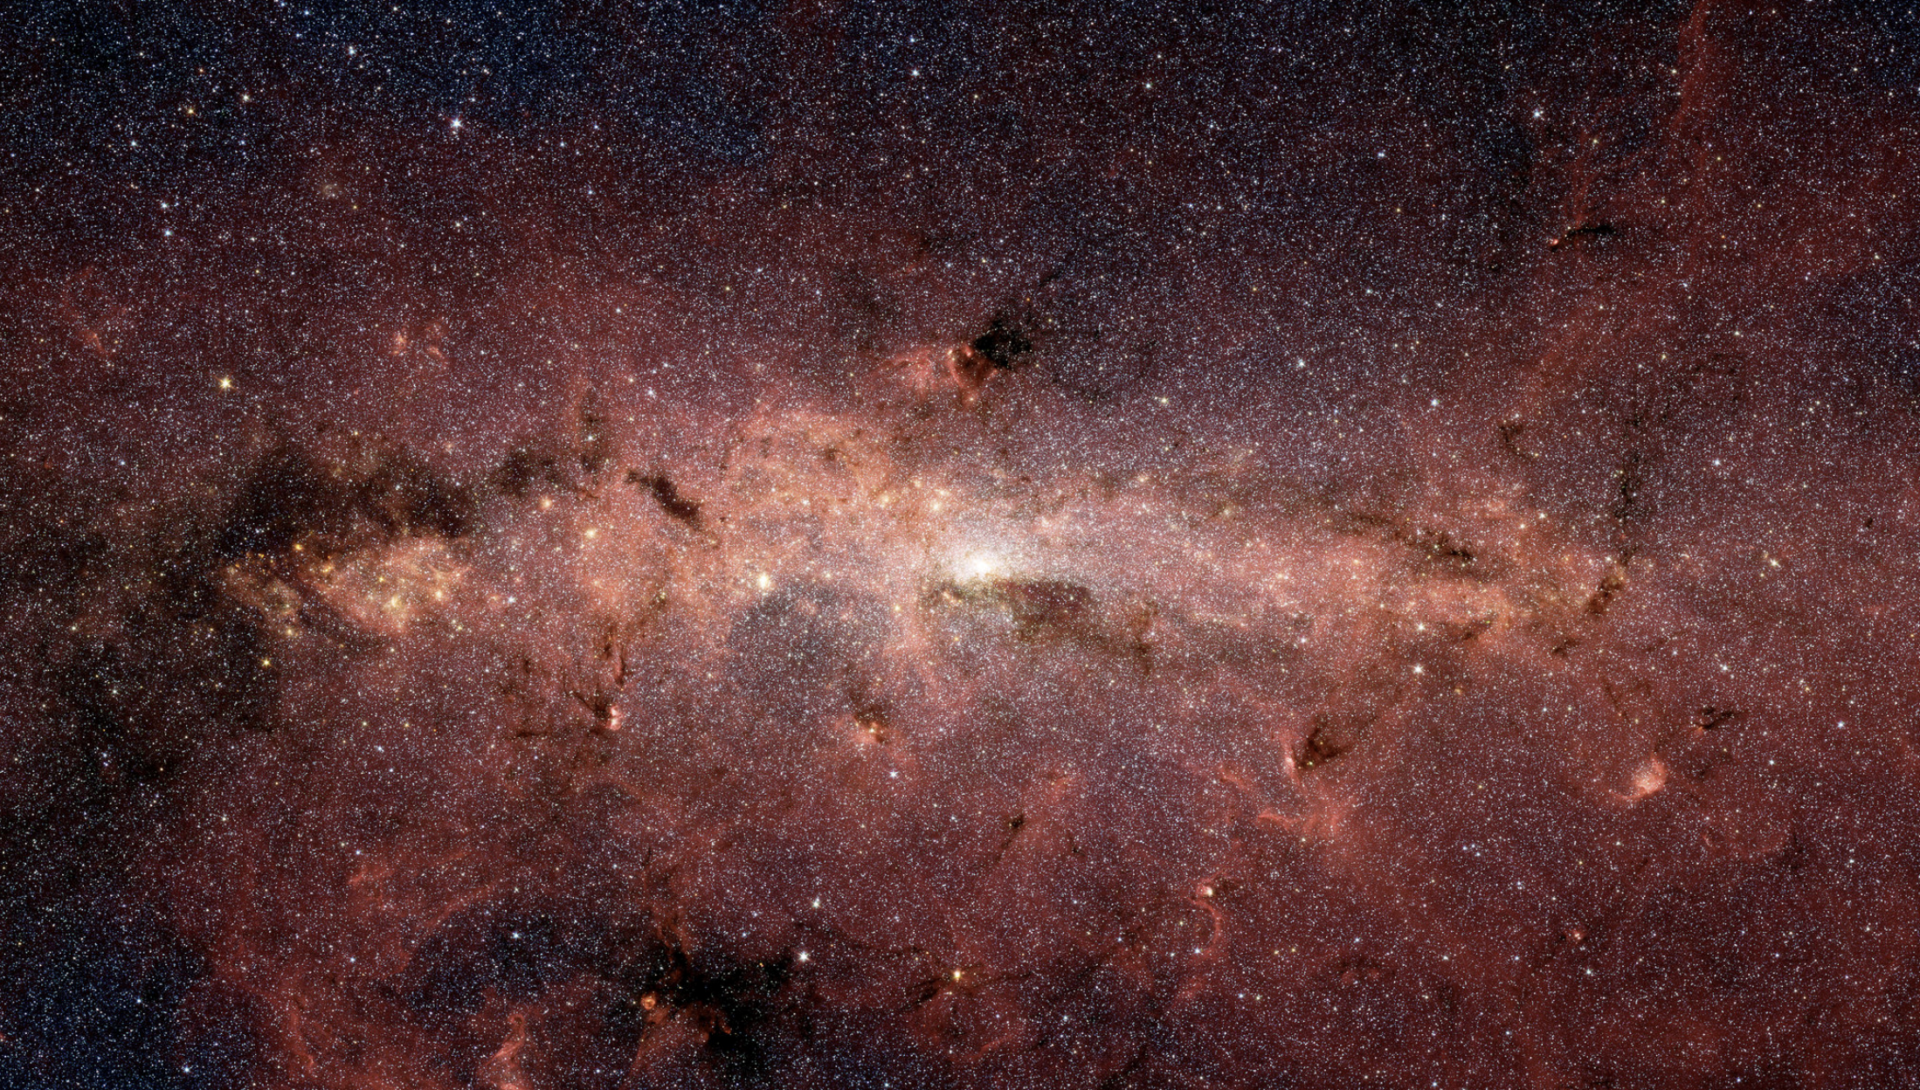
Science Teams and Advisory Committees

Slide 2
Summary
Science Definition Teams provided scientific input to pre-Formulation mission concept development
Science Definition Team #1
Chartered by HQ to work with Project to provide advice on implementation of WFIRST as-recommended by Astro-2010
No funded science team support
February 2011 – August 2012
Final Report: arXiv:1208.4012
Science Definition Team #2
Chartered by HQ to work with Project to determine whether or not to base WFIRST on the 2.4m telescope assets
No funded science team support
November 2012 – February 2015
Final Report: arXiv:1503.03757
Formulation Science Working Group & Science Investigation Teams
Chartered by HQ to support Project during Formulation and through the Mission Critical Design Review
11 Science investigation teams funded, spanning wide range of science (see subsequent slides)
FSWG consisted of PIs of the SITs, members of Project, Science Centers, and HQ
February 2016 – October 2021
Reports & papers: many; see science team community briefings:
https://roman.gsfc.nasa.gov/science/workshop112021/agenda.html https://roman.ipac.caltech.edu/mtgs/Roman_CGI_workshop.html
Roman Science Interest Group
Chartered by Project Scientist to provide broad-based scientific input

Slide 3
Science Investigation Teams (2016 - 2021)
Supernova Cosmology: Ryan Foley, Saul Perlmutter
Weak Lensing and Galaxy Redshift Survey: Olivier Dore
Exoplanet Microlensing: Scott Gaudi, David Bennett
Exoplanet Coronagraphy: Bruce Macintosh, Margaret Turnbull
Nearby Galaxies: Ben Williams
Extragalactic: Brant Robertson
Archival Research: Alexander Szalay
Cosmic Dawn: James Rhoads
Milkyway: Jason Tumlinson
~300 scientists in total
scientific performance requirements related to the specific science area,
design of overall observational strategy concept,
science data analysis techniques,
ground and space calibration requirements,
science simulations, precursor observations,
ground calibration, observational needs, data processing, ancillary data collection/incorporation, analysis, dissemination and documentation of the proposed science investigation.
science team contracts expired late 2021
Adjutant Scientists
David Spergel - WFI
Jeremy Kasdin - CGI
(Code of conduct established/discussed in 2019)

Slide 4
Formulation Science Working Group (2016– 2021)
Formulation Science Working Group (FSWG)
Coordinated overall work of teams & interactions with Project
Chaired by Project Scientist & the CGI and WFI Adjutant Scientists
Julie McEnery (chair) | Senior Project Scientist
Jeremy Kasdin (co-chair) | Adjutant (CGI)
David Spergel (co-chair) | Adjutant (WFI)
Ex-Officio
Dominic Benford | Program Scientist
Lee Armus | Science Center
Ken Carpenter | Deputy Proj. Sci.
Jeff Kruk | Deputy Sen. Proj. Sci.
Jason Rhodes | Deputy Proj. Sci.
Roeland van der Marel | Science Center
Science Team PIs
Olivier Dore | Weak Lensing, GRS
Ryan Foley | Supernovae
Scott Gaudi | Microlensing
Jason Kalirai | Milky Way (GO/GI)
Bruce Macintosh | Exoplanets
Saul Perlmutter | Supernovae
James Rhoads | Cosmic Dawn (GO/GI)
Brant Robertson | ExtraGalactic (GO/GI)
Alex Szalay | Archival Science (GO/GI)
Maggie Turnbull | Exoplanets
Ben Williams | Nearby Galaxies (GO/GI)
Science Team Deputy PIs
Dave Bennett | Microlensing
Chris Hirata | Weak Lensing, GRS
Nikole Lewis | Exoplanets
Aki Roberge | Exoplanets
Yun Wang | Weak Lensing, GRS
David Weinberg | Weak Lensing, GRS

Slide 5
Roman Science Interest Group (2020 - .. )
https://roman.gsfc.nasa.gov/science/rsig.html
Meeting presentations and notes available on the meetings tab
Discussions on observing program, proposal opportunities, mission/instrument status etc
Regular opportunities to join this group
Reports to Project and Program Scientists
Megan Donohue (Chair) | Michigan State U.
Zeljko Ivesic | U. Washington
Jessica Lu | UC Berkeley
John MacKenty | STScI
Ashley Villar | Columbia U / Flatiron Institute
Alice Shapley | UCLA
Keith Bechtol | UW, Madison
Saurabh Jha | Rutgers U
Peter Melchior | Princeton U
Dara Norman | NOIRlab
Jessie Christiansen | NEXSci/ CalTech
Rachel Bean | Cornell U
Ryan Hickox | Dartmouth
Dimitri Mawet | CalTech
David Spergel | Simons Foundation (ex-officio)
Jeremy Kasdin | U. San Francisco (ex-officio)
Roeland van der Marel | Science Center (STScI) (ex-officio)
Lee Armus | Science Center (IPAC) (ex-officio)

Slide 6
Roman Space Telescope Advisory Committee (2020 - …)
Charged to provide advice to the STScI director on Roman Science Operations
Beth Willman(Chair) | Aura
Zeljko Ivesic | U. Washington
Zachory Berta-Thompson | University of Colorado
Enzo Branchini | Universita Roma Tre
Wendy Freedman | University of Chicago
Joshua Frieman | Fermi National Laboratory
Lori Lubin | University of California, Davis
John Mather | GSFC
Kristen McQuinn | Rutgers University/University of Texas at Austin
Matthew Penny | Louisiana State University
Adam Riess | Johns Hopkins University/STScI
David Spergel | Simons Foundation (ex-officio)
Dominic Benford | NASA/HQ(ex-officio)
Julie McEnery | GSFC (ex-officio)
Neill Reid | STScI ex-officio)

Slide 7
Backup

Slide 8
SDT #1 Charter (key points)
“The SDT is to provide science requirements, investigation approaches, key mission parameters, and any other scientific studies needed to support the definition of an optimized space mission concept satisfying the goals of the WFIRST mission as outlined by the Astro2010 Decadal Survey.”
“In particular, the SDT report should present assessments about how best to proceed with the WFIRST mission, covering the cases that the Euclid mission, in its current or modified form, proceeds to flight development, or that ESA does not choose Euclid in the near future.”

Slide 9
SDT #1 Membership
name | affiliation | expertise
J. Green | Univ. of Colorado/CASA (Co-Chair) | UV Instrum
P. Schechter | MIT (Co-Chair) | Theory
R. Bean | Cornell University | (BAO/Alternate Gravity,CMB) Theory-Obs
C. Baltay | Yale | DE
C. Bennett | JHU | DE, BAO, mission development
D. Bennett | Univ. of Notre Dame | EXOP (ML)
R. Brown | STScI | Exoplanet
C. Conselice | Univ. of Nottingham | Surveys
M. Donahue | Michigan State Univ. | galaxy clusters
S. Gaudi | Ohio State Univ. | ExoP (ML)
T. Lauer | NOAO | WL/SN; Mission development
B. Nichol | Univ. of Portsmouth | BAO
S. Perlmutter | Univ. of Berkeley / LBNL | DE (SN)
B. Rauscher | GSFC | IR detectors
J. Rhodes | JPL | DE, WL, detectors
T. Roellig | Ames | Tech/Manag
D. Stern | JPL | IR Surveys
T. Sumi | Nagoya Univ. | Exop (ML)
A. Tanner | Georgia State Univ. | Exoplanet
Y. Wang | Univ. of Oklahoma | Theory/observations
E. Wright | UCLA | IR Surveys - WISE PI
N. Gehrels | GSFC (Ex-Officio)
R. Sambruna | NASA HQ (Ex-Officio)
W. Traub | JPL (Ex-Officio)

Slide 10
SDT #2 Charter (key points)
The SDT is to continue the development of science requirements, investigation approaches, key mission parameters, and any other scientific studies needed to support the refinement and optimization of a space mission concept (Design Reference Mission) to further the science priorities described in NWNH for a wide field infrared survey telescope and maturation of technology and science for an exoplanet direct imaging mission. Justification for conducting the proposed science investigations from space and an assessment of how such investigations will complement existing and planned domestic and international ground and space facilities should continue to be addressed in the SDT's report.
The SDT and Astrophysics Focused Telescope Assets (AFTA) Study Office will update the April 2013 Design Reference Mission (DRM) and document the effort in a study report. The AFTA Study Office will develop cost and schedule scenarios that address both optimal build scenarios as well as other funding profiles that might be provided during the course of the study. Overall mission cost is to be kept as low as possible while still achieving all or part of the science priorities for a wide field infrared survey telescope and exoplanet technology and science maturation. A descopable internal coronagraph instrument for the detection and study of exoplanets will be included in the design reference mission, consistent with the design reference and requirements for the existing telescope asset and the IR survey. Modularity to facilitate emerging robotic servicing capabilities shall also continue to be studied.

Slide 11
SDT #2 Membership
Name | Affiliation
David Spergel | Princeton
Neil Gehrels | Goddard
James Breckinridge | Caltech
Megan Donahue | Michigan State U
Alan Dressler | Carnegie Institution
Chris Hirata | Caltech
Scott Gaudi | Ohio State U.
Thomas Greene | Ames
Olivier Guyon | U. Arizona
Jason Kalirai | STScI
Jeremy Kasdin | Princeton
Peter Lawson | JPL
Warren Moos | Johns Hopkins U.
Saul Perlmutter | Berkeley
Marc Postman | STScI
Bruce Macintosh | Stanford
Name | Affiliation
Bernie Rauscher | Goddard
Jason Rhodes | JPL
David Weinberg | Ohio State U.
Yun Wang | U. Oklahoma
Dave Bennett | Notre Dame
Charles Baltay | Yale
Toru Yamada | Tohoku U., Japan
Yannick Mellier | IAP, France
Dominic Benford | HQ
Wes Traub | JPL
Bernie Rauscher | Goddard
Ex officio
George Helou | Caltech-IPAC
Roc Cutri | Caltech-IPAC
Mike Seiffert | JPL

Slide 12
FSWG Charter (key points)
The FSWG is to continue the development of science requirements, investigation approaches, key mission parameters, and any other scientific studies needed to support the refinement and optimization of the Phase A Design Reference Mission (DRM) to further the science priorities described in NWNH for a wide field infrared survey telescope and maturation of technology and science for an exoplanet direct imaging mission.
The FSWG and WFIRST Study Office (hereafter referred to as the Project Office, assuming Formulation has been entered) are to update the existing DRM and document the effort in annual presentations. This shall include several facets for the FSWG:
Refine science requirements and performance metrics and objectives for the WFIRST telescope, instrumentation, software, operations, and other aspects of the program,
Participate in negotiations involving the observatory/science interfaces,
Participate in refining the mission design,
Participate in the refinement of project science plans and the philosophy for defining and conducting the science program,
Recommend solutions to technical and resource problems during the development and implementation phases of the mission.
Overall mission cost is to be kept as low as possible while still achieving all or a critical part of the science priorities for a wide field infrared survey telescope and exoplanet technology and science maturation.
The FSWG shall evaluate all areas identified by the selected SITs, with special attention to several overarching subjects:
Requirements development, refinement and flowdown, including calibration
Operations concept refinement, survey yield predictions and survey efficiency drivers, including calibration
Optimization of observatory to reduce risk and minimize cost
Optimization of the observatory to address any changes in the scientific landscape
Payload performance assessments
The FSWG shall participate in WFIRST Project reviews in order to coordinate scientific requirements and assist the WFIRST Project in mission decisions as they relate to the scientific objectives.

Slide 13
RSIG Charter
The Roman Science Interest Group (RSIG) will provide broad-based community input to the Roman project and NASA headquarters. Its primary purpose is to assist NASA in ensuring that the interests of the scientific community are served by the Roman project in planning for and executing Roman development and operations.
The RSIG will provide input to the Roman Project and NASA HQ on the structure of future science team and investigation calls; user support functions across the Roman project; considerations for defining and conducting the science program, including time allocation; and other science needs as requested by the project or program.

Slide 14
WFIRST Science Assessment Team (2019)
NASA HQ has chartered a group to review the WFIRST Level-1 and Level-2 requirements and provide options for potential changes that might reduce cost or reduce cost risk in the future.
Such suggestions would not affect the mission architecture, but could affect approaches to requirements verification.
Could save on test equipment or test time during Integration and Test
Schedule:– Final report: January 15
Membership: John MacKenty (chair), Lee Feinberg, Cynthia Froning, Adam Riess, Glenn Schneider, Michael Schneider, Michael Strauss, Alycia Weinberger; Dominic Benford (HQ) and Jeff Kruk (PS)

