Slide 1
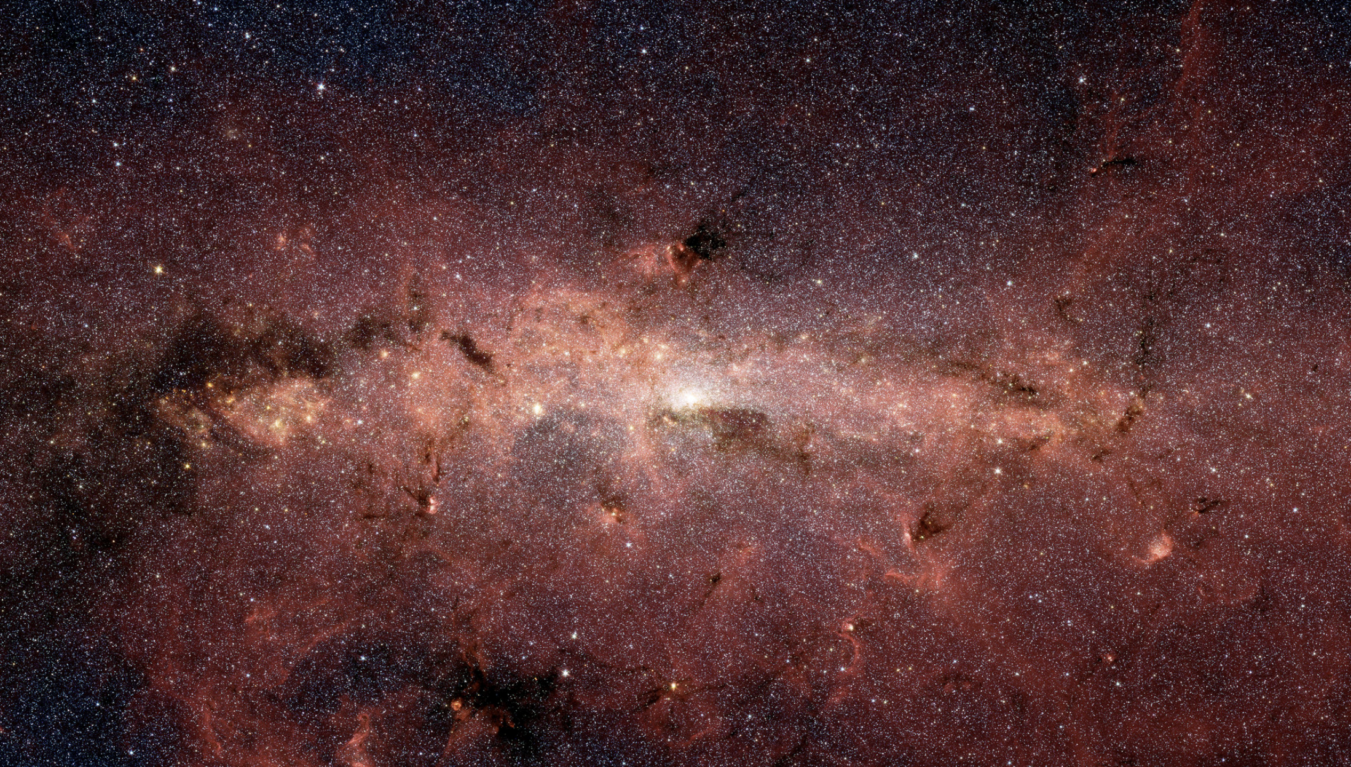
General Astrophysics Surveys – Program Balance

Slide 2
General Astrophysics Surveys – program balance
Roman’s Core Community Surveys will enable an exceptionally broad range of science
But won’t do everything
General Astrophysics Surveys provide flexibility to pursue additional science
Current baseline program allows for 30 surveys over 3 proposal cycles
~2 weeks per survey if time was equally divided
Other large ambitious survey ideas that would have broad science reach
Milkyway survey (on plane or in halo)
Snapshot survey of entire Rubin footprint
Etc
Should we explicitly set aside time for large General Astrophysics Surveys?

Slide 3
General Astrophysics Surveys – number of programs
Larger programs leverage Roman’s strengths in observing efficiency
Structure of our program will encourage community cooperation to design the best surveys
e.g. one program to observe 15 nearby galaxies vs 15 independent programs each observing one
Maximizing science reach without increasing mission scope /cost (i.e. guaranteeing more than 30 programs) will require community coordination
In the meantime, the project will continue to explore ways to increase the number of programs in a cost neutral way
Is this a reasonable approach?

