Slide 1
WFIRST Requirements Flowdown
Jeffrey Kruk
WFIRST Project Scientist
NASA/GSFC
October 22, 2018

Slide 2
Requirements Flow
Program Level Requirements Appendix (PLRA)
  Defines Objectives, Project organization, performance metrics, mission success criteria
Science Requirements Document
  Provides flowdown from objectives to observatory & ground system capabilities
Mission Requirements Document
  Provides flowdown to mission segment requirements
Science Objectives
Mission Success Criteria
PLRA
Science & Technical Requirements
(Baseline & Threshold Requirements)
Level 1 Requirements
Science Requirements (SRD)
Level 2 Requirements
Mission Requirements (MRD)
Instrument and Spacecraft
Requirements
Level 3 Requirements
Component Requirements

Slide 3
Science Objectives
Science | Science Objective
NIR Survey | Conduct near-infrared (NIR) sky surveys in both imaging and spectroscopic modes, providing an imaging sensitivity for unresolved sources better than 26.5 AB magnitude.
Expansion History | Determine the expansion history of the Universe using GRS, WL, & SN, at redshifts up to z = 2 with high-precision cross-checks between techniques.
Growth of Structure | Determine the growth history of the largest structures in the Universe using WL, RSD, & Galaxy Clustering, at redshifts up to z = 2 with high-precision cross-checks between techniques.
Exoplanet Census | Carry out a statistical census of exoplanets from the outer habitable zone to free floating planets, including analogs to all of the planets in our Solar System >MMars, using microlensing.
GO Program | Devote a substantial fraction of the mission lifetime to a peer-reviewed GO program.
AR Program | Provide a public archive and a peer-reviewed archival research program.

Slide 4
Technology Demonstration Objectives
Technology | Technology Demonstration Objective
Active Wavefront Control | Demonstrate coronagraphy in space with an obscured aperture and active wavefront control
Coronagraph Elements | Advance the engineering and technical readiness of key coronagraph elements: coronagraph masks, low-order wavefront sensors, high actuator count deformable mirrors, low noise detectors, and integral field spectrographs.
Coronagraph Algorithms | Support development and in-flight demonstration of coronagraph software that could enhance the capability or simplify the architecture of future missions.
Performance Characterization | Perform measurements that characterize the integrated performance of the coronagraph and observatory as a function of time, wavelength, and polarization.
Data Processing | Demonstrate advanced data processing and analysis techniques required to identify, spectrally characterize and distinguish astronomical sources at high contrast.

Slide 5





SRD Flowdown Description
Objective
PLRA
SRD
Science Requirements
Science Data Record
e.g., mosaics, catalogs
Calibrated Data Record
e.g., calibrated images
Raw Data Record
e.g., N_{images} (mag, filter, cadence)
MRD & Element Specs
Data Processing
Gnd Sys/Operations
Flight Hardware

Slide 6
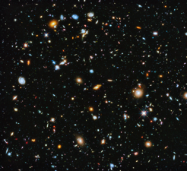
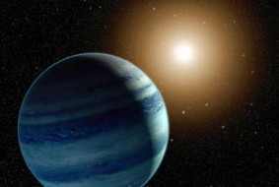
Primary Objectives from PLRA
Dark Energy
Exoplanets
Direct Imaging (≥ Super Earth’s & Disk Formation)
Exoplanet Spectroscopy
Use 3 different methods to measure cosmic expansion history and growth of structure
Enables tests of theories of accelerated expansion including Dark Energy and modifications to General Relativity
Expand Census of Exoplanets (Outer Habitable Zone - Free floating, ≥ Mars Mass)
Provide General Observer and Guest Investigator Programs for the community
Science Objectives
Dark Energy
  Expansion History of the Universe
  Growth of Structure in the Universe
Exoplanets
  Exoplanet Survey
Technology Objectives
Demonstrate coronagraphy in space
Super-nova Survey | High Latitude Imaging Survey
High Latitude Spectral Survey | Micro-Lensing Survey
Direct Imaging
Spectro-scopy

Slide 7
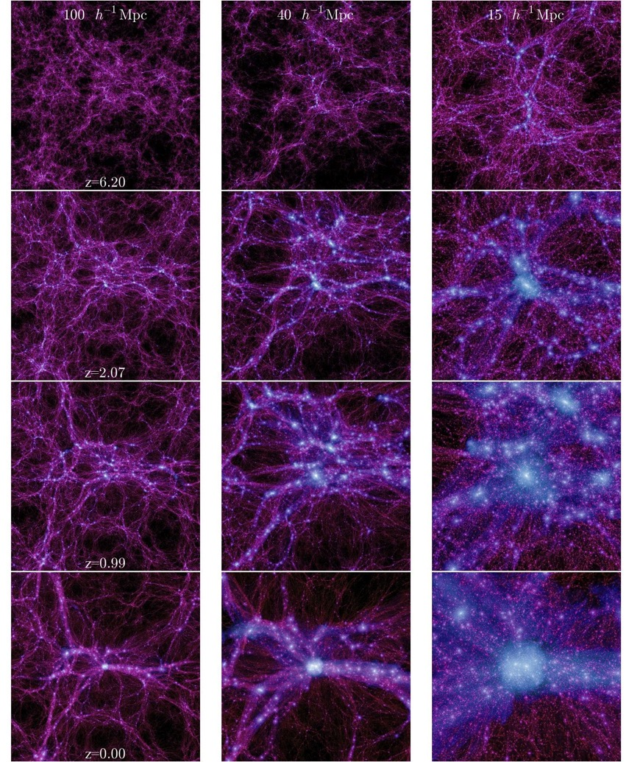
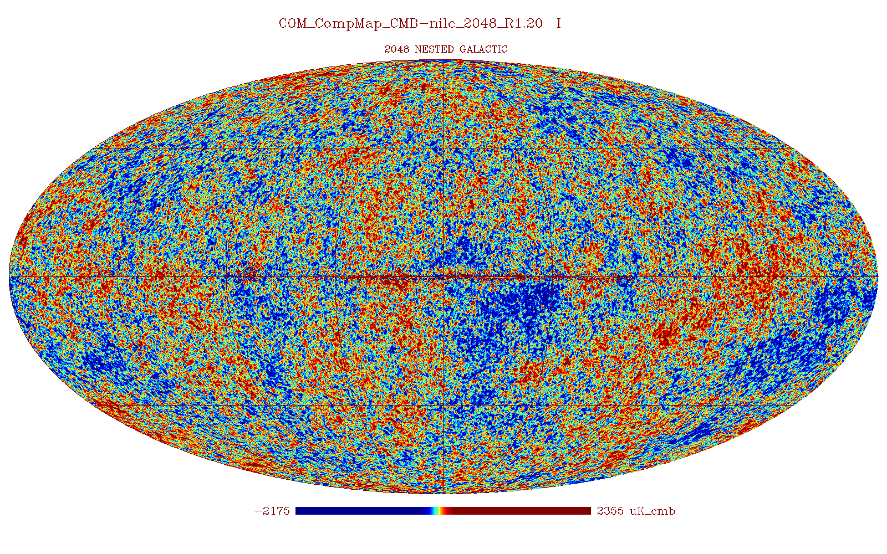
High-Latitude Survey addresses 3 Objectives
WFIRST will measure expansion history and growth of structure
  If results discrepant -> breakdown of general relativity
  If results agree -> learn about nature of dark energy
WFIRST provides multiple probes, enabling cross-checks for astrophysical and instrumental systematics.
Datasets also address NIR survey objective.
~ 1 WFIRST FoV
Z=6.20
Z=2.07
At z~1100, matter distribution is uniform to 10⁻⁵
Z=0.99
Z=0.00

Slide 8
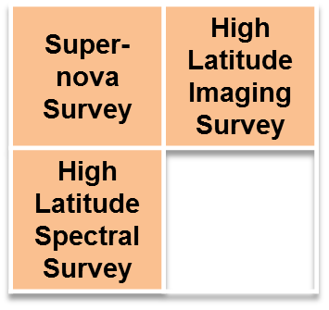
WFIRST Dark Energy Program
Methods of Investigation for WFIRST
Weak lensing
Galaxy Redshift Distortion
Supernova

Slide 9
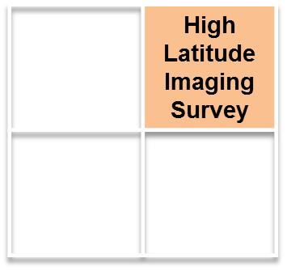
Weak Lensing
Measurement Requirements
Objective: Use weak gravitational lensing to sample matter distribution to z~2 over thousands of square degrees at a sampling density ≥27/sq arcminute.
What data are needed to do that? Galaxy morphologies & 3-D positions
    Obtain deep NIR (1-2μm) imaging in multiple bands
      S/N>18 at AB≥24.4 for galaxies w/R(ee50)=180 mas, over ≥1700 sq degrees (corresponding survey rate is 0.2 deg²/hour)
      Baseline: shapes in 3 bands, plus 4th band to facilitate photo-z
    Derive photometric redshifts by fitting spectral templates to multi-band images
      Requires spectroscopic “training set” of galaxy sample
      Places requirements on uniformity of flux calibration (<10mmag over angles 0.1°-10°), and relative calibration across filters (relative zeropoints known to 0.5%)

Slide 10
Weak Lensing
Measurement Requirements
Gravitational lensing produces distortions of galaxy shapes correlated over many galaxies (“cosmic shear”).
What is needed for this measurement?
  Weak Gravitational Lensing effects are indeed weak:
    ~1% typical “shear” on galaxy ellipticity; want 1% accuracy
  Need small Point Spread Function
    diffraction limited at 1.2μm
    Increases number density of usable galaxies
    Maximizes S/N of each measurement
      Larger and/or irregular PSF degrades S/N, requiring longer exposures
  Must know (calibrate) PSF size and shape.
    Additive shear bias (independent of galaxy ellipticity) ≤ 2.7x10⁻⁴
      Need PSF ellipticity knowledge to < 5.7 x 10⁻⁴ rms
      Need PSF second moment knowledge to <7.2 x 10⁻⁴ rms
      e+ = (Mxx – Myy) / (Mxx + Myy) ex = 2Mxy / (Mxx+Myy)
      Mxx = Σ (x-xc)(x-xc) w(x,y) S(x,y) / Σ w(x,y) S(x,y)
    Multiplicative shear bias (proportional to galaxy ellipticity): <3.2x10⁻⁴
      Example: error in PSF size calibration
    PSF knowledge will be derived from measurements of stars in each image

Slide 11
Weak Lensing
Requirements Validation
Cosmological simulations & analytic models of WL observables set top-level SRD requirements (2.0.x)
Detailed simulations of galaxy shape measurements performed on all scales
  Simulations of individual instrumental effects, (e.g. inter-pixel capacitance), informs calibration rqmts
  Wide area simulations (5 deg²) with many (not yet all) astrophysical & instrumental uncertainties
    Used to develop SRD requirements (2.1.x, 2.2.x, 2.3.x), calibration budgets, observing strategy
Figure of Merit forecasts for each scenario compared to top-level requirement

Slide 12
Weak Lensing
Requirements Summary
Survey Capability
(HLIS 2.0.x)
Science Data Records
(HLIS 2.1.x)
Calibrated Data Records
(HLIS 2.2.x)
Raw Data Records
(HLIS 2.3.x)
1: FoM_{WL}>327400
2: N_{eff}>27/arcmin²
3: Additive shear
error <2.7 10⁻⁴
4: Multiplicative shear
bias <3.2 10⁻⁴
5: deep field
1: Mosaic images,
astrometric frame
2: Mosaic images,
metadata
3: source catalog contents,
basic
4: source catalog contents,
extended
5: source catalog contents,
uncertainties
6: deleted
7: angular mask, noise maps
8: redshift probability distr.
9: redshift probability
distribution shape
10: redshift sample bias
11: limiting sensitivity for
galaxy sample
12: spectroscopic redshifts
13: source injection
14: processing simulated data
1: PSF knowledge
for each image
2: flux calibration
spatial uniformity
3: PSF ellipticity
knowledge
4: PSF size
knowledge
5: astrometric accuracy
relative
6: astrometric accuracy
absolute
7: pixel response
8: flux cal over FoV
for known spectrum
9: flux calibration
absolute
10: flux calibration
over time
11: flux calibration
across filters
1: Raw data
2: filter bandpasses
3: PSF R(EE50) in each filter
4: Survey strategy
5: Spectral datasets
6: Imaging deep fields
7: Downlinked data samples
8: Deleted
9: Spectral dispersion
10: Spectral bandpass
11: Spectrometer spatial
resolution
12: Spectrometer FoV
13: Spectrometer R(EE50)

Slide 13
Key Weak Lensing Science Performance Requirements
Representative values shown; full details in SRD. |  | Expansion, Structure, NIR Survey |  | Expansion | Exoplanet
 |  | Weak Lensing | Galaxy Redshift Survey | Supernovae | Microlensing
Surveys & Data | Area/Survey Speed | 0.20 deg²/hr (1,700 deg²)
 | Redshift | 0≤z≤3
 | Sensitivity | S/N≥18 @ 24.4/24.3/23.7 (AB J/H/F184) r_{eff}=0.18”
 | Cadence
 | Data Vol. | ≥3 reads/exp
PSF | Quality | EE50 ≤ 0.12” (J) EE50 ≤ 0.17” (IFC)
 | Stability | 1 nm RMS 𝚫WFE in 180s
 | Knowledge | 2nd moment ≤7.2x10⁻⁴ Ellipticity ≤5.7x10⁻⁴
Flux Calibration Relative Over | Time | 0.5% /observing program
 | Wavelength | <2% abs/0.5% photo zeropt
 | Dynamic Range
 | Area | <10 mmag
Color | Filters | 4 NIR bands for photo-z, 3 reddest for shapes
 | Dispersion

Slide 14
Key Wide Field Science Performance Requirements
Representative values shown; full details in SRD. |  | Expansion, Structure, NIR Survey |  | Expansion | Exoplanet
 |  | Weak Lensing | Galaxy Redshift Survey | Supernovae | Microlensing
Surveys & Data | Area/Survey Speed | 0.20 deg²/hr (1,700 deg²) | 0.34 deg²/hr (1,700 deg²) | 14, 5 deg² >100 SNe/Δz=0.1 | 586 deg²-day Over 6+ seasons
 | Redshift | 0≤z≤3 | 1.1 < z < 1.9 (2.9 w/OIII) | 0.2≤z≤1.7
 | Sensitivity | S/N≥18 @ 24.4/24.3/23.7 (AB J/H/F184) r_{eff}=0.18” | S/N≥6.5 for 1.0x10⁻¹⁶ erg/cm²/s | S/N≥13 (brightest filters at peak) | S/N>100 for H_{AB}=21.4 star
 | Cadence |  |  | ~ 5 days | 15 min
 | Data Vol. | ≥3 reads/exp | ≥3 reads/exp | ≥3 reads/exp | ≥3 reads/exp
PSF | Quality | EE50 ≤ 0.12” (J) EE50 ≤ 0.17” (IFC) | EE50≤0.21”@1.5 μm | EE50 ≤ 0.12” (J) EE50 ≤ 0.14” (IFC) | EE50 ≤ 0.15” (wide)
 | Stability | 1 nm RMS 𝚫WFE in 180s
 | Knowledge | 2nd moment ≤7.2x10⁻⁴ Ellipticity ≤5.7x10⁻⁴ |  | 0.2%
Flux Calibration Relative Over | Time | 0.5% /observing program | <2% rel spect-photometry | <0.5% / 2 wk | <0.1%/season
 | Wavelength | <2% abs/0.5% photo zeropt | <2% rel over bandpass | <2% abs/ 0.5% photo zeropt | <3% abs <1.4% photo zeropt
 | Dynamic Range |  |  | <0.3% 15<AB<26 | <0.1% over 2 mag
 | Area | <10 mmag | <2% rel over survey area
Color | Filters | 4 NIR bands for photo-z, 3 reddest for shapes | Overlap with HLIS for 3 filter imaging | 6 filters 0.5-2.0μm | Wide filter, & 1 short, 1 longward of 1μm
 | Dispersion |  | 10-12 Å/pix | 70 < R < 150

Slide 15
Coronagraphy as a Key
Technology
Direct Imaging
Spectro-scopy
NWNH: “the committee recommends a program to lay the technical and scientific foundations for a future space imaging and spectroscopy mission.”
  Key drivers for technology demonstration are:
    Low-order wavefront sensing and control
      Deformable mirrors, fast steering mirror, use of IFS as wavefront sensor, control algorithms
    Shaped pupil and occulting mask design and fabrication
      Tailored for obstructed pupil
    Ultra-low noise detectors
    Manage polarization effects
    Optical stability of entire observatory
      Coronagraph doesn’t drive observatory requirements, but integrated model validation is critical for future missions

Slide 16
Scientific Goals Inform Technology Development
Direct Imaging
Spectro-scopy
NWNH: “This survey is recommending a program to explore the diversity and properties of planetary systems around other stars, …”
  Potential science program serves to drive technology requirements, informs instrument design parameter decisions
    Characterize exoplanet atmospheres composition and temperature via imaging and R=50 spectroscopy
      Determine depth of H₂O, methane, absorption to 15%
      Determine semi-major axis, eccentricity, of each planet
        Estimate planet masses, irradiance
    Search for previously-undiscovered planets around nearby stars
    Determine characteristics of protoplanetary and exo-zodiacal dust disks on wide range of angular scales

Slide 17
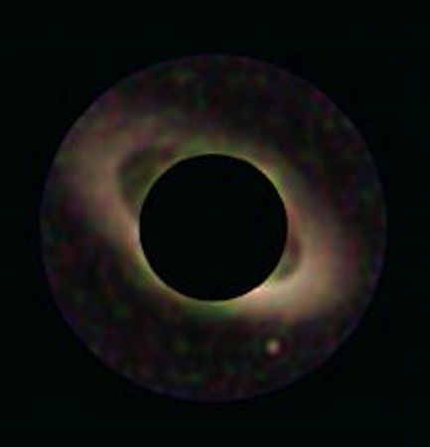
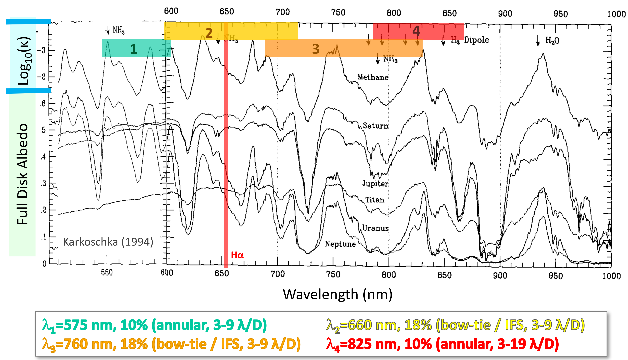
Coronagraphy
Observables
Direct Imaging
Spectro-scopy
Multi-band imaging, spectra at high contrast enables direct detection & characterization of exoplanets
WFIRST CGI multi-color imaging simulation of a Jupiter-mass planet around a Sun-like star, with a 10-zodi interplanetary dust structure.
Image credit: J. Krist
  CGI can probe the atmospheric chemistry of Extra-Solar Giant Planets, as well as aerosol and cloud properties, providing unique constraints on their formation and evolution.

Slide 18
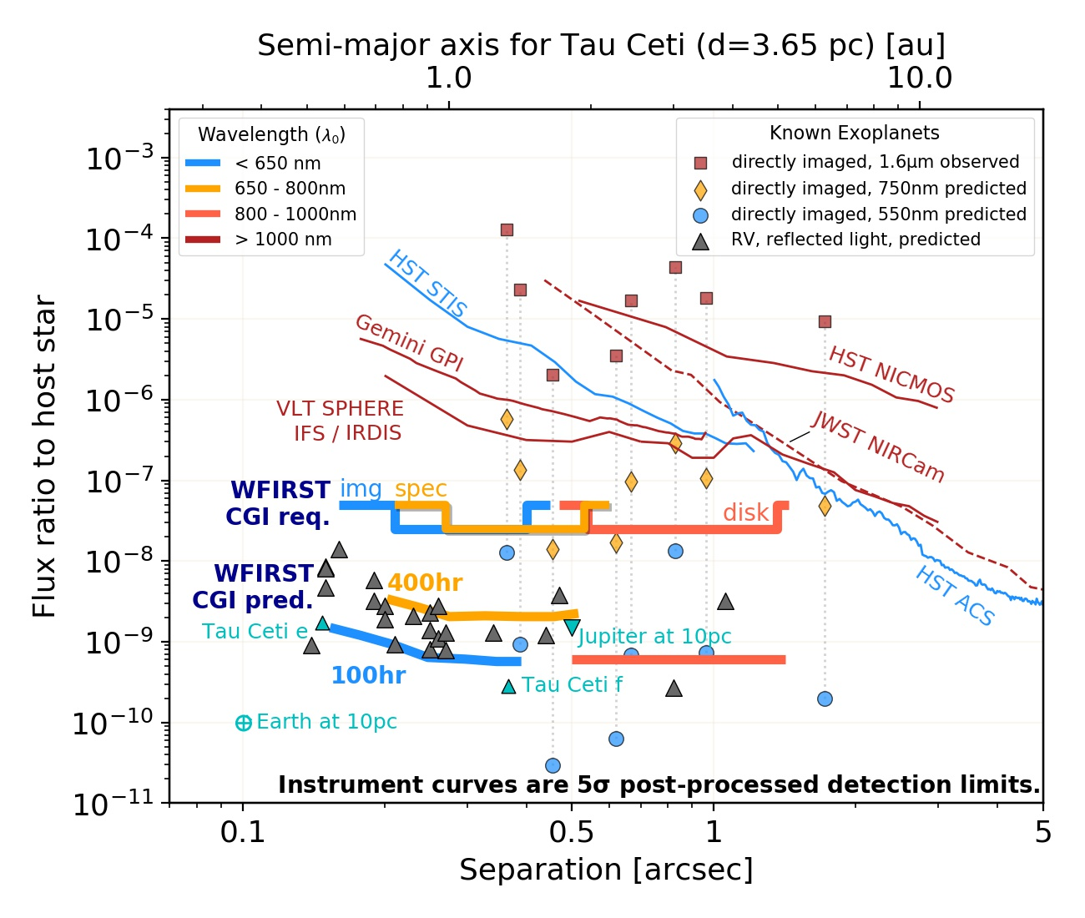
Coronagraphy
Performance Requirements
Direct Imaging
Spectro-scopy
CGI implements both architectures & 3 modes:
HLC imaging 3-9 𝝀/D
SPC spectra 3-9 𝝀/D
SPC imaging 6.5-20 𝝀/D

Slide 19
GO & AR Programs
The General Observer and Archival Research objectives:
  Do not impose unique requirements on the observatory
  Do impose requirements on the ground system
    User interfaces for observation planning, documentation, data analysis tools, query tools, etc.

Slide 20
Mission Requirements Document
The MRD contains the top level requirements for the mission, launch vehicle, the Observatory (Telescope, Wide Field, Coronagraph, Instrument Carrier & Spacecraft) and the Ground System. These flow from the:
  PLRA – BTRs & BDRs, including CGI technology requirements
  SRD – Science requirements decomposed into requirements on the mission
  Mission architecture decisions – e.g., guiding from the WFI focal plane
Mission-level requirements are decomposed in the MRD as necessary and allocated to each of the elements.
  Each MRD requirement identifies the element(s) to which the requirement is allocated
Mission Requirements Doc
1.0 Mission Requirements
2.0 LV Requirements
3.0 Observatory Requirements
3.1 Design Specifications
3.2 OTA
3.3 WFI
3.4 CGI
3.5 IC
3.6 Spacecraft
4.0 Ground System Requirements

Slide 21
Key Wide Field Science Performance Requirements
Representative values shown; full details in SRD. |  | Expansion, Structure, NIR Survey |  | Expansion | Exoplanet
 |  | Weak Lensing | Galaxy Redshift Survey | Supernovae | Microlensing
Surveys & Data | Area/Survey Speed | 0.20 deg²/hr (1,700 deg²) | 0.34 deg²/hr (1,700 deg²) | 14, 5 deg² >100 SNe/Δz=0.1 | 586 deg²-day Over 6+ seasons
 | Redshift | 0≤z≤3 | 1.1 < z < 1.9 (2.9 w/OIII) | 0.2≤z≤1.7
 | Sensitivity | S/N≥18 @ 24.4/24.3/23.7 (AB J/H/F184) r_{eff}=0.18” | S/N≥6.5 for 1.0x10⁻¹⁶ erg/cm²/s | S/N≥13 (brightest filters at peak) | S/N>100 for H_{AB}=21.4 star
 | Cadence |  |  | ~ 5 days | 15 min
 | Data Vol. | ≥3 reads/exp | ≥3 reads/exp | ≥3 reads/exp | ≥3 reads/exp
PSF | Quality | EE50 ≤ 0.12” (J) EE50 ≤ 0.17” (IFC) | EE50≤0.21”@1.5 μm | EE50 ≤ 0.12” (J) EE50 ≤ 0.14” (IFC) | EE50 ≤ 0.15” (wide)
 | Stability | 1 nm RMS 𝚫WFE in 180s
 | Knowledge | 2nd moment ≤7.2x10⁻⁴ Ellipticity ≤5.7x10⁻⁴ |  | 0.2%
Flux Calibration Relative Over | Time | 0.5% /observing program | <2% rel spect-photometry | <0.5% / 2 wk | <0.1%/season
 | Wavelength | <2% abs/0.5% photo zeropt | <2% rel over bandpass | <2% abs/ 0.5% photo zeropt | <3% abs <1.4% photo zeropt
 | Dynamic Range |  |  | <0.3% 15<AB<26 | <0.1% over 2 mag
 | Area | <10 mmag | <2% rel over survey area
Color | Filters | 4 NIR bands for photo-z, 3 reddest for shapes | Overlap with HLIS for 3 filter imaging | 6 filters 0.5-2.0μm | Wide filter, & 1 short, 1 longward of 1μm
 | Dispersion |  | 10-12 Å/pix | 70 < R < 150

Slide 22
Implement Surveys in 5 years and Provide Data
Implement Surveys in 5 years and Provide Data
PLRA
PLRA BSR5
NIR Survey Speed
PLRA BSR6
25% GO
SRD
MRD
SN 2.0.3
>100 SN/0.1 Δz bin
HLSS 2.03
0.34 deg²/hr
HLIS 2.0.2
0.20 deg²/hr
Next Slide
EML 2.3.2
585.4 deg²-day
EML 2.3.5
15 minute cadence
Science Survey Data Products
HLSS, HLIS, SN, EML, GO, AR
MRD 152
WFC Field of View
MRD 011
Operational Lifetime
MRD 294-298
Slew Times
MRD 414-418
Slew Times
(1 RWA failed)
MRD 166, 173
IFC Field of View
MRD 432-434
WFC S/N Rqmts
MRD 032
WFC Fine Pointing Acc
MRD 035
IFC Pointing Acc
MRD 051
Parallel Inst. Ops
MRD 340
Core Survey Support
MRD 341
GO/GI Support
MRD 409-411
Settle Times
MRD 465-467
IFC S/N Rqmts
MRD 052
Event Driven Ops
MRD 042, 044
Field of Regard
MRD 153
WFC Ang. Samp.

Slide 23
Implement Surveys in 5 years and Provide Data
Implement Surveys in 5 years and Provide Data
PLRA
PLRA BDR2
WFI Data Release
PLRA BDR3
CGI Data Release
PLRA BDR1
Public archive
PLRA BDR4
WFIRST Data Products
SRD
MRD
Science Survey Requirements
Science Survey Data Products
HLSS, HLIS, SN, EML, GO, AR
HLIS 2.3.7
3 samples/exp
EML 2.3.7
3 samples/exp
MRD 023
WFI Level 1
MRD 429
WFI Init Lvl 3
MRD 349
WFI Level 3
MRD 337
Public archive
MRD 011
Operational Lifetime
MRD 018
11 Tb/day data volume
MRD 329
Produce Data Products
MRD 330
Custom Data Red.
MRD 445
SIT Provided S/W
MRD 020
Science Data Loss
MRD 348
CGI Level 1
MRD 186
WFI Multi-Accum
MRD 279
D/L Data Rate
MRD 254
Stored Science Data Recovery

Slide 24
Implement Surveys in 5 years
Mission Implementation (1 of 3)
MRD 011: Execute the science program in an operational phase lifetime of 5 years.
  Flows to Observatory & Ground System – Establishes requirements for environments, redundancy, efficiency related requirements (parallel science & downlink, parallel instrument ops, event driven ops), power
MRD-051: Support parallel science ops of both instruments without degrading the performance of the primary inst.
  Flows to OTA for mechanisms, S/C for data recorder and Ground System for planning
MRD 052: Perform event driven science observations.
  Flows to Obs & Ground Sys – Provide TLM in response to commands, obs planning, script engine
MRD 042: Operate continuously with the Observatory +X axis pointed between 54 degrees and 126 degrees from the Sun.
  Flows to Observatory elements – – Establishes requirements for environments, solar array
MRD 044: Operate continuously while maintaining the Sun vector within 15 degrees of the Observatory X/+Z half-plane.
  Flows to Observatory elements – – Establishes requirements for environments, solar array
MRD 032: Provide fine pointing of the Wide Field Channel FOV boresight within 640 milliarcsec (1 sigma) in pitch and yaw and 87 arcsec (1 sigma) in roll in the Observatory coordinate system, relative to the commanded attitude.
  Flows to S/C, WFI and Ground Sys – see Pointing Budget
MRD 035: Be able to place a source in one slice of the IFC accurate to 30 mas (1 sigma).
  Flows to S/C, WFI and Ground Sys – see Pointing Budget
Remaining 4 slides in this section moved to MRD backup

Slide 25
Key Wide Field Science Performance Requirements
Representative values shown; full details in SRD. |  | Expansion, Structure, NIR Survey |  | Expansion | Exoplanet
 |  | Weak Lensing | Galaxy Redshift Survey | Supernovae | Microlensing
Surveys & Data | Area/Survey Speed | 0.20 deg²/hr (1,700 deg²) | 0.34 deg²/hr (1,700 deg²) | 14, 5 deg² >100 SNe/Δz=0.1 | 586 deg²-day Over 6+ seasons
 | Redshift | 0≤z≤3 | 1.1 < z < 1.9 (2.9 w/OIII) | 0.2≤z≤1.7
 | Sensitivity | S/N≥18 @ 24.4/24.3/23.7 (AB J/H/F184) r_{eff}=0.18” | S/N≥6.5 for 1.0x10⁻¹⁶ erg/cm²/s | S/N≥13 (brightest filters at peak) | S/N>100 for H_{AB}=21.4 star
 | Cadence |  |  | ~ 5 days | 15 min
 | Data Vol. | ≥3 reads/exp | ≥3 reads/exp | ≥3 reads/exp | ≥3 reads/exp
PSF | Quality | EE50 ≤ 0.12” (J) EE50 ≤ 0.17” (IFC) | EE50≤0.21”@1.5 μm | EE50 ≤ 0.12” (J) EE50 ≤ 0.14” (IFC) | EE50 ≤ 0.15” (wide)
 | Stability | 1 nm RMS 𝚫WFE in 180s
 | Knowledge | 2nd moment ≤7.2x10⁻⁴ Ellipticity ≤5.7x10⁻⁴ |  | 0.2%
Flux Calibration Relative Over | Time | 0.5% /observing program | <2% rel spect-photometry | <0.5% / 2 wk | <0.1%/season
 | Wavelength | <2% abs/0.5% photo zeropt | <2% rel over bandpass | <2% abs/ 0.5% photo zeropt | <3% abs <1.4% photo zeropt
 | Dynamic Range |  |  | <0.3% 15<AB<26 | <0.1% over 2 mag
 | Area | <10 mmag | <2% rel over survey area
Color | Filters | 4 NIR bands for photo-z, 3 reddest for shapes | Overlap with HLIS for 3 filter imaging | 6 filters 0.5-2.0μm | Wide filter, & 1 short, 1 longward of 1μm
 | Dispersion |  | 10-12 Å/pix | 70 < R < 150

Slide 26
PSF Requirements
WFI PSF Quality, Stability, Knowledge
PLRA
SRD
HLSS 2.3.4
EE50
HLIS 2.2.3
PSF ellipticity
HLIS 2.2.4
PSF Size
MRD
HLIS 2.3.3
EE50
HLIS 2.3.4
Exposure in bands
HLIS 2.3.11
IFC Spatial Res
HLIS 2.3.13
IFC EE50
SN 2.3.8
IFC Spatial Res
SN 2.3.10, 2.3.11 IFC EE50
MRD 428
WFI Focus Diversity Phase Retrieval
MRD 352
≤110 nm WFE
MRD 355
≤198 nm WFE
MRD 394
WSM pointing stability
MRD 003
L2 Orbit
MRD 033
Sub-Pixel Scale Offset Accuracy
MRD 187
WFI Eng Data Mode
MRD 114
PSF Determination
MRD 353
≤1 nm WF stability
MRD 174
IFC Spatial Res
MRD 361
≤172 nm WFE @ FP
MRD 044
Solar Vector Range, X/+Z
MRD 100
Guide from WFC
MRD 038
≤8 mas pointing stability
MRD 167
IFC Spatial Res
MRD 358
≤117 nm WFE @ Slicer
MRD 440
≤130 nm WFE @ FP
MRD 153
WFC Angular Sampling
MRD 039
≤12 mas LOS jitter

Slide 27
Key Wide Field Science Performance Requirements
Representative values shown; full details in SRD. |  | Expansion, Structure, NIR Survey |  | Expansion | Exoplanet
 |  | Weak Lensing | Galaxy Redshift Survey | Supernovae | Microlensing
Surveys & Data | Area/Survey Speed | 0.20 deg²/hr (1,700 deg²) | 0.34 deg²/hr (1,700 deg²) | 14, 5 deg² >100 SNe/Δz=0.1 | 586 deg²-day Over 6+ seasons
 | Redshift | 0≤z≤3 | 1.1 < z < 1.9 (2.9 w/OIII) | 0.2≤z≤1.7
 | Sensitivity | S/N≥18 @ 24.4/24.3/23.7 (AB J/H/F184) r_{eff}=0.18” | S/N≥6.5 for 1.0x10⁻¹⁶ erg/cm²/s | S/N≥13 (brightest filters at peak) | S/N>100 for H_{AB}=21.4 star
 | Cadence |  |  | ~ 5 days | 15 min
 | Data Vol. | ≥3 reads/exp | ≥3 reads/exp | ≥3 reads/exp | ≥3 reads/exp
PSF | Quality | EE50 ≤ 0.12” (J) EE50 ≤ 0.17” (IFC) | EE50≤0.21”@1.5 μm | EE50 ≤ 0.12” (J) EE50 ≤ 0.14” (IFC) | EE50 ≤ 0.15” (wide)
 | Stability | 1 nm RMS 𝚫WFE in 180s
 | Knowledge | 2nd moment ≤7.2x10⁻⁴ Ellipticity ≤5.7x10⁻⁴ |  | 0.2%
Flux Calibration Relative Over | Time | 0.5% /observing program | <2% rel spect-photometry | <0.5% / 2 wk | <0.1%/season
 | Wavelength | <2% abs/0.5% photo zeropt | <2% rel over bandpass | <2% abs/ 0.5% photo zeropt | <3% abs <1.4% photo zeropt
 | Dynamic Range |  |  | <0.3% 15<AB<26 | <0.1% over 2 mag
 | Area | <10 mmag | <2% rel over survey area
Color | Filters | 4 NIR bands for photo-z, 3 reddest for shapes | Overlap with HLIS for 3 filter imaging | 6 filters 0.5-2.0μm | Wide filter, & 1 short, 1 longward of 1μm
 | Dispersion |  | 10-12 Å/pix | 70 < R < 150

Slide 28
Relative Flux Calibration Over:
Time
Wavelength
Dynamic Range
HLIS 2.2.10: Variance in photometric zero points
EML 2.2.6: Rel photometric systematic daily & seasonal precision
SN 2.2.2: Relative instrumental bias on photo cal. btwn 2 filters
HLIS 2.2.9: Absolute photometry
SN 2.2.3: Photometric cal accuracy btwn AB 26 and 15 sources
HLIS 2.2.11: Relative zero points of filter photometry knowledge
HLIS 2.2.4: Absolute photometry
SN 2.2.8: Time series calibrated spectra
EML 2.2.7: Rel photometric systematic from separate seasons
Spatial
SN 2.2.5: Absolute photometry
EML 2.2.8: Absolute photometry
HLIS 2.2.2: Rel. photometric cal spatially uniform
HLSS 2.2.4 Rel spectrophotometric flux calibration
SN 2.2.6: Variance in photometric zero points
EML 2.2.9: Relative zero points of filter photometry knowledge
HLIS 2.2.8: SED corrected to 0.5%
WFI Relative Calibration System
MRD 181
Detector Linearity Cal.
MRD 384
WFC Dark Setting
MRD 385
IFC Dark Setting
MRD 329
Produce Data Products
MRD 330
Custom Data Red.
MRD 445
SIT Provided S/W
MRD 340
Core Survey Support
MRD 033
Sub-Pixel Scale Offset Accuracy
MRD 406
Return Pointing & Offset Accuracy
MRD 390
Flat Field Cal.
MRD 391
Calibration Sources
MRD 187
WFI Eng Data Mode

Slide 29
Key Wide Field Science Performance Requirements
Representative values shown; full details in SRD. |  | Expansion, Structure, NIR Survey |  | Expansion | Exoplanet
 |  | Weak Lensing | Galaxy Redshift Survey | Supernovae | Microlensing
Surveys & Data | Area/Survey Speed | 0.20 deg²/hr (1,700 deg²) | 0.34 deg²/hr (1,700 deg²) | 14, 5 deg² >100 SNe/Δz=0.1 | 586 deg²-day Over 6+ seasons
 | Redshift | 0≤z≤3 | 1.1 < z < 1.9 (2.9 w/OIII) | 0.2≤z≤1.7
 | Sensitivity | S/N≥18 @ 24.4/24.3/23.7 (AB J/H/F184) r_{eff}=0.18” | S/N≥6.5 for 1.0x10⁻¹⁶ erg/cm²/s | S/N≥13 (brightest filters at peak) | S/N>100 for H_{AB}=21.4 star
 | Cadence |  |  | ~ 5 days | 15 min
 | Data Vol. | ≥3 reads/exp | ≥3 reads/exp | ≥3 reads/exp | ≥3 reads/exp
PSF | Quality | EE50 ≤ 0.12” (J) EE50 ≤ 0.17” (IFC) | EE50≤0.21”@1.5 μm | EE50 ≤ 0.12” (J) EE50 ≤ 0.14” (IFC) | EE50 ≤ 0.15” (wide)
 | Stability | 1 nm RMS 𝚫WFE in 180s
 | Knowledge | 2nd moment ≤7.2x10⁻⁴ Ellipticity ≤5.7x10⁻⁴ |  | 0.2%
Flux Calibration Relative Over | Time | 0.5% /observing program | <2% rel spect-photometry | <0.5% / 2 wk | <0.1%/season
 | Wavelength | <2% abs/0.5% photo zeropt | <2% rel over bandpass | <2% abs/ 0.5% photo zeropt | <3% abs <1.4% photo zeropt
 | Dynamic Range |  |  | <0.3% 15<AB<26 | <0.1% over 2 mag
 | Area | <10 mmag | <2% rel over survey area
Color | Filters | 4 NIR bands for photo-z, 3 reddest for shapes | Overlap with HLIS for 3 filter imaging | 6 filters 0.5-2.0μm | Wide filter, & 1 short, 1 longward of 1μm
 | Dispersion |  | 10-12 Å/pix | 70 < R < 150

Slide 30
Color
PLRA
SRD
SN 2.3.5, HLIS 2.3.2, EML 2.3.4, EML 2.3.11
Filters
HLSS 2.3.2
Spec. Dis
SN 2.3.6
HLIS 2.3.9
Spectral Resolution & Sampling
SN 2.3.7
HLIS 2.3.10
Bandpass
MRD
HLSS 2.3.3
Wavelength Range
MRD 154
Filter Bandpasses
MRD 161
Spectral Dispersion
MRD 168
IFC Spectral Sampling
MRD 169
IFC Resolving Power
MRD 370
IFC Bandpass

Slide 31
PLRA Technical Flow Down
PLRA BTR1
5 year life
PLRA BTR 2
2.36-m PM
PLRA BTR3
Servicing
PLRA BTR4
Starshade Ready
PLRA BTR9
TOOs in 2 weeks
PLRA
SRD
MRD
MRD 011
5 year life
MRD 392
2.36-m PM
MRD 058
Servicing
MRD 063
Starshade Comp
MRD 334
TOOs in 2 weeks

Slide 32
Flow From Key Requirements
(Representative values shown; full details available in MRD)
Key Science Requirements ⬇ |  | Observatory | Optical System (OTA & WFI) | Ops Concept and Ground System
Surveys & Data | Area/Survey Speed | Field of Regard Slew/Settle Times Pointing Accuracy Event Driven Ops | ≥0.25 deg² FOV ≤0.11 a-s/pix sampling S/N budget (throughput, background, electronic noise) | DRM – Tiling patterns, obs functions (e.g., momentum unloads, stationkeeping) GS – Execute surveys
 | Sensitivity
 | Cadence
 | Data Vol. | 11 Tb/day D/L, D/L Data Rate | Multi-Accum | Grd Receipt & Process, Data Recovery
PSF | Quality |  | WFE=110/198 nm (WIM/WSM) WFE=130 nm/172 (IFC) ≤1 nm WF stability, ≤8 mas drift, ≤12 mas LOS jitter Guide from WFC WFI FDPR | 4-5 dither positions per orientation Recreate pointing history using Obs data Generate PSFs
 | Stability | L2 Orbit Jitter isolation
 | Knowledge | D/L guide windows, IRU, RWA speeds
Flux Calibration Relative Over | Time | Pixel scale offset pointing (dither) within 11 mas, return pointing within 1 pixel and offsets up to 20 pixels | Calibration System with cal sources over 5 orders of magnitude, 1 source/filter, flat fielding, dark to enable background measurement | Periodic calibration observations of astronomical sources and deep fields
 | Wavelength
 | Dynamic Range
Color | Filters |  | 7 filters R,Z,Y,J,H,F184 & Wide 0.48-2.0 μm & 1.0-2.0 μm
 | Dispersion |  | 10-12 Å/pix over 1.0-1.9 μm

Slide 33
CGI Technology Flow Down
PLRA BTR5
Hi-Cont. Imaging
PLRA BTR 6
Hi-Cont. Spect.
PLRA BTR 7
Ext. Source Img.
MRD 449
Filter Bands
MRD 436
Hi-Cont. Imaging
MRD 454
Tele. Pol.
MRD 437
Hi-Cont. Spect.
MRD 438
WFC Large FOV
MRD 451
Pol. of Disks
MRD 452
Astrom. Acc.
MRD 455
Meas. Jitter
MRD 457
Field of View
MRD 453
WFS Telemetry
MRD 456
Meas WF Aber.

Slide 34
Update
Material shown was current as of Mission SRR (Feb 22, 2018)
  Apart from descope of the IFC, changes are minor
Many Level-3 requirements documents are now baselined or will be very soon.
  Attitude Control System, Telescope, Spacecraft, WFI, CGI, etc.

Slide 35
Backup

Slide 36
WFIRST Breadth
WFIRST must meet the Decadal Survey’s vision for several science experiments:
  Dark energy / growth of structure
  via multiple techniques
  Exoplanet census
WFIRST must meet the Decadal Survey’s recommendation for technology development aimed at direct detection of exoplanets
WFIRST must meet the Decadal Survey’s mandate for broad science impact in key areas via a general observer + guest investigator capability

Slide 37
Science Objectives vs. Mission Success
The Science Objectives define expected science return for WFIRST.
Mission Success defines minimum science return to declare WFIRST a success:
Science | Science Objective | Mission Success Criteria
NIR Survey | conduct near-infrared (NIR) sky surveys in both imaging and spectroscopic modes, providing an imaging sensitivity for unresolved sources better than 26.5 AB magnitude. | No corresponding success criteria
Expansion History | Determine the expansion history of the Universe using GRS, WL, & SN, at redshifts up to z = 2 with high-precision cross-checks between techniques. | Conduct surveys providing data for the measurement of the history of cosmic expansion and the growth of structure, achieving at least two of the following: detect ≥10M galaxies spectroscopically over z = 1-2; shape measurement of ≥100M galaxies over z = 1-3; light curve measurement of ≥2000 supernovae at redshifts reaching at least 1;
Growth of Structure | Determine the growth history of the largest structures in the Universe using WL, RSD, & Galaxy Clustering, at redshifts up to z = 2 with high-precision cross-checks between techniques.
Exoplanet Census | Carry out a statistical census of exoplanets from the outer habitable zone to free floating planets, including analogs to all of the planets in our Solar System >MMars, using microlensing. | Conduct a microlensing survey providing sufficient quality and quantity of data to detect at least 2000 microlensing events with source magnitudes of H<23 AB and impact parameters <1.
GO Program | Devote a substantial fraction of the mission lifetime to a peer-reviewed GO program and have an archive & GI program. | Provide a minimum of 15% of aggregated operational lifetime to a peer-reviewed GO program

Slide 38
Tech Demo Objectives and Fulfilling Them
The Tech Demo Objectives define expected coronagraph technology advancement for WFIRST.
Operational expectation – how WFIRST/CGI fulfills:
Technology | Technology Demonstration Objective | Operational Expectation
Active Wavefront Control | Demonstrate coronagraphy in space with an obscured aperture and active wavefront control | Detect a companion object next to a star, on at least two stars, at a contrast level and separation that requires a functional active coronagraph.
Coronagraph Elements | Advance the engineering and technical readiness of key coronagraph elements: coronagraph masks, low-order wavefront sensors, high actuator count deformable mirrors, low noise detectors, and integral field spectrographs. | Demonstrate in-space operation of the elements listed.
Coronagraph Algorithms | Support development and in-flight demonstration of coronagraph software that could enhance the capability or simplify the architecture of future missions. | Demonstrate the ability to modify the wavefront sensing and control algorithms during the prime science mission.
Performance Characterization | Perform measurements that characterize the integrated performance of the coronagraph and observatory as a function of time, wavelength, and polarization. | Gather data on a target star that enables in-flight performance characterization of the coronagraph, including a revisit and a repoint.
Data Processing | Demonstrate advanced data processing and analysis techniques required to identify, spectrally characterize and distinguish astronomical sources at high contrast. | Produce photometric, astrometric, and spectrographic measurements of at least one point source and at least one extended object.

Slide 39
Level 1 Requirement Paradigm
Objectives are science outcomes
Level 1 science requirements (BSRs) are critical instrument sensitivities that support those outcomes
  Verifiable pre-launch
  One called out for each survey
  Used by HQ to ensure WFIRST capabilities sufficient to meet the objectives.
Level 1 technical and data requirements include essential top-level items to fulfill all mission objectives
Success criteria are expected measurements using those capabilities to support the science outcomes

Slide 40
L1/L2 Requirements Flow
Interrelationships:
Level 1 science requirements are critical instrument sensitivities that support objectives
Set of Level 2 requirements flow from Baselines and flow directly from Objectives (for items that are less critical or don’t describe sensitivity).
Science and Technical Objectives
(PLRA Section 2)
Level 1 BSRs
(PLRA Section 4)
Level 1 BDRs and BTRs
(PLRA Section 4)
Level 2 Requirements
(SRD and MRD)

Slide 41
L1/L2 Requirements Flow
Notes:
Mission success criteria associate only with science requirements
“Any decision to abandon a baseline requirement in favor of its corresponding threshold requires the approval of the Science Mission Directorate Associate Administrator.”
Consider as predefined descope limits that fulfill success criteria.
Science and Technical Objectives
(PLRA Section 2)
Level 1 BSRs
(PLRA Section 4)
Level 1 BDRs and BTRs
(PLRA Section 4)
Mission Success
Level 2 Requirements
(SRD and MRD)

Slide 42
Baseline & Threshold Science Requirements
BSR/ TSR # | Baseline Science | Threshold Science
1 | Be able to measure positions and redshifts of Hα emission-line galaxies to a redshift precision of 1 part in 1000 (1σ) in the range z = 1.0 – 1.8 and a minimum detectable point-source line flux of 2·10⁻¹⁶ ergs/cm²/s | Be able to measure positions and redshifts of Hα emission-line galaxies to a redshift precision of 1 part in 1000 (1σ) in the range z = 1.0 - 1.8 and a minimum detectable point-source line flux of 3·10⁻¹⁶ ergs/cm²/s
2 | Be able to measure positions, second moment shapes, and brightnesses of 0.18″ radius galaxies in at least three infrared filters, to a depth of 26.2 AB in the shortest wavelength filter and 25.6 AB in the longest | Be able to measure positions, second moment shapes, and brightnesses of galaxies in at least three infrared filters, to a depth of 25.6 AB in the longest wavelength
3 | Be able to measure the brightness of point sources in three infrared filters to a depth of 26 AB in each filter, providing a color uncertainty of <0.03 mag, and with the ability to repeat observations at least once every 5 days for ≥120 days | Be able to measure the brightness of point sources in three infrared filters to a depth of 25.6 AB in each filter, providing a color uncertainty of <0.03 mag, and with the ability to repeat observations at least once every five days for ≥120 days
4 | Be able to measure the brightness of stars with a statistical S/N of 100 per exposure for a H=20.9 AB star, with the ability to repeat observations of a star field at least once every 15 minutes for ≥60 days | Be able to measure the brightness of stars with a statistical S/N of 100 per exposure for a H=20.4 AB star, with the ability to repeat observations of a star field at least once every 15 minutes for ≥60 days
5 | Be able to produce NIR sky images in multiple filters over 20°² at J = 26.5 AB in each filter, and spectra over 9°² at Fline = 2·10⁻¹⁶ erg cm⁻² s⁻¹ , each in <24 hours | Be able to produce NIR sky images in multiple filters over 20°² at H = 26.2 AB in each filter, and spectra over 9°² at Fline = 3·10⁻¹⁶ erg cm⁻² s⁻¹ , each in <24 hours
6 | Provide a peer-reviewed General Observer program comprising 25% of total time, with access to the full sky within the mission lifetime, and a peer-reviewed Guest Investigator program for archival research | Provide a peer-reviewed General Observer program comprising 15% of the total time, and a peer-reviewed Guest Investigator program for archival research

Slide 43
Baseline & Threshold Technical Requirements
CGI-only
BTR/ TTR # | Baseline Technical | Threshold Technical
5 | Be able to measure the brightness of an astrophysical point source located between 0.21″ and 0.40″ from an adjacent star with a V magnitude as dim as 5, with a flux ratio down to 5·10⁻⁸ in a 10% bandwidth with an SNR=10 or better. | Be able to measure the brightness of an astrophysical source located between 0.30″ and 0.45″ from a nearby star, with a flux ratio down to 10⁻⁷ in a 10% bandwidth with an SNR=5 or better.
6 | Be able to measure the spectrum of an astrophysical point source located between 0.27″ and 0.53″ from an adjacent star with a V magnitude as dim as 5, with a flux ratio down to 5·10⁻⁸ over an 18% bandwidth at R=50 with an SNR=10 per spectral resolution element. | Coronagraphic spectroscopy is not required at the threshold level.
7 | Be able to map the extended surface brightness from 0.6″ to 1.3″ around a host star with V magnitude as dim as 5, at an integrated surface brightness per resolution element sensitivity equivalent to a source-to-star flux ratio as faint as 5·10⁻⁸ with an SNR of at least 10, and be able to map a linear polarization with a polarization fraction ≥0.3 with a systematic uncertainty of less than 0.03. | Coronagraphic extended source imaging and polarimetry are not required at the threshold level.

Slide 44
Baseline and Threshold Technical Requirements
Full list
BTR/ TTR # | Baseline Technical | Threshold Technical
1 | Mission Duration: 5 year mission after checkout | Same
2 | Telescope: existing components, including 2.36-m diameter PM | Same
3 | Serviceability | Not required at the threshold level.
4 | Starshade Compatibility | Not required at the threshold level.
5 | Broadband High-Contrast Imaging | Yes, but degraded.
6 | High-Contrast Imaging Spectroscopy | Not required at the threshold level.
7 | High-Contrast Extended Source Imaging and Polarimetry | Not required at the threshold level.
8 | Target of Opportunity – within two weeks | Same

Slide 45
Baseline and Threshold Data Requirements
BDR/ TDR # | Baseline Data | Threshold Data
1 | Provide a public archive of data products with capabilities that enable scientific studies and data mining of its data holdings. | Provide a public archive of data products.
2 | Provide a public release, of 95% of WFI data at: uncalibrated data ≤72 hours of acquisition on WFIRST; resampled/coadded prelim calibration ≤168 hours; resampled/coadded all final calibrated ≤6 months. | Provide a public release, of 90% of WFI data at: uncalibrated data ≤72 hours of acquisition on WFIRST; resampled/coadded prelim calibration ≤168 hours; resampled/coadded all final calibrated ≤6 months.
3 | Provide a public release, of 90% of CGI data at: uncalibrated data ≤72 hours. | Provide a public release, of 50% of CGI data at: packetized data ≤96 hours
4 | Produce images, catalogs, and other high-level data products from its observations to be made available via the WFIRST archive for the benefit of the astronomical community, with no period of limited data access. | Same

Slide 46
Backup for SRD section

Slide 47
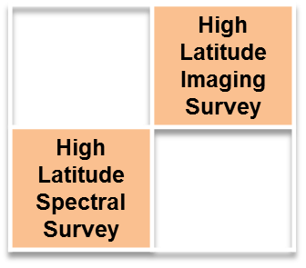
Galaxy Redshift Survey
Observables
Wide-field imaging & slitless spectroscopy measures 3-D galaxy distribution

Slide 48
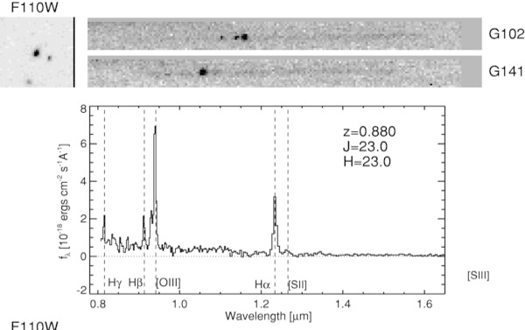
Galaxy Redshift Survey
Observables
Sample HST WFC3-IR grism spectrum (Atek et al 2010)

Slide 49
Galaxy Redshift Survey
Measurement Requirements
Objective: Measure positions & redshifts of > 10⁷ galaxies over 1<z<2 and thousands of square degrees
  Obtain NIR images and spectra over >1700 sq deg
    Measurement accuracy corresponds to σ_{z} < 0.001(1+z)
    Sampling density sufficient to resolve features in galaxy power spectrum on spatial scales corresponding to k~0.2 h/Mpc
    Spectroscopic survey rate >0.34 deg²/hour
  Requires good S/N on faint objects
    S/N ≥ 6.5 for 1×10⁻¹⁶ ergs/cm²/s limiting line flux
  Requires good spatial uniformity of flux & wavelength cal.
    Don’t want to introduce sampling biases in galaxy distributions
    σ_{λ}/λ ≤ 0.001, varying field-to-field by ≤ 2×10⁻⁵, σ_{f}/f uniform to < 0.02

Slide 50
Galaxy Redshift Survey
Measurement Requirements
GRS measurement requirements
  Obtain multi-object spectroscopy
    WFIRST approach is slitless grism spectroscopy
    Similar to HST grism spectroscopy, but higher resolving power for desired redshift accuracy.
    Bandpass of at least 1.0-1.9μm for desired redshifts w/Hα
    Need good temporal & spatial uniformity in flux calibrations, to understand survey depth
  Obtain NIR images in at least one band
    Required position measurement accuracy is easy
    Multiple bands preferred: photometric redshifts reduce ambiguities in emission line identification.
    Can use Weak Lensing imaging survey data
Same dataset -> growth of structure via redshift-space distortions

Slide 51
Galaxy Redshift Survey
Requirements Validation
Cosmological simulations & analytic models of GRS observables set top-level SRD requirements (2.0.x)
Cosmological simulations and galaxy evolution models used to generate 4 deg² samples
  probe astrophysical & instrumental systematic effects
    changing bias of galaxies as tracers of overall matter, varying chemical composition (affects spectral diagnostics & potential redshift errors) etc.
    Derive sensitivity to flux and wavelength calibration
  Used to develop SRD requirements (2.1.x, 2.2.x, 2.3.x), calibration budgets, observing strategy
Figure of Merit forecasts for each scenario compared to top-level requirement

Slide 52
Galaxy Redshift Survey
Requirements Summary
Survey Capability
(HLSS 2.0.x)
Science Data Records
(HLSS 2.1.x)
Calibrated Data Records
(HLSS 2.2.x)
Raw Data Records
(HLSS 2.3.x)
1: FoM_{BAO}>7533
2: FoM_{RSD}>4047
3: Slitless spectra
4: Completeness
> 0.6
5: redshift accuracy,
outlier fraction
1: Completeness &
depth systematics
2: outlier fraction
knowledge
3: source catalog
metadata
4: source catalog
contents
5: extracted spectra
6: roll angle variation
7: spectral metadata
8: redshift determination
9: emission line wavelengths, flux
10: source position measurement
11: source imaging data
1: Calibrated spectra
2: Wavelength accuracy
absolute
3: wavelength accuracy
correlated errors
4: Flux calibration
spatial uniformity
1: Raw data
2: Spectral dispersion
3: Spectral bandpass
4: PSF R(EE50)
5: Relative orientation
of roll angles
6: Spectral deep fields

Slide 53
Key GRS Science Performance Requirements
Representative values shown; full details in SRD. |  | Expansion, Structure, NIR Survey |  | Expansion | Exoplanet
 |  | Weak Lensing | Galaxy Redshift Survey | Supernovae | Microlensing
Surveys & Data | Area/Survey Speed | 0.20 deg²/hr (1,700 deg²) | 0.34 deg²/hr (1,700 deg²)
 | Redshift | 0≤z≤3 | 1.1 < z < 1.9 (2.9 w/OIII)
 | Sensitivity | S/N≥18 @ 24.4/24.3/23.7 (AB J/H/F184) r_{eff}=0.18” | S/N≥6.5 for 1.0x10⁻¹⁶ erg/cm²/s
 | Cadence
 | Data Vol. | ≥3 reads/exp | ≥3 reads/exp
PSF | Quality | EE50 ≤ 0.12” (J) EE50 ≤ 0.17” (IFC) | EE50≤0.21”@1.5 μm
 | Stability | 1 nm RMS 𝚫WFE in 180s
 | Knowledge | 2nd moment ≤7.2x10⁻⁴ Ellipticity ≤5.7x10⁻⁴
Flux Calibration Relative Over | Time | 0.5% /observing program | <2% rel spect-photometry
 | Wavelength | <2% abs/0.5% photo zeropt | <2% rel over bandpass
 | Dynamic Range
 | Area | <10 mmag | <2% rel over survey area
Color | Filters | 4 NIR bands for photo-z, 3 reddest for shapes | Overlap with HLIS for 3 filter imaging
 | Dispersion |  | 10-12 Å/pix

Slide 54
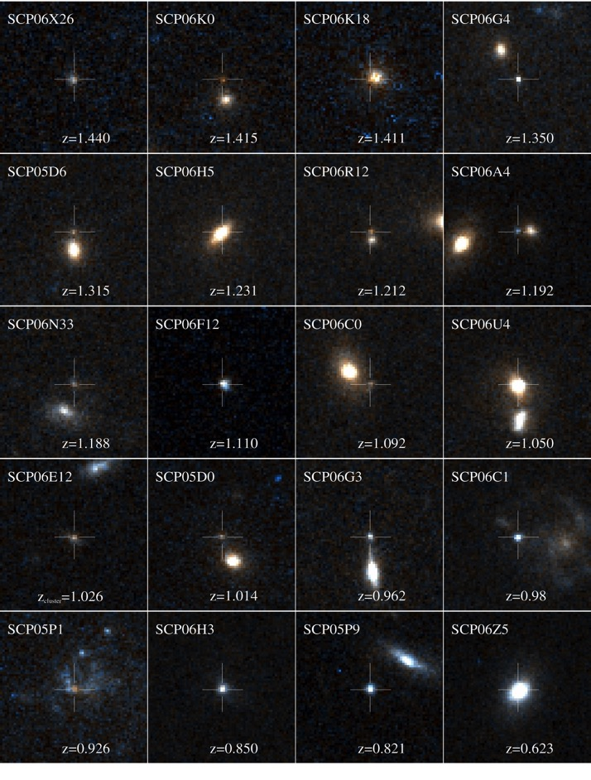
Type Ia Supernovae
Observables
Super-nova Survey
Sometimes SNe are well-separated from their host galaxy, and sometimes they’re not!
Have to accurately subtract the light of the host galaxy.
N. Suzuki et al. 2012 ApJ 746 85 doi:10.1088/0004-637X/746/1/85

Slide 55
Type Ia supernovae
Observables
Super-nova Survey
Shape of SNIa spectrum changes with time.
Need at least one spectrum for redshift & confirm type (or host galaxy redshift)
Need rest-frame spectrum to obtain luminosity and correct for dust extinction
  Obtain spectra or multi-band imaging light-curves

Slide 56
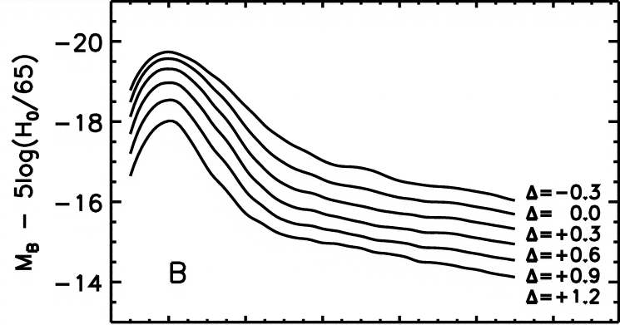
Type Ia supernovae
Observables
Super-nova Survey
Intrinsic brightness correlates with shape of light curve
  Measure brightness at multiple times throughout evolution of each SN, beginning prior to peak
Figure shows rest-frame B band light curve templates.
SNIa with broader light curves are intrinsically brighter.
Jha, Riess, Kirschner 2007

Slide 57
Type Ia supernovae
Measurement Requirements
Super-nova Survey
Objective: Obtain large sample of Type Ia supernovae: >100 per Δz=0.1 over 0.2 ≤ z ≤ 1.7
  Obtain NIR images in multiple bands on ~5 day cadence to discover SNe
    Bands & area to monitor depend on redshift:
Sample SN imaging program; exposure times tailored to provide SN color uncertainty <0.03.
Provides serendipitous multi-band deep field over wide area.
2-tier SNIa Discovery Imaging, cumulative 5σ point source depth in AB mag
Redshift Tier | Area Sq deg | R 0.48-0.76 | Z 0.76-0.98 | Y 0.92-1.19 | J 1.13-1.45 | H 1.38-1.77 | F 1.68-2.0
<0.8 | 14 | 28.2 | 27.8 | 27.9 | 28.4 | 28.8
<1.7 | 5 |  | 28.8 | 29.5 | 29.4 | 29.6 | 29.9

Slide 58
Type Ia supernovae
Measurement Requirements
Super-nova Survey
Type Ia supernovae – multiple possible observation approaches:
  High-precision multi-band lightcurves, IFC spectra near peak for typing & redshift measurement (WFIRST baseline)
  Discovery with multi-band NIR imaging, high-precision spectro-photometric follow-up throughout lightcurve with IFC
  High-precision multi-band lightcurves, on-board prism or grism for redshifts of subset of SN or host galaxies
  High-precision multi-band lightcurves, ground-based spectroscopy for redshifts (SN or host galaxy)

Slide 59
Type Ia supernovae
Measurement Requirements
Super-nova Survey
Type Ia supernovae - critical requirements (both imaging and spectrophotometry):
  Relative (wavelength-dependent) flux calibrations
    Slope of (F_{true}(λ) – F_{meas}(λ))/F_{true}(λ) <0.005 over bandpass
  Time-dependence of flux calibrations
    Must be accurate to <0.5% over SN lightcurve and through host-galaxy measurement
  PSF knowledge
    sufficient for residuals of host-galaxy subtraction to be <0.5%
  Non-linearity of flux calibrations must be <0.3% over a dynamic range of 15<AB<26
    Transfer of standard star SED to SNe SED
  Bias σ_{z} in mean redshift for a given redshift bin
    must be σ_{z} < 0.001(1+z)
  Observatory Field of Regard must provide access to SN survey region throughout SN lightcurves --> stable CVZ away from Galactic plane
  Requires good S/N on faint objects (AB 25.5 or fainter)

Slide 60
Type Ia supernovae
Requirements Validation
Super-nova Survey
Cosmological simulations & analytic models of SNIa observables set top-level SRD requirements (SN 2.0.x)
Individual supernovae & host galaxies are simulated to create mock datasets
    Known ranges of properties of SNe are sampled randomly
    Astrophysical & instrumental systematics are included
Used to develop SRD requirements (2.1.x, 2.2.x, 2.3.x), calibration budgets, observing strategy
Figure of Merit forecasts for each scenario compared to top-level requirement

Slide 61
Type Ia supernovae
Requirements Summary
Super-nova Survey
Survey Capability
(SN 2.0.x)
Science Data Records
(SN 2.1.x)
Calibrated Data Records
(SN 2.2.x)
Raw Data Records
(SN 2.3.x)
1: FoM_{SN}>325
2: μ(z), 0.2≤ z ≤ 1.7
σμ ≤ 0.02
per Δz=0.1
3: >100 SNIa
per Δz=0.1
4: σ_{z} /(1 + z) bias
1: Mosaic images
each epoch
ICRF astrometry
2: Mosaic image
metadata
3: Mosaic images
stacked over time
4: source catalog
basic data
5: source catalog
extended data
6: source catalog
uncertainties
1: PSF & bandpass
knowledge, each image
2: flux calibration
wavelength dependence
3: flux calibration
dynamic range
4: Wavelength accuracy
absolute
5: flux calibration
absolute
6: flux calibration
over time
7: spectral data cubes
8: calibrated spectra
9: Spectrum characteristics
& uncertainties
1: Raw data
2: low extinction
3: field of regard
4: observation cadence
5: imaging filters
6: spectral dispersion
7: spectral bandpass
8: spectral spatial
resolution
9: spectrometer FoV
10: spectrometer PSF @
image slicer
11: spectrometer PSF @
focal plane
12: spectral follow-up
latency
13: spectral S/N

Slide 62
Key Supernova Science Performance Requirements
Representative values shown; full details in SRD. |  | Expansion, Structure, NIR Survey |  | Expansion | Exoplanet
 |  | Weak Lensing | Galaxy Redshift Survey | Supernovae | Microlensing
Surveys & Data | Area/Survey Speed | 0.20 deg²/hr (1,700 deg²) | 0.34 deg²/hr (1,700 deg²) | 14, 5 deg² >100 SNe/Δz=0.1
 | Redshift | 0≤z≤3 | 1.1 < z < 1.9 (2.9 w/OIII) | 0.2≤z≤1.7
 | Sensitivity | S/N≥18 @ 24.4/24.3/23.7 (AB J/H/F184) r_{eff}=0.18” | S/N≥6.5 for 1.0x10⁻¹⁶ erg/cm²/s | S/N≥13 (brightest filters at peak)
 | Cadence |  |  | ~ 5 days
 | Data Vol. | ≥3 reads/exp | ≥3 reads/exp | ≥3 reads/exp
PSF | Quality | EE50 ≤ 0.12” (J) EE50 ≤ 0.17” (IFC) | EE50≤0.21”@1.5 μm | EE50 ≤ 0.12” (J) EE50 ≤ 0.14” (IFC)
 | Stability | 1 nm RMS 𝚫WFE in 180s
 | Knowledge | 2nd moment ≤7.2x10⁻⁴ Ellipticity ≤5.7x10⁻⁴ |  | 0.2%
Flux Calibration Relative Over | Time | 0.5% /observing program | <2% rel spect-photometry | <0.5% / 2 wk
 | Wavelength | <2% abs/0.5% photo zeropt | <2% rel over bandpass | <2% abs/ 0.5% photo zeropt
 | Dynamic Range |  |  | <0.3% 15<AB<26
 | Area | <10 mmag | <2% rel over survey area
Color | Filters | 4 NIR bands for photo-z, 3 reddest for shapes | Overlap with HLIS for 3 filter imaging | 6 filters 0.5-2.0μm
 | Dispersion |  | 10-12 Å/pix | 70 < R < 150

Slide 63
Scientific Objectives
 | High Latitude Imaging Survey
High Latitude Spectral Survey
Wide-Field IR Survey
WFIRST will conduct near-infrared (NIR) sky surveys in both imaging and spectroscopic modes, providing an imaging sensitivity for unresolved sources better than 26.5 AB magnitude.
This objective does not lead to any performance requirements not encompassed by the high-latitude survey.

Slide 64
Scientific Objectives
 | Micro Lensing Survey
Exoplanet Census
WFIRST will carry out a statistical census of exo-planetary systems in the Galaxy, from the outer habitable zone to free floating planets, including analogs to all of the planets in our Solar System with the mass of Mars or greater, by monitoring stars toward the Galactic bulge using the microlensing technique.

Slide 65
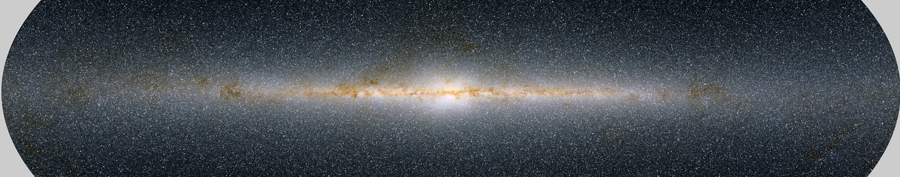
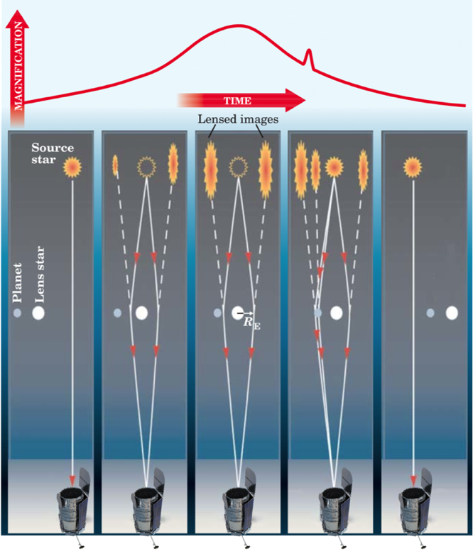
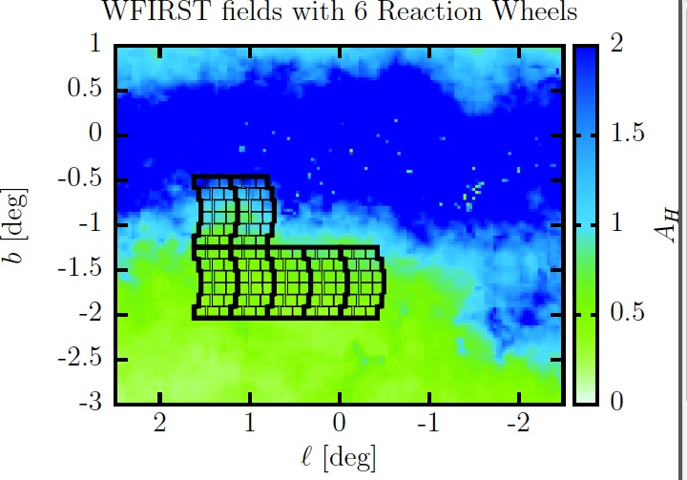
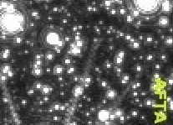
Microlensing
Observables
 | Micro Lensing Survey
Great benefit of space observations in the crowded galactic bulge field

Slide 66
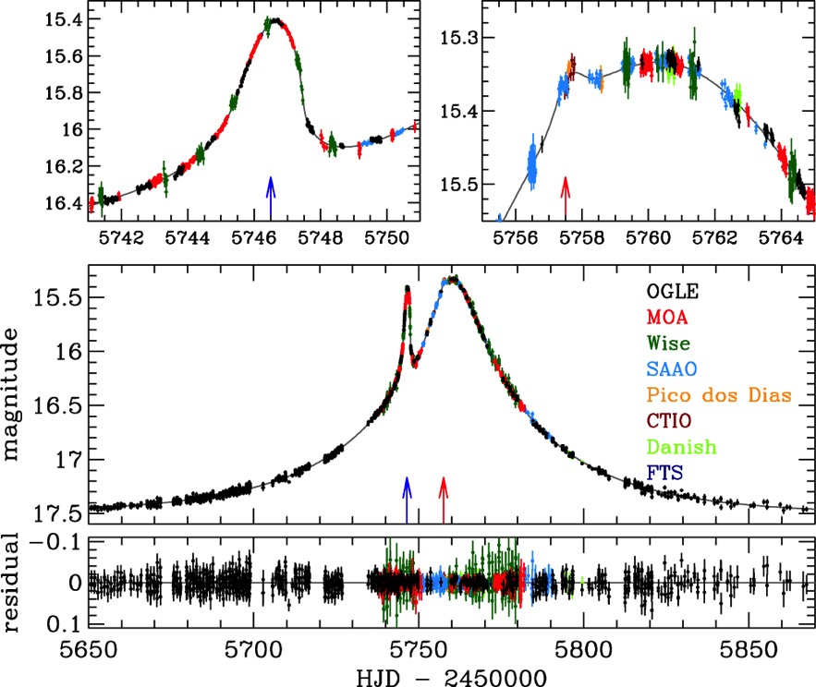
Microlensing
Observables
 | Micro Lensing Survey
  Microlensing event from Jupiter-mass planet around an M-dwarf (Skowron et al 2015)
  Shape of light curve is governed by changing geometry of source & host stars & planet; motion of Earth about Sun affects shape of star-star light curve.
  High-precision relative photometry is essential
  Flux calibration over time
    ≤0.1% over a season
  Flux calibration linearity
Days

Slide 67
Microlensing
Measurement Requirements
 | Micro Lensing Survey
Microlensing Measurement Requirements & Observation Approach
  Monitor fields in Galactic Bulge with NIR images at ~15 minute cadence
    High density of stars maximizes event rate
    NIR reduces effects of dust extinction -> access to higher density sightlines
  Need accurate lightcurve shapes
    15 minute cadence samples planet event light curve (~2 hr timescale for low-mass planets)
    Use wide filter (~1-2μm) to obtain high signal to noise (>100:1)
  Need to determine distances of stars to break degeneracies in system masses and orbit parameters
    Measure parallax
      Astrometric precision <1mas/visit, ≤100 μas per season; observe both Fall & Spring seasons
    Measure stars periodically in all filters
      determine spectral type, improve position measurement accuracy
      Absolute flux cal < 3%, relative filter zeropoints known to <1.4%
    Maximize time from first to last observations to get best baseline for parallax and star-star separation for spectral typing
        Spectral type + brightness gives distance independent of parallax
  Minimum monitor time: 60 days
    Needed to characterize star-star lensing light curves
    Drives Field of Regard: presently supports 72 day seasons

Slide 68
Microlensing
Requirements Validation
 | Micro Lensing Survey
Models of planet formation, knowledge of distributions inside habitable zone from Kepler used to set top-level requirements (SRD 2.0.x)
Models of distribution of stars in the Galaxy, and models of planet formation are used to generate samples of microlensing events
Events are then “observed” through a model of the observatory, and analyzed to set lower-level requirements (SRD 2.1.x, 2.2.x, 2.3.x)
  Optimize observing strategy
    Field placement, filters, cadence, exposure time, etc
  Study instrumental effects such as persistence
  Derive calibration requirements, data product requirements
Forecasts of yields compared to top-level requirements

Slide 69
Microlensing
Requirements Summary
 | Micro Lensing Survey
Super-nova Survey
Survey Capability
(EML 2.0.x)
Science Data Records
(EML 2.1.x)
Calibrated Data Records
(EML 2.2.x)
Raw Data Records
(EML 2.3.x)
1: Mass function for
1M_{Earth}< m <30M_{jupiter}
to <15%
2: Mass function for
0.1M_{Earth}< m <0.3M_{Earth}
to <25%
3: masses, distances
to 40% host stars
4: free-floating
planet frequency
5: estimate η_{Earth}
1: Mosaic images
each season
2: source catalog
basic data
3: source catalog
extended data
4: source catalog
uncertainties
5: daily calibrated
moment curves
6: astrometry:
≤100 μas per season
1: calibrated images
2: calibrated moment
curves
3: astrometry per exposure
≤1 mas at AB=21.4
4: Stellar image radius
precision <1% per day
5: Stellar image radius
precision <0.2% per season
6: flux calibration <0.1%
w/in a season
7: flux calibration <0.1%
season to season
8: flux calibration absolute
9: flux calibration across filters
1: Raw data
2: monitor 585 deg-days
S/N=100 H_{AB}=21.4
3: S/N=100 H_{AB}=21.4
per exposure
4: filter bandpass
5: observation cadence
6: PSF R(EE50) <0.15”
7: data downlink
8: deleted
9: season duration (FoR)
10: duty cycle
11: additional filters
12: season interval
13: distortion calibration

Slide 70
Key Microlensing Science Performance Requirements
Representative values shown; full details in SRD. |  | Expansion, Structure, NIR Survey |  | Expansion | Exoplanet
 |  | Weak Lensing | Galaxy Redshift Survey | Supernovae | Microlensing
Surveys & Data | Area/Survey Speed | 0.20 deg²/hr (1,700 deg²) | 0.34 deg²/hr (1,700 deg²) | 14, 5 deg² >100 SNe/Δz=0.1 | 586 deg²-day Over 6+ seasons
 | Redshift | 0≤z≤3 | 1.1 < z < 1.9 (2.9 w/OIII) | 0.2≤z≤1.7
 | Sensitivity | S/N≥18 @ 24.4/24.3/23.7 (AB J/H/F184) r_{eff}=0.18” | S/N≥6.5 for 1.0x10⁻¹⁶ erg/cm²/s | S/N≥13 (brightest filters at peak) | S/N>100 for H_{AB}=21.4 star
 | Cadence |  |  | ~ 5 days | 15 min
 | Data Vol. | ≥3 reads/exp | ≥3 reads/exp | ≥3 reads/exp | ≥3 reads/exp
PSF | Quality | EE50 ≤ 0.12” (J) EE50 ≤ 0.17” (IFC) | EE50≤0.21”@1.5 μm | EE50 ≤ 0.12” (J) EE50 ≤ 0.14” (IFC) | EE50 ≤ 0.15” (wide)
 | Stability | 1 nm RMS 𝚫WFE in 180s
 | Knowledge | 2nd moment ≤7.2x10⁻⁴ Ellipticity ≤5.7x10⁻⁴ |  | 0.2%
Flux Calibration Relative Over | Time | 0.5% /observing program | <2% rel spect-photometry | <0.5% / 2 wk | <0.1%/season
 | Wavelength | <2% abs/0.5% photo zeropt | <2% rel over bandpass | <2% abs/ 0.5% photo zeropt | <3% abs <1.4% photo zeropt
 | Dynamic Range |  |  | <0.3% 15<AB<26 | <0.1% over 2 mag
 | Area | <10 mmag | <2% rel over survey area
Color | Filters | 4 NIR bands for photo-z, 3 reddest for shapes | Overlap with HLIS for 3 filter imaging | 6 filters 0.5-2.0μm | Wide filter, & 1 short, 1 longward of 1μm
 | Dispersion |  | 10-12 Å/pix | 70 < R < 150

Slide 71
Coronagraphy
Requirements Validation
Direct Imaging
Spectro-scopy
Performance forecasts are done with end-to-end simulations of planet observations
  Emergent planet flux modeled with varying atmospheric compositions, stellar spectra, planet size and orbit radius, viewing conditions
  Simulated observations done with high-fidelity integrated models of the observatory and coronagraph instrument.

Slide 72
WFI Data Processing
Wide-Field Instrument
  Initial data reduction of raw NIR detector data similar to that for WFC3/IR.
  Assemble sequences of overlapping images into mosaics
    PSF determination from stars in each image & from downlinked guide star image series
  Identify sources, compute positions, fluxes, shapes, photometric redshifts, etc., populate catalogs
    For weak lensing, additional steps for iterative shape determination, possible joint analysis with LSST data
    Generate 3-D matter distribution maps from WL data
  Galaxy redshift survey (GRS):
    Extract spectra associated with sources in image catalog
    Fit spectra, assign redshifts
    Generate precise 3-D galaxy distribution
  Cosmological analysis of WL, GRS: computing correlation functions over entire matter distribution dataset gives info on growth of structure and evolution of cosmic distance scale
  Microlensing, SNIa monitoring:
    Use successive images of field to compute time-series for each source
  Microlensing analysis: Combination of light curve shapes, stellar photometry and astrometry gives planet masses & orbit radii
  SNIa spectra
    Derive 2-D spectral time series for each SN and host galaxy, extract SN spectra
    Fit spectra, assign redshifts, compute rest-frame photometry
  Cosmological analysis of SNIa done by fitting Hubble diagram of distance-redshift points

Slide 73
Backup for MRD

Slide 74
Implement Surveys in 5 years
Mission Implementation (2 of 3)
MRD 152: WFC have an active field of view ≥0.25 deg²
  Flows to WFI – Sets WFC focal plane size
MRD 166: Supernova Spectroscopy FOV have a field of view ≥9 arcsec²
  Flows to WFI – Establishes requirements for Supernova Spectroscopy IFC optics
MRD 173: Photometric Redshift Calibration Spectroscopy FOV have a field of view ≥36 arcsec²
  Flows to WFI (IFC) – Establishes requirements for Photometric Redshift Calibration Spectroscopy IFC optics
MRD 153: Have an average angular sample of 0.11 arcsec/pix in the WFC.
  Flows to OTA & WFI – Establishes requirements for optical prescription
MRD 294-298: Slew in <23 sec for slew of 212 arcsecond (gap-filling), <56 sec for slew of 0.41 deg (short FoV), <78 sec for slew of 0.82 deg (long FoV), <92 sec for slew of 1.16 deg (ML return), <3700 sec for slew of 180 deg
  Flows to S/C – Establishes requirements for number and size of wheels
MRD 409-411: Settle within 10 sec for slew <1 deg, within 10 sec + 1 sec per degree of slew between 1 and 10 deg, within 20 seconds for slews >10 deg.
  Flows to S/C – Establishes requirements for deployed frequency, centroiding algorithms

Slide 75
Implement Surveys in 5 years
Mission Implementation (3 of 3)
MRD 432: Observatory throughput efficiency greater than the values listed in table.
  Flows to OTA & WFI – See S/N Budget
MRD 433: Intrinsic background contribution (thermal & dark current) from the Observatory less than values listed in table.
  Flows to OTA & WFI – See S/N Budget
MRD 434: WFC total noise less than 7.5e-.
  Flows to WFI – See S/N Budget
MRD 465: Observatory throughput efficiency for the IFC greater than 0.44 averaged over the bandpass in MRD-370.
  Flows to OTA & WFI – See S/N Budget
MRD 466: Intrinsic background contribution (thermal & dark current) from the Observatory in the IFC less than 0.0036 e-/pix at 2 μm and 0.0022 e-/pix at 0.45 μm .
  Flows to OTA & WFI – See S/N Budget
MRD 467: IFC total noise less than 7.5e-.
  Flows to WFI – See S/N Budget
MRD 340: Execute the core WFIRST surveys and calibration observations from the SITs
  Flows to the Ground Sys – Establishes requirements for planning and scheduling system
MRD 341: Execute the General Observer/Guest Investigator program.
  Flows to the Ground Sys – Establishes requirements for planning and scheduling system

Slide 76
Provide Data
Mission Implementation
MRD 018: Total daily downlink of at least 11 Tbits on high rate science downlink
  Decomposed in MRD to WFI, S/C & Ground
    WFI requirements
      MRD 186: WFI provide subsets of detector frames, either individual frames or linear combinations of frames at ground-specified intervals during an exposure
      Also establishes requirement for WFI data compression
    Ground Sys & S/C
      MRD 279: Ka-Band downlink information rate up to 500 Mbps
MRD 020: Limit total science data lost to <2%
  MRD-254: Recover the daily science data volume from a missed contact within 7 days.
    Establishes requirements for SSR size and scheduling downlink time to enable data recovery

Slide 77
Provide Data (Data Release Rqmts)
Mission Implementation
MRD 337: Archive raw, instrument housekeeping and processed/calibrated data generated as well as all higher-level science products in a public archive.
  Flows to Ground Sys – Establishes requirements for sizing data archive
MRD 023: Provide a public release of uncalibrated (Level 1) data within 72 hours of WFI data acquisition at least 95% of the time.
  Flows to Ground Sys – Establishes requirements for latency for downlinking & processing data
MRD 429: Provide a public release of WFI data processed to at least the resampled/coadded (Level 3) standard using then-available calibrations within 168 hours of acquisition at least 95% of the time.
  Flows to Ground Sys – Establishes requirements for data processing
MRD 349: Provide a public release of all WFI data processed to at least the resampled/coadded (Level 3) standard within 6 months of acquisition.
  Flows to Ground Sys – Establishes requirements for data processing and data releases
MRD 348: Provide a public release of uncalibrated (Level 1) data within 72 hours of CGI data acquisition at least 90% of the time.
  Flows to Ground Sys – Establishes requirements for data processing
MRD 329: Generate science data products for all observations per the applicable requirements in the Science Requirements Document (WFIRST-RQMT-05301).
  Flows to Ground Sys – Establishes requirements for data processing pipeline
MRD 330: Enable science investigators to perform custom data reduction of the WFIRST data set
  Flows to Ground Sys – Establishes requirements for SOC tools
MRD 445: Incorporate compatible software provide by SITs into operational high-level data processing pipelines
  Flows to Ground Sys – Establishes requirements for data processing pipeline

Slide 78
PSF Requirements
Mission Implementation (1 of 2)
MRD 003: Operate the observatory in orbit about Sun-Earth L2
  Flows to Observatory, Launch Vehicle & Ground System – Establishes requirements for environments, mass, S/C (ACS, comm, prop, power), flt dyn
MRD 114: Provide data to support the determination of the PSF in the Wide Field Instrument for each exposure
  Flows to WFI to provide guide window image data, S/C to provide IRU & wheel speed data, and Ground for PSF reconstruction
MRD 187: Provide a capability to download all frames of science data without data compression from all WFC SCAs over an exposure
  Flows to WFI & S/C – Establishes requirements for throughput of data system
MRD 428: Provide a capability to perform focus diversity phase retrieval using the WFI
  Flows to WFI for range & resolution of focus mechanism
MRD 353: Provide wavefront stability of ≤1 nm RMS per 180 sec for at least 95% of exposures in WIM
  Flows to IC, OTA & WFI – Establishes requirements for thermal stability, basis for architecture decision to guide from WFC FPA
MRD 352: Provide a wavefront error of ≤110 nm rms, including line of sight motion, in WIM, for at least 95% of the exposures and over 95% of the FOV
  Flows to IC, OTA, & WFI – see WFE & Align budget
MRD 038: Maintain the WFC pointing stability within 8 milliarcsec (1-sigma per axis) in WIM for exposures up to 1000 seconds.
  Flows to WFI & S/C – see Stability budget
MRD 039: Maintain the WFC line of sight jitter within 12 milliarcsec (1-sigma per axis) in WIM WIM for exposures up to 1000 seconds.
  Flows to S/C for RWA isolators, limiting RWA speed range and separating RWA wheel speeds, IC for payload isolation
MRD 355: Provide a wavefront error of ≤198 nm rms at 1.5 μm for a monochromatic point source, including line of sight motion, for at least 95% of the exposures and over 95% of the FOV
  Flows to IC, OTA, & WFI – see WFE & Align budget
MRD 394: Maintain the WFC pointing stability within 99 milliarcsec (1-sigma) in the spectral dispersion direction on the WFC focal plane and 48.5 milliarcsec (1-sigma) in the cross-dispersion direction in WSM for exposures up to 360 seconds.
  Flows to WFI & S/C – see Stability budget

Slide 79
PSF Requirements
Mission Implementation (2 of 2)
MRD 033: Perform sub-pixel scale slews of 22 milliarcsec relative to the current pointing with an accuracy of 11 milliarcsec (RMS/axis) about pitch and yaw in the WFC Focal Plane frame for the WIM
  Flows to WFI & S/C – see Pointing budget, basis for architecture decision to guide from WFC FPA
MRD 153: Have an average angular sample of 0.11 arcsec/pix in the WFC.
  Flows to OTA & WFI – Establishes requirements for optical prescription
MRD 167: SN Spectroscopy FOV have 2- to 4-pixel spatial resolution of ≤0.20 arcsec for at least 95% of the exposures and over 95% of the slicer FOV.
  Flows to OTA, WFI – Establishes requirements for 2 slicer design, see WFE & Align budget
MRD 174: Photometric Redshift Calibration Spectroscopy FOV shall have 2- to 4-pixel spatial resolution of ≤0.30 arcsec for at least 95% of the exposures and over 95% of the slicer FOV.
  Flows to OTA, WFI – Establishes requirements for 2 slicer design, see WFE & Align budget
MRD 358: Observatory provide a wavefront error of ≤ 117 nm RMS at a wavelength of 1.3 µm at the image slicer in the IFC for the Supernova Spectroscopy FOV, for at least 95% of the exposures and over 95% of the slicer FOV.
  Flows to IC, OTA, & WFI – see WFE & Align budget
MRD 440: Observatory provide a wavefront error of ≤ 130 nm RMS at a wavelength of 1.3 µm at the focal plane in the IFC for the Supernova Spectroscopy FOV, for at least 95% of the exposures and over 95% of the slicer FOV.
  Flows to WFI – see WFE & Align budget
MRD 361: Observatory provide a wavefront error of ≤ 172 nm RMS at a wavelength of 1.3 µm at the focal plane in the IFC for the Photometric Redshift Calibration Spectroscopy FOV, for at least 95% of the exposures and over 95% of the slicer FOV.
  Flows to IC, OTA,& WFI – see WFE & Align budget
MRD 100: Use stars in the Wide Field Instrument field of view to meet the fine pointing accuracy and stability requirements.
  Flows to WFI, S/C & Ground Sys – Establishes requirements for use of guide window & ground selection of guide stars

Slide 80
Relative Flux Calibration
Mission Implementation (1 of 2)
Calibration implemented via calibration observations and using a WFI Relative Calibration System for calibrations which can’t be performed using astronomical sources
On-Board Calibration Requirements
  MRD 181: WFI provide a flight cal light source to the WFI detectors, selectable and repeatable, over the range from a max full pixel well in 1 frame time to a min down 5 orders of magnitude.
  MRD 390: WFI provide a cal light source to the WFI detectors that varies by no more than 50% peak-to-trough across each FPA
  MRD 391: WFI provide at least 1 quasi-monochromatic source per filter bandpass
  MRD 384: WFI provide a dark setting in the WFC that allows the instrumental background to be measured
  MRD 385: WFI provide a dark setting in the IFC that allows the instrumental background to be measured
    All flow to WFI - Establishes requirements for relative calibration system and dark capability

Slide 81
Relative Flux Calibration
Mission Implementation (2 of 2)
Astronomical Calibration Requirements
  MRD 340: Execute the core WFIRST surveys and calibration observations from the SITs
    Flows to the Ground Sys – Establishes requirements for planning and scheduling system
  MRD 033: Perform sub-pixel scale slews of 22 milliarcsec relative to the current pointing with an accuracy of 11 milliarcsec (RMS/axis) about pitch and yaw in the WFC Focal Plane frame for the WIM
    Flows to WFI & S/C – see Pointing budget, basis for architecture decision to guide from WFC FPA
  MRD 406: Return on successive visits to a field such that the WFC FOV boresight is within 110 milliarcsec RMS of its commanded direction, and with offsets up to 2.2 arcsec from the nominal target
    Flows to WFI & S/C – see Pointing budget, basis for architecture decision to guide from WFC FPA
Ground Processing Requirements
  MRD 329: Generate science data products for all observations per the applicable requirements in the Science Requirements Document (WFIRST-RQMT-05301).
    Flows to Ground Sys – Establishes requirements for data processing pipeline
  MRD 330: Enable science investigators to perform custom data reduction of the WFIRST data set
    Flows to Ground Sys – Establishes requirements for SOC tools
  MRD 445: Incorporate compatible software provide by SITs into operational high-level data processing pipelines
    Flows to Ground Sys – Establishes requirements for data processing pipeline

Slide 82
Color
Mission Implementation
MRD 154: WIM provide at least seven imaging filters spanning the range 0.48 μm to 2.0 μm with wavelength ranges as specified in the filter table
  Flows to WFI – Establishes requirements for WFI filters, element wheel
MRD 161: WSM provide slitless spectroscopy with a spectral dispersion between 1.0 nm/pix and 1.2 nm/pix over the bandpass 1.0 to 1.93 µm and across the full field.
  Flows to WFI – Establishes requirements for WFI grism, element wheel
MRD 168: IFC shall provide a spectral sampling of 2 to 4 pixels/slice.
MRD 169: IFC shall provide integral field spectroscopy with a resolving power between 70 and 150 per one slice spectral resolution element over the bandpass of 0.6 μm – 2.0 μm.
MRD 370: IFC shall have a bandpass spanning at least 0.45 -2.0 μm.
  168, 169, 370 flow to WFI – Establishes requirements for IFC design

Slide 83
PLRA Technical Flow Down
Mission Implementation
MRD 011: Execute the science program in an operational phase lifetime of 5 years.
  Flows to Observatory & Ground System – Establishes requirements for environments, redundancy, efficiency related requirements (parallel science & downlink, parallel instrument ops, event driven ops), power
MRD 392: Employ components of an existing telescope with a 2.36 m diameter primary mirror, on-axis secondary mirror, and associated metering structure.
  Flows to Telescope – Establishes requirements for overall optical system design and observatory size
MRD 058: Be designed to support on-orbit robotic servicing of the instruments and spacecraft.
  Flows to WFI, CGI, IC, & S/C – Establishes requirements for instrument-IC interface, accessible instrument connectors, S/C services for orbital replacements & interfaces to servicer
MRD 063: Be capable of performing observations in combination with a starshade occulter
  Flows to CGI & S/C – Establishes requirements for additional filters, starshade lateral sensing, and thruster plume scattered starlight protection in CGI, addition of starshade acquisition camera and space-to-space comm link in S/C
MRD 334: Execute a Target of Opportunity order within 2 weeks of approval of a request
  Flows to Ground Sys – Establishes requirements for planning and scheduling system

Slide 84
CGI Technology Flow Down
Mission Implementation (1 of 2)
MRD 449: Provide at least four filters as specified in filter table
MRD 436: Be able to measure the brightness of an astrophysical point source to an SNR of 10 or greater within 10 hours of integration time on the target in CGI Filter Band 1 for an object with a source-to-star flux ratio as faint as 1x10⁻⁷ at separations from 0.16 arcsec to 0.21 arcsec, 5x10⁻⁸ at separations from 0.21 arcsec to 0.4 arcsec, and 1x10⁻⁷ at separations from 0.4 arcsec to 0.45 arcsec.
MRD 437: Be able to measure spectra of an astrophysical point source with R=50 or greater spectral resolution with a wavelength accuracy of 5 nm or smaller (TBR9) to an SNR of 10 within 100 hours of integration time on the target in CGI Filter Band 3 for an object with a source-to-star flux ratio as faint as 1x10⁻⁷ at separations from 0.21 arcsec to 0.27 arcsec, 5x10⁻⁸ at separations from 0.27arcsec to 0.53 arcsec, and 1x10⁻⁷ at separations from 0.53 arcsec to 0.60 arcsec.
MRD 438: Be able to measure the brightness around a star as faint as V = 5 mag with an SNR of 10 or greater within 24 hours (TBR12) of integration time on the target in CGI Band 4 for an extended source with an integrated surface brightness per resolution element equivalent to a source-to-star flux ratio as faint as 1x10⁻⁷ at separations from 0.47 arcsec to 0.54 arcsec, 5x10⁻⁸ at separations from 0.54 arcsec to 1.36 arcsec, and 1x10⁻⁷ at separations from 1.36 arcsec to 1.44 arcsec.
MRD 451: Be able to map the linear polarization of a circumstellar debris disk that has a polarization fraction greater or equal to 0.3 with an uncertainty of less than 0.03 in CGI Filter Band 1 and CGI Filter Band 4, assuming SNR of 100 per resolution element.

Slide 85
CGI Technology Flow Down
Mission Implementation (2 of 2)
MRD-452: Be able to measure the relative astrometry between an astrophysical point source and its host star, in photometric images, for separations from 0.21 arcsec to 1.36 arcsec, with an accuracy of 5 milliarcsec or less, assuming SNR of 10 or greater, including systematic errors.
MRD-453: Be able to capture wavefront control system telemetry concurrently with science data, including raw wavefront sensor measurements and commanded deformable mirror actuator values
MRD-454: Be able to measure the complex electric fields of incident light in two orthogonal polarization states.
MRD-455: Be able to measure observatory tip/tilt disturbances at the CGI occulter at frequencies from 0.1 Hz to 100 Hz with accuracy better than 0.5 mas rms on sky per axis for a V=2 mag or brighter star
MRD-456: Be able to estimate the average rate of change over 1 hour period at the CGI occulter for each of focus, astigmatism, coma, trefoil, and 3rd-order spherical aberrations, with accuracy better than 0.1 nm/hour, when pointed at a V=2 mag or brighter star.
MRD-457: Direct imaging camera shall have a field of view with a radius of ≥3 arcseconds.
  All Flow to CGI
Additionally, per the PLRA, CGI not allowed to drive observatory performance; therefore image quality and jitter requirements are derived from the CGI technology requirements consistent with Observatory requirements derived from wide field science requirements:
  Image quality requirements specified at input to CGI
  Quasi-static optical interface requirements documented in Level 3 specs
  CGI jitter requirements captured in CGI spec, met by operating over wheel speed range that provides low jitter

Slide 86
Key requirements sorted by mission segment

Slide 87
OTA Key Requirements
Implement Surveys & Provide Data
  Image quality & stability requirements - MRD 352, 353, 355, 358, 361 & 420
    Sub-allocated in WFE & Align Budget
  Throughput, background, noise - MRD 432, 433, 465, 466
    Sub-allocated in S/N budget
  Prescription & Angular Sampling - MRD 79, 153
  Common OTA alignment - MRD 102
Directed Requirements
  Use existing heritage hardware - MRD 392

Slide 88
WFI Key Requirements
Implement Surveys & Provide Data
  FOV - MRD 152(WFC), MRD 166 & 173 (IFC)
  Throughput, background, noise - MRD 432-434, 465-467 (Sub-allocated in S/N budget)
  Pointing – MRD 035 (Sub-allocated in Pointing Budget)
  Data volume – MRD 018, 186
PSF
  Image quality & stability requirements - MRD 352, 353, 355, 358, 361, 440, 167, 174 (Sub-allocated in WFE & Align Budget)
  Prescription & Angular Sampling – MRD 147, 153
  Fine Guidance Sensor – MRD 177
  Pointing – MRD 033, 038, 039, 394, 395, 430 (Sub-allocated in Pointing Budget)
  Focus Diversity Phase Retrieval - MRD 428
Calibration
  Calibration requirements - MRD 181, 390, 391, 384, 385
  WFI Engineering Data Mode - MRD 187
Colors
  Filters & Spectral Dispersion - MRD 154, 161
  IFC – 168, 169, 370
Directed Requirements
  Serviceability - MRD 185

Slide 89
CGI Key Requirements
Implement Surveys & Provide Data
  Prescription – MRD 79
  Pointing & stability accuracy – MRD 202
  3 Tbits/day data volume – MRD 204
Directed Requirements
  CGI technology requirements - MRD 436-438, 449-457
  Serviceability – MRD 203
  Starshade accommodation - MRD 206, 207, 426

Slide 90
IC Key Requirements
PSF
  Optically stable payload support - MRD 208
  Image quality & stability requirements - MRD 352, 353, 355, 358, 361, 420, 038, 039, 394, 395
    Sub-allocated in WFE & Align Budget
Directed Requirements
  Serviceable mechanical interfaces - MRD 209

Slide 91
Spacecraft Key Requirements
Implement Surveys & Provide Data
  Provide standard S/C services, e.g., power, data, comm, GN&C - MRD 214
  Payload accommodation – MRD 219
  Pointing - MRD 032, 035, 038, 394 (Sub-allocated in Pointing Budget), 100
  Field of Regard - MRD 042, 044
  Event Driven Ops - MRD 052
  Slew Times/Settle Times - MRD 294-298, 414-418 /409-411
  Data Volume, Stored Science Data Recovery, Ka-Band Downlink Rate - MRD 018, 254, 279
PSF
  Sub-Pixel Pointing - MRD 033 (Sub-allocated in Pointing Budget)
  Jitter - MRD 039, 395
Calibration
  Return Pointing with Offset - MRD 406
  WFI Engineering Data Mode - MRD 187
Directed Requirements
  Serviceability - MRD 223
  Starshade accommodations - MRD 282, 310
Other Key Requirements
  Provide OBA - MRD 220

Slide 92
Ground System Key Requirements
Implement Surveys & Provide Data
  Implement core science surveys and GO/GI Program - MRD 050, 051, 372, 052, 340, 341
  Routine Operations - MRD 053, 327, 388, 328
  Observatory management - MRD 027, 387, 336
  Manage Data Volume - MRD 018, 279, 447, 331
  Science Data Processing & Archiving - MRD 329, 024, 025, 423, 429, 349, 337
Calibration
  Custom Data Reduction - MRD 330
  SIT Provide S/W - MRD 445
Directed Requirements
  Target of Opportunity - MRD 334

Slide 93
Driving Requirements
Program | PSF |  |  | Flux Calibration relative over: |  |  | Slew & settle time | Data Volume
 | Quality | Stability | Knowledge | Time | Wavelength | Dynamic range
WL | ✓✓ | ✓✓ | ✓✓ | ✓ | ✓ |  | ✓ | ✓
GRS | ✓ |  |  | ✓ |  |  | ✓
SNIa | ✓ | ✓ | ✓ | ✓✓ | ✓✓ | ✓ | ✓ | ✓
ML |  |  | ✓ | ✓ |  | ✓ | ✓✓ | ✓✓
- Important for part of program, but perhaps not all, or is not most stressing case
✓✓ - Essential for entire program, and/or is most stressing case

