Slide 1
Astro2020 Science Themes
Worlds and Suns in Context
“quest to understand the interconnected systems of stars and the worlds orbiting them, tracing them from the nascent disks of dust and gas from which they form, through the formation and evolution of the vast array of extrasolar planetary systems.”
New Messengers and New Physics
“The New Messengers and New Physics theme captures the key scientific questions associated with a broad range of inquiries, from astronomical constraints on the nature of dark matter and dark energy, to the new astrophysics enabled by combined observations with particles, neutrinos, gravitational waves, and light.”
Cosmic Ecosystems
“The universe is characterized by an enormous range of physical scales and hierarchy in structure, from stars and planetary systems to galaxies and a cosmological web of complex filaments connecting them. A major advance in recent years has been the realization that the physical processes taking place on all scales are intimately interconnected, and that the universe and all its constituent systems are part of a constantly evolving ecosystem.”

Slide 2
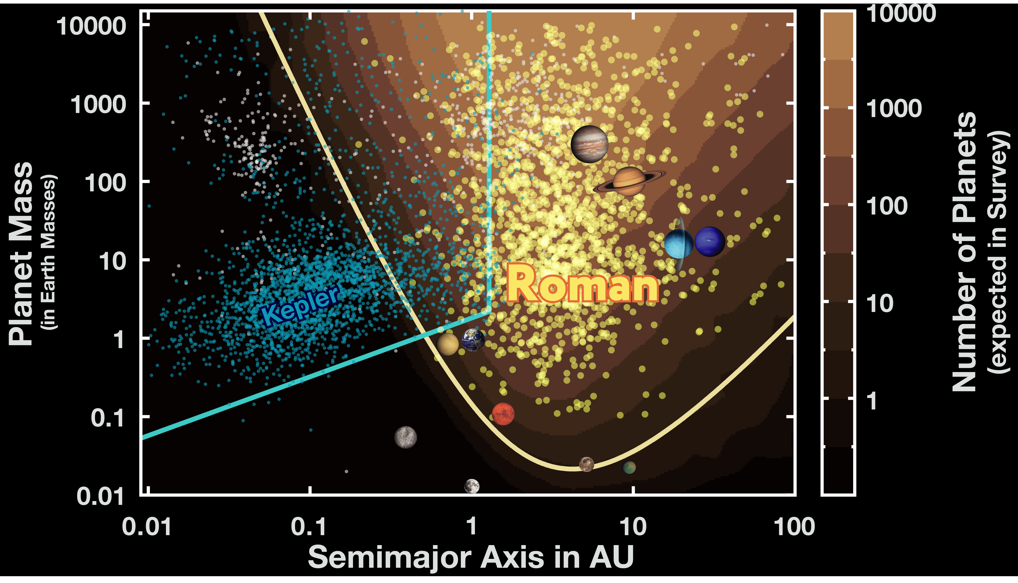
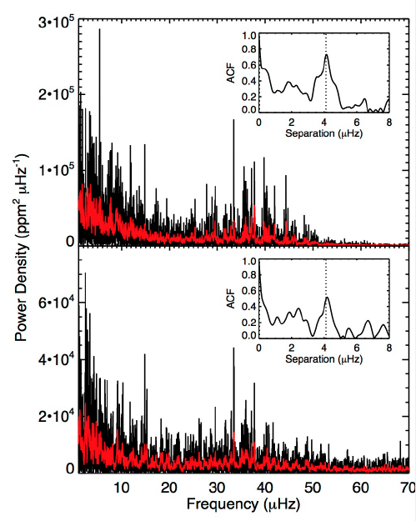
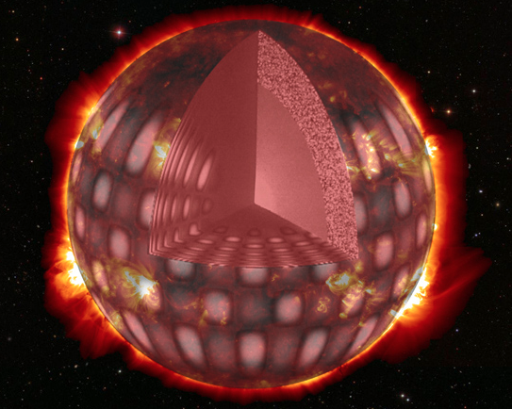
Worlds and Suns in Context
Exoplanet demographics
Roman’s microlensing program with the Galactic Bulge Time Domain (GBTD) Survey will fill out the census of exoplanets by finding exoplanets in the outer reaches of planetary systems that are inaccessible by other detection techniques
Stellar Astrophysics
GBTD Survey will monitor >200 million stars
Microlensing studies will reveal the population of neutron stars and stellar mass black holes in the galactic bulge
Astroseismology – use stellar oscillations to measure mass and radius of stars in the galactic bulge
and lots more – stellar flares, pulsating variable stars etc
GBTD Survey will provide a deep image of 2 deg² region of the bulge
Identify unusual stellar populations down to very faint levels
measure positions, distances precisely
Roman General Astrophysics Surveys of nearby galaxies open new windows in extragalactic stellar astrophysics
Kepler
Roman

Slide 3
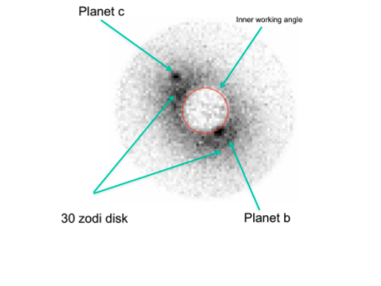
Worlds and Suns in context
Priority Area: Pathways to Habitable Worlds
How to answer the question “Are we alone?”
The planets around Sun-like stars are only accessible via an ultra-stable, space-based telescope equipped to block the star’s light and directly image the planet
The Roman coronagraph instrument tech demo is an important part of the path
Simulated Roman Space Telescope coronagraph image of the star 47 Ursa Majoris

Slide 4
New Messengers and New Physics
The unknown physical natures of dark matter and dark energy remain outstanding Grand challenges in physics and astronomy
Exploring these on large scales by measuring galaxy shapes, distributions of galaxies on large scales and by detecting distant supernova was a prime motivation for the Roman mission with the High Latitude Wide Area and Time Domain Surveys
Roman can also map dark matter more locally, by measuring populations of stars in our Milkyway and nearby galaxies. (using General Astrophysics surveys of the Milkyway and local galaxies)

Slide 5
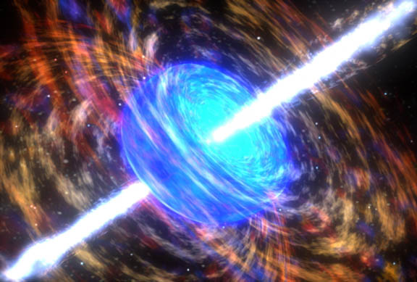
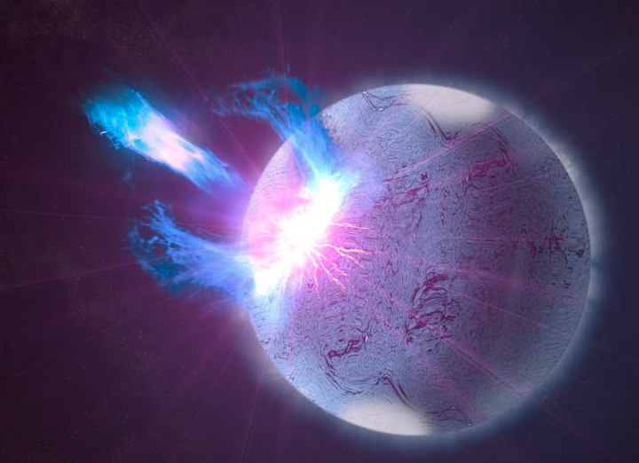
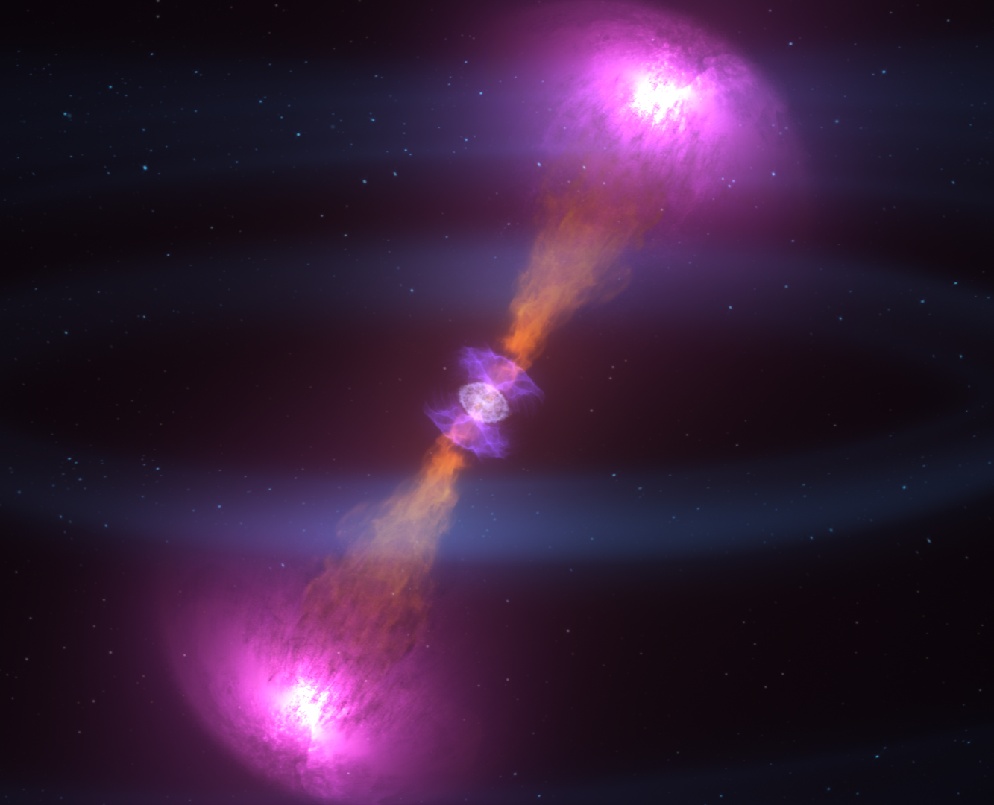
New Messengers and New Physics
Priority area: New windows on the Dynamic Universe
Exploring the Universe in the time domain is a discovery machine
Gamma-ray bursts, tidal disruption events, supernovae, fast radio bursts, etc were all discovered, and can only be studied by observatories monitoring large areas of the sky on a variety of timescales.
Roman will study all these, and almost certainly make new discoveries of our own
The Galactic Bulge and High Latitude Time Domain Surveys will be the engine of these discoveries
Observing/identifying the counterparts to gravitational wave and neutrino events
Connecting the whole new world revealed by GW and neutrinos to things we know from the rest of astronomy
Using the High Latitude Time Domain Survey and TOO observations to identify/follow up interesting events

Slide 6
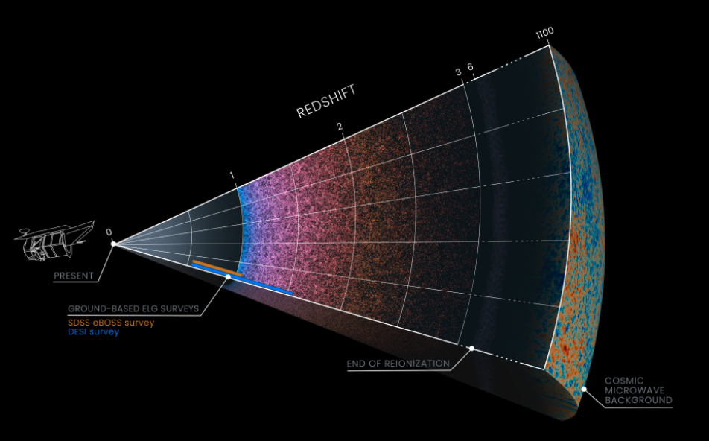
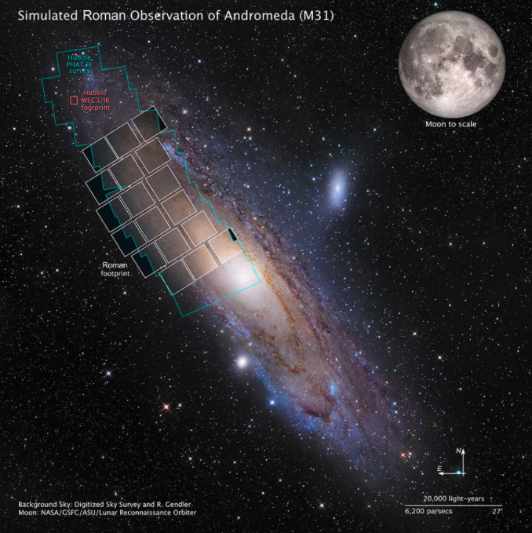
Cosmic Ecosystems
Cosmic structure
How the seeds of galaxies planted during the first moments of the big bang become the structures and galaxies seen today
Roman’s galaxy redshift survey (from the High Latitude Wide Area Survey) has a major role to play
Galaxies are ecosystems of their own
Balance between formation of stars and planets and feedback from stellar winds, outflows and supernovae
What is the role of the supermassive black holes that reside at the center of most galaxies
General Astrophysics surveys of Milkyway and nearby galaxies will provide insight into this

Slide 7
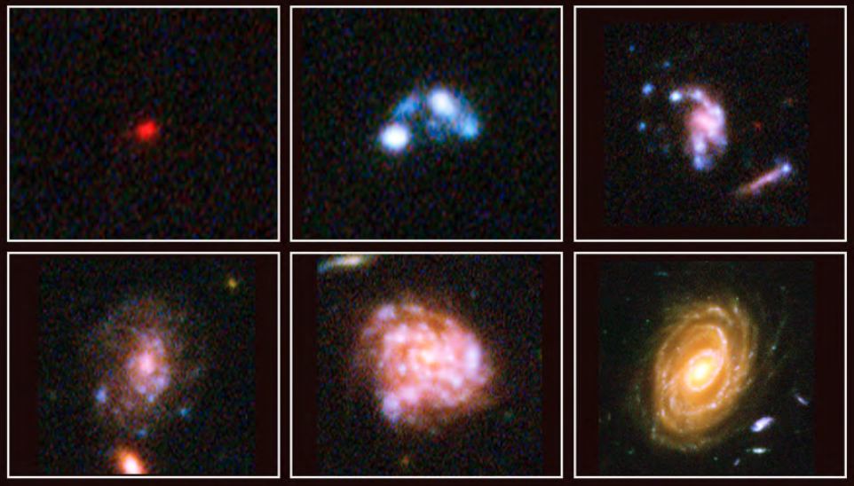
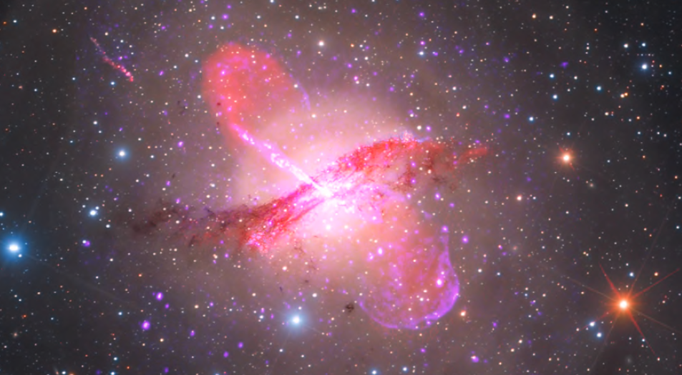
Cosmic Ecosystems
Priority Area: Unveiling the Drivers of Galaxy Growth
Roman’s High Latitude Wide Area and High Latitude Time Domain will greatly expand our sampling of the structure, colors and spectra of galaxies over a significant fraction of cosmic time
General Astrophysics Survey of an Ultra Deep Field would provide additional deptth
Track the growth of normal galaxies as a function of environment
Enable discoveries of rare galactic objects

Slide 8
All three of our Core Community Surveys and the CGI Tech Demo have central roles to play in the science priority areas identified by Astro2020 General Astrophysics Surveys will also have key contributions

