Slide 1
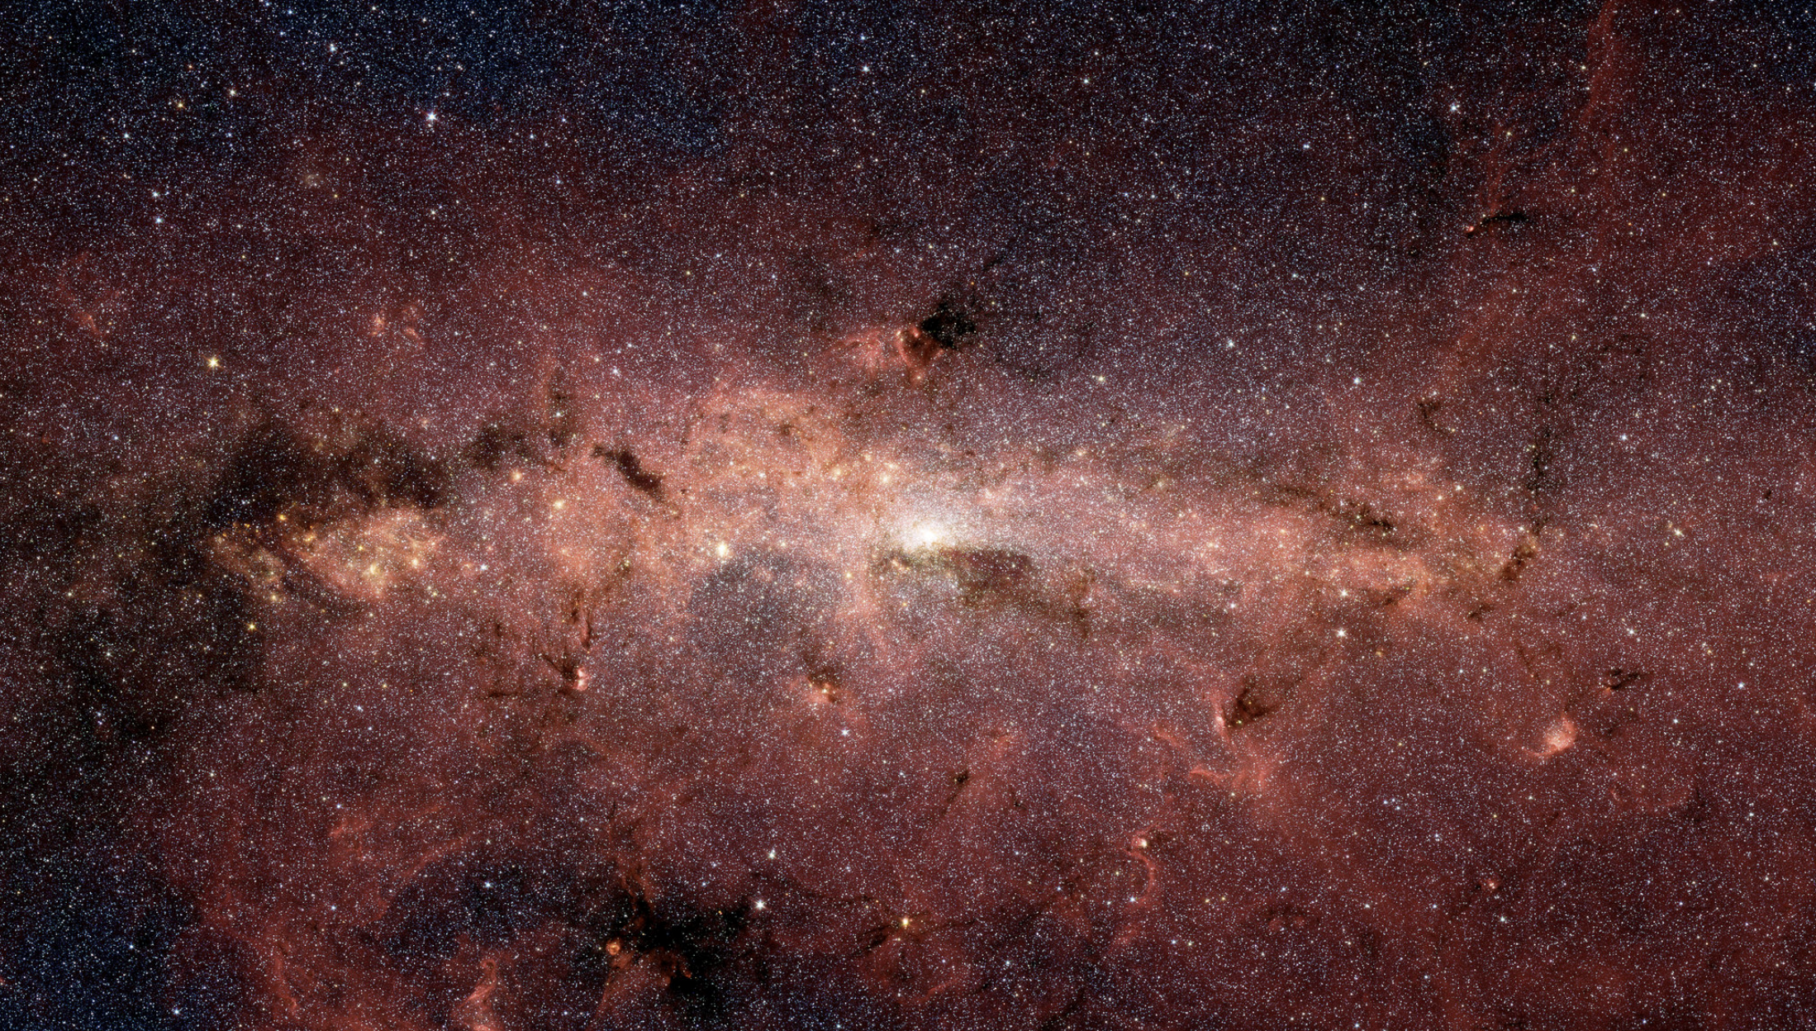
Science Requirements vs observing time trades

Slide 2
Core Community Surveys – Observing time trades
Relationship between science requirements and observation time for each survey is complex because there are multiple ways to adjust observation time for each survey
In what follows, we’ll list the survey parameters that affect observing time, and describe the impact of changing them

Slide 3
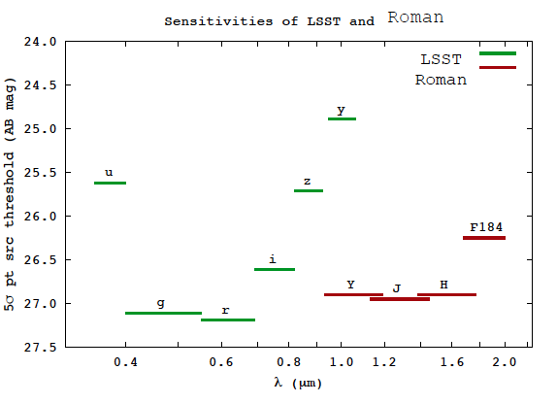
High Latitude Wide Area Survey - Imaging
Reduction in Survey Area
Reduces statistical power of survey
Reduces sensitivity to largest angular scales
Reduces margin in budget that could be available to devote to other terms
Reduction in Survey Depth
Reduces statistical power of survey by reducing the number of galaxies
Loss is preferentially at higher redshifts
Reduced sensitivity on small angular scales
Reduced precision of PSF characterization affects entire sample
Several planned internal calibrations may be degraded

Slide 4
High Latitude Wide Area Survey - Imaging
Reduce number of dithers
Reduced sampling PSF (Roman pixels are undersampled at 0.11 arcsec)
Because chip gaps cause parts of survey to have fewer exposures than the rest, these areas are already at the minimum number of samples
Increases effects of chip gaps on survey depth
Already have significant variation in cumulative exposure time over survey area
Reduce number of filters
Would impact ability to determine photo-z over significant redshift ranges
Reduces ability to detect subtle wavelength-dependent PSF errors
Would reduce ability to use cross-power spectrum tests of shear bias
Shear maps in 3 filters provides internal consistency checks and test for multiplicative bias

Slide 5
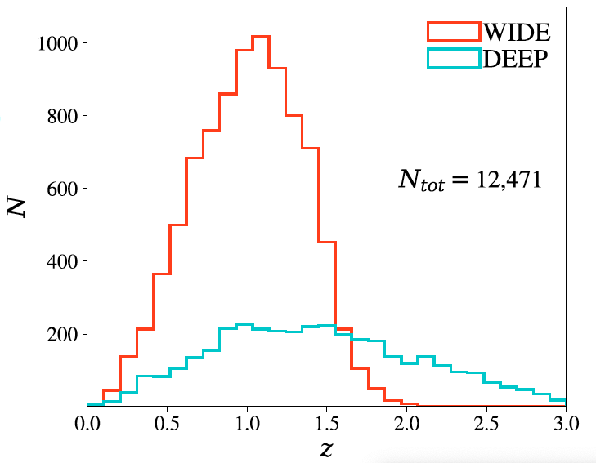
High Latitude Time Domain Survey
Reduce Survey Area
Number of transients
Loss is greater than linear as smaller tiling pattern is less efficient: lose increasing fractions of light curve as tiling pattern rotates on the sky
Increased Cadence
Ability to characterize SNIa
Coarse sampling of light curve reduces accuracy of light curve fits at low redshift end of sample
Reduced Imaging Exposure time
Number of transients as a function of redshift
Ability to characterize transients
Reduces accuracy of SNIa luminosity distance determination
Reduced Prism Exposure times
Redshifts, classification, standardization, systematics and evolution control
Reduced Number of filters
Broad wavelength range to measure colors and build templates
Greatly reduced SNIa redshift coverage in each tier

Slide 6
Galactic Bulge Time Domain
Reducing time allocation to this program does not affect:
Survey Area
Cadence
Imaging Exposure time
Number of filters
Because the survey revisits the same fields over and over at a particular cadence
Conversely: don’t save time by changing any of the above
Reducing duration of seasons:
Reduces number of planets,
more than linearly because light curves are interrupted, especially for gaps in the middle of a season
Reducing Number of Seasons
Reduces number of planets

Slide 7
Trade Space for High Latitude Survey
Current HLWA survey will enable galaxy shape measurements in multiple colors and two roll angle
Provides exquisite control of systematics
To reach the weak lensing FoM requirement in minimum time, could survey part of the Rubin footprint with a single wide-band filter (Euclid-like)
Good statistical constraining power for weak lensing
BUT
Won’t provide internal checks on shear systematics for the region with a single NIR filter
No color information in near IR, degraded photo-z at z>1
Meets the letter, but not the spirit of objective 1 (wide field IR survey to AB 26.5 mag)
Greatly impacts astrophysics science return

Slide 8
Backup

Slide 9
Survey Capability Requirements Summary
Weak Lensing
(HLIS 2.0.x)
Galaxy Redshift
(HLSS 2.0.x)
Supernova Cosmology
(SN 2.0.x)
Exoplanet Microlensing
(EML 2.0.x)
1: FoM_{WL}>327400
2: N_{eff}>27/arcmin²
3: Additive shear
error <2.7 10⁻⁴
4: Multiplicative shear
bias <3.2 10⁻⁴
5: deep field
1: FoM_{BAO}>7533
2: FoM_{RSD}>4047
3: Slitless spectra
4: Completeness
> 0.6
5: redshift accuracy,
outlier fraction
1: FoM_{SN}>325
2: μ(z), 0.2≤ z ≤ 1.7
σμ ≤ 0.02
per Δz=0.1
3: >100 SNIa
per Δz=0.1
4: σ_{z} /(1 + z) bias
1: Mass function for
1M_{Earth}< m <30M_{jupiter}
to <15%
2: Mass function for
0.1M_{Earth}< m <0.3M_{Earth}
to <25%
3: masses, distances
to 40% host stars
4: free-floating
planet frequency
5: estimate η_{Earth}

Slide 10
Key Wide Field Science Performance Requirements
Representative values shown; full details in SRD. |  | Expansion, Structure, NIR Survey |  | Expansion | Exoplanet
 |  | Weak Lensing | Galaxy Redshift Survey | Supernovae | Microlensing
Surveys & Data | Area/Survey Speed | 0.20 deg²/hr (1,700 deg²) | 0.34 deg²/hr (1,700 deg²) | 14, 5 deg² >100 SNe/Δz=0.1 | 586 deg²-day Over 6+ seasons
 | Redshift | 0≤z≤3 | 1.1 < z < 1.9 (2.9 w/OIII) | 0.2≤z≤1.7
 | Sensitivity | S/N≥18 @ 24.4/24.3/23.7 (AB J/H/F184) r_{eff}=0.18” | S/N≥6.5 for 1.0x10⁻¹⁶ erg/cm²/s | S/N≥13 (brightest filters at peak) | S/N>100 for H_{AB}=21.4 star
 | Cadence |  |  | ~ 5 days | 15 min
 | Data Vol. | ≥3 reads/exp | ≥3 reads/exp | ≥3 reads/exp | ≥3 reads/exp
PSF | Quality | EE50 ≤ 0.12” (J) EE50 ≤ 0.17” (IFC) | EE50≤0.21”@1.5 μm | EE50 ≤ 0.12” (J) EE50 ≤ 0.14” (IFC) | EE50 ≤ 0.15” (wide)
 | Stability | 1 nm RMS 𝚫WFE in 180s
 | Knowledge | 2nd moment ≤7.2x10⁻⁴ Ellipticity ≤5.7x10⁻⁴ |  | 0.2%
Flux Calibration Relative Over | Time | 0.5% /observing program | <2% rel spect-photometry | <0.5% / 2 wk | <0.1%/season
 | Wavelength | <2% abs/0.5% photo zeropt | <2% rel over bandpass | <2% abs/ 0.5% photo zeropt | <3% abs <1.4% photo zeropt
 | Dynamic Range |  |  | <0.3% 15<AB<26 | <0.1% over 2 mag
 | Area | <10 mmag | <2% rel over survey area
Color | Filters | 4 NIR bands for photo-z, 3 reddest for shapes | Overlap with HLIS for 3 filter imaging | 6 filters 0.5-2.0μm | Wide filter, & 1 short, 1 longward of 1μm
 | Dispersion |  | 10-12 Å/pix | 70 < R < 150

