Slide 1
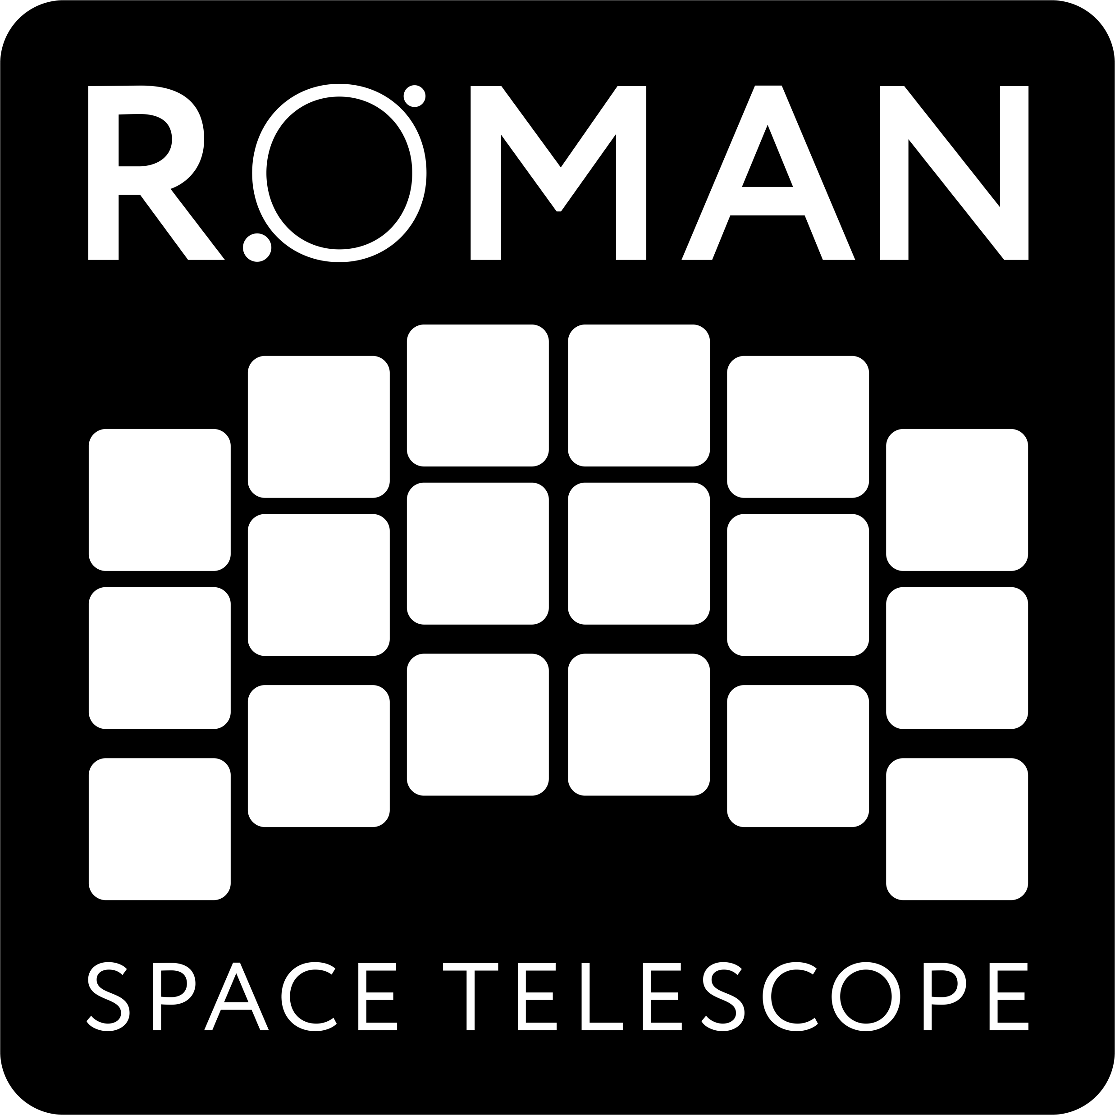
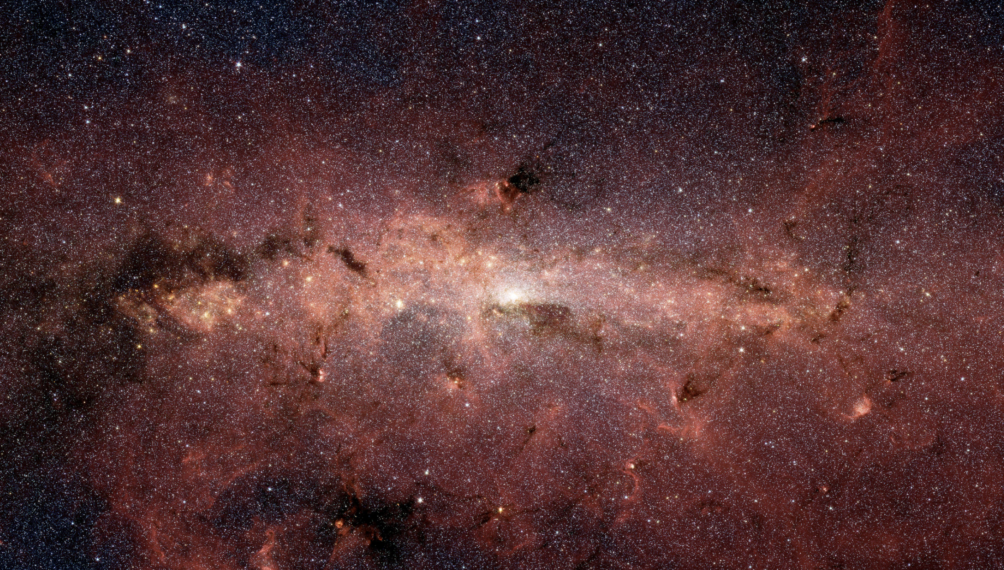
Community Support and Science Analysis Plans

Slide 2
New Roman Science Teams and Community Support
Roman Science investigation team contracts ended in 2021
Draft ROSES Solicitation for new teams/community support will be released within the next few weeks
What are we trying to achieve
Variety of award sizes and durations
Multiple funding opportunities between now and launch for support for people at US institutions to work independently or with existing science teams
Longish term stable support of teams to allow development of software/pipelines etc
Ability for people to engage with Roman project/science teams independently of funding

Slide 3
Three Opportunities
Wide Field Instrument Science
This opportunity provides support to prepare for and enhance the science return of Roman that can be addressed with its Wide Field Instrument (WFI).
Multiple calls between now and launch
Regular and Large categories
Infrastructure Teams
This opportunity provides sustained funding for teams to develop infrastructure needed to enable the community to pursue Roman’s ambitious science goals in cosmology and exoplanet demographics that are part of Roman’s mission success criteria.
Additional science areas that require extensive and sustained infrastructure development will also be considered.
Coronagraph Community Participation Program (CPP)
This provides an opportunity for proposers to work with the coronagraph instrument team to plan and execute its technology demonstration observations.
Multiple calls between now and launch

Slide 4
Wide Field Science Proposals
Preparing for and enhancing Roman WFI Science
Can include, but are not limited to, any combination of the following topics:
Precursor observations using ground- and/or space-based observatories to prepare for future Roman science observations and/or to provide calibration capability;
Development of Roman analysis software beyond that provided by the Science Centers. This could include topics like machine learning techniques in time domain astrophysics, high precision astrometric measurement techniques, etc.;
Development of algorithms for joint processing with data from other space- or ground-based observatories such as deblending algorithms, photometric redshift training and calibration, or forced photometry;
Theoretical and/or phenomenological modeling directly related to Roman capabilities;
Instrument calibration and characterization;
Development of survey strategies;
Development of simulation tools, producing simulated datasets, and conducting or participating in data challenges.
Supporting the Roman project and Science Centers
WFS supported teams are expected to form part of the funded Roman science community providing support and guidance to the Roman project and science centers.

Slide 5
General Investigator Program
WFS solicitations every two years until ~1 year before launch
First General Investigator proposal opportunity one year prior to launch, and annually thereafter which provides:
funding to conduct Roman science investigations
and/or new general astrophysics surveys
No proprietary period for any Roman science data

Slide 6
Roman Science Operations
STScI
Science Operations Center Data Management System
Downlinked science data
WFI
Exposure-level processing
WFI
High-level processing
Low-level processed data
Archive
Data Analysis
IPAC
Science Support Center
Science community
WFI high-level processing
Microlensing & spectroscopy
CGI data analysis environment
Data and software
Science ready data

Slide 7
Roman Science Operations
Data system consists of:
Pipeline for low level data processing
Pipeline for high level processing
Science platform (HLPP) allowing users to interact with data and high-level processing software in the cloud
Archive with HST/JWST/MAST like functionality
Updated data processing plans at STScI (SOC) and IPAC (SSC) to augment high level science processing
catalog functions to be implemented by science centers: include deblending, photo-z, some time-domain functions etc
Astrometry functions – e.g. tying to Gaia
Some elements of PSF characterization
Instrument simulations
Notes:
The catalog/astrometry etc functions will be developed in partnership with the science teams/science community, but the responsibility for robust code implementation now lies with the science centers

