Slide 1
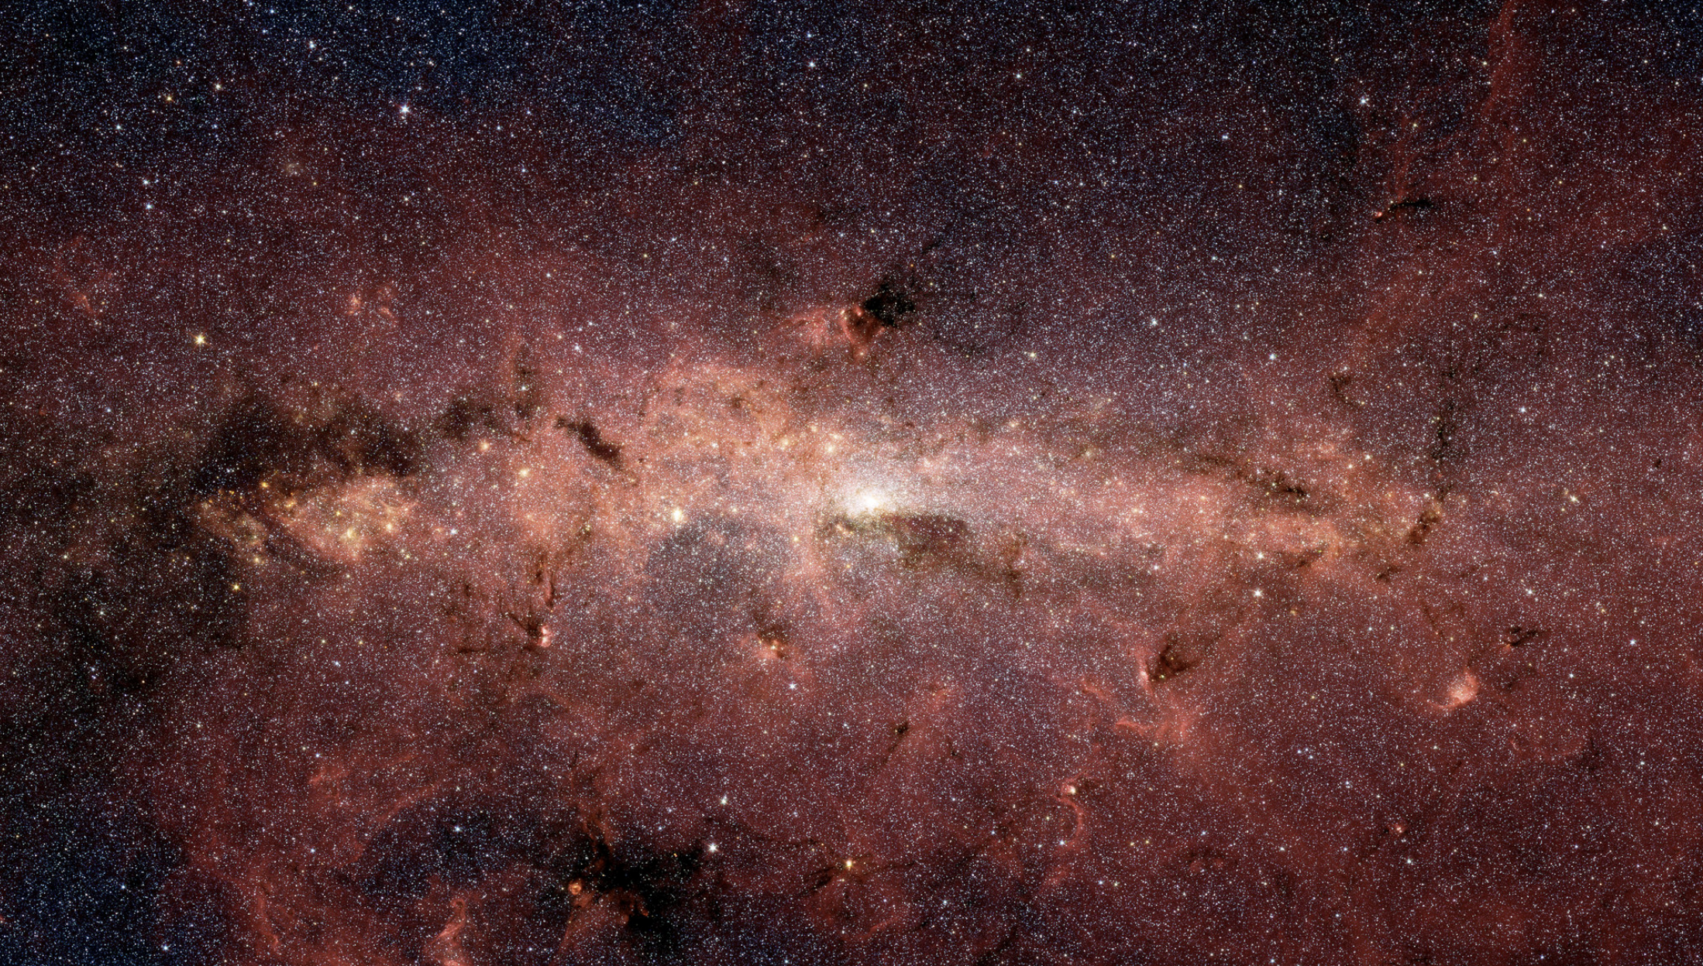
Community Process for Survey Definition

Slide 2
Core Community Survey Definition
Goals:
Provide observations needed to enable mission science objectives in cosmology and exoplanet demographics
Maximize science return
Ensure breadth of science and community across all surveys
Maximize community engagement and input in definition of surveys
Establish a transparent process
Ensure final survey definition recommendations made by a body and process the community perceives as representative and balanced
We are developing the community process with our science centers (who lead the implementation) and will review plans with our advisory committees. What’s presented here is not a final plan for review, but an outline of the kind of things we have in mind to guide discussion.

Slide 3
Community Engagement
Workshops to inform community about Roman capabilities
Outline available parameter space for each survey
Constraints are that each survey provides data needed to meet the science requirements, and at least 25% time (TBC) is retained for General Astrophysics Surveys
White paper call for papers detailing science that can be done with the survey
Encourage development of metrics/figures of merit, and description of specific observational needs
Additional workshops to enable community cooperation and consensus
Provides a forum for iterative development of survey concepts

Slide 4
An Inclusive process
Make sure that the entire community has a voice in the survey definition process
Reach out as broadly as possible
Leverage mailing lists at both Roman science centers (STScI and IPAC) in addition to existing Roman mailing lists and other astrophysics lists (e.g. Chandra)
AAS, APS etc (town halls, special sessions, announcements in newsletters)
Enable and encourage participation from early career scientists
Provide travel support for workshops
Proactively reach out to researchers at undergraduate serving institutions and minority serving institutions
Formed a small focus group to get input on how Roman can best engage and support that part of our community

Slide 5
Evaluation and recommendations
Set up and charter a committee structure to do the work of recommending survey definitions based on community input
Individual survey committees (one for each of the core community surveys)
Solicit and incorporate additional community input via a variety of mechanisms (workshops, focused white paper calls, Town Halls, etc.)
Evaluate survey options against science metrics/figures of merit
Produce recommendations for survey definition with options for extensions/enhancements
Needs to be specific enough that it is clear how to implement
Top level Steering committee (comprising reps from the individual survey committees + advocates for general astrophysics surveys)
Provides recommendations on balance between the various core community surveys and the general astrophysics survey program

Slide 6
Notional Timeline
First General Investigator call
2022 | 2023 | 2024 | 2025 | 2026 | 2027 | 2028
Kickoff Workshops
Community Workshops
Final report
On-orbit review
White Paper deadline
Panel deliberations & additional information gathering
Prelaunch review

Slide 7
Questions for the Committee
Is a community process an appropriate way to define the Core Community Surveys?
If yes, is our general approach on running the community process reasonable?

Slide 8
Backup

Slide 9
Community input on pre-selection of an Astrophysics Survey
Option to pre-select one survey of up to one month of observations notionally to be executed within the first two years of the mission
Provides opportunity for observations that would substantially benefit from multi-year preparatory activities (precursor observations, simulations etc.)
Allows for a substantive survey, but does not commit to a large amount of early observation time
Leaves most of the General Astrophysics Survey time to be assigned closer to launch (and after the Core Community Surveys are defined)
Science topic/justification is open

Slide 10
Community input on pre-selection of an Astrophysics Survey
Two Step Process
1) Lightweight white paper request for information (released 2021 Aug 27, deadline Oct 22)
Short (~2 pages) focusing on science case, science benefit from pre-definition and brief outline of strawman concept / or describe why we should NOT proceed
20 white papers received on a broad range of topics
Evaluation committee (Spring 2022)
Determine whether to proceed with pre-selection of a survey
Which scientific area(s)/survey concept(s) to focus on
2) Community process to define/optimize the survey (2022)
Opportunity for additional people/groups to provide input on implementation of the survey concept
Community owned (no PI)
Support for preparatory activities available via multiple ROSES calls between now and launch

