Slide 1
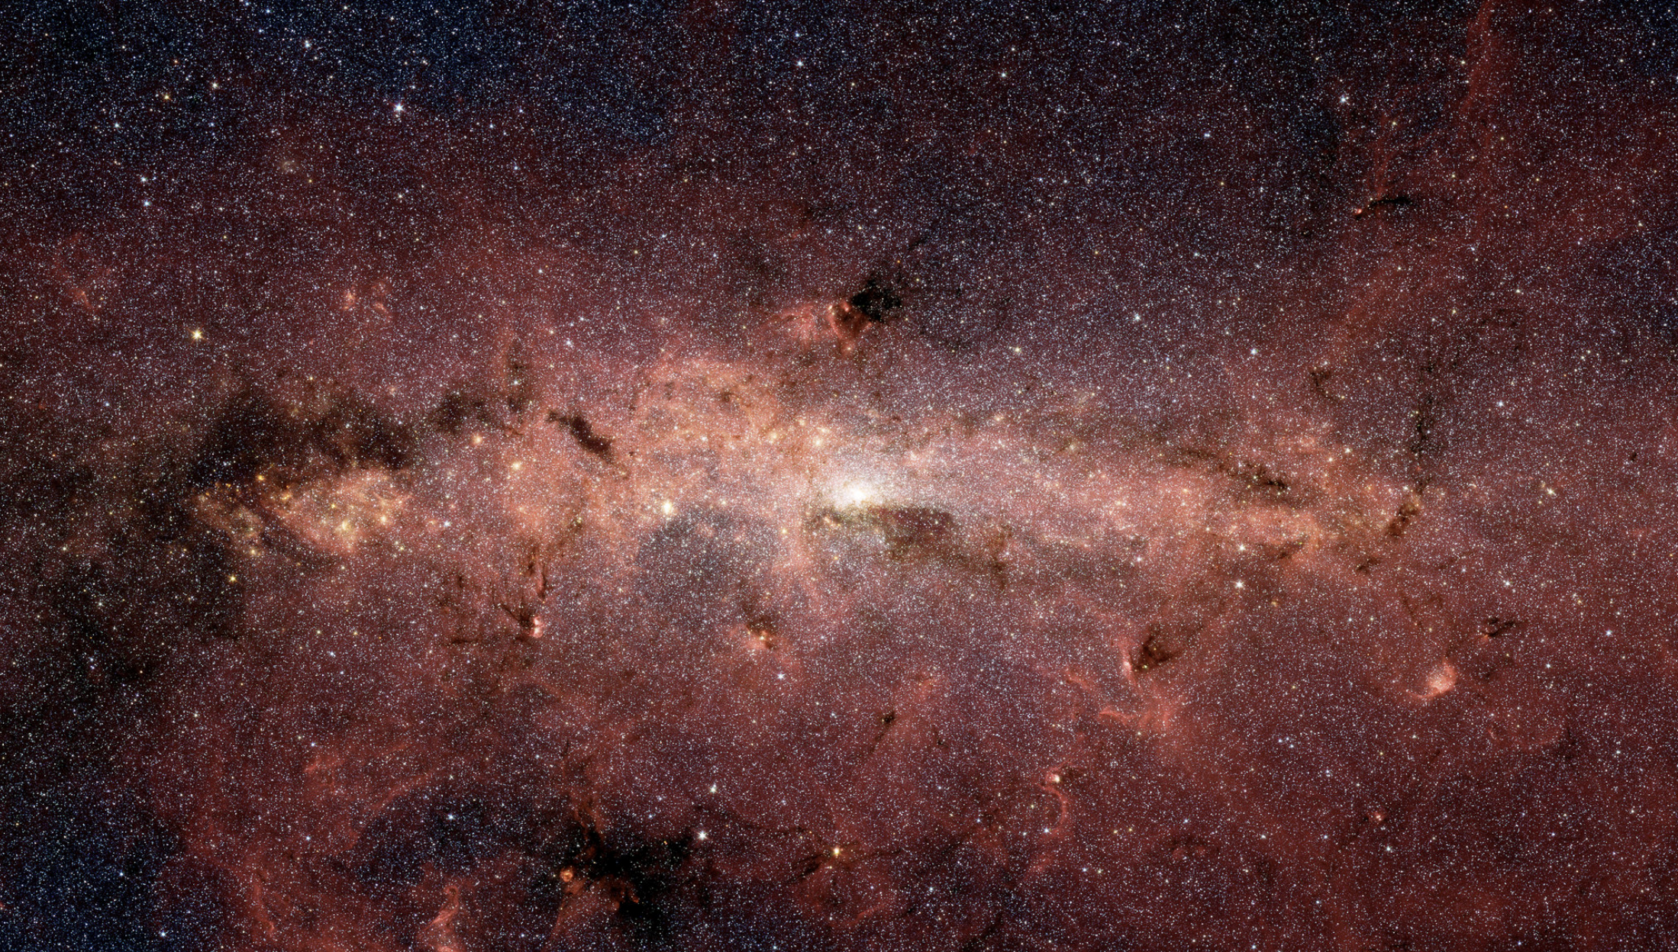
Roman Observations and Design Reference Mission

Slide 2
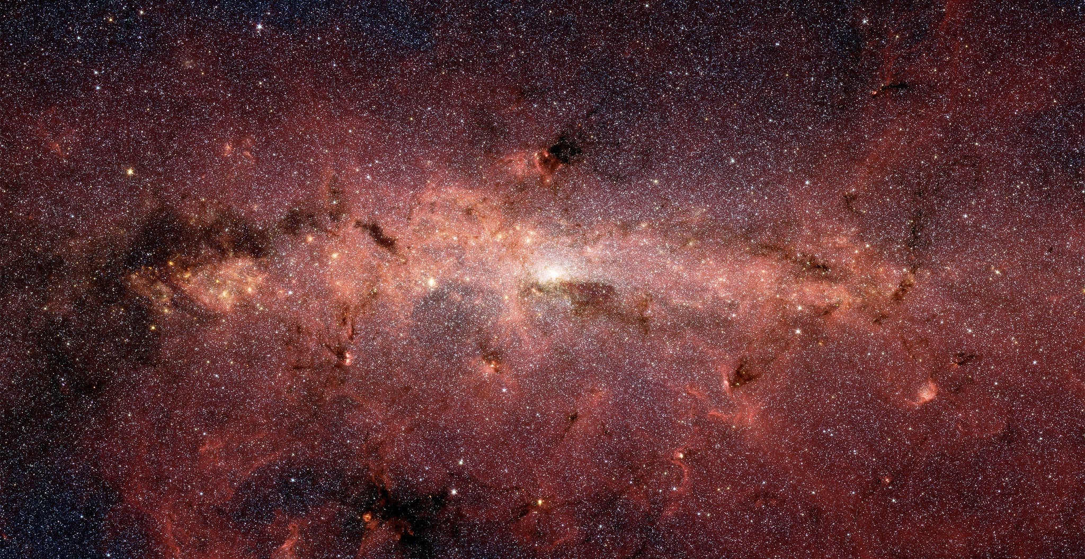
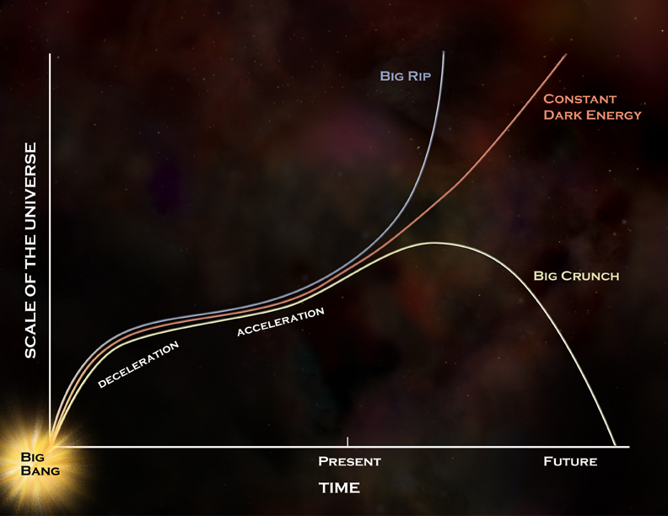
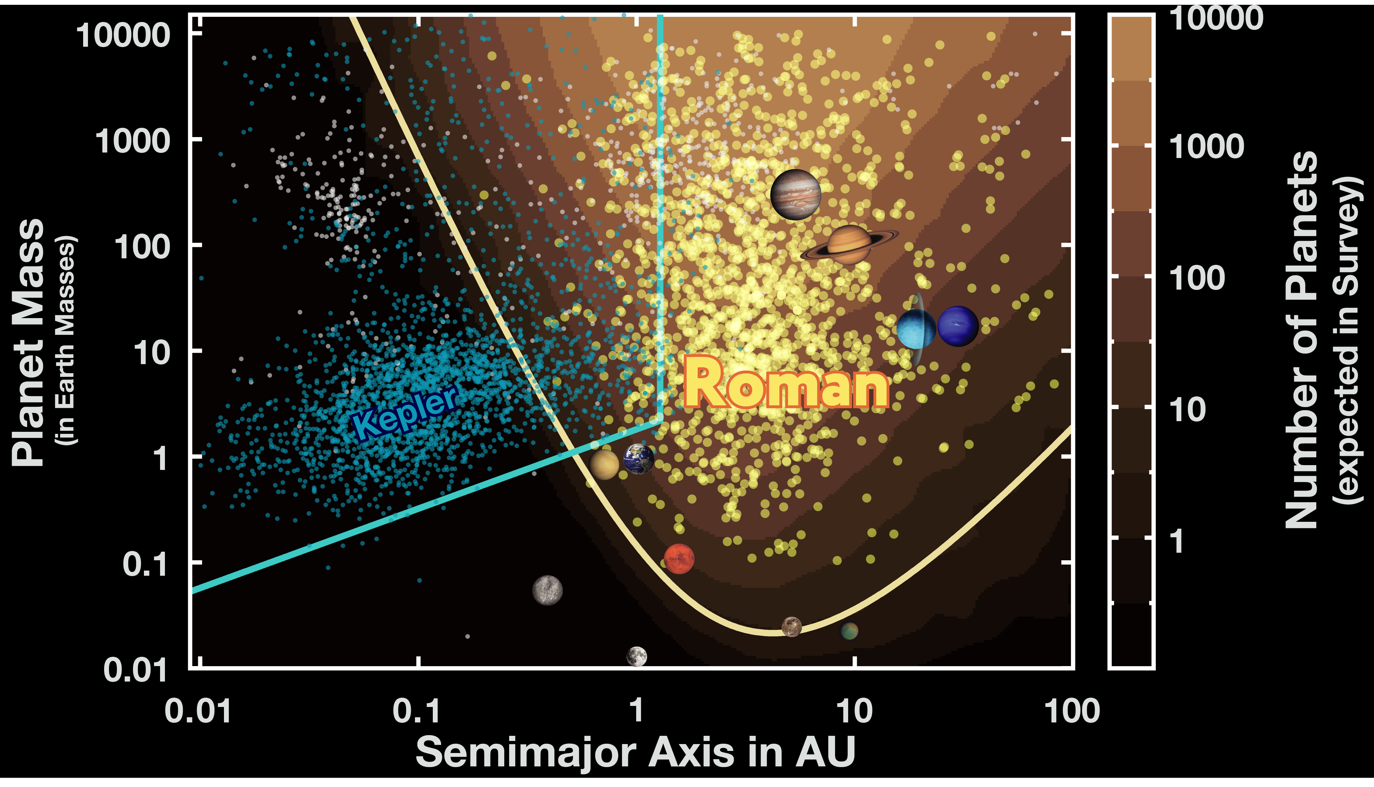
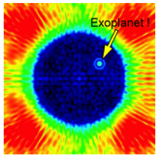
Roman Mission Objectives
Wide Field Infrared Survey
Imaging and spectroscopy to >26.5 AB mag
Expansion history of the Universe
Using supernova, weak lensing and galaxy redshift survey techniques
Growth of Structure in the Universe
Weak lensing, redshift space distortions and galaxy cluster techniques
Exoplanet Census
Statistical census of exoplanets from outer habitable zone to free floating planets via microlensing technique
General Astrophysics Surveys
Devote substantial fraction of mission lifetime to peer-reviewed program
Coronagraph technology demonstration
Demonstrate exoplanet coronagraphy with active wavefront control
Wide-Field Infrared Surveys of the Universe
Dark Energy and the
Fate of the Universe
Exoplanet demographics

Slide 3
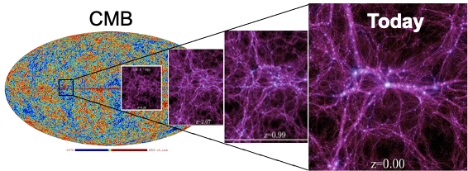
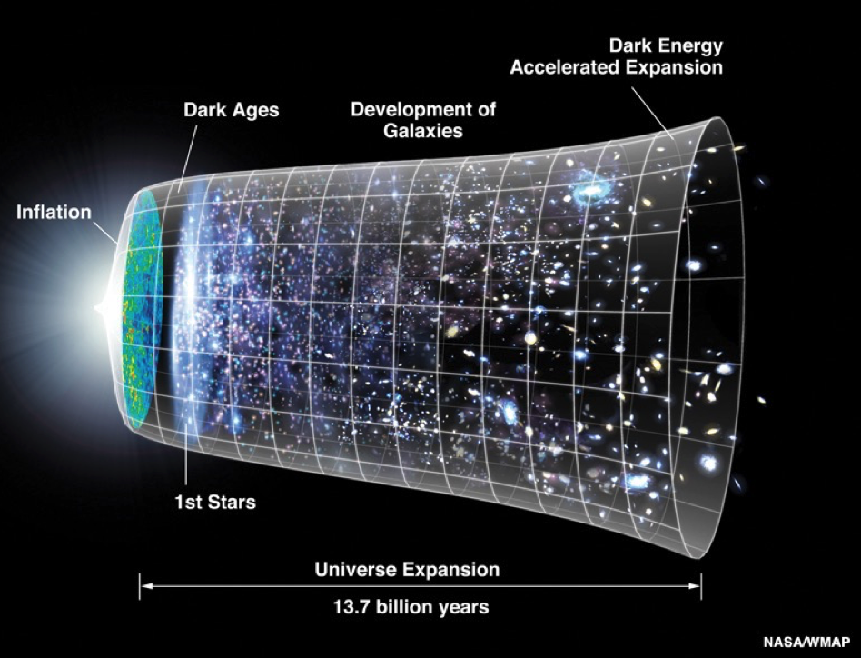
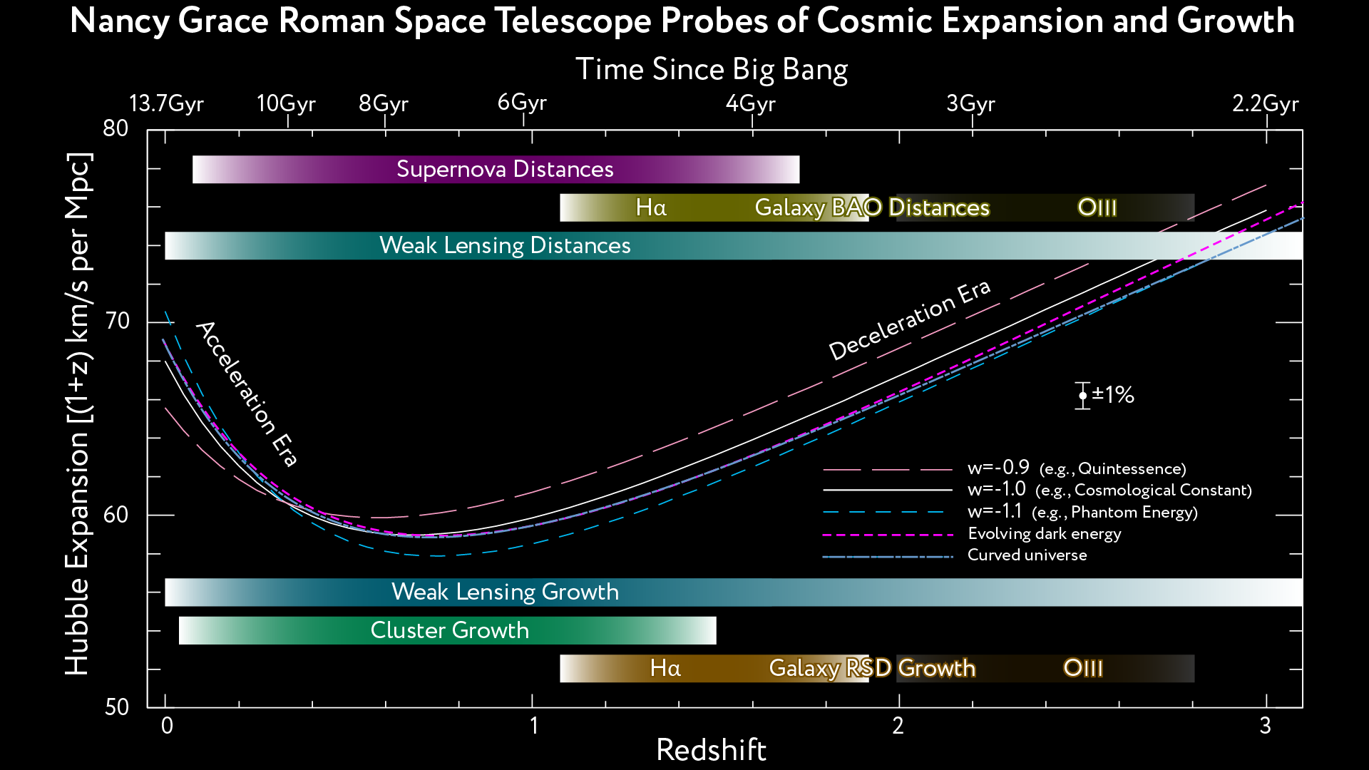
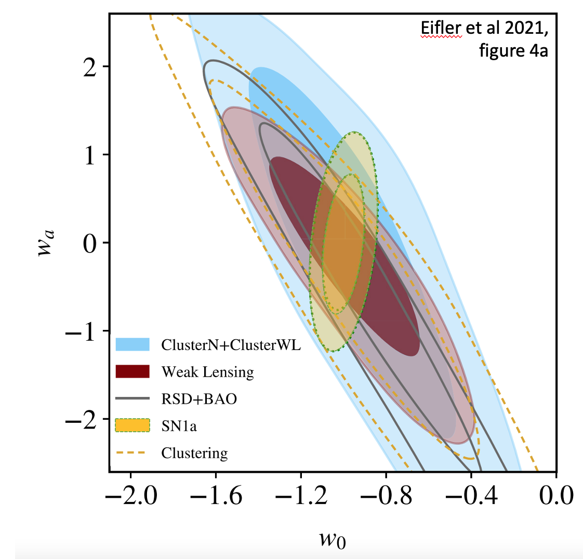
From Objectives to Plans: Cosmology
Roman’s mandate from Astro2010 is to conduct definitive measurements of the expansion history of the universe and growth of structure across cosmic time:
Using imaging (e.g. weak lensing, clusters, supernovae)
Using spectroscopic techniques (baryon acoustic oscillations, redshift-space distortions)
Cover ~10Gyr of time to study dark energy vs. dark matter
Optimal combination of techniques & priors for best result
Objectives map to science requirements that drove the design of the observatory and guide the definition of the major surveys

Slide 4
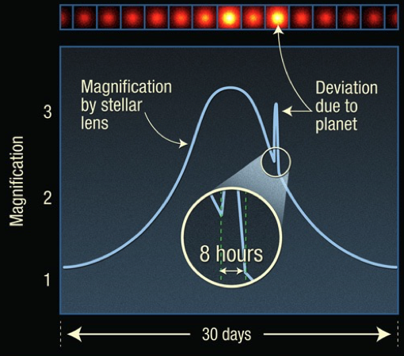
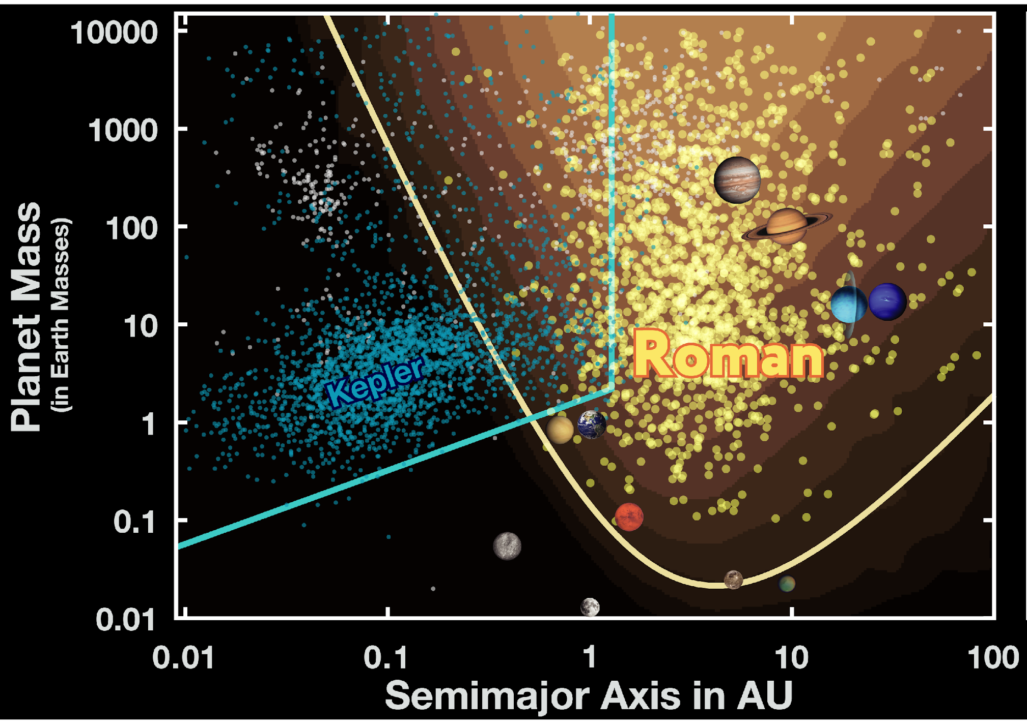
From Objectives to Plans: Exoplanets
Roman’s mandate from Astro2010 is to conduct definitive measurements of exoplanet demographics
Using the microlensing technique
Able to measure well the occurrence rate of rocky planets in and beyond the habitable zone
Objectives map to science requirements that drove the design of the observatory and guide the definition of the major surveys

Slide 5
The Long and Winding Road…from Objectives to Requirement
Top-level science requirements were included in the RFI submissions to Astro-2010
The first Science Definition Team (SDT) and Project Office began defining Objectives and resulting science requirements based on the Astro-2010 recommendations
Based on the 1.5m concept for WFIRST
SDT #1 report: arXiv:1208.4012
When the 2.4m telescope elements became available, a second SDT was established to explore a mission concept based on this telescope.
The first drafts of the Science Requirements Document were developed by this group
SDT #2 report: arXiv:1503.03757
The Mission Concept Review held Dec. 2015 was based on the work of this SDT with the Project Office
This review was the basis for formally entering Phase A in February 2016
The Formulation Science Working Group began work February 2016
This group developed the Science Requirements Document we have today
The essential aspects of the SRD have been stable since SDT #2, though substantial work has gone into understanding margins and refining observing strategies
The science requirements and resulting flowdown to mission requirements was reviewed by several external groups
National Academy Reviews: Harrison review (2014), Astro2010 mid-decadal review (2016)
NASA Reviews: WFIRST Independent External Technical, Cost, Management Review - WIETR (2017), APAC (2018), WFIRST Science Assessment Team (2019)

Slide 6
Roman Observations
Three Core Community Surveys address the 2010 Decadal Survey science goals while providing broad scientific power
High Latitude Wide Area Survey
Wide area multiband survey with slitless spectroscopy
Enables weak lensing and galaxy redshift cosmology mission objectives
High Latitude Time Domain Survey
Tiered, multiband time domain observations of 10s deg² at high latitudes
Enables Type Ia supernova cosmology mission objectives
Galactic Time Domain Survey
~<15 min cadence observations over few deg² towards galactic bulge
Enables exoplanet microlensing mission objectives
Minimum 25% time allocated to General Astrophysics Surveys
90 days for Coronagraph technology demonstration within first 18 months of mission

Slide 7
Core Community Surveys are for Everyone
Core Community Surveys: a significant fraction of the prime mission used for revolutionary surveys of unprecedented scale.
Core Community Surveys definition will be via an open process, maximizing the overall science return while meeting the cosmology and exoplanet science requirements

Slide 8
Design Reference Mission
The Design Reference Mission is a notional observing plan that is used to demonstrate that Roman can execute a science program that will meet the mission objectives within the prime phase of the mission
It is NOT the observing plan but gives a flavor for that nature of surveys that address the science objectives and the degree of flexibility to optimize the observing program for a broad range of science
High Latitude Wide Area Survey
1700 deg² (wide), 20 deg² (deep), 4 filters (Y, J, H, F) for wide and deep fields and grism spectroscopy
High Latitude Time Domain Survey
19 deg², (wide), 4.2 deg² (deep), 4 filters (R, Z, Y, J – wide) /(Z, Y, J, H – deep), 5 day cadence, and prism spectroscopy.
Galactic Time Domain Survey
2 deg², 15 min cadence with W filter, 12 hour cadence for R or Z and Y or J for 60 – 72 day seasons; 6 seasons

Slide 9
High Latitude Wide Area Survey
Imaging
Main driver is weak lensing. Basic needs are a wide area survey with:
Angular resolution (+ well understood PSF) for shapes constrained by 2.4 m aperture
Depth (may trade with area)
Near IR photometric coverage (from space)
+ need visible data from ground for photo-z’s (Rubin/LSST or HSC)
Internal cross checks
Internal calibration requires repeat observations
Deep fields used to understand sensitivity limits and systematic effects in shallower survey.
Spectroscopic data to calibrate photo-z’s
Spectroscopy
Slitless spectroscopy (driven by Galaxy redshift survey)
Multiple rolls for spectral de-contamination; baseline = 4.
Dispersion directions not the same: with Roman, this means we need to roll the telescope (only 1 grism) and thus observe ~n+ ½ years later
Sensitivity at given area & time is a major driver
This survey also addresses the mission objective for a Wide Field infrared Survey with Imaging and spectroscopy to >26.5 AB mag

Slide 10
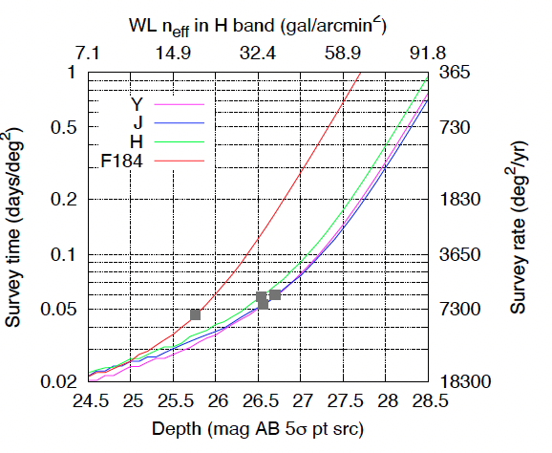
HLWA Survey – Design Reference Mission
1700 sq deg area to measure ~>10⁸ galaxy shapes and ~>10⁷ galaxy spectroscopic redshifts
Imaging
Two passes in 4 NIR bands (F106, F129, F158, F184) spanning the range from 0.93-2.00 μm to magnitudes 25.8-26.7 AB (band-dependent) and reaching the diffraction limit in F129 and redder bands
4 dithers on each pass (to enable shape measurements and diagnose systematics)
140 s for each exposure
Spectroscopy
Four passes
Two dithers per pass
298 s per exposure
20 sq deg deep field
10% of time allocated to imaging+spectroscopic survey.

Slide 11
HLWA Survey - Additional Possible Primary Science
Tens of thousands of Galaxy Clusters
Huge sample of galaxies enable studies of galaxy formation and evolution
thousands of galaxies at redshift 10-15
Rare objects
Stellar streams and dwarfs around nearby galaxies
brown dwarf census and luminosity function through large volume of Milky Way
white dwarf luminosity function down to tip of cooling curve, to much greater distances than present surveys - provides chronometer for age of MW, or equivalent for different stellar populations

Slide 12
HLWA Survey – Possible trades, modifications and extensions
Location of survey footprint
Depth vs area
Add additional filters to all or part of the survey footprint
Increase the survey footprint
Place part of HLWAS, esp. part of the deep field, accessible to the Subaru PFS for spectroscopic calibration of photometric redshifts
Extend time baseline of deep field portion of the HLWAS
Add the F213 filter to these datasets, [especially with sufficient observing time, would enable detection of transients at high redshifts]
Adding long time baselines will have interesting astrometric application
Stellar kinematics in distant halo to measure MW mass

Slide 13
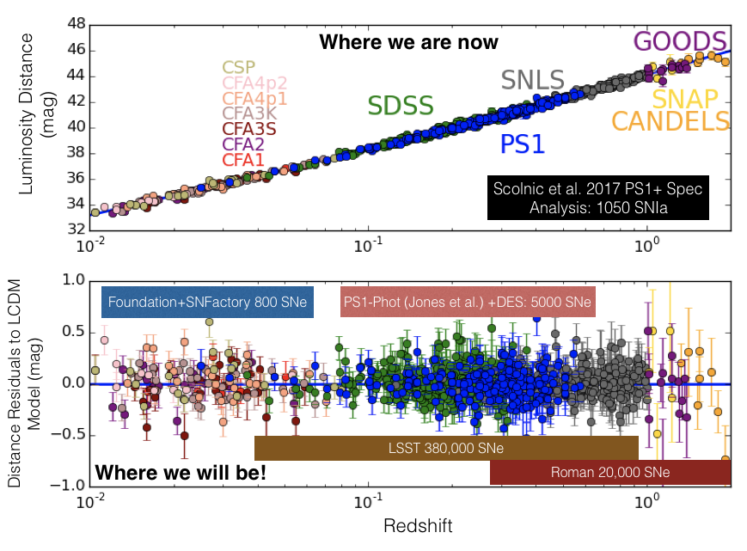
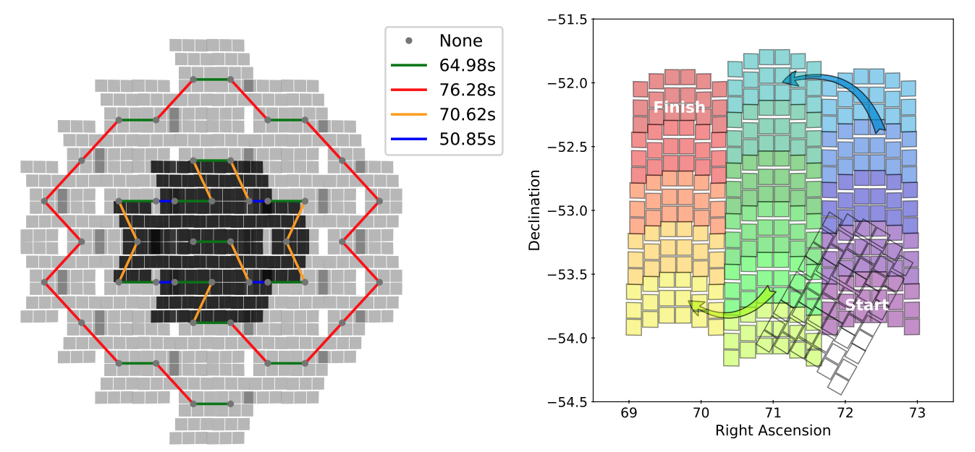
High Latitude Time Domain Survey
Enables Type Ia Supernova Cosmology
6 months over 2 yrs
5-day cadence
2 tier survey:
Wide: z < 1
Deep: z < 1.5, and to characterize SN
4 filters per tier:
Wide: RZYJ
Deep: YJHF
~30 hr visits
Some fraction of imaging and prism spectroscopy
Imaging exposures based on achieving a S/N ~ 10 for each filter at peak.
Prism exposures based on achieving a S/N ~25 in rest frame
Images: Top – Current observations of SN Ia and how Roman will increase the number observed at higher redshifts.
Bottom – Possible slewing strategies.

Slide 14
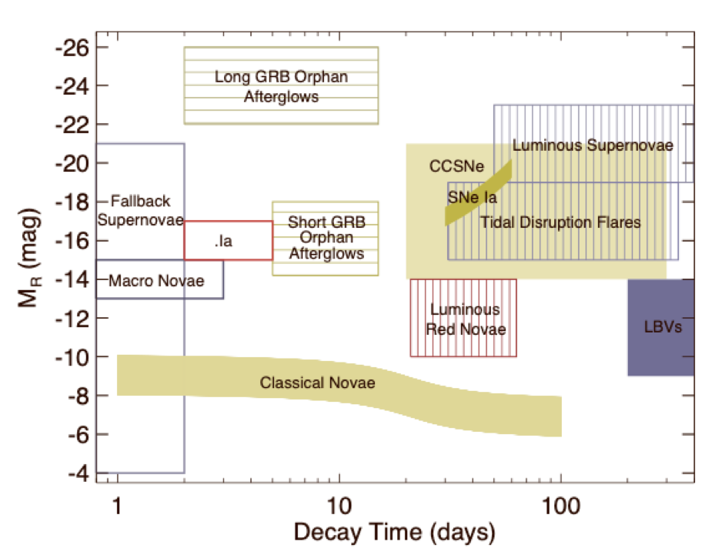
HLTD Survey – possible additional primary science
Reverberation mapping to measure black hole masses of high redshift quasars
Blind searches for Kilonovae
Tidal Disruption events
AGN variability studies
Long and short GRB studies
Cataclysmic variables
Other kinds of supernovae
Core collapse
Luminous
.Ia
R-band peak magnitude as a function of decay time. Taken from Rau et. al., 2009​

Slide 15
HLTD Survey – Possible trades, modifications and extensions
Location of survey footprint
Increase cadence for some period
Enable timely identification of kilonova
Add F213 filter observation
Add periodic Grism observations
Extend baseline of survey beyond 2 years

Slide 16
Galactic Bulge Time Domain Survey – Microlensing needs
Monitor hundreds of millions of bulge stars continuously on a time scale of ~10 minutes.
Event rate ~10⁻⁵/year/star.
Detection probability ~0.1-1%.
Shortest features are ~30 minutes.
Relative photometry of a few %.
Deviations are few – 10%.
Resolve main sequence source stars for smallest planets.
Resolve unrelated stars for lens flux measurements.
Longest possible time baseline for proper motion measurements

Slide 17
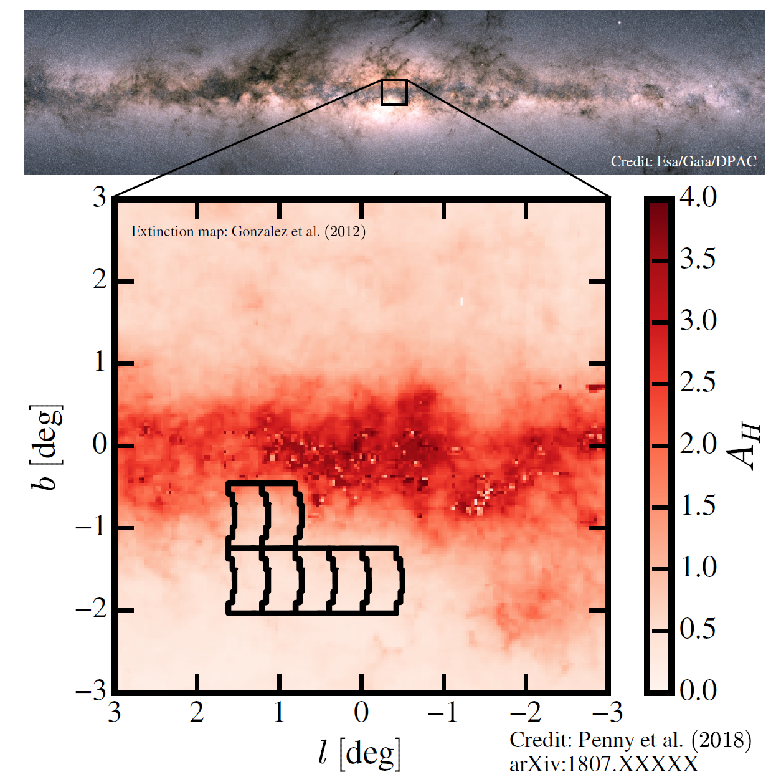
Galactic Bulge Time Domain Survey – Design Reference Mission
7 fields for a total of ~2 deg²
Wide F146_{AB} (0.93-2 μm) filter**.
15-minute cadence.
Observations every at 6 hours in alternating filters (e.g., F087,F219), 2 x 450 total obs
6 x 72-day seasons.
~41,000 exposures in W149_{AB}
~432 total days spread over 5-year mission

Slide 18
GBTD Survey – Additional possible primary science
Measurement of the Compact Object Mass Function over 10 Orders of Magnitude.
Detection of ~10⁵ Transiting Planets.
Astroseismology of ~10⁶ Bulge Giants.
Resolved Stellar Populations and Galactic Structure.
Detection of ~5x10³ Trans-Neptunian Objects.
Parallaxes and Proper Motions of ~6x10⁶ Bulge and Disk Stars.

Slide 19
GBTD Survey – Possible trades, Modifications and Extensions
Modifications
Periodic observations of the GC.
Periodic observations of the survey fields in all filters.
Periodic observations of a much larger survey area
Extensions
Extending the survey for additional seasons
Very high cadence observations of a smaller area
Lower-cadence observations of a larger area
High-cadence observations in alternate filters
Surveying Northern Galactic fields
High cadence observations of the GC

Slide 20
Evaluation of Design Reference Mission against high level requirements
Survey – type of FOM | Requirement | Projected Performance with DRM
HLWA – Weak Lensing (WL) | 327,400 | 506,000†
HLWA – Baryon Acoustic Oscillations (BAO) | 7,533 | 11,300†
HLWA – Redshift Space Distortions (RSD) | 4,047 | 5,750†
HLTD – Dark Energy Task Force (SNIa) | 325 | 443-602*
GBTD - # planets | 1179 | 1400
N.B. These FoM are different metrics appropriate to each study, so are not intercomparable
FoM definitions:
WL: 1/ 𝛔(F_{W})² where F_{W} is scaling of 𝛔_{m}(z) (amplitude of mass clustering) wrt 𝚲_{CDM}
BAO: 1/𝛔(F_{D})𝛔(F_{H}), where F_{D}, F_{H} are scaling of D_{A}(z), H(z) wrt 𝚲_{CDM}
RSD: 1/ 𝛔(F_{G})² where F_{G} is scaling of 𝛔_{m}(z)f(z) wrt 𝚲_{CDM}, f(z)=d𝛔_{m}(z)/dlna
SNIa: 1/det(Cov(w₀,w_{a}))
References:
HLIS, HLSS: †1700 deg² - C. Hirata memo dated Aug 25, 2021; Troxel et al 2021, Eifler et al 2021
SN: *systematics-limited, statistics limited; SN teams joint report, 9/1/2021
EML: Penny et al 2019 APJS 241:3, Johnson et al 2020
SN FOM Range reflects impact of astrophysical uncertainties; the upper end of the range matches the assumptions used in the SRD FOM requirement.

Slide 21
Time Allocations in Design Reference Mission
 | Durations (days)
High Latitude Wide Area Survey (HLWA Survey) – Imaging | 283.6
High Latitude Wide Area Survey (HLWA Survey) - Spectroscopy | 169.4
High Latitude Wide Area Survey (HLWA Survey) – Deep field | 51.6
High Latitude Time Domain Survey (HLTD Survey) – Imaging and Spectroscopy | 189.3
Galactic Bulge Time Domain (GBTD Survey) | 372.1
General Astrophysics Surveys | 412.6
Coronagraph Technology Demonstration | 90
WFI Calibration | 113.8
Mission operations overheads | 62.6
Total | 1744.9
Margin | 81.1

Slide 22
Margins in Design Reference Mission
Considerable flexibility because current design reference mission demonstrates that we can meet science requirements with margin
Three Areas of Margin
Margin between predicted performance and science requirements/FoM
Explicit margin
Days not currently assigned to anything (could be added to GA surveys or used to enhance core community surveys)
Implicit margin (e.g. slew rates assume 5 reaction wheels)
Real opportunities for the planned community process to result in enhancements to the core community surveys for broader astrophysics return and/or increase the time allocated to General Astrophysics Surveys above 25%

Slide 23
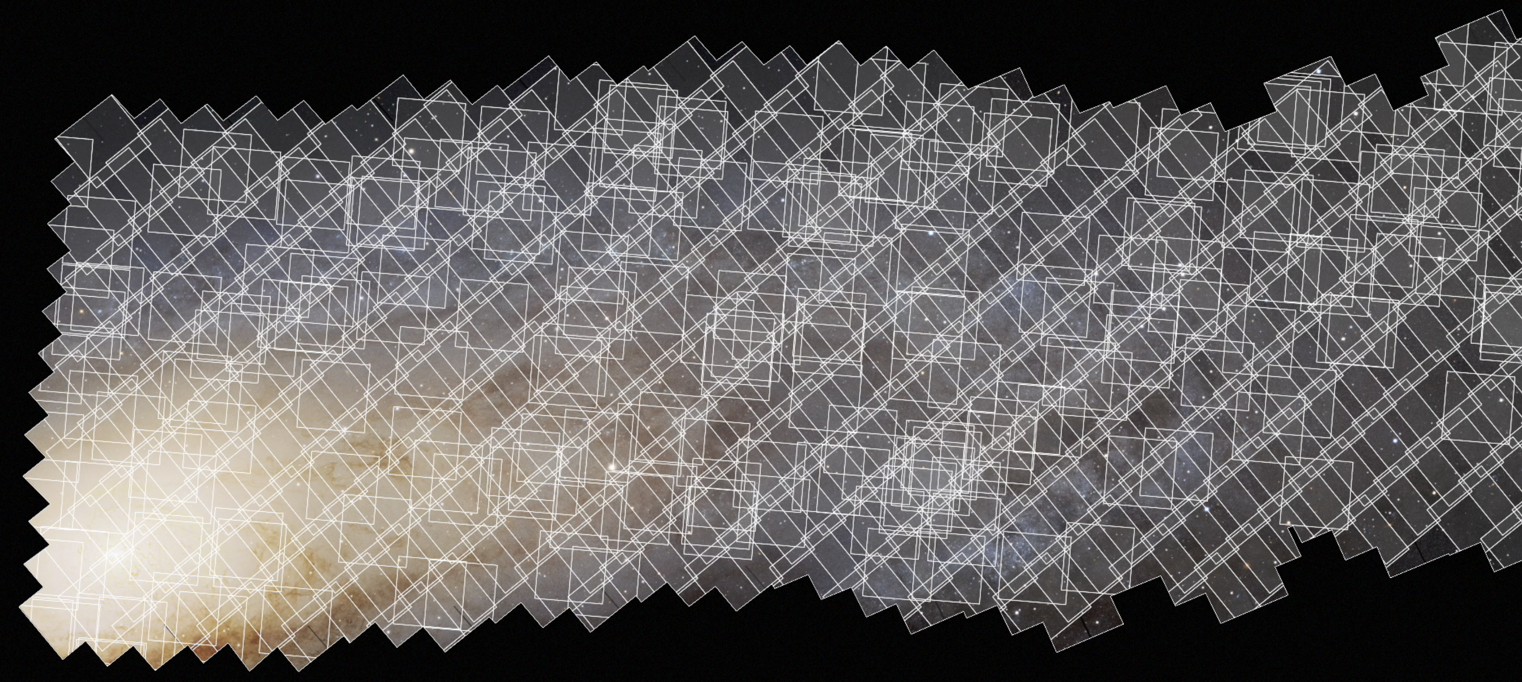
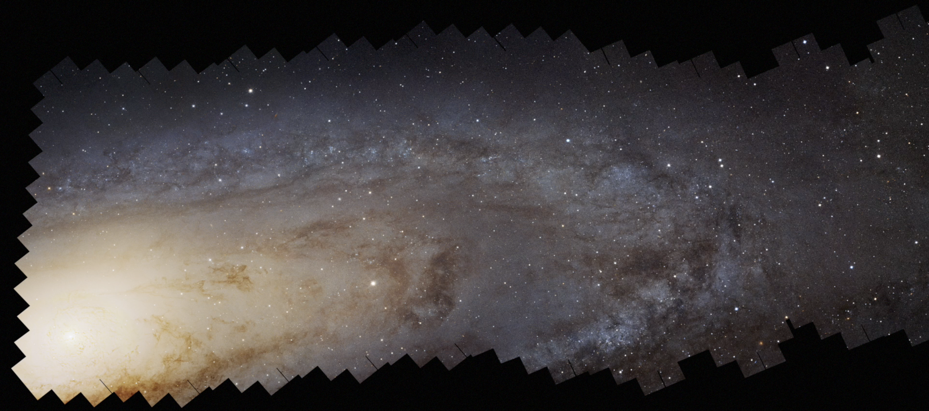
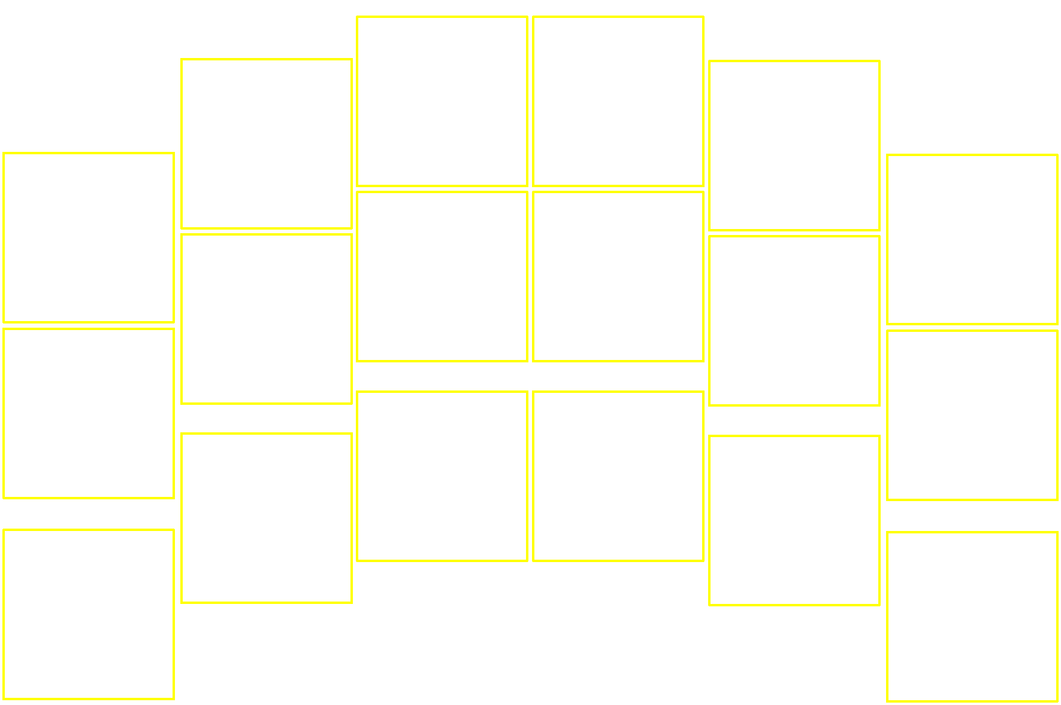
Roman as a Precise Survey Facility
The power of Roman is not just the large field of view:
Very efficient observations
Rapid slew & settle
No Earth occultations
No South Atlantic Anomaly
Well understood and stable PSF
Stable thermal environment (L2 orbit, thermal control of all parts of the optical system)
Rigid optical structure with vibration isolation from the spacecraft
Stable attitude control
Excellent flux calibration
The onboard Relative Calibration System enables 0.3% photometric accuracy

Slide 24
Notional Observation Plans Designed During Formulation
The DRM shows that it is possible to meet the science objectives, ensure the minimum 25% of time for General Astrophysics, and still have some margin.
There is real scope for the future open community process to optimize the Core Community Surveys for broad and deep astrophysics return and also have the option of reallocating time back to the General Astrophysics survey pool.
Is this the right amount of flexibility?
Should we constrain things further now and provide less flexibility in the future Core Community Survey definition, in order to ring-fence a larger allocation for General Astrophysics Surveys? Or reduce the ring-fence to allow more community optimization?

Slide 25
Backup

