Slide 1

Development of the Next Generation Microshutter Arrays for Space Telescope Applications
Meng-Ping Chang, Regis P. Brekosky, Ari D. Brown,
Nick P. Costen, Rainer Fettig, Matthew Greenhouse (PI),
Gang Hu, Kyowon Kim, Carl A. Kotecki, Alexander S. Kutyrev,
Mary J. Li, Stephan R. McCandliss, Frederick H. Wang, Ed J. Aguayo
NASA Goddard Space Flight Center
https://asd.gsfc.nasa.gov/ngmsa/

Slide 2
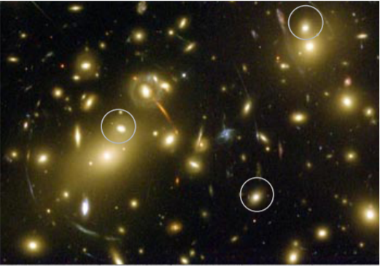
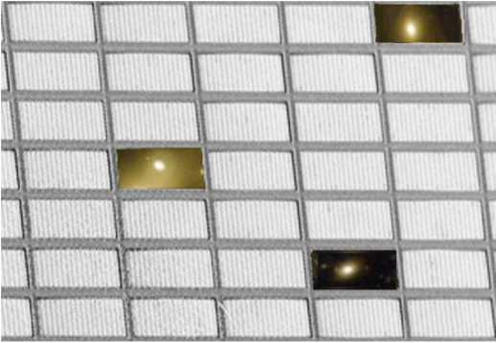
Next Generation Microshutter Arrays (NGMSA) - programmable field masks
View of the sky without light blockage. Selected shutters are opened to allow light to pass
through from selected light sources.
Microshutter arrays are programmable field selector masks for optical spectroscopy based on MEMS technology.
The original device was developed as a sub-assembly instrument for JWST (James Webb Space Telescope: Random access addressing of the individual pixels; High contrast optical blocking > 1e4; and long life time for the operation of 20,000 cycles or more.
NGMSA: electrostatic actuation; JWST MSA: magnetic actuation
https://asd.gsfc.nasa.gov/ngmsa/

Slide 3
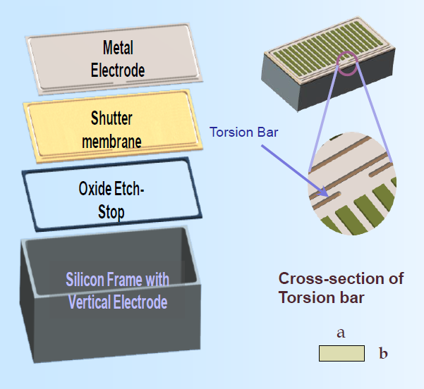
Microshutter cell, array, and assembly design
Fully electrostatic actuation
- Higher voltage electrical insulation:
ALD aluminum oxide
- Thinner microshutter blades
Modifications of arrays and assembly
- Improved antistiction
- Simplified electronics design
- Various array sizes to meet instrument requirements
- Arrays are packaged with ceramic substrate instead of Si substrate
a: 2um, b: 0.25um
https://asd.gsfc.nasa.gov/ngmsa/

Slide 4
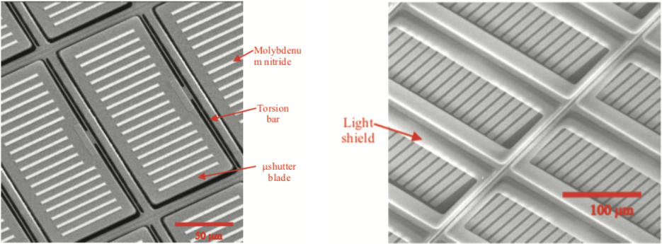
Fabrication development
Left: A SEM image of the front side image of the MSA. On the microshutters, the patterned microshutter blade, torsion bar and strips of molybdenum nitride are shown .
Right: A SEM image of the MSA with the light shields that prevent light passing through the perimeters around the microshutters.
https://asd.gsfc.nasa.gov/ngmsa/

Slide 5
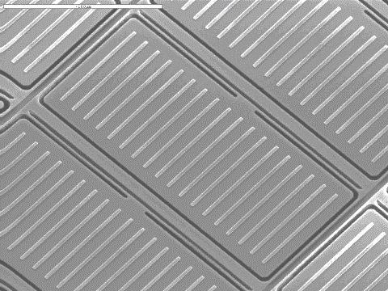
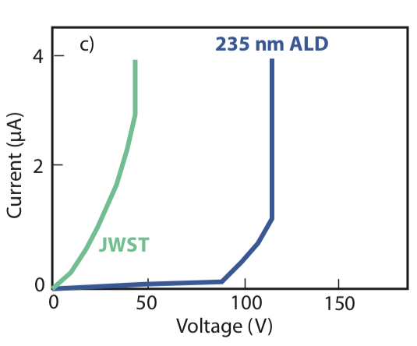
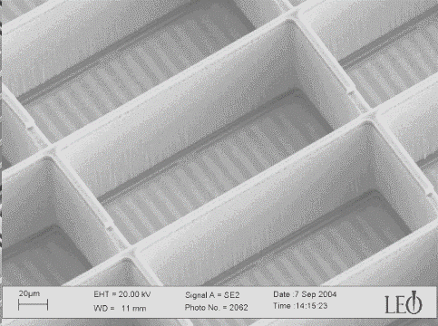
Shutter electrodes and ALD aluminum oxide insulation
2um gaps to delineate front electrodes
Trenches
Front side of shutter: column electrodes
The ALD (atomic layer deposition) aluminum oxide process developed for the NGMSA shows required level of breakdown voltage exceeding 100V. This ALD insulation improvement was critical over the JWST enabling the NGMSA electrostatic actuation.
20um gaps to delineate back electrodes
Backside of shutter: row electrodes
https://asd.gsfc.nasa.gov/ngmsa/

Slide 6
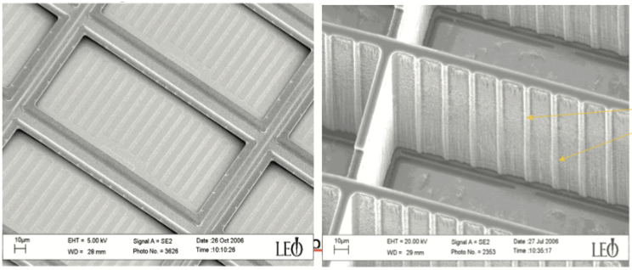
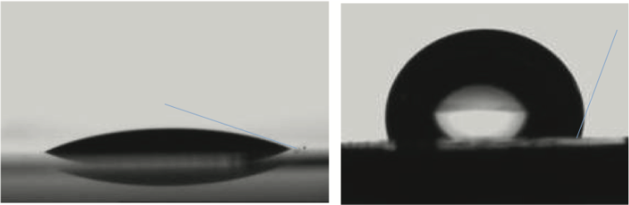
Antistiction measures
Heptadecafluoro-1,1,2,2-tetrahydrodecyltrichlorosilane - (FDTS) coated on entire NGMSA assemblies to prevent stiction due to water molecules
Dimples/bumps on light shields are to prevent shutters stuck on light shields when shutters close
Ribs on back walls are to prevent shutters from getting stuck when shutters opened and latched.
Optical images of water drops obtained before and after anti-stiction coating is applied.
https://asd.gsfc.nasa.gov/ngmsa/

Slide 7
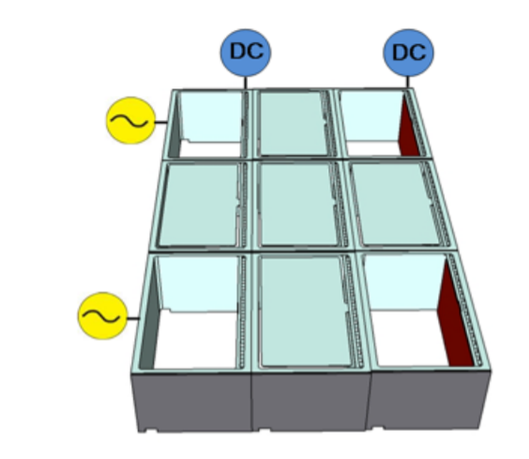
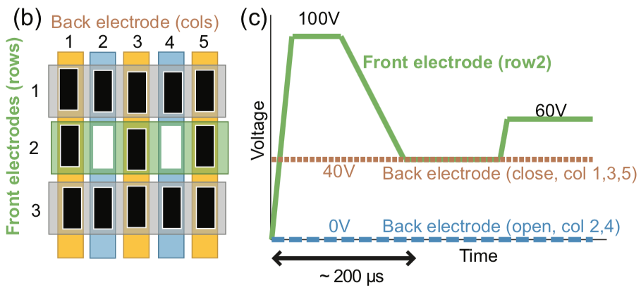
Electrostatic operation: actuation, latch and addressing
Left figure: Reconfigurable 2-D addressing electrostatic actuation
Middle figure: an illustration of how the shutters are individually actuated and addressed by applying a pulsed voltage to the front electrodes (left) and a DC voltage to back electrodes (top). Only the shutters with voltage difference between the front and back electrodes latch open by rotating 90° about their torsion bars
Right figure: an illustration of the row and column voltages applied to open, latch, hold, and close a single shutter using DC plus pulse actuation.
https://asd.gsfc.nasa.gov/ngmsa/

Slide 8
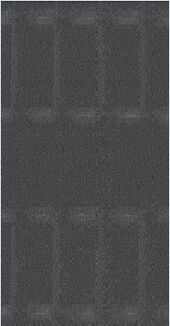
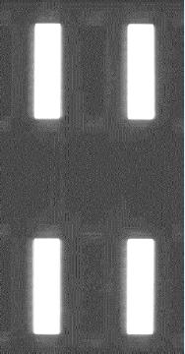
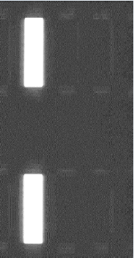
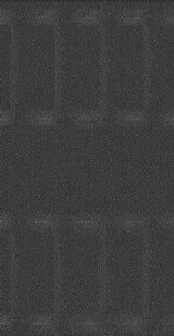
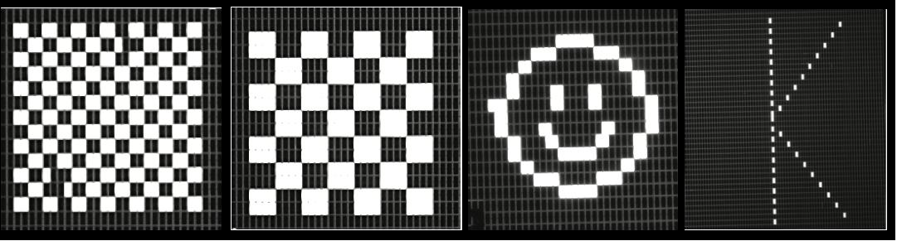
Microshutters addressed
Image sequences demonstrating shutter operation. The opened shutter at the intersection of the applied DC-bias and pulse signals will remain latched as a DC-bias is applied at the corresponding rows.
-25V DC bias applied at columns one and three
100V pulse at rows one and three
DC bias removed at column three
DC bias moved from column one.
i
ii
iii
iv
2-D addressing images made on a NGMSA shutter array using DC pulsed actuation mechanism. The demonstration was performed in vacuum using a 100V DC, 200 μs pulse to open selected shutters.
https://asd.gsfc.nasa.gov/ngmsa/

Slide 9
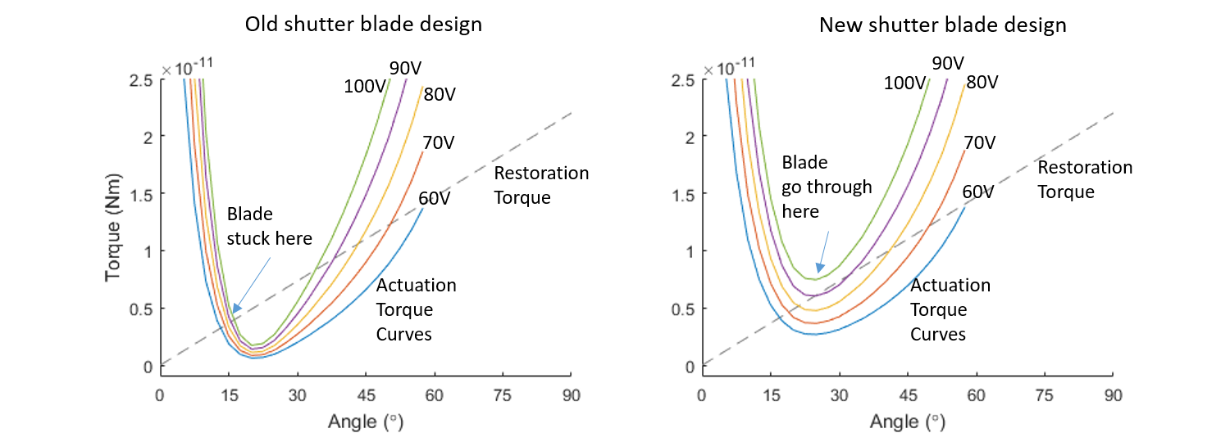
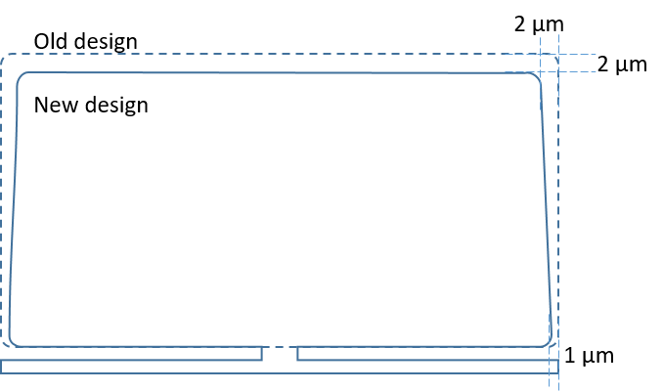
Current modifications
Simulation results of actuation torque between the original rectangle and new keystone-shaped shutter. For 100-volt actuation voltage, the minimum actuation torque (20 degree) of the new design increases by a factor of 3.
The simulation results provide a potential to reduce actuation voltages with small dimension change of shutter blades.
https://asd.gsfc.nasa.gov/ngmsa/

Slide 10
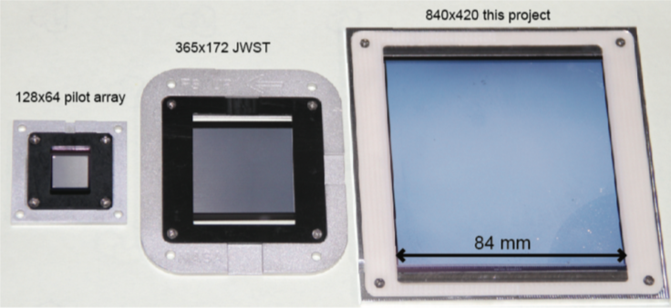
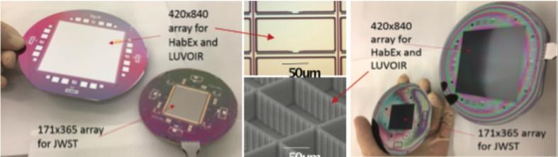
Microshutter arrays formats
Microshutter arrays in several formats have been produced: pilot array -128 x 64 (left), JWST- 365 x 171 (center) and current development – 840 x 420 (right).
NGMSA 840x420 and JWST arrays size comparison: front (left) and back (right) side of the device wafers.
https://asd.gsfc.nasa.gov/ngmsa/

Slide 11
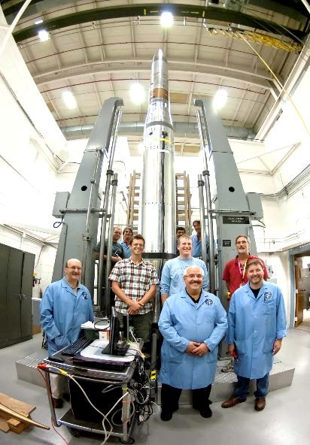
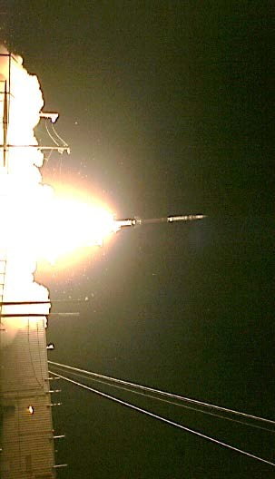
NGMSA arrays integrated in Big-θ assembly for NG-FORTIS flight mission
Microshutter Arrays
Fully integrated 128x64 NGMSA array attached to a Big-θ assembly on NG-FORTIS telescope
Sounding Rocket carrying NG-FORTIS telescope before launch.
NG-FORTIS flight mission was successfully executed on Oct 27, 2019, NGMSA array functioned as required.
https://asd.gsfc.nasa.gov/ngmsa/

Slide 12
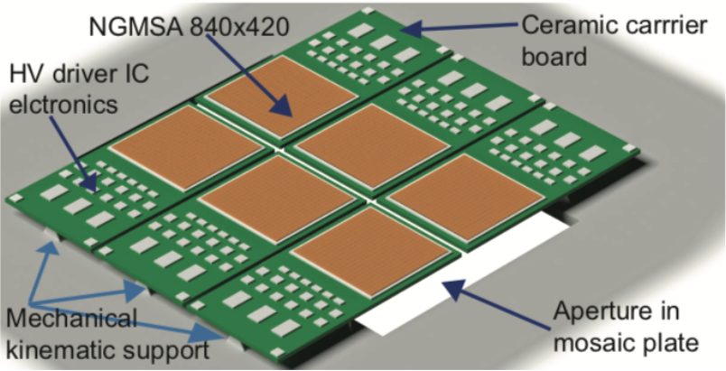
NGMSA modularity for future large format space missions
The microshutter baseplate is supported on the mosaic plate using a 3-vane kinematic mount.
The mosaic plate is made of the instrument structural material, and the baseplate most favorite material is alumina ceramic.
The mount provides precision position stability over a range of temperatures and provides stress-free mounting of the baseplate.
Electrical interconnects on the board will set a limit on the width of the baseplate.
This mosaic concept is for a 2 x 3 array of microshutters modules as proposed in a study for LUVOIR, a future space telescope candidate.
https://asd.gsfc.nasa.gov/ngmsa/

Slide 13
Summary
Next Generation Microshutter Arrays have been developed for electrostatic actuation.
NGMSA arrays are being fabricated with modifications for simplified design, and more reliable performance
Functions of 128x64 NGMSA array assemblies have been demonstrated in a sounding rocket space mission: NG-FORTIS telescope that was launched to space successfully in Oct. 2019.
840x420 large NGMSA arrays are being developed for future large format deep space telescopes.
For further questions, please contact Dr. Meng-Ping Chang
Email address: meng-ping.chang@nasa.gov
https://asd.gsfc.nasa.gov/ngmsa/

