Slide 1
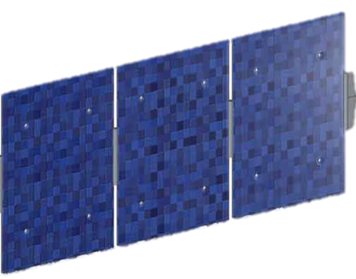
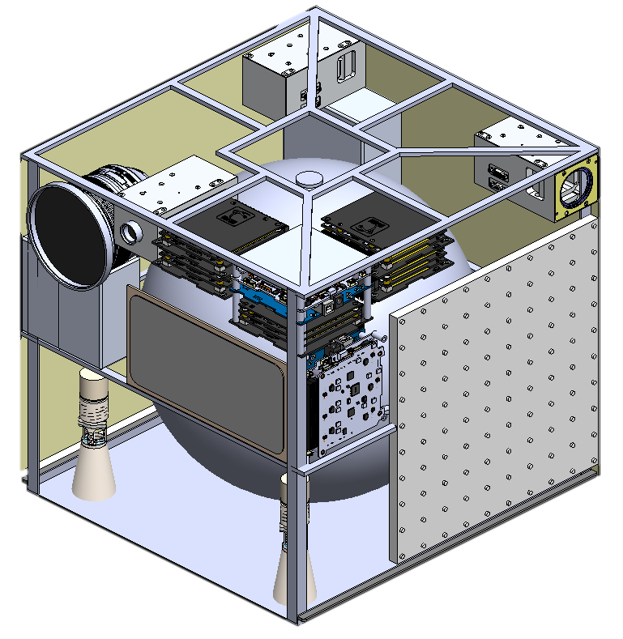
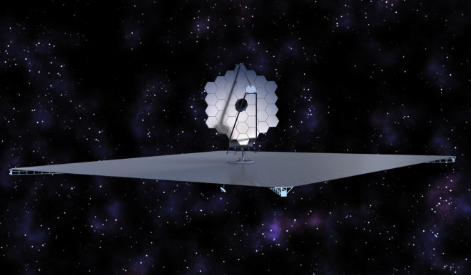
Laser Guide Star for Large Aperture Segmented Space Telescopes
Laser Guide Star for Large Aperture Segmented Space Telescopes
Kerri Cahoy, Jim Clark, Ewan Douglas, Paulo Lozano, Yinzi Xin, MIT; Olivier Guyon, Jennifer Lumbres, Jared Males, University of Arizona; Collaborators: Jon Arenberg, NGC; Rémi Soummer, STScI. NASA Research Collaborator: Lee Feinberg, NASA GSFC.
Dec 4, 2018

Slide 2
Overview
The idea
NASA Relevance
Technical Approach
Are picometers of stability really needed?
Laser Guide Star brightness and stability
How well do we need it to point at the telescope?
How far away does it need to be?
How many more exoplanet systems could we target?
Lifetime and agility - how many would need to fly?
What about… scattered light?
Lab experiment updates (paired segmented DM)
Simulation updates (paired segmented DM)
More work to do… !

Slide 3
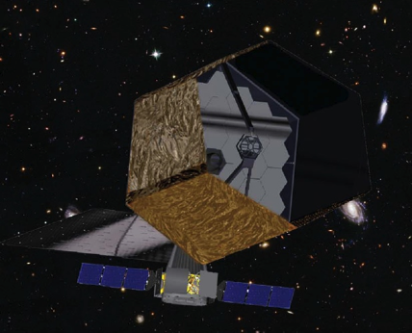
Challenge
How to control stability to ~few picometers on a large aperture segmented space telescope
Large aperture needed for higher throughput, improved resolution
Segments are needed because launch vehicle fairings* < 5 m
Typically, don’t need “artificial” guidestars for space telescopes
Current metrology systems such as capacitive edge sensors and internal laser metrology help, but are very complex for dozens to hundreds of segments
http://www.stsci.edu/atlast
*SLS may have an exploration fairing with diameter 8.4 m (for EM-2), but w/support structure, max diameter aperture would be less than that

Slide 4
The idea
Reduce the cost and complexity of large aperture segmented space telescopes... … by using an external laser guide star to relax observatory stability requirements.
It’s bright, and you can put it where you want it.
If you support the idea of a formation flying 72-meter diameter starshade (we do, too), then this should not especially alarm you.
Notes:
72-m diameter is the baseline for HabEx currently.

Slide 5
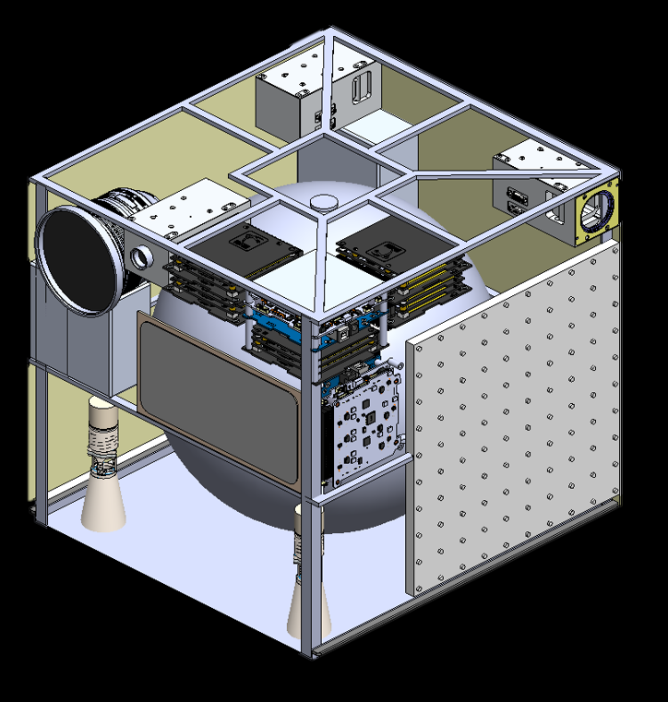
Starshade-like LGS Formation Flight Concept
Acquisition
After transition from target
LED wide-FOV array
RF ranging, DSN orbits/nav
Lock and Control
Acquire with Beacon laser
RF ranging, closed-loop RF comm
Science Mode
Fine pointing Guide Star laser
RF ranging, closed-loop RF comm
~40,000 km separation
low-power beacon laser
RF
link
RF link
RF link
1 m cross track stability
LEDs detected by telescope star tracker or a camera
Beacon detected by telescope science imager
W. Marlow, MIT

Slide 6
Overview
The idea
NASA Relevance
Technical Approach
Are picometers of stability really needed?
Laser Guide Star brightness and stability
How well do we need it to point at the telescope?
How far away does it need to be?
How many more exoplanet systems could we target?
Lifetime and agility - how many would need to fly?
What about… scattered light?
Lab experiment updates (paired segmented DM)
Simulation updates (paired segmented DM)
More work to do… !

Slide 7
NASA Relevance
Relevance to NASA: A Laser Guide Star can retain or improve observatory performance while relaxing stability requirements, thus reducing the cost and complexity of large space telescopes such as NASA concepts for LUVOIR and HabEx. Objectives:
Assess the ability of a LGS to provide better throughput for faster wavefront control with application to primary segment phasing and high contrast imaging.
Determine how use of the LGS would relax manufacturing and assembly tolerances on the observatory.
Increase ability to do high contrast imaging of more targets.
Consider how LGS can benefit photometric calibration.

Slide 8
Overview
The idea
NASA Relevance
Technical Approach
Are picometers of stability really needed?
Laser Guide Star brightness and stability
How well do we need it to point at the telescope?
How far away does it need to be?
How many more exoplanet systems could we target?
Lifetime and agility - how many would need to fly?
What about… scattered light?
Lab experiment updates (paired segmented DM)
Simulation updates (paired segmented DM)
More work to do… !

Slide 9
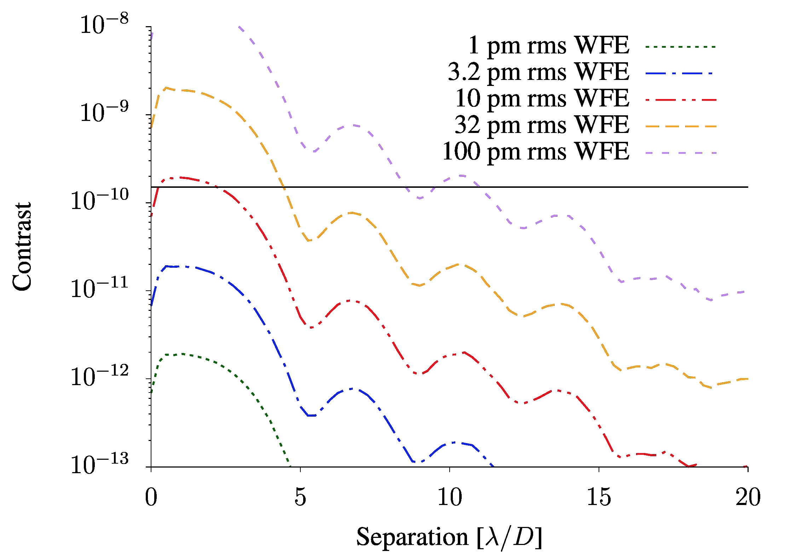
Are picometers really needed?
RMS Segment motion Wavefront Error (curves) vs. Contrast and Separation
Douglas et al., 2018 (Accepted to AJ)
Notes:
Figure 1. Left: Numerical simulation of contrast versus RMS segment motion wavefront error for an ideal coronagraph. Curves show decreasing wavefront error from top to bottom. A horizontal line indicates the contrast of an Earth-radius exoplanet with an albedo of 0.25 at quadrature. Right: Raw contrast versus residual WFE at 3λ/D, showing that 10 pm is a good approximation for a WFE requirement for detection of Earth-like planets with a segmented-aperture telescope.

Slide 10
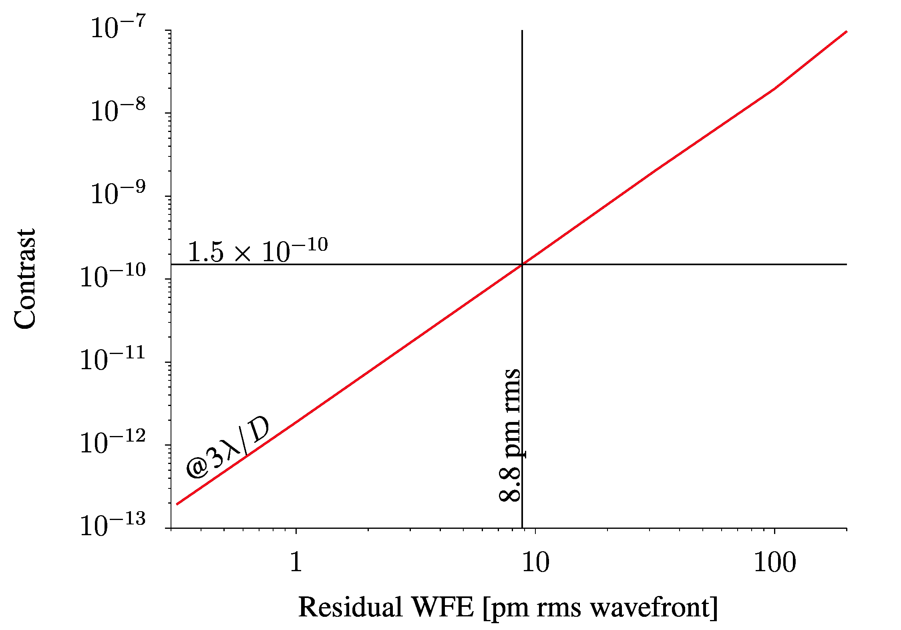
Are picometers really needed?
Raw contrast vs. Residual Wavefront Error at 3 Lambda/D
Douglas et al., 2018 (Accepted to AJ)
Notes:
Figure 1. Left: Numerical simulation of contrast versus RMS segment motion wavefront error for an ideal coronagraph. Curves show decreasing wavefront error from top to bottom. A horizontal line indicates the contrast of an Earth-radius exoplanet with an albedo of 0.25 at quadrature. Right: Raw contrast versus residual WFE at 3λ/D, showing that 10 pm is a good approximation for a WFE requirement for detection of Earth-like planets with a segmented-aperture telescope.

Slide 11
Overview
The idea
NASA Relevance
Technical Approach
Are picometers of stability really needed?
Laser Guide Star brightness and stability
How well do we need it to point at the telescope?
How far away does it need to be?
How many more exoplanet systems could we target?
Lifetime and agility - how many would need to fly?
What about… scattered light?
Lab experiment updates (paired segmented DM)
Simulation updates (paired segmented DM)
More work to do… !

Slide 12
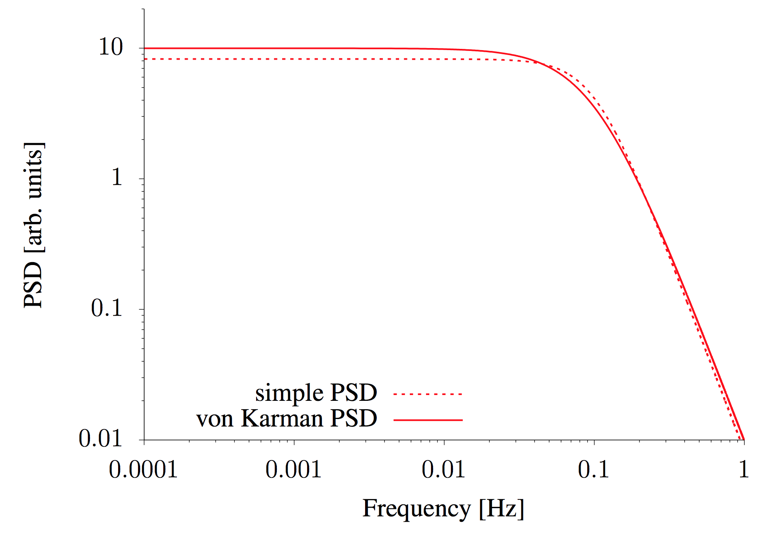
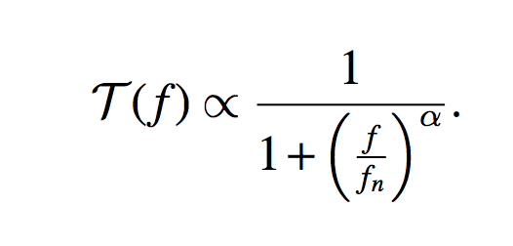
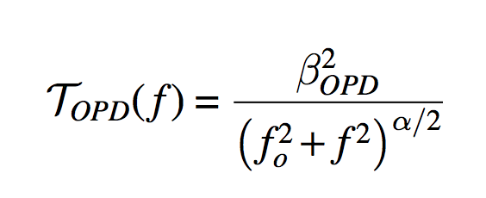
PSD used for WFE Simulation
PSD vs. Frequency (alpha is steepness of rolloff, f0 is knee frequency)
(1)
(2)
Douglas et al., 2018 (Accepted to AJ)
Notes:
Figure 2. Comparison with arbitrary units of the simple PSD form of Equation 1 (dashed) with the more general von Karmàn or K-correlation form of Equation 2 (solid). For equal knee frequencies, fn =0.1 Hz in this case, the forms are very similar. We adopt the von Karmàn PSD in this work.

Slide 13
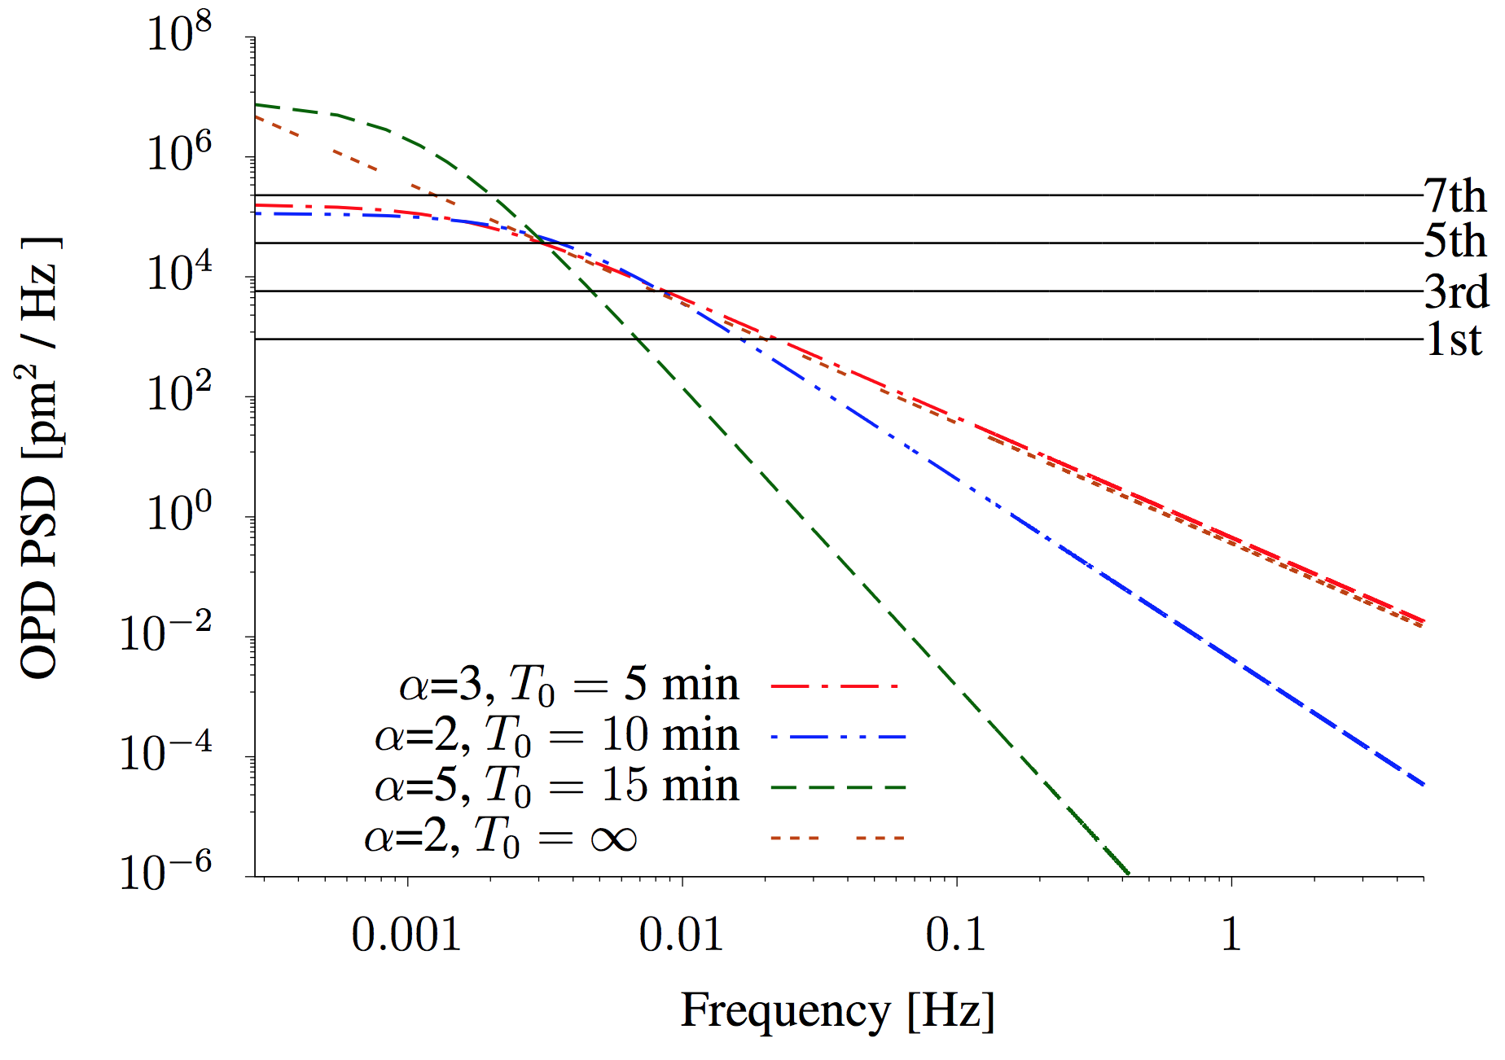
Stellar Noise Floor
Different PSDs vs. stellar measurement noise floors Sets >100 s stability requirement for natural guide stars
Douglas et al., 2018 (Accepted to AJ)
Notes:
Figure 3. Comparison of PSDs with with different power law constants (α) and different T0 outer times. The dashed lines show the optical path difference PSDs and the horizontal solid lines show the measurement noise floor for stars of different magnitudes. For mV=7 and dimmer stars measurement noise dominates. Even for a steep α=5 PSD, stellar noise will dominate above 0.01 Hz for an mV=1 star. This sets the > 100 second stability requirement for natural guide stars. All OPD PSDs are normalized with σ10 = 10 pm rms.. 14

Slide 14
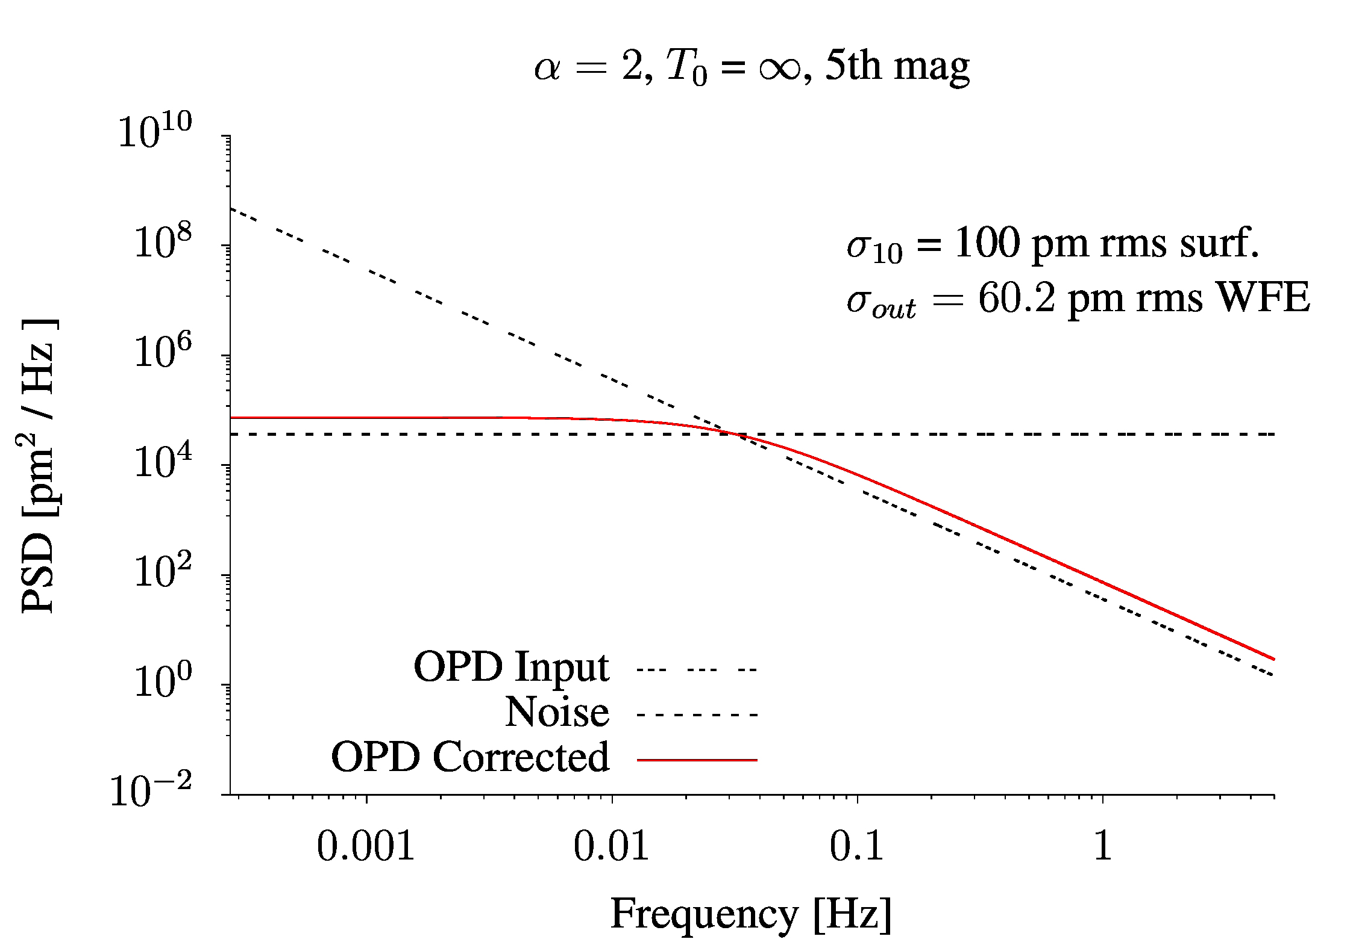
Closed Loop Control
Example correcting with an mV=5 star to 60.2 pm rms WFE
Douglas et al., 2018 (Accepted to AJ)
Notes:
Figure 4: Example application of closed loop control to OPD using mV=5 (left) and mV=-3 (right) guide stars. The input disturbance is shown as a triple dashed line and the corrected output is a solid line. The photon limited noise floor is shown as a horizontal dashed line.
Residual segment disturbance OPD as a function of guide star magnitude for α = 2 (left) and α = 3 (right) for T0 = ∞. The RMS residual across all temporal frequencies, σout, for the mV=5 star is 60.2 pm which is too high to detect Earth-like exoplanets. Conversely, a hypothetical mV=-3 guide star is sufficient to control OPD to 10.7 pm and reach contrasts of ∼ 10−10. These guide star magnitudes assume a 10% system throughput. For an ideal detector and minimal loss system with ∼40% throughput, these curves shift 1.5 magnitudes dimmer.

Slide 15
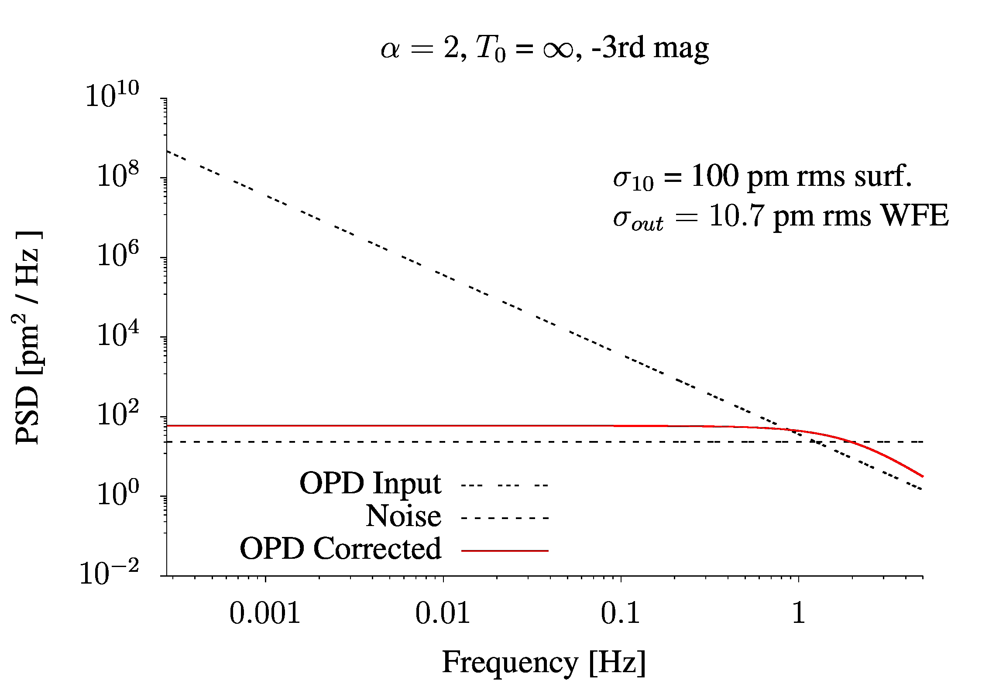
Closed Loop Control
Example correcting with an mV=-3 star to 10.7 pm rms WFE
Douglas et al., 2018 (Accepted to AJ)
Notes:
Figure 4: Example application of closed loop control to OPD using mV=5 (left) and mV=-3 (right) guide stars. The input disturbance is shown as a triple dashed line and the corrected output is a solid line. The photon limited noise floor is shown as a horizontal dashed line.
Residual segment disturbance OPD as a function of guide star magnitude for α = 2 (left) and α = 3 (right) for T0 = ∞. The RMS residual across all temporal frequencies, σout, for the mV=5 star is 60.2 pm which is too high to detect Earth-like exoplanets. Conversely, a hypothetical mV=-3 guide star is sufficient to control OPD to 10.7 pm and reach contrasts of ∼ 10−10. These guide star magnitudes assume a 10% system throughput. For an ideal detector and minimal loss system with ∼40% throughput, these curves shift 1.5 magnitudes dimmer.

Slide 16
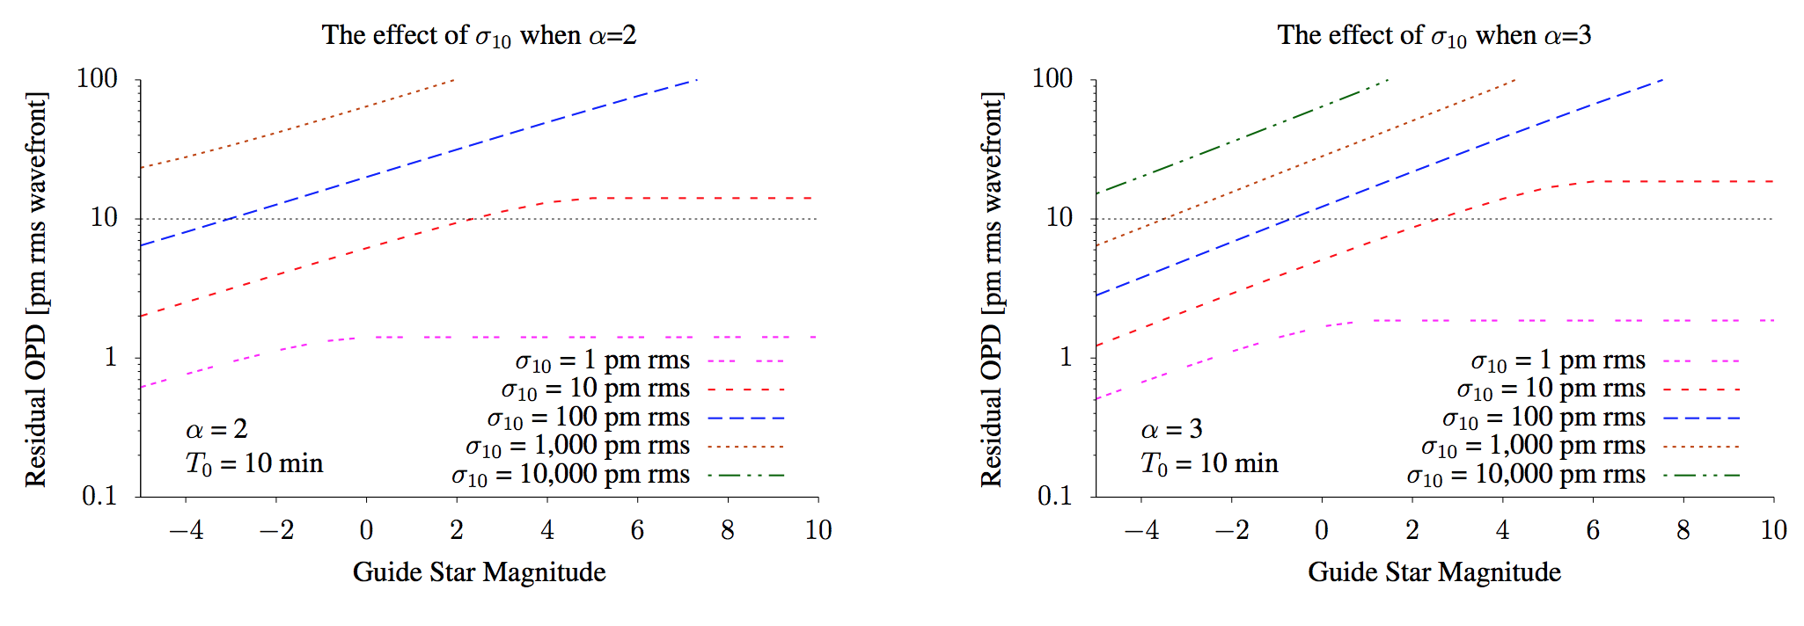
Guide Star mV vs. Residual
Want to reduce residual below 10 pm RMS with bright stars for larger sigma10s
Douglas et al., 2018 (Accepted to AJ)
Notes:
Figure 5: Residual segment disturbance OPD as a function of guide star magnitude for α = 2 (left) and α = 3 (right) for T0 = ∞. The RMS residual across all temporal frequencies, σout, for the mV=5 star is 60.2 pm which is too high to detect Earth-like exoplanets. Conversely, a hypothetical mV=-3 guide star is sufficient to control OPD to 10.7 pm and reach contrasts of ∼ 10−10. These guide star magnitudes assume a 10% system throughput. For an ideal detector and minimal loss system with ∼40% throughput, these curves shift 1.5 magnitudes dimmer.

Slide 17
Guide Star mV vs. Residual
Want to reduce residual below 10 pm RMS with bright stars for larger sigma10s
Douglas et al., 2018 (Accepted to AJ)
Notes:
Figure 5: Residual segment disturbance OPD as a function of guide star magnitude for α = 2 (left) and α = 3 (right) for T0 = ∞. The RMS residual across all temporal frequencies, σout, for the mV=5 star is 60.2 pm which is too high to detect Earth-like exoplanets. Conversely, a hypothetical mV=-3 guide star is sufficient to control OPD to 10.7 pm and reach contrasts of ∼ 10−10. These guide star magnitudes assume a 10% system throughput. For an ideal detector and minimal loss system with ∼40% throughput, these curves shift 1.5 magnitudes dimmer.

Slide 18
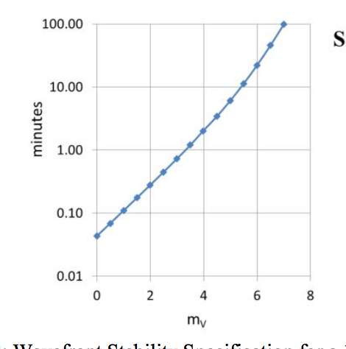
Previous mV’s optimistic...
10 m telescope, 10 pm Wavefront Stability Requirement
~8 min, sun at 10 parsec
Douglas et al. found this may be optimistic, suggest mV < 4 needed instead, depends strongly on throughput.
Time
Stellar flux
Stahl et al. 2015
Notes:
Previous research has suggested that 10 minute stability at the 10 picometer level is necessary for the detection of Earth-like planets around 5th to 6th magnitude stars (Stahl et al. 2013, 2015). The analysis presented here shows that the combination of a limiting magnitude of mV = 5 to mV = 6 and σ10 = 10 minutes may be overly optimistic. The ideal coronagraph model output shown in Douglas et al. Fig. 1 supports the previous finding that 10 pm control of segment motion is necessary to reach contrasts of 10−10 at the IWA. However, after accounting for system transmission, detector noise, and photon noise using a closed-loop control law, Fig. 5 shows controlling segment rigid-body motion to this level requires guide star magnitudes mV < 3.
Statement of the problem - increased stability is required for dimmer stars.
“Specification for a 10-meter telescope with a nominal Coronagraph. “
Stahl, Mark T., Stuart B. Shaklan, and H. Philip Stahl. 2015. “Preliminary Analysis of Effect of Random Segment Errors on Coronagraph Performance.” In Proc SPIE, 9605:96050P–96050P–14. https://doi.org/10.1117/12.2190160.

Slide 19
Overview
The idea
NASA Relevance
Technical Approach
Are picometers of stability really needed?
Laser Guide Star brightness and stability
How well do we need it to point at the telescope?
How far away does it need to be?
How many more exoplanet systems could we target?
Lifetime and agility - how many would need to fly?
What about… scattered light?
Lab experiment updates (paired segmented DM)
Simulation updates (paired segmented DM)
More work to do… !

Slide 20
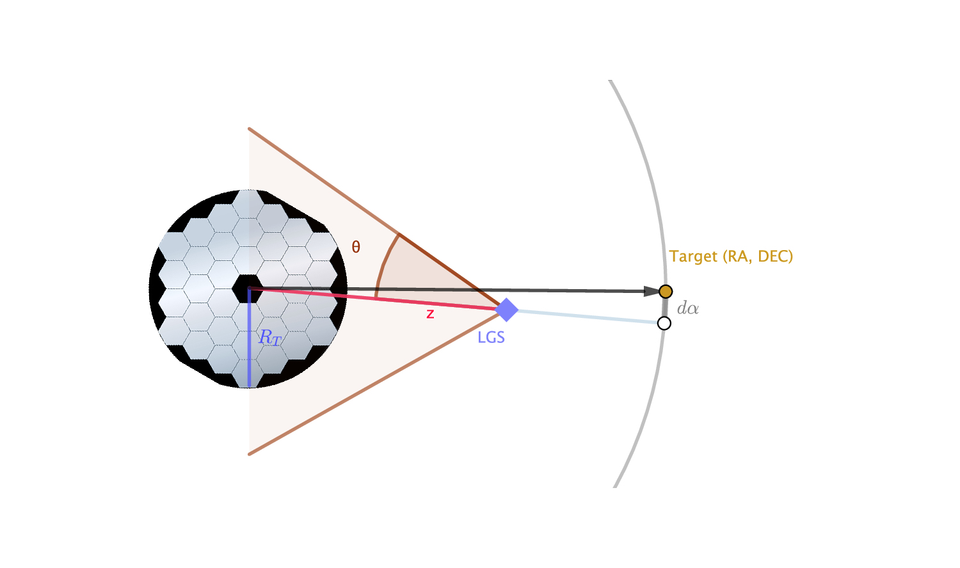
Observing Scenario
Douglas et al., 2018 (Accepted to AJ)
Notes:
Figure 6. Two dimensional representation of the LGS observing scenario. The observing telescope (left) direction of regard is shown as a vector projected onto the celestial sphere (right), while at range z the LGS (tilted square) is offset from the direction of regard by angle dα. The width of the Gaussian LGS beam, with a half-width divergence θ, is shaded.

Slide 21
Measuring Intensity vs. Phase
Intensity
∝ phase error
Electric field from telescope
~𝛌/D diameter mask
E. Douglas (MIT)
Notes:
Figure 7. Example of ZWFS with a LGS, illustrating that a Gaussian input beam and a flat input phase disturbed by random segment motion (middle) leads to an varying output intensity (right) which is degenerate with phase errors. Accurate LGS pointing allows for quasi-static measurement of the intensity distribution and correction of this error. This simulation used w = 23.4000 at a range of 4.4 ×104 km, which corresponds to a beam-width of 4.7 km at the telescope.

Slide 22
Beamwidth and pointing jitter
The observatory pointing jitter has to be tiny (< 1 mas) to get 10^-10 contrasts, anyway
If you offset the LGS beam a bit, but want to keep phase error below 10 pm, can calculate (beam divergence / tx jitter) > 380
If LGS jitter is 15 mas (not hard to meet) then beam divergence > 0.325” (about 1 urad)
NASA’s Lunar LaserCom Demo used a FWHM beam of 16.2 urad from lunar orbit 384,400 km to Earth (at 622 Mbps)
Douglas et al., 2018 (Accepted to AJ)

Slide 23
Overview
The idea
NASA Relevance
Technical Approach
Are picometers of stability really needed?
Laser Guide Star brightness and stability
How well do we need it to point at the telescope?
How far away does it need to be?
How many more exoplanet systems could we target?
Lifetime and agility - how many would need to fly?
What about… scattered light?
Lab experiment updates (paired segmented DM)
Simulation updates (paired segmented DM)
More work to do… !

Slide 24
Formation Flying Range
Take defocus into account
Want to keep the peak to valley wavefront error from defocus less than pi/2
Separation = 2*(Diameter/2)^2 / Lambda
For a 9.2 m diameter telescope, minimum range is ~43,000 km for Lambda = 980 nm
For a 9.2 m diameter telescope, minimum range is ~105,000 km for Lambda = 400 nm
Douglas et al., 2018 (Accepted to AJ)

Slide 25
Overview
The idea
NASA Relevance
Technical Approach
Are picometers of stability really needed?
Laser Guide Star brightness and stability
How well do we need it to point at the telescope?
How far away does it need to be?
How many more exoplanet systems could we target?
Lifetime and agility - how many would need to fly?
What about… scattered light?
Lab experiment updates (paired segmented DM)
Simulation updates (paired segmented DM)
More work to do… !

Slide 26
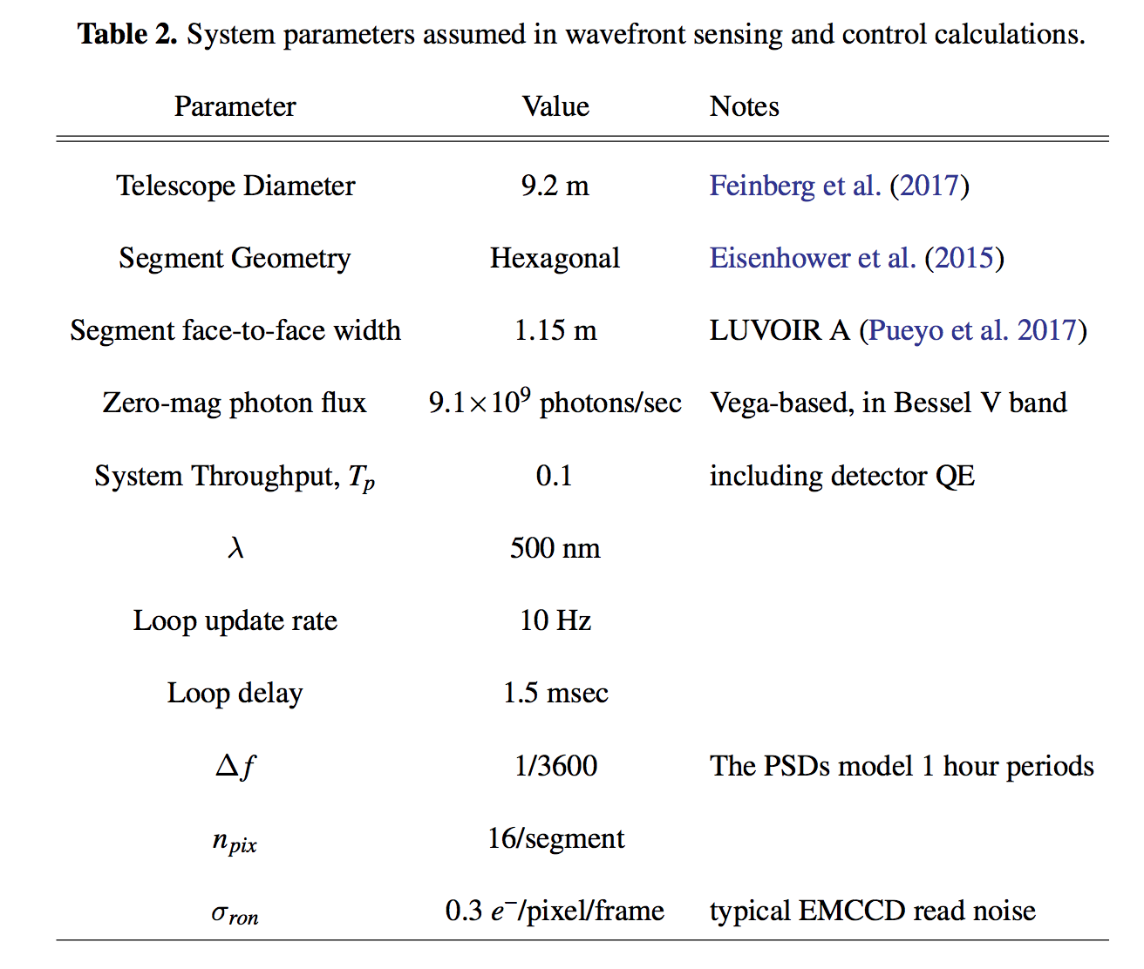
Simulation Parameters
Table 2: System parameters assumed in wavefront sensing and control calculations.
Douglas et al., 2018 (Accepted to AJ)

Slide 27
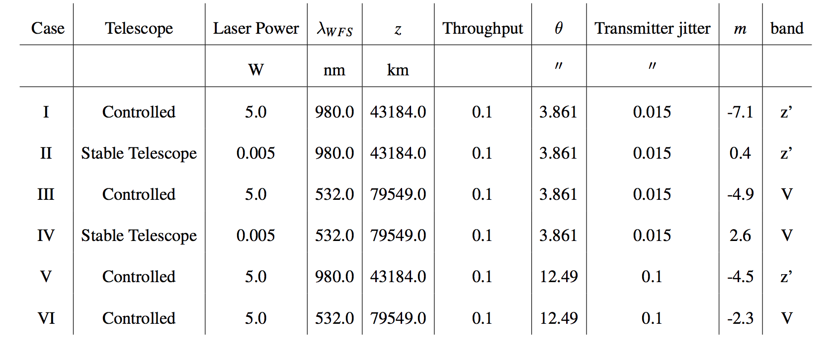
Example Configurations mV
Douglas et al, 2018 (Accepted to AJ)
Notes:
Table 3: LGS transmitter possible scenarios paired w/segmented telescope. The “stable” telescope cases, Cases II and IV, are based on recent designs for a well-damped telescope using natural guide stars for wavefront sensing. The controlled cases, Cases I, III, V, and VI, would use a more powerful laser to enable faster update, relaxing telescope stability requirements. Throughput here refers to total observatory sensitivity, including the impacts of coating reflectivity and detector quantum efficiency. Transmitter jitter here is the maximum allowable excursion of the LGS beam from the bore-sight of the telescope. The rightmost “band” column indicates the filter over which the effective magnitude, m, is calculated.

Slide 28
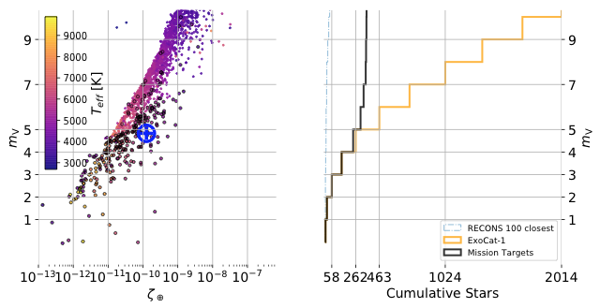
Impact on Science Yield
ExoCat, “Earth” mV’s vs. Flux
mV vs. # of Target Stars
But there are 2,014 stars < 10 mV which could be reached w/LGS
Sun at 10 pc
There aren’t many bright target stars. Only 142 stars are < 3 mV, the NGS limit
Douglas et al., 2018 (Accepted to AJ)
Notes:
Figure 9: Left: Magnitude vs flux ratio of a 1R⊕ planet at the Earth-equivalent insolation distance for stars in the ExoCat database below 10,000 Kelvin (Turnbull 2015). The sun at 10 parsecs is encircled cross. Black stars have been previously flagged by NASA missions as priorities for the WFIRST (Kasdin et al. 2018), LBTI (Ertel et al. 2018), Exo-S (Seager et al. 2015), and Exo-C (Stapelfeldt et al. 2015) projects in the Exoplanet Archive. Right: Number of target stars as function of magnitude. There are 40 stars brighter than 10th magnitude in the RECONS databases of the closest stars and 2,014 in ExoCat. Natural guide star wavefront sensing and 10 min telescope stability limit at 3rd magnitude or brighter which leaves 142 ExoCat stars accessible. The solid black line shows the same mission stars as are circled in the left panel.

Slide 29
Overview
The idea
NASA Relevance
Technical Approach
Are picometers of stability really needed?
Laser Guide Star brightness and stability
How well do we need it to point at the telescope?
How far away does it need to be?
How many more exoplanet systems could we target?
Lifetime and agility - how many would need to fly?
What about… scattered light?
Lab experiment updates (paired segmented DM)
Simulation updates (paired segmented DM)
More work to do… !

Slide 30
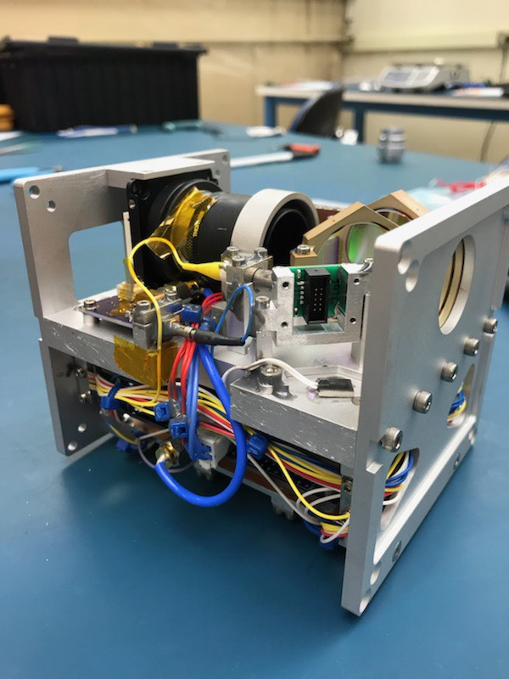
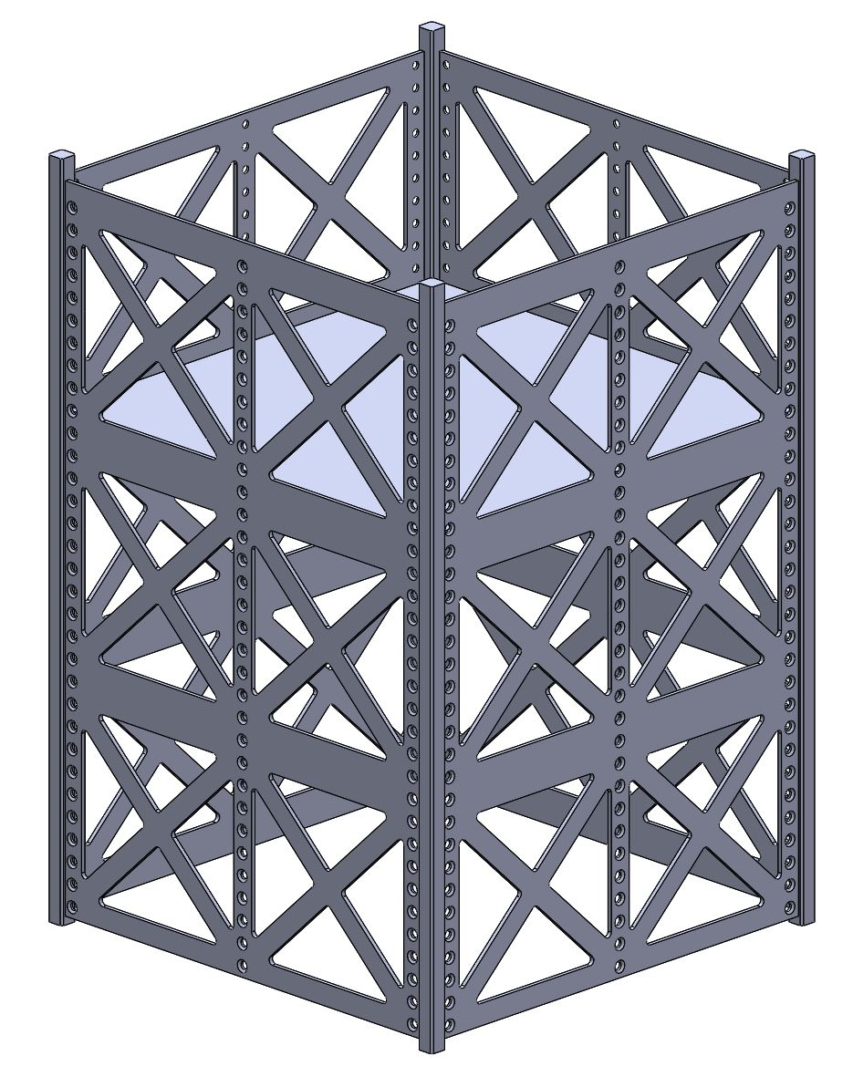
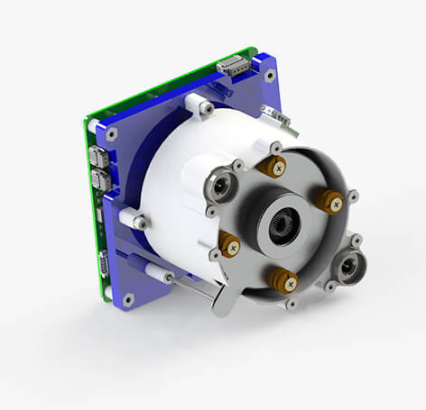
12U Spacecraft Design
Fine pointing lasercom transmitters
are now CubeSat-scale...
MIT CLICK-A
22.6 cm
22.6 cm
Optics Volume (4U)
… and so are electric propulsion thrusters
34 cm
Bus
Volume
(8U)
W. Kammerer (MIT)
Conservative power budget for operations at 80,000 km
Enpulsion

Slide 31
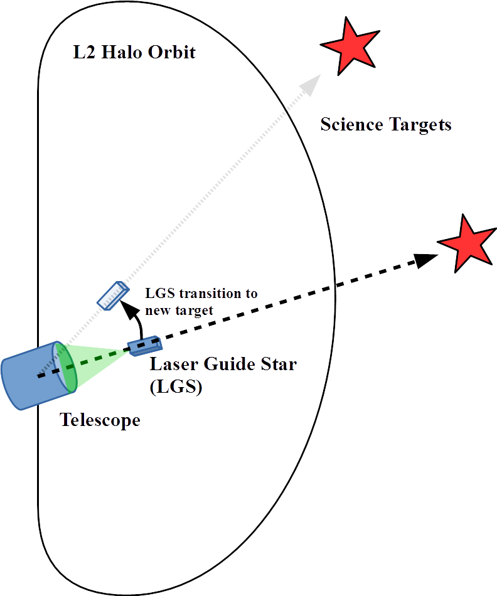
Orbit and Propulsion Modeling
Large telescope stays on a periodic L2 halo orbit
LGS will fly between the telescope and its target star, on a non-periodic orbit
LGS will maneuver around the telescope to track targets and transition to new targets
J. Clark, MIT

Slide 32
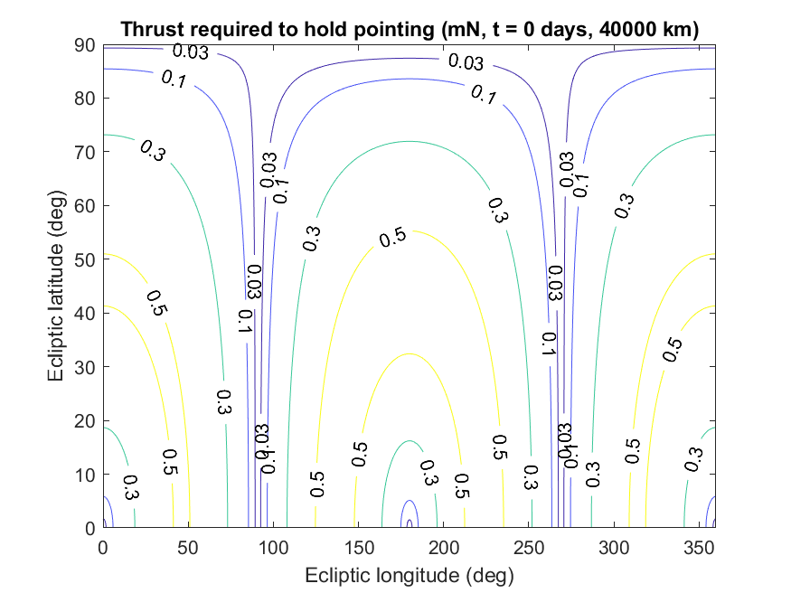
Orbit and Propulsion Modeling
Cost to maintain formation flight not constant over sky
Least expensive to hold OBS-LGS-star vector directly towards or away from Sun
Or, at nearly-right angle from Sun (preferable, to minimize glint)
Plot is for 12U (24 kg) satellite, flying in formation 40,000 km from OBS
J. Clark, MIT

Slide 33
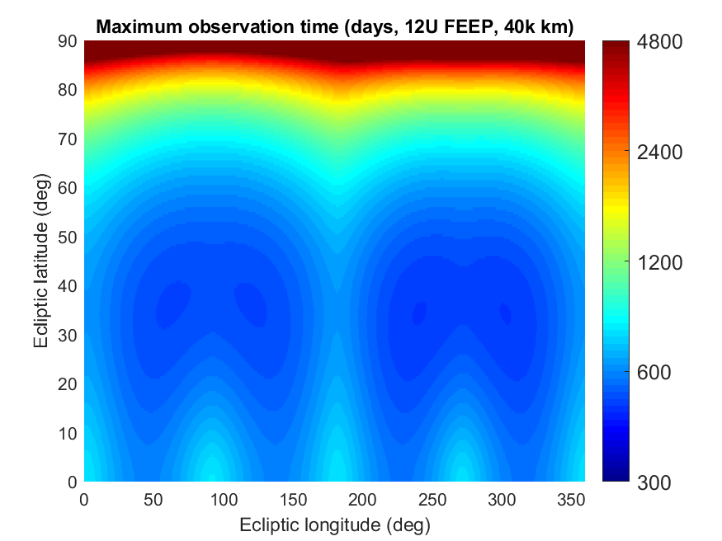
Orbit & Propulsion Model: FEEP
Max obs time vs. ecliptic lat/lon
Consider thrust vs. lat/lon contours for all points in time in a halo orbit
1 full period ~6 months
Average, and divide into spacecraft’s delta-V budget
Shows “mean maximum” obs time LGS can sustain for any point in the sky
Poles are the least expensive
But, with LGS, can observe any point for hundreds of days
J. Clark, MIT
Notes:
Figure generated using the FEEP (Enpulsion) system, so total dV is 664 m/s. RF ion will do 2x better from its much-increased dV capacity, iEPS about 0.7x as well (slightly better thrust, but substantially lower Isp and fuel mass).

Slide 34
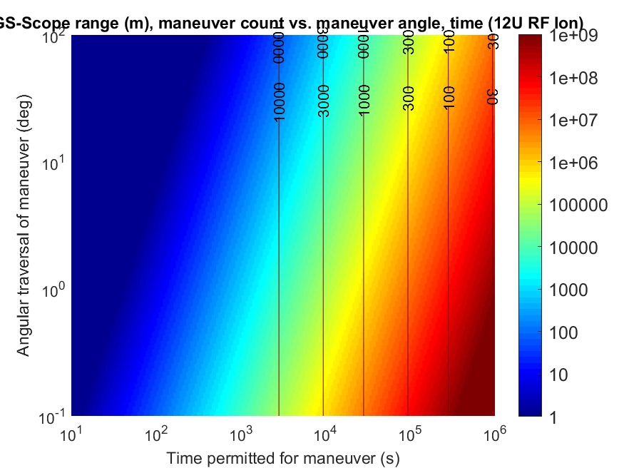
Orbit & Propulsion Model: RF Ion
Step 2: LGS-Scope range (40,000 km)
Step 1: separation between stars (10 deg)
Step 3: Read off maneuver duration (9 days) and total maneuver count (37)
J. Clark, MIT
Notes:
The other major fuel cost for the LGS is transitioning between targets.
With the 12U RF ion design, at 40,000 km separation, the LGS would have to thrust for nine days to make that maneuver, and would only be able to make 37 such maneuvers with its fuel capacity (never mind the fuel cost to sustain a long-duration observation of any star). If we’re “only” 10,000 km out (orange), that maneuver only requires 4 days, and the LGS can make 75 such maneuvers. (Essentially, for range R, delta-V cost and maneuver duration scale by sqrt(R).) It is also possible to trade time for number of targets by reducing thrust -- reducing thrust by a factor of N improves the number of targets reached by a factor of N.
(Even though this doesn’t sound like a lot of observations, it still represents nearly a year of firing at full thrust (all 1.2 mN of it…) -- the spacecraft actually has quite a bit of delta-V for a small satellite, over 1400 m/s, it’s just that it’s having to spend it all ‘stopping-and-going’ its way around the telescope, rather than firing in a single direction to raise its orbit or escape a gravity well.)
These charts all assume the LGS masses 24 kg, which is the maximum mass permitted for a 12U CubeSat. We expect that a more detailed design (in development by STAR Lab) can achieve substantial mass savings, which should improve both metrics by at least 20%.

Slide 35
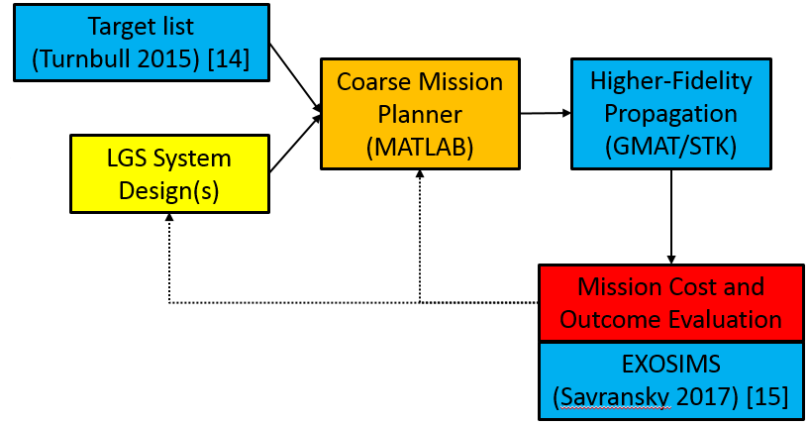
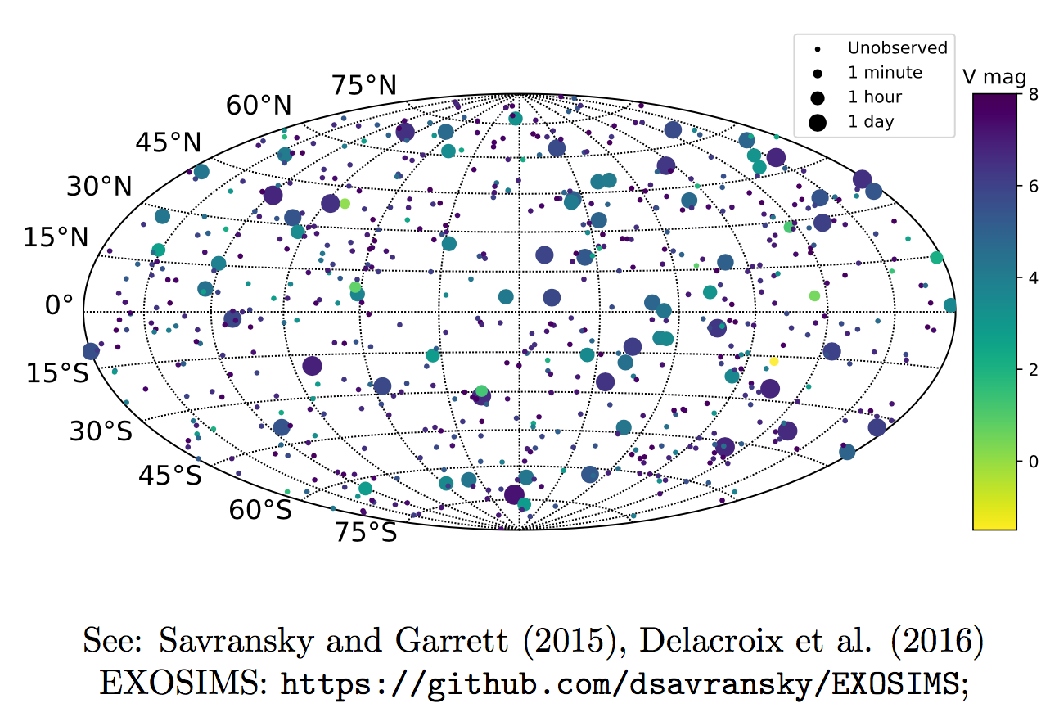
Full Mission Simulation
Build on open-source EXOSIMS framework:
w/NGS, only 142 stars from ExoCat
w/LGS, all stars accessible
Probably need ~9 LGS to survey all stars
Add ~3 more LGS to have a “revisit top 100 team”
Need to refine LGS maneuver & coordination overhead
Savransky et al. 2017
Notes:
http://sioslab.com/wp-content/uploads/2017/08/spie2017_talk.pdf

Slide 36
Overview
The idea
NASA Relevance
Technical Approach
Are picometers of stability really needed?
Laser Guide Star brightness and stability
How well do we need it to point at the telescope?
How far away does it need to be?
How many more exoplanet systems could we target?
Lifetime and agility - how many would need to fly?
What about… scattered light?
Lab experiment updates (paired segmented DM)
Simulation updates (paired segmented DM)
More work to do… !

Slide 37
Mitigating Scattered Light
Optical notch filters up to OD 12 have been manufactured (Landulfo et al., 2018)
Up to OD 8 are commercially advertised (Alluxa)
The LGS would be further suppressed by keeping the transmitter inside the coronagraph IWA
The edges of the LGS will scatter sunlight, which cannot be optically filtered, but this will be magnitude 17 at brightest
Notes:
Alluxa notch filter website: https://www.alluxa.com/optical-filters/ultra-series-optical-filters-and-coatings/notch-filters/
Landulfo doi:10.1117/12.2324295

Slide 38
Overview
The idea
NASA Relevance
Technical Approach
Are picometers of stability really needed?
Laser Guide Star brightness and stability
How well do we need it to point at the telescope?
How far away does it need to be?
How many more exoplanet systems could we target?
Lifetime and agility - how many would need to fly?
What about… scattered light?
Lab experiment updates (paired segmented DM)
Simulation updates (paired segmented DM)
More work to do… !

Slide 39
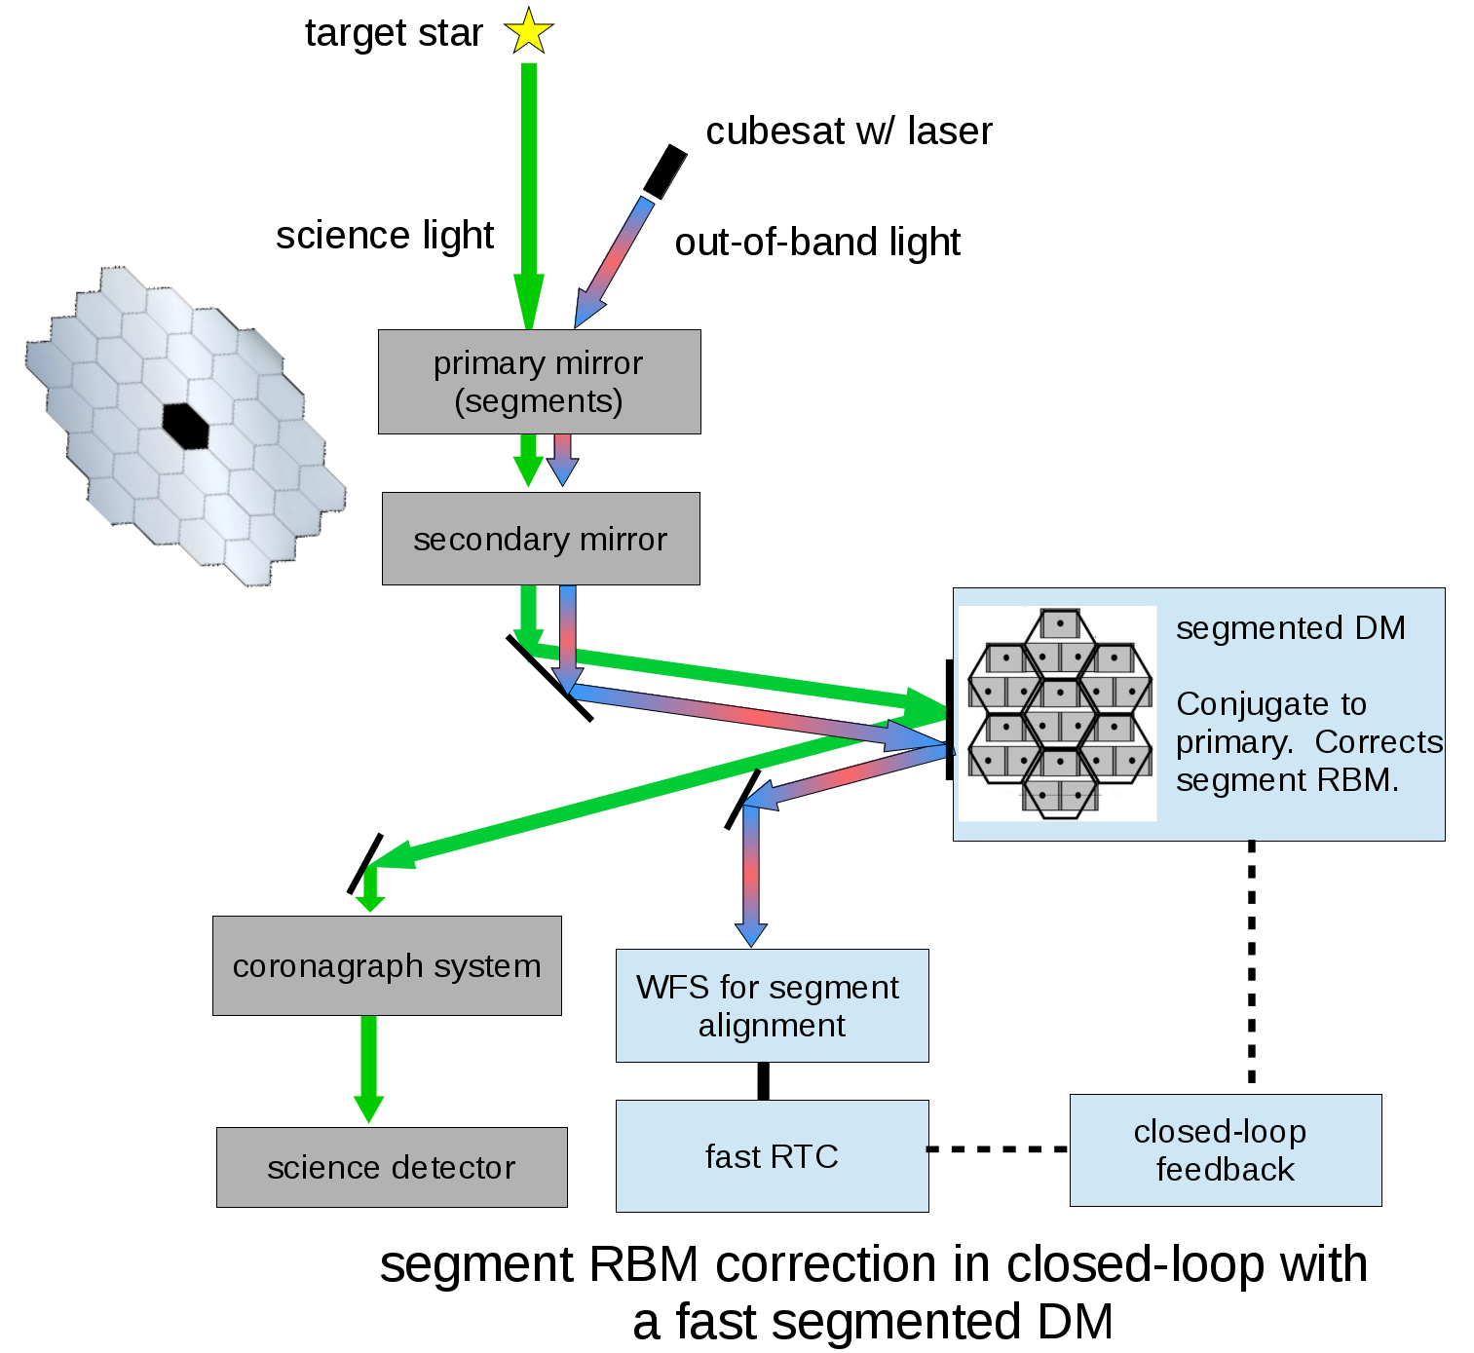
Approach for Primary Segment Compensation
Use LGS for segment rigid-body motion (RBM) compensation
One (of possibly many) implementation idea:
1) Primary is re-imaged on fast segmented DM
2) LGS light is split to a WFS, science light goes to coronagraph.
3) WFS feedback in closed-loop to segmented DM, which corrects piston & tip/tilt
J. Males (U. of A.)

Slide 40
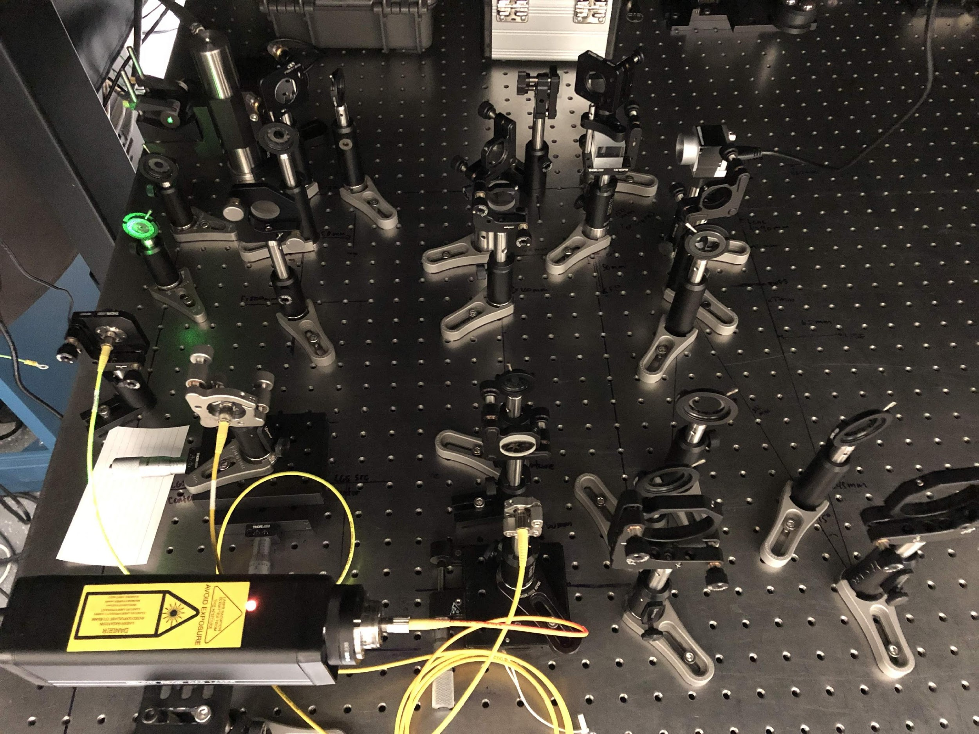
Testbed: Assembly Progress
At Camera:
LGS Pupil Stop
Relay Lens 2
Beam Combiner
LGS PSF
Camera (focal plane PSF for alignment checking)
Relay lens 1
Relay lens 2
Target PSF
Target pupil stop
Alignment procedure goals:
Build and align LGS and Target relays on-axis together through entire optical system before continuing to segmented DM
Translate LGS source relative to defocus and tilt of LGS CubeSat
LGS source
Relay lens
Target source
J. Lumbres (U. of A.)
Notes:
The testbed update picture captures progress with aligning the LGS and target source relays. Both are being aligned on-axis with no defocus, since we can always insert the LGS defocus and tilt after we get everything set up. The PSFs are shown for the combined relays. The LGS source is looking pretty good, but we need more time to chase the target source alignment (hence the defocus and offset present). Once this is reliably aligned, then we can move onto the OAP relay with the DM.

Slide 41
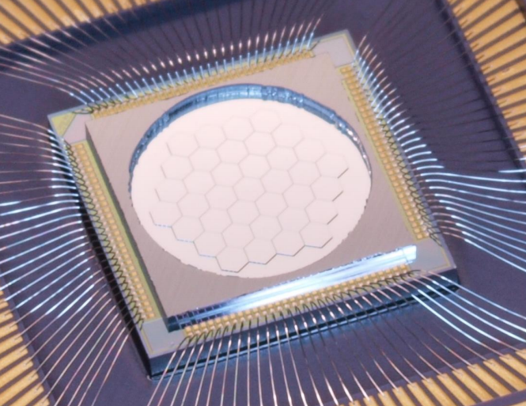
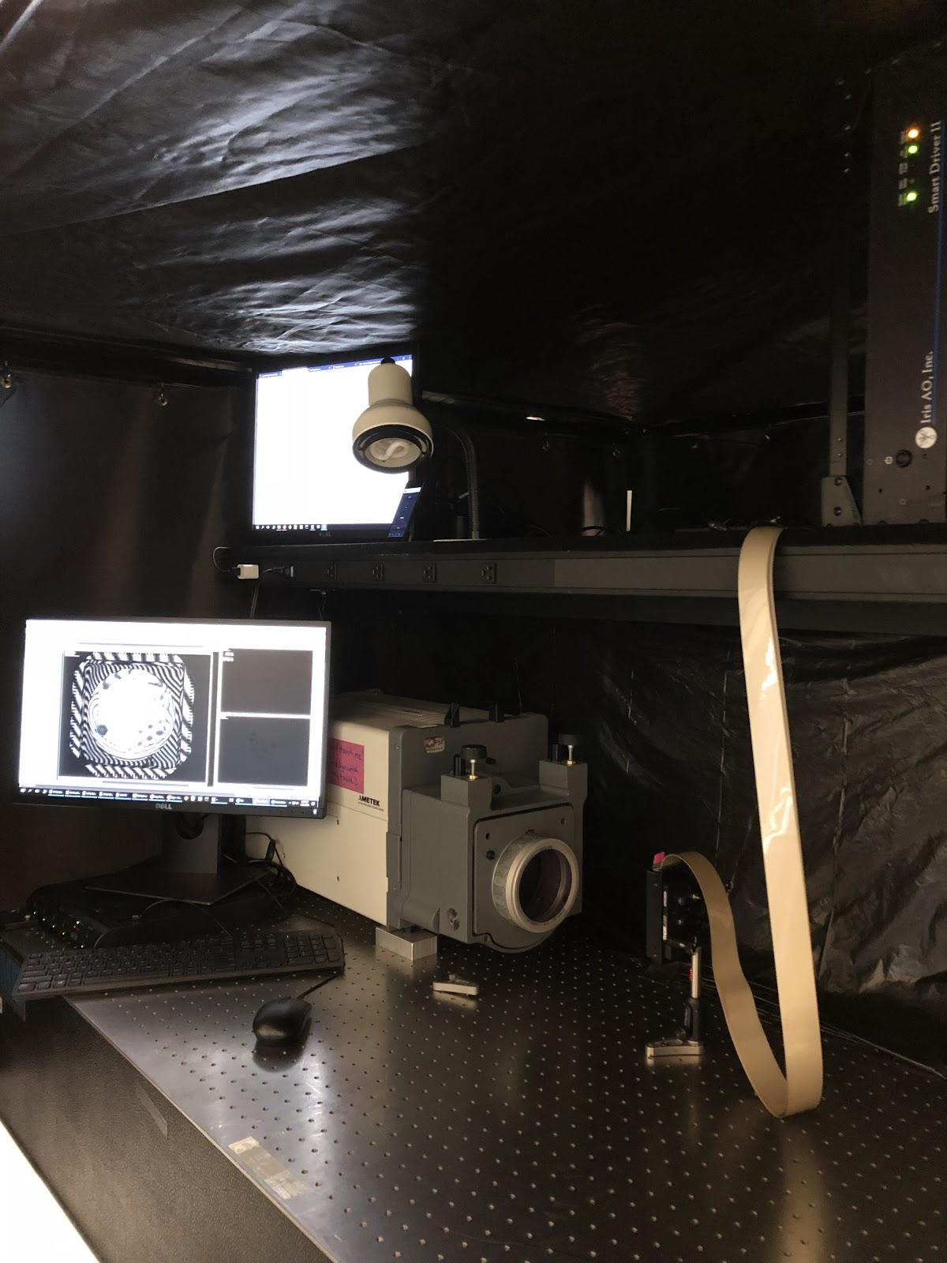
Segmented Deformable Mirror Characterization
IrisAO PTT-111L 37 segments, arrived July 2018
Stroke: 5 um total
Angle range: +/- 2 mrad
Inscribed aperture: 7mm
J. Lumbres (U. of A.)

Slide 42
Segmented Deformable Mirror Characterization
Task 1: Characterizing Iris AO mirror “flat” state
Testing underway with Zygo Verifire interferometer
Corrected using iterative least square fitting per segment
Approximately 18 nm RMS error for flat state currently
Task 2: Verify Mirror Functionality Range
Testing underway with Zygo Verifire interferometer
Step through segment PTT with Zygo to verify no stuck or coupled segments
Phase unwrapping analysis for piston
J. Lumbres (U. of A.)

Slide 43
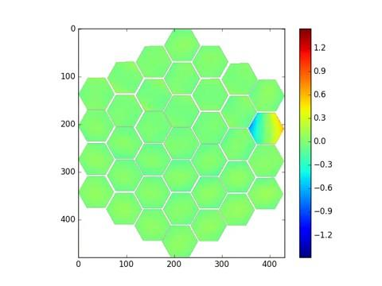
Segmented Deformable Mirror Video
Individual segment tilt step test measured from Zygo
(-1.5 mrad to +1.5 mrad, 0.1 mrad steps)
Surface units (microns)
J. Lumbres (U. of A.)
Notes:
Sample data collected for tilt verification measurements using Zygo Verifire in lab. The IrisAO PTT111L is rated for +/- 2 mrad, however the data shown ranges from +/- 1.5 mrad. The slopes greater than 1.5mrad was too steep for the Zygo to measure, so they were omitted in this data set. Additional tests were done for both piston and tip.

Slide 44
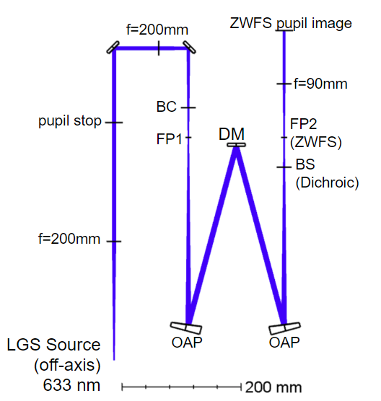
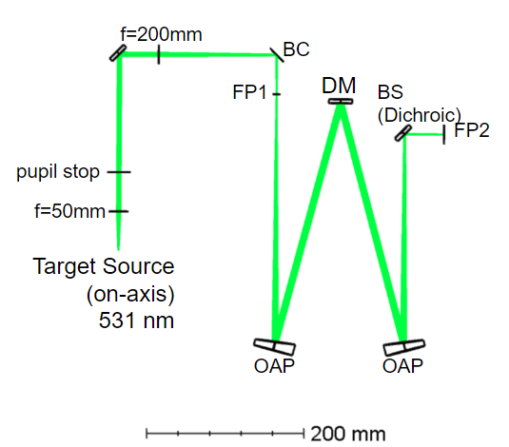
Testbed: Zemax Modeling
Off-Axis LGS Source Relay
On-Axis Target Source Relay
J. Lumbres (U. of A.)
All optics common for LGS and target sources between BC and dichroic BS
Notes:
The LGS and on-axis target sources have afocal relays with a pupil stop in place to create the inscribed aperture on the segmented DM. Each source is combined using a beamsplitter cube (labelled BC in diagram). The OAP relay with the segmented DM become the common path between each source. A dichroic beamsplitter is placed to separate the two sources, where the LGS source will pass into a Zernike WFS and the on-axis target source goes directly to a detector.

Slide 45
Overview
The idea
NASA Relevance
Technical Approach
Are picometers of stability really needed?
Laser Guide Star brightness and stability
How well do we need it to point at the telescope?
How far away does it need to be?
How many more exoplanet systems could we target?
Lifetime and agility - how many would need to fly?
What about… scattered light?
Lab experiment updates (paired segmented DM)
Simulation updates (paired segmented DM)
More work to do… !

Slide 46
Simulating Diffraction Effects
Even assuming wavefront control input perfectly matched to input disturbance…
Adding segmented conjugate DM for wavefront control introduces dynamic effects from diffraction
Resulting contrast floor increases with input disturbance amplitude
Future work will explore strategies for mitigating diffraction effects, such as:
Apodizers or other masks.
Alternative segmented DM technologies
Continuous facesheet DM for segment RBM correction
Direct feedback to primary segments (no additional DM)
Notes:
alternative segmented DM technologies: i.e., other than BMC MEMS. Can we make bigger segments with smaller (relative) gaps?
continuous facesheet: can we reproduce segment RBM with high enough fidelity while avoiding the edge diffraction?
direct feedback: estimate we need ~10 to 100Hz bandwidth.

Slide 47
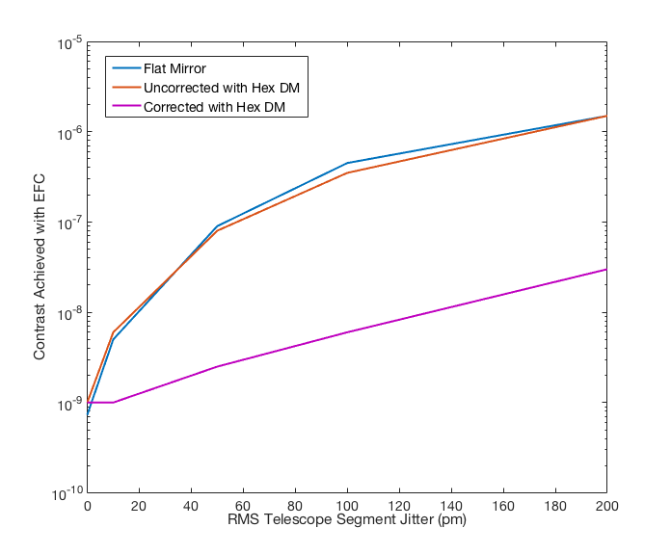
Simulating Diffraction Effects
Note: “Flat Mirror” indicates that the segmented DM is replaced by a flat mirror, which is physically equivalent to the segmented DM not being in place.
Y. Xin (MIT)
Notes:
2 reasons not 10^-10 - small gap size is hard to model

Slide 48
Simulating Diffraction Effects
Future work needed to explore strategies to mitigate dynamic effects of diffraction concentrated around segment gaps.
See talk by Yinzi Xin at AAS Seattle next month
MDM: Matched DM
Y. Xin (MIT)

Slide 49
Overview
The idea
NASA Relevance
Technical Approach
Are picometers of stability really needed?
Laser Guide Star brightness and stability
How well do we need it to point at the telescope?
How far away does it need to be?
How many more exoplanet systems could we target?
Lifetime and agility - how many would need to fly?
What about… scattered light?
Lab experiment updates (paired segmented DM)
Simulation updates (paired segmented DM)
More work to do… !

Slide 50
Next Steps (1/2)
Laboratory tests at the University of Arizona to demonstrate WFSC increase TRL from 1-2 to 3-4 (in progress, at TRL 3).
Completion of Part 2 of the LGS paper series, focusing on laboratory demonstration
Detailed simulations of a paired segmented DM for WFSC are being evaluated at MIT (in progress)
Consideration of use of LGS for photometric calibration
Refinement of design reference mission and lifetime based on realistic LGS spacecraft

Slide 51
Next Steps… (2/2)
Explore synergies with capacitive sensors/laser metrology/natural guide stars
Capacitive sensors sensitive to high-frequency disturbances, but subject to drift over >1 sec timescales
Laser metrology for secondary mirror alignment
LGS could provide calibration, primary mirror segment cophasing
Narrow down implementation of wavefront sensing
How/where do we pick up the beam?
Is LGS spacecraft behind coronagraph, or out of focal/pupil plane?
Explore defocused wavefront sensor

Slide 52
Thank you!
Please send questions to the team at: laserguidestarlab@mit.edu

Slide 53
Presentations & Publications
Cahoy, K.L.“Telescope Technology for Decadal Missions Seminar”(hosted by Bob Laskin, Astronomy and Physics Directorate Chief Technologist JPL) Friday, 2/24/2017
Clark, J. HabEx STDT Telecon, “Telescope/Companion formation flight”, 3/24/2017
Lumbres, J. American Museum of Natural History Astrophysics Department seminar, “Extreme Wavefront control on Ground and Space Telescopes for Exoplanet Imaging”, 5/19/2017
Cahoy, K.L. The LUVOIR (Habex) “Ultra-stable Systems Working group”, 7/28/2017
Clark, J. MIT Space Systems Laboratory seminar, “Capabilities of a Laser Guide Star for a Large Segmented Space Telescope”, 10/02/2017
Cahoy, K.L. et al., “Laser Guide Star for Large Aperture Segmented Space Telescopes,” Annual Technical Seminar Year 1 at NASA GSFC on 11/20/2017
Clark, J. et al., “Capabilities of a Laser Guide Star for a Large Segmented Space Telescope,” AAS mtg #231, January, 2018.
Lumbres, J. et al. “Laser Guide Star for Large Aperture Segmented Space Telescopes,” SPIE Astronomical Telescopes and Instrumentation, Austin, TX, June 2018
Douglas, E.. et al. “Laser Guide Star for Large Aperture Segmented Space Telescopes,” Cubesat Developers Workshop, San Luis Obispo, CA, April 2018
Douglas, E. et al. “Laser Guide Star for large segmented aperture space telescopes: Part 1: Implications for Terrestrial Exoplanet Detection and Observatory Stability,” accepted in Astronomical Journal on Nov. 20, 2018.
Xin, Y. et al., “Diffraction analysis of Laser Guide Star enabled cophasing wavefront control for large segmented aperture space telescopes,” accepted for oral presentation at AAS January 7, 2019.
Cahoy, K.L. et al., “Laser Guide Star for Large Aperture Segmented Space Telescopes,” Annual Technical Seminar Year 2 at NASA GSFC on 12/7/2018.

