Slide 1
New Front of Exoplanetary Science: High Dispersion Coronagraphy (HDC)
Ji Wang
Caltech

Slide 2
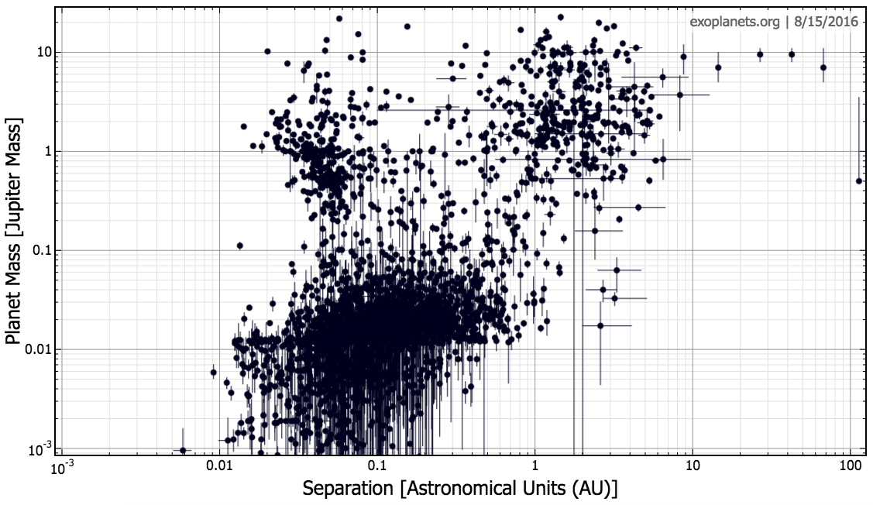

Slide 3
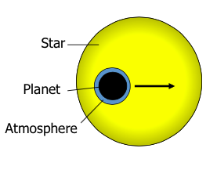
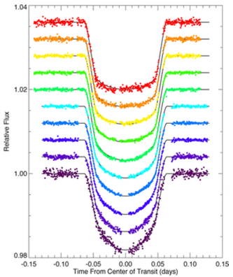
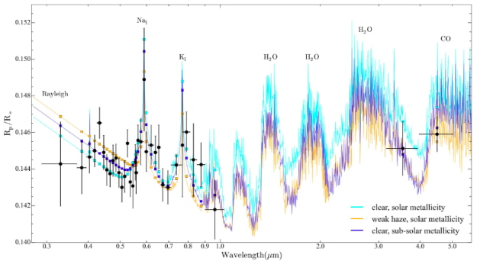
Transmission Spectroscopy
Fischer et al. 2016
Knutson et al. 2007

Slide 4
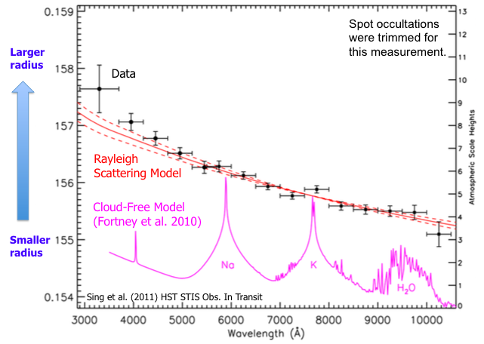
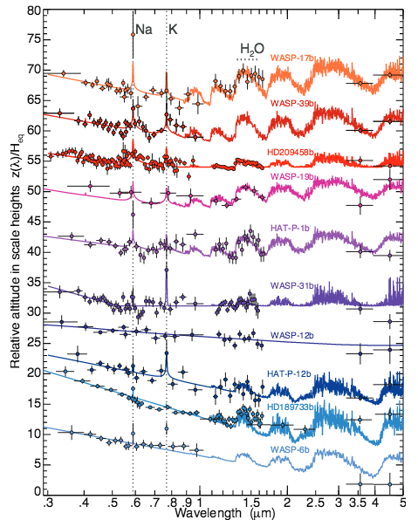
Cloud and Haze
Sing et al. 2011
Sing et al. 2016
Kreidberg et al. 2014
Notes:
Degeneracy between cloud and high-mean molecular weight atmosphere. HRS is less susceptible to the degeneracy bc it relies resolving molecular lines in the atmosphere.

Slide 5
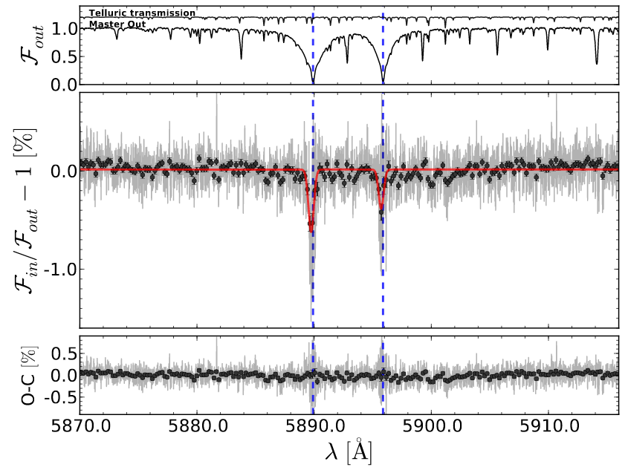
High Resolution Spectroscopy
Wyttenbach et al. 2015
HD 189733b
See also Khalafinejad et al. 2016
Notes:
Increasing signal for sharp lines

Slide 6
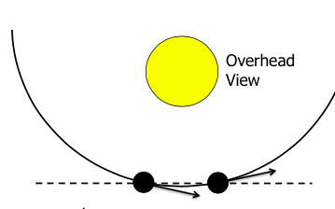
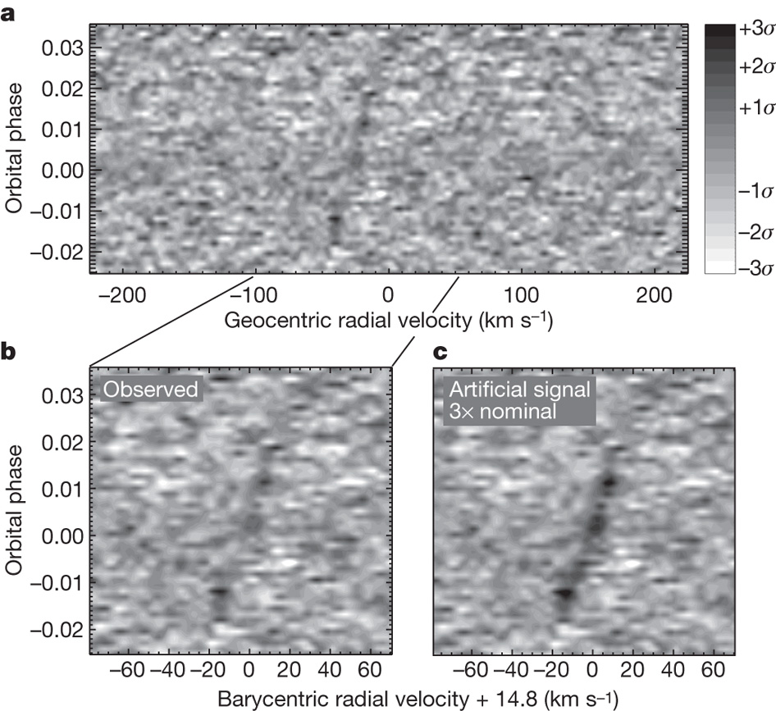
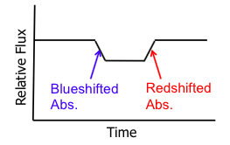
Atmospheric Composition From High-Resolution Spectroscopy
HD 209458, Snellen et al. 2010
Notes:
Directly detection through radial velocity modulation.
Dominating noise source is photon noise from the star!

Slide 7
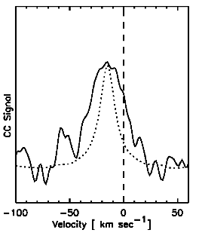
Planet Rotation – Beta Pic b
Snellen et al. 2014
Dashed - Instrument Profile
Solid – Measured Line Profile
Notes:
Enable new sciences such as measuring planet rotation and cloud map

Slide 8
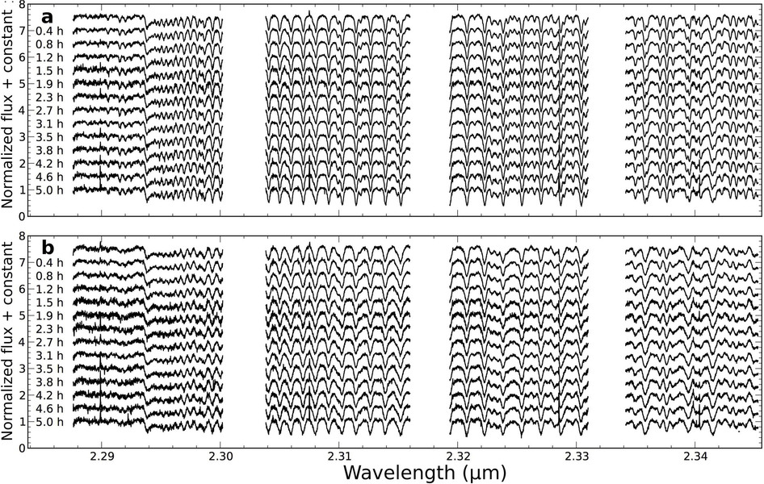
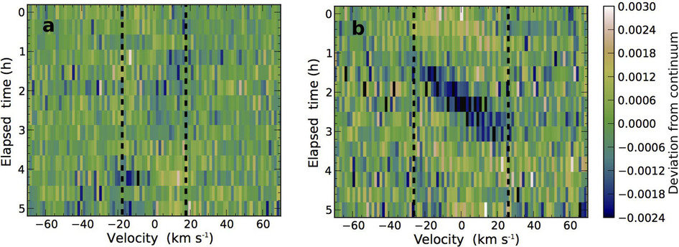
Doppler Imaging – Luhman 16 A & B
Deviation from mean
line profile vs. time

Slide 9
CCloud map of Lunman 16 B
Luhman 16 B (Crossfield et al. 2014)

Slide 10
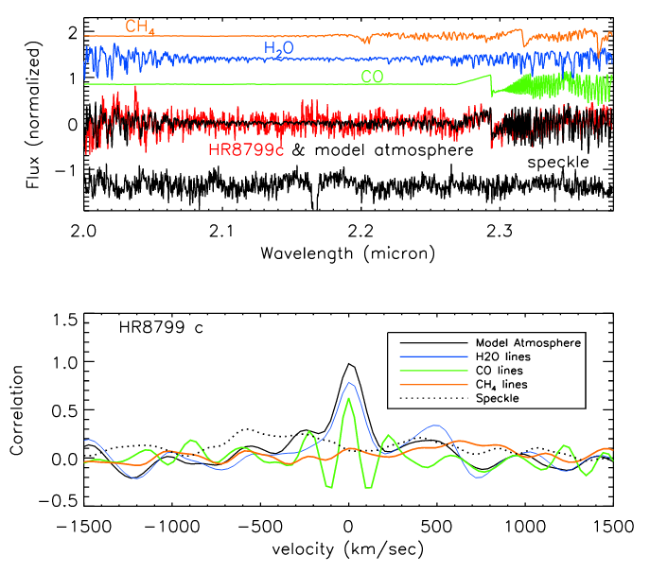
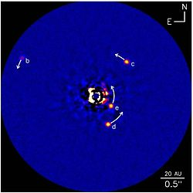
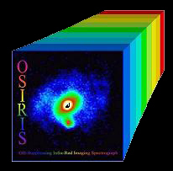
Detection of H₂O and CO on HR 8799 c
Keck OSIRIS
Konopacky et al. 2013
Notes:
Template matching
Stellar photon noise is dominating, so AO helps! R=4000 works.

Slide 11
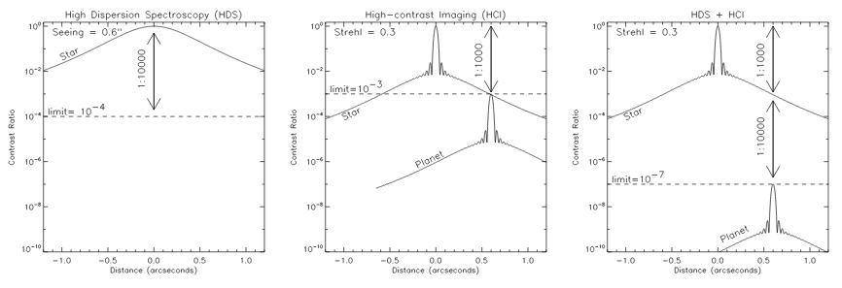
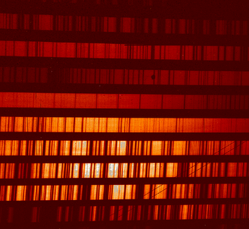
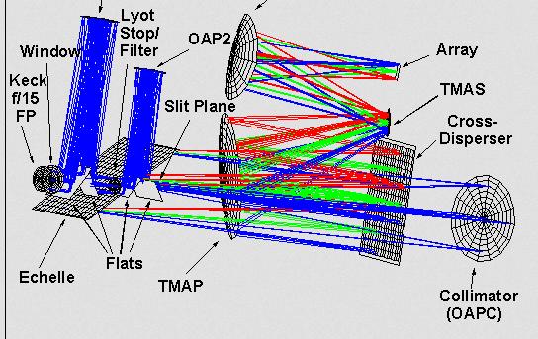
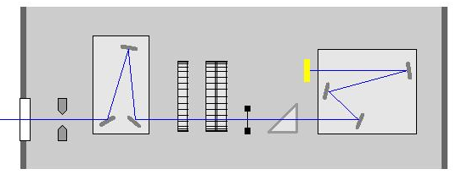
High Dispersion Coronagraphy
Snellen et al. 2015
Keck NIRSPEC
Keck NIRC2 Vortex

Slide 12
Keck Planet Imager and Characterizer PI: D. Mawet (Caltech)
Upgrade to Keck II AO and instrument suite:
L-band vortex coronagraph in NIRC2 - deployed
IR PyWFS – funded (NSF)
SMF link to upgraded NIRSPEC (FIU) - funded (HSF & NSF)
High contrast FIU – seeking funding
MODIUS: New fiber-fed, Multi-Object Diffraction limited IR Ultra-high resolution (R~150k-200k) Spectrograph – design study encouraged by KSSC
Pathfinder to ELT planet imager exploring new high contrast imaging/spectroscopy instrument paradigms:
Decouple search and discovery from characterization: specialized module/strategy for each task
New hybrid coronagraph designs: e.g. apodized vortex
Wavefront control: e.g. speckle nulling on SMF

Slide 13
HDC Instruments
CRIRES
SPHERE + ESPRESSO
SCExAO + IRD
MagAO-X + RHEA
Keck Planet Imager and Characterizer (KPIC)
Notes:
Jayne Birkby has given an excellent introduction to the high contrast imaging high resolution spectroscopy technique, so I won’t offer redundant introduction. Aware of the potential of this technique, many teams around world are exploring the technique at large telescopes. Here I list a few of them but the list may not be exhaustive. Many people working on these projects are sitting among audience.

Slide 14
Science cases for HDC
Planet detection and confirmation at moderate contrast from ground
Detecting molecular species in planet atmospheres
Measuring planet rotation
Measuring cloud map for brown dwarfs and exoplanets
Notes:
After Jayne’s talk, we all realize the power of the HCI+HRS technique. I list 4 science cases enabled by the technique. For example:
1, it helps us to detect a planet at a star light suppression level that is a few orders of magnitude worse than the planet/star contrast. But we don’t know the limit, how much can we push to?
2, Is it limited by photon-noise, what if the template we use doesn’t match with observation? What is the degree of degradation.
3, What is the minimum spectral resolution and SNR required to measure planet spin.
4, Marshall Johnson gave a excellent talk on this topic. We would like to know the SNR limit and its impact on retrieved map quality and fidelity.
All these questions are unknown unless we develop a framework to simulate the performance of a HCI+HRS instrument and study these problem in a systematic way.

Slide 15
HDC Simulator
Notes:
This is why I develop such a simulator for HCI+HRS instrument. It is very easy to use, all you need to do is to set up an initiation file for all the required input of the pipeline.
It takes planet and star spectra
Simulating atmosphere effect, the impact of residual star light, detector noise, etc.
It also simulates the data reduction process such as sky emission removal, telluric removal, continuum removal, etc. And results in reduced spectrum.
With the reduced spectrum, we can do template matching, or Doppler imaging, which results in a data product, such as the cross correlation function and the retrieved surface map.

Slide 16
Template Matching
Mawet et al. 2016

Slide 17
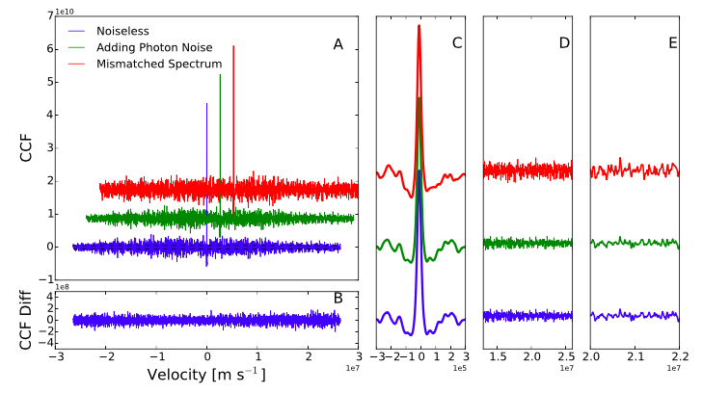
CCF SNR
SNR = Peak / Fluctuation
Notes:
We use CCF SNR to quantify detection significance, which is the ratio between the CCF peak and rmslevel.
What is shown here on the top panel is CCF in different cases.
Blue and green are identical, why adding noise doesn’t change the shape of CCF? Photon noise level is supposed to be much smaller than that (bottom panel). Because of intrinsic fluctuation. If using fluctuation level, we will have a smaller CCF SNR than photon-noise limited CCF SNR.
If the spectra are mismatched, then we can a even worse CCF SNR.

Slide 18
Limiting Factors of CCF SNR for HR 8799e Observation
Notes:
10^-4 in L, 10^-6 in J
HRS gain
Prospect for Retrieval
you should mention that star light suppression often depends on throughput

Slide 19
Detecting Molecular Species
Notes:
Multi-band observation

Slide 20
Space-based vs. Ground-based
Non-cryogenic vs. cryogenic
Atmosphere-free vs. atmosphere
Absorption bands vs. lines
Starlight suppression
Inner working angle
Sun-Earth vs. M dwarf planet

Slide 21
Redefining CCF SNR for Space-based Observation
CCF does not work well in low spectral resolution (few data points)

Slide 22
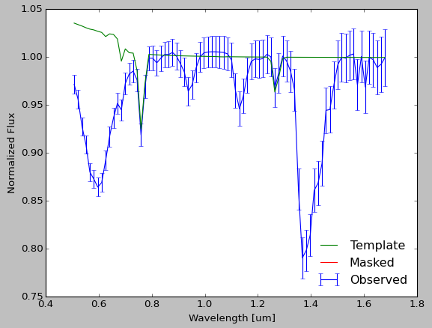
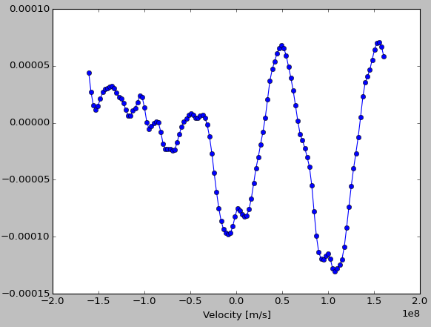
CCF at Low Resolutions
Searching for O₂

Slide 23
Redefining CCF SNR for Space-based Observation
CCF does not work well in low spectral resolution (few data points)
Masked cross correlation function

Slide 24
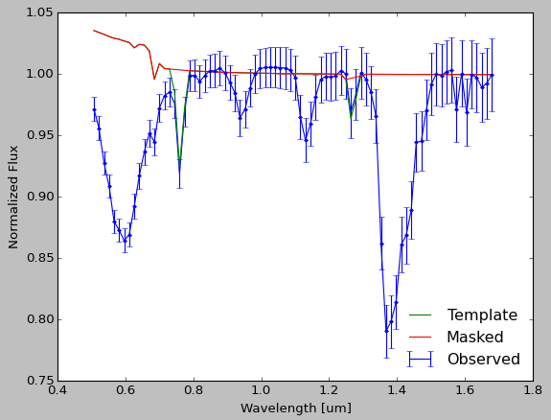
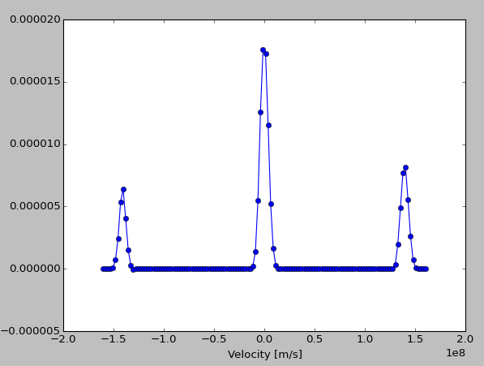
Masked Cross Correlation
Searching for O₂

Slide 25
Redefining CCF SNR for Space-based Observation
CCF does not work well in low spectral resolution (few data points and speckle chromatic noise)
Masked cross correlation function
Photon-noise changes a factor of a few at two ends of spectrum (0.5 – 1.7 um)

Slide 26
Redefining CCF SNR for Space-based Observation
CCF does not work well in low spectral resolution (few data points and speckle chromatic noise)
Masked cross correlation function
Photon-noise changes a factor of a few at two ends of spectrum (0.5 – 1.7 um)
Speckle chromatic noise

Slide 27
Speckle Chromatic Noise
Simulation by Garreth Ruane

Slide 28
New Definition of CCF SNR
Red arrow – noiseless CCF peak
Blue error bar – median and 1-sigma range of simulated CCF peak distribution

Slide 29
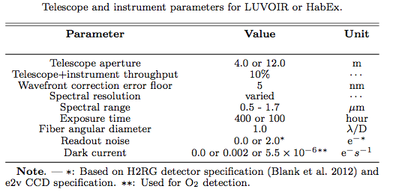
LUVOIR

Slide 30
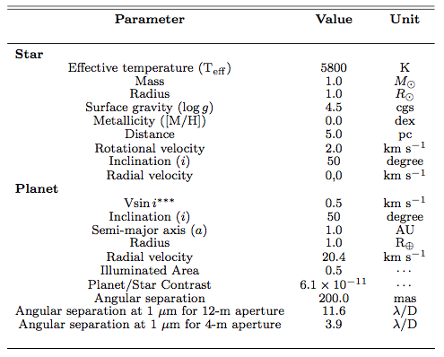
LUVOIR

Slide 31
LUVOIR – photon-noise only
Notes:
General trend
CO2 and O2 rely on higher resolution
Consistent with Exo-C report
Relaxed by > 10^2 in star suppression level. Even at low R, relaxed by >10.

Slide 32
Absorption bands vs. lines

Slide 33
Absorption bands vs. lines

Slide 34
Adding Detector Noise

Slide 35
Adding Spectral Chromatic Noise
Notes:
Removing low-frequency by applying a high-pass filter. The low-f signal includes both speckle chromatic noise and absorption bands
O2 can only be detected at 3-sigma level, CO2 no longer detectable

Slide 36
Source of Noise

Slide 37
HabEx
Notes:
Key difference between HabEx and LUVOIR: exoplanet-focused mission and can afford longer exposure time, optimized for better contrast

Slide 38
HabEx– photon-noise only
Notes:
A receding contours plot compared to LUVOIR. CO2 no longer detectable.

Slide 39
Adding Spectral Chromatic Noise
Notes:
CO2 no longer detectable

Slide 40
Summary
We develop a framework to simulate performance of an HDC instrument.
KPIC, a Keck HDC instrument, will be capable of characterizing directly-imaged giant exoplanets at high spectral resolution, e.g., HR 8799 bcde.
Limiting factors for template matching technique are:
Photon noise
CCF intrinsic structure
Mismatched template
HDC may be the only viable method to search and characterize Proxima Cen b and other planets around M dwarfs from ground using 30-m class telescope in near infrared.
HDC relaxes star suppression level by 1-2 orders of magnitude for space-based mission to detect an Earth-like planet around a solar-type star
Detector noise and speckle chromatic noise are two major factors that limit the performance of a space-based HDC instrument.

Slide 41
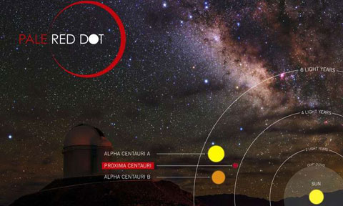
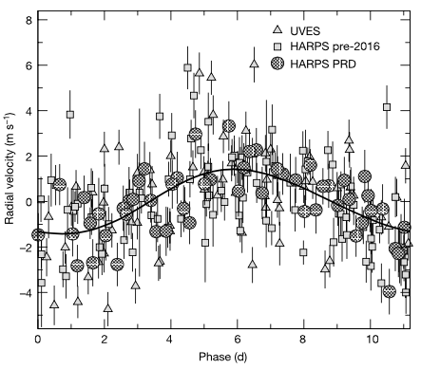
M Dwarf Planet “Frenzy”
Anglada-Escudé et al. 2016
Proxima Cen b
Notes:
Keck workshop coincides with the discovery of Prox Cen b. 40 mas, 1e-7 contrast. Tough from ground for HCI only instrument, but potentially doable with HCI+HRS technique. What is the minimum requirement for star suppression level?

Slide 42
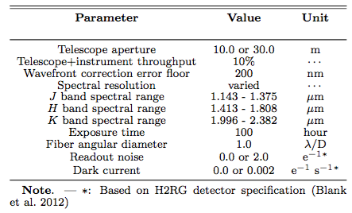
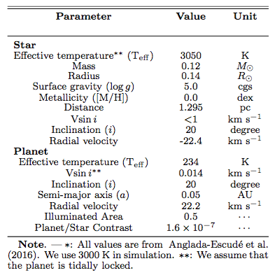
NIR HDC Observation of Prox Cen b with 30-m Class Telescopes
Notes:
NIR observation only, optical wavelength observation is discussed in Lovis et al. (2016) and see MagAO+RHEA
The contrast we assumed is 1.6x10^-7

Slide 43
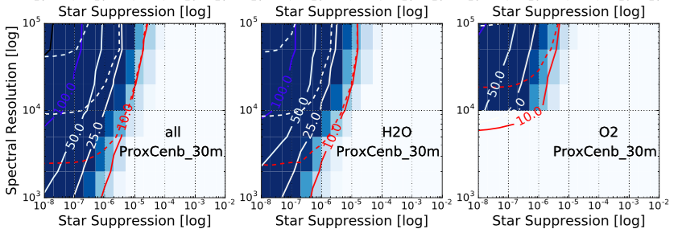
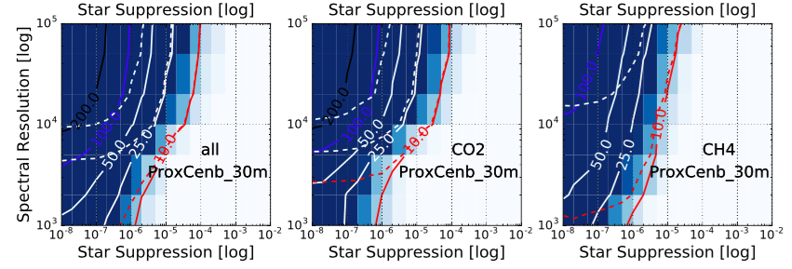
Notes:
Explain axis
The general trend
The interesting parameter space is at low level of star light suppression because reaching 10^-6 level is very challenge from ground. The minimum requirement is 10^-4 for planet detection and CO2 detection.
The difference between solid and dashed lines

Slide 44
Sources of Noise
Notes:
Since the technique is operated at high spectral resolution, limited signal is dispersed into many pixels, one question I always get is what the impact of detector noise is. This plot shows a comparison of different noise sources. Detector noises such as dark and readout noise are marked by black and green lines. This is for a M dwarf planet at 5 pc, which is a more general case than Prox Cen b. There are dozens of M dwarfs within 5 pc. Detector noise is not really a concern for 30m telescopes at 10^-7 or worse star suppression level

