Slide 1
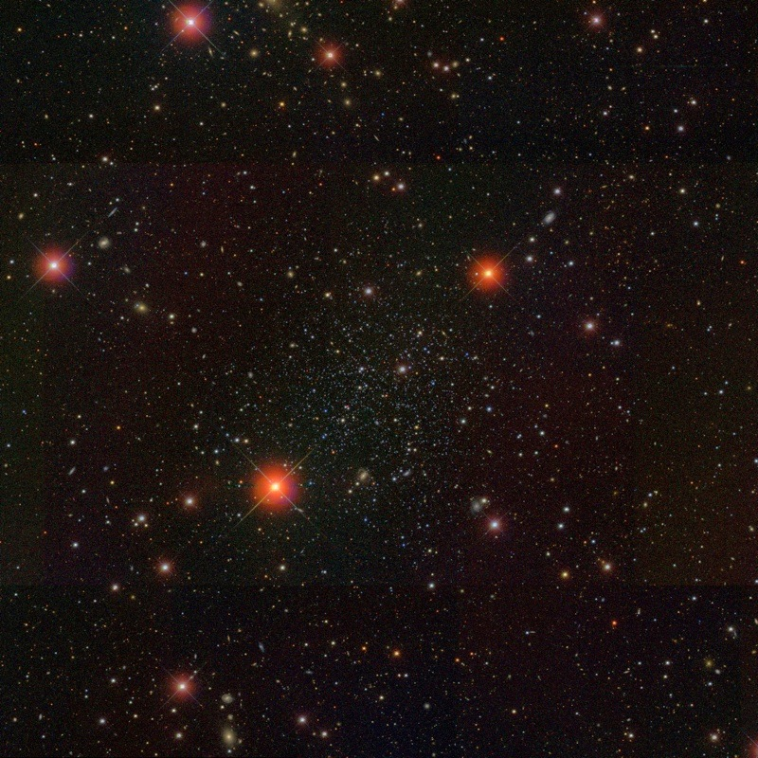
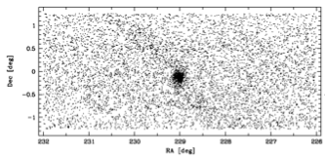
Proper Motions in the Local Group: Next Generation Astrometry.
Nitya Kallivayalil
Kalli - violin
UVa
ATLAST Symposium, July 2015

Slide 2
Heyday for Near-Field Cosmology
SDSS DR8:
Bonaca, Geha & NK (2012)

Slide 3
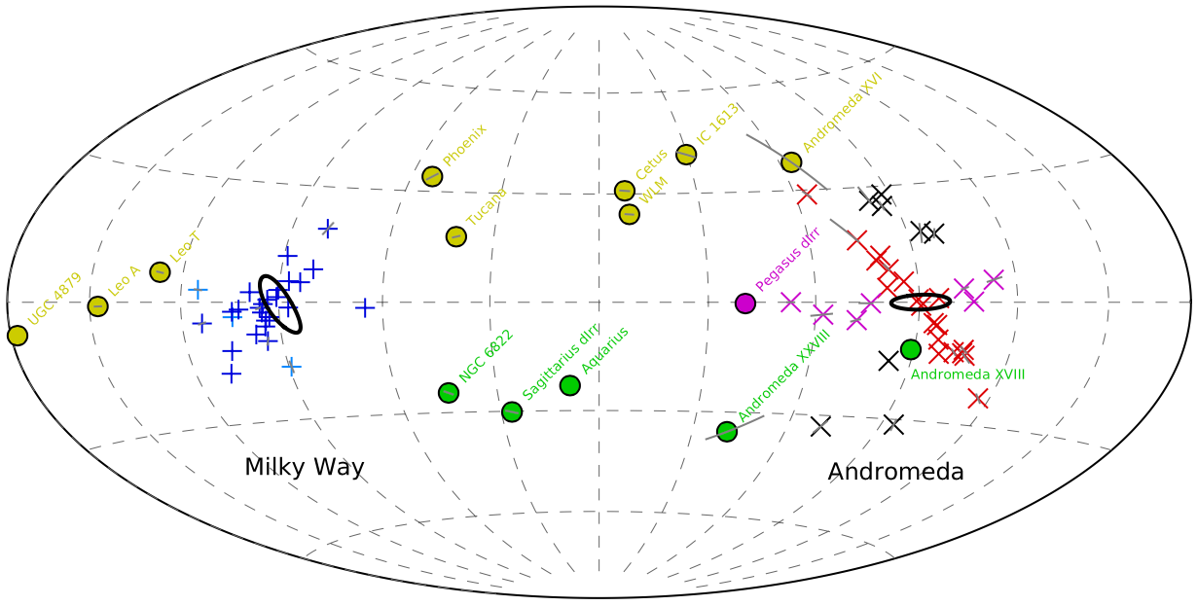
Heyday for Near-Field Cosmology
Proper Motions are a major missing component in this effort
Missing Satellites Problem (e.g., Moore et al. 1999)
Low densities of dwarf galaxies: core vs. cusp, and Too Big to Fail (e.g., Walker & Penarrubia 2011; Boylan-Kolchin et al. 2011)
Shape of dark matter halo (e.g., Law & Majewski 2010)
Planes of satellites (e.g., Pawlowski et al. 2013)

Slide 4
HST has been an extremely successful astrometry machine!
determining the orbit of the LMC & SMC (Kallivayalil et al. 2013)
detecting internal rotation in the LMC (van der Marel & Kallivayalil 2014)
measuring the tangential motion of M31 (Sohn et al. 2012, van der Marel et al. 2012a,b)
measuring the space motion of Leo I and dynamically measuring the mass of the Milky-Way halo (Sohn et al. 2013, Boylan-Kolchin et al. 2013)
constraining the presence of intermediate-mass black holes in globular clusters (Anderson & van der Marel 2010)
measuring the proper motion of tidal streams (Sohn et al. 2015)
Anderson & King 2006; Anderson 2007; van der Marel et al. 2007, Bellini et al. 2011

Slide 5
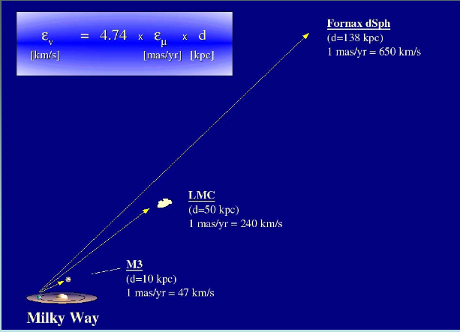
Required Proper Motion Uncertainty
dwarf galaxy
dwarf galaxy
Star cluster
image credit: Dana Dinescu

Slide 6
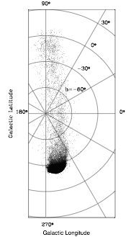
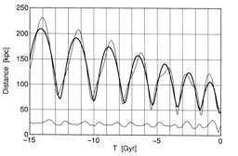
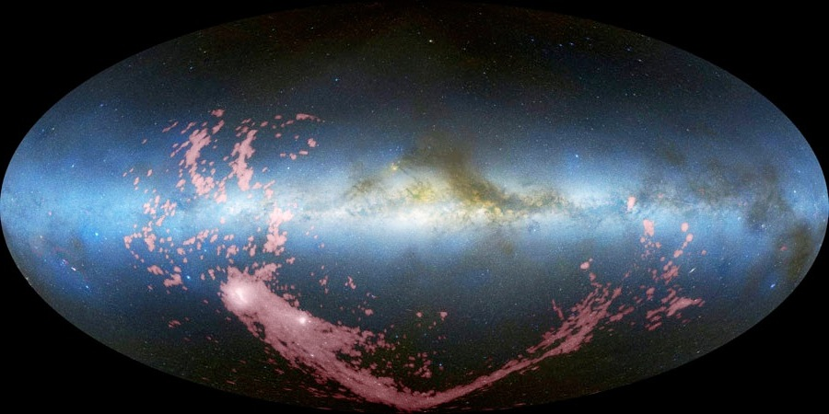
Tidal Stripping: Gardiner & Noguchi (1996)
Ram Pressure Stripping: Mastropietro+ (2010)
SMC
LMC
image credit: David Nidever
Putman et al. 2003

Slide 7
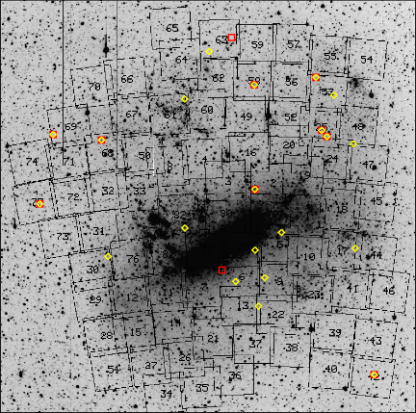
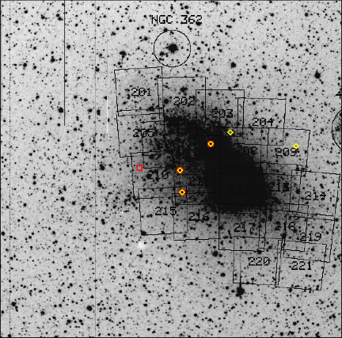
Reference Frame
LMC
SMC
Geha et al. 2003

Slide 8
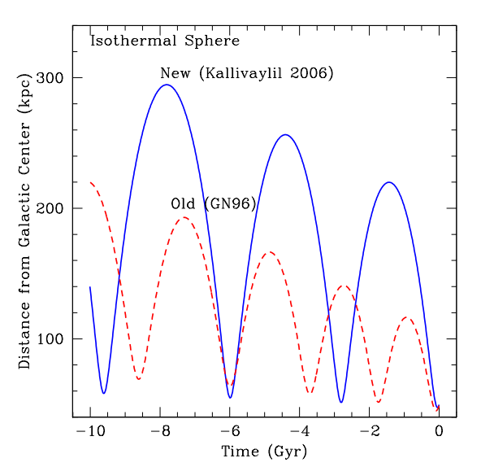
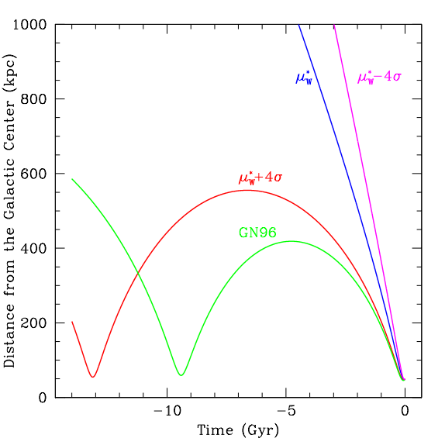
Orbital properties in a cosmological context
NFW
450 km/s
310 km/s
Rvir
Note that models are static in time
NK + (2009); Besla, NK+ (2007)

Slide 9
LMC Rotation in 3D

Slide 10
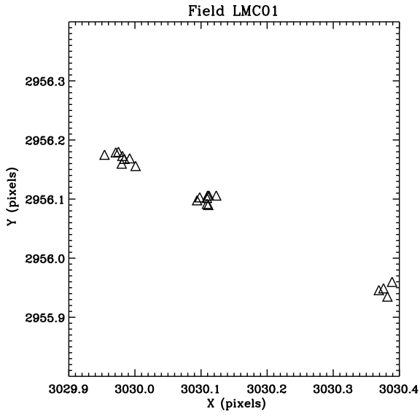
ACS1
ACS2
WFC3
3 Epcoh Analysis (ACS+WFC3):
NK+ (2013)

Slide 11
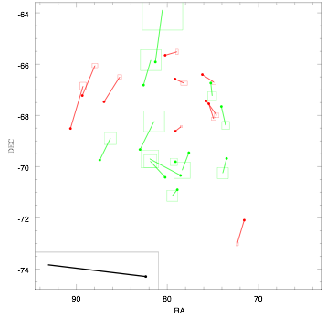
van der Marel & NK (2014)

Slide 12
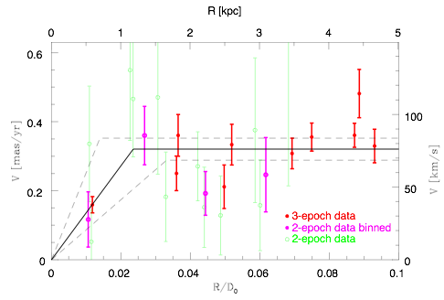
LMC Proper Motion Rotation Curve
van der Marel & NK (2014)

Slide 13
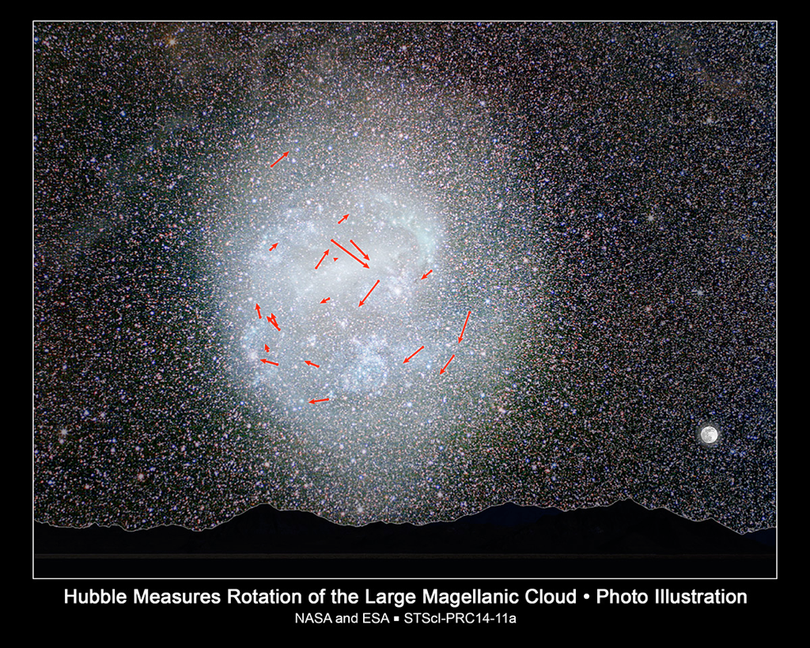

Slide 15
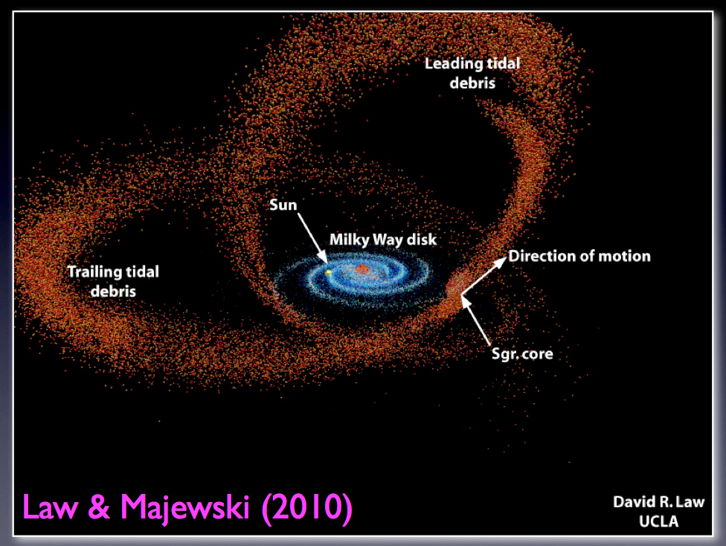
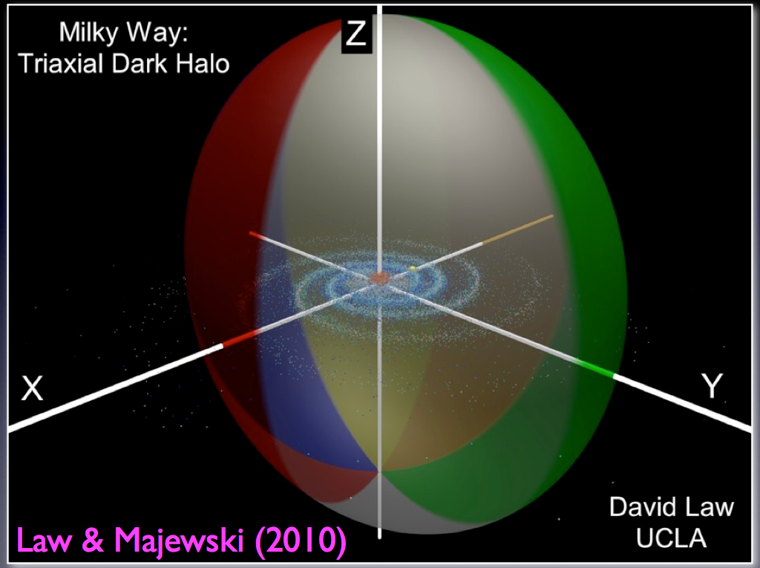
Sagittarius Stream
Near-oblate, q = 0.72, short axis in disk plane!
Unexpected from galaxy formation models/sims (Debattista et al. 2012); see also Vera-Ciro & Helmi (2013)

Slide 16
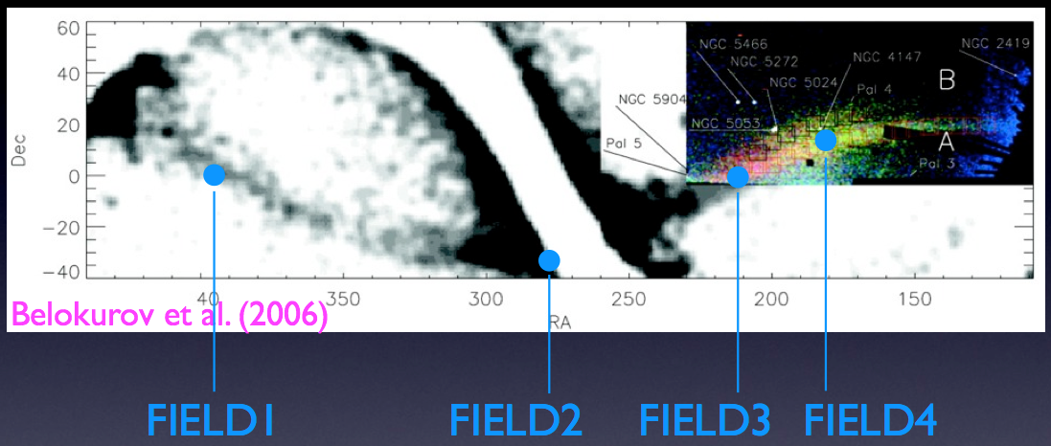
HST Proper Motions
HST w/ 6-9 year time baselines
Two additional components of motion can strongly constrain models

Slide 17
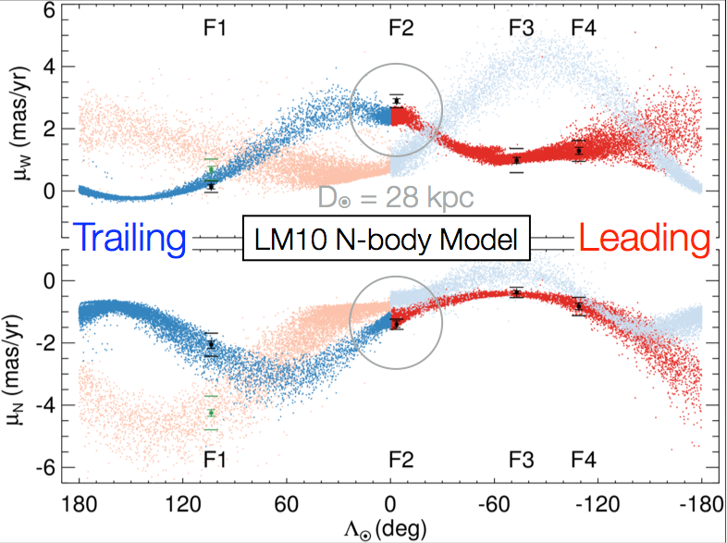
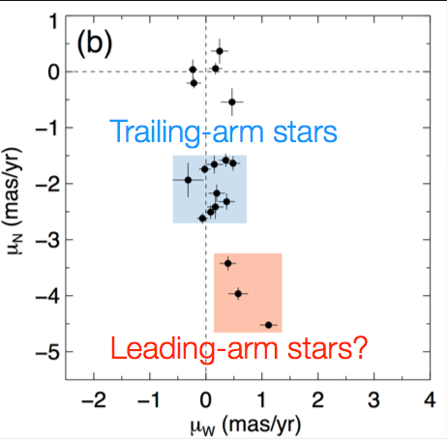
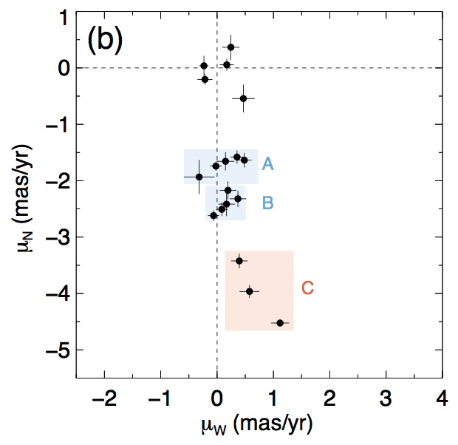
PM to N-body Comparison
Remarkably good fit ….
Sohn..,NK et al. 2015
Law & Majewski 2010
Trailing
data
N-body
Leading

Slide 18
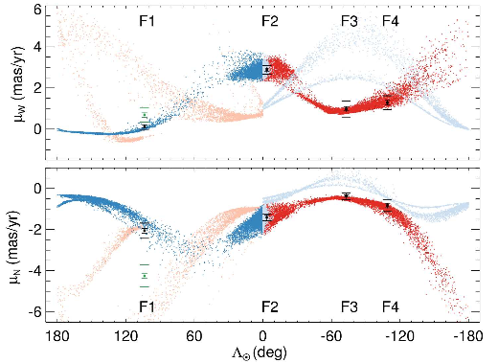
PM to N-body Comparison
Sohn..,NK et al. 2015
Penarrubia et al. 2010
Trailing
data
N-body
Leading

Slide 19
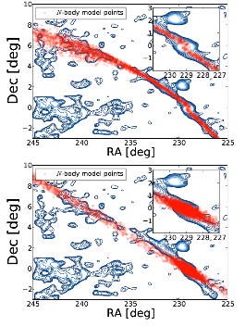
Even further down the luminosity function: Pal 5
Theory (Pearson+ 2014, Kupper et al. 2015)
Best fit halo model is spherical, not the triaxial model of Law & Majewski.
Tails hint at a pattern of over- and under-densities that have been attributed to sub-halo encounters (e.g. Siegel-Gaskins & Valluri 2008; Carlberg 2013).

Slide 20
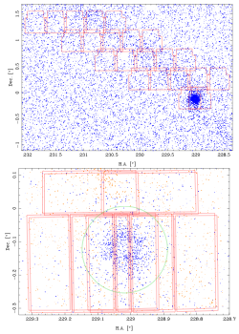
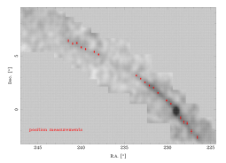
First CCD-based PM:
SDSS-LBT/LBC Data
15 year baseline
Fritz & NK submitted

Slide 21
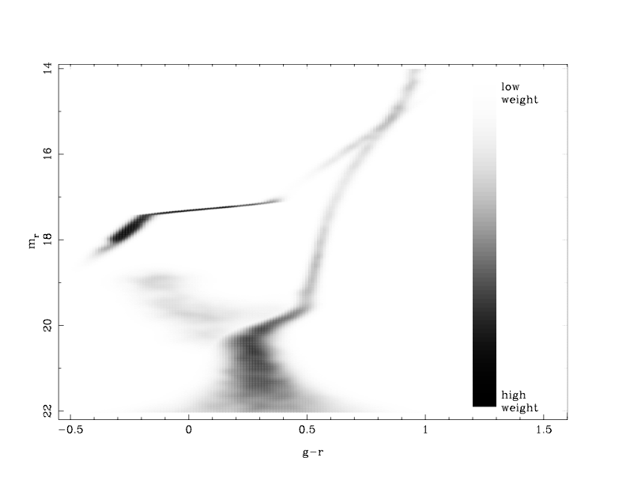
Ground-based PMs: stars must be selected by means of a matched filter
Fritz & NK in prep

Slide 22
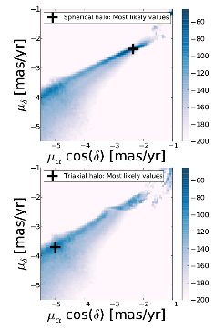
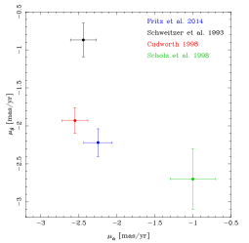
& NK
2015
*
Fritz & NK submitted
Pearson et al. 2014

Slide 23
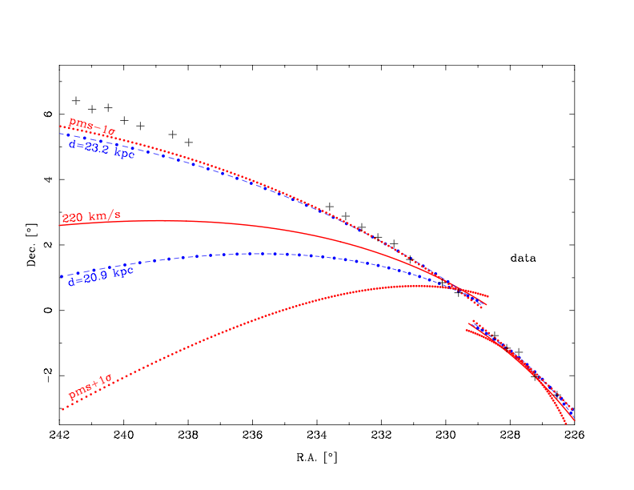
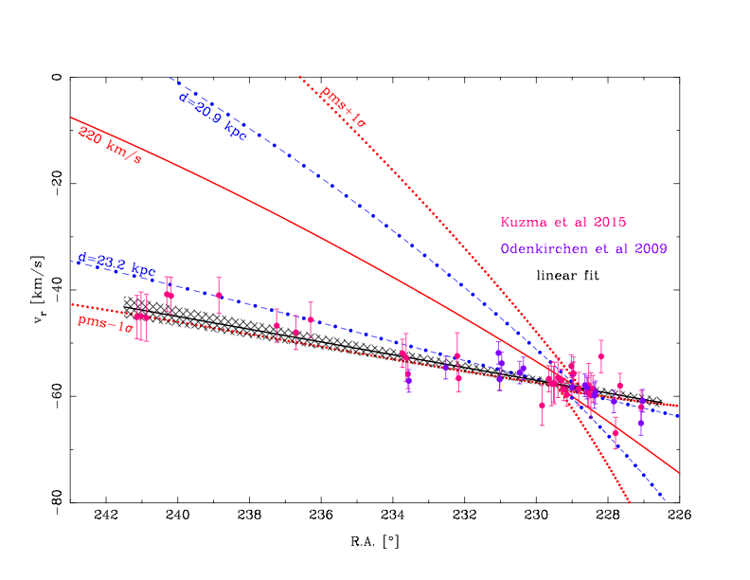
We use galpy (Bovy 2014). Spherical halo fits, but with preference for high distance.

Slide 24
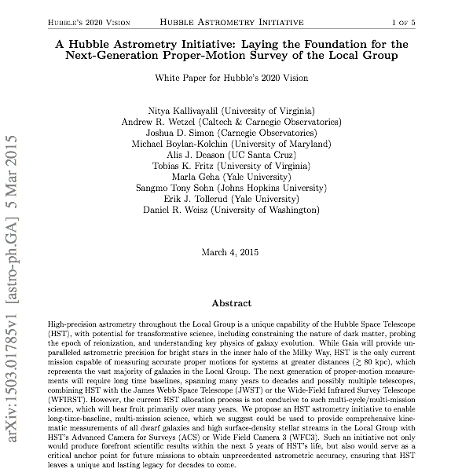

Slide 25
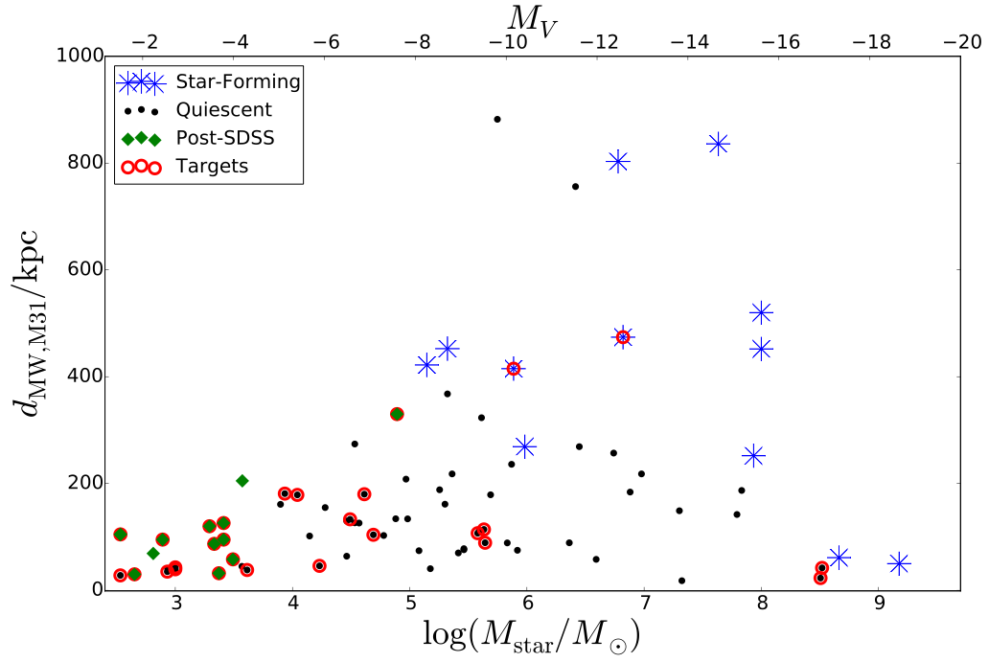
Five science drivers that motivate a comprehensive proper-motion survey of the Local Group:
image credit: E. Tollerud
Direct dynamical measurements of the mass of the Milky Way and M31.
(2) Understanding the physics of environment on satellite galaxies.
(3) Physical associations of dwarf galaxies and stellar streams, i.e. “planes of galaxies”.

Slide 26
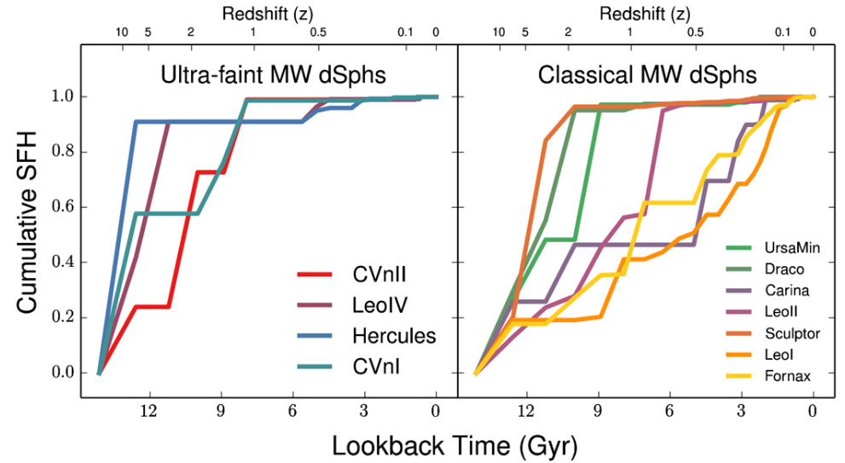
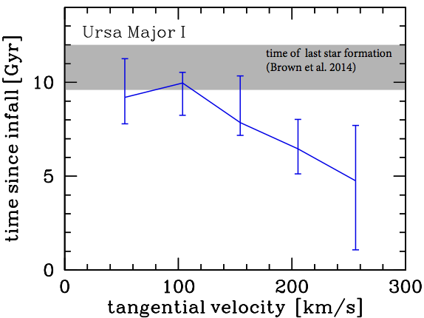
Brown et al. 2014, Weisz et al. 2014
(4) Dwarf galaxies as probes of cosmic reionization.
Wetzel et al. in prep.

Slide 27
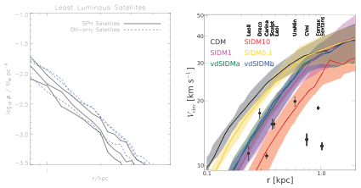
From Alyson Brooks: Zolotov et al. 2012; Zavala et al. 2013
(5) Internal kinematics of dwarf galaxies. The inner mass profile of dwarfs perhaps the most important test of the nature of dark matter, as well as the strength of galactic feedback.

Slide 28
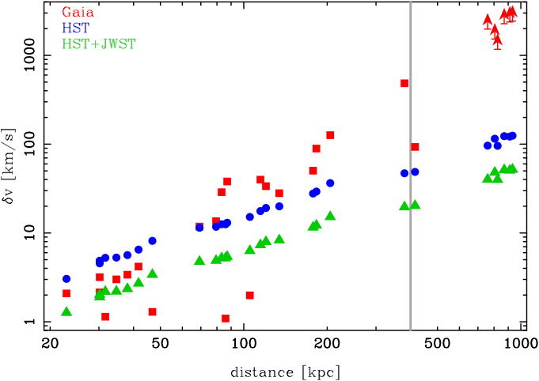
What will Gaia do?
T. Fritz

Slide 29
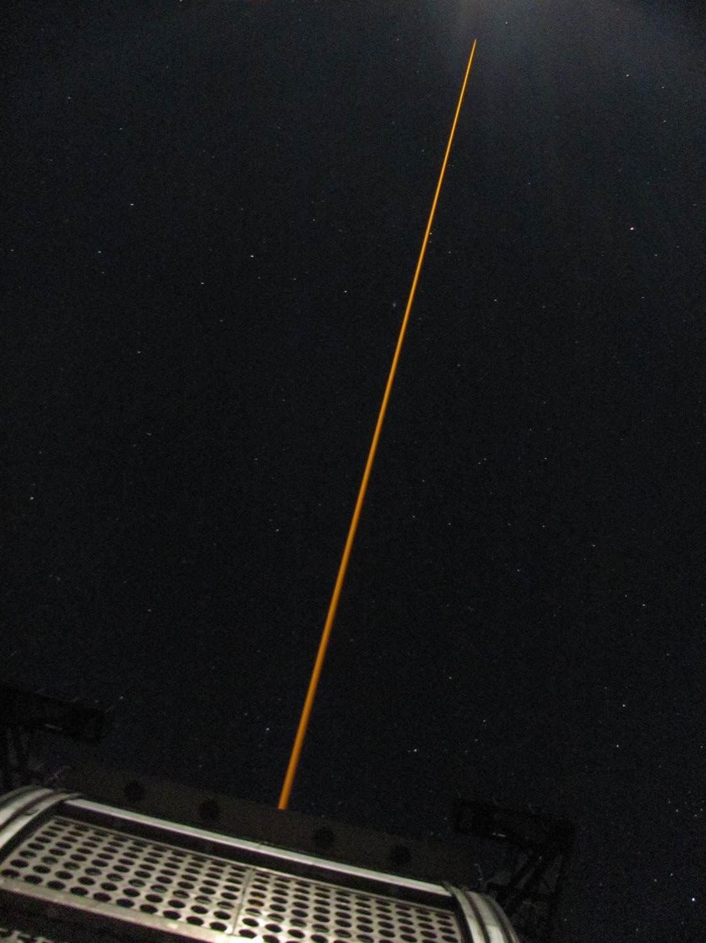
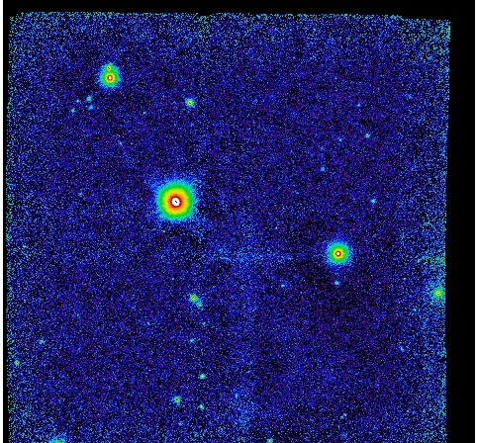
Probing the dark halo of the Milky Way with GeMS/GSAOI
102”
Streams
T. Fritz, N. Kallivayalil, S. Majewski, G. Damke, R. Beaton, J. Bovy, M. Boylan-Kolchin, R. Carrasco, R. van der Marel, T. Sohn, R. Davies, D. Angell, P. Zivick, B. Neichel

Slide 30
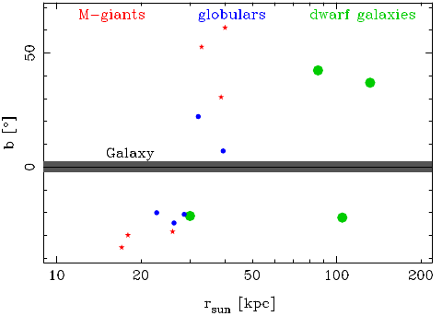
15 targets
6 M-giants in the Sagittarius stream
5 globular clusters:
3 possible members of Sagittarius system: Arp 2, Terzan 7, Terzan 8
2 others in outer halo: NGC5824, Pyxis
4 dwarf galaxies:
Sagittarius, Hercules, Sextant, Carina

Slide 31
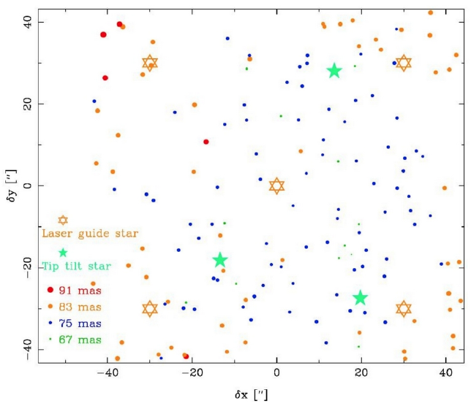
High image quality: FWHM of 79 mas
Pyxis field 1 K'-band

Slide 32
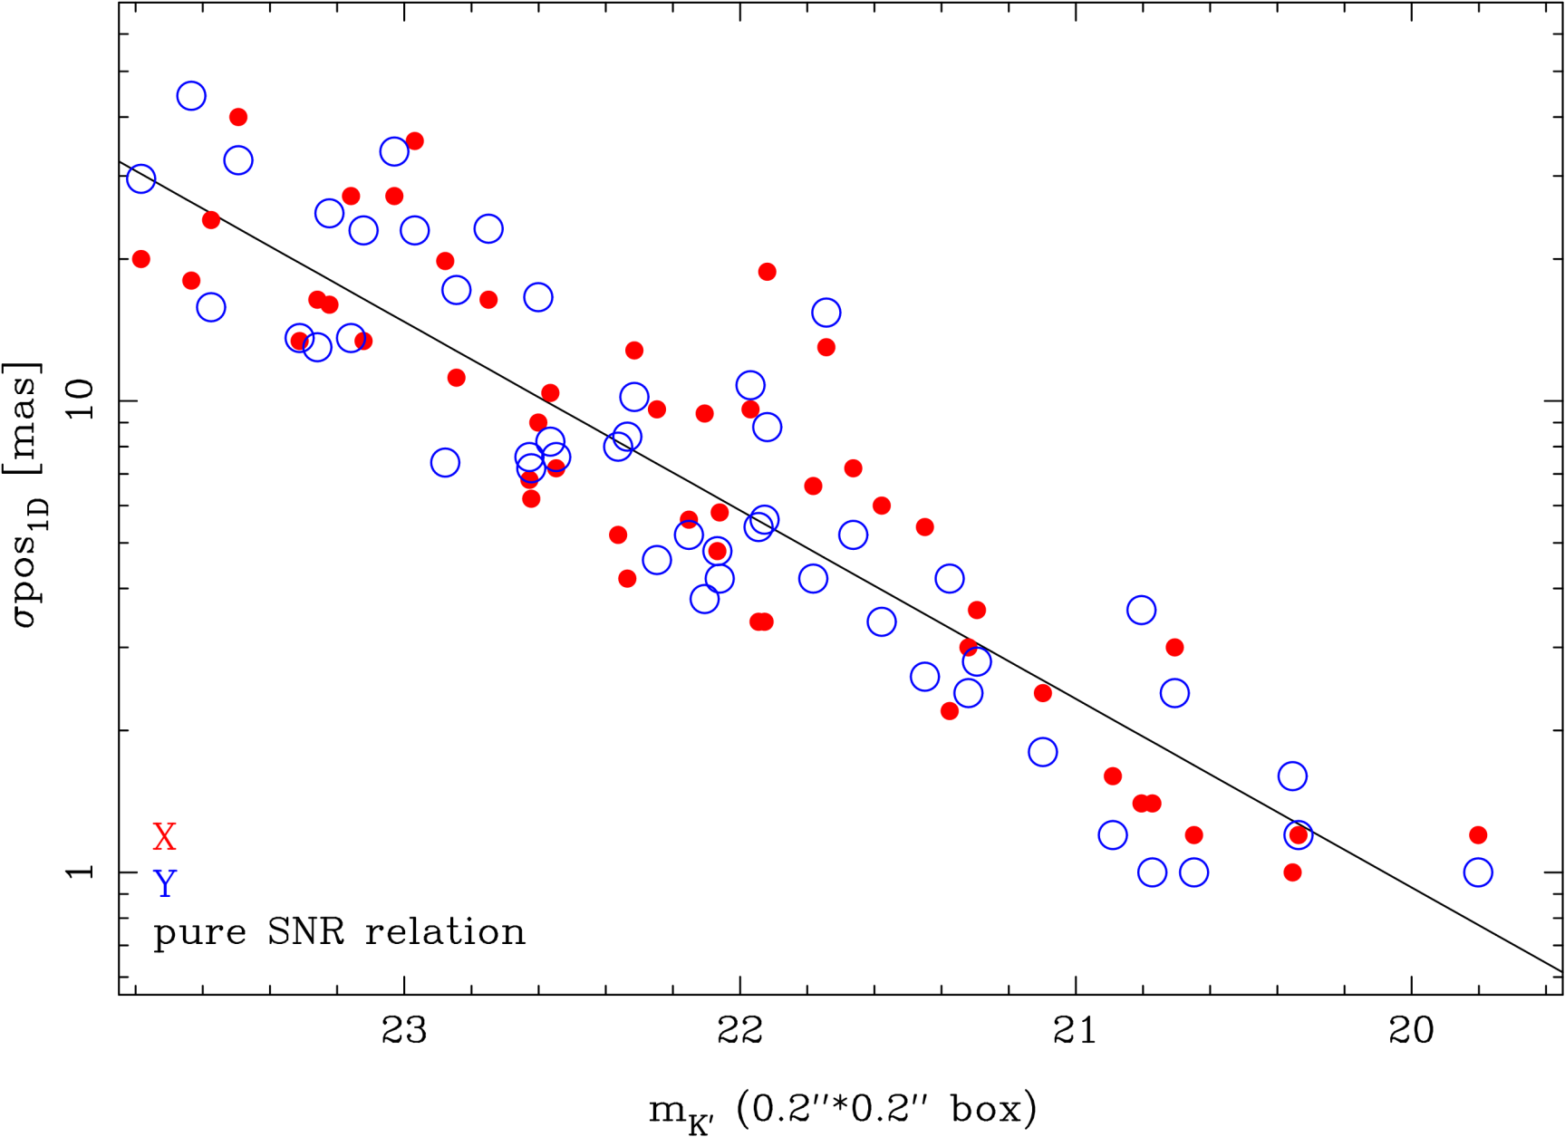
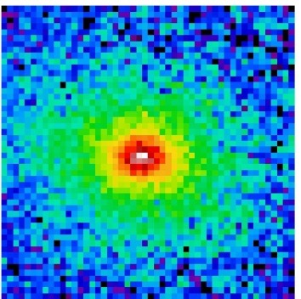
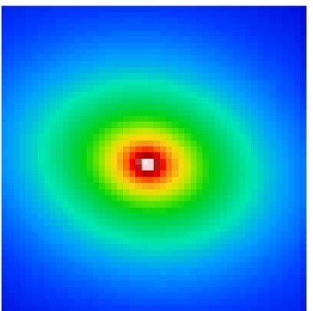
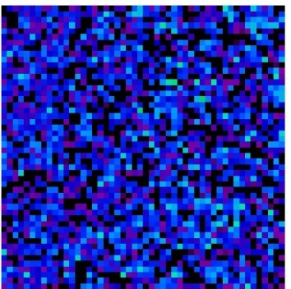
Position uncertainty of galaxies
Image
Model
Residuals
Pyxis
Position fit: single Sersic with Galfit
Results in total registration error of ~0.3 mas.
→ total proper motion error of ~0.15 mas/yr per target (Preliminary)

Slide 33
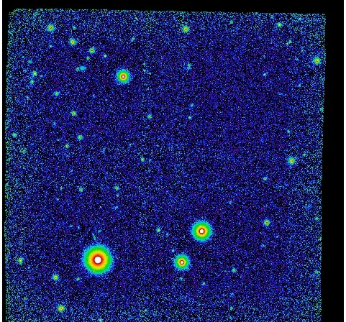
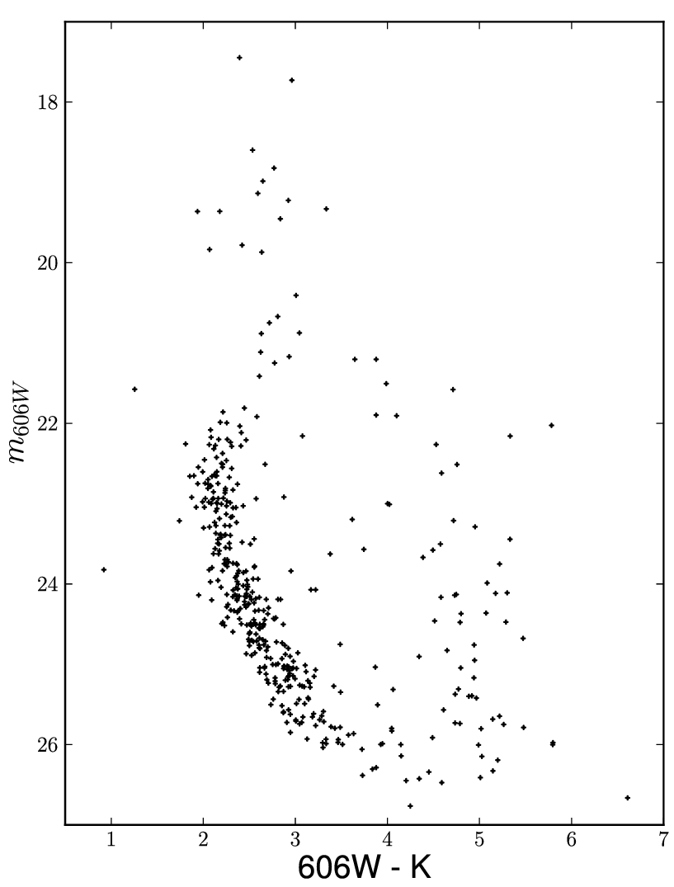
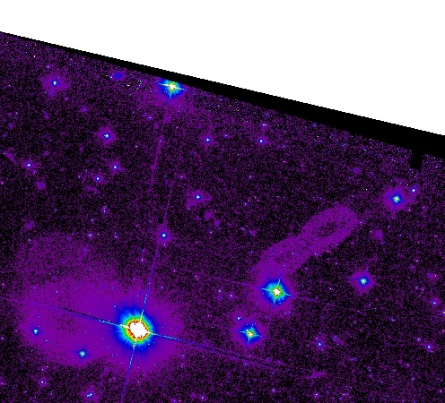
Pyxis Field 1: HST + Gemini
K' GSAOI
2015
F606W ACS
2009
(Preliminary)
F

Slide 34
Conclusions
At HST precision it is possible to separate out substructure via PMs alone. Expensive.
Ground-based efforts can compete if there is wide coverage of stream. Much cheaper. RV’s and chemistries can greatly aid ground-based PM efforts. We have a first result for Pal 5.
Models have come a long way. Realistic treatment of errors as well as stream-orbit offsets (Bovy 2014, Lux et al. 2013, et al. 1999, Eyre & Binney 2011, Varghese et al. 2011)
Many stars with low accuracy vs. few targets with very high accuracy? e.g., SDSS-PanSTARRs or some other large FOV imager.
Beyond Gaia/inner halo: HST - AO provides a powerful way to obtain very high precision motions in the outer halo (for a few stars) in a relatively efficient way.

