Slide 1
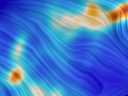
Magnetic Fields and Turbulence in the ISM & Potential OST studies
with thanks to Chat Hull and Erik Rosolowsky who lead the development of the Magnetic Fields and Turbulence Killer App
Laura Fissel
Jansky Fellow, NRAO-CV
OST Face to Face Meeting
June 14th 2017
Notes:
Explain first part of the talk is to show the scientific motivation and techniques for studying magnetic fields and turbulence in the ISM.
In the second part I will focus on putting the planned OST polarimetry capabilities in context with current and future ground based capabilites, and discuss the scientific consequences of the descoping measures.

Slide 2
Outline For This Talk
Why is it important to study magnetic fields and turbulence?
  What have we learned from polarimetry to date.
  Discussion will mostly focus on magnetic field studies.
Polarimetry with the OST – Far IR Polarimeter
  OST vs other Polarimeters
  How do the descope options affect our science?

Slide 3
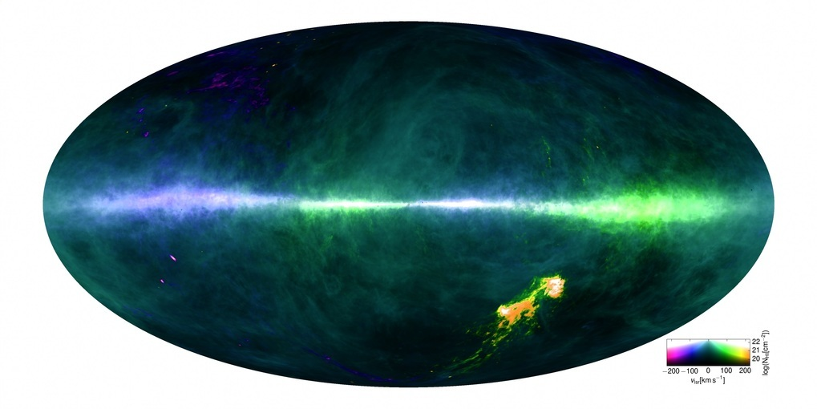
The Goal: Understanding Gas Dynamics and Energy Transport on All Scales in the ISM
HI4PI 21 cm HI
Parkes/Effelsberg
Turbulence:
M_{s} = v/c_{s}

Slide 4
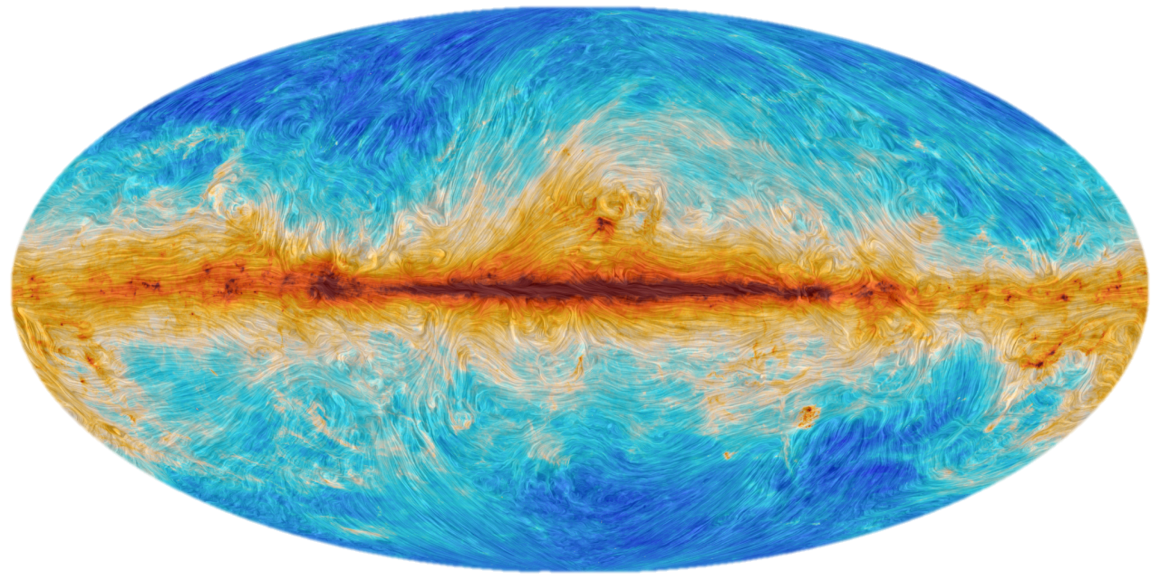
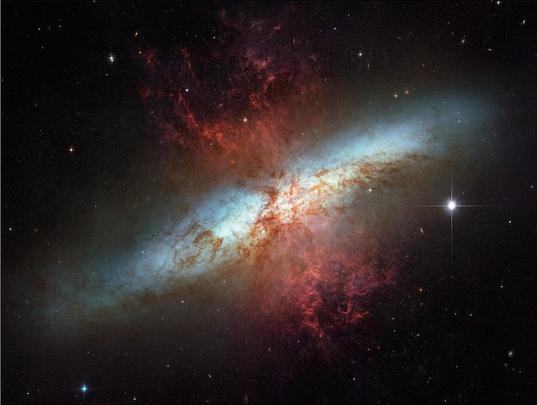
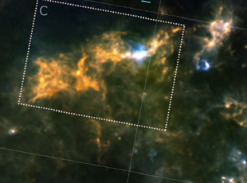
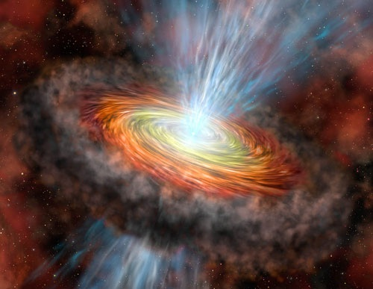
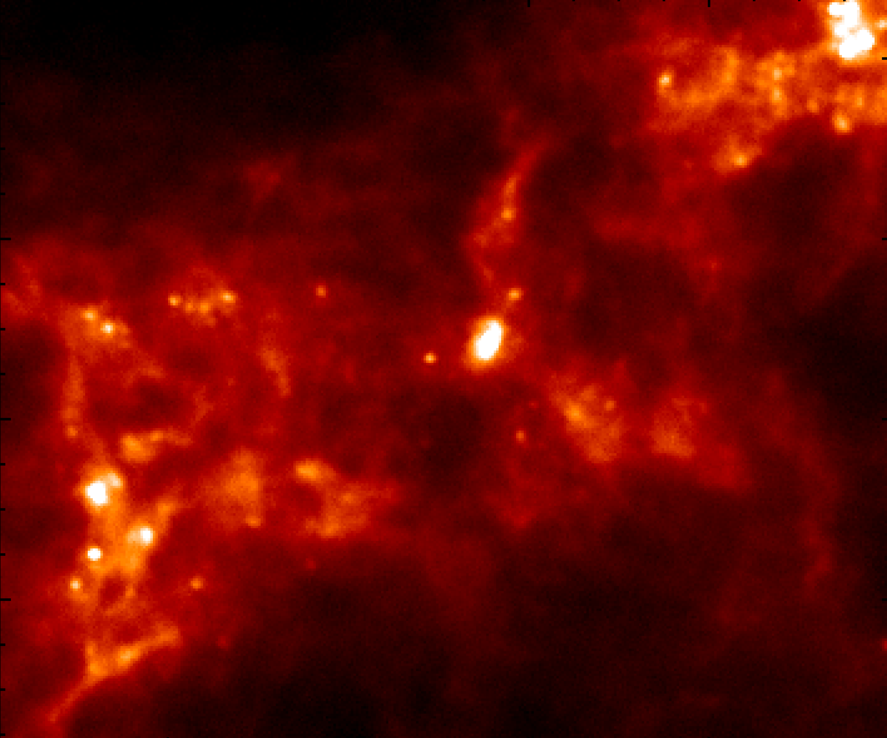
The Goal: Understanding Gas Dynamics and Energy Transport on All Scales in the ISM
Planck Int XIX 2015
< 0.05 pc
~0.1 to 10 pc
Molecular cloud
formation
~50 pc
Galaxy Feedback
~kpc
dense filaments
cores and disks
Turbulence:
Magnetic Fields:
M_{s} = v/c_{s}
M_{A} = v√(4πρ)/B
B-Fields make turbulence anisotropic Turbulence can amply B-Field strength
Planck Int XXXV 2016

Slide 5
Polarized Dust Emission
E-vector
Andersson+ 2015 ARAA
Alignment of grains perpendicular to the magnetic field
  most likely through radiative torques
    Requires an anisotropic source of radiation with λ < a
Can trace the orientation of the B_{POS}
  (weighted by grain alignment and dust emissivity)

Slide 6
Magnetic Fields as traced by Polarization
BLASTPol 500 micron inferred B-field
BLASTpol
(PI: Mark Devlin)
Median Polarization = 2.6%

Slide 7
Planck: Histograms of relative orientation
Planck Int. XXXV (2016): 353 GHz, 10 MCs within 400 pc, 10’ resolution (0.4-1.2 pc)
⟂
|| to B
⟂
⟂
|| to B
⟂

Slide 8
Shape Parameter vs Column Density with Planck
Planck Int. XXXV (2016): 353 GHz, 10 MCs within 400 pc, 10’ resolution (0.4-1.2 pc)
perp
parallel
perp
E
C
E
magnetic field can
support cloud against gravity
diffuse clouds
dense clouds
magnetic field is too weak to support cloud against gravity
Crutcher 2012
Grey (data), Colours RAMSES MHD Simulations (Soler et al. 2013):
weak field (B= 0.35 μG)
intermediate field (trans-Alfvenic, B= 3.5 μG)
strong field (sub-Alfvenic, B= 11 μG)

Slide 9
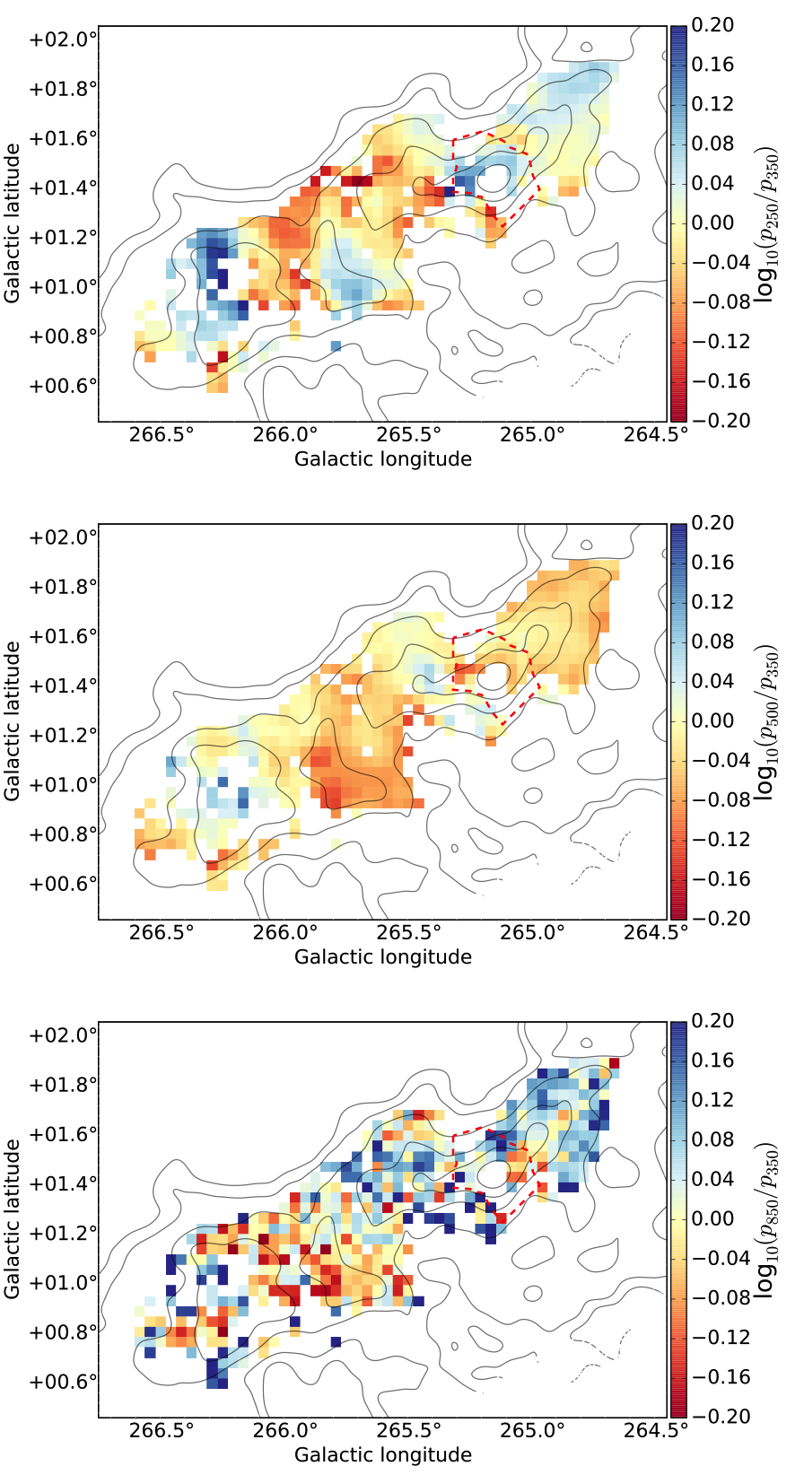
Studying the Properties of Polarized Dust
p₂₅₀/p₃₅₀
OST FIP
p₅₀₀/p₃₅₀
BLASTPol/Planck
p₈₅₀/p₃₅₀
Gandilo et al. 2015

Slide 10
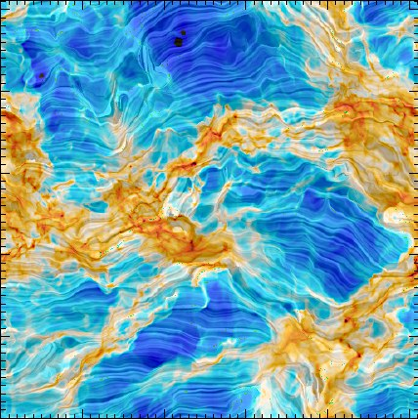
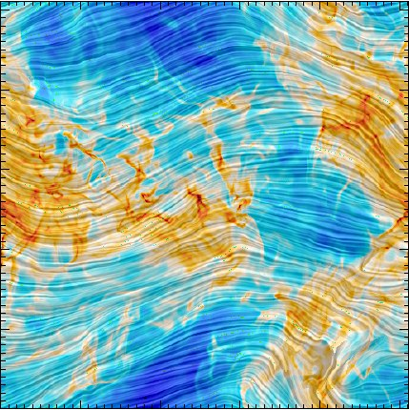
Magnetic fields in Molecular Cloud Simulations
Weak magnetic field
(|B₀|=0.35μG)
Strong magnetic field
(|B₀|=10.97μm)
disordered B-field
ordered B-field
Can be used to estimate |B_{POS}| (Davis 1951, Chandrasekhar & Fermi 1953, Ostriker, Stone & Gammie 2001)
Characterize the MHD turbuence power spectrum (e.g. Houde et al. 2011)
RAMSES MHD Simulations from Soler et al. 2013

Slide 11
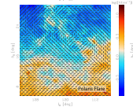
OST Polarimetry Case Study: Polaris Flare
High Latitude Cirrus Cloud, distance ~150 pc
Planck Int XIX 2015
SPIRE 250 (16’’ FWHM)
Miville-Deschênes et al. 2010
Planck resolution: 10’ (0.4pc)
>8000, FIP beams could fit into 1 Planck beam !
In this cloud at 240 microns, FIP would probe scales from 1,000 AU to 20 pc (a factor of 4000 in spatial scale) with up to 4,000,000 independent measurements of B-direction.

Slide 12
OST Polarimetry Case Study: Polaris Flare
High Latitude Cirrus Cloud, distance ~150 pc
SPIRE 250 (16’’ FWHM)
OST-FIP NEFD₂₅₀ = 0.1 MJy/Sr
(low background detectors)
Beam FWHM = 6.6’’
t_{req} = (2xNEFD₂₅₀/σ_{P})² N_{beams}
For a 5-σ detection of 5% polarized dust
t_{req} = 33 hours
Same survey with BLAST-TNG 250 micron band at 25’’ resolution: 900 hours!
Miville-Deschênes et al. 2010
T_{d} = 14.5 ± 1.6 β = 2.3 ± 0.6
I₂₅₀~20 MJy/Sr

Slide 13
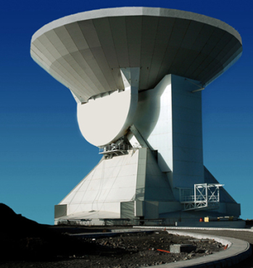
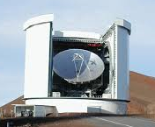
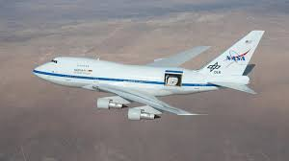
Time Required to map a 1 deg² region
20 MJy/Sr Dust @240μm with σ_{p}=1%
POL-2 870 μm
(2017)
TolTEC 1.1m
(2019)
HAWC+: 89, 154, 214 μm
BLASTPol (2012) and BLAST-TNG (2018)
250, 350, 500 μm
FIP 80 μm
FIP 120 μm
FIP 240 μm
Assume β = 2, T = 16 K

Slide 14
Time Required to map a 1 deg² region
20 MJy/Sr Dust @240μm with σ_{p}=1%
POL-2 870 μm
(2017)
TolTEC 1.1m
(2019)
HAWC+: 89, 154, 214 μm
BLASTPol (2012) and BLAST-TNG (2018)
250, 350, 500 μm
FIP 80 μm
FIP 120 μm
FIP 240 μm
FIP at 240 microns has ~400x the mapping speed of BLAST-TNG!
Assume β = 2, T = 16 K

Slide 15
If the FIP had a longer wavelength band we could better study the magnetic fields in cold early stage star forming regions.
Polaris Flare SED
Miville-Deschênes 2010
T_{d} = 14.5 ± 1.6
β = 2.3 ± 0.6
I₂₅₀~20 MJy/Sr
Dust temperatures are not actually uniform even in clouds without star formation: dust is warmer near the cloud surface.
At 240 microns 20K dust is 6x brighter than 10K dust.
  Magnetic field direction measured is weighted toward the lower density cloud regions.
At 500 microns 20K dust is only 1.6x brighter.

Slide 16
Descope Options:
We would really not like to lose:
  Dynamic range in instrument sensitivity.
  Ability to recover polarization structure on large scales (up to 10 degrees).
  The 240 micron band!

Slide 17
Other Descope Options
Sensitivity:
  2x decrease in sensitivity would mean we could map ¼ as many clouds to the same depth OR not target as many diffuse ISM clouds.
Resolution:
  This limits the cloud distance (and number of clouds) for which we can get high resolution.
    Example: For the 120 μm we can resolve the core scale (~0.03pc) out to 2kpc.
  A moderate degradation in resolution (e.g. ~25%) wouldn’t degrade our science case very much.
Instantaneous Field of View:
  Shouldn’t affect us as long as we can recover emission on scales larger than the FOV.

Slide 18
Conclusions
Polarimetry allows us to trace magnetic and turbulent energy over all ISM scales, from galactic feedback to star forming cores.
OST will be revolutionary in terms of:
  Ability to trace MHD turbulence over range in spatial scale and column density scales.
  Mapping speed, which will allow OST to map hundreds of clouds.

