Slide 1


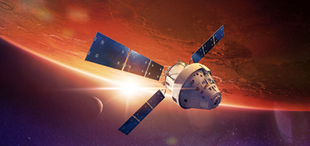
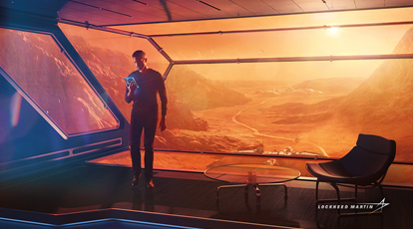
Advanced Technology Center
Overview
OST Face-to-Face
June 2017
Greg Feller
Advanced Technology Center
Lockheed Martin Space Systems Company

Slide 2
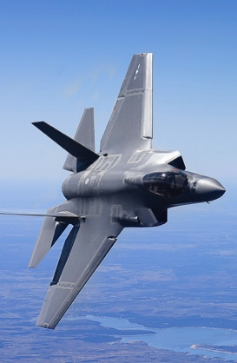
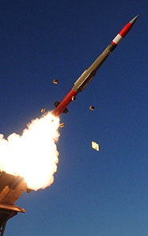
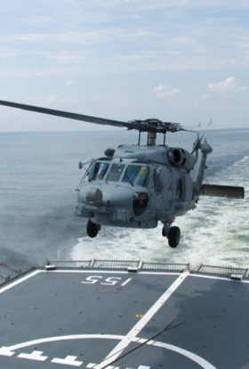
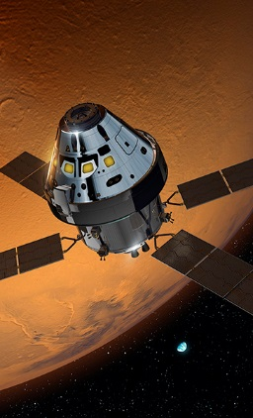
Lockheed Martin Business Areas
Aeronautics
Tactical Fighters
Tactical /Strategic Airlift
Advanced Development
Sustainment Operations
Missiles and Fire Control
Air and Missile Defense
Tactical Missiles
Fire Control
Combat Maneuver Systems
Energy
Rotary and Mission Systems
Naval Combat Systems
Radar and Surveillance Systems
Aviation Systems
Training and Logistics Solutions
DOD Cyber Security
Space Systems
Surveillance and Navigation
Global Communications
Human Space Flight
Strategic and Defensive Systems
Strategic / Operational Command & Control Systems

Slide 3
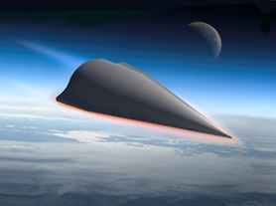


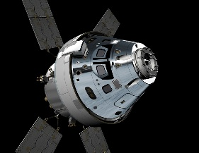




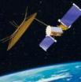

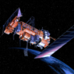
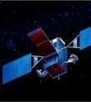
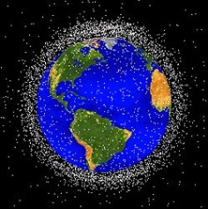
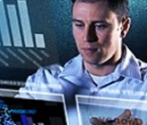
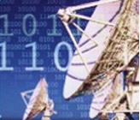











Space Systems Company Portfolio
Civil Space
Special
Programs
Strategic & Missile Defense
NASA
Adv Programs
Strategic Missiles
Missile Defense
Human
Exploration
Planetary
Exploration
Weather & Environment
Military Space
Mission Solutions
Protected
Comms
Narrowband Comms
Navigation
Weather
Early
Warning
Space
Protection
End-to-End Mission Systems
Geospatial
Technologies
Commercial Space
Advanced Technology Center
Subsidiaries
Remote
Sensing
Commercial
SATCOM
Wind Energy Management
Optics, RF
& Photonics
Adv. Materials
& Nano Systems
Space Sciences & Instruments

Slide 4
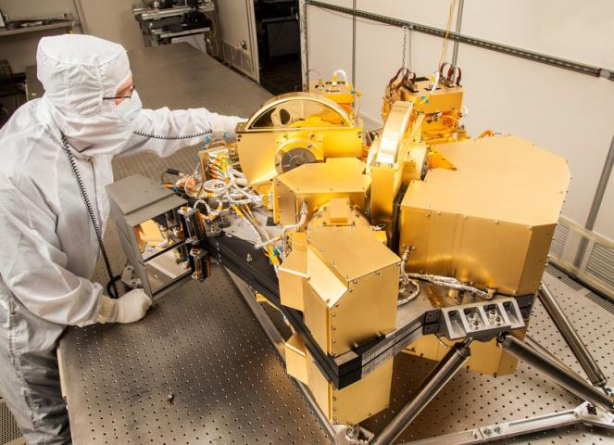
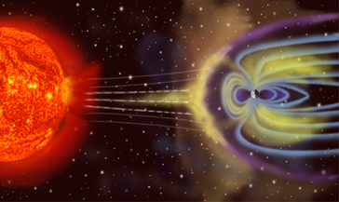
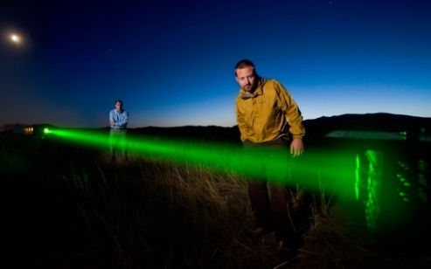
Advanced Technology Center (ATC)
SSC’s R&D Laboratory; ~500 Scientists and Technologist – 2/3rd with Advanced Degrees
Technology Invention & Innovation
Contracted and Independent R&D
Payloads and Payload Technologies
Space and Earth Science
Classified Advanced Development
Key Partnerships: Engineering, Universities,
and Other R&D Institutions
Creating the Generation After Next
© 2015 Lockheed Martin Corporation, All Rights Reserved
Notes:
4
Lockheed Martin Proprietary Information
Lockheed Martin Proprietary Information

Slide 5

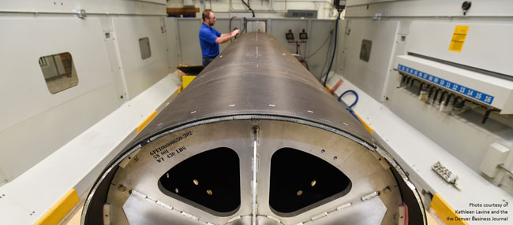

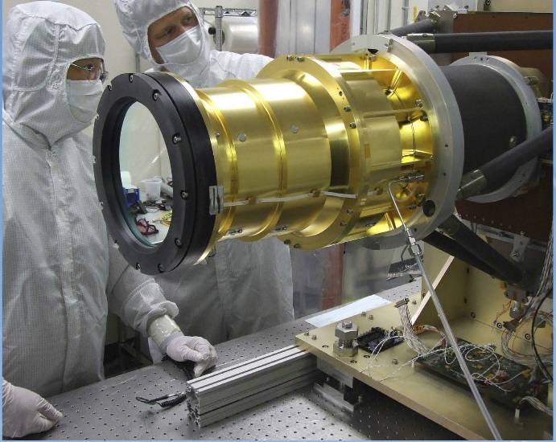
Payload Centers of Excellence
The RF Payload Center of Excellence, is shaping the future of space-based RF and Communications payloads.
This center combines a proven, integrated team with new talent and facilities – collocating design, manufacturing and testing of all types of RF systems, products and antennas
The Optical Payload Center of Excellence,
is defining the future of imaging in Space
A network of experts and facilities
headquartered Palo Alto, California
the Center of Excellence is focused on
advancing Lockheed Martin capability, efficiency and agility in optical technologies and products

Slide 6
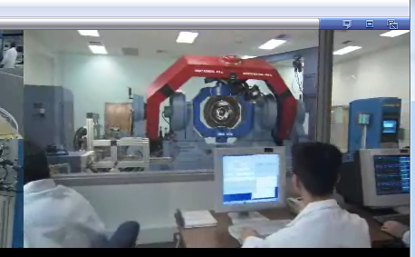
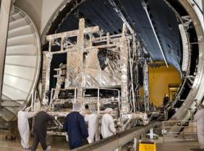
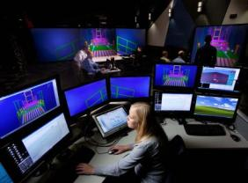
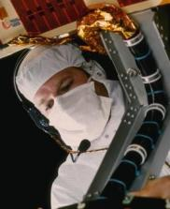
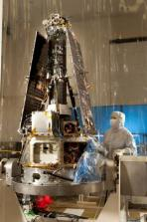
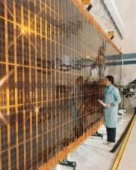
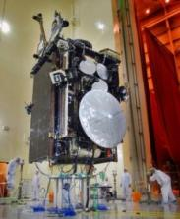
World Class Facilities
Core infrastructure in place to execute space-based missions
Advanced Simulation
Environmental Tests
Virtual Design & Production
Clean Rooms
Payload Development
Manufacturing/
Assembly
Satellite Integration
Decades of Industry and Government Investment
PIRA# ssa201404009

Slide 7
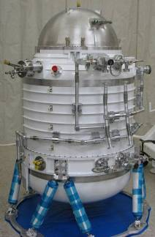
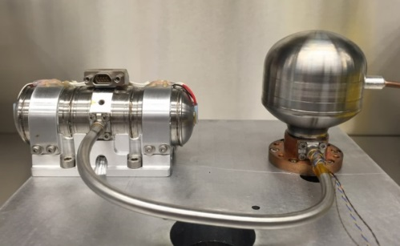
Lockheed Martin Cryocoolers
Lockheed Martin ATC Thermal & Energy Sciences has over 40 years experience in Space Cryogenics
  45 years in Space Cryogenic Dewars and Cryostats (WISE, GP-B)
  20 years in Mechanical Cryocoolers
Industry leader in simple, robust space cryocoolers for cooling below 10 K
Lockheed Martin has a well-defined path forward to demonstrate required OST cooling with a simple pulse tube cryocooler

Slide 8
The Case for Non-Contact Payload Isolation
The need for high payload dynamic stability is an overarching technology need to ensure the performance of future large optical systems
  The large 8-15 meter OST Primary Mirror will require very low levels of mechanical vibration to meet its wavefront error stability requirements and 40 mas rms jitter requirement
Previous passive architectures will be hard-pressed to achieve the dynamic WFE stability requirements of systems like OST
  Passive isolation disturbances is limited at low
  frequency, and complicated by internal structural
  resonances of the isolation system itself
  Active cancellation of LOS error arising from
  disturbances has sensing, mechanism and control
  challenges
Lockheed Martin has developed and
tested a Disturbance Free Payload (DFP)
technology, that fundamentally separates the
optical telescope from spacecraft disturbances
Pedreiro, N., “Spacecraft architecture for disturbance-free payload”,
US Patent 6,454,215 (2002).

Slide 9
A Disturbance-Free, Non-Contact Architecture
The DFP isolation system is an entirely novel and revolutionary concept for isolation of a sensitive science payload from the supporting spacecraft mechanisms
  A DFP-configured spacecraft is actually two spacecraft flying in close formation
The spacecraft measures and
controls its attitude using star
trackers and reaction wheels’
  Requirements for control are no
  more stringent than those for
  conventional communications
  satellites
The payload controls its attitude
by pushing against the spacecraft
using a set of six non-contact
linear-motion, electromechanical
Lorentz force actuators

Slide 10
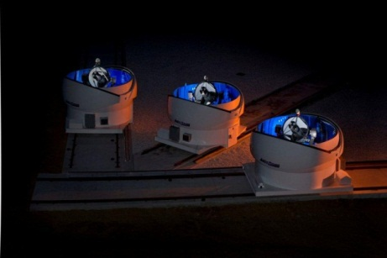
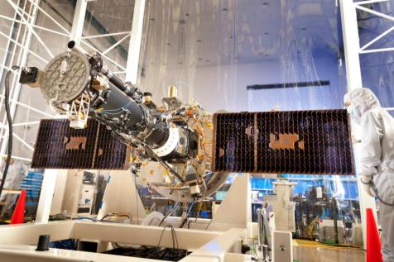
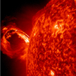
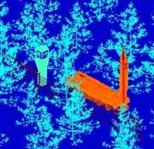
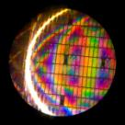
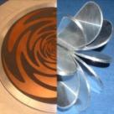

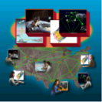
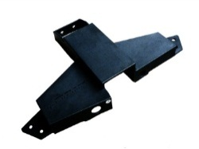
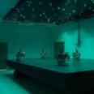
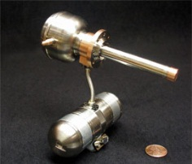

  ATC Portfolio of Technical Discriminators
Phenomenology & Sensors Technology
Optics &
Electro-Optics
Space Science & Instrumentation
Enabling Missions of Today and Tomorrow through Innovation
Laser Radar
RF & Photonics
Advanced Materials & Nanosystems
Thermal & Energy Sciences
Control Systems &
Information Sciences
© 2015 Lockheed Martin Corporation, All Rights Reserved

Slide 11
© 2015 Lockheed Martin Corporation, All Rights Reserved
11

