Slide 1
OST Technology Roadmap
Mike DiPirro & Johannes Staguhn (a few edits)
14-June-2017

Slide 2
List of Technology Gaps
1. Direct Detectors –
1a. higher sensitivity, high dynamic range, and larger arrays
1b. cryogenic multiplexing and pre-amps
1c. room temperature readout-lower power {assessed at TRL4}
2. Compact Far-IR Spectrometer {labeled as enhancing}
3. Heterodyne Improvements {labeled as enhancing]
4. Sub-Kelvin Cooler (funded SAT for CADR) {assessed at TRL4}
5. Cryogenic Mirror Technology (actuators and material studies) {TRL4}
6. 4 K mechanical coolers {assessed at TRL4}
7. Mid–IR Coronagraph (need breakdown of components that need development)
Send any additions/updates to Mike DiPirro by June 23 for inclusion in this year’s PATR

Slide 3

Origins Space Telescope
 |  | Total Gaps | TRL 2 Gaps | TRL 3 Gaps | TRL 4+ Gaps
 | Enabling+ enhancing | 11 | 3 | 4 | 4
 | Enabling only | 5 | 1 | 1 | 3
ID | Technology Gap | TRL | Note
1.1 | Far-IR (FIR) detectors | 3 | NEP requirements relaxed, but main challenge is in multiplexing.
1.2 | Cryogenic readouts for large-format FIR detectors | 2 | If speed requirement chosen to be enhancing then TRL may rise.
1.3 | Warm readout electronics for large- format FIR detectors | 4 | May need further assessment; existing technology could likely limit number of channels
2* | Compact integrated spectrometers | 3
3* | Heterodyne FIR detector arrays | 3
4 | Sub-K Coolers | 4
5 | Cryogenic FIR mirror segments | 4 | Assumes Be segments, otherwise TRL decreases; other materials may require cryo-figure actuators
6* | Advanced Cryocoolers | 4 | SOA is acceptable
7.1* | Coronagraph optics and architecture | 2 | An optical design with masks and mirrors compatible with a segmented primary mirror
7.2* | Cryogenic deformable mirrors | 2 | Deformable mirrors that operate at cryogenic temperatures
7.3* | Mid-IR detectors _{* Enhancing tech} | no ³ gy lo | 8 SOA may be OK, pending analysis

Slide 4
60 second tutorial on TRL definitions from Pause and Learn
TRL | TRL | Definition in NPR 7123.1B | Summary
2 | Technology concept and/or application formulated | Invention begins, practical applications is identified but is speculative, no experimental proof or detailed analysis is available to support the conjecture. | Concept
3 | Analytical and experimental critical function and/or characteristic proof-of- concept | Analytical studies place the technology in an appropriate context and laboratory demonstrations, modeling and simulation validate analytical prediction. | Proof-of-concept
4 | Component and/or breadboard validation in laboratory environment. | A low fidelity system/component breadboard is built and operated to demonstrate basic functionality in critical test environments, and associated performance predictions are defined relative to final operating environment. | Low-fidelity prototype demonstrated in a lab
5 | Component and/or breadboard validation in relevant environment. | A medium fidelity system/component brassboard is built and operated to demonstrate overall performance in a simulated operational environment with realistic support elements that demonstrate overall performance in critical areas. Performance predictions are made for subsequent development phases. | Medium-fidelity prototype demonstrated to meet performance in the relevant environment

Slide 5
Road to TRL-6
Mature the Key Technologies to TRL 4 by 2019, TRL 5 by 2024, and TRL 6 by 2026
  From the Pause and Learn we found that OST was in the best shape of the 4 STDTs with only two enabling technologies below TRL 4
    Stated “goal” is 3 or fewer TRL <4 enabling technologies
    Enabling vs. Enhancing needs further discussion
Studies
Complete
OST
Launch!
Phase A
PDR
2017
2019
2024
2026
2035

Slide 6
1a. Detector Details-1
Enabling noise equivalent power (NEP) 1e-19 W/√Hz
Enhancing NEP to 3e-20 W/√Hz or better
Enabling 10^4 pixels per array
Enhancing 3x10^4 pixels per array
Must be compatible with cryogenic multiplexers

Slide 7
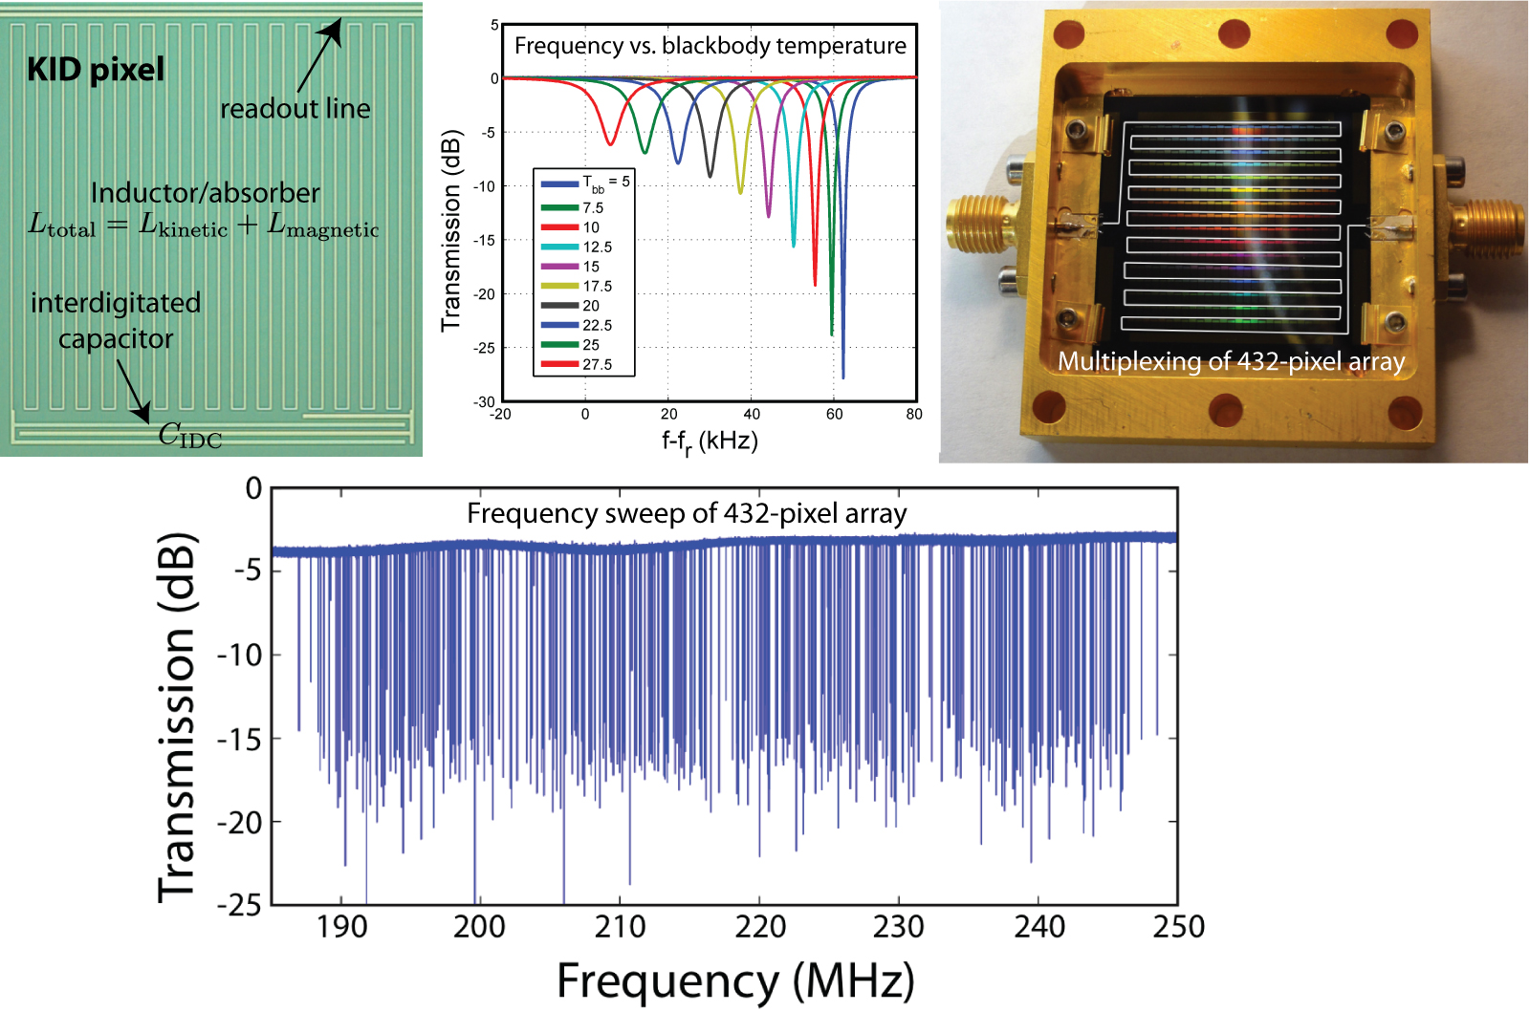
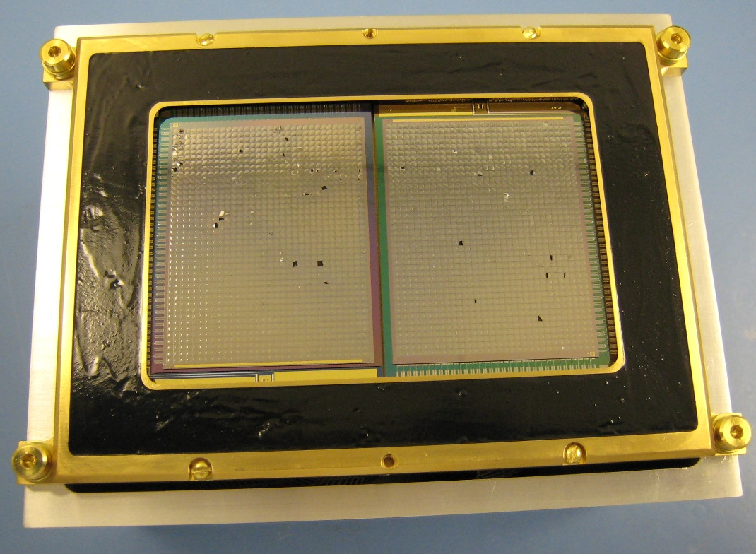
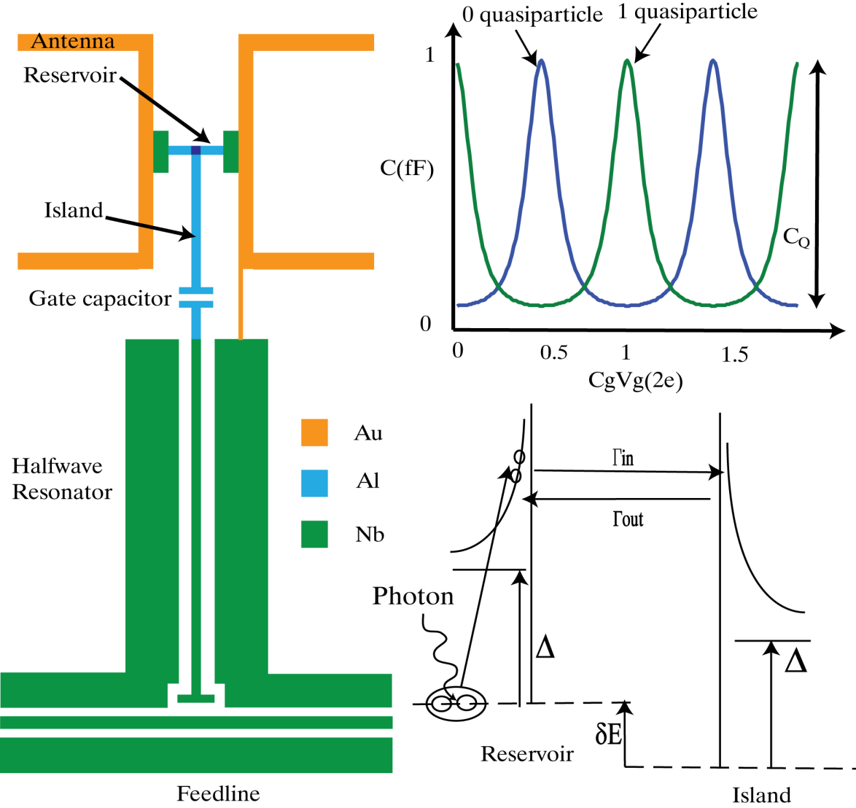
1a. Detector Details-2
HAWC+
40x32x2
1 mm pixel
1e-18 W/√Hz
KID 432 pixel
Array
1e-18 W/√Hz
Quantum
Capacitance
Detector

Slide 8
1b. Multiplexing & Preamp Details
Multiplexing using rf resonator circuits
  Enabling goal is >1000 pixels per channel without loss of sensitivity or cross-talk
Preamplifiers using µwave SQUIDs and/or parametric amplifiers and/or HEMTs
  Enabling is < 0.7 mW per channel
  Enhancing is < 0.3 mW per channel
Achieved 20+ dB gain over 4.5 GHz instantaneous bandwidth
with near-quantum-limited noise temperature < 400 mK (Lincoln Labs)

Slide 9
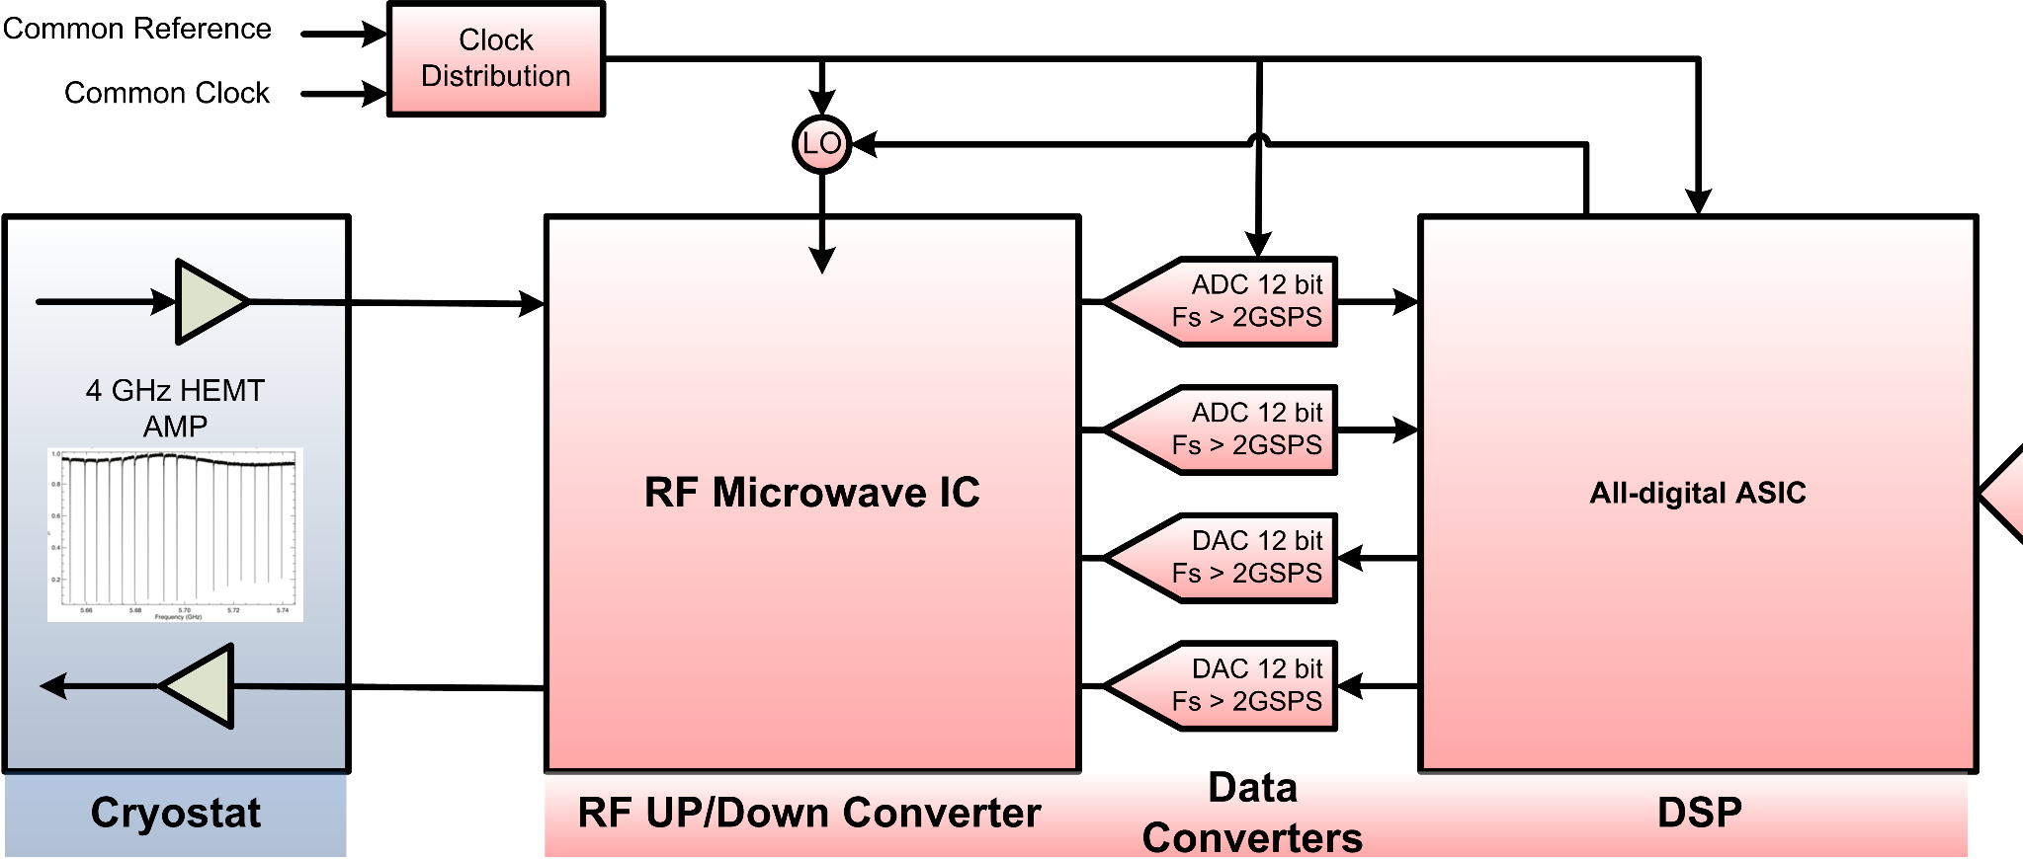
1c. Room Temperature Readout Details
ASICs to perform frequency demultiplexing task with low power requirement
  Current state of the art is 60 W/channel using FPGAs
  Enabling is <30 W/channel using ASICs assessed at TRL4

Slide 10
Discussion
Please provide Input for Next COR and PCOS PATR
Have we used enabling and enhancing properly?
What updates are there to the technolgy in the last year?
Can we make it to TRL 4 with enabling technologies by 2019?

Slide 11
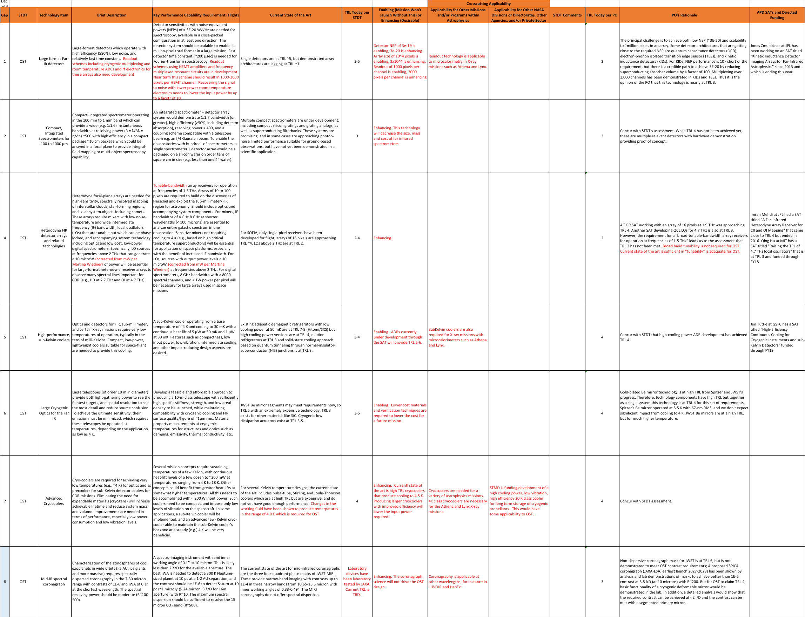
Present OST Technology Gap Matrix

