Slide 1
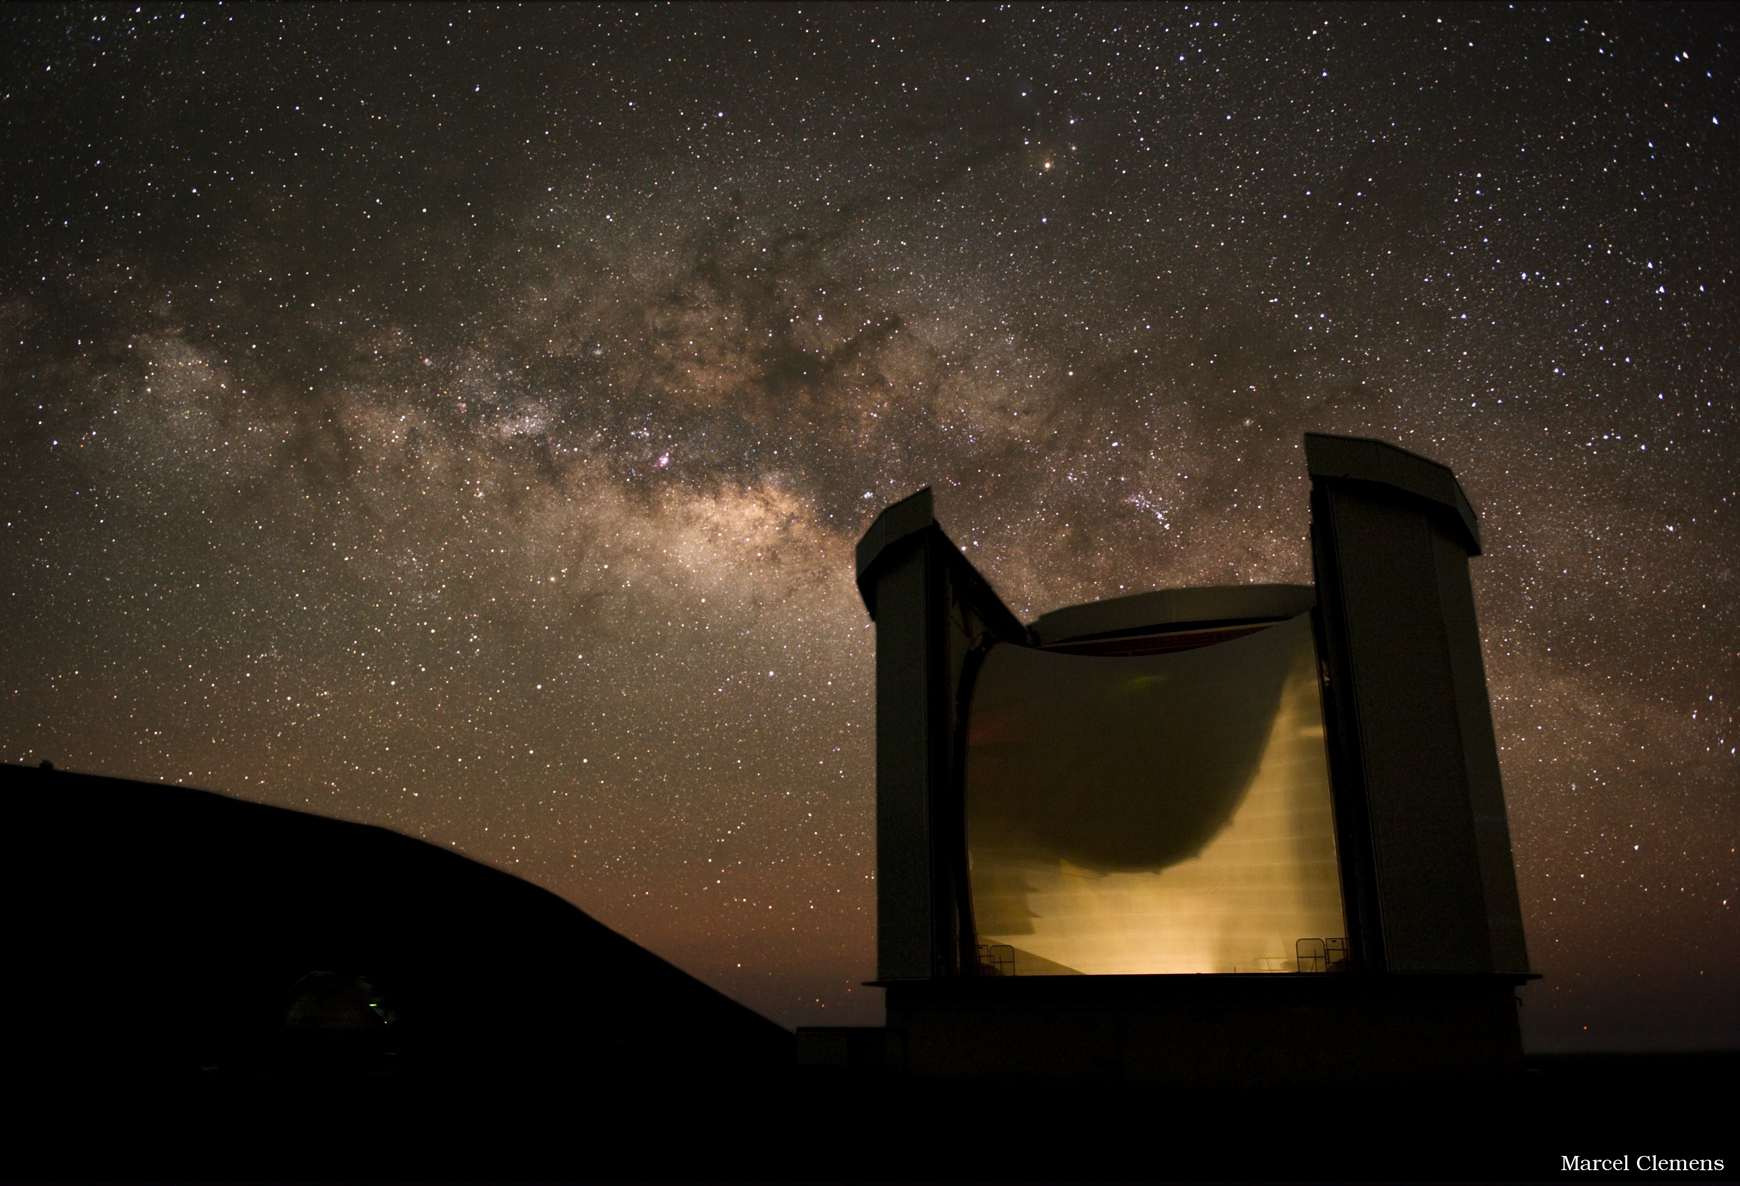
What the Variability of Embedded Protostars Tells Us about Accretion
Past, Present, and Future
(with help from W. Fischer, M. Dunham, and the 2-pager)
Doug Johnstone:
NRC Herzberg
University of Victoria
With:
S. Mairs, J. Lane, H. Kirk
H. Yoo, J-E Lee - Korea
G. Herczeg – Kavli, China
The JCMT Transient Survey Team

Slide 2
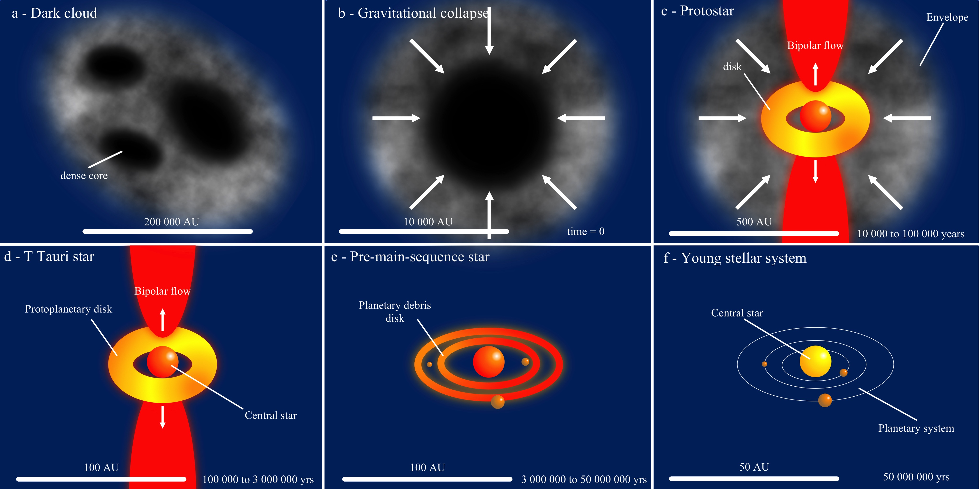
Formation of a star in one slide!
Key point for this talk: mass of star is assembled from cloud, through envelope and disk.

Slide 3
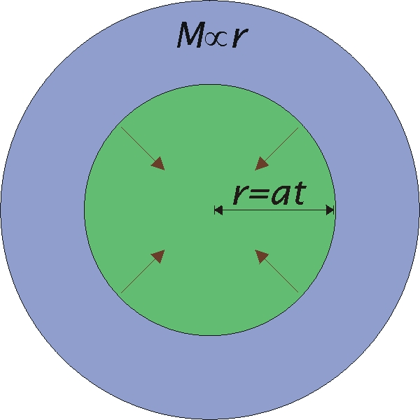
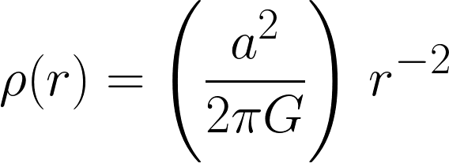
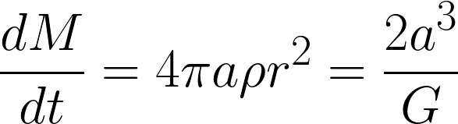
Accretion via Inside Out Collapse:
“Shu Model”
Start with an isothermal sphere
Perturb the centre slightly
  Loss of pressure support yields collapse!
Rarefaction wave races out at sound speed
Half of this mass flux is accreted onto the central protostar while half is added to the in-falling envelope
  Steady-state protostellar accretion ~ a³/G

Slide 4
Importance of Rotation (or B fields):
Rotation (and B fields) break isotopic symmetry
  Produces a flattened inner region (a disk)
Mass flux that would have reached the protostar now misses and lands on disk
No a priori reason why mass transport through disk = mass flux onto disk!
  If disk transports faster – no disk build up
  If disk transport slower – significant disk build up
Note: mass transport through disk may even be radially dependent!

Slide 5
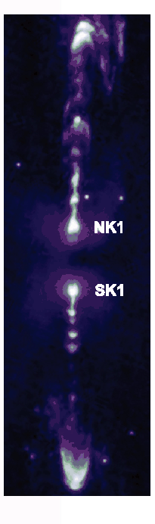
Mass Accretion – Non-Steady?
Disk models suggest disk transport often inefficient
  Outer disk fills with mass until gravitationally unstable
  Next, spiral forms in disk efficiently transporting mass inward
  Accretion takes place in short energetic bursts and long
  quiescent intervening periods
Observations of knots/bullets in jets also suggestive …
HH212
Vorobyov and Basu 2005, ApJ, 633, L137

Slide 6
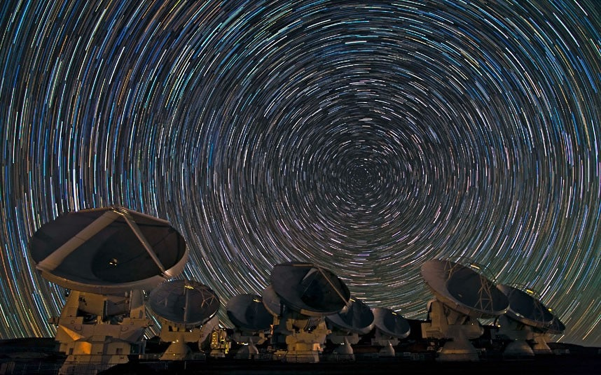
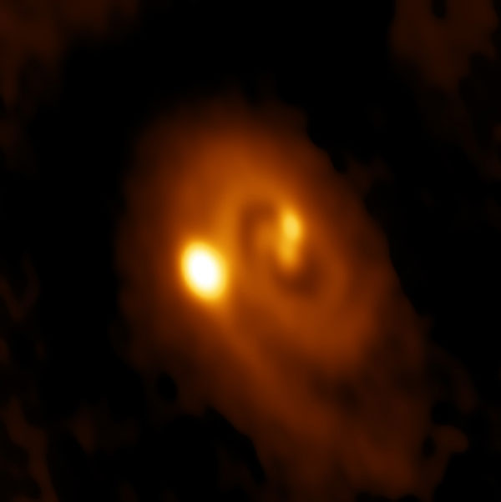
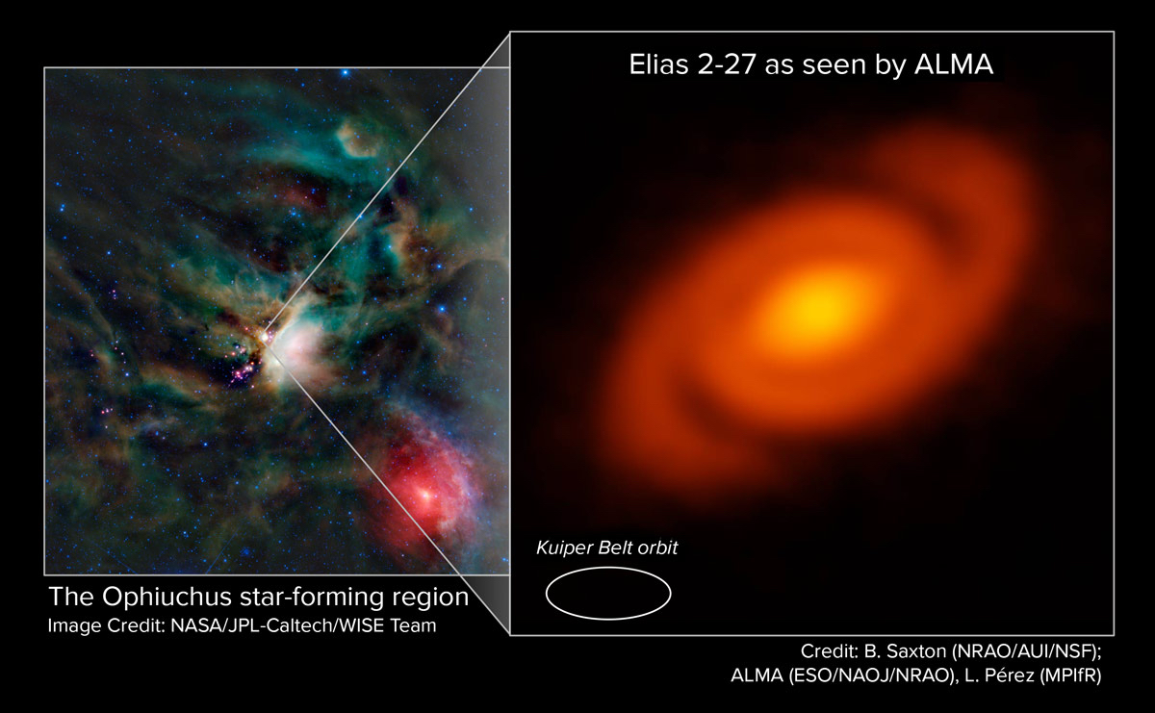
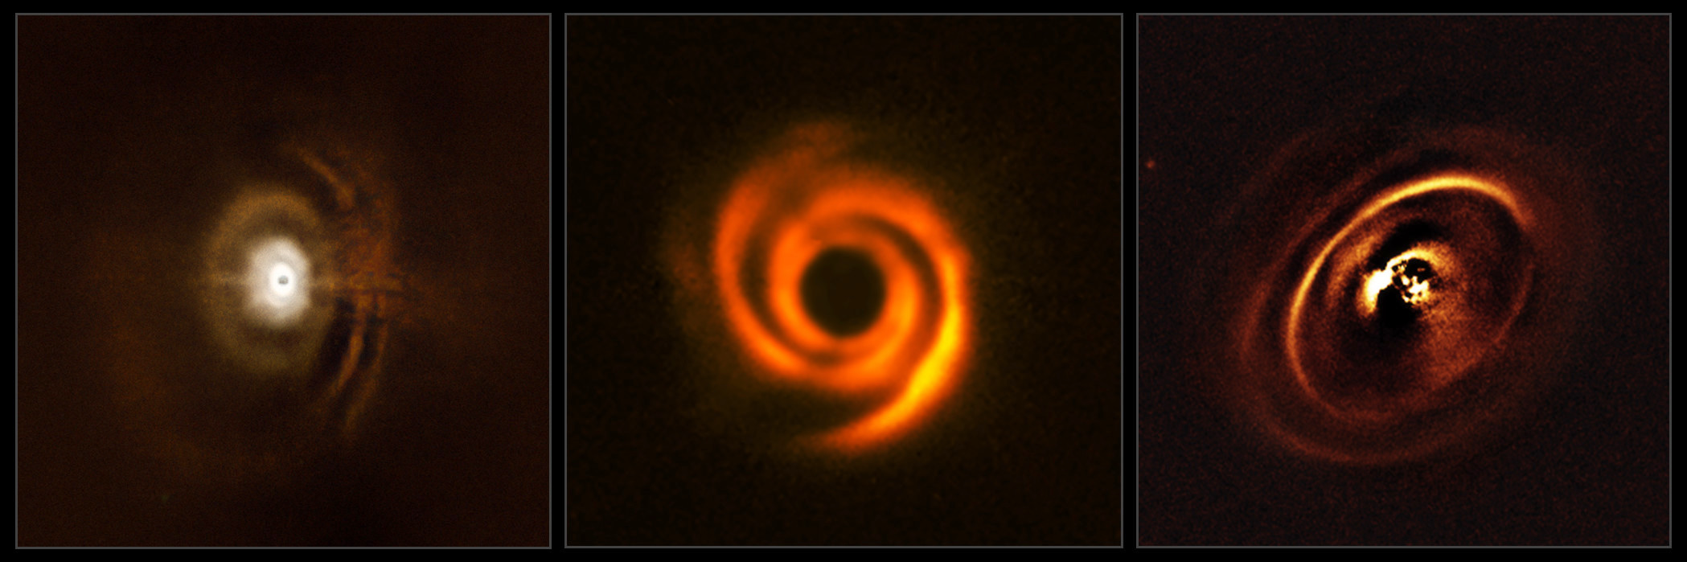
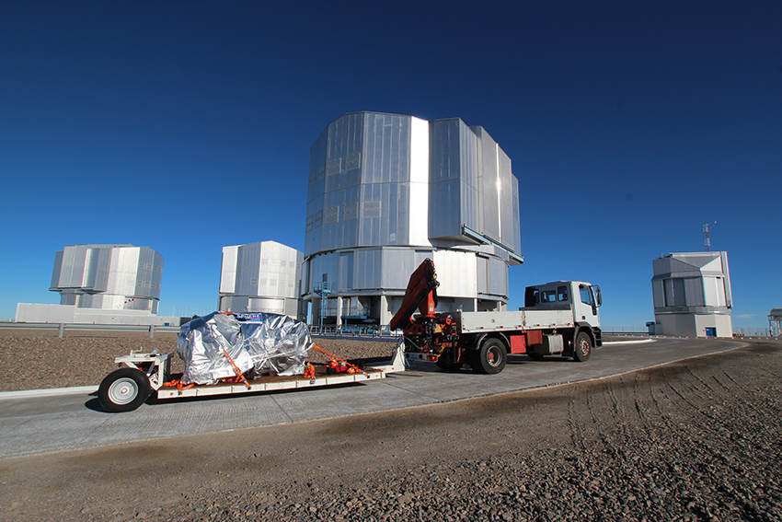
Young Disk Observations (IR & mm):
Whether observed in scattered light (IR) or dust emission (mm)
disks around young stars appear structured!
(Spiral Driven Accretion: Bae et al. 2016, ApJ, Hennebelle et al. 2017 A&A)
ALMA
VLT-Sphere

Slide 7
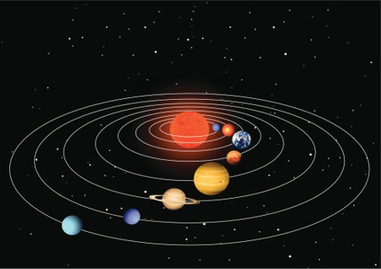
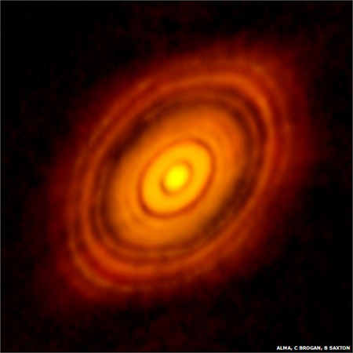
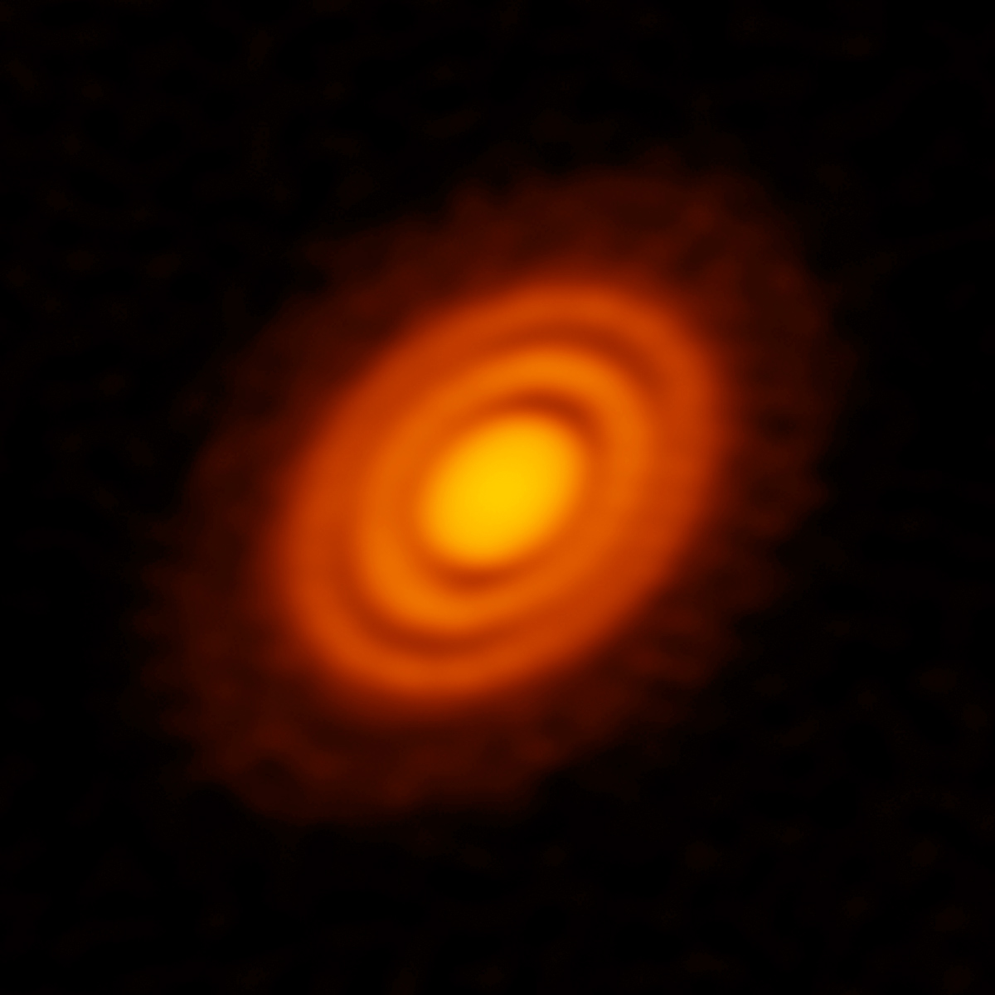

Young Disk Observations (IR & mm):
Interestingly, many disks observed in mm show rings and gaps indicating a more quiescent environment, a non-smooth mass transport … and suggesting planets in formation!
If significant mass from the envelope still falls onto the outer disk, how might this impact the time dependence of accretion?
ALMA – HL Tau
ALMA – HD 163296
ALMA – TW Hydra

Slide 8
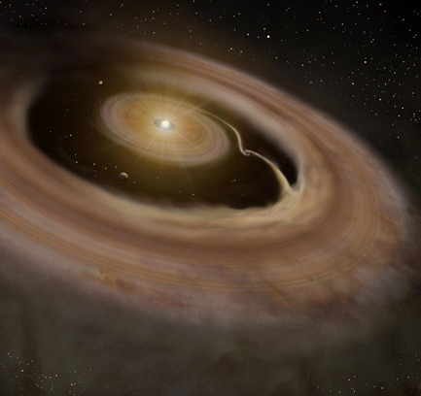
Young Disk Observations (IR & mm):
Gaps in disks may be due to sculpting by planets.
Accretion periodicity perhaps?
Very likely to be an unstable flow …
ALMA – HL Tau
Graduate University for Advanced Studies, Japan

Slide 9
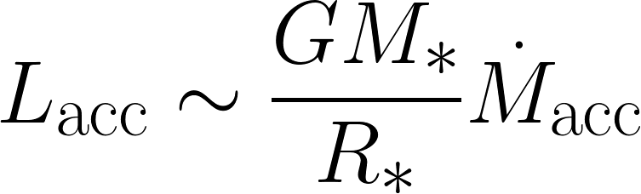
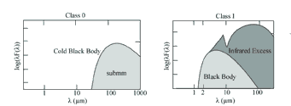
Spectral Energy Distribution (SED):
For a low mass star, the mass accretion onto the protostar releases as much (or more) energy as the protostar itself produces
This energy is absorbed by the envelope and re-radiated in the far IR through mm. Thus, the SED acts as a calorimeter for accretion.
Observations near the SED peak provide a proxy, allowing surveys such as a potential OST Variability Survey to search for accretion variability through brightness variations.

Slide 10
Spitzer: Mass Accretion Result
Confirms the well known Kenyon et al. (1990) ‘luminosity problem’
Dunham et al. 2010, ApJ, 710, 470

Slide 11
Protostellar Envelope Model:
Deeply Embedded Phase
Density structure follows inside-out collapse
  M_{env} = 1.5 M_{sun}
  R_{env} = 2x10⁴ AU
  R_{x} = 6x10³ AU (transition from static to infall)
Protostar mass ~ 0.25 M_{sun}
Luminosities:
  L_{PS} = 1.2 L_{sun}
  L_{acc} = 5 L_{sun} (if steady-state: c^3/G)
  L₁₀ = 12 L_{sun}
  L₁₀₀ = 120 L_{Sun}

Slide 12
Implications of Variable Accretion - I
Temperature Profile of the Envelope responds to accretion luminosity
Location of effective photosphere
Johnstone et al. 2013, ApJ, 765, 133

Slide 13
Implications of Variable Accretion - II
Luminosity of Source gets higher and SED shifts to the blue (Warmer)
Approximately linear with accretion ratio
Approximately linear with temperature ratio
Johnstone et al. 2013, ApJ, 765, 133

Slide 14
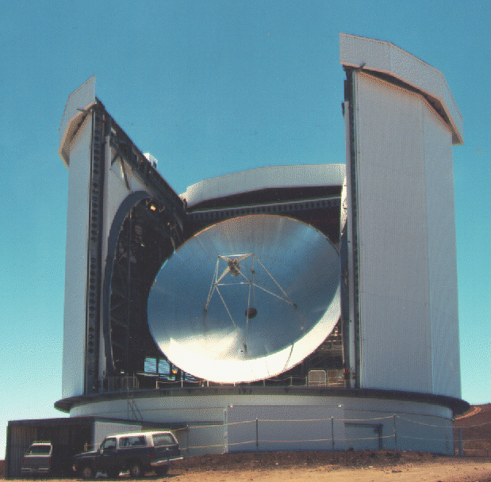
Implications of Variable Accretion - IV
The light propagation time must be taken into account …
1000 hrs
100 hrs
Crossing time of the effective
photosphere (R_{ph} ~ 50 AU)
is ~ 5 hrs
Johnstone et al. 2013, ApJ, 765, 133

Slide 15
Implications of Variable Accretion - V
The observable timescale for variability can be assessed:
500 hrs 5000 hrs
Don’t
Trust
0.5 hrs 5.0 hrs 50 hrs
Johnstone et al. 2013, ApJ, 765, 133

Slide 16
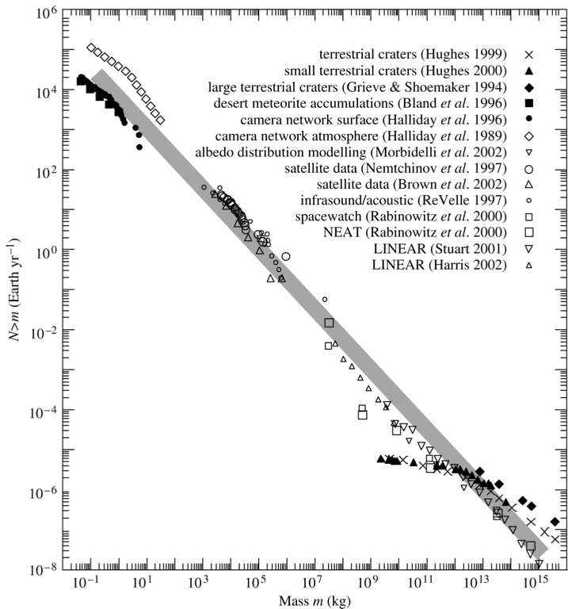
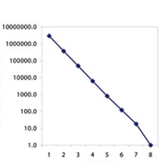
Aside: Variability and Accretion
Much effort invested in determining how majority of mass accreted
  Steady-state vs. powerful, rare outbursts
But, accretion variability may be much more nuanced than this
  c.f. earthquakes, meteor impacts
  Timescale(s)/amplitude(s), process(es)?
Earthquakes
Number per Year
Number per Year
Meteors
Magnitude
Mass (kg)

Slide 17
Spitzer/Wise Variability … (W. Fischer)
Spitzer vs Wise ~ 5-10 year delta
HOPS 383, for example

Slide 18
Spitzer/Wise Variability … (W. Fischer)

Slide 19
Herschel Variability … (Billot et al 2012)
70 and 160 microns
Orion observed six times over six weeks.
8/17 found to have >10% flux variability
(LHS of figure)!
Argue likely due to inner disk variability in mass accretion.

Slide 20
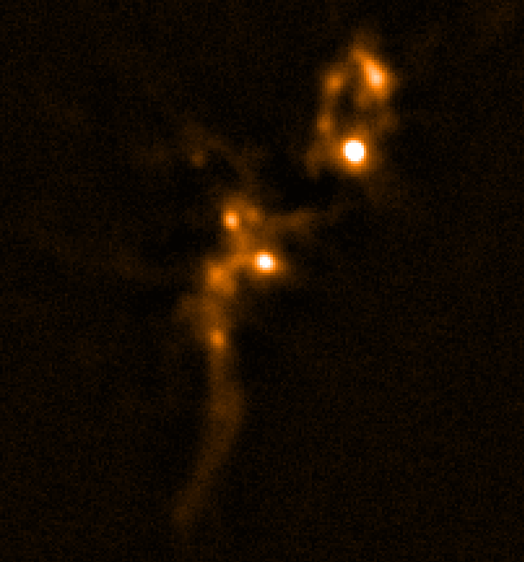

The First JCMT Protostellar Variable:
Serpens Main ~ 400pc
Aligned and calibrated
JCMT SCUBA-2 850 micron
30’ Pong (viewing central region)
13 epochs ~ monthly cadence
2016-February – 2017-April
Careful Investigation by Korean graduate student
Hyunju Yoo …

Slide 21
The First JCMT Protostellar Variable:

Slide 22
The First JCMT Protostellar Variable:
EC 53 (V371 Ser)
  Class I source (Hodapp et al 1999)
    [possibly Class 0 seen pole on]
  Observed physical binary 296 mas (92 AU) away – possibly sub-stellar
  Cometary nebula (One visible lobe of a bipolar structure)
  Ongoing outflow activity (H₂ jet)
  18 month periodic variable at 2μm (Hodapp et al. 1999, 2012)
Postulatation …
  18 month periodicity suggests disk irregularity at ~ 1 AU
  Unseen inner companion star (Hodapp et al.) -> ejection of 92AU source?
    Or perhaps a planet in formation …
  We have observed for ~14 months with JCMT – awaiting full period
    Planned monitoring at 2μm to determine lags and shape variations

Slide 23
JCMT Variation Over A Few Years …
GBS Survey ~4yrs before
Transient Survey
Bottom Line:
With the JCMT we are, so far, sensitive to less than 100 sources. So even these two detections, plus a few others that ‘look’ good, provides a few percent return at 850 microns.

Slide 24
What Requirements with OST …
Protostar Peak Brightness ranges from ~200 Jy to 0.02 Jy
  2 pager suggest 10% calibration – I’d argue for ~1% (e.g. 200 μJy noise)
  To capture bright and faint sources requires a dynamic range ~ 10⁶
  Prefer to capture as broad a wavelength range as possible
    50 – 300 micron would be ideal (MRSS perhaps)
Statistics for FU Ori’s suggest ~1000 to 10⁴ protostars (out to 1 kpc)
  2 pager suggest need to observer about 60 sq. degree
  Scaling from Matt’s MRSS Galaxy survey case suggests ~60 hrs (per epoch)
  With 1% calibration, I anticipate we will see variations in ~10% of sources
Cadence of once a year (nominal) or perhaps every few months
  Yearly will provide enough epochs to spot variations and calculate calibration statistics but bi-monthly will provide evidence of short term periodicity
  For 5 year mission 5 epochs (300 hrs) to 30 epochs (1800 hrs)
    Could do smaller, rich fields bi-monthly and larger sample yearly
Mid- to Far-IR spectra (MRSS) could be helpful diagnostic too

Slide 25
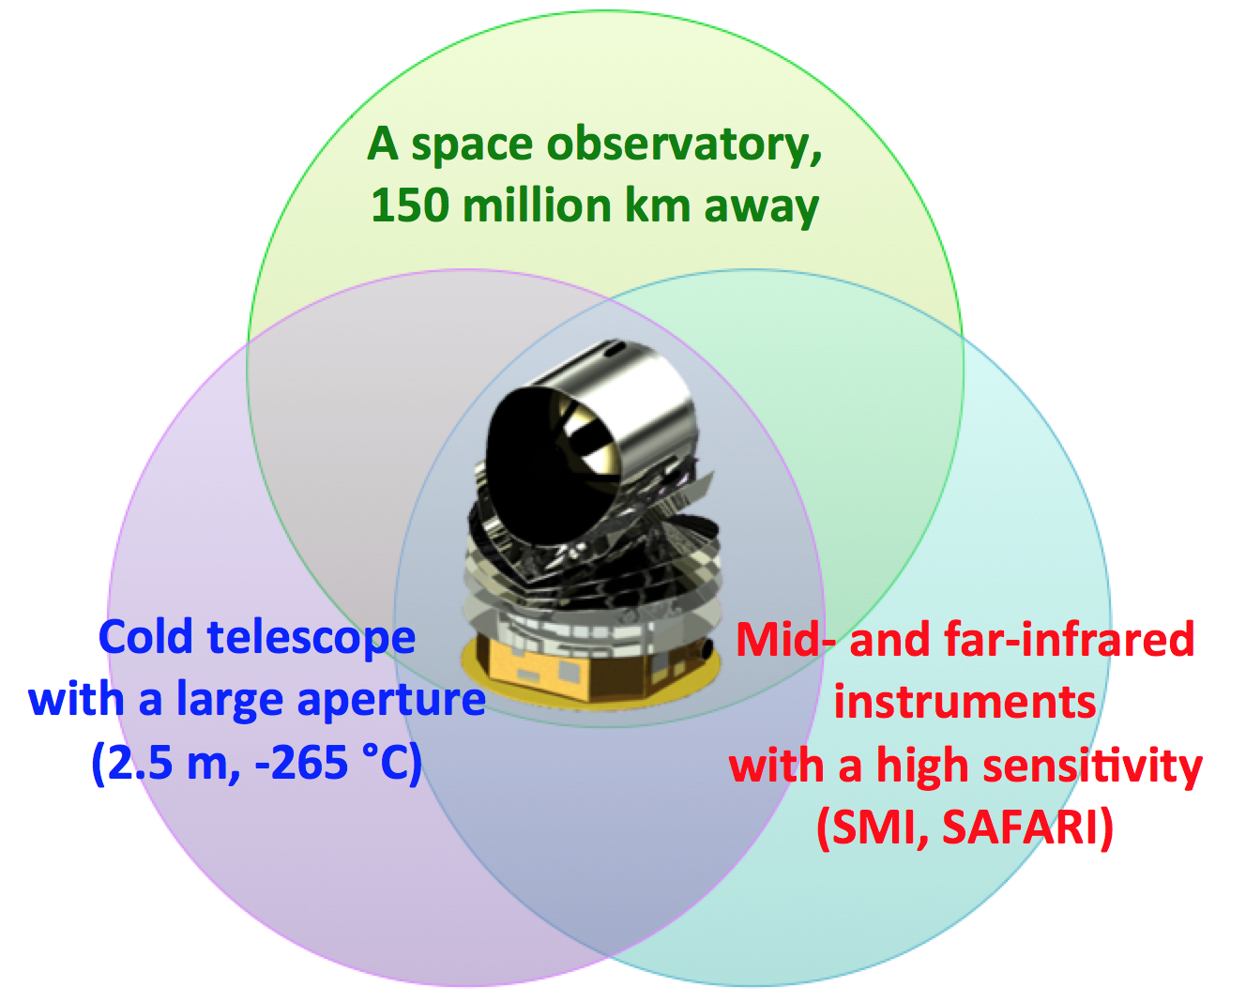
Other Opportunities In Next Decades?
JCMT Transient – Steve Mairs (PhD) James Lane (u.grad)
  Continues for another 2 yrs (at least)
ALMA Monitoring/Serendipity – Logan Francis (Masters)
  ALMA Cycle 5 proposal to resolve inner part of EC 53 during quiescence and burst
  Archival comparison of sources over time
CCAT-P
  Higher sensitivity, larger field of view,
  higher frequency observations possible
Far IR Space Telescopes (SPICA/ORIGINS)
  The future of well calibrated temporal
  studies of protostars

Slide 26
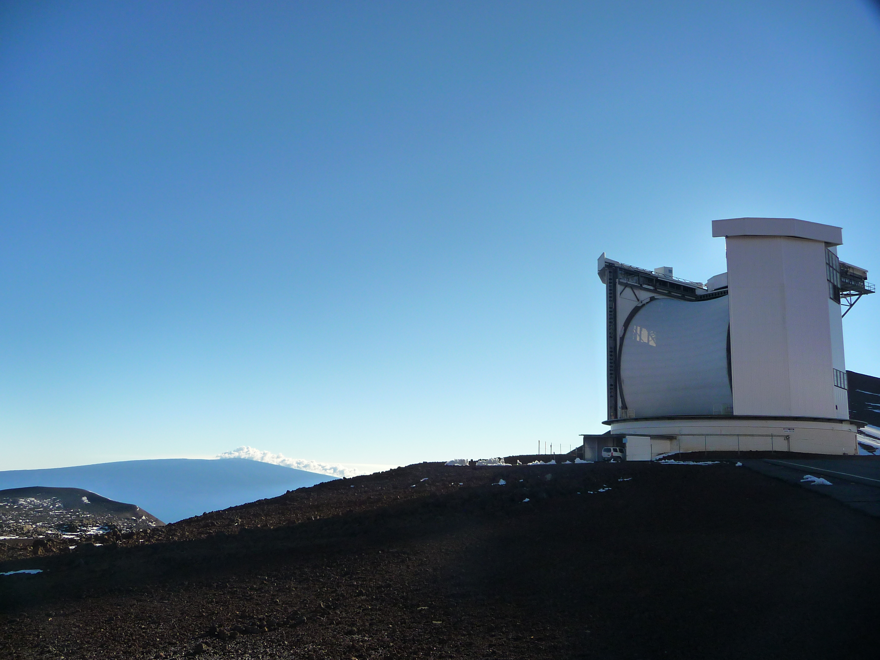
Variability of Deeply Embedded Protostars
Accretion onto a protostar is unlikely to be constant
  Variability timescales will illuminate underlying processes
Observational and theoretical arguments for variability
  Jet knots, FU Ori’s, EX Ori’s, disk viscosity
Observational evidence for structure in disks
  Spirals, gaps, and rings
First JCMT Transient Variable Identified
  Known 2 micron periodic variable (18month)
    Inner disk physics, companion or planet …
OST has the requisite wavelength coverage and sensitivity to make a big difference toward understanding episodic mass accretion onto embedded protostars.

Slide 27
Fin

Slide 28
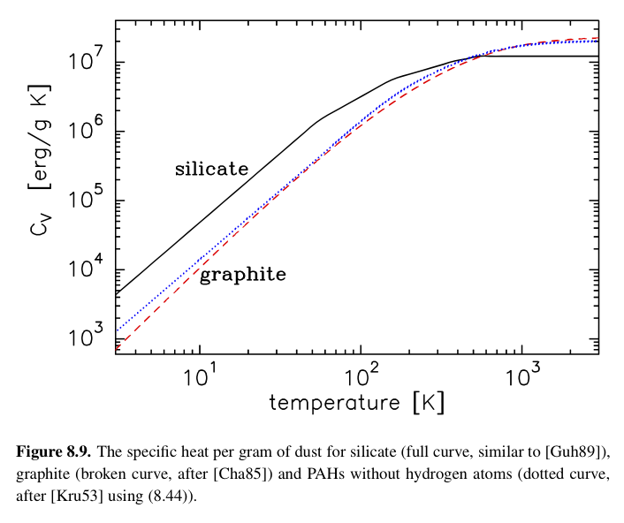
Implications of Variable Accretion - III
Dust must be heated (cooled) to these new temperatures …
For an ideal gas
C_{V} constant
Guhathakurta & Draine 1989, ApJ, 345, 230

Slide 29
The first JCMT Protostellar Variable:
Light curves – 850 microns – Calibrated Images (see Steve’s Talk)
% Flux Variation vs. Absolute Flux
EC 53
Behind Sun
Relative
Flux
calibration
~ 2%
limited to
high S/N
Sources.
Noise-dominated uncertainty
Calibrator 1
Calibrator 2

Slide 30
Implications of Variable Accretion - V
A stepwise change in accretion luminosity will be smeared out
  Within envelope’s effective photosphere – hard to detect variation
    Photons don’t freely escape – high optical depth
    Sets minimum timescale for process R_{ph} ~ 50 AU -> t_{ph} ~ 5hrs
    Sets peak wavelength for source SED -> T_{ph} ~ 100 K
  Emission at longer wavelengths dominated by larger, colder envelope
    Takes ever longer to heat the enormous envelope
    Sets maximum timescale R_{env} ~ 10⁴ AU -> t_{env} ~ 10,000 hrs
Observations of variability should be able to constrain theory
  Identify the underlying timescales for accretion changes
    Periodic?, Episodic?, Stochastic?, Structured chaos?
  Probe variations in amplitude of mass accretion with timescales?
Possibility to open up a new branch of star formation studies

