Slide 1
Realities and Considerations
UV-Visible Space Astrophysics Workshop
Mario R. Perez
Astrophysics Division
Science Mission Directorate
June 25, 2015

Slide 2
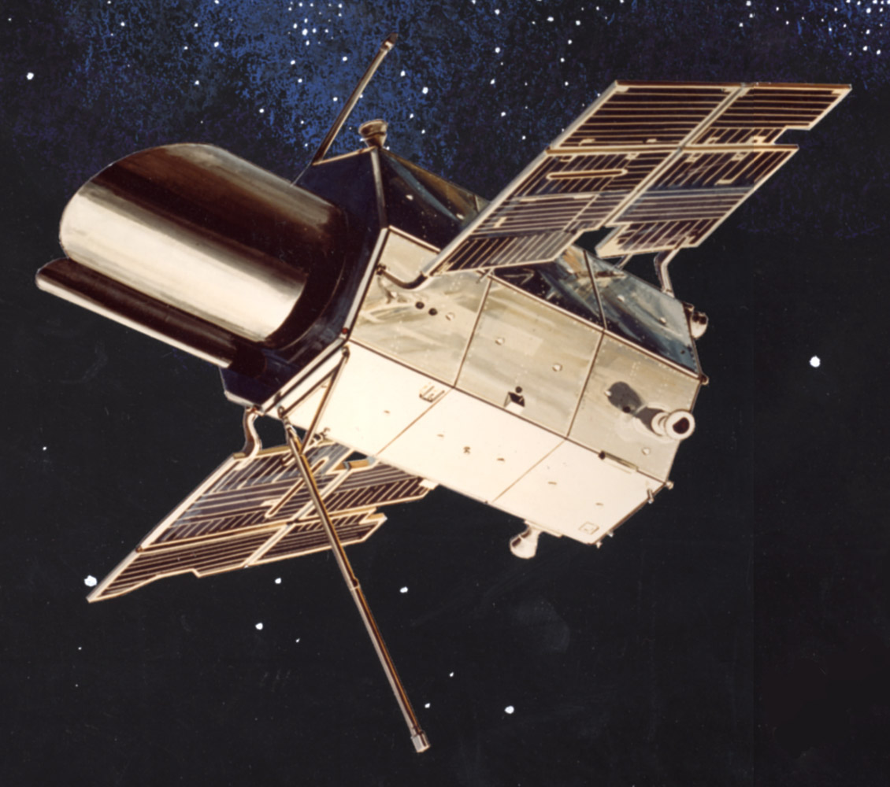
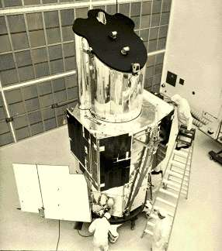
Orbiting Astronomical Observatories (OAO)
OAO-2 (1968-1973)
11 UV telescopes
OAO-3 (1972-1981)
Copernicus
1m UV telescope
The Orbiting Astronomical Observatory program set the stage for the development of the Hubble Space Telescope (HST) and other orbiting observatories.
Image Credits: NASA

Slide 3
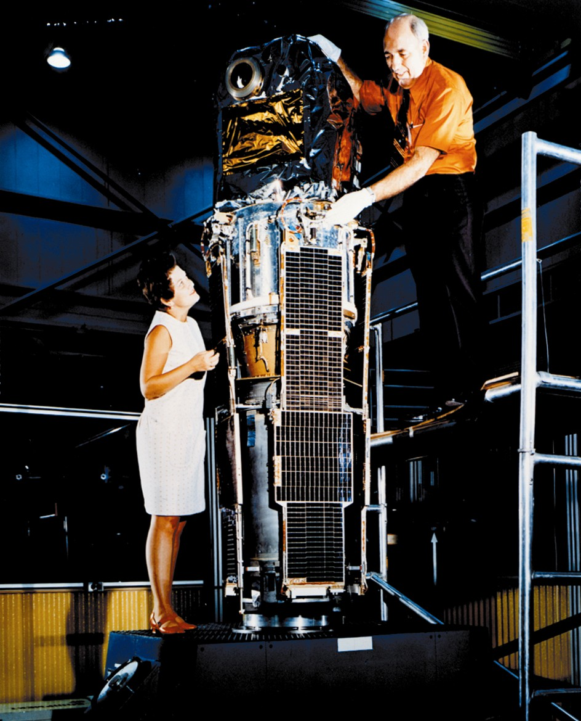
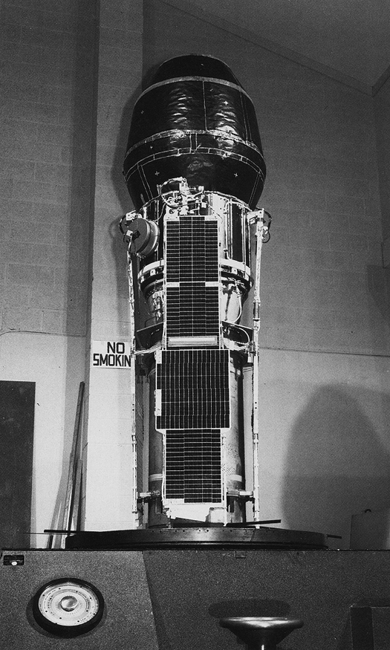
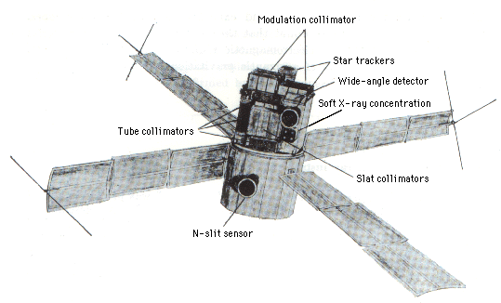
Small Astronomy Satellites (SAS)
SAS-2
1972-1973
SAS-3
1975-1979
SAS-1 (Uhuru)
1970-1973
Image Credits: NASA

Slide 4
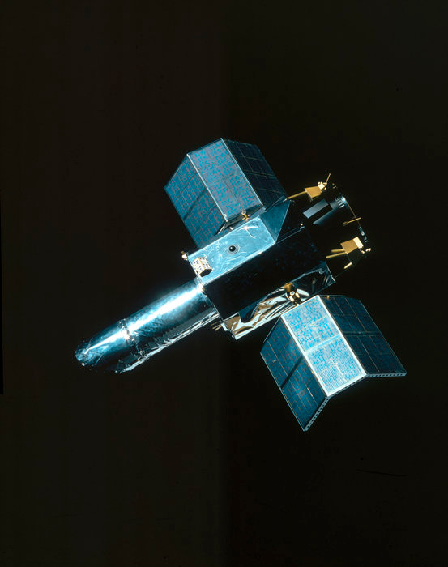
Small Astronomy Satellites (SAS)
SAS-D
International Ultraviolet Explorer (IUE)
1978-1996
45 cm mirror
Low- and High-dispersion spectrographs
FES camera
Observed more than 10,000 objects
Image Credit: NASA

Slide 5
UV Science at NASA
NASA has been involved directly or indirectly in many UV missions:
Legacy: ANS, TD-1, Copernicus, IUE, Astro I/II (UIT, WUPPE, HUT), MSX
Large Observatory: HST (FOC, WPFC2, FOS, STIS, GHRS, ACS, COS)
Explorer Series: EUVE, FUSE, GALEX and limited capabilities: XMM and Swift

Slide 7
Decadal Survey 2010
Main Report Table ES.1 | Main Report Page 7-26 | Panel Reports Page 6-36 | Panel Reports Fig. 6.17-19
Definition of a future UV-optical space capability. Technology development benefiting a future UV telescope to study hot gas between galaxies, ISM, and exoplanets $40M for decade | Key advances could be made with a telescope with a 4-m diameter aperture with large FOV ad fitted with high-efficiency UV and optical cameras/spectrographs operating at shorter wavelengths than HST | The panel views this is a unique opportunity that requires a dedicated technology development program. Because it believes that a UV-optical telescope is a particularly strong candidate for a new stars in the 2021-2030 decade…… | UV Detectors, Large Focal Plane Arrays UV and Optical Detectors, Wave Front Sensing and Control, Coatings, Occulters, Deployable Mirrors Mirror and Optical Technologies, UV coatings, Nulling Interferometry

Slide 8
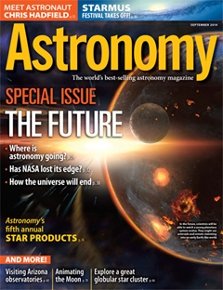
The Future of Astronomy – September 2014
The discovery of life on an Earth-like world will have a more profound, perhaps an even greater, impact on our 21st-century society than the Apollo Moon landings had in the last century. Such a discovery holds the promise to create a renaissance in scientific and spiritual thought beyond anything in recent history, and that might spark a renewed interest in preserving life on our home, Earth 1.0. This is the scientific and human space exploration vision we believe is worthy of our investments in our space agency and our great nation, representing an opportunity to alter the course of human history.
John Grunsfeld, AA for Science (SMD)
Superficially, dark energy and inflation do seem to have some similarities," says Fermilab's Dan Hooper. Scientists say that the universe is expanding at an accelerated rate today because of something called dark energy and that for a fraction of a second shortly after the Big Bang, the universe expanded at a tremendously accelerated rate during the inflation epoch. Might dark energy be a contemporary version of what physicists call the inflaton field, which they suspect drove inflation? "
Biosignatures, big data, international scientific collaborations, examine exoplanets, search for life…

Slide 9
Astrophysics (1990 – now)
Community Growth
Sustainability
Great Observatories Era:
All four missions (Hubble - 25, Chandra - 16, Spitzer -12, CGRO - 9)
Named fellowships (2015 - Sagan: 6, Hubble: 17, Einstein: 14) => ~ 90+ fellows!
Roman Technology Fellowship (2)
Data archives (MAST, ADS, IPAC/NED/NExScI, HEASARC)
Promises of Technologies:
APRA, SAT, STMD
Science Case for Mission Concepts:
RFI for UV/Vis science – 34 submissions – 2012 (Scowen et al. 2013, Experimental Astronomy)
Articulating & Formulating
Communicating
Marketing and Selling
Increasing system throughput is the single most important and cost-effective way to increase science productivity at UV wavelengths.
(from White Paper to Astro Decadal 2010, by Sembach et al. 2009)

Slide 10
AAS Members

Slide 11
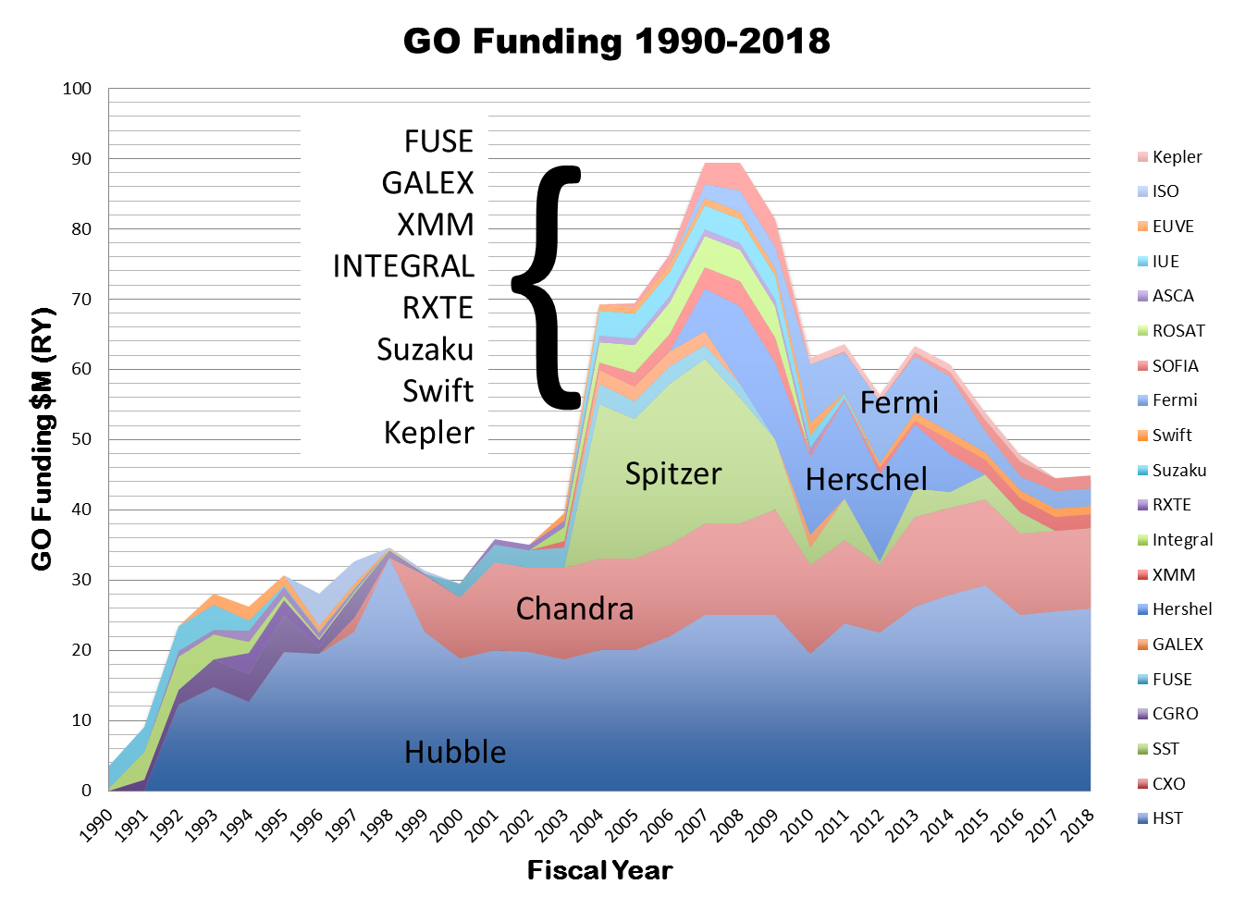
GO Funding
$60M

Slide 12
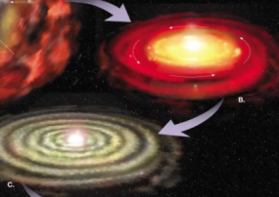
Strategic Astrophysics Technology (SAT)
Introduced in 2009, the Strategic Astrophysics Technology (SAT) Program was established to support the maturation of mid-range Technology Readiness Level (TRL) technologies developed and tested in the laboratory (TRL ≥ 3) to a point where they can be incorporated into flight missions with an acceptable level of risk (TRL ~ 5-6).
How did we get here? ➔ Cosmic Origins Program (COR) – GSFC Program Office
Are we alone? ➔ Exoplanet Exploration Program (EXEP) – JPL Program Office
How does the universe work?➔ Physics of the Cosmos (PCOS) – GSFC Program Office

Slide 13
Why Technology Maturation?
The need for technology maturation is imposed by the entrance requirements for proposing flight missions (TRL ~ 5-6).
The impact of “technology maturity and design stability,… can lessen cost and schedule risks” (US Government Accountability Office report on 21 large NASA projects for a combined life-cycle cost in excess of $43B).
There are many programs about technology inception, but few on technology maturation because they are more expensive, specific and laborious.

Slide 14
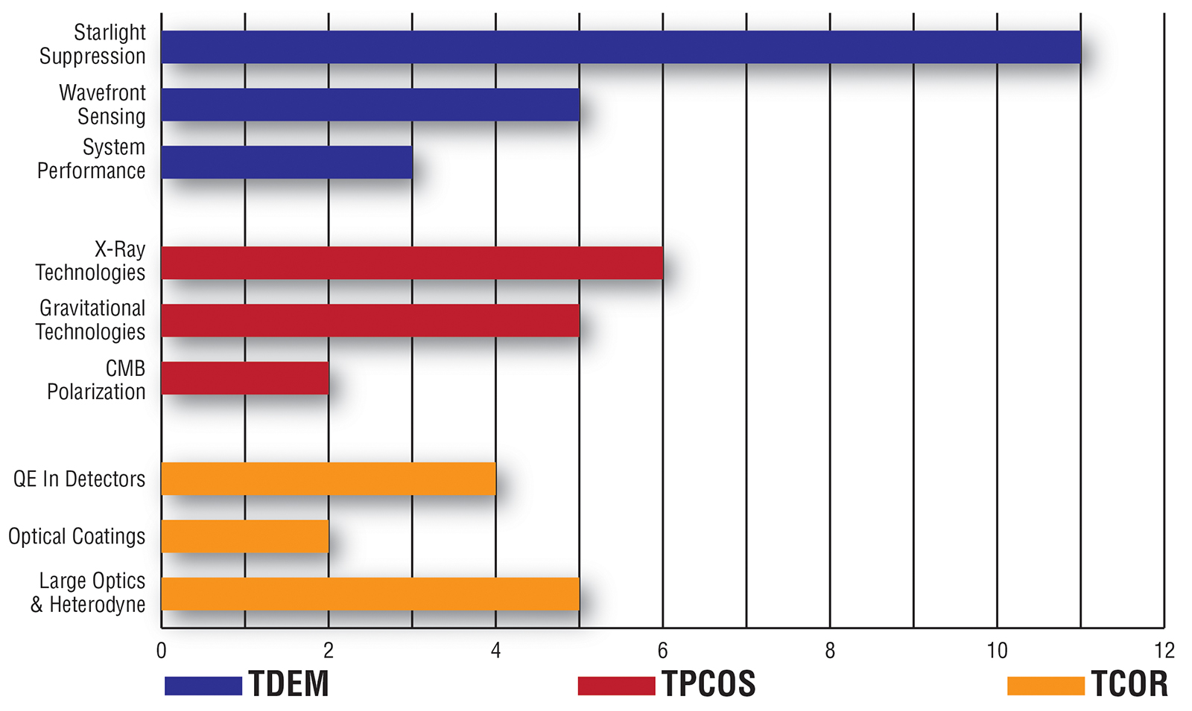
SAT Selected Proposals in Themes (2014)
SAT COR investment has ben $18M since FY10
~ $30 - 40M FY17 & Beyond

Slide 16
Astrophysics and Heliophysics Workshop

Slide 17
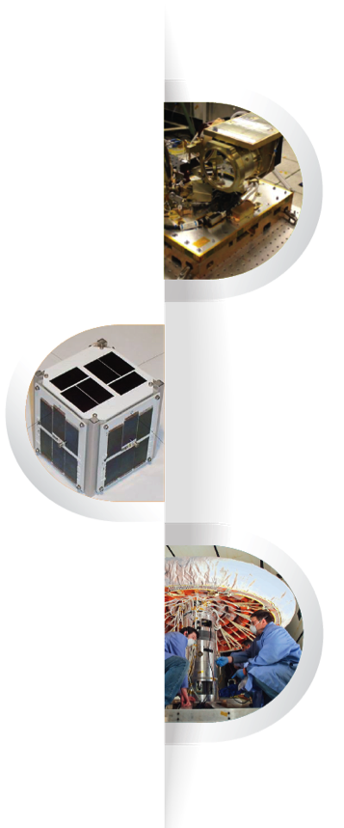
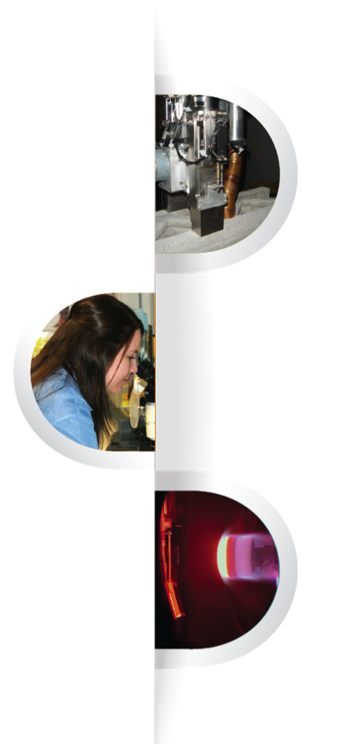
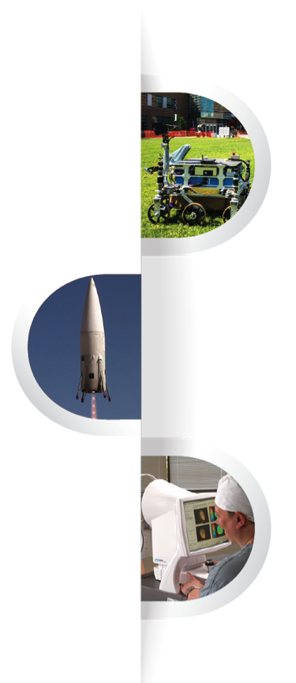
Space Technology Portfolio
Transformative & Crosscutting Technology Breakthroughs
^{Pioneering Concepts/Developing}
^{Innovation Community}
^{Creating Markets & Growing}
^{Innovation Economy}
Office of the
Associate Administrator
^{Technology} ^{Demonstration}
Missions (TDM) bridges the gap between early proof-of-concept tests and the final infusion of cost-effective, revolutionary technologies into successful NASA, government and commercial space missions.
^{NASA Innovative Advanced}
Concepts (NIAC) nurtures visionary ideas that could transform future NASA missions with the creation of breakthroughs—radically better or entirely new aerospace concepts–while engaging America’s innovators and entrepreneurs as partners in the journey.
Centennial Challenges directly engages nontraditional sources advancing technologies of value to NASA’s missions and to the aerospace community. The program offers challenges set up as competitions that award prize money to the individuals or teams that achieve a specified technology challenge.
^{Small Spacecraft}
Technology Program (SSTP) develops and demonstrates new capabilities employing the unique features of small spacecraft for science, exploration and space operations.
Space Technology Research Grants (STRG) seeks to accelerate the development of “push” technologies to support future space science and exploration needs through innovative efforts with high risk/high payoff while developing the next generation of innovators through grants and fellowships.
^{Flight Opportunities}
facilitates the progress of space technologies toward flight readiness status through testing in space-relevant environments. The program fosters development of the commercial reusable suborbital transportation industry.
^{Game Changing}
Development (GCD) seeks to identify and rapidly mature innovative/high impact capabilities and technologies that may lead to entirely new approaches for the Agency’s broad array of future space missions.
Center Innovation Fund (CIF) stimulates and encourages creativity and innovation within the NASA Centers by addressing the technology needs of the Agency and the Nation. Funds are invested to each NASA Center to support emerging technologies and creative initiatives that leverage Center talent and capabilities.
^{Small Business} Innovation Research (SBIR) and Small Business Technology Transfer (STTR) Programs provide an opportunity for small, high technology companies and research institutions to develop key technologies addressing the Agency’s needs and developing the Nation’s innovation economy.
Space Technology Research Grants
17
17

Slide 18
FY 2015 Tentative Solicitation Schedule
STMD Program | Solicitations | FY 2015 Targeted Release
 |  | Q1 | Q2 | Q3 | Q4
NASA Innovative Advanced Concepts (NIAC) | NIAC Phase I | X
 | NIAC Phase II |  | X
Space Technology Research Grants (STRG) | Early Career Faculty (ECF) |  | X
 | Early Stage Innovations (ESI) |  |  | X
 | NASA Space Technology Research Fellowships (NSTRF)-Fall 2015 | X (Sept)
Game Changing Development (GCD) | GCD Technology Topics | X
 | GCD Technology Topics |  |  | X
Technology Demonstration Missions (TDM) | Technology Demonstration Mission Topics |  |  |  | X
Small Spacecraft Technology (SST) | SST Development and Demonstration |  | X
 | SST Partnerships |  | X
Flight Opportunities Program (FOP) | FOP Technology Topic | X |  | X
 |  | (Sept)
Small Business Innovative Research (SBIR) | SBIR/STTR Phase I | X
 | SBIR/STTR Phase II | X

Slide 19
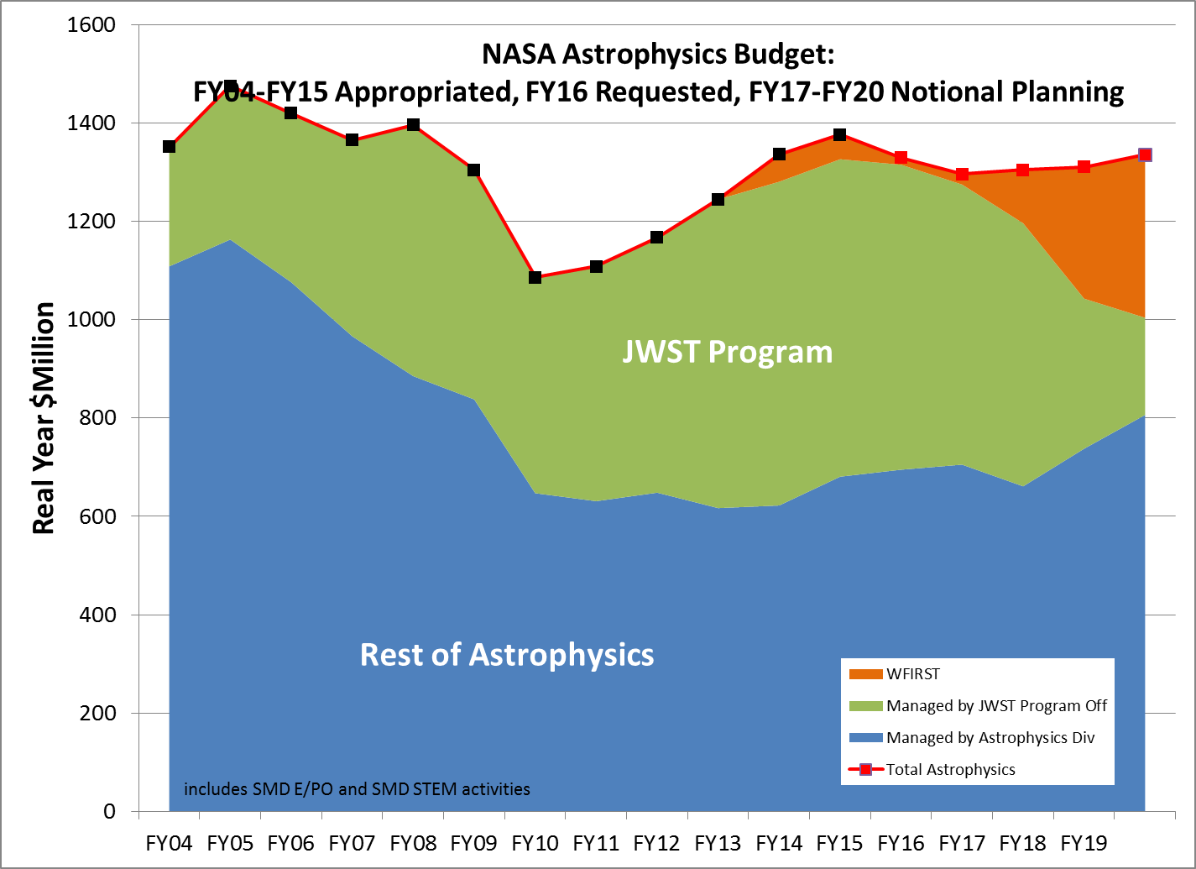

Slide 20
Looking Ahead Potential Start Date of Decadal 2020 Mission
JWST Predicted Launch Date
2018
AFTA/WFIRST
Predicted Launch Date
2025
AFTA/WFIRST Mission Start
2017
Decadal 2020 Mission Start
2024
Budget Request For AFTA/WFIRST Mission Start
2016
Budget Request For New Mission Start
2023
Gives us minimum 4 years from Decadal 2020 to enter Phase-A.
Notes:
Planck ~ 2.5 years
Fermi = 5 years (10 years)
Euclid = 5 years & WFIRST = 5 years

Slide 21
Roadmap To Decadal 2020
Industrial Partnerships
White Papers submittal to Decadal
FY 20
2020 Decadal Science Prioritization
White Papers submittal to Decadal
Independent Community White Papers
FY 18-19
White Papers submittal to Decadal
CST Formulation
RFI
Workshop
ROM Costs
CST Formulation
RFI
Workshop
ROM Costs
FY 15-16
CST Formulation
RFI
Workshop
FY 16-17
Notional Missions
Cost Bucket A
Cost Bucket B
Cost bucket ….
FY 17-18
Technology Roadmaps
Competed SAT Development
FY 24-25
Initiate Phase-A
FY 23-24
Formulate Budget Request for New Start
FY 22-23
Independent Assessment by NRC
FY 21-23
Competed Mission Concept Studies for Highest Priority Science
FY 20-21
Develop Implementation Plan
FY 21-25
Directed Technology Development
NASA Sponsored, Community Lead Activity
NRC Activity
NASA Lead Activity

Slide 22
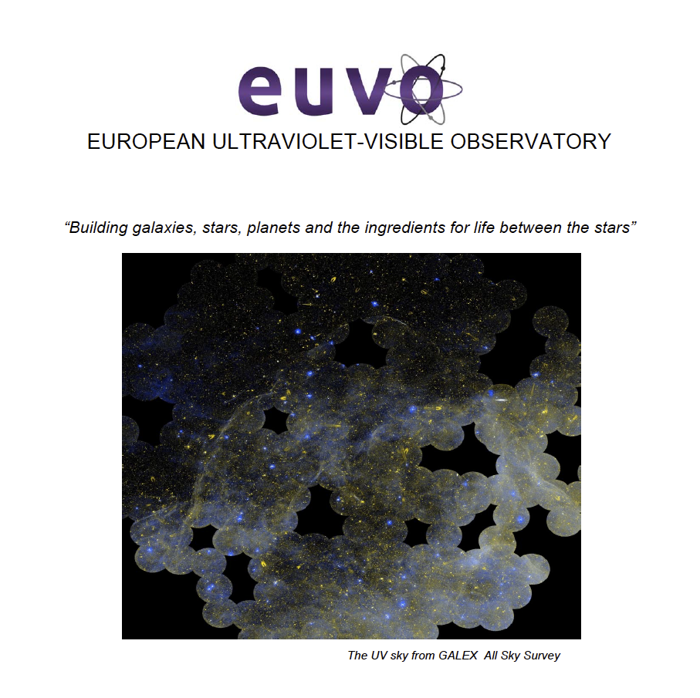

Slide 23
ESA Cosmic Visions
June 4, 2015 - M4 Selection for further study – launch in 2025:
Atmospheric Remote-Sensing Infrared Exoplanet Large-survey (ARIEL)
Turbulence Heating ObserveR (THOR)
X-ray Imaging Polarimetry Explorer (XIPE)
Past Selections (blue astrophysics)
L1 – JUICE – 2022 (Planetary)
L2 - Athena - 2028
L3 - eLISA - 2034
M1 – Solar Orbiter – 2018 (Heliophysics)
M2 – Euclid - 2020
M3 – PLATO - 2024
S1 – CHEOPS - 2017
Should we try to collaborate with ESA on the M4 mission?

Slide 24
Planning for the 2015-2016 Mid-Decade Review
The NASA Authorization Act of 2005 requires assessments of NASA’s science programs that include mid-decade reviews.
The Astrophysics Mid-Decade Review will be during 2015-2016
Study will be co-sponsored by NASA, NSF, and DOE (the Agencies)
Given the funding circumstances that are substantially below those assumed in the Decadal Survey, the committee's review will describe:
The most significant scientific discoveries, technical advances, and relevant programmatic changes in astronomy and astrophysics since the Decadal Survey;
How well the Agencies' programs address the strategies, goals, and priorities outlined in the Decadal Survey and other NRC reports;
Progress toward realizing these strategies, goals and priorities; and
Any actions that could be taken to maximize the science return of the Agencies’ programs.
The Agencies are in the process of charging the NRC, and formation of the Study Committee will begin soon (Jackie Hewitt, Chair).

Slide 25
Planning for the 2015-2016 Mid-Decade Review
Directions in New Worlds, New Horizons relevant to NASA (paraphrased)
LISA: If LISA is not L1, or LISA Pathfinder is not successful, or equal partnership is not possible, then conduct review to reconsider LISA’s prioritization. (p.9, p.213)
NASA working toward partnership on ESA L3, will invest in enabling technology and LPF; anticipate review by 2020 Decadal Survey regarding priority of strategic partnership on ESA L3.
IXO: If IXO is L1, conduct review then (maybe) invest immediately in technology. By mid-decade, invest aggressively in technology. (p. 9, p. 214, p. 215)
NASA planning on partnership on ESA Athena, investing in technology now, expect details of partnership to be established soon; anticipate partnership well underway by time of 2020 Decadal Survey.
New Worlds: If precursor science is favorable, conduct review then (maybe) downselect technology and invest to ready a mission for the 2020 decadal survey. (p.20, p.195, p.216)
NASA maturing multiple technologies and studying multiple architectures in advance of 2020 Decadal Survey, not planning to downselect technology prematurely; anticipate review by 2020 Decadal Survey regarding priority – and possibly size and architecture – of strategic mission.
Inflation Probe: If B-mode detected, conduct review then (maybe) invest in technology for an all-sky mission. (p.198, p.217)
NASA maturing multiple detector technologies, considering potential partnerships on ESA and JAXA led missions; anticipate review by 2020 Decadal Survey regarding priority of probe-class mission.
DSIAC: Conduct review to see whether any contingencies have occurred and recommend action. (p.102, p.237)

Slide 26
Preparing for the 2020 Decadal Survey Large Mission Concepts
The 2020 Decadal Survey will prioritize large space missions to follow JWST and WFIRST.
To enable this prioritization, NASA needs to provide information on several candidate large space mission concepts for consideration by the 2020 Decadal Survey Committee.
What information needs to be provided to the Decadal Survey committee to enable prioritization of large missions
Science case
Strawman design reference mission with strawman payload
Technology development needs
Cost requirements assessment
NASA needs to initiate technology development for candidate large missions so that technology will be ready when needed.
Technology needs to be sufficiently mature when it is time to start the highest priority large mission in the 2020 Decadal Survey.
The next large mission after WFIRST could be started when funding becomes available as WFIRST approaches launch in the early or mid-2020s.

Slide 27
Preparing for the 2020 Decadal Survey Large Mission Concepts
Study 3-4 large mission concepts as candidate prioritized large missions
Science case
Technology assessment
Design reference mission with strawman payload
Cost assessment
Community Plan
2015: PAGs gather community input on selecting concepts for study
2016: Appoint STDTs and Center study office, STDT assess technology
2017: Fund technology development through SAT, STDT works
2018: STDT submits DRM for cost assessment
2019: STDT issues report, input to Decadal Survey
Community workshops (incomplete list)
Mar 19, Joint PAG EC meeting, Baltimore
Jun 3-5, Far-IR workshop, Pasadena
Jun 13-14, ExoPAG meeting, Chicago
Jun 25-26, UV-Vis SIG meeting, Greenbelt
Jun 29-Jul 1, HEAD & PhysPAG meeting, Chicago
Aug 1, Joint PAG session @ IAU General Assembly, Honolulu

Slide 28
Preparing for the 2020 Decadal Survey Large Mission Concepts
The initial short list (in alphabetical order):
FAR IR Surveyor – The Astrophysics Visionary Roadmap identifies a Far IR Surveyor as contributing through improvements in sensitivity, spectroscopy, and angular resolution.
Habitable-Exoplanet Imaging Mission – The 2010 Decadal Survey recommends that a habitable-exoplanet imaging mission be studied in time for consideration by the 2020 decadal survey.
UV/Optical/IR Surveyor –The Astrophysics Visionary Roadmap identifies a UV/Optical/IR Surveyor as contributing through improvements in sensitivity, spectroscopy, high contrast imaging, astrometry, angular resolution and/or wavelength coverage. The 2010 Decadal Survey recommends that NASA prepare for a UV mission to be considered by the 2020 Decadal Survey.
X-ray Surveyor – The Astrophysics Visionary Roadmap identifies an X-ray Surveyor as contributing through improvements in sensitivity, spectroscopy, and angular resolution.

Slide 29
Preparing for the 2020 Decadal Survey Large Mission Concepts
Part A – 2015
Identify a small set of candidate large mission concepts to study
NASA draws a small set of candidate mission concepts from existing roadmap and strategic documents
Incorporate community input through the three Astrophysics Program Analysis Groups (PAGs)
Part B – 2016-2019
Initiate studies
Includes community-based Science and Technology Definition Teams
Conduct studies
Includes NASA Center-provided engineering teams
Identify technology requirements to motivate early technology development
Enables funding through existing Astrophysics technology programs
Deliver results to 2020 Decadal Survey committee
Planning for the 2020 Decadal Survey: An Astrophysics Division White Paper
available at http://science.nasa.gov/astrophysics/documents

Slide 30
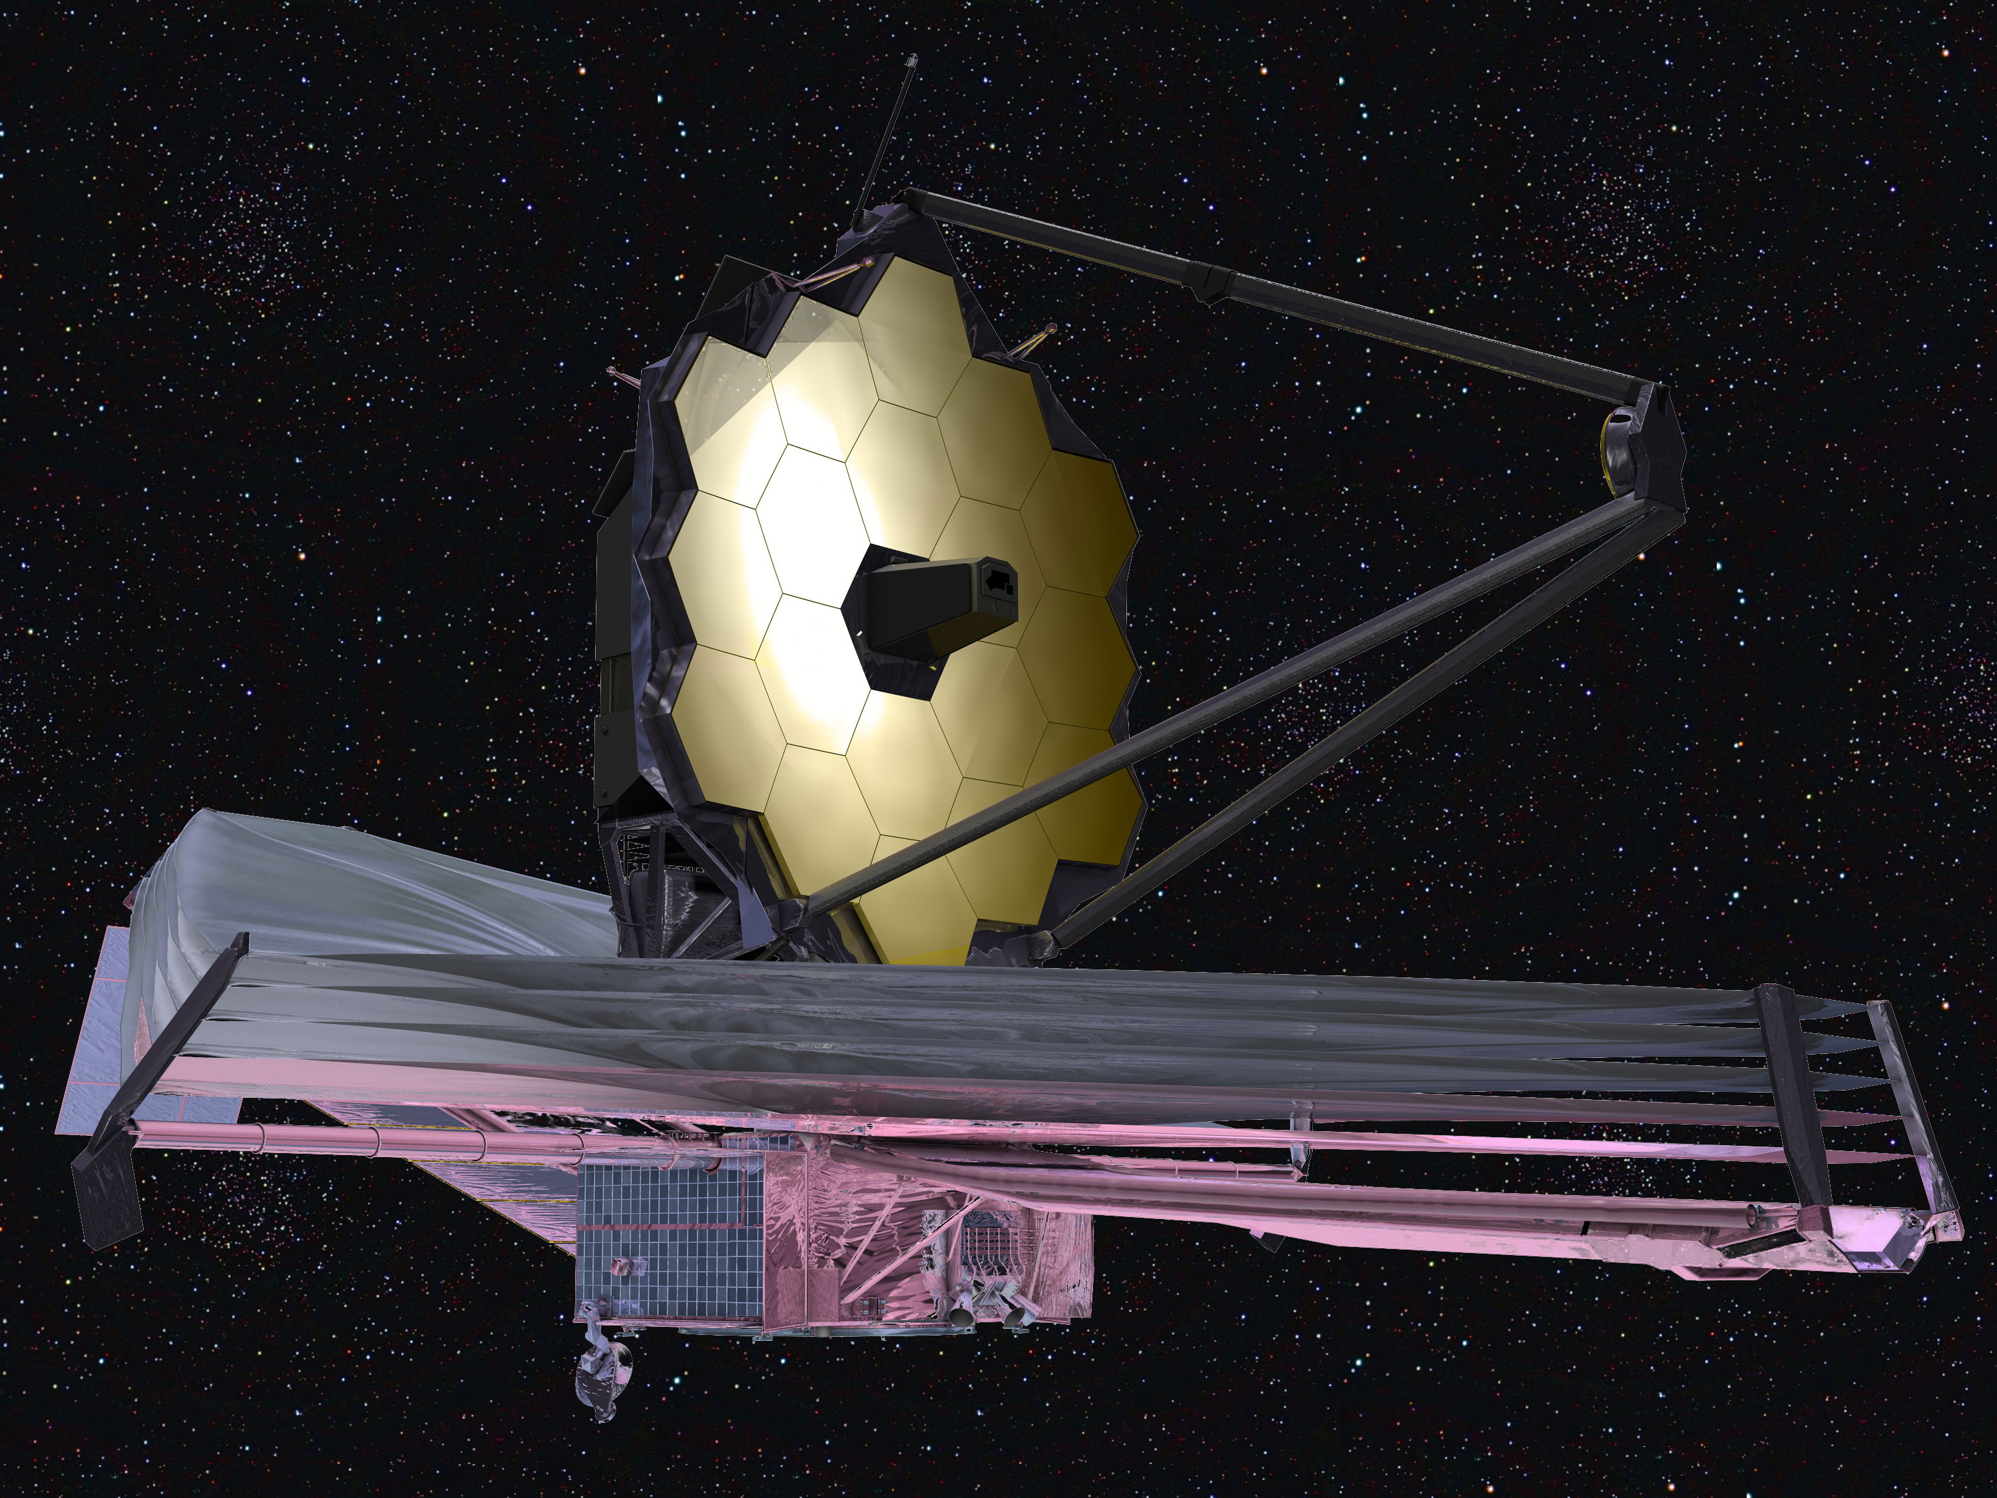
Preparing for JWST Science
Need to ensure a smooth transition of JWST management back into the Astrophysics Division when prime ops begin.
Need to ensure that the budget is right. Adequate to reap the science benefits of JWST. Balanced to enable appropriate GO funding.
Constrained to permit development of future observatories.

Slide 31
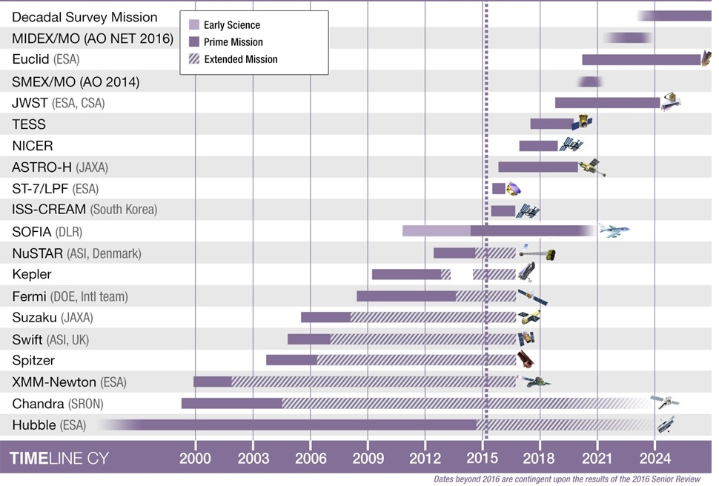
Astrophysics Timeline
31
31

Slide 32
May 2015

Slide 33
Backups

Slide 34
Astrophysics PAGs
→ NASA / Charlie Bolden
→ SMD / John Grunsfeld
→ Astrophysics / Paul Hertz
Program Scientist:
Mario Perez
Mike Garcia
Program Executive:
Jeanne Davis
Program Manager:
Mansoor Ahmed (GSFC)
Chief Scientist:
Susan Neff
Deborah Padgett (GSFC)
Program Scientist:
Doug Hudgins
Martin Still
Program Executive:
John Gagosian
Program Manager:
Gary Blackwood (JPL)
Chief Scientist:
Wes Traub (JPL)
Program Scientist:
Rita Sambruna
Wilt Sanders
Program Executive:
Jeanne Davis
Program Manager:
Mansoor Ahmed (GSFC)
Chief Scientist:
Ann Hornschemeier
Peter Bertone
(GSFC)

Slide 35
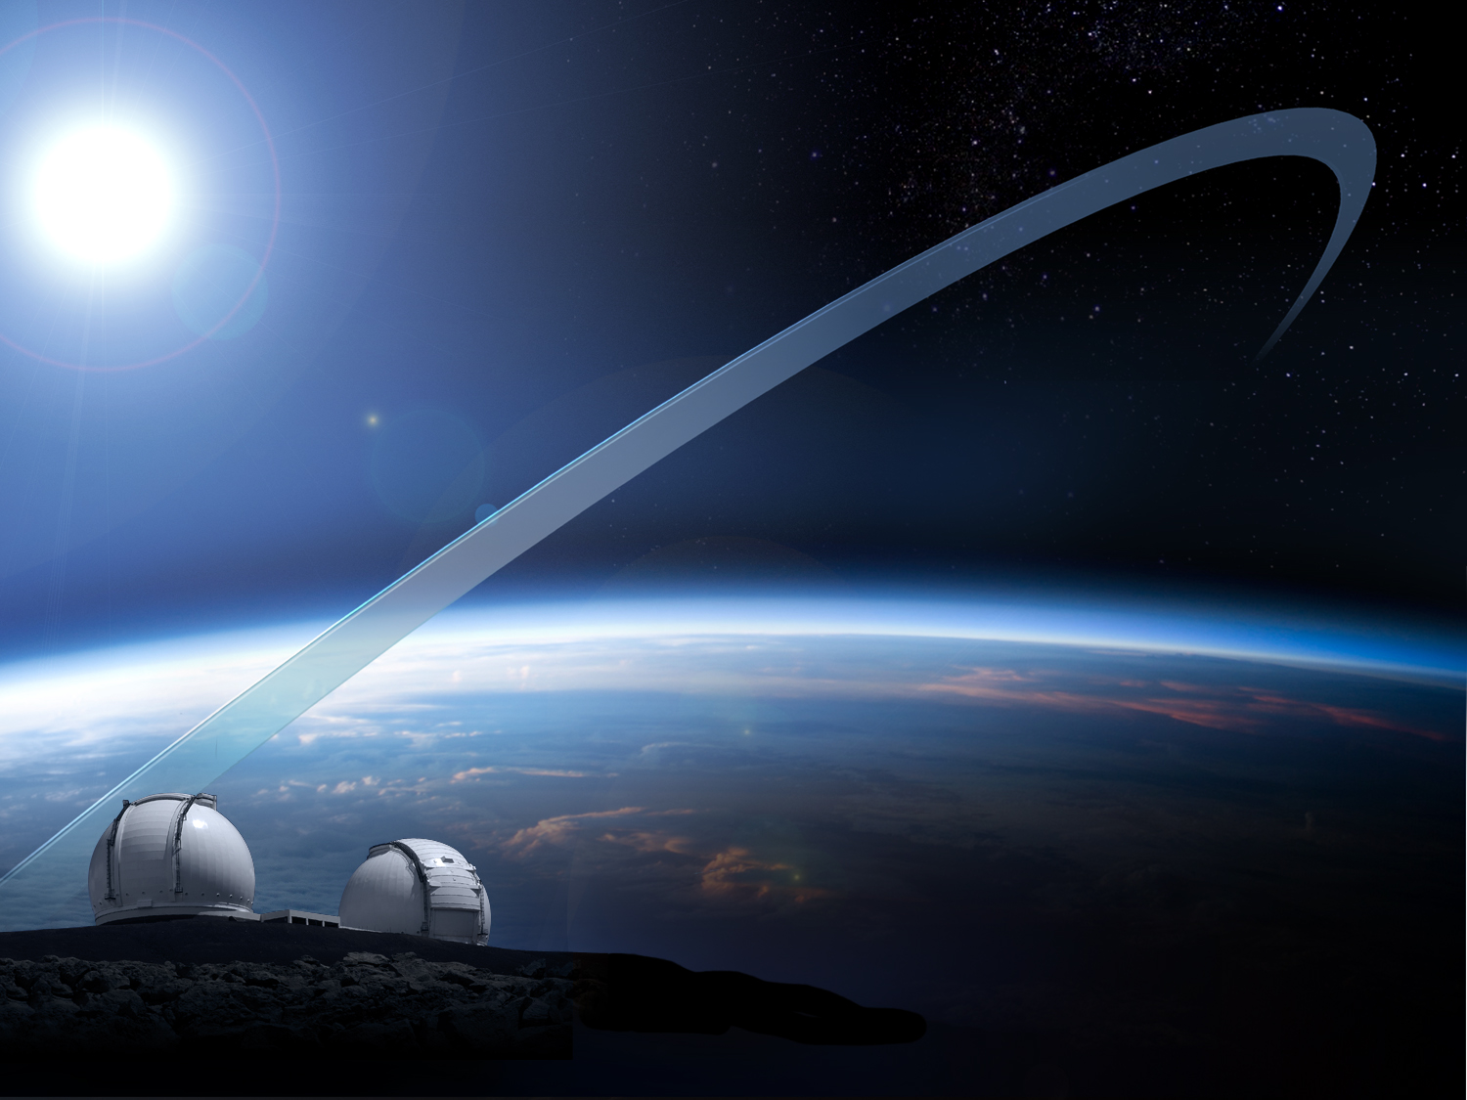
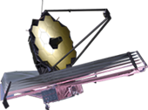
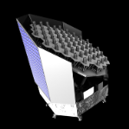
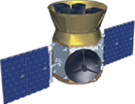
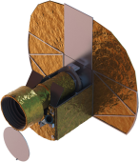
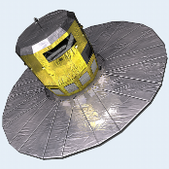
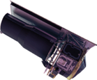
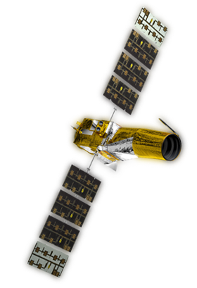
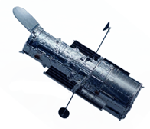
Missions formally part of Exoplanet Exploration Program Portfolio.
WFIRST/AFTA
NASA Missions advancing Exoplanet Science goals
JWST
TESS
PLATO
Kepler
CHEOPS
Spitzer
Gaia
New Worlds Telescope
Hubble*
CoRoT **
NASA
Missions
ESA/European
Missions
Demographics
Characterization
Ground-based Observatories
* NASA/ESA Partnership
** CNES/ESA
35

Slide 36
NN-EXPLORE Partnership
NASA and the NSF have teamed up to establish
“NN-EXPLORE” – the NASA/NSF EXoPLanet Observational REsearch partnership.
NN-EXPLORE capitalizes on the NOAO share (40%) of the observing time on the 3.5-m WIYN at Kitt Peak National Obs.
Primary objective is to enable a community-based exoplanet research program that advances NSF research interests and supports the exoplanet observations of NASA missions (e.g. K2, TESS, JWST, etc.).
The cornerstone of NN-EXPLORE will be a state-of-the-art extreme precision Doppler spectrometer with open access to the U.S. astronomical community (est. delivery 2018).
Partnership commences with the WIYN 2015B observing semester, using the existing compliment of instruments to conduct observations that advance NN-EXPLORE science goals.

Slide 37
NN-EXPLORE Partnership
NASA and the NSF have teamed up to establish
“NN-EXPLORE” – the NASA/NSF EXoPLanet Observational REsearch partnership.
NN-EXPLORE capitalizes on the NOAO share (40%) of the observing time on the 3.5-m WIYN at Kitt Peak National Obs.
Primary objective is to enable a community-based exoplanet research program that advances NSF research interests and supports the exoplanet observations of NASA missions (e.g. K2, TESS, JWST, etc.).
The cornerstone of NN-EXPLORE will be a state-of-the-art extreme precision Doppler spectrometer with open access to the U.S. astronomical community (est. delivery 2018).
Partnership commences with the WIYN 2015B observing semester, using the existing compliment of instruments to conduct observations that advance NN-EXPLORE science goals.

Slide 38
Astrophysics - Big Picture
The FY15 appropriation and FY16 budget request provide funding for NASA astrophysics to continue its programs, missions, and projects as planned
The total funding (Astrophysics including JWST) is flat at ~$1.3B through FY20
Fully fund JWST to remain on plan for an October 2018 launch
Fund continued pre-formulation and technology work leading toward WFIRST
Restore SOFIA to the budget with a reduction in FY15 and full funding beyond
Provide funding for SMD’s education programs
The operating missions continue to generate important and compelling science results, and new missions are under development for the future
Chandra, Fermi, Hubble, Kepler/K2, NuSTAR, Spitzer, Suzaku, Swift, XMM-Newton continued following the 2014 Senior Review
SOFIA is in prime operations as of May 2014
Missions on track for launch include LISA Pathfinder (2015), ASTRO-H (2015), NICER (2016), TESS (2017), JWST (2018), Euclid (2020)
New Explorers being selected (SMEX in 2015, MIDEX in 2017), WFIRST being studied, NASA joining ESA’s Athena and ESA’s L3 gravitational wave observatory
Progress being made against recommendations of the 2010 Decadal Survey
Update to the Astrophysics Implementation Plan has been released
NRC Mid Decade Review (with NSF, DOE) to begin in early 2015
NASA initiating large mission concept studies for 2020 Decadal Survey

Slide 39
Progress Toward Decadal Survey Priorities
The NASA FY15 Appropriation, the President’s FY16 Budget Request, and the notional out year budget planning guidance in the President’s FY16 Budget Request, support:
Large-scale 1. WFIRST | Preformulation and focused technology development for WFIRST/AFTA (a 2.4m version of WFIRST with a coronagraph) are underway to enable a new start NET FY2017. Budget line established for an Astrophysics Decadal Strategic Mission.
Large-scale 2. Augmentation to Explorer Program | Astrophysics Explorers planned budget increased to support decadal cadence of AOs including SMEX AO in Fall 2014 and MIDEX AO in late 2016/early 2017.
Large-scale 3. LISA | Discussing partnership on ESA’s L3 gravitational wave observatory and participating in ESA-led assessments in 2014-2015. Strategic astrophysics technology (SAT) investments plus support of LISA Pathfinder.
Large-scale 4. IXO | NASA is pursuing a partnership on ESA’s L2 Athena X-ray observatory; the Athena study phase, with U.S. participation, is underway. Strategic astrophysics technology (SAT) investments.
Medium-scale 1. New Worlds Technology Development Program | Focused technology development for a coronagraph on WFIRST, strategic astrophysics technology (SAT) investments, and exoplanet probe mission concept studies. Established partnership with NSF to develop extreme precision Doppler spectrometer as facility instrument. Exozodi survey using LBTI.

Slide 40
Progress Toward Decadal Survey Priorities
The NASA FY15 Appropriation, the President’s FY16 Budget Request, and the notional out year budget planning guidance in the President’s FY16 Budget Request, support:
Medium-scale 2. Inflation Probe Technology Development Program | Balloon-borne investigations plus strategic astrophysics technology (SAT) investments.
Small-scale. Research Program Augmentations | Increased annual R&A budget by 10% from FY10 to FY12 and another 10% from FY14 to FY16. Within R&A: established Theoretical and Computational Astrophysics Networks (TCAN) program with NSF; funding available for astrophysics theory; funding available for lab astrophysics; funding available for suborbital payloads.
Small-scale. Intermediate Technology development Augmentation | Established competed Strategic Astrophysics Technology (SAT) program element; directed technology funding for WFIRST and other large-scale decadal priorities.
Small-scale. Future Ultraviolet-Visible Space Capability | Strategic Astrophysics Technology (SAT) investments.
Small-scale. SPICA (U.S. contribution to JAXA-led) | Not supported as a strategic contribution; candidate for Explorer Mission of Opportunity.

Slide 41
LRD: 2018
LRD: 2020s
2003
1999
1990
41

