Slide 1
UVI BurstCube
Cucchiara (UVI)
D. Morris (UVI)
---many collaborators.

Slide 2
The Science
We live now in the epoch of Time-Domain astronomy
We are also at the verge of multi-messanger astronomy
New satellite concepts like the Neil Gehrels Swift Observatory (Swift) and Fermi have revolutionized the way we look at the transient sky

Slide 3
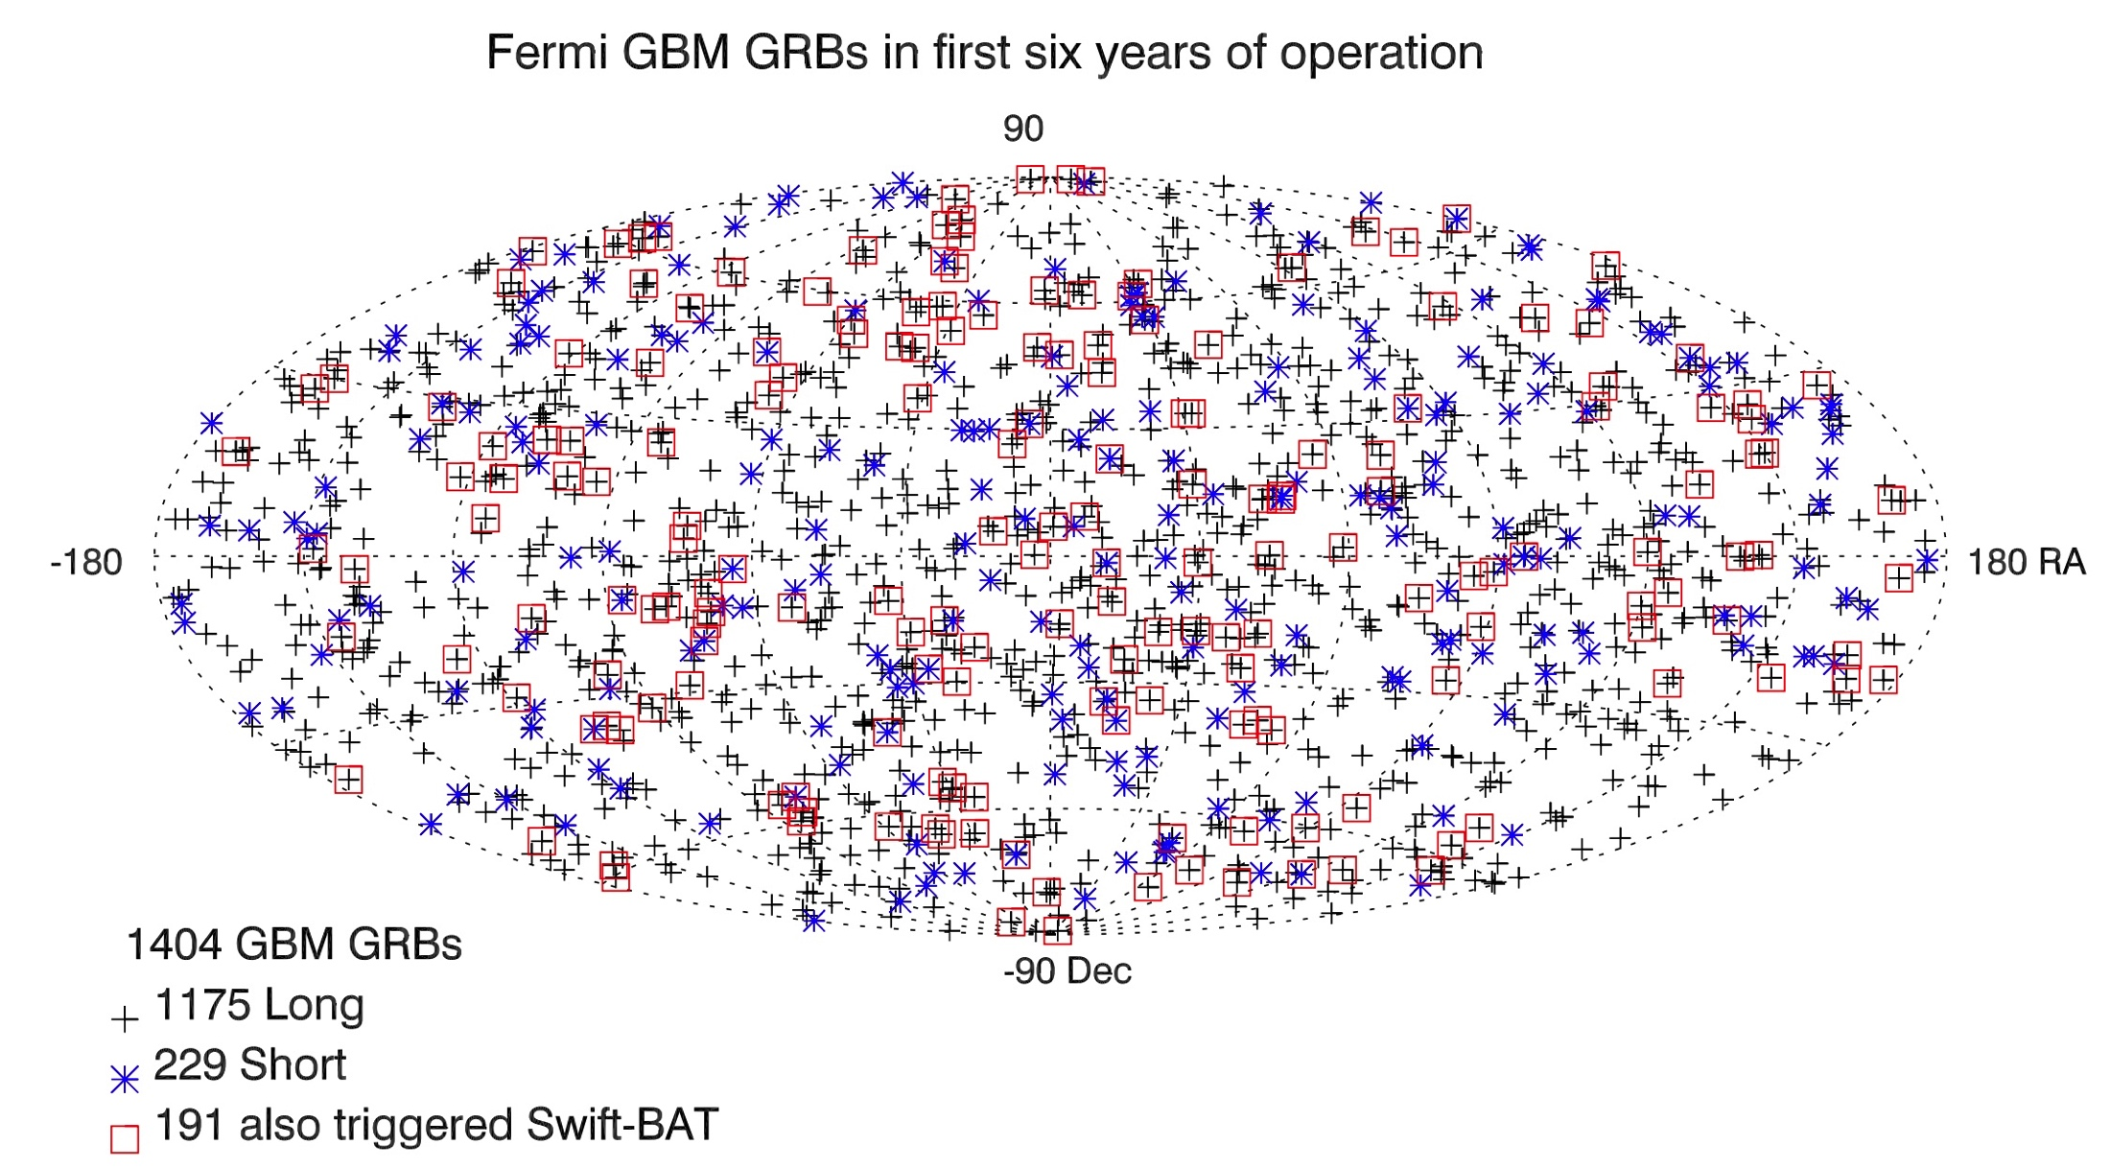
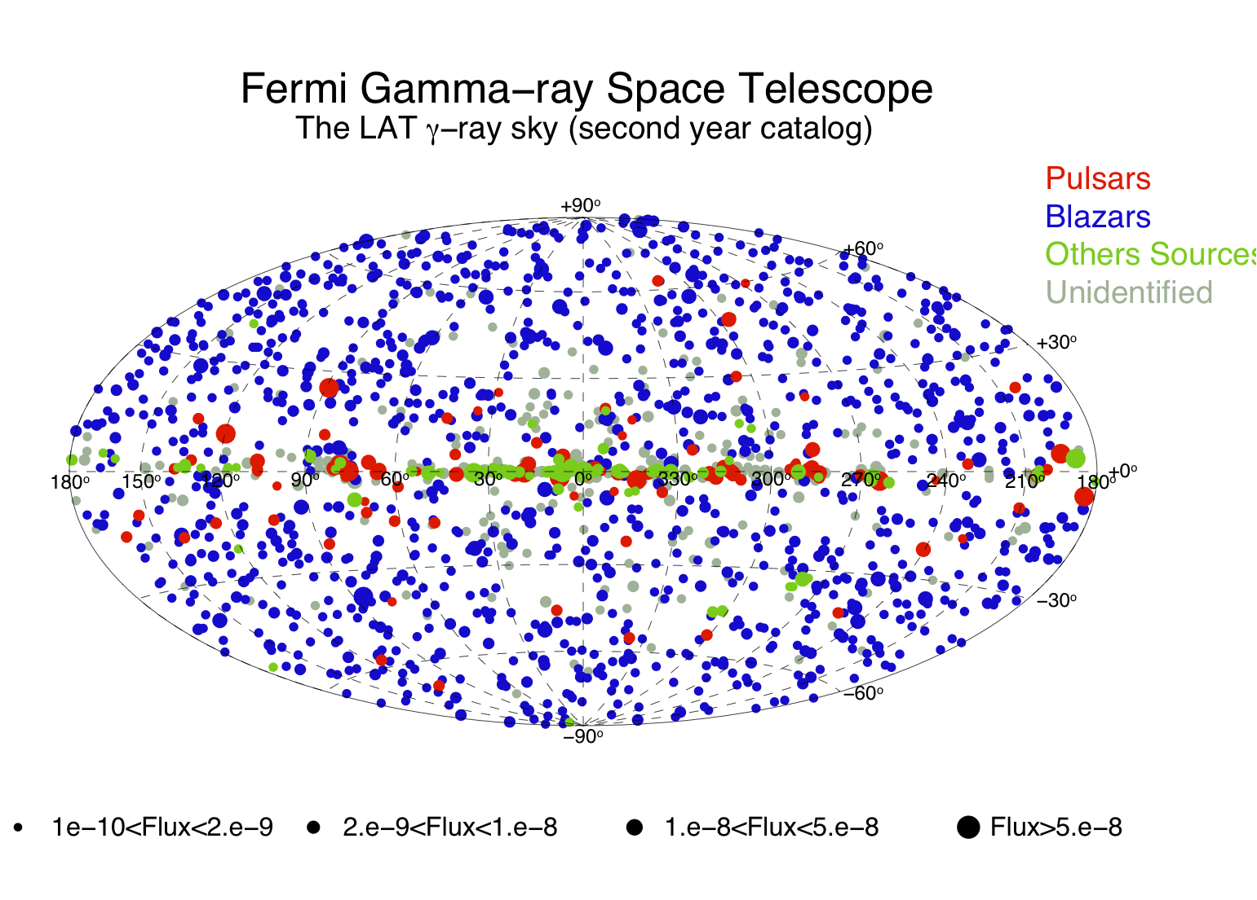
The Transient Sky
30% of GRBs are Short GRBs
Distribution is isotropic
Only a fraction of them have ground-based follow-up
Synergy between LAT-GBM and Swift/BAT
Bhat+16
Many known sources have been monitored
Many unknown sources have been discovered
Public data allow “data-mining” and ground-based follow-up

Slide 4
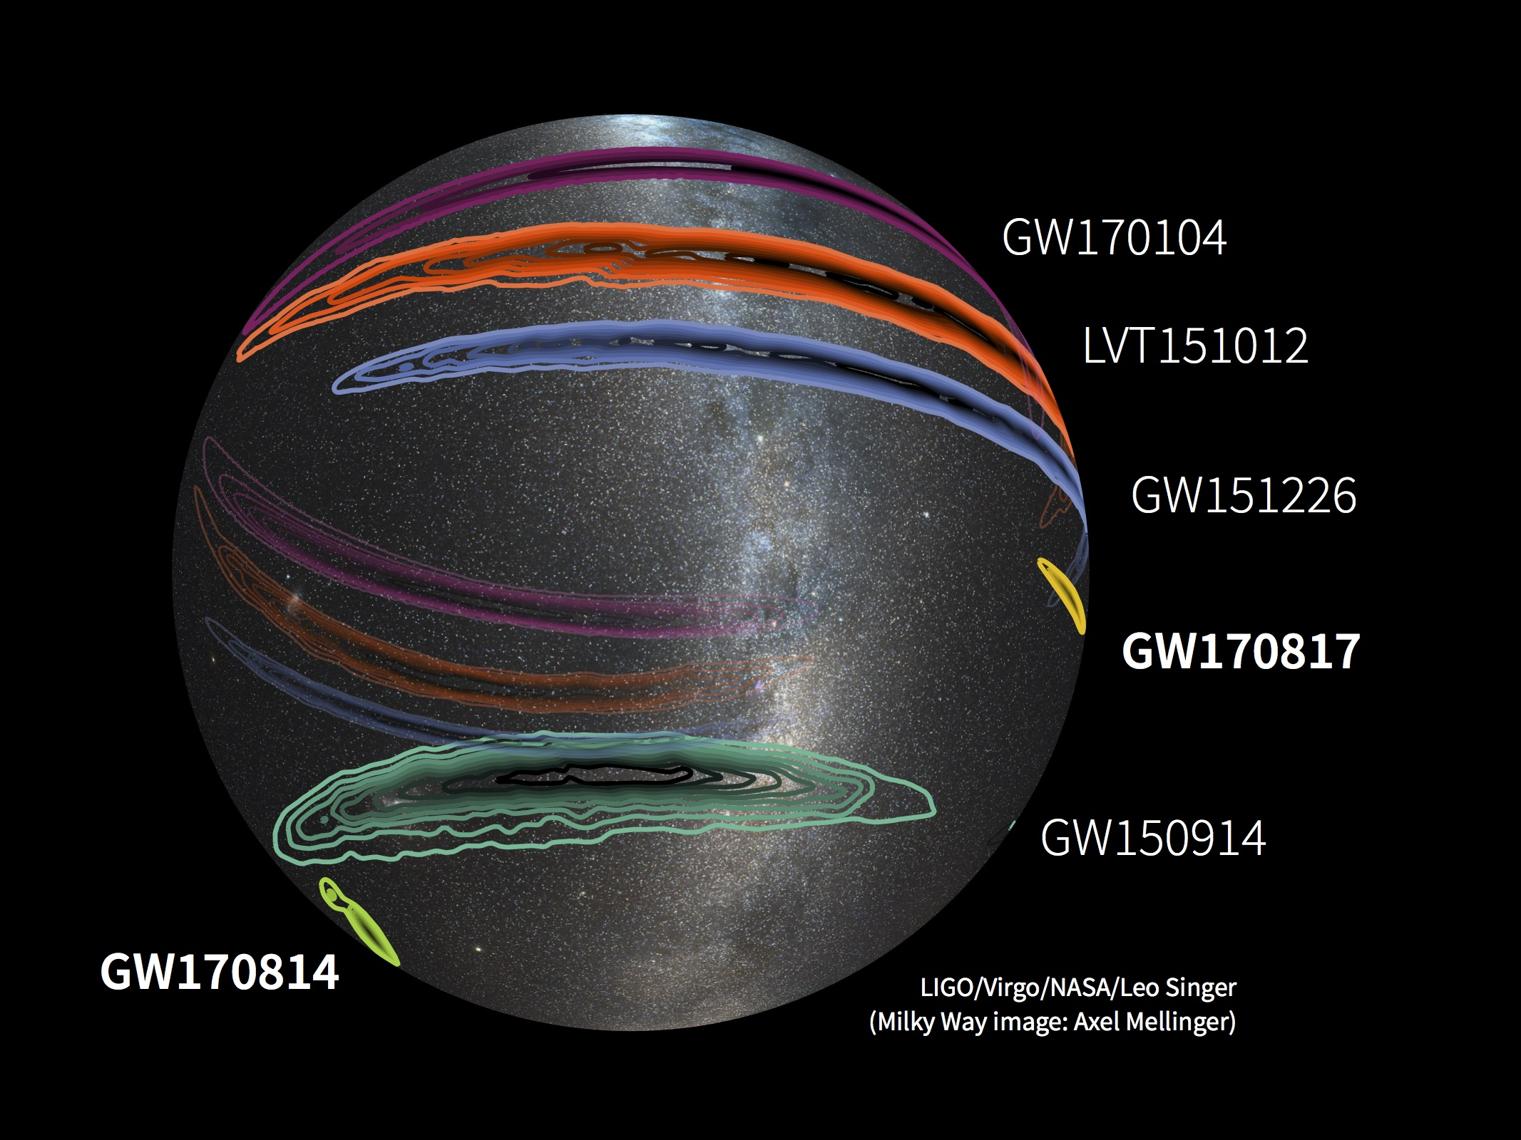
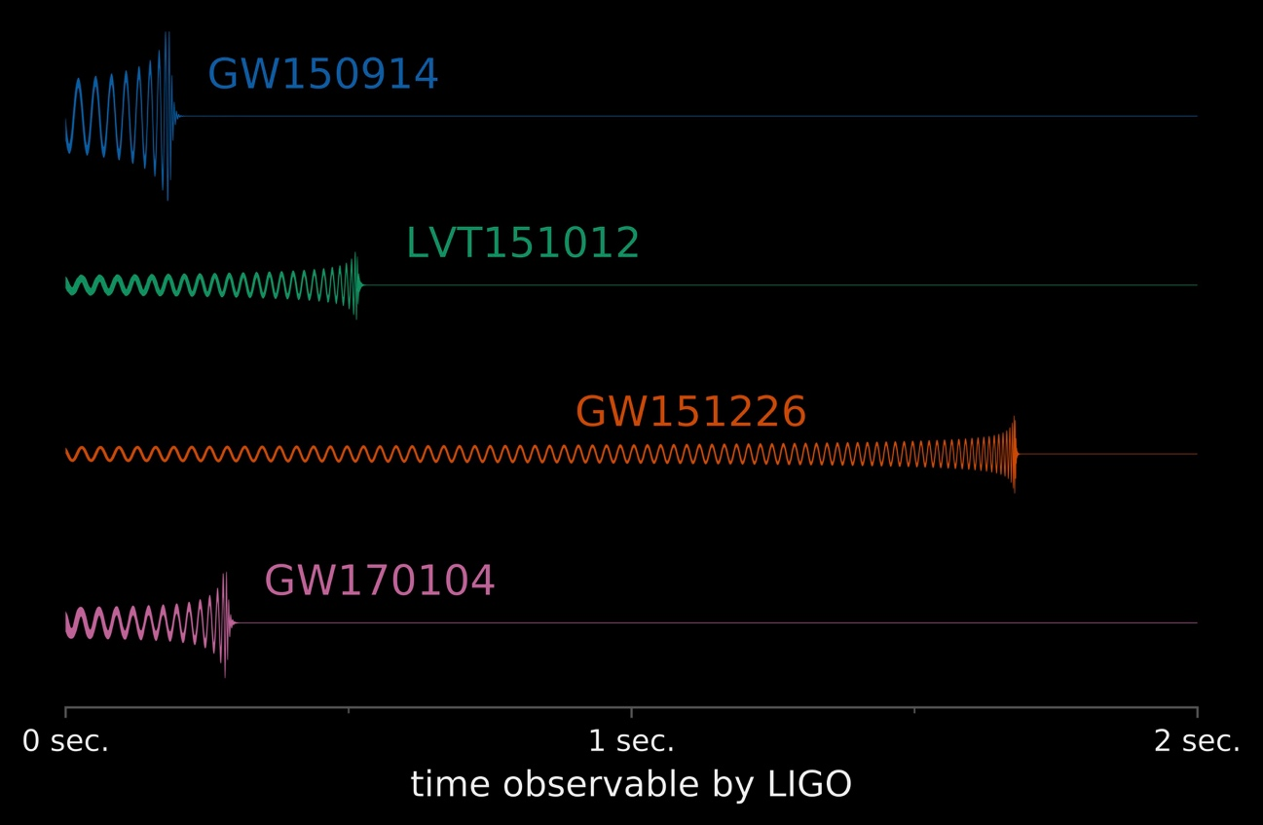
Gravitational Waves
Short GRBs are progenitors of GW emission. The current effort has demonstrated the need of:
All-sky coverage
Rapid response
Accurate localization
Multiwavelength rapid follow-up

Slide 5
UVI BurstCube
3U Cubesat concept in development at the University of the Virgin Islands
10 keV to 1MeV energy range
CsI crystals + array of low-voltage SiPMs
Aim to to provide time and spectral information
Possible gross localization (in development)
60% duty cycle (low-orbit)
Expect >6 sGRBs/yr (>20 long GRBs/yr)
Chances of 1 sGRB-GW event per year (joint with other CubeSats)

Slide 6
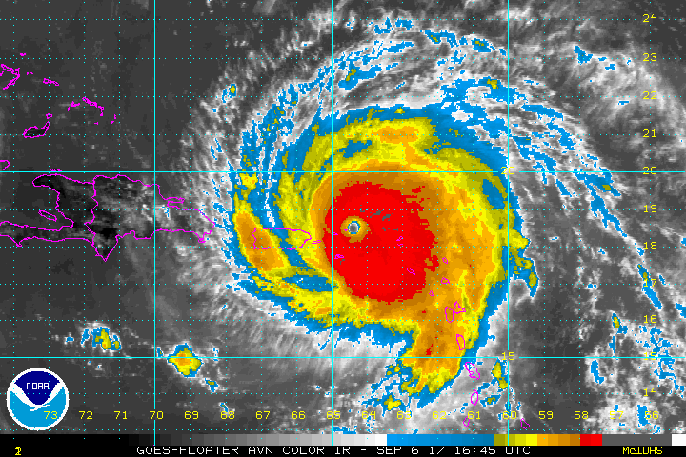
UVI BurstCube - status
The 2017 hurricanes that hit the U.S. Virgin islands pushed back the development for the first part of the 2018.
Since March we have been collaborating with NASA-GSFC and the Burscube team(PI Perkins)
We have been invastigating possible 3U configurations (coll. De Nolfo –NASA-GSFC)
We have been put in orders for crystals/SiPMs
We have been working on Geant simulations
Spetember 12th, 2018

Slide 7
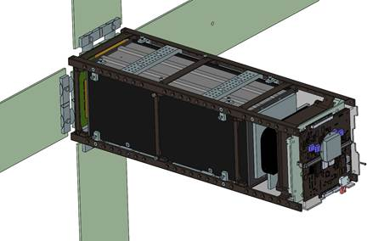
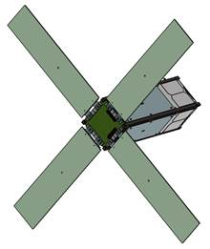
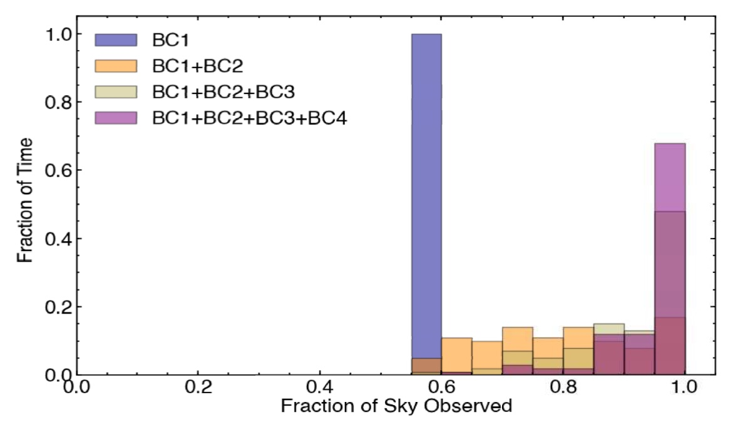
UVI BurstCube - status
Possible design (from Iker Liceaga)
Sky coverage with a single Burstcube vs. a constellation of similar nanosats.
A series of 4 cubesats may provide almost 100% sky coverage.

Slide 8
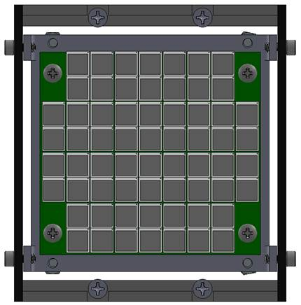
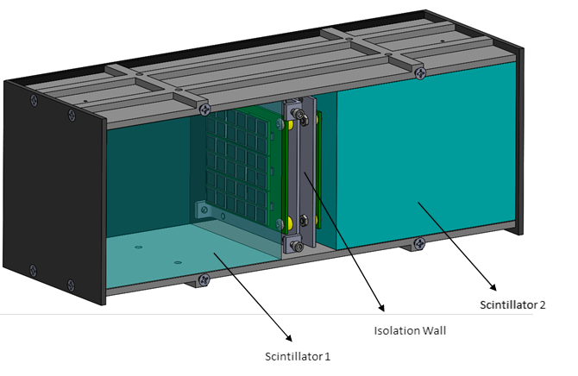
UVI BurstCube - status
Possible 2-crystal configuration, with absorbing material between boards
Board filled with SiPMs (2x2 mm) to maximize photon collection (Hamamatsu)

Slide 9
UVI BurstCube – towards 2022
We have requested quotes and parts for lab testing (to be started in 2019)
We are moving forward with the final design decision (hopefully by end 2018)
We are hiring a cubesat-experienced postdoc
We will continue working with simulations

Slide 10
UVI BurstCube – towards 2022
Lab testing on the Crystals (CsI, NaI) (2019)
Lab testing on SiPMs (2019)
Finally set on a configuration
Power consumptions tests
Solar panels studies
UVI BursCube is been developed by 2 UVI faculty and a group of undergraduate students.
It is a great opportunity to merge the educational component with top of the line short time-scale research (students see some final products during their 4-years at UVI).
Great for Physics/Astronomy and Engineering students.

Slide 11
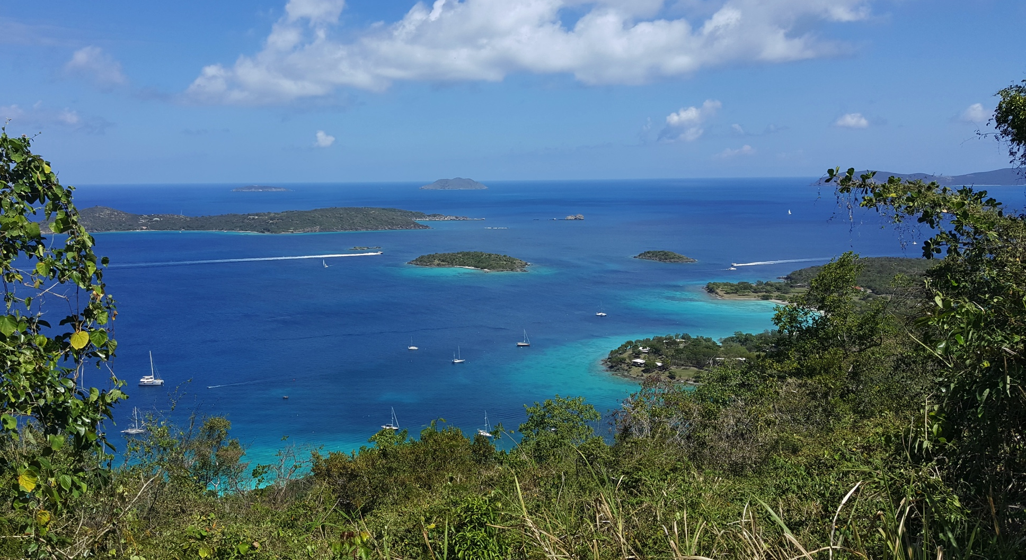
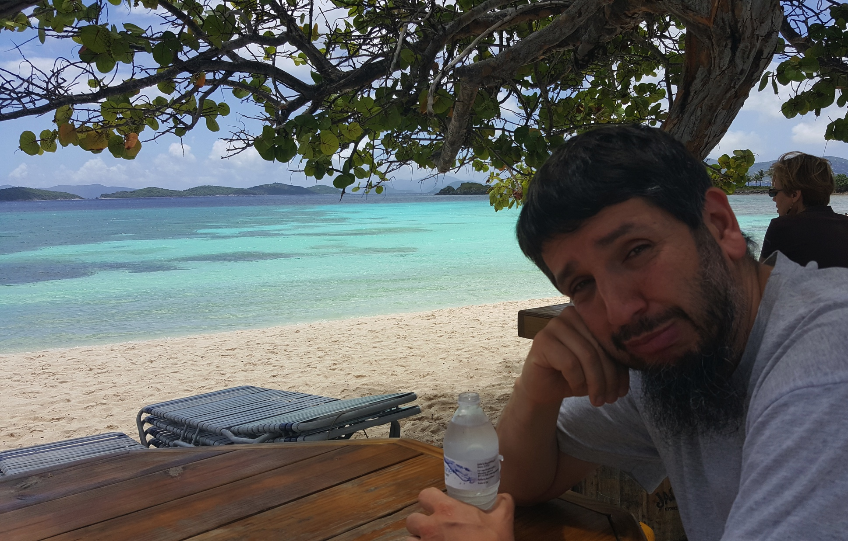
Thank you!!
See you all in the US Virgin Islands?
GW theorist

