Slide 1
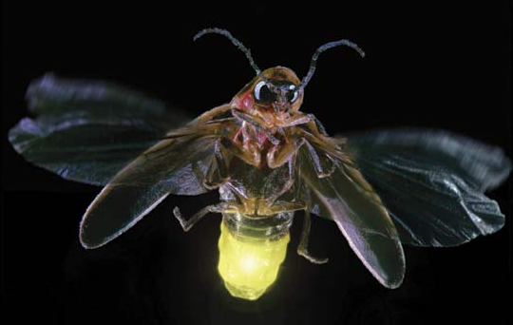
Glowbug: a gamma-ray telescope for bursts and other transients
J.E. Grove, M. Kerr, C.C. Cheung, L.J. Mitchell, B.F. Phlips, E.A. Wulf (Naval Research Lab), M.S. Briggs (University of Alabama Huntsville), C.A. Wilson-Hodge, D. Kocevski (NASA Marshall Space Flight Center), J. Perkins (NASA Goddard Space Flight Center)
September 2018
J. Eric Grove, U.S. Naval Research Laboratory
eric.grove@nrl.navy.mil

Slide 2
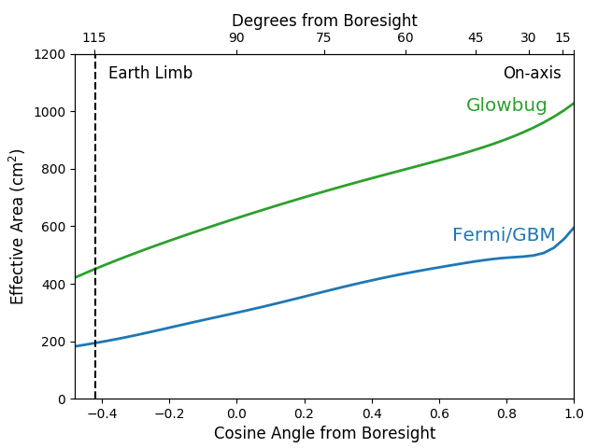
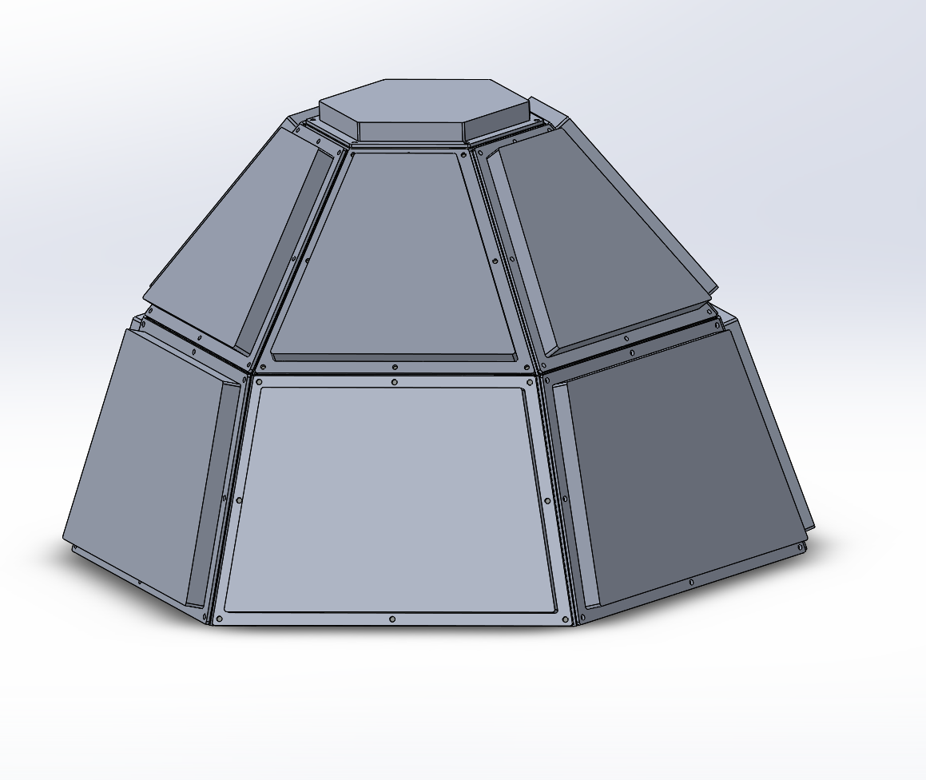
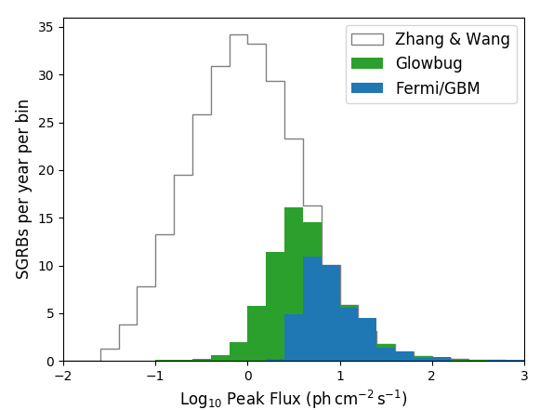
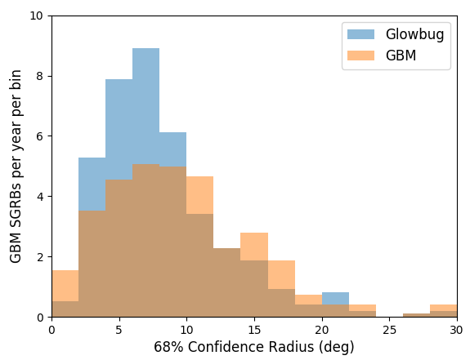
Glowbug: all-sky (unocculted) 20 keV – 2 MeV band transient monitor optimized for GRBs
Good sensitivity at low cost
Attached payload concept
Instrument ~30kg
Effective area ~2 x Fermi GBM
(all 12 NaI dets)
17 cm
High rate of GRB detections
Modest localization ability
Rate ~ 70 sGRBs / year
Comparable to Fermi GBM
Notes:
Glowbug is an all-sky transient monitor
20 keV to 2 MeV
Optimized for GRB detection
It’s bigger than a CubeSat payload: 2 x the effective area for a typical burst than the full set of 12 GBM NaI detectors
It delivers a lot of GRB detections: perhaps 70 short hard GRBs per year
It localizes them as well as GBM

Slide 3
Glowbug instrument
Tech demonstrator for GAMERA SmallSat mission concept
Large scintillator array
CsI(Tl) + SiPM readout
Good stopping power; not hygroscopic
Low size, weight, and power readout
Front end and DAQ from NRL’s SIRI-2
Low power, space qualified
Selected by NASA APRA
Funding to begin January 2019
Launch via DoD Space Test Program (STP)
Proposed for STP-H9 to International Space Station (ISS) in early 2023
STP provides integration, launch, and 1 year operations costs
Glowbug detector array
17 cm
6U CubeSat
detectors
20 cm
Notes:
This isn’t a dream. It’s funded, and it has a ride to space (or at least a defined path to a ride). This will fly.
I’ve already said we wanted maximal detector area, and that we wanted inexpensive, simple detectors
SO the solution was clear: a large-area array of scintillators.

Slide 4
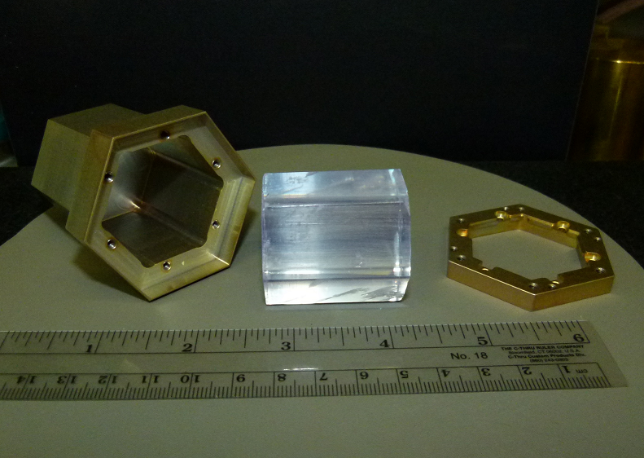
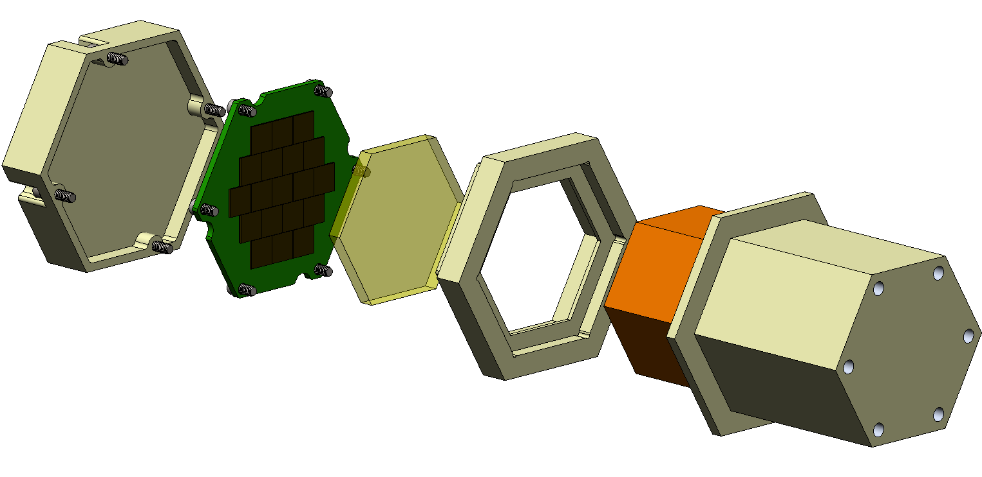
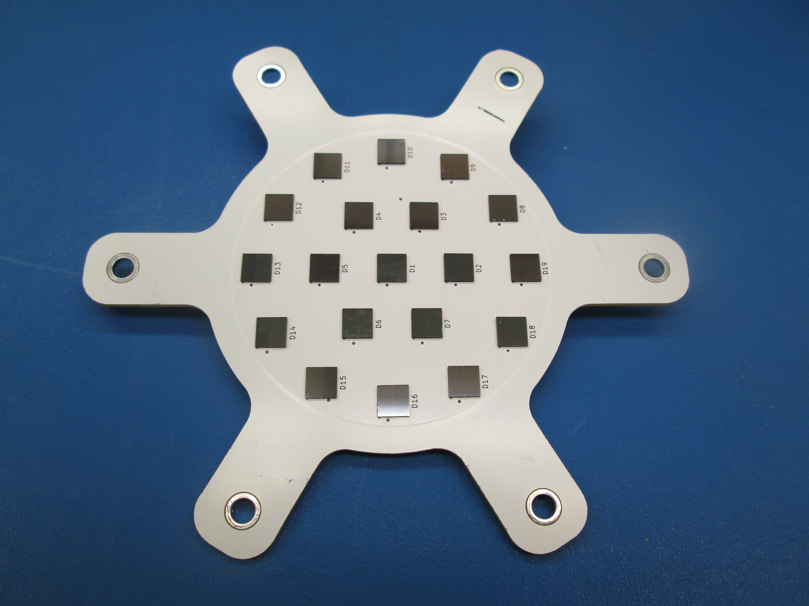
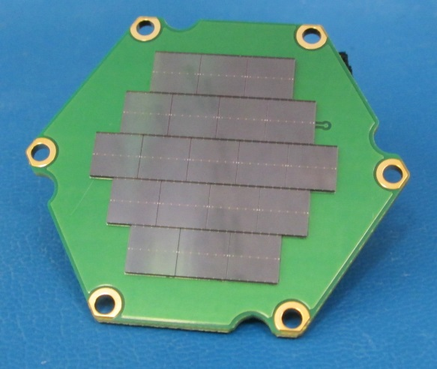
Glowbug detectors
Goal: obtain the best-possible sensitivity (maximal detector area, minimal background) and degree-scale localization as tech demonstrator for SmallSat mission concept
Can be built today with components at TRL 6 or higher
Cesium iodide CsI(Tl): better stopping power and photopeak efficiency than NaI, and is minimally hygroscopic, which eliminates need for hermetic enclosures
Silicon photomultipliers (SiPMs): fast readout of large areas of
thin scintillators with low size, weight, and power (SWaP). Low cost and low operating voltage
Heritage through NRL’s Strontium Iodide Radiation Instrumentation (SIRI) program
Design concept: large-area array of SiPM-read CsI(Tl) scintillators
Distribution A. Approved for public release; distribution unlimited.
Notes:
… and we’re leveraging experience we developed for other programs
some homeland security work
my thunderstorm radiation detection arrays, where we’ve deployed small scintillators at several locations around the world
and SIRI, a program to space qualify SrI2 and SiPMs
This is a SIRI crystal before insertion into its housing
It’s read out with a SiPM array
And we’ve done alternate SiPM array geometries with lower filling fraction
SIRI 1 was delivered 2 years ago. Still awaiting launch. Maybe, just maybe this fall.
SIRI 2 is in TVAC for delivery in September. Launch in 2019.

Slide 5
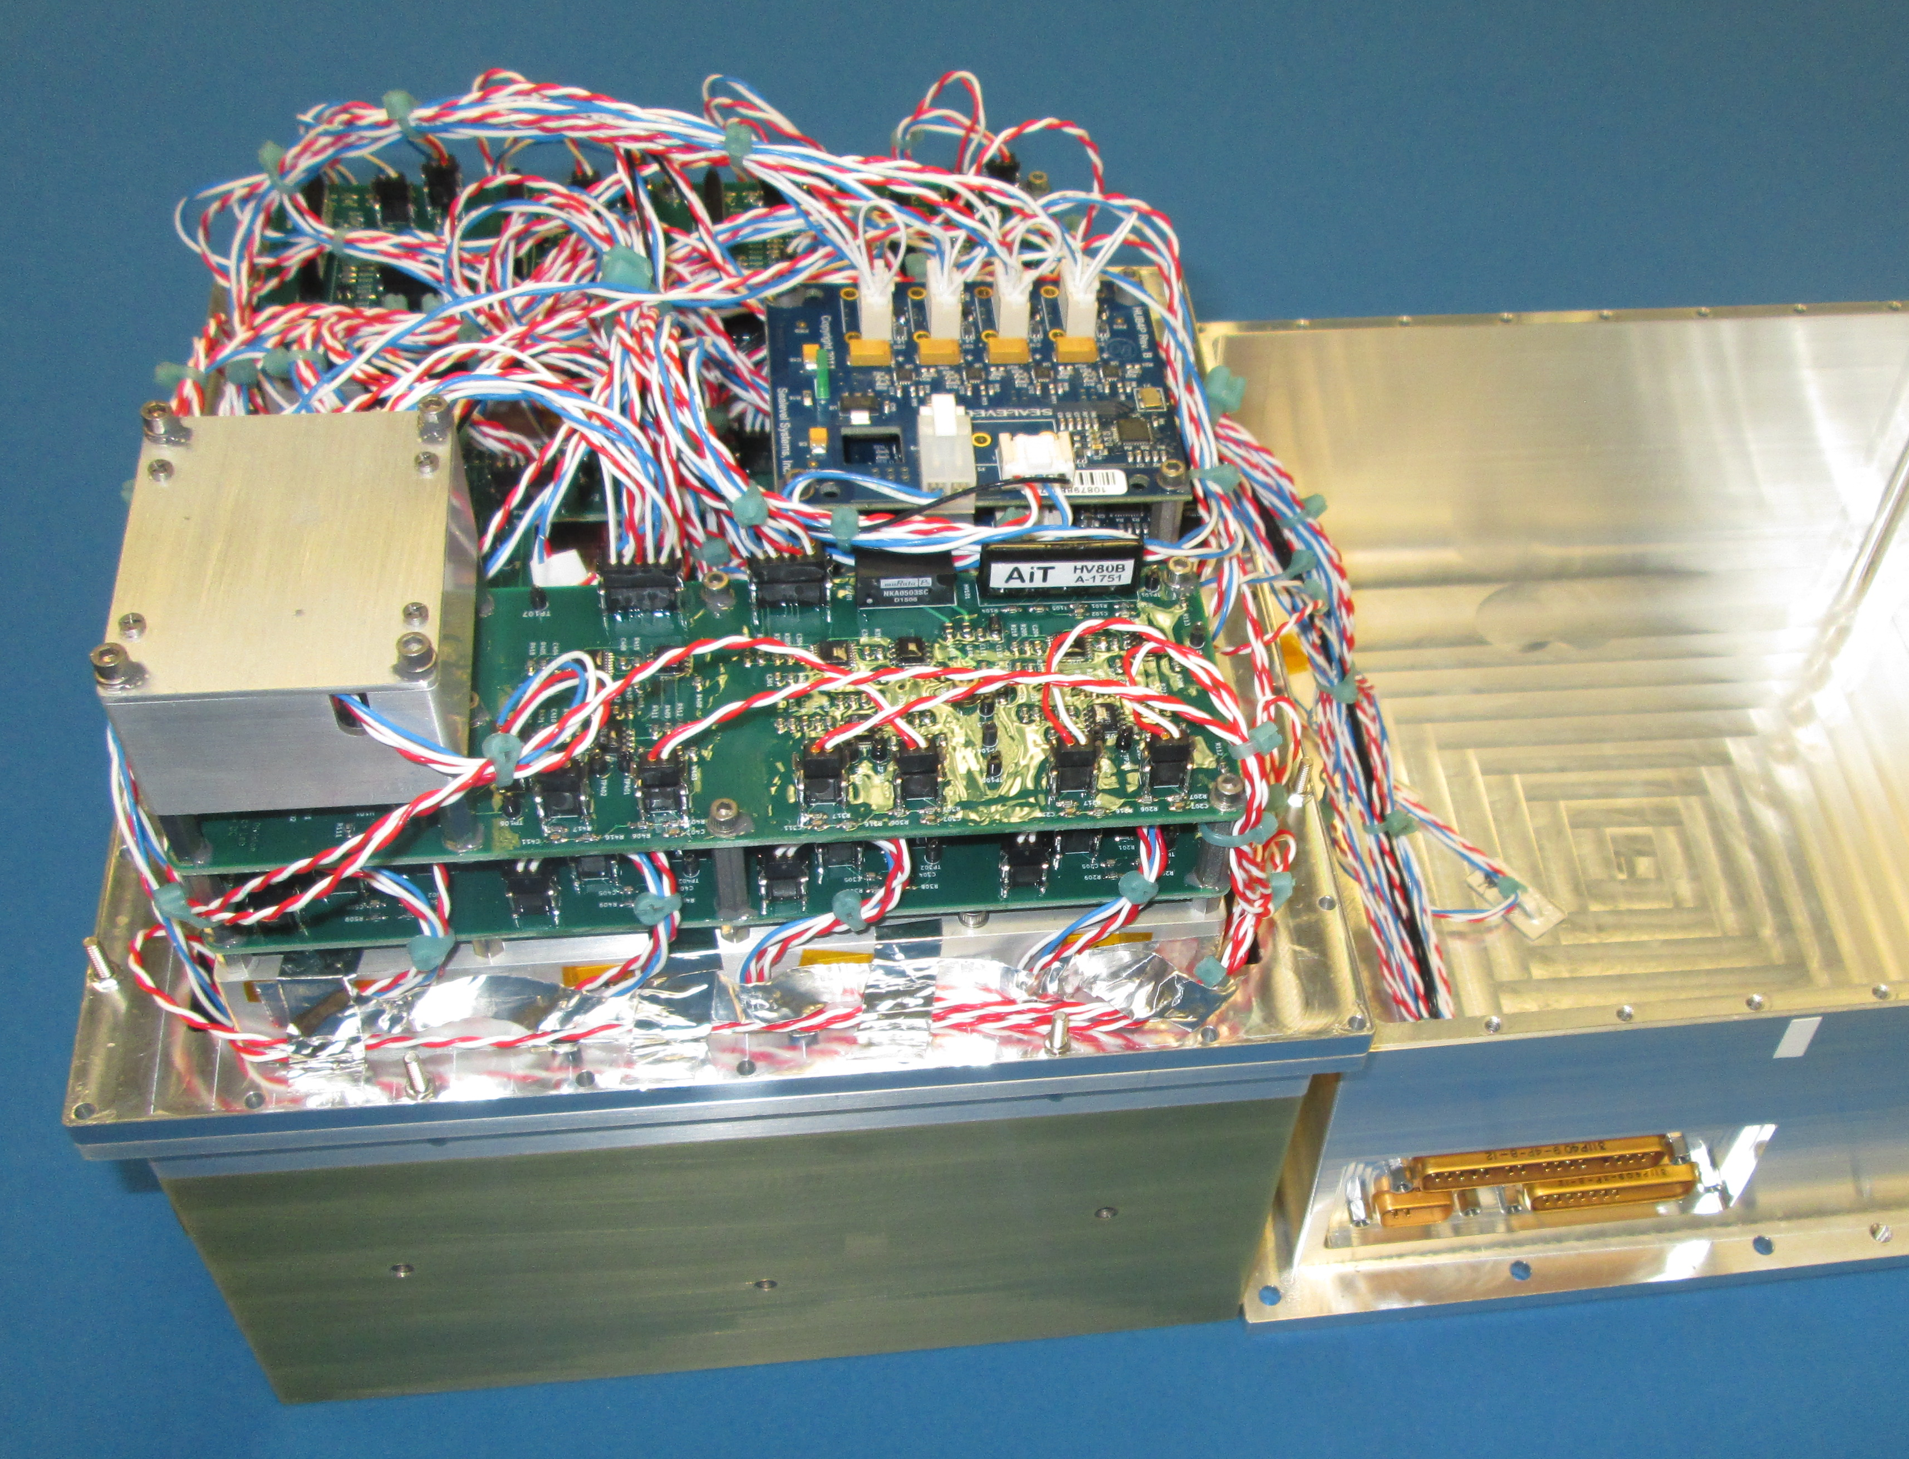
Glowbug data acquisition
Front end and data acquisition system
Replicates existing SIRI-2 design
Average power 23 W
GPS-derived time stamps (<1 us)
Concept of operations
Rate mode, formed from event list stream
Autonomous burst detection, switching to event list downlink in ~100 sec pre and post window
Burst Alert message
Note: if ISS, entire ~3 GB/day event list dataset will be downlinked
SIRI-2 flight DAQ and sensor head
+28 V
Discrete
EMI Filter
+28 RTN
Data Packets/ Cmds
RS422 TX/RX
DC-DC Converter
Power
Single Board Computer (SBC)
Comms
1 PPS
1 PPS
+5V, +/-3.3V
USB
Analogs
I2C
x13
x13
x13
Temperatures
Bias (29 V)
SrI₂ Detector SiPM
Multichannel Analyzer
Bias (29 V)
SrI₂ Detector SiPM
Multichannel Analyzer
Bias (29 V)
Bias
CsI Detector SiPM Array
Multichannel Analyzer
Event Signal

Slide 6
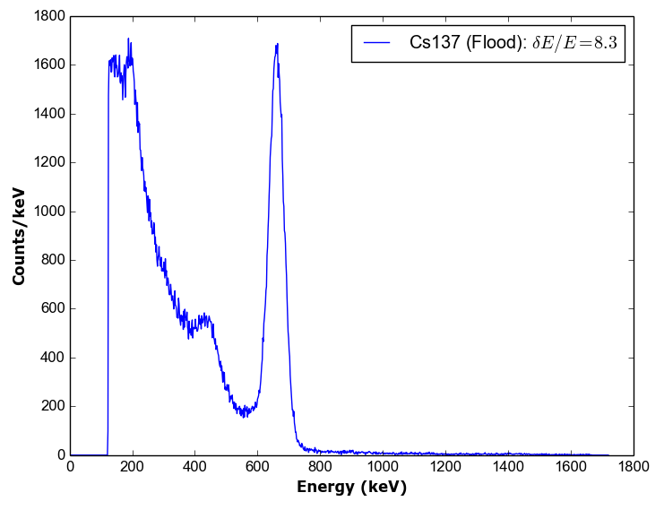
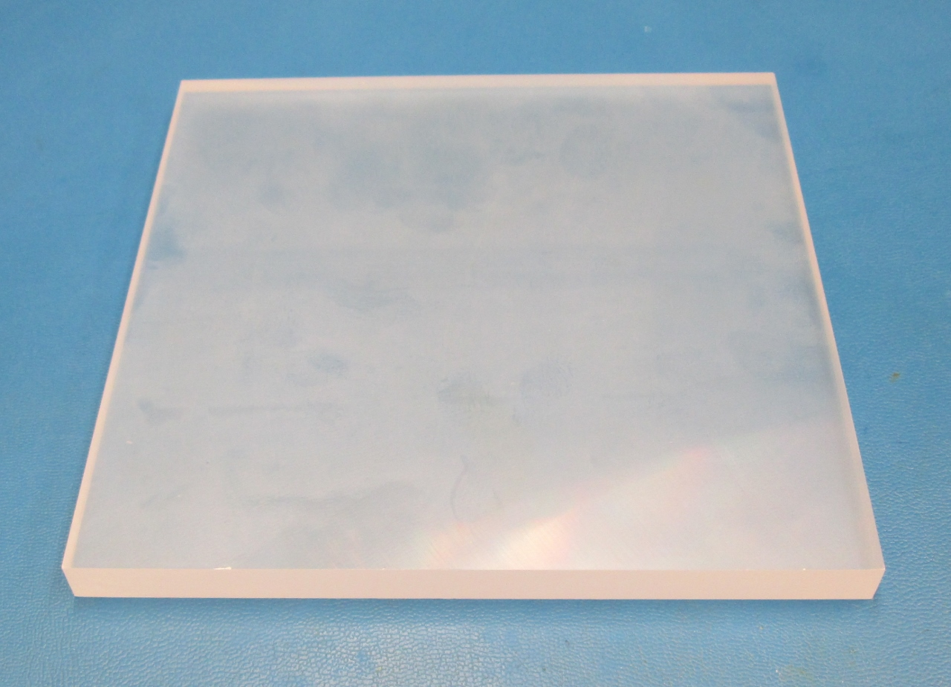
Bench test performance demo
Detector performance
Used SIRI-2 flight unit to shape, digitize largest Glowbug detector
CsI(Tl) crystal 15x15x1 cm
SiPM array
SIRI-2 flight DAQ and sensor head
Measured energy resolution with flood illumination of 15x15x1 cm CsI(Tl) tile, SiPMs, and flight-model SIRI-2 front end and DAQ.
FWHM = 8.3% at 662 keV
15x15x1 cm CsI(Tl)
Saint-Gobain
Notes:
We used the SIRI flight unit to shape and digitize SiPMs mounted on a 15x15 cm CsI xtal
Found 8.3% at 662 keV, and a threshold <50 keV – no tweaking.
It’ll be launched through the DoD STP, hoping for a ride on STP-H7 to the ISS in 2022
STP provides full support for integration, launch, and 1 year of operations costs
Experimenters find their own funding for instruments and deliver to STP for integration

Slide 7
Instrument sensitivity
Performance estimated from detailed Monte Carlo simulations of scintillator modules, instrument geometry model, and maximum likelihood analyses performed using realistic GBM background
∼2x Fermi GBM effective area (total, 12 NaI dets) for typical GRB spectrum
∼ ½ x effective area at 2 MeV of two BGO detectors of Fermi GBM
Increase in effective area expands horizon for faint sources in local universe by ∼1.4
(all 12 NaI dets)
Notes:
We generated a detailed Monte Carlo simulation of the detector modules and the instrument geometry
We developed a max likelihood analysis direction reconstruction using GBM backgrounds
And we used that to understand the instrument performance.
First the effective area
7x GBM (that’s the total over all 12 detectors) for a typical GRB spectrum
2x GBM BGO at 2 MeV
Quantity has a quality all its own
That increase of 7 expands the horizon by ~2.5, the volume by ~4

Slide 8
Glowbug summary
Good sensitivity at low cost
Larger than CubeSat
Instrument ~30kg
Effective area ~2 x Fermi GBM
(all 12 NaI dets)
Funded by NASA Launch to be provided by DoD
17 cm
High rate of GRB detections
Modest localization ability
Rate ~ 70 sGRBs / year
Comparable to Fermi GBM
Notes:
Glowbug is an all-sky transient monitor
20 keV to 2 MeV
Optimized for GRB detection
It’s bigger than a CubeSat payload: 2 x the effective area for a typical burst than the full set of 12 GBM NaI detectors
It delivers a lot of GRB detections: perhaps 70 short hard GRBs per year
It localizes them as well as GBM

