Slide 1


Solar Neutron and Gamma-ray Detector for a Small Satellite
Kazutaka Yamaoka & Hiroyasu Tajima
(Nagoya University, Japan)
GRB nanosat meeting @ Budapest, Sep. 12, 2018

Slide 2
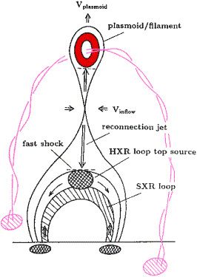
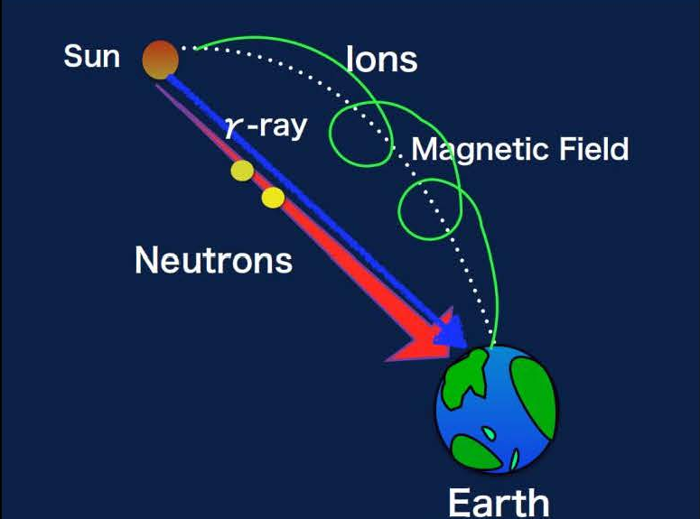
Solar Neutron Observations
Ion acceleration mechanism in solar flares
is still unknown. Magnetic Reconnection ?
But how, when and where are particles
(especially protons and heavy ions) accelerated ?
Solar flares have been mainly studied via
★ Electro-magnetic waves
(radio, optical, UV, X / gamma-rays etc..)
★ Charged particles (protons, electrons, ions)
Neutrons can be direct probes for
understanding ion acceleration
mechanisms in the Sun.

Slide 3
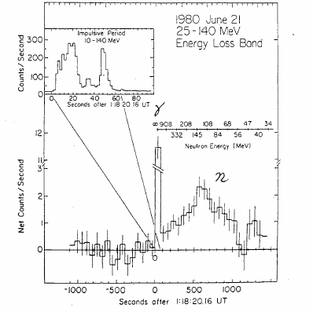
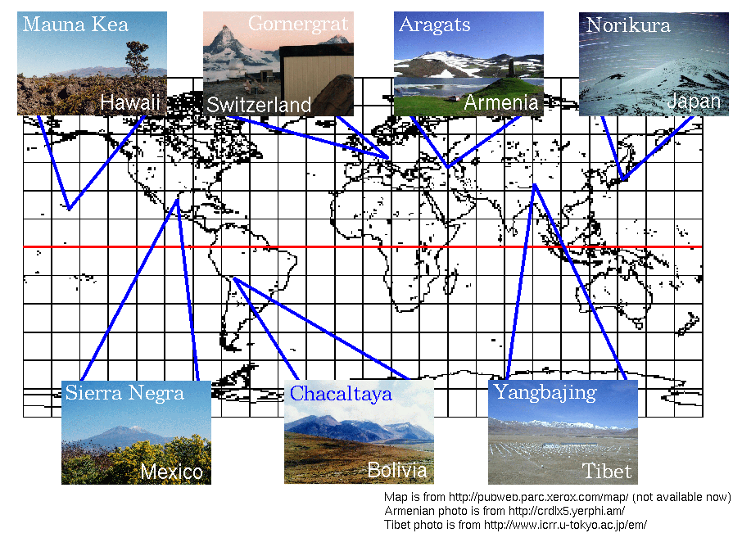
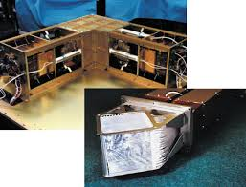
Previous and Current Solar Neutron Observations
・Discovery of solar neutrons with the Solar Maximum
Mission (SMM) in 1980 (Chupp et al. 1982)
・Observations have been carried out from ground and space.
  ★ Ground: Neutron telescopes in the world-wide network
  ★ Space: FIBer detector of the SEDA-AP on the
  International Space Station (ISS) Aug. 2009 – Apr. 2018
  (Muraki et al. 2012, Koga et al. 2017)
  only ~40 detections for 38 years, and no space mission at this moment
(Chupp et al. 1982 )
neutron
SEDA-AP/FIB Engineering Model

Slide 4
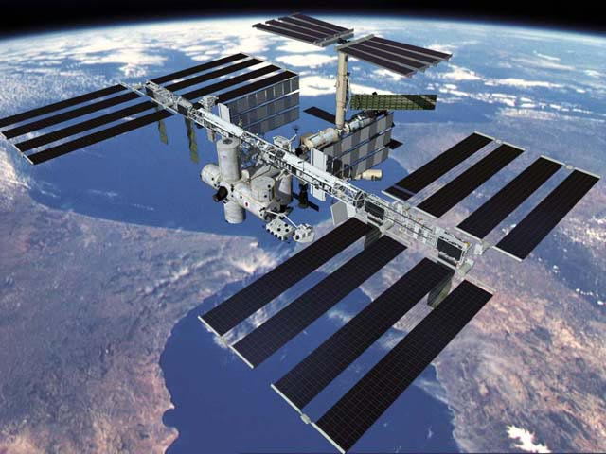
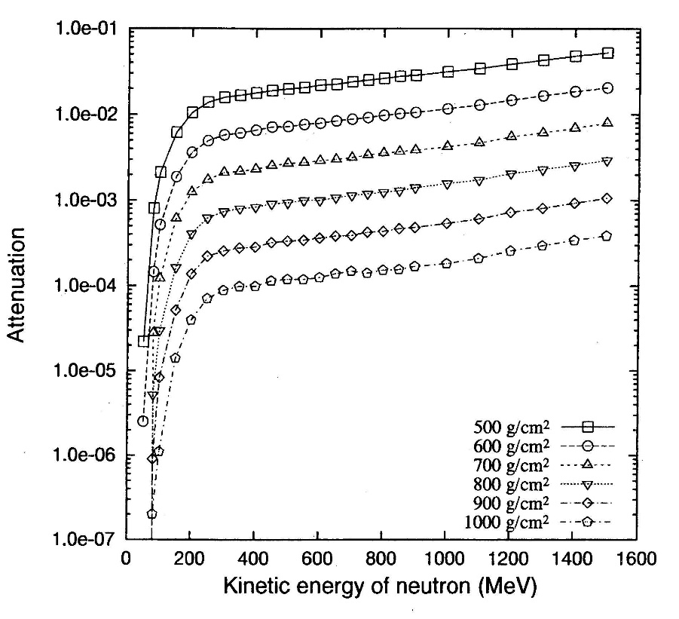
Merits of Microsatellite Observations
1. The SEDA-AP observations on the ISS are affected
by secondary neutron background produced in the ISS
with a mass of 420 ton. → A smaller satellite (<100 kg)
should have less neutron background.
2. Neutron fluxes on the ground are strongly attenuated by a factor
of ~1/1000 by the Earth atmosphere.
→ Good statistics even for small detector in space
e.x. 1 m² @ Ground telescopes < 100 cm² @ space
3. Long and un-interrupted observations
e.x. Sun-synchronous orbit
High sensitive observations are
possible using microsatellites.
SEDA-AP
500 g/cm²
1/1000
1000 g/cm²
0
1600 MeV

Slide 5
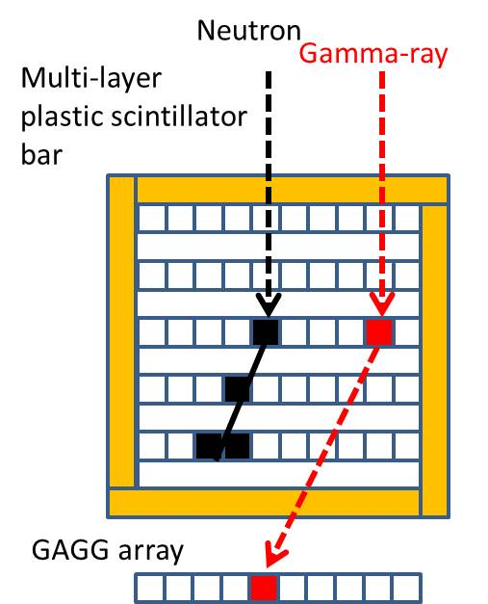
Detector Concept (I)
★The detector is originally designed based on SEDA-AP FIB,
and gamma-ray detection function has been added
(GRB observations are possible.).
★Detection Principle
1. Neutron Detection Part: Multi-layered Plastic Scintillator Bars
- Detected by elastic scattering with Hydrogen atoms
- A recoiled proton loses its energy (Ep) in the bars.
Incident neutron energy En = Ep / cos²θ
- The same technique is used in SEDA-AP FIB.
2. Gamma-ray Detection Part: Inorganic Scintillators
- Detected via Compton scattering and/or photo-electric
absorption.
3. Anti-coincidence Detector Part
Covered by plastic scintillators to reject charged particles.

Slide 6
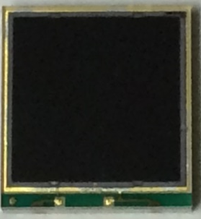
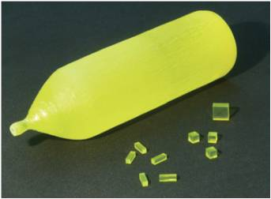
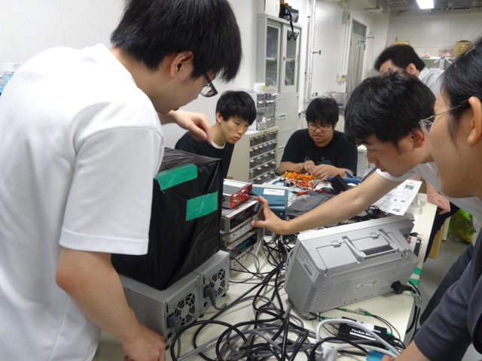

Detector Concept (II)
6.85 mm
New sensor technology has been used
  Si PM (MPPC in Hamamatsu K.K.)
    Very compact and light weight
    Low bias voltage +55 V (cf. ~1000 V for PMT)
  GAGG scintillator (Gd₃Al₂Ga₃O₁₂)
    High density: (6.63 g / cm³)
    High Light Output: ~57000 photons/MeV
This mission was originally proposed by
graduate students who belong to the Educational
Program.
7.35 mm

Slide 7
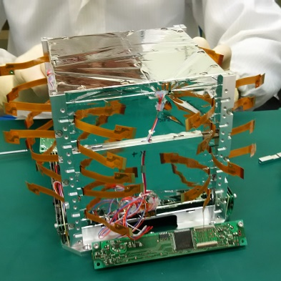
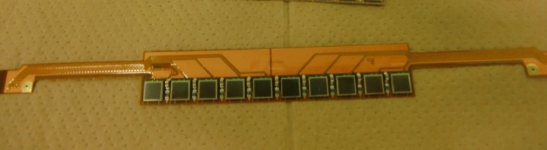
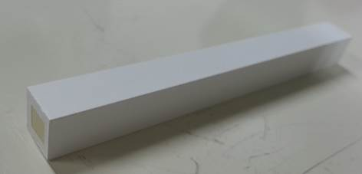
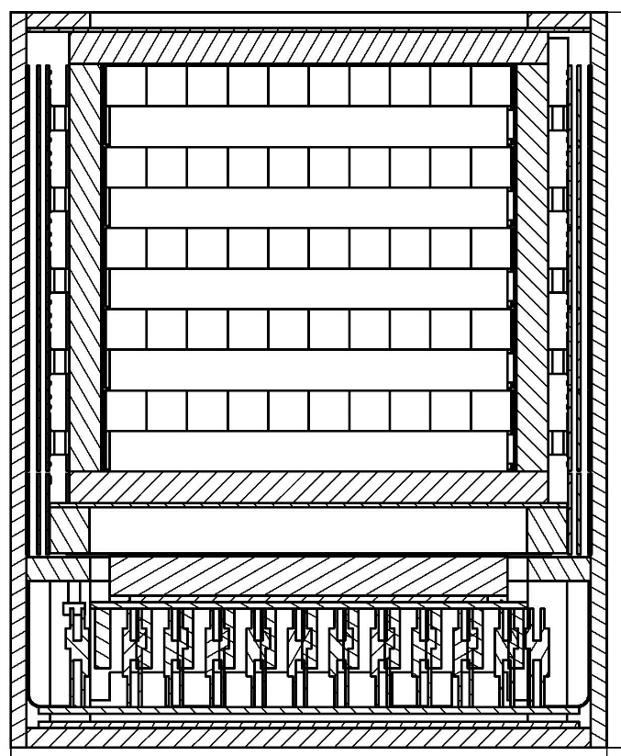
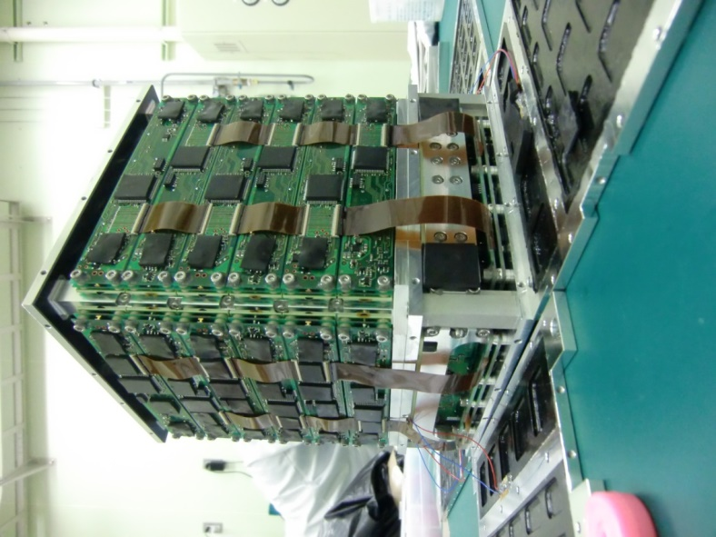
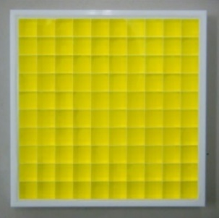
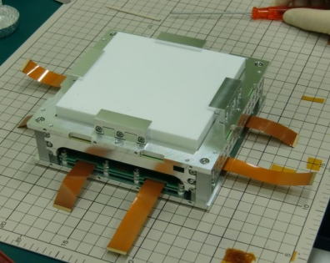
Realized Structure for the 50-kg class satellite ChubuSat-2
Flexible board for SiPMs
Sensors and electronics packaged in an Aluminum box → Very compact (~6 kg)
Fabrication at facilities of Nagoya Univ.
100 Plastic Scintillator Bars
GAGG 10 x 10 Array
7

Slide 8
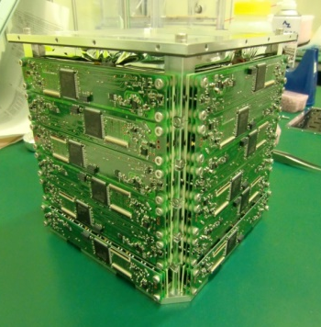
Characteristics of the Solar
Neutron Detector
Items | Specification
Detectors | Upper part: Plastic scintillators 10x10 bars Lower part: GAGG scintillators with 10x10 array of 1cm-cubic read out with MPPC
Number of processing signals | Total: 312: 200 (Plastic Scintillators), 12 (Anti-coincidence detector), 100 (GAGG)
Size | 15 cm x 17 cm x 18.5 cm (Detector area ~100 cm²)
Weight | 6.2 kg
Power | 12 W (Operation Voltage 4 V, Current 3 A)
Onboard Memory size | 1 Gbyte
Downlink data size | About 5Mbyte (assuming 3 contact pass per day and 100 kbps in the S-band)

Slide 9
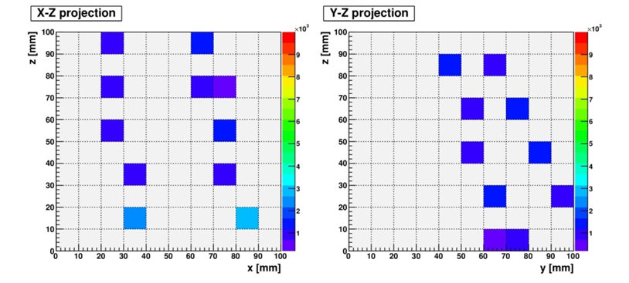
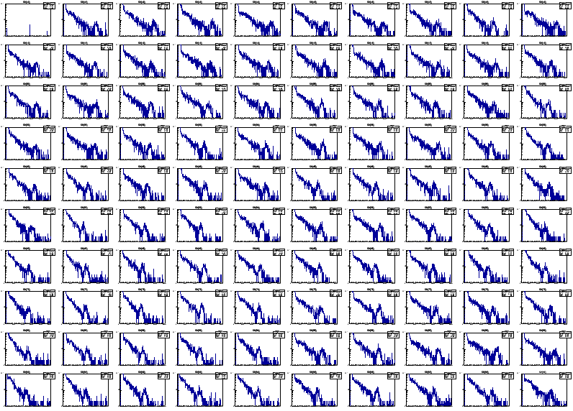
Results From
Performance of the ChubuSat-2 Solar Neutron Detector on the Ground
Almost of all the sensors were working
well during a pre-flight operation test.
Cosmic-ray muon track was clearly
detected in plastic scintillator bars.
662 keV gamma-rays from ¹³⁷Cs
source were also detected in the
GAGG 10x10 array.
We launched ChubuSat-2
on Feb. 17, 2016. However,
the detector has not been
turned on In orbit.
9

Slide 10
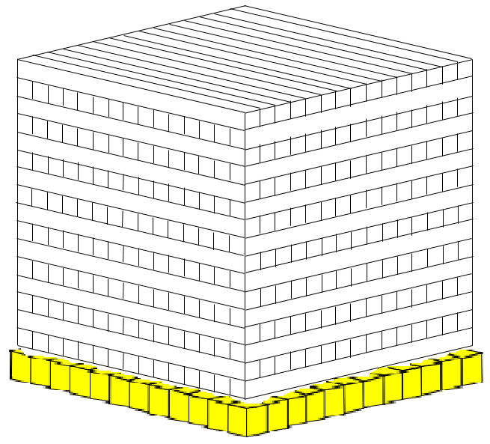
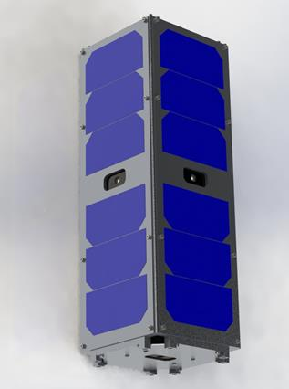
Next step to a 3U CubeSat
64 mm
(16 pc)
64 mm
(16 pc)
Further constraints
Need more compact and higher performance
Reduction of large power consumption (12 W→< 3 W)
64 mm
(16 layers)
 | SEDA-AP FIB | ChubuSat-2 Neutron Det. | CubeSat Neutron Det.
Satellite Size | (ISS) | 50cm cubic | 3U(10x10x30cm)
Detector Size | 53.2x53.2 x17.1cm | 15x17x18.5 cm | 1U (10cm cubic)
Weight | 12.7kg | 6.2kg | 2kg
Power | 25.4W | 12W | 3W
Plastic Scintillators | 3x6x96mm (512 pc) | 10x10x100 mm (100 pc) | 4x4x64mm (256 pc)
GAGG (Ce) | No | 10 mm cubic | 6 mm cubic
72 mm (12 pc)
72 mm (12 pc)

Slide 11
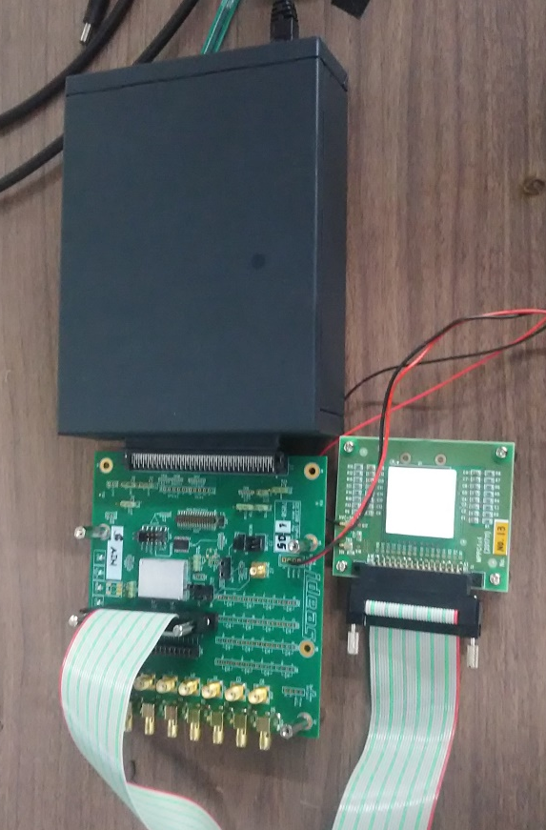
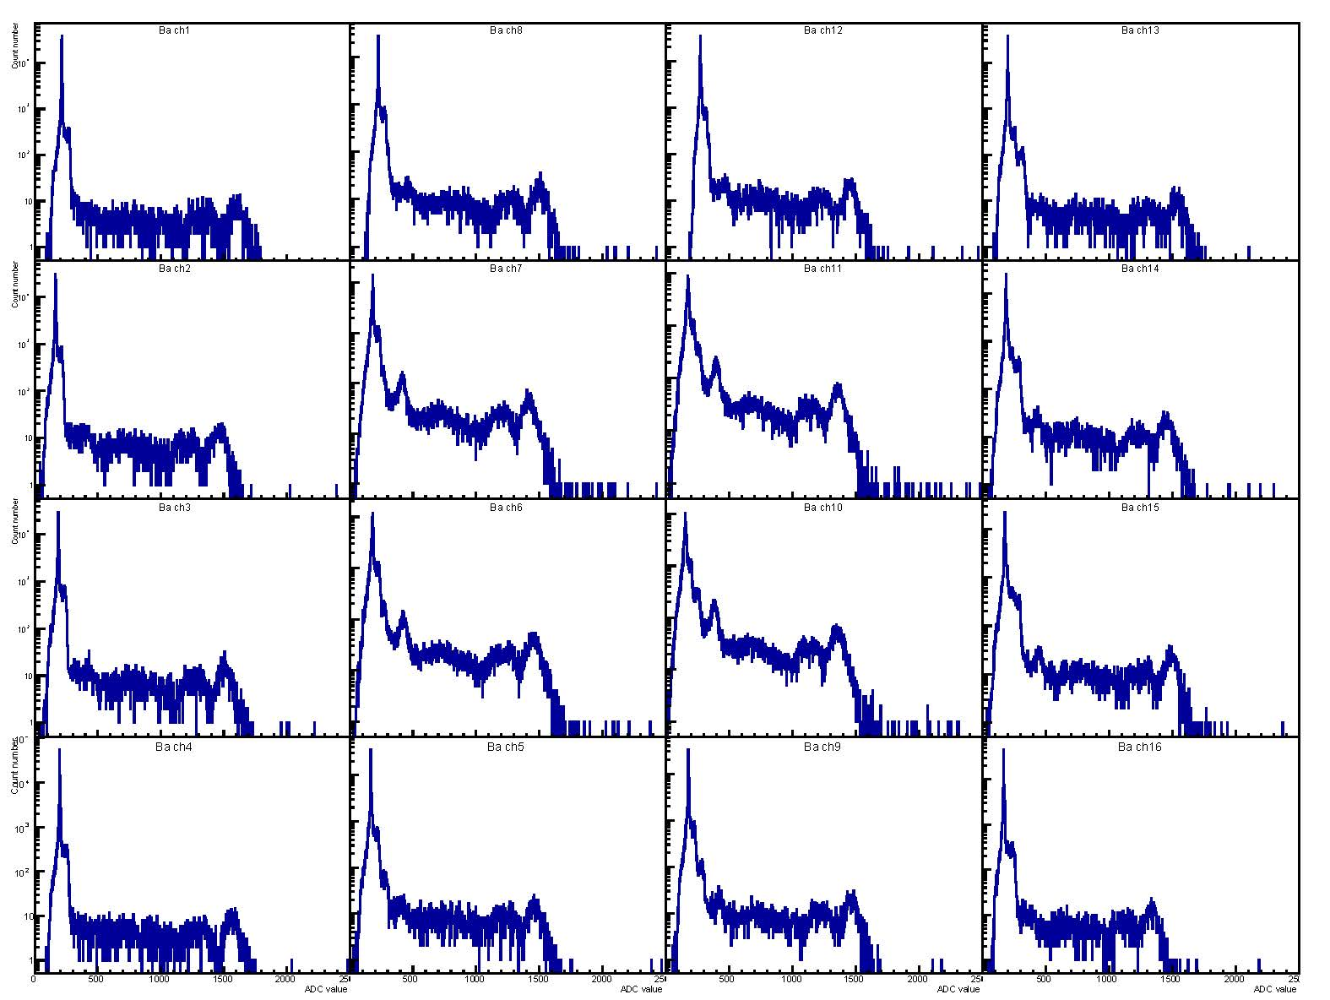
Basic evaluation: ASIC
Large power consumption 12 W for ChubuSat-2
→ We can reduce power consumption by using 16-channel IDEAS
ASIC IDE3380 (< 2 mW per channel).
ASIC readout of MPPC+GAGG 4x4 array
¹³³Ba Spectra
ASIC test board
GAGG+MPPC 4x4 array
We have successfully read out the detector array with ASIC.

Slide 12

Summary
Nagoya University have proposed solar neutron observations using microsatellites.
Solar neutron detector was realized in the 50-kg class ChubuSat-2 satellite, but it was not turned on yet.
We have just moved to the next step to recover the mission for a 3U CubeSat (NuSAT or NuCube) in new collaboration with people at department of aerospace engineering.
The launch of 3 3U CubeSat will be aimed at 2021-2022.

Slide 13
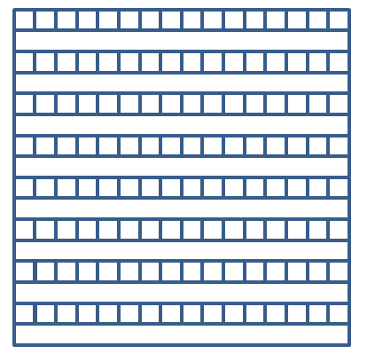
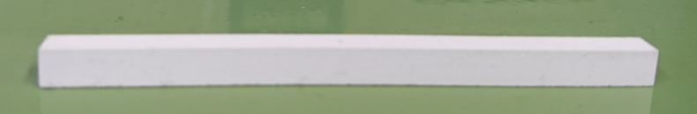
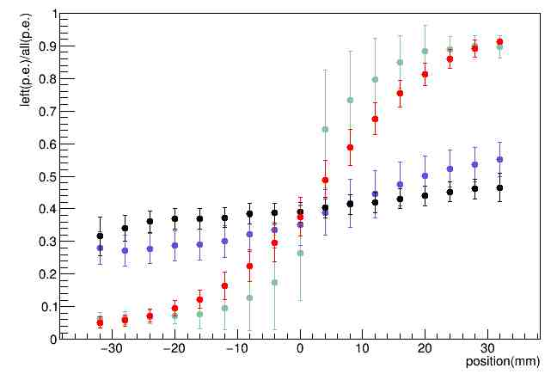
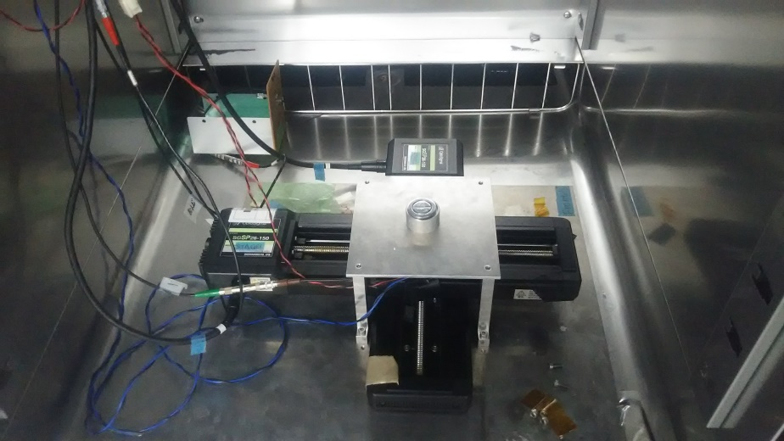
Basic evaluation: Scintillator bars
We have studied a position capability by reading out from both sides of scintillator bars.
→ The scintillator bar can have a position resolution in its bar direction by using white paint as a reflector.
64 mm
4 mm
x 4mm
Relative Light yield
Alminized mylar
White paint
Measurement Setup
Position (mm)

Slide 14
Backup Slides

Slide 15
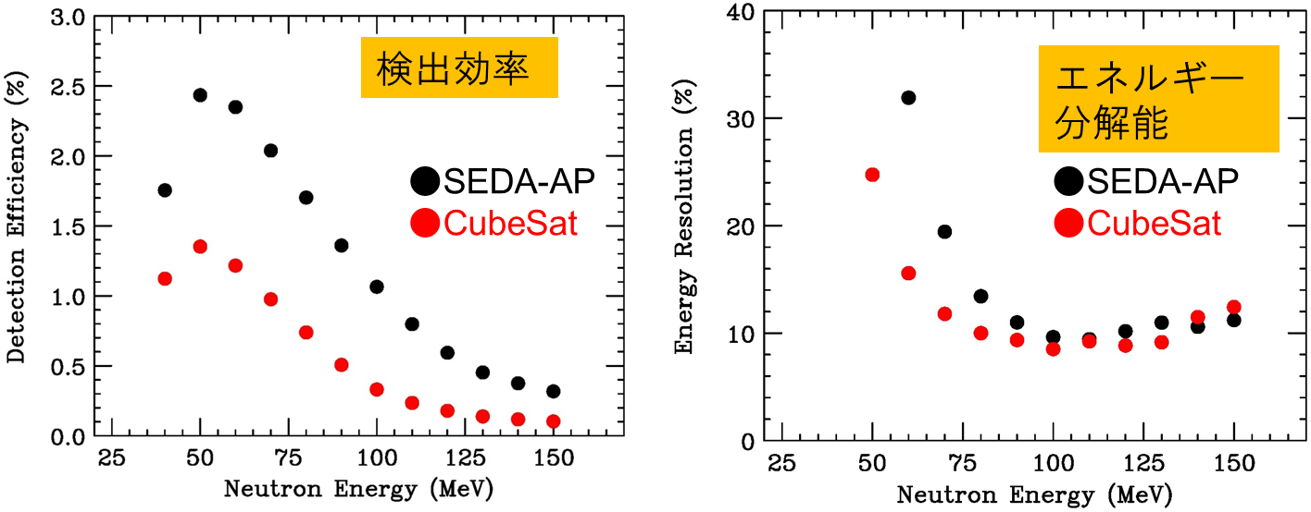
Comparison between SEDA-AP and CubeSat
Neutron events are selected by passing through at least 4 layers of plastic scintillators.
Detection efficiency is smaller than that of SEDA-AP due to thickness of the detector.
→ A use of GAGG at the bottom can increase the efficiency ?
Energy resolution is better than that of SEDA-AP due to smaller size of each plastic scintillator.
★SEDA-AP FIB
3x6x96 mm
96 mm thick
★CubeSat
4x4x64 mm
64 mm thick
Detection Efficiency
Energy Resolution

Slide 16

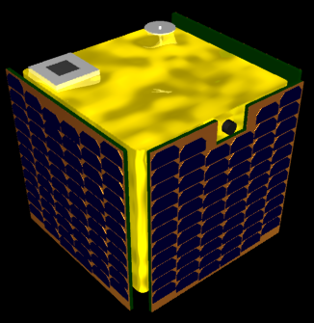



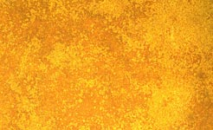
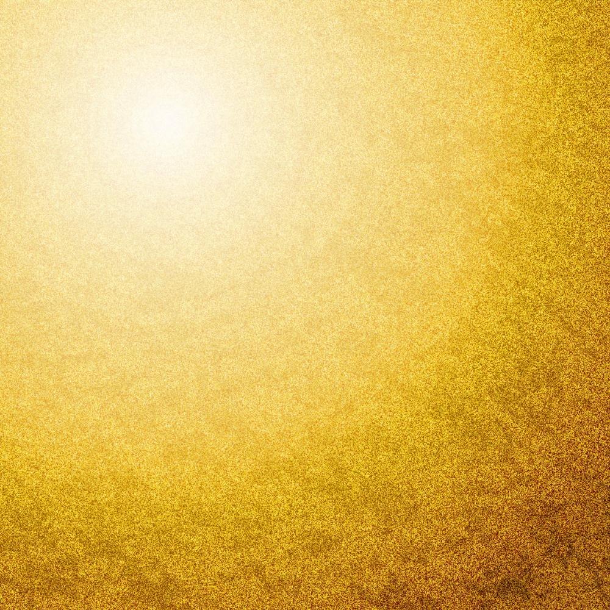
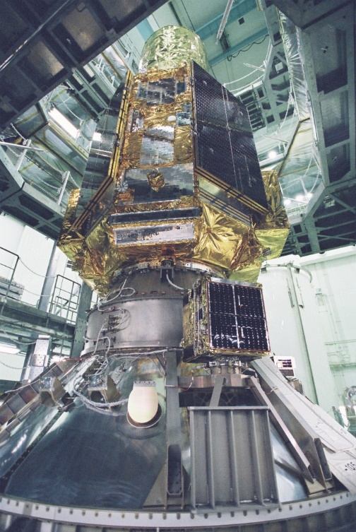
ChubuSat-2
ChubuSat
A series of 50 kg-class microsatellite
Developed by Nagoya University, Daido University, Mitsubishi
Heavy Industry (MHI), and other small or medium-sized companies
around the Chubu (I.e. central part) region of Japan.
ChubuSat-2 (2nd satellite of ChubuSat)
Selected as one of the four piggy-back satellites of the X-ray
astronomical satellite ASTRO-H by JAXA on Aug. 27, 2015
Mission
  Radiation Monitor for the main satellite ASTRO-H
  Message Exchange Service via amateur radio band.
Launched on Feb. 17, 2016 from JAXA Tanegashima Space Center
ChubuSat-2

Slide 17
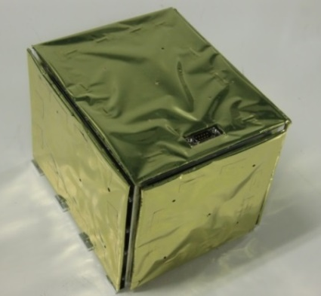
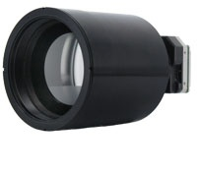
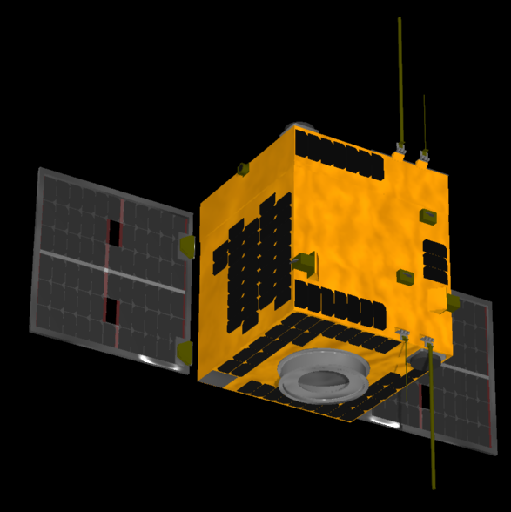
Characteristics of Chubusat-2
Items | Specification
Mission Instrument | * Solar Neutron Detector * Infrared Camera
Weight | About 50 kg
Size | Height 65 cm x Width 56 cm x Depth 55 cm
Launch Date | February 17, 2016 by H-IIA rocket 30th
Orbital information | Circular LEO Orbit (575 km altitude, 31 degree inclination angle)
Mission Life | More than half year
Consumption Power | 12 W (low power mode), 25 W (safe hold mode), about 50 W(nominal operation)
Communication System | S band (Uplink/Downlink Mission data) Amateur VHF (Uplink), UHF (Downlink HK data)

Slide 18
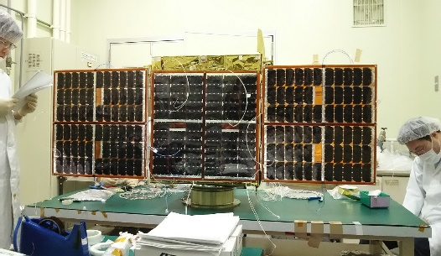
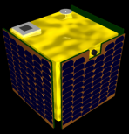
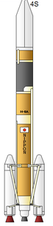
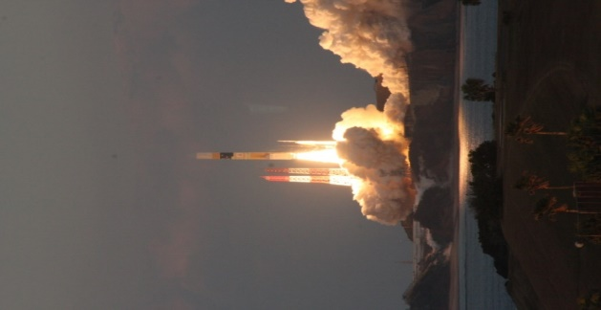
Launch and Operation
Communication
via amateur
radio-band
Separation
6:07 PM
Attitude control
& Paddle deployment
Mission
Operation
Mission Data
Downlink
Launch at 5:45 PM on Feb.17, 2016
Communication failure between instruments on Feb. 21, 2016
Since then,
our detector was not turned on.
Komaki Station(Amateur radio band）
Kyushu Station
（S-band)
18

