Slide 1
BlackCAT
Black hole Coded Aperture Telescope
Abe Falcone
(Penn State)
Co-I’s: D. Burrows, T. Chattopadhyay, D. Fox, D. Palmer

Slide 2
Science
The BlackCAT CubeSat is a soft X-ray sky monitor, transient finder, and burst detector for high-energy and multi-messenger astrophysics
Soft X-ray response with wide-FOV is tuned to discover high redshift GRBs and probe the epoch of cosmic star formation in the early universe
locate the EM counterparts of the gravitational wave events with sub-arcminute accuracy (as well as other potential multi-messenger events such as HE neutrinos)
Monitor the transient sky and trigger alerts from Galactic transients, blazars, Short GRBs, tidal disruption events, XRFs, supernova shock breakouts, etc. using wide sky nearly continuous X-ray monitoring
Notes:
Only 1 module will:
see z>8 GRBs, as well as many others at lower redshift and localize them-
Could have detected the X-ray EM from GW170817 at 4.1 sigma

Slide 3
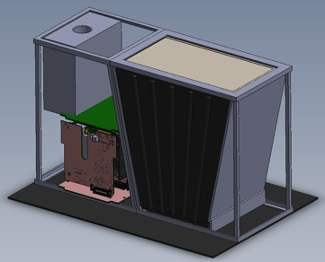
Overview
Table 1. Mission overview
Instrument | Soft X-ray coded mask telescope with hybrid CMOS detectors
Spacecraft | Standard 6U CubeSat (from Clyde Space)
Orbit | Sun-synchronous LE orbit
Science | Detection of EM counterparts of gravitational waves, high reshift GRBs, transients, monitoring

Slide 4
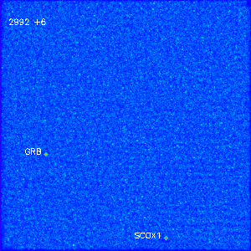
Response and localization
BlackCAT detects and localizes Gamma Ray Bursts, transients, and GW counterparts
  determines GRB position to ~ 60” in < 30 s
  sends position to S/C and to ground
  telemeters light curve and spectral info
Simulated BlackCAT GRB Image
T~30 sec
T~300 sec

Slide 5
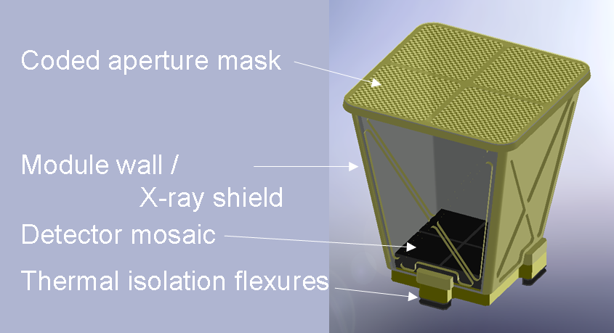
Coded Mask
- Each mask will consist of a ribbed frame that supports electroformed Nickel coated with gold
- Mask pitch of 320 um matches that of detector superpixels
Table 2: BlackCAT Mask Parameters
Parameter | Value
Focal Length | 158 mm
Mask size (aperture) | 170 x 88 mm
Mask element | 320 x 320 μm
Detector superpixel | 320 x 320 μm
DM FOV | 0.95 sr
Open element size | 263 x 263 μm
Mask Transmission | >40%
Image Scale | 52 "/pixel
 | 6.9 arcmin/superpixel

Slide 6
Coded Mask Imaging
Coded Aperture Mask + Silicon Hybrid CMOS Detectors
Source 1
Same technique as INTEGRAL IBIS and Swift BAT, but at lower energies.
Mask pattern casts X-ray shadows on
detector for E < 20 keV.
Notes:
Add some statement about having pixel size = mask cell size

Slide 7
Coded Mask Imaging
Coded Aperture Mask + Silicon Hybrid CMOS Detectors
Source 1
Source 2
Same technique as INTEGRAL IBIS and Swift BAT, but at lower (soft X-ray) energies.
Mask pattern casts X-ray shadows on
detector for E < 20 keV.
Deconvolution of detector image with mask
pattern produces sky image
Imaging is a multi-step process using the same sophisticated algorithms used by the Swift BAT:
Reconstruct sky image with superpixel resolution.
Back-project sources at full resolution.
Notes:
Add some statement about having pixel size = mask cell size

Slide 8
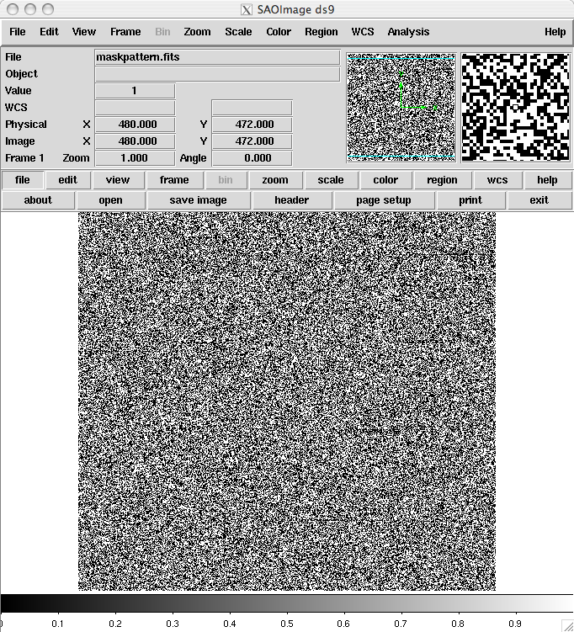
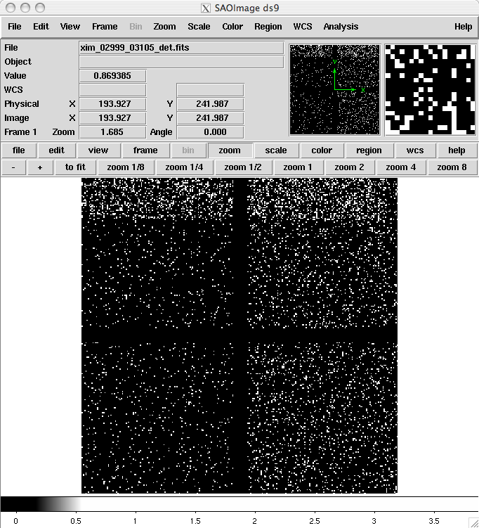
BlackCAT Imaging Simulation
Simulation of 6 s image (single module with H2RG) of field containing Sco X-1, a GRB, and the X-ray background.
2D Coded Aperture Mask
Detector Plane Image

Slide 9
BlackCAT Imaging Simulation
Simulation of 6 s image (single module with H2RG) of field containing Sco X-1, a GRB, and the X-ray background.
Sky Image
2D Coded Aperture Mask
Detector Plane Image

Slide 10
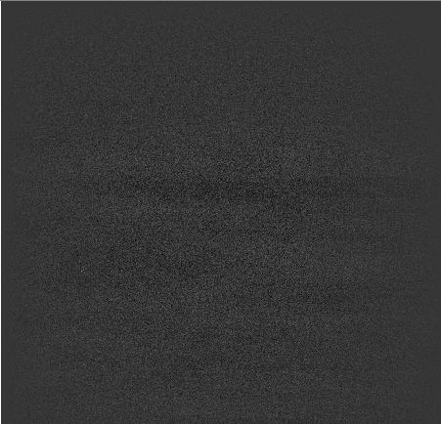
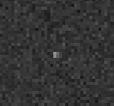
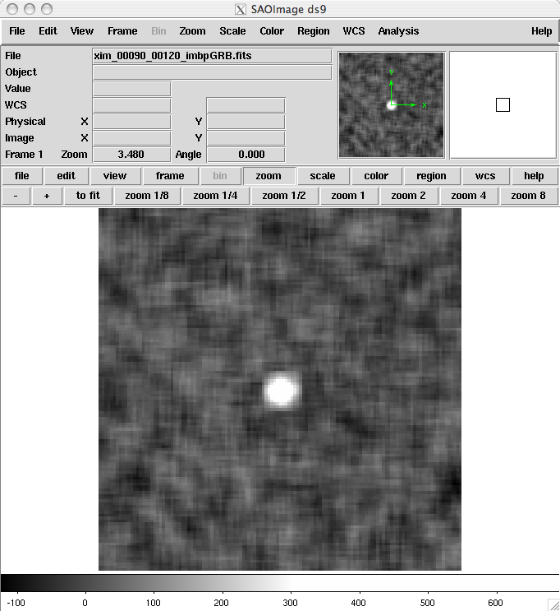
BlackCAT Imaging Simulation
Simulation of 6 s image (single module with H2RG) of field containing Sco X-1, a GRB, and the X-ray background.
Reconstructed Sky Image
Blowup of GRB Image
at superpixel resolution
Back-projected Sky Image at Full Detector Resolution

Slide 11
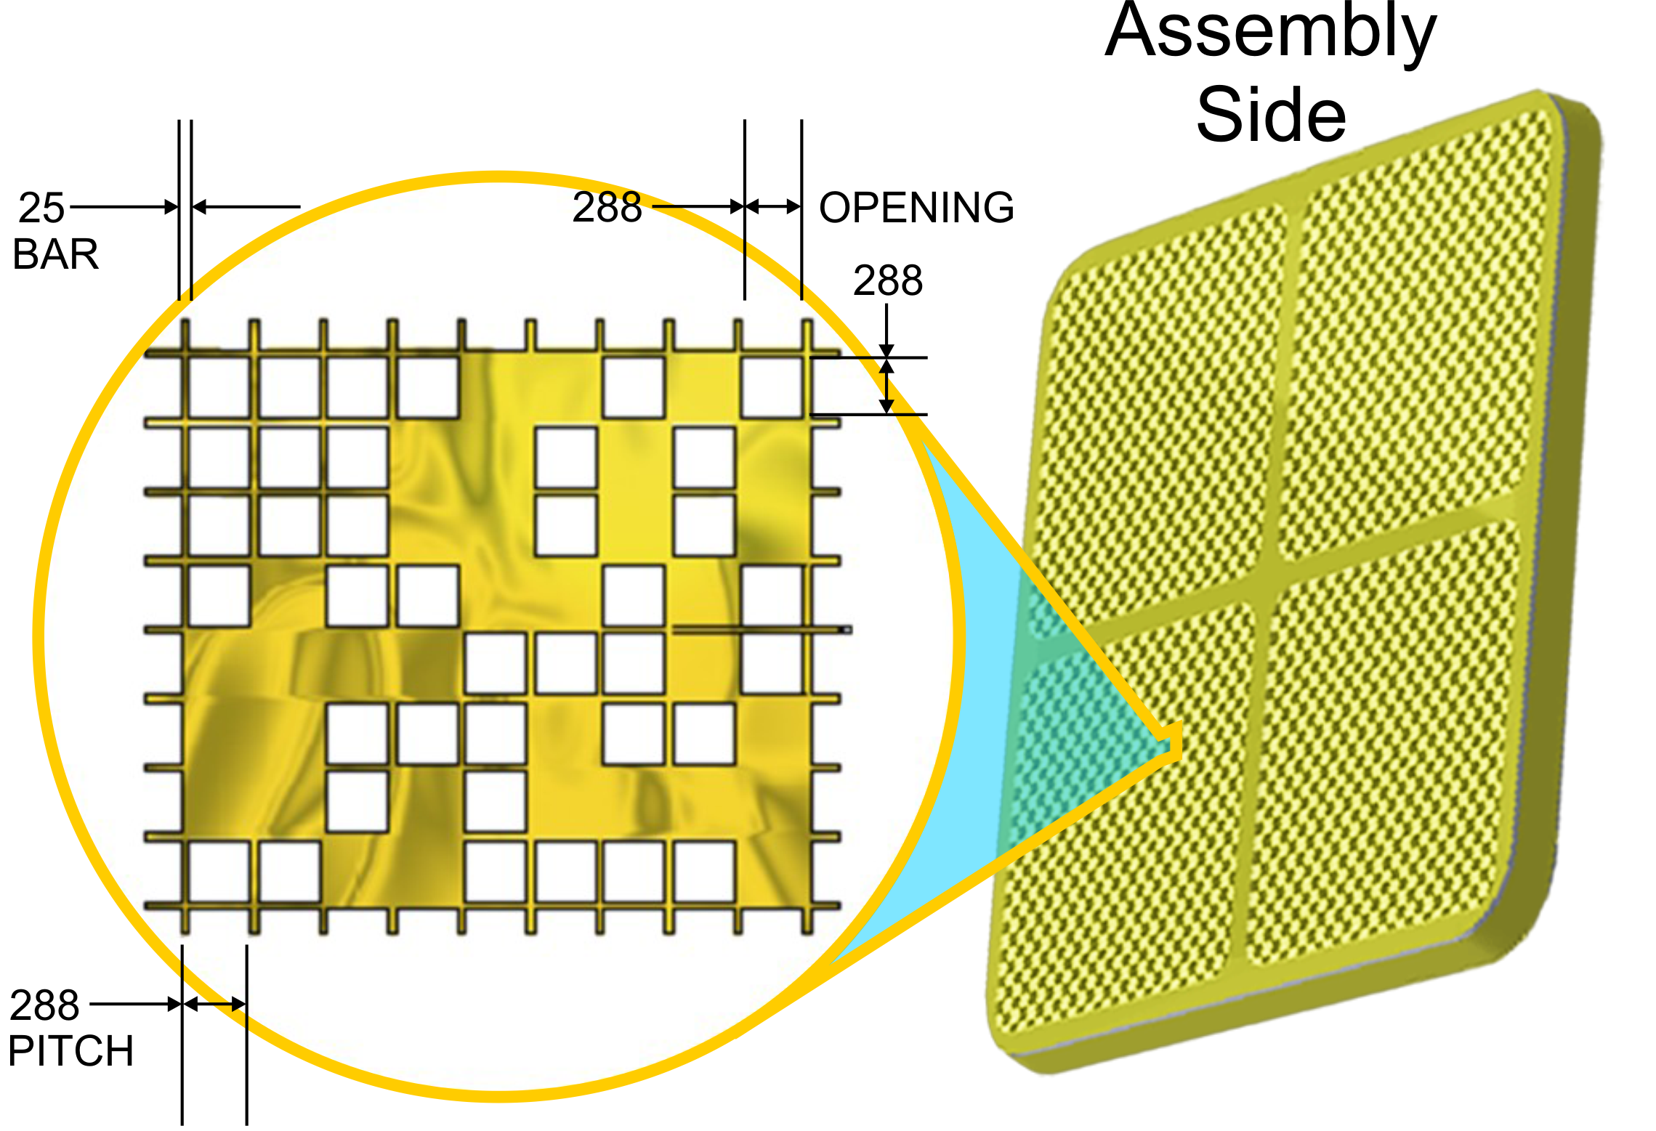
Coded Mask
- Each mask will consist of a ribbed frame that supports electroformed Nickel coated with gold
- Mask pitch of 320 um matches that of detector superpixels
Table 2: BlackCAT Mask Parameters
Parameter | Value
Focal Length | 158 mm
Mask size (aperture) | 170 x 88 mm
Mask element | 320 x 320 μm
Detector superpixel | 320 x 320 μm
DM FOV | 0.95 sr
Open element size | 263 x 263 μm
Mask Transmission | >40%
Image Scale | 52 "/pixel
 | 6.9 arcmin/superpixel

Slide 12
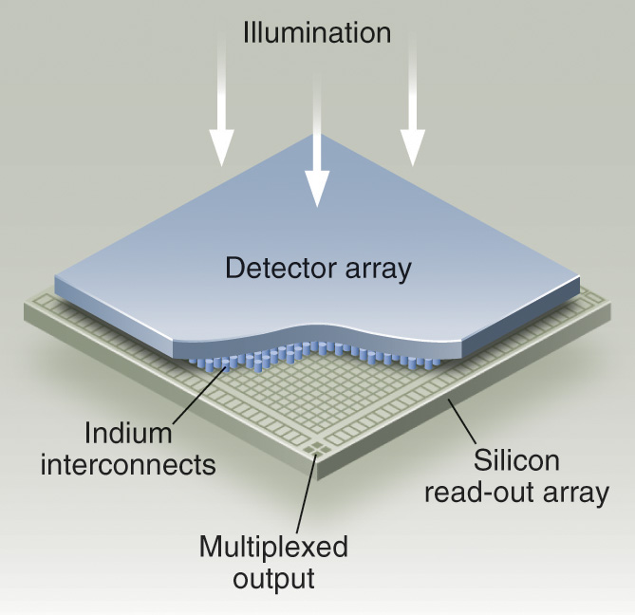
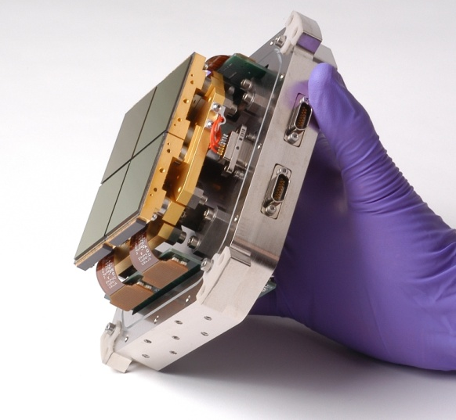
Detectors
Table E.6.a.1.1-3: Detector Parameters
Parameter | Value
Type | Si Hybrid CMOS
Absorber material | Silicon
Absorber thickness | 100 μm
Detector Format | 550 x 550
Readout | Sparse Event Driven
Readout rate | 1 kHz
Pixel Size | 40 x 40 μm
Software binning | 8 x 8
Power | ∼ 100 mW
Operating Temp. | ~ -60° C
Time resolution | 1 msec
Each focal plane detector consists of 4 Si hybrid CMOS detectors (Speedsters)
The intrinsic pixel pitch is 40 um (binned to 8x8 superpixels)
passively cooled to below ∼ -60 C to achieve sufficiently low dark current

Slide 13
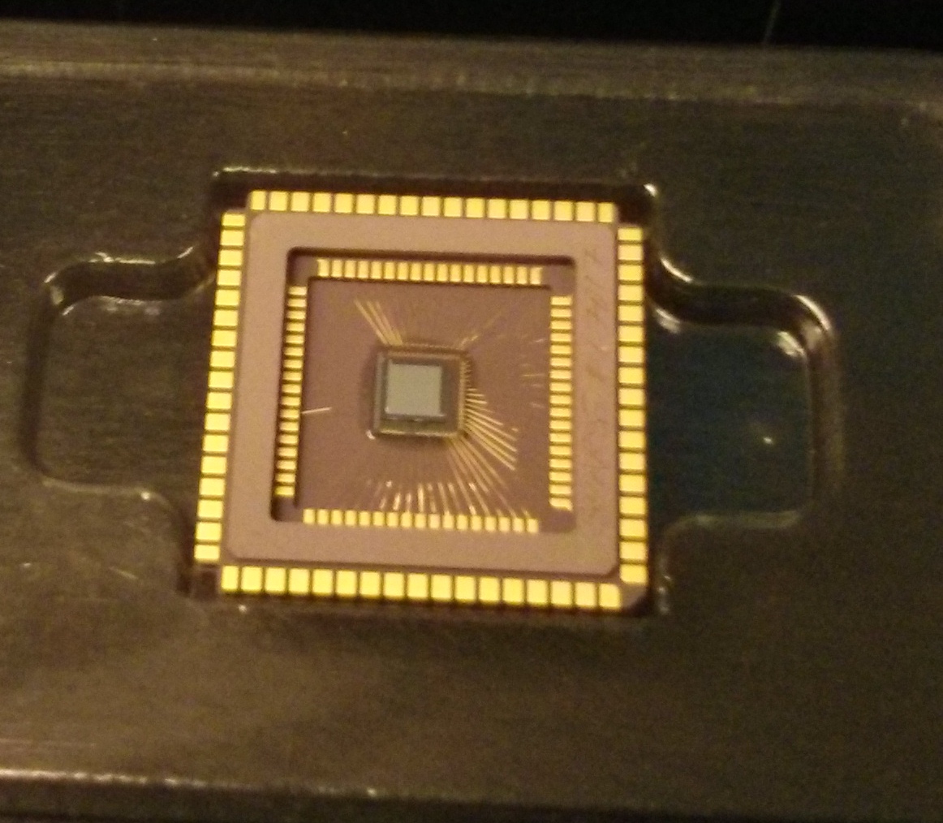
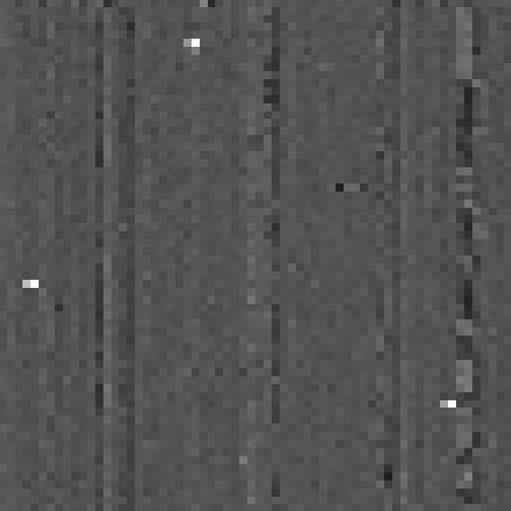
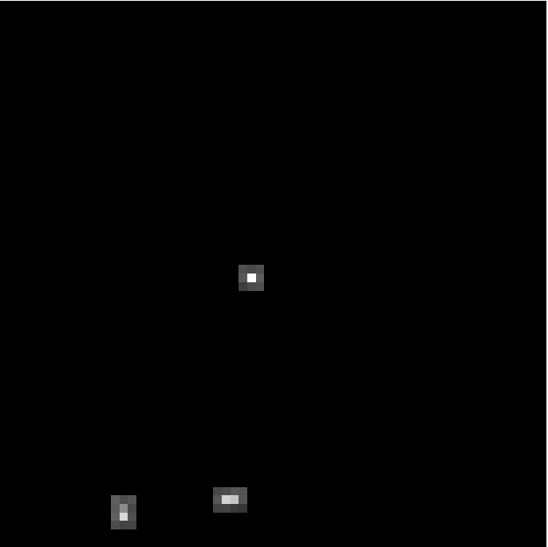
The Speedster Event Driven X-ray Hybrid CMOS Detector
By reading only the pixels with x-ray events, effective frame rates can be faster by orders of magnitude!
Full Frame Read Out Mode:
Comparator threshold set below the noise floor
3x3 Sparse Read Out Mode:
Comparator threshold set above the noise floor
Prototype detector (64x64 pixels with 40 micron pitch and 100 micron fully-depleted depth) successfully tested with its in-pixel comparators. The Speedster also has in-pixel CDS, no measurable interpixel crosstalk, and selectable gain (up to ~200 μV/e). Read noise ~12 e⁻
(Griffith et al. 2016)
A larger format device (550x550) with on-chip digitization is being developed now.

Slide 14

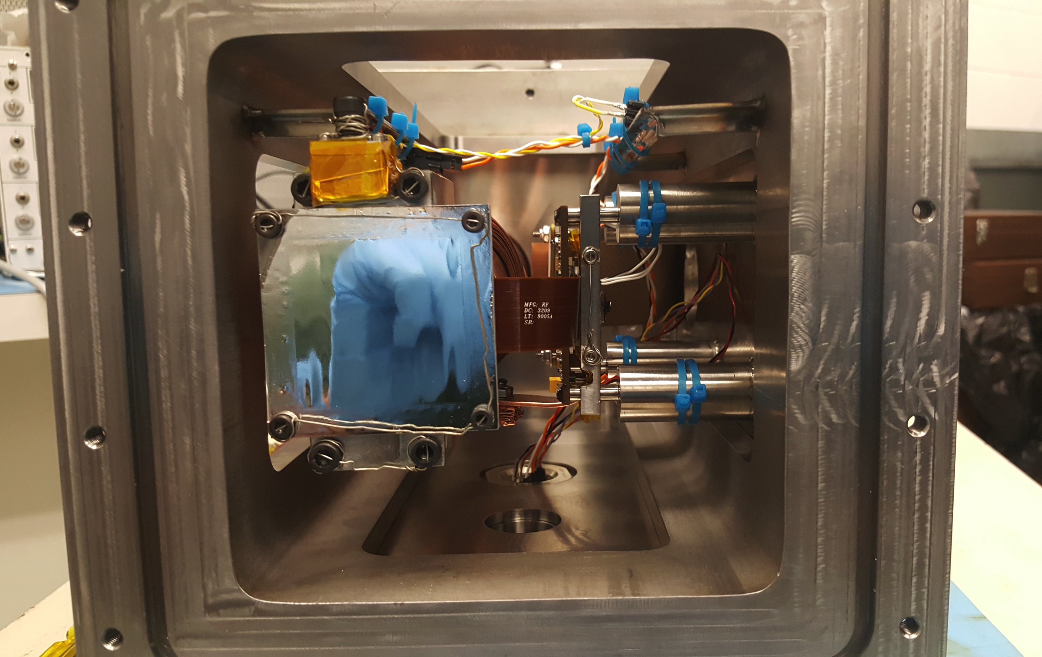
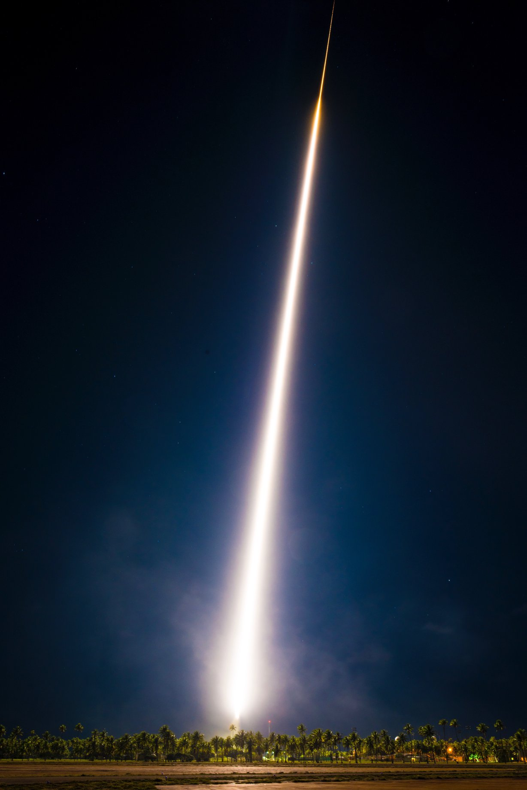
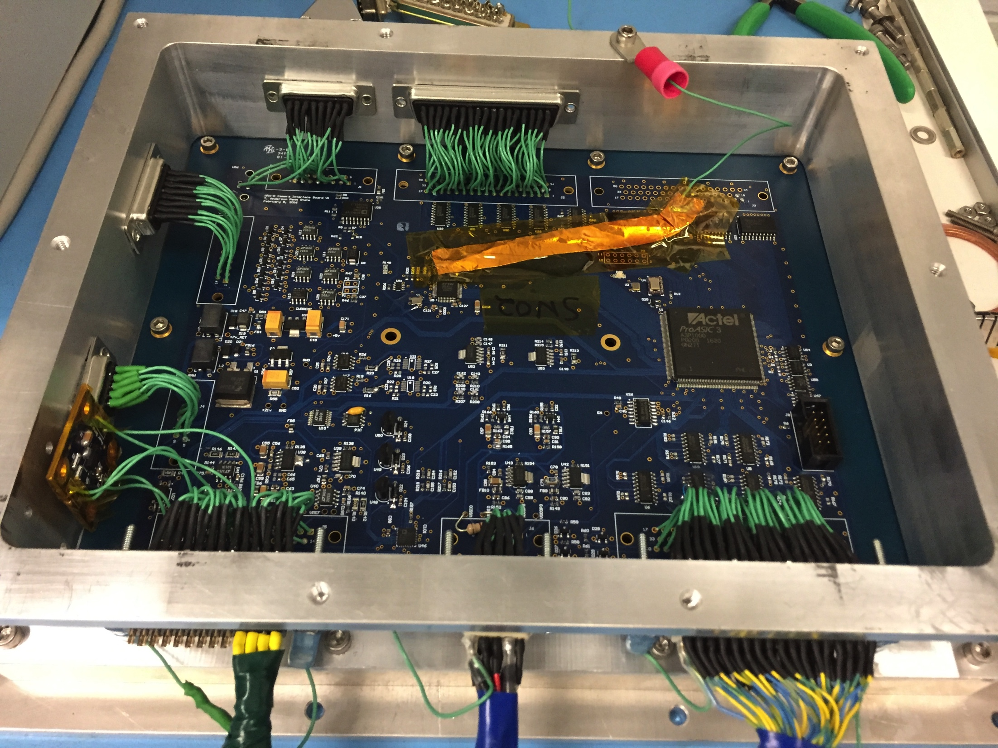
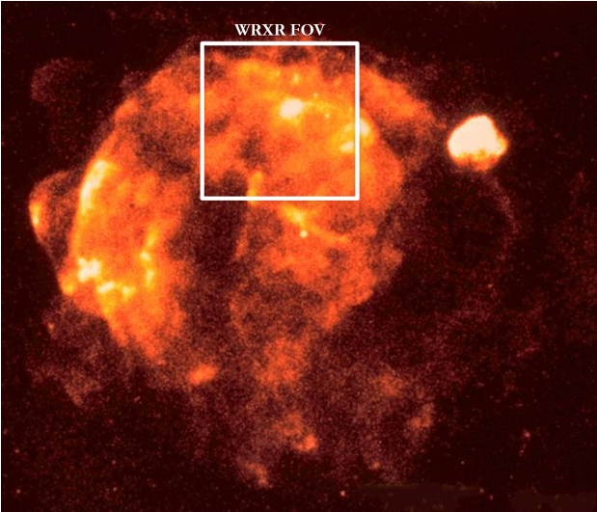
HCDs on WRX Rocket
(X-ray Hybrid CMOS is now high TRL)
In collaboration with McEntaffer group at PSU, we launched Water Recovery X-ray Rocket (WRX-R) with a soft x-ray spectrometer that includes an off-plane reflection grating array and H2RG hybrid CMOS detector
Launched April 4, 2018. First NASA astrophysics sounding rocket payload to achieve water recovery
Key test of x-ray HCDs in space environment; raises X-ray H2RG to TRL-9
Raises our Camera Interface Board to TRL-9
Target: Vela supernova remnant; instrument optimized for 3rd and 4th order OVII; analysis in-progress
Provided flight hardware experience for students

Slide 15
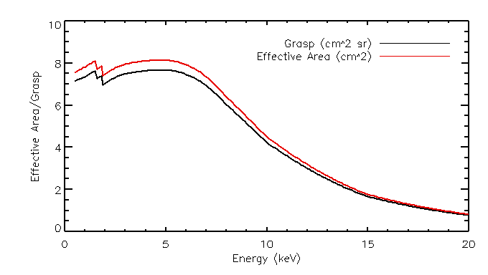
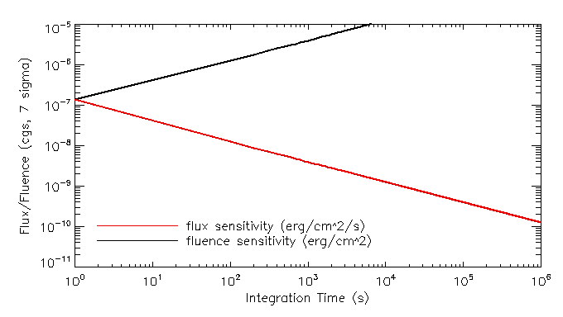
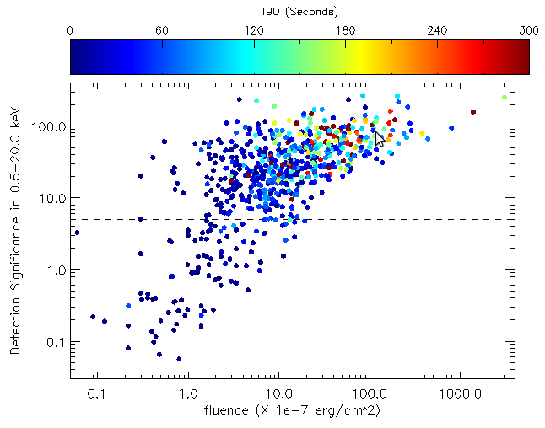
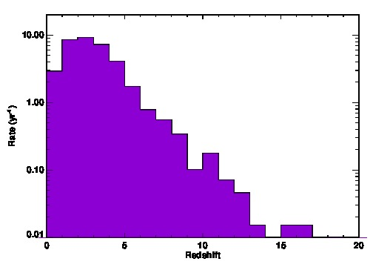
BlackCAT sensitivity (first module)
Fig 1: Top: Effective area (left) and sensitivity (right) for the proposed 1st BlackCAT configuration, using four 550x550 detectors. Bottom: Distribution of GRB fluence and T₉₀ with BlackCAT 5σ detection threshold (left) and redshift distribution of the detectable GRBs with BlackCAT (right).

Slide 16
BlackCAT x N Parameters & Requirements
N Independently flying identical modules (N=1, or 4-10)
Each module contains a coded mask in front of an array of 4 Si hybrid CMOS detectors
× N
Parameter | BlackCAT single module
Bandpass | 1 – 20 keV (goal 0.5-20 keV)
FoV | 1.2 sr (~3.5 sr for 6 modules with anti-Sun offsets)
Angular Resolution | 6.3 arcmin (FWHM)
Position Accuracy | 1 arcmin (30 arcsec for bright GRBs)
Module opening area | 17.0 x 8.8 cm
ΔE/E | <5% at 5.9 keV (goal of <3%)
DXRB rate | ~ 540 cts s⁻¹ (TBD?)
Internal Bkgnd | < 1 cps
Pt Src Sensitivity | ~ 240 mCrabs (7σ, 30s, 1 module) (with H2RGs)

Slide 17
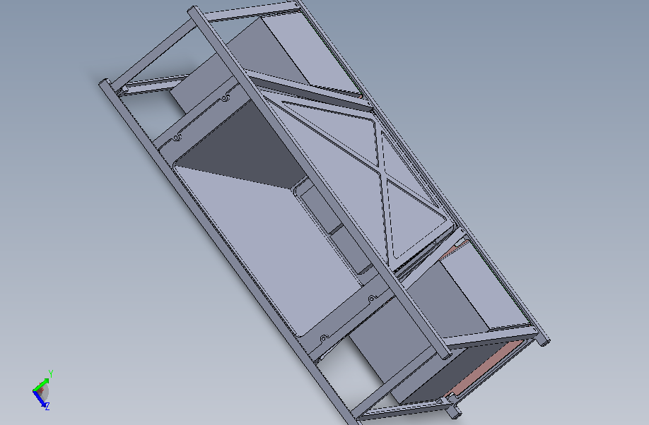
BlackCAT/s orbit and orientation
BlackCAT is currently proposed as a single 6U cubesat
… we envision an eventual expansion to 4-10 detector modules spaced in Sun synchronous orbits on individual spacecraft
- FOV faces anti-Sun
- solar panels (on side opposite the FOV) always face Sun
- radiator on large side always facing away from Earth
- antenna on large side always facing Earth
Simulation of 6 separately orbiting BlackCAT modules
Offsets of 20º (2 DMs) and 40º (4 DMs) from horizon

Slide 18
Stray Light
Detectors coated with 1000 Å Aluminum
  Optical transmission < 10⁻⁶
  No damage to detectors from Bright Objects
  No degradation from Moon
  Earth is opaque, so no degradation from bright Earth

Slide 19
BlackCAT Pointing Needs & Positioning
Table 3: ADCS | Performance
Pointing Knowledge (3σ) | <30 arcsec
Pointing accuracy (RMS) | <30 arcmin
Stability (deg/s) | ±0.0004
Jitter | <50 arcsec
BlackCAT expects to obtain the following centroided position accuracy for GRBs (90% confidence radius):
  70 arcsec for dim GRBs
  41 arcsec for bright GRBs

Slide 20
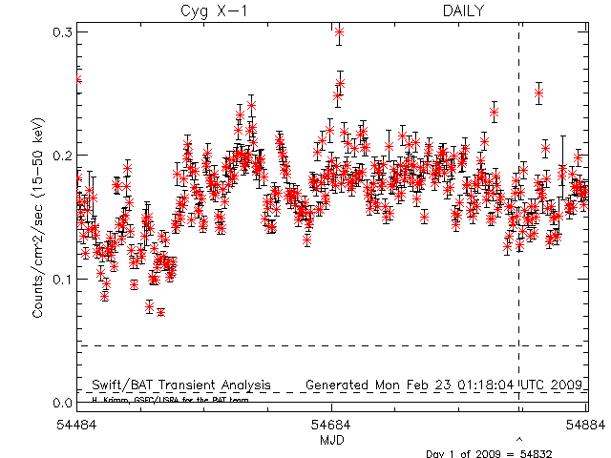
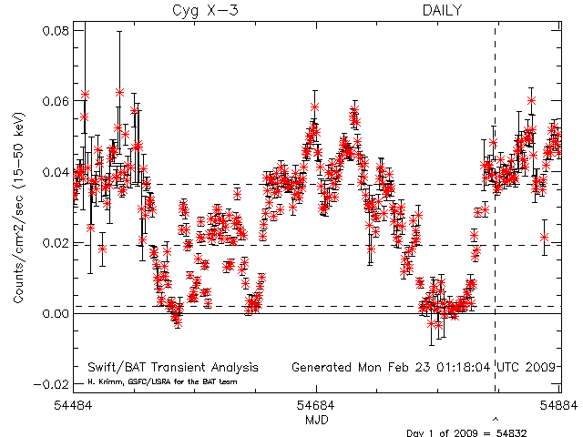
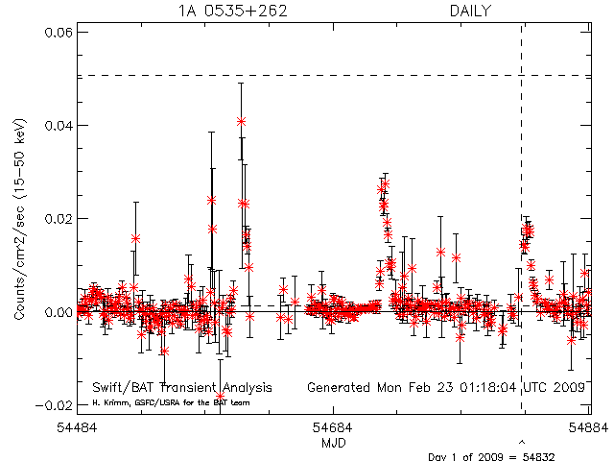
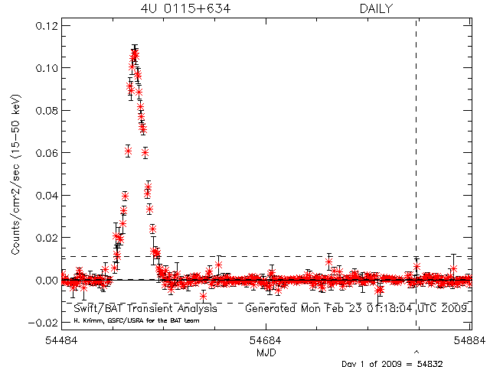
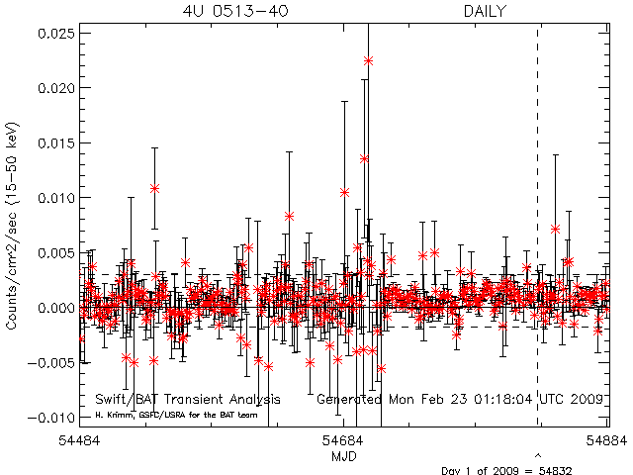
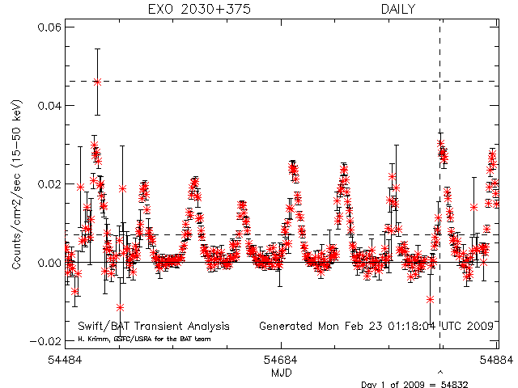
BlackCAT Transient Survey
BlackCAT will also survey the sky and produce light curves (0.5-20 keV) of hundreds of transient X-ray sources
Cyg X-3
1A 0535+262
Cyg X-1
4U 0115+634
(Swift BAT,
15-150 keV)
4U 0513-40
EXO 2030+375

Slide 21
Concluding Remarks
BlackCAT has been proposed to NASA as a small CubeSat mission, with a proposed launch in April 2022.
This small mission would detect high redshift GRBs and gravity wave counterparts during this prime-time for multi-messenger missions accompanying advanced GW detectors, as well as LSST and neutrino detectors.
It would pave the way for a network of several enhanced versions of BlackCAT to monitor a larger solid area of the sky with multiple cheap CubeSats viewing different directions.

Slide 22
Extra Slides

Slide 23
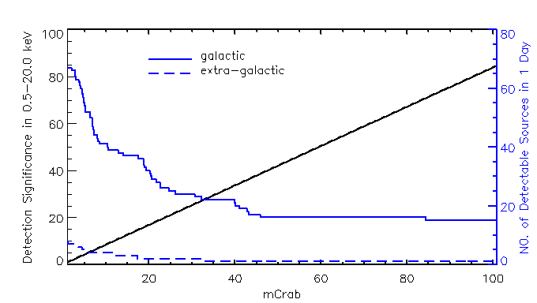
Monitoring sensitivity (1 Module)
Fig 2. Daily monitoring sensitivity of BlackCAT (black solid line) assuming 50% of duty cycle. Detectable galactic and extra-galactic sources in 1 day is shown in blue solid and blue-dashed lines, respectively.

Slide 24

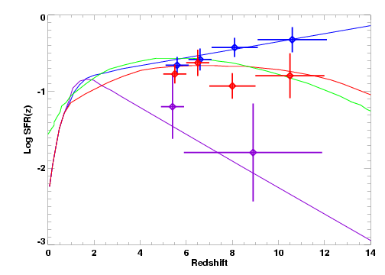
High redshift GRB Science
Measure the cosmic star formation rate over 5<z<12 by detecting and observing high-redshift gamma-ray bursts and their afterglows.
Single module will detect many bursts at z>5, and ~1/year at z>8
redshift derived from ground data
Burst redshifts will reveal the cosmic star formation rate over 5 < z < 12
Stellar light was likely the dominant cause of the cosmic reionization
Star formation estimates are crucial to constructing a full picture of reionization

