Slide 1
XRCF Hardware Contribution
Kristin K. Madsen
on behalf of GSFC, MSFC, and ESA

Slide 2
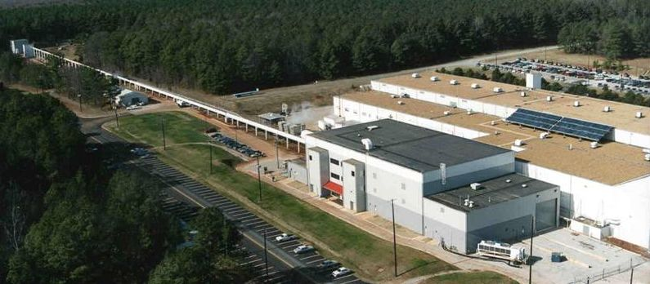
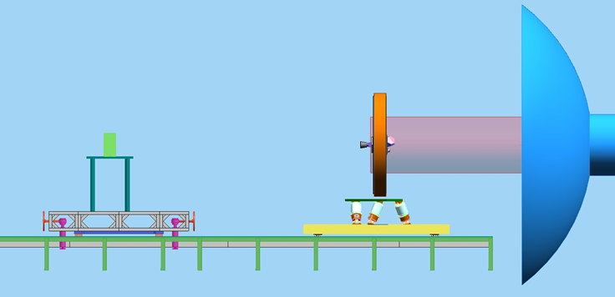
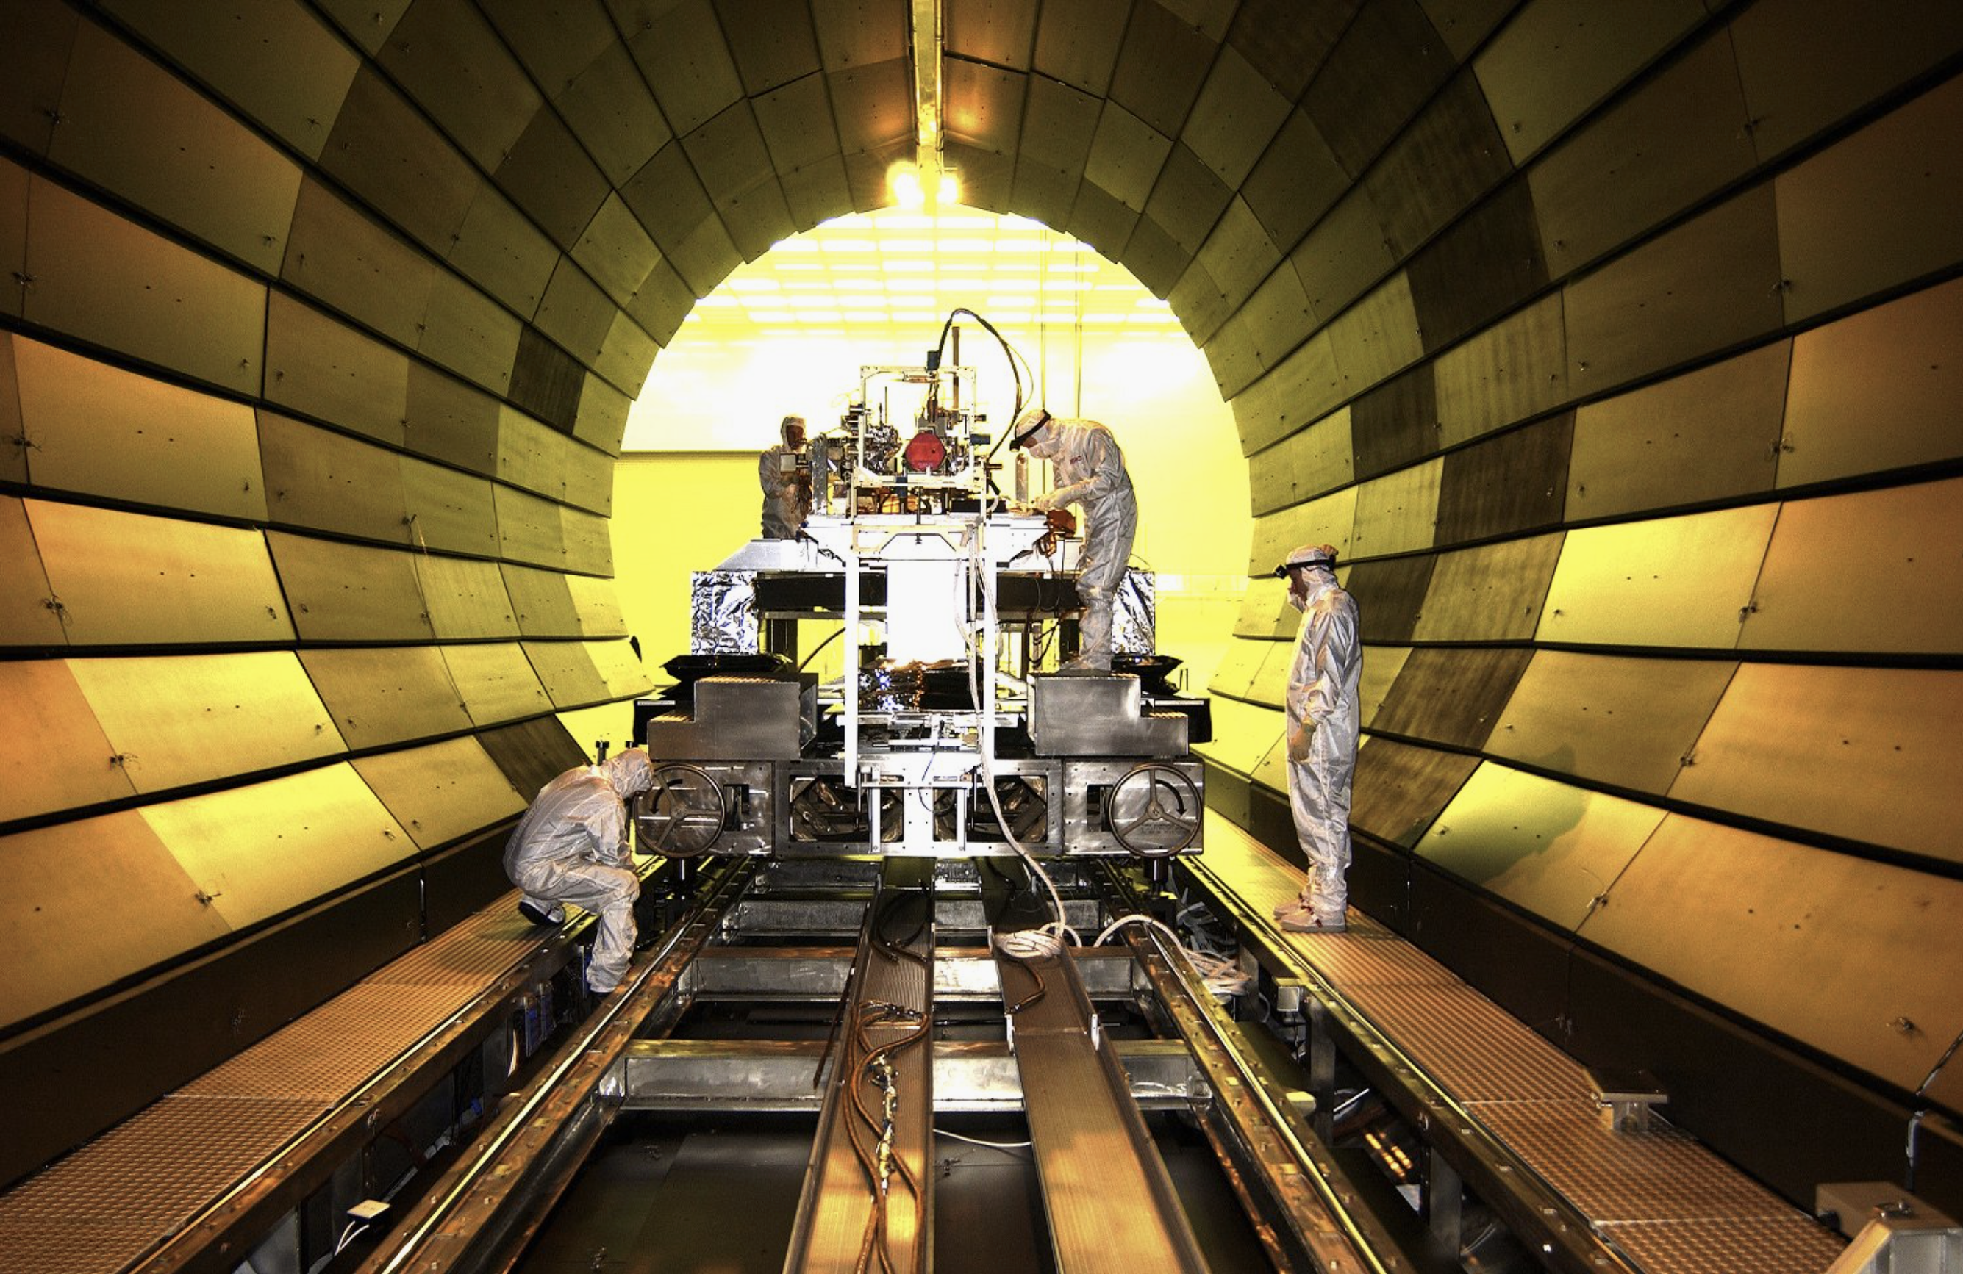
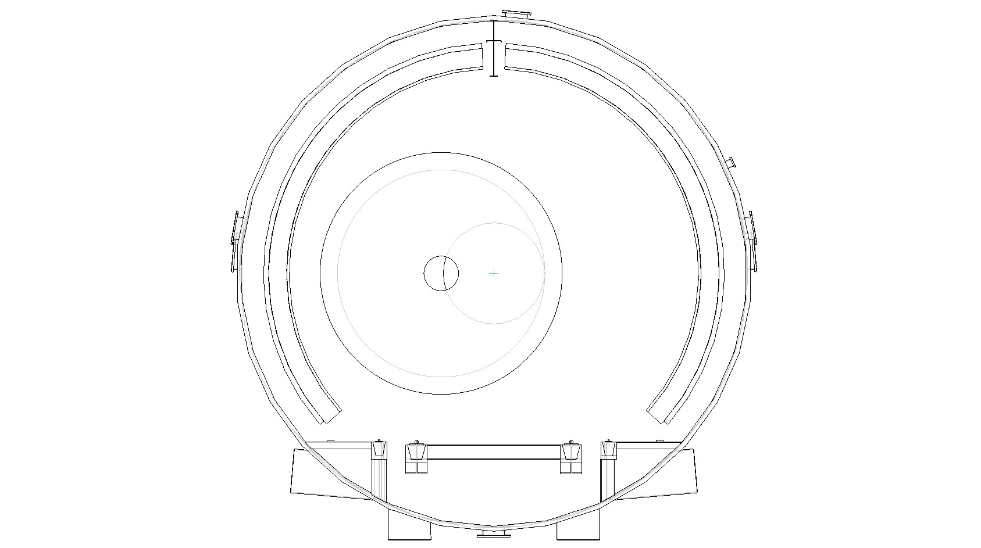
XRCF – X-ray & Cryogenic Facility
CCD
3-DOF
Translation
Stage
MAMD
6-DOF
Motion
Stage
MAMD
Hexapod
Existing
Test Bench & Support Structure
X-ray Beam
2-DOF
Translation
Stage
XRCF @ MSFC
Solar X-Ray Imager Testing in XRCF
BEAM

Slide 3
XRCF contribution
MAMD (Mirror Assembly Module Demonstrator)
  2 MAMD test-articles pre- and post-environmental test (2 Primes)
    MAMD#1: 1st June 2022 - 1st October 2022
    MAMD#2: 15th July 2022 - 1st November 2022
QM
  Performance verification campaign tests for the MA QM
  QM verification (3 months) - start: ~04/2025
FM
  Perform the calibration campaign for the MA FM
  FM calibration (6 months) - start: ~02/2029

Slide 4
MAMD testing goals
The MAMD is the EM of the MAM
As an EM, the goals of the MAMD are to enable the verification of the critical functions:
  The ability to manufacture a full-sized Mirror Structure compatible with the ATHENA Mission Requirements and the ATHENA Reference Telescope Design
  The ability to accommodate the MMs (SPO mirror modules)
  The assurance that the materials and processes envisaged for the manufacture have the required maturity and quality
  The ability to provide environments for the MMs that are within the specified range for all mission phases
  The ability to align MMs along the aperture with the required accuracy
  The ability to retain MM alignment under structural environmental loads

Slide 5
MAMD phases
In order to allow the verification of the 6 critical functions, the MAMD shall undergo 3 technical phases:
Phase 1: Design and manufacture a full-size Mirror Structure, MGSE, Mirror Dummies (MD), HDRM, etc…
Phase 2: Populate appropriately with MM MDs, and put through a mechanical test-campaign to verify the load environment provided by the MS to the MMs, and prove the mechanical performance of the dowel pins.
Phase 3: Substitute a few MDs for real MMs, repeat mechanical test-campaign to verify the load environment with pre/post alignment checks IN X-RAY at XRCF

Slide 6
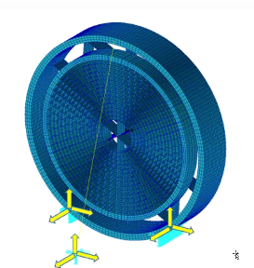
MAMD
DUMMY
DUMMY
DUMMY
DUMMY
DUMMY

Slide 7
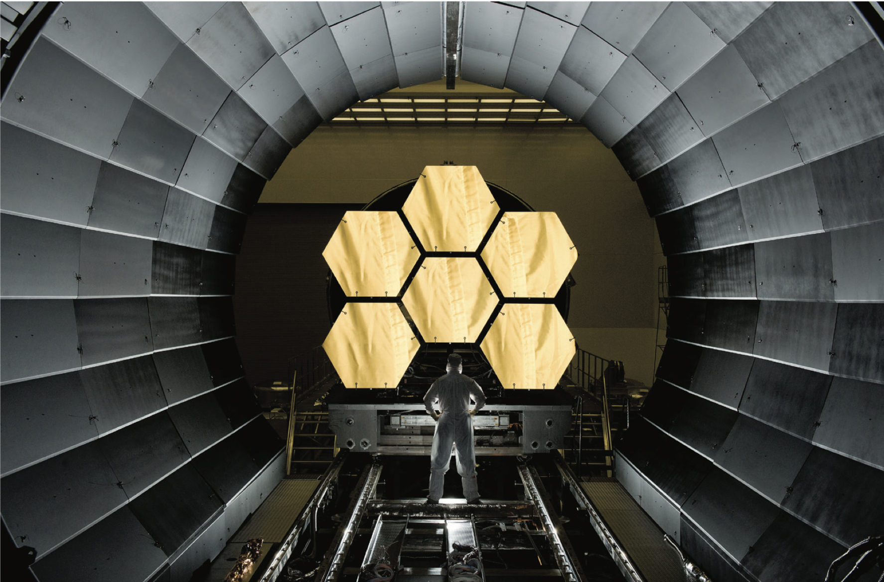
MAMD

Slide 8

MAMD campaign
Two staggered MAMD test articles
XRCF
Europe
XRCF
Pre-environmental test
Mechanical & Environmental tests
Pre-environmental test
X-ray tests:
Optical axis
Focal length
Off-axis
PSF
Thermal gradient test (front-to-back)
Tests:
Shock
Vibration
Etc …
X-ray tests:
Optical axis
Focal length
Off-axis
PSF
(Gravitational compensation test)

Slide 9
MAMD campaign
Two staggered MAMD test articles
XRCF
Europe
XRCF
Pre-environmental test
Mechanical & Environmental tests
Pre-environmental test
X-ray tests:
Optical axis
Focal length
Off-axis
PSF
Thermal gradient test (front-to-back)
Tests:
Shock
Vibration
Etc …
X-ray tests:
Optical axis
Focal length
Off-axis
PSF
Test results
Critical to the down select of the final prime (vendor)

Slide 10
Current activity
Agree on test requirements
  Define tests
  Generate schedule
Finalize procurements
  Stage hardware upgrades
  Detectors
  Metrology system
Commence facility upgrade
  Should have started early this year
  To accommodate the 2022 schedule, MSFC are working on getting their projects started back up

