Slide 1
US Contributions to the Athena WFI
NAST Virtual Meeting
July 14, 2020
PSU, MIT, SAO, Stanford

Slide 2
WFI Status
Successful completion of all ESA reviews to date
Breadboarding and hardware demonstrations of detector subsystem, filter subsystem, etc. to achieve TRL 5/6
  64x64 DEPFETs under test with switching ASICs and VERITAS-2.2 front-end electronics ASIC. 2.6 e- noise, 130 eV FWHM (5.9 keV)
  First lot of flight-sized detector fabrication built
  Flight-sized detector assembly under development
  Successful acoustic tests of filters. Vibration tests delayed due to COVID-19

Slide 3
US Contributions: Enhance science in 3 areas
Transient sources
  Monitor observation target for variability
  Search for serendipitous sources that are variable and/or brighter than catalog fluxes
  Facilitate rapid multiwavelength followup
Clusters and other extended sources:
  Improve background determination through on-board analysis of all events.
    On-board event recognition rejects > 99.5% of background events, which are not telemetered to the ground
    On-board background determination can improve knowledge of background level and variability
Provide critical electronics support required for successful instrument design
  Front-end VERITAS processing ASIC analog design support
Transient Analysis Module
Software contributions
Background Analysis Module
Notes:
MPE decided they can telemeter all MIPS events to ground => don’t need to do background analysis on board.
NASA decided to drop support of SPM => software contribution only for both TAM and BAM

Slide 4
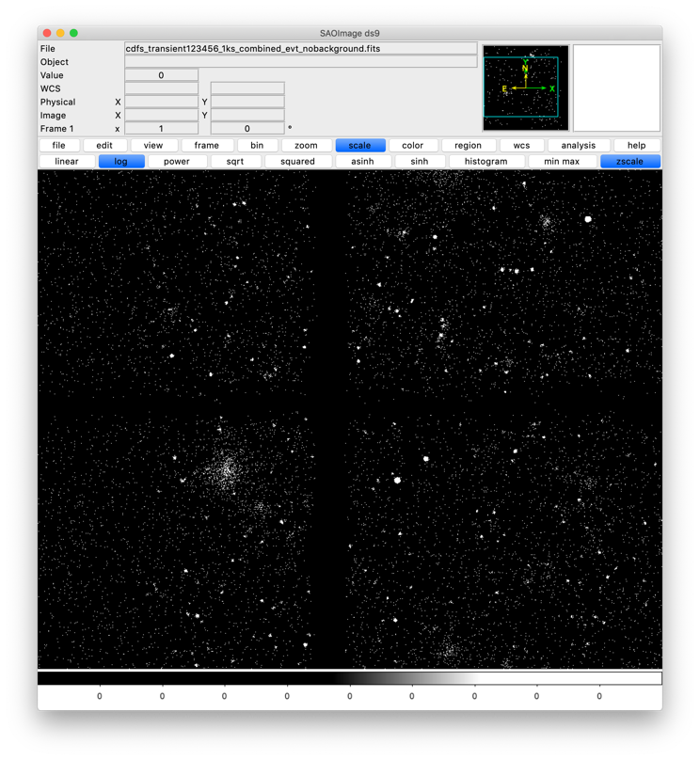
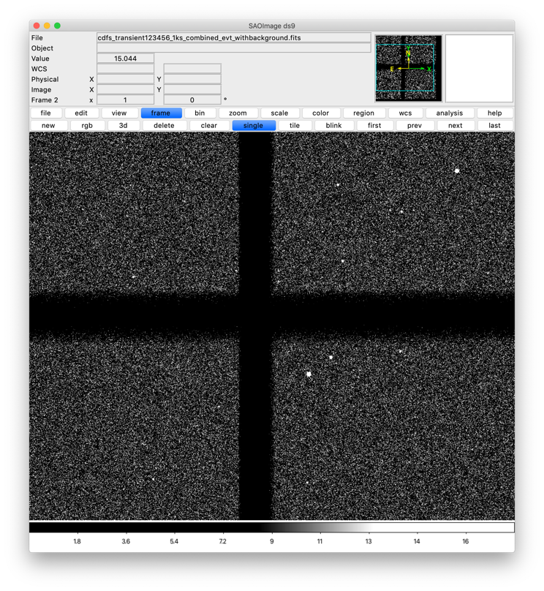
SIXTE simulations, low and high background
CDFS simulations with low / high background

Slide 5
Transient alerts
Ground implementation:
  Basic algorithm developed, meets performance requirements from MPE
  Software design of ground-based version is complete
  Near-real time alerts possible during ground contacts
  Team is participating in W-ISC discussions

Slide 6
Athena will study outer regions of X-ray clusters
SG1.3: Non-gravitational cluster heating processes:
Measure entropy profiles in groups (down to ~5 × 10¹³ M_{sun}) and clusters (up to ~10¹⁵ M_{sun}) out to their virial radius (R200) in the local Universe. Investigate their evolution out to z~2 within R500. This requires X-ray surface brightness and gas temperature measurements down to the background-dominated regime.
SIXTE-Simulated WFI Image of Fornax Cluster
Credit: Y. Su

Slide 7
WFI Background Analysis
3-pronged approach:
  Investigation of background in XMM small window mode data
  Investigation of background in GEANT-4 simulations
  Investigation of AI approaches to background reduction
Team is participating in the WFI Background Working Group

Slide 8
Instrumental background in PN SWM FW closed data
 | Athena WFI | XMM-PN
Pixel Size (micron) | 130 x 130 (2.2′′ x 2.2′′) | 150 x 150
Depletion Depth (microns) | 450 | 280
~300 PN SWM slew observations with filter wheel closed
Read 64x64 region of CCD4, 5.67 ms frame time (well-matched to WFI DEPFETs)
Goals
  Empirical confirmation of “Self AntiCoincidence” (SAC) – consistency of results between SAO, MIT, and WFI BWG
  Improve SAC by including parameters such as particle energy and event grade (i.e. use ALL information available)
Paper on this work published (Bulbul+2020, ApJ)
Valid events, no track
Notes:
Strong modulation with the Solar cycle observed for all types of frames (Cases A, B, and C) indicates that XMM-Newton EPIC-pn unfocused background is dominated by the galactic cosmic rays.

Slide 9
AMS Galactic Cosmic Ray Variability
6 years of data at 27-day cadence, centered on solar max of 5/2014
AMS shows energy-dependent p & He episodic variability:
  ~5–10% amplitude, timescales 1–3 months, greatest in solar-min to max epoch
  superposed on expected 2x variation anti-correlated with solar cycle
Spectral range 1–60 GV rigidity; 24 spectral bins, 1.1–11 GV (Ep,kinetic= 0.5–10 GeV)
Combined with XMM data, suggests we may expect similar variability in WFI background
  Q: will this change in L1 or L2?

Slide 10
GEANT4:
Need to model impact to detector with GEANT-4:
  Perform additional Geant4 simulations and analysis incorporating variability. WFI design fidelity is not vital, but we need ~10x more statistics than current simulations.
  Analyze resulting unrejected background variability and its effect on low-surface-brightness science. Compare to in-situ X-ray missions (XMM-Newton, Chandra).

Slide 11
AI approaches to background reduction:
Goal is to accurately distinguish between “events” caused by X-rays and those caused by charged particles
  Event Grades/patterns are 20th century concepts due to limited telemetry
  Identify additional information we can use to improve science return and calibration (soft response, photon localization, ….)
  Tailor the analysis of each event to produce a probability distribution for energy and position
Develop methodologies that incorporate calibration uncertainties into data analysis
  e.g. temporal gain variations from each pixel
  Adapt IACHEC best practices and concordance methodology
Requires simulations with a realistic detector model
  Accomplish similarly to Geant4 work; we need simulation results, not the model
Investigate advanced machine learning solutions

Slide 12
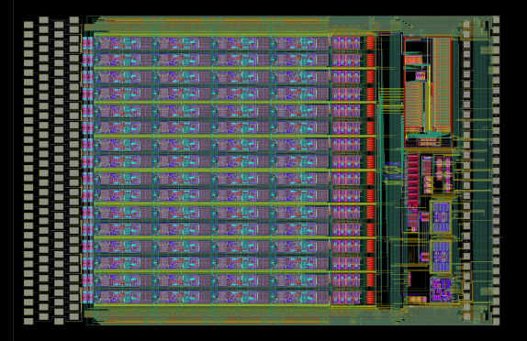
VERITAS ASIC design, testing and data analysis
The VERITAS ASICs provide a central component of the WFI electronics
The Stanford team is providing input (schematics, simulations, layout) to all design updates
VERITAS 2.2 design has 3 variants for risk mitigation and development staging
  Devices in all 3 variants fabricated on the same wafer run and are being tested

Slide 13
VERITAS ASIC (Stanford)
Conversion from AMS process to XFAB process underway
  Transition requires optimization of transistors and adjustment of RC compensation
  Requires full new layout
  Test structures designed and in fabrication

Slide 14
Conclusions
PSU, MIT, SAO, and Stanford continue to work on hardware and software contributions to the Athena WFI in the areas of
  Transient source analysis
  Background analysis
  Front-end electronics design and testing

