Slide 1
Roller Coaster Flip w/ Conservation of Energy
Presented by Jonah Kanner
July 12, 2012

Slide 2
Things you’ll need
About 40 3x5” index cards
1 inch brads (x2) to bind your flip book together
Colored pencils
Scissors
Hole punch
Calculator
Scratch paper

Slide 3
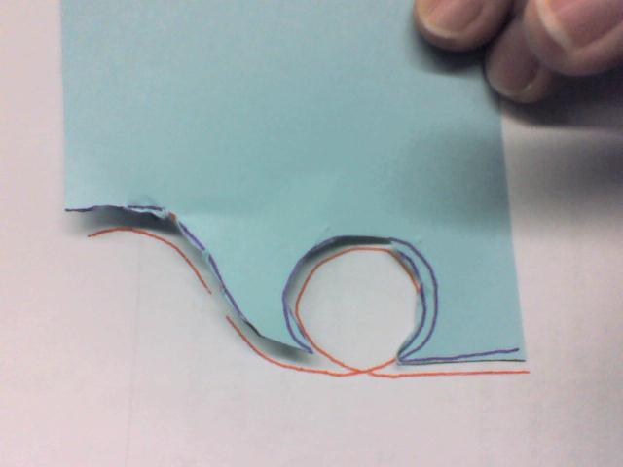
Making your coaster
Use the patterns provided to make a stencil for your track. Cut the stencil from 1 index card

Slide 4
Making your coaster
Trace the stencil onto an index card to create the track
For the first card, draw the car at the top of the first hill.

Slide 5
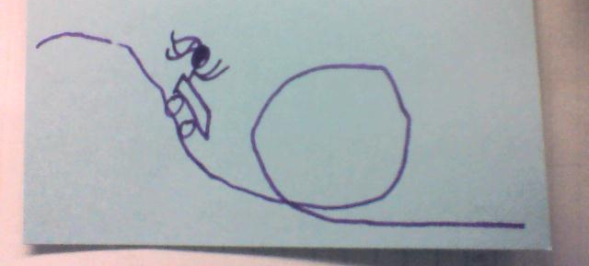
Making your coaster
On each card, measure Δh
Δh

Slide 6
Making your coaster
Calculate Δx. This is how far the car should move along the track on the next card
Δx

Slide 7
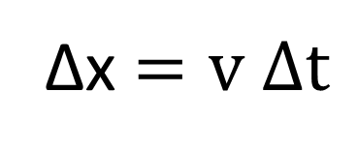
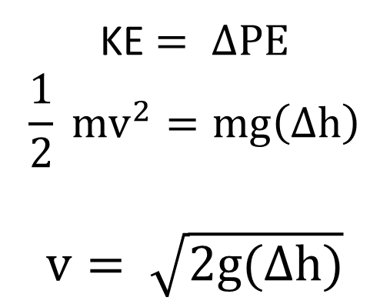
Key Equations
KE $= ΔPE$
$$\frac{1}{2} mv^{2}=mg\left(Δh\right)$$
$$v= \sqrt{2g(Δh)}$$
Δx $=v Δt$
g = 1000 cm/s/s
Δt = 0.02 s

