Slide 1
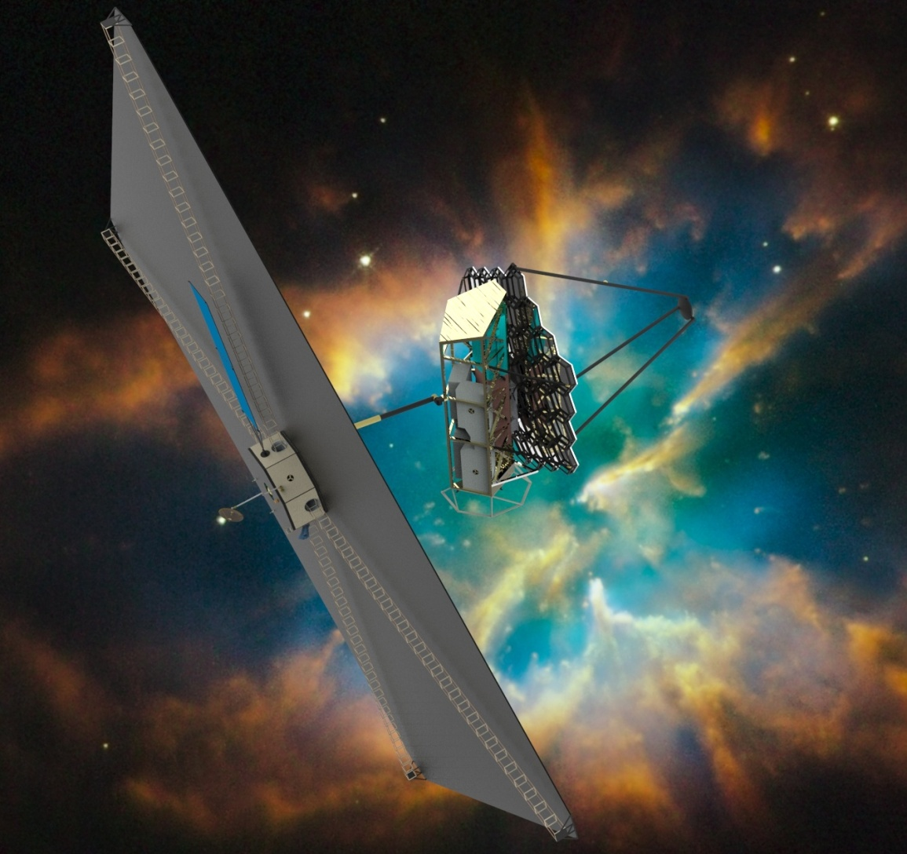
Estimated Two-Year FTE Requirements
To Support the STDT Studies
March 2015

Slide 2
Preparing for the 2020 Decadal Survey Supporting SMD’s STDT Assessment
HQ has documented and initiated a plan for Science and Technology Definition Teams (STDTs) to conduct mission concept studies
The STDTs will be charged with the following tasks:
Define science objectives for the mission concept
Develop a design reference mission, including a “straw man” payload
Identify the technology development requirements
Identify a mission cost-box
Study management and appropriate engineering support will be provided to the STDT by partnering institutions (i.e., GSFC and ATLAST partners, academia, industry)
Provide the necessary technical resources for the STDT to carry out its charge from HQ
These charts summarize estimated support for the STDT
Charts do not include
technology funding (the highest priority “medium activity” in the 2010 Decadal Survey) estimated in the $10 -- $30 M range per year.
Distribution of FTEs among participating institutions
Study management, administrative support, etc.; may be supplied by participating Center(s)

Slide 3
Preparing for the 2020 Decadal Survey Supporting SMD’s STDT Assessment
The resources identified in these charts include:
Engineering support to STDT analyses and products
Define a straw man payload
Identify the technology development requirements
Develop a design reference mission
Conduct a cost assessment with the possibility of iteration in order to identify a cost-effective approach.
Professional outreach and engagement
Report to and build support within science and engineering communities
Educate likely members of NRC review teams: SSB, CAA, 2015 Mid-Decade Review, Decadal Survey, industry/academic/international partners
TIMs with partnering institutions, visualizations, graphics

Slide 4
Example: Allocation of FTEs Across Skills
Skills Mix – FTEs Per year
Support STDT processes and products with quantitative analyses
Enable decision making and substantiation of STDT’s findings
Requires successive refinement of formulation analyses to support STDT’s charge

Slide 5
Impacts of Partial Funding for FTEs
The resources indicated are necessary to assist the STDT in carrying out its charge from HQ.
If less resources are provided, then risks increase:
Incomplete or inadequate definition of payload
Technology development requirements inadequately identified and inadequately substantiated
Design reference mission inadequately specified, and with inadequate detail to support costing effort
Cost assessment with uncertainties so large, results are of little credibility

Slide 6
Preparing for the 2020 Decadal Survey Supporting SMD’s STDT Assessment
Professional outreach and engagement includes
Report to and build support within science and engineering communities
Conferences, workshops, and TIMs, including hosting workshops
Educate likely members of NRC review teams: SSB, CAA, 2015 Mid-Decade Review, Decadal Survey, industry/academic/international partners
Industry and international partners offer significant opportunities for cost savings
Academic and research institutes (SAO, STScI, NRAO, USRA . . ) are major sources of review teams
TIMs among partnering institutions , visualizations, graphics, web development
WAG on outreach and engagement costs
Travel: four professional meetings/year for half the study team: 2 years x 8 x 4 x $1500 = $96 K
Conference registrations: 2 years x 8 persons x 2 conferences x $750 per meeting = $24 K
Visualizations: 2 years x $25 K = $50 K
Publication charges: 2 years x $5 K = $10 K
TOTAL ~ $180 K

