Slide 1
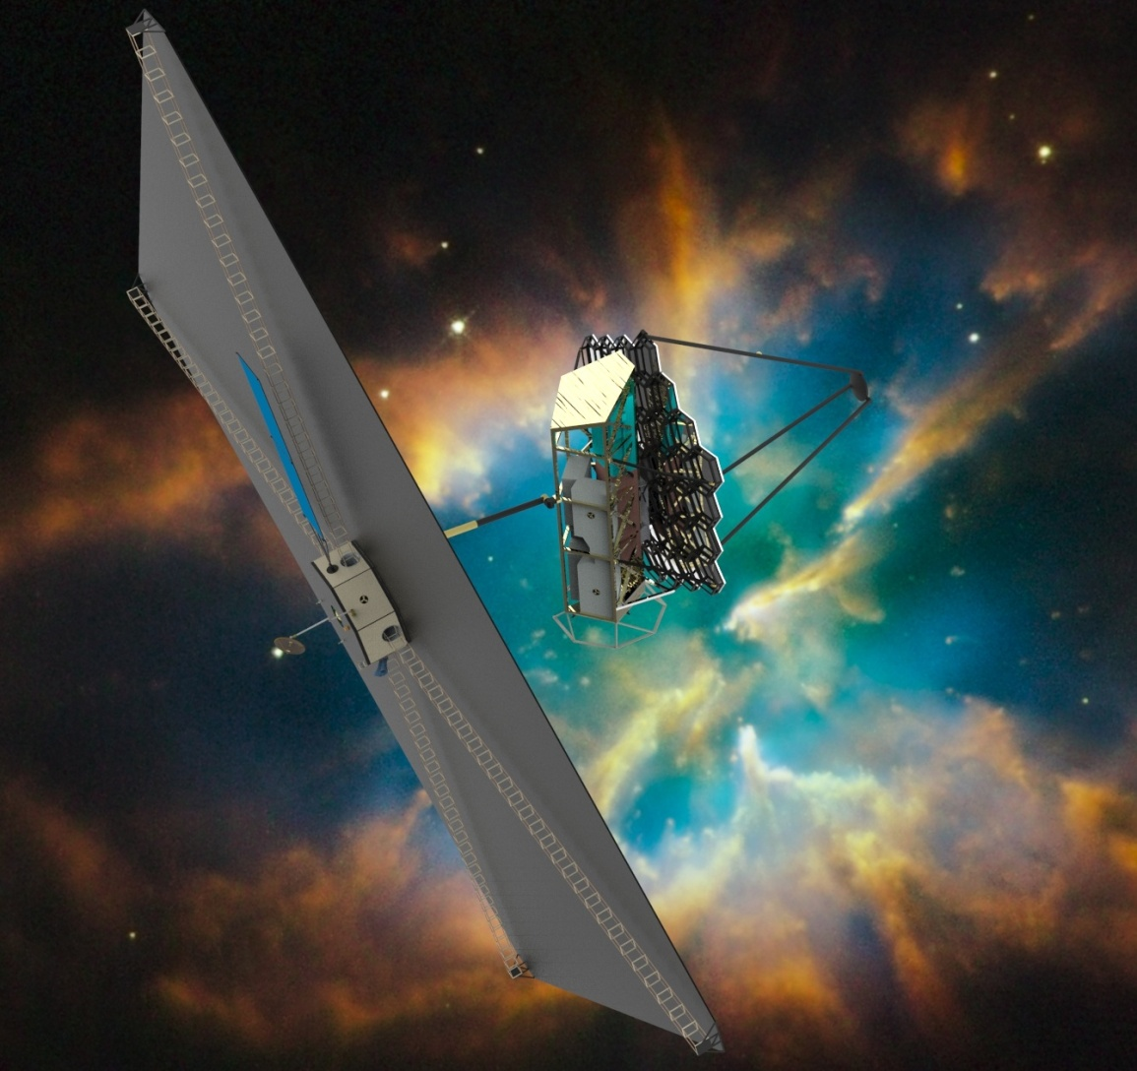
Augmenting ATLAST
Sustaining Goddard Leadership on the Road to the 2020 Decadal Survey
March 2015
The will to win means nothing without the will to prepare!

Slide 2
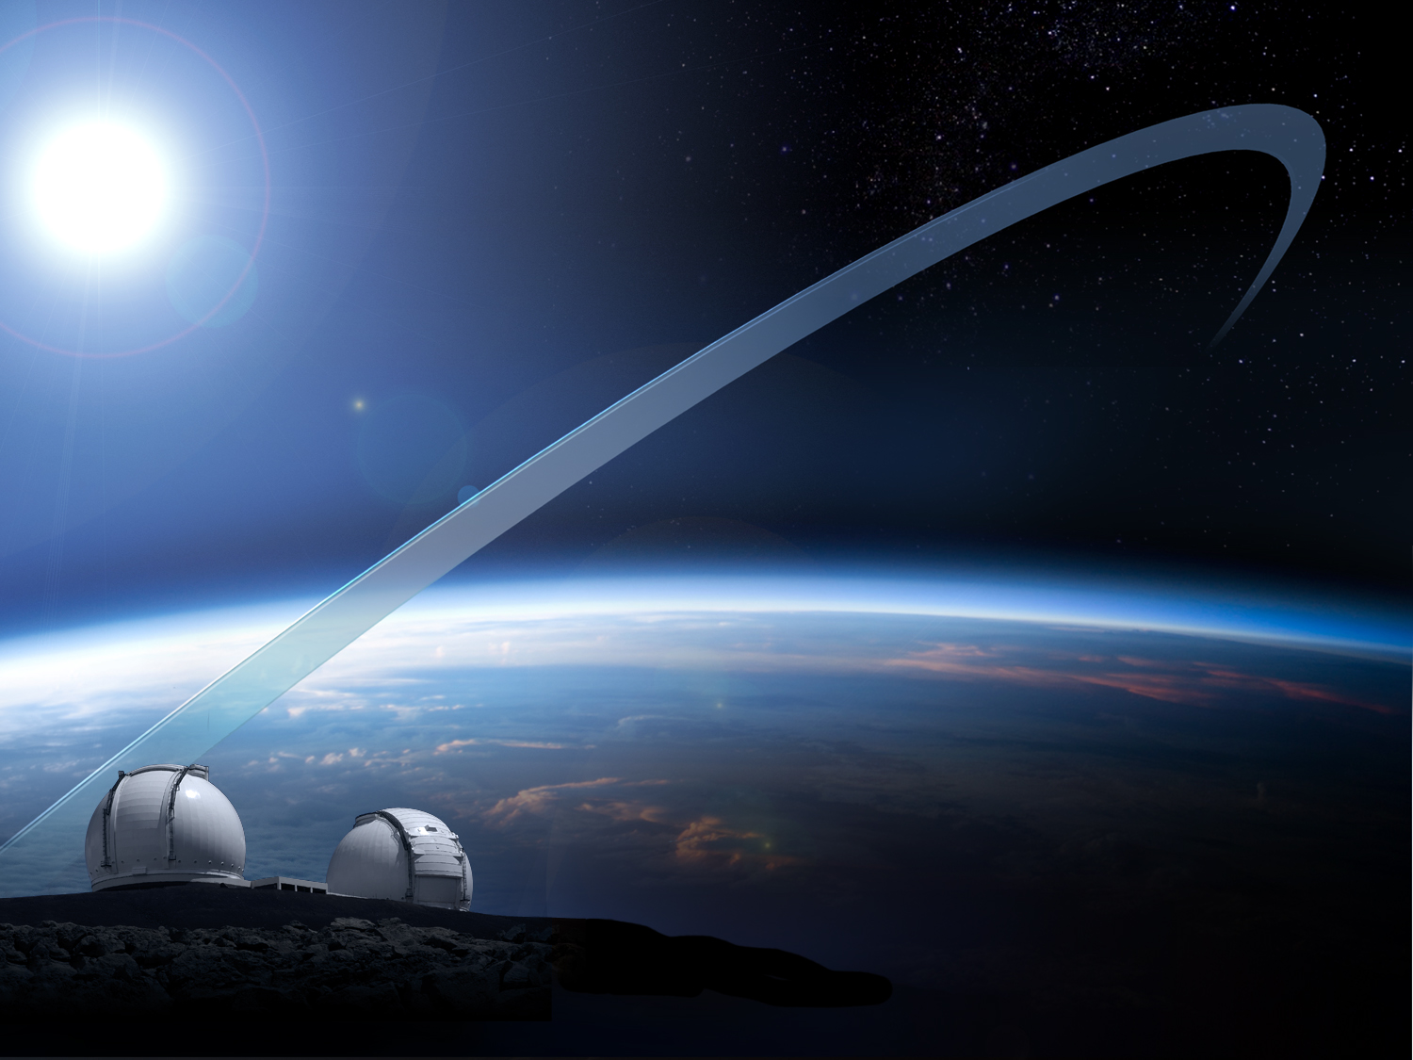
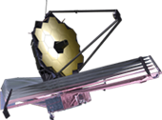
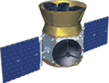
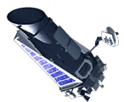
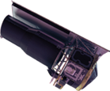
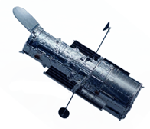
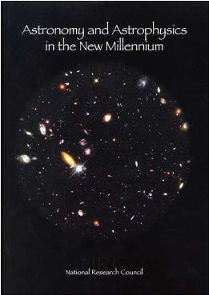
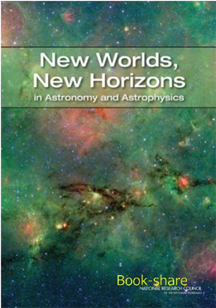
NASA’s Exoplanet &
Astrophysics
Facilities
JWST
AFTA
TESS
Kepler
New Worlds Telescope
Spitzer
2001
Decadal
Survey
2010
Decadal
Survey
Hubble
Ground-based Observatories
Adapted from invited Goddard Symposium talk by J. Grunsfeld (Mar 11, 2015)

Slide 3
Led by GSFC and including JPL, STScI, and MSFC, our overarching goal is to win the Astrophysics NRC 2020 Decadal Survey
FY2015 is a “watershed year,” with major opportunities for ATLAST and its competitors
The priority science goals and 10 m-class reference design is very well-regarded
AURA’s Beyond JWST report has recommended that a mission nearly identical to ATLAST follow WFIRST/AFTA
Our team has been approached by candidate international and industry partners
Priority challenge for an ATLAST win is perceived technology readiness by early 2020s
The Exoplanet Program Office is prepared to augment relevant tech funding in FY16 and SMD astrophysics is putting in an “over guide” augmentation to FY17
We are seeking an FY15 funding augmentation to accelerate technology development in two (of three) key areas
Assessment and design work of starlight suppression (partially matched by JPL)
Advanced design of optical wavefront sensing and control

Slide 4
Facing the 2020 NRC Decadal Survey Committee
In 2010: twenty-three professionals from twenty institutions supported by 120 colleagues in ten panels
Our technology must be ready and our design sufficiently detailed.
We must be seen more often, be better prepared, and in more places than our competitors.
We must be prepared to meet with candidate industrial and international partners.
GSFC’s priorities, as well as our partners, must be unambiguous.
Our visualizations must impress and our media presence widely accessed (via STScI).
Are we preparing to face the NRC?

Slide 5
Augmented Funding to Accelerate GSFC-led ATLAST
Technology Readiness and Mitigate Risk
ATLAST’s scientific “killer app” is the detection of biosignatures in the spectra of exoplanets around stars in the solar neighborhood: Are we alone?
This requires major progress in two key technologies: starlight suppression and overall systems stability
Starlight suppression: Matched by JPL funding, we are requesting $200 K in CY15 to jointly support [four] coronagraph teams to assess feasibility of their designs to suppress starlight in a large-aperture segmented observatory
Results will be submitted to Stuart Shaklan (JPL) for apples-to-apples comparison
We are requesting $100 K in CY15 to fund JPL assessment of star shade option for starlight suppression
Systems stability: ATLAST requires mechanical and thermal stability beyond that which has ever been achieved, requiring exploration via sophisticated integrated modeling
As the small number of GSFC integrated modelers are fully occupied, we are requesting $75 K for Carl Blaurock (Night Sky Systems, Inc.), one of the world experts, to expand his work on this activity.
Although our JPL, STScI, and MSFC partners in ATLAST have been excellent, it is essential that GSFC maintain leadership by being the “face” of the mission to the professional communities.
We request continued senior Center support for professional engagement and outreach

