Slide 1
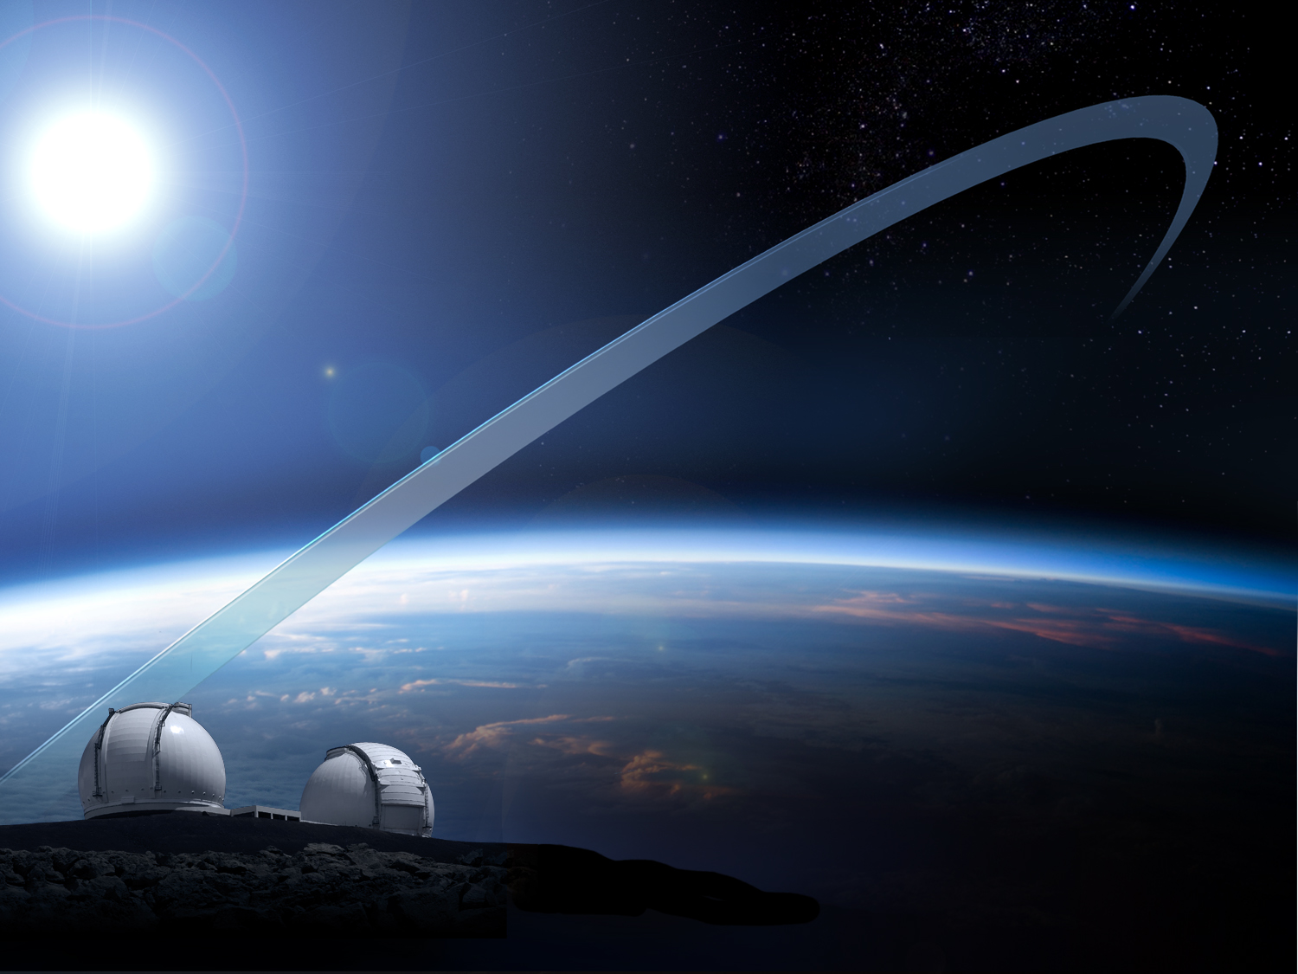
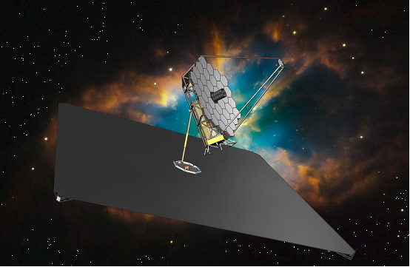
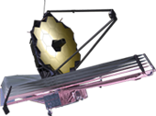
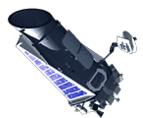
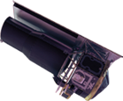
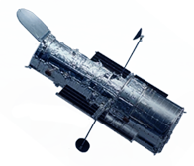
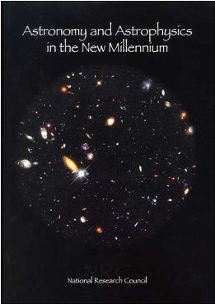
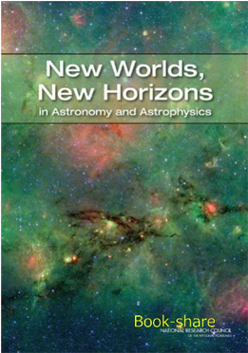
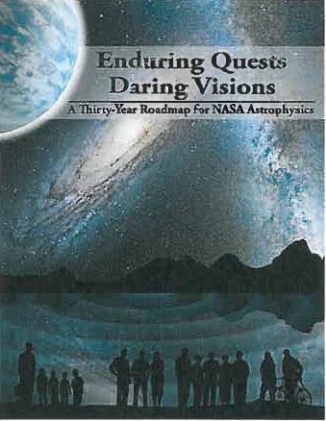
Four Decades of NASA’s World Leadership in UV, Visual, and IR Astronomy
AFTA
Kepler
UVOIR Observatory for the 2020s
JWST
Spitzer
Hubble
2001
Decadal
Survey
2010
Decadal
Survey
2013
Astrophysics
Roadmap
Ground-based Observatories
The science community’s program for UVOIR astrophysics

