Slide 1
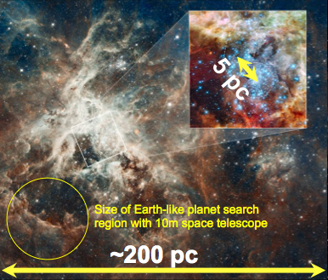
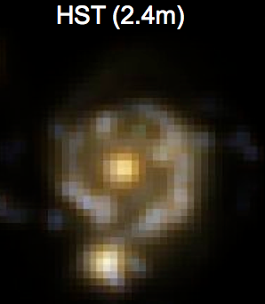
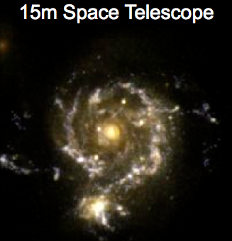
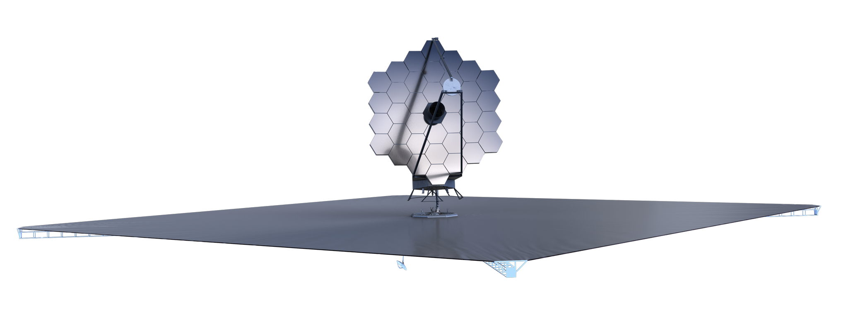
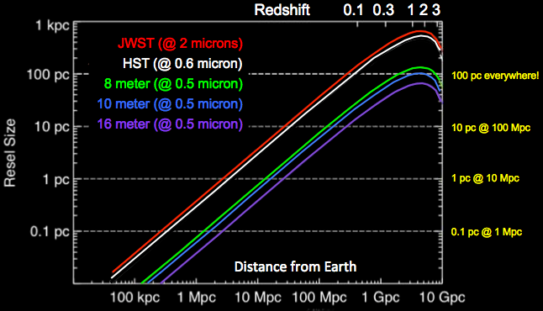
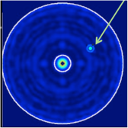
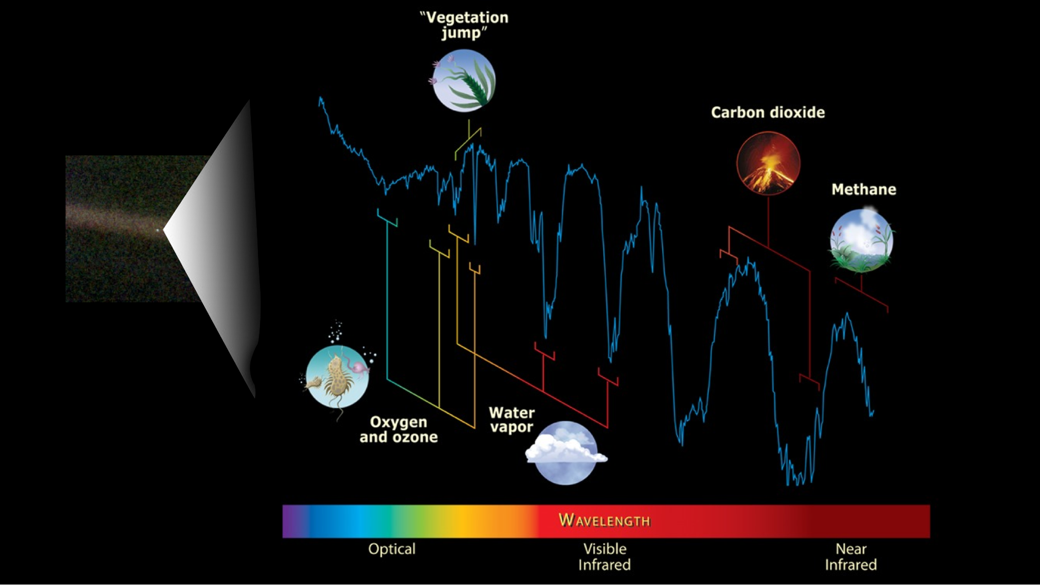
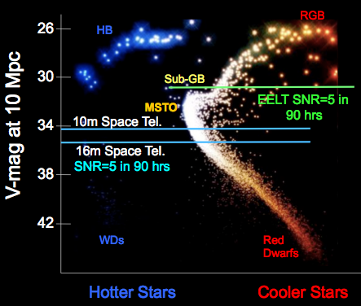
The Advanced Technology Large-Aperture Telescope (ATLAST)
The Next Great Leap In Astrophysics
H. Thronson (660), M. Clampin (667), M. Bolcar (551), J. Crooke (101), S. Domagal-Goldman (699),
K. Hartman (401), A. Mandell, N. Rioux (599), A. Roberge (667), C. Stark (STScI)
Breakthrough in UVOIR Resolution and Sensitivity throughout the Universe
The ATLAST Reference Design
This ATLAST reference design is a 10 m-class observatory under assessment as a candidate for selection by the 2020 NRC Decadal Survey. It is designed to be a powerful general-purpose non-cryogenic observatory operating from 0.1 μm to 1.8+ μm and able to search for biomarkers in the spectra of candidate exoEarths in the Solar neighborhood.
Resolve 100 pc Star-Forming Regions Everywhere in the Universe
Identification of Habitable Zone Planets and detection of Biosignatures
Tracing the History of Star Formation in all Types of Galaxies up to 10 Mpc

