Slide 1
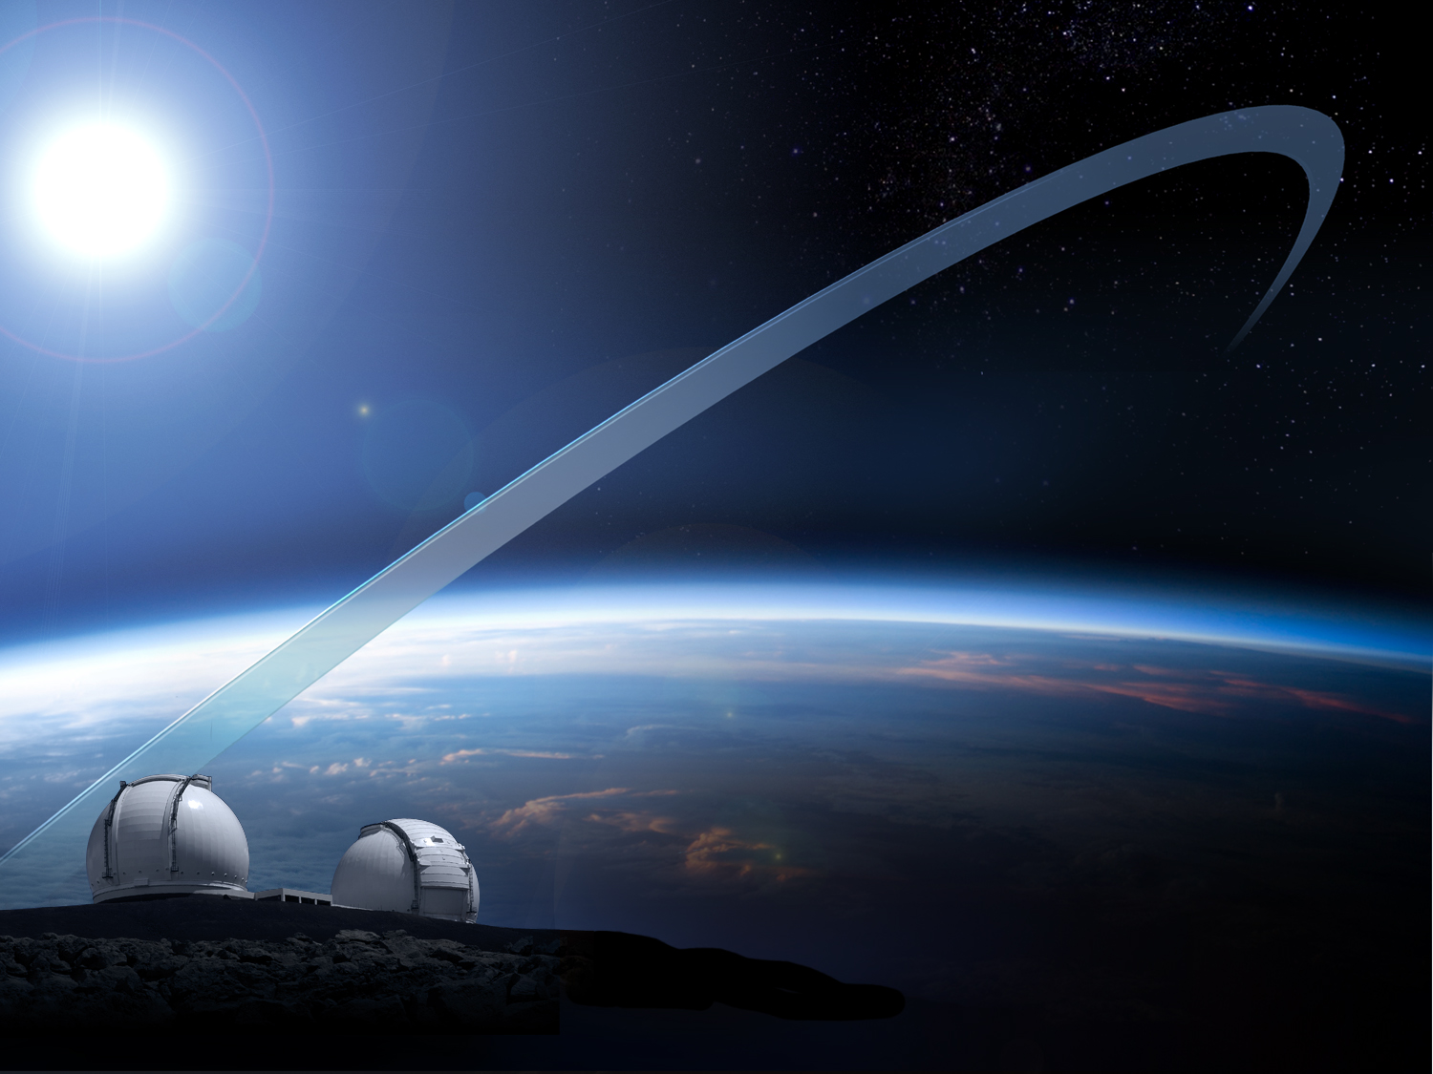
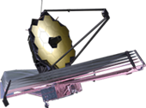
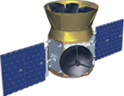
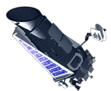
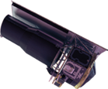
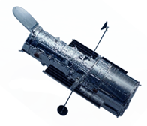
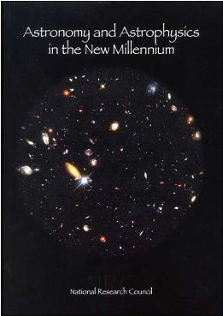
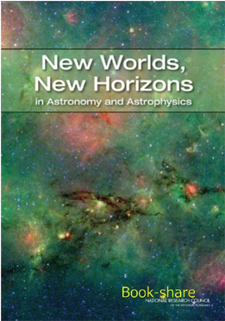
NASA’s Exoplanet &
Astrophysics
Facilities
JWST
AFTA
TESS
Kepler
Observatory for the 2020s
Spitzer
2001
Decadal
Survey
2010
Decadal
Survey
Hubble
Ground-based Observatories
Adapted from Testimony to Congress Given by J. Grunsfeld (May 5, 2013)

