Slide 1
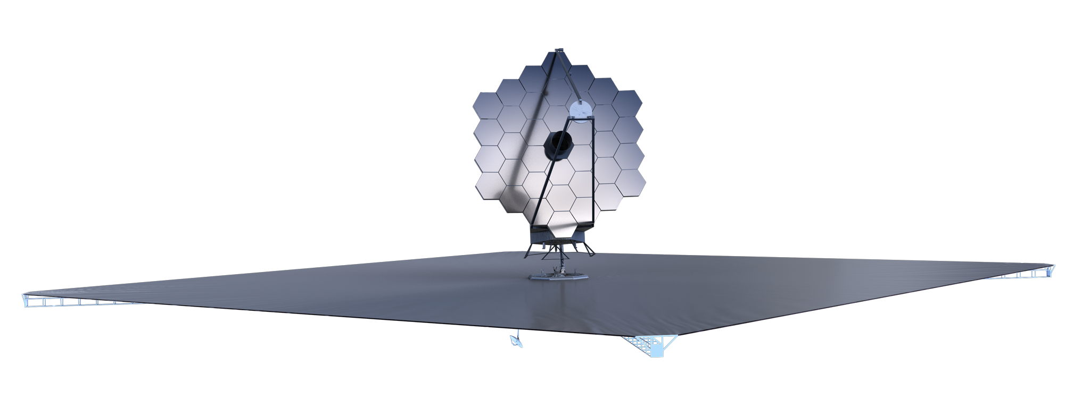
Continuing the Legacy of the Hubble Space Telescope
Advanced Technology Large-Aperture Space Telescope (ATLAST)
-AKA-
The Large UV/Optical/IR Observatory (LUVOIR)
The ATLAST Study Team
July 9, 2015

Slide 2
CONCEPT OVERVIEW
A four-institution design study of a 10-m class UVOIR observatory
Detailed conceptual engineering design studies traceable to science goals
Identification of technology priorities and requirements
Room temperature telescope avoids complex cryogenic design and I&T
Serviceable and upgradable, also allows ready access during I&T
Better together: concept provides for both exo-earth survey/characterization and for cutting-edge general astrophysics, as recommended by
Enduring Quests, Daring Visions (NASA 30-Year Roadmap, 2014)
From Cosmic Birth to Living Earths (AURA report, 2015)
Public release at AMNH on July 6

Slide 3
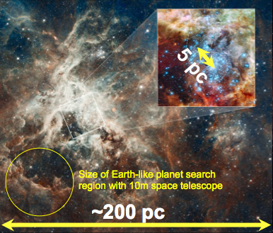
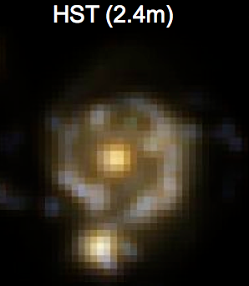
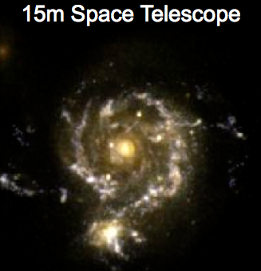
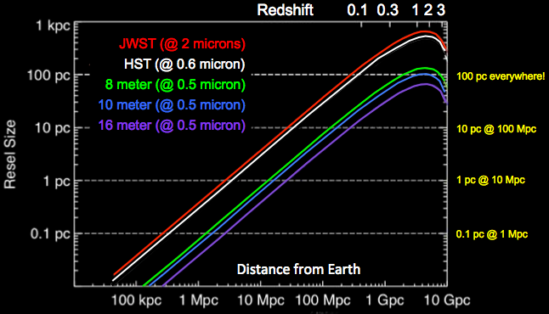
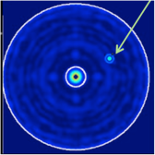
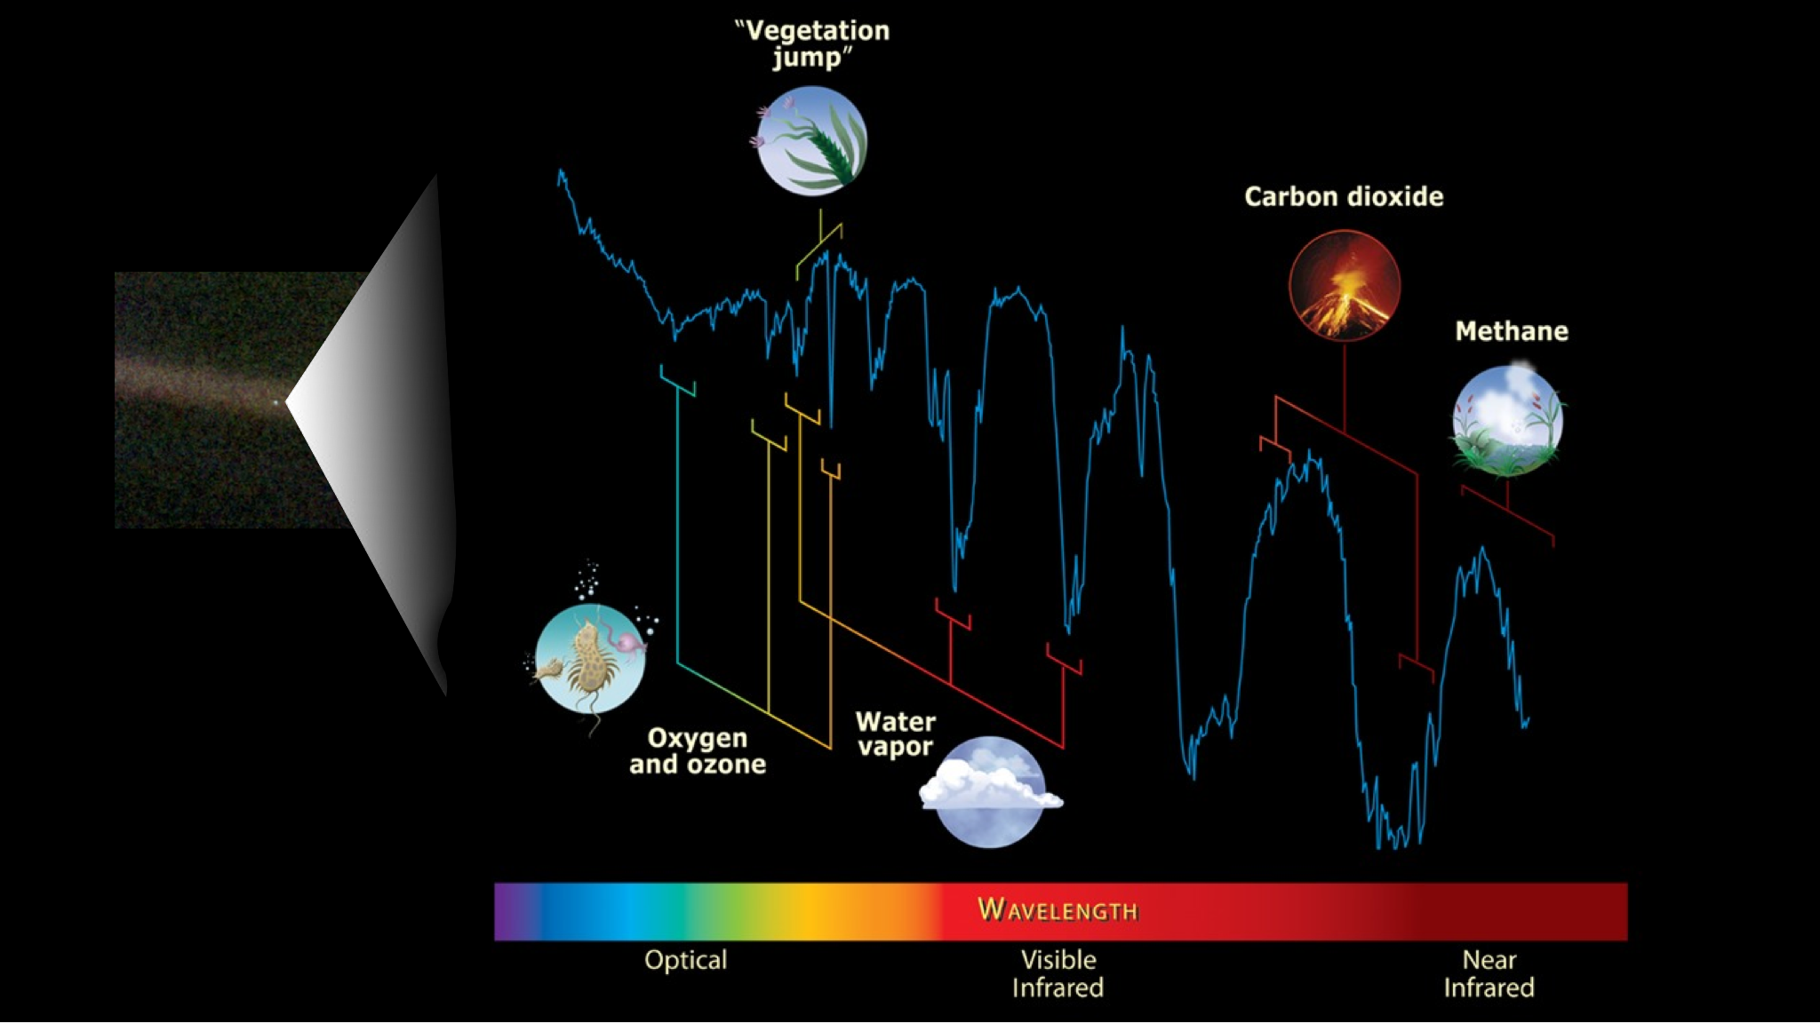
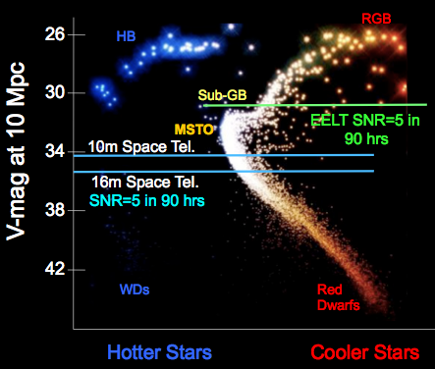
The Advanced Technology Large-Aperture Space Telescope (ATLAST)
The Next Great Leap In Astrophysics
The ATLAST Reference Design
Breakthrough in UVOIR Resolution and Sensitivity throughout the Universe
This ATLAST reference design is a 9.2-m observatory under assessment as a candidate for selection by the 2020 Decadal Survey. It is designed to be a powerful general-purpose non-cryogenic observatory operating from 0.1 μm to 1.8+ μm and able to search for biomarkers in the spectra of candidate exoEarths in the Solar neighborhood.
Resolve 100 pc Star-Forming Regions Everywhere in the Universe
Identification of Habitable Zone Planets and detection of Biosignatures
Tracing the History of Star Formation in all Types of Galaxies up to 10 Mpc

Slide 4
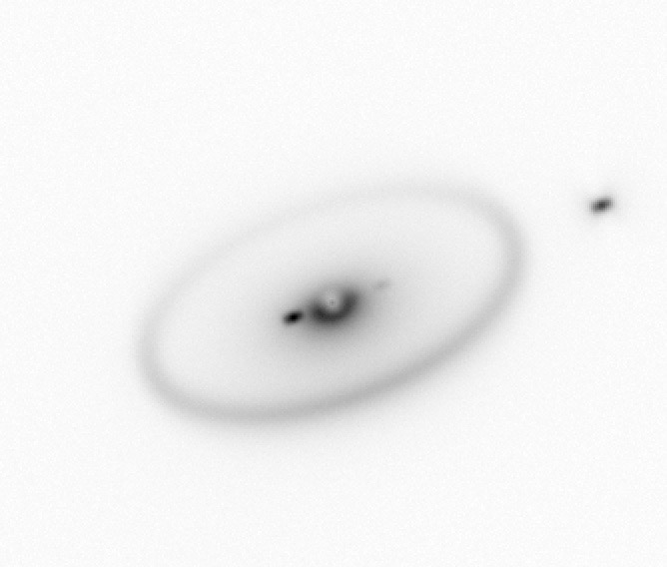
Engineering Progress: I
Starlight suppression via coronagraph
Coronagraph
Multiple concepts for segmented mirror coronagraphs in early development stages (e.g. Guyon, Pueyo and Lyon)
Phase-Occulted Nuller could reduce requirements on system dynamic stability since it interferes telescope pupil against itself via rotational shearing
Starshade could be employed in second generation for spectroscopic followup
Interface Development:
Bounding Instrument Interfaces
Initiating study of observatory constraints on instrument complement
Mass, power, thermal, physical volume, max data rate and volume, etc.
SLS and ATLAST Synergy
Engineer-to-engineer conceptual interface development meetings ongoing
Meetings held in December 2014 and May 2015

Slide 5
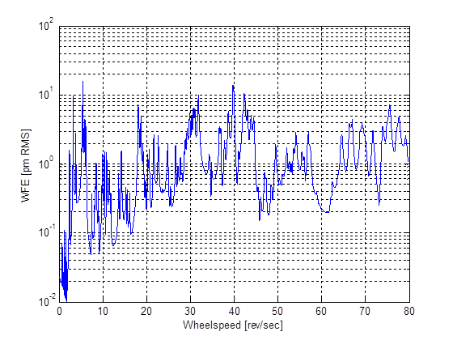
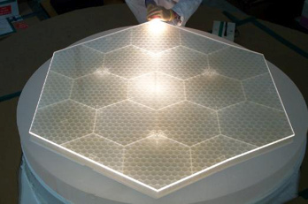
Engineering Progress: II
Dynamic Stability
Bounding analysis via integrated modeling indicates feasibility for achieving 10 pm over a reasonable band pass of reaction wheel speeds with a state of the art non-contact isolation system
Thermal Stability
Goal of <5 pm analytically demonstrated with 1 mK control from rear-side radiative heater plate without taking advantage of time variation
Analysis based on realizable ULE or SIC mirrors leveraging existing mirrors and real radial CTE data
MMSD Lightweight ULE Segment Substrate (GSFC/MSFC)

Slide 6
Key Technical Tall Poles: I
Starlight suppression requires contrast at 10⁻¹⁰. Key contributors are:
Coronagraph: Significant ongoing investment in starlight suppression via STMD, WFIRST and SAT programs.
Telescope: Primary mirror thermal stability and backplane structure
Mirror segments: <5 pm analytically demonstrated with 1 mK control
Telescope support structure
Slow instabilities can be actively controlled, although high-speed motions have to be isolated
Ultra stable, low-mass structures require technology investment
Complements investments being made in starlight suppression and isolation systems
Ultra stable low-mass structures
Design of ~zero CTE composite structures has to address three issues:
Temporal instability:
Single events (micro-lurches): occurs whenever stress state changes
Moisture desorption:
Solution is to mature nano-particle composite technology
Material is already in commercial use

Slide 7
Key Technical Tall Poles
New technology composite structures will have to be tested to pm levels
Requires new metrology approach and sub scale testbed
Build upon dynamic testing at nm level on JWST mirror segments
ATLAST has assembled a telescope structures team
Ball Aerospace, Orbital ATK, GSFC, JPL & MSFC
Development Goals:
Demonstrate an ultra-stable nano-composite structure and the associated actuator and hexapod mount needed for a segmented telescope with picometer class dynamic stability
Build a breakthrough high-speed speckle interferometer capable of <50 picometer-class spatial dynamic measurements of an ultra-stable composite structure and mirror system along with a laser metrology system for measuring motions
Develop an ultra-stable spatial dynamics testbed for model validation to the picometer level that will bound and characterize the picometer scale non-linearities
Ultrastable structures have cross-cutting applications
Other astrophysics missions: e.g., gravity wave detection
Optical communications

Slide 8
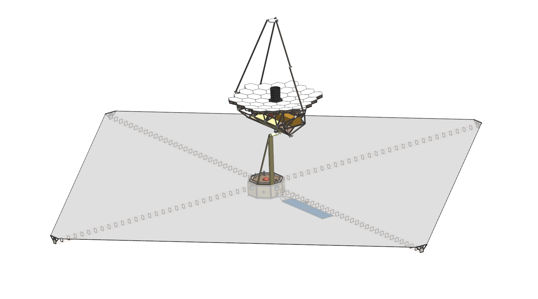
ATLAST 9.2 m Scalable Architecture
36 JWST-Size Segments
(Glass or SiC, Heater Plates)
Actively controlled SM
6-dof control metrology to SI
Deployed Baffle
Telescope Isolated from SC
6-DOF magnetic isolation
Signal & Power fully isolated
Serviceable Instruments
are externally accessible
W
3-layer sunshield,
Constant angle to sun ➡︎ stable sink
Sunshield deployed using 4 booms
Pointing gimbal maintains constant sun angle
Single pointing axis
Stowed

Slide 9
ATLAST Gimbal Deployment
This CAD drawing sequence depicts the rotation of the science payload from its stowed position to deployment into its science-pointing configuration.

Slide 10
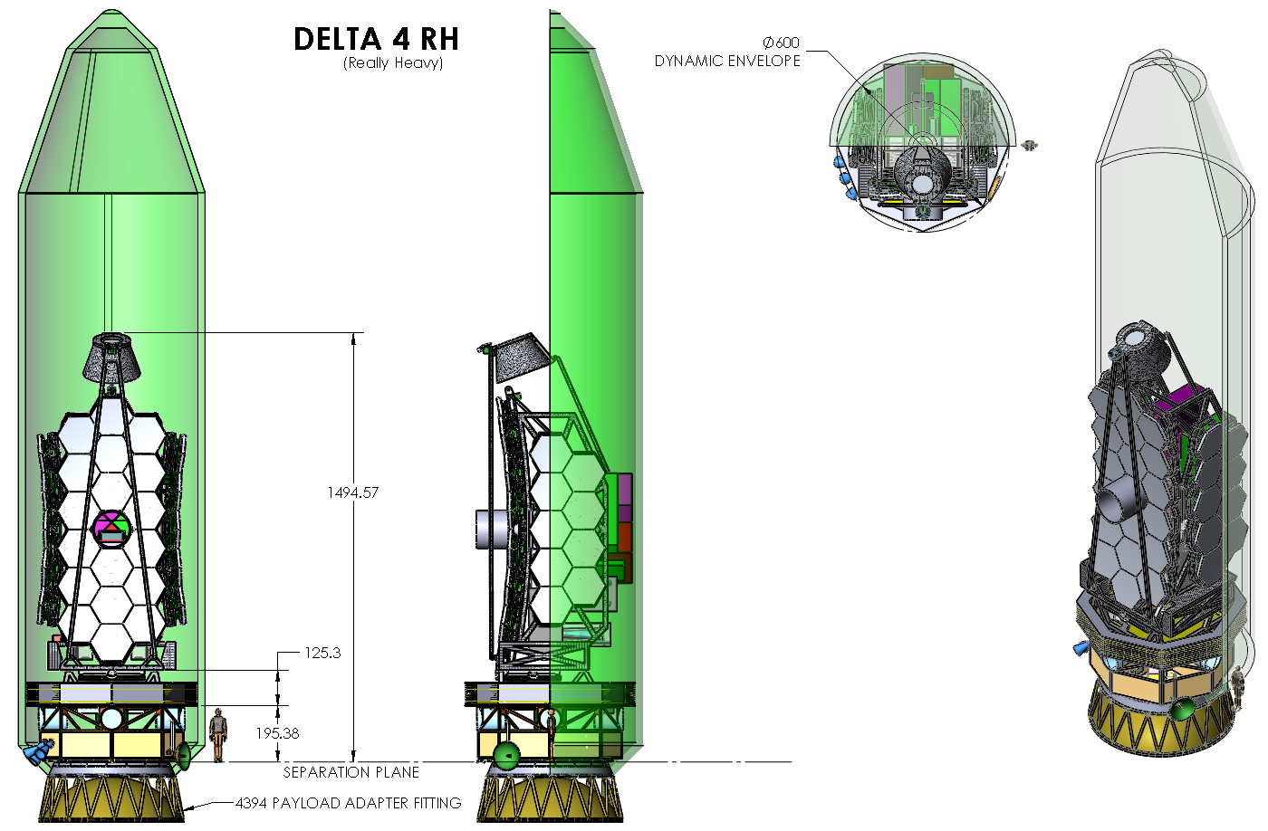
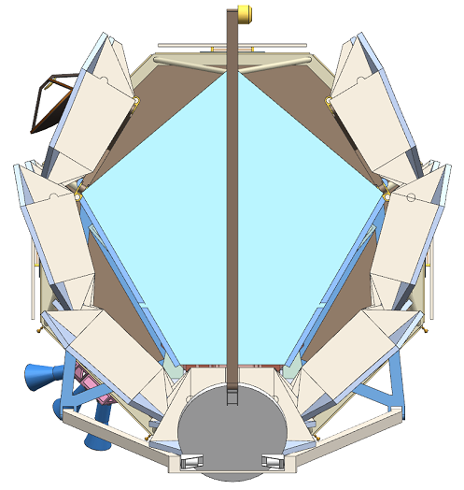
ATLAST Reference Design Leverages Existing JWST Deployment for Large Aperture
2009 (First ATLAST Studies)
Assumed Larger EELV was Under Development
Note: JWST-Type Wings
2013 Circular Geometry
Delta IVH
Design reference mission builds upon existing investments in JWST to manage overall cost and is scalable to larger aperture sizes.

Slide 11
Telescope Design Parameters
Parameter |  | Requirement | Stretch Goal
Primary Mirror Aperture |  | ≥ 8 meters | 12 meters
Telescope Temperature |  | 273 K – 293 K | -
Wavelength Coverage | UV | 100 nm – 300 nm | 90 nm – 300 nm
 | Vis | 300 nm – 950 nm | -
 | NIR | 950 nm – 1.8 µm | 950 nm – 2.5 µm
 | MIR | - | Capability Under Evaluation
Image Quality | UV | < 0.20 arcsec at 150 nm | -
 | Vis/NIR/MIR | Diffraction-limited at 500 nm | -
Stray Light |  | Zodi-limited between 400 nm – 1.8 µm | -
Wavefront Error Stability (for Exoplanet Science) |  | < 10 pm RMS uncorrected WFE per control step | -
Pointing |  | ≤ 1 milli-arcsec | -

Slide 12
Managing the Perception
The ATLAST/LUVOIR reference concept is designed to be substantially less costly than simple extrapolation from, for example, the cost of JWST. For example . . .
Unlike JWST, ATLAST/LUVOIR is non-cryogenic, thus obviating complex thermal design, technologies, and I&T
ATLAST/LUVOIR builds upon designs, personnel, ground support equipment, facilities, and experience with JWST and other segmented optical systems
ATLAST/LUVOIR team is identifying technology tall poles and advocating early funding of them
ATLAST/LUVOIR, working with senior NASA managers, have identified management strategies that have been demonstrated opportunities to manage cost and schedule growth.
Compatibility with multiple launch vehicles manages risk and associated costs: Delta IV Heavy, SLS (5,8.4,10m fairings), Falcon Heavy

Slide 13
Takeaway: I
Study just entering its third year with three priority elements:
Develop an affordable large-aperture conceptual design for a broadly capable UVOIR observatory
Identify and invest in the maturation of priority technology investments to ready the design for selection in the early 2020s
Establish the most compelling science goals for a mission that will continue the heritage of HST
Large aperture observatory continues to be recommended as high priority
Enduring Quests, Daring Visions (NASA 30-year astrophysics roadmap, 2014)
The Associated University for Research in Astronomy (AURA) report
From Cosmic Birth to Living Earths report identified a UVOIR mission very similar to ATLAST.
Killer app will be the capability to search for the spectroscopic signatures of biological activity in the atmospheres of hypothetical Earth-like worlds in the solar neighborhood: Are We Alone?

Slide 14
Takeaway: II
ATLAST has identified key technologies and need for early investment
Significant investment in coronagraph technology already underway
Propose STMD investment in remaining tall-pole: ultrastable structures
Demonstrate ultra-stable nano-composite structure
Build interferometer capable of <50 pm dynamic measurements
Develop an ultra-stable spatial dynamics testbed for model validation including laser metrology
Initial investment of $900 k ( detailed costing is available)
First step would be release of an RFI by GSFC for industry interest - Industry would like to participate, and is the main source of recent advances in materials for ultrastable structures
Cross-cutting technology with applications in gravity-wave missions

Slide 15
“FLY AROUND” VIDEO HERE

Slide 16
BACK UP: TECHNOLOGY ROADMAP OVERVIEW

Slide 17
Internal Coronagraph | Need | Capability | Current TRL | Enabling / Enhancing | Technology, Engineering, or Manufacturing
Segmented Aperture, High-Contrast, Broadband Coronagraph (Includes all Wavefront Sensing & Control Development) | 1x10⁻¹⁰ raw contrast IWA 2λ/D OWA 64λ/D 400 nm – 1.0 µm 200 nm – 1.8 µm (goal) Segmented Pupil | 1.3x10⁻⁹ between 3-16λ/D 720 nm – 880 nm Unobscured 5.7x10⁻⁹ between 1.5-2.5λ/D monochromatic Segmented DM | 3 | Enabling | Technology
Deformable Mirrors | 128x128 continuous DM Electronics/harnesses, etc Environmentally robust | 64x64 continuous DM Wire-dense, single point failure harnesses, etc. | 3 | Enabling | Engineering, Manufacturing
Autonomous Onboard Computation | Closed-loop control Rad-hard, low power | Human-in-the-loop (JWST) Ground-based desktop CPUs/GPUs | 3 | Enabling | Technology
Image Processing & Spectra Extraction Algorithms (Including PSF Calibration) | Factor of 50-100x improvement in PSF calibration | 25x demonstrated 30x goal for WFIRST-AFTA | 3 | Enabling | Engineering
High-Contrast Integral Field Spectrometer Instrument Development | TBD | TBD | TBD | Enabling | TBD

Slide 18
Starshade | Need | Capability | Current TRL | Enabling / Enhancing | Technology, Engineering, or Manufacturing
Starshade Edge Scatter | Edge radius ≤ 1 µm Reflectivity < 10% | Edge radius > 10 µm | TBD | TBD | Technology
Formation Flight & Guidance, Navigation & Control | Lateral sensing err ≤ 20cm Control peak-to-peak 1 m | TBD | TBD | TBD | Engineering
Petal & Truss Construction & Deployment | Demonstration of petal & truss construction and deployment for ATLAST-sized starshade | Petal prototype for 40-m class starshade meets fabrication tols. 12-m Astromesh deployment on ground to tols. with 4 petals | TBD | TBD | Engineering, Manufacturing
Starshade Contrast Performance & Model Validation | Contrast validation with flight-like Fresnel numbers (≤ 50) Model validation of contrast performance | Experimental contrasts at Fresnel number of ∼500 Models not yet correlated to 10⁻¹⁰ level | TBD | TBD | Technology

Slide 19
Ultra-Stable, Large Aperture Telescopes | Need | Capability | Current TRL | Enabling / Enhancing | Technology, Engineering, or Manufacturing
Thermal Control System | 10 nm/K stability 0.01 mK control accuracy | 100 nm/K stability 1 mK control accuracy | 3 | Enabling | Technology
Stable Structures | Low CTE, micro-lurch characteristics | CTE TBD Experience mico-lurch at interfaces | 3 | Enabling | Technology
Mirrors (Surface Figure, Areal Density, Cost, Production Rate) | < 7 nm RMS figure <36 kg/m² (Delta IV) <$1M/m² 30-50 m²/year | ∼ 7 nm RMS (HST, ULE) 70 kg/m² (JWST) $6 M/m² (JWST) 4 m²/year (JWST) | 4 | Enabling | Engineering, Manufacturing
Disturbance Isolation & Damping Systems | 140 dB isolation > 40 Hz | 80 dB > 40 Hz (JWST passive) Disturbance Free Payload at TRL 5 with 70 dB | 4 | Enabling | Technology
Metrology & Actuators | 1 pm accuracy (metrology) 1 pm accuracy (actuators) | 1 nm accuracy (metrology) 5 nm accuracy (actuators) | 3 | Enabling | Technology

Slide 20
Detectors | Need | Capability | Current TRL | Enabling / Enhancing | Technology, Engineering, or Manufacturing
UV Photon-Counting Detectors For Exoplanet Imaging & Characterization | 200 nm – 300 nm Read noise << 1 e⁻ Dark cur. < 0.001 e⁻/pix/s Rad hard; 5 year lifetime Visible blind | GaN-based EBCMOS Needs lifetime tests Micro-channel plates Not room temperature Limited lifetime | 5 | Enhancing | Technology
Large-Format High-Sensitivity UV Detectors for General Astrophysics | 100 nm – 300 nm (90 nm – 300 nm goal) 70% q.e. >2k x 2k format Rad hard Visible blind | δ-doped EMCCD: 50% q.e. (100 nm-300 nm) 1k x 1k format Not visible blind Not rad hard Operation at -120 C | 4 | Enhancing | Technology
Vis/NIR Photon-Counting Detectors for Exoplanet Imaging & Characterization | 400 nm – 1.0 µm (1.8 µm goal) Read noise << 1 e⁻ Dark cur. < 0.001 e⁻/pix/s Rad hard, 5 year lifetime | EMCCD: Not proven rad hard Dark cur. may not be low Hard cutoff at 1.1 µm HgCdTe APD: Dark cur. too high | 5 4 | Enabling | Technology

Slide 21
Mirror Coatings | Need | Capability | Current TRL | Enabling / Enhancing | Technology, Engineering, or Manufacturing
UV Coating Reflectivity | >70% 90 nm – 120 nm >90% 120 nm – 300 nm >90% 300 nm – 3.0 µm | <50% 90 nm – 120 nm 80% 120 nm – 300 nm >90% 300 nm – 3.0 µm | 2 3 6 | Enabling Enhancing Enhancing | Technology
UV Coating Uniformity | < 1% at λ ≥ 90 nm | TBD 90 nm – 120 nm > 2% 120 nm – 250 nm 1-2% 300 nm – 3.0 µm | 2 2 3 | Enhancing | Engineering
UV Coating Polarization | < 1% at λ ≥ 90 nm | Not yet assessed; needs study. | 2 | Enhancing | Engineering
Coating Environmental Durability | Easy to use, reliable automated FUV characterization is needed for testing and cross verification. | Stable performance over a year have been made, though performance below 200 nm is low. | 3 | Enabling | Engineering

