Slide 1

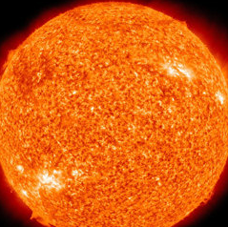
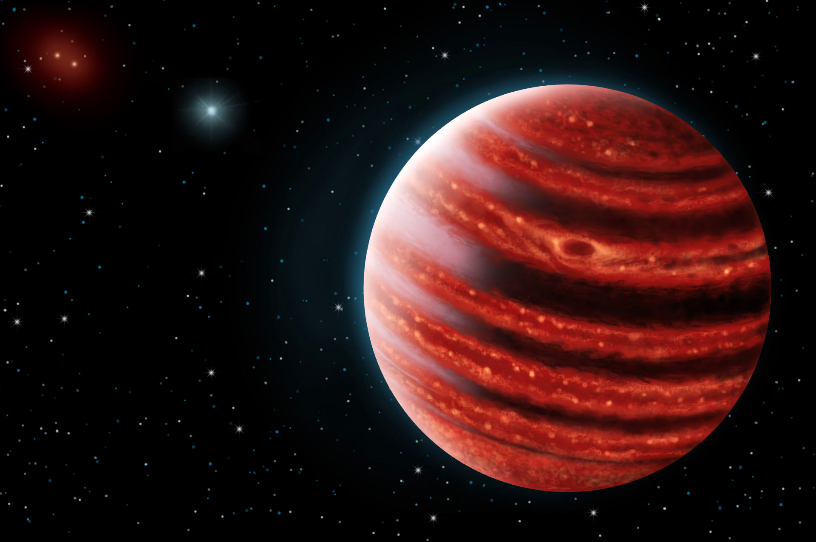
ORBITS FOR THE IMPATIENT
a Bayesian Rejection-sampling
Algorithm for Rapidly Fitting the
Orbits of Long-period Exoplanets
SARAH BLUNT
Eric Nielsen, Rob De Rosa, Quinn Konopacky,
Dominic Ryan, Jason Wang, Laurent Pueyo, Julien Rameau, Christian Marois, Franck Marchis, Bruce Macintosh,
James Graham, Gaspard Duchêne, & Adam Schneider

Slide 2
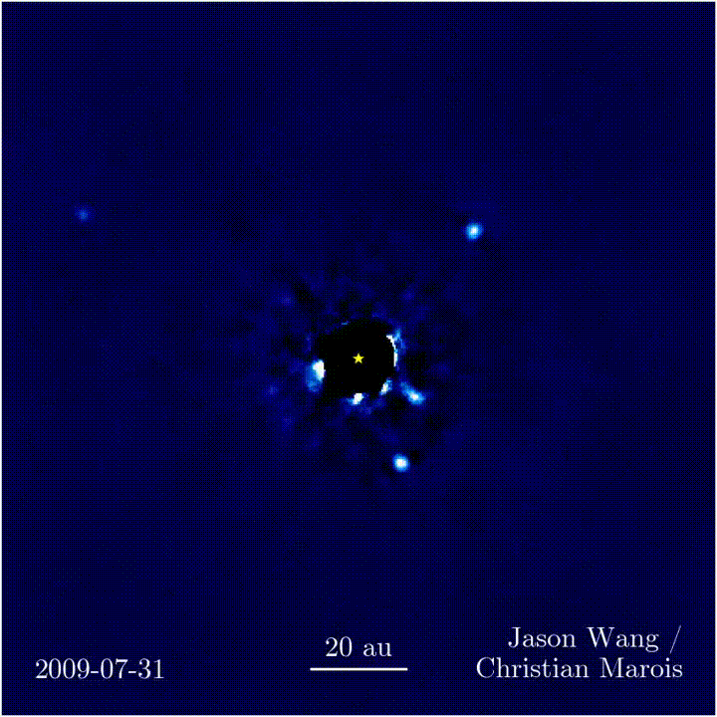
Direct Imaging Reveals Orbital Motion
Notes:
-image of HR 8799, 4 planet system, over the course of 6 years
-orbital motion of planets is apparent

Slide 3
Direct Imaging Probes New Regions of Parameter Space
Abhi Rajan
Notes:
- Direct imaging important bc probes different area of parameter space than indirect methods
Why direct imaging gets at high-sep planets
Want to know whether high mass/high sep planets form like rocky planets or like stars

Slide 4
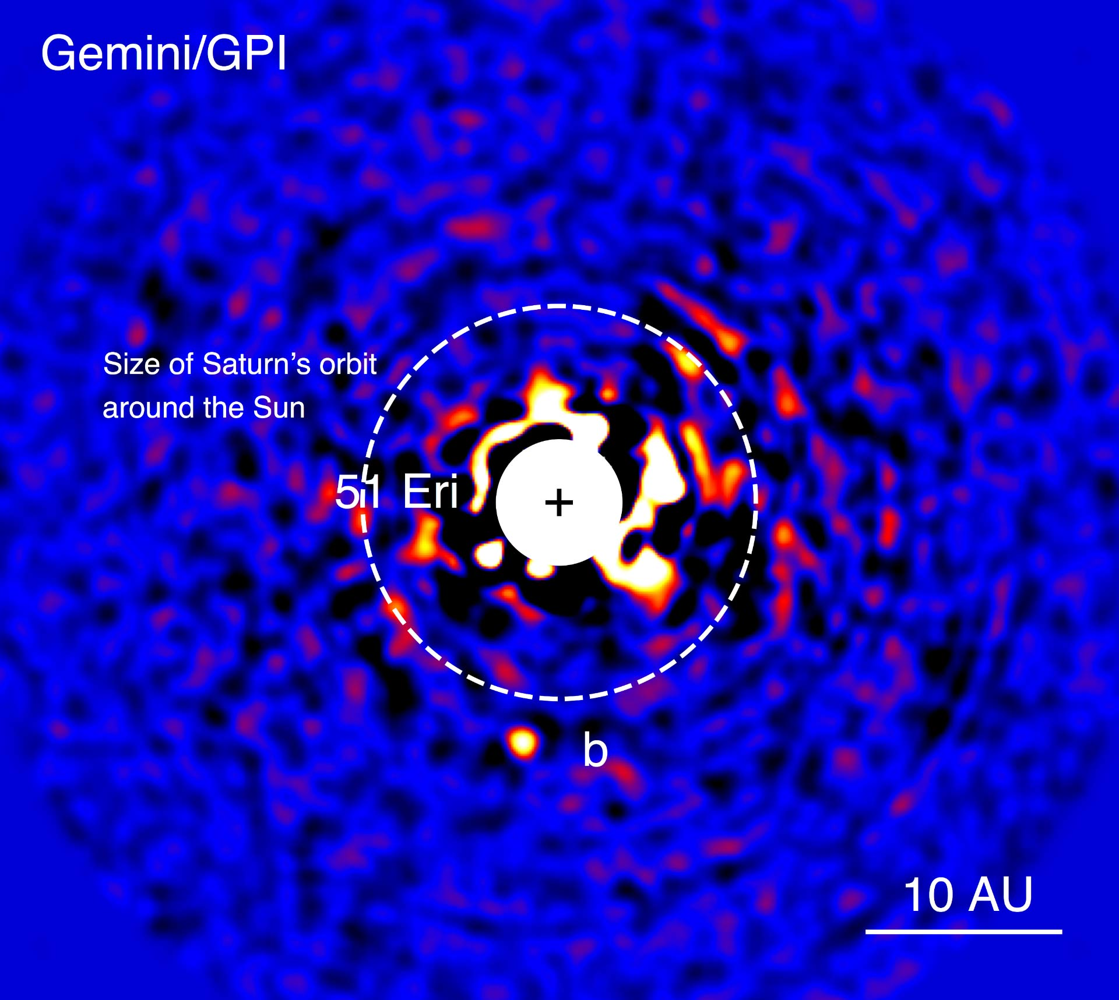
Orbit Fitting Lets Us Study Planets & Planet Formation
ASTROMETRY
Notes:
orbit fitting = turning 2d astrometric errors into errors in 3d orbital model
Example: do giant planets form in place, or are they scattered to their locations by inner planets? -> Numerical sims show that scattering results in eccentric orbits
Example: sma important bc of albedo, interactions with dust disks
Example: sin(i) also interesting

Slide 5
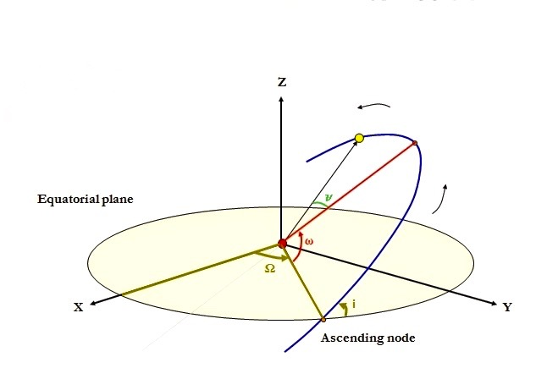


Orbital Parameterization
1. semi-major axis (a)
2. eccentricity (e)
3. epoch of periastron passage (T₀)
4. inclination angle (i)
5. position angle of nodes (Ω)
6. argument of periastron (ω)
(( 7. period (P) ))
Notes:
- sma and ecc
3: phase
4-6: viewing angle
Note about why period isn’t always included

Slide 6
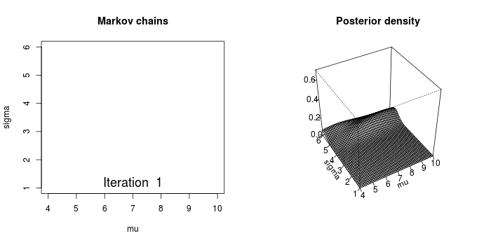
Commonly Used Orbit Fitting Algorithms
1. Markov Chain Monte Carlo (MCMC)
** awesome gif from blog.revolutionanalytics.com
Notes:
Most rigorous statistical method for determining PDFs
Explain axes
Chains initialized in parameter space, chi sq probability calculated & posterior updated, next point computer from previous point
Note: burn in very off from final answer

Slide 7
Commonly Used Orbit Fitting Algorithms
(( 2. Least Squares Monte Carlo (LMSC) ))
Notes:
Explain method: calculate chi square on a grid in parameter space, zoom in on maximum probability region
Great at finding maxima, not great at finding overall shape of PDF

Slide 8
The Problem
MCMC algorithms take too long to converge when accessible astrometry covers a short fraction of the total orbit.
GPI H-band
GPI J-band
Keck/NIRC2

Slide 9
The Solution
Orbits for the Impatient (OFTI)
1
3
2
4
Notes:
1: what is rejection sampling
2: OFTI is a clever speedup of rejection sampling
Explain method
- Note: Next few slides are summary of Blunt et al 2017

Slide 10
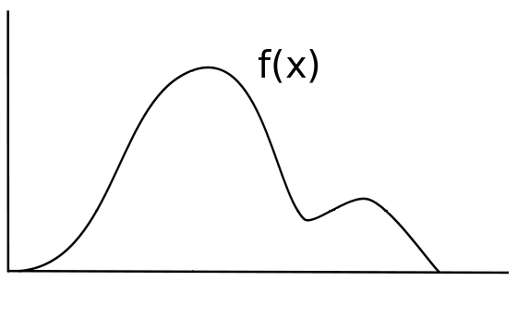
Speedups & Tricks
Vectorized array operations instead of loops
Runs in parallel
Minimum Χ² estimation
Range restriction
p(x)
x
Notes:
Min chisq:
1: best fitting orbit has chi sq prob less than 1
2: we only generate random numbers less than this max probability
- Visual for last two tricks: restrict x’s tested and probabilities possible to within box, speeds rejection sampling

Slide 11
Validation with MCMC

Slide 12
Advantage Over MCMC
OFTI: 136 mins
MCMC: 10 hours
Notes:
Typical situation for small orbital fraction
Order of magnitude improvement!
Lumpy MCMC posteriors sign that MCMC has not yet found full solution
(( ROXs 42B b))

Slide 13
OFTI > MCMC… But not Everywhere
Notes:
- Calculated for beta Pic

Slide 14
OFTI uses Independent Steps, while
MCMC uses Correlated Chains
Notes:
- Why is OFTI better for smaller orbital fractions?
- Y axis: how well distribution accepted so far matches underlying distribution (1 is perfect match)

Slide 15
Science with OFTI: 51 Eri b
Dec ’14 Feb ‘15
Feb ’15 Dec ’14

Slide 16
Science with OFTI: 51 Eri b

Slide 17
Science with OFTI: HD 95086 b

Slide 18
Science with OFTI: Widely Separated Companions
Notes:
Bryan et al 2016, study of widely separated companions
Provided evidence against scattering bc of strong evidence against high ecc (indep. of choice of prior)

Slide 19
Science with OFTI: HD 984 B
Notes:
Had to put one triangle plot in talk….
7% orbital coverage
Brown dwarf companion discovered in 2012

Slide 20
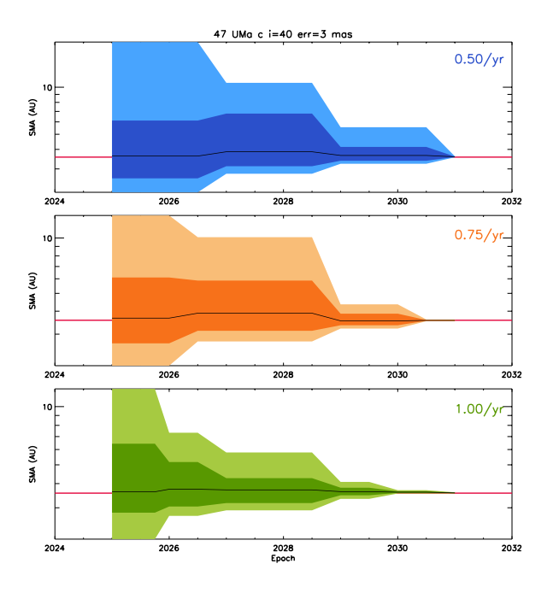
Simulations with OFTI: WFIRST Discoveries
Notes:
Example of one sim in a suite used to help WFIRST develop astrometric accuracy reqs & observing strategy
47 Uma c, known RV planet, pretended to have been discovered with WFIRST
Typically 4 well-timed observations are necessary to constrain orbital uncertainty, once per year is best
OFTI’s efficiency makes these sims possible: fitting hundreds of orbits in less than a day

Slide 21
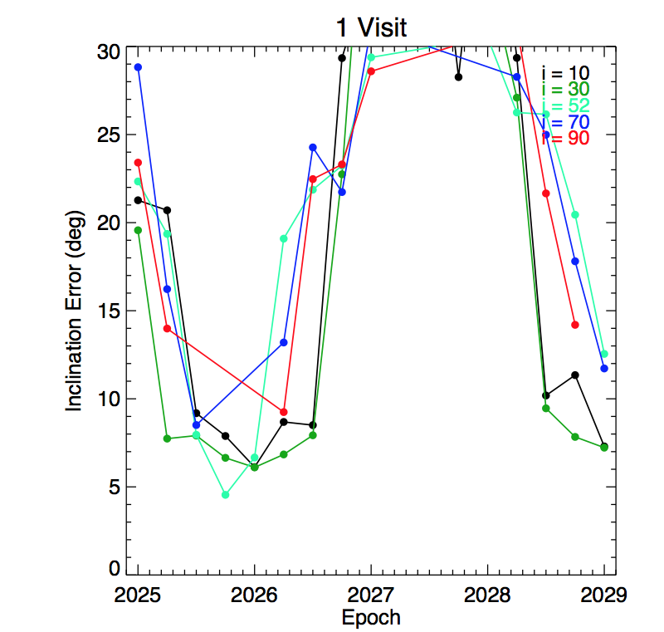
Simulations with OFTI: WFIRST Re-Observations
Notes:
Another example of sims that are useful for space missions: re-observing known RV planet at different times in its orbit
Shape of curve: observing planet at line of nodes gives no inclination angle information
Again, OFTI’s efficiency is critical

Slide 22
Future Hacks and Science
more orbits
more simulations
the eccentricity distribution of Brown Dwarfs
add systematics parameters
fit radial velocity & imaging combined datasets
explore Nyquist sampling problems for smaller orbital periods (Eric already working on this)
…and much much more!
What can OFTI do for you?
Notes:
emphasize OFTI usefulness for starshade not moving stuff

Slide 23
References
Overview:
AJ, Blunt et al 2017
Similar Techniques:
ApJ, Konopacky et al 2016
ApJ, Price-Wheelan et al 2017
Science Papers:
AJ, Nielsen et al 2017 (submitted)
AJ, Ngo et al 2017
AJ, Johnson-Groh et al 2017
ApJ, Bryan et al 2016
ApJL, Rameau et al 2016
ApJL, De Rosa et al 2015

Slide 24








Acknowledgments
OFTI is based on a method described in Ghez et al (2008), and was jointly developed by the authors of this talk.
S.B. has been supported by the National Science Foundation Research Experiences for Undergraduates Program under Grant No. AST-1359346 and the Stanford Summer Research Early-Identification Program. S.B. would also like to acknowledge and thank Charles Royce and the Royce Fellowship for their support, and Jasmine Garani for useful discussion. Thanks to Mike Fitzgerald, Anand Sivaramakrishnan, Alexandra Greenbaum, Max Millar-Blanchaer, and Vanessa Bailey for helpful discussion. Based on observations obtained at the Gemini Observatory, which is operated by the Association of Universities for Research in Astronomy, Inc., under a cooperative agreement with the National Science Foundation (NSF) on behalf of the Gemini partnership: the NSF (United States), the National Research Council (Canada), CONICYT (Chile), the Australian Research Council (Australia), Ministério da Ciência, Tecnologiae Inovacao (Brazil) and Ministerio de Ciencia, Tecnología e Innovación Productiva (Argentina). E.L.N., S.B., B.M., F.M., and M.P. were supported by NASA grant NNX14AJ80G. R.J.D.R, D.R, J.J.W, J.R.G have been supported by NSF grant AST-1518332, National Aeronautics and Space Administration (NASA) Origins grant NNX15AC89G, and NASA NExSS grant NNX15AD95G. This work benefited from NASA’s Nexus for Exoplanet System Science (NExSS) research coordination network sponsored by NASA’s Science Mission Directorate.

