Slide 1
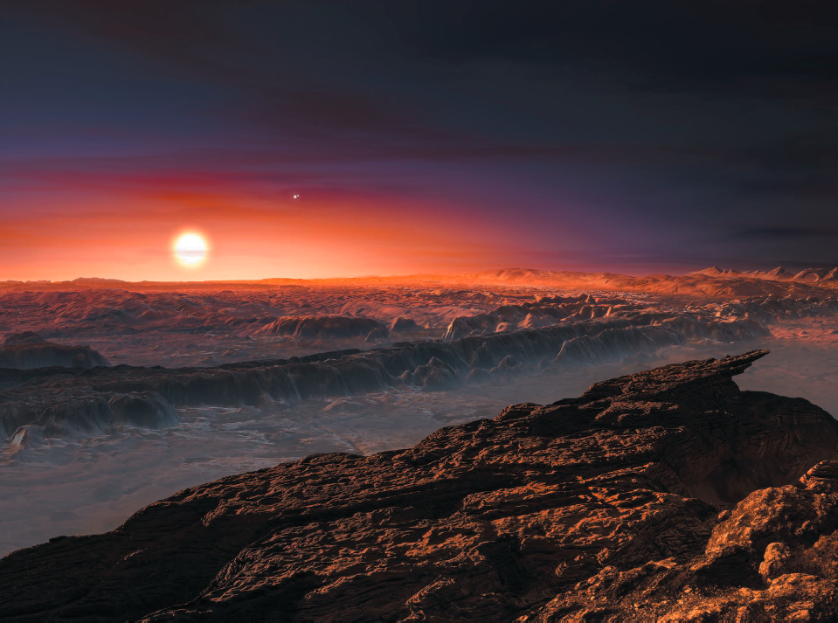

Proxima Centauri b: A World of Possibilities
Victoria Meadows (University of Washington/NAI)
Rory Barnes, Giada Arney, Russell Deitrick, Peter Driscoll, David Fleming, Benjamin Guyer, Andrew Lincowski, Rodrigo Luger, Jacob Lustig-Yaeger, Diego McDonald, Tom Quinn, Ty Robinson, Eddie Schwieterman, Shawn Domagal-Goldman, David Crisp
Credit: Kornmesser, ESO

Slide 2
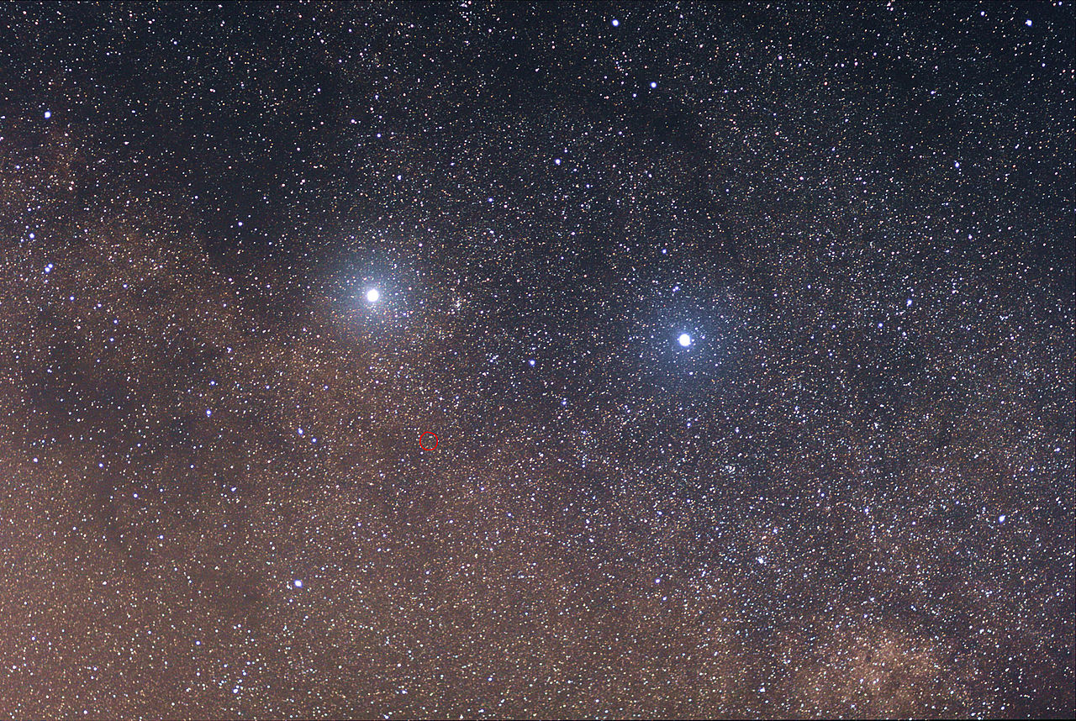
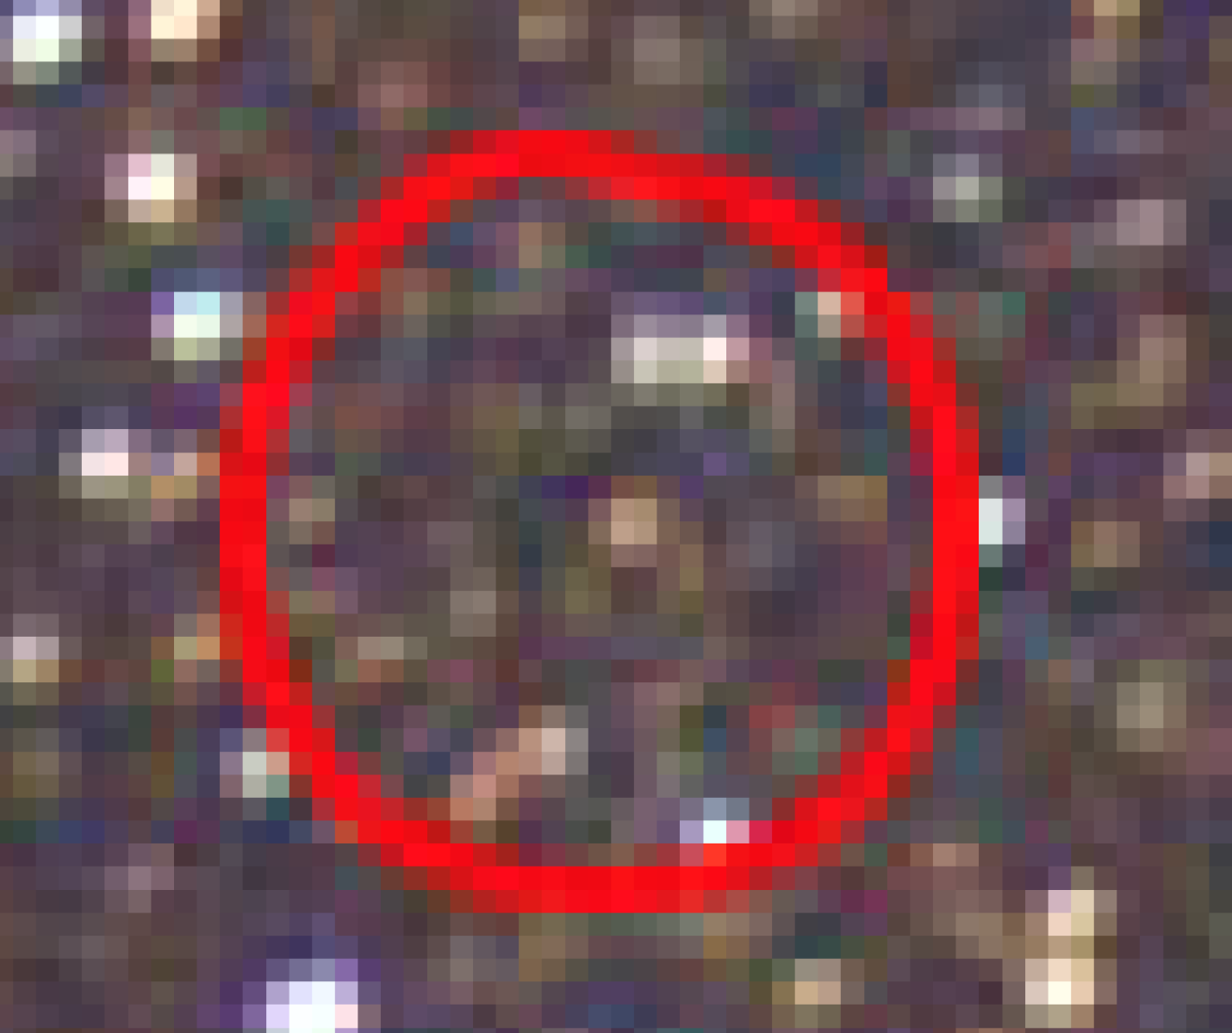
Proxima Centauri
Proxima Centauri is Our Sun’s nearest neighbor
  M5.5V star that is 4.24 l.y. (1.3pc) distant.
It is likely part of the α Centauri system
  Similar motion through the Galaxy
Proxima Cen
0.12 M, 0.14 R
0.0017 L (Boyajian et al., 2012)
~5 Gyrs

Slide 3
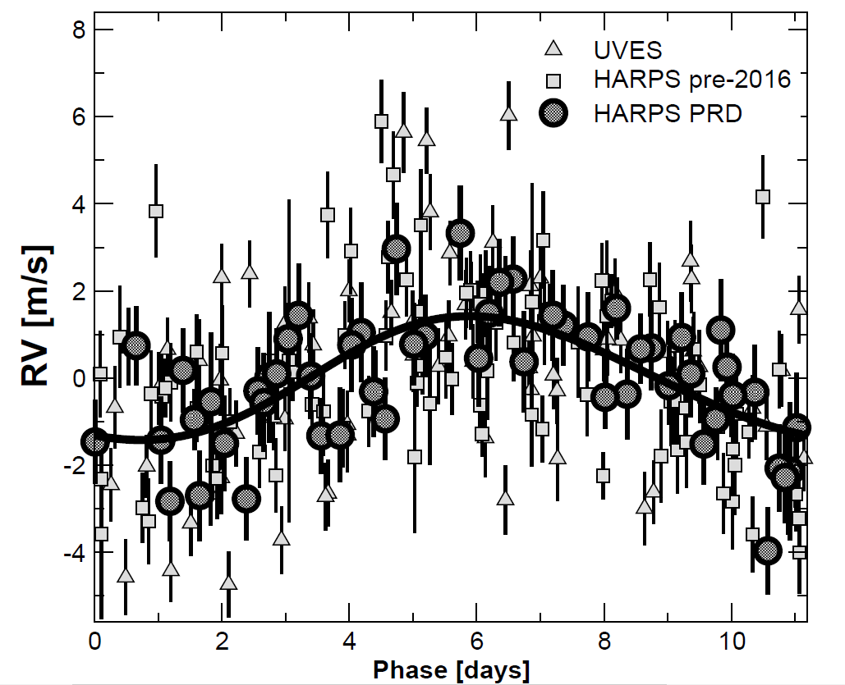
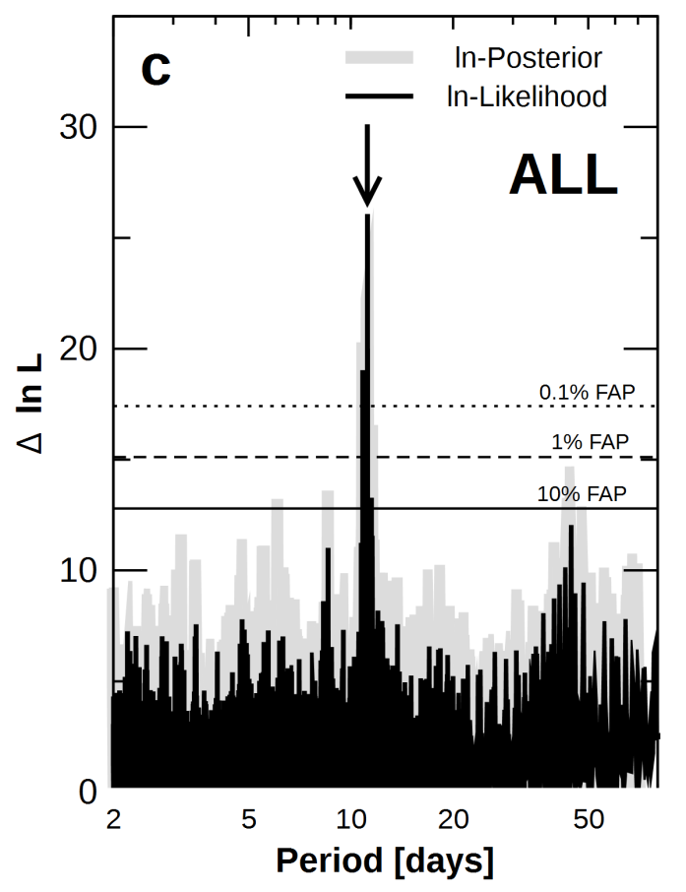
Proxima Centauri b
Proxima Centauri b was discovered by Anglada-Escude et al. (2016) using the radial velocity method, and announced on Aug 24th, 2016.
  Minimum mass of 1.3 M_{Earth}, orbital period of 11.2 days, a=0.0485 AU, e < 0.35
  No conclusive evidence that Proxima Cen b transits its star (Kipping et al., 2016)
Anglada-Escudé et al., 2016
Notes:
There was only a 1.5% chance of transit

Slide 4
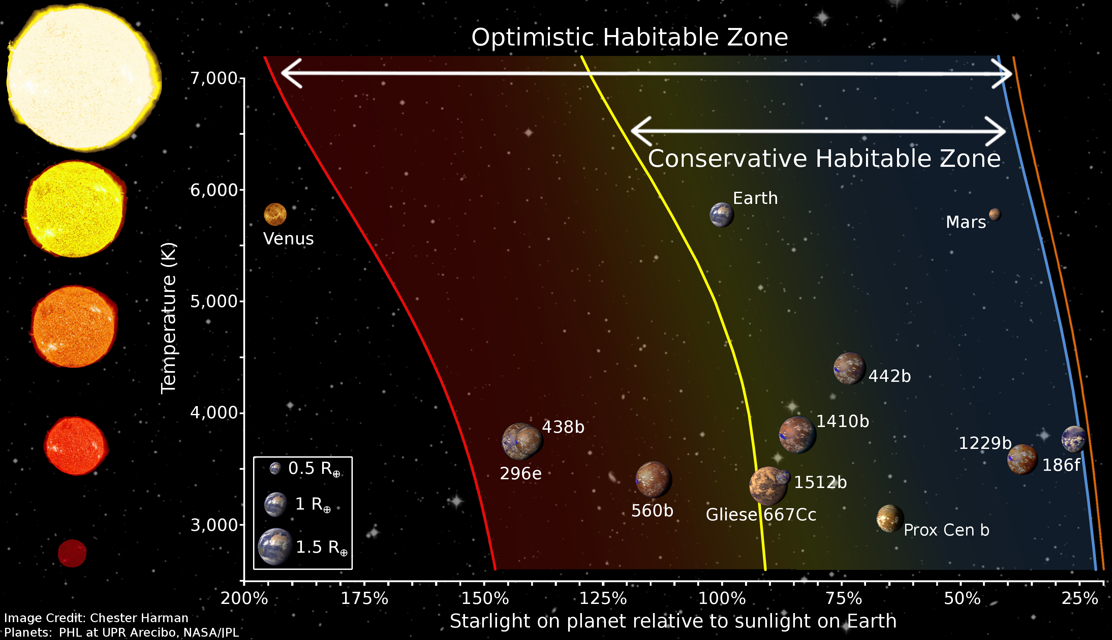
Proxima Cen b orbits within the Habitable Zone
Proxima Cen b receives 65% of the sunlight that the Earth receives
Notes:
There are likely degrees of habitability

Slide 5
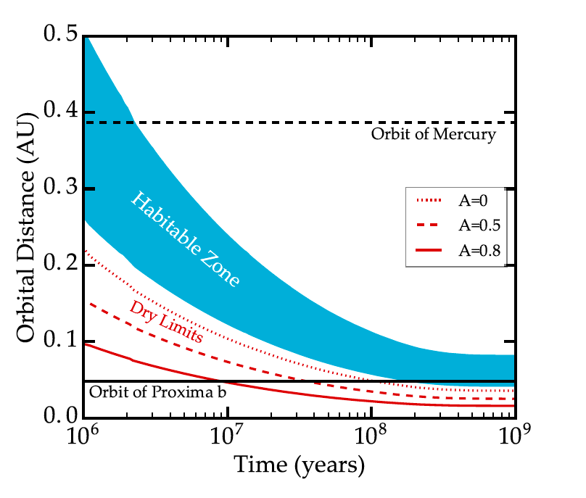
Proxima Cen b was not always in the Habitable Zone
The star’s likely luminosity evolution suggests that if Proxima Cen b had formed at its current position, then the habitable zone would not have moved in towards the star to encompass the planet until abut 160 Myrs after formation.
Barnes et al., 2016
Notes:
The gure also shows the \dry" HZ limits of Abe et al. (2011), which apply to planets
with very limited surface water (. 1% of the Earth's water inventory); these planets are
signicantly more robust to an instellation-triggered runaway. Consequently, if Proxima b's
initial water content was very low, it would have spent signicantly less time in a runaway
greenhouse. However, a dry formation scenario for Proxima b does not help its present-day
habitability. As we show in x4.4, Proxima b loses 1 ocean of water in . 4 Myr; if it formed
with less water than that, it would be completely desiccated long before entering the Abe
et al. (2011) HZ. One can envision cases in which the planet forms dry but with a protective
hydrogen envelope, or forms after 10 Myr, but such scenarios are unlikely a priori and
hence we do not consider them here.

Slide 6
The Significance of Proxima Cen b
A very nearby potentially habitable planet orbiting an M dwarf, the most common type of star in the Galaxy
  Proximity means relatively large star-planet separation (for M dwarf)
  Relatively bright (for a late-type M dwarf!)
  Oh, and we could go there!!
Contributes to two key areas of exoplanet research
  Comparative Planetology: Understand the evolution of terrestrial planets.
  Astrobiology: Understand the distribution of life in the Universe.
Credit: Kornmesser, ESO
Notes:
There are likely degrees of habitability

Slide 7
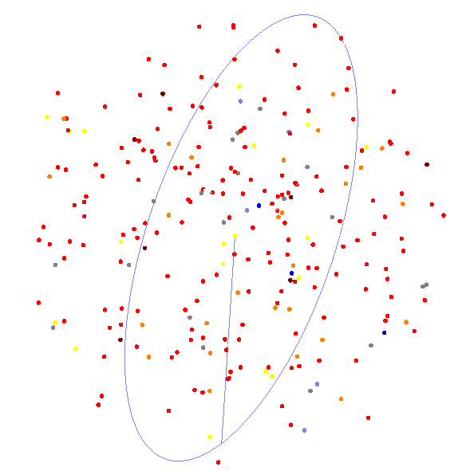
M Dwarf Habitable Planets May Be The Most Common
M dwarf stars comprise 75% of the stars in our Galaxy
260 of them are within 10pc
For these stars, the HZ terrestrial planet occurrence rate may be as high as 0.8 per star (Morton&Swift, 2014)
Even a more conservative estimate of 0.24 HZ terrestrials per M dwarf predicts that the nearest HZ terrestrial is within 2.6pc (✔), and the nearest transiting one is within 10.6pc
(Dressing and Charbonneau, 2015)
Image: Riedel, Henry, & RECONS group
Notes:
(transiting within 35 light years).
“Mdwarfs: Our galaxy’s silent majority”
260 M dwarfs within 10 pc.
We present an improved estimate of the occurrence rate of small planets orbiting small stars by searching the full four-year Kepler data set for transiting planets using our own planet detection pipeline and conducting transit injection and recovery simulations to empirically measure the search completeness of our pipeline. We identified 156 planet candidates, including one object that was not previously identified as a Kepler Object of Interest. We inspected all publicly available follow-up images, observing notes, and centroid analyses, and corrected for the likelihood of false positives. We evaluated the sensitivity of our detection pipeline on a star-by-star basis by injecting 2000 transit signals into the light curve of each target star. For periods shorter than 50 days, we find 0.56 (+0.06/-0.05) Earth-size planets (1-1.5 Earth radii) and 0.46 (+0.07/-0.05) super-Earths (1.5-2 Earth radii) per M dwarf. In total, we estimate a cumulative planet occurrence rate of $2.5\pm0.2$ planets per M dwarf with radii 1-4 Earth radii and periods shorter than 200 days. Within a conservatively defined habitable zone based on the moist greenhouse inner limit and maximum greenhouse outer limit, we estimate an occurrence rate of 0.16 (+0.17/-0.07) Earth-size planets and 0.12 (+0.10/-0.05) super-Earths per M dwarf habitable zone. Adopting the broader insolation boundaries of the recent Venus and early Mars limits yields a higher estimate of 0.24 (+0.18/-0.08) Earth-size planets and 0.21 (+0.11/-0.06) super-Earths per M dwarf habitable zone. This suggests that the nearest potentially habitable non-transiting and transiting Earth-size planets are $2.6\pm0.4$ pc and 10.6 (+1.6/-1.8) pc away, respectively. If we include super-Earths, these distances diminish to $2.1\pm0.2$ pc and 8.6 (+0.7/-0.8) pc. Dressing and Charbonneau 2015.

Slide 8
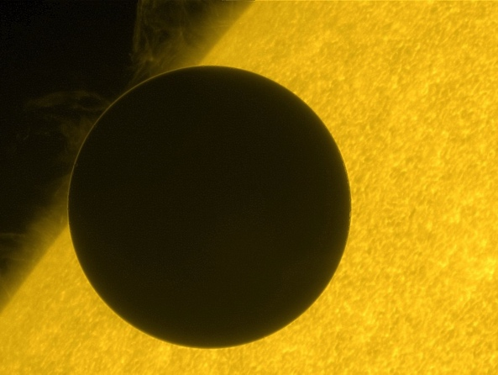
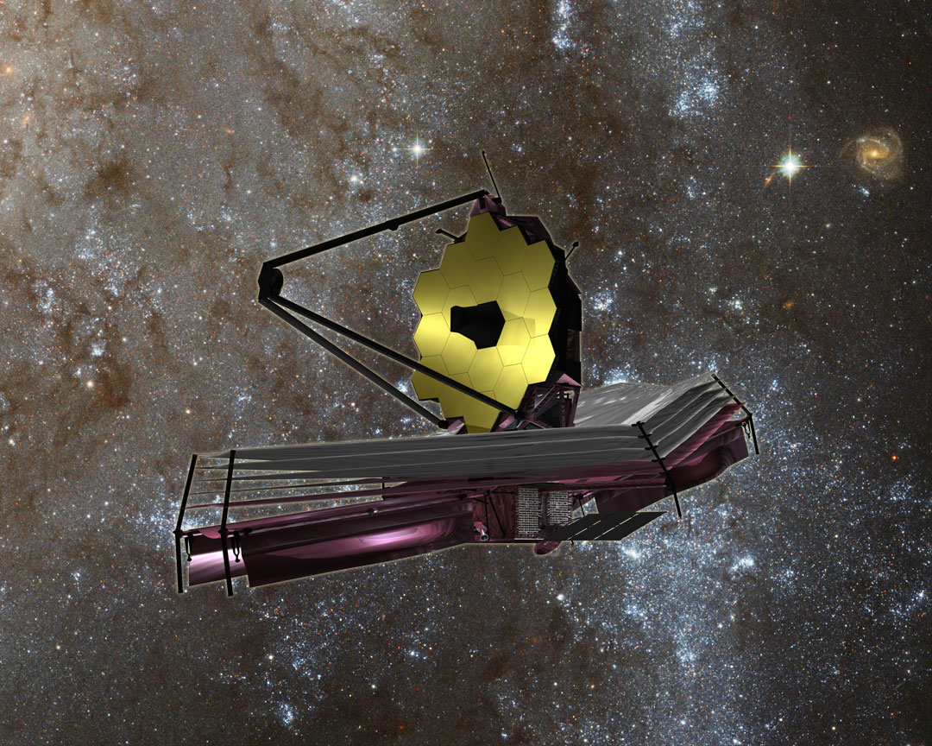
M Dwarf Planets Will Be The First Searched For Life
M dwarf planets are prime targets for transmission spectroscopy with JWST
Star/planet size ratio
proximity of the HZ
Still challenging though! JWST may obtain spectra of 1-3 M dwarf HZ terrestrials (Cowan et al., 2015).
Notes:
Scheduled launch Oct, 2018
6.5 m mirror
Transit transmission of planets in the HZ of M dwarf stars
Point out refracted light through the Venus atmosphere.

Slide 9
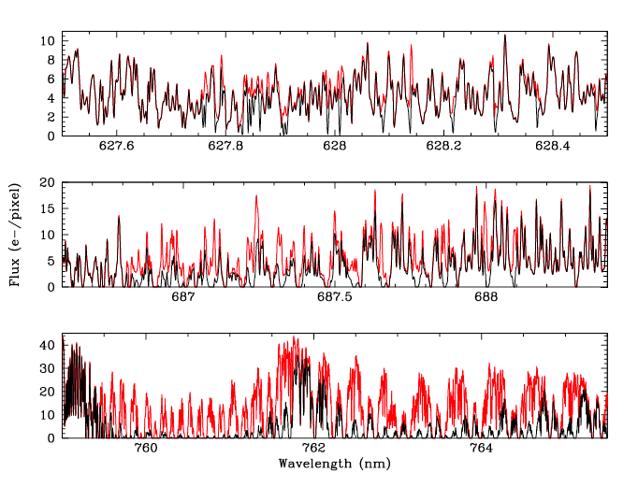
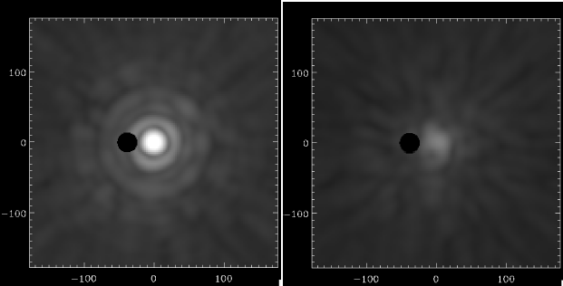
Possible Near-Term Ground-Based Observations
VLT/SPHERE nulling demonstration
with fiber feed position
O₂
Lovis et al., 2016
Ground-based telescopes could use direct imaging, ultra-high resolutions spectroscopy, or both to observe M dwarf planets (e.g. Snellen et al., 2013; 2014; Quanz et al., 2014)
Proposed upgrades to the high-contrast imager SPHERE and the new ESPRESSO high-resolution spectrograph on the ESO VLT may provide “early” results.
Planet detection and mass determination, visible O_{2,} CH₄ bands.
3-σ O₂ detection in 60 nights of telescope time, spread over 3 years (Lovis et al., 2016).
Ground-based and space-based observations could be combined (Brogi et al., 2016).
Notes:
We propose to develop a coupling interface between the SPHERE high-contrast imager and the new ESPRESSO spectrograph,
both installed at ESO VLT. The angular separation of 37 mas between Proxima b and its host star requires the use of
visible wavelengths to spatially resolve the planet on a 8.2-m telescope. At an estimated planet-to-star contrast of 10􀀀7 in reflected
light, Proxima b is extremely challenging to detect with SPHERE alone. The use of the high-contrast/high-resolution technique can
overcome present limitations by combining a 103-104 contrast enhancement from SPHERE to a 104 gain from ESPRESSO.
We find that significant but realistic upgrades to SPHERE and ESPRESSO would enable a 5- detection of the planet and
yield a measurement of its true mass and albedo in 20-40 nights of telescope time, assuming an Earth-like atmospheric composition.
Moreover, it will be possible to probe the O2 bands at 627, 686 and 760 nm, the water vapour band at 717 nm, and the methane band
at 715 nm. In particular, a 3.6- detection of O2 could be made in about 60 nights of telescope time. Those would need to be spread
over 3 years considering optimal observability conditions for the planet
Fig. 7. Simulated spectrum of Proxima b in the O2 bands, assuming 60 nights of observations with SPHERE+ESPRESSO. The flat-albedo model
comprising only the reflected stellar component and telluric absorption is shown in red, while the full model including O2 absorption from the
planet is shown in black. The top, middle, and bottom panels show portions of the O2
-, B-, and A-bands, respectively. Note that the direct stellar
component, which dominates the observed spectrum, has been subtracted. The plotted model spectra are noise-free. Actual noise levels in this
simulation are at the level of 200 e-/pixel (for K = 5000).

Slide 10
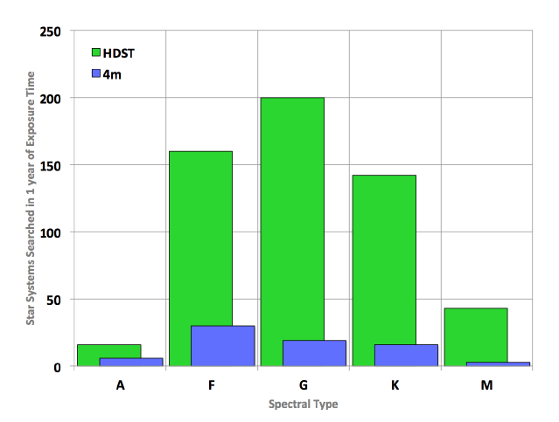
LUVOIR may also observe M dwarf planets
(12m)
Not as many as the G dwarfs,
but not an insignificant amount
Seager et al., 2016; Stark et al., 2015
Notes:
12m HDST

Slide 11
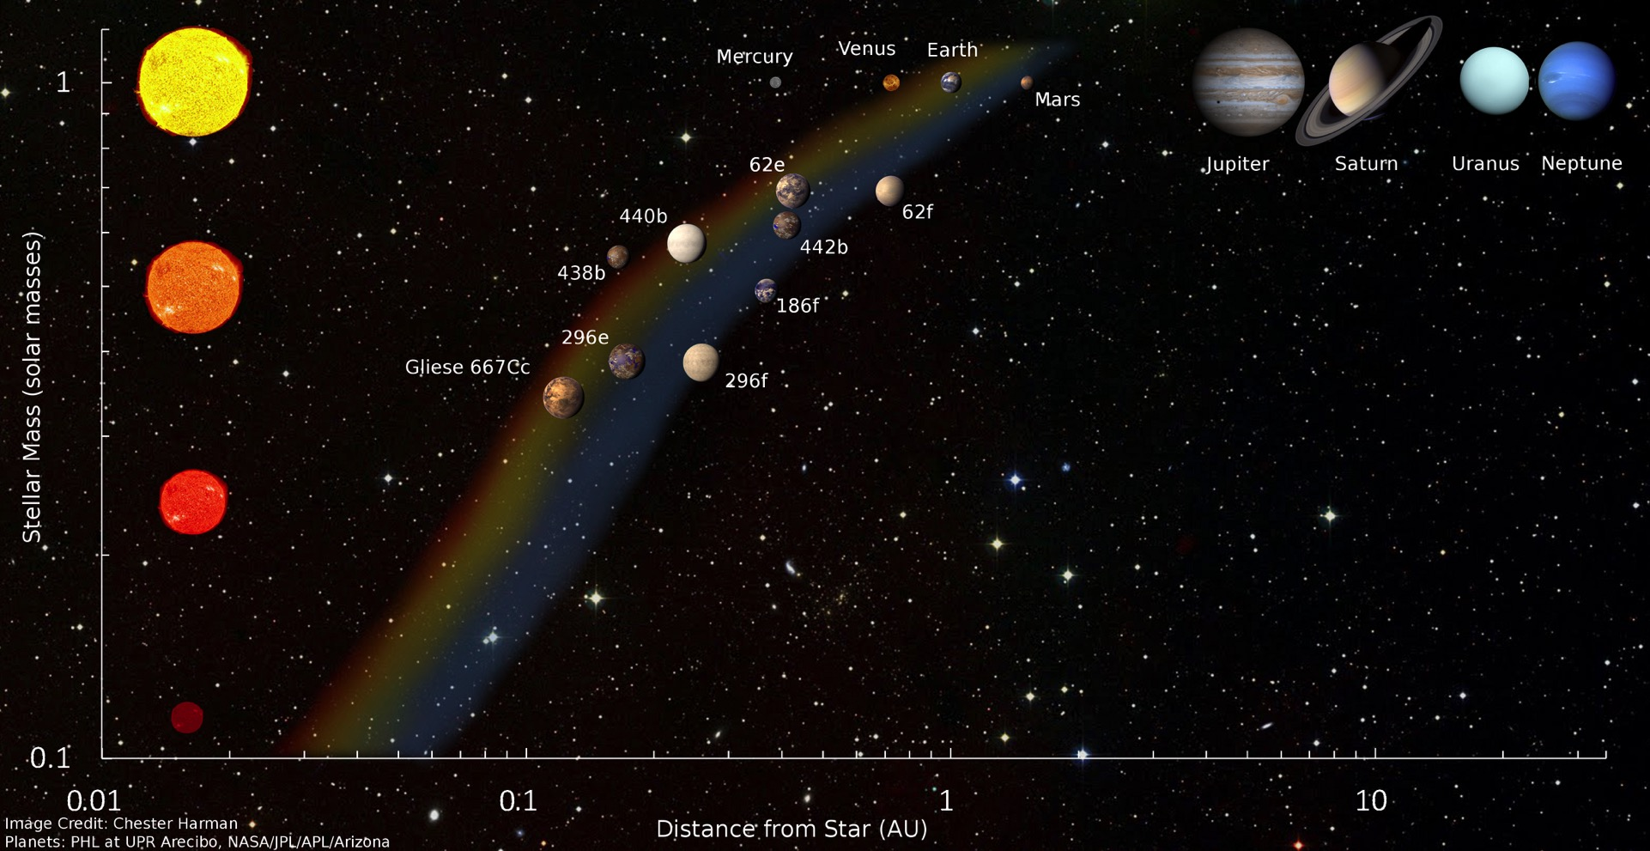
The Surface Liquid Water Habitable Zone
“That region around a star in which an Earth-like planet
can maintain liquid water on its surface” (Kasting et al., 1993).
Translation: That region around a star where life’s
requirements are most likely to be met, and be detectable
Kopparapu et al., (2013)
http://depts.washington.edu/naivpl/content/hz-calculator
Notes:
Could a habitable planet exist outside this zone? Absolutely! But how likely is it? And would we recognize it as habitable?

Slide 12
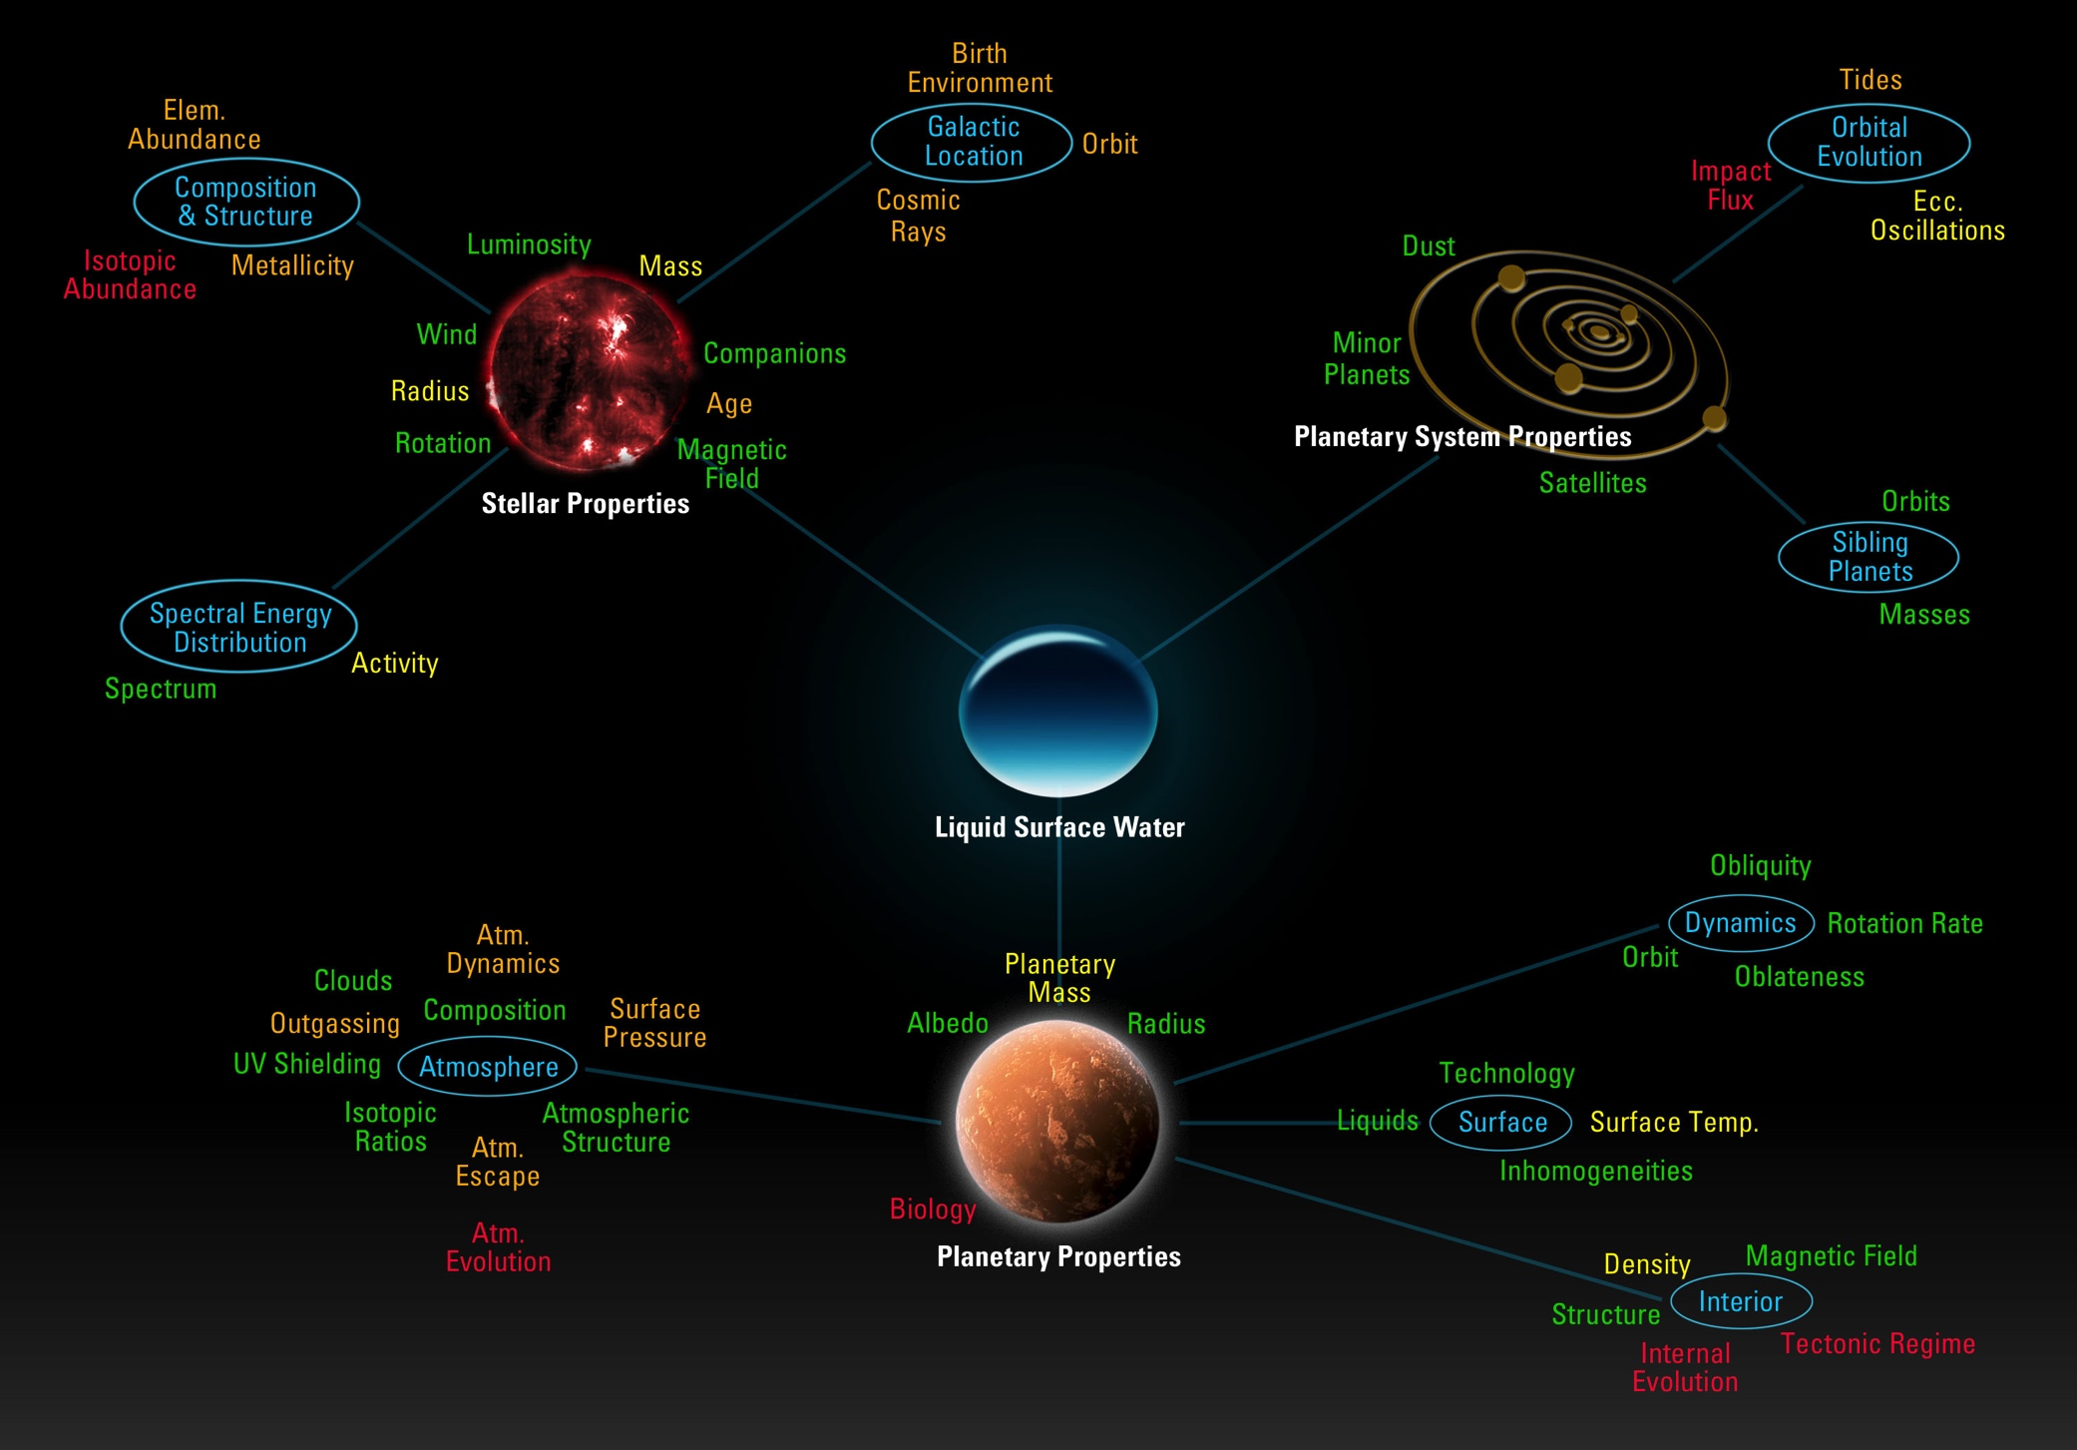
Star/planet/planetary system interactions and evolution can all affect habitability
The VPL used Proxima Cen b to explore a large fraction of these!

Slide 13
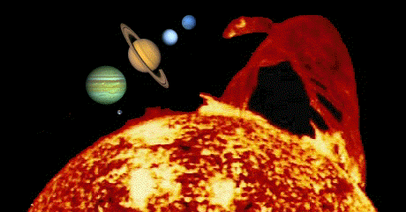
M Dwarf Planets: Radiative Effects
Spectrum of starlight
  Affects climate via changes to atmospheric/surface absorption
Stellar Activity
  Photochemistry
  Surface UV fluxes
Stellar Evolution
  Extended Pre-Main Sequence

Slide 14
M dwarf vs G dwarf stellar spectra
Lincowski, Arney, Schwieterman, Lustig-Yaeger
Meadows, Arney et al., 2016
Lower stellar T produces more radiation at longer wavelengths – affects climate
Higher activity produces more UV radiation – affects photochemistry
Proxima Cen spectrum available for download at https://depts.washington.edu/naivpl/
Notes:
There are likely degrees of habitability

Slide 15
Stellar Spectrum Affects Position in the HZ
Notes:
There are likely degrees of habitability

Slide 16
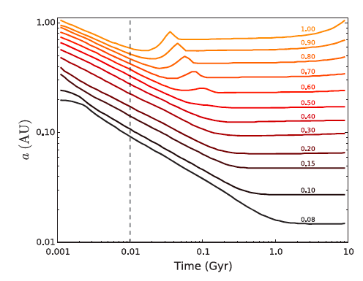
Pre-Main Sequence Super Luminous Phase
Line shows the evolution of the inner edge of the HZ as a function of time
Numbers are stellar mass in solar masses
Luger & Barnes, 2015
Late K and and all M dwarfs undergo a significant super-luminous phase as they contract down on to the main sequence.
Any planet that forms in what will become the main sequence habitable zone of these stars can be subjected to very high levels of radiation for up to a Gyr.
Notes:
0.5 M sol is cutoff for M dwarfs.

Slide 17

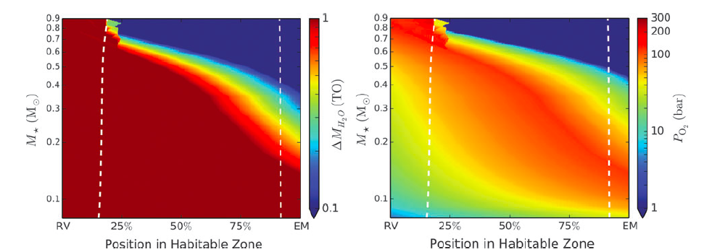
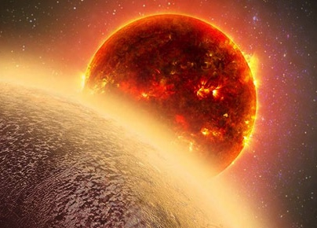
Stellar Evolution, Water Loss and O₂ buildup.
GJ1132b
Proxima Centauri b
Proxima Centauri b
Water Loss
Atmospheric O₂
Atmospheric O₂
Total Water Lost
During the Pre-MS of M dwarfs terrestrial planets can lose several
Earth oceans of water via hydrodynamic escape (Luger & Barnes, 2015)
Hot Earths such as GJ1132b (Berta-Thompson et al.,2015)
may undergo a similar process (Schaeffer et al., 2016). They
will be excellent initial tests of the abiotic production of O₂,
and the planet’s ability to sequester it.
Notes:
, but are still
interior to the HZ, so the process is ongoing

Slide 18
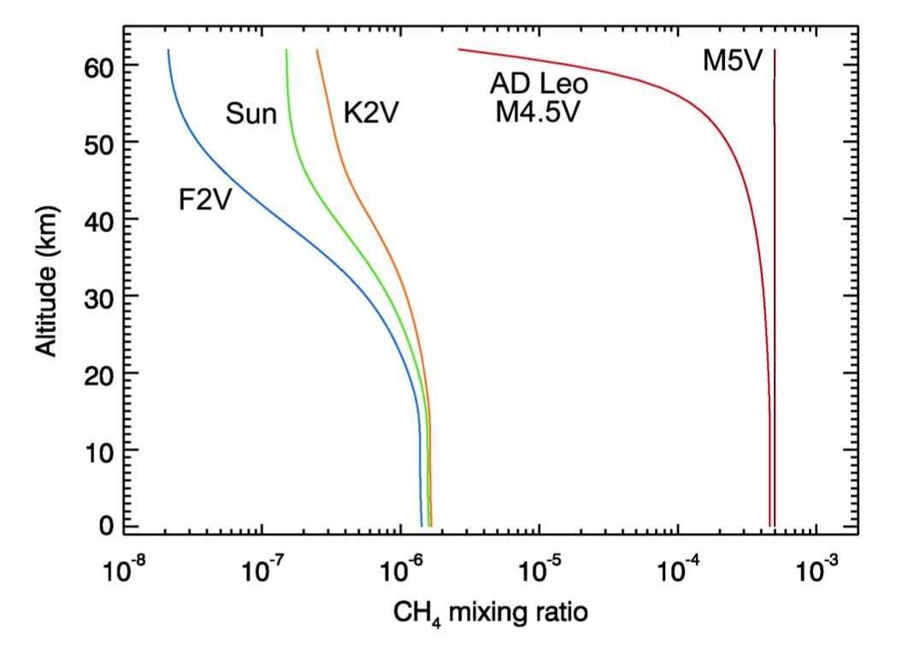
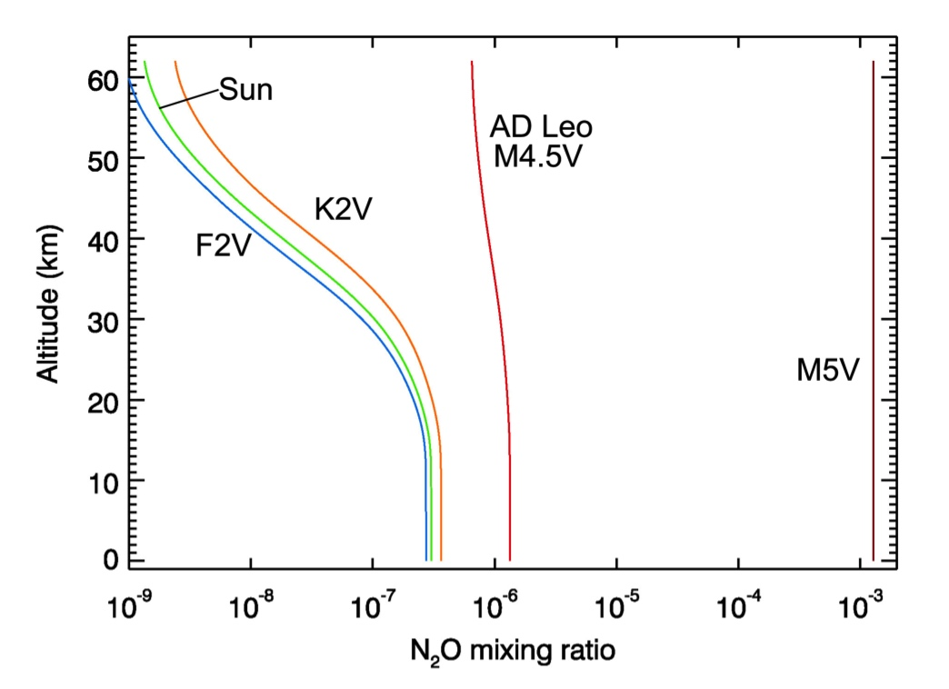
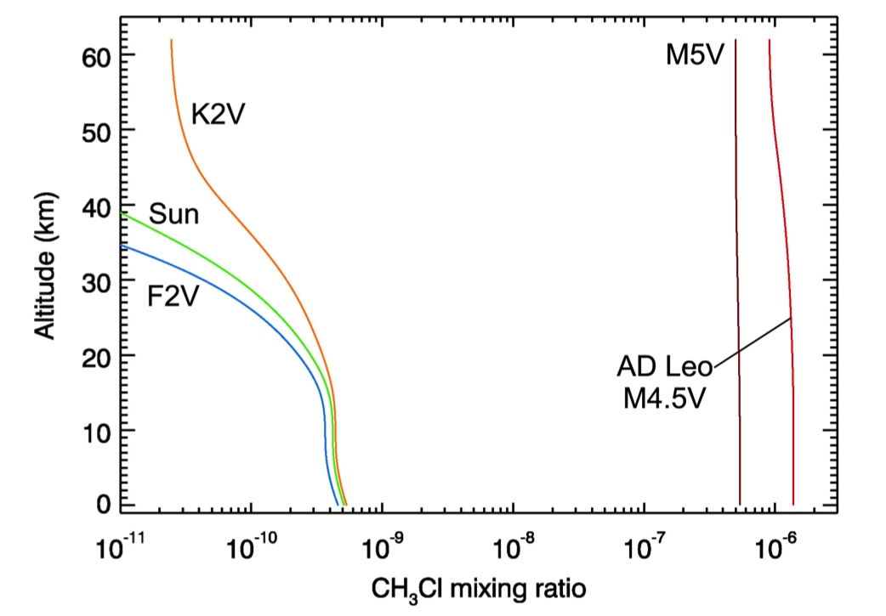
M Dwarfs May Enhance Biosignature Gases
N₂O
Segura et al., 2003, 2005
CH₄
f_{s} = 7.3 x 10¹² g/yr
f_{s} = 9.5 x 10¹⁴ g/yr,
except M5V
more
Earth-like planets around cooler stars show enhanced biosignature abundances (Segura et al., 2003, 2005)
  M stars less effective at O₃ photolysis
Enhancements in biosignatures, (including are also seen towards the outer edge of its habitable zone (Grenfell et al., 2006, 2007)
False positives for O₂ can be generated depending on stellar spectrum.
CH₃Cl
f_{s} = 1.3 x 10¹³ g/yr

Slide 19
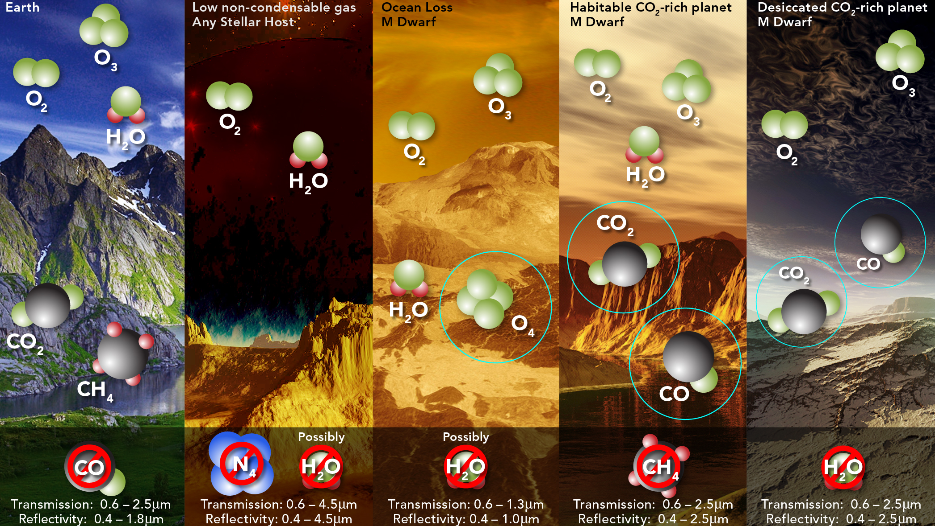
Several mechanisms may produce biosignature false positives
for planets orbiting M dwarfs
Figure Credit: Hasler/Meadows/Domagal-Goldman
Meadows, 2016, in review

Slide 20
M Dwarf Planets: Gravitational Effects
Orbital Evolution
  Tidal Locking
  Circularization
  Climate effects
Tidal Effects
  Tidal Venuses
  Loss of magnetic field

Slide 21
Proxima Centauri b: Things We Considered...
We used coupled models of planetary and Galactic orbital, tidal and rotational evolution, along with models of thermal interior evolution, and radiogenic models. We also used coupled stellar evolution and atmospheric escape models
Galactic Migration
Star’s early brightness
Flares/Atm. Loss
Tidal Heating
Composition
Magnetic Shielding
Tidal Locking
Tidal Circularization
Tilt Erosion
Orbital Instabilities
Orbital Oscillations
We examined all of these, including interactions between multiple processes, in Barnes et al., 2016.
Credit: Kornmesser, ESO
Notes:
We used coupled models of orbital, tidal, rotation evolution. Geophysics radiogenic model, thermal interior, tracks T and magnetic field.
Stellar evolution model, atmospheric escape. Galaxy evolution radial migration, role of the Galactic tide, perturbations from passing stars. (Driscoll & Berkovici, 2014; Driscoll & Barnes, 2015)

Slide 22
Proxima Cen b and Stellar Luminosity Evolution
Barnes et al., 2016
The star’s likely luminosity evolution suggests that if Proxima Cen b had formed at its current position, then the habitable zone would not have moved in towards the star to encompass the planet until abut 160 Myrs after formation.
Notes:
The gure also shows the \dry" HZ limits of Abe et al. (2011), which apply to planets
with very limited surface water (. 1% of the Earth's water inventory); these planets are
signicantly more robust to an instellation-triggered runaway. Consequently, if Proxima b's
initial water content was very low, it would have spent signicantly less time in a runaway
greenhouse. However, a dry formation scenario for Proxima b does not help its present-day
habitability. As we show in x4.4, Proxima b loses 1 ocean of water in . 4 Myr; if it formed
with less water than that, it would be completely desiccated long before entering the Abe
et al. (2011) HZ. One can envision cases in which the planet forms dry but with a protective
hydrogen envelope, or forms after 10 Myr, but such scenarios are unlikely a priori and
hence we do not consider them here.

Slide 23
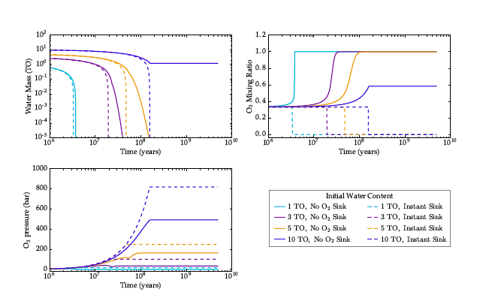
Water Loss from Proxima Cen b
Abundant water but no H₂ envelope
Water lost
O₂ builds up
Coupled stellar and atmospheric evolution models
Barnes et al., 2016
Only one of the modeled scenarios (initial 10 oceans of H₂O, no O₂ sink) produced a planet that was NOT desiccated in the first 160 Myrs.
If Proxima Cen b formed at it current location, it is likely desiccated
(c.f Ribas et al., 2016 who used a significantly lower XUV flux and find that Proxima Cen b lost less than an ocean of water).
Notes:
In this scenario, 1 TO of water remains, alongside a thick 500 bar O2
atmosphere. If Proxima b formed with less than ten times Earth's water content, and/or
had a persistent convecting, reducing magma ocean, it is likely desiccated today.
O₂ buildup from photolysis of H₂O can throttle further loss of H.

Slide 24
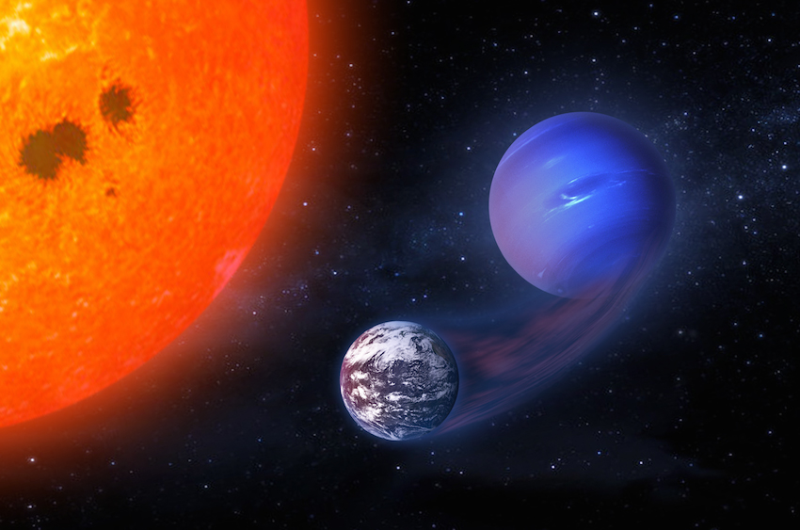
H₂ Envelope as Water Shield
If Proxima Centauri b forms with a significant primordial H₂ envelope
  whether in situ, or
  as the result of inward migration of a more H₂-rich body
the H₂ envelope could act as a sacrificial shield to protect the planet from total water loss, producing a Habitable Evaporated Core.
This may be one of the few ways that Proxima Cen b could be habitable.
Luger et al., 2015
Notes:
There are likely degrees of habitability

Slide 25
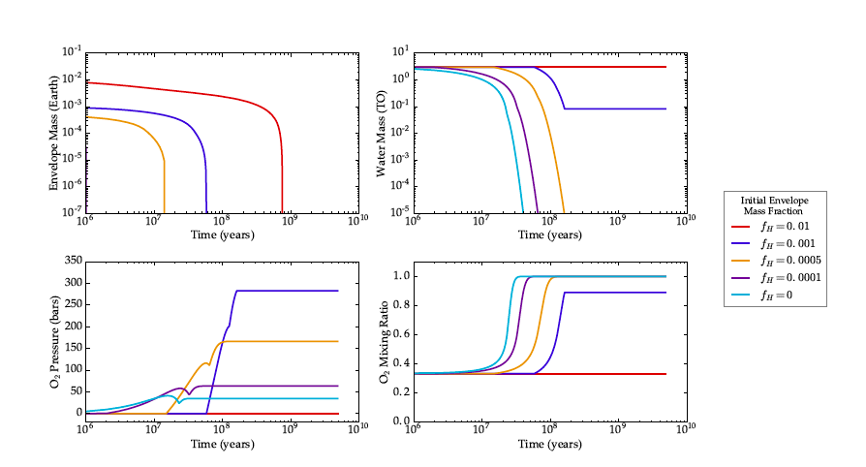
Loss of a H₂ envelope
H₂O retained
H₂ removed
No abiotic O₂
Barnes et al., 2016
Too little H₂, and all water is lost.
Too much (>1% or a larger mass planet), and the H₂ envelope is not lost, likely rendering the planet uninhabitable (c.f. Owen & Mohanty, 2016).
Notes:
We x the initial water content at 3 TO and consider initial envelope mass fractions
fH ranging from 10􀀀4 to 10􀀀2. In all cases, the envelope evaporates completely within the
rst several hundred Myr. For fH . 10􀀀3, the envelope evaporates early enough such that
all the water is still lost from the planet. For fH = 10􀀀3, only about 0.1 TO remain once the
planet enters the HZ; only for fH 10􀀀2 does the presence of the envelope guard against
all water loss. In these calculations, we assumed inecient surface sinks, so the escape of
water at late times was bottlenecked by the presence of abundant O2. Planets that form
with hydrogen envelopes may have quite reducing surfaces, which could absorb most of the
O2 and lead to even higher total water loss. As before, a few tens to a few hundreds of bars
of O2 remain in the atmosphere or in the solid body at the end of the escape phase.

Slide 26
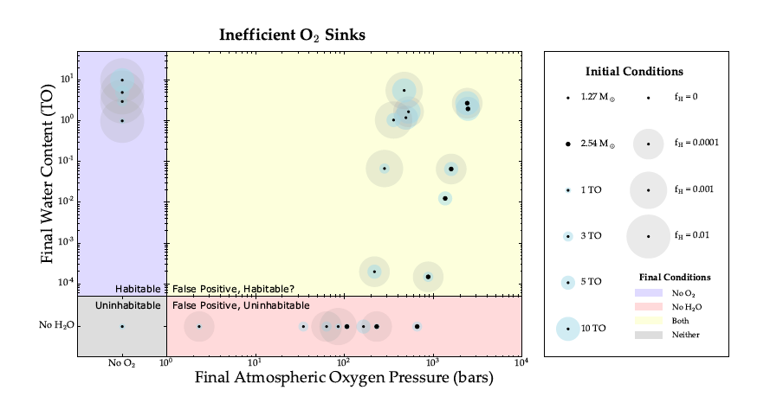
Several evolved states are possible
Barnes et al., 2016
Depending on H₂ envelope fraction, planet mass, and initial water inventory, planets could be habitable/uninhabitable, and have high abiotic O₂, or not.
An exact mass for Proxima Cen b could help inform the atmospheric escape history.
Notes:
There are likely degrees of habitability

Slide 27
Proxima Centauri b: Current Atmospheric States
To simulate the current composition and climate of the evolutionary states described in the previous section we used coupled 1-D climate-photochemical models (Atmos) and climate-condensation models (VPL Climate).
  This allows us to model a diversity of planetary states.
Complementary studies using 3-D GCMs for synchronously rotating and 3:2 spin-orbit resonance were performed by Turbet et al., 2016.
  They argue that the planet may not have had time to circularize.
  Undetected planetary companions may keep the eccentricity high enough to avoid synchronous rotation.
Credit: Kornmesser, ESO
Notes:
Ribas companion paper suggests that orbit of Proxima b may not have time to circularize and that e > 0.06 may be sufficient to capture into 3:2 spin-orbit resonance

Slide 28
1D and 3D Climate Model Comparisons
Atmosphere | VPL | Model | Comparison | Reference
1 bar CO₂ | 271 K | VPL Climate Meadows et al., 2016 | 266K (3:2) 247K (synch) | Turbet et al., 2016
4 bar CO₂ | 306K | VPL Climate | 305K (3:2) 289K (synch) | Turbet et al., 2016
6 bar CO₂ | 320K | VPL Climate | 324K (3:2) 309K (synch) | Turbet et al., 2016
1 bar N₂, 376ppm CO₂ | 247K | VPL Climate | 238K (3:2) 220K (synch) | Turbet et al., 2016
2% CO₂, 0.02% CH₄, water | 282K | Atmos Arney et al., 2016. | 287K | Charnay et al., 2013
6% CO₂, water | 286K | Atmos | 288K | Wolf and Toon., 2013
For the 3:2 spin-orbit resonance cases our 1-D models agree with the 3-D GCM results to within ~10K.

Slide 29
Summary of Evolutionary End States Considered*
O₂-dominated (formed in situ, ocean loss)
  10 bar O₂-dominated with 0.5% CO₂, desiccated
  10 bar O₂-dominated with 0.5% CO₂, water remaining
CO₂/O₂-dominated (post ocean loss, CO₂ outgassed)
  90, 10 bar atmospheres 45% CO₂, 45% O₂, desiccated.
  1 bar desiccated atmosphere with CO₂/O₂/CO
CO₂-dominated atmospheres (post ocean loss, O₂ lost/sequestered)
  Venus-like 90, and 10 bar CO₂ atmosphere, 20 ppm water, self-consistent H₂SO₄ cloud formation.
N₂/O₂-dominated Earth-like (HEC, or planet-planet orbital evolution)
  photochemically self-consistent with stellar UV
N₂/CO₂/CH₄ anoxic early Earth-like (HEC, or orbital evolution)
  Self consistent formation of hydrocarbon haze.
  *representative, not complete!
Meadows, Arney et al., 2016
Notes:
There Figure 4. Self-consistent high-O2 (95%), post-runaway atmospheres with a surface ocean
remaining (left) and completely desiccated (right). Differences in temperature and O3 profiles are
primarily driven by the presence or absence of water vapor.
likely degrees of habitability

Slide 30
O₂-dominated, post ocean loss
O₃ higher in
desiccated
atmosphere
Schwieterman, Arney, Lincowski
Self-consistent “ocean-remaining” and “desiccated” cases
Lack of water (OH radicals) affected CO, O₃ profiles and surface temperature
Tsurf = 320K and water present for ocean remaining (habitable?)
Tsurf = 257K and desiccated (cold and dry - not habitable)
Notes:
water vapor also significantly impacts the O3 profile, because OH radicals from water photolysis
are efficient at O3 destruction. Thus, O3 can build up to higher levels in the desiccated atmosphere,
especially near the surface where the H2O mixing ratio would otherwise be high.
There Figure 4. Self-consistent high-O2 (95%), post-runaway atmospheres with a surface ocean
remaining (left) and completely desiccated (right). Differences in temperature and O3 profiles are
primarily driven by the presence or absence of water vapor.
likely degrees of habitability

Slide 31
CO₂/O₂ and CO₂– dominated, post ocean loss
90 bar 45% CO₂/45% O₂
Schwieterman, Lincowski, Arney
10 and 90 bar 45% CO₂, 45% O₂ and ~ 10% N₂ atmosphere
1-bar desiccated CO₂/O₂/CO atmosphere (Gao et al., 2016)
90 bar Tsurf = 383K, 10 bar Tsurf=342K (dessicated – not habitable)
1 bar Tsurf = 297K (nice!) but desiccated (not nice)
10 and 90 bar Venus-like (96% CO₂, 20ppm H₂O) Tsurf = 428-568K (not habitable!)
Notes:
Atmos loosely coupled to 1D SMART climate model for high CO2
1D SMART used for Venus, not photochemically self-consistent, but clouds condense at right altitude and participate in climate.
Figure 5. Temperature and gas mixing ratio profiles for a 10 bar (left panel) and 90 bar (right
panel) O2-rich and CO2-rich atmospheres with 45% CO2, 45% O2, and ~10% N2.
Figure 7. Temperature and mass mixing ratios of desiccated CO2/O2/CO atmosphere as a function
of altitude. CO2, O2, and CO are the most abundant gases and result from photochemistry of
outgassed CO2. Only major and spectrally observable gases are shown. The temperature profile is
the result of our SMART Climate model using these mixing ratios converted to volume mixing
ratios from the molar mass mixing ratio values of Gao et al. (2015; case 4).

Slide 32
N₂/O₂-dominated, HEC or orbital evolution
Schwieterman, Arney, Lincowski
1-bar N₂/O₂ atmosphere with trace gases determined self-consistently with the star’s UV flux Earth’s pre-industrial surface fluxes.
CH₄,N₂O are photochemically enhanced around Proxima Cen b
With 5% CO₂, Tsurf = 283K, water present (habitable)
Notes:
Figure 8. Self-consistent temperature and gas mixing ratio profiles for preindustrial modern Earth
orbiting the Sun (left) and a photochemically self-consistent Earth-like atmosphere for Proxima
Centauri b (right). The mixing ratios of trace gas species CH4, N2O, and CO for Proxima Centauri
b are determined from the flux required to produce their preindustrial concentration in Earth’s
atmosphere (see Section 4.2.3.1). Given the same fluxes as Earth, CH4, CO, and N2O would exist
in Proxima Centauri b’s atmosphere in much greater abundance.

Slide 33
N₂/CO₂ dominated (early Earth), HEC or orbital evolution
Hydrocarbon haze
Arney, Lincowski, Schwieterman
1-bar N₂-dominated atmosphere with 5% CO₂ and either 1% or 3% CH₄.
The larger CH₄ abundance produces a hydrocarbon haze.
Haze-free 1% CH₄, Tsurf = 289K (habitable)
Hazy 3% CH4, Tsurf= 285K (habitable) Haze has little effect for M dwarfs
Haze as a possible biosignature (Arney et al., 2016b; Guzman-Marmolejo et al., 2013)
Notes:
Figure 9. Gas profiles and temperature structure of the Archean-analog atmospheres. The
moderate temperature inversion seen in the right (3% CH4) plot is due to UV absorption by the
haze. UV-shielding by the haze in the 3% CH4 plot (right) prevents photolysis of gases such as
methane and ethane at higher altitudes than in the 1% CH4 (left) plot. Note the temperature profile
becomes an isoprofile above the top of the climate model grid when passed into the photochemical
model.

Slide 34
Proxima Cen b: A World of Climate Possibilities
Case | Tsurf | H₂O? | Notes | Hab?
N₂/O₂-rich, Modern Earth-like, 1 bar, H₂O cloud. | 283K | ✔ | 5% CO₂, self-consistent w/star, HEC or orbital evolution | ✔
N₂/CO₂/CH₄ Archean Earth-like, haze,1 bar | 289K 285K | ✔ | 5% CO₂, 1% CH₄ - 3% CH₄ for haze, HEC or orbital evolution | ✔
O₂-rich, H₂O-remains, 10 bar | 320K | ✔ | 0.5% CO₂, incomplete ocean loss. O₂ may hamper life’s origin | ✔?
CO₂/CO/O₂, no-H₂O 1 bar | 298K | ✗ | Stable mix if H < 1ppm. CO₂ recombination if H₂O/catalysts. | ✗
O₂-rich, H₂O lost 10 bar | 257K | ✗ | 0.5% CO₂, ocean loss, some O₂ sequestration | ✗
O₂/CO₂-rich, H₂O lost 10 and 90 bar | 342K 383K | ✗ | Ocean loss, outgassing of CO₂, some O₂ sequestration | ✗
CO₂-rich,20 ppm H₂O 10 and 90 bar | 428K 567K | ✗ | Ocean loss, outgassed CO₂, all O₂ sequestered, Venus-like | ✗
Although it sits squarely in the habitable zone, depending on the evolutionary path taken, Proxima Cen b may or may not be habitable.

Slide 35
What do we take away from this?
Clearly terrestrial planet evolution, and the resulting atmosphere, matters to a planet’s habitability.
Will observations allow us to recognize these different planetary states and the likely evolutionary path taken by the planet?
Credit: Kornmesser, ESO
Notes:
There are likely degrees of habitability

Slide 36
Proxima Centauri b
Observational Discriminants
To simulate thermal phase curves and spectra we used radiative transfer models and instrument simulator models for JWST and coronagraphs.
Credit: Kornmesser, ESO
Notes:
There are likely degrees of habitability

Slide 37
O₄ Discriminates Ocean Runaway vs Inhabited Earth-Like Planets
O₂-rich, ocean lost
Strong O₂ and O₃
O₄ CIA (0.35 - 1.3μm)
H₂O weak or missing
CO₂ present
O₂-rich, ocean loss
Earth-like Biosphere
Strong O₂ and O₃
No O₄ CIA
Strong H₂O
Strong CH₄
CO₂ present
Direct imaging
Transmission
Earth-like, photochemically
self-consistent with M5.5V
Schwieterman et al., 2016:
Meadows, Arney et al., 2016
Notes:
There are likely degrees of habitability

Slide 38
Desiccated O₂/CO₂ Atmospheres and Archean-type
Lack of H₂O indicates that the O₂ is more likely to have an abiotic source
(Gao et al., 2016; Schwieterman et al., 2016)
Early Earth shows strong CO₂, CH4 and haze absorption.
(Arney et al., 2016)
Notes:
There are likely degrees of habitability

Slide 39
Venus-like planet shows strong CO₂, and possibly H₂O
Model validated by predicting altitude of Venus cloud base at 48km
Notes:
Question for Giada about cloud formation. Any clue as to why H2SO4 forms so low? Can we even see the clouds?

Slide 40
Proxima Centauri b
Observations and Observational Capabilities
Credit: Kornmesser, ESO
Notes:
There are likely degrees of habitability

Slide 41
Proxima Cen b - Detecting Day/Night with JWST
Venus-like planet
Planet-star contrast most
favorable at wavelengths
longer than 20 microns.
No temperature difference
Nightside 20K cooler
No flux from nightside
At λ > 7μm, 20 hour exposures with JWST at two phase angles could detect the planet and search for day-night temperature differences, revealing atmospheric heat transport.
(Meadows et al., 2016; see also Turbet et al., 2016, Kreidberg & Loeb, 2016)
Detection of ocean glint is highly unlikely with JWST, but may be within the reach of larger aperture telescopes.
  2λ/D needed for LUVOIR to do glint, 3λ/D for ground-based telescopes (Meadows et al.,2017).
Notes:
Figure 11. Self-consistent Earth-like planet thermal phase contrast curves (left) and the
corresponding planet-star contrast spectra at full phase (right). Colored lines and shaded regions
indicate broadband wavelength binning consistent with R = 3. On the left, solid lines show the
case with no day-night temperature contrast (no phase-dependent modulation), dashed lines show
the case with no emergent flux from the nightside (maximal phase-dependent modulation), and
dotted lines show an intermediate case with the nightside temperature 20 K less than the dayside
temperature.
Phase Curves: Using MIRI/JWST it should be possible (we show it for photon limited observations) to observe phase curves for Proxima Cen b between about 5-25 microns. The amplitude of the signal, however, will depend on the day-night temperature contrast. We show end-member cases where there is no flux from the nightside (extremely inefficient heat redistribution) and where there is dayside thermal flux from the nightside (extremely efficient heat redistribution). For many of these cases, 20 hour exposures at a given phase angle are sufficient to detect the planet above the stellar photon noise.

Slide 42
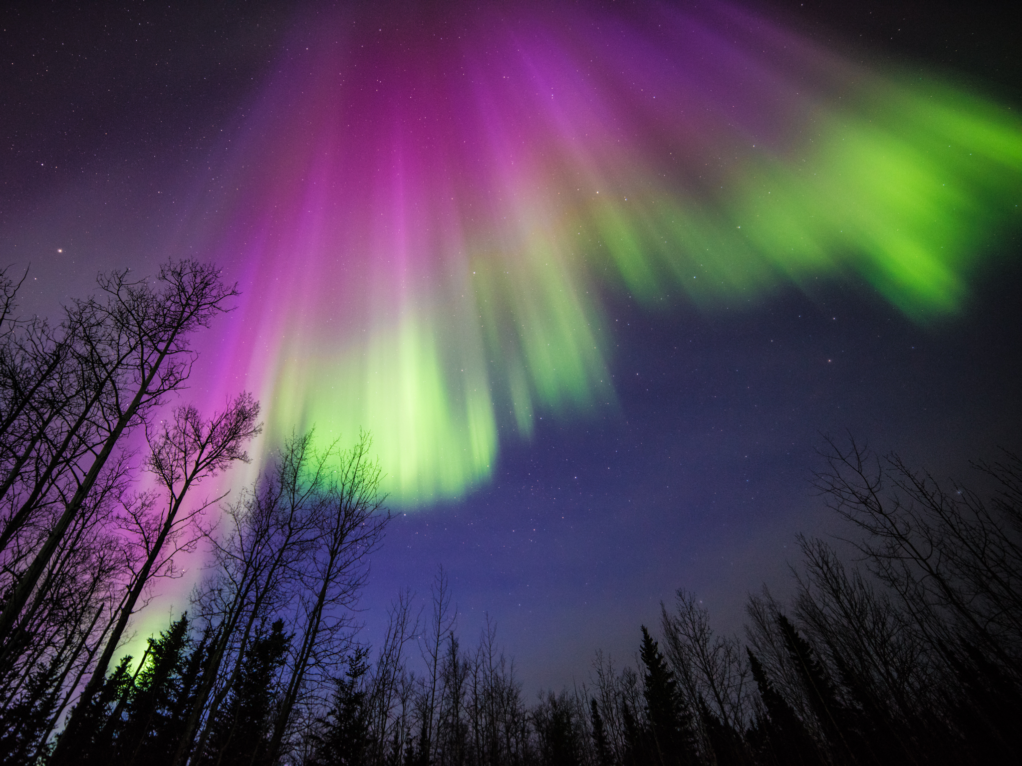
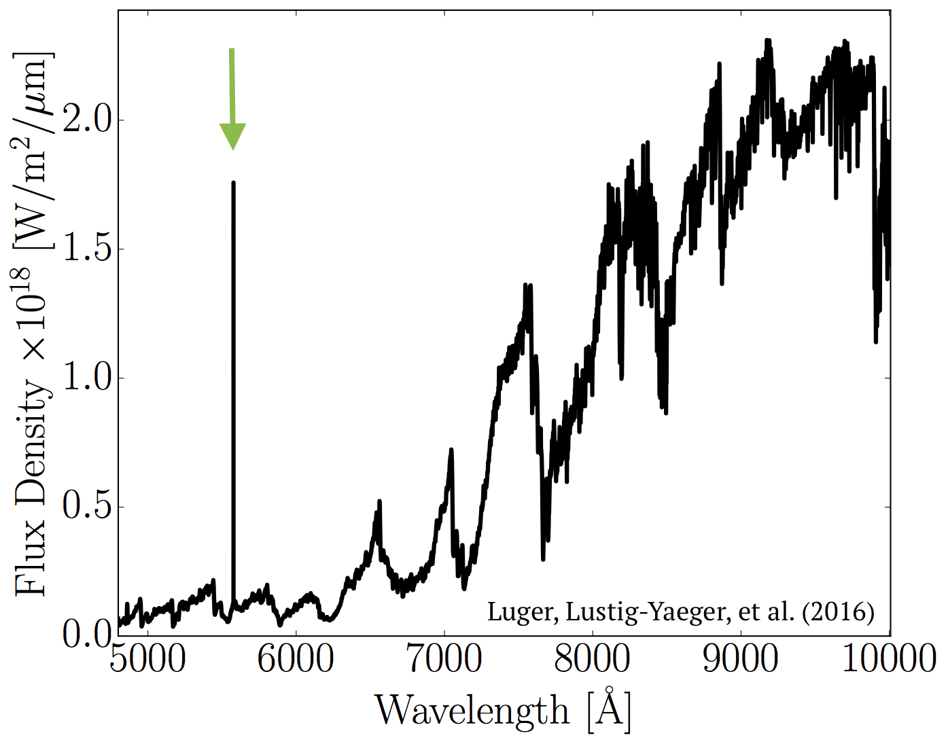
Exo-aurorae may reveal a planetary atmosphere
Oxygen
Green Line
Detect in 40 hours with ground-based 30 meter telescope if it achieves a coronagraph design contrast of 10⁻⁷ and negligible instrumental noise
Luger, Lustig-Yaeger, et al (2016) arxiv

Slide 43
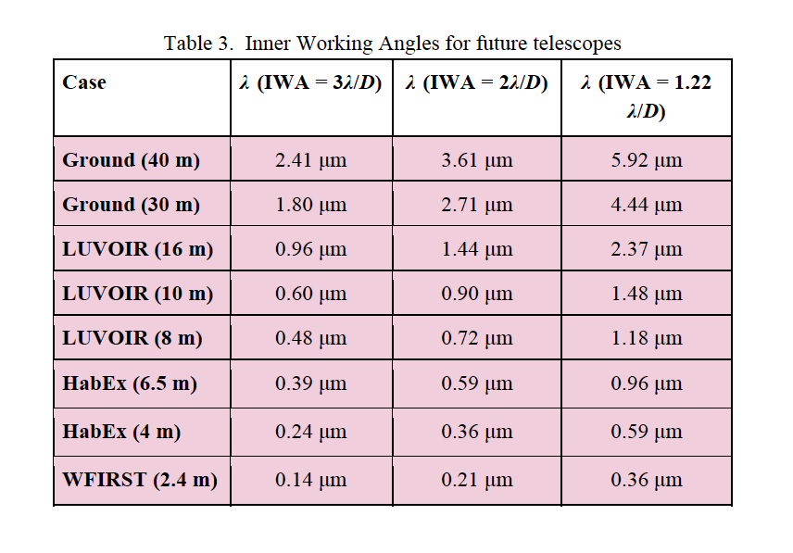
Direct Imaging Observations of Proxima Cen b
O₄ at 0.35-0.65, 1.-6-1.27, O₃ at 0.5-0.7, O₂ at 0.76um, H₂O at 0.94um, CO₂ at 1.6um CO at 2.3um
Need large aperture, starshade, or both.
Notes:
37mas separation

Slide 44
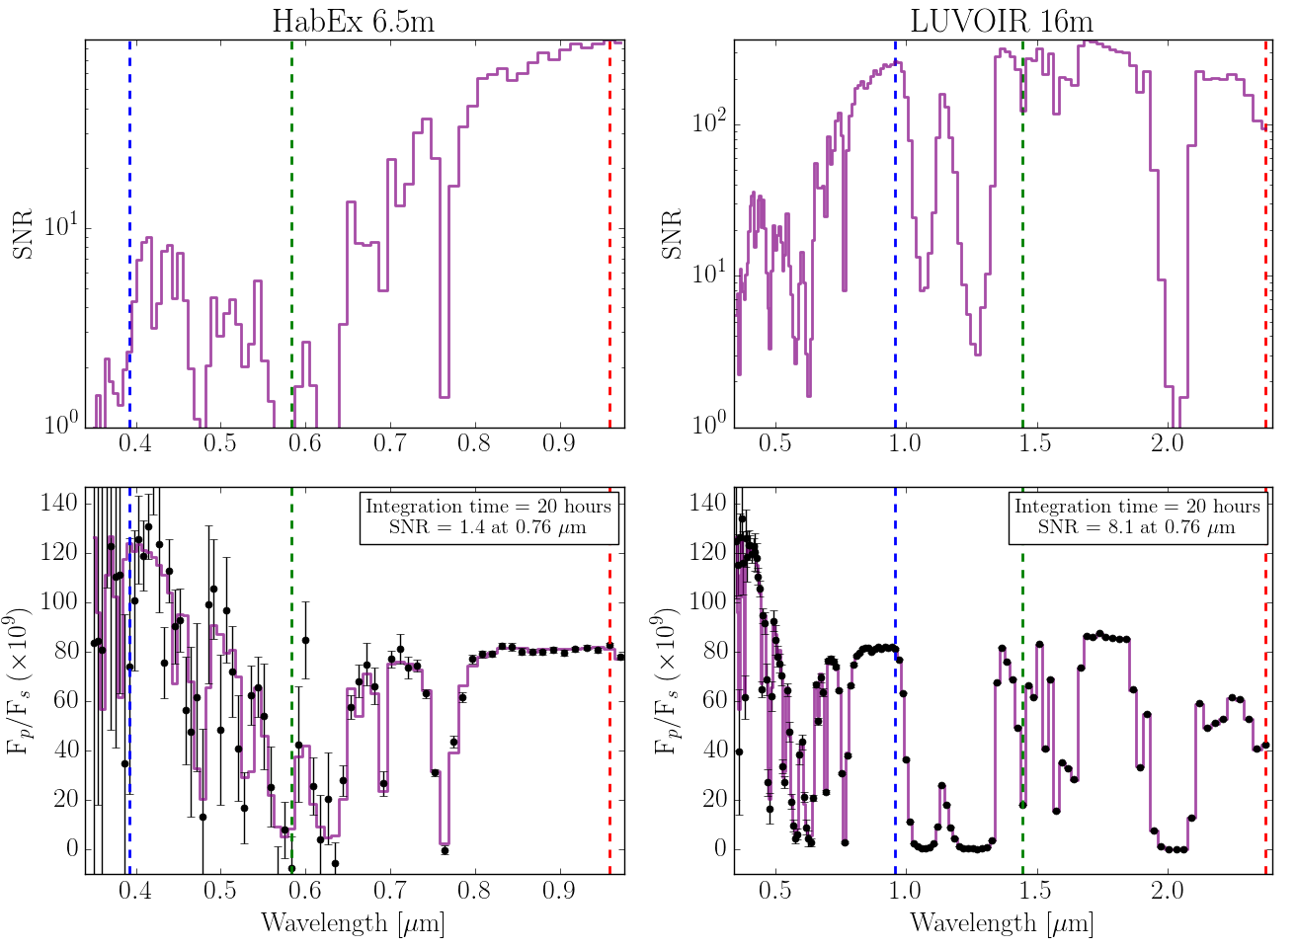
Space-based Direct Imaging Spectroscopy
HabEx 6.5m LUVOIR 16m
O₄
O₂
O₂
M dwarfs are
brighter out here
O₄
O₄
The LUVOIR (16m) simulation shows a S/N~8 at the oxygen A-band in a 20 hr exposure
Notes:
Figure 29. Simulated coronagraph integration times (top) and reflectance spectra (bottom) for the
“wet” 10 bar O2-rich planet using three different future telescope concepts: HabEx (left), LUVOIR
(middle), and a 30 m ground-based telescope (right). Dashed vertical lines are placed at
IWA = 1λ/D (red), 2λ/D (green), and 3λ/D (blue), to show the long-wavelength limit for the given
telescope diameter and planet-star angular separation. All spectra are shown for a spectral
resolution of R = 70. The integration times given are required to achieve S/N = 20 in each
resolution element, while the errors on each simulated observation (black) represent the estimated
1σ error bars for the integration time needed, per nulling bandwidth, to achieve S/N = 20 in the
resolution element at the 0.76 μm oxygen A-band.
Figure

Slide 45
Direct Imaging of Early-Earth-Type
Haze feature difficult to observe due to low stellar flux
Low stellar flux and small HZ separation conspire against small telescopes!
Notes:
Figure 29. Simulated coronagraph integration times (top) and reflectance spectra (bottom) for the
“wet” 10 bar O2-rich planet using three different future telescope concepts: HabEx (left), LUVOIR
(middle), and a 30 m ground-based telescope (right). Dashed vertical lines are placed at
IWA = 1λ/D (red), 2λ/D (green), and 3λ/D (blue), to show the long-wavelength limit for the given
telescope diameter and planet-star angular separation. All spectra are shown for a spectral
resolution of R = 70. The integration times given are required to achieve S/N = 20 in each
resolution element, while the errors on each simulated observation (black) represent the estimated
1σ error bars for the integration time needed, per nulling bandwidth, to achieve S/N = 20 in the
resolution element at the 0.76 μm oxygen A-band.
Figure

Slide 46
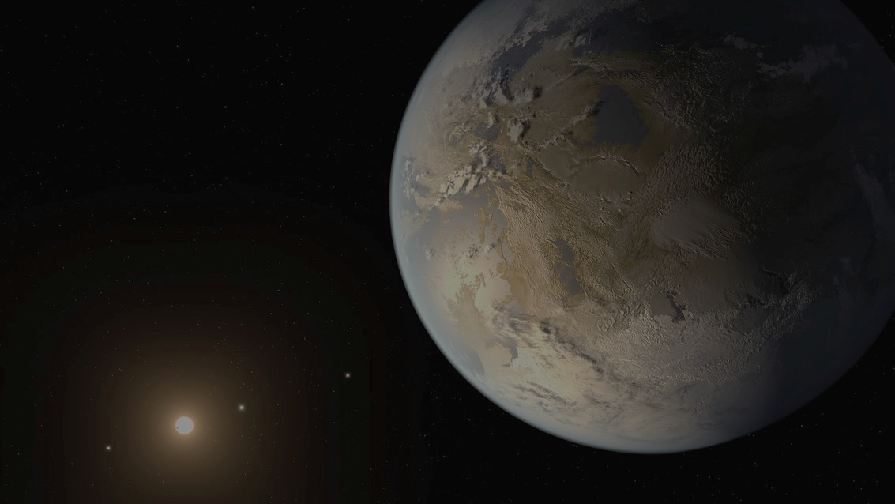
Proxima Centauri b
  If the planet formed at its current location, it was likely desiccated by the Pre-MS
  Migration or 1% H₂ envelope may have preserved H₂O
  Atmospheres could be O₂-rich initially, becoming more CO₂-rich as O₂ is sequestered and CO₂ is outgassed. Water may or may not have been retained.
  Models suggest that several of these environments could be habitable (Earth-like, early Earth-like and O₂-rich with water) but many are not, due to early desiccation or higher levels of CO₂
  Thermal phase curves longward of 7μm could be accessible with JWST, and may reveal the effects of an atmosphere. Ocean glint is not possible for this target with JWST.
  Observational discriminants including O₄, O₃, O₂, CO₂, CO, CH₄, H₂O and organic haze may be accessible to future direct imaging telescopes in space and on the ground.
  Barnes et al., 2016; Meadows et al., 2016.
Notes:
\

Slide 47
Questions?

Slide 48
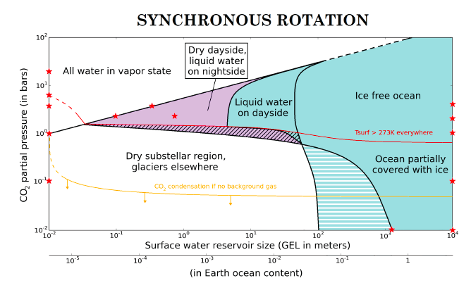
Backup Slides
Turbet et al., 2016

Slide 49
Photochemistry matters! Stellar UV matters!
CH₄ has a longer lifetime in the planet’s atmosphere under M dwarf UV irradiation, and so has higher abundance for the same surface flux.
Notes:
There are likely degrees of habitability

Slide 50
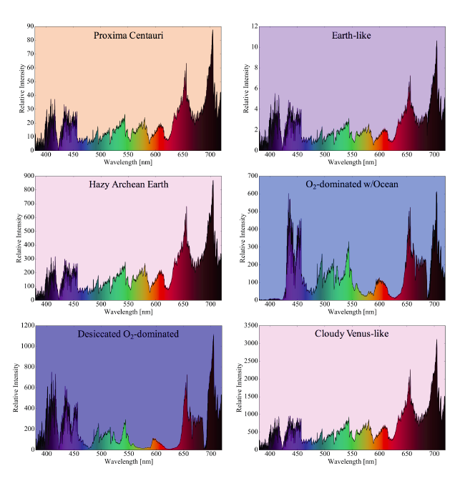
Proxima Cen b: The Pale Lavender Dot
Notes:
There are likely degrees of habitability

Slide 51
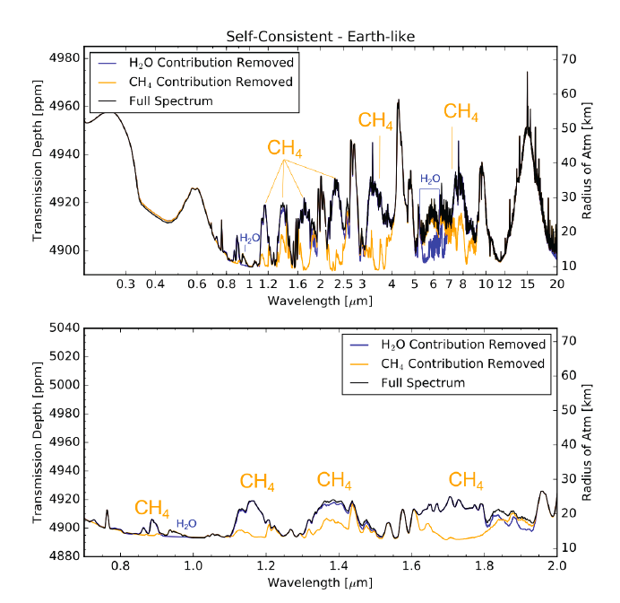
Proxima
Habitability is a measure of an environment’s potential to support life.
Notes:
There are likely degrees of habitability

Slide 52
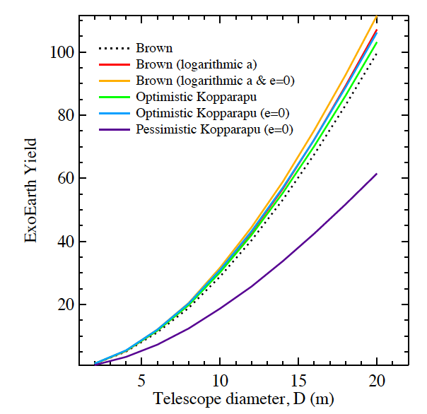
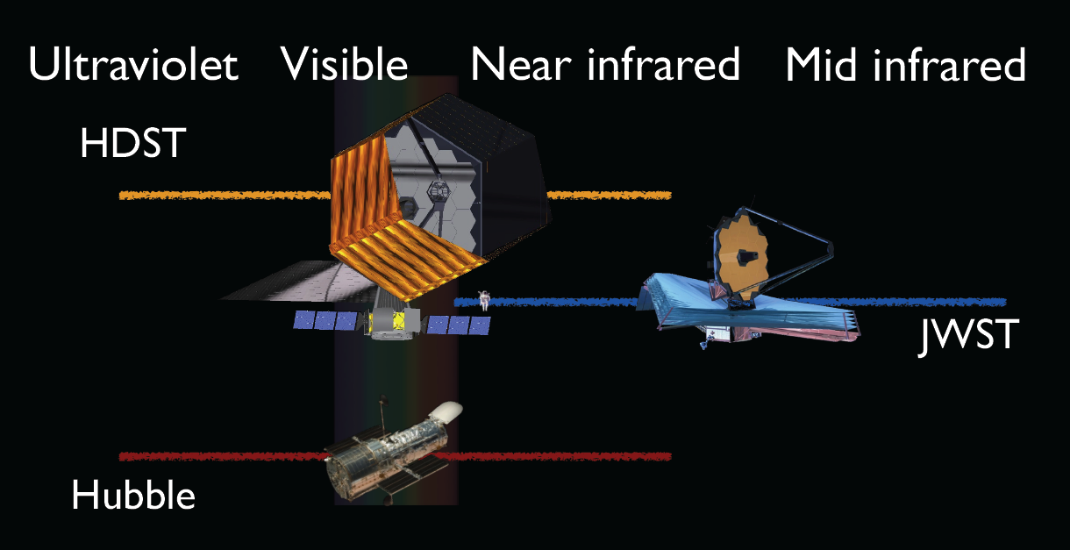
The High Definition Space Telescope Concept
Will be able to directly image tens of
Earth-sized planets in the Habitable Zone.
HabEx a smaller but exoplanet dedicated
telescope also under consideration
12 m
6.5 m
Stark et al., 2015
2.4 m
Dalcanton et al., 2015
Stark et al. 2015
Stark et al. 2015

Slide 53
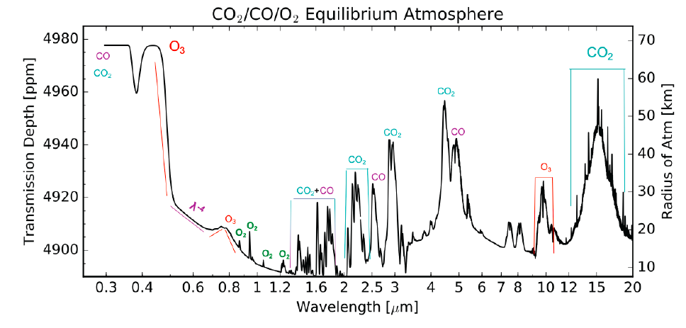
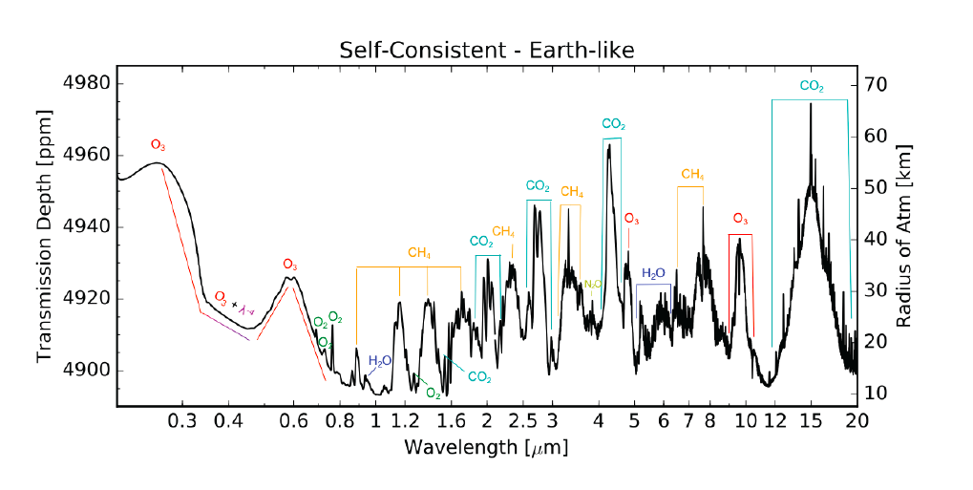
Proxima Cen b simulated environments - Transmission
Transmission
Transmission
Segura et al., 2005; Gao et al., 2015; Schwieterman et al., 2016: Meadows et al., 2016

Slide 54
Are Terrestrial Planets Orbiting M Dwarfs Habitable?
This is a very rich area with many avenues to explore:
How common are potentially habitable planets orbiting M dwarfs?
How do parent stars of terrestrial planets shape habitability over long timescales?
Can M dwarf HZ terrestrial planets produce, keep, and if necessary, get rid of atmospheres?
What is the nature of the delivery, cycling and loss of H₂O and N₂ for terrestrial planets?
What role does the planetary magnetic field play, if any, in retention of an atmosphere and protection from surface radiation and particles?
What is the effect of synchronous rotation and clouds on M dwarf planet habitability?
How do we identify the best M dwarf planets for spectroscopic follow-up?
How do we detect signs of habitability on M dwarf planets?
Meadows, Kavli ExoFrontiers Symposium, Sep 5-6, 2016
Notes:
M Dwarfs comprise 70% of the Galactic populations. (Lammer et al., 2009; Ribas et al., 2016)
(Luger et al., 2015; Lopez et al., Owen & Mohanty, 2016)

Slide 55
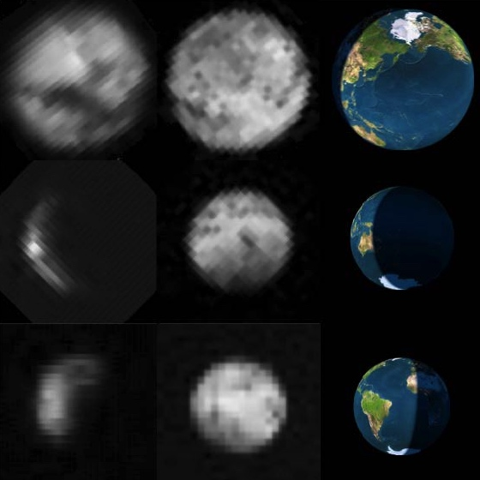
LCROSS Observations of Earth Glint
Images of the Earth taken with the LCROSS NIR2 camera (0.9-1.7μm) and MIR1 camera (6-10μm)
Robinson et al., 2014

Slide 56
LCROSS Data Confirm VPL Glint Predictions
This phase (129°) would require 77mas separation
for an Earth twin at 10pc
Robinson et al., 2014
Earthshine data provided by Enric Pallé (Pallé et al., 2003);, EPOXI data provided by Tim Livengood (Livengood et al.2013; LCROSS data provided by Kimberley Ennico (Robinson et al., 2014).
Notes:
This comparison confirms model predictions of Earth’s brightness made in Robinson et al., (2010) We note that the phase angle of Earthlook 2 (129°),
Observing an Earth-twin in an edge-on orbit around a Sun-like star at 10pc would require a telescope inner working angle of at least 77 mas.
This estimate doubles if the system is instead taken to be at 5pc. These inner working angles are comparable to those being considered for future terrestrial exoplanet characterization mission concepts (e.g.,Brown & Soummer 2010), and so searching for glint at this phase is theoretically possible for such missions.
For crescent phase the separation of planet and star is about 77 milliarcseconds or less for an Earth twin at 10pc, but in the best case scenario, 500 mas for a planet orbiting alpha centauri A. To be able to discriminate things this close to their star we need both large telescopes and excellent suppression of the light from the central star. The probe-class exoplanet missions currently under consideration (Exo-S and Exo-C) are able to discriminate star and planet if they are 115 - 170 milliarcseconds apart, so they might be able to take observations of an Earth twin close to crescent phase if we find one nearby.

Slide 57
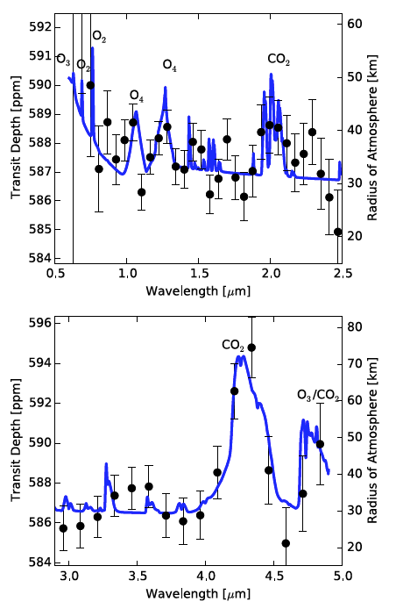
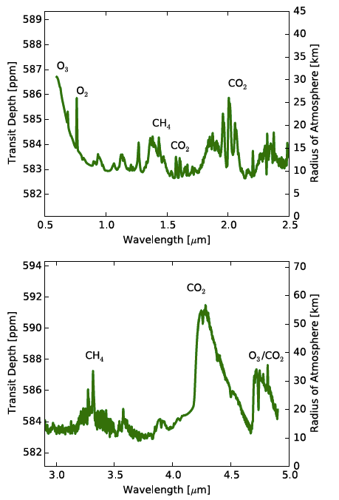
Massive O₂ atmospheres will likely have O₄
Earth
JWST transmission simulations (65 hrs)
Schwieterman et al., 2016

Slide 58
Modern Earth orbiting an M5V
Features at 2-30 ppm. Water vapor seen at the few ppm level.
Transmission model (includes refraction) from Misra et al., (2014)
Model is cloud-free, however continuum corresponds to 8km above the planetary
surface, likely above any actual cloud deck.

Slide 59
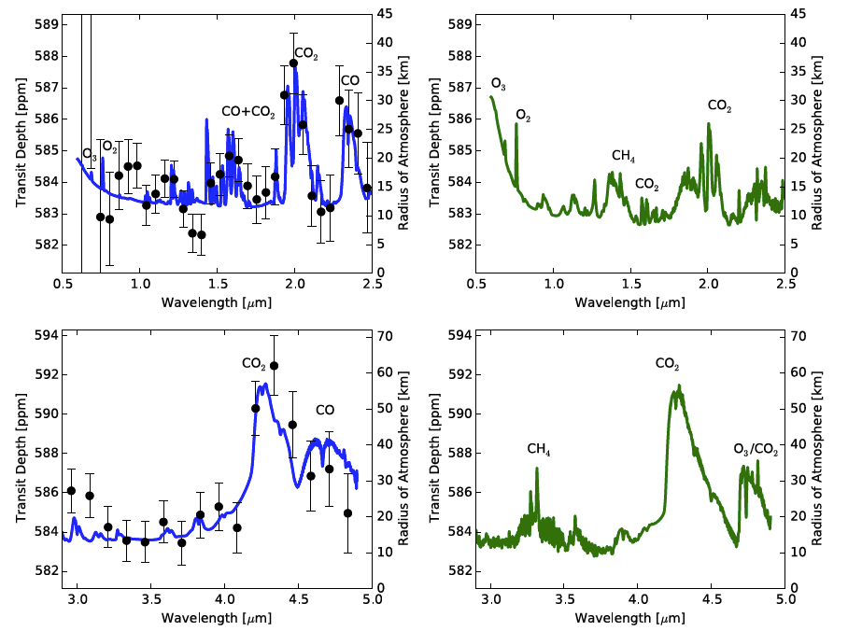
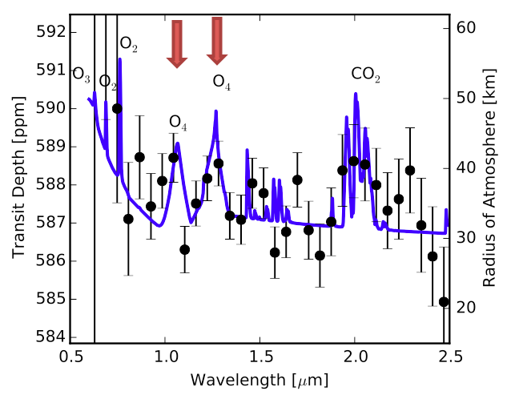
CO and O₄ may help identify abiotic O₂ generation
Photolytic source
Earth
The CO and O₄ absorption is stronger and more detectable than the abiotic O₂
Atmospheric Escape
Schwieterman et al., 2016

