Slide 1
From Red Dwarfs to Pale Blue Dots:
Searching for Potentially Habitable Planets in the Galaxy with Kepler, K2, TESS, & Beyond
We thank the IRTF TAC & the Caltech TAC for enabling these follow-up observations and the K2 Guest Observer Office for supporting our numerous K2 proposals.
Courtney Dressing
NASA Sagan Fellow at Caltech
LUVOIR Seminar
November 30, 2016
Collaborators: Elisabeth Newton, Josh Schlieder,
Andrew Vanderburg, Ian Crossfield, Arturo Martinez, Heather Knutson,
David Charbonneau, the K2 California Consortium, & the HARPS-N Consortium

Slide 2
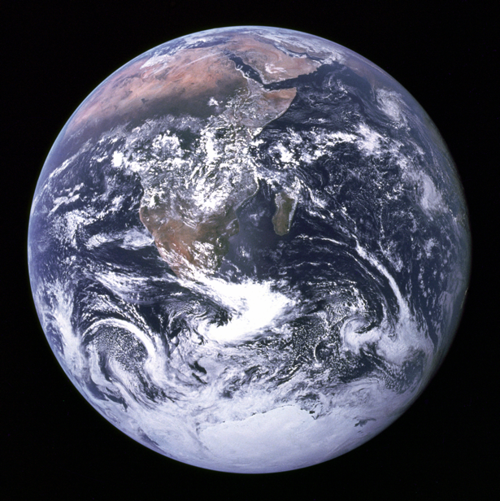
The Big Question: Are we alone?

Slide 3
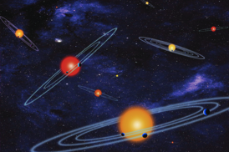
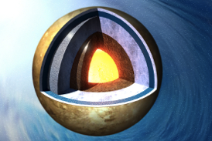
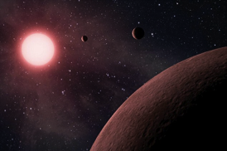
Questions Addressed Today
How common are
planets orbiting low-mass stars
?
1
How diverse are the compositions of small planets
?
2
How can we identify potentially habitable planets
?
3
Notes:
Image 1: ESO/M. Kornmesser
Image 2: image from UCL webpage at https://www.ucl.ac.uk/cps/researchthemes

Slide 4
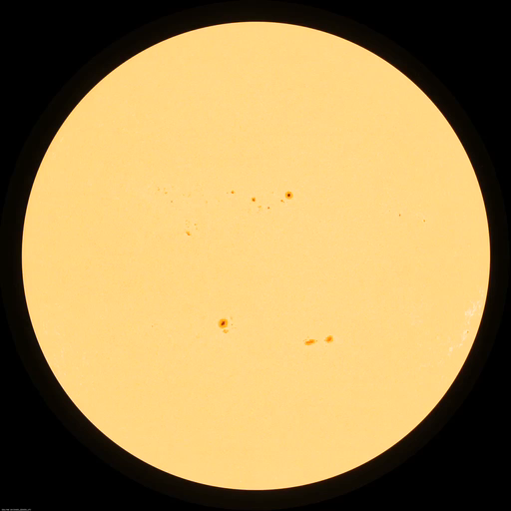

Transit Observations Reveal
Planet Sizes
Radial Velocity Observations Reveal
Planet Masses
Image credit: NASA/SDO, Scientific American

Slide 5
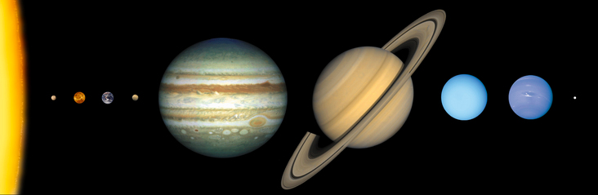


How detectable are these signals?
 | Jupiter-Sun System | Earth-Sun System
Transit Depth (Light Curve Dip) | 1% | 0.0084%
RV Semiamplitude (Doppler Wobble) | 12.5 m/s | 0.09 m/s
Notes:
----- Meeting Notes (4/2/15 14:53) -----
physical example of 12.5 m/s (driving speed in residential neighborhood)

Slide 6
Proxima Centauri
14% Solar Radius
12% Solar Mass
3042 Kelvin
The Sun
1 Solar Radius
1 Solar Mass
5777 Kelvin
Early
M Dwarf

Slide 7
Most Stars are M Dwarfs
Notes:
20 WD
4 A
6 F
20 G
44 K
248 M

Slide 8
Most Stars are M Dwarfs
Notes:
20 WD
4 A
6 F
20 G
44 K
248 M

Slide 9
Most Stars are M Dwarfs
How many planets orbit these stars?
Notes:
20 WD
4 A
6 F
20 G
44 K
248 M

Slide 10
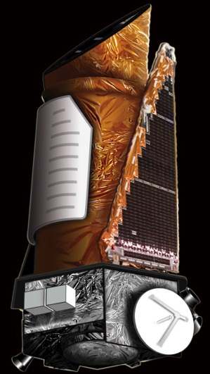
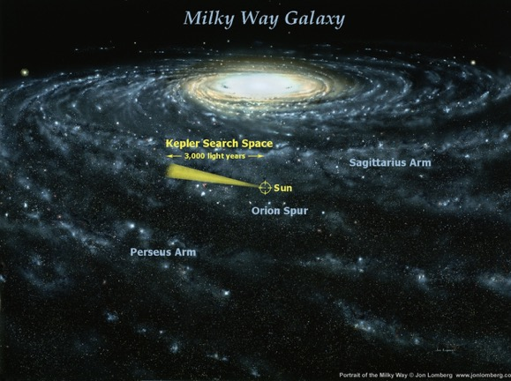
The Kepler Mission: 2009 - 2013
Credit: NASA/Kepler mission

Slide 11
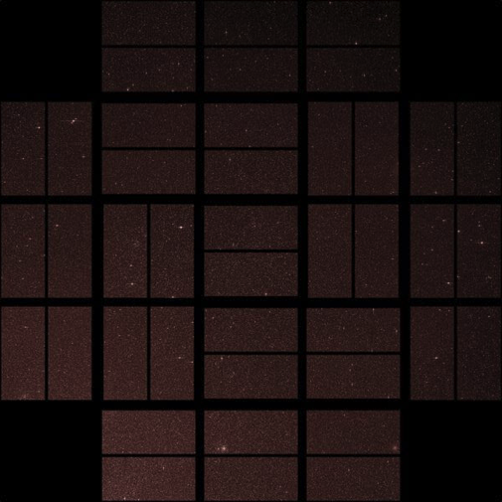
Kepler Looked for Planets Orbiting These Stars
Credit: NASA/Kepler mission

Slide 12
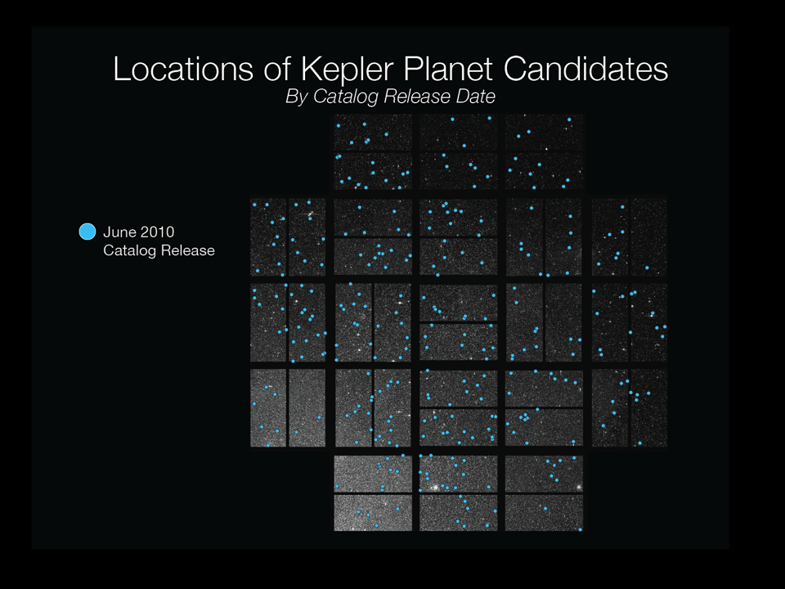
312
Credit: NASA/Kepler mission

Slide 13
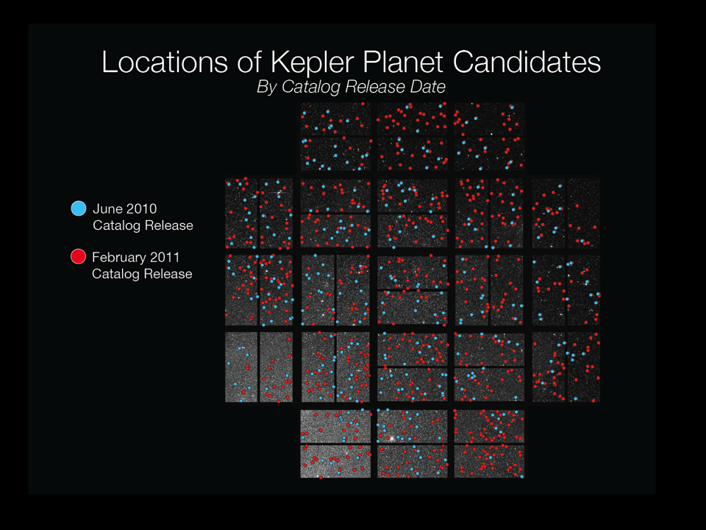
1235
Credit: NASA/Kepler mission

Slide 14
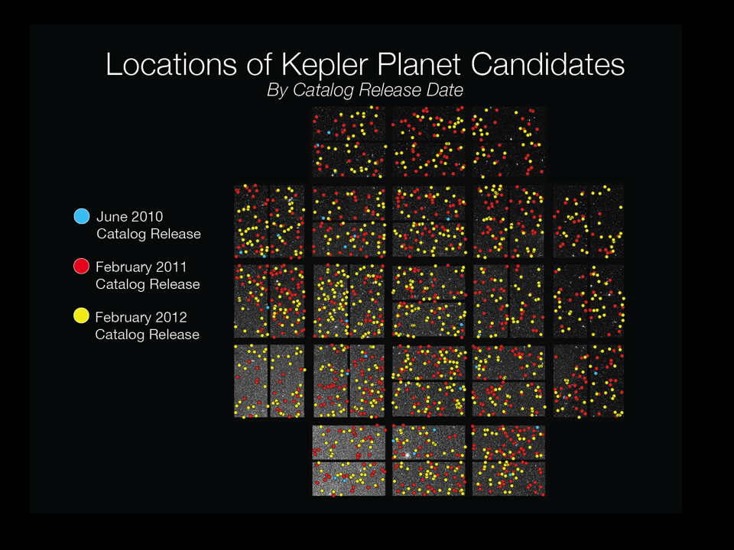
2321
Credit: NASA/Kepler mission
Notes:
1091 new
1790 host stars

Slide 15
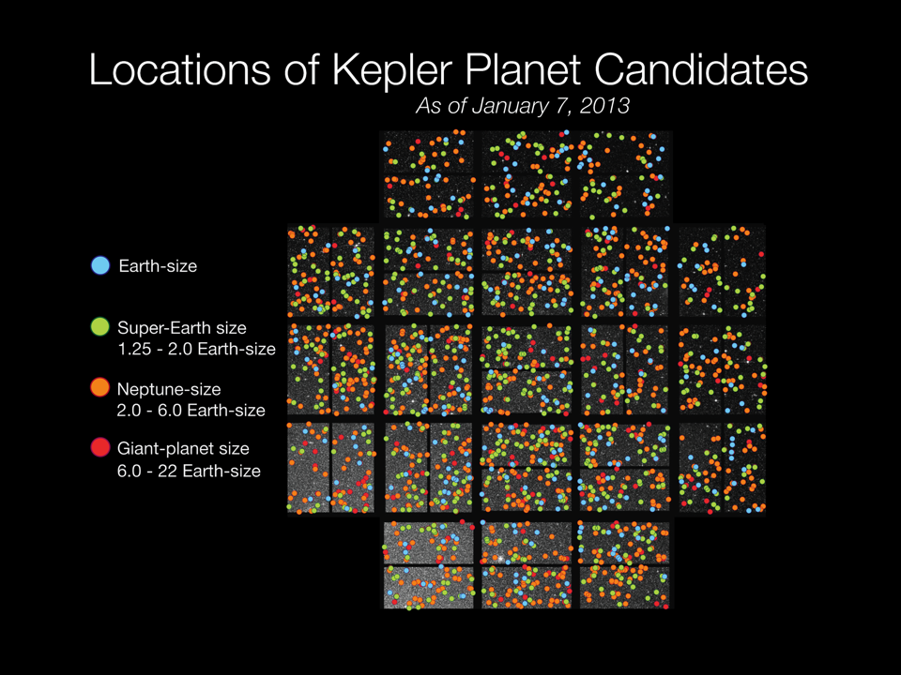
2740
Total Today: 4696!
Credit: NASA/Kepler mission

Slide 16
# of Planets = # of Planet Candidates – # of False Positives
Planet Occurrence Rate
Number of Planets
Number of Stars “Searched”
Transit detectability depends on stellar and planetary properties

Slide 17
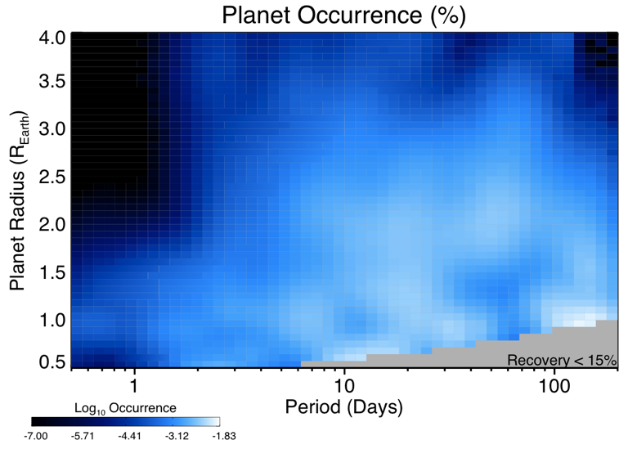
Smaller Planets Are More Prevalent
0.0
3.8
0.3
16
19
5.5
Dressing & Charbonneau 2015, ApJ, 807, 45

Slide 18
Planets Orbiting Low-Mass Stars are Common
TOTAL:
2.5 ± 0.2
Planets per M dwarf
with P<200 days, R_{P} = 1-4 REarth
Dressing & Charbonneau 2015, ApJ, 807, 45

Slide 19
Are any of these planets habitable?
Rocky Surface
Liquid Water
How large can a rocky planet be?
Image credit: NASA/Apollo 17
Notes:
Earth photo: Apollo 17

Slide 20
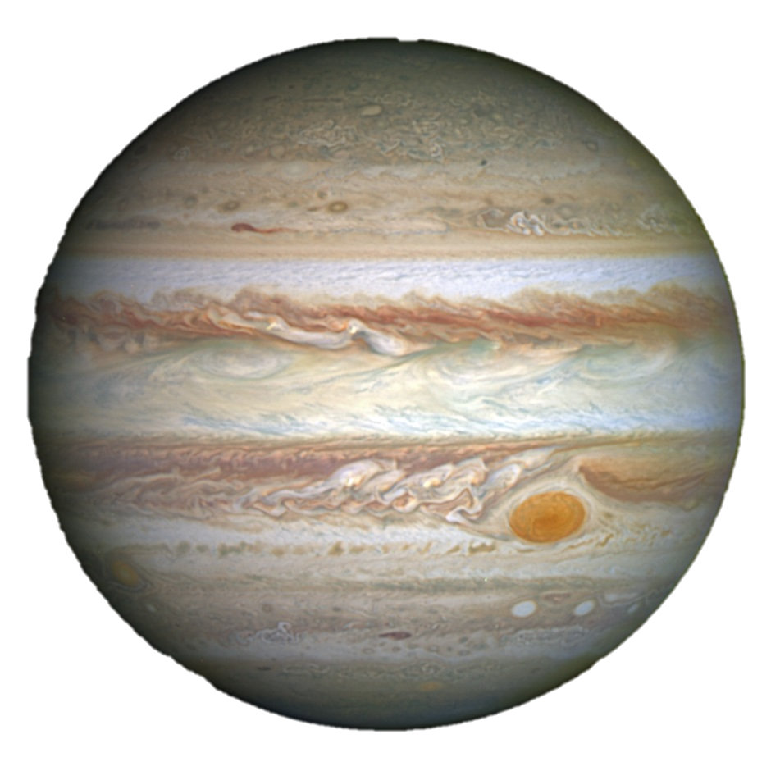



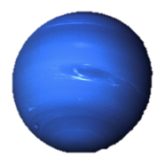

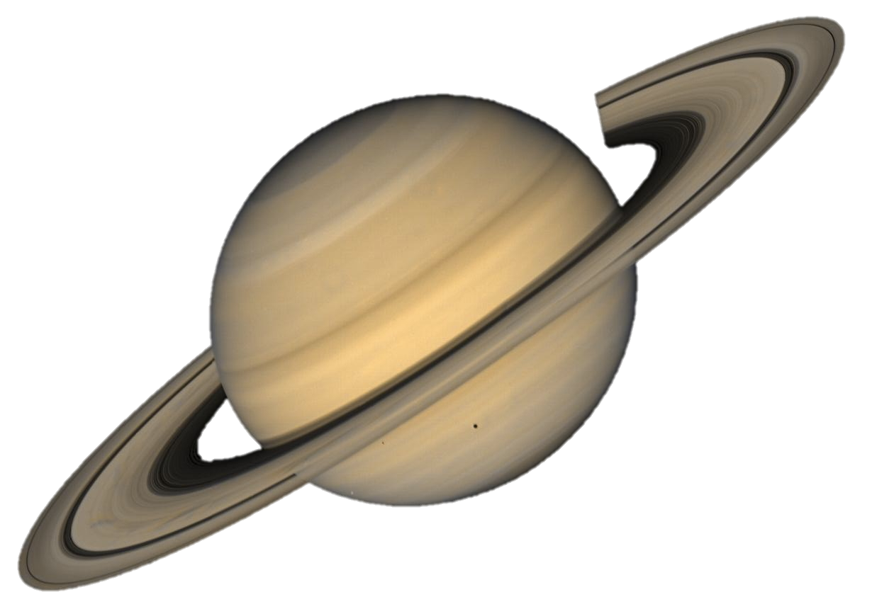
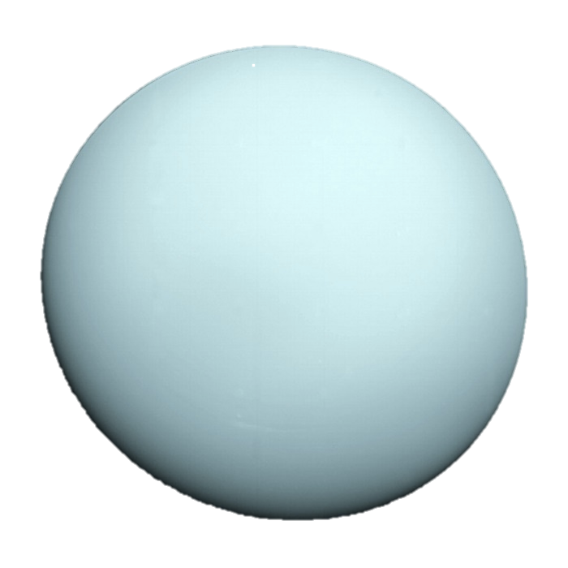
Our Solar System has Two Types of Planets
Not to scale

Slide 21
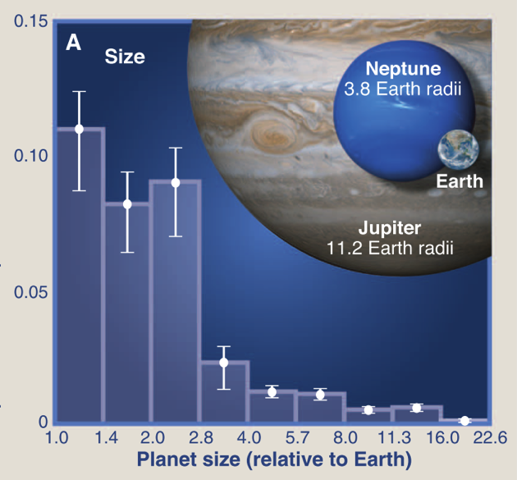
Planets 2-4x Larger than Earth are Common
Number of Planets per Star
Howard 2013, Science, 340, 572

Slide 22
Planets 2-4x Larger than Earth are Common
Number of Planets per Star
?
Howard 2013, Science, 340, 572

Slide 23
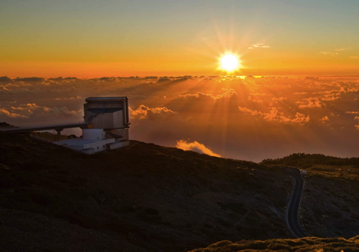
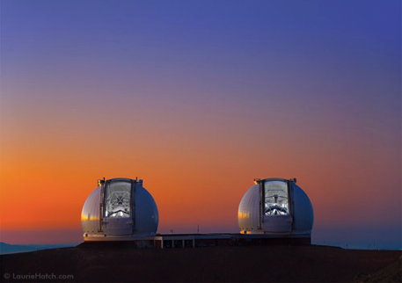
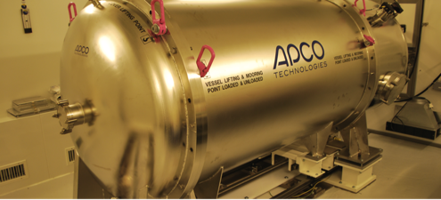
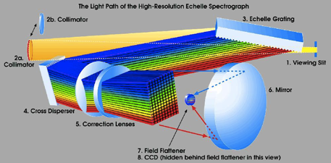
RV Observations of Transiting Planets Constrain the Densities of Small Worlds
HARPS-N at TNG
HIRES at Keck
Notes:
Future: Levy spectrograph at APF?

Slide 24
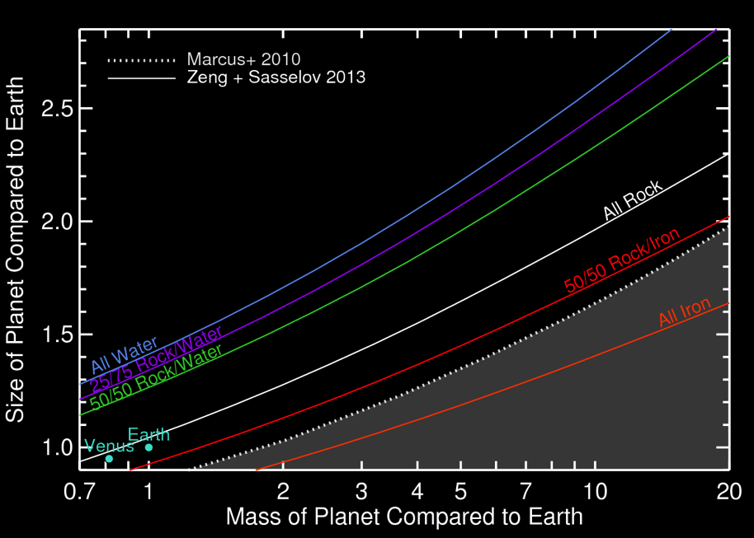
Dressing et al. 2015, ApJ, 800, 135

Slide 25
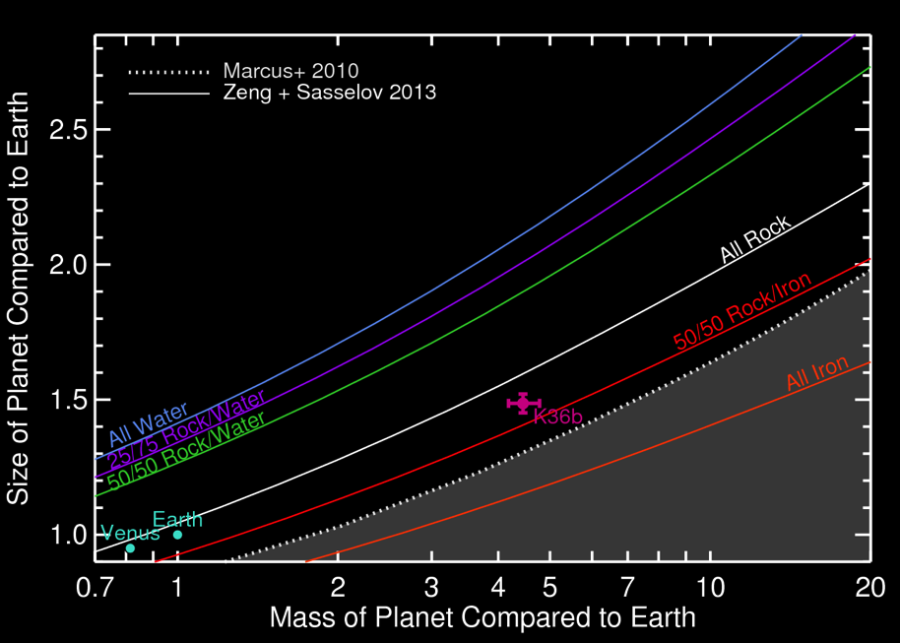
Carter+ 2012
Dressing et al. 2015, ApJ, 800, 135

Slide 26
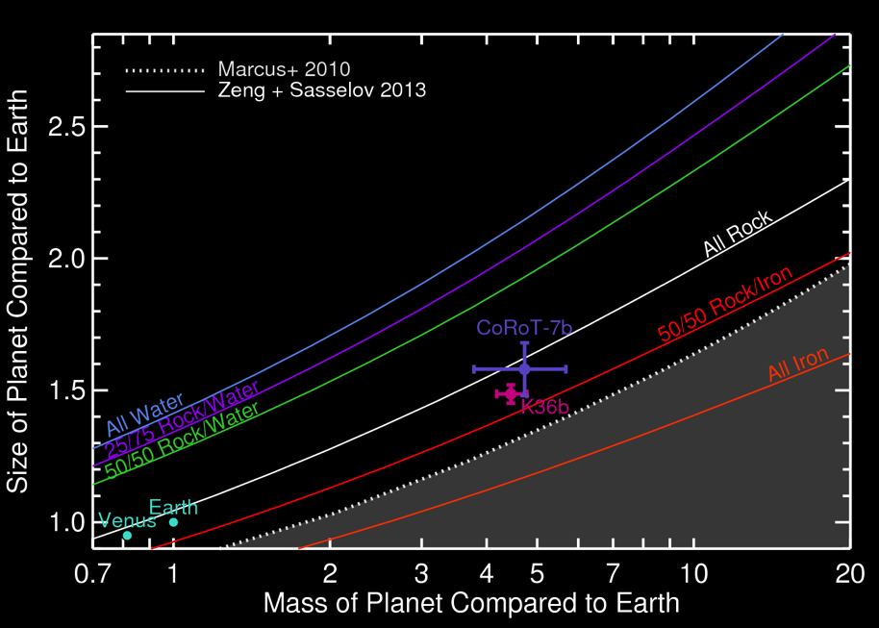
Carter+ 2012, Barros+ 2014, Haywood+ 2014,
Dressing et al. 2015, ApJ, 800, 135

Slide 27
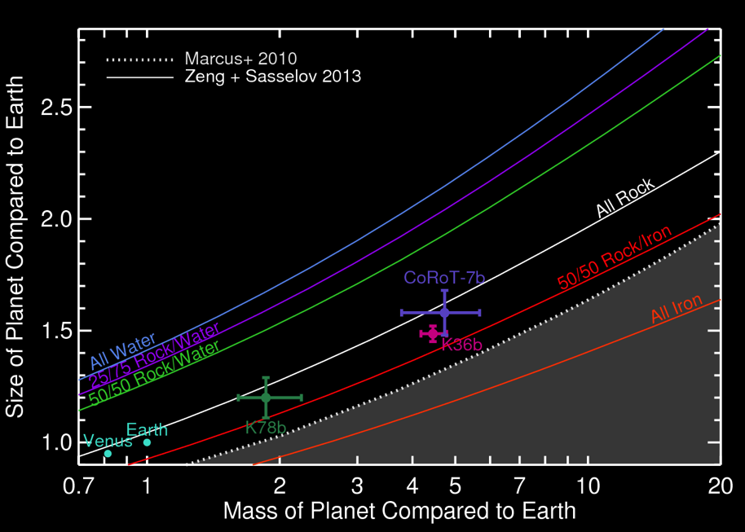
Carter+ 2012, Barros+ 2014, Haywood+ 2014, Pepe+ 2014, Howard+ 2014
Dressing et al. 2015, ApJ, 800, 135

Slide 28
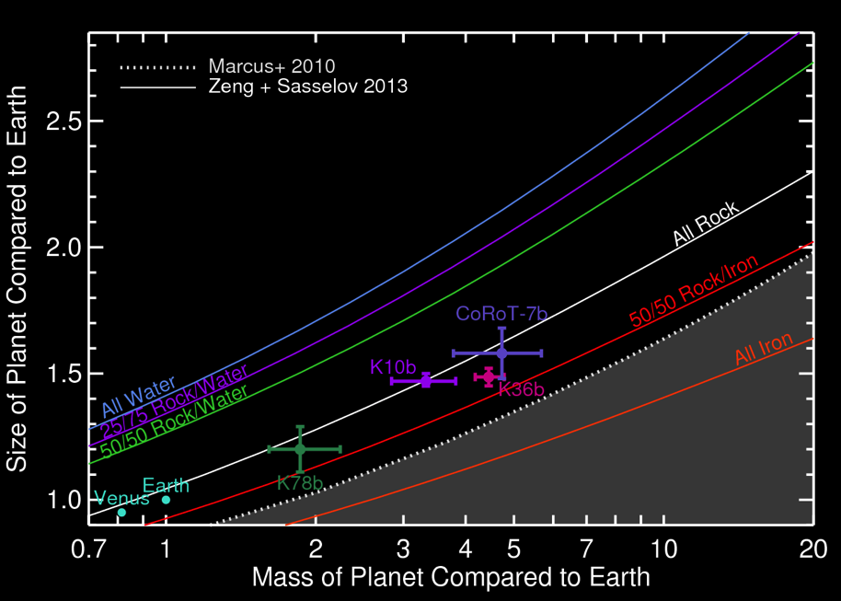
Carter+ 2012, Barros+ 2014, Haywood+ 2014, Pepe+ 2014, Howard+ 2014, Dumusque+ 2014
Dressing et al. 2015, ApJ, 800, 135

Slide 29
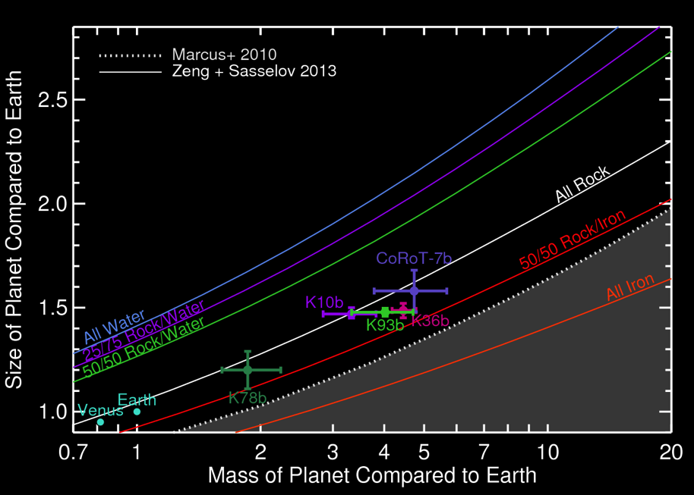
Carter+ 2012, Barros+ 2014, Haywood+ 2014, Pepe+ 2014, Howard+ 2014, Dumusque+ 2014
Dressing et al. 2015, ApJ, 800, 135
Notes:
Mention that small errors on planet properties require small errors on stellar properties.

Slide 30
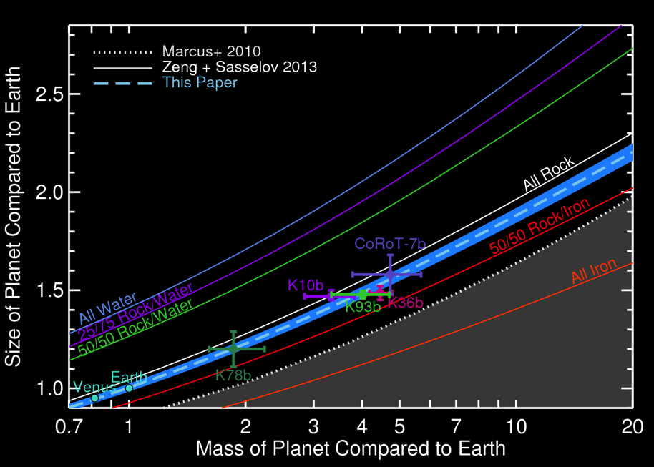
Carter+ 2012, Barros+ 2014, Haywood+ 2014, Pepe+ 2014, Howard+ 2014, Dumusque+ 2014
Dressing et al. 2015, ApJ, 800, 135

Slide 31
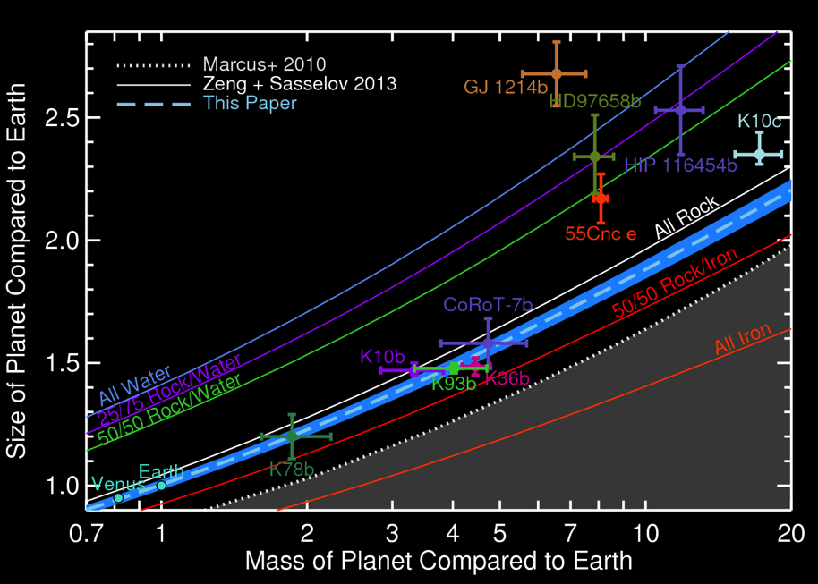
Carter+ 2012, Barros+ 2014, Haywood+ 2014, Pepe+ 2014, Howard+ 2014, Dumusque+ 2014
Charbonneau+ 2009, Dragomir+ 2013, Vanderburg+ 2014, Gillon+ 2012, Nelson+ 2014
Dressing et al. 2015, ApJ, 800, 135

Slide 32
Carter+ 2012, Barros+ 2014, Haywood+ 2014, Pepe+ 2014, Howard+ 2014, Dumusque+ 2014
Charbonneau+ 2009, Dragomir+ 2013, Vanderburg+ 2014, Gillon+ 2012, Nelson+ 2014
HD219134b
Dressing et al. 2015, ApJ, 800, 135

Slide 33
Carter+ 2012, Barros+ 2014, Haywood+ 2014, Pepe+ 2014, Howard+ 2014, Dumusque+ 2014
Charbonneau+ 2009, Dragomir+ 2013, Vanderburg+ 2014, Gillon+ 2012, Nelson+ 2014
HD219134b
Dressing et al. 2015, ApJ, 800, 135

Slide 34
Carter+ 2012, Barros+ 2014, Haywood+ 2014, Pepe+ 2014, Howard+ 2014, Dumusque+ 2014
Charbonneau+ 2009, Dragomir+ 2013, Vanderburg+ 2014, Gillon+ 2012, Nelson+ 2014
K454b
HD219134b
Dressing et al. 2015, ApJ, 800, 135

Slide 35
Carter+ 2012, Barros+ 2014, Haywood+ 2014, Pepe+ 2014, Howard+ 2014, Dumusque+ 2014
Charbonneau+ 2009, Dragomir+ 2013, Vanderburg+ 2014, Gillon+ 2012, Nelson+ 2014
K454b
Caveat: These planets are hot!
HD219134b
For cooler planets, see Weiss et al. 2013;
Weiss & Marcy 2014; Rogers 2015; Wolfgang & Lopez 2015
Dressing et al. 2015, ApJ, 800, 135

Slide 36
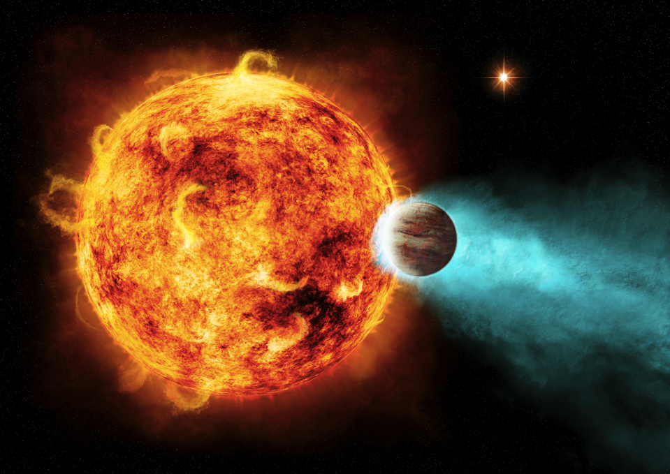

Slide 37
Carter+ 2012, Barros+ 2014, Haywood+ 2014, Pepe+ 2014, Howard+ 2014, Dumusque+ 2014
Charbonneau+ 2009, Dragomir+ 2013, Vanderburg+ 2014, Gillon+ 2012, Nelson+ 2014
Also see:
Weiss + Marcy 2014
Rogers 2015
Wolfgang + Lopez 2015
Chen + Kipping 2016
Dorn+ 2016a, b
K454b
HD219134b
Dressing et al. 2015, ApJ, 800, 135

Slide 38
Are any of these planets habitable?
Rocky Surface
Liquid Water
Look for planets with temperate climates
Is there an upper limit on the size of a rocky planet?
Look for planets smaller than
1.7 Earth Radii
Image credit: NASA/Apollo 17
Notes:
Earth photo: Apollo 17

Slide 39
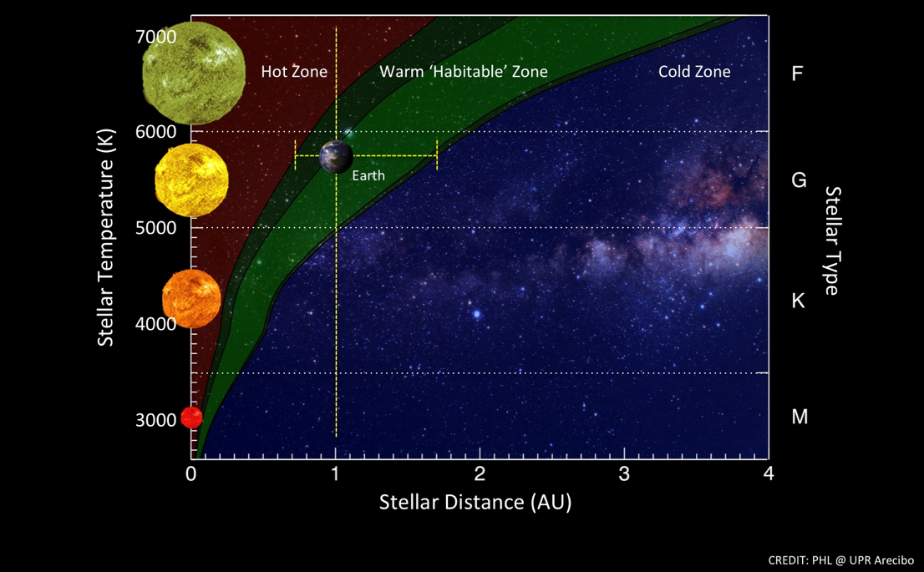
Likely Locations of Habitable Worlds
One orbit = 365 days
80 days
0.24 Earth-size planets
per broad M dwarf HZ
Dressing & Charbonneau 2015, 807, 45
17 days
HZ Figure: PHL @ UPR Arecibo

Slide 40
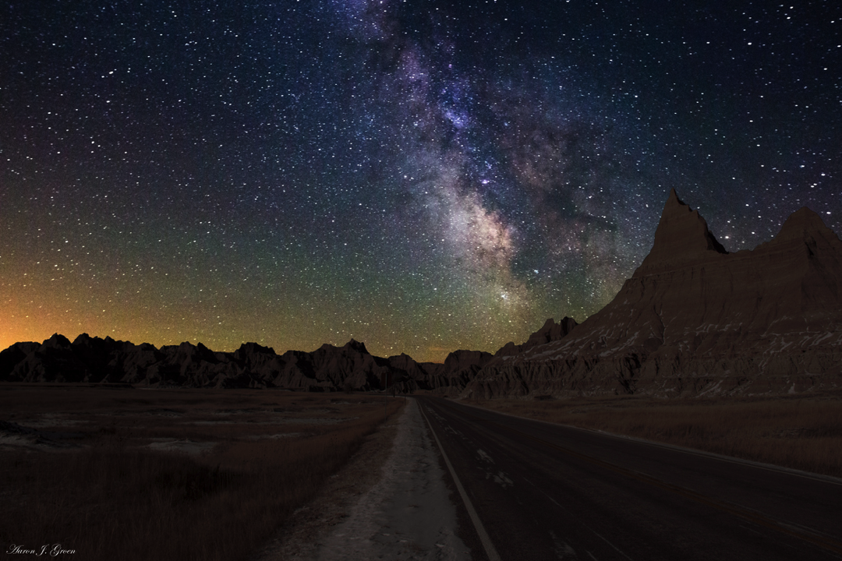
Nearest HZ Earth 2.6 pc
Transiting HZ Earth 11 pc
Notes:
Venus/Mars HZ, Earth-size non-transiting: 2.6 +/- 0.4
Venus/Mars HZ, Earth-size transiting: 10.6 +1.6/-1.8
Venus/Mars HZ, 1-2 Rearth non-transiting: 2.1 +/- 0.2
Venus/Mars HZ, 1-2 Rearth transiting: 8.6 +0.7/-0.8
Within 5 pc: 46 red dwarfs, 10 more massive stars, 14 brown dwarfs, 4 white dwarfs
Proxima: M5.5, 4.2 LY = 1.3 pc
Barnard’s Star: M4.0, 5.96 LY = 1.8 pc
Wolf 359: M6.0, 7.7825 LY = 2.4 pc
Lalande 21185: M2.0, 8.29 LY = 2.5 pc
Luyten 726-8: M5.5/M6 binary, 8.73 LY = 2.7 pc
Ross 154: M3.5, 9.68 LY = 3.0 pc
Ross 248: M5.5, 10.32 LY = 3.2 pc

Slide 41
How did these estimates fare?
Nearest HZ Earth 2.6 pc
Transiting HZ Earth 11 pc
Notes:
Venus/Mars HZ, Earth-size non-transiting: 2.6 +/- 0.4
Venus/Mars HZ, Earth-size transiting: 10.6 +1.6/-1.8
Venus/Mars HZ, 1-2 Rearth non-transiting: 2.1 +/- 0.2
Venus/Mars HZ, 1-2 Rearth transiting: 8.6 +0.7/-0.8
Within 5 pc: 46 red dwarfs, 10 more massive stars, 14 brown dwarfs, 4 white dwarfs
Proxima: M5.5, 4.2 LY = 1.3 pc
Barnard’s Star: M4.0, 5.96 LY = 1.8 pc
Wolf 359: M6.0, 7.7825 LY = 2.4 pc
Lalande 21185: M2.0, 8.29 LY = 2.5 pc
Luyten 726-8: M5.5/M6 binary, 8.73 LY = 2.7 pc
Ross 154: M3.5, 9.68 LY = 3.0 pc
Ross 248: M5.5, 10.32 LY = 3.2 pc

Slide 42
How did these estimates fare?
Nearest HZ Earth 2.6 pc
TRAPPIST-1 System 12 pc
Gillon et al. 2016, Nature
Notes:
Venus/Mars HZ, Earth-size non-transiting: 2.6 +/- 0.4
Venus/Mars HZ, Earth-size transiting: 10.6 +1.6/-1.8
Venus/Mars HZ, 1-2 Rearth non-transiting: 2.1 +/- 0.2
Venus/Mars HZ, 1-2 Rearth transiting: 8.6 +0.7/-0.8
Within 5 pc: 46 red dwarfs, 10 more massive stars, 14 brown dwarfs, 4 white dwarfs
Proxima: M5.5, 4.2 LY = 1.3 pc
Barnard’s Star: M4.0, 5.96 LY = 1.8 pc
Wolf 359: M6.0, 7.7825 LY = 2.4 pc
Lalande 21185: M2.0, 8.29 LY = 2.5 pc
Luyten 726-8: M5.5/M6 binary, 8.73 LY = 2.7 pc
Ross 154: M3.5, 9.68 LY = 3.0 pc
Ross 248: M5.5, 10.32 LY = 3.2 pc

Slide 43
How did these estimates fare?
Proxima Centauri b 1.3 pc
TRAPPIST-1 System 12 pc
Gillon et al. 2016, Nature
Anglada-Escudé et al. 2016, Nature
Notes:
Venus/Mars HZ, Earth-size non-transiting: 2.6 +/- 0.4
Venus/Mars HZ, Earth-size transiting: 10.6 +1.6/-1.8
Venus/Mars HZ, 1-2 Rearth non-transiting: 2.1 +/- 0.2
Venus/Mars HZ, 1-2 Rearth transiting: 8.6 +0.7/-0.8
Within 5 pc: 46 red dwarfs, 10 more massive stars, 14 brown dwarfs, 4 white dwarfs
Proxima: M5.5, 4.2 LY = 1.3 pc
Barnard’s Star: M4.0, 5.96 LY = 1.8 pc
Wolf 359: M6.0, 7.7825 LY = 2.4 pc
Lalande 21185: M2.0, 8.29 LY = 2.5 pc
Luyten 726-8: M5.5/M6 binary, 8.73 LY = 2.7 pc
Ross 154: M3.5, 9.68 LY = 3.0 pc
Ross 248: M5.5, 10.32 LY = 3.2 pc

Slide 44
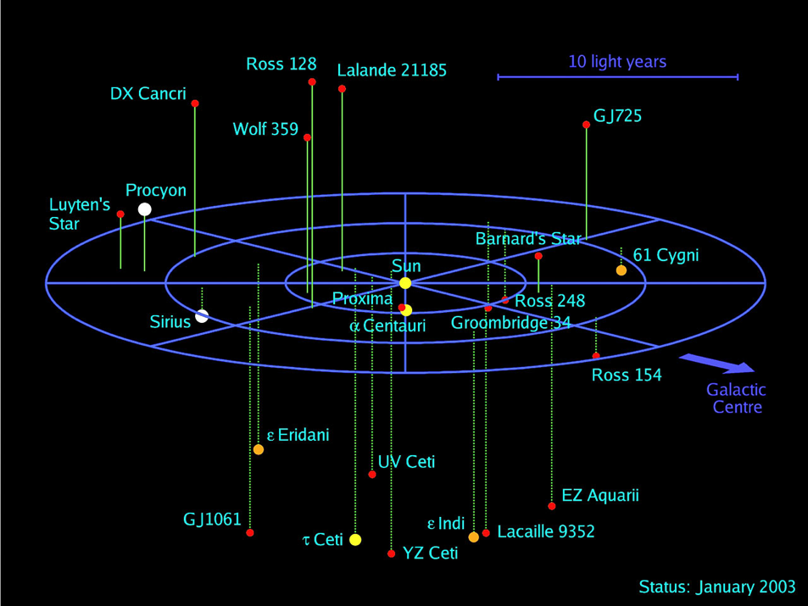
Do our other neighbors host potentially habitable planets?
Credit: ESO

Slide 45
The Kepler Mission: 2009 - 2013
Credit: NASA/Kepler mission

Slide 46
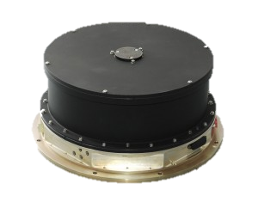
The Kepler Mission: 2009 - 2013
Credit: NASA/Kepler mission

Slide 47
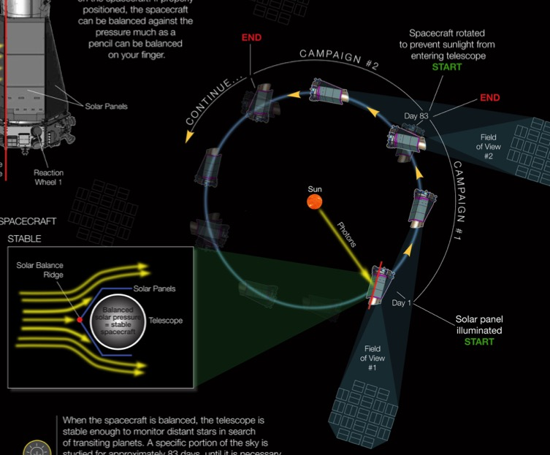
Each K2 Campaign Lasts Roughly 80 Days
http://www.nasa.gov/kepler/keplers-second-light-how-k2-will-work

Slide 48
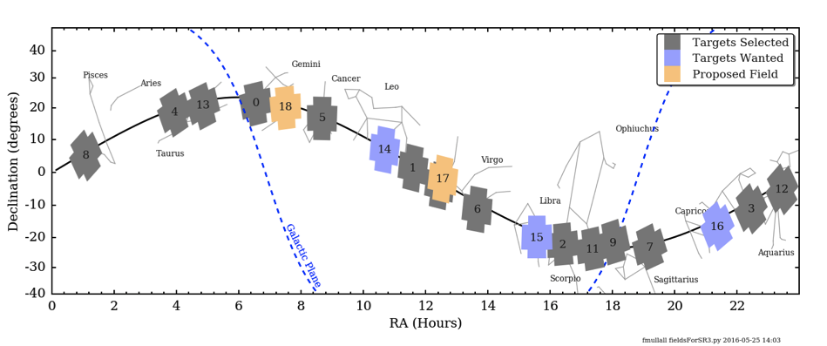
Where is K2 Looking?
Image Credit: F. Mullally

Slide 49
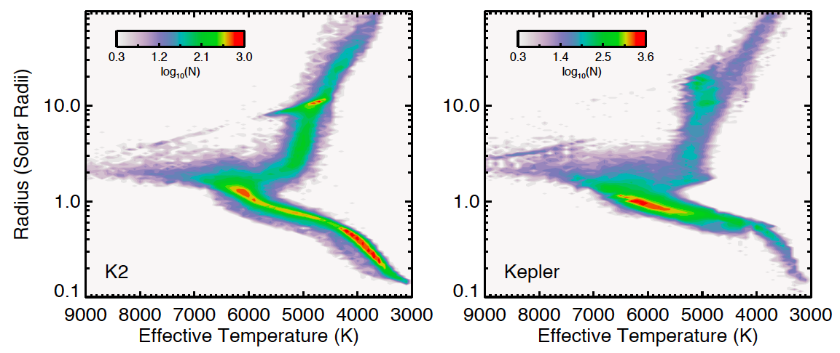

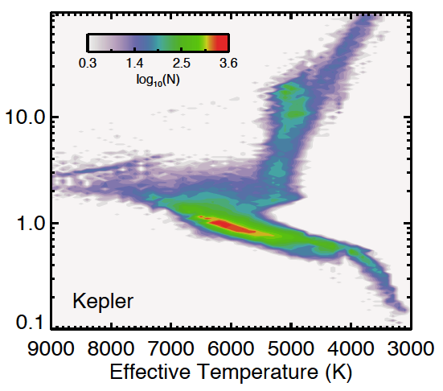
K2 is Observing Many Small Stars
K2
Kepler
41%
of selected K2 targets are K and M dwarfs
Huber et al. 2016, ApJS, 224, 2

Slide 50
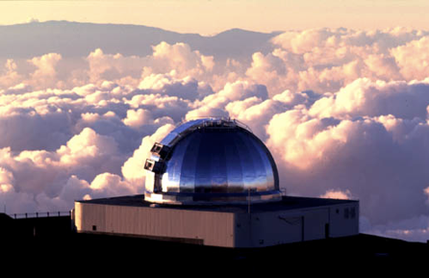
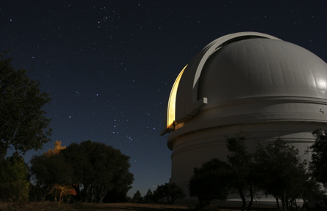
Near-Infrared Spectroscopy
Enables Host Star Characterization
IRTF/SpeX |  | Palomar 200”/TripleSpec
21 (mostly partial) | Nights Observed | 7 (5 clear, 2 bad weather)
1 partial | Upcoming Nights | 2 full
0.7 – 2.55 microns (SXD mode) | Wavelength Coverage | 1.0 – 2.4 microns
2000 (SXD mode with 0.3x15” slit) | Spectral Resolution | 2500 – 2700 (1x30” slit)
3.0 meters | Telescope Aperture | 200” = 5.1 meters

Slide 51
We Concentrate on Bright Targets
Median
KepMag = 13.5
Median
Kmag = 10.9
Dressing et al. 2016a, accepted to ApJ

Slide 52
Only 51% of our targets are actually Low-mass Dwarfs

Slide 53
The Cool Dwarf Sample Extends from K3 – M4
How big are these stars?
Dressing et al. 2016a, accepted to ApJ

Slide 54
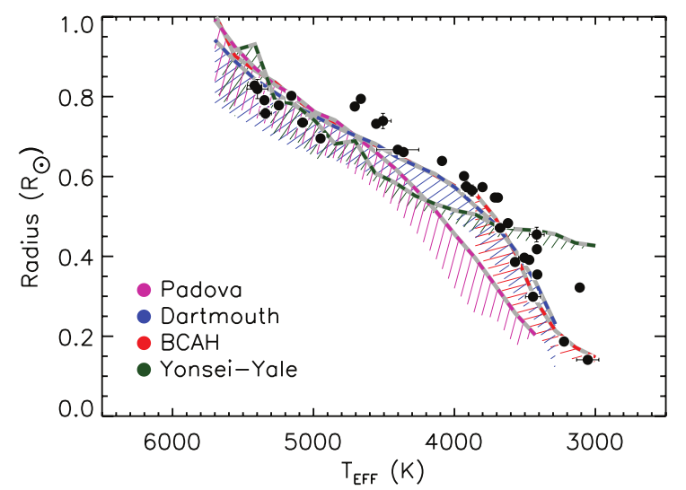
Stellar Models Underestimate the Radii of Low-Mass Stars
Boyajian et al. 2012, ApJ, 757, 112

Slide 55
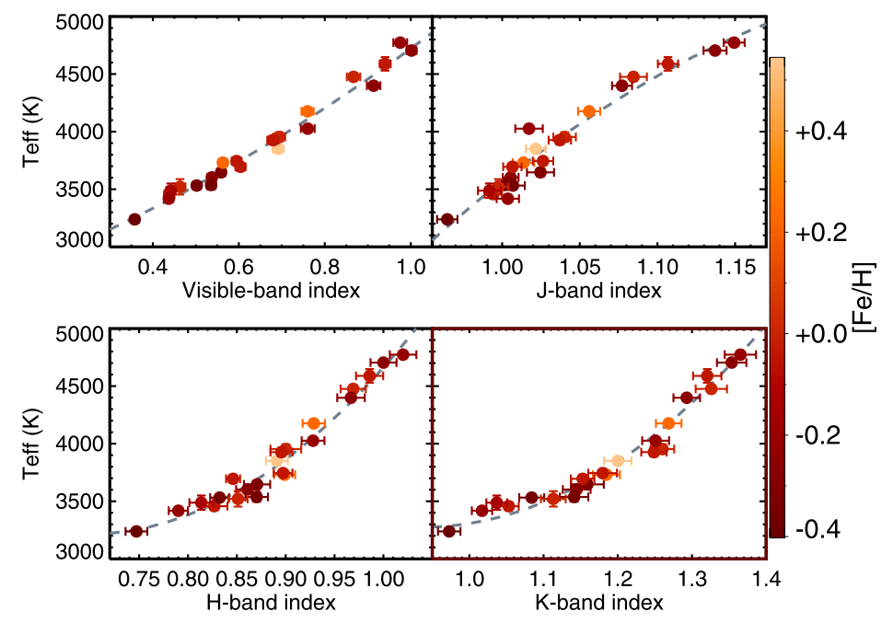
Estimate Stellar Effective Temperatures using Features in J, H, & K Bands
Mann et al. 2013, ApJ, 779, 118

Slide 56
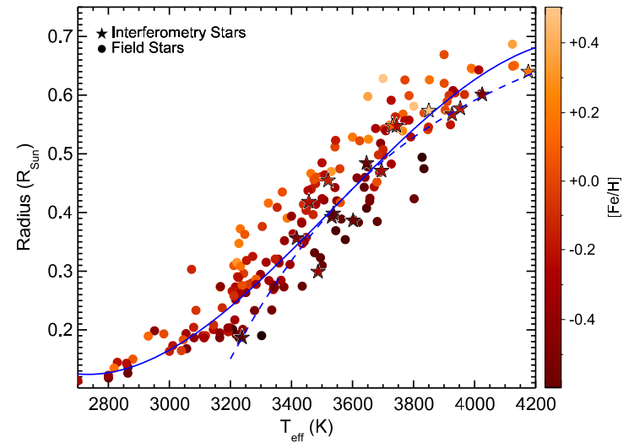
Estimate Stellar Radii from
Effective Temperatures & Metallicities
[Fe/H]
Radius (Solar Radii)
Stellar Effective Temperature (K)
Mann et al. 2015, ApJ, 804, 64
Notes:
Solid Line: Mann et al. 2015
Dashed Line: Mann et al. 2013

Slide 57
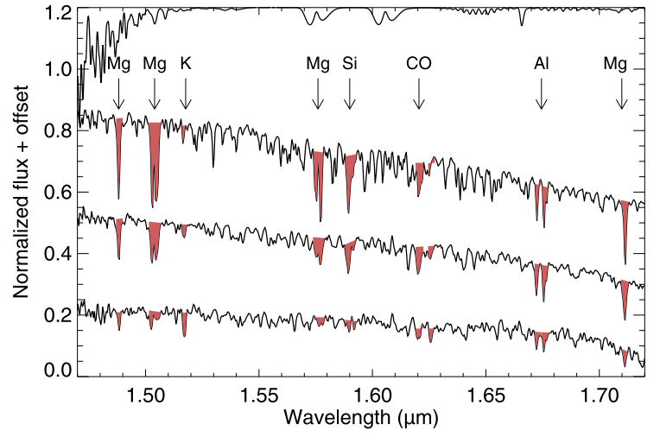
Alternate Approach: Directly Estimate Temperatures, Luminosities, and Radii Using H-Band Features
Newton et al. 2015, ApJ, 800, 85

Slide 58
Our Typical Cool Dwarfs are Roughly 0.6 R_{Sun}
Median : 0.56 R_{Sun}
Median : 3884K
Dressing et al. 2016a, accepted to ApJ

Slide 59
Most stars are larger than previously estimated (ΔR* = +0.13R_{Sun} = 34%)
Dressing et al. 2016a, accepted to ApJ
Notes:
Quoted increases don’t include the 4 stars previously classified as giants.

Slide 60
Most stars are larger than previously estimated (ΔR* = +0.13R_{Sun} = 39%)
Dressing et al. 2016a, accepted to ApJ
Notes:
Quoted increases don’t include the 4 stars previously classified as giants.

Slide 61
We Use the Revised Stellar Radii to Update the Radii of the Associated Planet Candidates
Dressing et al. 2016b (in prep)
Published planets from Adams+ 2016, AJ accepted, arXiv:1603.06488;
Barros+ 2016, A&A accepted, arXiv:1607.02339, Crossfield+ 2016, ApJ accepted, arXiv:1607.05263;
Montet+ 2015, 809, 25; Pope+ 2016, MNRAS accepted, arXiv:1606.01264; Vanderburg+ 2016, ApJS, 222, 14

Slide 62
Most of our Planets are Small
Dressing et al. 2016b (in prep)

Slide 63
Our K2 Planet Sample Is Similar to the Kepler Planet Sample…
Kepler Candidates & Planets: NASA Exoplanet Archive
Dressing et al. 2016b (in prep)

Slide 64
…but the K2 planets generally orbit brighter stars
Kepler Candidates & Planets: NASA Exoplanet Archive
Dressing et al. 2016b (in prep)

Slide 65
Our Smaller Planets Tend to Orbit Cooler Stars (consistent with expected detection bias)
Dressing et al. 2016b (in prep)
Notes:
Excludes False Positives

Slide 66
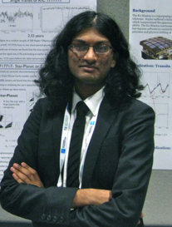
Spectra are Expensive!
How can we classify the full K2 M dwarf sample?
Trained random forest using spectroscopically-classified stars
Reported probabilities that individual targets are M dwarfs
Girish Duvvuri
Senior at Wesleyan
Caltech SURF 2016
Notes:
The “not low-mass dwarf” sample likely contains some M dwarfs.
Correcting for that factor, the breakdown is 96000 (58%) non-low-mass dwarfs and 70119 (42%) low-mass dwarfs.
166119 stars total

Slide 67
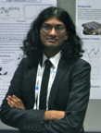
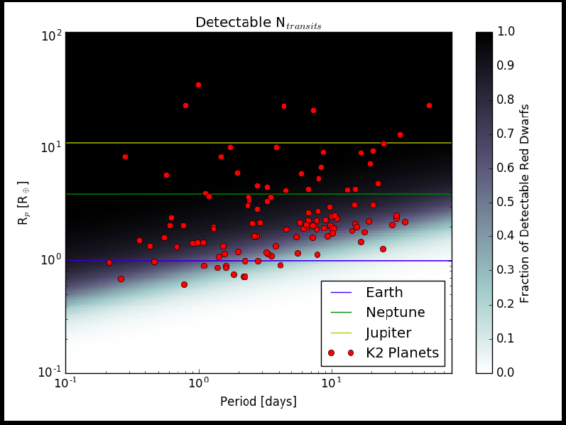



Girish Estimated K2’s Sensitivity to Planetary Systems Orbiting M Dwarfs
G. Duvvuri
100
10
Planet Radius (Earth Radii)
Detectable Fraction of Transiting Planets
1
0.1
0.1
1
10
Orbital Period (Days)

Slide 68
Typical K2 M dwarfs host 1.2 small planets with periods < 50 days
G. Duvvuri
Size Range: | Period < 10 Days | Period 10 – 50 Days
Smaller than Earth | 0.21 | 0.07
Earth – Neptune | 0.35 | 0.45
Neptune - Jupiter | 0.07 | 0.07
Notes:
Roughly 2/3 of the “Earth-Neptune” category are Super-Earths
Kepler M dwarfs host roughly 2 with P < 50 days. Low completeness in K2 sample?

Slide 69

Looking toward the future:
A Pathway for the Discovery & Characterization of Potentially Habitable Worlds

Slide 70

Pathway to Earth 2.0
Constrain planet frequencies
Figure out which sizes of planets are rocky
Find cool potentially habitable planets
Measure masses to identify rocky worlds
Determine atmospheric compositions
Search for biosignatures
Perform detailed characterization
✔
✔
for hot planets
(Work in progress for cool planets)
Up
Next!

Slide 71
Pathway to Earth 2.0
Constrain planet frequencies
Figure out which sizes of planets are rocky
Find cool potentially habitable planets
Measure masses to identify rocky worlds
Determine atmospheric compositions
Search for biosignatures
Perform detailed characterization
✔
✔
for hot planets
(Work in progress for cool planets)

Slide 72
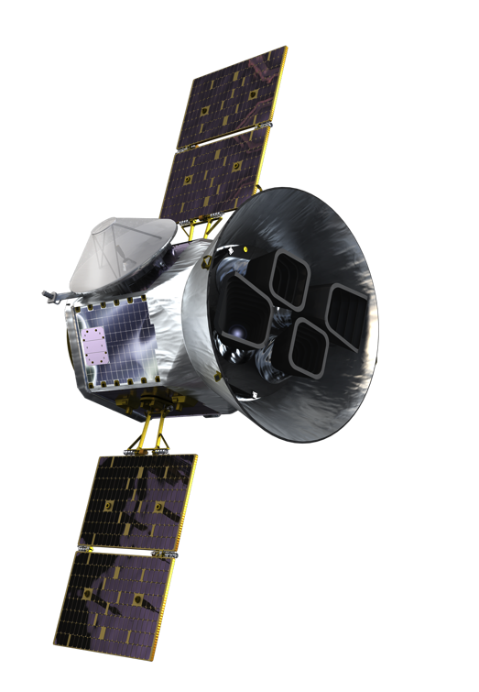

TESS
TESS Slides from Zach Berta-Thompson
Explorer
Mission
launch in 2017,
to find hundreds of
nearby small exoplanets amenable to detailed characterization
Ricker et al., JATIS, (2014)
Notes:
TESS is a NASA Explorer mission launching in 2017 to find hundreds of nearby small transiting planets.

Slide 73
TESS
TESS Slides from Zach Berta-Thompson
George Ricker (P.I.)
Roland Vanderspek (Deputy P. I.)
Massachusetts Institute of Technology
science center shared between
MIT + Harvard/Smithsonian CfA
collaboration including:
NASA Goddard, NASA Ames, MIT Lincoln Lab, Orbital Sciences, STScI, SAO, MPIA-Germany, Las Cumbres Observatory, Geneva Observatory, OHP-France, University of Florida, Aarhus University-Denmark, Harvard College Observatory, Vanderbilt University
Ricker et al., JATIS, (2014)
Notes:
TESS is a NASA Explorer mission launching in 2017 to find hundreds of nearby small transiting planets.

Slide 74

TESS Slide from Zach Berta-Thompson
TESS Slides from Zach Berta-Thompson
Where do we point JWST?
Notes:
So, we’re in this unusual situation: we’re soon going to have a 6.5m telescope in space than can study the atmospheres of small planets transiting nearby small stars, but besides a few targets, we don’t know where to point it.

Slide 75

TESS Slide from Zach Berta-Thompson
TESS Slides from Zach Berta-Thompson
Where do we point JWST?
TESS
is our
finder
scope!
Notes:
To solve this problem, TESS will be our finder scope.

Slide 76

TESS Slide from Zach Berta-Thompson
Lens Hood
Lens Assembly
Detector Assembly
10.5 cm diameter,
24°x24° field of view
Ricker et al. (2014), Sullivan et al. (2015)
Notes:
These CCDs sit behind small 10cm refractive telescopes. There is no denying each of these has 100X less collecting area than Kepler. However, each of these cameras has a very wide 24x24 degree field of view.

Slide 77
TESS Slides from Zach Berta-Thompson
simulated images by Zach Berta-Thompson
1°
Notes:
The ground-based wide-field survey folks kind of know what this means, but for the rest of you, let me show you. This is what 1x1 degree patch of TESS data will look like.

Slide 78

TESS Slides from Zach Berta-Thompson
one CCD:
12°
simulated images by Zach Berta-Thompson
Notes:
It’s just a tiny fraction of the area spanned by a single CCD.

Slide 79

FOV from one TESS camera:
TESS Slides from
Zach Berta-Thompson
24°
simulated images by Zach Berta-Thompson
Notes:
And there are four CCDs per TESS camera. So for a sense of scale…

Slide 80
FOV from one TESS camera:
TESS Slides from
Zach Berta-Thompson
24°
constellations by H. A. Rey
Slide by Zach Berta-Thompson
Notes:
…the constellation Orion fits entirely within one TESS camera field of view.

Slide 81

TESS Slides from Zach Berta-Thompson
4 cameras
Ricker et al. (2014), Sullivan et al. (2015)
Notes:
TESS has four cameras, which ride on a space craft just a little bit bigger than I am.

Slide 82

TESS Slides from Zach Berta-Thompson
TESS Slides from Zach Berta-Thompson
Ricker et al. (2014), Sullivan et al. (2015)
Notes:
The cameras are arranged into a contiguous 24x96 degree rectangle. With this giant field of view, we can map most of a hemisphere with month-long stares at 13 observational sectors.

Slide 83

TESS Slides from Zach Berta-Thompson
ecliptic pole
Ricker et al. (2014), Sullivan et al. (2015)
Notes:
We plan to do so for both hemispheres over the course of the two year main mission, covering 90% of the sky. These fields overlap at the ecliptic poles, which are in the JWST continuous viewing zone. This maximizes sensitivity to longer period planets, including M dwarf habitable zone planets, in exactly the position on the sky where we’ll want them most.

Slide 84
Play TESS Movie
Notes:
So, to conclude, I want to return to the animation I showed at the start of my talk, but now include our expectation for the planets we’ll find with TESS, based on what we know about their statistics from Kepler. As I zoom out, you see the huge cloud of TESS planets appearing.
We expect to find 1200 planets within 100pc;
450 of those between 1 and 2 Earth radii
700 between 2 and 4 Earth radii.

Slide 85

Pathway to Earth 2.0
Constrain planet frequencies
Figure out which sizes of planets are rocky
Find cool potentially habitable planets
Measure masses to identify rocky worlds
Determine atmospheric compositions
Search for biosignatures
Perform detailed characterization
✔
✔
for hot planets
(Work in progress for cool planets)

Slide 86
Pathway to Earth 2.0
Constrain planet frequencies
Figure out which sizes of planets are rocky
Find cool potentially habitable planets
Measure masses to identify rocky worlds
Determine atmospheric compositions
Search for biosignatures
Perform detailed characterization
✔
✔
for hot planets
(Work in progress for cool planets)

Slide 87

Pathway to Earth 2.0
Constrain planet frequencies
Figure out which sizes of planets are rocky
Find cool potentially habitable planets
Measure masses to identify rocky worlds
Determine atmospheric compositions
Search for biosignatures
Perform detailed characterization
✔
✔
for hot planets
(Work in progress for cool planets)

Slide 88
Pathway to Earth 2.0
Constrain planet frequencies
Figure out which sizes of planets are rocky
Find cool potentially habitable planets
Measure masses to identify rocky worlds
Determine atmospheric compositions
Search for biosignatures
Perform detailed characterization
✔
✔
for hot planets
(Work in progress for cool planets)

Slide 89
Pathway to Earth 2.0
Constrain planet frequencies
Figure out which sizes of planets are rocky
Find cool potentially habitable planets
Measure masses to identify rocky worlds
Determine atmospheric compositions
Search for biosignatures
Perform detailed characterization
✔
✔
for hot planets
(Work in progress for cool planets)

Slide 90
Pathway to Earth 2.0
Constrain planet frequencies
Figure out which sizes of planets are rocky
Find cool potentially habitable planets
Measure masses to identify rocky worlds
Determine atmospheric compositions
Search for biosignatures
Perform detailed characterization
✔
✔
for hot planets
(Work in progress for cool planets)

Slide 91

Transits, Eclipses, and Phase Curves of Exoplanets Reveal Atmospheric Properties
Cowan et al. 2015, PASP, 127, 311
Notes:
point out that we’ll need imaging for non-transiting planets.

Slide 92


LUVOIR will Assess Planetary Habitability
LUVOIR
16 meters
Hubble mirror
2.4 meters
This is one possible architecture for LUVOIR

Slide 93



Pathway to Earth 2.0
Constrain planet frequencies
Figure out which sizes of planets are rocky
Find cool potentially habitable planets
Measure masses to identify rocky worlds
Determine atmospheric compositions
Search for biosignatures
Perform detailed characterization
✔
✔
for hot planets
(Work in progress for cool planets)

Slide 94
Big Picture Summary
How common are
planets orbiting low-mass stars
?
1
How diverse are the compositions of small planets
?
2
How can we identify potentially habitable planets
?
3
Notes:
Image 1: ESO/M. Kornmesser
Image 2: image from UCL webpage at https://www.ucl.ac.uk/cps/researchthemes

Slide 95
Big Picture Summary
2.5 small planets per M dwarf
0.25 Earth-like planets per M dwarf
1
How diverse are the compositions of small planets
?
2
How can we identify potentially habitable planets
?
3
Notes:
Image 1: ESO/M. Kornmesser
Image 2: image from UCL webpage at https://www.ucl.ac.uk/cps/researchthemes

Slide 96
Big Picture Summary
2.5 small planets per M dwarf
0.25 Earth-like planets per M dwarf
1
Highly-irradiated small planets have Earth-like compositions
Larger planets require volatiles
2
How can we identify potentially habitable planets
?
3
Notes:
Image 1: ESO/M. Kornmesser
Image 2: image from UCL webpage at https://www.ucl.ac.uk/cps/researchthemes

Slide 97
Big Picture Summary
2.5 small planets per M dwarf
0.25 Earth-like planets per M dwarf
1
Highly-irradiated small planets have Earth-like compositions
Larger planets require volatiles
2
Planet detection with K2 + TESS
Follow-up with JWST + ELTs
Biosignatures with LUVOIR?
3
Notes:
Image 1: ESO/M. Kornmesser
Image 2: image from UCL webpage at https://www.ucl.ac.uk/cps/researchthemes

Slide 98




K2 Highlights
We’ve acquired NIR spectroscopy of 144 possible low-mass stars hosting K2 planet candidates
51% of our targets are actually low-mass dwarfs
Classified stars using empirical relations based on interferometry (Newton+ 2015, Mann+ 2013)
Our revised stellar radii are 6-39% larger
63 planets are smaller than Neptune
3 planets are in or near the habitable zone
Red dwarfs have lots of small planets!
K2 planets are great for follow-up studies!
Notes:
Image 1: ESO/M. Kornmesser
Image 2: image from UCL webpage at https://www.ucl.ac.uk/cps/researchthemes

Slide 99
Acknowledgements
HARPS-N Consortium: Francesco Pepe, Andrew Collier Cameron, Stephane Udry, David Latham, Emilio Molinari, David Charbonneau, Lars Buchhave, Xavier Dumusque, Sara Gettel, Raphelle Haywood, John Asher Johnson, Mercedes Lopez-Morales, David Phillips, Andrew Vanderburg, Laura Affer, Aldo Bonomo, Rosario Consentino, Pedro Figueira, Aldo Fieorenzano, Avet Harutyunyan, Eric Lopez, Christophe Lovis, Luca Malavolta, Michel Mayor, Giusi Micela, Annelies Mortier, Fatemeh Motalebi, Valerio Nascimbeni, Giampaolo, Piotto, Don Pollacco, Didier Queloz, Ken Rice, Dimitar Sasselov, Damien Segransan, Alessandro Sozzetti, Andrew Szentgyorgyi, Chris Watson
K2 California Consortium (K2C2): Kimberly Aller, Christoph Baranec, Chas Beichman, Bjoern Benneke, Jessie Christiansen, David Ciardi, Justin Crepp, Ian Crossfield, Trevor David, BJ Fulton, Brad Hansen, Thomas Henning, Lynne Hillenbrand, Andrew Howard, Howard Isaacson, Heather Knutson, Sebastian Lepine, Michael Liu, John Livingston, Arturo Martinez, Erik Petigura, Evan Sinukoff, Josh Schlieder, Michael Werner
TESS Minjas: Phil Muirhead, Andrew Mann, Barbara Rojas Ayala
Current funding provided by the NASA Sagan Fellowship Program
Ground-based telescope time from Caltech TAC & IRTF TAC. K2 funding & targets from NASA.

Slide 100
Big Picture Summary
2.5 small planets per M dwarf
0.25 Earth-like planets per M dwarf
1
Highly-irradiated small planets have Earth-like compositions
Larger planets require volatiles
2
Planet detection with K2 + TESS
Follow-up with JWST + ELTs
Biosignatures with LUVOIR?
3
Notes:
Image 1: ESO/M. Kornmesser
Image 2: image from UCL webpage at https://www.ucl.ac.uk/cps/researchthemes

Slide 101
K2 Highlights
We’ve acquired NIR spectroscopy of 144 possible low-mass stars hosting K2 planet candidates
53% of our targets are actually low-mass dwarfs
Classified stars using empirical relations based on interferometry (Newton+ 2015, Mann+ 2013)
Our revised stellar radii are 6-39% larger
63 planets are smaller than Neptune
3 planets are in or near the habitable zone
Red dwarfs have lots of small planets!
K2 planets are great for follow-up studies!
Notes:
Image 1: ESO/M. Kornmesser
Image 2: image from UCL webpage at https://www.ucl.ac.uk/cps/researchthemes

Slide 102
Additional Slides

Slide 103

Most TESS Planets will be Inside the IWA
Simulated Planets with R_{p} < 2 R_{Earth}
Figure 2.1.1 from the Habitability Science Case
Simulated Planets from Sullivan et al. (2015)
Notes:
Optimistic estimate that IWA = 2 lamda/D.
Planets from Sullivan et al. 2015.

Slide 104

Some M Dwarf HZs will be Accessible
Simulated Planets with R_{p} < 2 R_{Earth}
Figure 2.1.2 from the Habitability Science Case
Stars from Dittmann et al. (2015)
Notes:
Assumed IWA = 2 lamda/D
Assumes all nearby M dwarfs have planets at inner edge of HZ

Slide 105

Exoplanet science goals in Roadmap
Study the atmospheres of a broad range of exoplanets
Search for signs of habitable environments
LUVOIR
Surveyor
Notes:
Figure modified from the 2013 NASA Astrophysics Roadmap.
Another important science focus for LUVOIR is solar system science (not captured in the 2013 Astrophysics Roadmap, of course).

Slide 106





How do we detect life on an exoplanet?
Turnbull et al. (2006)
Notes:
So how would we find life on a terrestrial planet in the habitable zone of a nearby star? We will look for “disequilibrium chemistry” in its atmosphere, meaning the presence of gasses that shouldn’t exist together for any appreciable length of time. They would have to be replenished by some active process, possibly life.
This “Earthshine” spectrum shows what I mean. It is light reflected from the Earth, then reflected from the un-illuminated part of the Moon, and then back to a small telescope on the Earth. The light is then separated out by wavelength or color. This is a high-quality version of what we might someday get for an Earth-like planet around a nearby star. CLICK
What we see is mostly the Earth’s atmosphere. The rise in brightness on the far left at short wavelengths is literally our blue sky. This narrow dip is caused by absorption of sunlight by O_2, which comes from plant photosynthesis. CLICK
Here are strong features of water vapor, which we astronomers take as the likely signpost of a “habitable” planet with liquid water on its surface. CLICK
And here is part of a methane feature, which comes from bacteria living in the digestive tracts of our livestock and in swamps. So as you can, see the Earth’s atmosphere is full of biosignatures. CLICK

Slide 107

Observations with Large Space Telescopes Could Generate Coarse Surface Maps
Cowan et al. 2009, ApJ, 700, 915
Notes:
EPOXI data. 2 principle eigencolors (cloud-free oceans & continents). Based on two 1-day observations of the full disk of Earth.

Slide 108
The M Dwarf Advantage
Detectability of Earth-like planet | Sun | Kepler M dwarf | Typical M dwarf
Orbital Period (days) | 365 | 80 | 17
Transit Probability (%) | 0.46 | 0.89 | 1.41
Transit Depth (ppm) | 84 | 250 | 1890
Doppler Wobble (cm/s) | 9 | 21 | 85

Slide 109

Spectroscopic investigations could expose potentially habitable worlds

