Slide 1




On the Hunt for Counterparts to Gravitational-Wave Events
Peter Shawhan
U. of Maryland / Joint Space-Science Institute
LUVOIR Seminar
December 7, 2016
LIGO-G1602298-v1
GOES-8 image produced by M. Jentoft-Nilsen, F. Hasler, D. Chesters (NASA/Goddard) and T. Nielsen (Univ. of Hawaii)
LIGO-G1600320-v10

Slide 2
NEWS FLASH:
We detected gravitational waves

Slide 3















































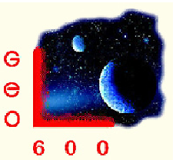




















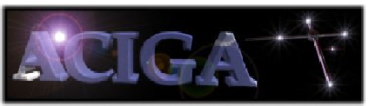







We = the LIGO Scientific Collaboration
together with the Virgo Collaboration

Slide 4
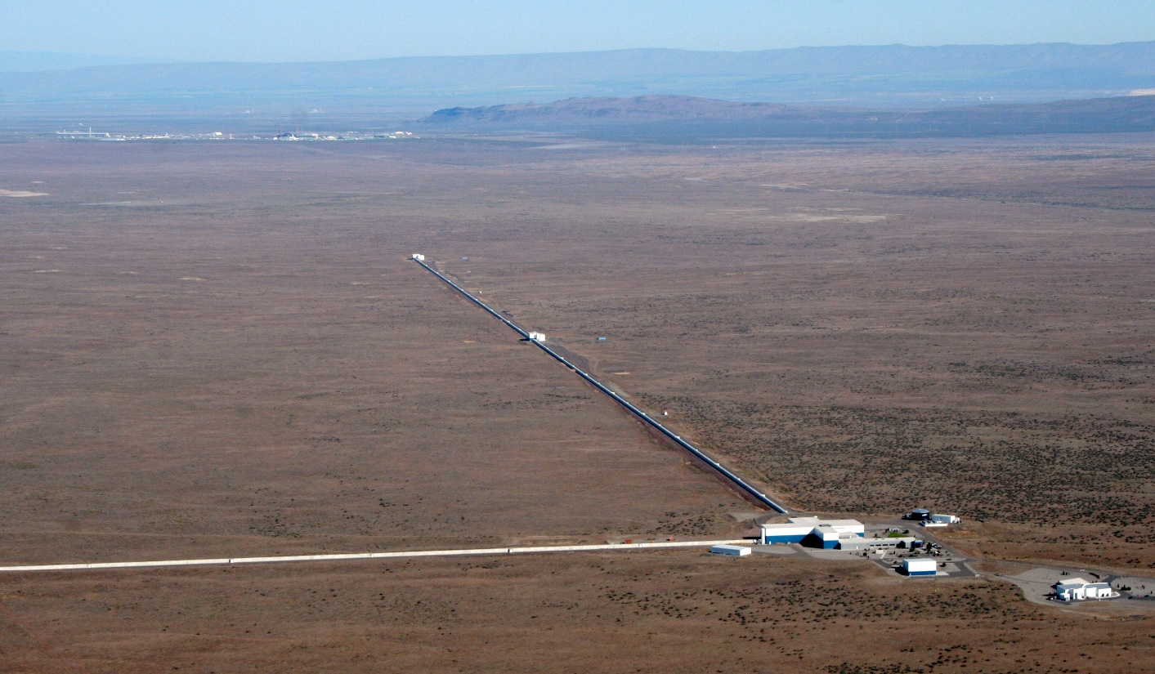
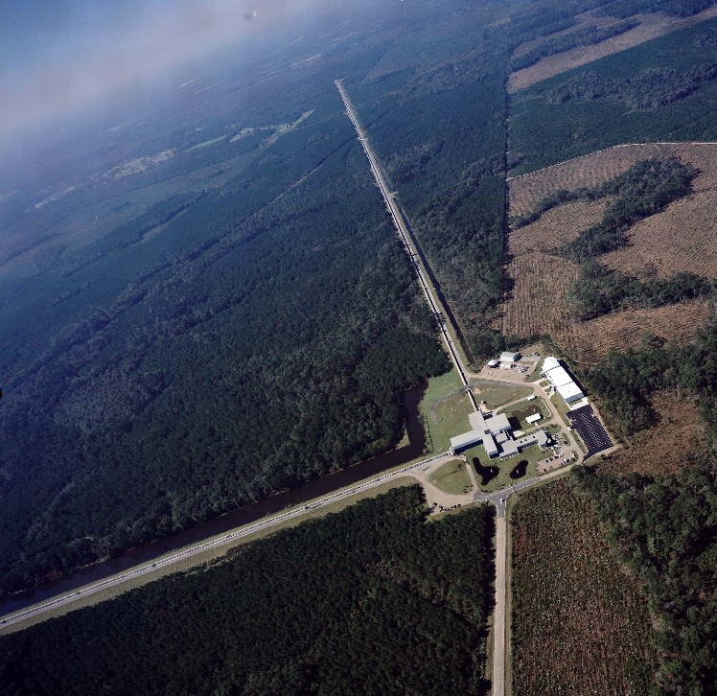
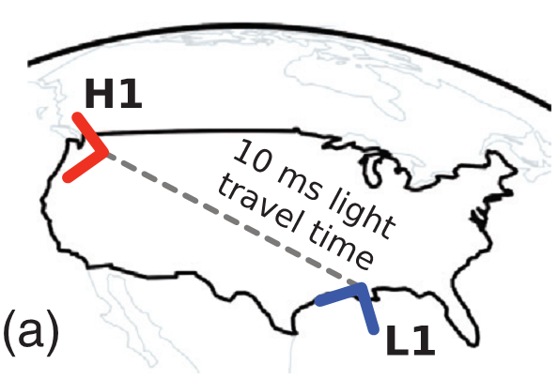
… using the LIGO* Observatories
* LIGO = Laser Interferometer Gravitational-wave Observatory
LIGO Hanford
LIGO Livingston

Slide 5


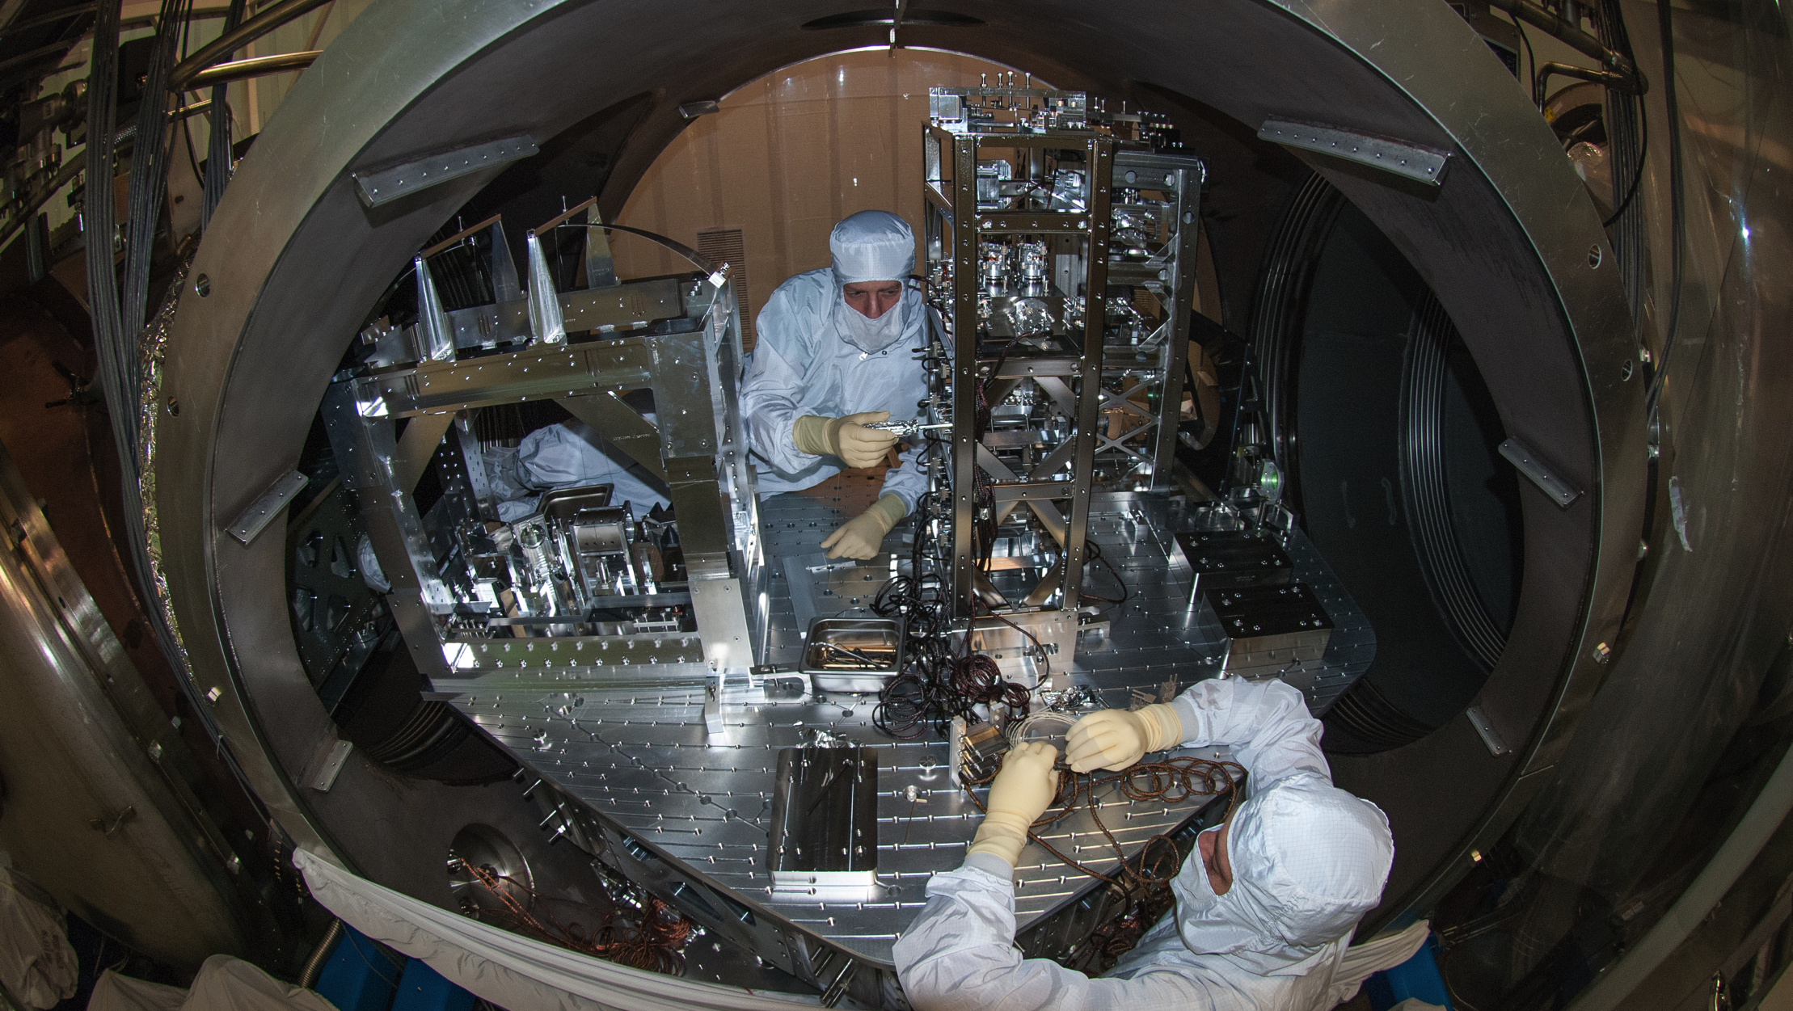
… after the Advanced LIGO Upgrade
Comprehensive upgrade of
Initial LIGO instrumentation in same vacuum system
  Higher-power laser
  Larger mirrors
  Higher finesse arm cavities
  Stable recycling cavities
  Signal recycling mirror
  Output mode cleaner
  and more …
First observing run (O1) began in September 2015
Improvements

Slide 6
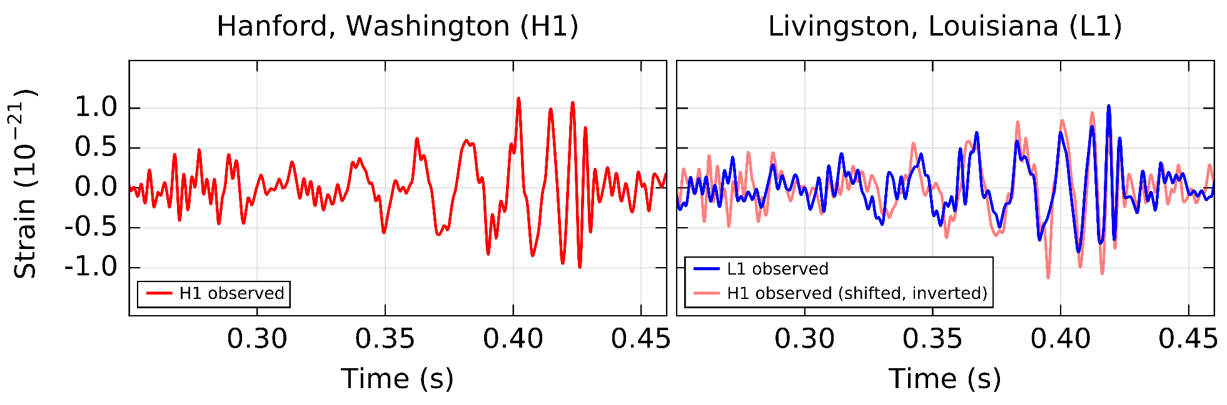
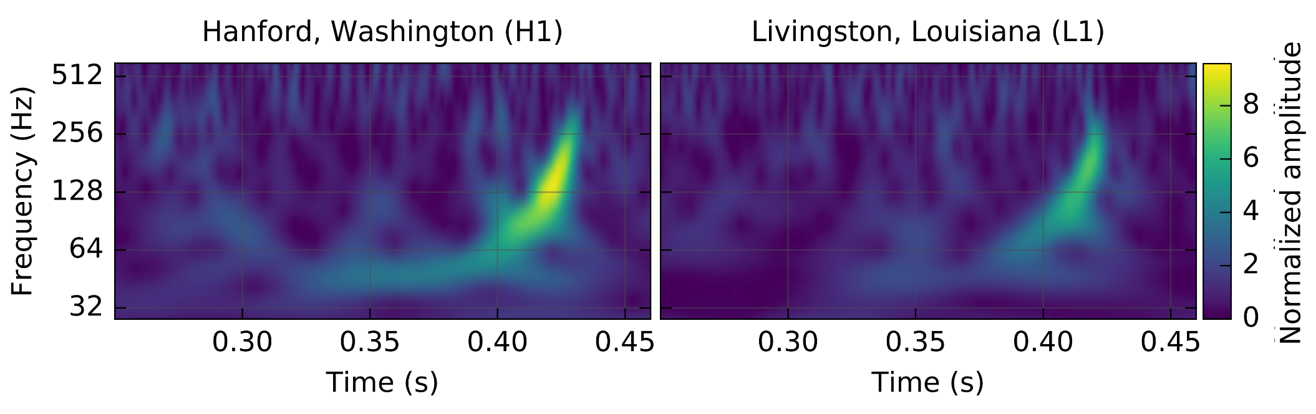
GW150914
Arrived a couple of days before the official start of the
first Advanced LIGO observing run (O1) !
Signal arrived 7 ms earlier at L1
Bandpass filtered

Slide 7
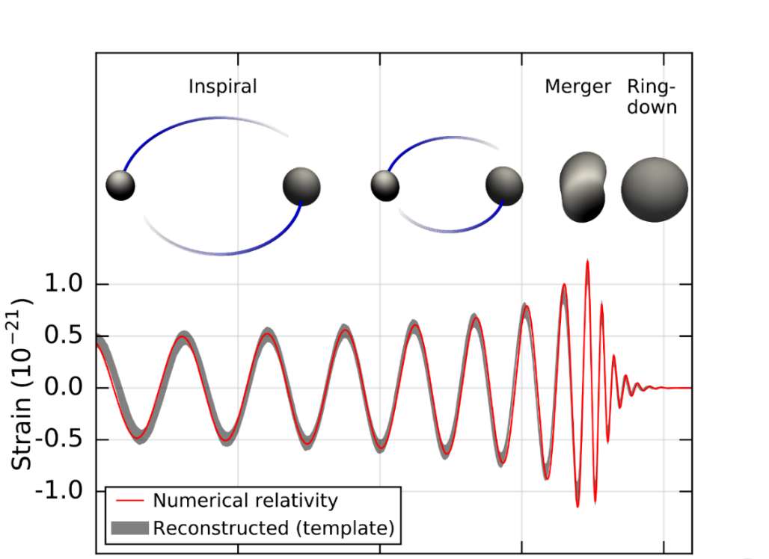
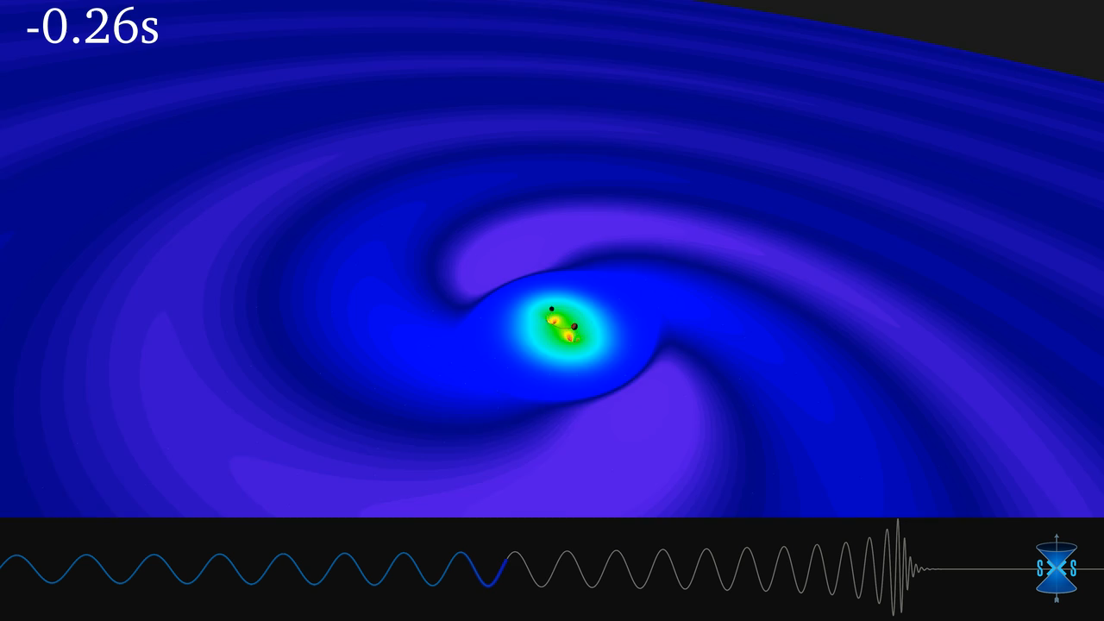
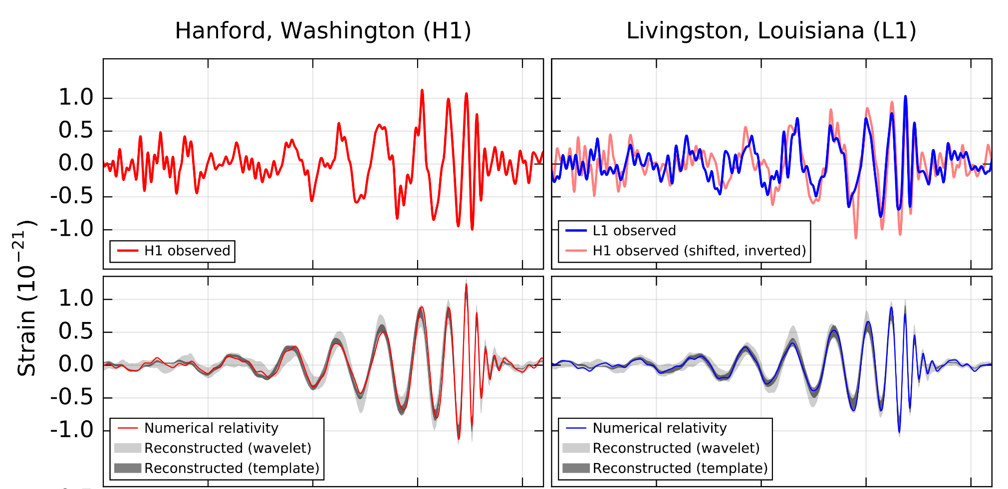
Looks just like a binary black hole merger!
Bandpass filtered
Matches well to BBH template when filtered the same way

Slide 8
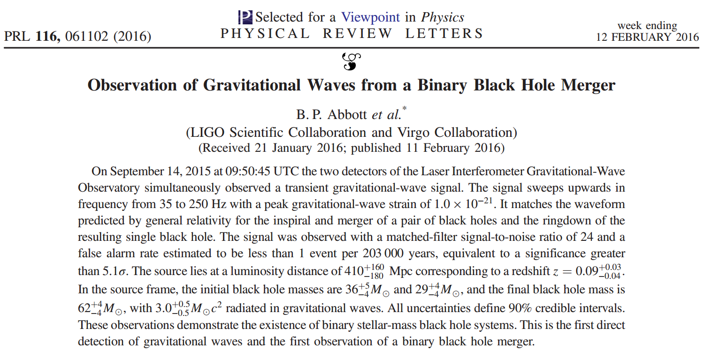
Announcing the Detection

Slide 9
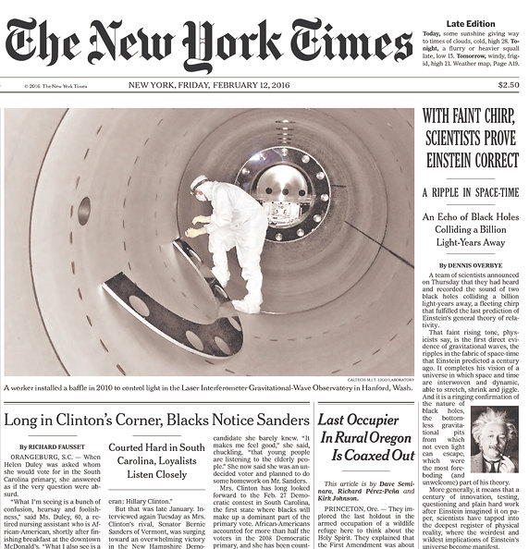

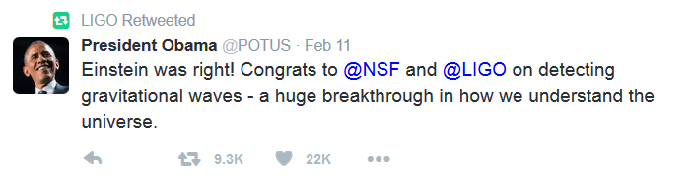
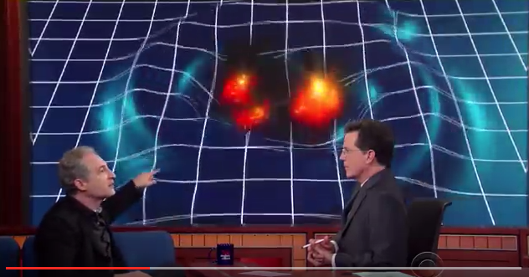
A Big Splash in February
with both the scientific community and the general public!
Press conference
PRL web site
Twitter
Facebook
Newspapers & magazines
YouTube videos
The Late Show, SNL, …

Slide 10
A long-awaited confirmation

Slide 11
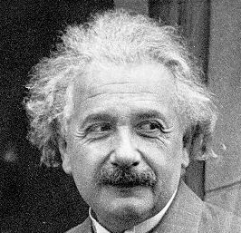
Gravitational Waves
Predicted to exist by Einstein’s general theory of relativity
… which says that gravity is really an effect of “curvature” in the geometry of space-time, caused by the presence of any object with mass
Encoded in the Einstein field equations
Solutions describe the regular (static) gravitational field,
but also wave solutions which travel at the speed of light
These waves are perturbations of the spacetime metric —
the effective distance between points in space and time
The geometry of space-time is dynamic, not fixed!
It alternately s t r e t c h e s and shrinks with a characteristic strain
g_{μν}

Slide 12
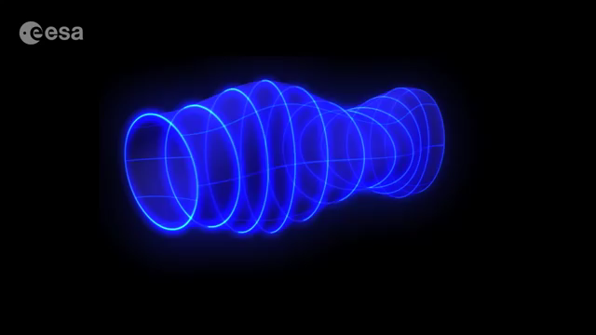
Gravitational Waves in Motion

Slide 13



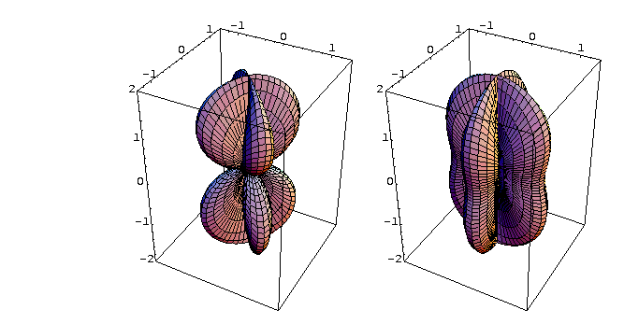
Gravitational Wave Polarizations
…
“Plus” polarization
“Cross” polarization
Circular polarization
Directional sensitivity of detector depends on polarization of waves
A broad antenna pattern
⇒ More like a radio receiver than a telescope
Notes:
Emitted by time-changing quadrupole (or higher multipole)

Slide 14
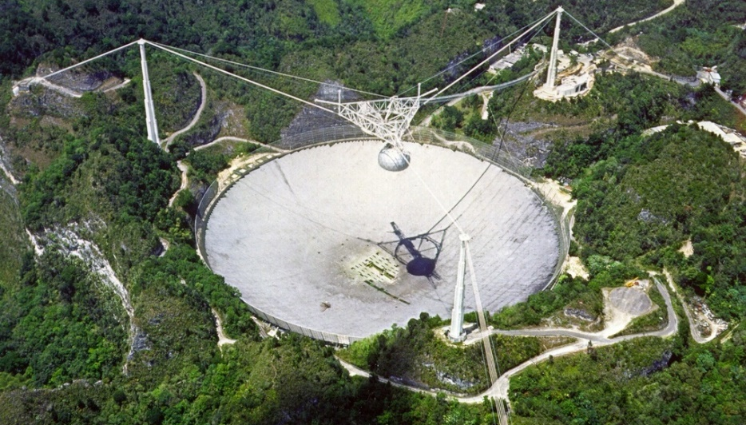
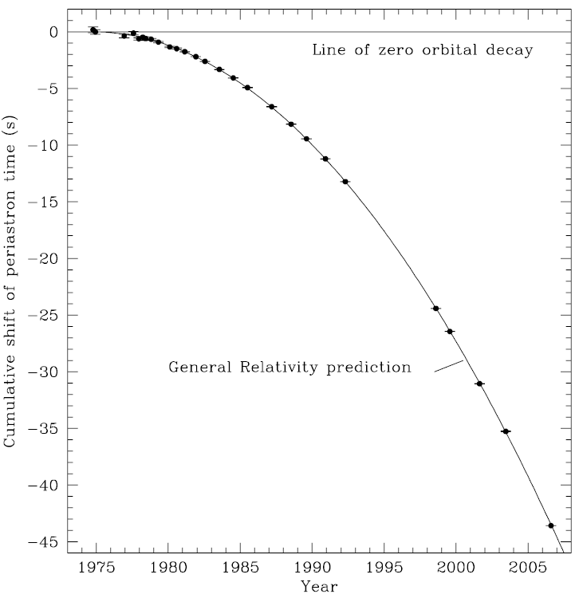
Earlier Evidence for Gravitational Radiation
Very
gradual
decay
Arecibo radio telescope observations of the binary pulsar B1913+16 give us the masses (1.44 and 1.39 M) and orbital parameters
This binary neutron star system is changing, just as general relativity predicts!
Very strong indirect evidence for gravitational radiation
of orbit
Weisberg, Nice & Taylor,
Astrophysical Journal 722, 1030 (2010)
Notes:
A few other binary pulsars too

Slide 15
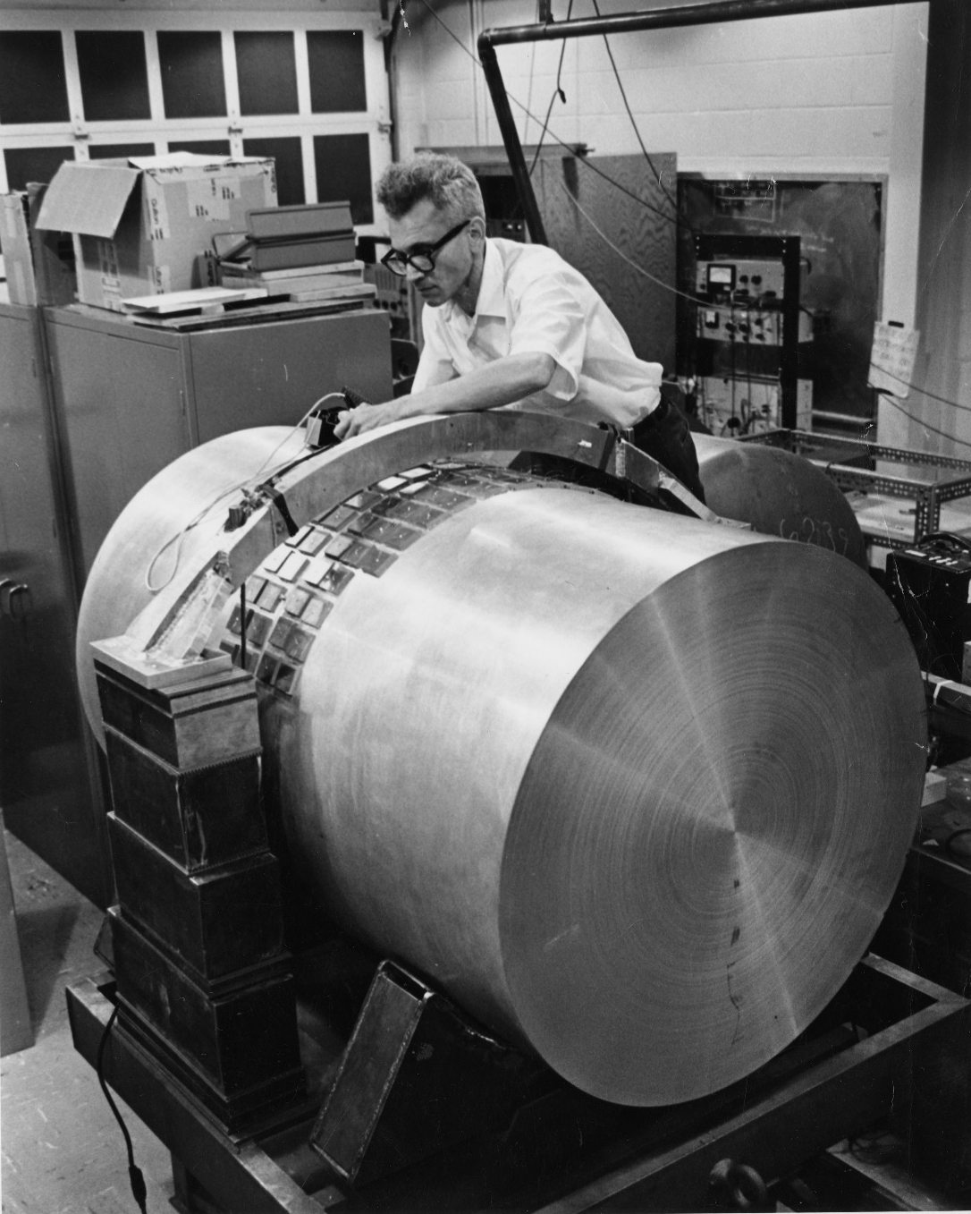
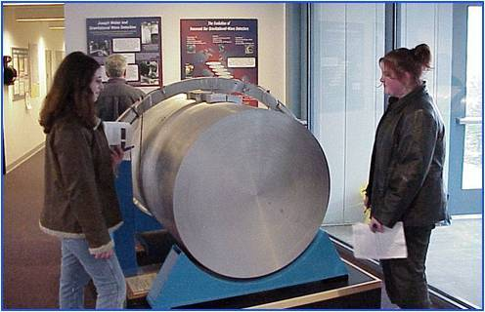
Joe Weber’s Fearless Idea!
LIGO and other gravitational wave detectors have built on Weber’s pioneering efforts using
resonant “bar” detectors,
first constructed on the
UMD campus in the 1960s
Special Collections and University Archives, University of Maryland Libraries
Weber bar on permanent display at LIGO Hanford Observatory

Slide 16
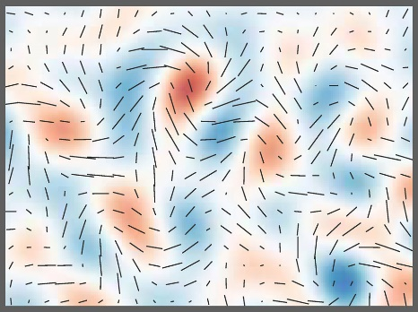
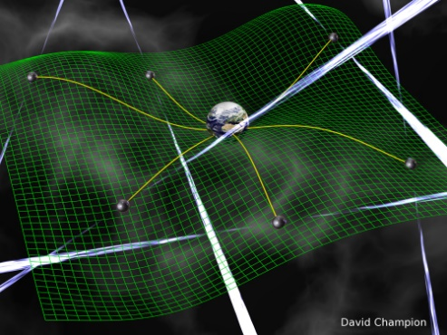
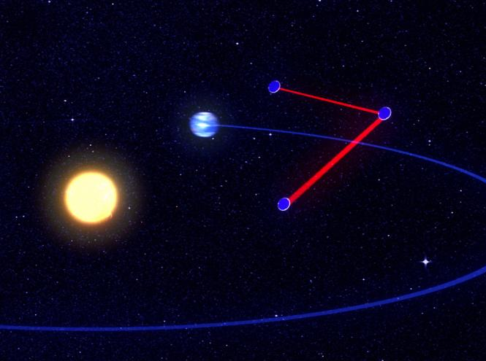

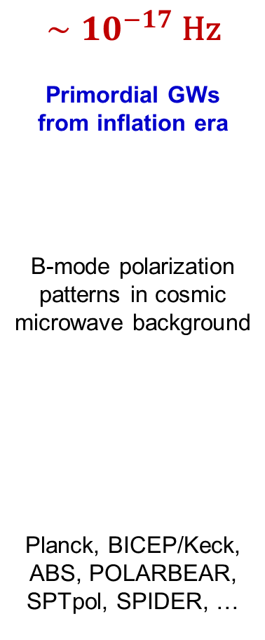


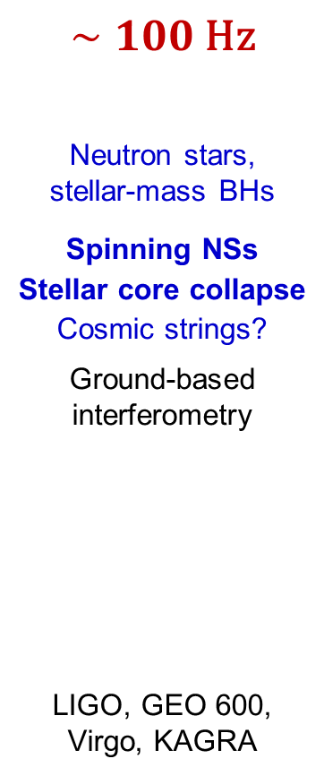
The Wide Spectrum of Gravitational Waves
$$∼{10}^{−17} \text{Hz}$$
Primordial GWs
from inflation era
B-mode polarization patterns in cosmic microwave background
Planck, BICEP/Keck,
ABS, POLARBEAR,
SPTpol, SPIDER, …
$$∼{10}^{−8} \text{Hz}$$
Supermassive BHs
Cosmic strings?
Pulsar Timing Array (PTA) campaigns
NANOGrav, European PTA, Parkes PTA
$$∼{10}^{−2} \text{Hz}$$
Massive BHs, extreme mass ratios
Ultra-compact Galactic binaries
Interferometry between spacecraft
eLISA, DECIGO
$$∼100 \text{Hz}$$
Neutron stars,
stellar-mass BHs
Spinning NSs
Stellar core collapse
Cosmic strings?
Ground-based interferometry
LIGO, GEO 600, Virgo, KAGRA
Gravitational radiation driven Binary Inspiral + Merger
Likely sources
Detection method
BICEP2
David Champion
AEI/MM/exozet
LIGO Laboratory
Projects

Slide 17
But what exactly did we detect?
And what is significant about it?

Slide 18
Exploring the Properties of GW150914
Bayesian parameter estimation: Adjust physical parameters of waveform model to see what fits the data from both detectors well
➔ Get ranges of likely (“credible”) parameter values
Illustration by N. Cornish and T. Littenberg

Slide 19
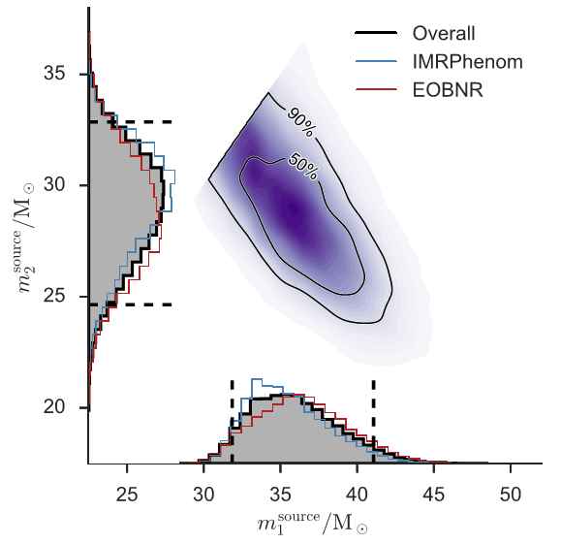


Properties of GW150914
Use waveform models which include black hole spin,
but no orbital precession
Final BH mass: $62±4 M_{⨀}$
Energy radiated: $3.0±0.5 M_{⨀}c^{2}$
Peak power $∼200 M_{⨀}c^{2}/\text{s}$ !
Luminosity distance
(from absolute amplitude of signal):
$41{0 }_{−180}^{+160} \text{Mpc}$
(~1.3 billion light-years!)
➔ Redshift $z≈0.09$
Frequency shift of signal is taken
into account when inferring masses
Masses:
${36 }_{−4}^{+5} M_{⨀}$ and ${29 }_{−4}^{+4} M_{⨀}$
Abbott et al., PRL 116, 241102
Reanalysis with fully precessing waveform model (PRX 6, 041014) is consistent, with slightly smaller errors

Slide 20
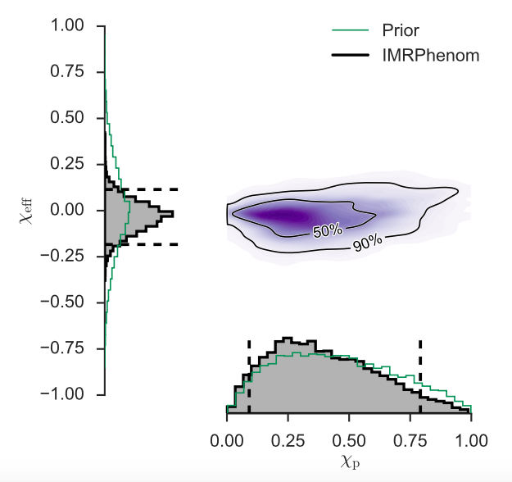

Properties of GW150914
The spin of the final black hole is inferred to be ${0.67 }_{−0.07}^{+0.05}$
(as a fraction of the maximum spin allowed by GR, $\frac{Gm^{2}}{c}$)
We don’t find evidence for
spin of the initial component
black holes (and only weak limits)
  From parameters that
  influence the waveform:
  $χ_{eff}=\frac{c}{G}\left(\frac{{\vec{S}}_{1}}{m_{1}}+\frac{{\vec{S}}_{2}}{m_{2}}\right)⋅\frac{\hat{L}}{\left(m_{1}+m_{2}\right)}$
  affects how the signal “chirps”
  $χ_{p}$ quantifies the expected
  precession of the orbital plane
Abbott et al., PRL 116, 241102

Slide 21
But wait, there’s more!

Slide 22
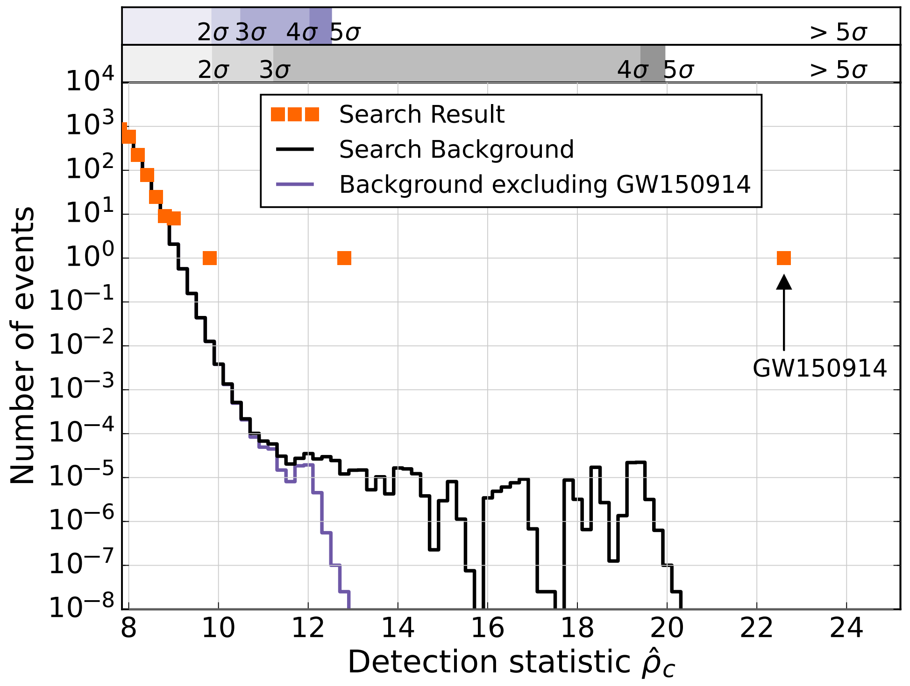

The Boxing Day Event
Analysis of the complete O1 run data revealed one additional significant binary black hole coalescence signal, GW151226
  Weaker than GW150914, but still detected with $>5σ$ significance
  And there’s also a marginally significant candidate, LVT151012
Data set:
Sept 12 to Jan 9
LVT151012
GW151226
GW150914
Abbott et al.,
PRL 116, 241103

Slide 23
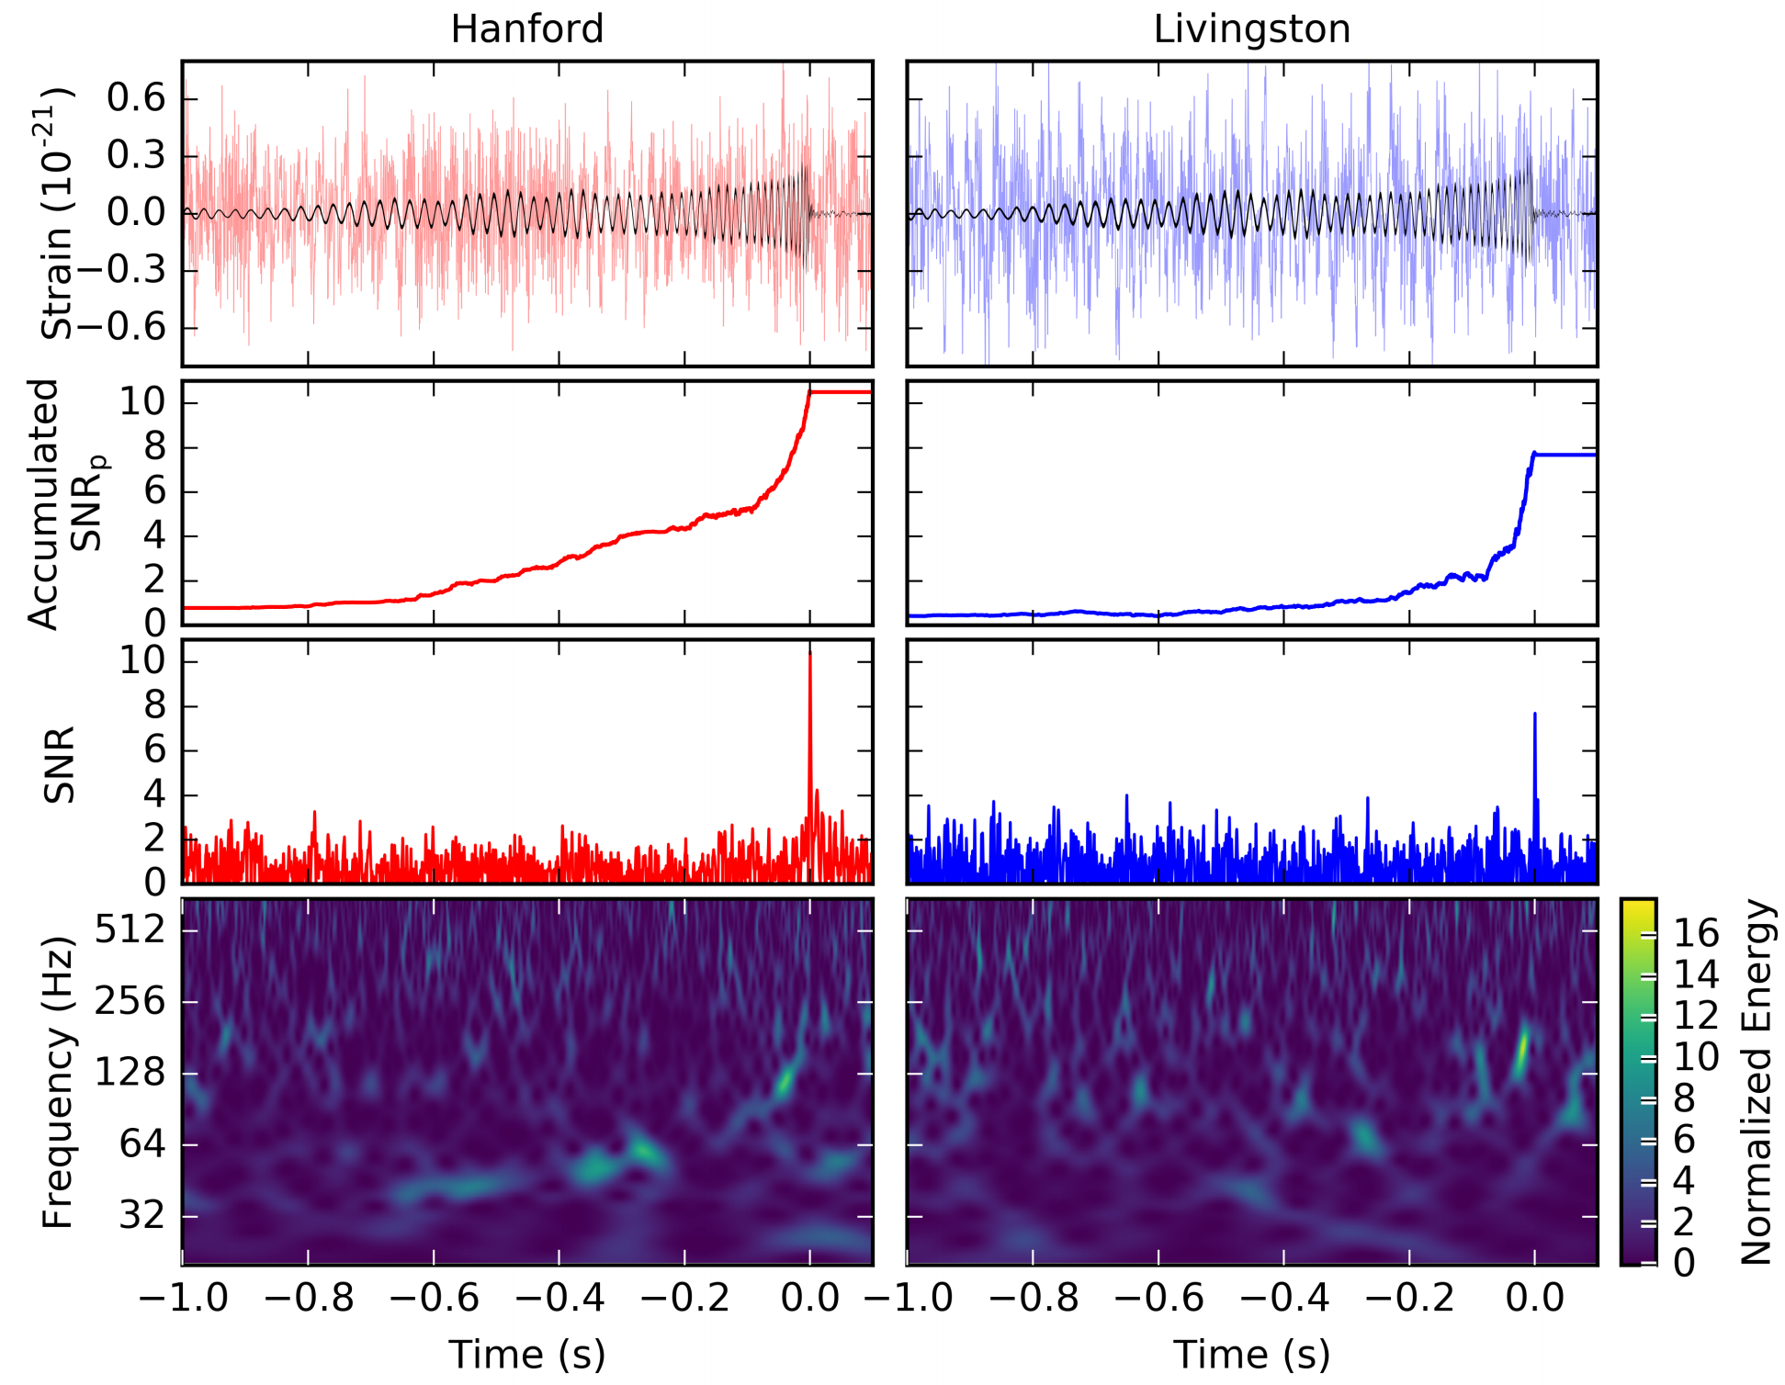
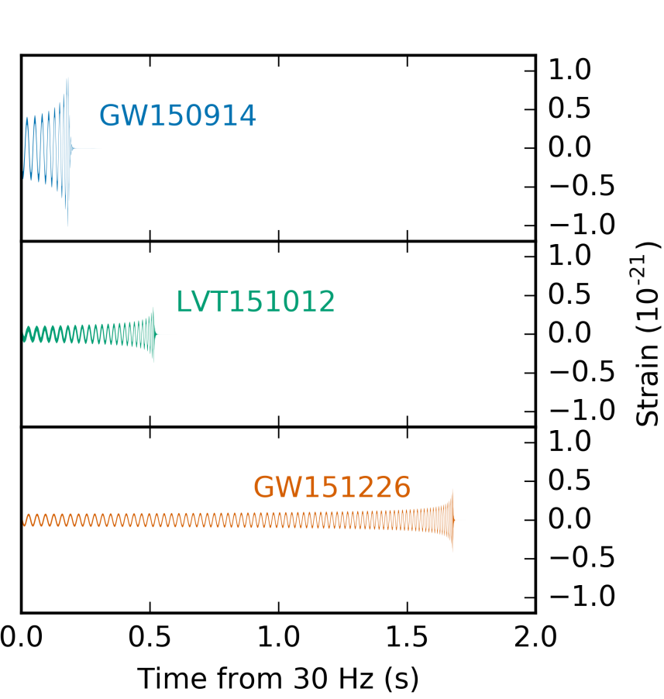
Not so visible in the data…
Another signal consistent with GR, but qualitatively different
  Longer duration,
  lower amplitude,
  more “cycles” in band
  ➔ Matched filtering
  was essential for
  detecting GW151226

Slide 24
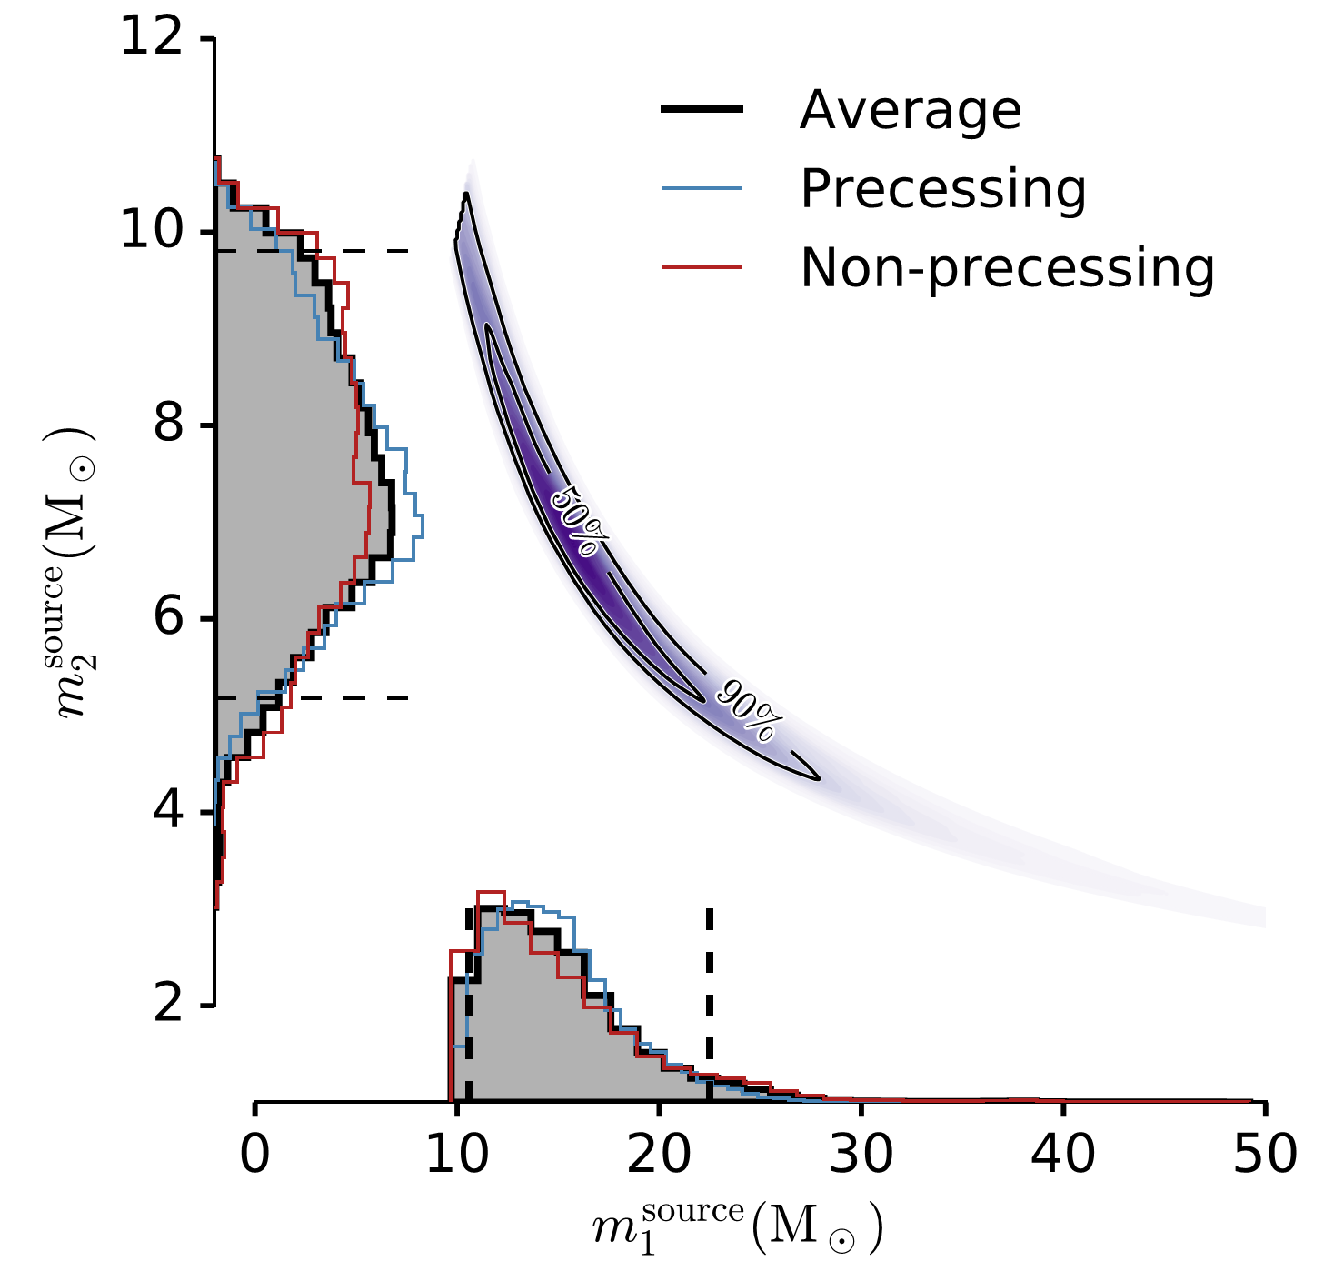
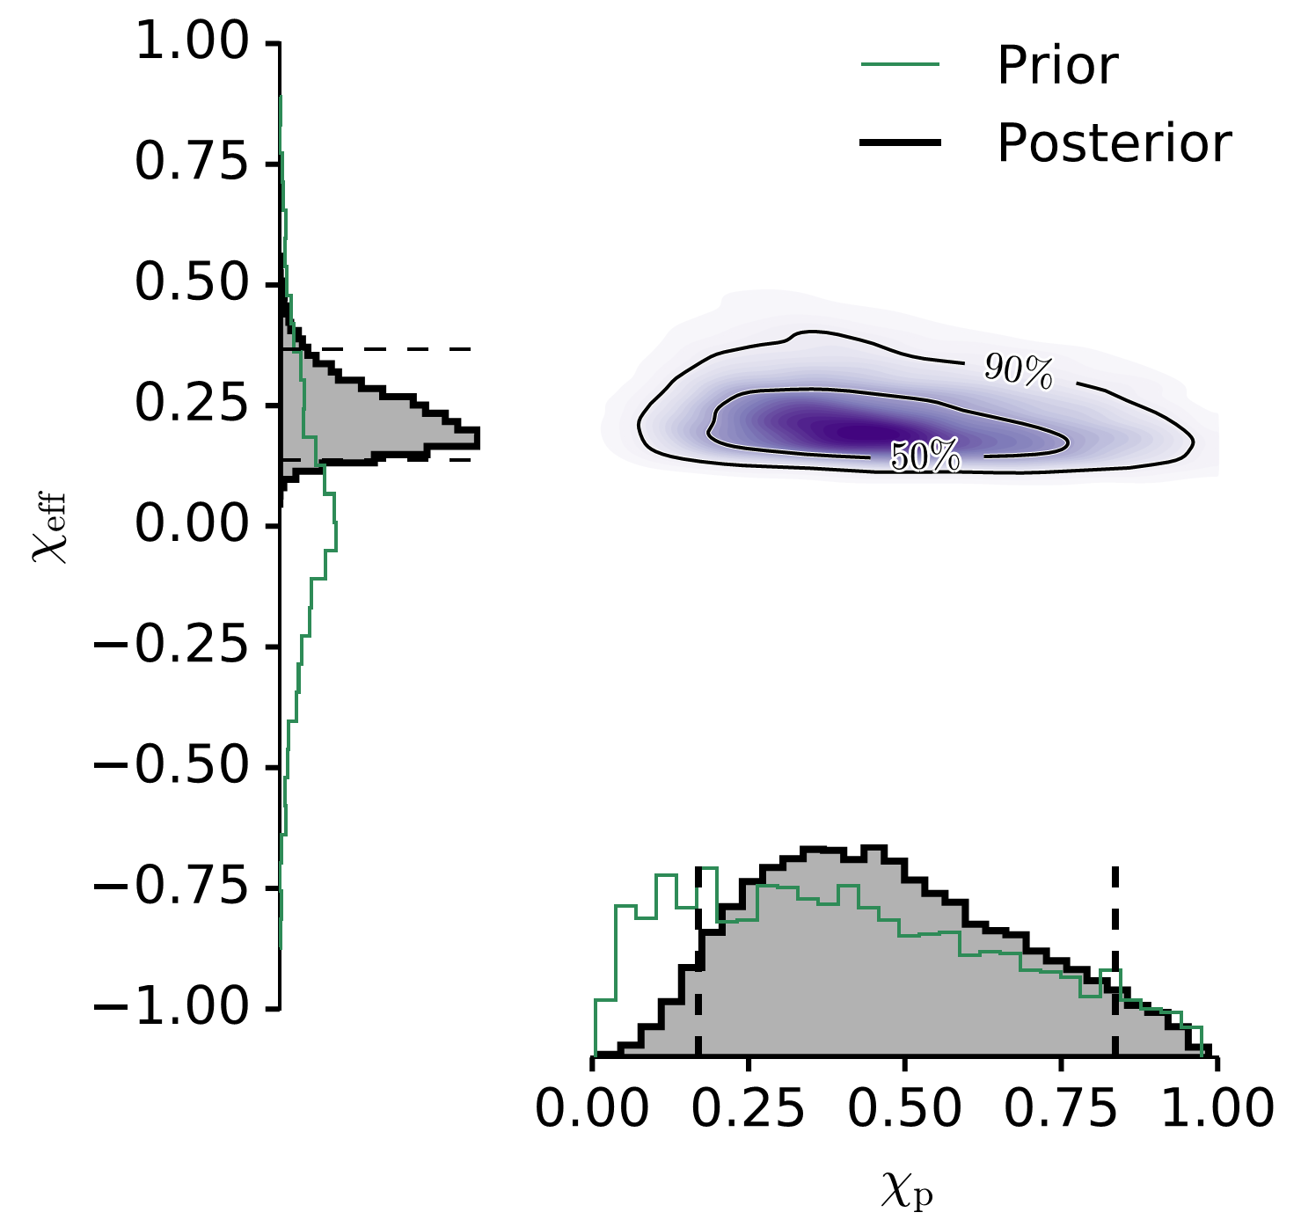

Properties of GW151226
GW151226 has lower mass than GW150914
  Initial masses: ${14.2 }_{−3.7}^{+8.3}$ and $7.5±2.3 M_{⨀}$
Final BH mass: ${20.8 }_{−1.7}^{+6.1} M_{⨀}$
Energy radiated: ${1.0 }_{−0.2}^{+0.1} M_{⨀}c^{2}$
Luminosity distance: $44{0 }_{−190}^{+180} \text{Mpc}$
… and nonzero spin !
Effective signed spin combination definitely positive
$⇒$ at least one of the initial BHs had nonzero spin
(we can’t tell how the spin is divided up between
them due to waveform degeneracy)
Abbott et al., PRL 116, 241103

Slide 25
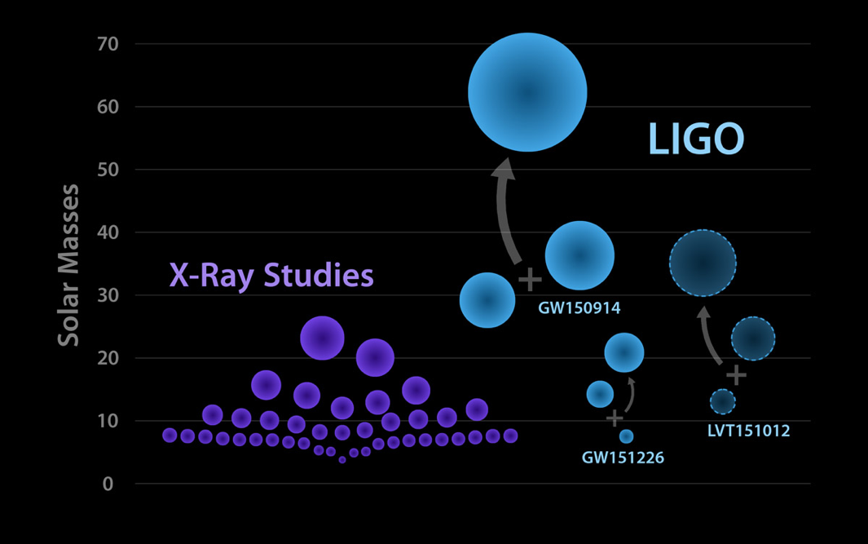
Comparison of Black Hole Masses
GW150914 is heavy! That has implications for how it was formed

Slide 26
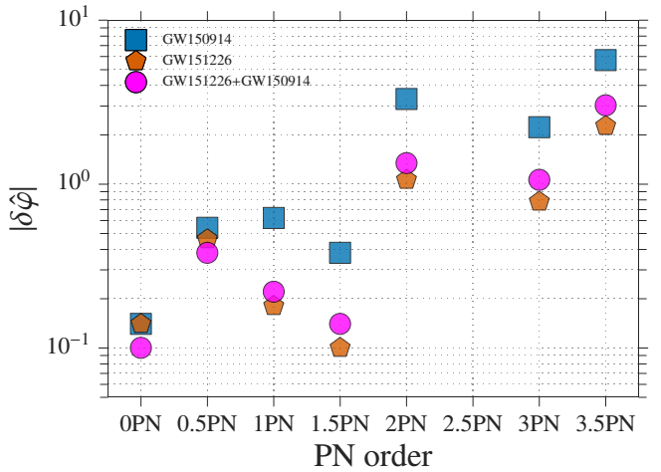
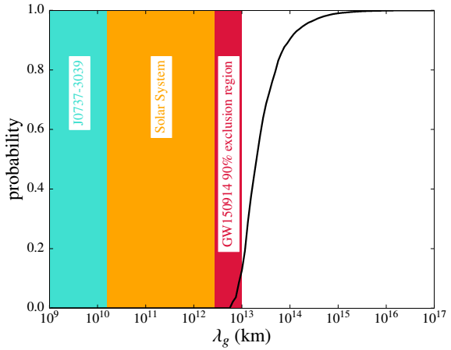

Testing GR as the Theory of Gravity
Check consistency of
inspiral / merger / ringdown
Allow deviations from GR in
the post-Newtonian parameters
of the “chirp”
  GW151226, with more cycles,
  permits more stringent tests
Allow for a massive graviton
  Would distort waveform due to dispersion
  We can place a limit on graviton
  Compton wavelength: $>{10}^{13}$ km
  ➔ $m_{g}<1.2×{10}^{−22} \text{eV}/c^{2}$
Abbott et al., PRX 6, 041015
Abbott et al., PRL 116, 221101

Slide 27
Multi-messenger astronomy and the hunt for counterparts

Slide 28

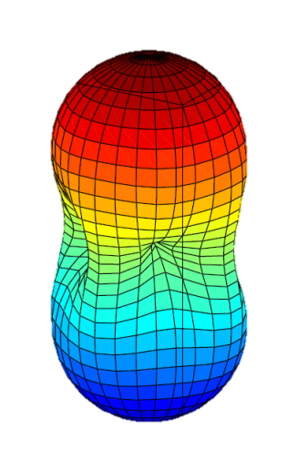
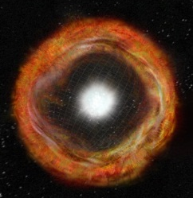
Gravitational Waves: A Unique Messenger
Oscillating spacetime distortions from massive objects in motion
  Caused by rapid motion or flow of mass or energy,
  in particular from a time-varying quadrupole moment
  Direction-dependent polarization content
GW emissions are only weakly beamed, and
GW detectors are only weakly directional
    Monitor the whole sky for sources with all orientations
    Not dependent on being within the cone of a jet
GWs come directly from the central engine
of astrophysical objects
  Not significantly attenuated or scattered by material
    Complements photon (& neutrino?) diagnostics of
    photosphere, outflows, circumburst medium, …
Bill Saxton, NRAO/AUI/NSF

Slide 29
Motivation from Energetics
For any GW event detected by LIGO/Virgo, the energy emitted in GWs is enormous
  e.g. for GW150914: ~5e54 erg in a fraction of a second!
One can imagine many ways for some of that energy to be reprocessed, directly or indirectly, into electromagnetic emission that can be detected by astronomers as a transient “counterpart”
➔ Our general philosophy is that it is worth looking for counterparts over as many EM bands and timescales as possible

Slide 30
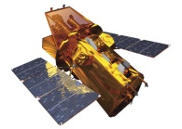

Outline of the “EM Follow-up” Project
LIGO Hanford
GEO 600
KAGRA
Virgo
LIGO Livingston
LIGO-India
Send info
to observers
Transfer data
Validate
(data quality, etc.)
Analyze data, identify triggers,
infer sky position
Trigger database
GW data
Select event candidates
Swift: NASA E/PO, Sonoma State U., Aurore Simonnet
Estimate background

Slide 31
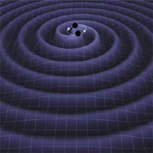
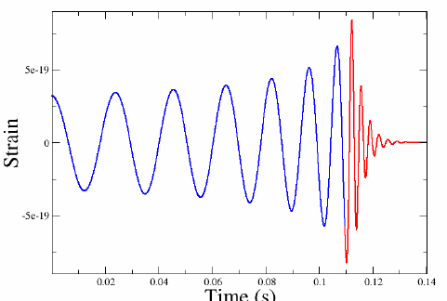


Searches for GW Transient Sources
Compact Binary Coalescence (CBC)
Known waveform ➔ Matched filtering
Templates for a range of component masses
(spin affects waveforms too, but not so important for initial detection)
Unmodelled GW Burst (< ~1 sec duration)
e.g. from stellar core collapse
Arbitrary waveform ➔ Excess power
Require coherent signals in detectors,
using direction-dependent antenna response
Low-latency searches run continuously as data is collected
  Whenever two or more detectors are operating normally
  With coherent analysis, identify event candidates and generate preliminary sky position probability maps within a few minutes

Slide 32
Goals of the EM Follow-up Project
Identify GW event candidates as quickly as possible
  With basic event parameters and an estimate of confidence
Provide rapid alerts to other observers
  Allow quick correlation with other transient survey events or candidates
  Trigger follow-up observations (prompt and/or delayed)
What this can enable:
  ★ Pick out interesting (strong or marginal) events from GW and other surveys
  ★ Prioritize follow-up observing resources
  ★ Maybe catch a counterpart that would have been missed,
  or detected only later
  ★ Identify host galaxy ➔ provide astronomical context
  ★ Obtain multi-wavelength (and multi-messenger!) data for remarkable events
Challenge: GW reconstructed sky regions are large !
  With just the two LIGO detectors: typically a few hundred square degrees
  With LIGO+Virgo: typically tens of square degrees

Slide 33
Partnerships for Follow-up Observing
Confident detection of first few GW signals requires time and care—need to avoid misinformation / rumors / media circus
Established a standard MOU framework to share information promptly while maintaining confidentiality for event candidates
LIGO & Virgo have signed MOUs with >80 groups so far
  Broad spectrum of transient astronomy researchers and instruments
  Optical, Radio, X-ray, gamma-ray, VHE
  Set up to distribute GCN “notices” and “circulars” to partners
Encourage free communication among all “inside the bubble”
for multi-wavelength follow-up
Once GW detections become routine (≥4 published), there will be prompt public alerts of high-confidence detections

Slide 34


Response by Observers During O1
About half of those with observing capability during O1 responded to at least one of the 3 alerts during the run
  For GW150914:
  Covered most of skymap area
  at a wide range of wavelengths
  starting within a few hours
  ~50 GCN Circulars, ~12 papers
  Also strong response for GW151226
Figures from Abbott++, ApJL 826, L13

Slide 35



A Possible Gamma-ray Counterpart?
A weak signal was detected by the Gamma-ray Burst Monitor (GBM) on board the Fermi satellite about
0.4 second after the time of GW150914
Connaughton et al., ApJL 826, 13
Post-trials false alarm prob ~ 0.0022
Fermi: NASA E/PO, Sonoma State U., Aurore Simonnet

Slide 36

GBM Transient Localization
High-probability GBM region is consistent with LIGO region
  Near the limb of the Earth from GBM’s viewpoint
  But doesn’t match any known type of terrestrial signal
A real counterpart, or just a chance coincidence?
  Inconclusive – we’ll have to wait for more comparable events!
  No GBM signal seen for GW151226 – but that had lower energy and LIGO skymap region was partly occulted by Earth (Racusin et al., arXiv:1606.04901)

Slide 37
Can a binary black hole merger produce a detectable EM transient?
We don’t expect a stellar-mass binary black hole system to have enough matter around for the final BH to accrete and form a relativistic jet [e.g., Lyutikov, arXiv:1602.07352] — or can it? Various models have been proposed:
  Single star: collapse of a very massive, rapidly rotating stellar core, which fissions into a pair of black holes which then merge [Fryer+ 2001; Reisswig+ 2013; Loeb 2016, ApJL 819]; but see Woosley, arXiv:1603.00511v2 for modeling that does not support this idea
  Instant BBH: massive star-BH binary triggers collapse of star to BH, then immediate inspiral and merger; final BH can be kicked into circumbinary disk and accrete from it [Janiuk+ 2013, A&A 560; arXiv:1604.07132]
  BBH with fossil disk: activates and accretes long-lived cool disk [Perna+ 2016, ApJL 821]
  BBH embedded in AGN disk: binary merger assisted by gas drag and/or 3-body interactions in AGN disk, which provides material to accrete [Bartos+, arXiv:1602.03831; Stone+ 2016, MNRAS]
  Third body: tidal disruption of a star in a hierarchical triple with the BBH at time of merger [Seto&Muto 2011, cited in Murase+ 2016, ApJL 822]
  Charged BHs: Merging BHs with electric (or magnetic monopole!) charge could produce a detectable EM transient [Zhang 2016, ApJL 827; Liebling&Palenzuela 2016, PRD 84]
  Magnetic reconnection [Fraschetti, arXiv:1603.01950]
Also models for high-energy neutrino and ultra-high energy cosmic ray emission

Slide 38
The special promise of neutron star binary mergers

Slide 39



Short Gamma-ray Bursts = Mergers?
NASA
P.J.T. Leonard
(NASA/GSFC)
Compact binary mergers are thought to cause most short GRBs
  Strong evidence from host galaxy types and typical offsets
  [Fong & Berger, ApJ 776, 18]
  Could be NS-NS or NS-BH, with post-merger accretion producing a jet
Beamed gamma-ray emission → many more mergers than GRBs
  Some opening angles measured, e.g. $16±10°$ [Fong+ 2016, ApJ 815, 102]
Exciting possibility to confirm the merger-GRB association!
But are we stuck with the beaming limitation for the EM emission?

Slide 40

Tidal Disruption of Neutron Stars
Price/Rosswog/Press

Slide 41
Other Signatures of Neutron Star Mergers
X-ray afterglow
  May be detectable if gamma-ray emission is missed, or if off-axis
  ➔ We’re proposing to put a wide-field X-ray imager into orbit
Kilonova (aka “macronova”)
  IR/Visible/UV (?) emission powered by radioactive decay of r-process elements produced in neutron-rich ejecta [e.g., Barnes & Kasen, ApJ 775, 18]
  Roughly isotropic, though varies due to geometric effects
  Already seen for GRB 130603B? [Berger et al., ApJ 765, 121; Tanvir et al., Nature 500, 547] and possibly one or two other past GRBs
Radio transients
  Pulsar-like emission from transfer of energy to magnetic field [Pshirkov&Postnov, 2010] or MHD conversion [Moortgat&Kuijpers 2004]
Late-time radio afterglow
  Synchrotron radiation [Nakar&Piran 2011, Nature; Hotokezaka+, arXiv:1605.09395]

Slide 42
Kilonova Promise and Challenges
Great reference: Brian Metzger’s “Kilonova Handbook”, arXiv:1610.09381
Expected signature is unclear due to complicated astrophysics!
Different remnant scenarios
  Direct collapse to black hole (with some amount of spin)
  Hypermassive neutron star collapsing to black hole after a delay
  Stable, magnetized heavy neutron star
Different types of ejecta ➔ EM emission signatures
  Dynamical ejection of tidally disrupted mass (lanthanide-dense → IR)
  Decay of free neutrons in surface layer (faster heating → UV)
  Wind from remnant accretion disk (lanthanide-free → visible)
Uncertain ejecta mass and opacity ➔ brightness & time scales
  Likely faint, requiring 8+ meter scopes, especial as GW detectors improve
  ➔ An opportunity for LUVOIR !

Slide 43

Dependence on Progenitor & Remnant
Kasen, Fernández & Metzger, MNRAS 450, 1777

Slide 44

Colors and Light Curves
These are AB magnitudes for a
source at 200 Mpc
Dynamical ejecta:
  IR, peaking after several days
Thermal pulse from decay of
free neutrons:
  UV, peaking in ~1 hour
Wind from remnant accretion disk:
  Visible/IR, peaking in ~1 day
From Metzger, arXiv:1610.09381

Slide 45
Looking ahead

Slide 46








Advanced GW Detector Network:
Under Construction → Operating
→ Operating
2015
~2019
GEO-HF
2011
LIGO Hanford
600 m
4 km
3 km
3 km
4 km
~2024
4 km
LIGO Livingston
2015
Virgo
2017
3 separate collaborations working together

Slide 47
Observing Run History and Outlook
The LIGO detectors resumed observing operations in 2015 after the Advanced LIGO upgrade project – and Virgo will join soon
Initial LIGO
Enhanced LIGO
Advanced LIGO
’05
’06
’07
’08
’09
’10
’11
’12
’13
’14
’15
’16
’17
’18
Installation & commissioning
S4
S5
AstroWatch
S6
O1
O2
O3
VSR1
VSR2 + 3
VSR4
(future schedule approx.)
Installation & commissioning
Initial Virgo
Virgo+
Advanced Virgo
Meanwhile, GEO has run more-or-less continuously to demonstrate advanced technologies and to maintain “AstroWatch” vigil
KAGRA ~2019
LIGO-India ~2024
See Abbott et al., Liv. Rev. Rel. 19, 1: http://relativity.livingreviews.org/Articles/lrr-2016-1/

Slide 48





How will the GW detector network improve?
Sensitivity → Distance reach
  O1 amplitude noise level was
  ~3 times above Advanced LIGO
  design; commissioning continues
  Virgo will likely begin with modest
  sensitivity, and improve over time
  Further incremental upgrades and
  new facilities are being studied
More detectors → Better localization
  Varies event-by-event
  One example:
O1
LIGO-G1501223-v3
HL
HLVK
HLV

Slide 49
Summary
We’re already testing the predictions of GR in various ways and learning about the astrophysical source population
We have a full-scale EM follow-up program in place to try to catch and identify any counterpart
The GW detector network will grow and improve over the next several years
What will we detect next?
More binary black hole mergers! What can we learn from them?
Binary neutron star mergers? How else will we see them?
Other gravitational-wave sources?
➔ Opportunities for multi-messenger astronomy

Slide 50
Backup slides

Slide 51

Antenna Pattern of a Laser Interferometer
Directional sensitivity depends on polarization of waves
“×” polarization
“+” polarization
RMS sensitivity
A broad antenna pattern
⇒ More like a radio receiver than a telescope

Slide 52





Gravitational Wave Strain
Two massive, compact objects in a tight orbit
deform space (and any object in it) with a frequency which is twice the orbital frequency
(Neutron stars or black holes)
The stretching is described by a dimensionless strain, $h=ΔL/L$
$h$ is inversely proportional to the distance from the source
Challenge: only expect $h∼{10}^{−21}$ at Earth!

Slide 53

The Fate of B1913+16
Gravitational waves carry away energy and angular momentum
Orbit will continue to decay—“inspiral”—over the next ~300 million years, until…
The neutron stars will merge !
  And probably collapse to form a black hole
  Final ~minute will be in audio frequency band
h(t)
Notes:
Nearly ideal quadrupole → strong GW emission
Emits a few percent of rest mass in late inspiral and merger
Audio clip
What happens next? Heavy neutron star, OR collapse to a black hole

Slide 54

Advanced LIGO Optical Layout
  Higher-power laser
  Larger mirrors
  Higher finesse arm cavities
  Stable recycling cavities
  Signal recycling mirror
  Output mode cleaner
  and more …
Goal of the upgrade:
10$×$ lower noise ➔ 1000$×$ more volume of space searched
Improvements

Slide 55


Advanced LIGO Installation
Installation went pretty smoothly at both LIGO observatories
  Achieved full interferometer lock in 2014, first at LIGO Livingston, then at LIGO Hanford
  Commissioning: lots of work, lots of progress

Slide 56

LIGO GW Strain Sensitivity for O1
${10}^{−23}$ amplitude spectral density!
Range ~ 70 Mpc for binary neutron star inspiral,
averaged over orbital inclination & sky position
LIGO-G1501223-v3

Slide 57

LIGO Detector Noise Components
From Abbott et al., arXiv:1602.03838

Slide 58


Could it be an instrumental noise artifact?
Would have to have been (nearly) coincident at the two sites
We checked for possible correlated noise in the detectors
  No significant signals found in magnetometers, etc.
There are also uncorrelated “glitches” in the data
  Some can be rejected with data quality cuts on monitoring channels
  Still have “blip transients” with unknown origin,
  though they don’t look much like “The Event”
We can estimate the background
(from random false coincidences)
by analyzing time-shifted data
We calculated that we would need 16 days of data (livetime)
to check for background similar to the The Event at the “$5σ$” level

Slide 59

Final Analysis – Generic Transient Search
Data set: Sept 12 to Oct 20

Slide 60

Final Analysis – Binary Coalescence Search
Data set: Sept 12 to Oct 20
LVT151012

Slide 61
LIGO/Virgo Papers About GW150914
Basic physics of the BBH merger GW150914
PRL 116, 061102
Properties of GW150914
Tests of GR with GW150914
Rate of BBH mergers inferred from data including GW150914
Generic transient analysis
Astrophysical implications of GW150914
Compact binary coalescence analysis
Implications for stochastic GW background
High-energy neutrino follow-up search of GW150914 with ANTARES and IceCube
LIGO detectors
Broadband EM follow-up of GW150914
Calibration
Characterization of transient noise
Directly comparing GW150914 with numerical solutions of Einstein's equations
Improved analysis of GW150914 using a
fully spin-precessing waveform model

Slide 62

Could it be a blind injection?
LIGO and Virgo have done blind injections in the past
  A few people authorized to secretly insert a signal into the detectors
  Truly end-to-end test of the detectors, data analysis, and interpretation
  Including the “Equinox event” in Sept 2007 and “Big Dog” in Sept 2010
A blind injection exercise was authorized for O1
But it had not started as of September 14 !

Slide 63

Effect of Data Quality Cuts
From Abbott et al., arXiv:1602.03844

Slide 64

A Closer Look at a “Blip Transient”
From Abbott et al., arXiv:1602.03844

Slide 65
Multi-Messenger Searches with GWs
LIGO/Virgo have done many externally triggered GW searches
    (deep analysis of GW data around the time and/or sky position of reported EM event)
and have collaborated on joint searches
    (compare sets of candidate events)
Over two dozen papers…
  GRBs – using public (GCN) and private info
  Known pulsars public private
  SGR/magnetar flares public private
  Pulsar glitch (Vela) private
  High-energy neutrinos private
  Radio transients private
  Supernovae public (CBET, etc.)
  Offline follow-up with satellite public γ/X-ray data [methods paper only]
Also initiated an EM follow-up program, distributing GW event candidates to observers to enable them to search for counterparts
CBC, Burst
CW
Burst
CBC

Slide 66

Starting to see the population…
  We include LVT151012 here because it is probably a real signal;
  our analysis estimates ~87% chance of it being real

Slide 67


Astrophysical Implications
GW150914 proves that there are black hole binaries out there, orbiting closely enough to merge, and heavy !
  For comparison, reliable BH masses in X-ray binaries are typically $\sim 10 M_{⨀}$
We presume that each of our BHs formed directly from a star
  Low metallicity is
  required to get
  such large masses
  Otherwise, strong
  stellar winds limit
  the final BH mass
Spera et al., MNRAS 451, 4086
Abbott et al., ApJL 818, L22

Slide 68
Astrophysical Implications
We can’t tell when the binary was formed
  The merger may have followed billions of years of gradual inspiral
Different formation pathways have been considered:
A massive binary star system with sequential core-collapses
Chemically homogeneous evolution of a pair of massive stars in close orbit
Dynamical formation of binary from two BHs in a dense star cluster
Or, from a population of primordial black holes?

Slide 69
The First Alert – September 16, 2015
We weren’t really ready, but scrambled to package the event information, update software and send GCN notices and a “circular” out to our observing partners…
/////////////////////////////////////////////////////////////////////////////
TITLE: GCN CIRCULAR
NUMBER: 18330
SUBJECT: LIGO/Virgo G184098: Burst candidate in LIGO engineering run data
DATE: 15/09/20 00:53:16 GMT
FROM: Leo Singer at NASA/GSFC <leo.p.singer@nasa.gov>
Dear colleagues,
We would like to bring to your attention a trigger identified by the online Burst analysis during the ongoing Engineering Run 8 (ER8). Normally, we would send this in the form of a private GCN Circular, but the LIGO/Virgo GCN Circular list is not ready yet.
The LIGO Scientific Collaboration and Virgo report that the cWB unmodeled burst analysis identified candidate G184098 during real-time processing of data from LIGO Hanford Observatory (H1) and LIGO Livingston Observatory (L1) at 2015-09-14 09:50:45 UTC (GPS time: 1126259462.3910). Alerts were not sent in real-time because the candidate occurred in ER8 data; however, we have now sent GCN notices through our normal channel.
G184098 is an unvetted event of interest, as the false alarm rate (FAR) determined by the online analysis would have passed our stated alert threshold of ~1/month. The event's properties can be found at this URL:
https://gracedb.ligo.org/events/G184098
…
Now archived publicly at http://gcn.gsfc.nasa.gov/other/G184098.gcn3

Slide 70










GW150914 – What LIGO/Virgo Sent to Partners
16 Sept 05:39 UTC notification about the trigger identified by the online Burst analysis during ER8 (GCN 18330)
Burst sky maps
cWB
LIB
Event time 2015-09-14 09:50:45 UTC FAR 1.178e-08 Hz 1/2.7 yr
The 50% credible region spans about 200 deg² and the 90% region about 750 deg²
03 Oct 2015 update → waveform reconstruction appears consistent with expectations for a binary black hole coalescence (GCN 18388)
11 Jan 2016 update → offline calibration and re-analysis FAR < 1/100 yr (GCN 18851)
13 Jan update → Refined localizations from CBC parameter estimation (GCN 18858)
LALinference
2 days
19 days
4 months

