Slide 1
Galaxy growth as seen through simulations and models
Charlotte Christensen
Grinnell College
Romeel Davé, Alyson Brooks, Andrew Pontzen, Fabio Governato

Slide 2
Stellar Mass Fraction vs. Halo Mass
Behroozi+ ‘10
Log (Stellar Mass/Galaxy Mass)
Set by
  Mass of gas in
  Conversion of gas into stars
  Mass of gas out
    And mass of gas back in
Log (Galaxy Mass)

Slide 3
Stellar Mass Fraction vs. Halo Mass
Behroozi+ ‘10
Log (Stellar Mass/Galaxy Mass)
AGN feedback
Stellar feedback: (SNe, radiation pressure, stellar winds etc.)
UV background, lack of HI cooling
Log (Galaxy Mass)

Slide 4
Stellar Mass Fraction vs. Halo Mass
Behroozi+ ‘10
Log (Stellar Mass/Galaxy Mass)
Log (Galaxy Mass)

Slide 5
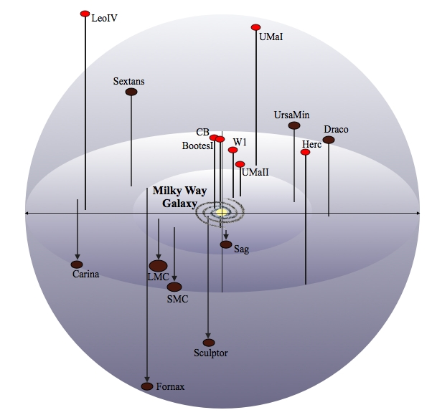
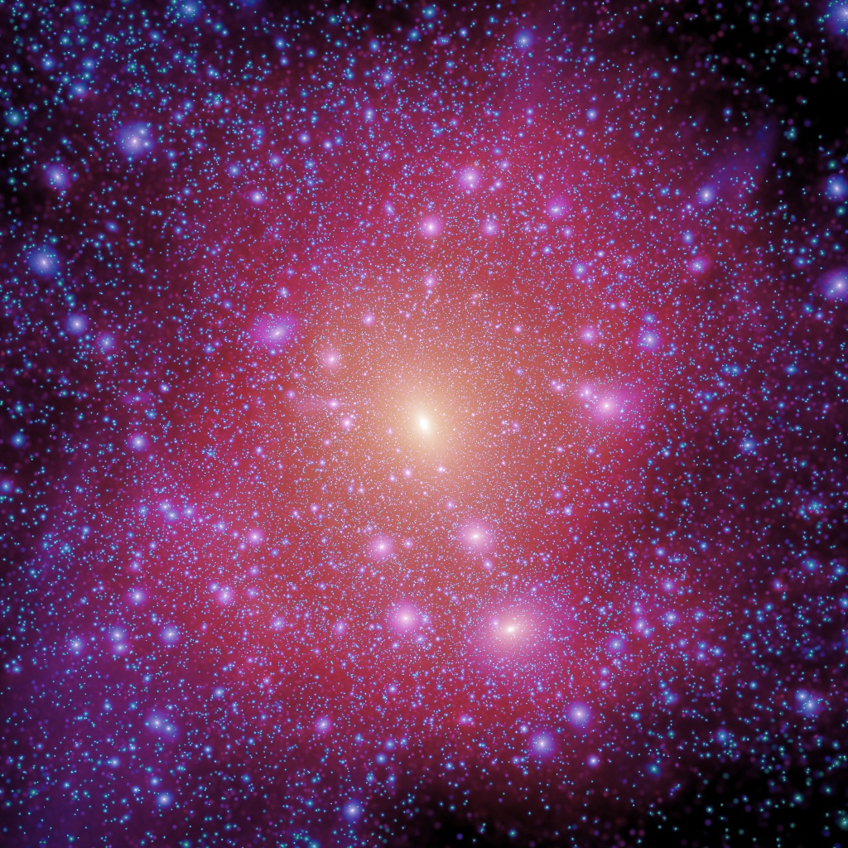
Dark Matter only models predict:
Missing satellites
Milky Way
Simulations
Moore et al., 1999

Slide 6
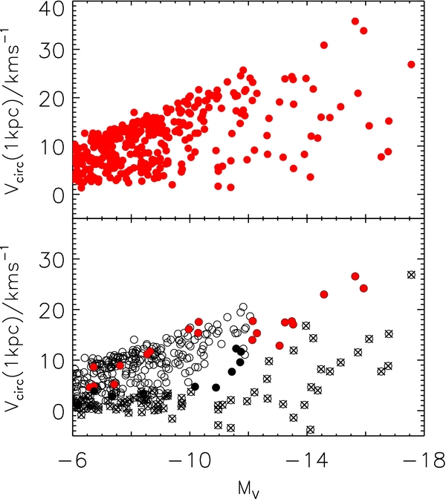
Stellar feedback results in
Fewer observable satellites
Smaller stellar mass/halo mass in low-mass galaxies
Log(M_{star}/M)
Log(M_{Halo}/M)
Hopkins+, 2014
Brooks+, 2013

Slide 7
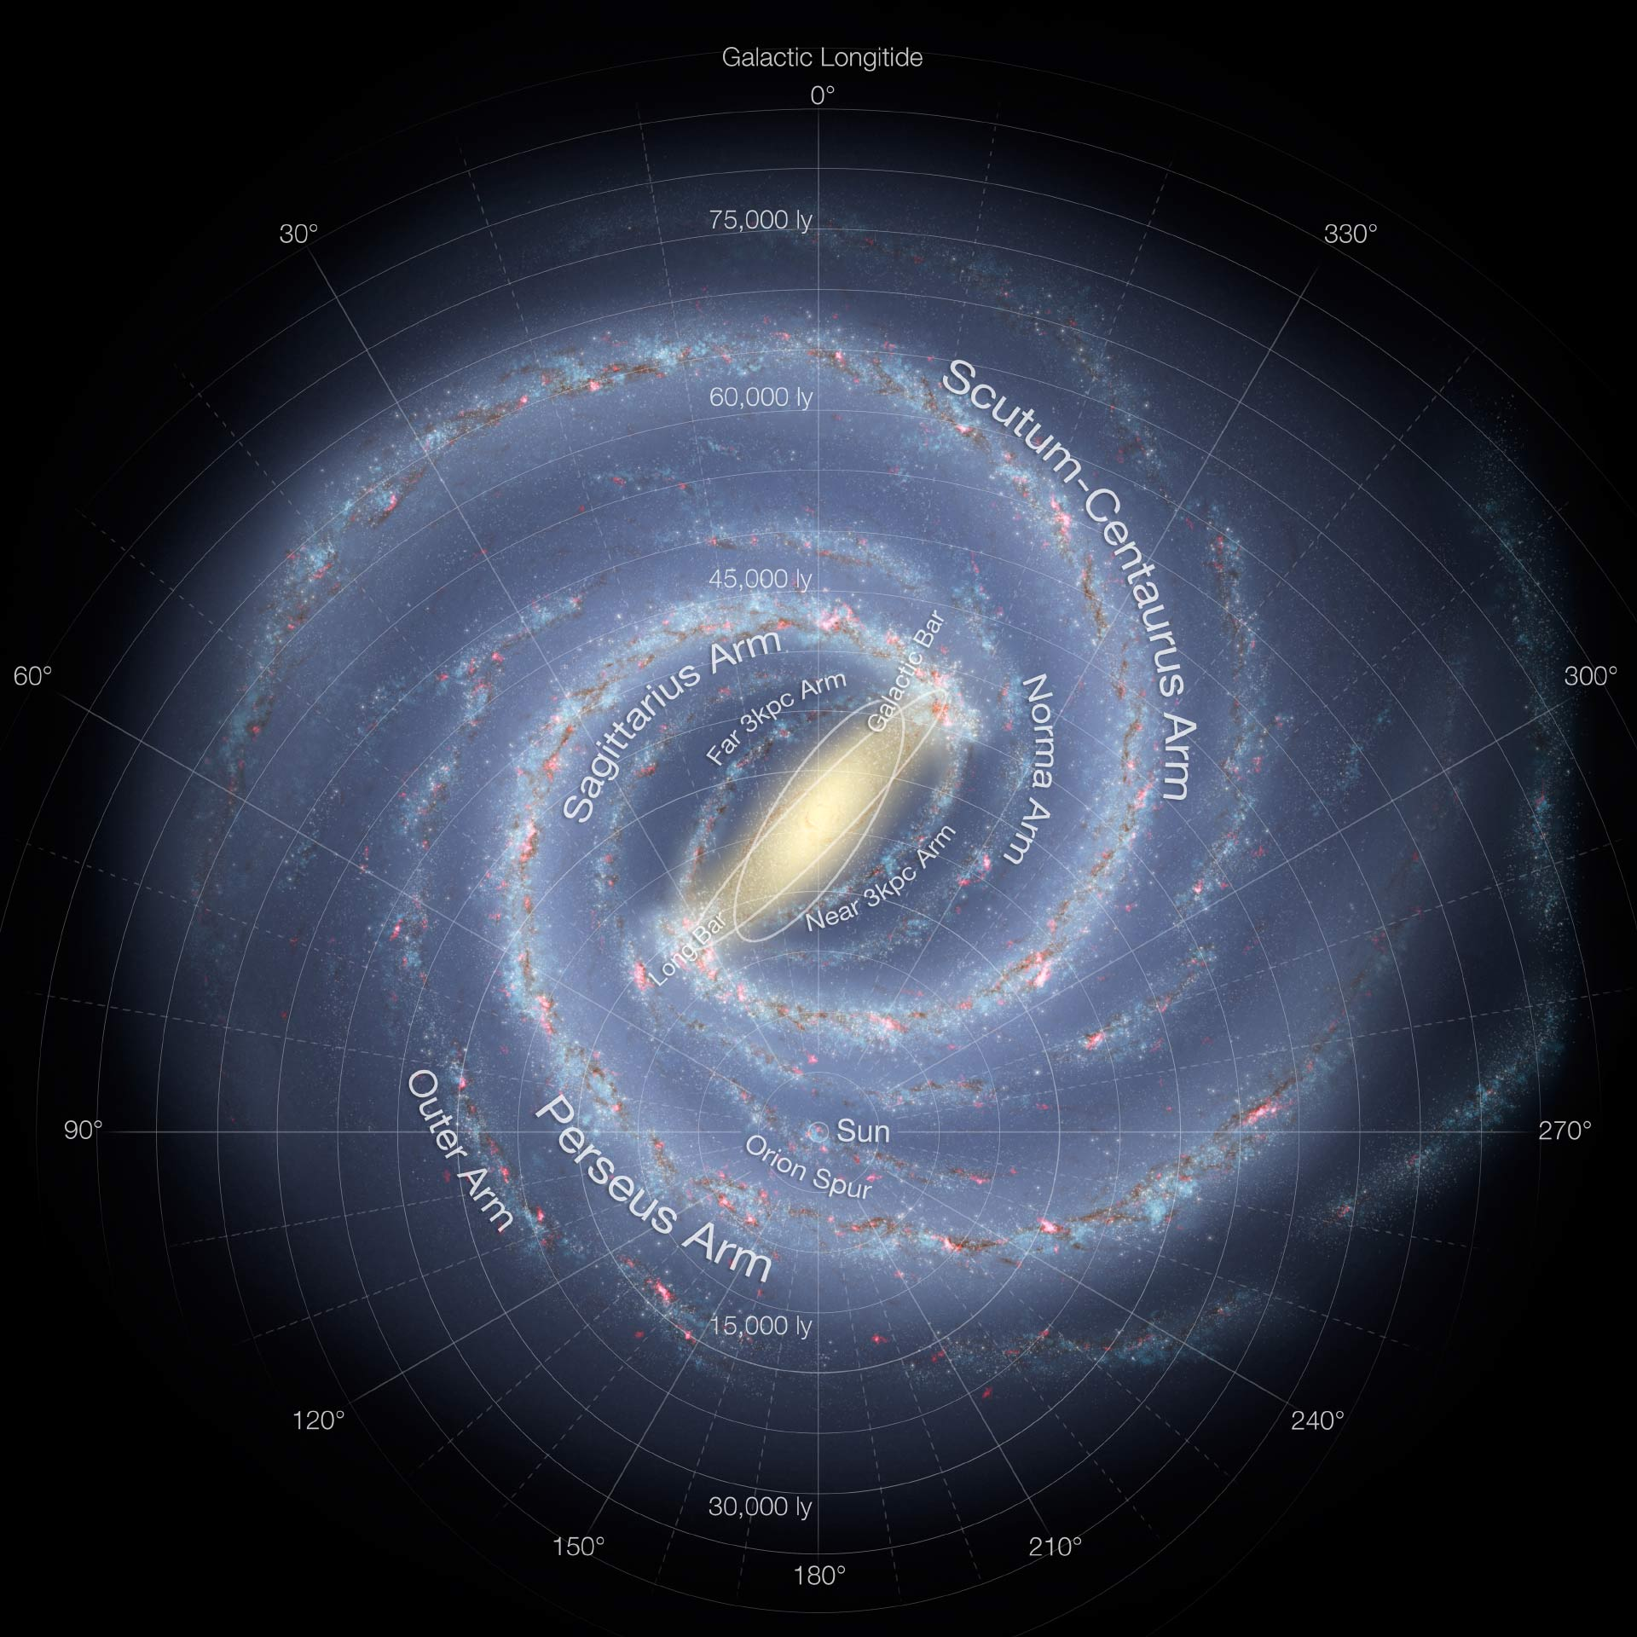
Dark Matter only models predict:
Too concentrated of galaxies
Milky Way
Simulations

Slide 8
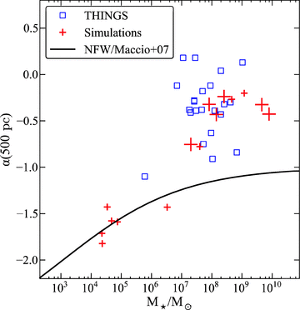
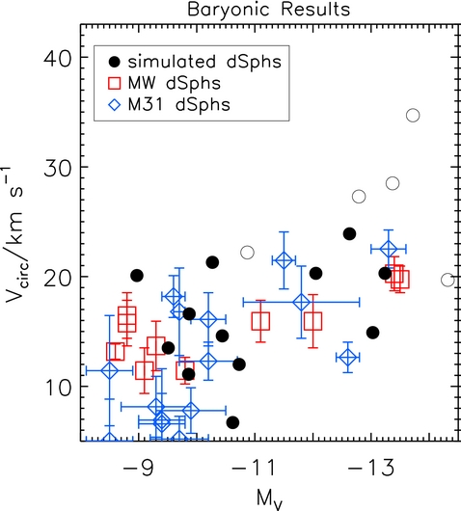
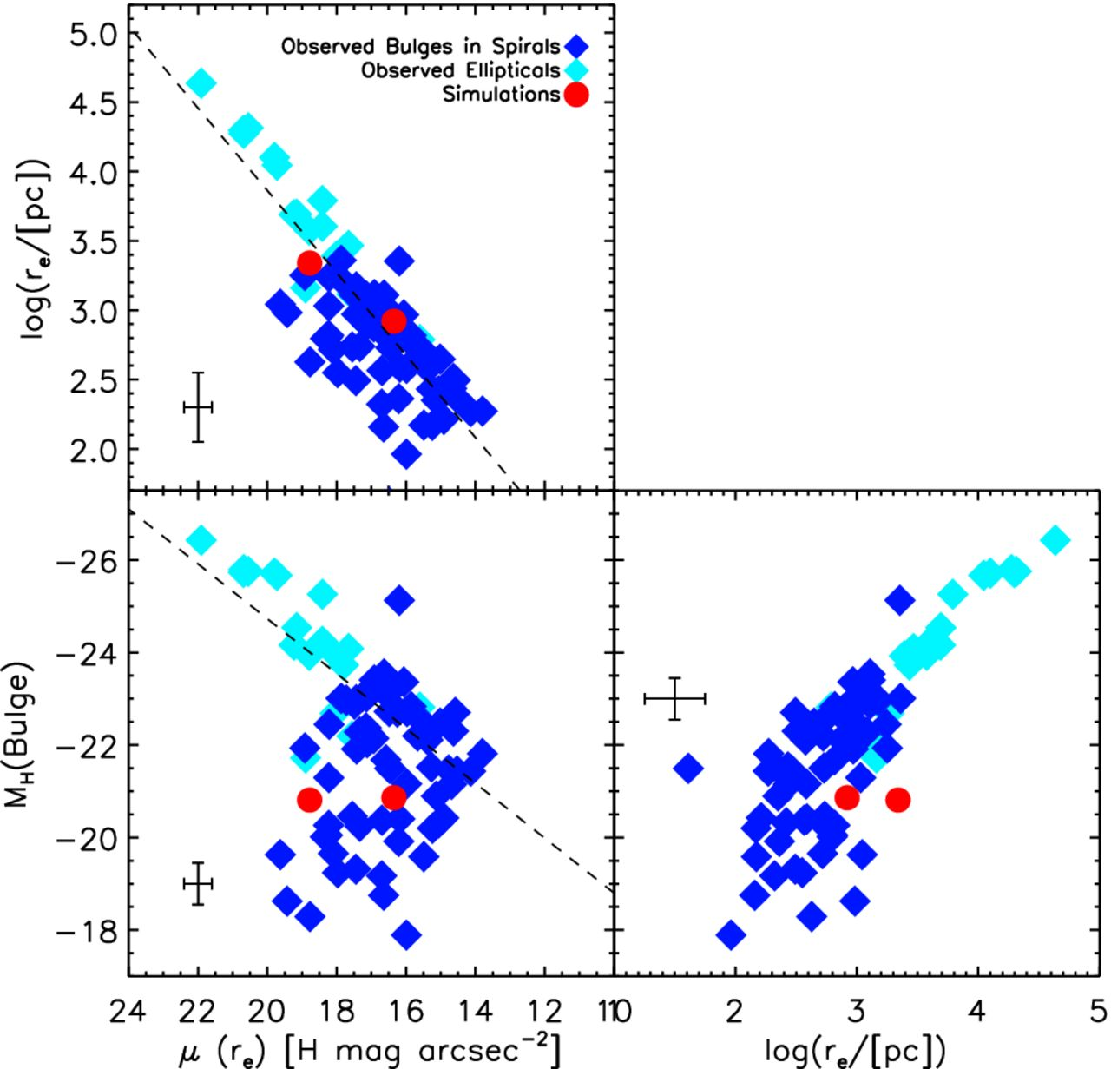
Stellar feedback results in
Cored Profiles
Appropriate Circular Velocity of Satellites
Appropriately Shaped Bulges
Governato+ 2012
Brooks and Zolotov 2014
For discussion on outflows changing central density, see Governato+ ‘10, Guedes+ ‘11, Brook+ ‘11, Pontzen+ ‘12, Teyssier+ ’13, Anglés-Alcázar+ ’13, Christensen+ ’13
Christensen+ 2014

Slide 9
What would a theorist like to have?
Spatially resolved star formation histories for a range of galaxies including ellipticals and extremely isolated faint dwarf galaxies.
Observations of sites of outflows
Measurements of the CGM

Slide 10
A simulator’s approach
Given a hydrodynamic code that produces galaxies with reasonably realistic properties, using a physically-motivated, tuned model for stellar feedback, let’s back out information about outflow properties as a function of halo mass
  Amount of ejection and recycling
  Source of gas
  Metallicity of gas

Slide 11
Code: Gasoline
(Wadsley+ 2004)
SPH code
Cosmic UV background radiation
H & He ionization; non-equilibrium H₂ (Christensen+ 2012)
Metal line cooling and metal diffusion (Shen+ 2010)
Probabilistic star formation based on free-fall time and H₂ abundance (shielded fraction) (Christensen+ 2012)
Supernovae feedback from type II and type Ia (blastwave, E_{SN}=10⁵¹ ergs) (Stinson+ 2006)

Slide 12
Blastwave Model for Feedback
  Thermal energy is transferred to gas particles near the star
  Cooling is disabled for the period of time equal to the momentum-conserving (snowplow) phase of the blastwave
    function of E, P and ρ (McKee and Ostriker 1977)
  The hot particle will naturally rise from the disk (no kick needed, no information about the halo included)

Slide 13
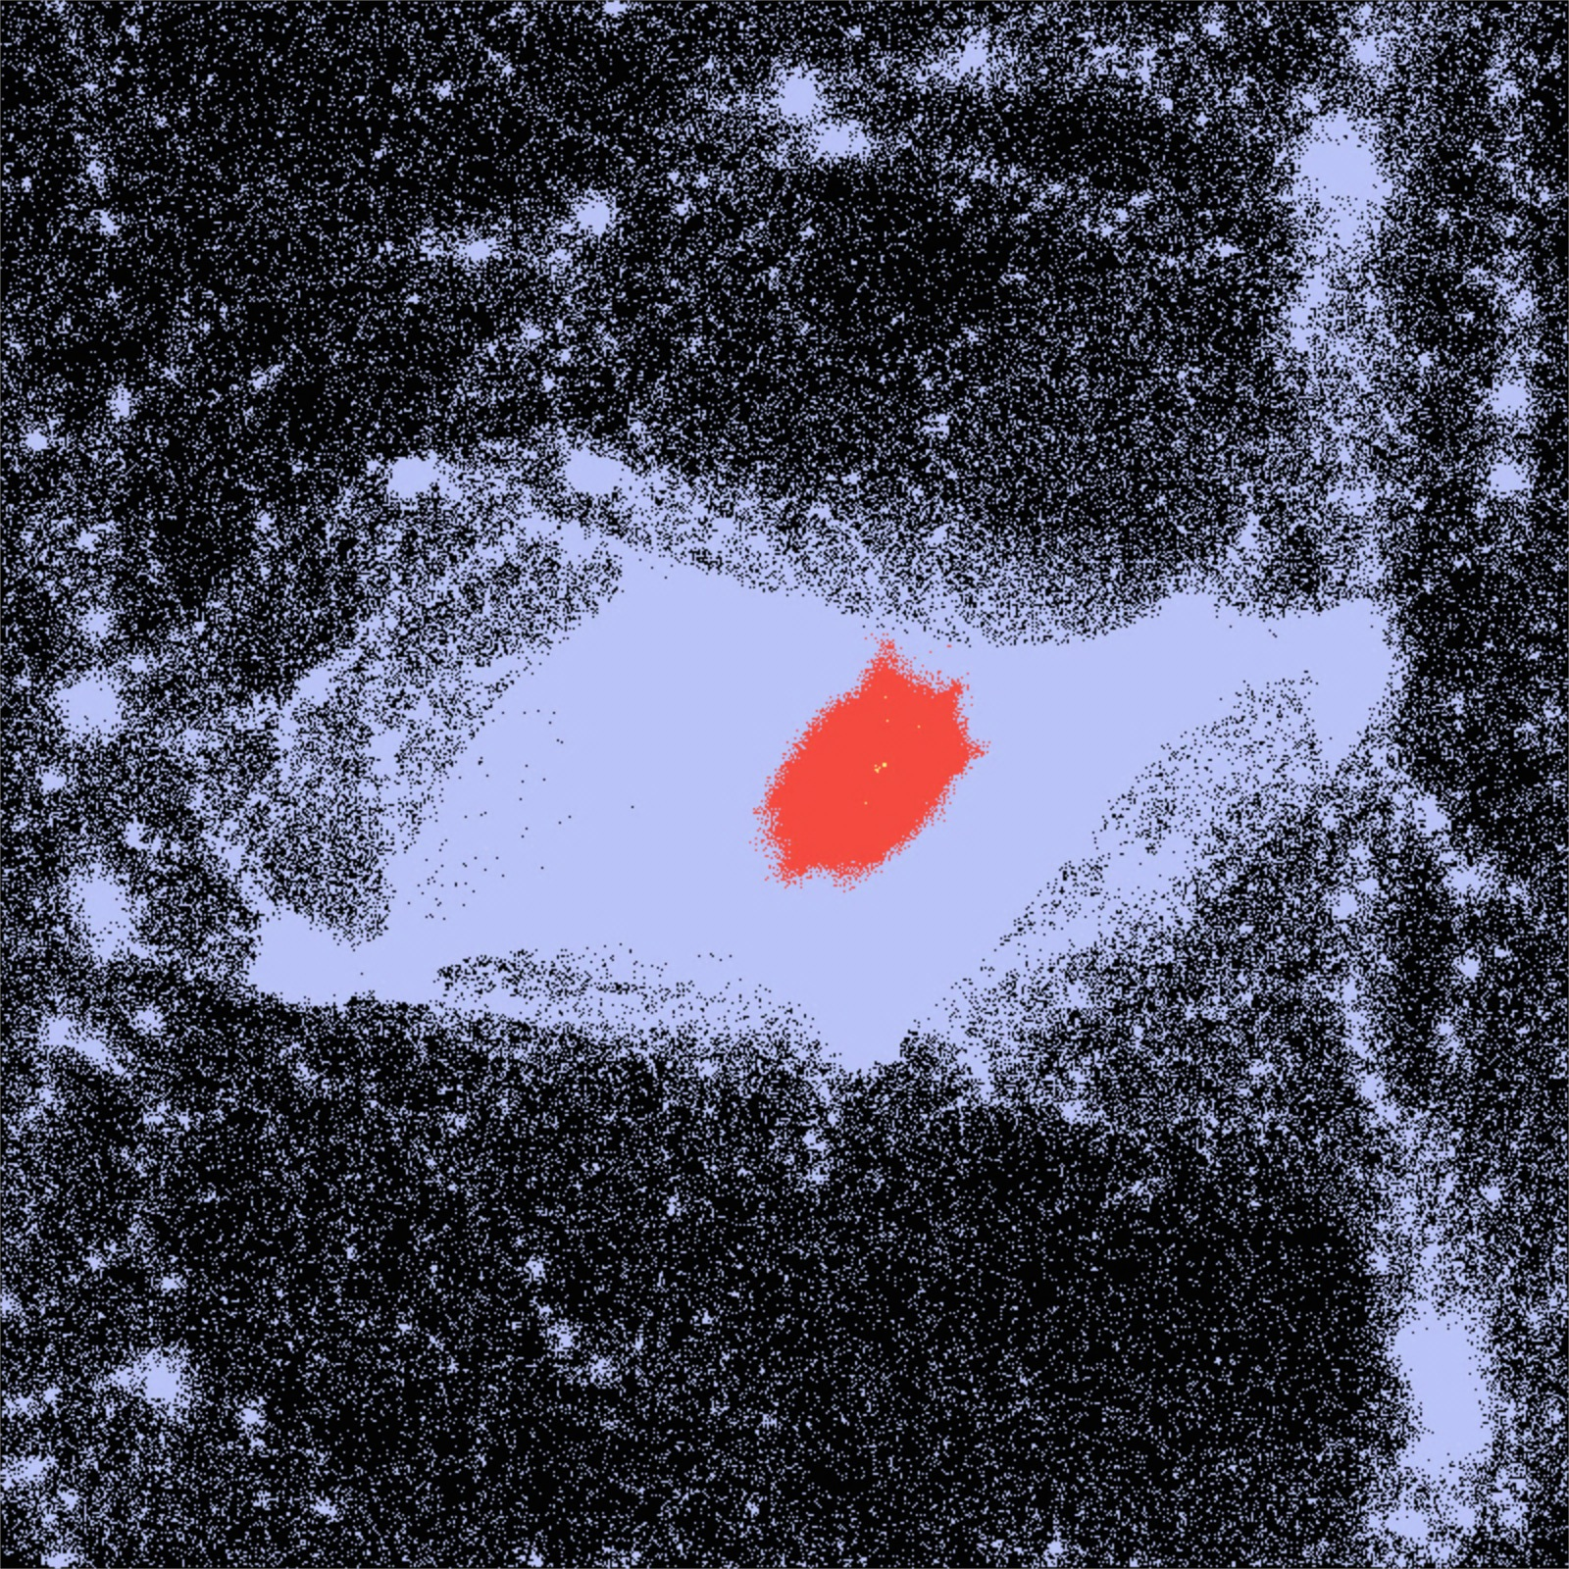
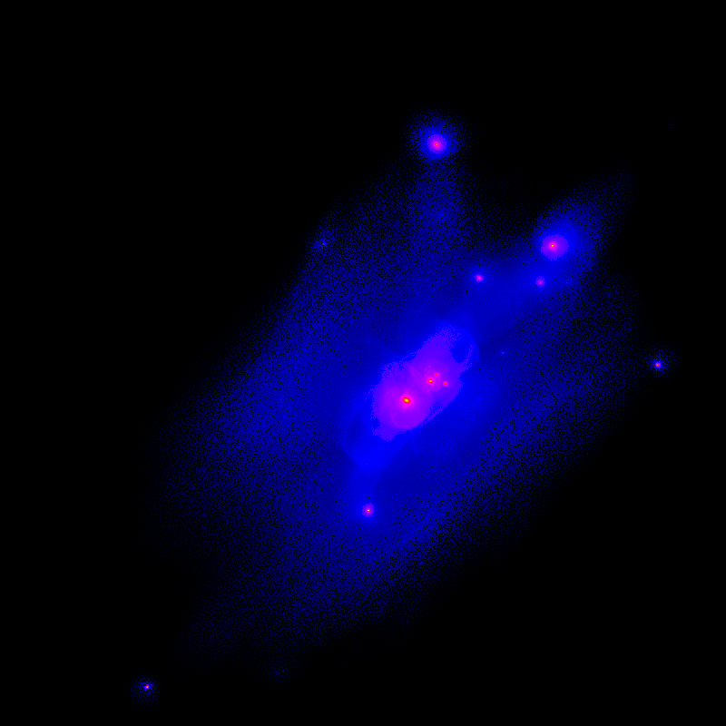
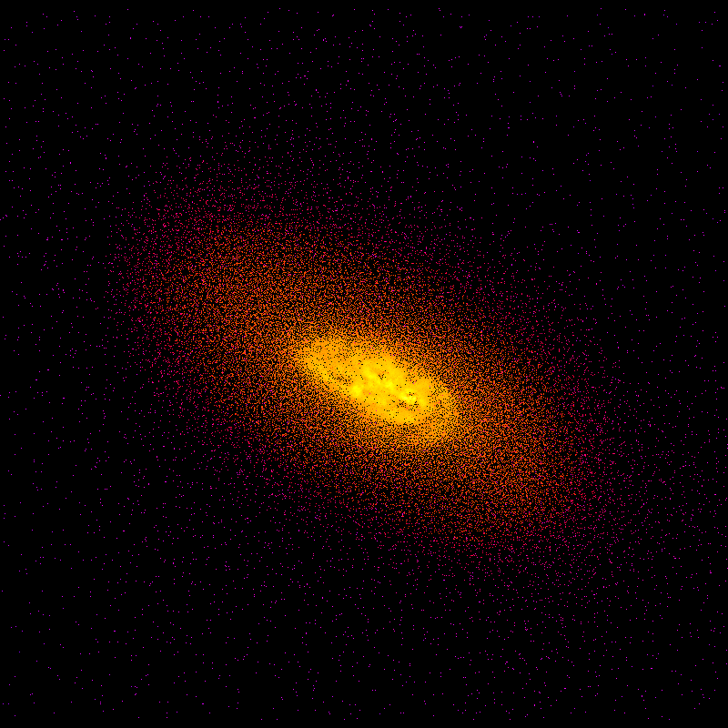
Cosmological Simulations

Slide 14
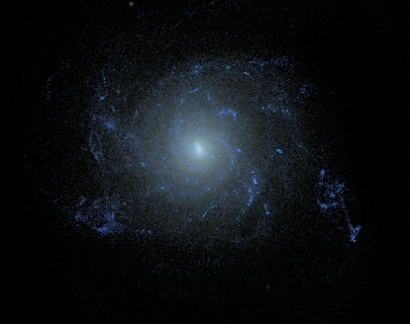
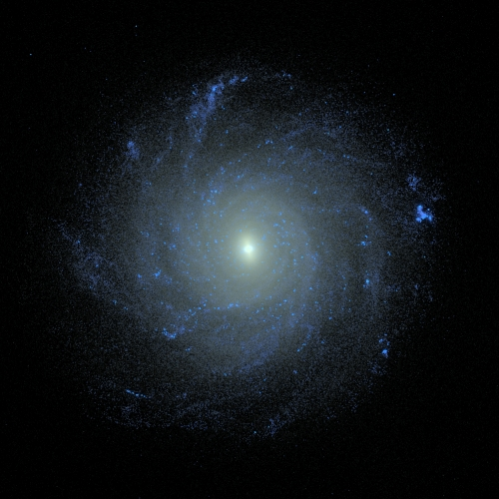
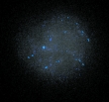
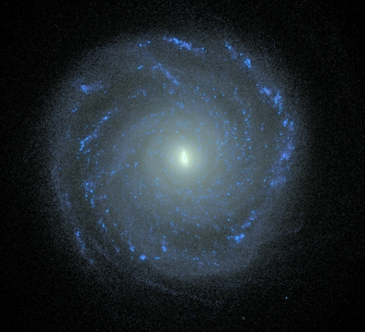
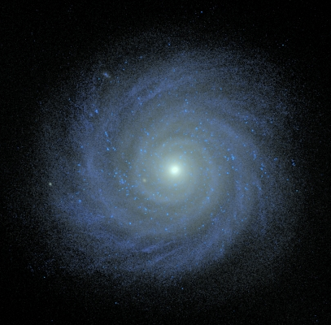
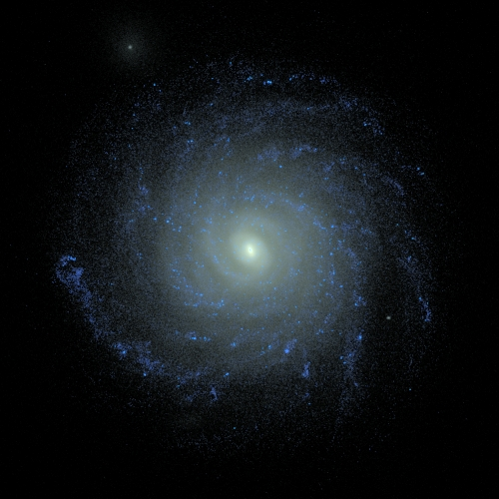
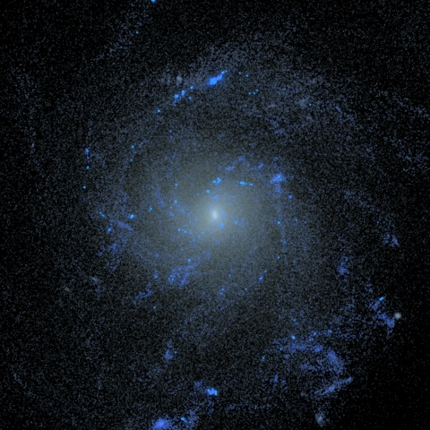
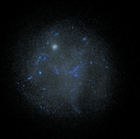
Simulations
20 central galaxies from zoom-in, cosmological simulations.
Virial masses at z = 0 from 5x10⁹ – 10¹² M
  Gas particle masses: 3300M or 25,000M
Softening lengths: 87 or 170 pc

Slide 15
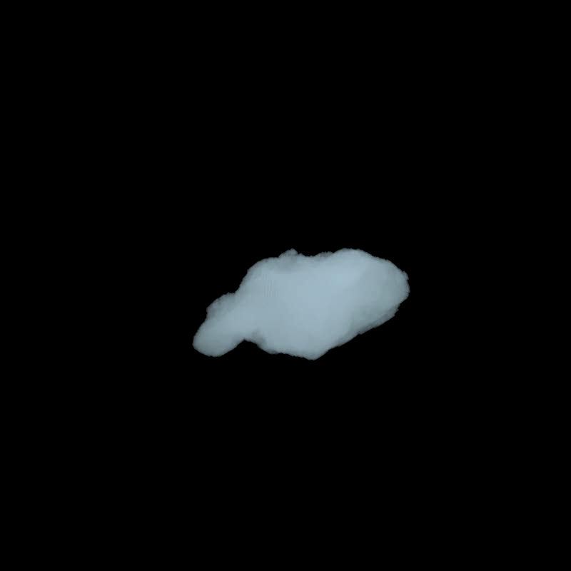

Slide 16
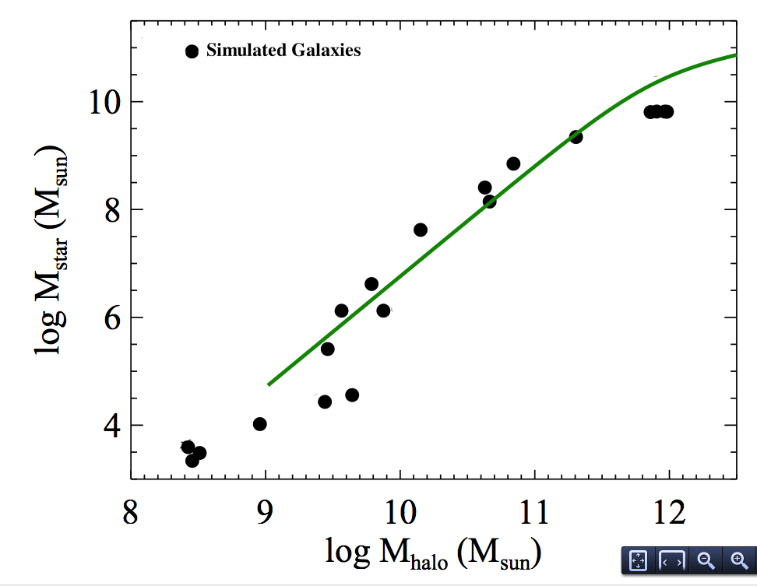
Observed relations of global properties at z = 0
Stellar Mass-Metallicity Relation
Also, realistic sizes, and gas fractions
Baryonic Tully-Fisher
Stellar Tully-Fisher
Stellar Mass-Halo Mass Relation
Moster+ ’10
Simulations
Munshi+ ‘13
Christensen et al, 2015

Slide 17
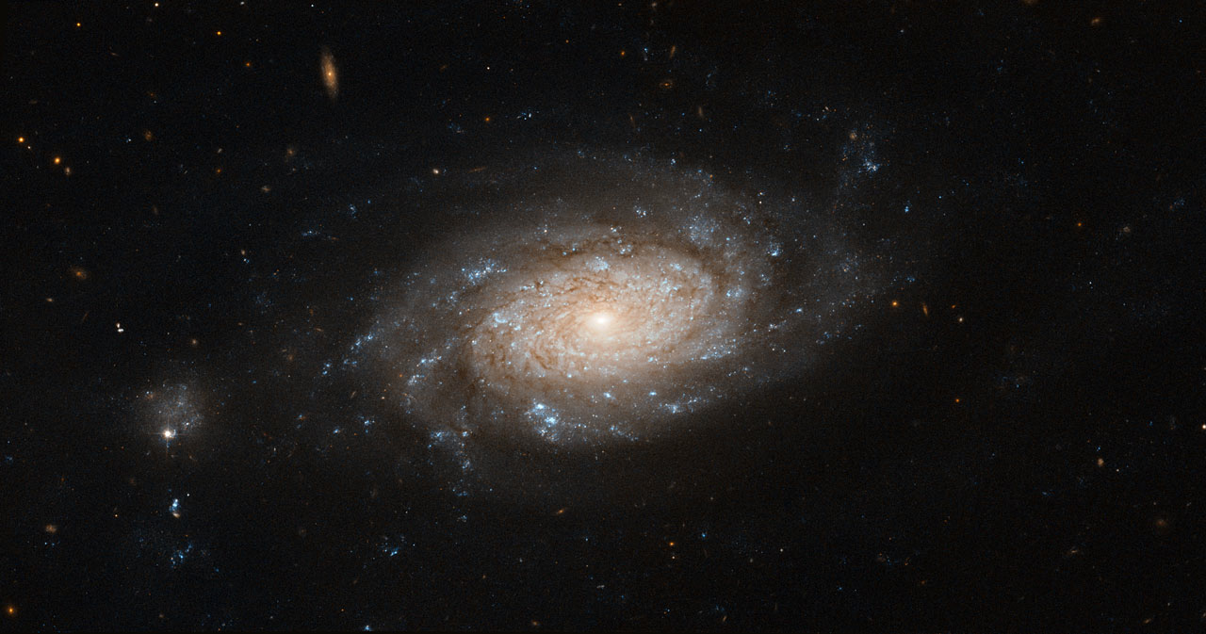
Tracking Particles
Ejected gas:
  Must have once been in the disk
  Kinetic energy greater than potential energy from the disk
(100 Myr time resolution)
Notes:
Particle tracing, 100 Myr steps

Slide 18
Baryonic Fraction
Fraction of Cosmic Baryon Abundance
Christensen et al, 2015

Slide 19
Baryonic Fraction
Fraction of Cosmic Baryon Abundance
Christensen et al, 2015

Slide 20
Mass Loading Factor for Ejected Material
Exponent ~ -1.85
Mass Ejected / Stellar Mass Formed
(1 Gyr time bin)
V_{circ} [km/s]
Christensen et al, 2015

Slide 21
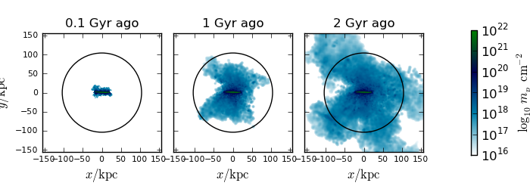
Spread of outflow material

Slide 22
Number of Times a Particle is Reaccreted
% Ejected Particles Accreted N times
Never Reaccreted Reaccreted once Reaccreted twice . . .. . .
Christensen et al, 2015

Slide 23
Amount of Time Before Reaccretion
Ejection
Expulsion
Log Galaxy Mass [M]
Christensen et al, 2015

Slide 24
Metal Enrichment of Outflows
Metallicity of ejected material
Gas metallicity at z = 0
Galaxy Mass [M]

Slide 25
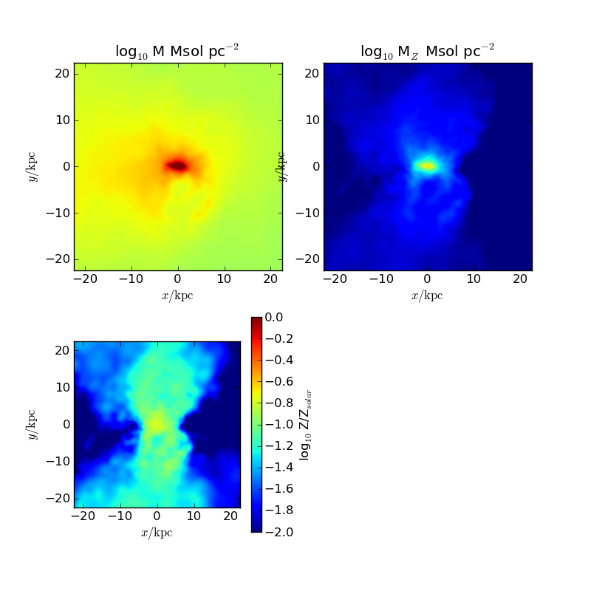
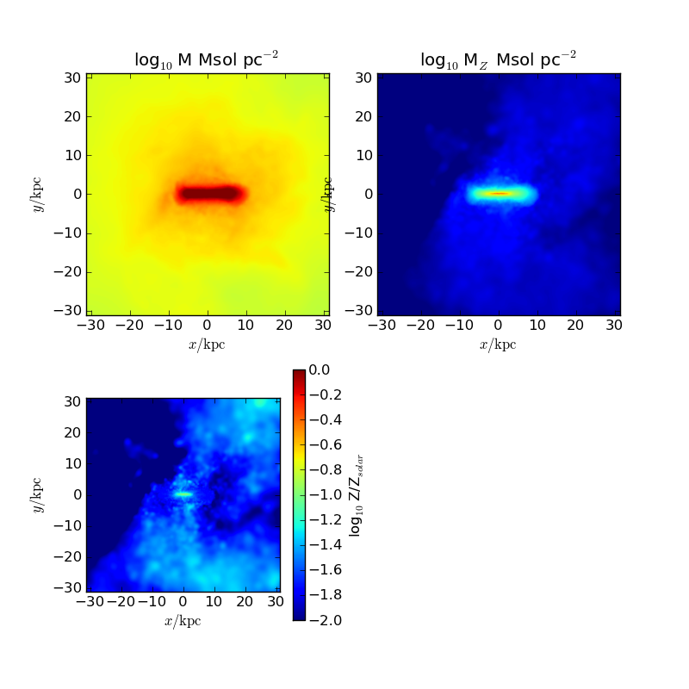
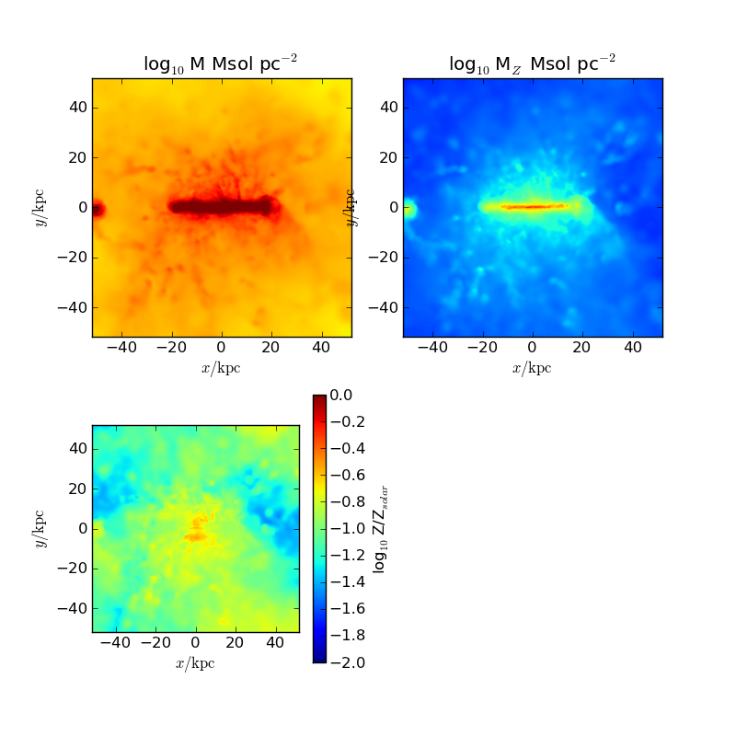
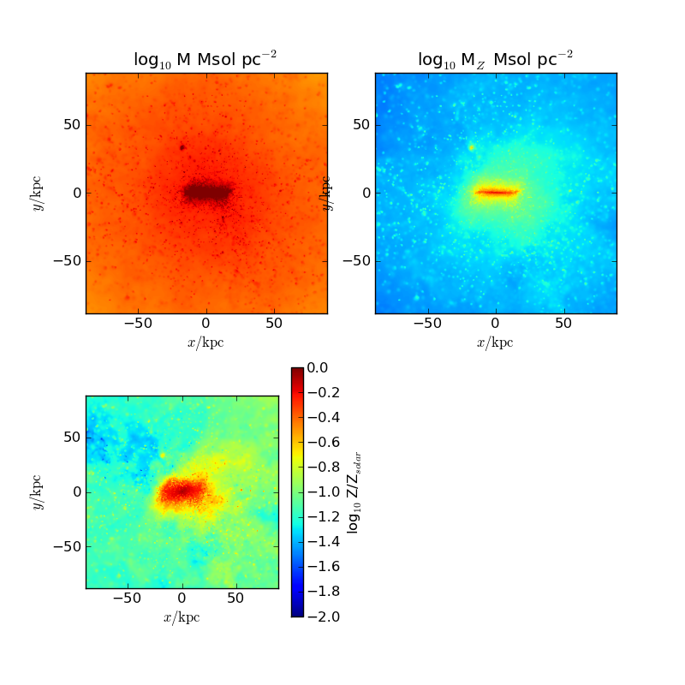
Metal Surface Density
Mass
Log Metallicity of Gas (slice through center of galaxy)

Slide 26
Observations of CGM through Quasar Absorption Line Spectra
COS-halos and COS-dwarfs
COS-halos and COS-dwarfs
Image from Jessica Werk

Slide 27
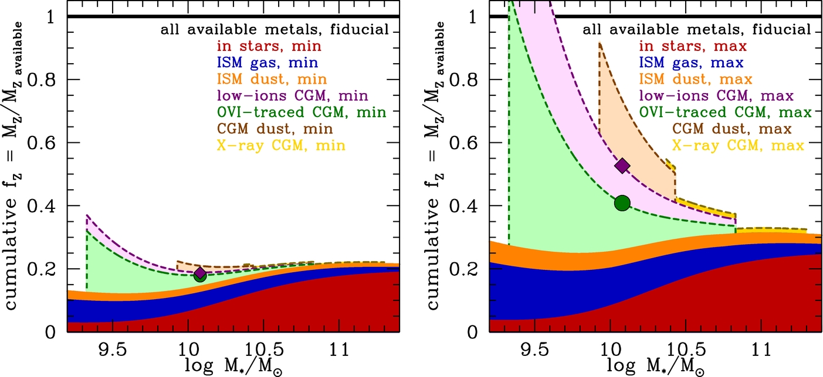
Metal budget
Lower estimate
Upper estimate
Peeples+2014
Compare with McQuinn+ 2015 of Leo P

Slide 28
Eventual Location of Metals
10⁶
10⁷
10^{8.5}
10^{10.5}
Stellar Mass

Slide 29
Working with semi-analytic models
What SAMs add
  Dramatically increase statistics
  Allows for testing of individual prescriptions
  Results in develop analytic models
Using simulations to inform SAMs
  Input models derived from simulations into SAM
  Select merger history from dark matter and re-simulate with SAM
Work done by Yotam Cohen with Rachel Somerville and myself

Slide 30
Comparing Sims and SAMs
Simulations Semi-analytic models
Virial Mass
M_{vir}(z = 0) = 8.7 x 10¹¹ M
M_{vir}(z = 0) = 3.7 x 10⁹ M
Virial Mass [M]
M_{vir}(z = 0) = 8.4 x 10¹¹ M
M_{vir}(z = 0) = 1.6 x 10⁹ M
M_{vir}(z = 0) = 7.1 x 10¹¹ M
M_{vir}(z = 0) = 1.5 x 10⁹ M
M_{vir}(z = 0) = 6.3 x 10¹¹ M
M_{vir}(z = 0) = 1.1 x 10⁹ M
Time [Gyr]

Slide 31
Comparing Sims and SAMs
Simulations Semi-analytic models
Stellar Mass
M_{vir}(z = 0) = 8.7 x 10¹¹ M
M_{vir}(z = 0) = 3.7 x 10⁹ M
Virial Mass [M]
M_{vir}(z = 0) = 8.4 x 10¹¹ M
M_{vir}(z = 0) = 1.6 x 10⁹ M
M_{vir}(z = 0) = 7.1 x 10¹¹ M
M_{vir}(z = 0) = 1.5 x 10⁹ M
M_{vir}(z = 0) = 6.3 x 10¹¹ M
M_{vir}(z = 0) = 1.1 x 10⁹ M
Time [Gyr]

Slide 32
Comparing Sims and SAMs
Simulations SAM I SAM II
Stellar Mass
M_{vir}(z = 0) = 3.7 x 10⁹ M
M_{vir}(z = 0) = 8.7 x 10¹¹ M
Virial Mass [M]
M_{vir}(z = 0) = 8.4 x 10¹¹ M
M_{vir}(z = 0) = 1.6 x 10⁹ M
M_{vir}(z = 0) = 1.5 x 10⁹ M
M_{vir}(z = 0) = 7.1 x 10¹¹ M
M_{vir}(z = 0) = 1.1 x 10⁹ M
M_{vir}(z = 0) = 6.3 x 10¹¹ M
Time [Gyr]

Slide 33
Summary and plan for future
We know that stellar feedback has a profound effect on galaxy growth and structure and yet is poorly understood
Use detailed simulations to measure properties of outflows and the resulting CGM
Apply models derived from simulations to SAMs to produce populations of galaxies and to interpret the simulations
In an ideal future, combine with measurements of resolved star formation histories, outflowing gas, and the CGM

