Slide 1
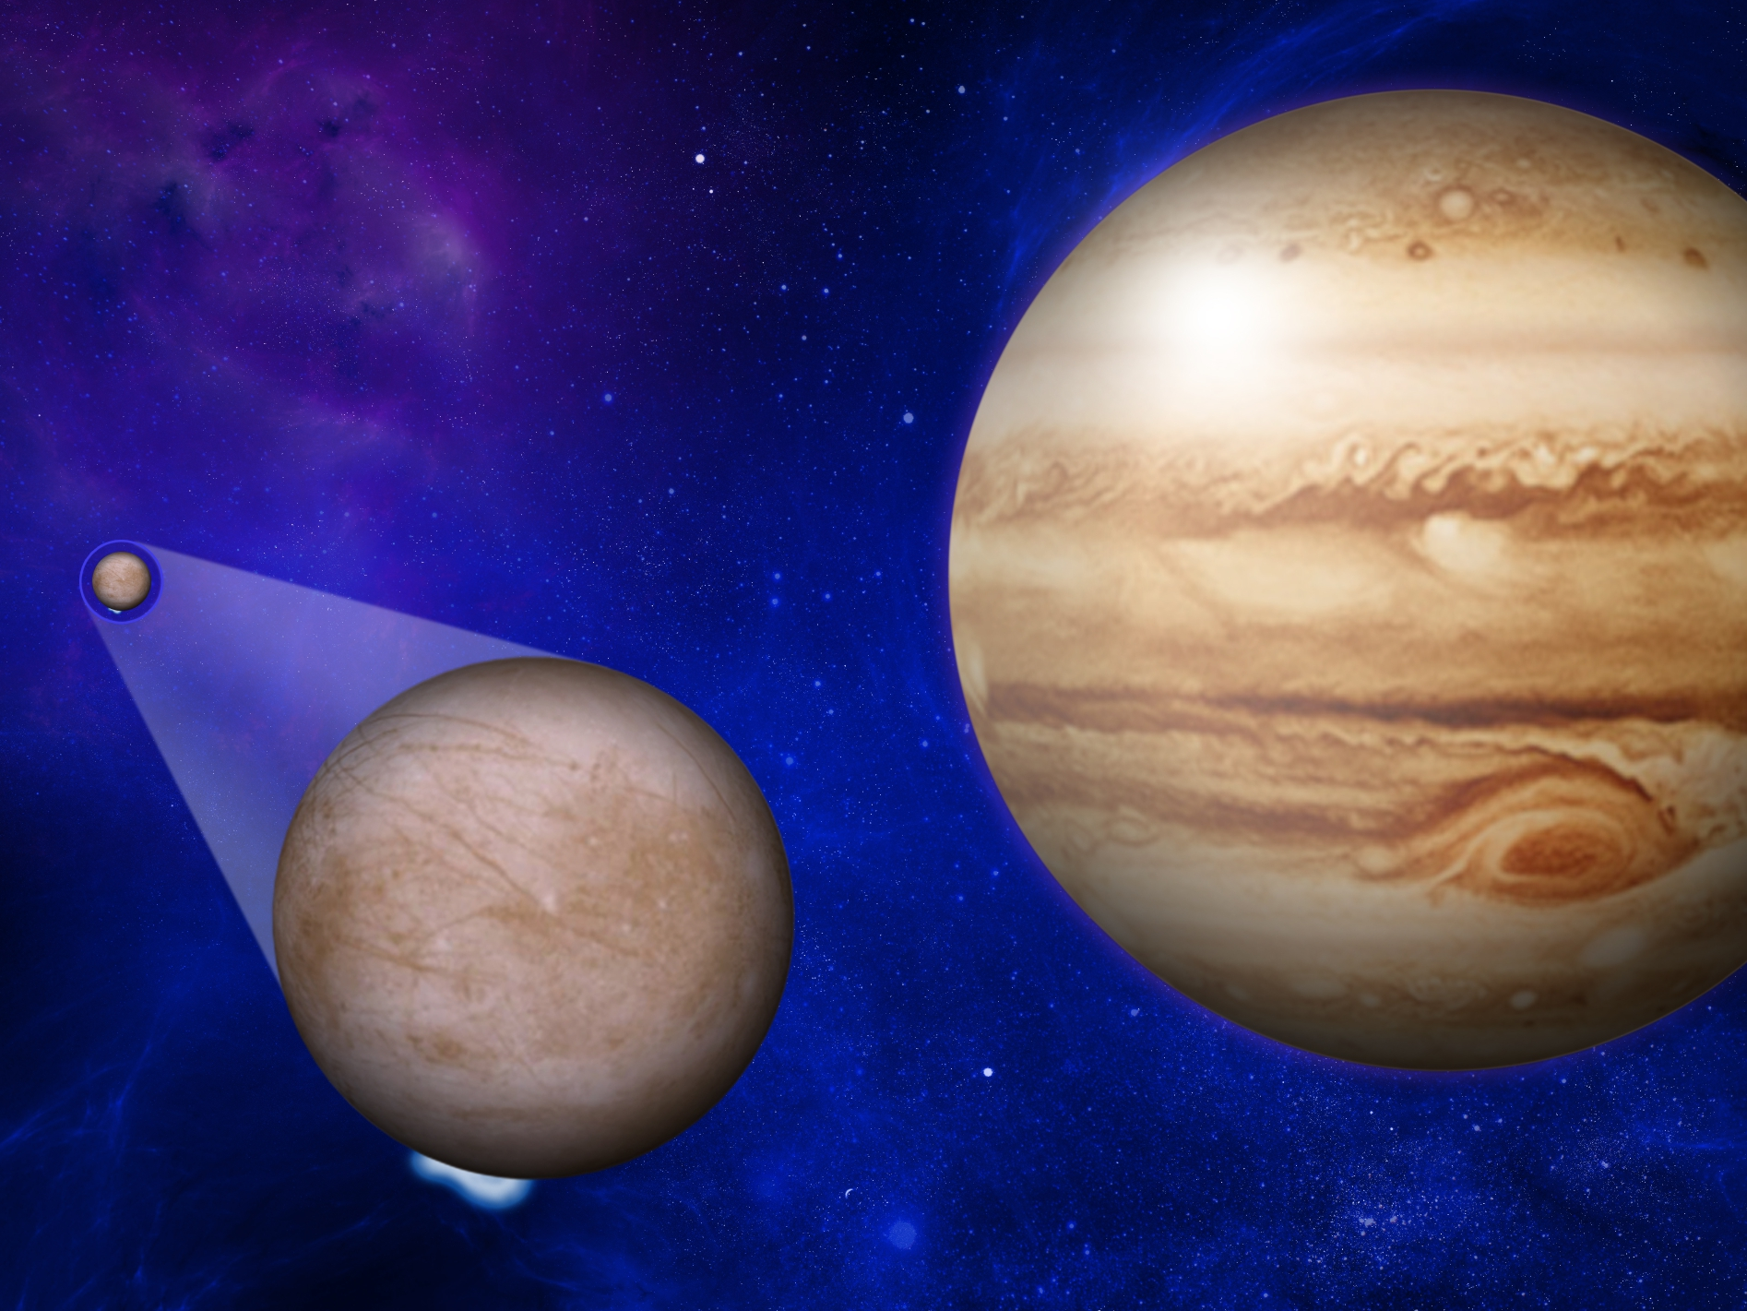

Europa’s Atmosphere and Plumes
Through Ultraviolet Observations
Lorenz Roth
KTH Royal Institute of Technology, Sweden
Southwest Research Institute, TX
Joachim Saur, Kurt Retherford, Darrell Strobel,
Paul Feldman,Melissa McGrath, Francis Nimmo,
John Spencer, Nickolay Ivchenko

Slide 2
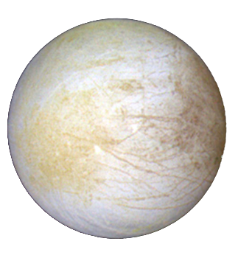
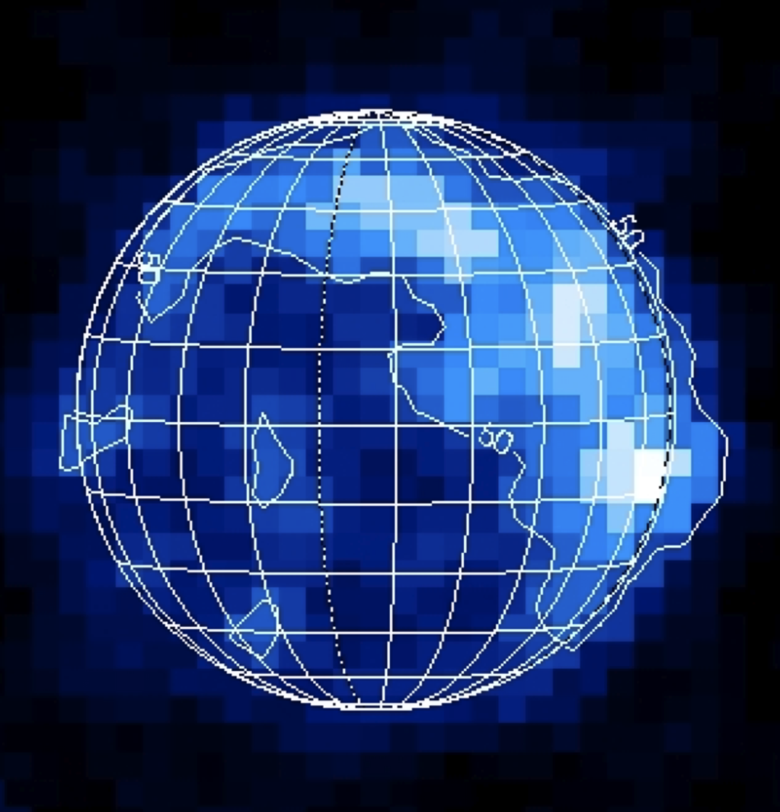
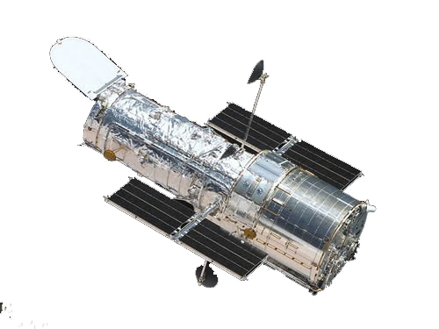
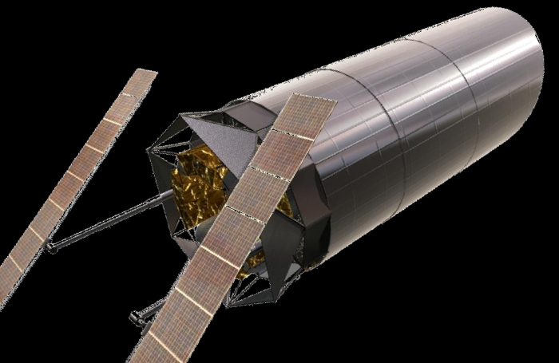
Outline
Jupiter’s moon Europa
& Upcoming missions
HST ultraviolet observations:
Discovery of Europa’s O₂ atmosphere and H₂O plume detection
Results from the 2014/2015 HST campaign and future prospects

Slide 3
John Spencer

Slide 4
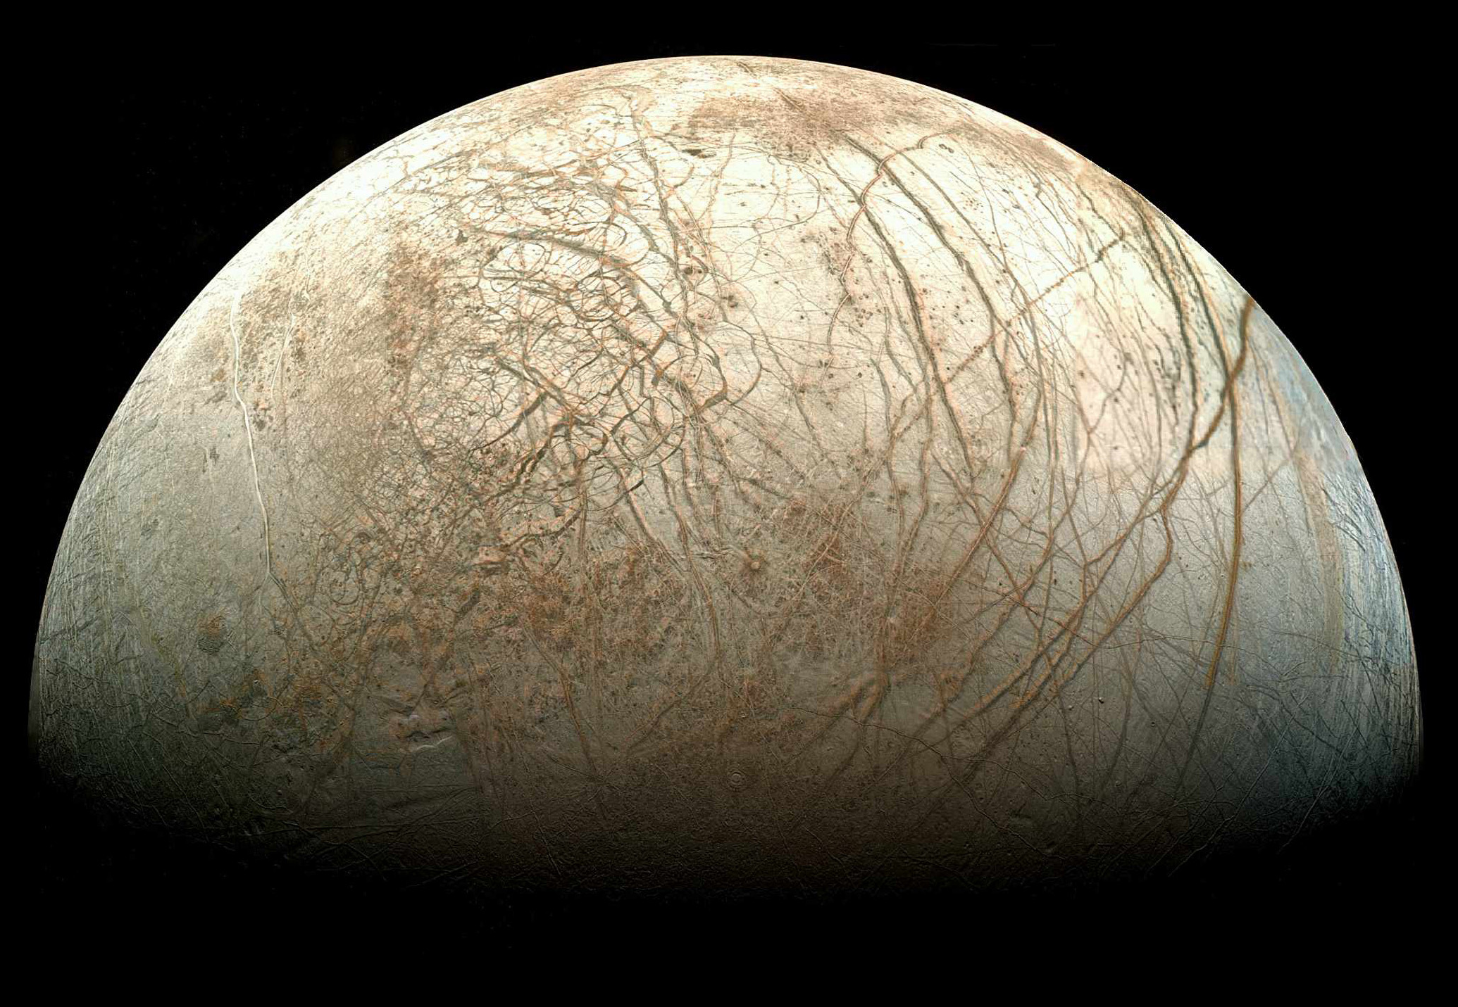




liquid
water
essential
elements
chemical
energy
stable
environment
Mosaic by T. Stryk
Copyright 2014 California Institute of Technology.

Slide 5
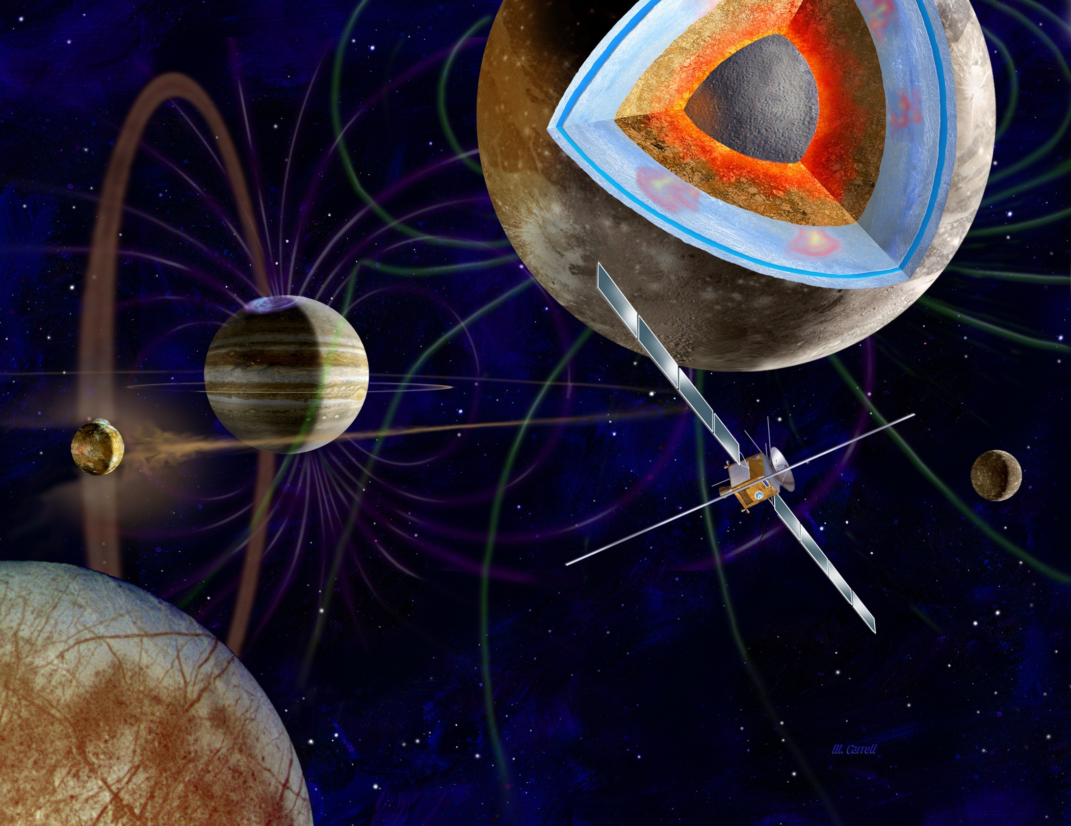
ESA’s Jupiter Icy
Moon Explorer (JUICE)
11 instruments onboard
Launch planned for 2022
Arrival at Jupiter in 2030
2 close Europa flybys
Into orbit around Ganymede (2033) after Jupiter orbit phase
Credits ESA

Slide 6
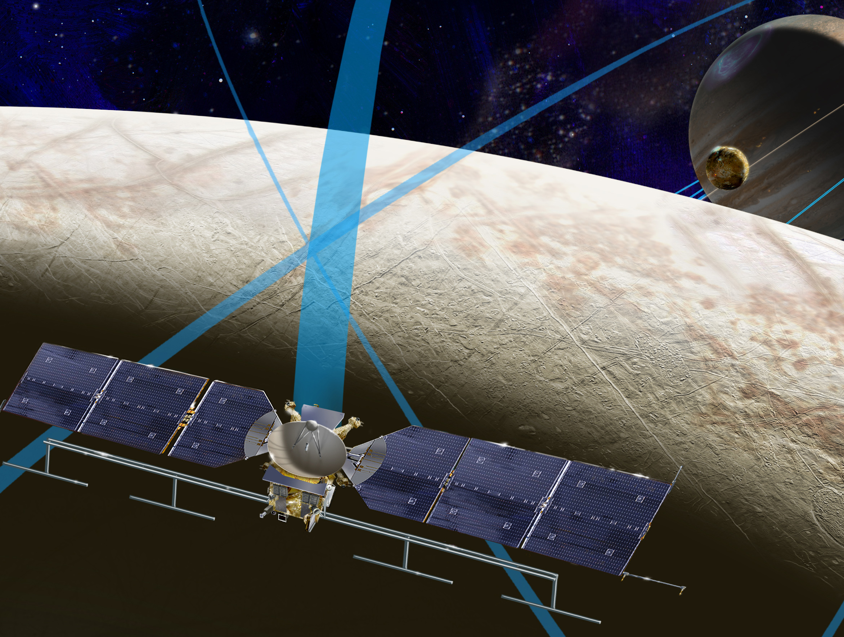
NASA’s Europa multiple-flyby mission
9 science instruments
Possible launch date in 2022 (or 2025)
2-year or 7-year cruise to Jupiter
NASA / JPL

Slide 7
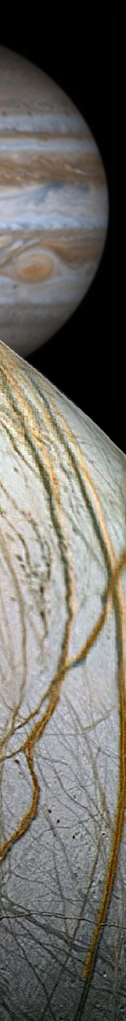
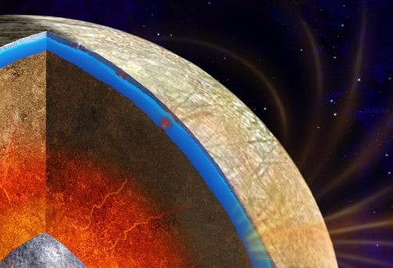
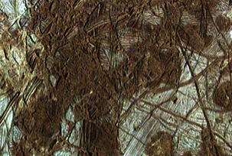
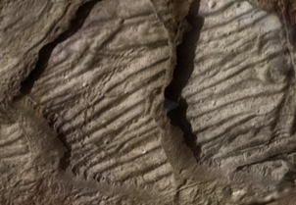
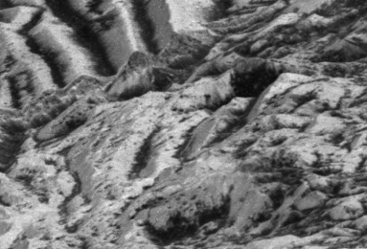
Europa Multi-Flyby Mission
Science Goal & Objectives
Goal: Explore Europa to investigate its habitability
Objectives:
  Ice Shell & Ocean: Characterize the ice shell and
  any subsurface water, including their heterogeneity,
  ocean properties, and the nature of
  surface-ice-ocean exchange
  Composition: Understand the habitability
  of Europa's ocean through composition
  and chemistry
  Geology: Understand the formation of surface
  features, including sites of recent or current activity,
  and characterize high science interest localities
  Reconnaissance: Characterize scientifically
  compelling sites, and hazards, for a potential
  future landed mission to Europa
The Europa Mission will provide an in depth look at Europa’s ice-shell-covered ocean, plumes, surface chemistry, and geophysics; identifying sites for future exploration.

Slide 8
2. Hubble UV observations:
O₂ Atmosphere and H₂O plumes

Slide 9
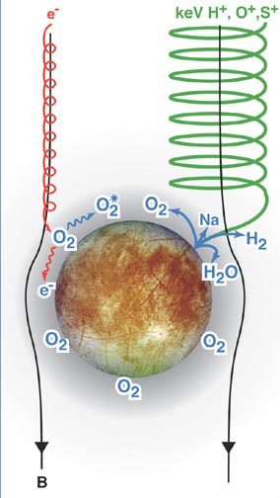
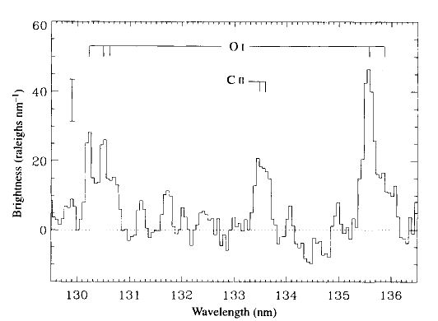
O₂ atmosphere detected with UV aurora spectra
HST/GHRS FUV spectrum revealed
oxygen emissions from the atmosphere
OI1356 Å / OI1304 Å ratio of ~2 is diagnostic for:
e⁻ + O₂ → O* → O + hv (OI)
➤ O₂ atmosphere / exosphere
Hall et al. 1995
Hall et al. 1995
Johnson et al. 2004

Slide 10
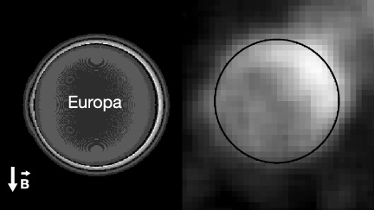
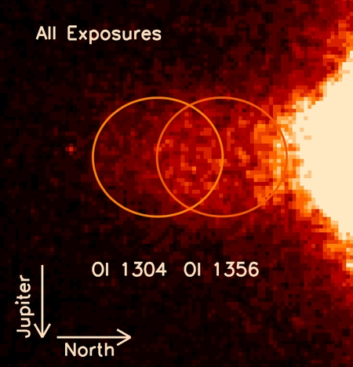
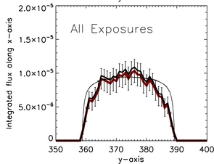
Irregular aurora morphology – hint for plumes?
OI 1356 Å
1999: First aurora images taken by Hubble’s Space Telescope Imaging Spectrograph (STIS)
Possible causes for irregular aurora morphology:
➤ Inhomogeneous electron
environment
➤ Atmospheric inhomogeneity
HST/ACS images 2008:
- High noise – low signal
- Hints of plumes?
McGrath et al. 2004 / Saur et al. 1999
e⁻ + O₂ → O* → O + hv (OI)
Saur et al. 2011

Slide 11
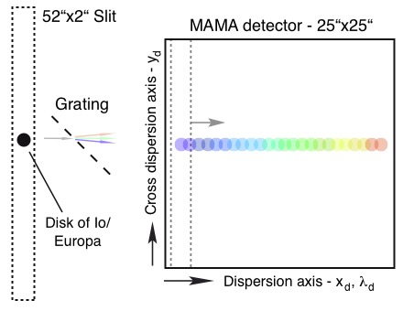
FUV imaging spectroscopy with HST / STIS

Slide 12
FUV imaging spectroscopy with STIS
HI 1216
Lyman-α
OI 1356
OI 1304
Aurora from global oxygen atmosphere:
  e⁻ + O₂ → O* → hv_{O}
  OI 1304 Å : OI 1356 Å ~ 1 : 2
  e⁻ + O → O* → hv_{O}
  OI 1304 Å : OI 1356 Å ~ 1 : 0.4
O /H Fluorescence - O1304 Å / H1216 Å
December 2012:
Coincident local OI 1216 Å and 1304 Å surpluses
  e⁻ + H₂O → H* / O* → hv_{H} / hv_{O}
  HI 1216 Å : OI 1304 Å : OI 1356 Å
  20 : 1 : 0.3

Slide 13
5-orbit images series
Local H Lyman-α and O 1304 Å emission surplus time-stationary
Persistency indicates atmospheric inhomogeneity
Surpluses consistent with two ~200 km high water vapor plumes with column densities of N ~ 10²⁰ H₂O/m⁻²

Slide 14
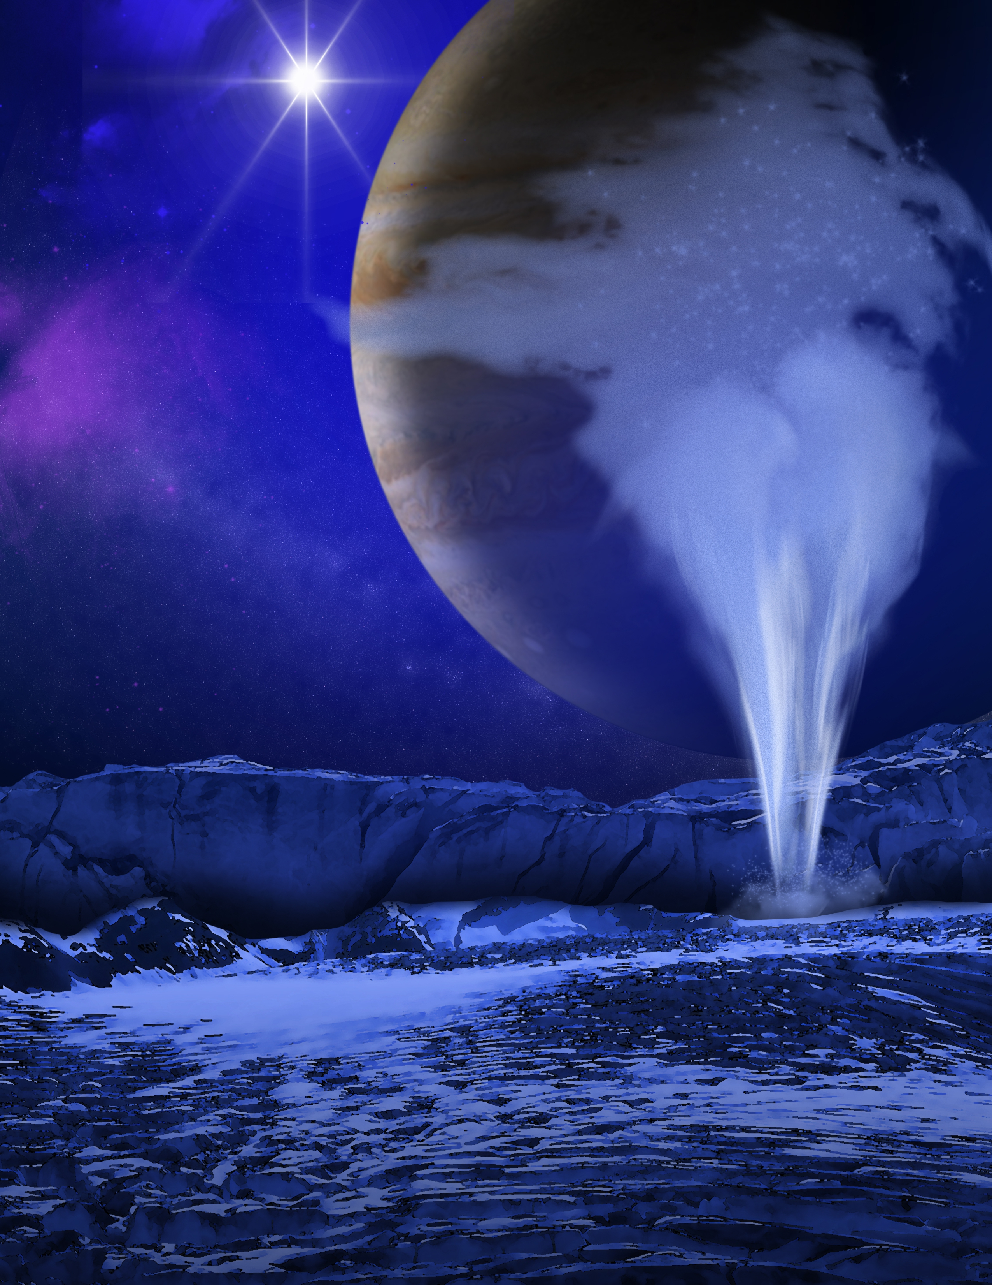
➧

Slide 15
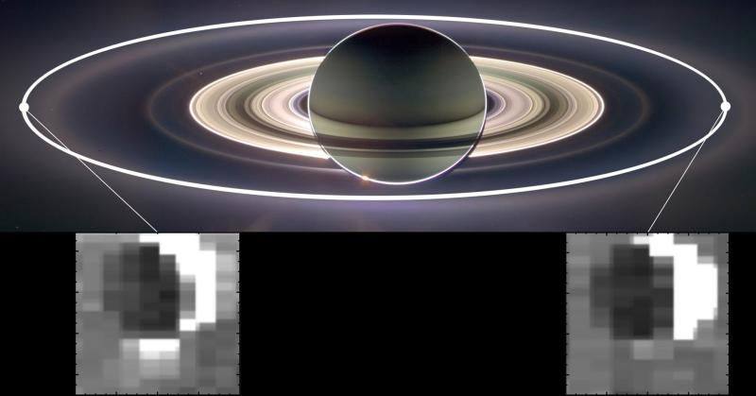
Tidal Forces Controlling Enceladus’ Jets
ASA/JPL-Caltech/University of Arizona/Cornell/SSI

Slide 16
As reported last year: 5 Visits - one detection
Pericenter
Pericenter
Apocenter
Apocenter
Apocenter
Plume activity connected to tidal stresses on surface fractures?
Roth et al., "Orbital apocenter is not a sufficient condition for HST/STIS detection of Europa’s water vapor aurora", PNAS, 2014

Slide 17
3. Results from the 2014/2015 HST Europa UV campaign and future prospects

Slide 18
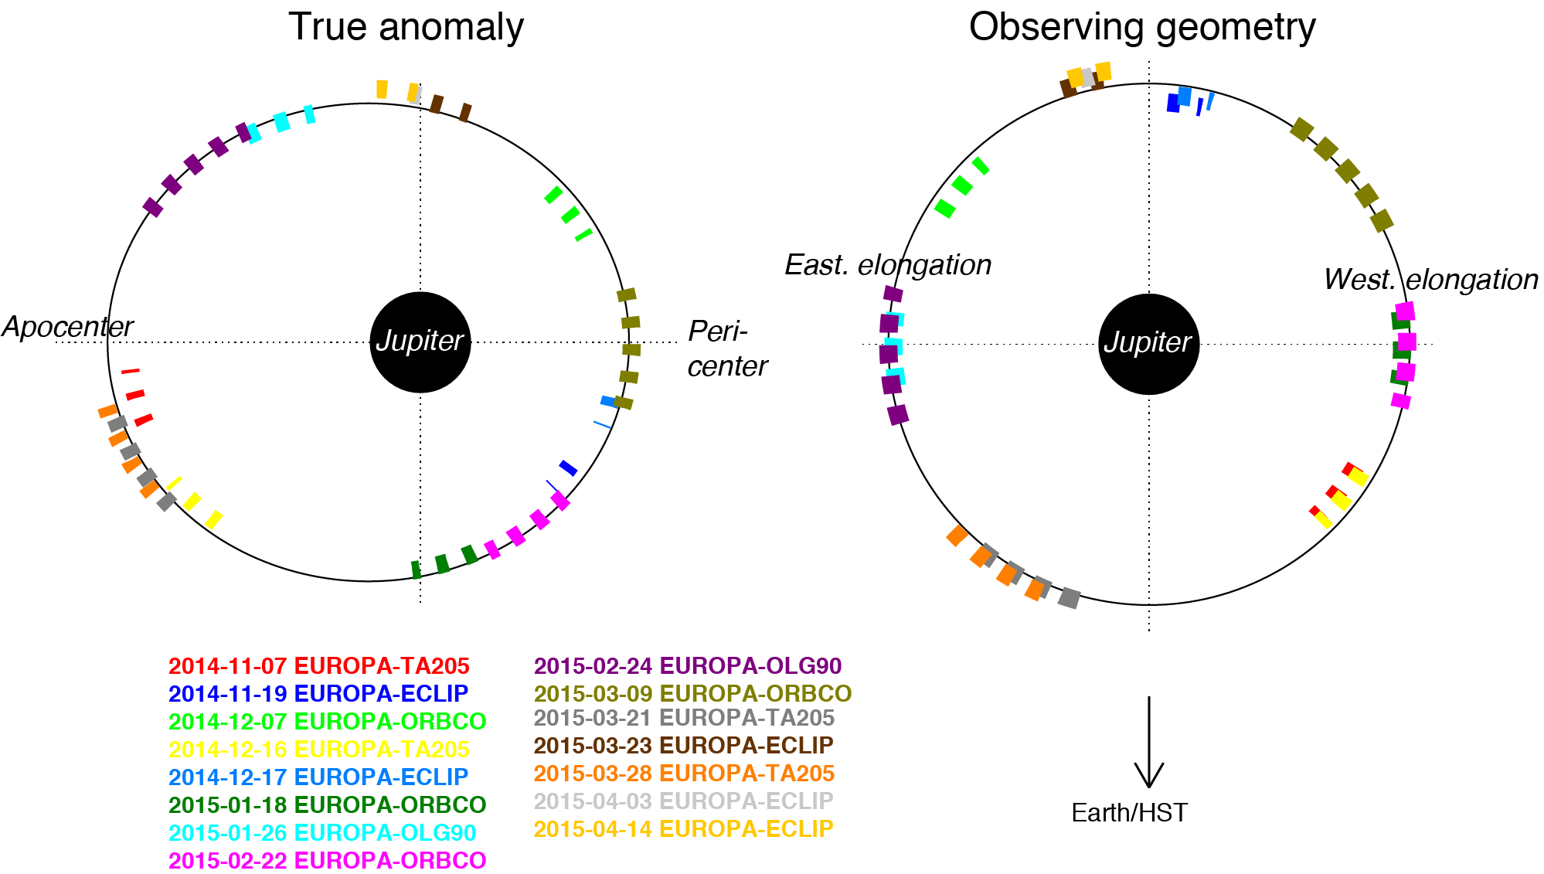
2014/2015 Cycle 22 HST Europa campaign:
15 aurora / emission visits

Slide 19
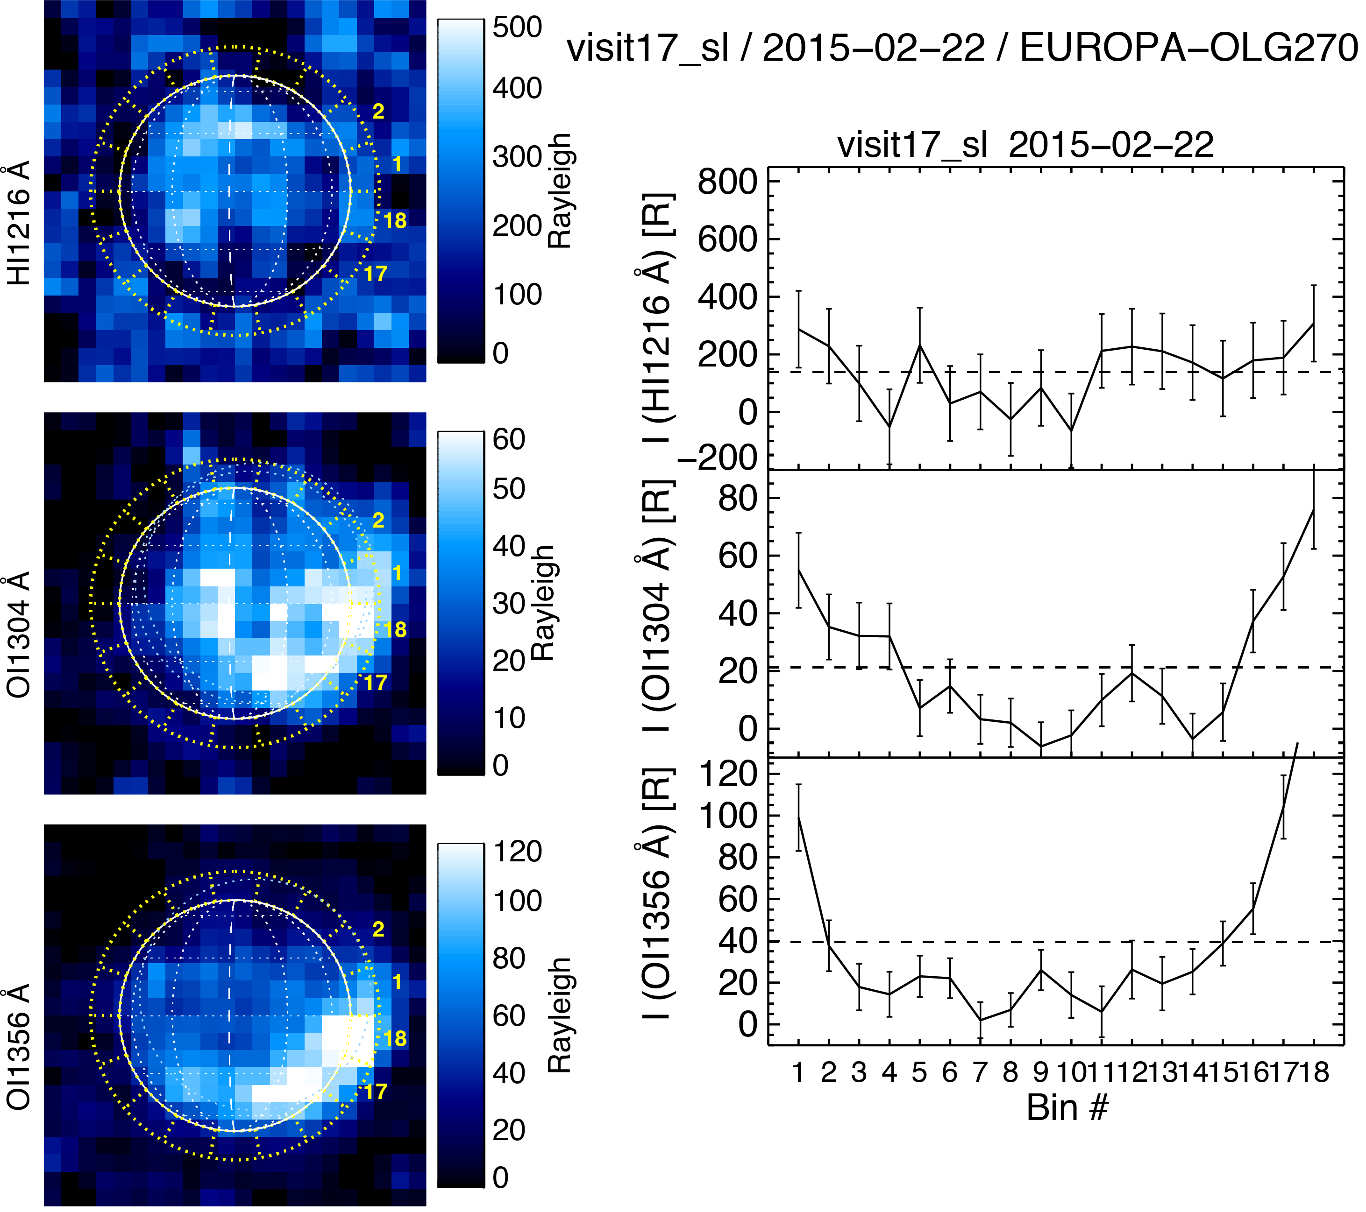
Maximum Ly-α:
300 R
Constraint on H₂O abundance:
N < 0.8 x 10¹⁶ cm⁻²
Dec 2012:
600 R Ly-α
N_{H2O} ~1.5x10¹⁶ cm⁻²

Slide 20
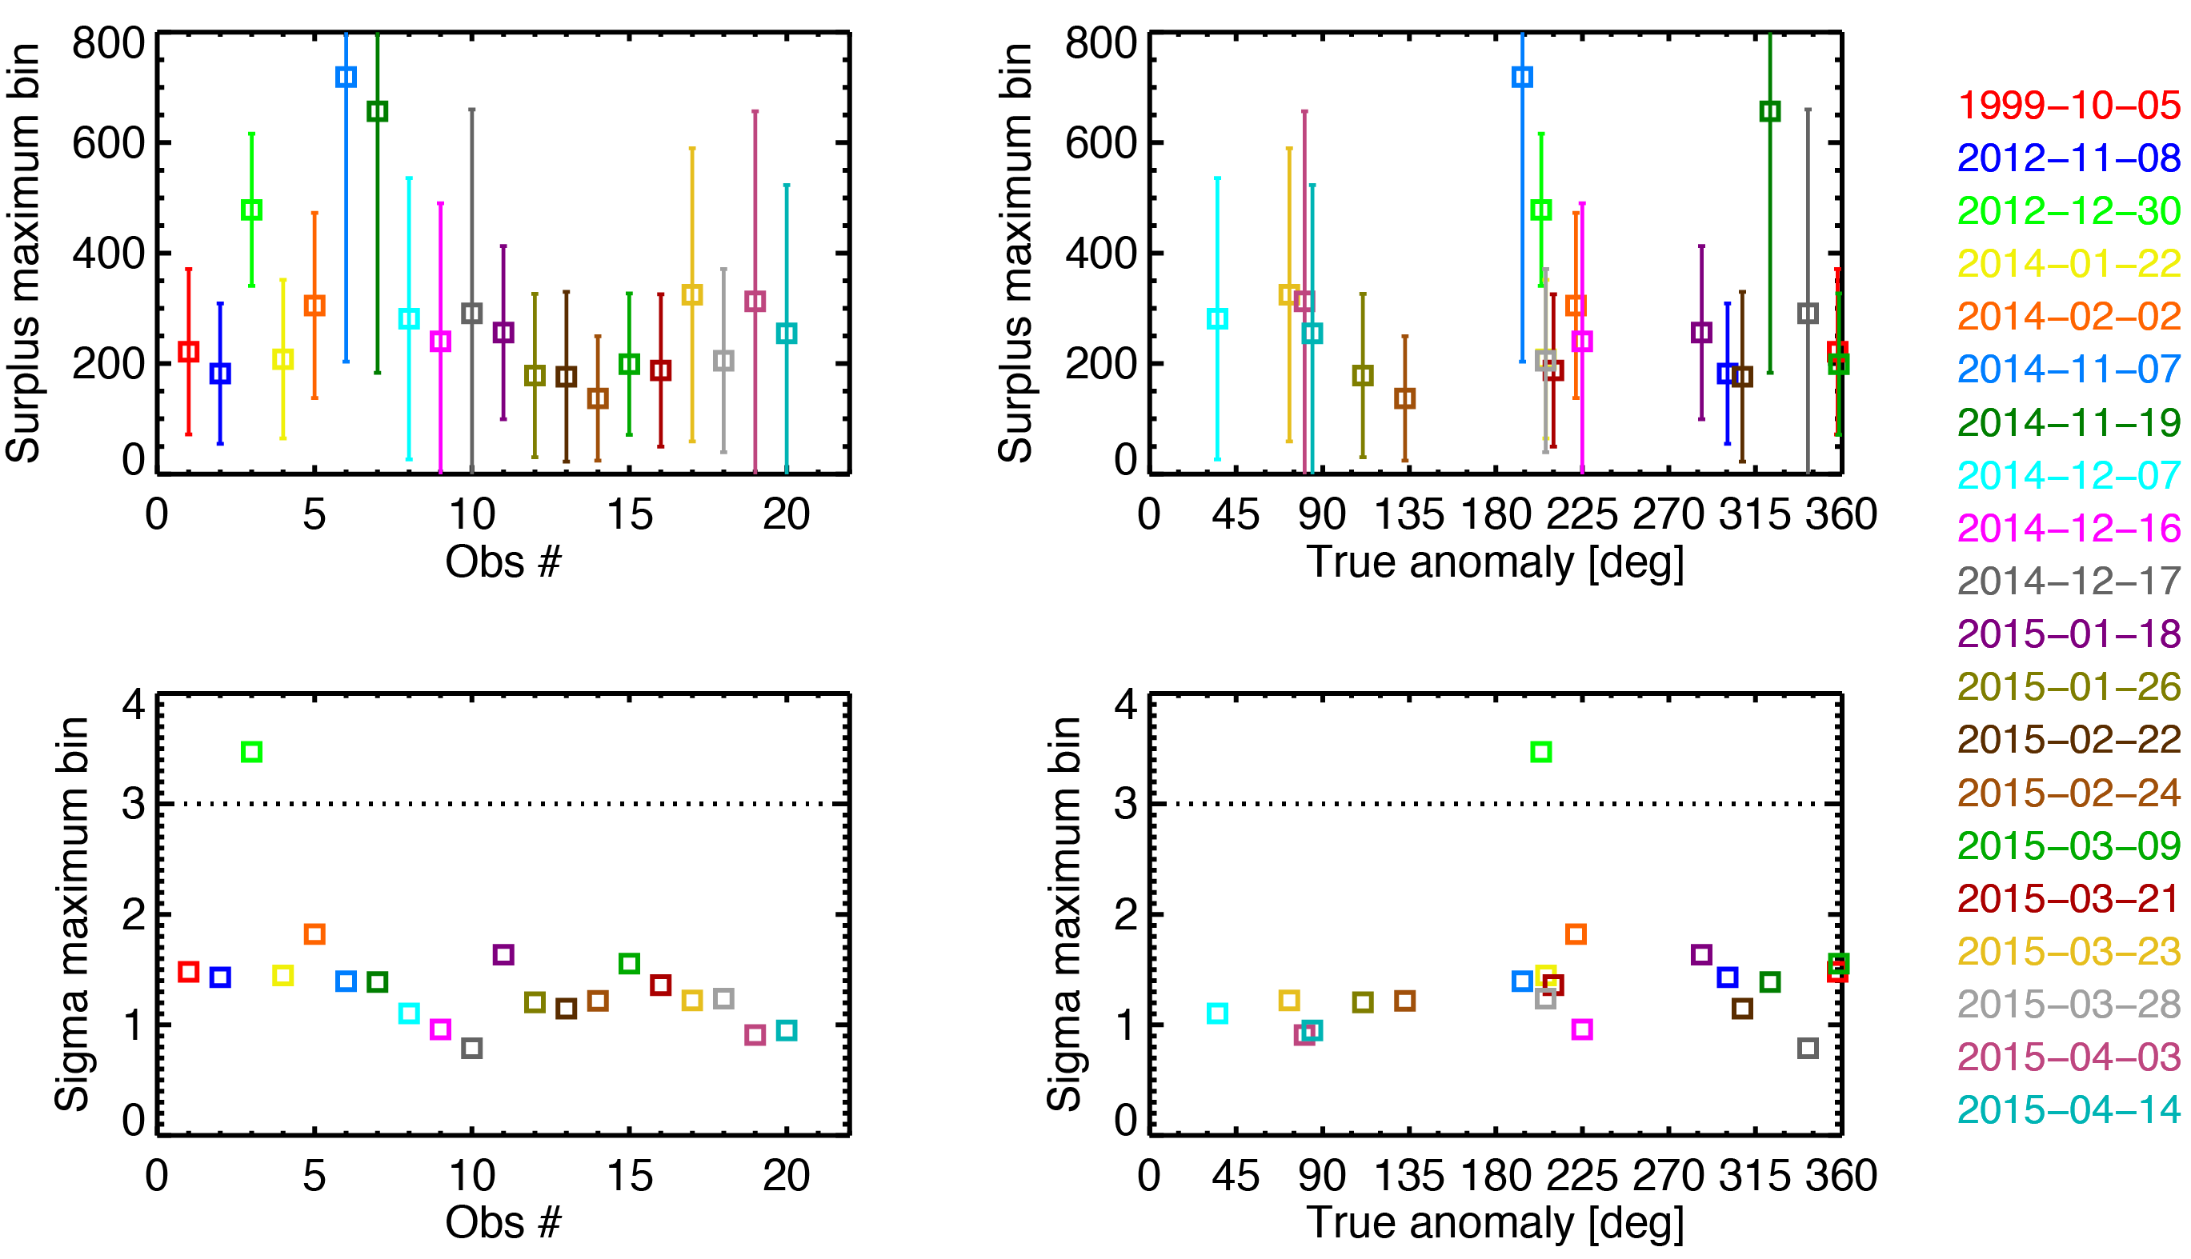
Ly-α limb surpluses for all 20 visits
No confirmtion of water vapor plumes
Apocenter
Apocenter

Slide 21
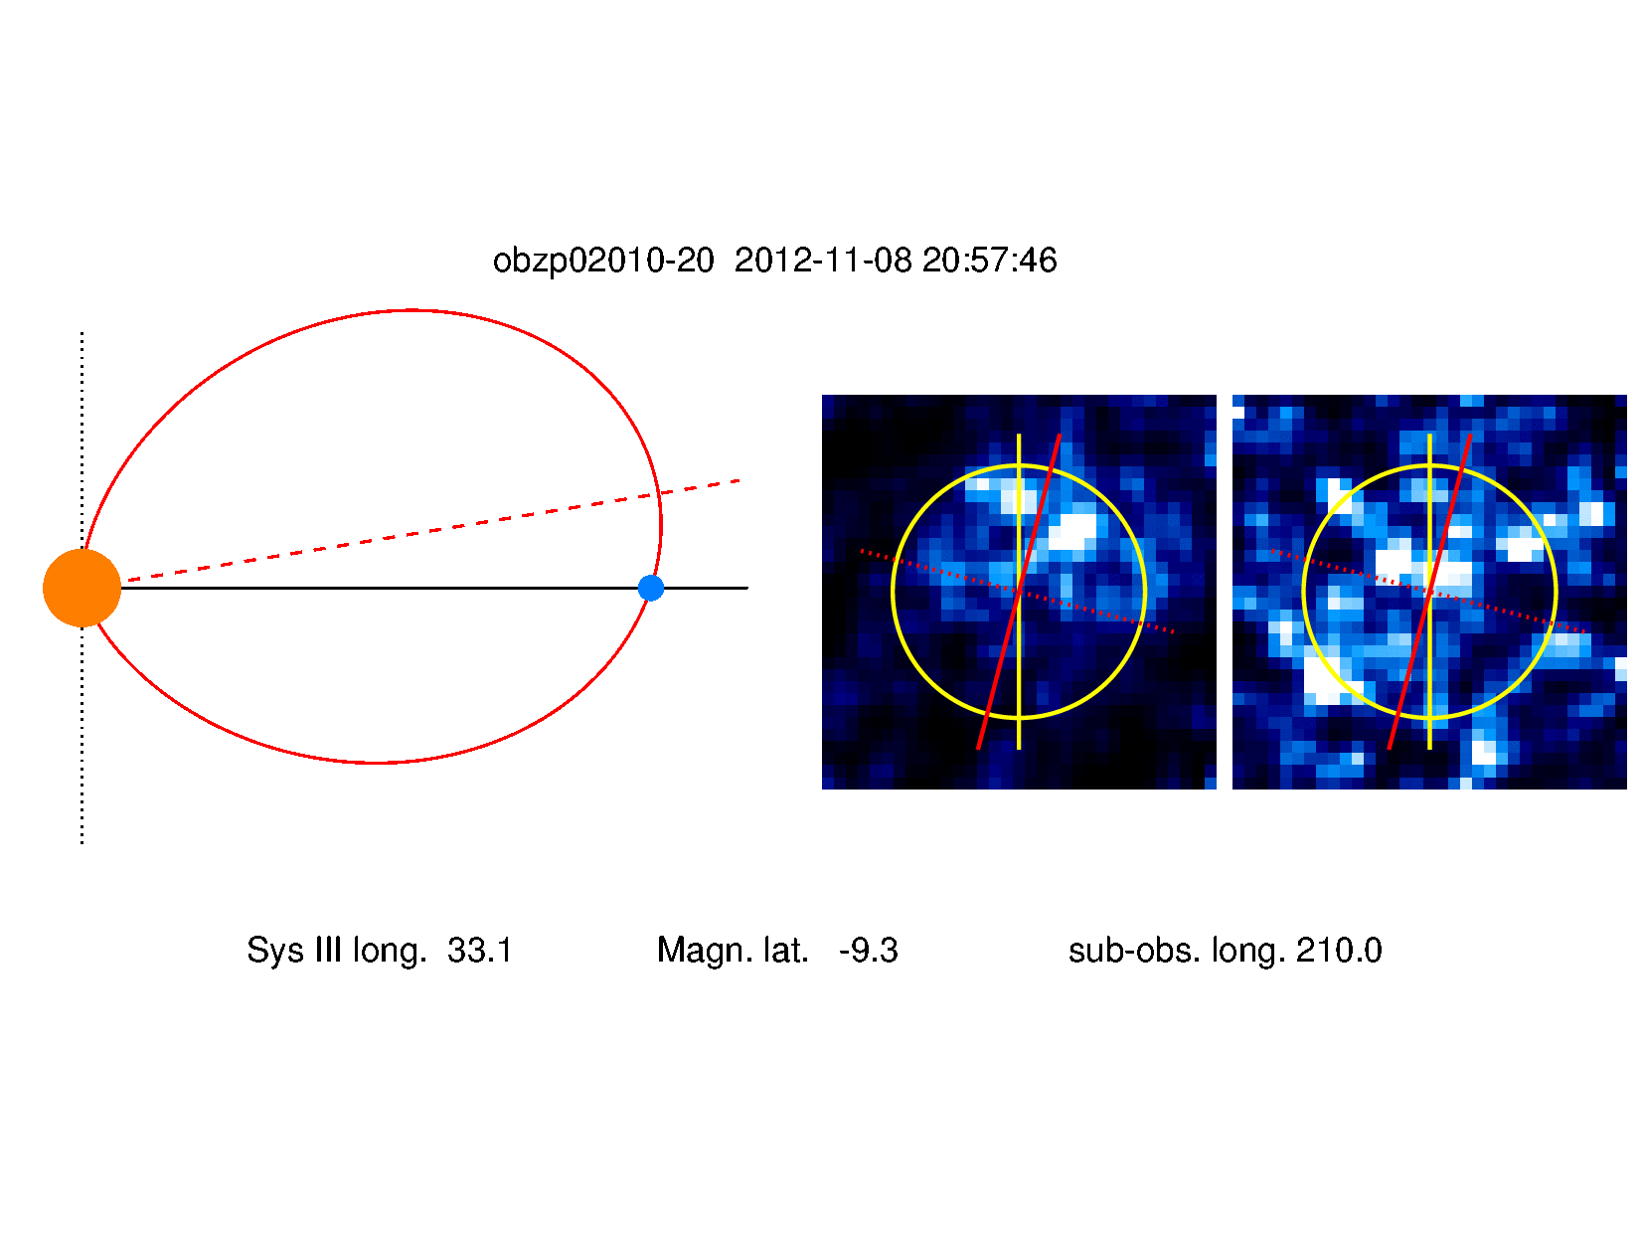
Oxygen aurora from global O₂ atmosphere correlated to magnetospheric environment
OI 1356 Å
OI 1304 Å
Jupiter
Europa
Brightness decreases with distance to the plasma sheet
Bright emission symmetric around ‘magnetic’ poles
Hemisphere that is facing the plasma sheet is brighter

Slide 22
1. Brightness variations
Consistent dependence on plasma sheet distance
Brightness decreases with distance
Fit for latitudinal plasma sheet profile (dashed): Characteristic length scale of H_{c} = 1.7 R_{J}
Consistent with density profile of Bagenal & Delamere (2011)
Brighter aurora in 1999 !
H_{c}
Bagenal+ 2015

Slide 23
2. Morphology correlated / symmetric to magnetic field orientation
Europa
Io
=> Polar aurora – no equatorial spots!

Slide 24
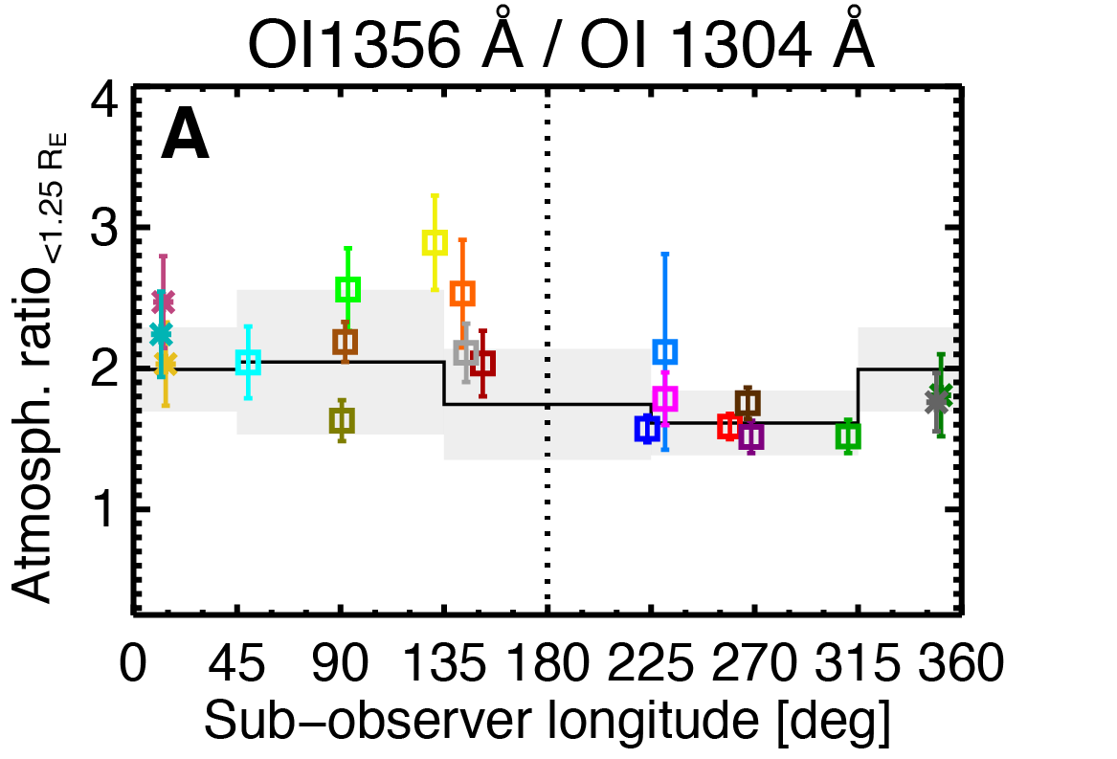
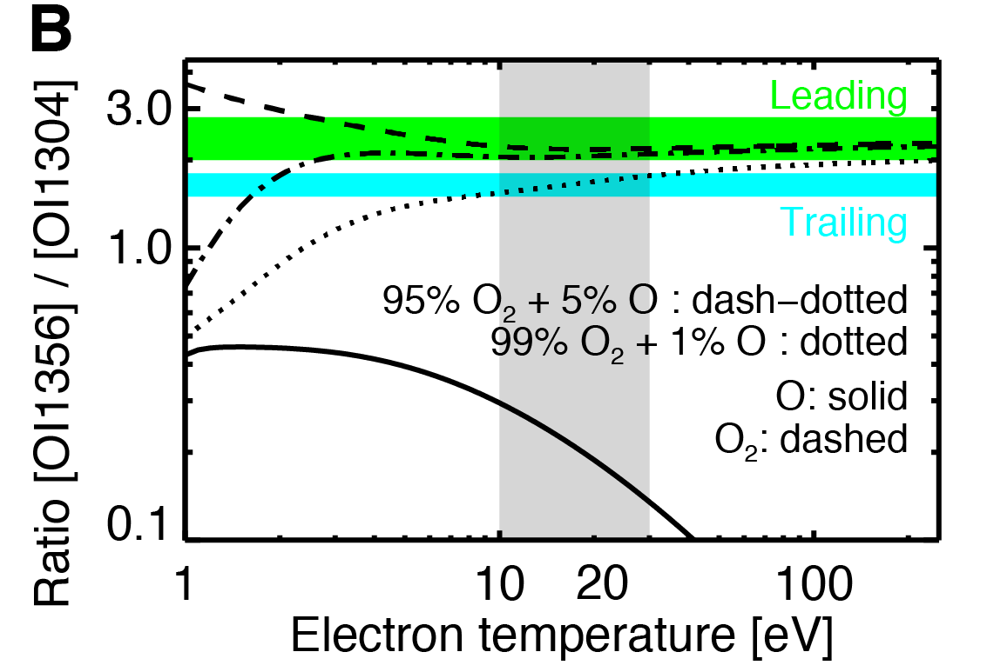
OI1356 Å / OI 1304 Å ratio => O / O₂ ratio
Leading/ Downstr.
Trailing/ Upstream
Oxygen line ratios between 1.5 and 2.8 detected
Upstream: < 2
Downstream: ≥ 2
=> lower abundance of atomic oxygen in downstream region
=> Roth et al., “Europa’s FUV oxygen aurora”, JGR, under revision

Slide 25
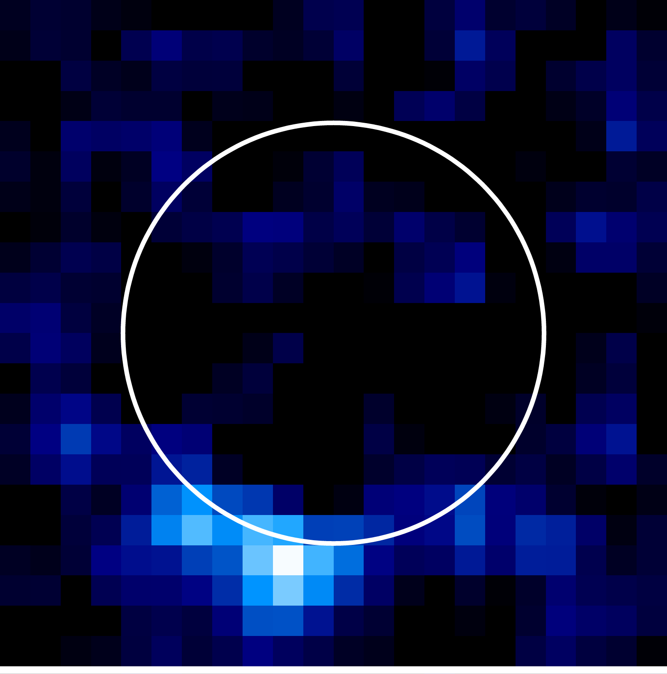
Hubble Science Summary
HST observations of Europa FUV emissions
a useful tool to explore the moon and its environment:
  First detection of global O₂ atmosphere in oxygen aurora
  Detection of coincident Lyman-α and OI 1304 Å surpluses indicative of transient H₂O plume abundance
  Large 2014/2015 HST FUV campaign provided
  (only) upper limits on H₂O plume abundance
  Detection of plumes hampered by variable plasma environment and possibly very transient plume nature
  Brightness and morphology of oxygen aurora can be used to probe Europa’s interaction with the magnetosphere

Slide 26

Observing issues and future UV telescope
Geocorona at H 1216 and O 1304 !
H Lyman-α signal essential diagnostic to search for plume aurora
But: Strong geocoronal contamination for HST
8 m telescope at L2:
  ~10 times higher SNR for 500 R Lyman-α plume signal
  Small (200 km x 200 km) plume signal detectable in 2 minutes with 3 sigma!
2 February 2014
22 January 2014

Slide 27
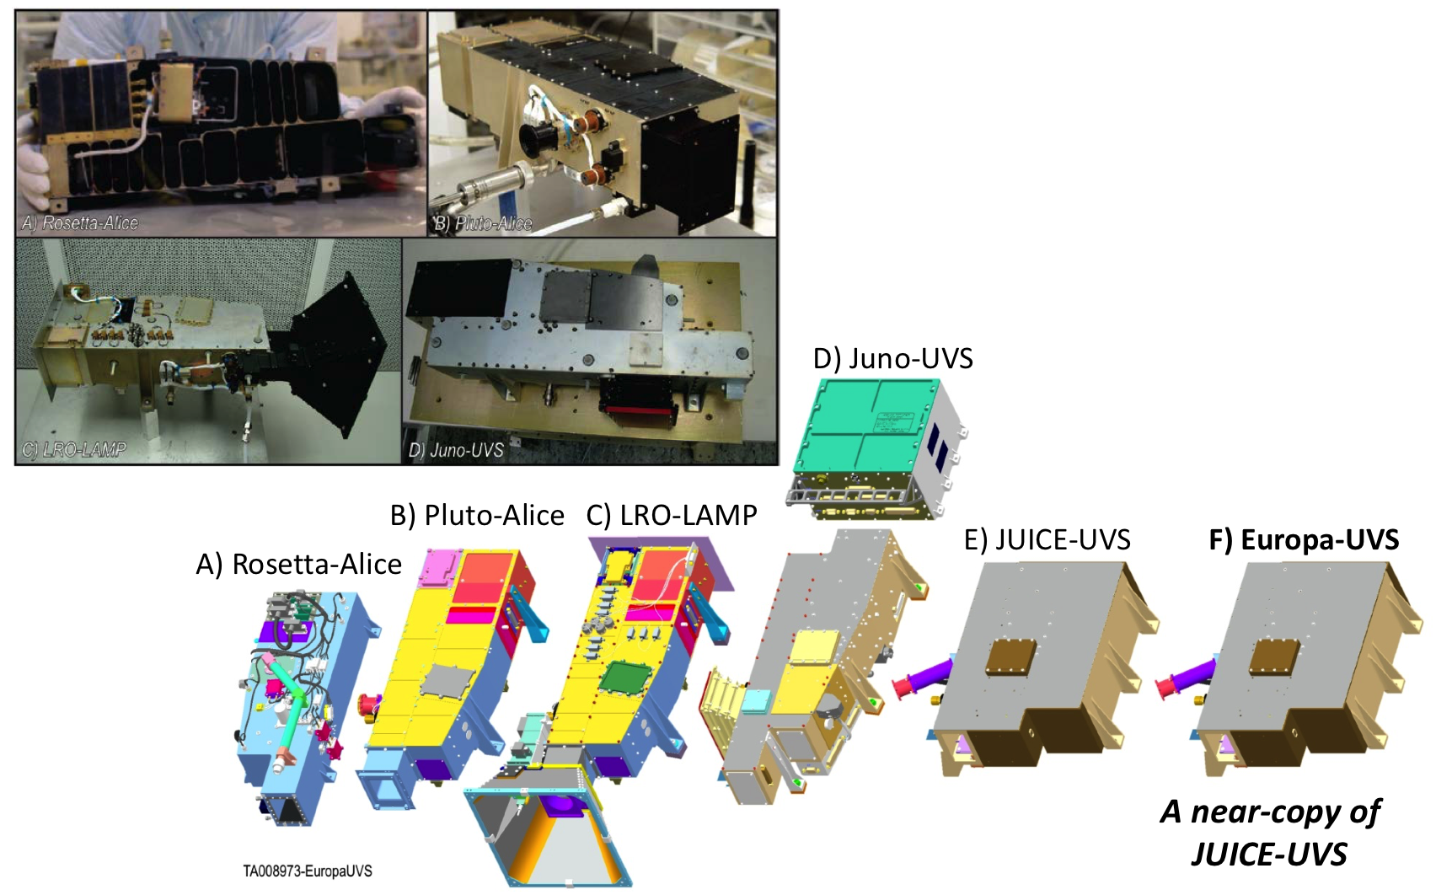
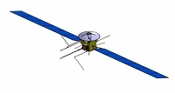
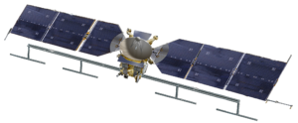
JUICE and Europa UVS
Extend SwRI’s UV Instrument Family

Slide 28
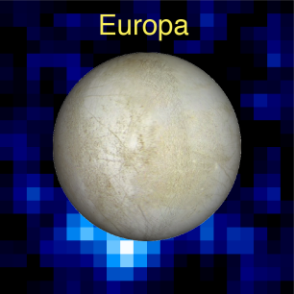
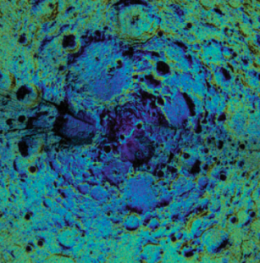
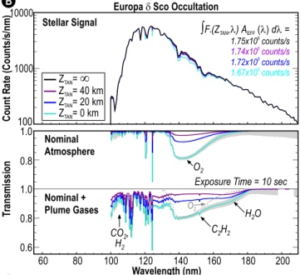
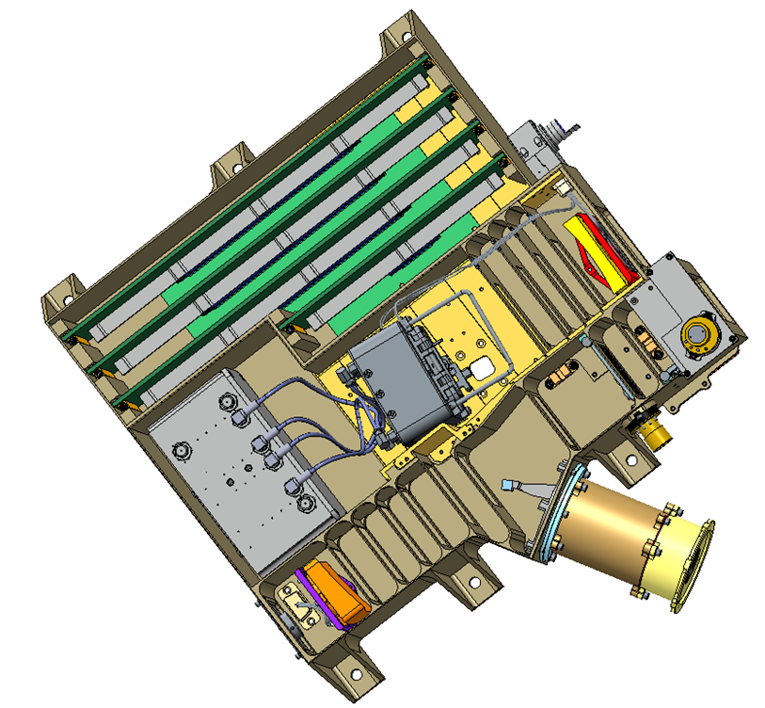
Europa-UVS
Selected by NASA in 2015 to serve as the Europa Multi-Flyby Mission “Plume Hunter”
Europa-UVS Instrument PI: Kurt Retherford (Southwest Research Institute)
1) UV Emissions
2) UV Reflections
3) UV Transmissions
HST-STIS observation of H aurora diagnostic of water vapor plumes
LRO-LAMP observation of reflected solar Lyα from the Moon’s north polar region
Simulated Europa-UVS observation of a stellar occultation by Europa
Mass (CBE+cont.): | 6.43 kg plus 11.1 kg shielding = 17.5 kg
Power (CBE+cont.): | 9.7 W
Dimensions: | 34.6 cm x 38.2 cm x 14.5 cm
Spectral Range: | 55-210 nm
Spectral Resolution: | <0.6 nm (point source); <1.2 nm (extended source)
Spatial Resolution: | 0.16° (AP); 0.04° (HP), Nyquist sampled
Field of View: | 0.1° x 7.3° + 0.2° x 0.2° (7.5° full length)
Effective Area: | 0.6 cm² @ 125 nm
Telescope / Spectrograph: | Off-axis Primary / Rowland circle mount
Detector Type: | 2D MCP (solar blind), Csl photocathode, cross-delay-line (XDL) readout, 2048 spectral x 512 spatial x 256 PHD
Radiation Mitigation: | Contiguous Tantalum / Tungsten shielding (4π sr @ detector and electronics)
Aurora & Airglow
Surface Albedos
Stellar & Solar Occultations
LVPS A
C&DH Board
HVPS A/
HVPS B
Tantalum
Shielding
LVPS B
Grating
Non-
sunlight
Detector
AP/HP
Detector
Electronics
Sunlight
OAP
SP

Slide 29
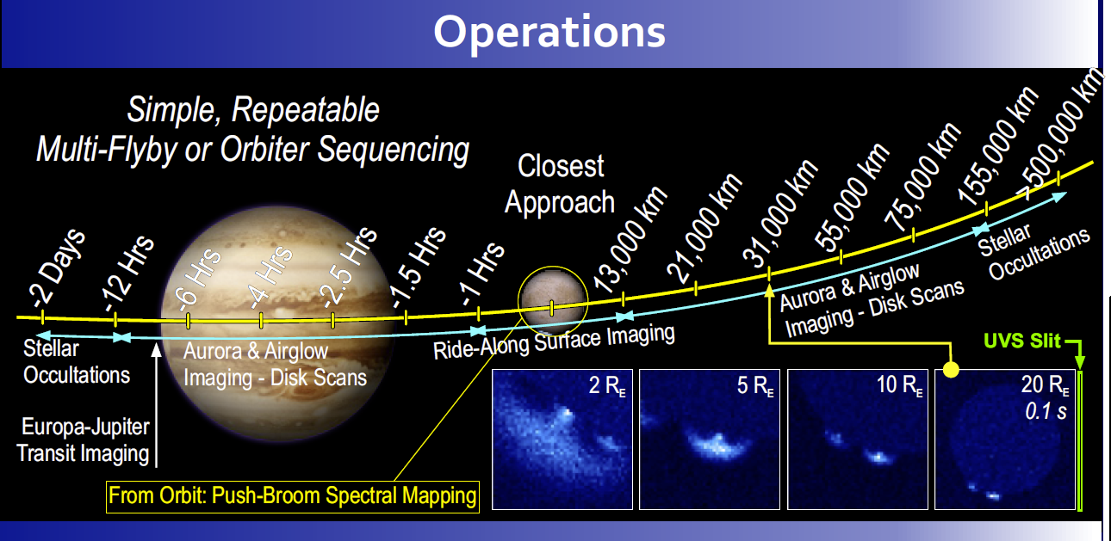
Europa-UVS – Flyby Sequence
Direct observation of UV emissions from Europa aurora, airglow, surface albedo, and other Jovian system atmospheres, and atmospheric absorption measurements via stellar and attenuated solar occultation

Slide 30
Outlook
NASA’s Europa mission might arrive as early as 2025!
ESA’s JUICE mission to arrive in 2030 with 2 Europa flybys
Future UV telescope above geocorona could be perfect tool to observe outer planetary water worlds!

