Slide 1
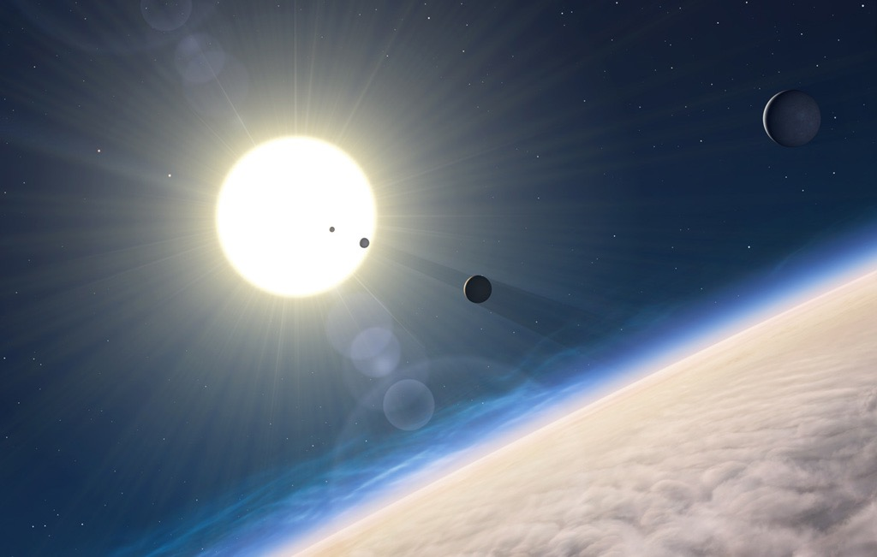
extrasolar planet occurrence Around FGKM stars
ravi kopparapu
(GSFC, VPL)
Credit: Paul Jorion

Slide 2
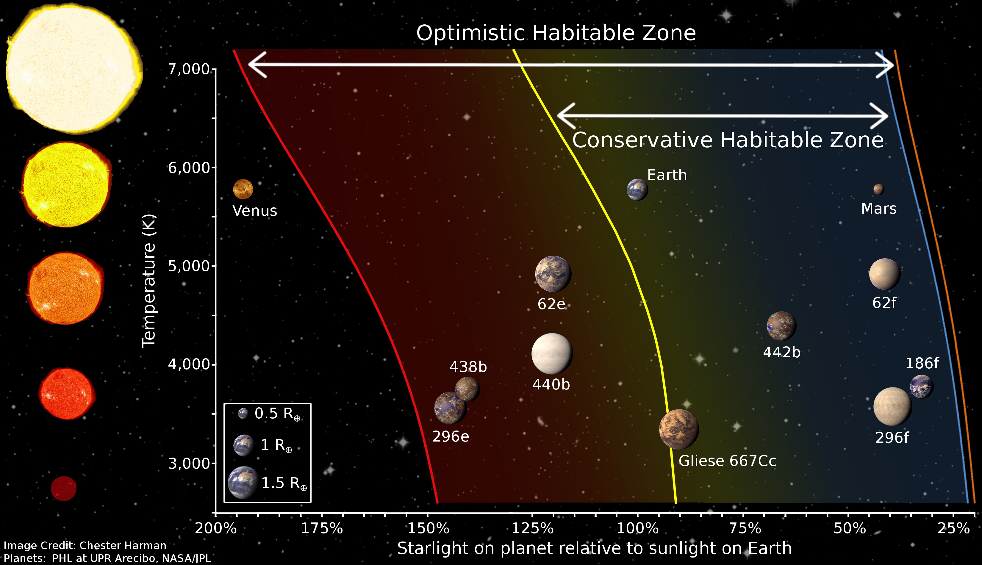
Revised Habitable Zones
Kopparapu et al.(2013), Astrophysical Journal, 765, 131
Kopparapu et al.(2014), Astrophysical Journal Letters, 787, L29

Slide 3
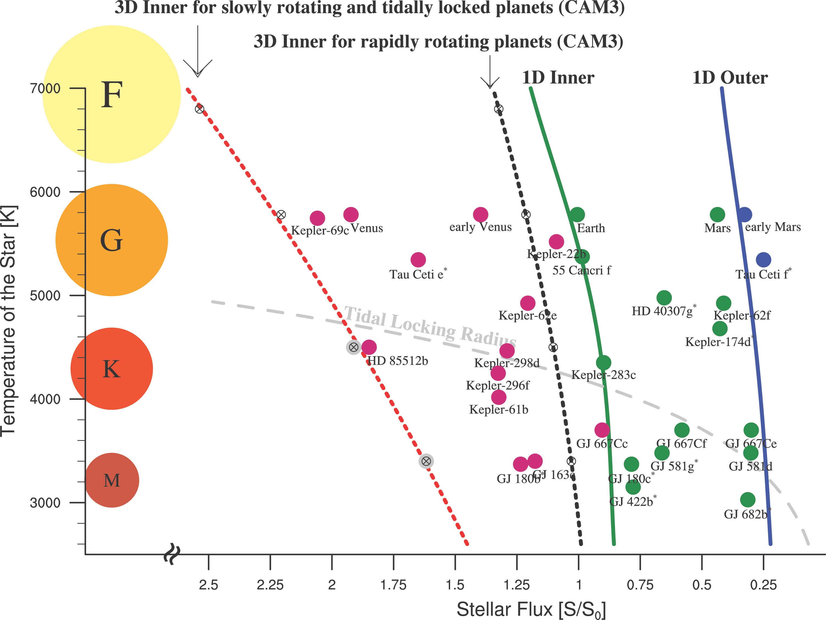
HZs around M-stars are wider?
3D GCM models show that the inner HZ can extend ~ 2 times closer to the star for synchronously rotating planets around M-stars, compared to 1-D models.
Yang et al.(2014)

Slide 4
HZs around M-stars are wider?
A word of caution….!! Inconsistent orbital periods.
They assumed 60 day orbital periods for all K & M stars!
Clouds dominate the sunny
side of tidally locked planets
orbiting M and late-K stars,
raising their albedos
Yang et al.(2014)

Slide 5
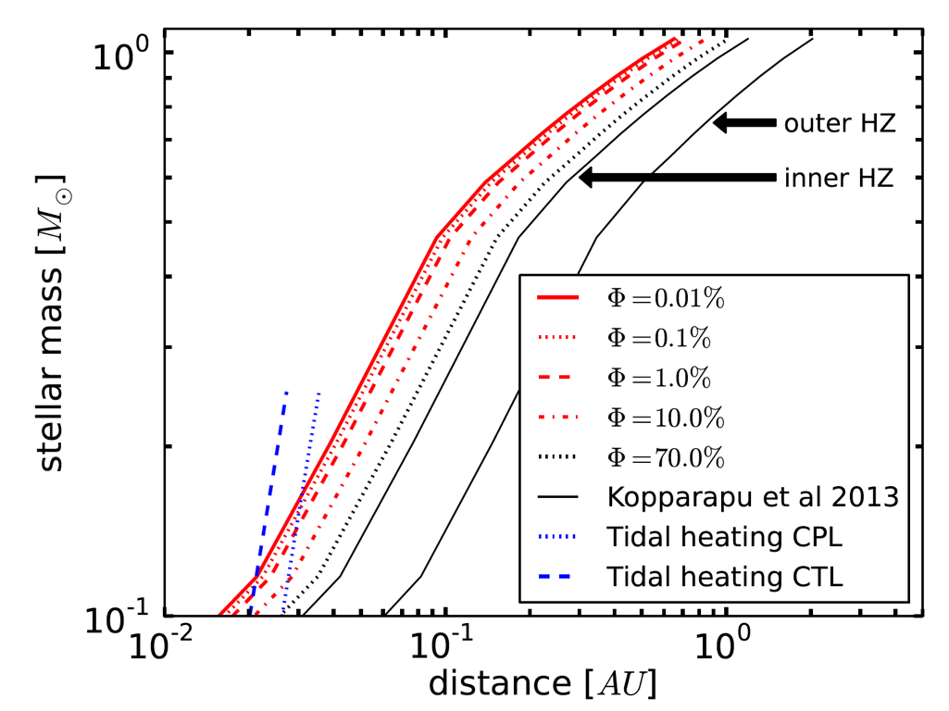
Wider habitable zones?
S. Seager,Science,
April, 2013
Zsom, Seager et al.(2013), ApJ, 778, 109
It was suggested that the inner edge is as close as 0.38 AU (orbit of Mercury!! ) around a Sun-like star, for a ‘Dry’ planet.
We showed that the Lifetime of an Earth ‘ocean’ is ~ 400 years.
Kasting, Kopparapu, Ramirez, Harman (2014), PNAS

Slide 6
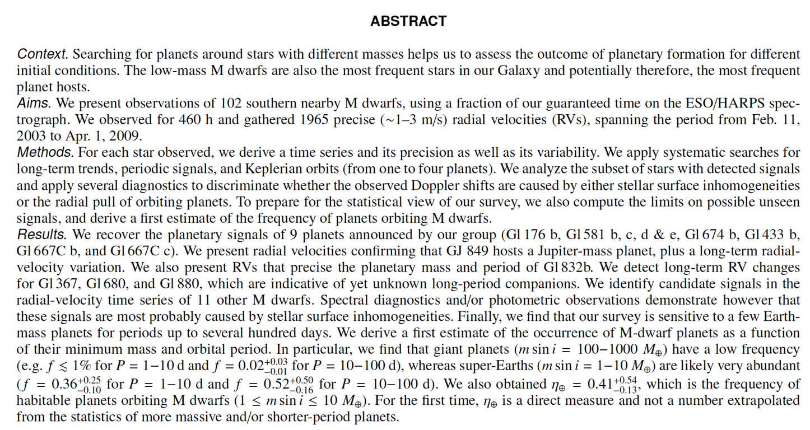
Bonfils et al.(2013)
η⨁ = 41%
(Gl 667Cc + Gl 581d)

Slide 7
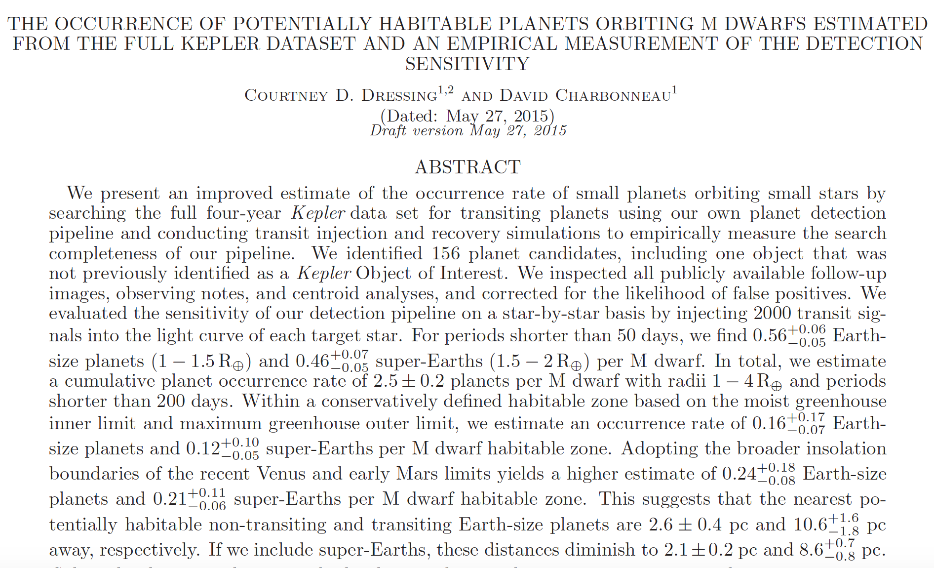
Dressing and Charbonneau (2015)
η⨁ = 16% (revised down from 48% Kopparapu(2013) Q1-Q6 data)

Slide 8
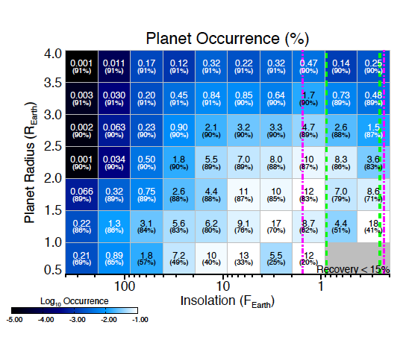
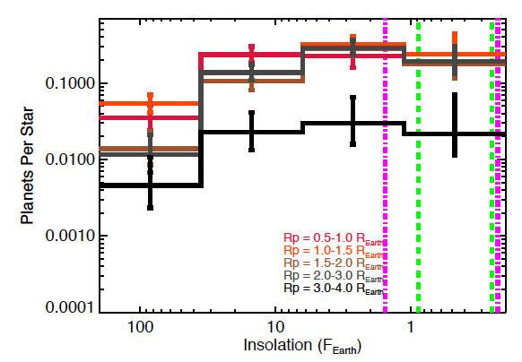

Slide 9
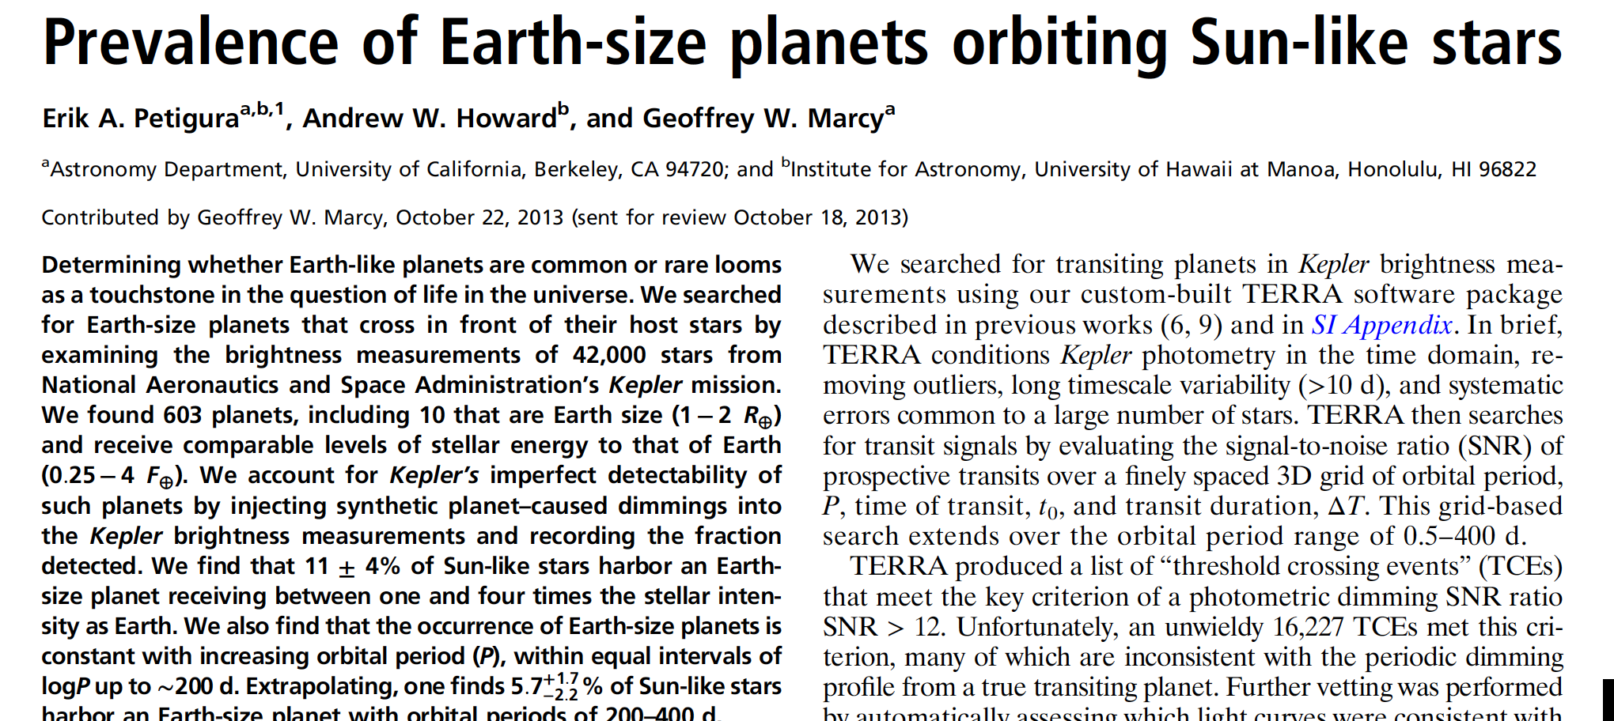
Petigura et al.(2013)
η⨁ = 22% *
4 times flux (0.5 AU) is too high.
Surface water is unstable (~few hundred years lifetime).

Slide 10
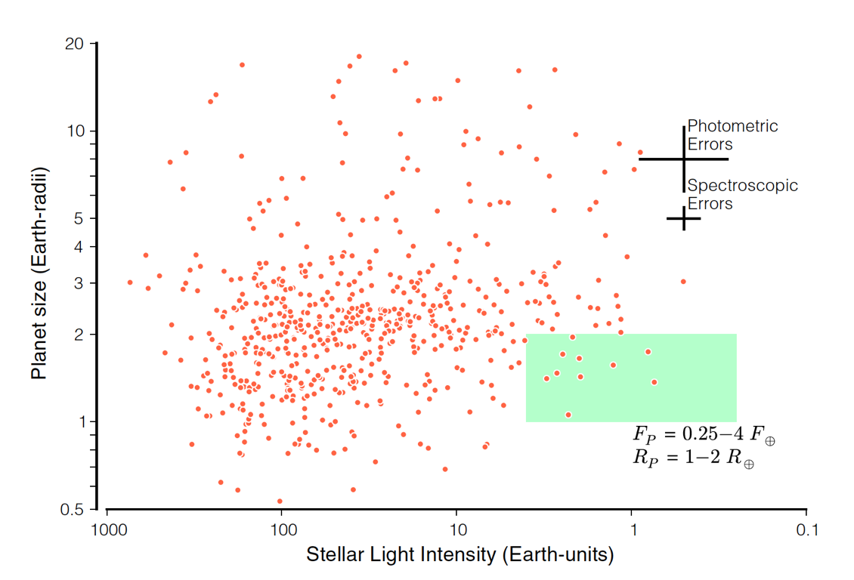
0.5 AU
2 AU
4 times flux (0.5 AU) is too high.
Surface water is unstable (~few hundred years lifetime).
Only 3 planets with 1-2 RE within the conservative HZ limits

Slide 11
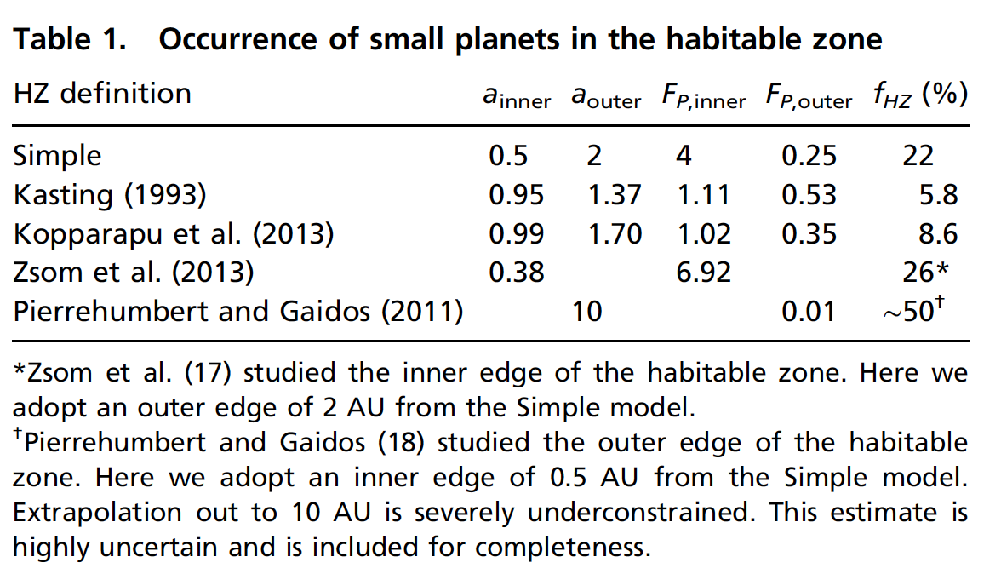
η_{Earth} for late-G and K stars
Petigura et al.(2013), PNAS
η⨁ for “solar-like” (GK spectral type) is probably closer to ~10% (using current Kepler data)...but....

Slide 12
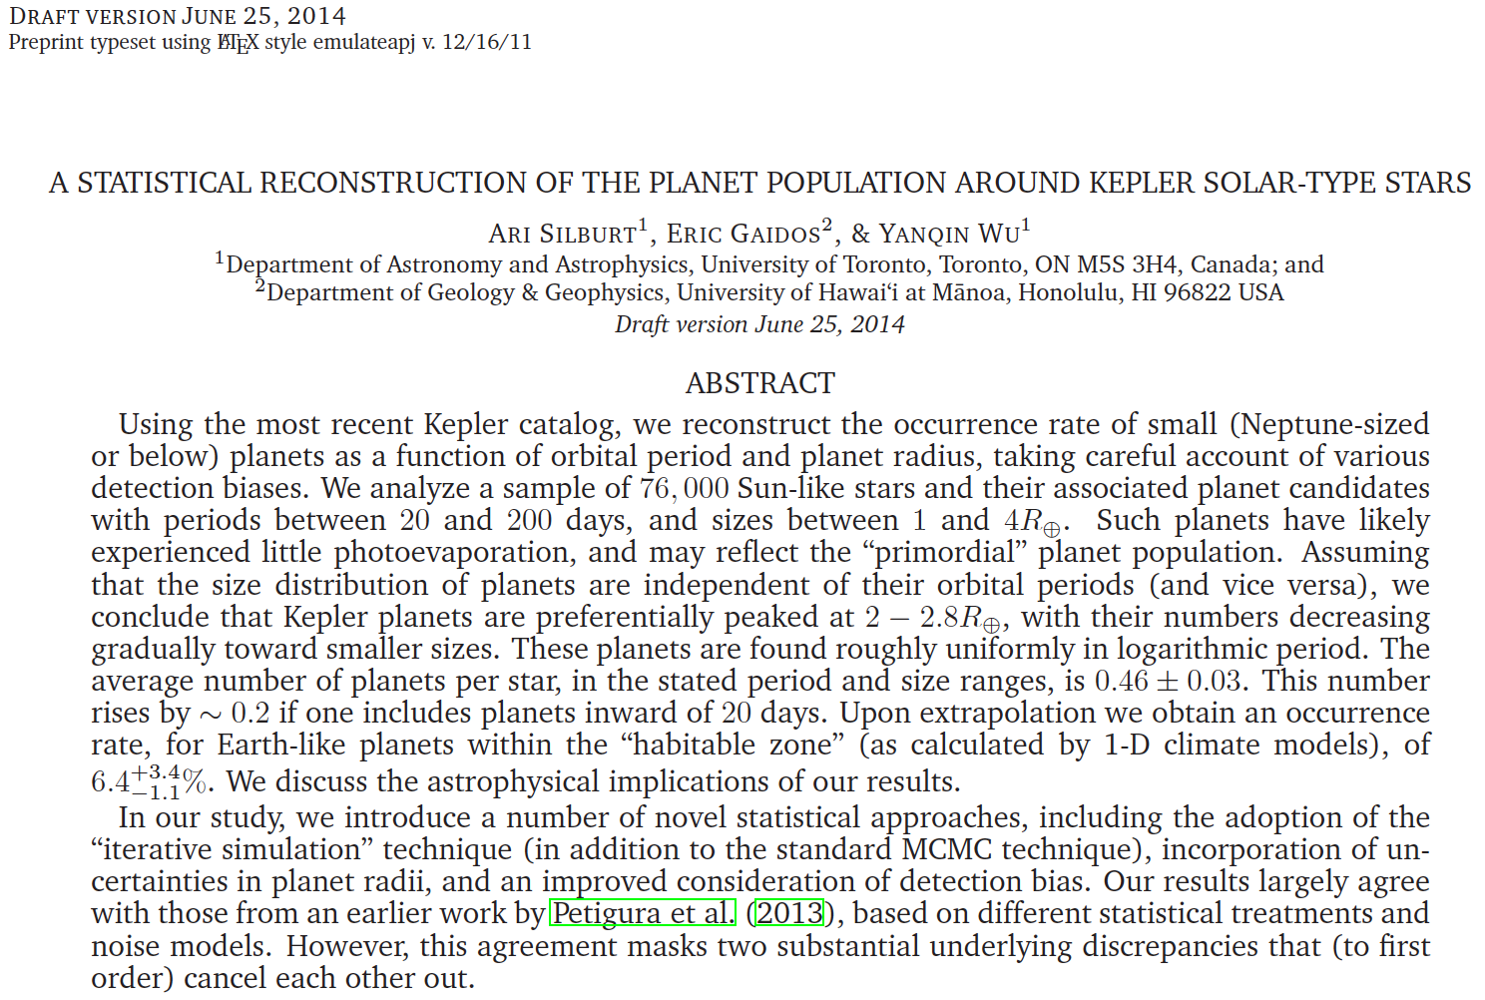
η⨁ = 6.4% (+3.4, -1.1)

Slide 13
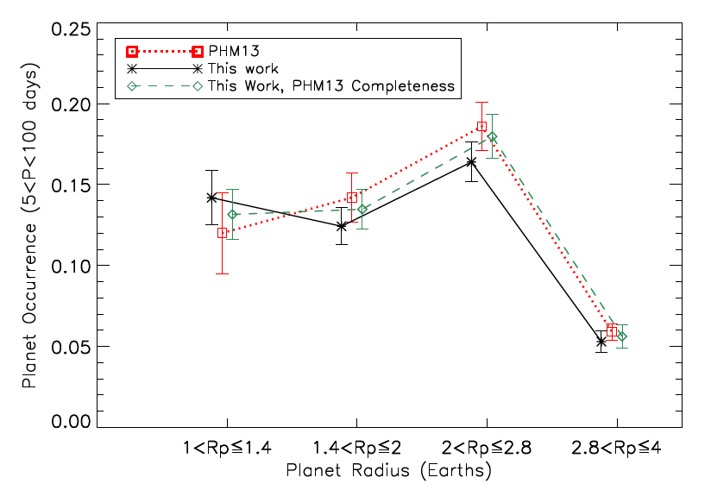
Silburt et al.(2015)

Slide 14
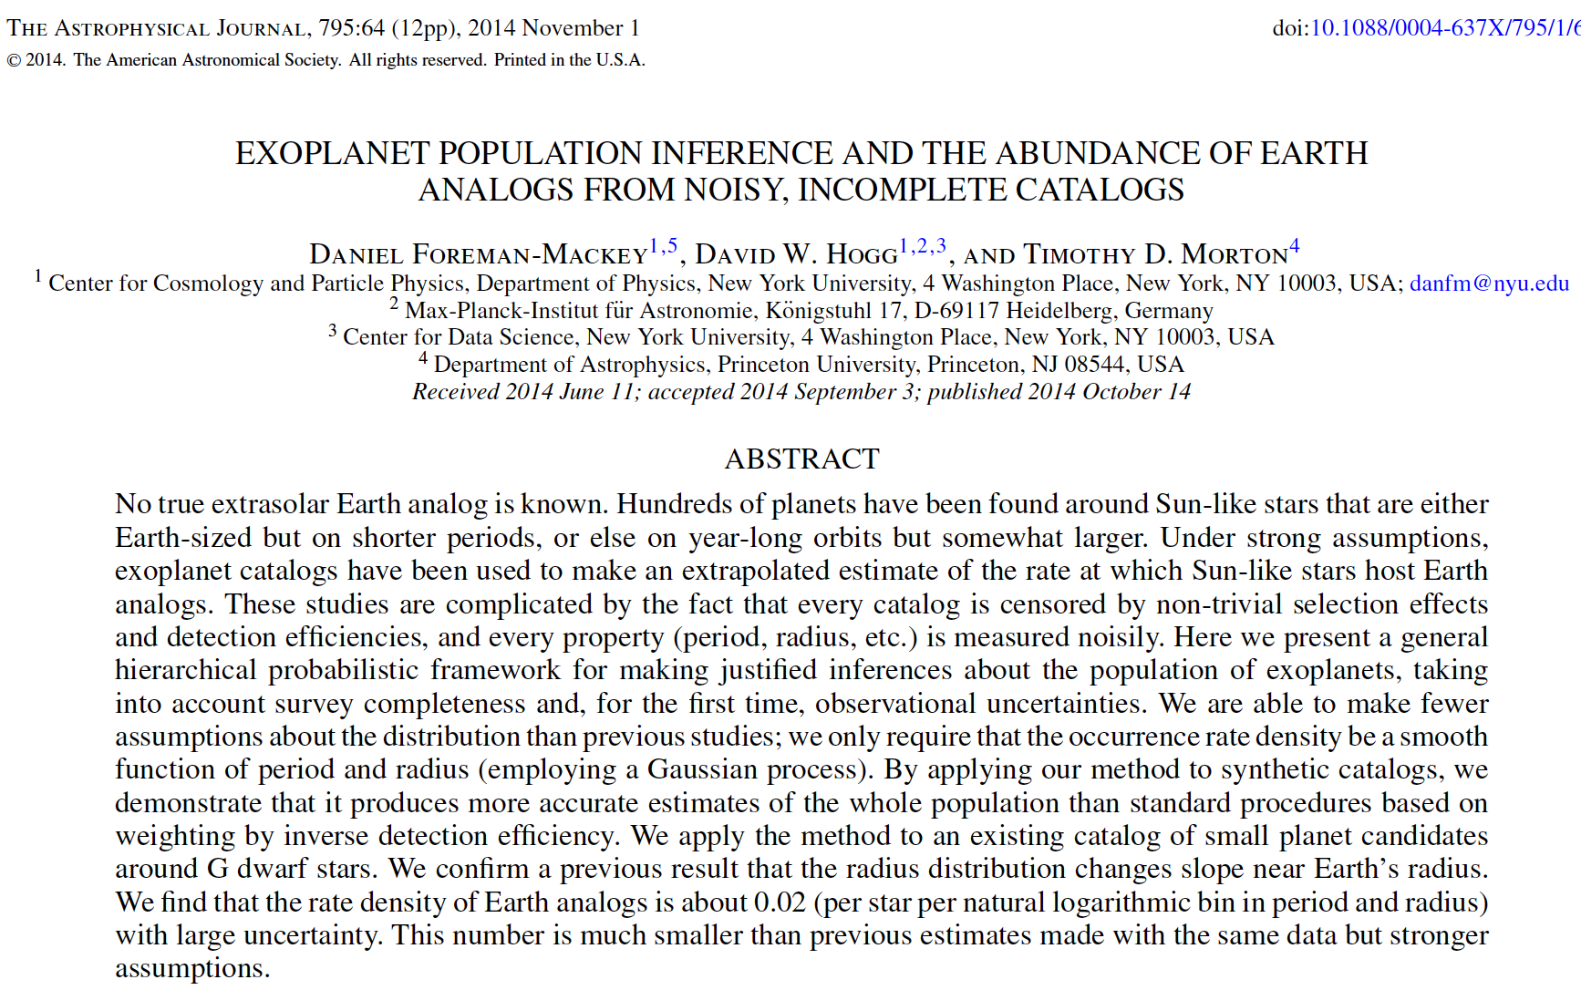
rate denisty= 2%

Slide 15
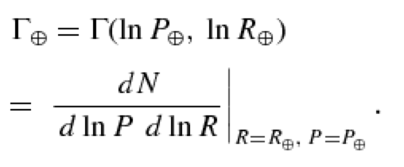

Slide 16
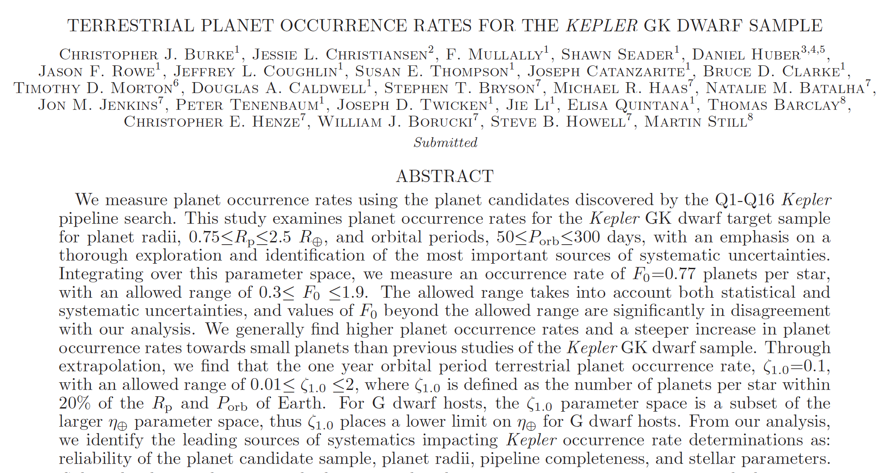
Number of planets per star in 1 year orbit ~10%
(with an allowed range of 1% to 200%)

Slide 17
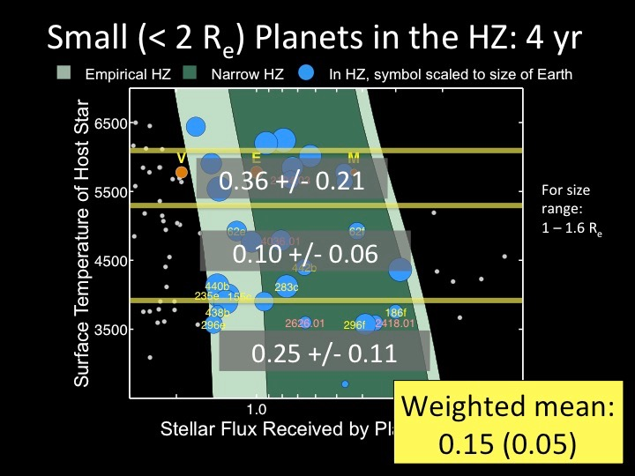
Courtesy: Batalha, N

Slide 18
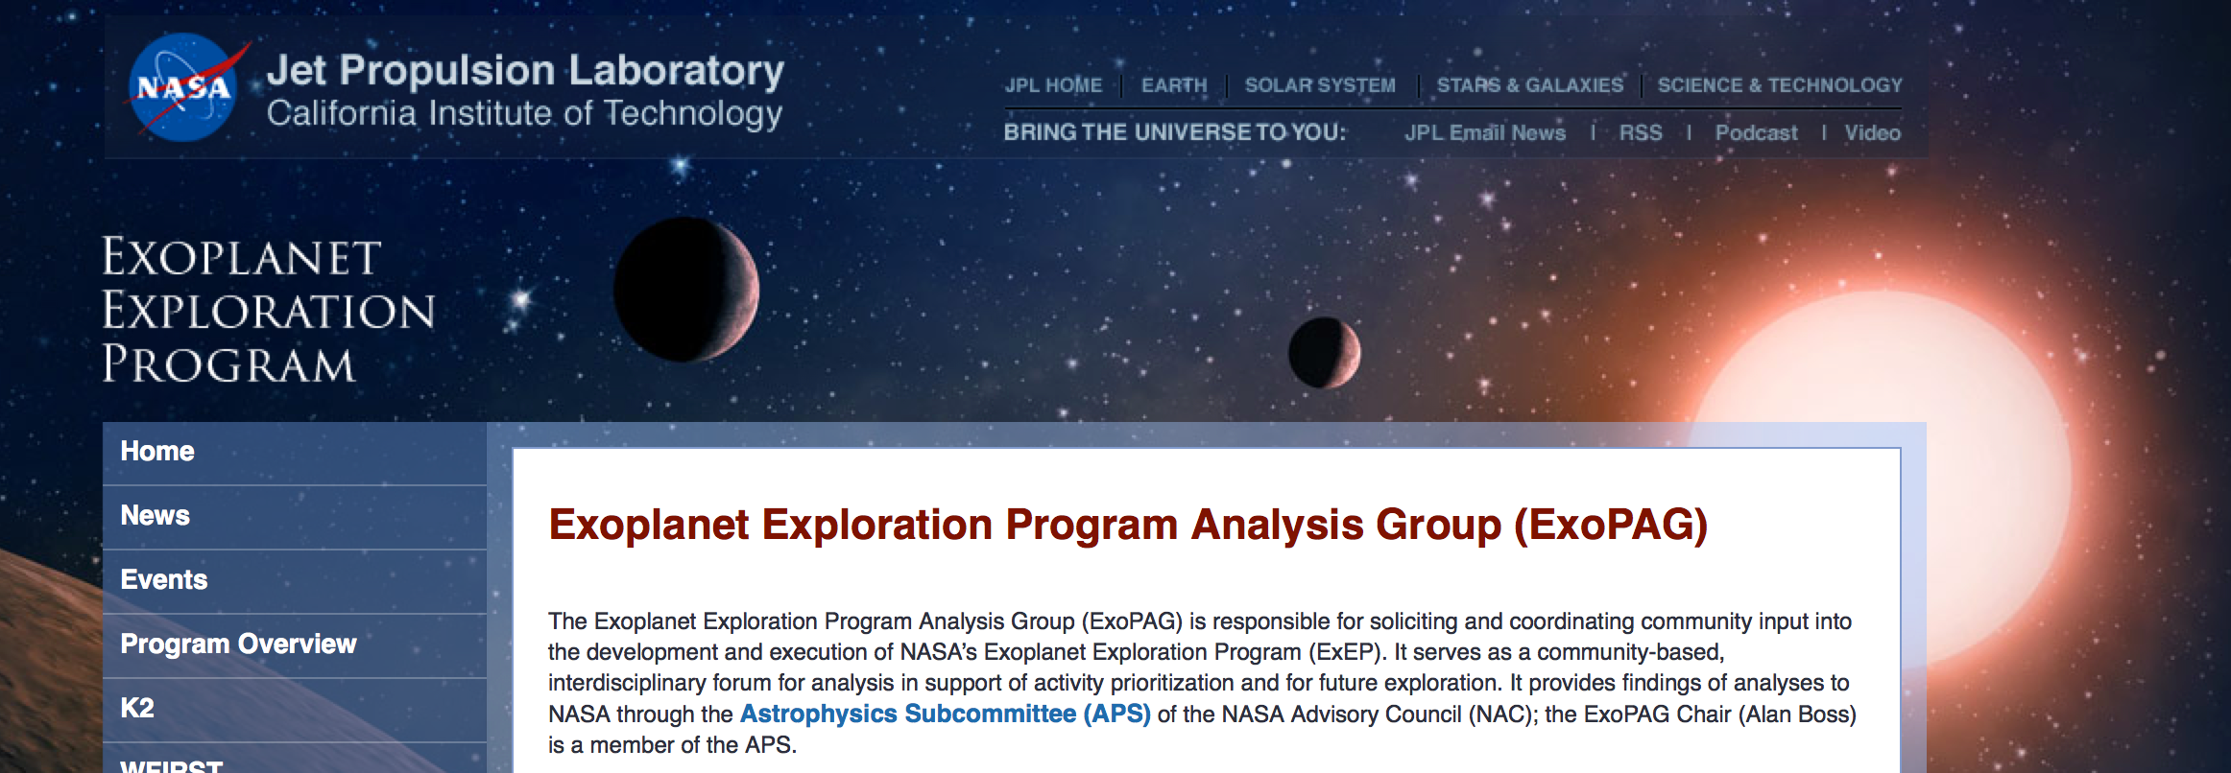
Rus Belikov and Chris Stark.

Slide 19
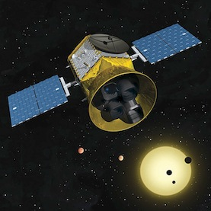
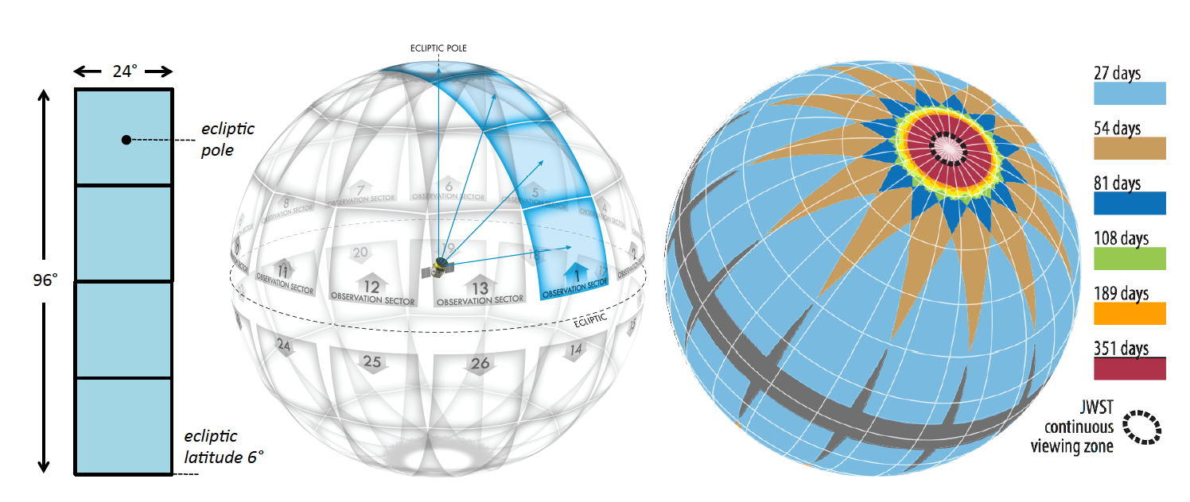
TESS
(Transiting Exoplanet survey satellite)

Slide 20
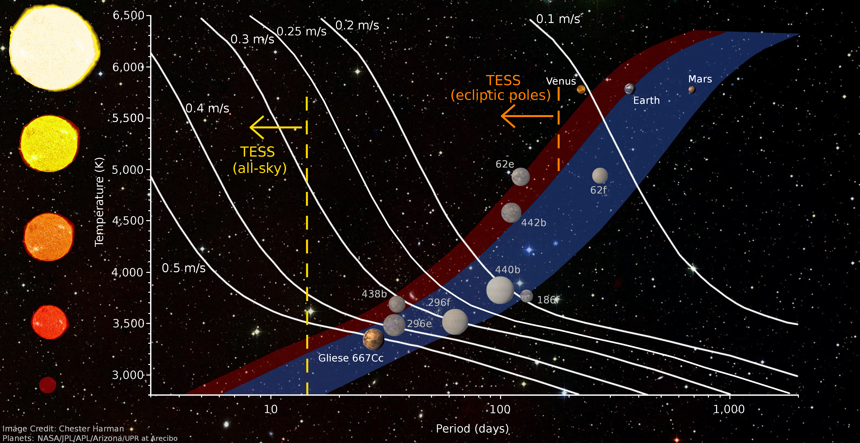
RV Sensitivity of HZ planets

Slide 21
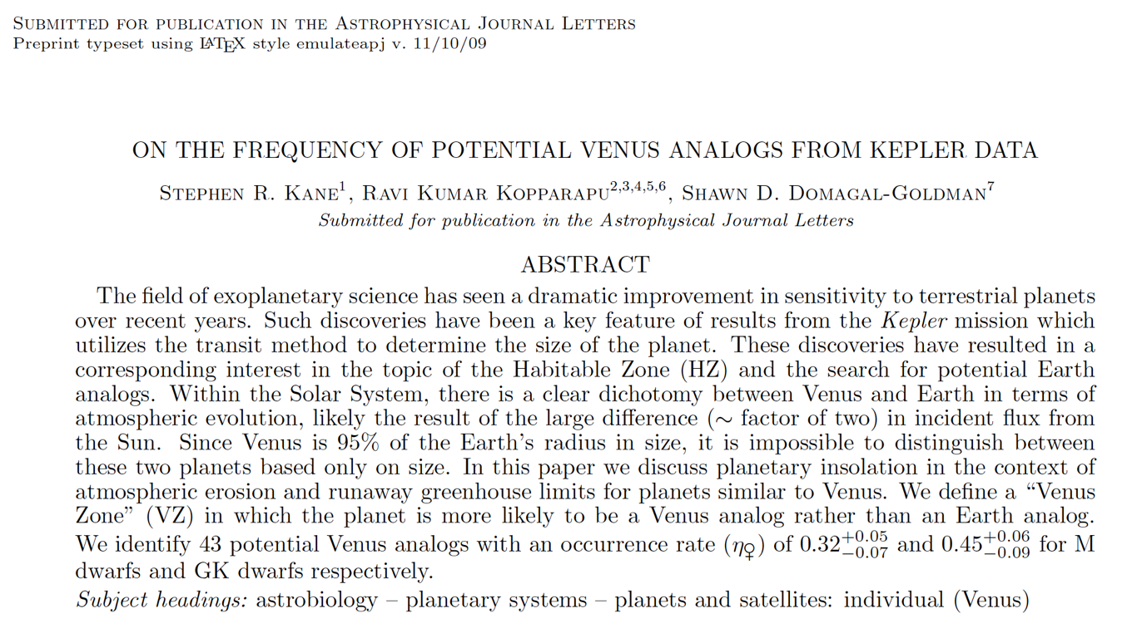
η♀
Kane, Kopparapu & Domagal-Goldman (2014), ApJLetters arXiv:1409.2886

Slide 22
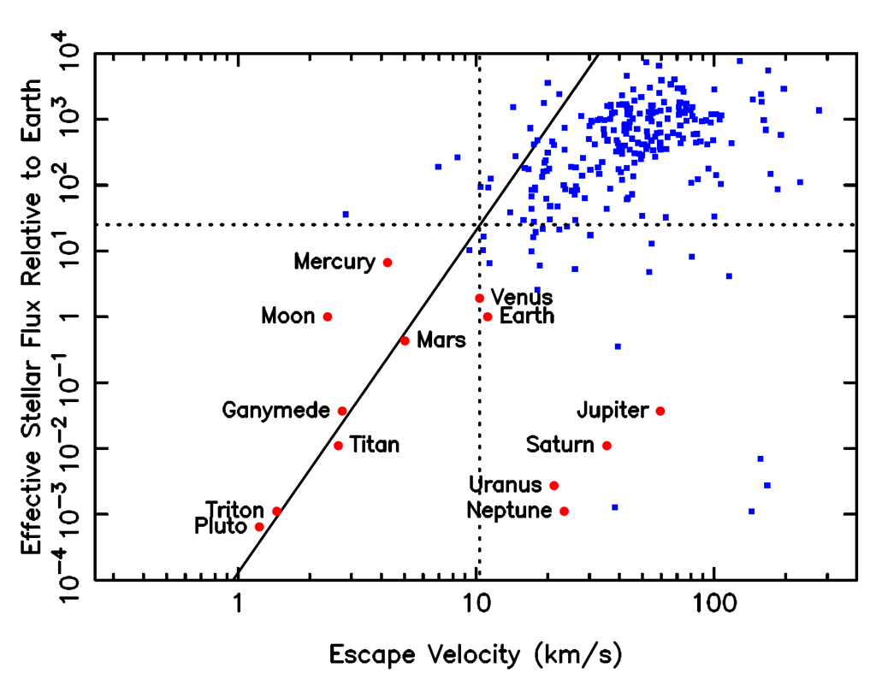

Slide 23
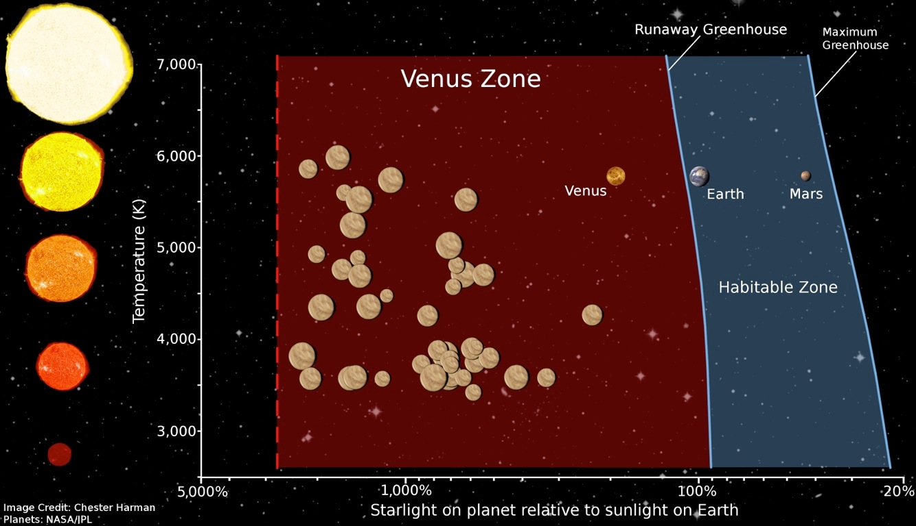
Occurrence of Venus Analogs
Kane, Kopparapu & Domagal-Goldman (2014), ApJLetters

Slide 24
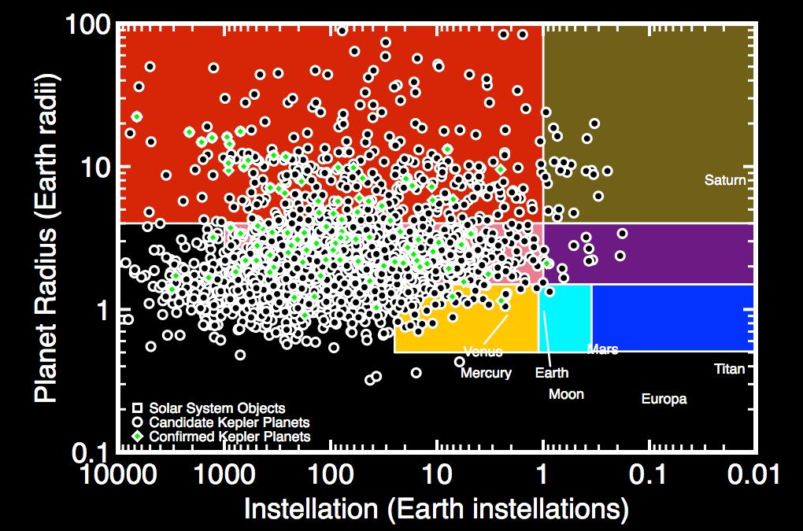

Slide 25
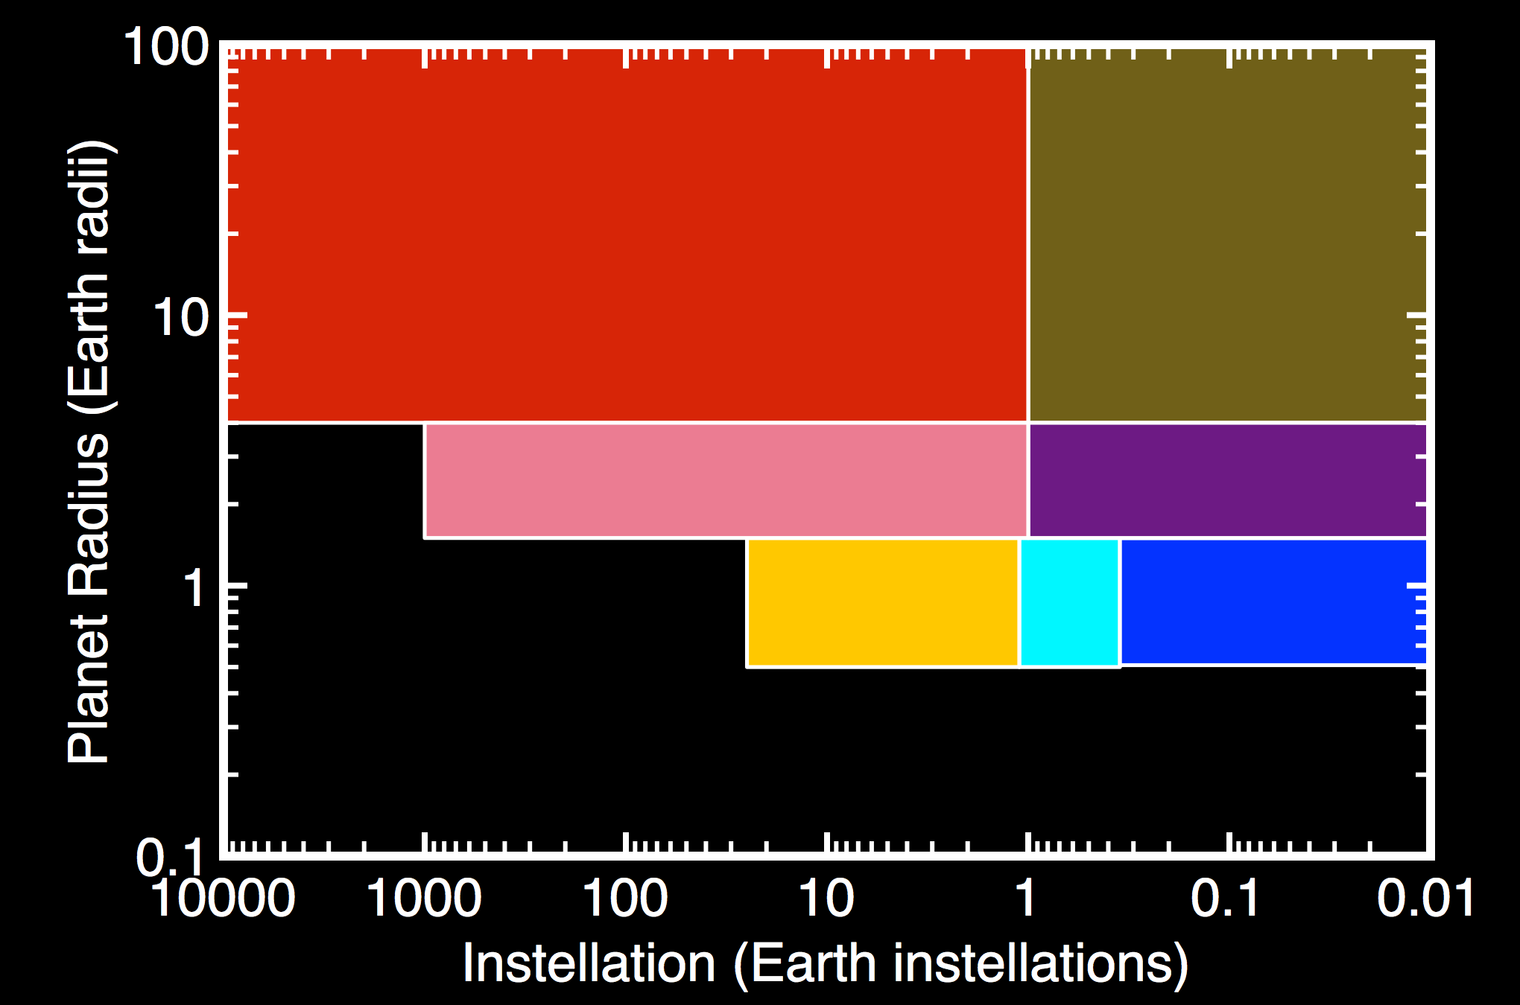
~15%
1.1%
~45%
~10%

