Slide 1
Using the OST on nearby galaxies
Alberto Bolatto
Dept. of Astronomy
University of Maryland

Slide 2
Exciting Science with MRSS
Statistically significant surveys of galaxies in “bread and butter” FIR lines ([CII], [NII], [OI], [OIII], [NIII], etc). The spectroscopy of large galaxy samples.
Mapping SFR, outflows, and kinematics (Herrera-Camus+ 2015, Kreckel+ 2014, de Blok+ 2016)
Photoelectric heating efficiency (Smith+ 2017)
Density of ionized gas in disks, ionized gas fractions (Herrera-Camus+ 2016, Croxall 2017)
ISM thermal pressure in atomic-dominated regions (Herrera-Camus 2017)
Cooling of low metallicity HII regions, ISM cooling budget (Cormier+ 2015, Rosenberg+ 2016)
High density neutral phases, shocks, etc
Beyond “bread and butter”: example, a new probe of the molecular gas using HD
To my knowledge not yet done outside the galaxy (except for Tumlinson+ 2010 using L-W UV bands in high-z starbursts)
Probing outer disks and halos of galaxies with deep [CII] imaging
The province of HI thus far. But [CII] can potentially do a very good job

Slide 3
What Would it Take to do Large Surveys?
Data from Hyperleda database and WISE archive
Most ”resolved” galaxies are beyond 30 Mpc
There are ~21,000 galaxies with optical sizes larger than 1 arcmin

Slide 4
What Would it Take to do Large Surveys?
Most ”resolved” galaxies are beyond 30 Mpc
There are ~21,000 galaxies with optical sizes larger than 1 arcmin
Most survey area is in a few very large Local Group objects, but most objects are 1 arcmin² or larger
LMC, SMC, Sag Dwarf, M31, M33

Slide 5
What Would it Take to do Large Surveys?
Most ”resolved” galaxies are beyond 30 Mpc
There are ~21,000 galaxies with optical sizes larger than 1 arcmin
Most survey area is in a few very large Local Group objects, but most objects are 1 arcmin² or larger
About 30,000 arcmin² of optical disks beyond the Local Group

Slide 6
What Would it Take to do Large Surveys?
Most ”resolved” galaxies are beyond 30 Mpc
There are ~21,000 galaxies with optical sizes larger than 1 arcmin
Most survey area is in a few very large Local Group objects, but most objects are 1 arcmin² or larger
About 30,000 arcmin² of optical disks beyond the Local Group
Large fraction are star-forming objects detected by WISE (~16,000)

Slide 7
Using Σ_{SFR} to Compute Σ_{[CII]}
SFR and [CII] have a tight relation over galaxy disks, except in “warm” sources (AGN, ULIRGs, low metallicity)
Although it is possible to correct for some of this, there is no need to do so for our purpose here
Herrera-Camus et al. (2015)

Slide 8
What Would it Take to do Large Surveys?
Projected “mean” brightness distribution
The “practical” sensitivity for Herschel mapping in large projects is indicated by green line: KINGFISH mapped spectroscopically a fraction of the disk of ~50 galaxies
The OST 8m 1-hour sensitivity is the red line: note that for truly extended emission the diameter of the telescope does not matter

Slide 9
What Would it Take to do Large Surveys?
This means the OST has sensitivity to map lines 1000 fainter than [CII]
Example from COBE is CH 116 um, a high density molecular gas tracer
Fixsen et al. (1999)

Slide 10
Tracing the Molecular Component with HD
The OST has the power to trace molecular surface densities independent of CO, by imaging HD
The temperature of the molecular gas can be inferred from the ratio of the 2-1/1-0 transitions (56, 112 um)
This is insensitive to Xco assumptions, although it may be sensitive to selective photo-dissociation and astration processes
Line to continuum contrast at low R

Slide 11
Tracing the Molecular Component with HD
The OST has the power to trace molecular surface densities independent of CO, by imaging HD
The temperature of the molecular gas can be inferred from the ratio of the 2-1/1-0 transitions (56, 112 um)
This is insensitive to Xco assumptions, although it may be sensitive to selective photo-dissociation and astration processes
Line to continuum contrast at low R

Slide 12
Tracing Extended Low Density Neutral Gas in [CII]
The OST can trace very low column densities of warm neutral atomic gas in [CII]
For partially ionized gas, this gets even better
It is much more sensitive than the VLA for approx. matched resolution, but the VLA has ~260² mapping “pixels” because of ~30 arcmin FOV
Variation in metagalactic radiation field (Lehner+ 2012)

Slide 13
Tracing Extended Low Density Neutral Gas in [CII]
The OST can trace very low column densities of warm neutral atomic gas in [CII]
For partially ionized gas, this gets even better
It is much more sensitive than the VLA for approx. matched resolution, but the VLA has ~260² mapping “pixels” because of ~30 arcmin FOV vs. 100 “pixels” for long-slit
C in C⁺? Variation in metagalactic radiation field (Lehner+ 2012)

Slide 14
Tracing Extended Low Density Neutral Gas in [CII]
The OST can trace very low column densities of warm neutral atomic gas in [CII]
For partially ionized gas, this gets even better
It is much more sensitive than the VLA for approx. matched resolution, but the VLA has ~260² mapping “pixels” because of ~30 arcmin FOV vs. 100 “pixels” for long-slit
C in C⁺? Variation in metagalactic radiation field (Lehner+ 2012)

Slide 15
Disk galaxy basics: how far does the ISM extend?
How large is the ISM emitting region we would expect from a galaxy?
The stellar and molecular component track each other fairly well in the inner regions, with ½ the mass/light inside ~0.4 D₂₅
However, HI disks are not exponential: they are rather flat or even increasing with radius, and can extend much beyond the bright optical emission
Log(Σ)
Stellar exponential disk
Molecular disk
Atomic disk
~10 M⦿/pc²
R
~0.4 R₂₅
half light radius
R₂₅

Slide 16
Extended ISM
NGC 628
Many galaxies are known to possess extended HI disks that go well beyond their optical radius
D25 isophote
Kamphuis & Briggs (1992)
Outer HI contour is 1.3✕10²⁰ cm⁻²

Slide 17
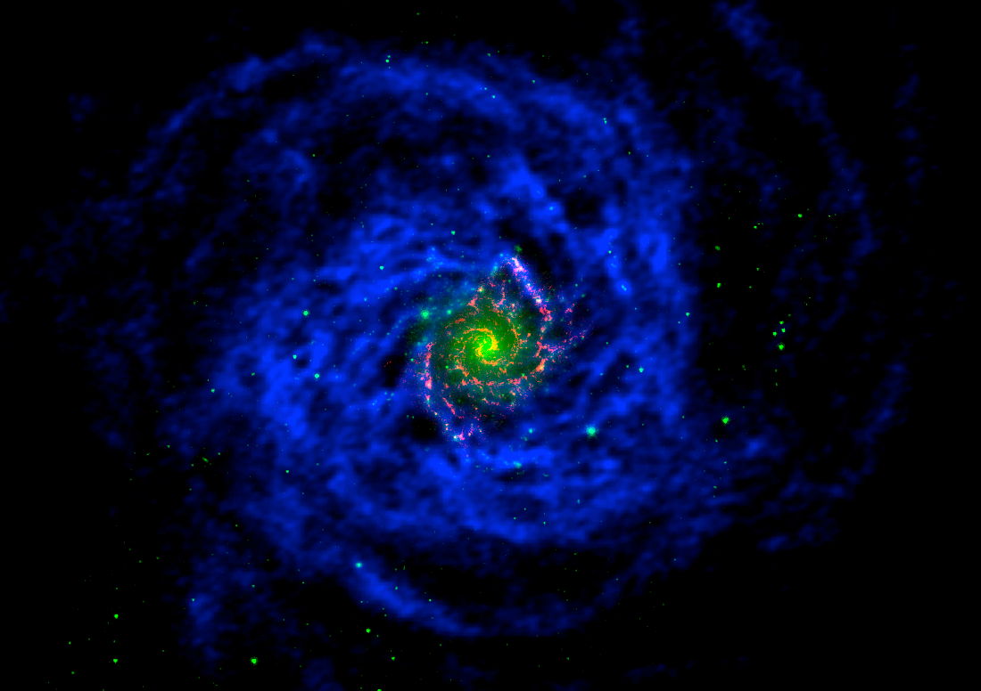
Extended ISM
NGC 628
Many galaxies are known to possess extended HI disks that go well beyond their optical radius
THINGS HI (blue), ALMA CO (red), Spitzer 4.5 um stellar disk (green)

Slide 18
Extended ISM
M83
Many galaxies are known to possess extended HI disks that go well beyond their optical radius
These disks have, in many cases, associated star formation. They are also “extended UV disks” as seen by GALEX
Thilker et al. (2005)
Red is HI at 1.8✕10²⁰ cm⁻²

Slide 19
Extended ISM
M31
Many galaxies are known to possess extended HI disks that go well beyond their optical radius
These disks have, in many cases, associated star formation. They are also “extended UV disks” as seen by GALEX
But we also see likely ongoing accretion events from the “cosmic web” in the form of HVCs
Thilker et al. (2003)
HI contours start at 0.5✕10¹⁸ cm⁻²

Slide 20
Extended ISM
Many galaxies are known to possess extended HI disks that go well beyond their optical radius
These disks have, in many cases, associated star formation. They are also “extended UV disks” as seen by GALEX
But we also see likely ongoing accretion events from the “cosmic web” in the form of HVCs
Besides radial extent, there is also evidence for vertically “thick” disks with differential rotation, likely connected with winds or “cosmic web” accretion (Fraternali & Binney 2008, Zschaechner & Rand 2015)
Oosterloo et al. (2005)
HI contours start at 5✕10¹⁸ cm⁻²

Slide 21
Extended ISM
M82
And, of course, there are also winds: material ejected by SF or accretion processes
11 arcmin
FIR, stars, X-ray emission

Slide 22
Extended ISM
And, of course, there are also winds: material ejected by SF or accretion processes
It turns out that dust appears to provide a good measure of ejected “cool” phases (presumably there will be also FIR spectral lines)
M82 cut along wind axis, Leroy et al. (2015)
1 kpc ~ 1 arcmin

Slide 23
Extended ISM
And, of course, there are also winds: material ejected by SF or accretion processes
It turns out that dust appears to provide a good measure of ejected “cool” phases (presumably there will be also FIR spectral lines)
There is evidence for significant amounts of dust in the CGM
Menard & Fukugita (2012)

Slide 24
Extended ISM
And, of course, there are also winds: material ejected by SF or accretion processes
It turns out that dust appears to provide a good measure of ejected “cool” phases (presumably there will be also FIR spectral lines)
There is evidence for significant amounts of dust in the CGM (Menard & Fukugita 2012)
And also “missing” metals: a lot of the material in the CGM is not primordial
Peeples et al. (2014)

Slide 25
Extended ISM
And, of course, there are also winds: material ejected by SF or accretion processes
It turns out that dust appears to provide a good measure of ejected “cool” phases (presumably there will be also FIR spectral lines)
There is evidence for significant amounts of dust in the CGM
And also “missing” metals: a lot of the material in the CGM is not primordial
Finally, there is also stripped gas (tidal or ram pressure)
HI mosaic from Yun et al. (1994), see also Chynoweth et al. (2008)

