Slide 1
Origins Space Telescope (OST) Mission Concept Overview
Instrument Interface and Face-to-Face Meetings
Science and Technology Definition Team (STDT)
A. Flores, Mission Systems Engineer (MSE)
NASA Goddard Space Flight Center
8800 Greenbelt Road, Greenbelt, MD 20771
June 13, 14 & 15, 2017

Slide 2
GSFC Design Team Members
OST GSFC Design Team Members are as follows:
Study Scientist: David “Dave” Leisawitz
Deputy Study Scientist: Johannes Staguhn
Study Manager (401): Ruth Carter
System Architect/Technologist (542): Mike DiPirro
Mission Systems Engineer (MSE) (599): Anel Flores
Instrument System Engineer (ISE) (592): James “Jim” Kellogg and Ed Amatucci
Optics (551): Joe Howard and James Corsetti
Cyro (541): Ed Canavan
Mechanical (543):, Greg Martin and Andrew Jones
Thermal (545): Lou Fantano
ACS (591): Eric Stoneking
Flight Dynamics: Dave Folta and Casandra “Cassie” Webster
Propulsion: Daniel “Dan” Rampspacker
Electromechanical (544): Rajeev Sharma
Structural Analysis and Modelling (542): Tim Carnahan
Materials (541) : Carley Sandin, Kevin Hodges
Detectors (553): Kevin Denis
Electrical and Data Systems (564): Damon Bradley and Porfirio Beltran
Integration and Test (568): Susanna Petro
Mission Operations & Ground System (581): Steve Tompkins

Slide 3
OST Mission Goals
The Origins Space Telescope is the mission concept for the Far Infrared Surveyor, a study in development by NASA in preparation for the 2020 Astronomy and Astrophysics Decadal Survey
OST is planned to be a large aperture (8-m to 15-m), actively-cooled telescope (~4K) covering a wide span of the mid- to far-infrared spectrum. Its spectrographs with enable three-dimensional surveys of the sky that will discover and characterize the most distant galaxies, exoplanets and the outer reaches of our Solar System. The observatory is planned to be placed in the Sun-Earth L2, similar to JWST.
Principal Science Themes include:
Tracing the Signatures of Life and the Ingredients of Habitable Worlds
Unveiling the Growth of Black Holes and Galaxies over Cosmic Time
Charting the Rise of Metals, Dust, and the First Galaxies
Characterizing Small Bodies in the Solar System
Measuring exoplanet biosignatures to search for signs of life

Slide 4
Top-Level Mission Requirements
Observatory to Accommodate the following five (5) instruments:
Medium Resolution Survey Spectrometer (MRRS) – JPL
Hi Res (Far-IR) Spectrometer (HRS) - GSFC
Heterodyne Instrument (HI) – Europe
FIR Imager/ Polarimeter (FIP) – GSFC
MID-IR Imager Spectrometer/ Coronagraph (MISC) – JAXA
Instrument Wavelength Coverage: 6 to 600 microns
Mission Duration: 5 years nominal with up to 10 years extended
Baseline Observatory to fit into a 5-m launch vehicle fairing, because this fairing size is rather common and is expected to be available for the foreseeable future.
Telescope size: the largest telescope compatible with a launch in a 5 m fairing, with the understanding that it’s aperture would be approximately 9 meters in diameter
Telescope type: three mirror, unobstructed, off-axis field
Observatory will be placed in appropriate orbit to be able to conduct the required science observations
Observatory operating temperature: 4 to 4.5 K
Observing Strategies: under development, TBD
Appropriate launch vehicle to place the observatory in the proper orbit
Observatory will transmit the science data to the Earth Mission and Science Operations Center’s (MOC and SOC)
Serviceable observatory: the instruments will be designed in serviceable modules with grapples and fixtures for servicing. A modular design could be helpful in I&T due to the accessibility of the instruments. We will assume the propellant fuel will also be serviceable. A servicing mission for OST itself; however, is not required to be designed at this stage.

Slide 5
Top-Level Derived Requirements
Orbit: Sun-Earth L2
Mission Classification: Class A, generally fully redundant and cross strapped
Launch Vehicle (LV): Vulcan Aces, Falcon Heavy or similar LV capability
LV Fairing Size: 5-m Atlas V fairing or similar
Launch Date: Mid-2030’s
Optical Telescope Assembly (OTA) Temperature: 4 K Actively cooled using cryocoolers
Baseline non-articulating (i.e., fixed) telescope: articulation could be considered if it is required by the science requirements. However, an articulating telescope will require a gimbal mechanism, which has to be cold. Such a mechanism will add complexity, cost and risk.
Instruments to be designed with appropriate internal redundancy and Level 1 components.
Instrument electronics will be separate, located in the spacecraft bus (warm side), from the cold portion of the instruments located in the Instrument Accommodation Module (IAM) behind the OTA on the cold side of the observatory
OST will provide ~4K for the instruments and an intermediate ~20 K zone for readout electronics using a total of eight cyro-coolers.
The instruments will have to share a total 100 milli-watts on the telescope cold-side not necessarily equally.
Total observatory power required is TBD watts at BOL.
Consumables: such as propellant fuel, will be sized for 10 years
OST will attempt to achieve attitude control requirements similar to JWST (or a combination with WFIRST) if possible, although, these requirements will be revised when all of the instruments requirements are known.

Slide 6
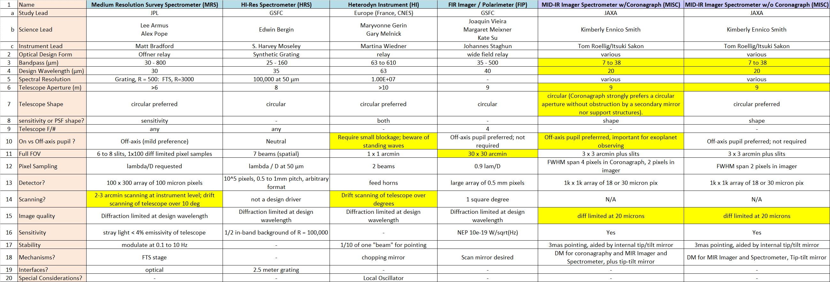
OST Instrument Optical Inputs Summary
Yellow cells highlight telescope design drivers

Slide 7
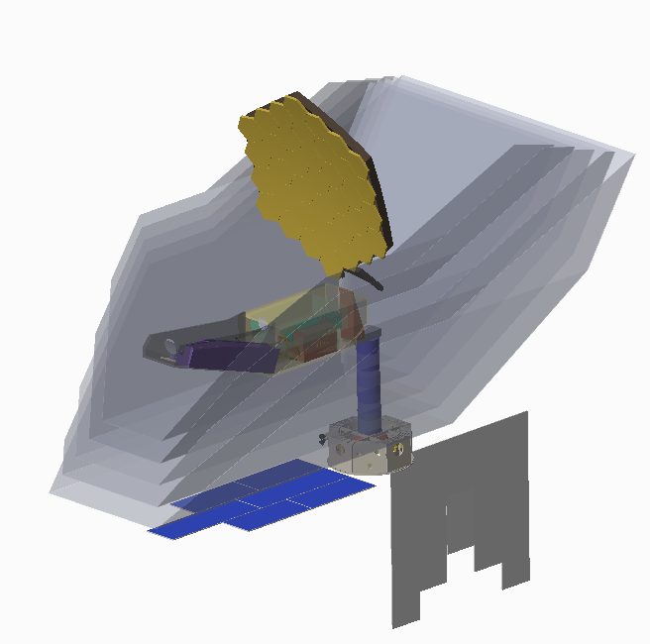
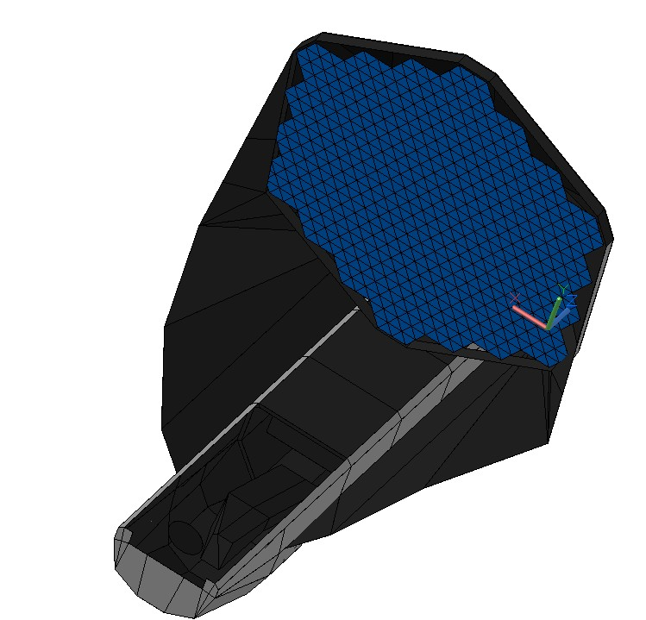
Notional Unobstructed, Off-Axis Field, Observatory
9.1-m Aperture Diameter Primary Mirror (~4 k), Three mirror, unobstructed, off-axis field
+Z
Deployed Observatory Configuration
Actively cooled (~4K) Baffle Assembly
(not shown on right, see inset below for concept)
Fixed (Deployable, Non-articulating) Optical Telescope Element (OTE)
Incident light
Sunshield
Five (5) Layers*
0.75-m Spacing
Cold Side
(Inner Layer
~35K)
+Y
+X
Field of Regard
+5˚ to -45˚ Pitch off Sun line
±180˚ Yaw about Sun line
±5˚ Roll about Line of Sight (LOS)
*Assumes parallel spacing between layers. Angular spacing between the Sunshield layers is also being explored
Warm Side
(250 – 300K)
Sun

Slide 8
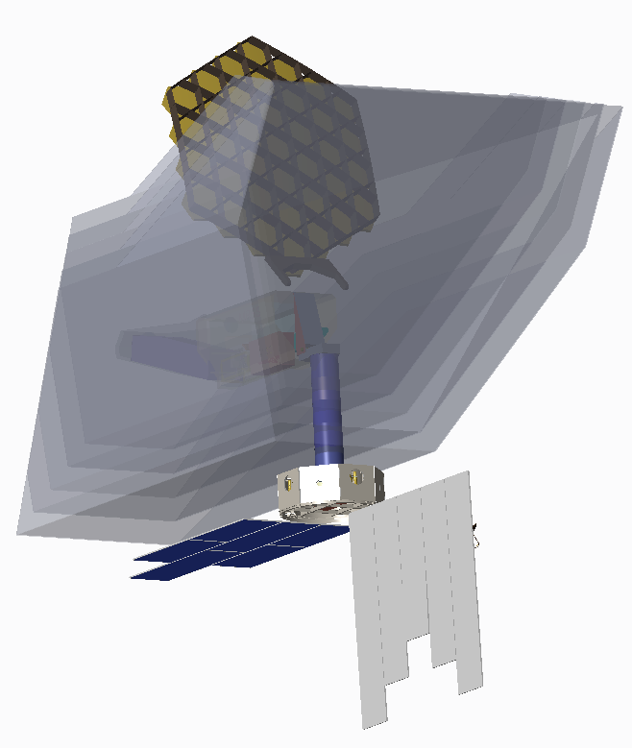
Unobstructed Observatory Aft View
Field of Regard
-5˚ to -45˚ Pitch off Sun line
±180˚ Yaw about Sun line
±5˚ Roll about Line of Sight (LOS)
Outermost Sunshield Layer
Deployable Tower Assembly (DTA)
(segmented)
Spacecraft bus
High Gain Antenna (HGA) (Behind Radiator)
Notional Solar Array
Notional Radiator

Slide 9
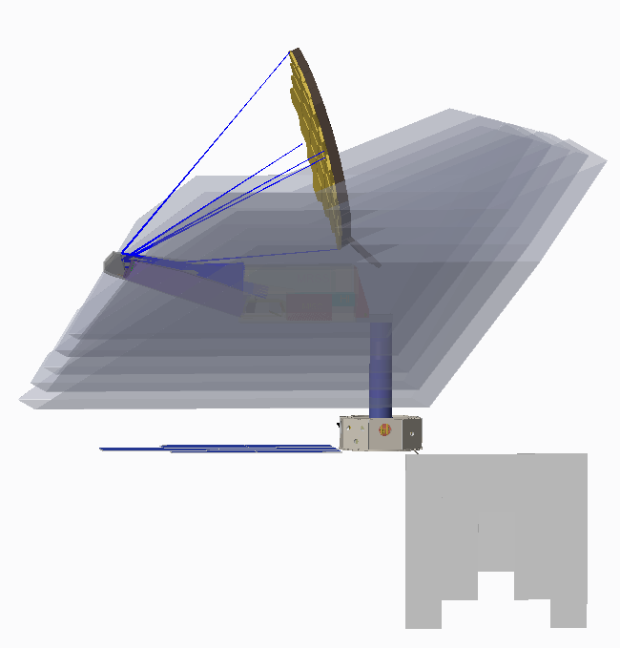
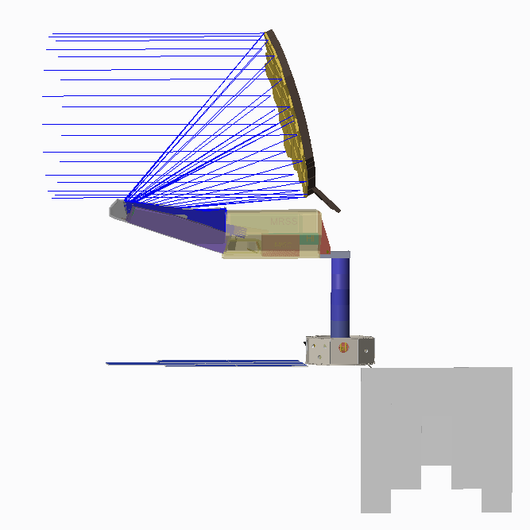
Unobstructed Observatory Side Views Showing Light Trace
Light Ray Trace
Primary Mirror (PM)
PM to attach to IAM with a two-Axis Gimbal (TBD)
Deployable Tower Assembly (DTA), Segmented
Instrument Accommodation Module (IAM)
4.4m

Slide 10
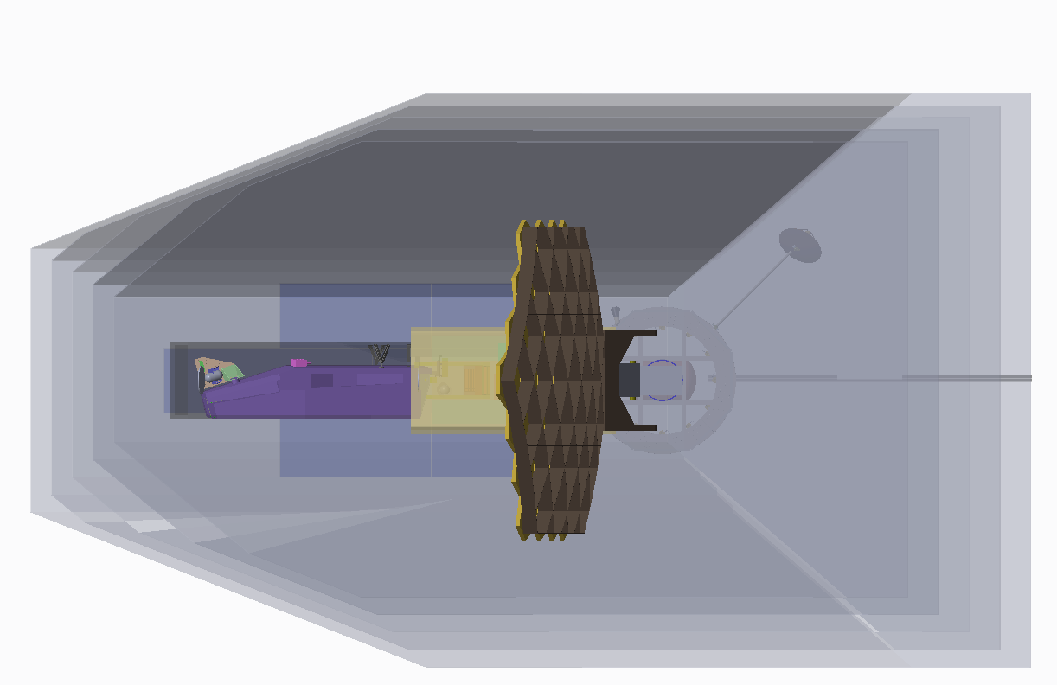
Unobstructed Observatory Top-View
Dimensions in Meters
25.7m
14.8m

Slide 11
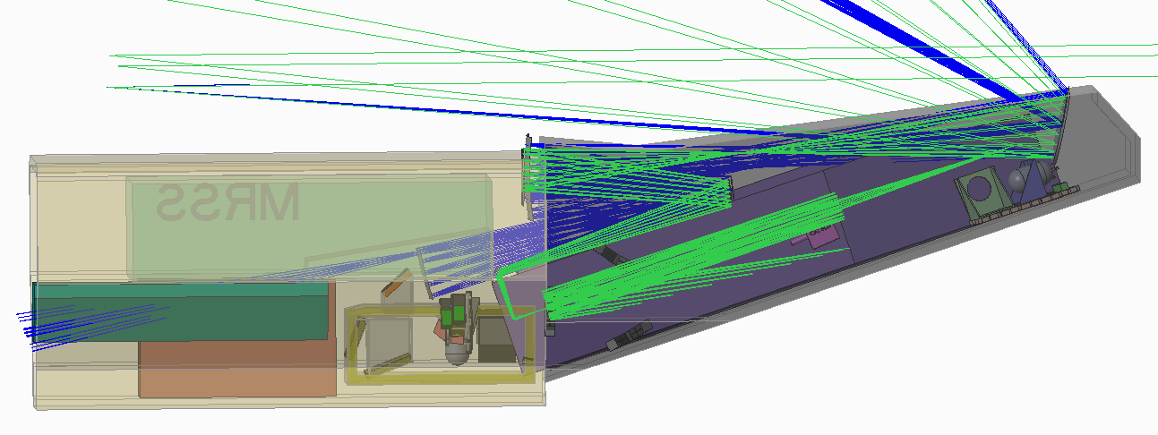
Instrument Accommodation Module (IAM)
Cut-Away View showing Instruments
Telescope Focal Surface
HRS
HI
MISC
FIP
HRS Ray Trace (in green)
MRSS
HI Ray Trace (in blue)

Slide 12
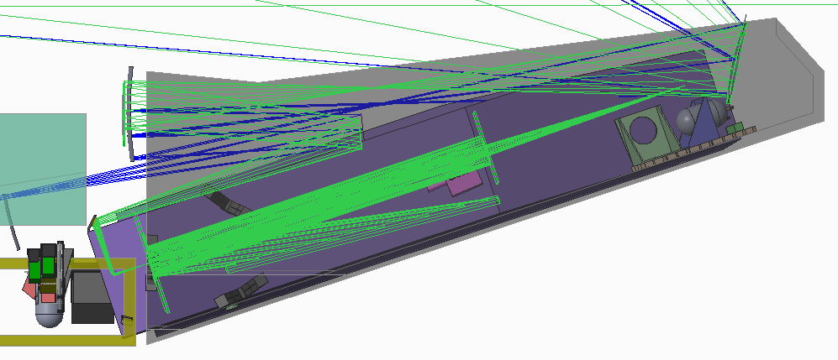
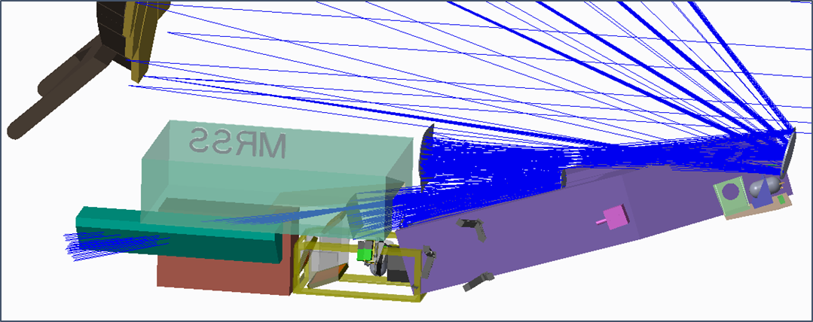
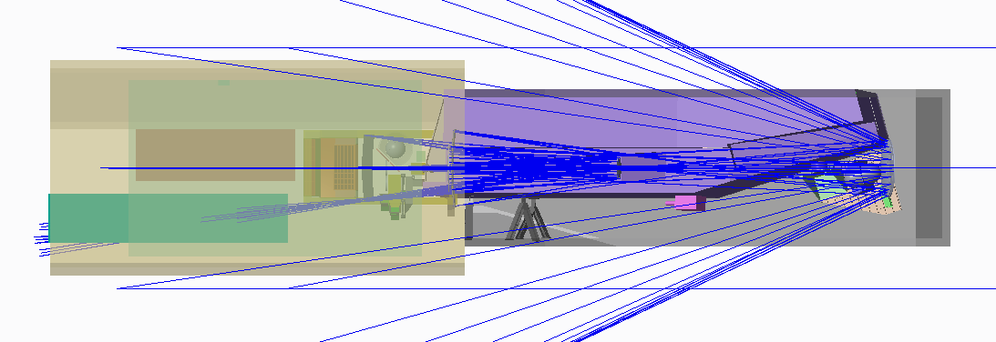
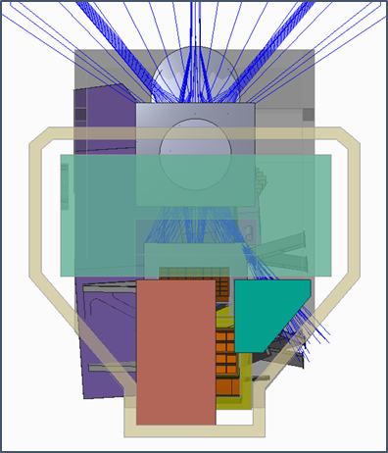
HI & HRS Instrument Ray Traces in the IAM and IAM Top-view
HRS Instrument & Its Ray Trace
FIP
HI Ray Trace
IAM Top-view
IAM Aft-View Looking FWD

Slide 13
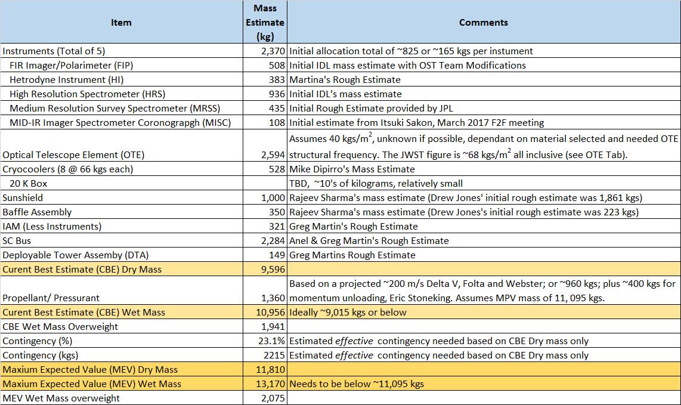
Observatory ROM Mass Estimate
Instrument and Flight System masses are preliminary and relatively immature

Slide 14
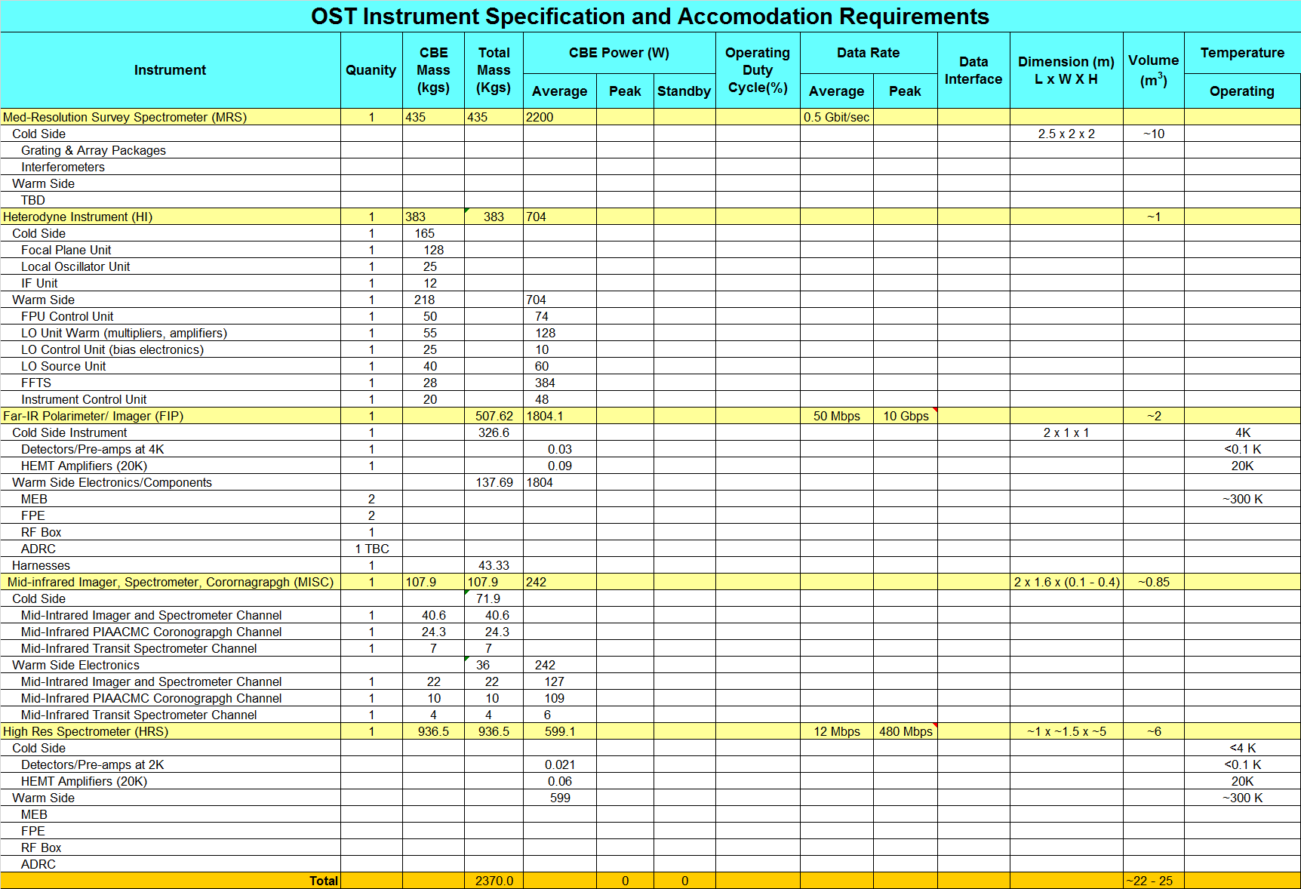
OST Instrument and Accommodation Requirements

Slide 15
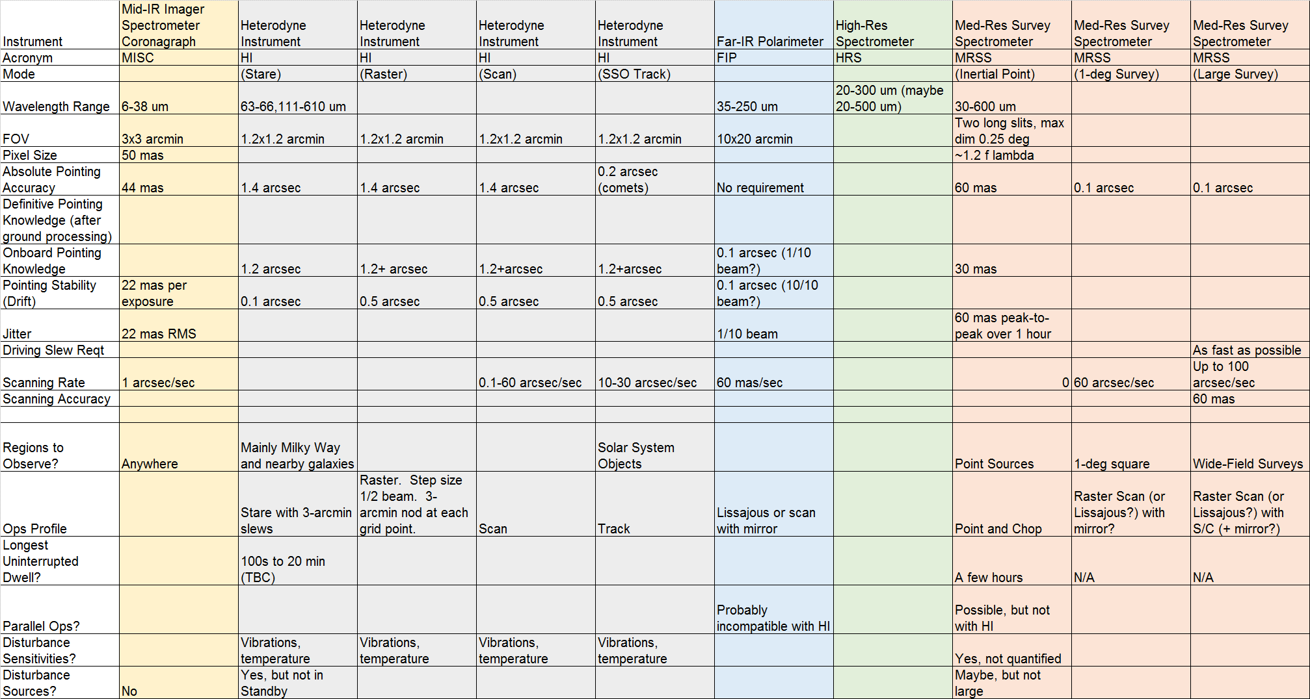
Instrument Attitude Control System Questionnaire Responses

Slide 16
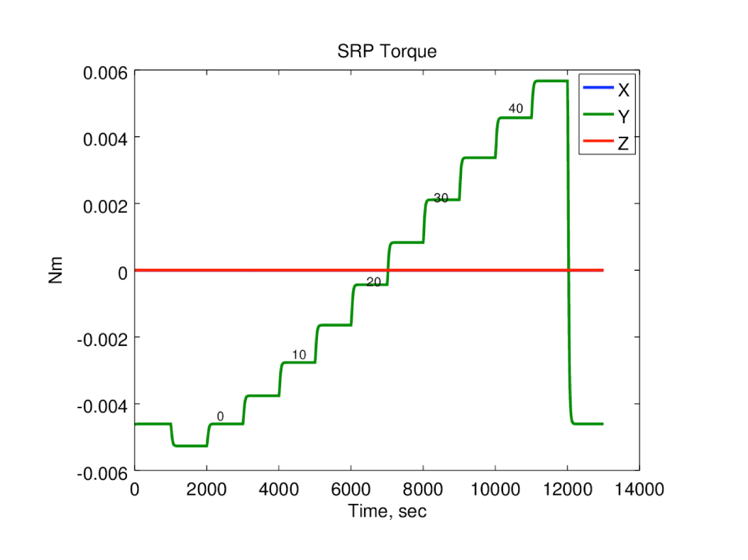
Attitude Control System
Solar Radiation Torque Vs. Pitch
Driving Requirements
Absolute Pointing: 44 mas (MISC)
Onboard Pointing Knowledge: 30 mas (MRSS Inertial Point)
Jitter: 22 mas RMS (MISC)
Scanning Rate: 100 arcsec/sec (MRSS Large Survey)
Assumptions
Moments of Inertia: [120,000 170,000 100,000] kg-m^2
2x JWST (till we know better)
Momentum Accumulation 450 Nms/day
At 45-deg pitch
“Compact” sunshield
Total specular reflection
Mass center assumed [3.0 0.0 4.0] from sunshield major fold center
Looking into techniques for reducing accumulation rate
Tailor sunshield reflectivity?
Trim tab?

Slide 17
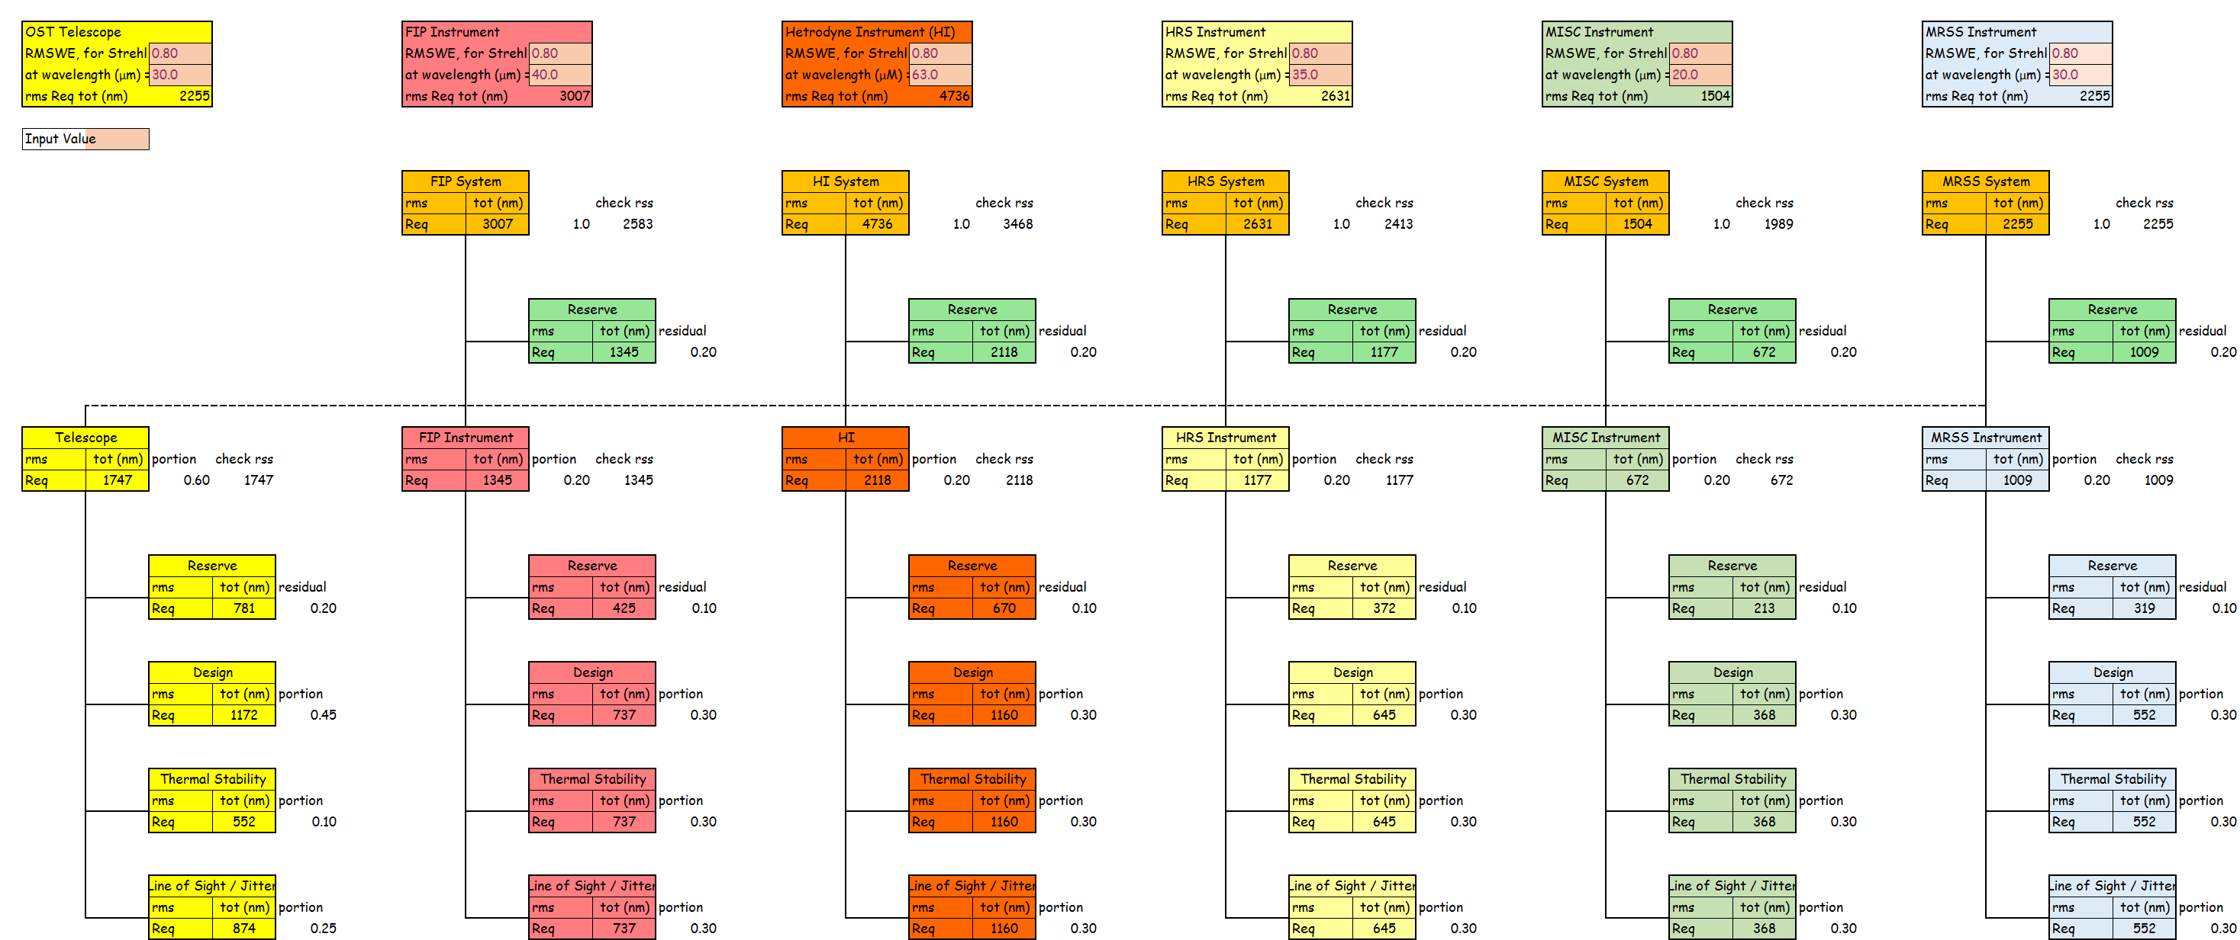
OST Optical Performance Budget

Slide 18
Future Work and Trades
Complete initial OTE design inclusive of deployment, in particular. As its design progresses determine its structural frequency is adequate in the deployed configuration.
Complete IAM and Spacecraft bus initial designs.
Define concept packaging and deployment schemes for the Sunshield and Baffle Assembly
Complete initial designs for the Deployable Tower Assembly (DTA) and the IAM’s hinge mechanism. Resolve whether the DTA needs to be located or partially located inside of the spacecraft bus.
Explore angular spacing between Sunshield layers.
Commence a Structural, Thermal, Optics, and Pointing (STOP) analysis.
Determine observatory Center of Pressure and Center of Gravity for stability.
Single or dual axis solar array gimbal trade.

Slide 19
Issues and Concerns
Packing of the telescope assembly remains a challenge in order to get everything to fit within the 5-m fairing. Total observatory volume, mass and power remain concerns.
The OTE areal mass is very preliminary and is assumed to be ~40 kg/m². JWST’s OTE areal density is ~68 kg/m².

Slide 20
Acronyms
Con Ops – Concept of Operations
DTA – Deployable Tower Assembly
FIP – Far Infrared Imager/ Polarimeter
FOV – Field of View
HGA – High Gain Antenna
HI - Heterodyne Instrument
HRS - High Resolution (Far-IR) Spectrometer
IAM - Instrument Accommodation Module
ISE – Instrument Systems Engineer
JWST – James Webb Space Telescope
LOS – Line of Sight or Loss of Signal
MISC - MID-IR Imager Spectrometer/ Coronagraph
MCWG – Mission Concept Working Group
MOC – Mission Operations Center
MRSS - Medium Resolution Survey Spectrometer
MSE – Mission Systems Engineer
OST – Origins Space Telescope
OTE – Optical Telescope Element
PM – Primary Mirror
SOC – Science Operations Center
STDT – Science and Technology Definition Team
STOP - Structural, Thermal, Optics, and Pointing analysis
WFIRST – Wide Filed Infrared Survey Telescope

Slide 21
Back-up Slides
Unobstructed Observatory Side Views Showing the Spacecraft Bus
Areal Density for JWST
Aft View of the Instrument Accommodation Module (IAM)
MRSS and HI Instrument Volumes

Slide 22
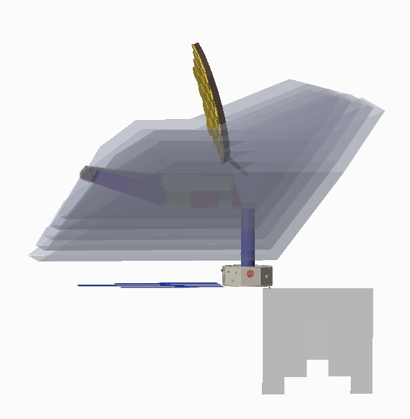
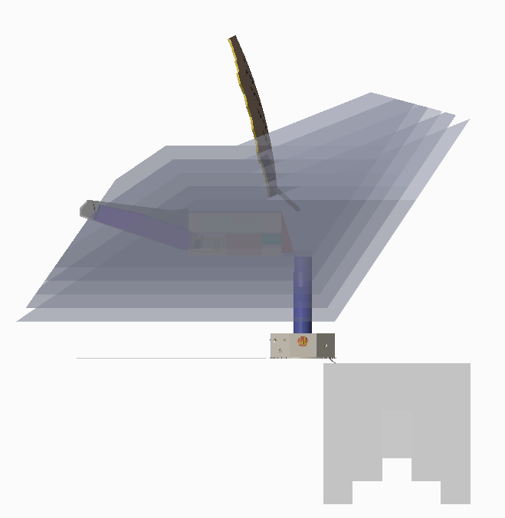
Unobstructed Observatory Side Views Showing the Spacecraft Bus
+Z
+Z
+X
+X
HGA located behind radiator

Slide 23
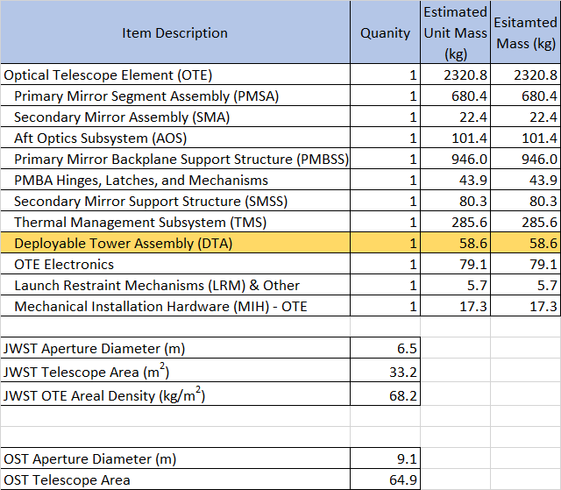
Areal Density for JWST

Slide 24
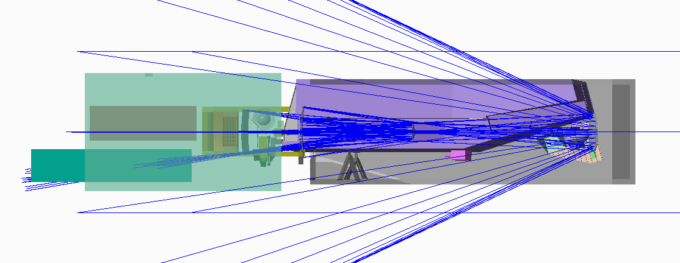
IAM Top-View Without Aft IAM Hosuing

Slide 25
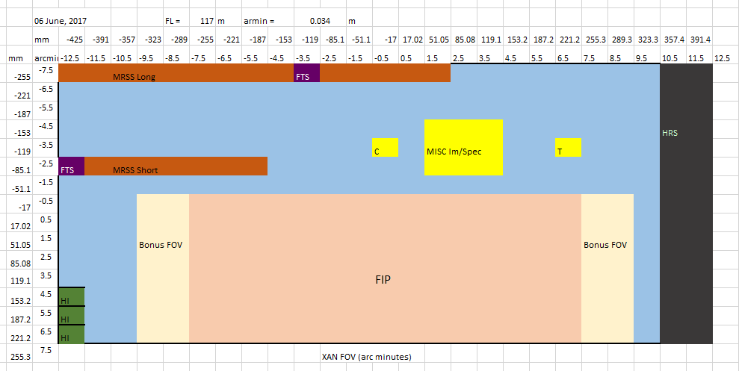
Telescope Field of View (FOV) Layout

