Slide 1
Origins Space Telescope (OST)
Mission Concept 1
Open Issues
Face-to-Face #5
June 1-2, 2017
Ruth.C.Carter@nasa.gov
1

Slide 2
Concept 1 Design Status/Issues
Concept 1 mass is ~2,000 kg over the launch vehicle (Vulcan Aces 5m fairing) lift capability
  Mass for 5 instruments is 2643 kg
    Far-IR Imager/Polarimeter (FIP): 781 kg
    High Resolution Spectrometer (HRS): 935 kg
    Medium Resolution Survey Spectrometer (MRSS): 435 kg
    Heterodyne Instrument (HI): 383 kg
    Mid-IR Spectrometer/Imager/Coronagraph (MISC): 108 kg
Optical ray traces for instruments are still in progress and some are near completion
  Elimination of any of these instruments will result in rework of ray traces and packaging for remaining instruments
Fairing volume is extremely tight and uncertain, overall packaging is uncertain and deployment is still TBD
Current Concept 1 is too heavy to be launched on a 5m fairing
  Volume is tight and uncertain

Slide 3
Solution: Larger Launch Vehicle (LV)
NASA Space Launch System (SLS) has larger mass and volume capabilities to accommodate current OST Concept 1
  Fairing Sizes: 8.4 x 19 m, 10 m x 31 m
SLS will be available in 2030’s when OST will be ready to launch
  Both LUVOIR and HabEx mission concepts include SLS
SLS is a development program and it is yet to have a first launch
  Higher risk item in mission development
Larger LV cost will be higher, however larger volume may allow flight system design to be less complex, resulting in lower mission cost overall

Slide 4
Study Office Plan and Request
Plan to work with instrument teams to scale down instrument volume, mass and power to fit into a 5 meter fairing
In the event that the scaled down instruments results in exceeding 5m fairing capabilities, we need design flexibility to assume a larger LV
  In order to complete Concept 1 design by 9/30/17, we need design flexibility
Study Office requests STDT permission to go to a larger launch vehicle, if necessary
  Need a decision by 6/15/2017, 5pm

Slide 5
Study Schedule

Slide 6
Back -Up

Slide 7
OST Concept 1 Design Parameters
9 meter diameter primary mirror
  Segmented, Off-Axis Telescope
5 science instruments
  Far-IR Imager/Polarimeter (FIP)
  High Resolution Spectrometer (HRS)
  Medium Resolution Survey Spectrometer (MRSS)
  Heterodyne Instrument (HI)
  Mid-IR Spectrometer/Imager/Coronagraph (MISC)
Instrument Accommodation Module (IAM)
8 cryo-coolers to cool and maintain Telescope and IAM at 4 Kelvin
Launch on a 5 meter fairing launch vehicle
  Vulcan Aces assumed
Mission Operations Orbit is Sun Earth L2

Slide 8
5m Fairing Design Challenges
Mass exceeds allowable.
Stowing and deploying Sunshade and Baffle:
  Might be enough space to do it in current configuration – TBD. Stowed stack-up only allows for .75m in height for stowing Sunshade.
  Engineer, with in-depth knowledge of JWST Sunshade design, is just starting to look at it.
  Cable harnesses and cryo lines (volume TBD) need to stow in same area as Sun Shade. May not be enough room for it all.
  How to deploy the cable harnesses and cryo lines AND the Sunshade when they all stow in same location may be unworkable.
  May not be enough room in bus to store everything. Many deployment booms are needed for Sunshade. Large prop tank takes up a lot of room, as well. Layout of Bus is TBD.
Currently HRS instrument interferes with lower corner of stowed Primary Mirror
  Packaging of HRS might not allow for removal of interference – TBD.
  Removing one hex segment of PM required if HRS interference remains.
CG if stowed assembly will be rather high. High CG and high mass may preclude using this launch vehicle.

Slide 9
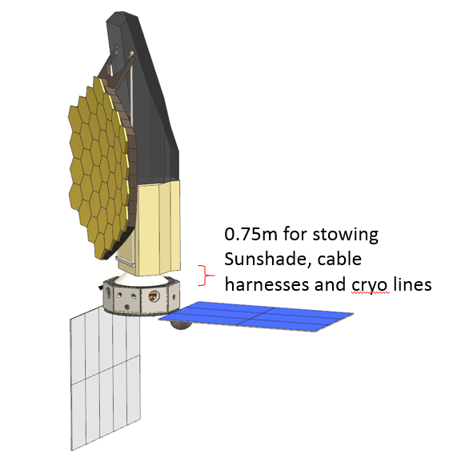
Layout shown is a bit obsolete, but the .75m space is accurate, given current launch vehicle fairing limitation.

Slide 10
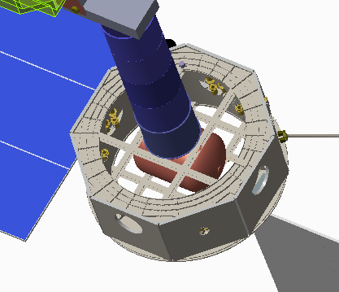
Bus Volume
Area of red triangle =1/2[(142-57)/2]^2 = 903 in^2
Area of DTA = Pi x D^2/4 = Pi x 40 in^2/4 = 1256 in^2
Area of bus top shape without DTA area =
142^2 – 4(903”) – 1256 =
20,164 in^2 – 3,612 in^2 – 1256 in^2 = 15, 296 in^2 (9.8m^2)
Volume available for sunshade stowage and cable harnesses and cryo lines = 9.8 m^2 x .75 m = 7.35 m^3
57”
142”
Area of sunshade = TBD

Slide 11
Concept 1 Mass Estimates preliminary and immature

Slide 12
Potential Launch Vehicles
Notes:
1) FT – Full Thrust is the latest version of the Falcon 9; versions v1.1 and v1.0 are retired from service.
2) ECA - The Ariane 5 ECA (Evolution Cryotechnique type A), first successfully flown in 2005, uses an improved Vulcain 2 first-stage engine with a longer, more efficient nozzle with a more efficient flow cycle and denser propellant ratio. The Ariane 5 ECA has a GTO launch capacity of 9,100 kg (20,100 lb.) for dual payloads or 9,600 kg (21,200 lb.) for a single payload. ES - the Ariane 5 ES (Evolution Storable) has an estimated LEO launch capacity of 21,000 kg (46,000 lb.). Ariane versions A5 G, A5 G+, and A5 GS are retired from service.
3) L2 - Lagrange point 2 named after Joseph Lagrange, an 18th century mathematician, who found the solution to the “three-body problem”. In astrodynamics, the characteristic energy (C₃) is a measure of the excess specific energy over that required to just barely escape from a massive body. The units are length²/time², i.e., energy per mass. In this case an initial C₃ estimate of -0.5 km²/sec² to L2 was assumed.
4) Assumes the Drone recovery option for the Falcon 9 FT 1st Stage and launch from SLC-41 at CCAFS.

