Slide 1
Origins Space Telescope:
Meixner: Science
Leisawitz: Mission
Dipirro: Cryo & Technology

Slide 2
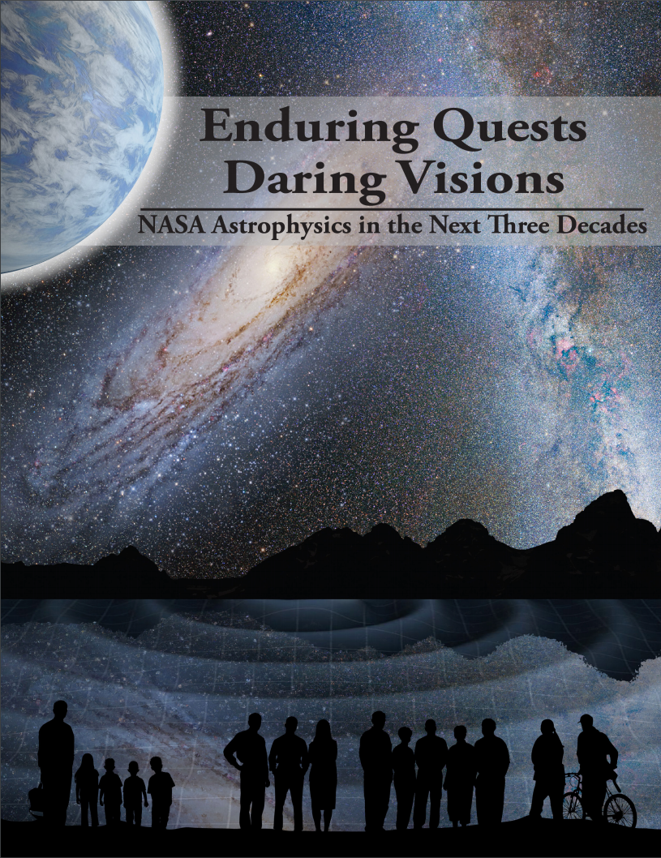
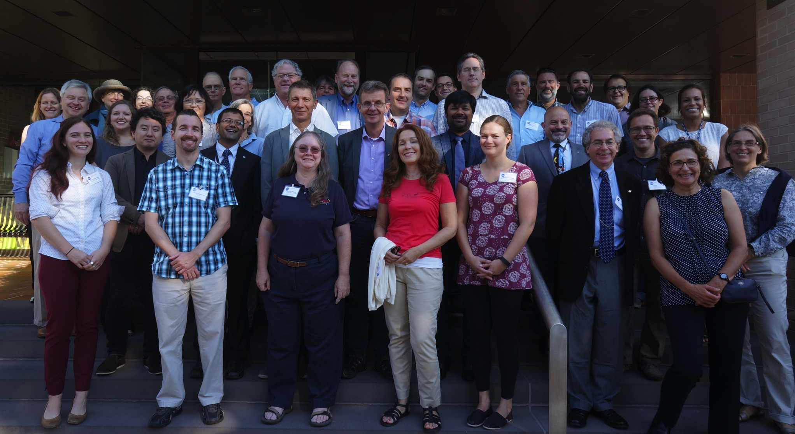
From the community, by the community, and for the community
Through the Astrophysics Roadmap, the community expressed interest in a “Far-IR Surveyor” mission.
asd.gsfc.nasa.gov/firs/team/
Guest Observers will use OST to answer the mission-driving science questions and make unexpected, transformative discoveries.
The OST Science and Technology Definition Team engages with and represents the community and directs the Decadal mission concept study.

Slide 3
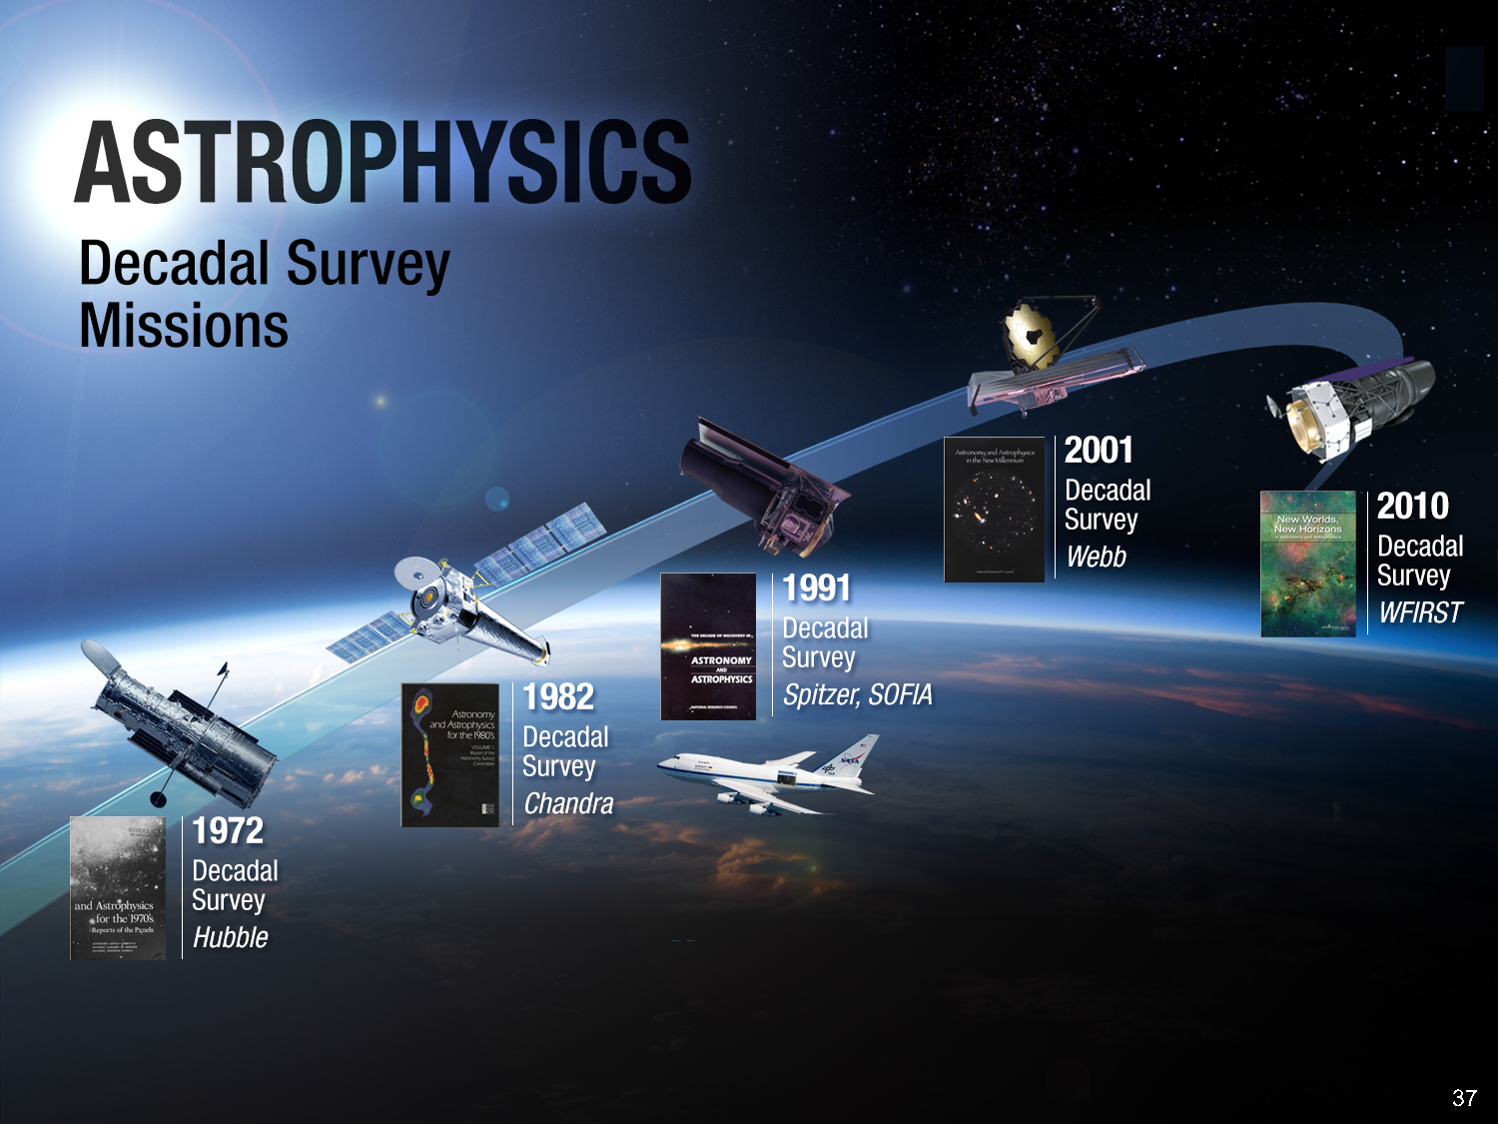

Study goal
Deliver a scientifically compelling, executable mission concept to the 2020 Astrophysics Decadal Survey by June 2019.
NASA has a strong track record when it comes to implementing the large missions recommended in past Decadal Surveys.
OST is one of four large missions under study. The others are Lynx, HabEx, and LUVOIR.
2020
TBD

Slide 4
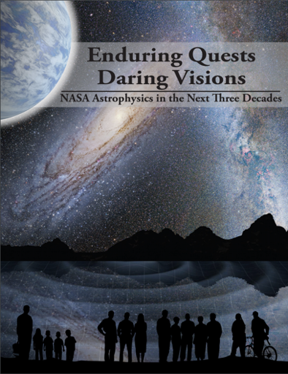
Top three themes
Are we alone? OST goal: OST will assess the habitability of nearby exoplanets and search for signs of life.
(II) How did we get here? OST question: How do the conditions for habitability develop during the process of planet formation?
(III) How does the Universe work? OST question: How do galaxies form stars, make metals, and grow their central supermassive blackholes from reionization to today?
OST level-0 goals map to 2013 NASA Astrophysics Roadmap top-level goals
(I): Exo-Planets; (II) Cosmic Origins; (III) Cosmic Origins+Physics of Cosmos
Notes:
With sensitive mid-infrared transit spectroscopy, OST will measure biosignatures, including ozone, carbon-dioxide, water, and methane in the atmospheres of Earth-sized habitable exoplanets.
With the sensitive and high-resolution far-IR spectroscopy OST will map the water trail in our Galaxy.
OST will spectroscopically 3D map wide extragalactic fields to measure simultaneously properties of growing super-massive blackholes and their galaxy hosts across cosmic time.

Slide 5
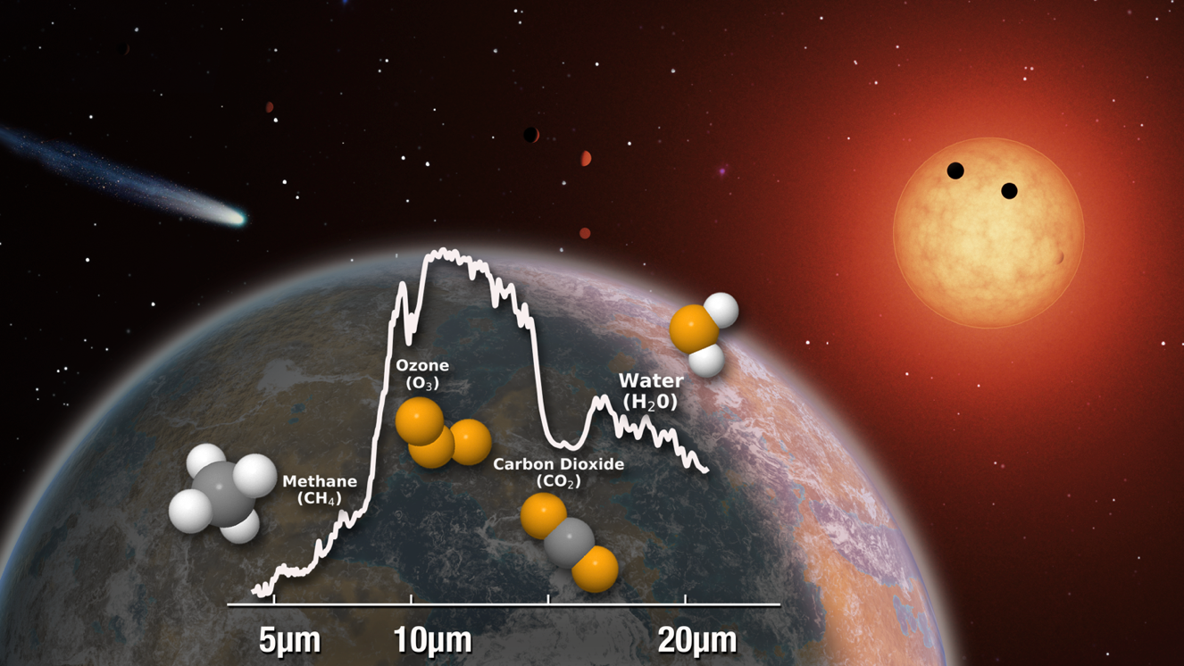
Are We Alone?
        OST will assess the habitability of nearby exoplanets and search for signs of life.
Notes:
*How common are life bearing planets around M dwarfs?

Slide 6
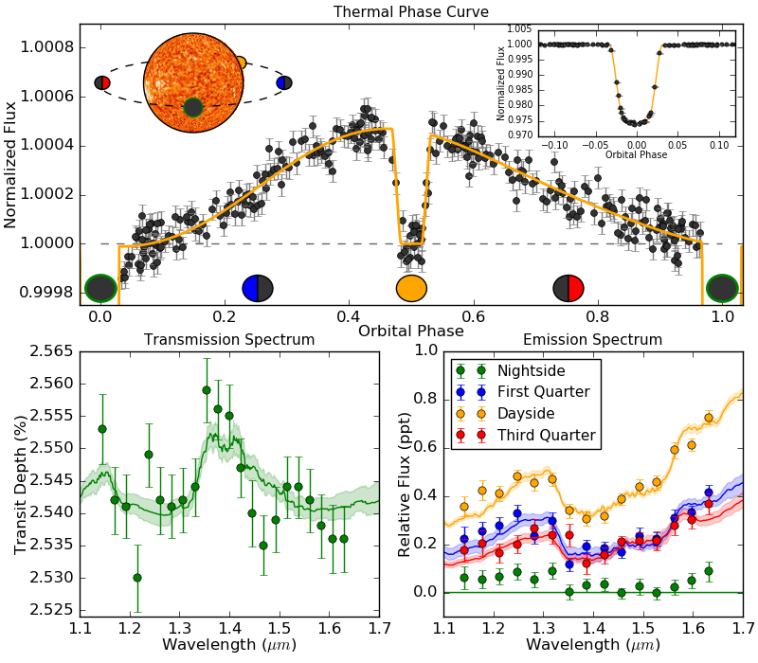
Geometry of Transiting Exoplanets
Primary Transits
  Phase = 0 & 1
  Transmission spectrum
Secondary Eclipses
  Phase = 0.5
  Dayside emission spectrum
Thermal Phase Curves
  Phase = 0 to 1
  Phase-resolved emission spectrum
Notes:
*Transit = planet passes in front of star
*Eclipse = planet passes behind star
*Phase curve = complete orbit

Slide 7
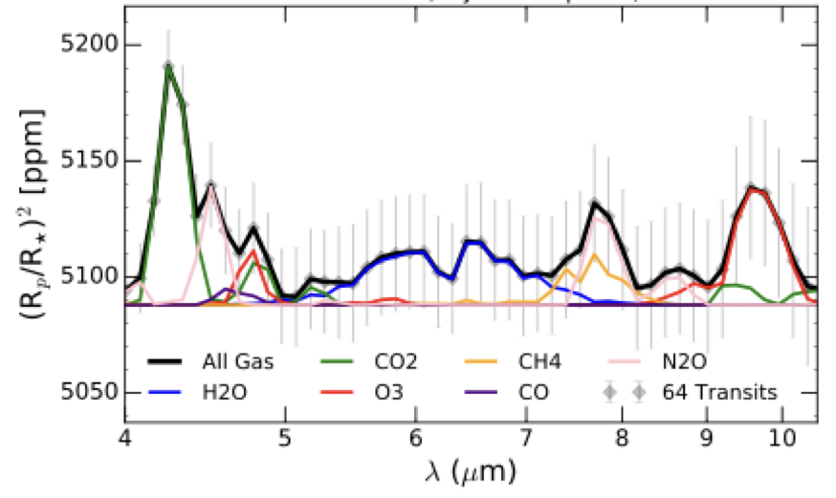
OST will assess the habitability of nearby exoplanets
and search for signs of life.
Science Objective 1: Characterize the atmospheres (clear or cloudy) of 10 habitable-zone (Teq < 400 K), terrestrial (<1.6 REarth) exoplanets in spectral regions containing bio-indcators (CO2, H2O), enabling a culling of the sample down to 5 candidate life-bearing planets for followup. >=10 habitable-zone exoplanets.
Tier-1: Observations of 10 candidates, 4 transists
Model transmission spectra for a TRAPPIST-1e like planet with an Earth-like atmospheric composition with a dry stratosphere orbiting a Kmag=8 star. The uncertainties assume 4 transits using OST MC2 and a noise floor of 5 ppm.

Slide 8
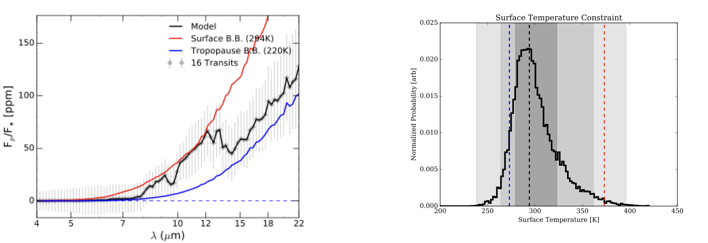
OST will assess the habitability of nearby exoplanets
and search for signs of life.
Science Objective 2: Constrain the temperature, Tsurf, at the apparent surface of 5 habitable zone exoplanets with detected bioindicators, to be consistent (at >95% confidence) with liquid water. >=10 habitable-zone exoplanets.
Model emission spectrum for a TRAPPIST-1e like planet with an Earth-like atmospheric composition and temperature profile orbiting a Kmag=8 star. The uncertainties assume 16 eclipses using OST MC2 and a noise floor of 5 ppm.
Surface temperature constraint for the above scenario. The red and blue vertical dashed lines indicate boiling and freezing, respectively, and the black the input value. The shading shows the 68, 95, and 99.7% confidence intervals
Tier-2: Observations of 5 candidates, 16 eclipses

Slide 9
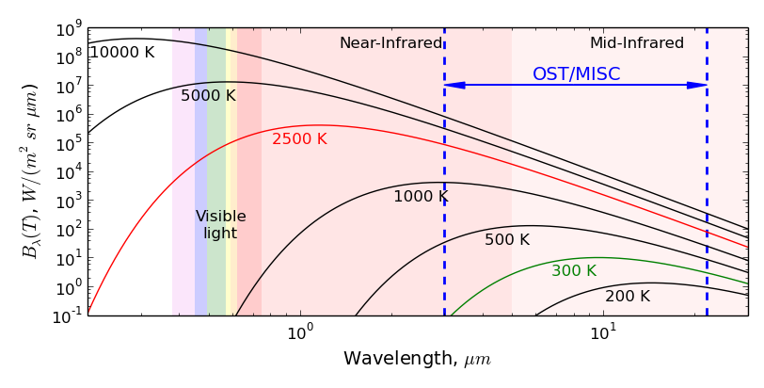
Thermal-IR Advantage
Earth-like Planet
M8 Star
Planet-star contrast ratio always improves at longer wavelengths
Overall SNR falls off at >22 µm
HZ SNR sweet spot is 8 – 10 µm
Notes:
*Plot shows spectral radiance of blackbodies at various temperatures
*Emission peaks at ~1.2 µm for M8 star and 8-10 µm for HZ planet
*OST covers wavelengths where HZ planets are brightest and SNR is best
*Gives access to thermal emission and the temperature structure of atmospheres

Slide 10
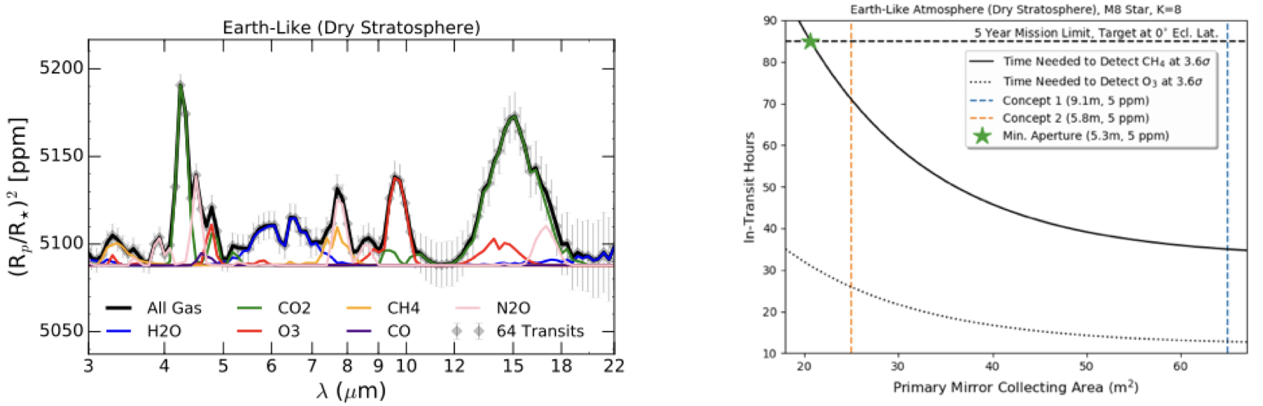
OST will assess the habitability of nearby exoplanets
and search for signs of life.
Science Objective 3: Confirm the presence of biosignatures at 3.6s (assuming an Earth-like atmosphere), if they exist, in the atmospheres of the 4 highest-ranked temperate Earth-like exoplanets.
Tier-3: Observations of 4 candidates, 64 transists
Model transmission spectra for a TRAPPIST-1e like planet with an Earth-like stratospheric composition orbiting a Kmag=8 star. The uncertainties assume 64 transits using OST MC2 and a noise floor of 5 ppm
Number of in-transit hours needed to detect methane (solid curve) and ozone (dotted curve) at 3.6 sigma confidence as a function of telescope primary mirror size.

Slide 11
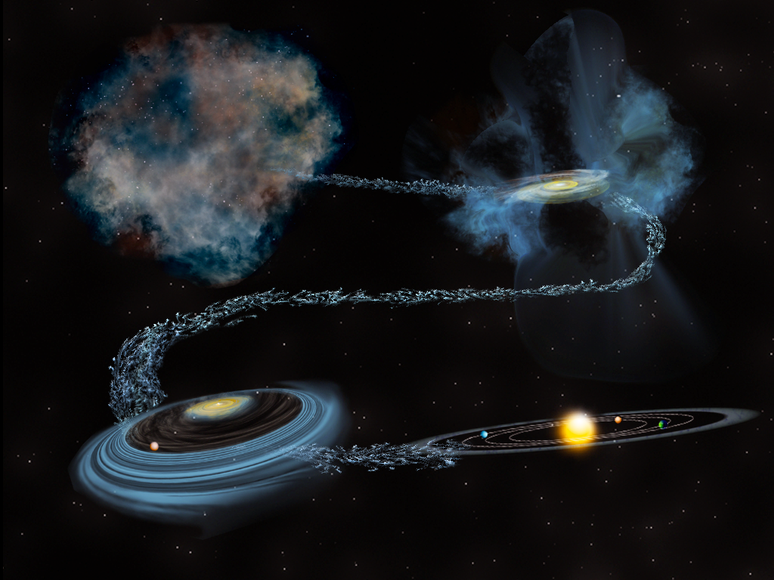
How do the conditions for habitability
develop during the process of planet formation?

Slide 12
How do the conditions for habitability develop during the
process of planet formation?

Slide 13
How do the conditions for habitability develop during the
process of planet formation?
Science Objective 1: Measure the water mass at all evolutionary stages and across the range of stellar mass tracing water vapor and ice at all temperatures between 10 and 10,000 K.

Slide 14
How do the conditions for habitability develop during the
process of planet formation?
Science Objective 1: Measure the water content in all evolutionary stages and across the stellar mass range tracing water vapor and ice at all temperatures between 10 and 10,000 K down to fundamental chemical limits.
OST will make the definitive statement on
the disposition of water as stars and planets are assembled.

Slide 15
How do the conditions for habitability develop during the
process of planet formation?
Science Objective 2: Determine the planet-forming disks gas mass from the mass of Neptune to 300 Jupiter masses in over > 500 disk systems via HD J=1-0.
OST will be the only observatory capable of
spectrally resolving the HD line with sensitivity - enabling exploration of total mass and its distribution in disks out to 500 pc.

Slide 16
How do the conditions for habitability develop during the
process of planet formation?
Science Objective 3: Definitively determine the cometary contribution to Earth’s water by measuring the D/H ratio with high precision (< 0.1 VSMOW*) in over 200 comets in 5 years.
*Vienna Standard Mean Ocean Water – standard definition of isotropic composition of ocean water
OST will detect and measure the D/H ratio
in water in over 200 comets with enough
precision to delineate the diversity in the population for the first time.

Slide 17
How do galaxies form stars, make metals, and grow their supermassive black holes from reionization to today?
Size of simulated field

Slide 18
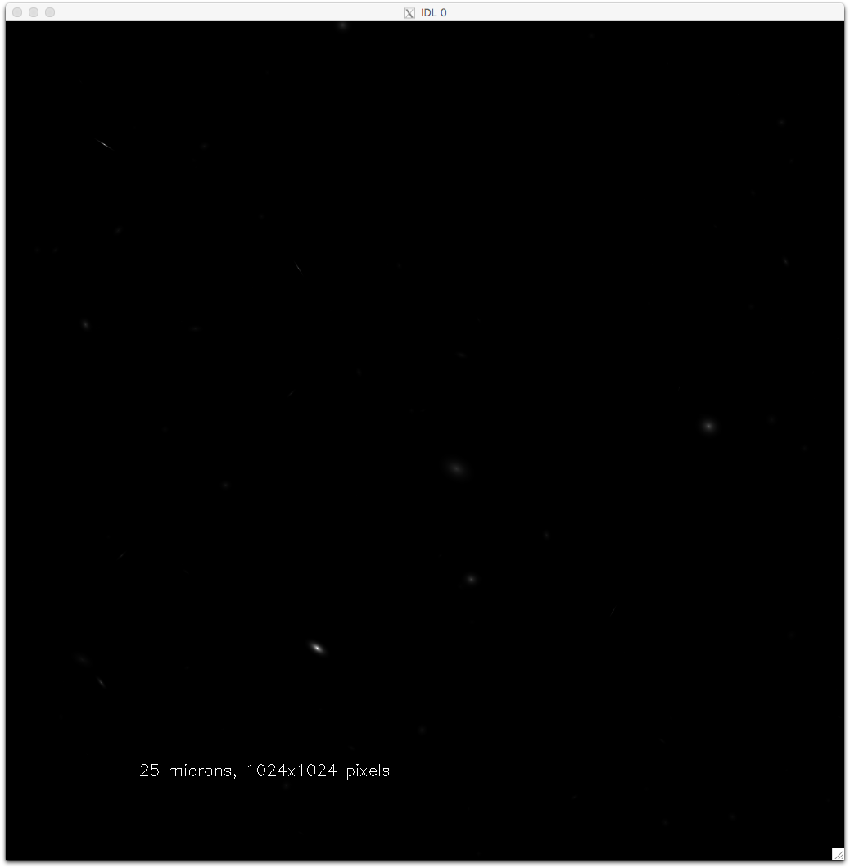
OST beam

Slide 19
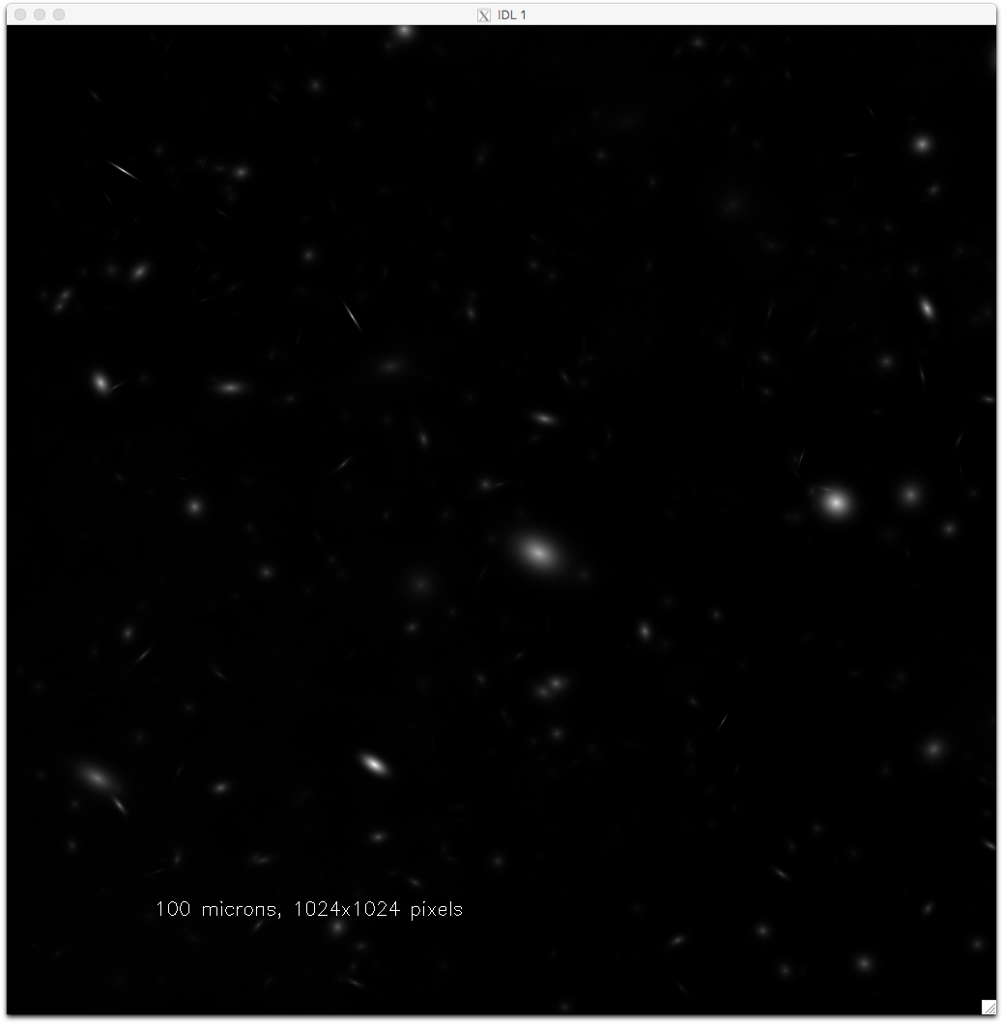
OST beam

Slide 20
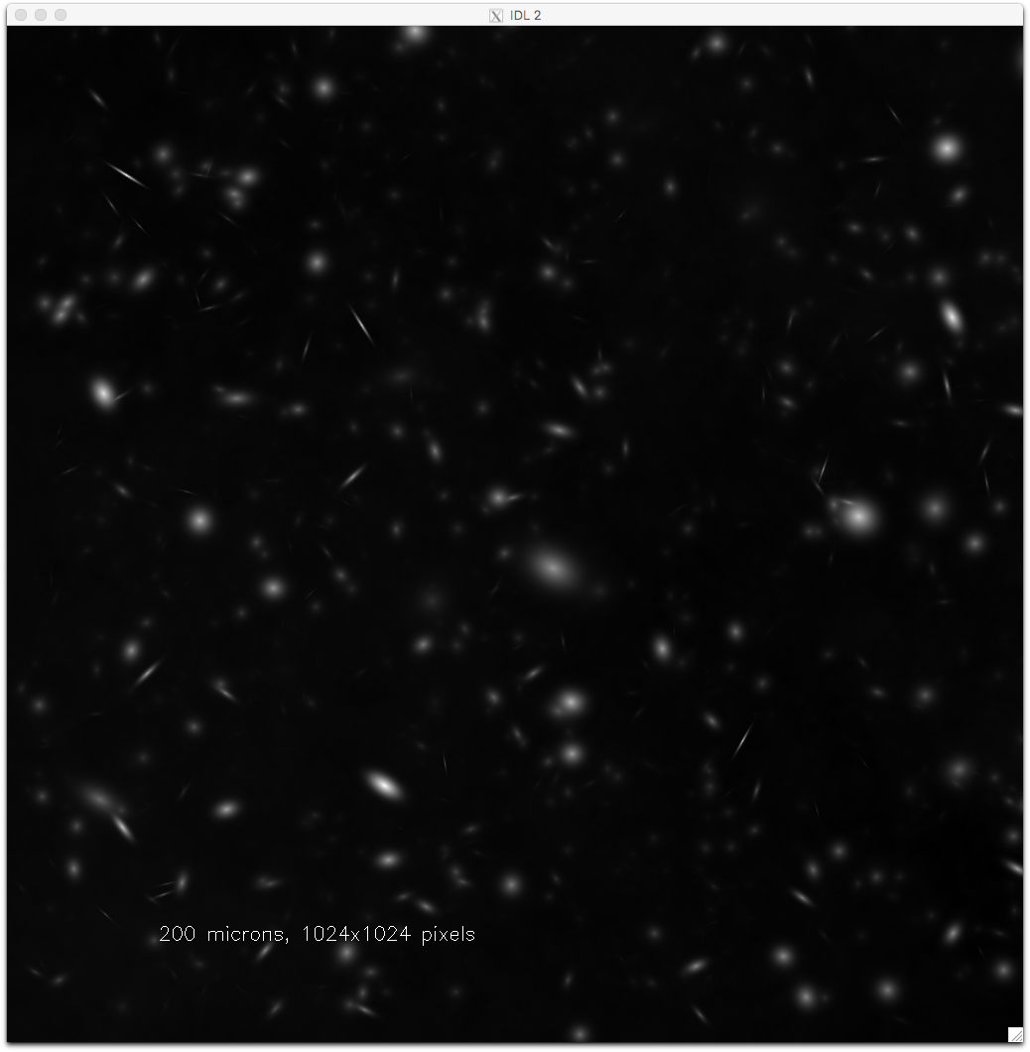
OST beam

Slide 21
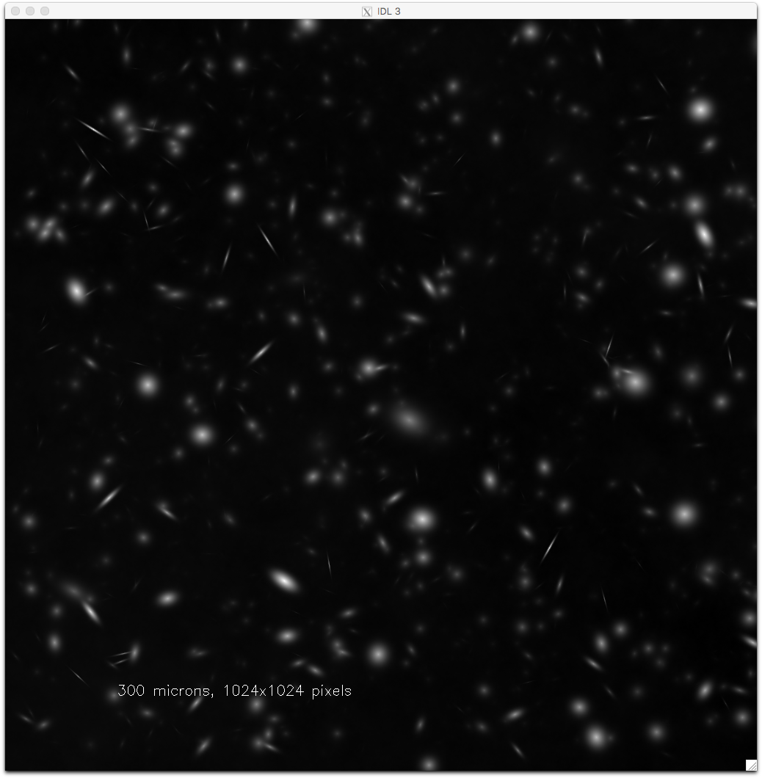
OST beam

Slide 22
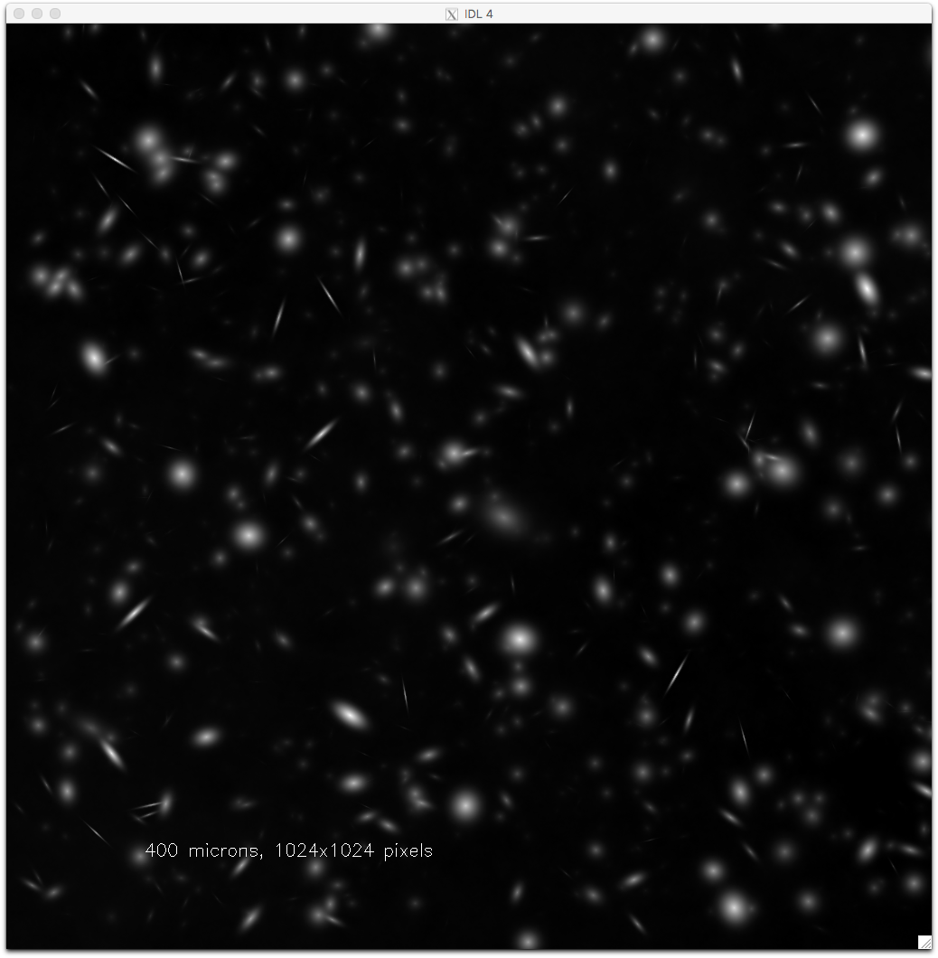
OST beam

Slide 23
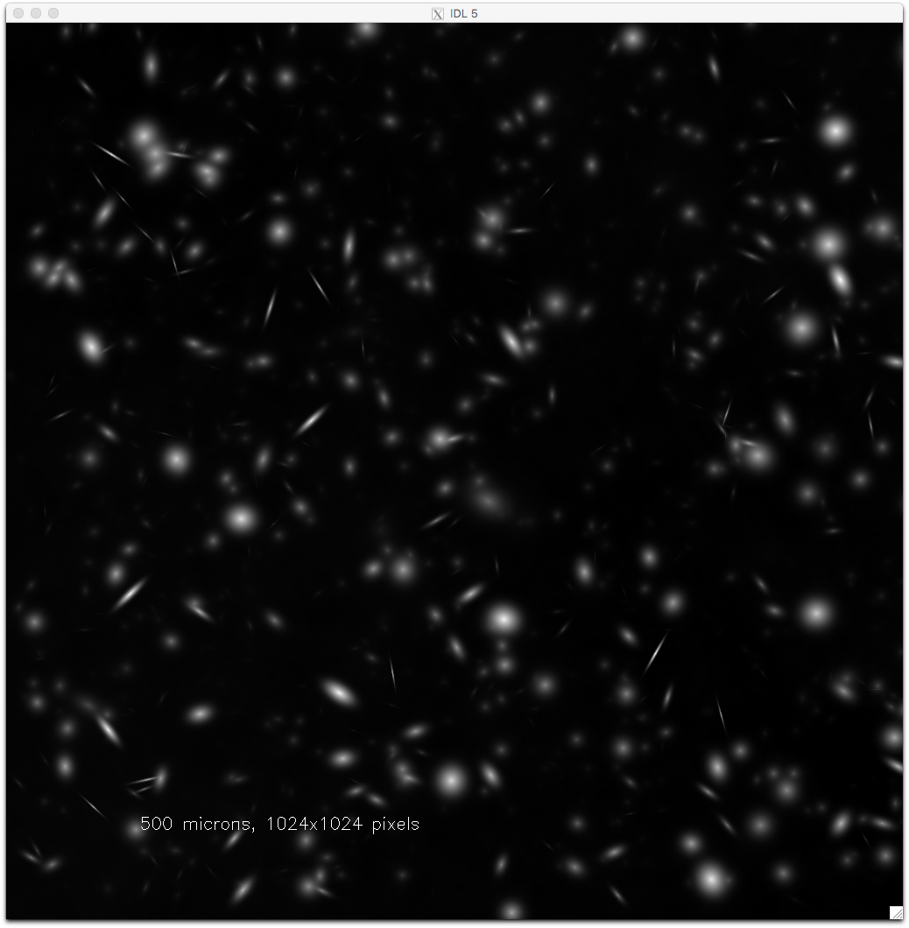
OST beam

Slide 24
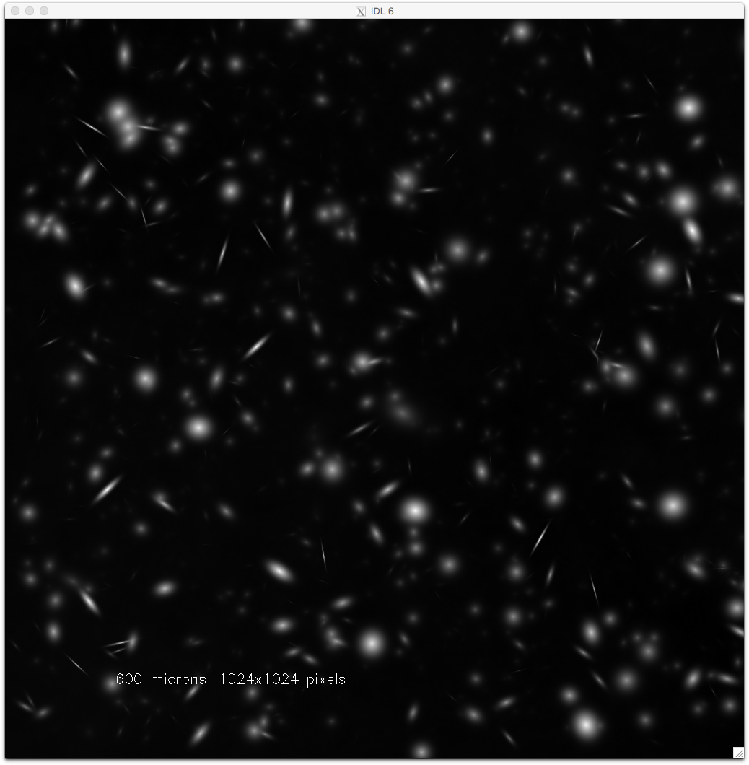
OST beam

Slide 25
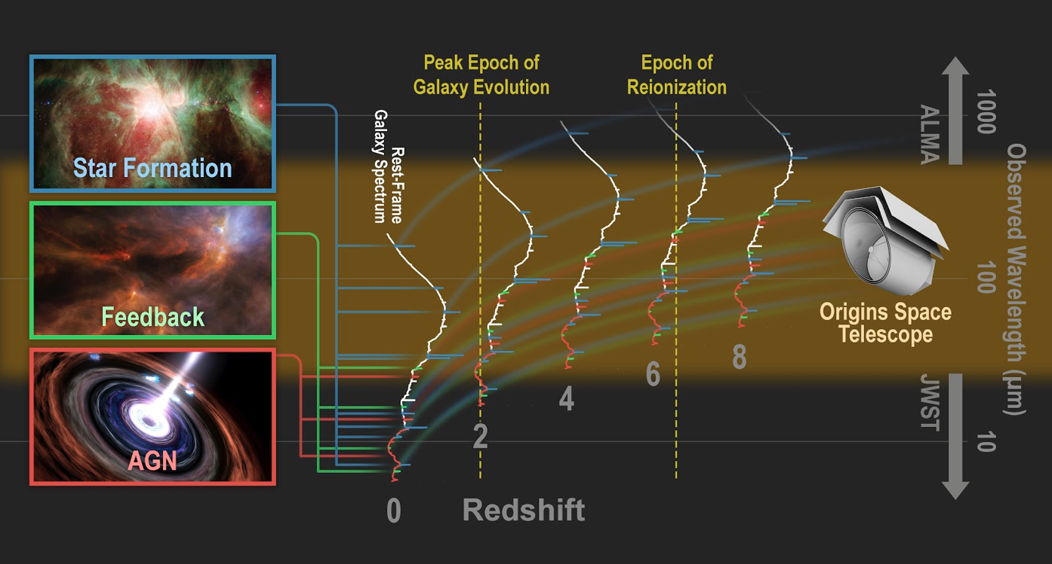
How do galaxies form stars, make metals, and grow their central
supermassive blackholes from reionization to today?

Slide 26
How do galaxies form stars, make metals, and grow their central
supermassive blackholes from reionization to today?
Science Objective 1: Measure the star formation and black hole accretion rates in galaxies since the epoch of reionization, performing the first unbiased survey of the co-evolution of stars and supermassive black holes over cosmic time.
Notes:
Dust obscured star form,ation dominates over cosmic time Madau & Dickenson 2014)

Slide 27
How do galaxies form stars, make metals, and grow their central
supermassive blackholes from reionization to today?
Science Objective 1: Measure the star formation and black hole accretion rates in galaxies since the epoch of reionization, performing the first unbiased survey of the co-evolution of stars and supermassive black holes over cosmic time.
Notes:
OST/OSS survey areas are driven by the need to maximize the number of redshifts and SFR measurements at z > 5 (wide survey) and the number of sources with accurate SFR and BH accretion rate measurements at z=3 (deep survey)

Slide 28
How do galaxies form stars, make metals, and grow their central
supermassive blackholes from reionization to today?
Science Objective 1: Measure the star formation and black hole accretion rates in galaxies since the epoch of reionization, performing the first unbiased survey of the co-evolution of stars and supermassive black holes over cosmic time.
Galaxy main sequence at z=1.5-2 from the OSS deep survey. Colors denote which galaxies will be detected in PAHs (red), bright FS lines (green), and fainter FS lines (blue). OST will measure SFRs for all galaxies in this plot, metallicities for galaxies above 10^9Msun and black hole accretion rates for every galaxy above 10^10 Msun!
OST/OSS survey areas are driven by the need to maximize the number of redshifts and SFR measurements at z > 5 (wide survey) and the number of sources with accurate SFR and BH accretion rate measurements at z=3 (deep survey)

Slide 29
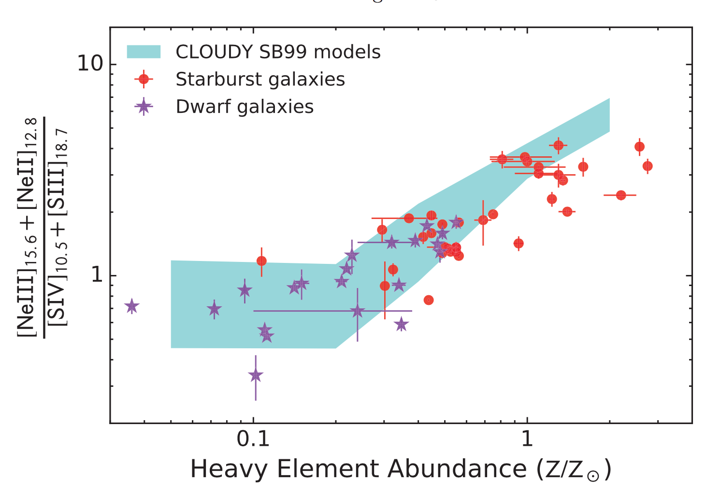
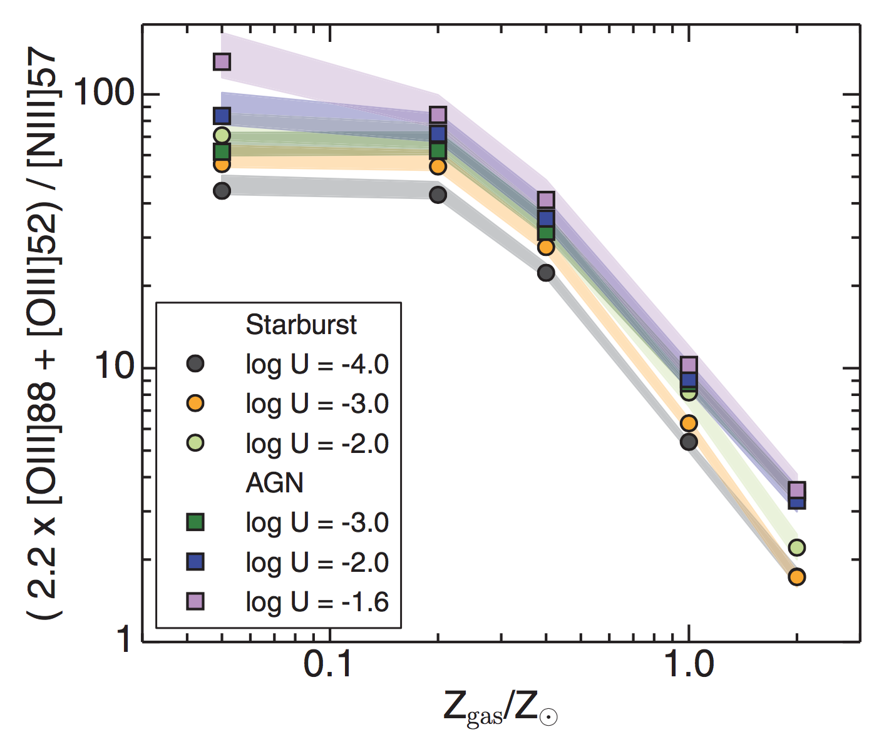
How do galaxies form stars, make metals, and grow their central
supermassive blackholes from reionization to today?
Science Objective 2: Measure the metal content of galaxies as a function of cosmic time, tracing the rise of heavy elements, dust and organic molecules across redshift, morphology and environment.
Fig. 3: Infrared metallicity line diagnostic diagrams for the bright MIR (left) and FIR(right) emission lines (Fernández-Ontiveros et al. 2016; Pereira-Santaella et al. 2017).

Slide 30
How do galaxies form stars, make metals, and grow their central
supermassive blackholes from reionization to today?
Science Objective 2: Measure the metal content of galaxies as a function of cosmic time, tracing the rise of heavy elements, dust and organic molecules across redshift, morphology and environment.
Notes:
Simulated mass-metallicity relations for the OSS Deep Survey for z=1-9 using relative metallicity indicator [OIII]52/[NIII]57, one of several available to OST.

Slide 31
How do galaxies form stars, make metals, and grow their central
supermassive blackholes from reionization to today?
Science Objective 2: Measure the metal content of galaxies as a function of cosmic time, tracing the rise of heavy elements, dust and organic molecules across redshift, morphology and environment.
Notes:
Number counts for Deep Survey of detections of faint FSL [NeII] 13 µm.

Slide 32
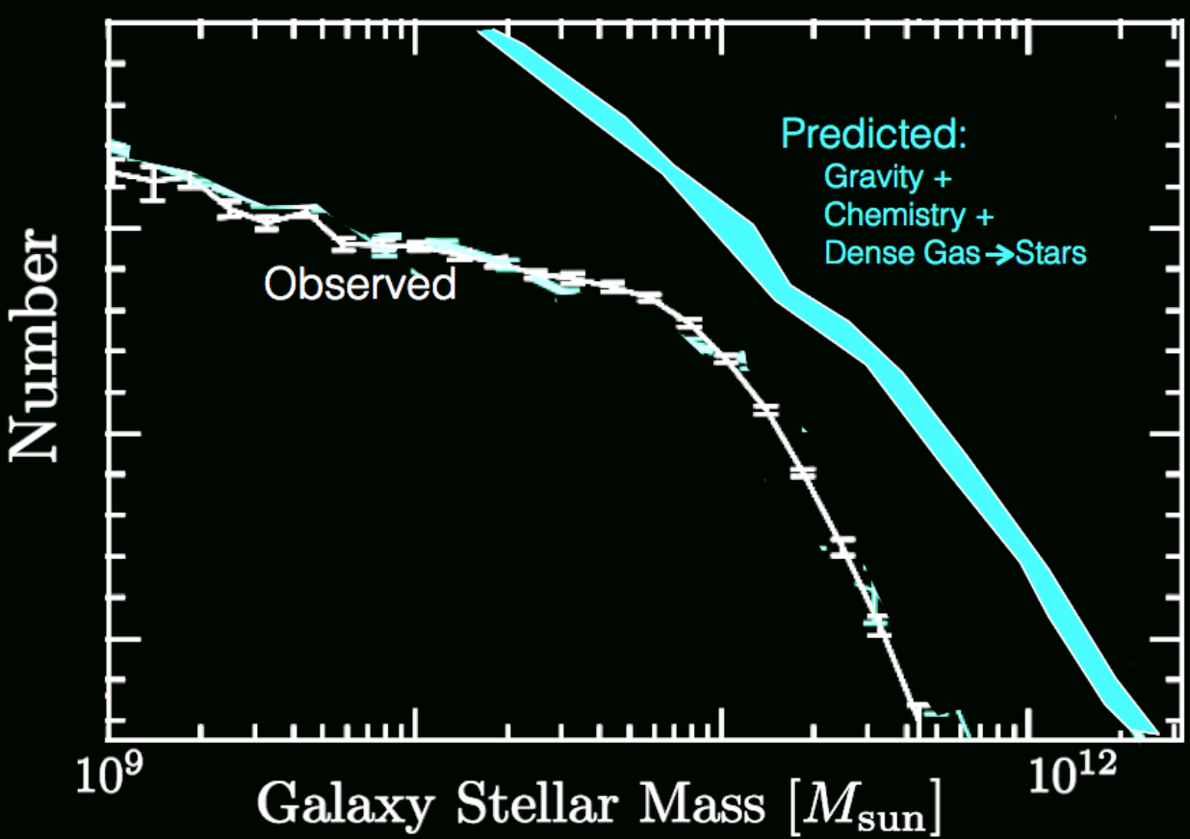
How do galaxies form stars, make metals, and grow their central
supermassive blackholes from reionization to today?
Science Objective 3: Determine how energetic feedback from AGN and supernovae regulate galaxy growth, quench star formation, and drive galactic ecosystems, by measuring galactic outflows as a function of SFR, AGN luminosity and redshift over the past 10 Gyr.
Notes:
Number of galaxies vs. stellar mass at z=0 showing the discrepancy between the observed mass density and that predicted by simple cosmological models without significant feedback. OST will be able to directly measure feedback in the progenitors of today’s high-mass galaxies galaxies out to z~5, quantifying the role of AGN feedback in the form of fast molecular outflows.

Slide 33
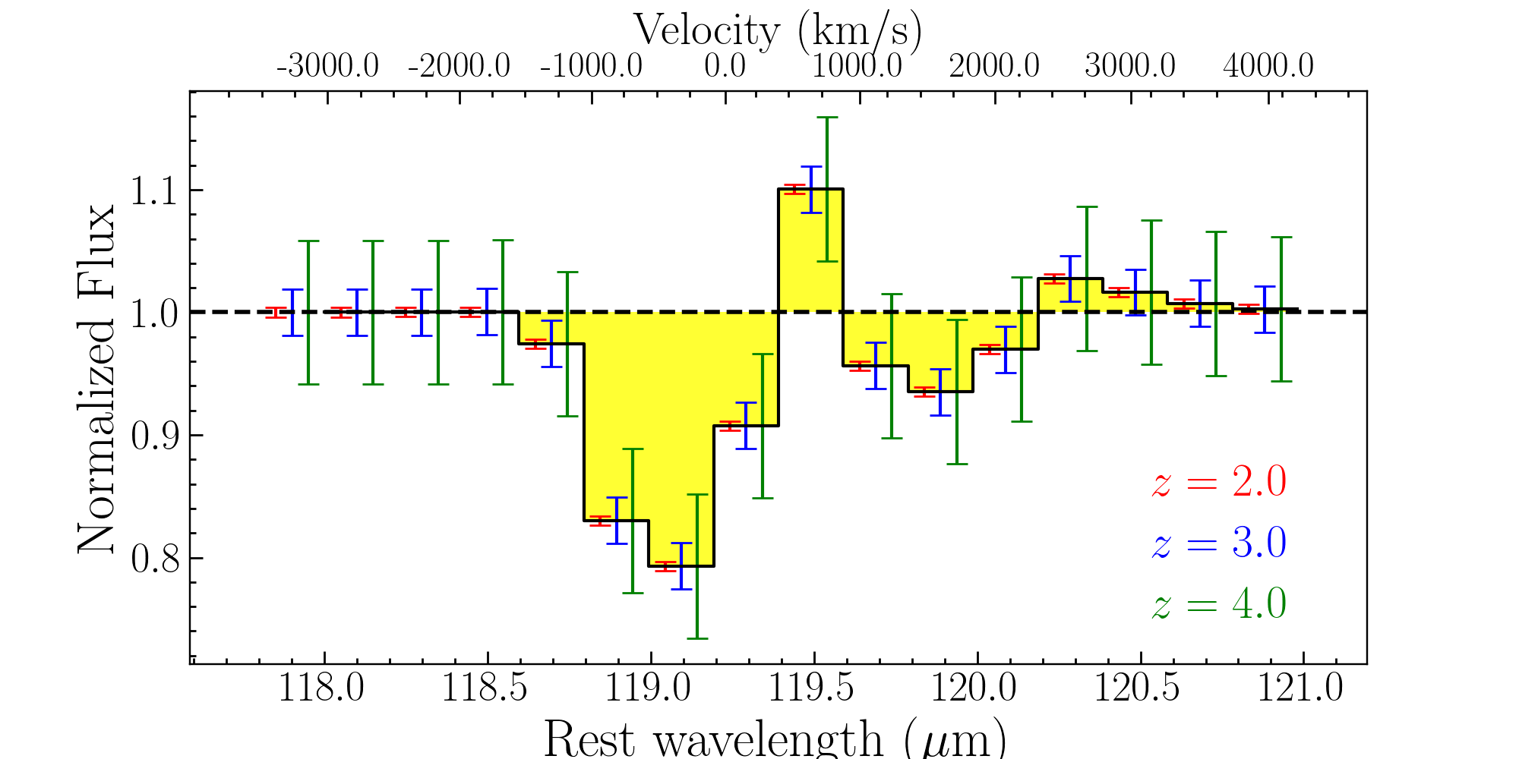
How do galaxies form stars, make metals, and grow their central
supermassive blackholes from reionization to today?
Science Objective 3: Determine how energetic feedback from AGN and supernovae regulate galaxy growth, quench star formation, and drive galactic ecosystems, by measuring galactic outflows as a function of SFR, AGN luminosity and redshift over the past 10 Gyr.
Notes:
In sources with strong outflows the emission and absorption components are separated by ~1000 km/s with absorption depths of ~20%. This sets a lower limit on the spectral resolving power of R~300, the sensitivity of 1E-21 W/m^2 at 100 microns, and the long wavelength cutoff of 600 microns. The figure shows a simulated OST/OSS spectrum for a 1hr integration on Mrk 231 at z=2, 3, and 4 – comparable to the depth in a deep, 2 sq. deg. OST/OSS survey

Slide 34
Science Summary
Are we alone? OST goal: OST will assess the habitability of nearby exoplanets and search for signs of life.
(II) How did we get here? OST question: How do the conditions for habitability develop during the process of planet formation?
(III) How does the Universe work? OST question: How do galaxies form stars, make metals, and grow their central supermassive blackholes from reionization to today?
Notes:
With sensitive mid-infrared transit spectroscopy, OST will measure biosignatures, including ozone, carbon-dioxide, water, and methane in the atmospheres of Earth-sized habitable exoplanets.
With the sensitive and high-resolution far-IR spectroscopy OST will map the water trail in our Galaxy.
OST will spectroscopically 3D map wide extragalactic fields to measure simultaneously properties of growing super-massive blackholes and their galaxy hosts across cosmic time.

Slide 35
Backup

Slide 36
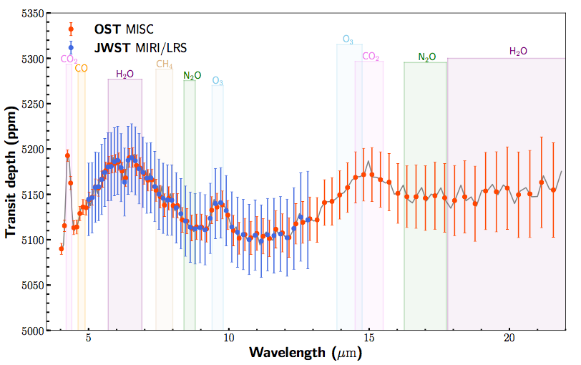
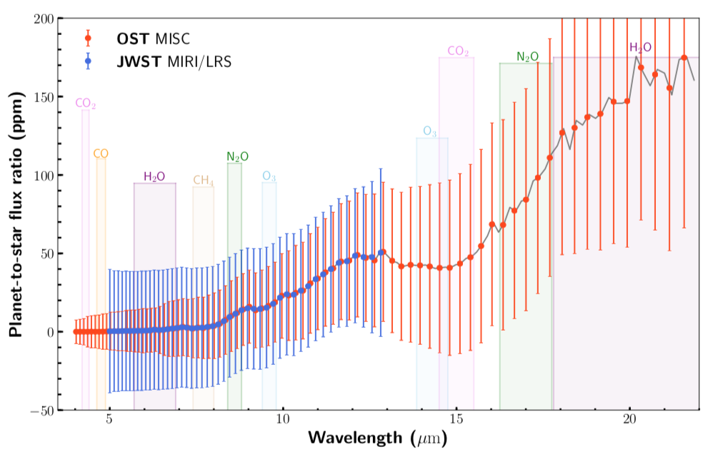
Science Overlap: OST vs JWST
Transmission Spectrum
Emission Spectrum
Optimistic 30 ppm noise floor for MIRI/LRS,
5ppm noise floor for MISC
Notes:
*JWST will not detect biosignatures (CH4 + O3) in an Earth-like atmosphere

Slide 37
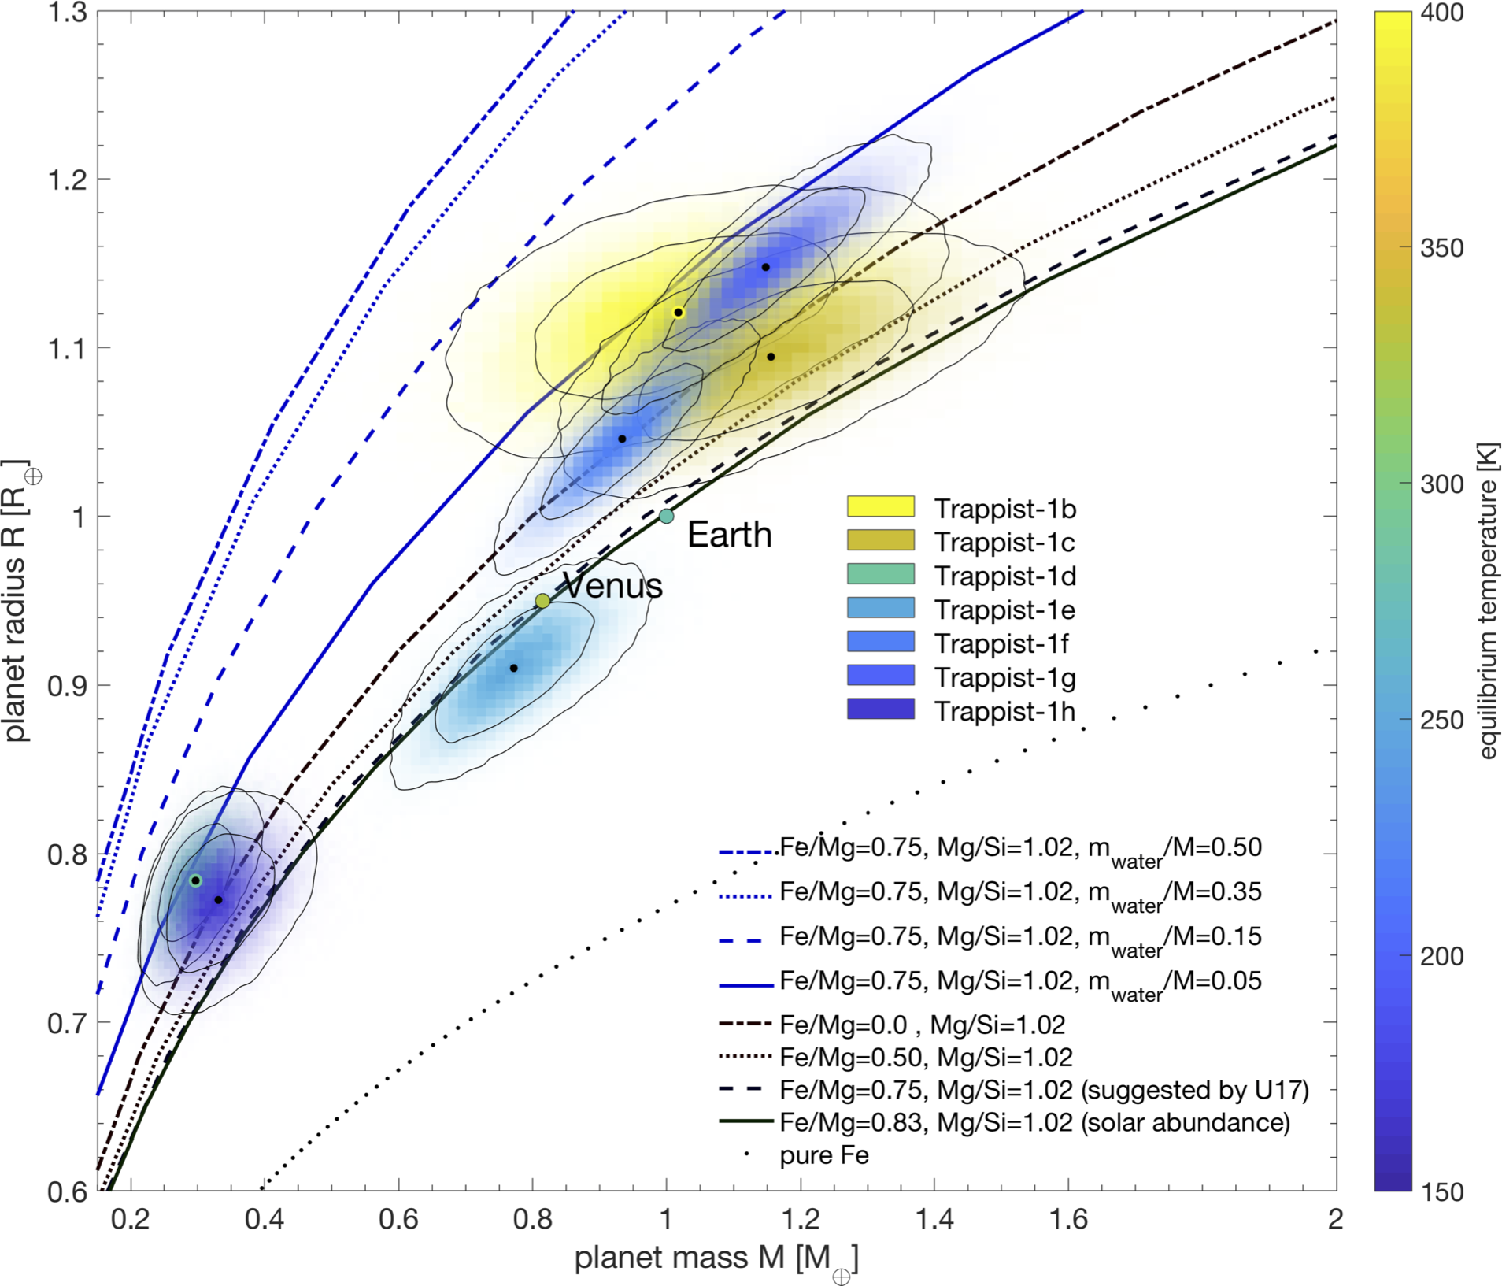
Why Transiting Exoplanets?
Precisely determined masses and radii
  Masses from RV instruments (more later)
  Stellar (and planetary) radii to ~5% with GAIA
Bulk densities for planetary classification before atmospheric characterization
Target rocky planets known to have volatile-rich atmospheres
Grimm+ (2018)
Notes:
*Mass radius diagram of TRAPPIST-1 system
*Dashed/dotted curves track relation for various compositions
*Most TRAPPIST-1 planets are consistent with having volatile-rich atmospheres

Slide 38
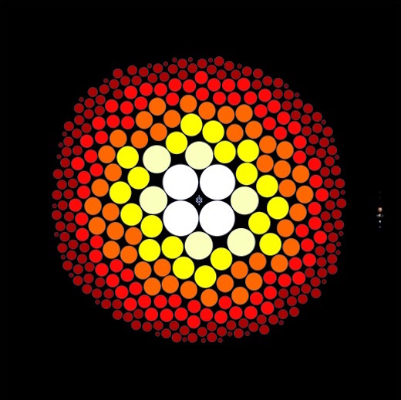
Why M Dwarfs?
M dwarfs are common
  75% of stars within 15 pc are M dwarfs
Rocky planets are common
  Expect to detect about a dozen HZ exoplanets transiting mid-to-late M dwarfs within 15 pc
  Four such planets are already known (TRAPPIST-1d,e,f and LHS-1140b)
Advantages of small (rocky) planets transiting M dwarf stars
  Larger transit depths
  Closer habitable zones (5 – 100 days)
  Increased transit probability in HZ
T. Henry, RECONS Survey

Slide 39

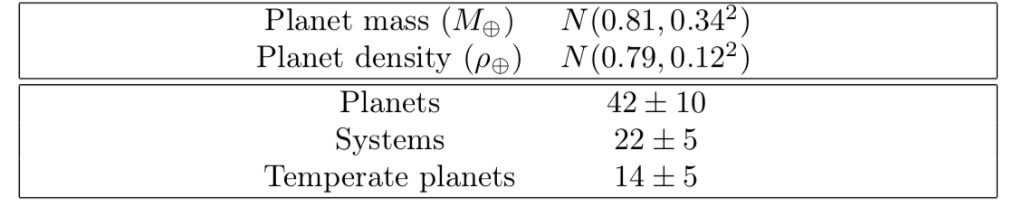
Predicted Yields
TESS is not ideal for late M dwarfs
SPECULOOS will observe ~1200 M7-L3
Delrez+ (2018) estimate 14±5 HZ planets
  1-3 systems within 10 pc (brighter than TRAPPIST-1)
MEarth+TESS+SPECULOOS+Others will yield ≳dozen temperate terrestrial planets around mid/late M dwarfs within 15 pc

Slide 40



Science Objectives
Tier 3: OST shall detect biosignatures (CH₄ and O₃) at >3.6σ, assuming an Earth-like atmosphere, for the four highest-ranked targets that exhibit indicators of habitability.
Tier 2: OST shall obtain emission spectra (over 4 - 22 µm) of 6-8 planets that exhibit spectral modulation and constrain the temperature at the apparent surface* to be consistent (at >95% confidence) with liquid water.
Tier 1: OST shall obtain transmission spectra (over 3 - 11 µm) of 12-16 terrestrial (R<1.6 R_{Earth}), habitable-zone (T_{eq} < 400 K) exoplanets transiting nearby M dwarf stars and, assuming an Earth-like atmosphere, detect spectral modulation at >3.6σ.
Tier 3
Tier 2
Tier 1
Notes:
*Wedding cake strategy, alien life is the prize on top
*Tier 1: non-flat transmission spectra
*Tier 2: liquid water from emission spectra
*Tier 3: biosignatures from transmission spectra

