Slide 1
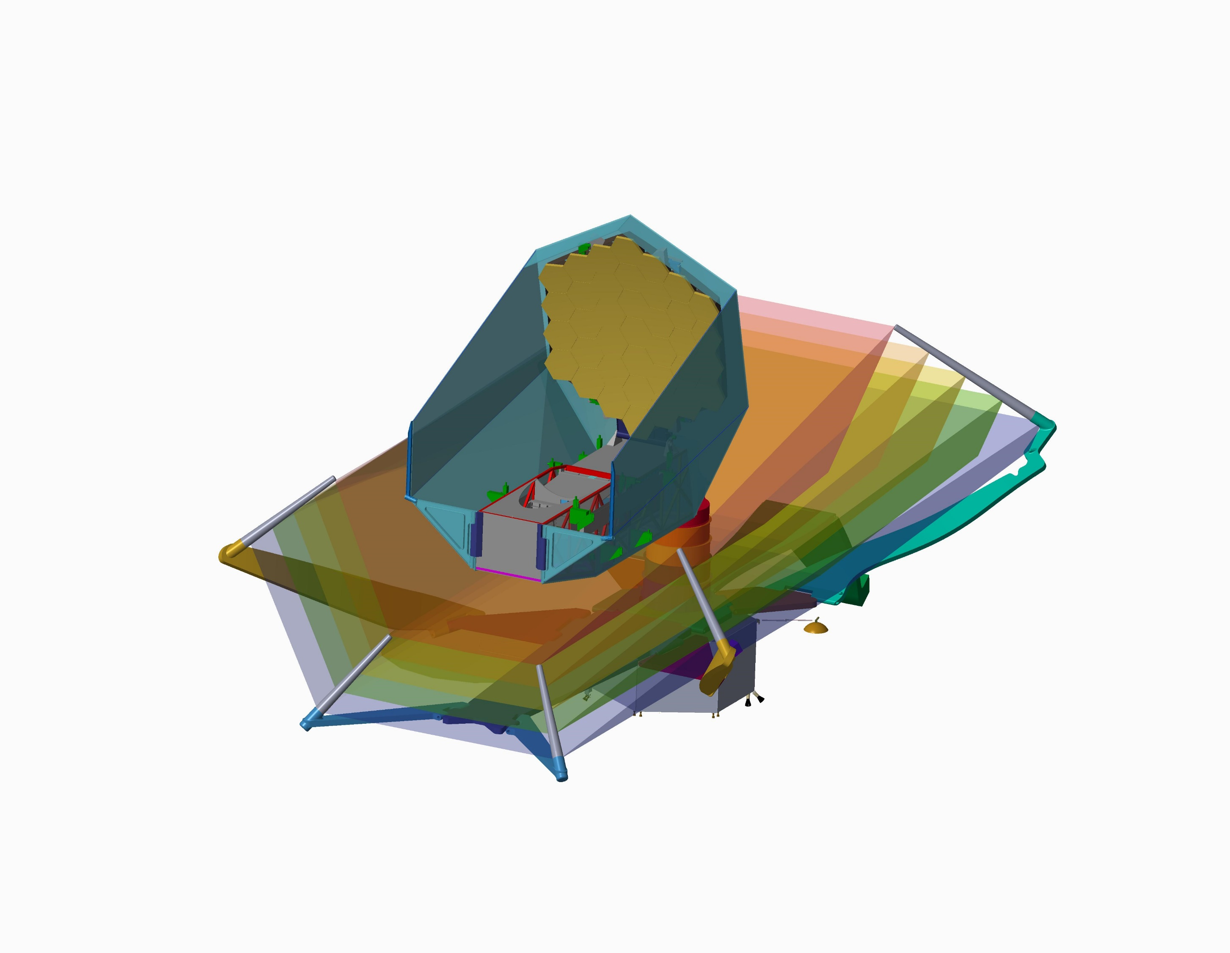
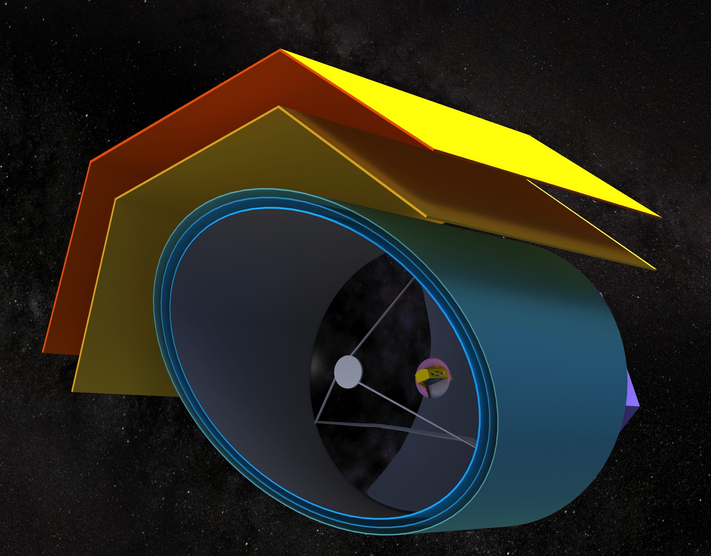
OST Mission Concept
Dave Leisawitz, NASA Study Scientist
on behalf of the OST mission concept study team

Slide 2
Study approach
Identify visionary, robust, and compelling science questions
Derive from those questions a set of high-priority measurement requirements for the mission
Choose a mission architecture
Evaluate trades and develop mission point design
Determine technology needs
Estimate costs (baseline concept and options)
Present to Decadal Survey
Iterate concept with STDT

Slide 3
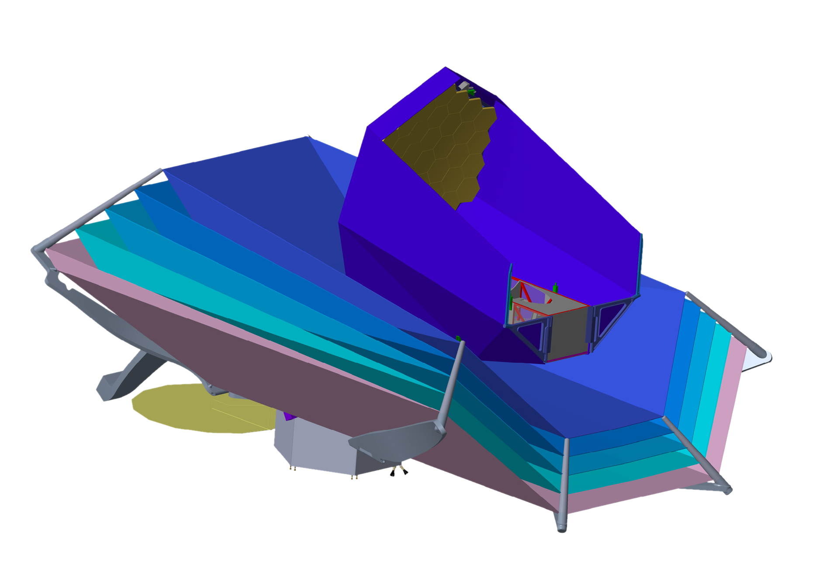
Architecture evolution
retain high-value science
eliminate complex deployments, reduce risk
reduce size
constrain cost
Concept 2
Concept 1
optimization
Decadal baseline concept with upscope options

Slide 4
Architecture inspiration
25 m²
52 m²
JWST
OST Concept 1:
Open architecture
Spitzer
OST Concept 2:
Better stray light protection
Can demonstrate shield deployment on the ground
0.5 m²
25 m²
All concepts studied are cryo-cooled ~4 K (no expendable cryogen)

Slide 5
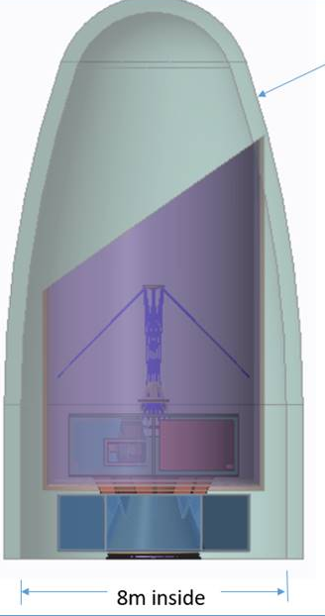
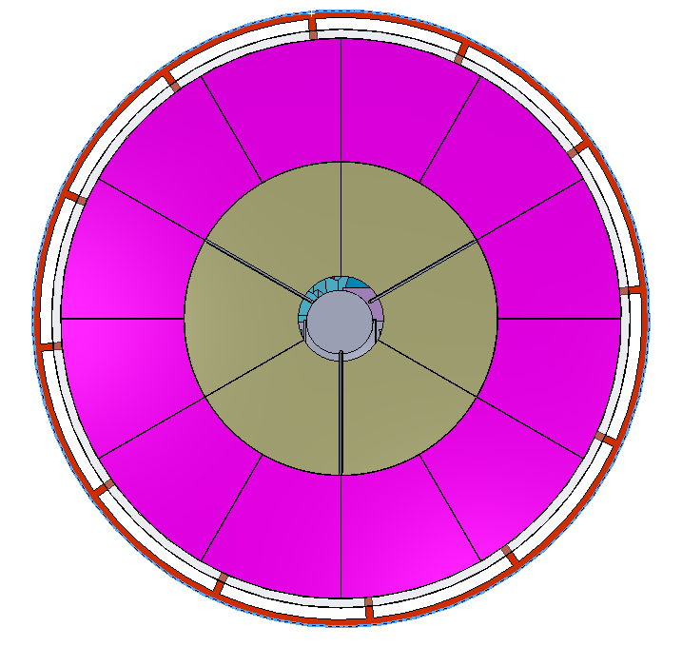
Major Architecture Trades
Telescope size
  JWST collecting area to capture transit spectroscopy from enough exoplanets
Deployed vs. Non-deployed
  Non-deployed optics for simplicity
  SLS (or BFR) required, but viewed as less risky than deployment
On- vs. off-axis
  On-axis for ease of packaging
Size of primary mirror segments
  JWST size, but forming circular aperture
    18 segments with only two prescriptions
    Manufacturing facilities exist

Slide 6
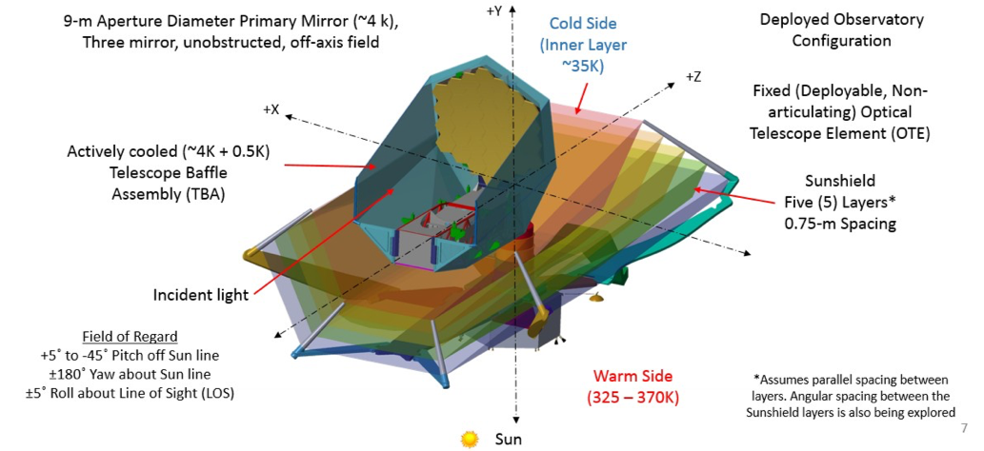
OST Concept 1
Satisfies nearly all of the science team’s “desirements”
No cost constraint
9.1 m tip-to-tip hexagonal segmented primary mirror, unobstructed

Slide 7
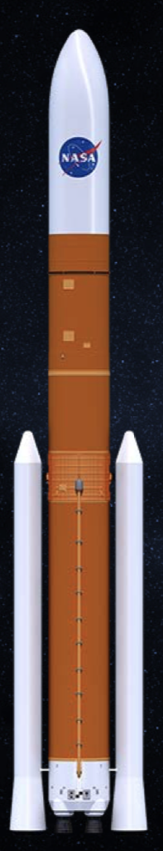
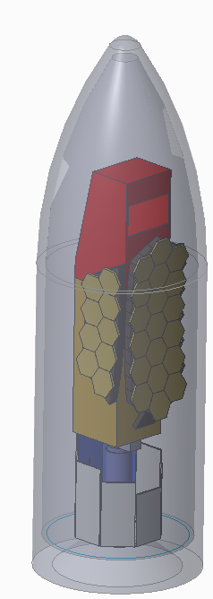
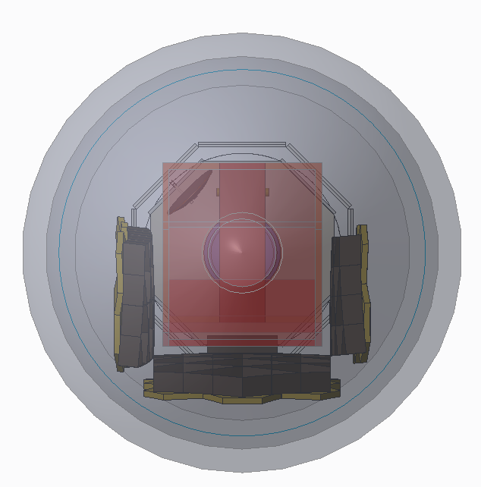
Concept 1 stowed for launch
8.4-m SLS fairing
7.5-m fairing ID
Primary mirror wraps around Instrument Accommodation Module

Slide 8
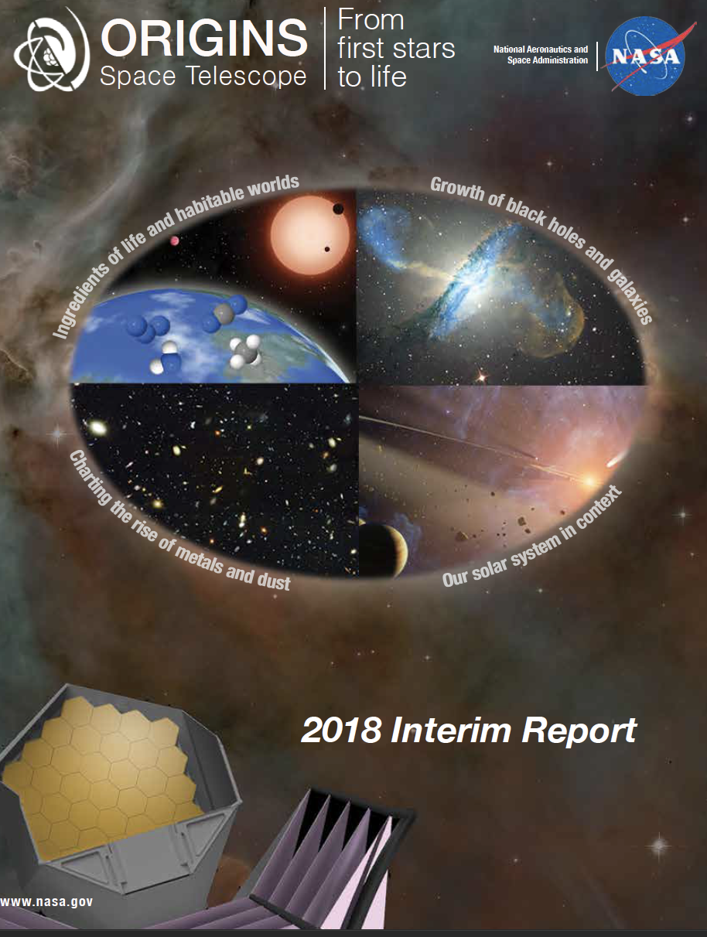
OST Concept 1
Concept 1 is described in the OST Interim Report
Available on our website https://asd.gsfc.nasa.gov/firs/docs/ or
https://arxiv.org/abs/1809.09702

Slide 9
Science drivers for OST C2
OST is a mid- and far-IR observatory whose design is driven by community-prioritized science to answer three questions:
How common are life-bearing planets orbiting M dwarf stars?
  Biosignatures in the mid-infrared
How do the conditions for habitability develop during the process of planet formation?
  Follow the trail of water (vapor and ice) from the interstellar medium to nascent planets
How do galaxies form stars, grow their central supermassive black holes, and make heavy elements over time?
  Probe the universe deeply in key diagnostic spectral lines without the adverse effect of dust extinction
Design drivers

Slide 10
Derived requirements
The prioritized scientific objectives for OST require:
exquisite sensitivity (e.g., 5σ sensitivity to spectral lines at10⁻²⁰ W m⁻² in 1 hour);
spectroscopy with resolving power ranging from 10 to >10⁵ in approximately order-of-magnitude increments;
an ability to survey large areas in a reasonable observing time (e.g., a deep extragalactic “Legacy survey” covering 10 deg² in 1000 hours); and
superlative stability (<5 ppm) to enable a fruitful search for biosignatures in the spectra of transiting exoplanets.
The prioritized scientific objectives do not require high (sub-arcsecond) angular resolution.
A cold (4.5 K) telescope equipped with next-generation detectors in high pixel count arrays can approach the astronomical background photon noise limit and satisfy the requirements.
ultra-deep
deep
shallow

Slide 11
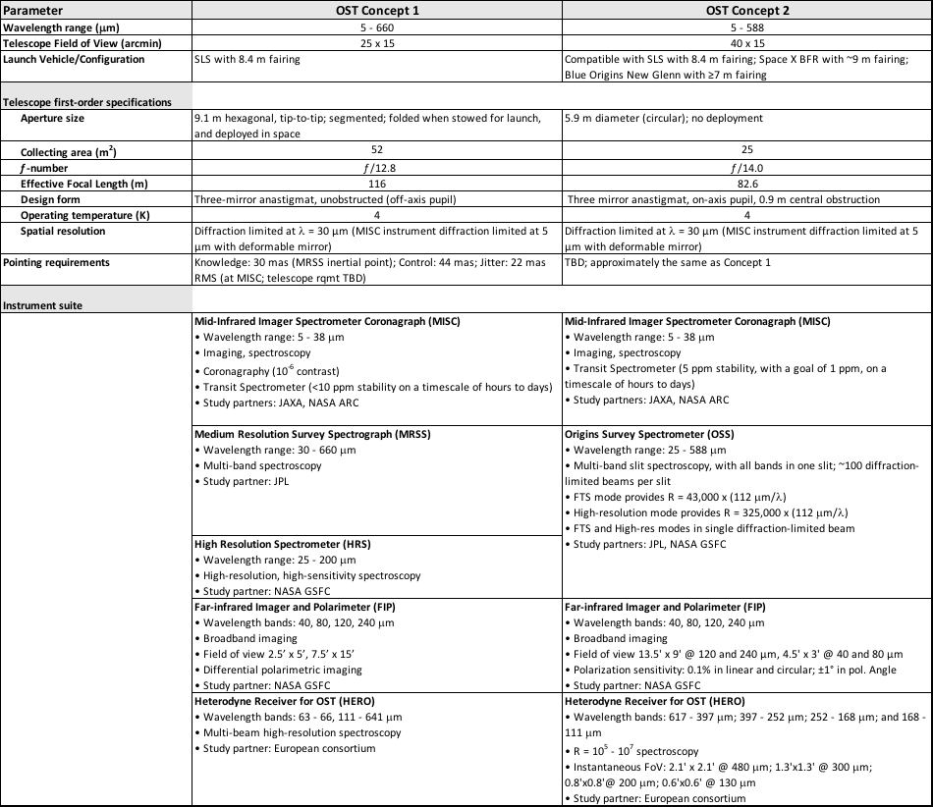
OST concept comparison

Slide 12
OST instruments by concept
Concept 1
Concept 2

Slide 13
OST Concept 2 telescope
f/0.63 primary
f/14.0 telescope
Three-mirror (TMA) selected over two-mirror system
  Larger FoV
  Improved imaging performance
  Incorporate Field Steering Mirror
On-axis selected over off-axis
  Easier to package in fairing
  Easier fabrication/testing – more symmetric segments
Circular pupil selected over elliptical or rectangular
  Cleaner/symmetric PSFs
5.9 m

Slide 14
Primary mirror segments
Option 1a: replace Herschel-sized (3.5m) monolith w/ six segments.12 segments in outer ring.
Option 2a: Hubble-sized (2.4m) monolith surrounded by ring of six segments.
2.4m-diameter
monolith
1.3m
1.2m
1.75m

Slide 15
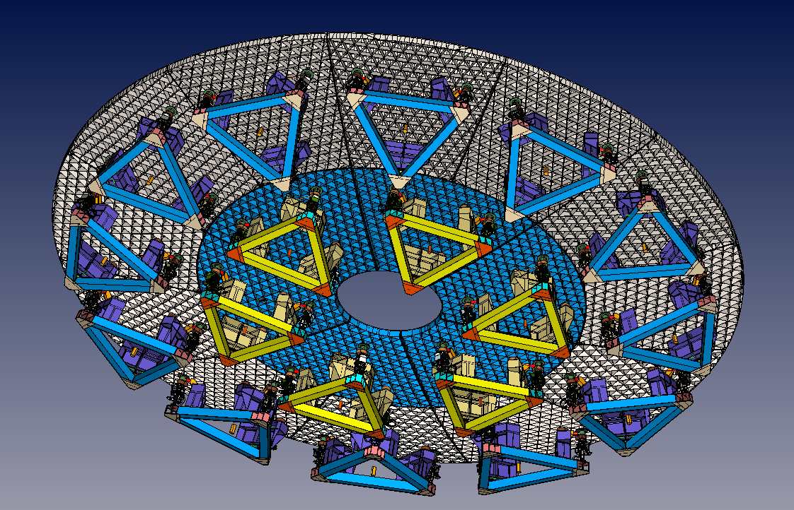
3 dof segment actuation
Only need to adjust piston, tip and tilt.

Slide 16
OST Concept 2 error budget
Shows how we take advantage of the relaxed WFE tolerance.
No cryo-null figuring
Deepen Budget as architecture matures
  Includes alignment of telescope optics and instruments
  low, mid, high allocations
  Break out thermal and dynamic terms
  Focus allocation

Slide 17
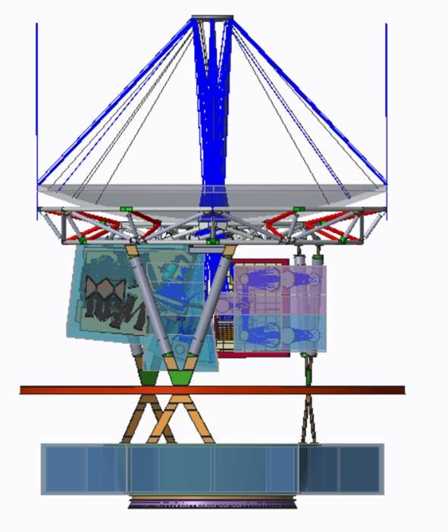
OST Concept 2
Secondary Mirror (SM)
Primary Mirror Backplane
Primary Mirror (PM)
Tertiary Mirror (TM)
Instrument Mounting Structure (IMS)
(not shown)
~35K boundary
Spacecraft bus

Slide 18
Baseline mission concept
5.9 m diameter telescope, same collecting area as JWST
MISC Transit Spectrometer (2.8 – 20 μm)
OSS instrument with all 6 bands, FTS, and etalon, with half the original number of pixels (reduced spatial dimension)
FIP instrument with 50 and 250 μm channels, polarization, and half the original number of pixels
Temperature increased from 4 to 4.5 K - modest cost saving, but reduces risk and relaxes detector NEP requirement
Dropped the heterodyne instrument, HERO, and the MISC imager, but maintain volumes allocated to these items
Descoped items become upscope options
Changes have only a modest impact on the highest priority science

Slide 19
OST Field of View: Concept 2
46 x 15 arcmin
OSS – Origins Survey Spectrometer
HERO – Heterodyne Receiver for OST
FIP – Far-IR Imager/Polarimeter
MISC – Mid-IR Imager and Spectrometer (WFI = Wide-field Imager; TRA = Transit Spectrometer)

Slide 20
OST Field of View: Baseline
46 x 15 arcmin
OSS – Origins Survey Spectrometer
HERO – Heterodyne Receiver for OST
FIP – Far-IR Imager/Polarimeter
MISC – Mid-IR Imager and Spectrometer (WFI = Wide-field Imager; TRA = Transit Spectrometer)

Slide 21
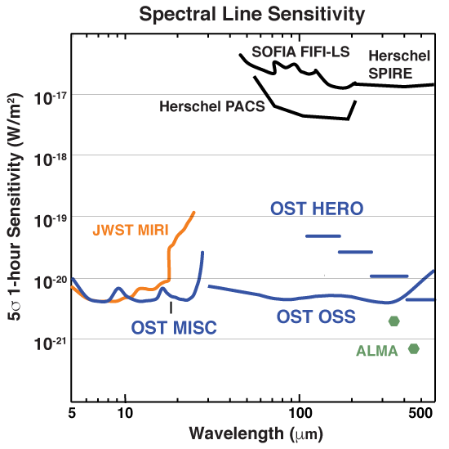
OST sensitivity
OST is about 3 orders of magnitude more sensitive than Herschel, thanks to its cold temperature and next-generation detectors.
Equivalent difference for an optical telescope to achieve 1000x sensitivity gain
Notes:
Note: To get the cold telescope, it’s a combination of the cyro-cooling, and it also motivates the Sun-Earth L2
Also the sensitivity is affeect by the telescope size, which here is 5.9 m in diamter or 25 m^2 im area, same as JWST

Slide 22
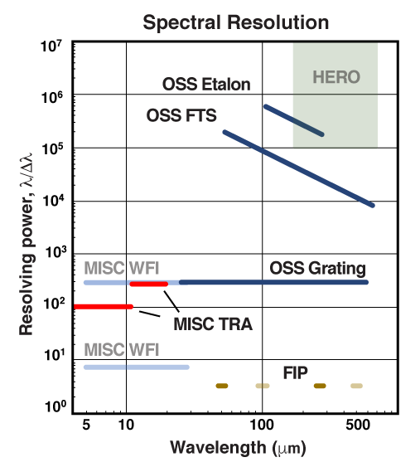
OST spectral resolution
OST’s instruments collectively provide the required spectral resolution.

Slide 23
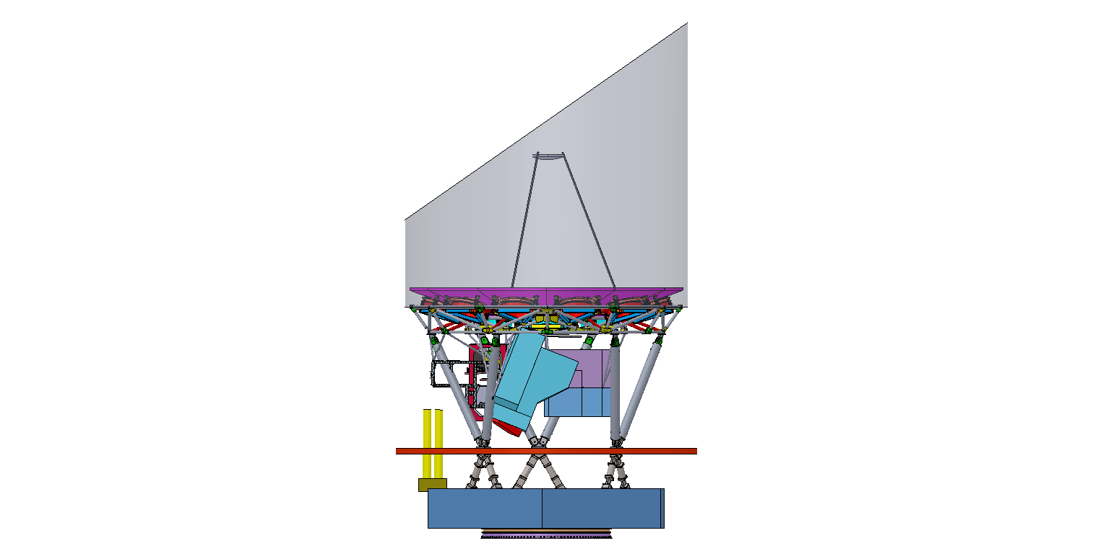
The OST study team will present a scientifically compelling, low-risk, executable mission concept to the 2020 Decadal Survey.

