Slide 1
Cryogenic Design
Staged cryogenic system provides immunity to external disturbances
2 layer sunshield (~140 K)
Deep space radiator (35 K)
3 stage cryocooler (70 K, 20 K, 4.5 K)
5 TRL4-5 cryocoolers in parallel gives 100% margin over current heat loads
Higher TRL chosen over larger, somewhat more efficient cryocoolers
NASA has 20 years of technology development in this kind of cryocooler
Jitter requirement is met with standard soft-mount techniques
Nothing warmer on the colder side of a shield
Thermal analysis is simpler and more amenable to back-of-the-envelope calculations
Use cold amplifiers to bring low level signals to room temperature
Thermal analysis shows > factor of 2 margin at each cooling stage

Slide 2
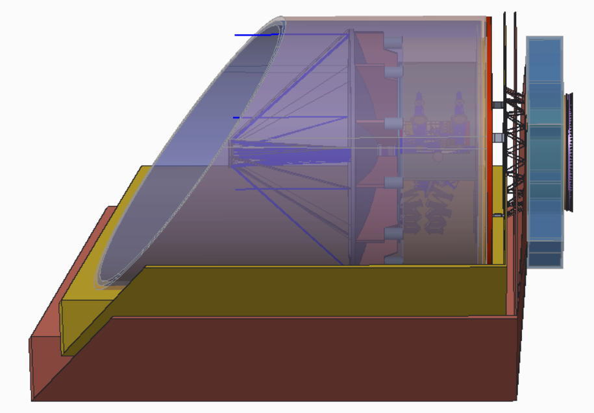
Thermal Zones
Single Stage Radiator
30-35 K, 1.5-2.9W
Inner Baffle (4K)
Room Temperature
(Spacecraft, Instrument electronics)
Outer Barrel
32-35 K
Sunshields

Slide 3
Sunshield
Very simple deployment with 4 actuators and spring-loaded mechanisms similar to those used in other missions
Sunshield design minimizes distance between center of pressure and observatory center of mass
Decrease fuel and overhead required for momentum unloading
Deployment can be demonstrated on the ground
Test-as-you-fly

Slide 4
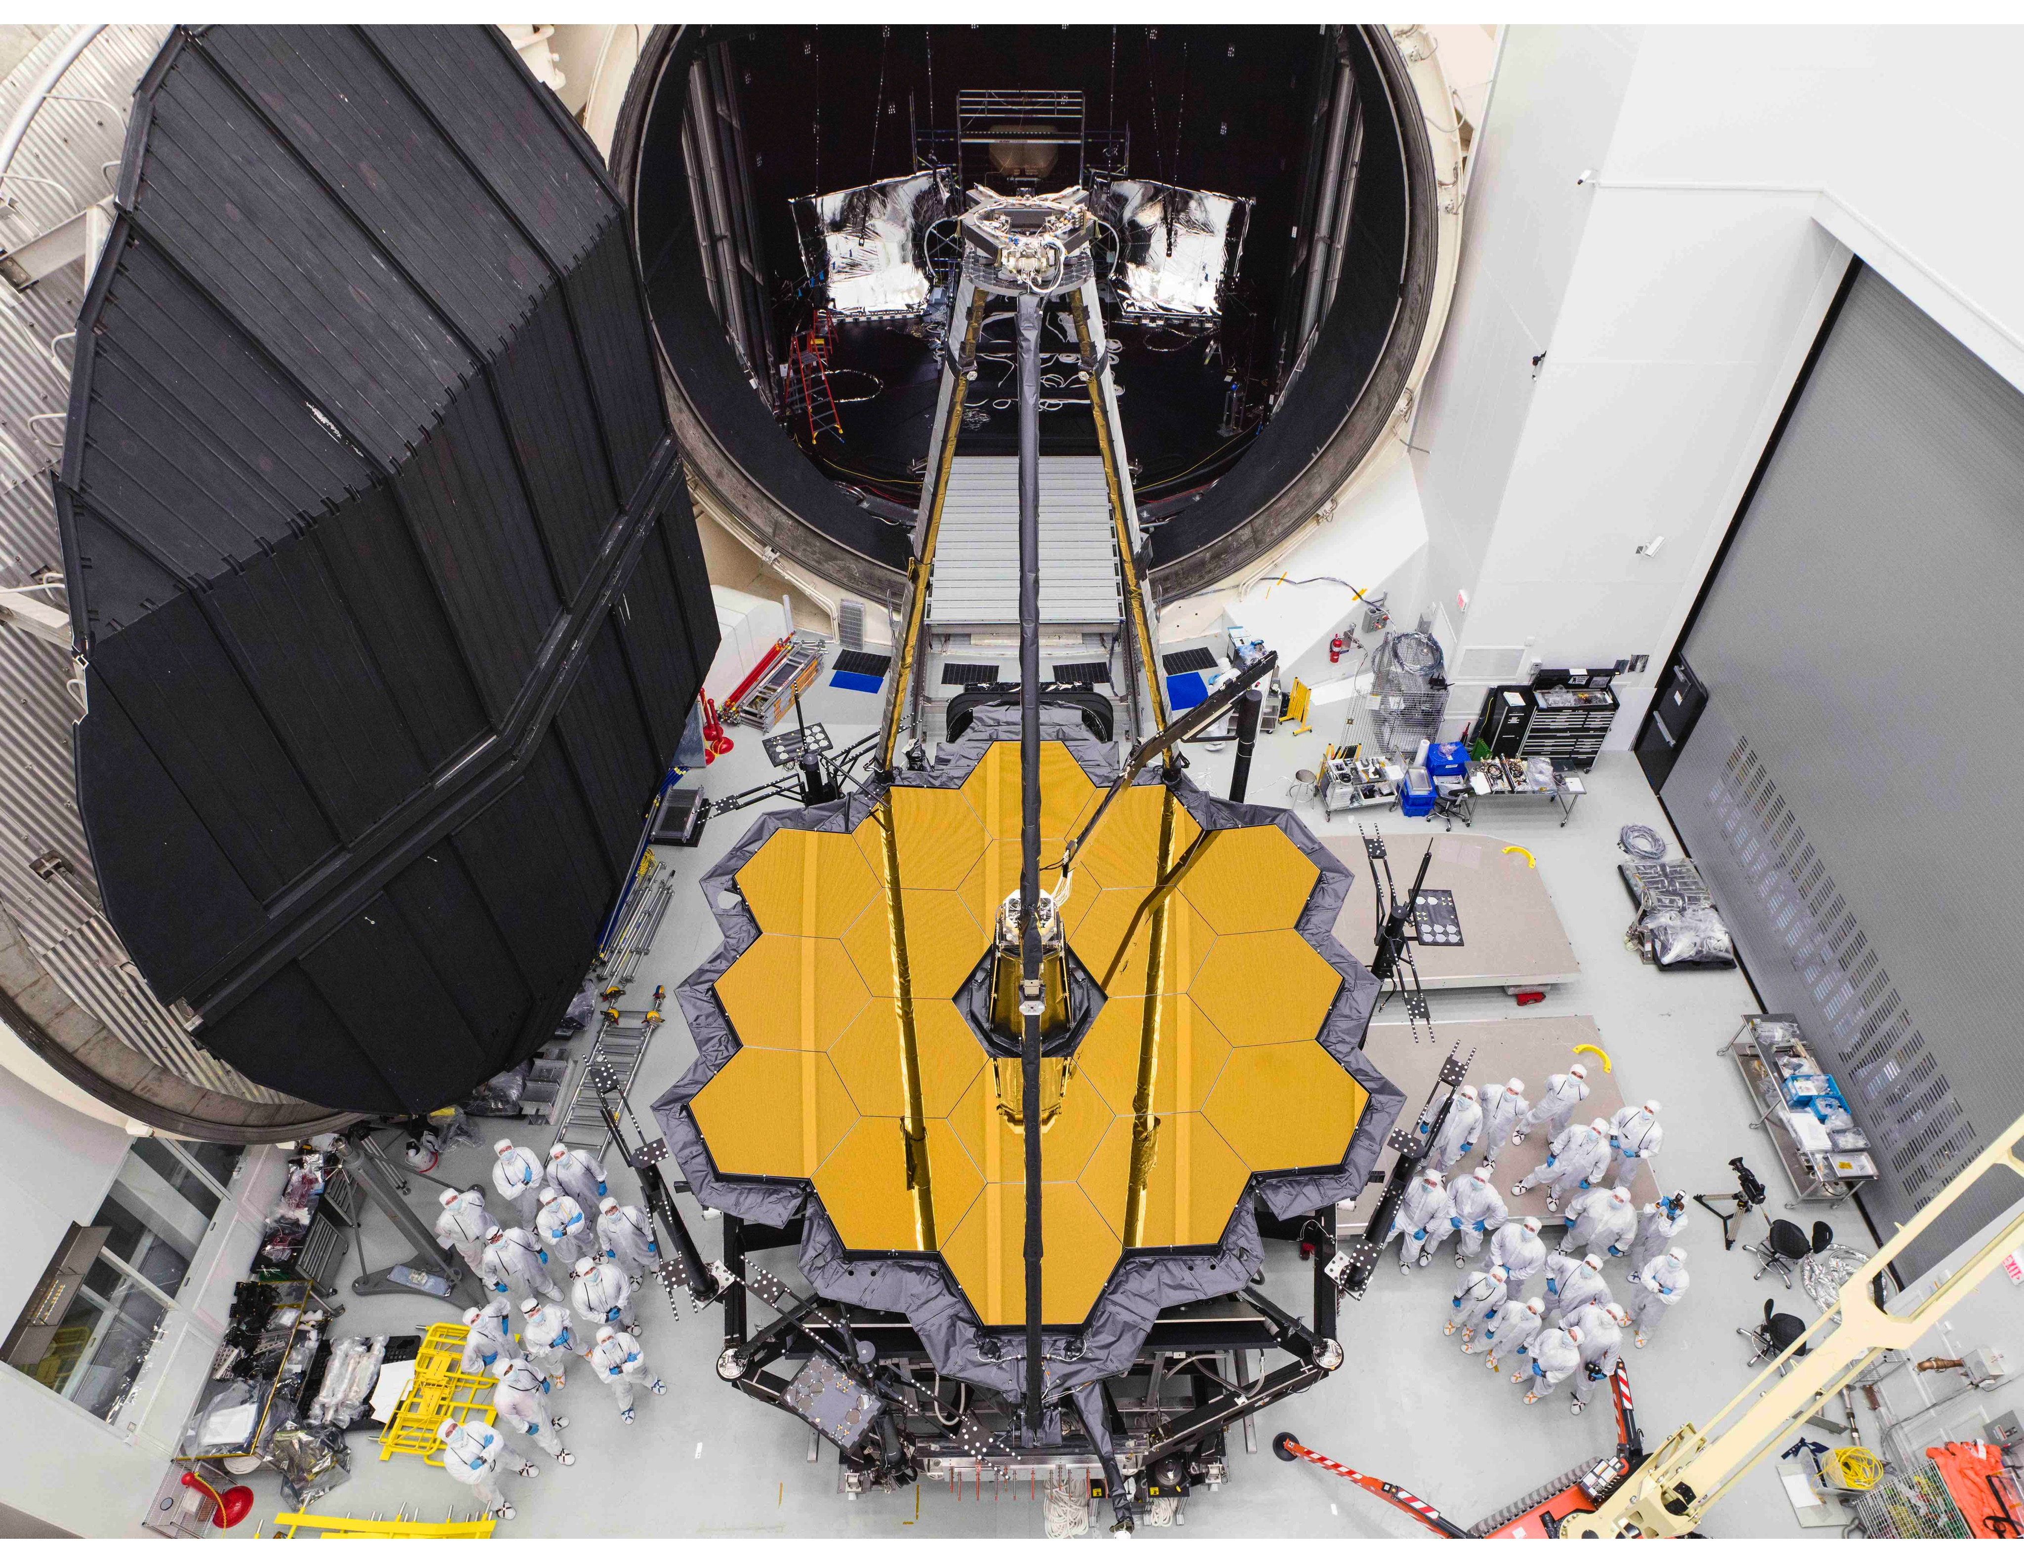
Testing/Verification
JSC Chamber A, which was used for JWST, is large enough and cold enough to thoroughly test OST
Full sunshield deployment will also be tested on ground
Full end-to-end test of entire observatory in thermal/vac is planned – “test-as-you-fly”
Shorter I&T overall than JWST because intermediate ISIM step is not needed

Slide 5
Enabling Technologies for OST
Far IR Detectors -- FIP, OSS
Mid IR Detectors -- MISC transit channel
4.5 K Cryocoolers -- FIP, OSS, HERO, telescope
Several qualified vendors (NGAS, Ball, Lockheed,and Creare)
SHI 4.5 K cryocooler with required specs has flown on Hitomi
SubKelvin Coolers -- FIP, OSS
Ongoing SAT to develop continuous ADR from TRL 4->6

Slide 6
Far IR Detectors-1 Focal Plane Array
Require
10⁴ scalable to 10⁶ pixels with <3x10⁻¹⁹ W/√Hz NEP (imaging) (10⁴ pixels is enabling)
Reduce readout frequencies / electronics power dissipation
<3x10⁻²⁰ W/√Hz NEP (spectroscopy) (enabling, OSS) with 3x10⁻²¹ background limited detection (enhancing)
Reaching enabling numbers decreases the observing time by factor of ~100 and increases areal coverage by 10-100 times
SOA
325 bolometers with 4x10⁻¹⁷ W/√Hz NEP (TRL9 Herschel/SPIRE)
5120 pixels with low x10⁻¹⁶ W/√Hz NEP (TRL 5 SCUBA 2)
Sensitive (NEP low 10⁻¹⁹ W/√Hz), fast detectors (TES bolometers, and MKIDs in kilo pixel arrays) are at TRL 3.
Path to get there: Develop MKID, TES, and QCD detector technologies in parallel
Three technologies offer multiple paths to required resolution and array size.

Slide 7
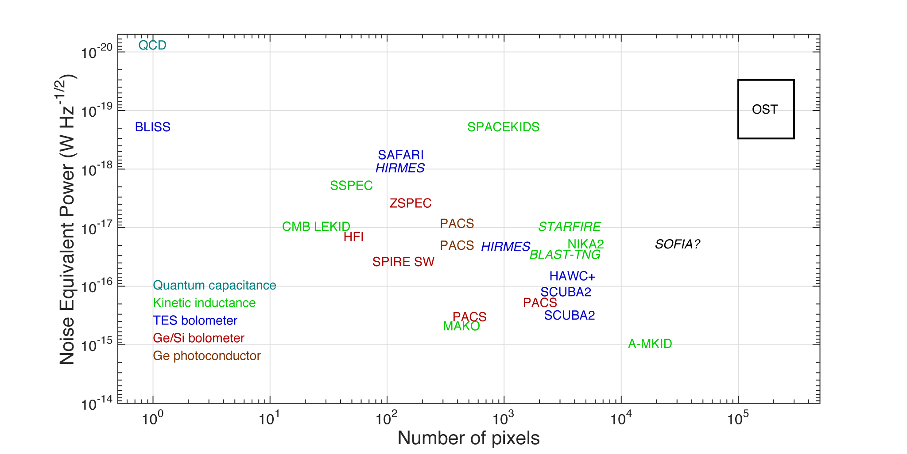
State-of-the-art NEP and Array Size

Slide 8
Far IR Detectors-2 Multiplexing and Amplification
Require
4 GHz Bandwidth per 2000 pixels
Microwave SQUIDs and/or discreet resonators for frequency domain multiplexing
Low dissipation at 4 K (0.3 mW per 2000 pixel amplifier)
SOA
LNF HEMT is commercial part
SQUIDs under development at NIST and SRON have demonstrated necessary resonator spacing but for smaller total numbers (<200)
LNF HEMT shows proper noise and gain for 0.3 mW/channel
Path to get there
Continue testing SQUID multiplexers and LNF HEMTs
X-ray microcalorimeters for Athena and Lynx require similar technology advances
Follow x-ray microcalorimeter SQUID developments and test LNF HEMTs

Slide 9
Far IR Detectors-3 Room Temperature Readout
Require
Low dissipation at per readout channel
SOA
FPGA requires 40 W per channel
Emerging RFSoCs (specialized FPGAs) need ~10 W (mobile phone 5G technology)
Path to get there
Hardware RFSoC codes adapted for our use
Follow with ASICs to lower power by another >factor of 4
Leverage 5G technology to lower input power required

Slide 10
Mid IR Detectors
Require: 5 ppm stability over 1-2 hours
SOA:
30 ppm (JWST/MIRI),
HgCdTe tests show good dark stability
Path to get there: More HgCdTe testing, develop calibration sources with required stability
Excellent background stability measured in HgCdTe

Slide 11
4.5 K Cryocoolers
Require: 200 mW cooling at 4.5 K + 400 mW cooling at 20 K + 20 W cooling at 70 K with input power of 2250 W
Includes 100% margin
Note that expected cryocooler-induced jitter has been shown to be not an issue even for the most sensitive instrument, MISC
SOA: MIRI cooler has 65 mW cooling at 6 K + 203 mW cooling at 18 K 425 W input power
SHI 4.5 K Cryocoolers have flown on Hitomi (2106)
Path to Get There: use 4 MIRI coolers with ³He as working fluid (to reach 4.5 K) or use Ball, Lockheed, or Creare coolers
Multiple manufacturers with TRL 4+ technology offer multiple paths to success

Slide 12
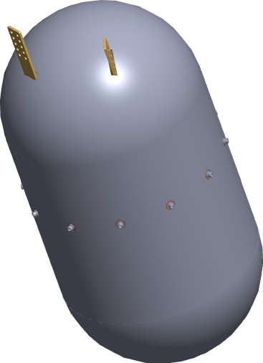
Sub-Kelvin Coolers
Require: 6 µW of cooling power at 50 mK
SOA: 0.4 µW@ 50 mK demonstrated on orbit by Hitomi. Lab demo 6 µW@50 mK of cooling power at TRL4. Electronics at TRL 6 (same cards have flown)
Path to Get There: SAT-funded development to achieve TRL 6 for a continuous ADR cooling to 50 mK with 6 µW of cooling power. Use same electronics as Hitomi.
255 mm
~ 1K interface
50 mK interface
486 mm
4K Interface
Superconducting
Nb Shield
TRL 4 demonstrated, TRL 6 funded for 2019 demonstration. High cooling power at
lower T also provides another path for meeting Far IR NEP resolution in TES.

Slide 13
Summary
OST’s architecture is simple, and is “test-as-you-fly”
Cooling technology has rapidly evolved and will be ready by 2020
Detector technology has a clear path to be ready by 2025 based on previous development progress

