Slide 1
NASA Astrophysics
Mario R. Perez
Wilton T. Sanders
Science Mission Directorate
June 25, 2015

Slide 2
Topics Requested
SAT & APRA Investments – M. Perez
Suborbital - W. Sanders
  Sounding Rockets
  Balloons (in progress)
Explorer Program
Probes Notional Plans
Others (Q&A)

Slide 3
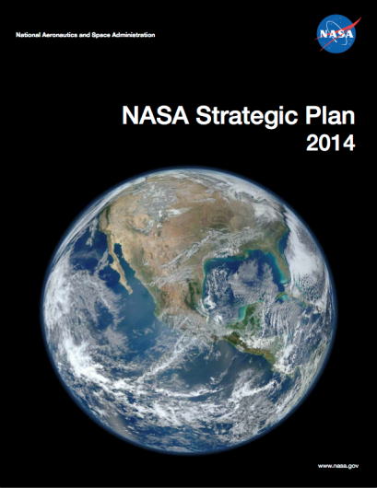
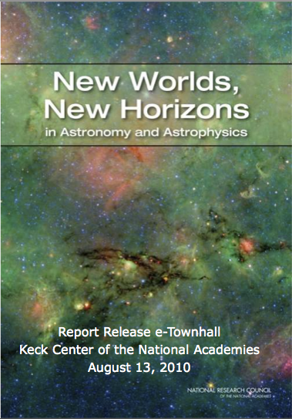
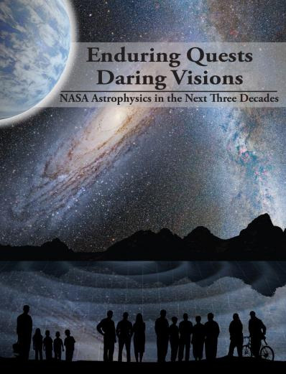
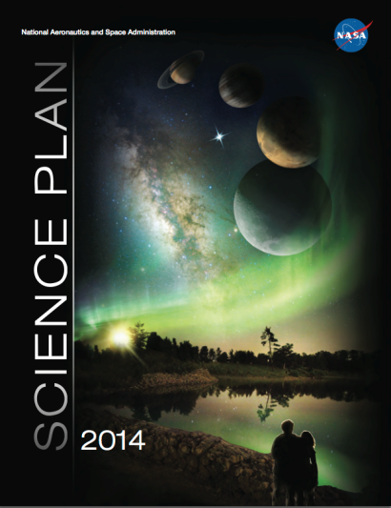
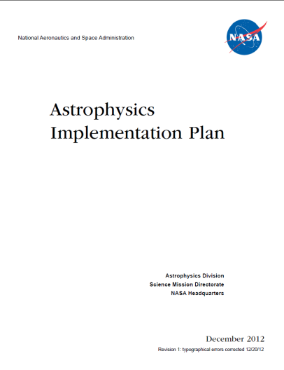
Astrophysics Driving Documents
http://science.nasa.gov/astrophysics/documents

Slide 4
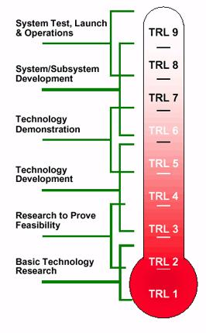
Technology Readiness Levels
Flight Ready Hardware
(7 ≤ TRL ≤ 9)
Challenge:
“Mid-TRL Gap”
SAT Program
3 ≤ TRL < 6
APRA (1 ≤ TRL ≤ 3+)

Slide 5
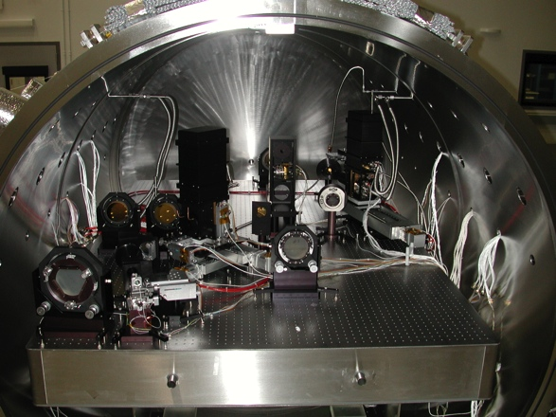
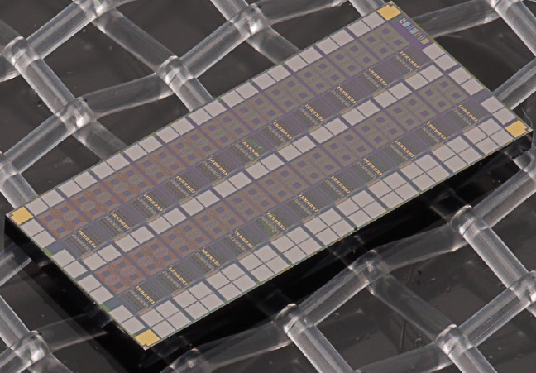
Strategic Astrophysics Technology (SAT)
Areas of emphasis:
TDEM
  Starlight Suppression Demonstrations
  Wavefront Sensing and Control of Scattered Light
  System Performance Assessment
TPCOS
  Technologies for X-ray Astrophysics
  Technologies for Gravitational Astrophysics
  Technologies for CMB Polarization Measurements
TCOR
  Detectors (QE < 100%)
  Optical Coatings (R < 100%, AR < 100%)
  Precision Large Optics, Heterodyne Receivers, and Cryocoolers
Since FY09 – a Total of $70M has been invested in SAT

Slide 6
Progress Toward Decadal Survey Priorities
The NASA FY15 Appropriation, the President’s FY16 Budget Request, and the notional out year budget planning guidance in the President’s FY16 Budget Request, support:
Medium-scale 2. Inflation Probe Technology Development Program | Balloon-borne investigations plus strategic astrophysics technology (SAT) investments.
Small-scale. Research Program Augmentations | Increased annual R&A budget by 10% from FY10 to FY12 and another 10% from FY14 to FY16. Within R&A: established Theoretical and Computational Astrophysics Networks (TCAN) program with NSF; funding available for astrophysics theory; funding available for lab astrophysics; funding available for suborbital payloads.
Small-scale. Intermediate Technology development Augmentation | Established competed Strategic Astrophysics Technology (SAT) program element; directed technology funding for WFIRST and other large-scale decadal priorities.
Small-scale. Future Ultraviolet-Visible Space Capability | Strategic Astrophysics Technology (SAT) investments.
Small-scale. SPICA (U.S. contribution to JAXA-led) | Not supported as a strategic contribution; candidate for Explorer Mission of Opportunity.
Starting in FY17 – a Total of $20M per year will be available

Slide 7
Astrophysics Research Program Funding
Snapshot: Most Recent Year
 | Proposals | Year-1 | Proposals | Success | Proposals
 | Rec'd | $M | selected | Rate | Rec’d 2015
APRA-13 | 179 | 10.0 | 43 | 24% | 151
SAT-13 | 18 | 5.4 | 10 | 56% | 28
ADAP-14 | 300 | 7.5 | 62 | 21%
XRP-14 | 62 | 1.3 | 11 | 18%
ATP-14 | 214 | 4.7 | 31 | 14%
TOTAL | 773 | 28.9 | 157 | 20%
~ ~
Does not include RTF, TCAN, WPS, GO programs
APRA Only
All R&A
FY15: $50M

Slide 8
Decadal Survey 2010 Goals
Suborbital Program
  Increase rate of flights
  Research rockets and orbital rockets
  Long-Duration Balloons (LDBs) and Ultra-Long Duration Balloons (ULDBs)
  Fly Super Pressure Balloons (SPB) from mid-latitudes to include more dark time, an astronomical requirements (e.g., around Australia)

Slide 9
Sounding Rockets

Slide 10
Sounding Rockets

Slide 11
Sounding Rockets

Slide 12
Sounding Rockets

Slide 13
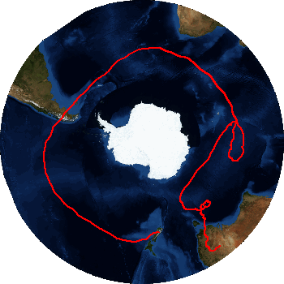
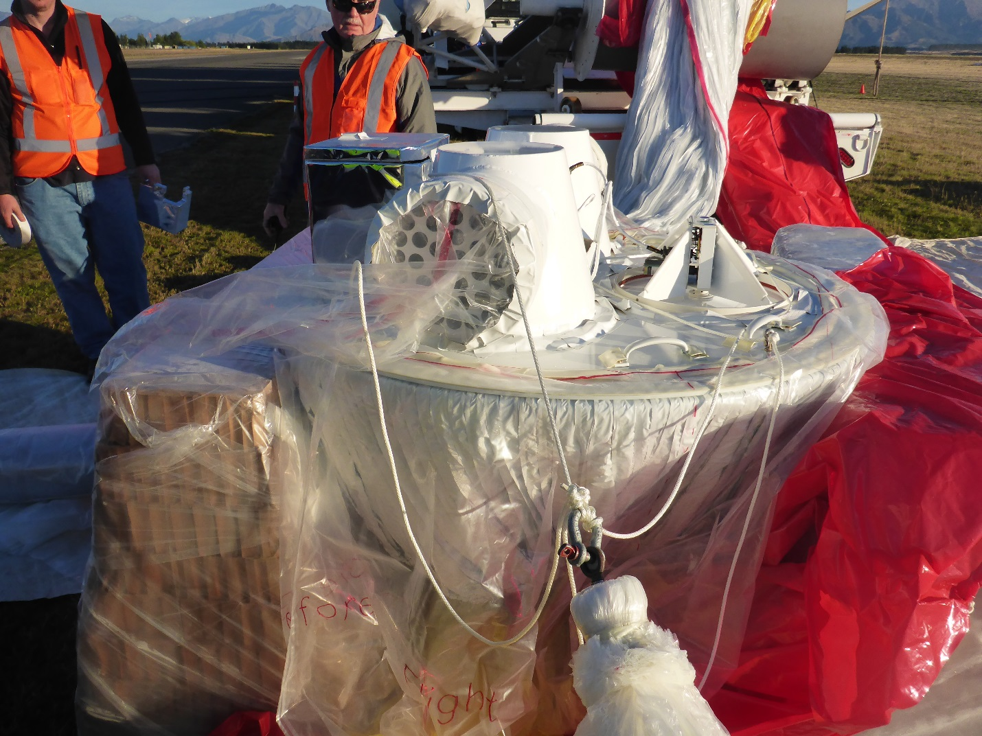
Balloons
NASA Super Pressure Balloon was launched from New Zealand on March 26 and flew for 32 days until April 27, 2015. It was terminated over central Australia. Maintained a constant float altitude of 110,000 feet with a test payload of 5,000 lb.

Slide 14
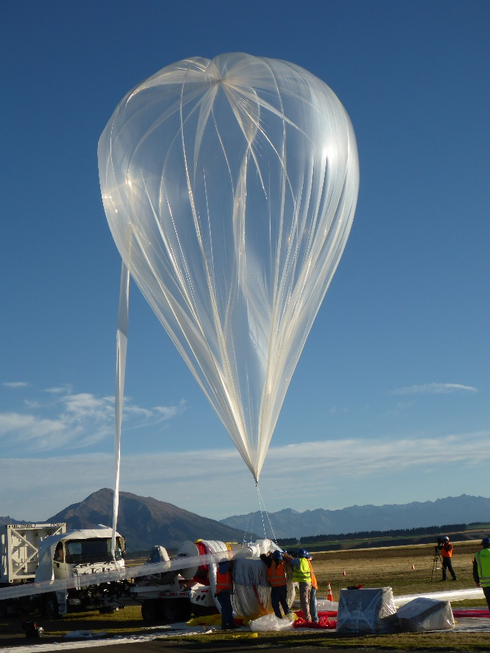
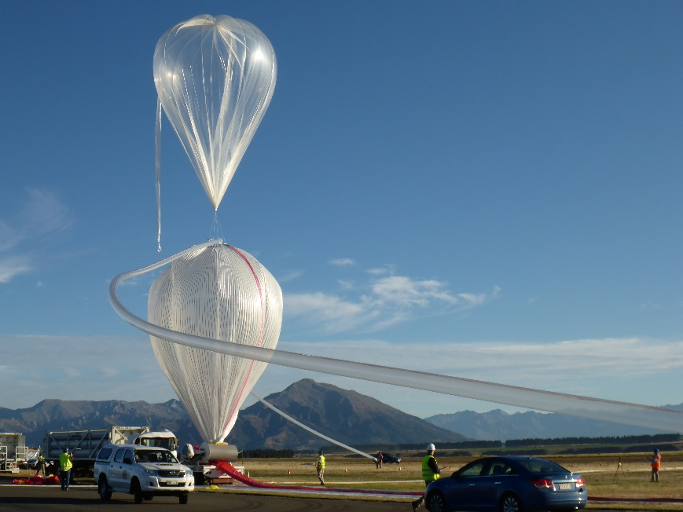
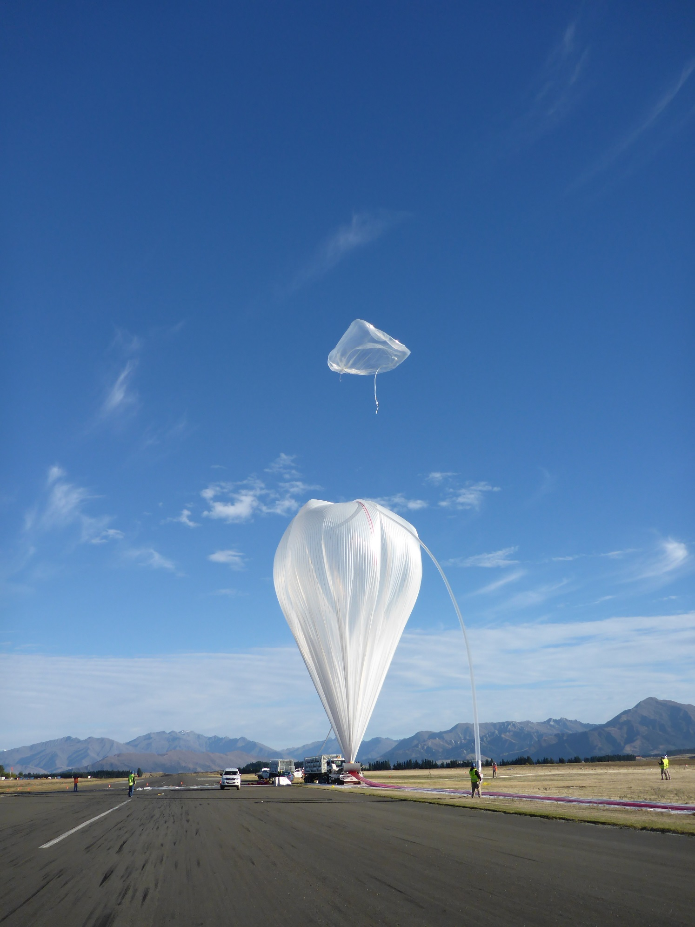
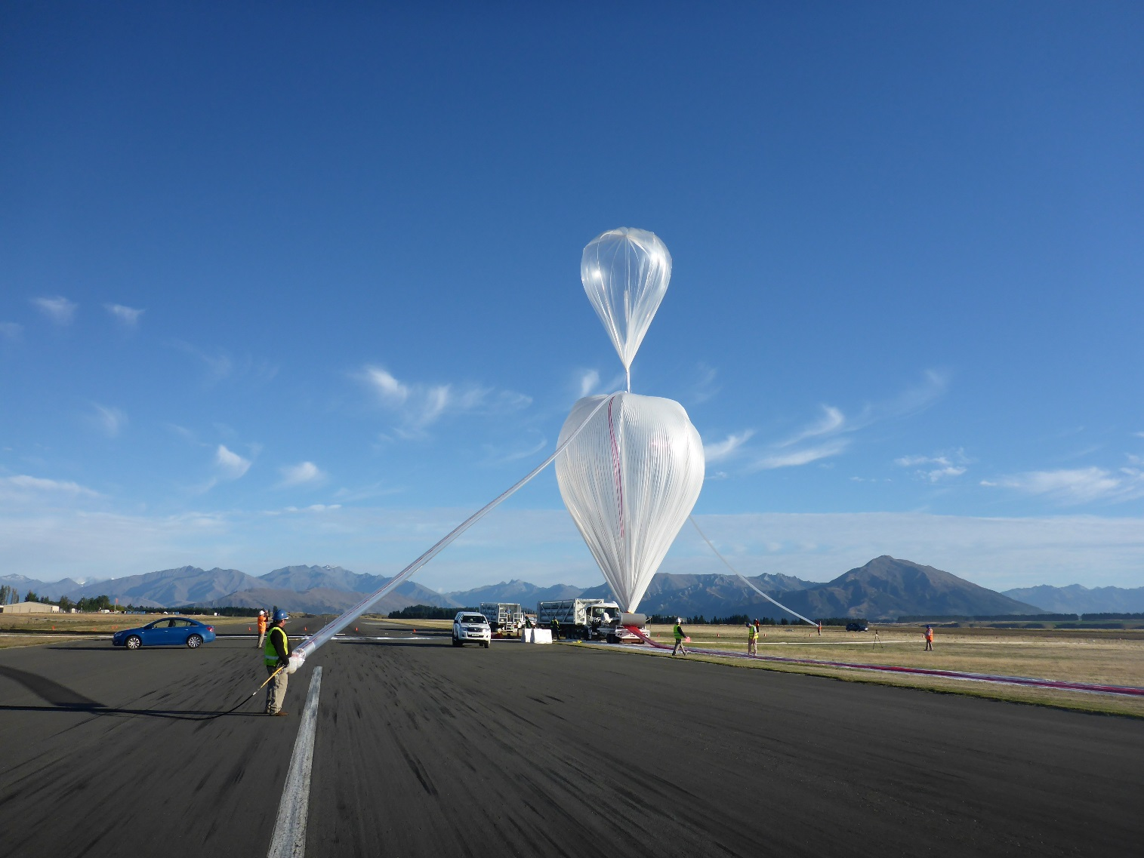
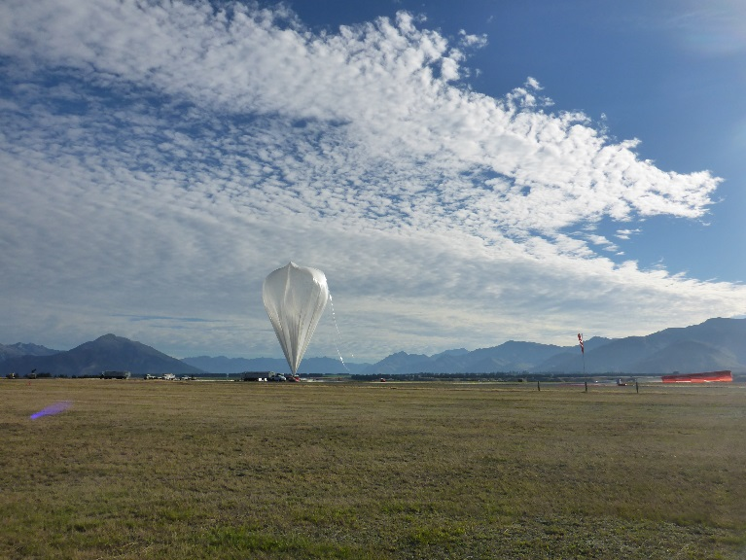

Slide 15
Funded Payloads
BETTI - Stephen Rinehart – NASA/GSFC (not flown yet)
FIREBALL2 – Chris Martin – Caltech (not flown yet)
PIPER – Al Kogut – NASA/GSFC (not flown yet)
ASCOT – Peter Bloser – U. New Hampshire (not flown yet)
ANITA – Peter Gorham – U. Hawaii
NCT – Steve Boggs, U. California, Berkeley
SPIDER – Bill Jones – Princeton U.
BLAST – Mark Devlin – U. Pennsylvania
EBEX – Shaul Hanny – U. Minnesota
Super TIGER – Bob Binns – Washington U.
CREAM – Eun-Suk Seo – U. Maryland (now an ISS payload)
STO – Chris Walker – U. Arizona
X-Calibur/InFOCμS – Krawczynski/Okajima – Washington U./GSFC
GRAPE – Mark McConnell – U. New Hampshire

Slide 16
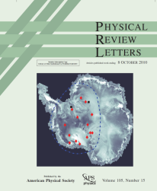
ANITA-3 science in the community
• Askaryan effect (SLAC 2001-2007)
  Coherent Cherenkov emission from cascades in ice
• Enables utilization of entire Antarctic ice sheet as a potential neutrino detector
• ‘Geosynchrotron’ emission
  Curvature radiation from UHECR air showers in Antarctic geomagnetic field (strongest, most vertical on Earth!)
• ANITA sees these UHE cosmic ray radio impulses in reflection off Antarctic surface

Slide 17
Progress Toward Decadal Survey Priorities
The NASA FY15 Appropriation, the President’s FY16 Budget Request, and the notional out year budget planning guidance in the President’s FY16 Budget Request, support:
Medium-scale 2. Inflation Probe Technology Development Program | Balloon-borne investigations plus strategic astrophysics technology (SAT) investments.
Small-scale. Research Program Augmentations | Increased annual R&A budget by 10% from FY10 to FY12 and another 10% from FY14 to FY16. Within R&A: established Theoretical and Computational Astrophysics Networks (TCAN) program with NSF; funding available for astrophysics theory; funding available for lab astrophysics; funding available for suborbital payloads.
Small-scale. Intermediate Technology development Augmentation | Established competed Strategic Astrophysics Technology (SAT) program element; directed technology funding for WFIRST and other large-scale decadal priorities.
Small-scale. Future Ultraviolet-Visible Space Capability | Strategic Astrophysics Technology (SAT) investments.
Small-scale. SPICA (U.S. contribution to JAXA-led) | Not supported as a strategic contribution; candidate for Explorer Mission of Opportunity.

Slide 18
2014 Astrophysics Explorers AO
AO released September 17, 2014.
  Small Explorer (SMEX), cost cap $175M including LV
  Mission(s) of Opportunity, cost cap $65M for space, $35M for suborbital-class
  US Participating Investigators
Notice of intent were due October 15, 2014.
  NASA received ~30 NOIs
Proposals received December 18, 2014.
  NASA received ~25 proposals (total of all three categories)
Step 1 Selections expected ~ Summer 2015.
Step 2 Downselections expected ~ early 2017.
Launch Readiness Date NLT end of 2020.
For additional info: http://explorers.larc.nasa.gov/APSMEX/
Notes:
Updated August 11, 2014

Slide 19
Progress Toward Decadal Survey Priorities
The NASA FY15 Appropriation, the President’s FY16 Budget Request, and the notional out year budget planning guidance in the President’s FY16 Budget Request, support:
Large-scale 1. WFIRST | Preformulation and focused technology development for WFIRST/AFTA (a 2.4m version of WFIRST with a coronagraph) are underway to enable a new start NET FY2017. Budget line established for an Astrophysics Decadal Strategic Mission.
Large-scale 2. Augmentation to Explorer Program | Astrophysics Explorers planned budget increased to support decadal cadence of AOs including SMEX AO in Fall 2014 and MIDEX AO in late 2016/early 2017.
Large-scale 3. LISA | Discussing partnership on ESA’s L3 gravitational wave observatory and participating in ESA-led assessments in 2014-2015. Strategic astrophysics technology (SAT) investments plus support of LISA Pathfinder.
Large-scale 4. IXO | NASA is pursuing a partnership on ESA’s L2 Athena X-ray observatory; the Athena study phase, with U.S. participation, is underway. Strategic astrophysics technology (SAT) investments.
Medium-scale 1. New Worlds Technology Development Program | Focused technology development for a coronagraph on WFIRST, strategic astrophysics technology (SAT) investments, and exoplanet probe mission concept studies. Established partnership with NSF to develop extreme precision Doppler spectrometer as facility instrument. Exozodi survey using LBTI.

Slide 20
Preparing for the 2020 Decadal Survey
Thinking about Probes
What was done 10 years ago?
  Origins Probes Mission Concepts (2004)
    ROSES call for quick (~9 month) paper concept studies
    ~9 concepts selected in 2004; total funding ~$1M ($100K average)
  Astrophysics Mission Concepts Study (AMCS; 2007)
    ROSES call for ~1 year paper concept studies
    Nineteen (+1) ASMC concepts selected in 2007; total funding $13M ($700K average)
  Was this effective? Efficient? Appropriately impactful?
Possibilities this time
  Real mission concept studies
    Just like we are doing for large mission concepts
    How would we select them? Where does funding come from?
  Paper mission concept studies
    Just like AMCS, but limited to Probes
  Self selected, self funded
    Anybody can submit a white paper to the 2020 Decadal Survey
Awaiting input from the PAG reports

Slide 21
Preparing for the 2020 Decadal Survey
Medium-class (Probe) Concepts
Probe-class (medium size) mission concepts
No decision has been made by NASA at this time on how to provide input to the 2020 Decadal Survey Committee regarding probe-class missions.
There are multiple paths to identifying probe-class mission concepts, and none have been precluded at this time.
Each of the STDTs for large mission concepts will be challenged to identify one or more probe-class versions of their mission and to estimate the percentage of the original science case that can be achieved.
The Mid-Decade Review may provide recommendations to NASA regarding the value of probe-class mission concept studies in advance of the 2020 Decadal Survey.
Should NASA conduct stand-alone probe-class mission concept studies, they would be initiated no earlier than FY2017.

Slide 22
Backups

Slide 23
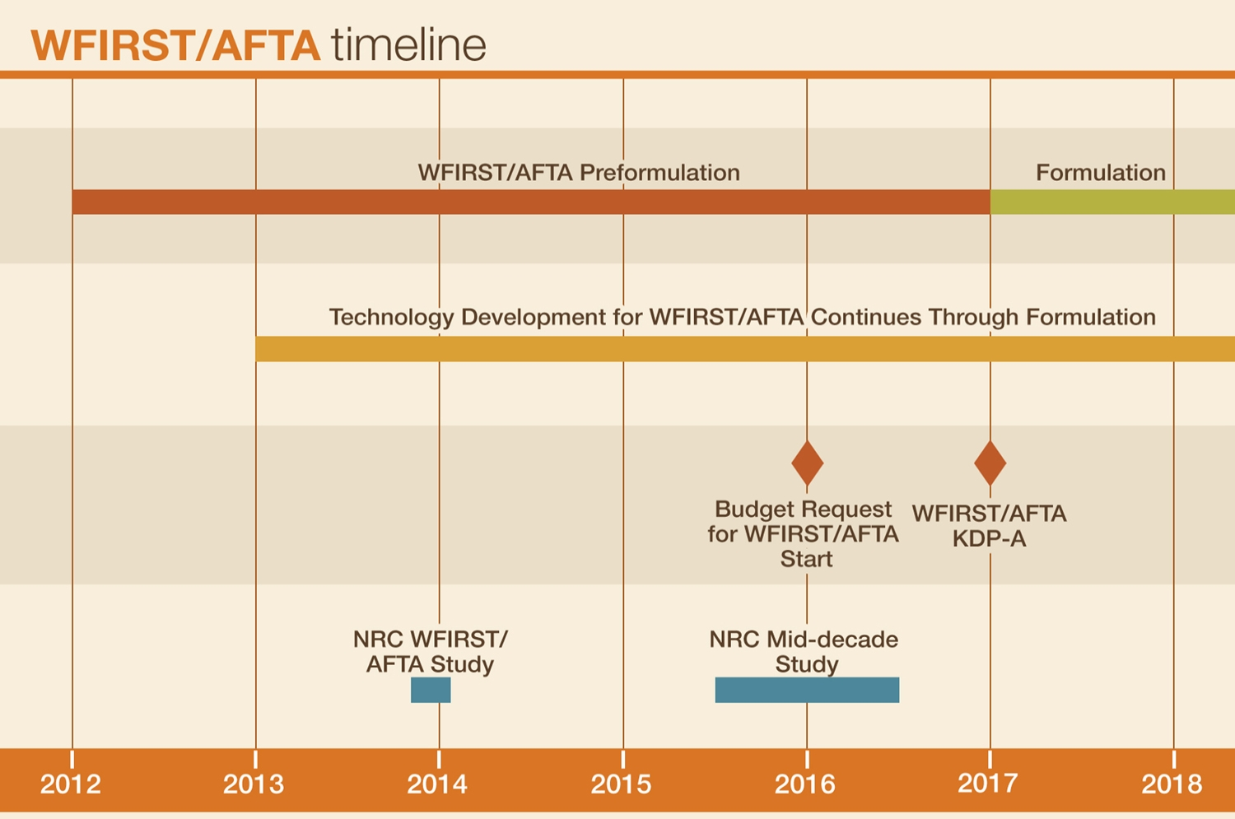
Plan for WFIRST/AFTA Preformulation
Widefield Infrared Survey Telescope using
Astrophysics Focused Telescope Assets
23

Slide 24
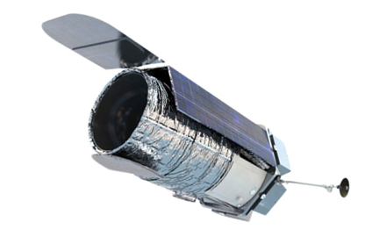
WFIRST / AFTA
Widefield Infrared Survey Telescope with Astrophysics Focused Telescope Assets
CURRENT STATUS:
May 2013, NASA Administrator Bolden directed study of WFIRST/AFTA and preserve option for FY17 new start if budget is available.
  No decision expected before early CY 2016.
Currently in pre-formulation phase.
  Activities include technology development for detectors and coronagraph (with STMD), assessment of the 2.4m telescopes including risk mitigation, mission design trades, payload accommodation studies, and observatory performance simulations.
Maturing key technologies by FY19.
  H4RG infrared detectors for widefield imager.
  Internal coronagraph for exoplanet characterization (two architectures identified December 2013; occulting mask coronagraph and phased induced amplitude apodization complex mask coronagraph).
  March 2014 NRC study on WFIRST/AFTA offers positive view of AFTA, with concerns about technology and cost risks.
  March 2015 SDT report with design reference mission presents baseline plan for WFIRST/AFTA
  WFIRST Preparatory Science funds 17 ROSES proposals that are relevant to WFIRST’s goals and WFIRST-specific simulations and models.
Widefield Infrared Survey Telescope
Top priority of 2010 Decadal Survey
Science themes: Dark Energy, Exoplanets, Large Area Near Infrared Surveys
Mission: 2.4m widefield telescope at GEO, uses existing AFTA hardware to image 0.28 deg² at 0.8-2.0 µm
Instruments (design reference mission): Wide Field Instrument, Coronagraph Instrument
  FY15 Appropriation and FY16 Budget Request support pre-formulation of WFIRST/AFTA
  Plans support Agency/Administration decision for formulation to begin NET FY 2017, should funding be available.
  http://wfirst.gsfc.nasa.gov/

Slide 25
WFIRST / AFTA
Widefield Infrared Survey Telescope with Astrophysics Focused Telescope Assets
Coronagraph Technology Milestones
1 | Shaped Pupil mask fabricated with reflectivity of 10⁻⁴ and 20 μm pixel size. | 7/21/14
2 | Shaped Pupil Coronagraph demos 10⁻⁸ raw contrast with narrowband light. | 9/30/14
3 | PIAACMC mask fabricated with 10⁻⁸ raw contrast with 10% broadband light. | 12/15/14
4 | Hybrid Lyot Coronagraph demos 10⁻⁸ raw contrast with narrowband light.. | 2/28/15
5 | Occulting Mask Coronagraph demos 10⁻⁸ raw contrast with 10% broadband light. | 9/15/15
6 | Low Order Wavefront Sensing provides jitter sensing better than 0.4 mas rms. | 9/30/15
7 | Spectrograph read-out demo to have low dark current and read noise. | 8/25/16
8 | PIAACMC coronagraph demos 10⁻⁸ raw contrast with 10% broadband light. | 9/30/16
9 | Occulting Mask Coronagraph demos 10⁻⁸ raw contrast with 10% broadband light. | 9/30/16
Widefield Detector Technology Milestones
1 | Produce, test, and analyze 2 candidate passivation techniques in banded arrays. | 7/31/14
2 | Produce, test, and analyze 1 additional candidate passivation techniques in banded arrays. | 12/30/14
3 | Produce, test, and analyze full arrays with operability > 95%. | 9/15/15
4 | Produce, test, and analyze final selected recipe in full arrays demonstrating a yield > 20% with operability > 95%. | 9/15/16
5 | Complete environmental testing of one sensor chip assembly, as per NASA test standards. | 12/1/16
✓
✓
✓
✓
✓
✓

Slide 26
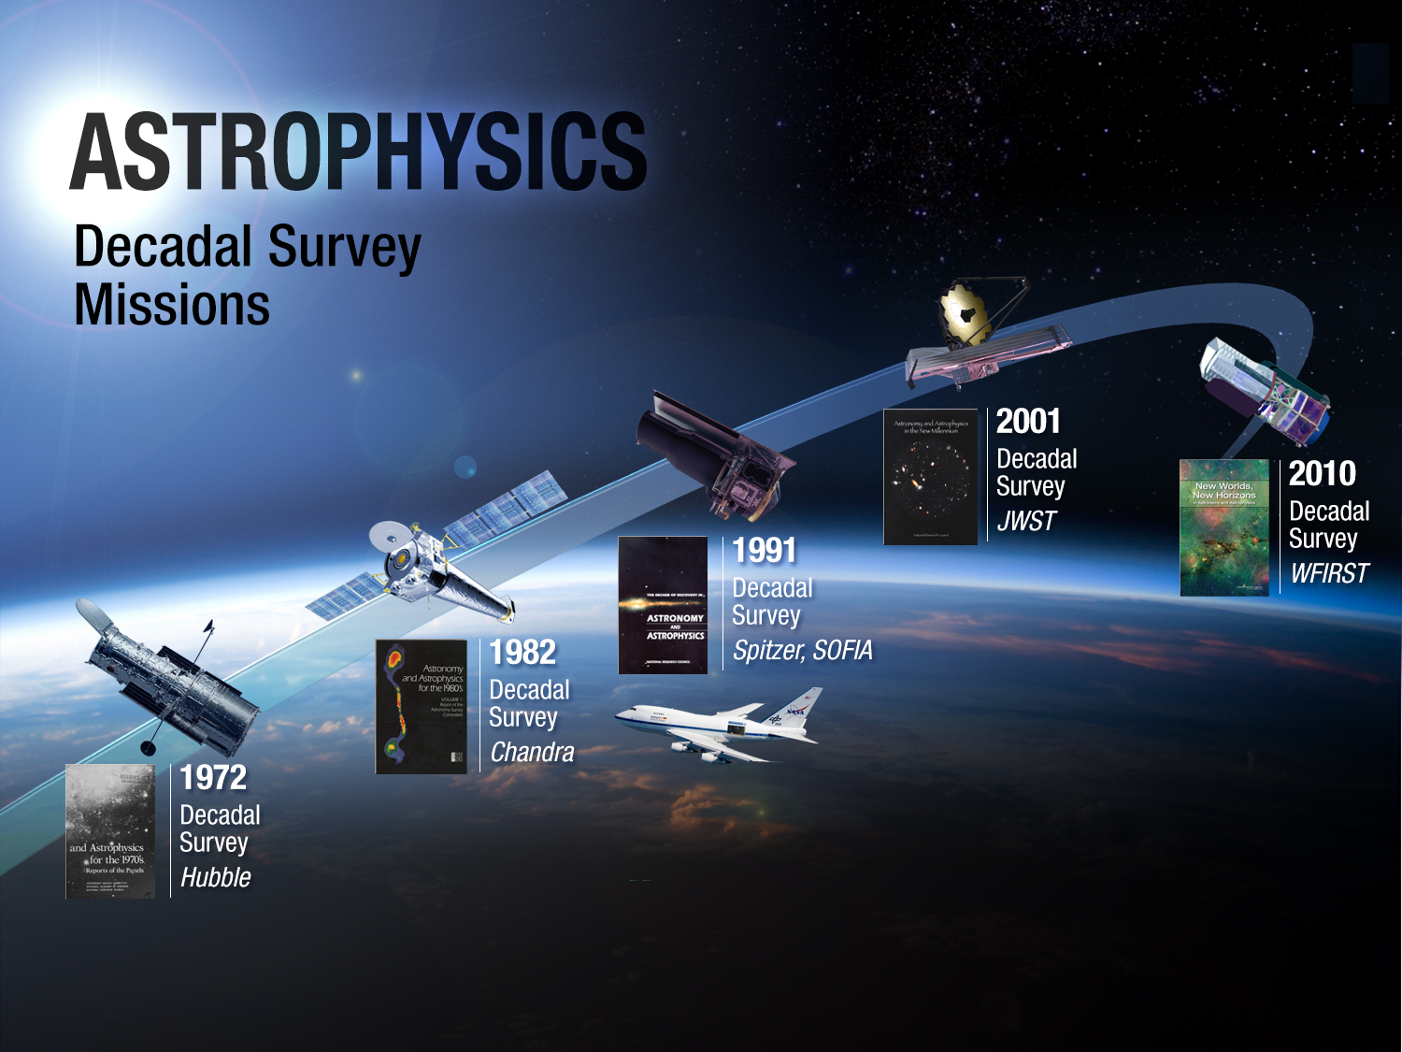
LRD: 2018
LRD: 2020s
2003
1999
1990
26

Slide 27
Preparing for the 2020 Decadal Survey
Large Mission Concepts
The initial short list (in alphabetical order):
FAR IR Surveyor – The Astrophysics Visionary Roadmap identifies a Far IR Surveyor as contributing through improvements in sensitivity, spectroscopy, and angular resolution.
Habitable-Exoplanet Imaging Mission – The 2010 Decadal Survey recommends that a habitable-exoplanet imaging mission be studied in time for consideration by the 2020 decadal survey.
UV/Optical/IR Surveyor –The Astrophysics Visionary Roadmap identifies a UV/Optical/IR Surveyor as contributing through improvements in sensitivity, spectroscopy, high contrast imaging, astrometry, angular resolution and/or wavelength coverage. The 2010 Decadal Survey recommends that NASA prepare for a UV mission to be considered by the 2020 Decadal Survey.
X-ray Surveyor – The Astrophysics Visionary Roadmap identifies an X-ray Surveyor as contributing through improvements in sensitivity, spectroscopy, and angular resolution.

