Slide 1


Enabling Detector Technologies for a Flagship UVOIR mission
John Vallerga
Space Sciences Laboratory
University of California, Berkeley

Slide 2
UV/Vis detector(s) for a new Flagship Mission
Large telescopes with large FOVs require large detectors (e.g. 4m f/3 with 30 arc min fov results in a detector size of 10 cm)
High QE trades directly with telescope area
Spatial resolution must match angular resolution of instrument – more pixels!
UV sky is dark, SNR is dominated by detector dark current and/or readout noise.
High dynamic range is needed to broaden science targets and overlap previous mission measurements

Slide 3
Other desirable attributes
Long lifetime
Radiation hardness
Response stability and uniformity for high SNR observations
Low out-of-band response
Low operational complexity (e.g. high voltage, cyrogenics, vacuum pumps and doors etc.)
Reasonable power and mass

Slide 4
Photon counting
Eliminates readout nose
Better for "photon starved" measurements (spectroscopy, interferometry, fast frame rates, diffuse backgrounds)
If event time is measured, can relax pointing control requirements if pointing knowledge is retained
Can often improve SNR of measurement, even if QE is lower

Slide 5
Photon Counting
Events
Count
(x,y,t)
Threshold
Charge integrating
Q
V ± σ_{v}
Events
± σ_{Events}
ADC

Slide 6












Photon Counting example: centroid in presence of noise
1000 photons
100 photons
10 photons
8 x 8
Noiseless
35% QE
8 x 8
2.5 e⁻ rms
90% QE
6 x 6
2.5 e⁻ rms
90% QE
4 x 4
2.5 e⁻ rms
90% QE
-
-
-

Slide 7
"Heritage" MCP detectors
Strengths
Weaknesses
Good FUV QE
Photon counting
Large area
Rad hard
Solar blind
Curved focal planes
Temporal resolution
NUV/optical QE
Limited lifetime
Limited count rate
Non-uniform response
Spatial distortions
High voltage
Vacuum operation

Slide 8
"Heritage" CCD detectors
Strengths
Weaknesses
Superb optical QE
Dynamic Range
Uniform response
Small pixels
Geometric stability
Readout Noise
Radiation ageing
Cyrogenic contamination
Red response (for UV)
Cosmic ray sensitivity
Focal plane tiling

Slide 9
MCP detector progress
Atomic layer deposition (ALD) to functionalize micropore surface
  Larger plates Longer lifetime
  Lower background Opaque photocathodes
Better readout anodes and electronics
  Higher count rates Lower gain (longer life)
  Lower HV Less distortion
Better MCPs
  More uniform Smaller pores

Slide 10
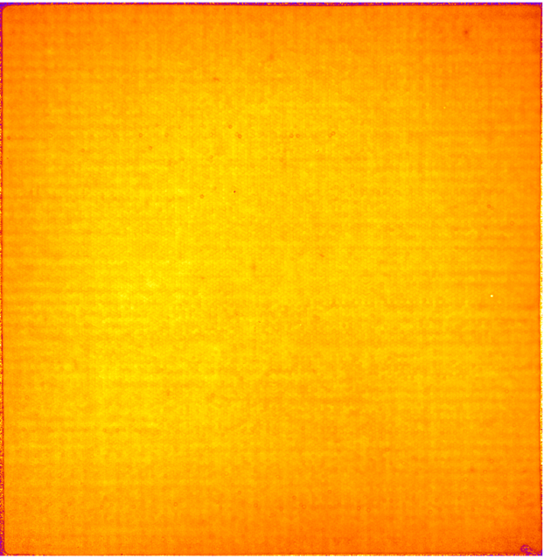
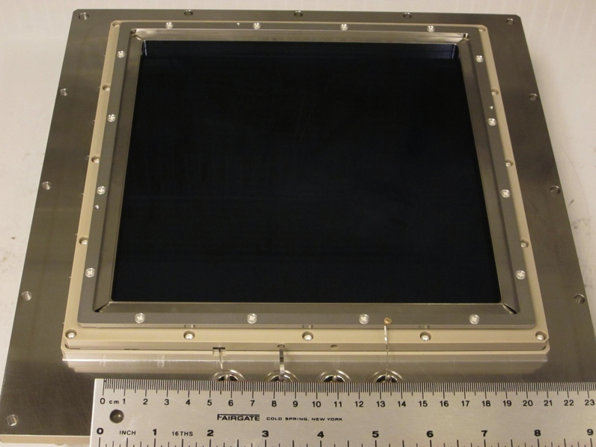

20 cm borosilicate glass ALD MCP
Average gain image “map” has <15% overall variation. 20cm MCP pair, average gain map image 20µm pore, 60:1
L/d ALD-MCP
20cm ALD 20µm pore MCP pair in detector with a cross delay line imaging readout.
Overall background ~5x better than standard glass MCPs (<K⁴⁰)
20cm MCP pair background, 2000 sec,
0.055 cnts sec⁻¹ cm⁻². 2k x 2k imaging.

Slide 11
MCP readout improvements
Cross Strip (SAT development to TRL 6)
  50 mm detector, ASIC low power electronics
  5 MHz global rate, 50 kHz local rate
  15µm FWHM spatial resolution
  10⁶ Gain, HV=2500V
Timepix pixellated ROIC (with CERN)
  10⁴ Gain
  40 MHz cm⁻² global rate, 100kHz local
  4 side buttable – can tile anode plane

Slide 12
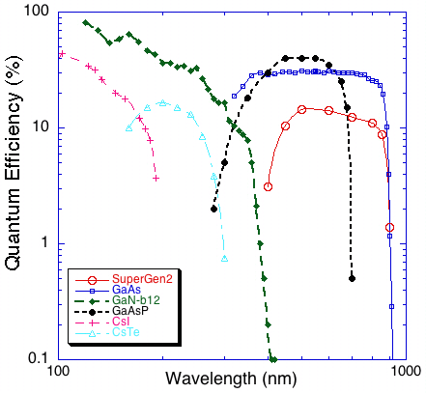
Photocathode QE

Slide 13
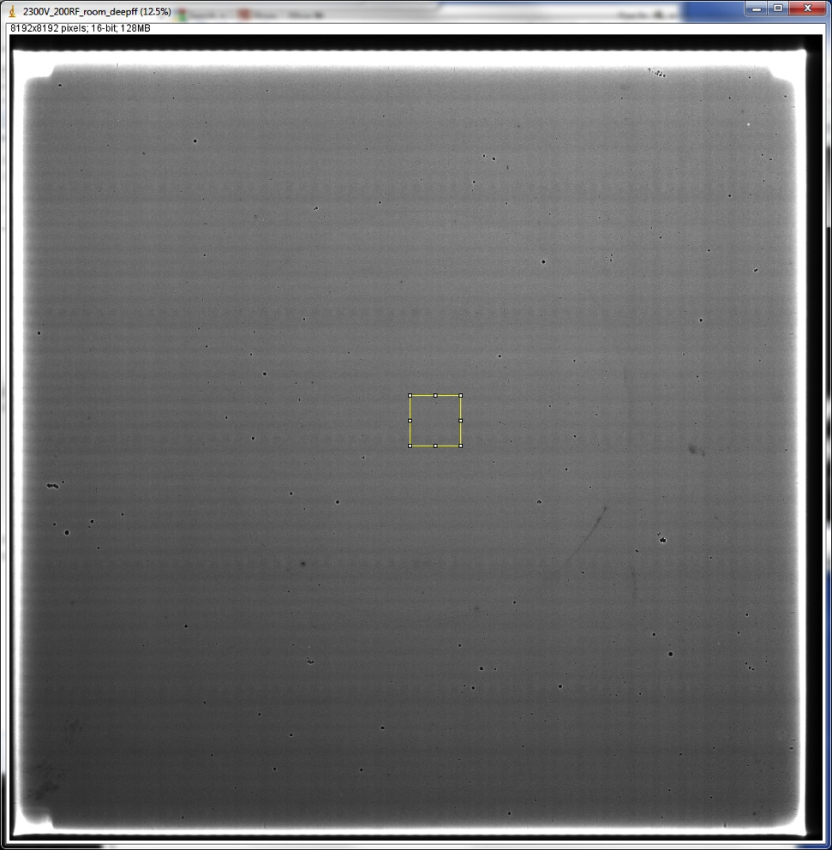
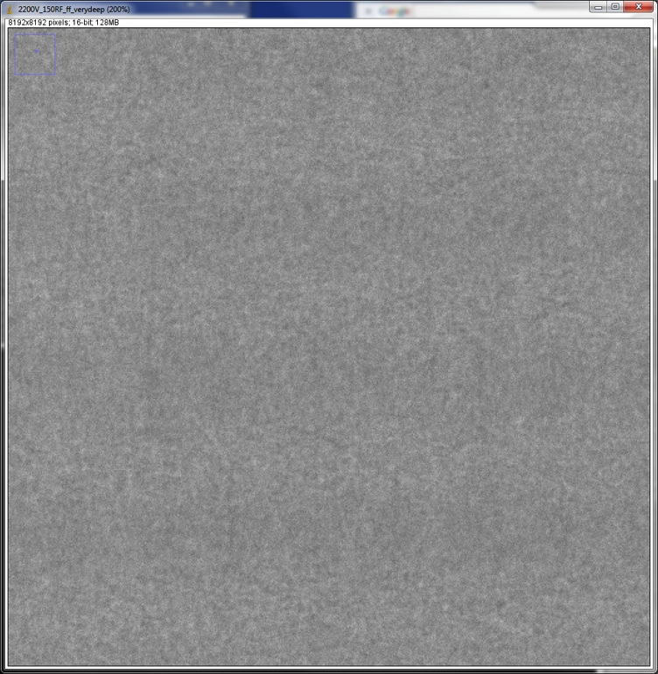
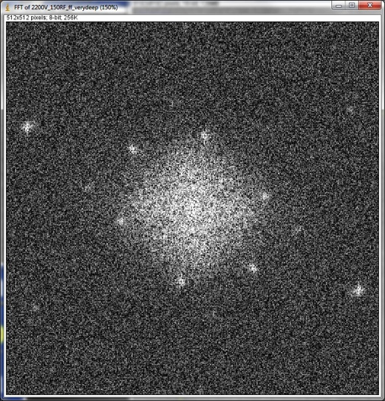
50mm XS detector
Response uniformity (PXS-II lab electronics)
450 cts. per 5 µm pxl
2.5mm
FFT of above image showing residual power at high spatial frequencies – 10µm/cycle
Deep UV flat (8k x 8k)
16 hours at 600 kHz
Photonis MCPs, 10µm pores on 12 µm centers.

Slide 14
CCD detector progress
Surface engineering via MBE Delta Doping and ALD coatings
  High (> 50%!), stable QE in FUV/NUV
  Anti-reflection coatings over defined bandpasses
  Diminished red response for specialized bandpasses
Can be applied to all back-illuminated Silicon devices: CMOS, APDs, EM-CCDs, p-CCDs, PIN Arrays

Slide 15
High Performance Silicon Imagers
Through Back illumination
With Band structure Engineering using MBE
and with ALD-AR coatings
Shouleh Nikzad, NASA JPL
100% Internal QE of Bare Delta doped CCDs
Molecular Beam Epitaxy (MBE) passivation and Atomic Layer Deposition (ALD) coatings uniquely enable atomic-level engineering of surfaces/interfaces to achieve high efficiency, stable and tailorable response, and low dark current in back-illuminated silicon arrays.
This is true for UV/Visible/NIR and especially true in UV where absorption happens within nanometers of the surface
We use MBE for delta doping/superlattice doping to achieve 100% internal QE (reflection limited) and ALD for AR coatings and visible blind coating to tailor the response. Versatile techniques applicable to essentially all silicon detectors and imagers including CCDs, EMCCDs, P-channel CCDs, CMOS, PIN arrays, Avalanche Photodiode Arrays (APDs)
See next slides for examples of tailored response on ALD coated delta doped arrays…..

Slide 16
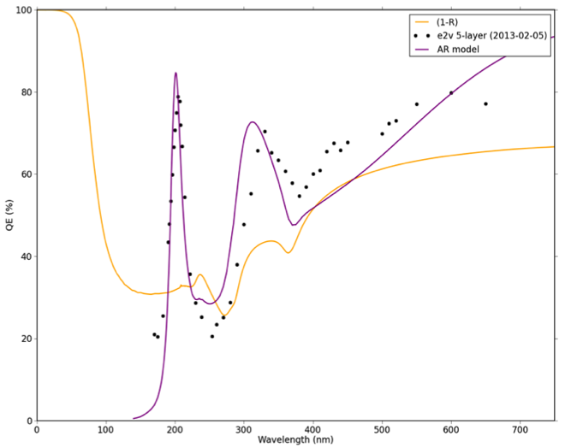
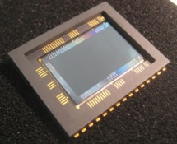
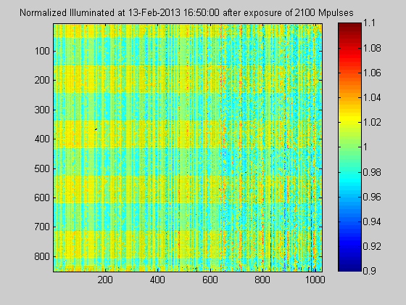
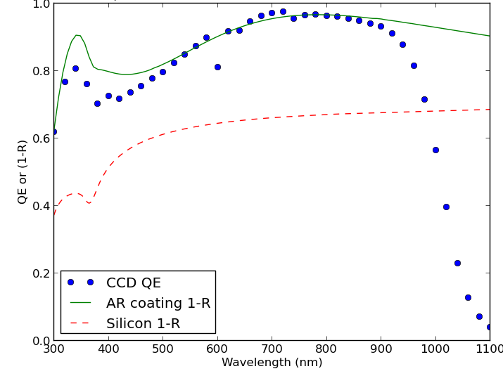
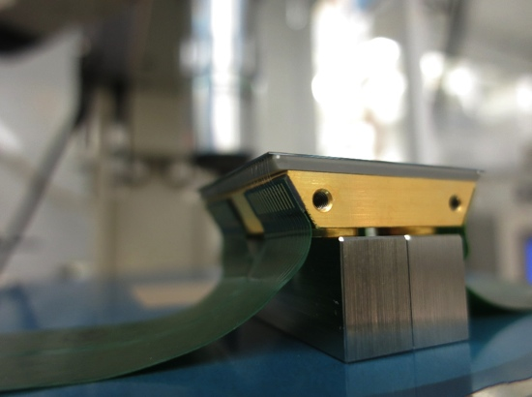
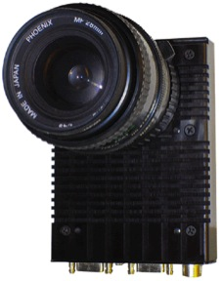
Examples of UV/Vis/NIR Detectors with Tailorable Response through Precision Control of Delta doping and ALD Coatings
≥50% UV QE on conventional CCDs & EMCCDs
Photon Counting Detector Optimized for Balloon UV Window
Ultrastable response
Broadband Response for Space and Ground-based Astronomy
>2 Billion 193 nm laser pulses at full saturation. No measureable change (within 1%) shown on delta doped /SL doped + ALD on CMOS
Delta doped and AR coated STA n-channel CCDs for WaSP at Palomar

Slide 17
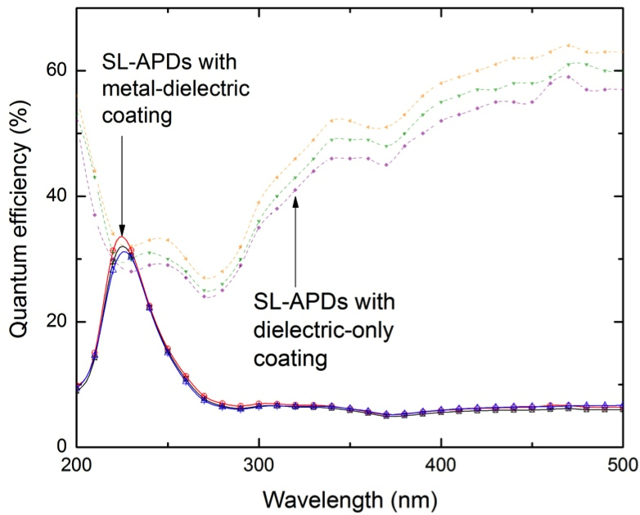
High Efficiency Silicon Detectors with High Out-of-band Rejection Ratio
Description
Measured QE and Rejection in a delta doped/superlattice(SL) doped avalanche phodiode (APD)
Combining MBE passivation and ALD coatings for Integrated “red” rejection filters on high efficiency Si detectors
Performance or capability
~4 orders of magnitude rejection
High efficiency in band
Tailorable response in Si
dielectric
Applications
metal
UV Imaging and Spectroscopy
Particle detection
X ray detectors
dielectric
metal
dielectric
Superlattice doped Si detector or array with integrated filter
Super-lattice doped layer
Grown on back illuminated Si
Detectors using Molecular beam
Epitaxy (MBE)

Slide 18
Other photon counting technologies
EM-CCDs
  Single photon counting limits dynamic range
APD arrays in silicon
  Geiger mode suffers from crosstalk, limited rates, tricky biasing
APD arrays in HgCdTe
  Can operate in linear mode because of low amplification noise
  Requires cryogens.
MKIDs
  Quasiparticle excitation, therefore intrinsic energy resolution
  Response UV to IR
  Cryogenic - 100 mK
  20 kpixels devices exist, Megapixel possible

Slide 19
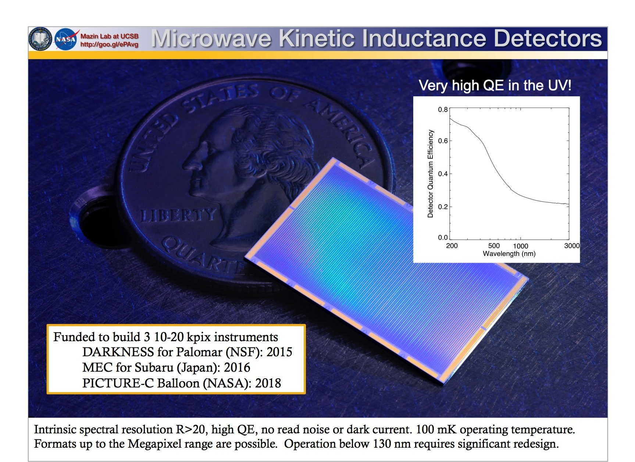
Cryogenic Detectors
Ben Mazin, UCSD

Slide 20
Conclusions
Given the recent progress made in the "standard" heritage detector types, most likely large, modern MCP detectors will be chosen for Flagship FUV instruments, CCDs for the optical instruments, and there will be a battle for the NUV crossover.
Photocathode improvements can still have a significant impact in overall instrument performance
Optical/NIR photon counters need their TRL increased significantly before becoming a Flagship detector

Slide 21
Backup Slides

Slide 22
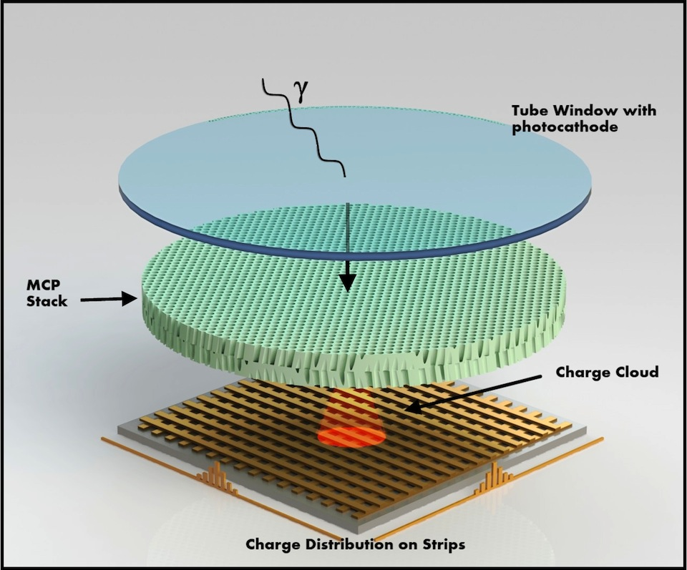
Microchannel Plate Detectors
Photocathode converts photon to electron
(ALD, Photocathodes APRA 2013, 2008 )
MCP(s) amplify electron by 10⁴ to 10⁷
(MCPs with ALD, APRA 2011)
Patterned anode measures charge centroid
  (XS and ASIC readouts, APRA 2007
  XS electronics ASIC, SAT 2011)
Photocathodes Readouts
Alkali halides, Multialkali, GaAs, GaN Cross strip, Cross delayline, ASIC
(Medipix or Timepix), Phosphor.

Slide 23
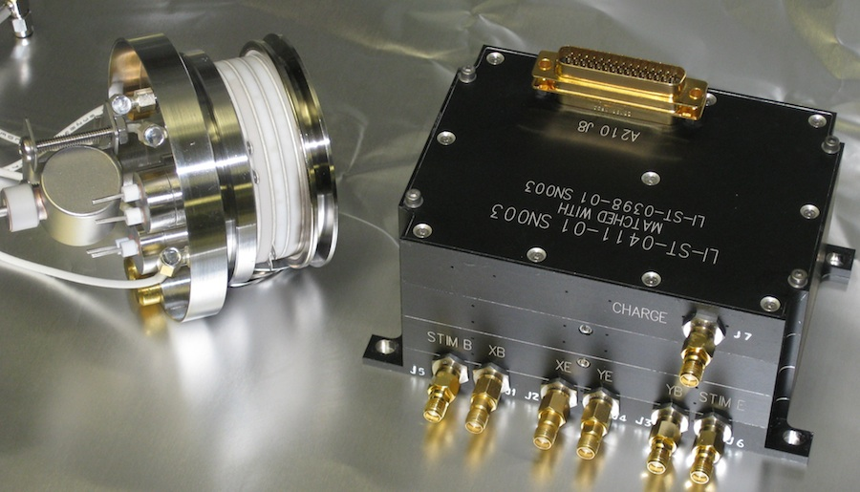
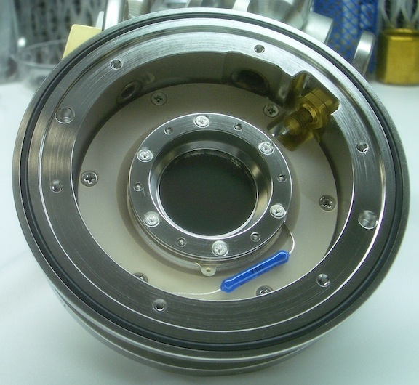
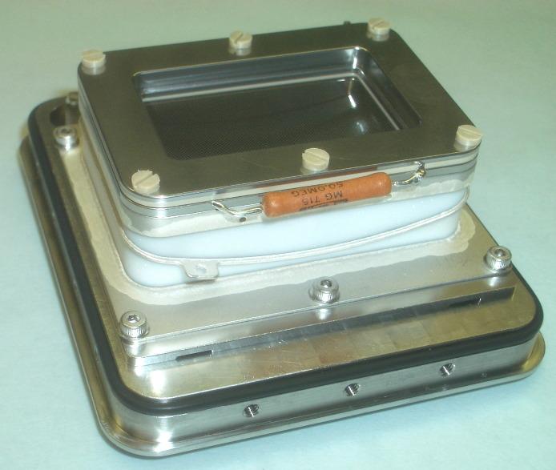
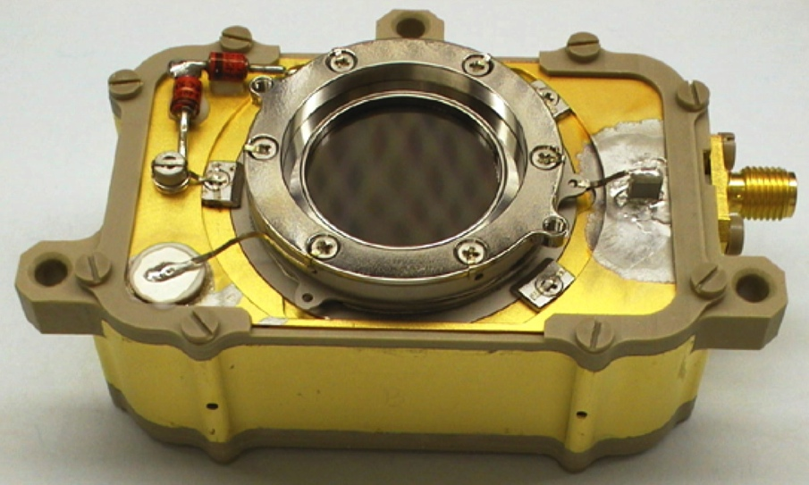
      UV + MCP Detectors on Recent Missions
SSULI x 3, 40mm cross delay line, 2009 – present,
UV spectrometer, 80 – 170nm, 512 x 512.
NRL-JPEX rocket, 25mm cross strip,
~18µm FWHM resolution, 22-25nm
spectrometer flown 2008.
Rosetta – ROSINA-RTOF. TOF mass
spectrometer, < 300ps time resolution.
Rosetta Alice, Pluto Persi-ALICE, LRO-LAMP, JUNO-UVS. Delay line up to 2048 x 512, 50 – 180nm, CsI & KBr. Highly curved (7cm R) - spectrometers.

Slide 24
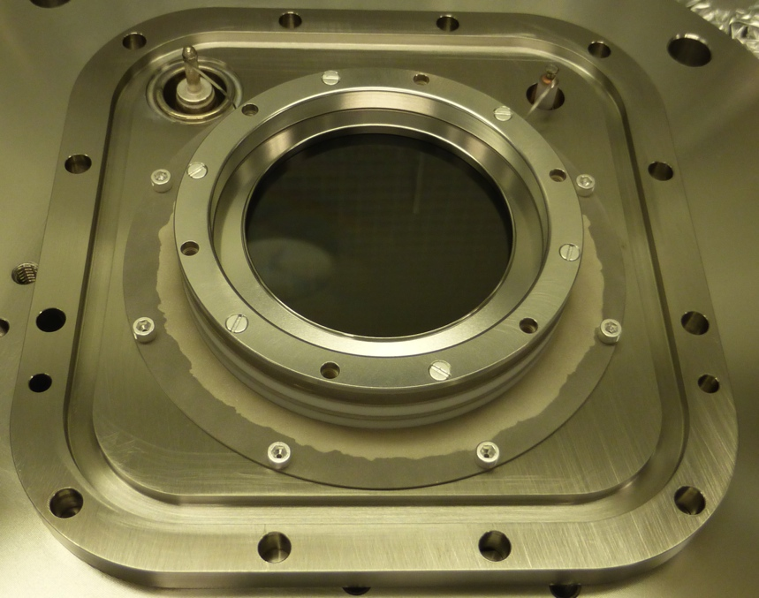
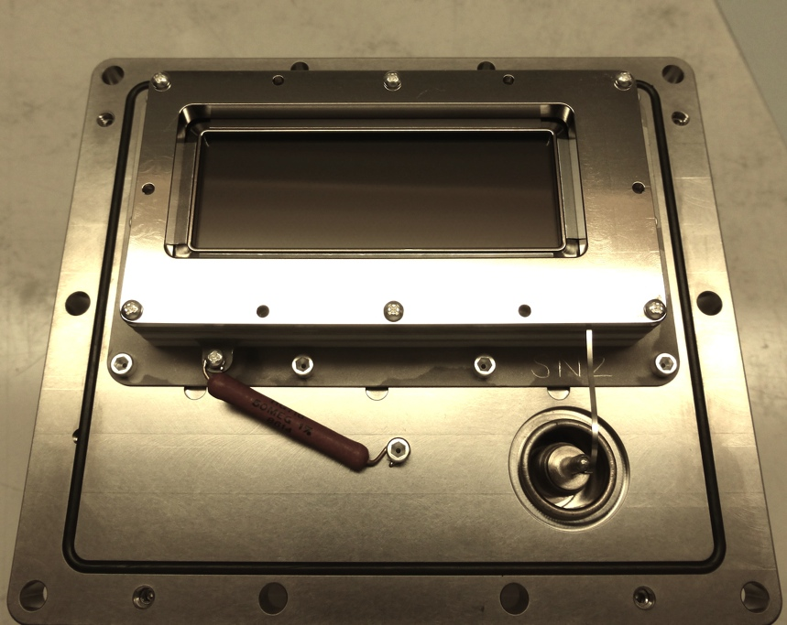
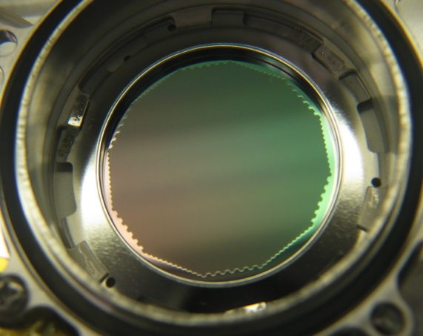
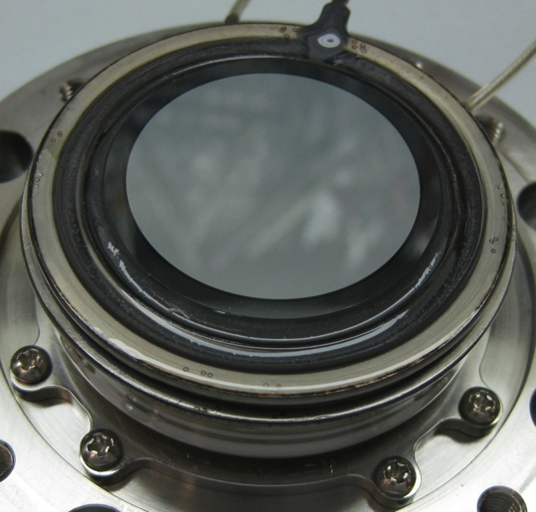
      UV MCP Detectors for Impending Missions
GOLD- SMEX, 40mm cross delay line
ICON-SMEX – EUV, XDL
SPICE – Solar Orbiter, 25mm MCP/Phosphor/CCD
ICON-SMEX – FUV, ICCD

