Slide 1
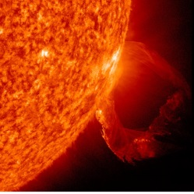
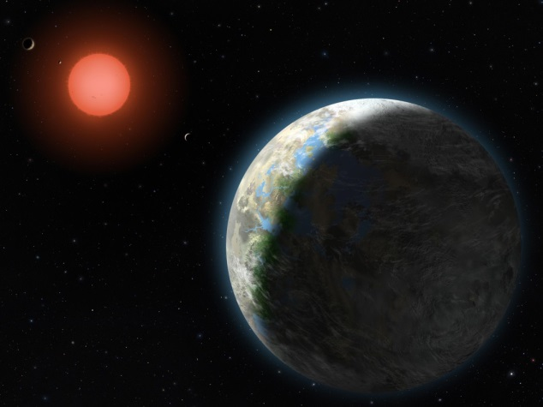
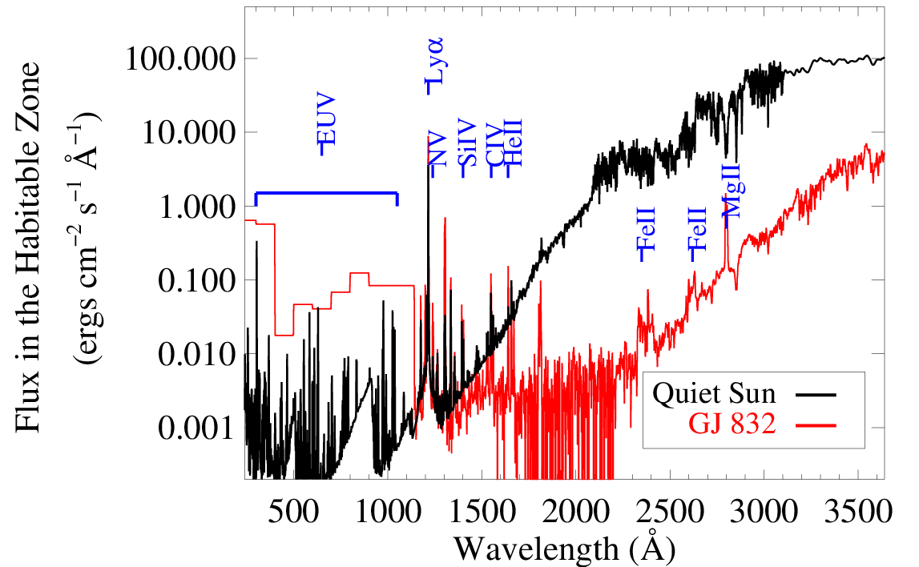
Earth-mass Planets around M and K dwarfs: The Production of (and eventual detection of) “Biomarker” Gases
Shape and amplitude of stellar UV spectrum may drive abiotic production of “biomarker” gases like ozone on rocky planets in the habitable zone
X-ray→ UV→ visible survey of M and K exoplanet host stars within 15 pc to understand the initial conditions for atmospheric chemistry: MUSCLES Survey with HST, Chandra, XMM, ground-based telescopes
Tian et al. 2014 Domagal-Goldman et al. 2014
FUV
NUV
PI - France
Kevin France
University of Colorado at Boulder
(w/ Linsky, Roberge, Kaltenegger, Llama et al.)
SIG2 UVOIR Workshop, June 2015
France+, 2012, 2013
M dwarf: FUV/NUV ~ 1
Sun: FUV/NUV ~ 10 ⁻³

Slide 2
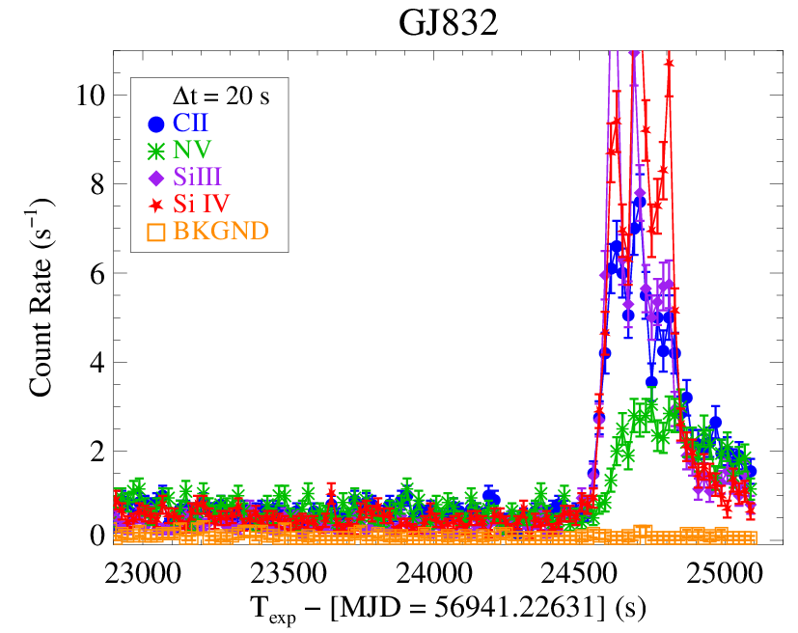
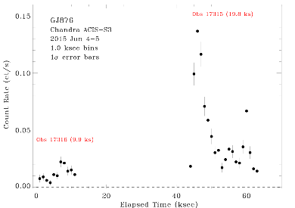
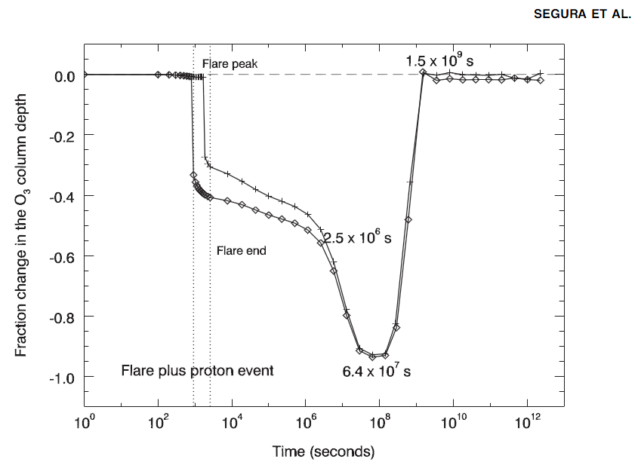
Earth-mass Planets around M and K dwarfs: The Production of (and eventual detection of) “Biomarker” Gases
Tian et al. 2014 Domagal-Goldman et al. 2014
Segura+ 2010, AsBio
PI - France
France+, 2012, 2013
94% O₃
depletion
Factor of 10 UV/X-ray flux changes on “inactive” stars
Notes:
Long-term evolution is no doubt important, but that can be done with a focused HST+X-ray survey today to establish long-term trends of M dwarf high-energy irradiances. NOTE: particle fluxes are important, and people are working on this (, but I think the best way to remote sense a ‘CME’-like event is with the FUV flare. ) //Fundamental Stellar Astrophysics//
We do not understand on a fundamental level what drives the flares nor can we predict their frequency from first principles. So, if we want to control for the effects of host star activity on the resultant atmospheric spectrum, you need to have at minimum have monitored the star ahead of time, if not have a separate mission to do simultaneous monitoring (subject of the ‘Discovery’ class smaller mission concept Linsky & I submitted). NOTE: HST is not sensitive enough to do this. It is costing ~10-15 orbits to get average M dwarfs at 10 pc. 20 pc is just not feasible for an inactive M dwarf. (need LyA, many bandpasses = lots of time)

Slide 3
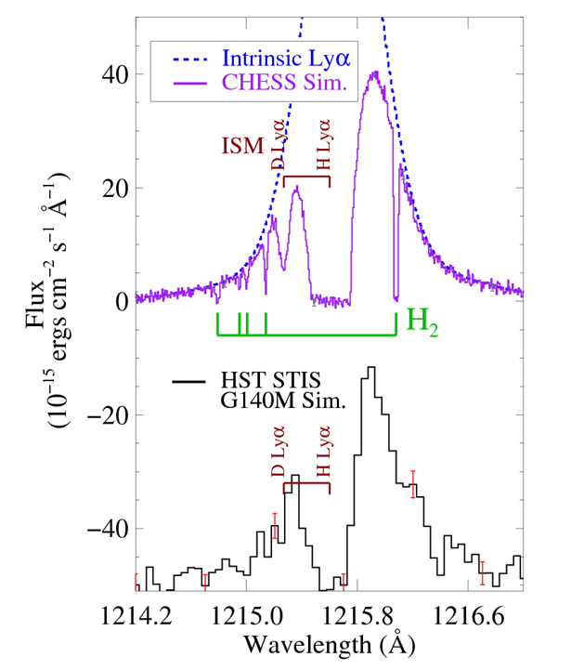
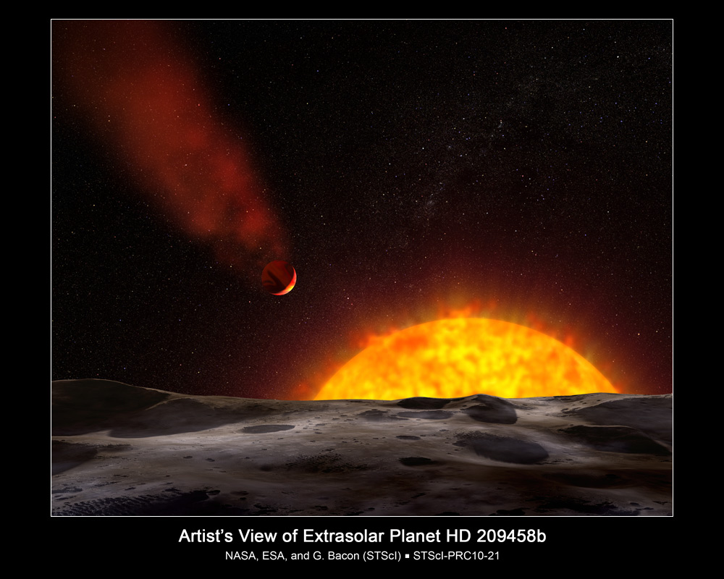
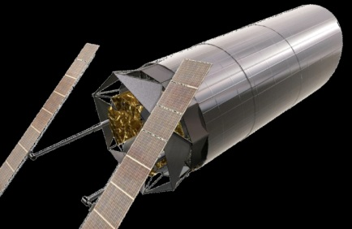
Earth-mass Planets around M and K dwarfs: The Production of (and eventual detection of) “Biomarker” Gases
Hot Jupiter transits: FUV transmission spectroscopy the best technique for observations of atmospheric mass-loss outside the solar system. Currently limited by data quality.
Kevin France
University of Colorado at Boulder
Notes:
Transit measurements of H, H2, C, and O.

Slide 4
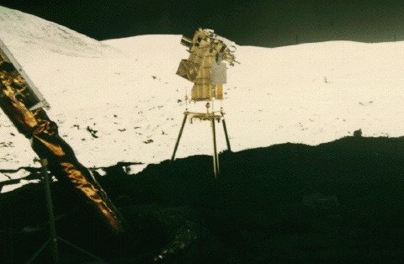
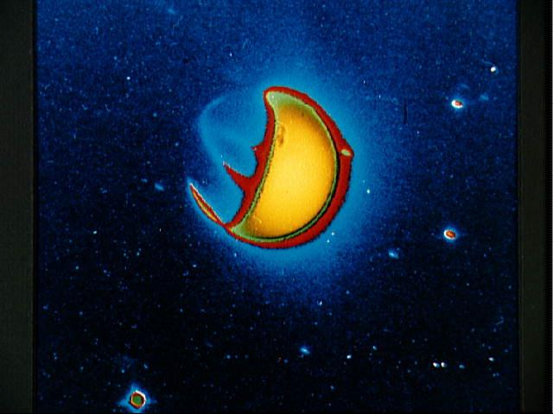
Earth-mass Planets around M and K dwarfs: The Production of (and eventual detection of) “Biomarker” Gases
Exo-Earth transits: they have extended atomic atmospheres too…
Kevin France
University of Colorado at Boulder
Notes:
Apollo 16 FUV camera. Note this camera had a LyA blocking filter (probably CaF2, but not sure) so this is almost entirely neutral oxygen emission.

Slide 5
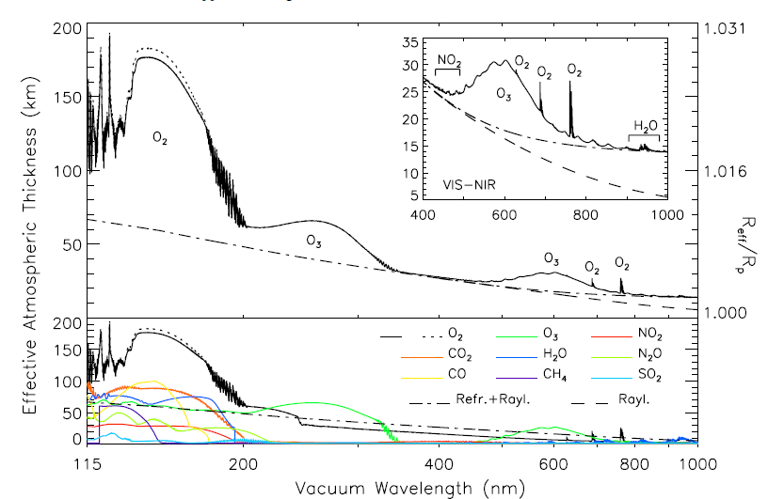
Earth-mass Planets around M and K dwarfs: The Production of (and eventual detection of) “Biomarker” Gases
(R_{planet}/R*) for O₂, O₃, CO, CO_{2,} H₂, and H all peak in the UV, 100 - 400 nm.
O₃ peak at 250 nm, O₂ peak at 160nm: habitable planets around F and A stars. (start discovery now)
NEED: 8+ m primary, facility-class UV spectrograph, large photon-counting UV detectors
2013
Kevin France
University of Colorado at Boulder
Notes:
I think this is the most ambitious application for UV exoplanet science:

Slide 6
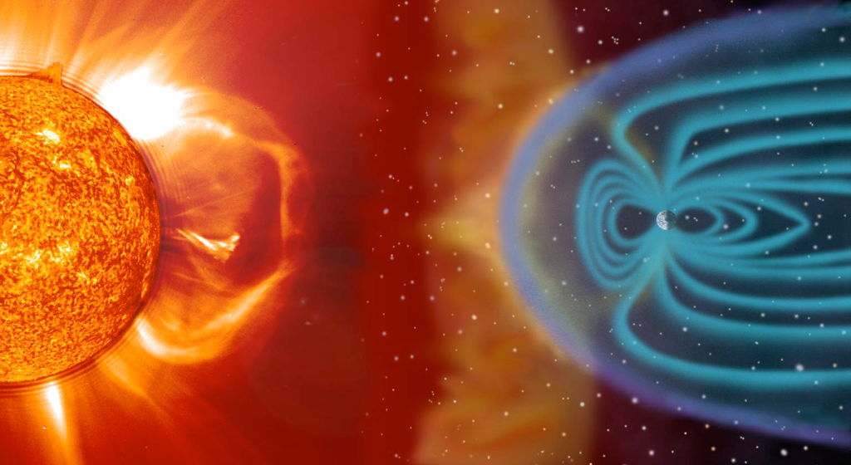
Slides from Joe Llama – Lowell Obs
Stellar wind
Vidotto et al. 2010: Interaction between stellar wind and planetary magnetic field causes compression.
Notes:
The link between exoplanets and the activity of the host star
What “Things” are, how they go bump, what this tells us about activity.
Image of the Sun. SDO. Image every 15 seconds
White light image. Sunspots, intense regions of magnetic field.
Jupiter and Earth for reference.

Slide 7
Shock model

Slide 8
Shock model

Slide 9
Shock model
*

Slide 10
Transit animation
Vidotto et al. (2010)

Slide 11
WASP-12b in the Near-UV
Llama et al. (2011):
Potential detection of a magnetic field around WASP-12b.
Magnetosphere protects the atmosphere to ~5 Rp.
Bp ~ 24 Gauss.
ArXiv: 1106.2935
1.000
Flux
0.985
0.970
-0.1
0.0
-0.1
Phase
Notes:
Results have been very unconvincing, but the low quality of the data (for the ~3 of this stars this can be done on) is the limiting factor at this point (in my mind)

Slide 12
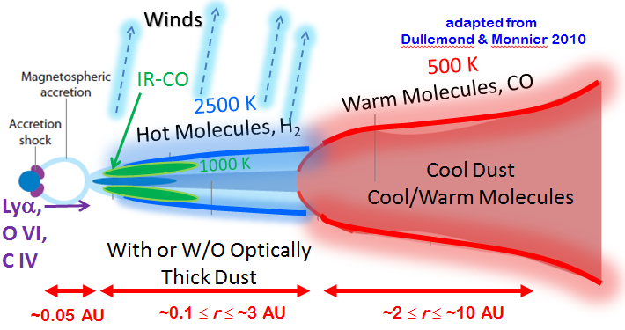
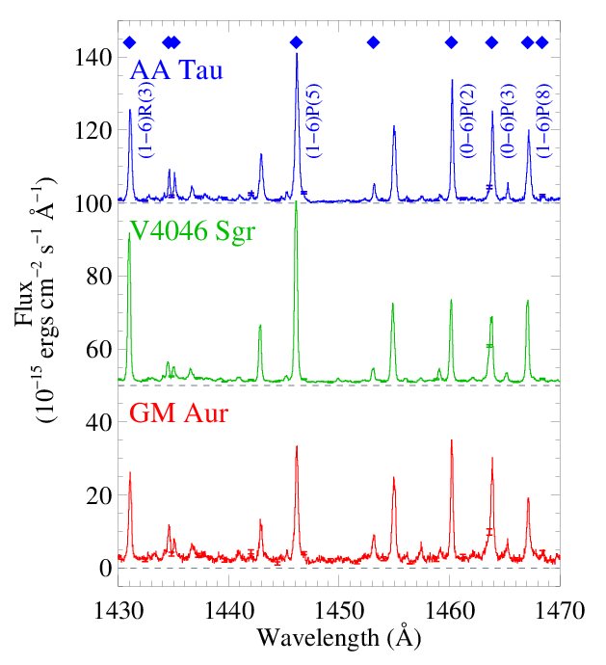
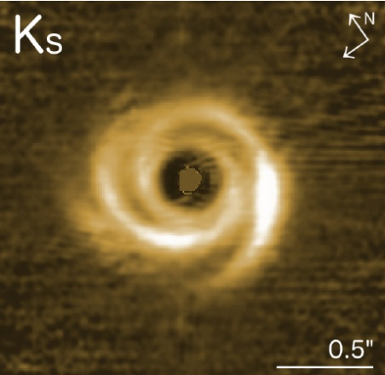
Composition, Distribution, and Lifetime of Molecular Gas at r < 10 AU in Protoplanetary Disks
The far-UV and Lyman-UV have the strongest dipole-allowed transitions systems of H₂ and CO. Resolved spectral line profiles contain information about the 3-D distribution of gas inside 10 AU in disks with ages ≤ 30 Myr
Survey of ~40 protoplanetary systems with HST-COS, characterizing the H₂ disks and discovering fluorescent CO in these environments (France+ 2011, 2012; Hoadley+ 2015)
Kevin France
University of Colorado at Boulder
(w/ Herczeg, Brown, Alexander, et al.)
SIG2 UVOIR Workshop, June 2015
Garufi+ (2013) ; France+ (2012)

Slide 13
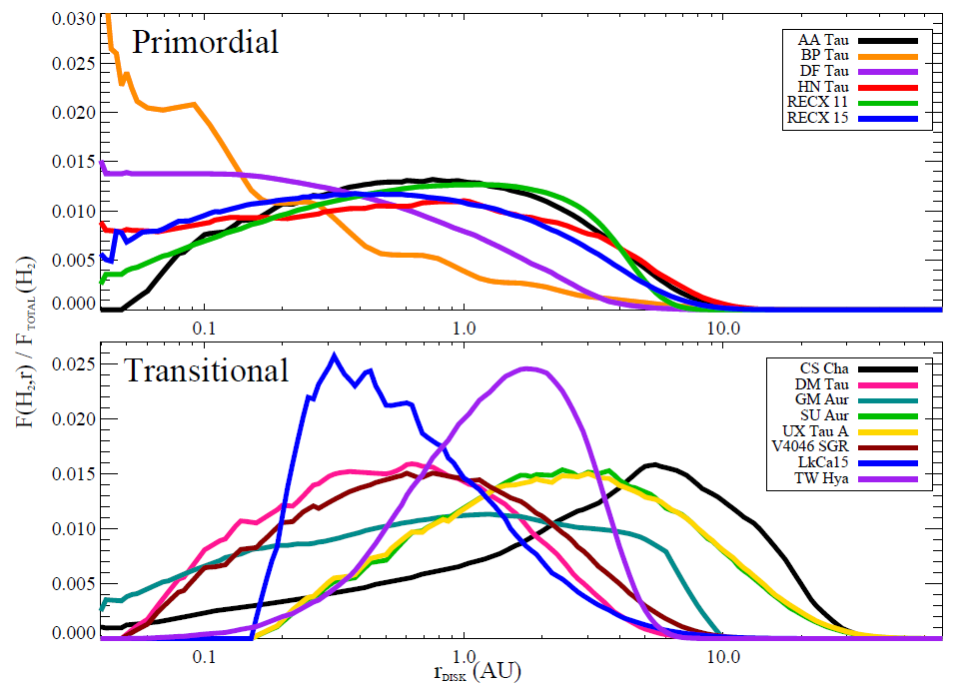
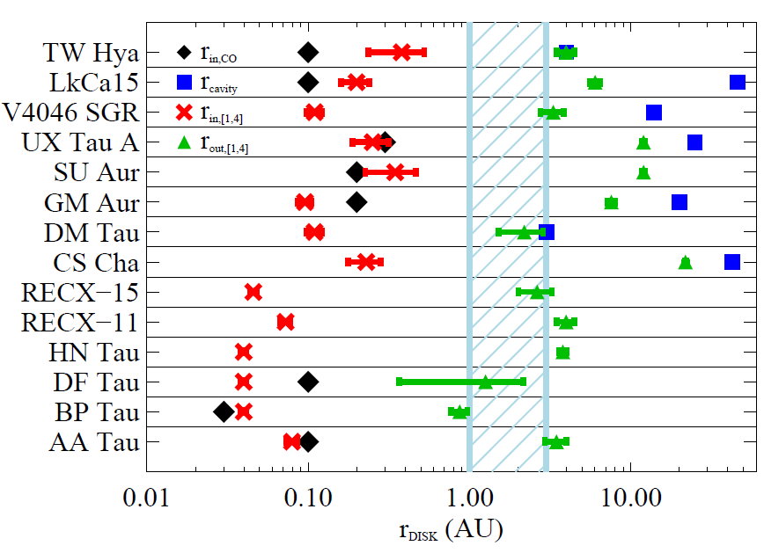
Composition, Distribution, and Lifetime of Molecular Gas at r < 10 AU in Protoplanetary Disks
UV and IR data finds molecular gas inside gust gaps to be ubiquitous. Possible signature of forming protoplanetary systems.
UV lines of H₂ & CO - Sensitive to extremely small amounts of gas, period of transition to debris disks: primordial gas disk lifetime.
MOS with R = 3000-5000 could survey hundreds/thousands of disks
Hoadley+ (2015)
Notes:
HIGH RES SPECTROGRAPH: Higher resolution and higher sensitivity means more angular resolution and more species we can do this with.

Slide 14
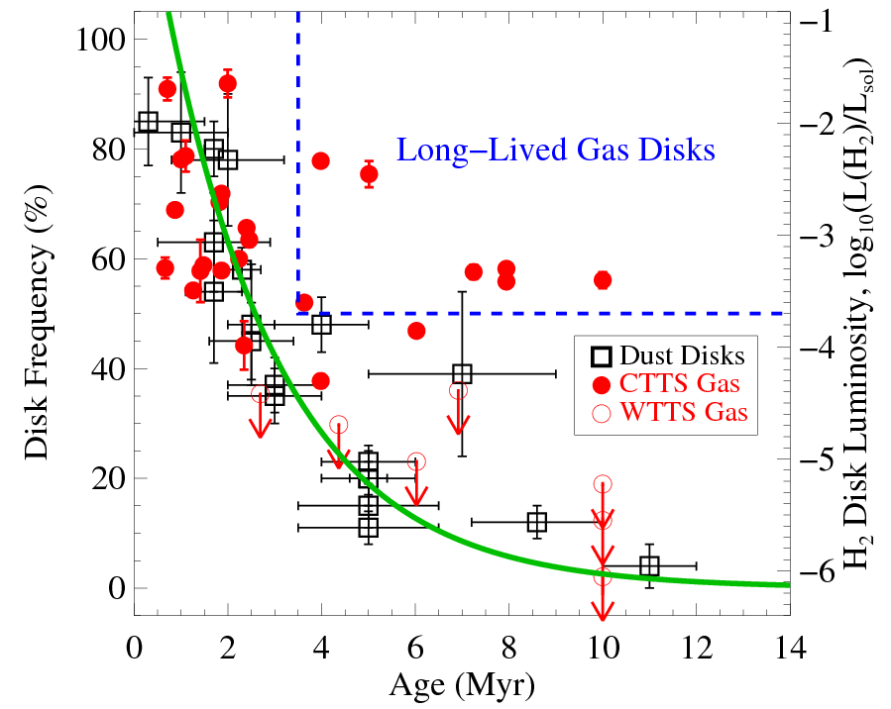
Composition, Distribution, and Lifetime of Molecular Gas at r < 10 AU in Protoplanetary Disks
UV and IR data finds molecular gas inside gust gaps to be ubiquitous. Possible signature of forming protoplanetary systems.
UV lines of H₂ & CO - Sensitive to extremely small amounts of gas, period of transition to debris disks: primordial gas disk lifetime.
MOS with R = 3000-5000 could survey hundreds/thousands of disks
France+ (2012)
Notes:
LO RES SPECTROGRAPH: We think that the gas evolution lags the dust evolution, so we don’t really know what the extended gas atmosphere lifetimes are. How long are raw materials around for planets to accrete as atmospheres? Survey of many hundreds/thousands of PPDs in regions of various ages would allow us to make the equivalent of this plot: the “gas disk frequency” as a function of star-forming region age. There are > 10^4 dust disks on this curve and about 3 dozen gas disks. Low-res only required for good line-ID and flux measurements. Then MOS gets you lots, specially once they are more distant and concentrated on the sky.

Slide 15
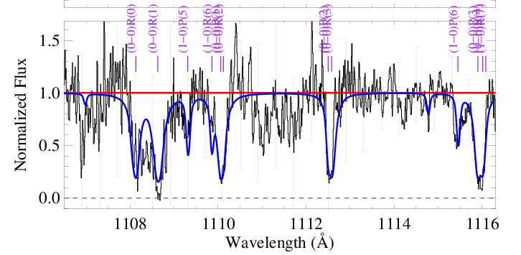
Composition, Distribution, and Lifetime of Molecular Gas at r < 10 AU in Protoplanetary Disks
Larger samples in a range of star-forming environments are necessary to provide a complete picture of the composition, structure, and lifetime of gas disks.
Higher sensitivity + high-resolution far-UV absorption line spectroscopy of CO, H₂, and H₂O enable quantitative compositional analysis
NEED: 8+ m primary, facility-class UV echelle spectrograph, advanced UV coatings for 100 - 120 nm region
First cool H₂ absorption detection towards a low-mass protoplanetary disk, France+ (2014b).
F_{cont} ~ 2 x 10⁻¹⁵ erg cm⁻² s⁻¹ Å⁻¹
Kevin France
University of Colorado at Boulder

Slide 16
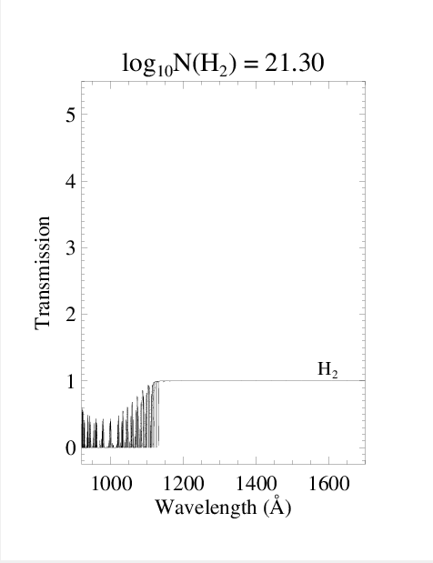
Composition, Distribution, and Lifetime of Molecular Gas at r < 10 AU in Protoplanetary Disks
Higher sensitivity + high-resolution far-UV absorption line spectroscopy of CO, H₂, and H₂O enable quantitative compositional analysis
NEED: 8+ m primary, facility-class UV echelle spectrograph, advanced UV coatings for 100 - 120 nm region
Kevin France
University of Colorado at Boulder

Slide 17
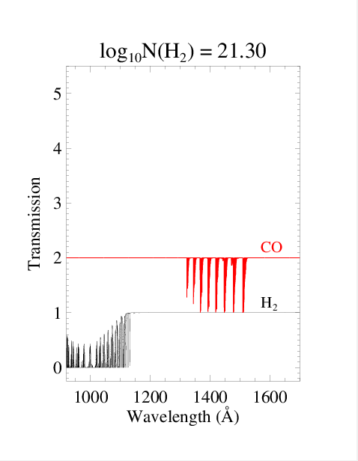
Composition, Distribution, and Lifetime of Molecular Gas at r < 10 AU in Protoplanetary Disks
Higher sensitivity + high-resolution far-UV absorption line spectroscopy of CO, H₂, and H₂O enable quantitative compositional analysis
NEED: 8+ m primary, facility-class UV echelle spectrograph, advanced UV coatings for 100 - 120 nm region
Kevin France
University of Colorado at Boulder

Slide 18
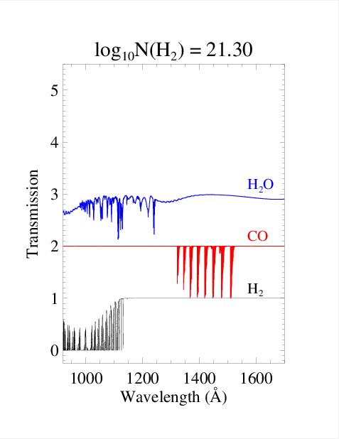
Composition, Distribution, and Lifetime of Molecular Gas at r < 10 AU in Protoplanetary Disks
Higher sensitivity + high-resolution far-UV absorption line spectroscopy of CO, H₂, and H₂O enable quantitative compositional analysis
NEED: 8+ m primary, facility-class UV echelle spectrograph, advanced UV coatings for 100 - 120 nm region
Kevin France
University of Colorado at Boulder

Slide 19
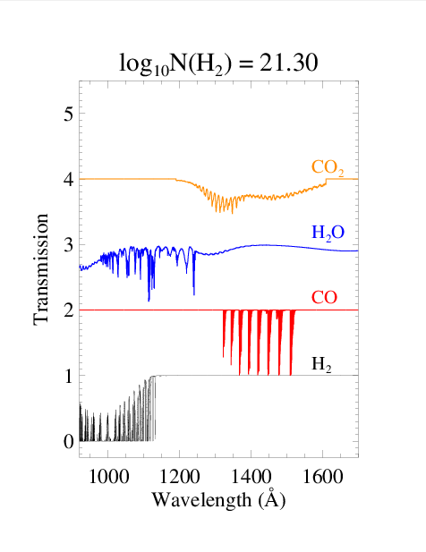
Composition, Distribution, and Lifetime of Molecular Gas at r < 10 AU in Protoplanetary Disks
Higher sensitivity + high-resolution far-UV absorption line spectroscopy of CO, H₂, and H₂O enable quantitative compositional analysis
NEED: 8+ m primary, facility-class UV echelle spectrograph, advanced UV coatings for 100 - 120 nm region
Kevin France
University of Colorado at Boulder

Slide 20
Composition, Distribution, and Lifetime of Molecular Gas at r < 10 AU in Protoplanetary Disks
Higher sensitivity + high-resolution far-UV absorption line spectroscopy of CO, H₂, and H₂O enable quantitative compositional analysis
NEED: 8+ m primary, facility-class UV echelle spectrograph, advanced UV coatings for 100 - 120 nm region
Kevin France
University of Colorado at Boulder

Slide 21
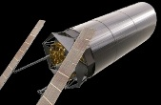
Composition, Distribution, and Lifetime of Molecular Gas at r < 10 AU in Protoplanetary Disks
Inclination of a large number of disks can be known from SMA and ALMA
Distribution of inclination angle and ages allows 4-D mapping of disks [r,h,t,λ]
Telescope aperture determines how close to the disk midplane you can probe (current record for UV spectroscopy: A_{V} =7.6)
Kevin France
University of Colorado at Boulder
Notes:
AV = 7.6 ➔ NGC 2024 – 1, a B0.5V star in the NGC2024 cloud, *BUT* R_v = 4.5. Of course, that is okay, because we expect that as grains grow in these disks, their UV extinction curves flatten off (become gray), which effectively is the same thing as lowering the R_v.

Slide 22
End.
Notes:
For cool stars, as you go to shorter wavelengths, the stars get more “patchy”, so you want to observe over many transits or complement your observing with nearly simultaneous Zeeman Doppler Imaging.

Slide 23
Transiting the Sun
Slides from Joe Llama – Lowell Obs
Extreme
ultraviolet
Far
ultraviolet
Soft X-ray
Optical
Flux
Phase
Llama & Shkolnik (submitted)
Notes:
For cool stars, as you go to shorter wavelengths, the stars get more “patchy”, so you want to observe over many transits or complement your observing with nearly simultaneous Zeeman Doppler Imaging.

