Slide 1
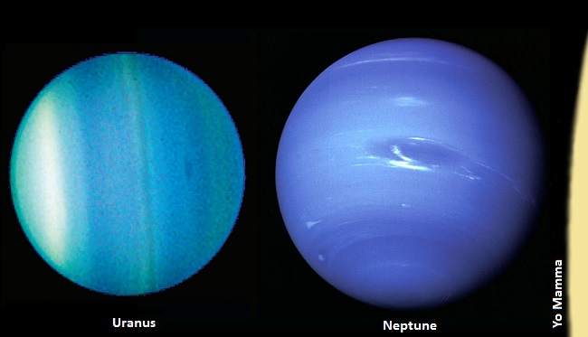
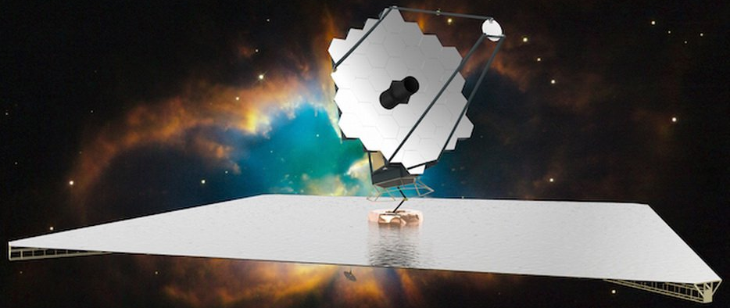
Exploring the Satellite Systems of
Uranus and Neptune with LUVOIR
Richard Cartwright
SETI Institute / NASA Ames
rcartwright@seti.org

Slide 2
Overview
Uranus
I. Introduction to ice giants and the case for their investigation
II. Uranian satellite system
III. Neptunian satellite system
Neptune
IV. Exploring icy satellites with LUVOIR

Slide 3
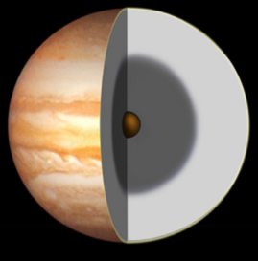
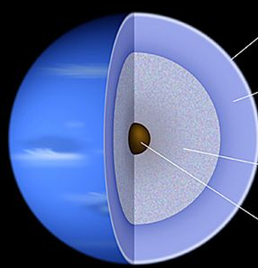
Part I.
What are ice giants?
Uranus
Gas giants: ~85% H₂ and He
Ice giants: ~65% water by mass, with some CH₄, NH₃, and ices
~20% mass in H₂ atmospheres
H₂, He envelope
H₂, He envelope
(some CH₄)
Neptune
“ice-rich” mantle
Rocky
core
Metallic H, atomic He mantle
Rocky
core

Slide 4
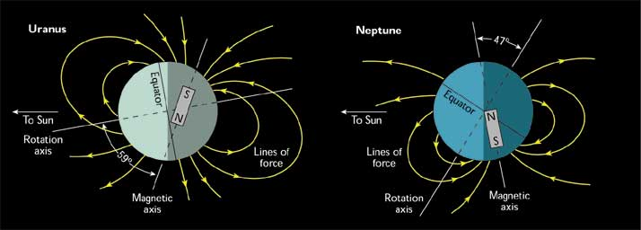
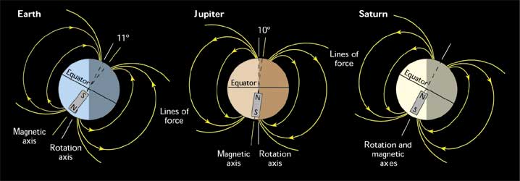
Part I.
What are ice giants?
Large offset between magnetic field and rotational axes
Magnetic dipole offset from planetary centers

Slide 5
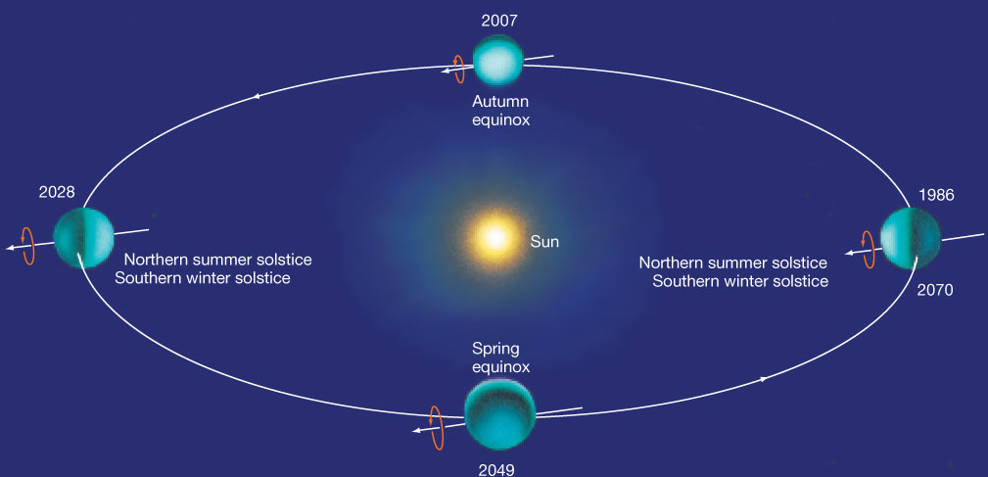
Part I.
What are ice giants?
Northern Spring
Cartwright SpeX, IRAC Prog. 1112 (2012 – 2018)
81° S
Late Southern Summer
Grundy SpeX, IRAC Prog. 71 (2000 – 2006)
90°S
17 – 45° N
4 – 30° S
0°
45°N
90°N
90°S
0°
45°S
35 – 50° N
Southern Summer Voyager 2 flyby (1986)

Slide 6
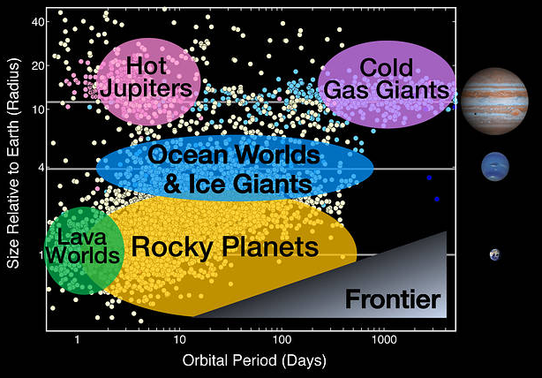
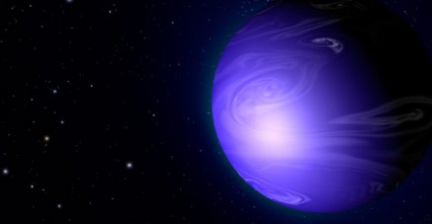
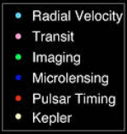
Part I.
Ice/ocean giant exoplanets common?
First “hot Neptune” exoplanet GJ 436b discovered (Butler et al. 2004)
First possible ice/ocean giant Kepler 421b (Uranus-mass) discovered with orbit near snow line (Kipping et al. 2014)
More challenging to detect exoplanets with long orbital periods – where ice/ocean giants are likely to be more common

Slide 7
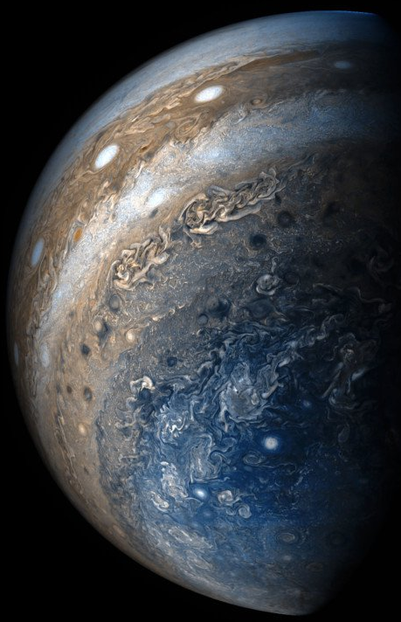
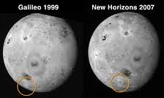
Part I.
Spacecraft missions to the outer Solar System
Jupiter: Pioneer 10, Pioneer 11, Voyager 1, Voyager 2, Galileo, Ulysses, Cassini, New Horizons, and Juno
*JUICE, Europa Clipper
Saturn: Pioneer 11, Voyager 1, Voyager 2, Cassini
Uranus and Neptune: Voyager 2

Slide 8
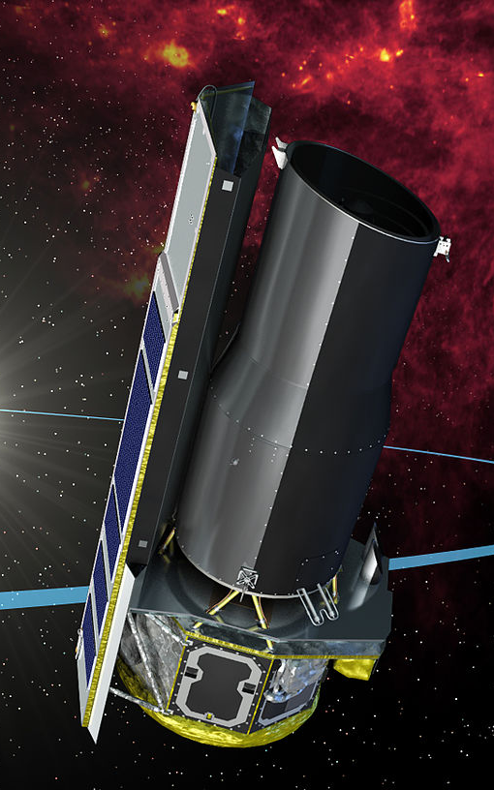
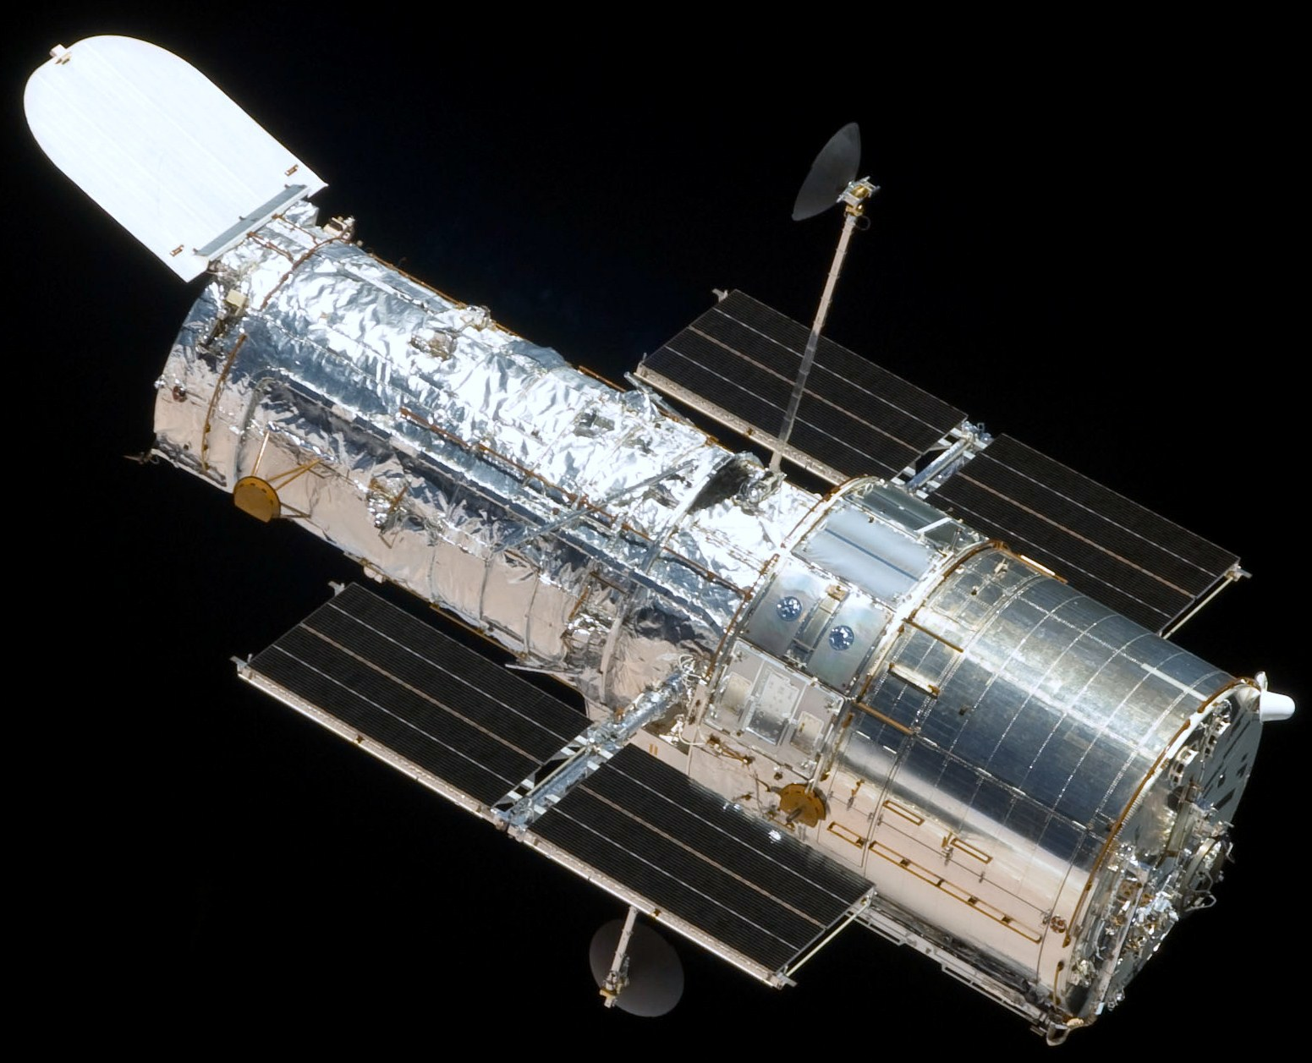
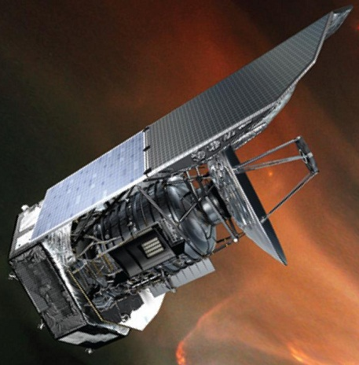
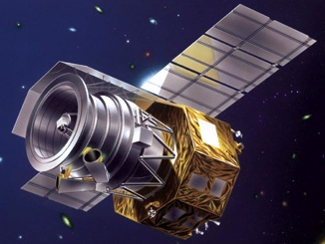
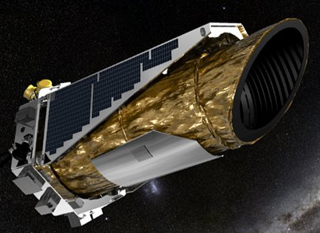
Part I.
Space telescopes observations of Uranus & Neptune
Sparse number of space telescope observations of ice giant satellite systems over the past 25 years.
Limited number of:
→ UV observations
→ Spatially-resolved images
→ High S/N spectra spanning UV-VIS-NIR
→ Follow up observations
HST
Spitzer
JAXA AKARI
Kepler (K2)
Herschel

Slide 9
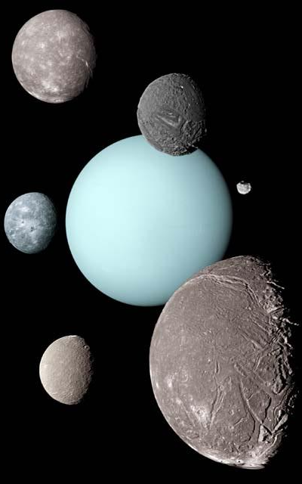
Part II.
Uranian satellite system
13 ring moons:
Cordelia, Ophelia,
Bianca, Cressida,
Desdemona, Juliet,
Portia, Rosalind, Cupid,
Belinda, Perdita, Puck, Mab
Miranda
Titania
Puck
5 “classical” moons:
Miranda, Ariel Umbriel
Titania, and Oberon
Oberon
Umbriel
9 irregular satellites:
Francisco, Caliban Stephano,
Trinculo, Sycorax, Margaret,
Prospero, Setebos, and Ferdinand
Ariel

Slide 10
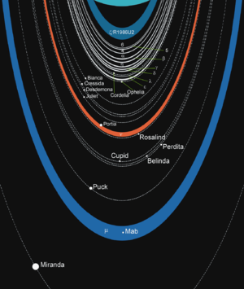
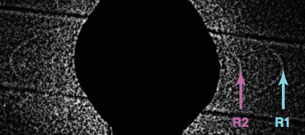
Part II.
Ring moons observed by HST
Discovery of two dusty rings and Cupid and Mab using the High Resolution Channel of HST’s Advanced Camera for Surveys (pixel scale 0.025”)
(Showalter and Lissauer, 2006)

Slide 11
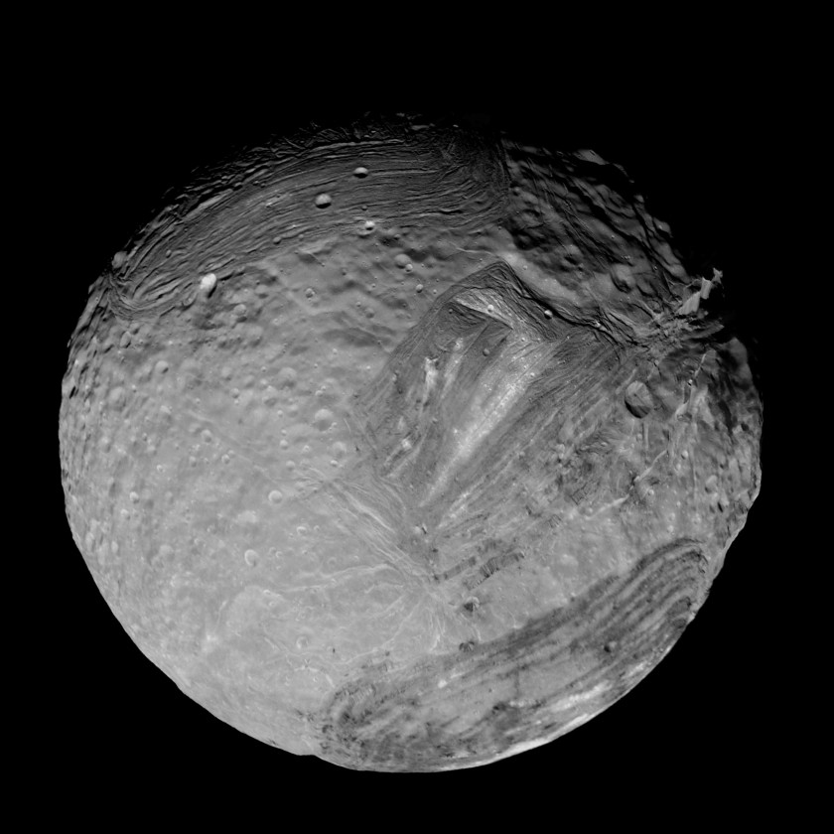
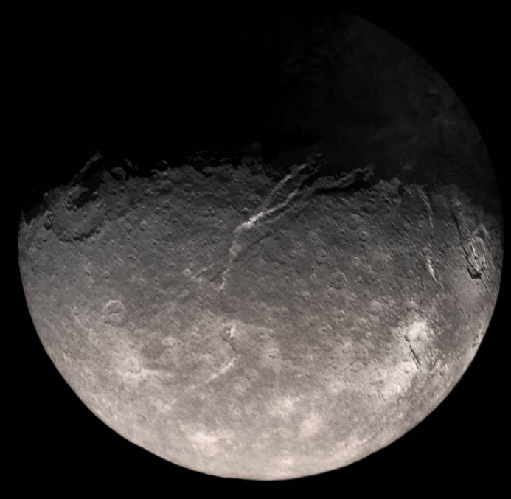
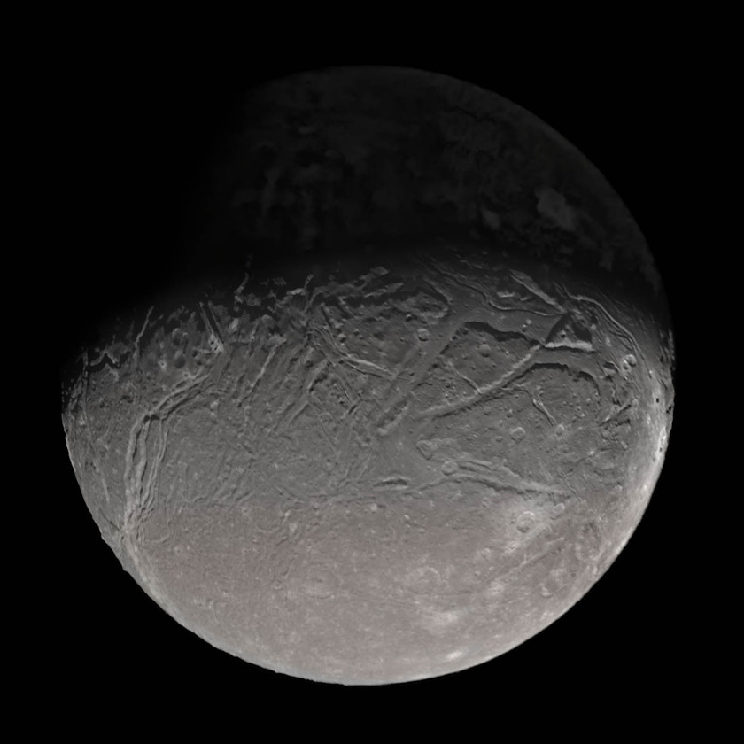
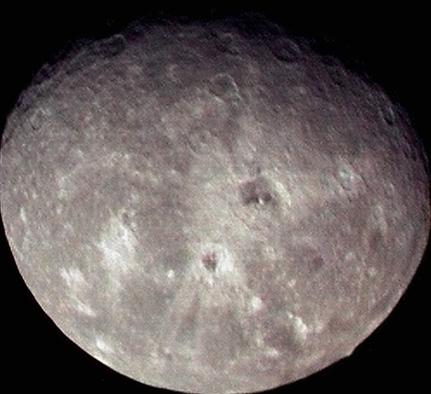
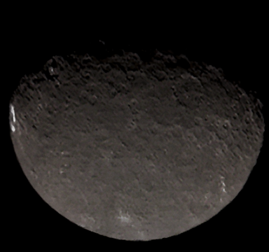
Miranda
Orbital radius: 129,900 km
Period: 1.41 days
Radius: 236 km
Titania
Part II.
Orbital radius: 436,300 km
Period: 8.71 days
Radius: 789 km
Ariel
Orbital radius: 190,900 km
Period: 2.52 days
Radius: 579 km
Oberon
Umbriel
Orbital radius: 583,500 km
Period: 13.46 days
Radius: 762 km
Orbital radius: 266,000 km
Period: 4.14 days
Radius: 585 km
Notes:
Mid-sized, tidally-locked moons.
Surface compositions dominated by intimately mixed H2O ice and dark material, along with segregated and pure CO2 ice.

Slide 12
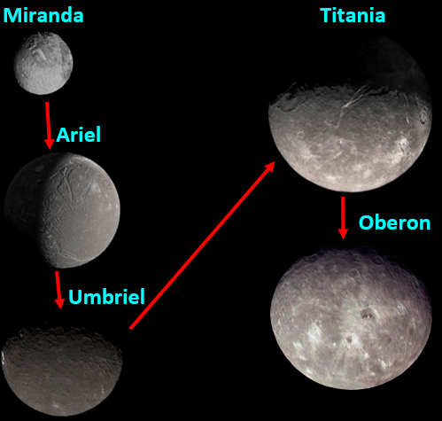
Part II.
Background: Surface Compositions
Surfaces dominated by H₂O ice mixed with dark material (e.g. Cruikshank et al. 1980)
Red material overprinting base composition, primarily on leading hemispheres of outer moons (e.g. Buratti and Mosher, 1991)
CO₂ ice detected, primarily on the trailing hemispheres of inner moons (except Miranda) (Grundy et al. 2006; Cartwright et al. 2015)
Tidally-locked objects commonly display hemispherical asymmetries in composition

Slide 13

Hemispherical Asymmetries in composition: Evidence for system-wide alteration processes
Trailing Hemisphere
(long. 181 – 360°)
Leading Hemisphere
(long. 1 – 180°)
90°
45°
CO₂ ice
present
Stronger H₂O ice
Bands, increased reddening
Ariel
0°
Charged particle
bombardment
Micrometeorite
impacts
-45°
Grundy et al. (2003, 2006)
Cartwright et al. (2015)
Cartwright et al. (2018)
-90°

Slide 14
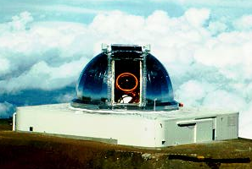
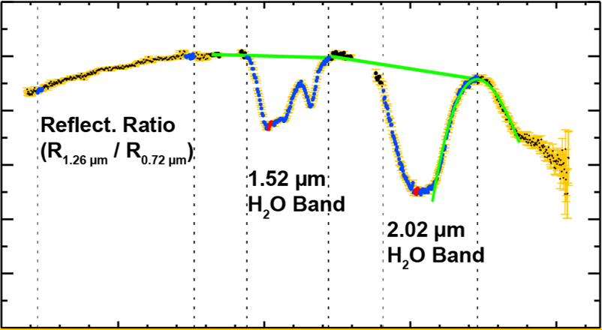
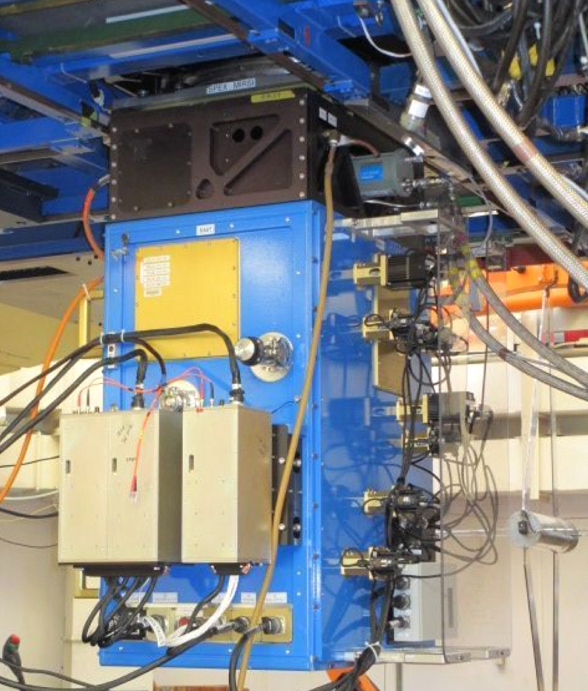
Part II.
IRTF/SpeX Observations
New NIR reflectance spectra IRTF/SpeX (~1.0 – 2.5 µm)
SpeX: Moderate resolution spectrograph with sufficient resolving power (λ/Δλ) for H₂O and CO₂ ice bands
1.0
Normalized Reflectance
0.6
0.2
1.0
1.5
2.0
2.5
Wavelength (µm)

Slide 15
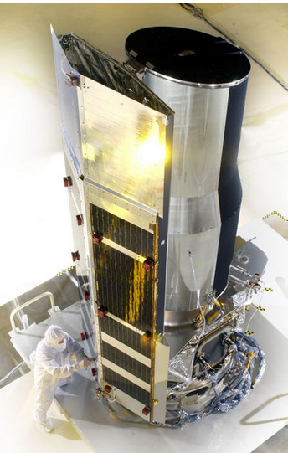
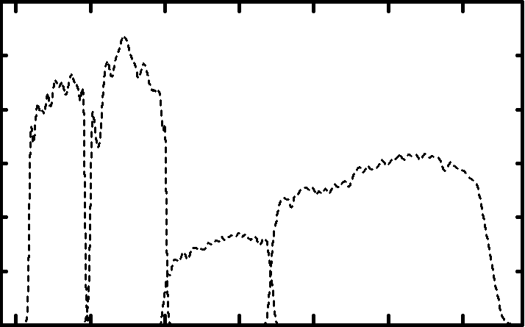
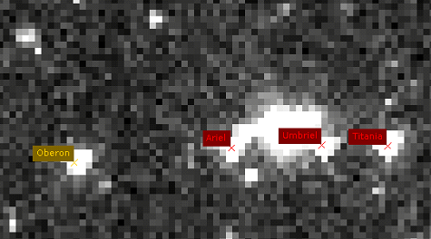
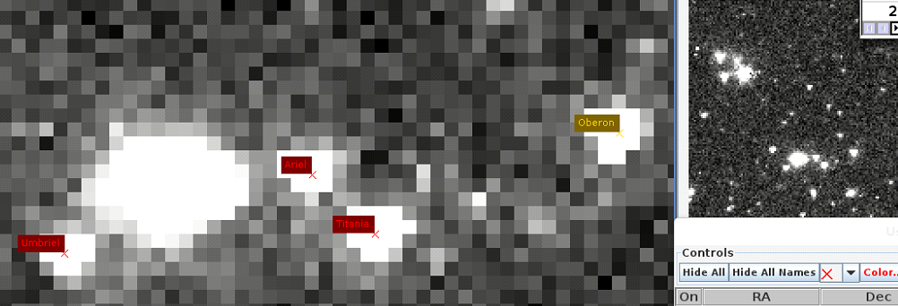
Part II.
Spitzer/IRAC Observations
4 channels centered near 3.6, 4.5, 5.8, 8.0 µm
Imaged leading/trailing hemispheres of classical Uranian satellites (Program 71, 2003-2005)
Performed aperture photometry, extracted fluxes, calculated geometric albedos
Ch.1 Oberon leading
Ch.1 Oberon trailing
Oberon
Oberon
Ariel
Titania
Ariel
Ch.1
Ch.2
Ch.3
Ch.4
Titania
3.6 µm
Umbriel
4.5 µm
5.8 µm
8.0 µm
Umbriel
3.0
6.0
9.0
Wavelength (µm)

Slide 16
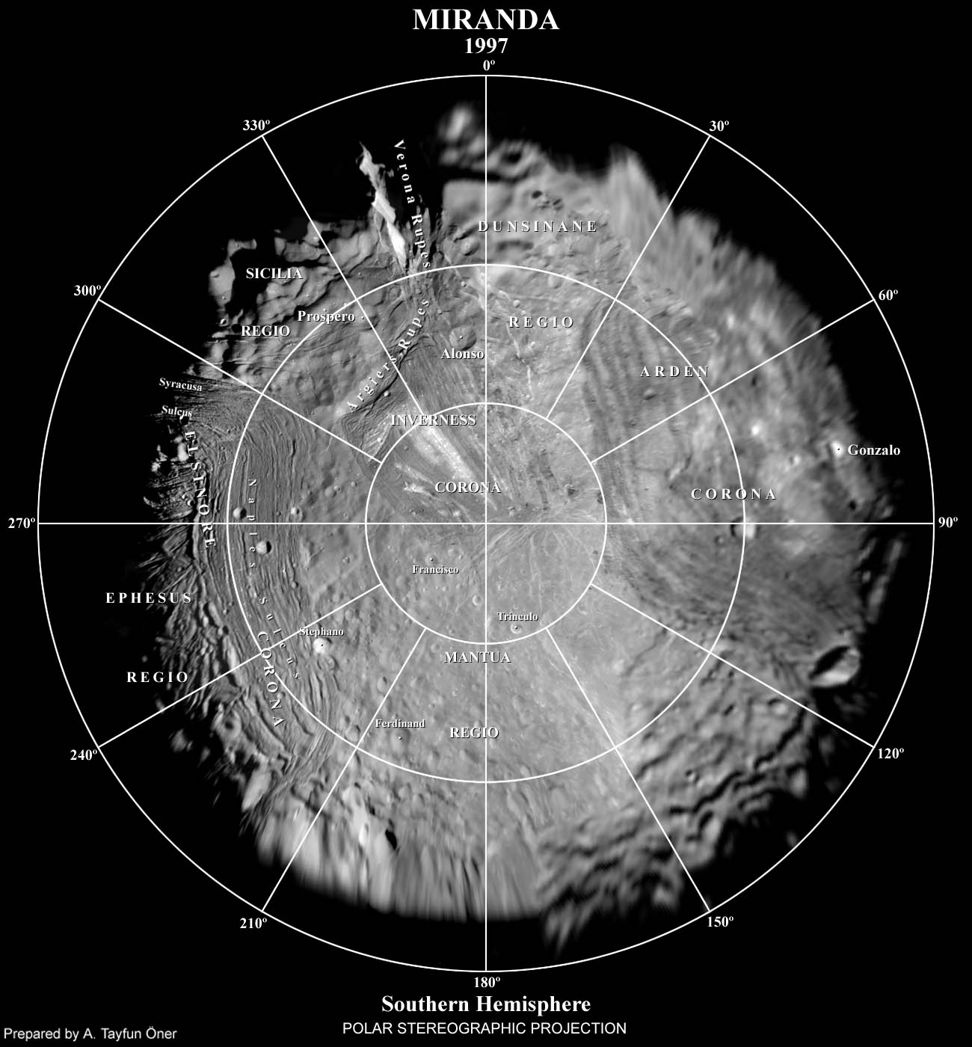
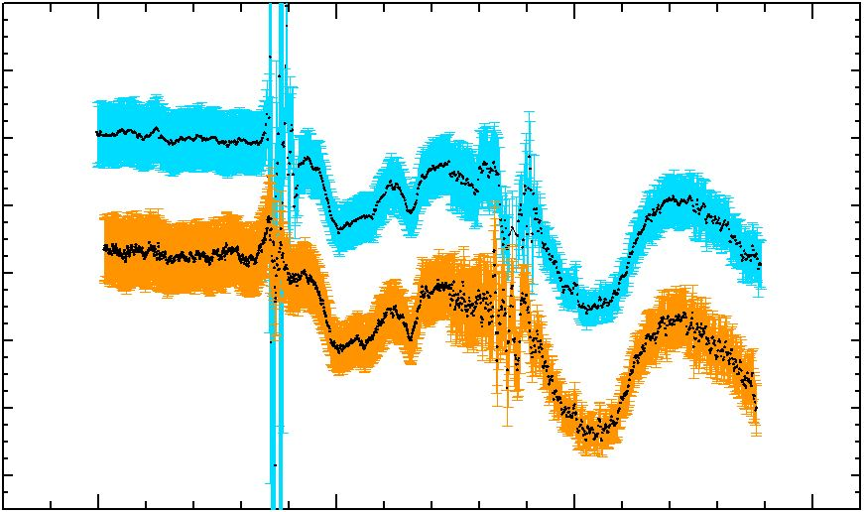
Part II.
Miranda
Trailing
Leading
SpeX
Leading
1.0
Trailing
Normalized Reflectance
0.5
0.0
1.0
1.5
2.0
2.5
Wavelength (µm)

Slide 17
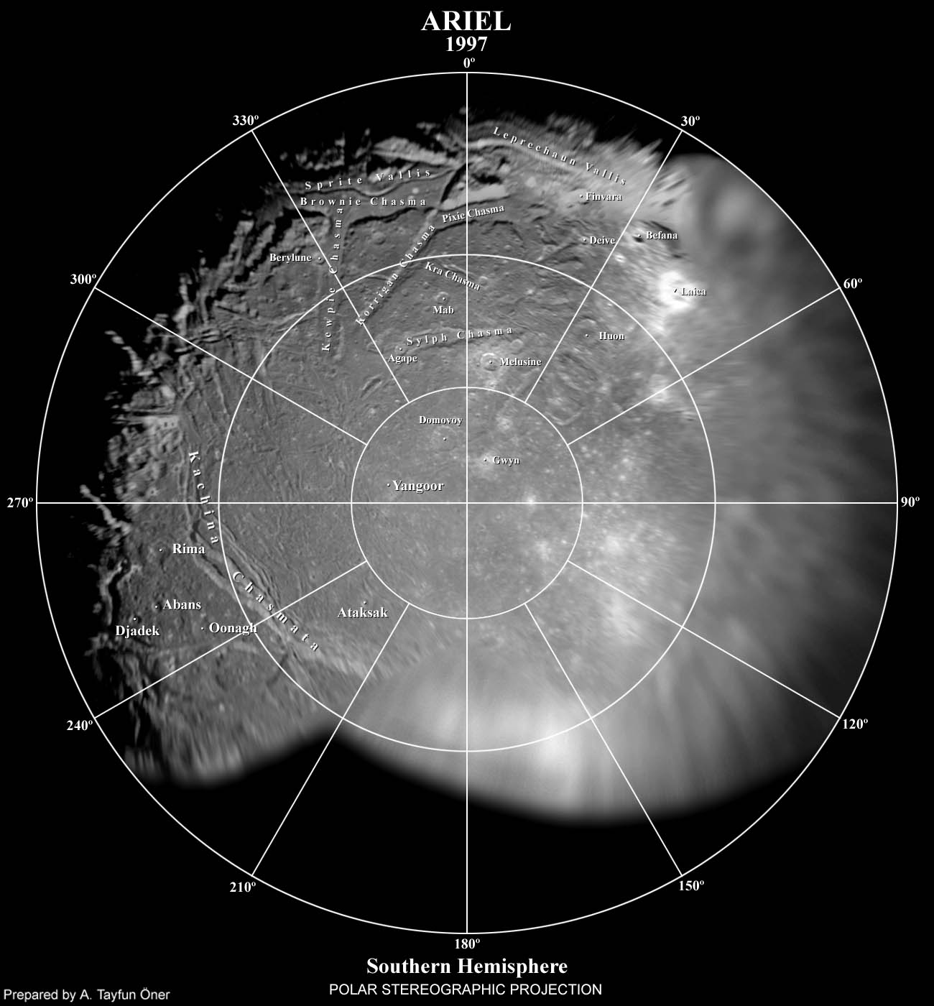
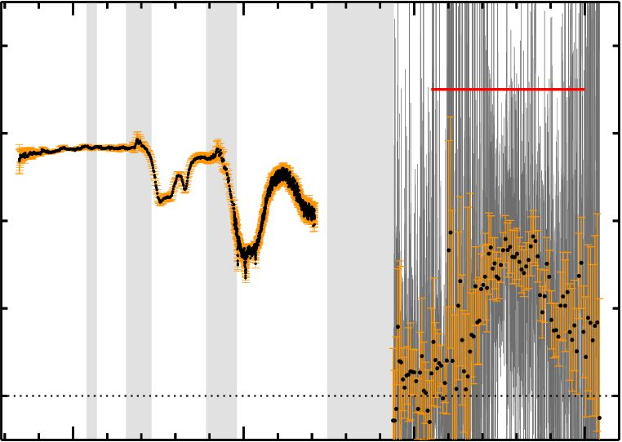
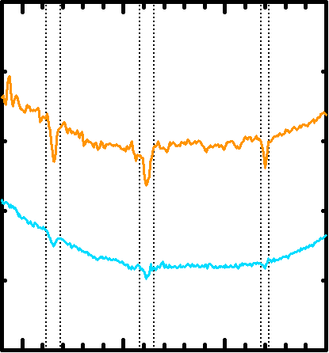
Part II.
Ariel
Trailing
Leading
0.8
SpeX
IRAC:
0.188 ± 0.04
0.4
0.0
Geometric Albedo
0.8
SpeX
IRAC:
0.232 ± 0.05
0.4
CO₂ ice bands
0.0
Ariel, Trailing
1.0
2.0
3.0
4.0
Wavelength (µm)

Slide 18
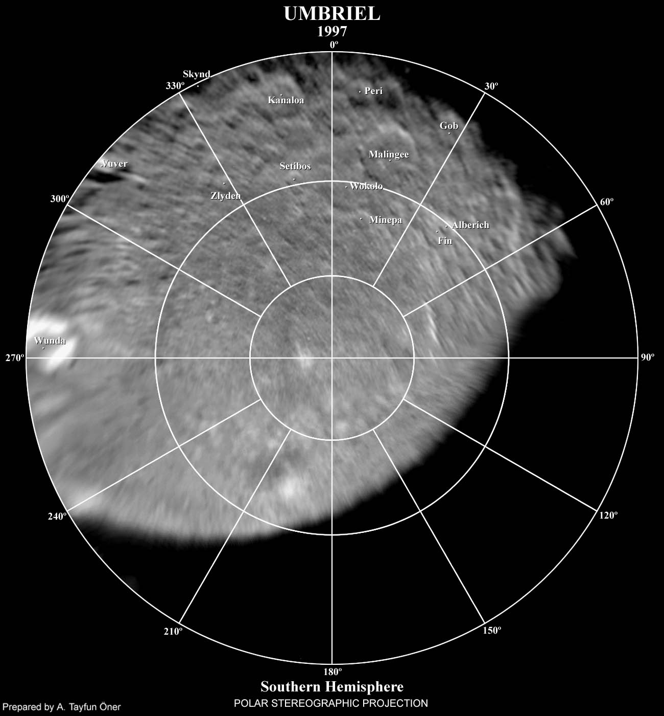
Part II.
Umbriel
Trailing
Leading
0.4
SpeX
IRAC:
0.153 ± 0.06
0.2
0.0
Geometric Albedo
0.4
IRAC:
SpeX
0.158 ± 0.02
0.2
0.0
1.0
2.0
3.0
4.0
Wavelength (µm)

Slide 19
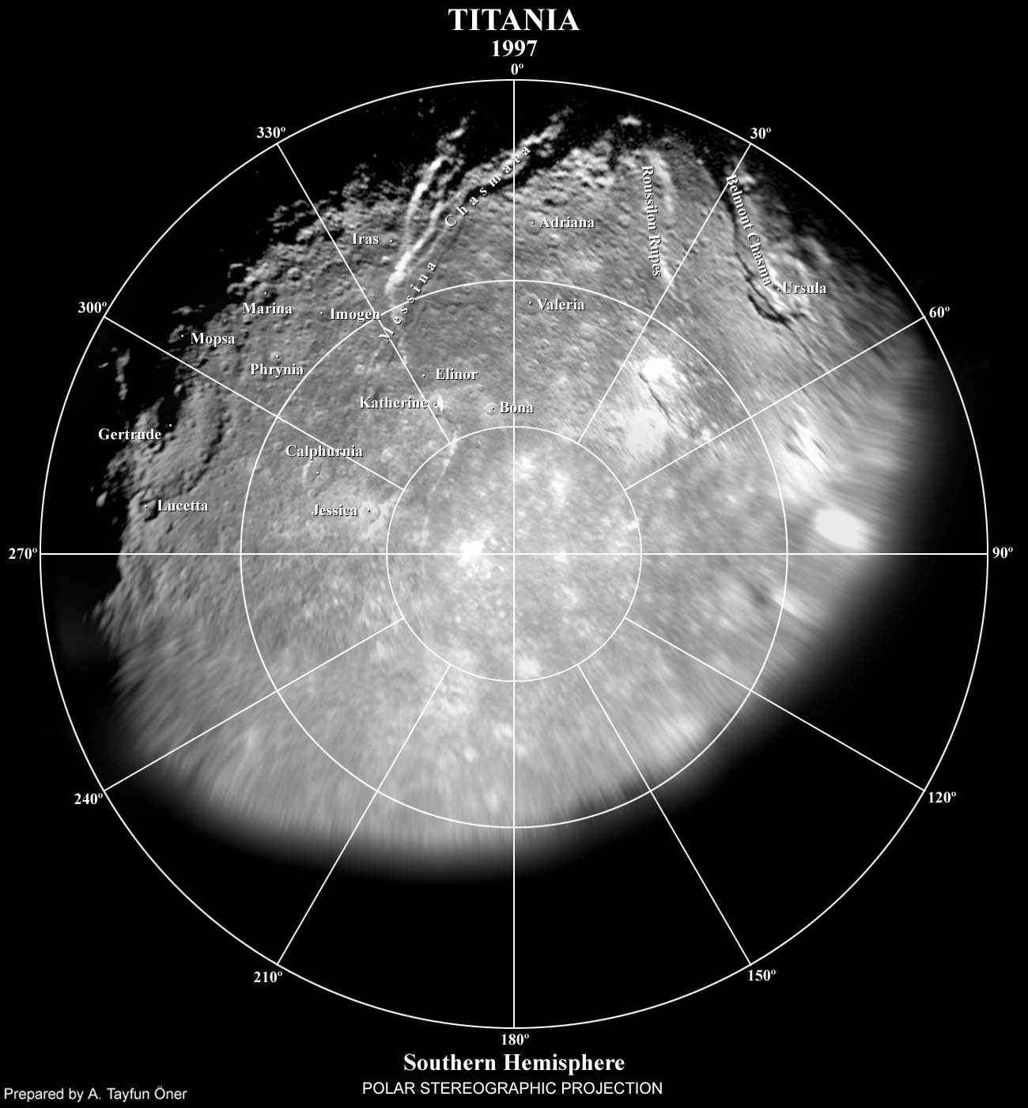
Part II.
Titania
Trailing
Leading
SpeX
IRAC:
0.4
0.160 ± 0.02
0.2
0.0
Geometric Albedo
SpeX
IRAC:
0.4
0.160 ± 0.03
0.2
0.0
1.0
2.0
3.0
4.0
Wavelength (µm)

Slide 20
Part II.
Oberon
Trailing
Leading
0.4
SpeX
IRAC:
0.167 ± 0.02
0.2
0.0
Geometric Albedo
0.4
SpeX
IRAC:
0.168 ± 0.01
0.2
0.0
1.0
2.0
3.0
4.0
Wavelength (µm)

Slide 21
Part II.
Mean H₂O Band Areas
2σ error bars
Ariel
1.2
Umbriel
Titania
Oberon
H₂O Band Area Ratios
1.0
Miranda
1.52 µm H₂O band areas
2.02 µm H₂O band areas
0.8
200
400
600
Distance from Uranus (x1000 km)
Mean leading/trailing H₂O band ratios indicate that H₂O bands stronger on leading hemispheres, except possibly for Miranda
(Cartwright et al., 2015, 2018)

Slide 22
Part II.
Mean Reflectance Ratios
Redder outer moons
No difference
between leading and trailing hemispheres of Ariel and Umbriel
Clear difference between leading and trailing hemispheres of Titania and Oberon
Mean Reflectance Ratios
1.2
Titania
Oberon
1.1
Umbriel
Mean Reflect. Ratios
Ariel
1.0
Leading
Trailing
2σ error bars
200
400
600
Distance from Uranus (x1000 km)

Slide 23
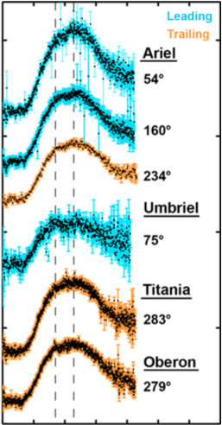
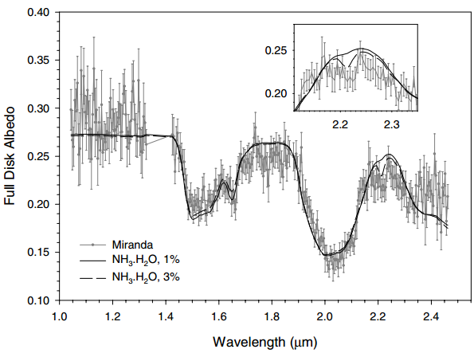
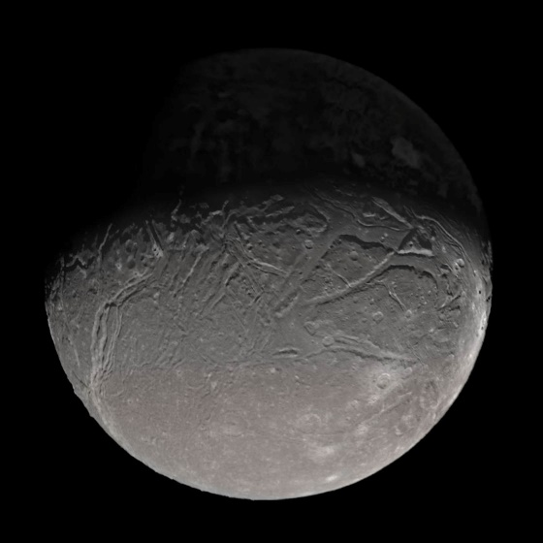
Part II.
Evidence for NH₃-Hydrates?
0.4
Miranda
Miranda
2.0
0.3
Full Disk Albedo
1.5
Flow Bands
0.2
Normalized Reflectance
Ariel
1.0
0.1
Medial groove
1.6
2.0
2.4
Wavelength (µm)
Bauer et al. (2002)
0.5
NH₃-hydrates evidence of recent geologic activity?
0.0
Cartwright et al. (2018)
2.0
2.3
2.6
Wavelength (µm)

Slide 24
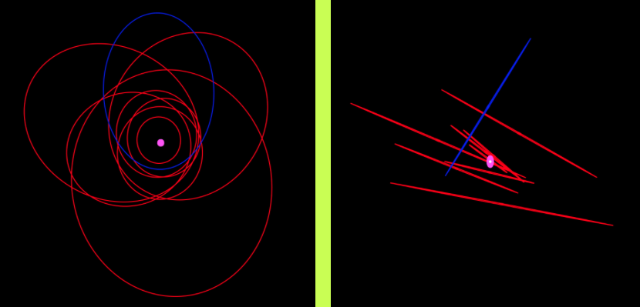
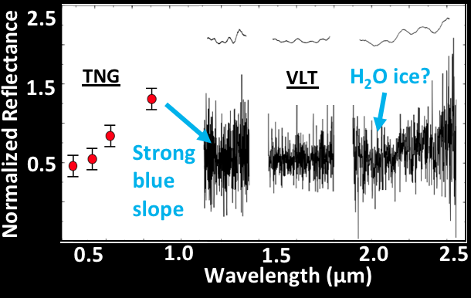
Part II.
Uranian irregular satellites
Margaret
Caliban Group
Romon et al. (2001)
Sycorax Group
Orbital parameters of the irregular satellites suggest two different dynamical groups dominated by Caliban and Sycorax (Grav et al. 2003)

Slide 25
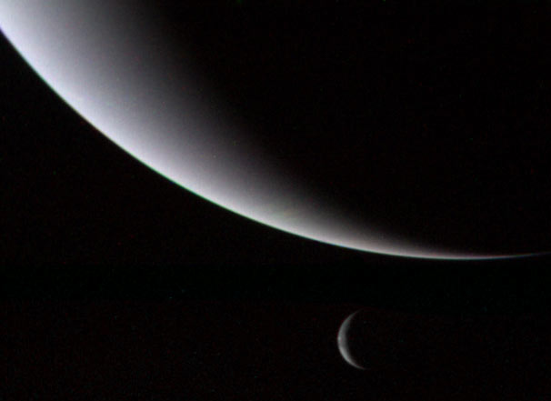
Part III.
Neptunian satellite system
7 regular moons:
Naiad, Thalassa,
Despina, Galatea,
Larissa, S2004 / N1,
Proteus
7 irregular satellites:
Triton, Nereid,
Halimede, Sao,
Laomedeia, Psamathe,
Neso
Voyager 2 approaches
Neptune
Triton

Slide 26
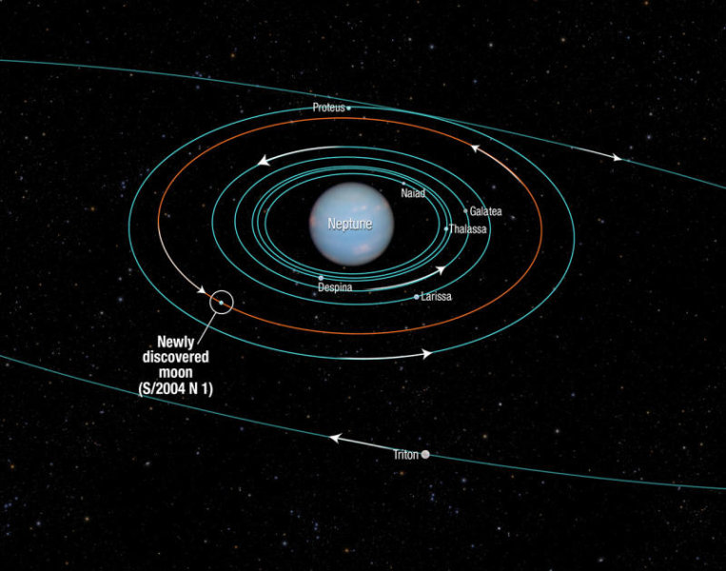
Part III.
Neptunian satellite system

Slide 27
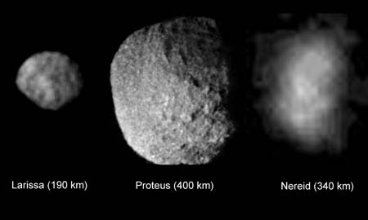
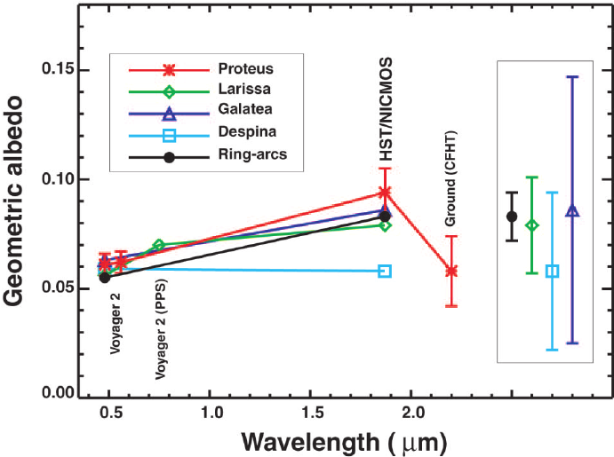

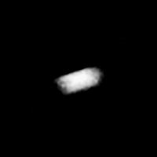

Part III.
Regular satellites of Neptune
Larissa (190 km)
Proteus (400 km)
Dumas et al. (2002)
Naiad
(66 km)
Galatea
(176 km)
Despina
(150 km)

Slide 28



Part III.
Triton: Geologic map and spectrum
Cantaloupe Terrain
Cryovolcanic Plains?
Holler et al. (2016)
Diameter: ~2700 km
Density: 2.1 g cm⁻³
Surface Temp: 38 K
Ridges
South Polar
Terrain

Slide 29



Part III.
Seasonal changes on Triton
Second densest satellite atmosphere supported by N₂-rich Geysers
Cloud activity detected by Voyager 2

Slide 30


Part III.
Irregular Neptunian Satellites
Triton: a ~3.54 x10⁵ km, e ~0.00002
Nereid: a ~5.51 x10⁶ km, e ~0.751
Other 5 irregular satellites considered “normal.”
Nereid
Triton
Nereid
(340 km)
Brown et al. (1998)

Slide 31
Part IV.
Observing icy moons with LUVOIR
Ideal facility for exploring icy satellites at UV wavelengths
VIS/NIR wavelength coverage ideal for monitoring changes in NIR H₂O ice bands and spectral slope
Imaging capabilities will provide spatially-resolved data of previously unobserved northern hemispheres
Long lifespan of LUVOIR will provide opportunities for repeat observations to monitor seasonal changes

Slide 32

Part IV.
UV observations with LUMOS
Roush et al. (1998)
UV imaging spectroscopy with LUMOS (France et al. 2017)
G300M grating: R > 30,000 across NUV (0.2 – 0.4 μm)
Imaging over 1.3 x 1.6 arcmin FoV, with 0.008” angular resolution
High R, high S/N, spatially-resolved UV observations of:
→ All five Uranian moons
→ Triton, Nereid, and Proteus
Titania
0.6
HST/FOS: Ariel
OH?
Oberon
0.4
Geometric Albedo
0.2
0.0
0.2
0.35
0.5
Wavelength (µm)
Miranda
Uranus
Ariel
Angular diameters ~0.01 to 0.13”
Umbriel

Slide 33

Part IV.
VIS/NIR imaging with HDI
VIS and NIR imaging with HDI
Grisms and narrow-band filters
provide low res. spectroscopy suitable for characterizing H₂O ice bands
Low sensitivity regions of array
allow for high dynamic range
near bright giant planets – Ideal for imaging rings and ring moons
Model of Pluto observed by LUVOIR/HDI (angular diameter ~0.11”) (Postman et al., 2016)
Imaging of Uranus, rings, and all five classical moons in one frame
Image Neptune, rings, and Triton in one frame

Slide 34


Part IV.
Monitoring seasonal changes
Investigate temporal changes
In Uranus and Neptune systems
Characterize changes in albedo and spectral slope variations
Investigate regional cryovolcanism on Triton and possibly Ariel?

Slide 35
Summary
Uranus and Neptune different could represent important analogs for ice- and water-rich exoplanets
Uranian and Neptunian satellite systems relatively unexplored
Northern hemispheres unobservable during Voyager 2 flybys
UV observations are needed
Investigation of seasonal changes require repeat observations
LUVOIR would provide spatially-resolved images over a wide wavelength range

Slide 36


Acknowledgments
Funding Support
NASA Earth and Space Science Fellowship Grant NNX14AP16H
Solar System Observing Grant 16-SSO16_2-0070
Research Support
IRTF staff and support astronomers
Will Grundy and Andy Rivkin for access to archived IRTF/SpeX datasets
References and Image Credit
Bolcar et al. 2017, WP
Grundy et al. 2006, Icarus 184
ESA/AOES Medialab
Brown et al. 1998,
Holler et al. 2016,,
Giant Planet Satellites Page (Sheppard)
Buratti and Mosher 1991, Icarus 90
Karkoschka 2001,
IRTF/SpeX: http://irtfweb.ifa.hawaii.edu
Butler et al. 2004,
Kipping et al. 2014,
JAXA/ISAS
Cartwright et al. 2015, Icarus 257
Postman et al. 2016, HDI overview
NASA/Ames Research Center/Natalie Batalha/Wendy Stenzel
Cartwright et al. 2018, Icarus 314
Romon et al. 2001,
Dumas et al. 2002,
Roush et al. 1998, LPSC 30
NASA/ESA/STScI/Feild
France et al. 2017, LUMOS WP
Showalter and Lissauer 2006,
NASA/JPL-Caltech/USGS
Pearson Education, Inc. (2011)
Gourgeot et al. 2014, A&A 562
Stryk and Stooke, 2008
Grav et al. 2003,
SST/Caltech

Slide 37
Bonus / Backup Slides

Slide 38


Part III.
Distribution of volatiles on Triton
Holler et al. (2016)

Slide 39

Triton vs. Pluto

Slide 40

IRTF/SpeX Observations of the Uranian moons
60°N
Leading
Ariel
Trailing
Leading
Umbriel
Trailing
60°N
Leading
Miranda
Trailing
30°N
30°N
0°
Satellite Latitude (°)
0°
30°S
30°S
60°S
60°S
Satellite Latitude (°)
0°
90°
Titania
Leading
Oberon
Trailing
180°
270°
60°N
Leading
Trailing
30°N
Satellite Longitude (°)
0°
30°S
60°S
0°
90°
180°
270°
0°
90°
180°
270°
Satellite Longitude (°)
Blue circles – Grundy (2001 – 2006)
Green triangles – Rivkin (2000)
Red diamonds – Cartwright (2012 – 2017)
Purple Squares – Gourgeot (2012)

Slide 41
Band Area Measurements
Conducted band parameter analyses on 3 SpeX datasets:
Rivkin (2000), Grundy (2001-2006), Cartwright (2012-2013)
1.966 µm Band
2.070 µm Band
Leading
2.012 µm Band
1.0
0.6
Trailing
Geometric Albedo
1.95
2.00
2.05
2.10
0.2
Wavelength (µm)
Ariel
CO₂ Band Areas:
Ariel – 8 L, 8 T
Umbriel – 5 L, 6 T
Titania – 5 L, 8 T
Oberon – 6 L, 6 T
1.0
1.5
2.0
2.5
Wavelength (µm)

Slide 42
CO₂ Band Analysis
Mean CO₂ Band Areas
Telluric CO₂ bands
Mean Ariel spectrum with visibly apparent CO₂ ice bands
Ariel
Leading
0.002
Trailing
Umbriel
0.001
Titania
Numerical compositional models including H₂O ice, amorphous C, and CO₂ ice
CO₂ band areas (µm)
Oberon
0.000
2σ error bars
200
400
600
Distance from Uranus (x1000 km)
CO₂ abundance greatest on trailing hemisphere of Ariel, decreases with distance from Uranus
1.95
2.00
2.05
Wavelength (µm)
Possible minor amount of CO₂ on leading hemispheres

Slide 43
Extrapolating SpeX Models over IRAC Wavelengths
Mean Ariel spectrum
CO₂ Combination and overtone bands
1.966, 2.012, 2.070 µm
0.6
Best Fit
SpeX Model
70% H₂O ice
27% CO₂ ice
3% Amorphous C
(10 – 50 µm grains)
0.4
Geometric Albedo
0.2
1.0
1.5
2.0
2.5
Wavelength (µm)
CO₂ asymmetric stretch fundamental
~4.27 µm
0.6
0.4
Geometric Albedo
0.240
0.176
0.251
0.2
Best Fit SpeX Model
Ch. 1
Ch. 2
Ch. 3
1.0
2.0
3.0
4.0
5.0
6.0
Wavelength (µm)
Notes:
Low flux/albedos of Ch. 3 relative to Ch.2 unexpected for bodies with CO2 bands.

Slide 44
SpeX and IRAC Models
Best Fit IRAC Model
76% H₂O ice
4% CO₂ ice
20% Amorphous C
(1 – 2 µm grains)
0.6
0.4
Geometric Albedo
Best Fit
SpeX Model
70% H₂O ice
27% CO₂ ice
3% Amorphous C
(10 – 50 µm grains)
0.2
0.0
Ch. 1
Ch. 2
Ch. 3
IRAC and SpeX probing different compositional layers in the near-surfaces of these moons?
1.0
2.0
3.0
4.0
5.0
6.0
Wavelength (µm)
Disparity between extrapolated SpeX model albedos and measured IRAC albedos
IRAC models poor fits to SpeX spectra
1.5
2.0
2.5
Wavelength (µm)
Notes:
Focusing on 3 bands between 1.9 – 2.1 um (strongest CO2 bands over SpeX wavelengths)

