Slide 1
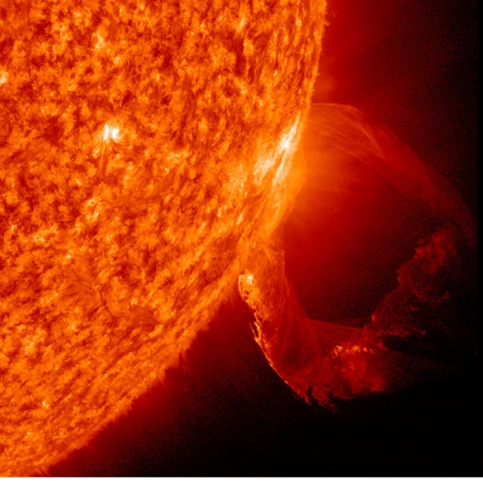
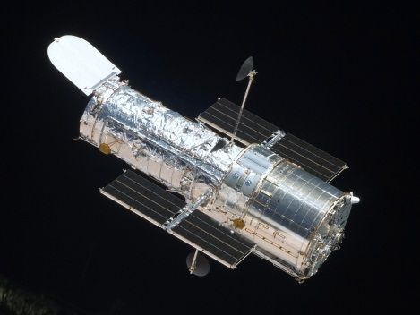
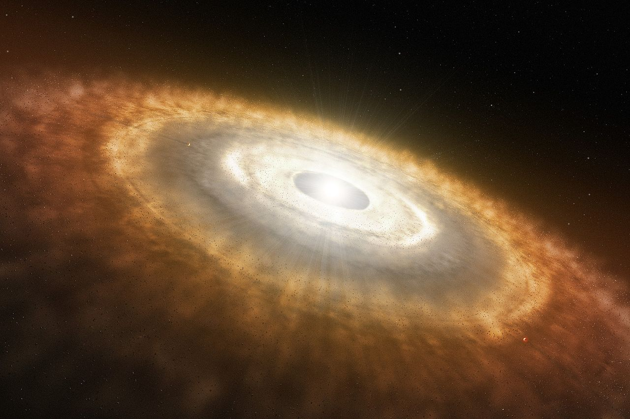
The Ultraviolet View of
Protoplanetary Disks:
from Hubble To LUVOIR
Kevin France
University of Colorado
LUVOIR Web Seminar – August 10th 2016

Slide 2
Outline
Circumstellar gas and dust are the building blocks of planetary systems. New molecular disk diagnostics probed using HST-COS
Structure, evolution, and composition of molecular gas at planet-forming radii (r < 10 AU) in protoplanetary environments
The future: Statistical surveys, absorption line spectroscopy towards nearly edge-on disks. Need more effective area, more field-of-view, more spectral resolution…
The CHISL spectrograph concept: high-resolution and multi-object FUV spectroscopy with LUVOIR

Slide 3
AU Mic
Fomalhaut
Kalas et al. 05
A. Roberge et al. 2009 – Astro2010 White Paper

Slide 4
AU Mic
Classical
T Tauri
Stars
Herbig Ae/Be Stars
Fomalhaut
Kalas et al. 05
A. Roberge et al. 2009 – Astro2010 White Paper

Slide 5
Dark cloud chemistry to disk chemistry
Planetary (core) formation
Disk dissipation
AU Mic
Classical
T Tauri
Stars
Classical
T Tauri
Stars
Evacuation of the Inner Disk
Fomalhaut
Kalas et al. 05
A. Roberge et al. 2009 – Astro2010
Notes:
Three fundamental things change during this first 10 Myr: 1) the dark cloud ISM chemistry (and therefore composition) is expected to change in response to UV radiation & grain coagulation, 2) terrestrial planet cores and Jovian planets form, 3) the disk dissipates. Most of what we know about phase comes from observations of circumstellar dust… lets take a look at a few examples….
[I have done some work on the UV radiation environment, and I will briefly discuss the chemical evolution, but I mostly want to focus on the properties of the disk during this dissipation]

Slide 6
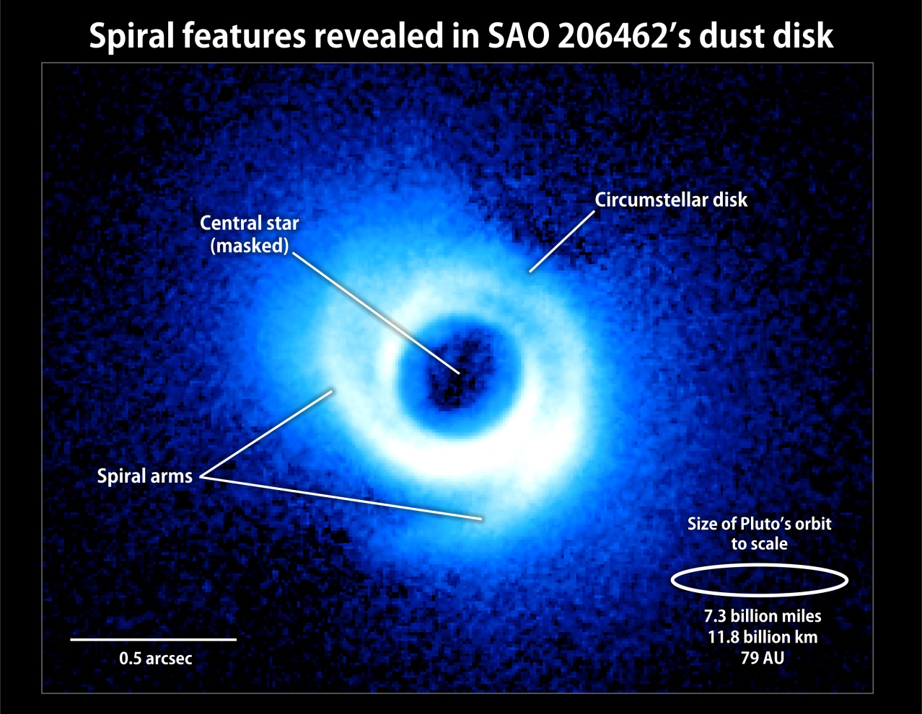
Gas & Dust Disk Structure and Evolution
Muto et al. 2012, Garufi et al. 2013
Subaru/HiCIAO VLT/NACO
Notes:
Observational evidence for dust evolution:
“Transitional” Phase where the inner disk develops a gap in its dust distribution but is not yet a “Debris” disk.

Slide 7
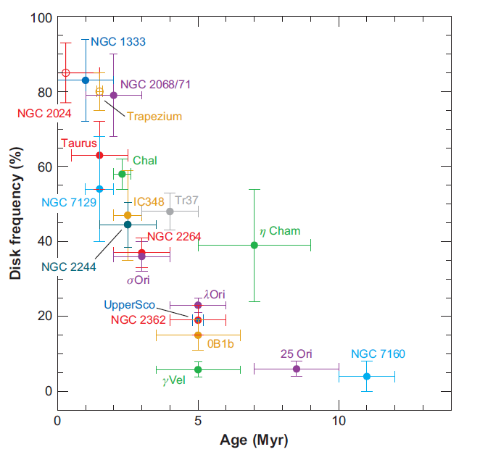
Dust at r < 10 AU
Dust disks are observed to clear between ~ 1 – 10 Myr
“Primordial” → “Debris”
Inner Disk
Dust Content
Hernandez+ 2007
Wyatt, ARAA, 2008
Notes:
Revealed by “missing” near/mid-IR flux relative to primordial disks. Mainly Spitzer & WISE photometry. Some spectroscopy with the Spitzer-IRS.
WHAT DRIVES THIS “TRANSITION”?

Slide 8
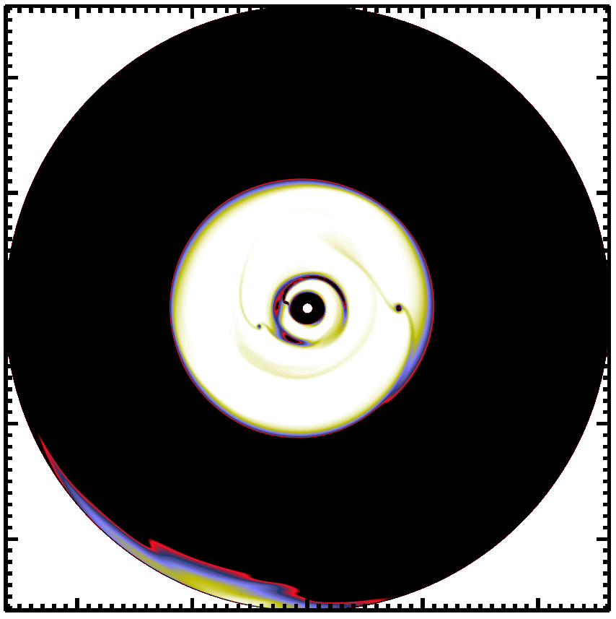
Dust and Gas at r < 10 AU
Dust disks clear between ~ 1 – 10 Myr
“Primordial” → “Transitional”?
→ “Debris”
(multi-)Planetary systems
(w/Magnetorotational instability?)
UV + X-ray photoevaporation
Dong & Dawson 2016
Dodson-Robinson & Salyk 2011
Chiang & Murray-Clay 2007
13 μm optical depth
(Dodson-Robinson & Salyk 2011)
Alexander et al. 2006
Alexander & Armitage 2007
Gorti & Hollenbach 2009
Alexander et al. PPVI 2014
Notes:
So, it seems that there is an intermediate phase. Do all disks go through this phase? Is it gradual or fast process? Does this dust picture hold for the gas?
Dong & Dawson ‘16: “we find systems of 3–6 giant planets are needed in order to open gaps with the observed depths and widths.”

Slide 9
Gas at r < 10 AU
Our definition of inner disk evolution is mostly driven by dust characteristics
Does dust content = gas content?
Notes:
The timescale and the details of gas dissipation are important because they forms the boundary conditions for 1) gas giants to acquire their atmospheres and for both Type 1 and Type 2 2) migration.

Slide 10
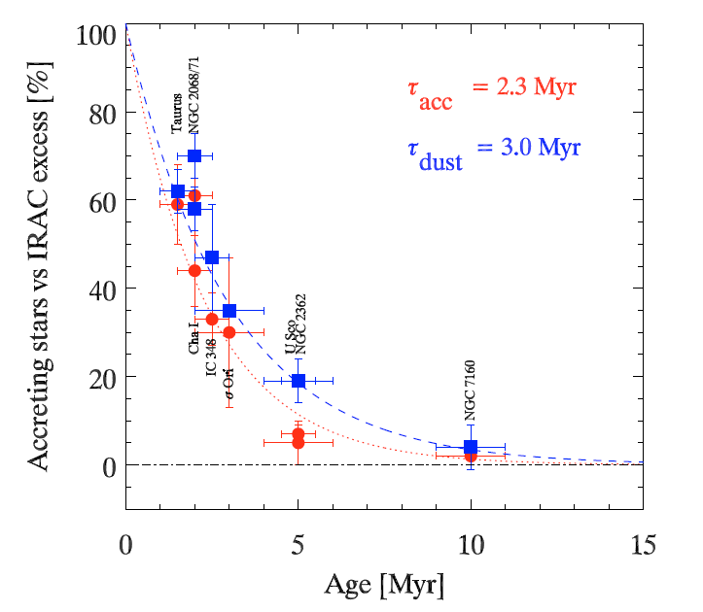
Indirect Gas Observations at r < 10 AU
Accretion indicates that gas depletes on comparable time-scales: ~ 2.5 Myr*
Fedele+, 2010
*τ_{dust} ~ 4 – 6 Myr @ 24 μm ; Ribas et al. (2014)
Notes:
Indirect evidence for gas disks. Note protoplanets could funnel gas in, so accretion rate may not be an accurate representation of the inner disk gas content and does not tell you about its distribution. So, these indirect disk observations are likely not the whole story.

Slide 11
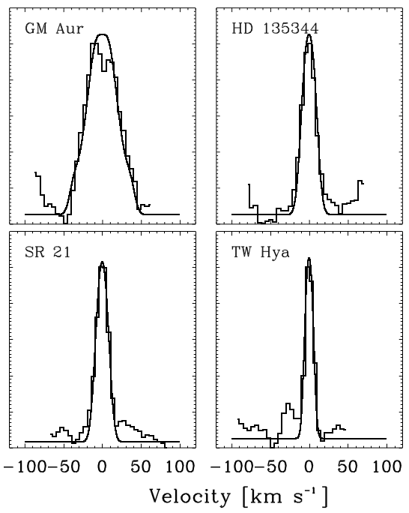
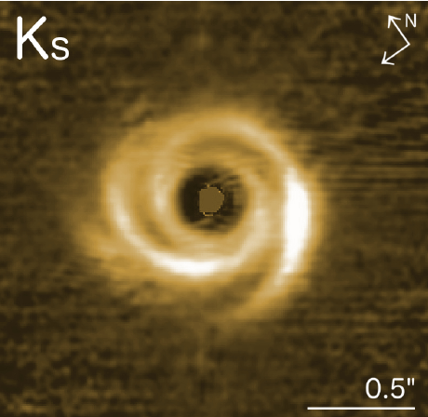
Molecules at r < 10 AU
1 AU ≤ 10 mas*
Salyk et al. 2009, Brown et al. 2013,
Banzatti & Pontoppidan 2015
Muto et al. 2012, Garufi et al. 2013
Subaru/HiCIAO VLT/NACO
Collisionally and photo-excited CO
disks remain at r ≤ 1 AU* in systems older than 5 Myr with evolved inner dust disks
*Spectral Line Widths
*Rotational Line Distribution -> T_{exc}
Notes:
We have known for about a decade now that molecular gas can persist in the gaps in these disks. Fundamental band CO most widely used tracer.
Assumption of Keplerian rotation – line widths can be mapped to a spatial location in the disk.
Cannot image spatial scales of a few AU, even with ALMA.

Slide 12
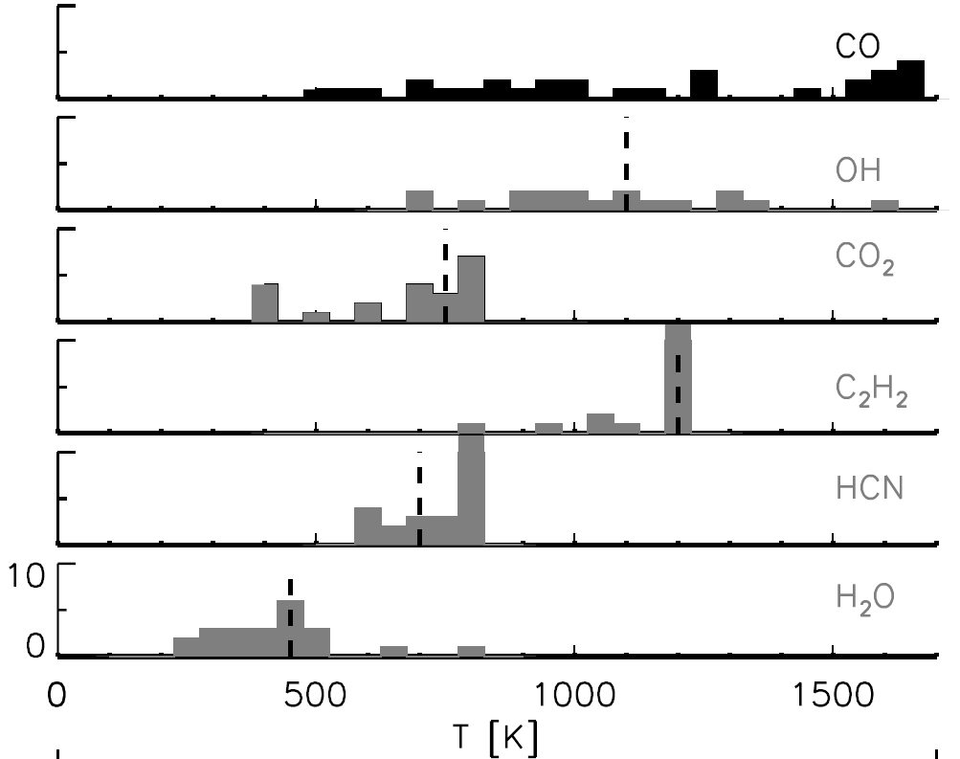
CO, H₂O & organics
Warm, Inner disk origin:
R_{mol} < 3 AU
T_{mol} ≈ 300 – 1200 K
Salyk et al. 2011b
also Pontoppidan et al. 2011
Mandell et al. 2012
Notes:
~a few dozen disks with simple organics and water: similar inner-disk origin.

Slide 13
CO, H₂O & organics
Warm, Inner disk origin:
R_{mol} < 3 AU
T_{mol} ≈ 300 – 1200 K
Most direct gas measurement have been trace species
Salyk et al. 2011b
also Pontoppidan et al. 2011
Mandell et al. 2012
Notes:
We would really like to be able to put these in context of the bulk gas species, molecular hydrogen.

Slide 14
Molecules at r < 10 AU
H₂ makes up > 99% of the molecular
gas mass in protoplanetary disks
Very hard from the ground
[may be done with JWST(?)]

Slide 15
Molecules at r < 10 AU
H₂ makes up > 99% of the molecular
gas mass in protoplanetary disks
Very hard from the ground
[may be done with JWST(?)]
“Space UV” ≡ 912 – 1700 Å
H₂ emission lines from warm
molecular disk surface
Molecular absorption lines from
deeper in the disk on
sightlines to accreting
protostar
Notes:
Note the emission and absorption diagnostics. We typically think of the IR or sub-mm as the place to study molecules, why is the UV a good place to look??

Slide 16
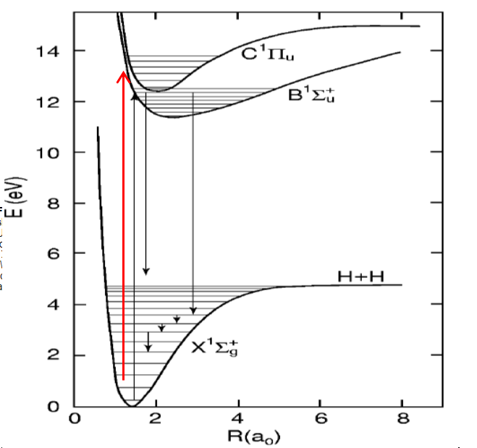
UV-H₂ and UV-CO
photoexcited H₂ & CO
The electronic band systems of H₂ have transition probabilities ~ 10¹⁵⁻¹⁸ times greater than near- and mid-IR rovibrational transitions
H₂
Notes:
Why study molecules in the FUV??

Slide 17
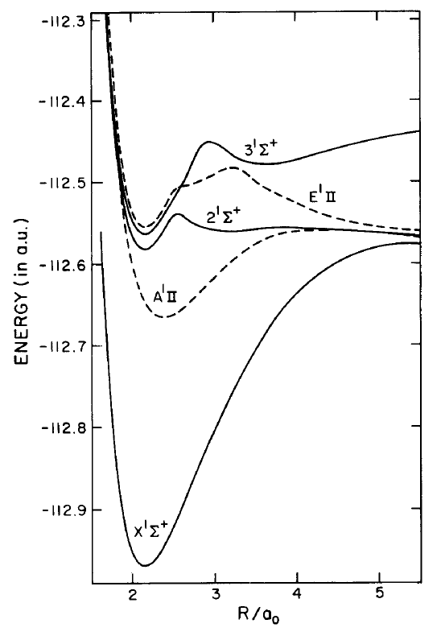
UV-H₂ and UV-CO
photoexcited H₂ & CO
The electronic band systems of H₂ have transition probabilities ~ 10¹⁵⁻¹⁸ times greater than near- and mid-IR rovibrational transitions
The CO A-X Band system in
the HST far-UV bandpass
H₂
Kirby & Cooper (1989)
Notes:
So, we wanted to take advantage of this capability to carry out a survey of molecular disks in the UV:

Slide 18
HST-Cosmic Origins Spectrograph
Protoplanetary Disk Program
Also starring:
Herve Abgrall, Richard Alexander
David Ardila, Alex Brown
Joanna Brown, Ted Bergin
Tom Bethell, Nuria Calvet
Eric Burgh, Suzan Edwards
Jim Green, Scott Gregory
Graham Harper, Lynne Hillenbrand
Laura Ingleby*, Chris Johns-Krull
Jeff Linsky, Christian Schneider
Evelyne Roueff, Jeff Valenti
Fred Walter, Hao Yang
Greg Herczeg – KIAA/Peking
Eric Schindhelm* – now SwRI
Matthew McJunkin* - CU
Keri Hoadley* - CU
Sample of ~50 young stars
(Class II and III protostars)
~80% with active accretion (CTTS)
~20% w/o accretion (WTTS)
(Ardila et al. 2013; France et al. 2012b)

Slide 19
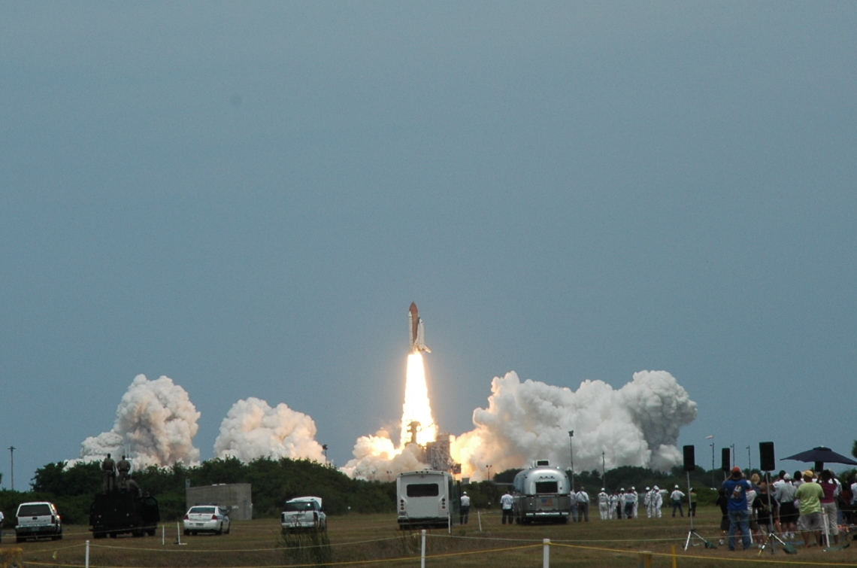
Cosmic Origins Spectrograph: 10 – 50 times sensitivity increase for medium-res (R ≈ 20,000) spectroscopy
STS-125 / Atlantis
Servicing Mission 4
COS Instrument and on-orbit performance: Green et al. (2012) & Osterman et al. (2011)
Notes:
The last big jump in UV spectroscopy prior to LUVOIR !!!
Big gains in sensitivity enable new science, but it is really the high-sensitivity AT medium spectral resolution that is really transformative because you not only get down to features you did not previously know existed, but then you can study their line profiles to open up a whole different level of quantitative analysis.

Slide 21
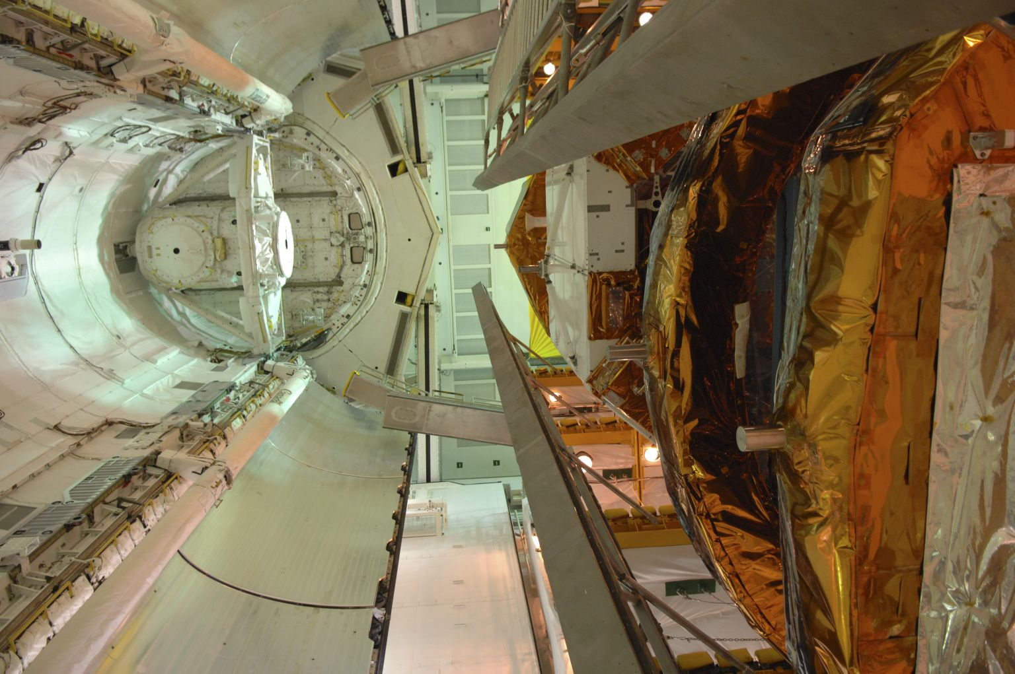

Slide 22
COS Instrument and on-orbit performance: Green et al. (2012) & Osterman et al. (2011)

Slide 23
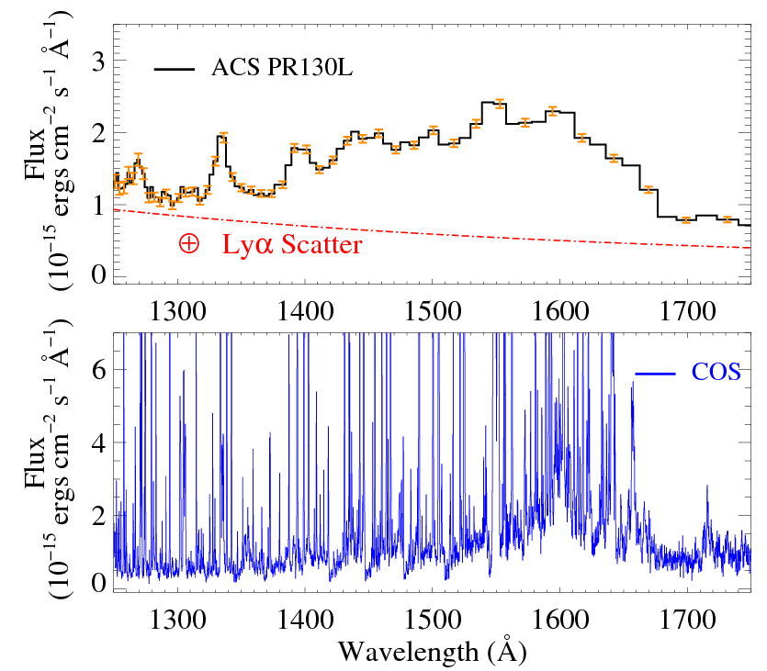
COS Disk Program
Typical (t < 10 Myr)
protoplanetary
disk, pre-COS
(France et al. 2012a; Green et al. 2012)

Slide 24
COS Disk Program
Typical (t < 10 Myr)
protoplanetary
disk, w/ COS
(France et al. 2012a; Green et al. 2012)

Slide 25
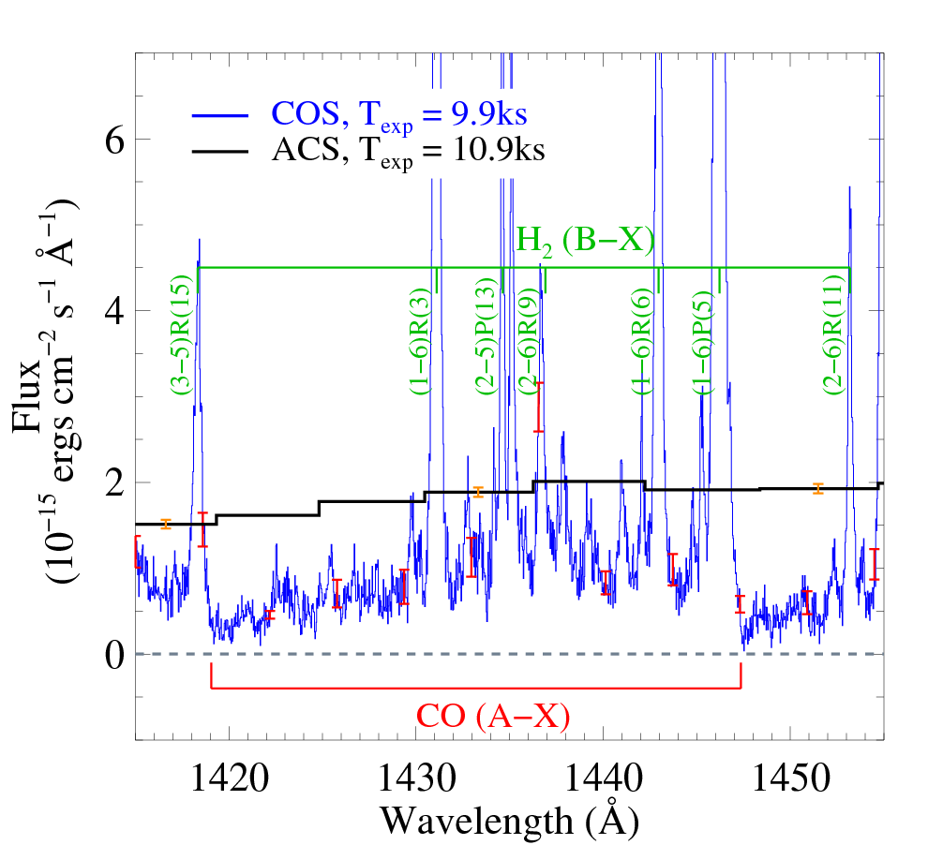
Molecules in Protoplanetary Disks: Ultraviolet Emission from the Inner Disk
Typical (t < 10 Myr)
protoplanetary
disk, w/ COS
Resolved H₂ and CO emission and absorption features from the disk
Notes:
So, this is really the story of the COS disks program, every gas-rich disk spectrum displayed of order 100 spectrally resolved H2 and CO emission and absorption features – and the vast majority of this emission/abs has a disk origin inside 10AU. It has really been a treasure trove of information. Just to show you a little more detail of the full UV spectrum from one of our objects…

Slide 26
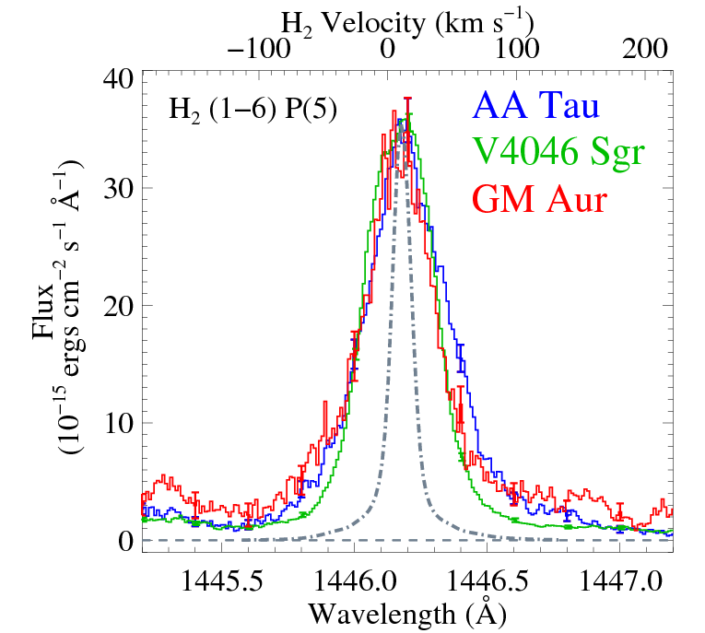
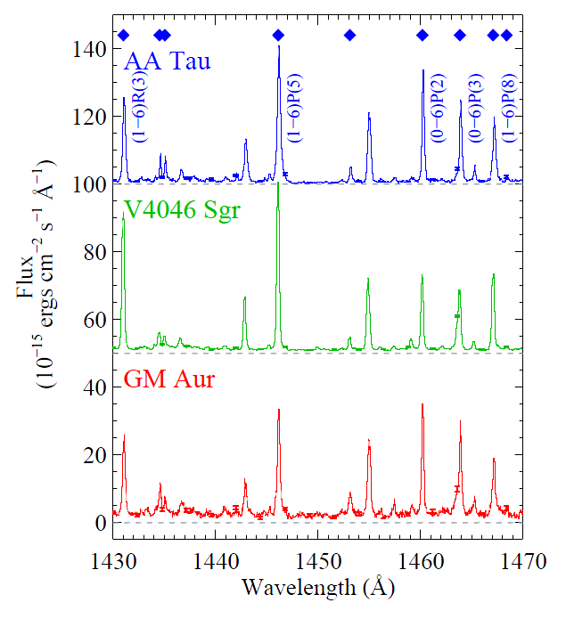
Molecules in Protoplanetary Disks: Ultraviolet Emission from the Inner Disk
H₂
H₂
COS Instrumental = 17 km s⁻¹
France et al. (2011a, 2012b)
Notes:
NOTE the importance of combining high-res and high-sensitivity

Slide 27
H₂ & CO
EMISSION SPECTRA
Lyα - pumped fluorescence
France et al. (2012b)

Slide 28
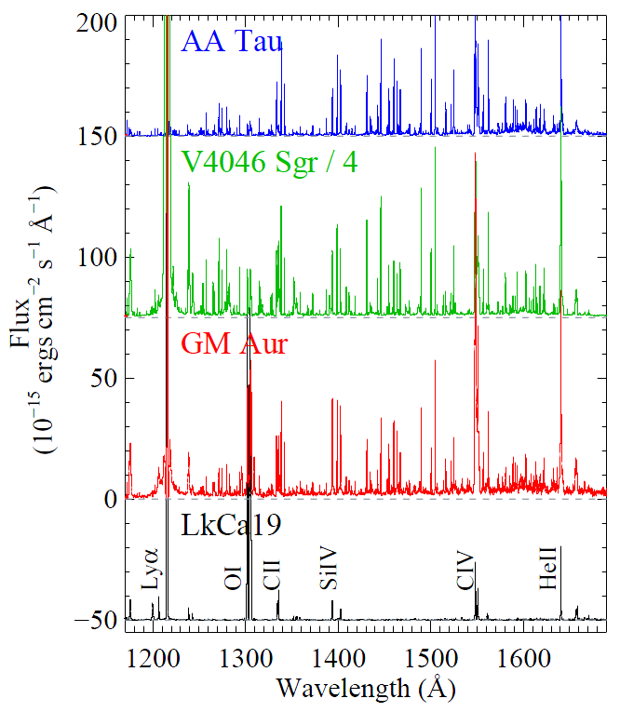
Molecules in Protoplanetary Disks: Ultraviolet Emission from the Inner Disk
H₂
Inner Disk Dust
Every actively accreting
star shows H₂ emission
excited by strong
Lyα illumination
(100% of CTTS,
0% of WTTS)
France et al. (2012b); also Ingleby et al. (2011a)
Notes:
Note the WTTS at the bottom. See the spectral richness has gone away.
At first cut, the molecular emission spectra appear to independent of dust characteristics/evolutionary state, so we performed a more detailed modeling analysis.

Slide 29
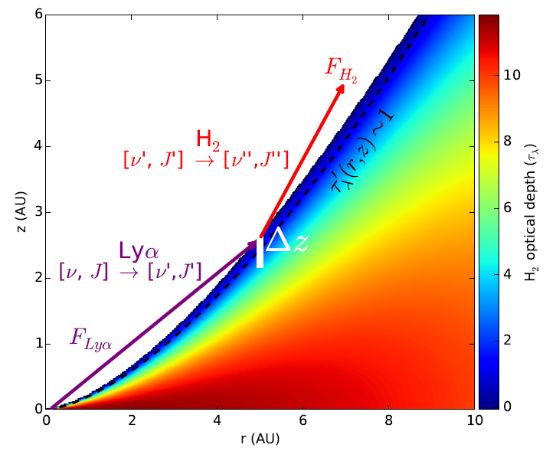
Molecular Structure in Protoplanetary Disks: Ultraviolet Emission from the Inner Disk
Photoexcitation and Radiative
Transfer Modeling
of Lyα Fluorescence
Hoadley, France et al. (2015)
Notes:
R/T & photo-excitation SPECTRAL SYNTHESIS modeling. Note that we confirm earlier work finding that the UV-H2 is a surface layer tracer

Slide 30
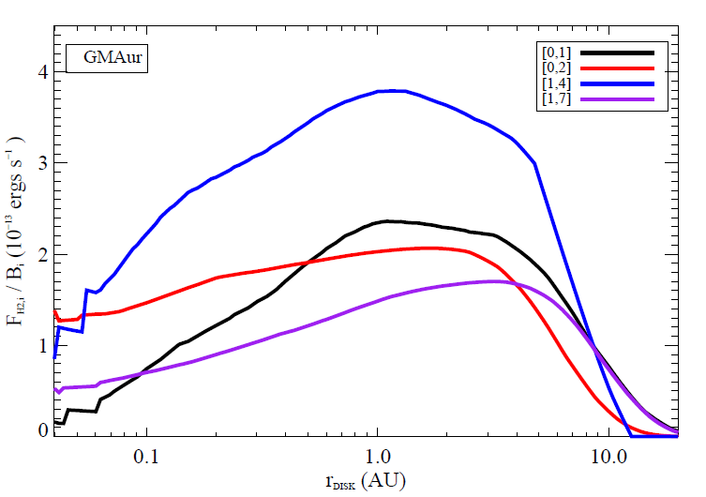
Molecular Structure in Protoplanetary Disks: Ultraviolet Emission from the Inner Disk
H₂
Simultaneously fit emission line flux and profiles from 12 H₂ lines
Flux
Flux
Velocity
(km/s)
Radius (AU)
Hoadley, France et al. (2015)
Notes:
We compare output of the spectral synthesis to line profiles from COS to recover the radial distribution of emission line flux.
R/T & photo-excitation SPECTRAL SYNTHESIS modeling

Slide 31
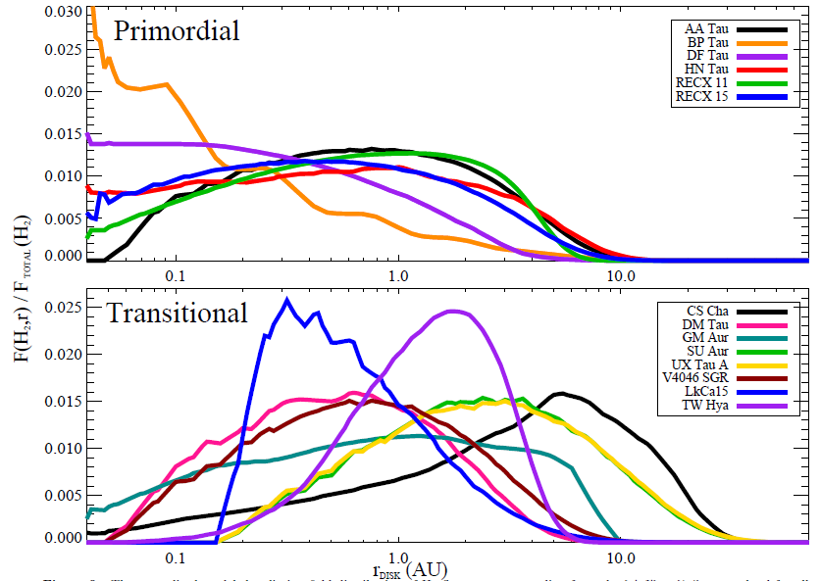
Molecular Structure in Protoplanetary Disks: Ultraviolet Emission from the Inner Disk
Flux
Radius (AU)
Hoadley, France et al. (2015)
Notes:
COMPARING PRIMORDIAL AND TRANSITIONAL FOR DISK EVOLUTION: You can see the primordial disks go in almost all the way to the inner allowable boundary, whereas the transitional sources are more peaked near 1 AU.
R_in increases by a factor of 4

Slide 32
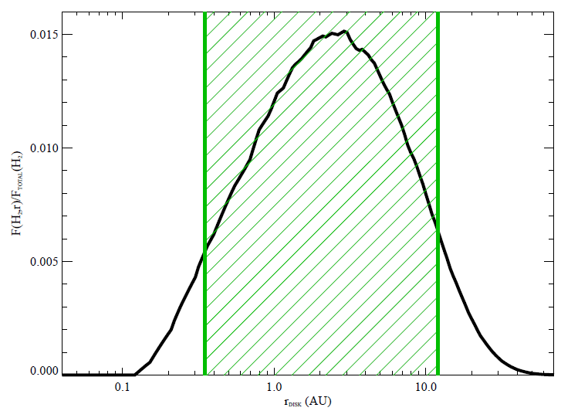
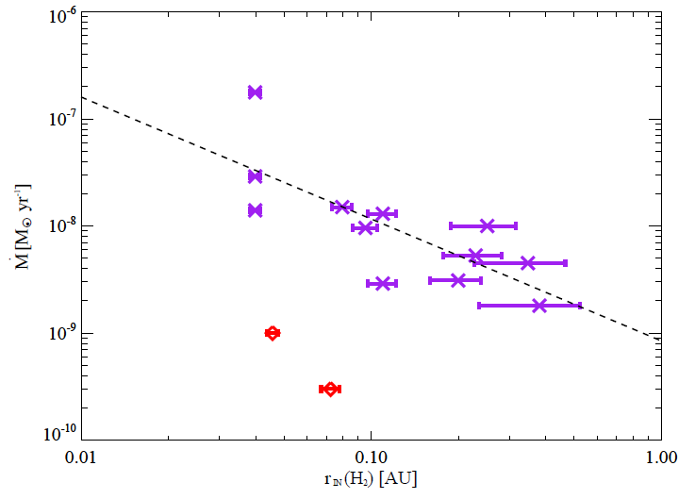
Molecular Structure in Protoplanetary Disks: Ultraviolet Emission from the Inner Disk
Flux
Radius (AU)
M_{acc}
r_{in} (H₂)
Hoadley, France et al. (2015)
Notes:
R_in and R_out BOTH move out with dust clearing. HERE is what we think that might mean :
1) R_in increases by a factor of 4 while M_dot decreases – suggests less material in the inner disk
2)
3)

Slide 33
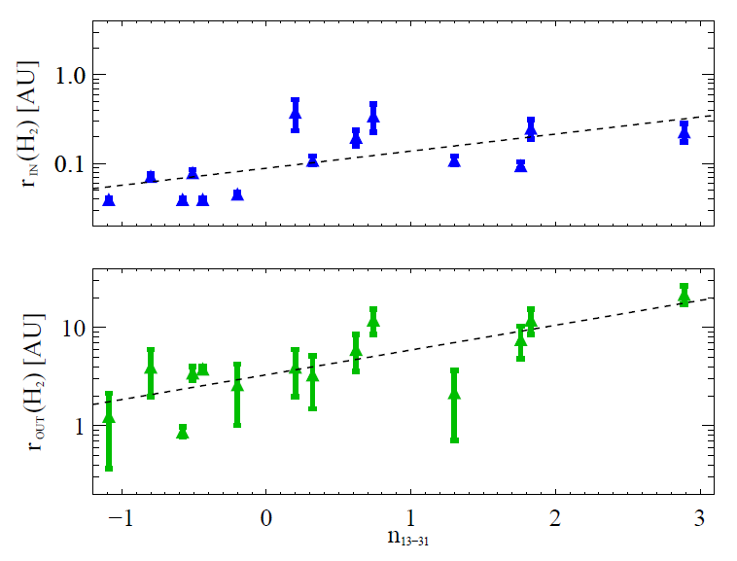
Molecular Structure in Protoplanetary Disks: Ultraviolet Emission from the Inner Disk
Flux
Radius (AU)
n₁₃₋₃₁ (dust clearing) →
Hoadley, France et al. (2015)
Notes:
R_in and R_out BOTH move out with dust clearing. HERE is what we think that might mean :
1) R_in increases by a factor of 4 while M_dot decreases – less material in the inner disk
2) R_outer increases, meaning LyA is penetrating farther out: suggests A) less geometric cross-section as seen by disk –or- B) less HI and H2 in the inner disk
3)

Slide 34
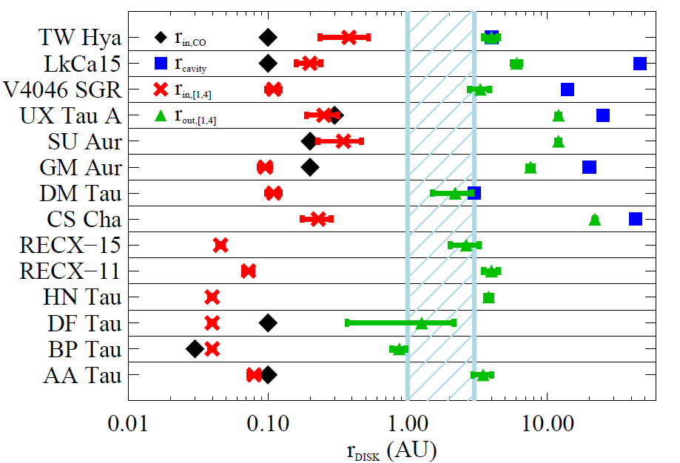
Molecular Structure in Protoplanetary Disks: Ultraviolet Emission from the Inner Disk
Radius (AU)
Hoadley, France et al. (2015)
Notes:
R_in and R_out BOTH move out with dust clearing. HERE is what we think that might mean :
1) R_in increases by a factor of 4 while M_dot decreases – less material in the inner disk
2) R_outer increases, meaning LyA is penetrating farther out: less HI and H2 in the inner disk
3) BUT(!) the r_out < r_cavity (seen in the top 8 rows), so it seems that the suggests molecular gas dispersal may lag the dust dispersal.

Slide 35
Molecular Structure in Protoplanetary Disks: Ultraviolet Emission from the Inner Disk
R_{in}(H₂) ↑ as M_{acc} ↓
R_{in}(H₂) ↑ as n₁₃₋₃₁ ↑
R_{out}(H₂) ↑ as R_{in}(H₂) ↑
R_{out}(H₂) < R_{cavity}(dust)
Gas clearing inner disk and/or geometric thinning
Lyα propagating to larger radii
Gas clearing lags dust clearing, possibly cleared by giant planets
Radius (AU)
Hoadley, France et al. (2015)
Notes:
SUMMARY of the findings from the radial distribution modeling:
R_in and R_out BOTH move out with dust clearing. HERE is what we think that might mean :
1) R_in increases by a factor of 4 while M_dot decreases – less material in the inner disk
2) R_outer increases, meaning LyA is penetrating farther out: less HI and H2 in the inner disk
3) BUT(!) the r_out < r_cavity, so it seems that the molecular gas dispersal may lag the dust dispersal.

Slide 36
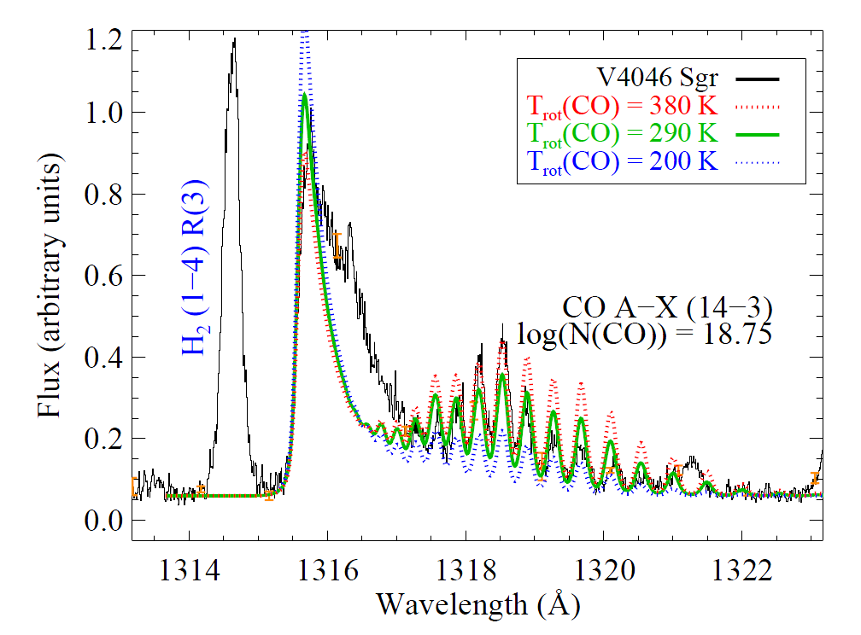
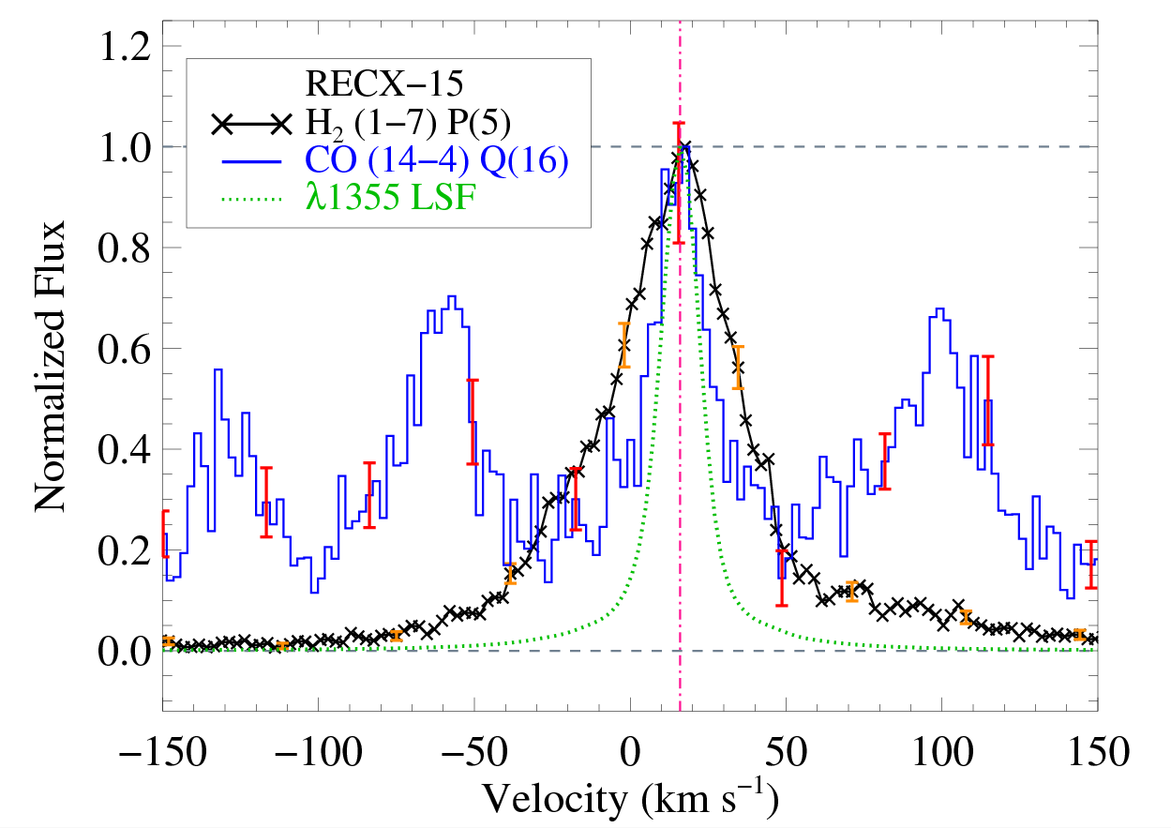
H₂ and CO emission in a single observation
Photoexcited CO observed in UV disk spectra for the first time
Thermal and kinematic evidence for separate populations
France et al. (2011b)
Schindhelm, France et al. (2012a)
Notes:
NOTE the line widths are narrower, the rotational temperatures are smaller than for fluorescent H2.

Slide 37
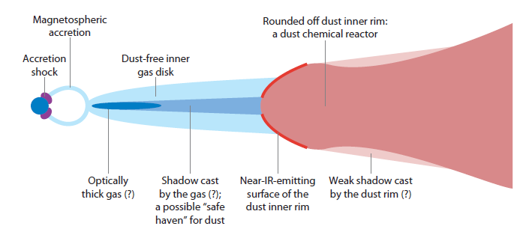
Molecular emission from the Inner Disk
Winds
500 K
IR-CO
Warm Molecules, CO
2500 K
Hot Molecules, H₂
1000 K
Cool Dust
Cool/Warm Molecules
Lyα
With or W/O Optically
Thick Dust
~0.05 AU
~0.1 ≤ r ≤ ~3 AU
~2 ≤ r ≤ ~10 AU
Dullemond & Monnier 2010
Notes:
R(H2) = 0.1 – 1.0 for primordial disks, extending to 5 – 10 AU for transitional disks

Slide 38
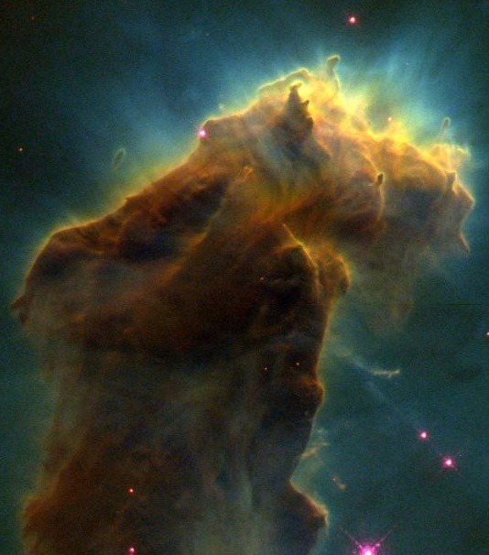
Molecular emission from the Inner Disk
Dullemond & Monnier 2010
(inspirational credit: G. Kriss, STScI)
Notes:
NOTE: “So, this is very informative for the spatial distribution of the gas, but what about the chemical abundances – another key initial condition for planet building??”

Slide 39
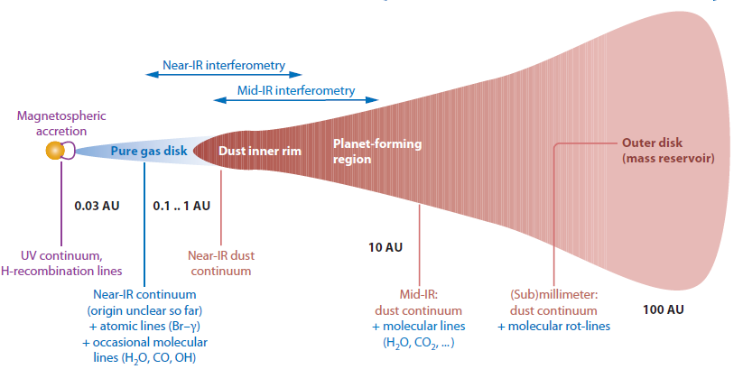
Composition of Protoplanetary Disks: H₂ and CO Absorption Spectroscopy
Direct line-of-sight absorption measurements could allow us to probe H₂ and CO in same, warm (~300 K) parcels of disk gas, set a better basis for molecular abundances and total
disk mass in these regions.
Notes:
So, in the last part of this section of the talk, I will tell you about some of the new work we have done to use absorption line spectroscopy to determine real CO abundance ratios.
NOTE: This is a technique whose viability we are proving on Hubble for special test cases, but this is an area where LUVOIR will be extremely powerful – I will discuss this in the second half of my talk.

Slide 40
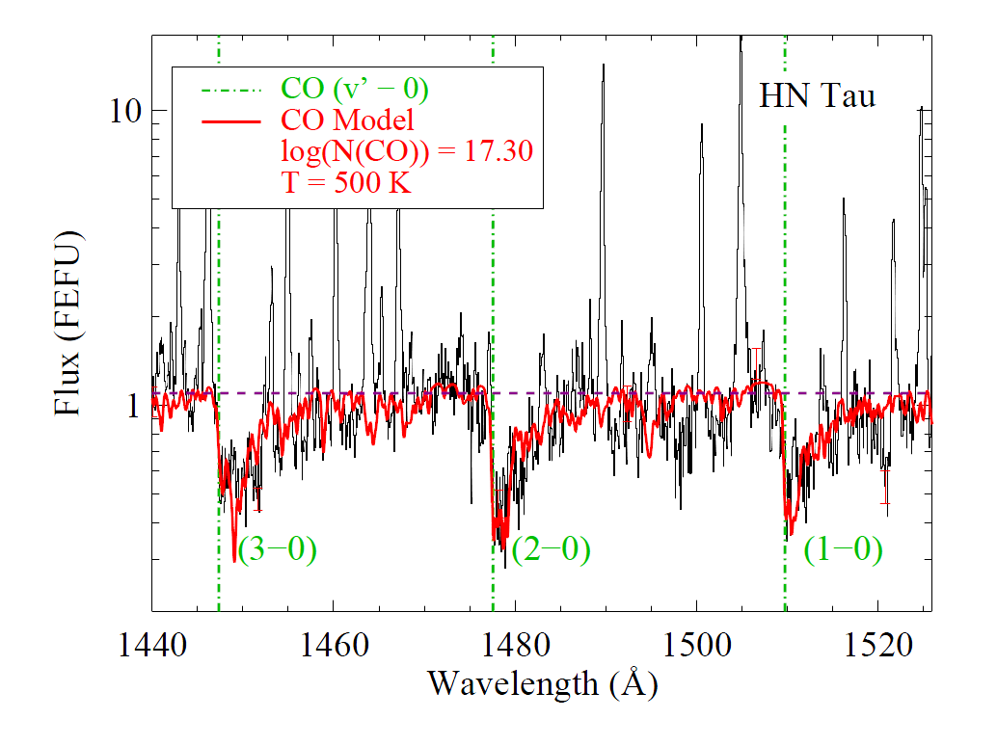
H₂ and CO Absorption Spectroscopy
Warm CO, 200 - 500K
France et al. (2011b, 2012a); McJunkin et al. (2013)
Warm CO and H₂ observed in UV spectra
of low-mass disk for the first time
Notes:
To get to the analogous (and we think co-spatial) H2 population, we have to work below the “traditional” HST wavelength cut-off: 1150Ang.

Slide 41
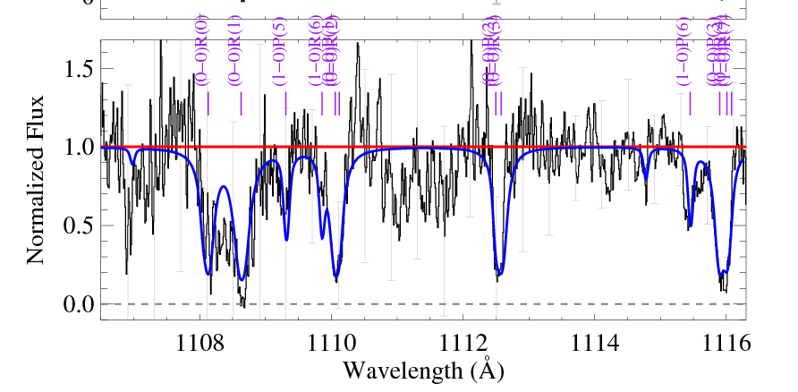
H₂ and CO Absorption Spectroscopy
Developed new HST spectroscopic mode for
medium-resolution
observations at
1070 ≤ λ ≤ 1130 Å
PI – S. Penton (GO 12505)
K. France
S. Osterman
Warm H₂ In Protoplanetary Systems (WH₂IPS)
Cycle 20 GO12876, France
France et al. (2014b)
Notes:
NOTE that this is with HST, not optimized for work below 1200 Ang. This is a strong driver for spectral coverage down to 1000 Ang.

Slide 42
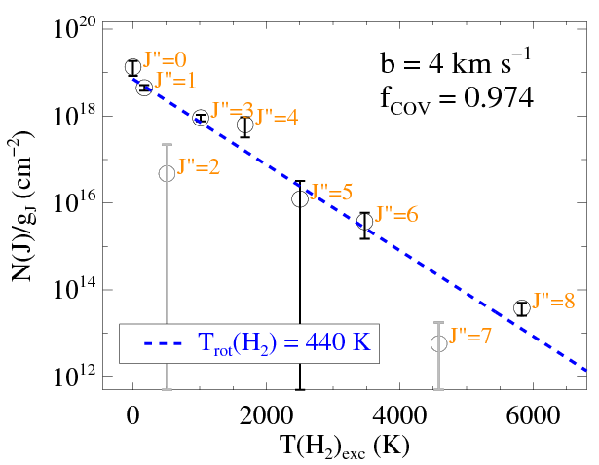
H₂ and CO Absorption Spectroscopy
Warm H₂, 400K
observed against FUV
continuum in T Tauri Stars
for the first time
Direct Abundances
N(CO)/N(H2) ~ 1.6 × 10⁻⁴
WH₂IPS
(Warm H₂ In Protoplanetary Systems)
France et al. (2014b)
Notes:
(models say that CO abundance should be indicator of changing photochemistry. Results by Ted Bergin’s group for TW Hya suggest that abundances have changed by more than an order of magnitude by 10 Myr. )
CO/H2 confirms expectation from dense cloud models. Significant chemical processing has not happened in the first 1-2 Myr.

Slide 43
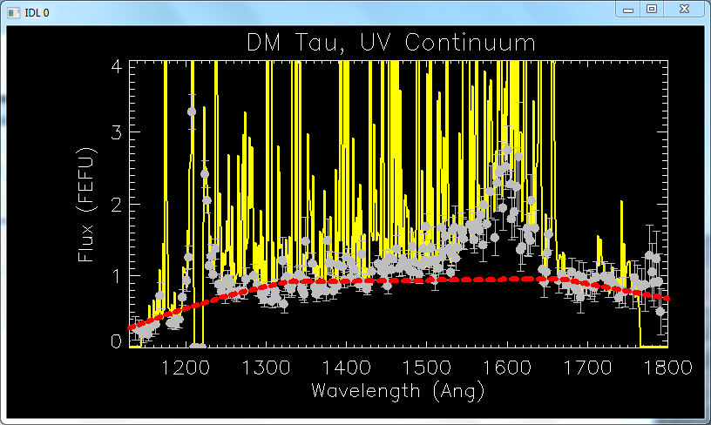
Composition of Protoplanetary Disks: Indirect Observations of H₂O at ~1 AU?
Additional ‘quasi-continuous’ emission feature quantified
France et al. (in prep)

Slide 44
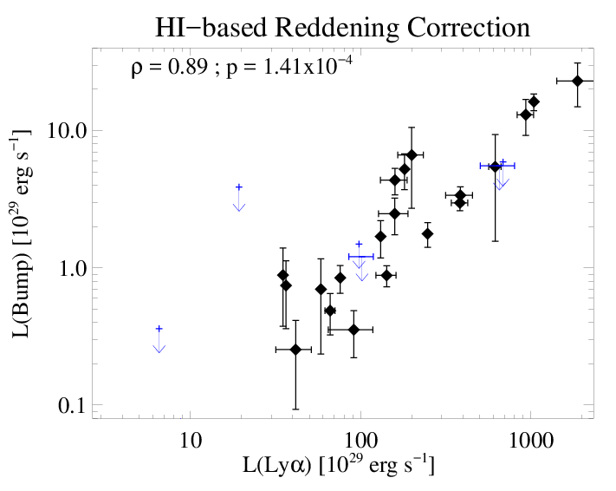
Composition of Protoplanetary Disks: Indirect Observations of H₂O at ~1 AU?
“1600Å Bump” Measurement and Correlations
Correlated with Lyα and other accretion tracers
France et al. (in prep)
Notes:
What is it?

Slide 45
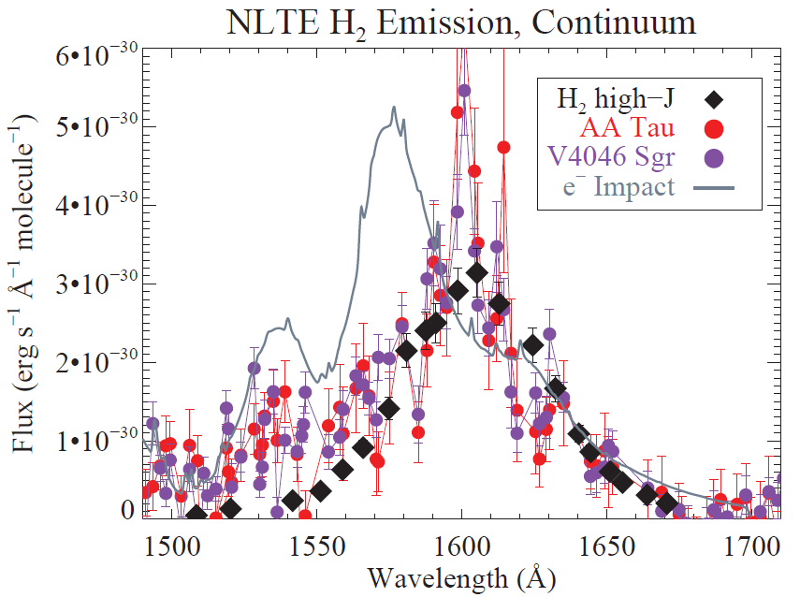
Composition of Protoplanetary Disks: Indirect Observations of H₂O at ~1 AU?
“1600Å Bump” mechanism: H₂O + Lyα -> H₂* + O (with P~10%)
H₂* + Lyα -> observed continuum spectra
Electron-impact does not fit, Lyα-pumped H₂O fragments do
France et al. (in prep)
Notes:
-Likely related to LyA.
-Previous work where this feature was qualitatively identified called it electron-impact, in analogy to the bright auroral emission on Jupiter
-But I think it is fluorescence from a highly non-thermal H2 population. What non-thermal H2 population best describes the data? Daughter product from LyA-induced WATER DISSOCIATION (van Harravelt & Hemert 2008)

Slide 46
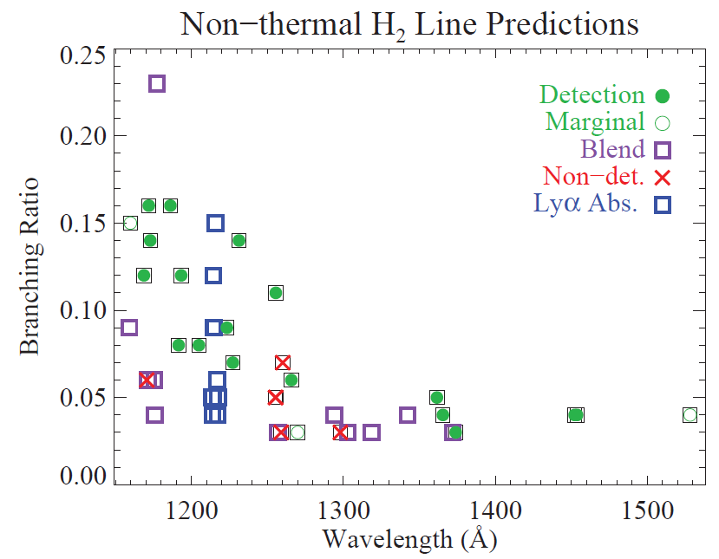
Composition of Protoplanetary Disks: Indirect Observations of H₂O at ~1 AU?
“1600Å Bump” mechanism: H₂O + Lyα -> H₂* + O
H₂* + Lyα -> observed continuum spectra
Electron-impact does not fit, Lyα-pumped H₂O fragments do
Notes:
NONE OF THE BOUND-BOUND LINES OF eIMPACT are unambiguously detected in the data whereas almost all of the brightest predicted non-thermal state fluorescence lines are detected.
So, the purpose of these last few, somewhat speculative, slides is to show that there is a whole treasure trove of molecular information to be gleaned from PPDs – by definition, most of the molecular tracers in the UV are sensitive to warm/hot molecular gas, meaning they trace material inside of a few to 10 AU, that is, the radii where rocky and gas giant planets are likely forming. ALMA does not do this, JWST will not spatially or spectrally resolve the gas here and it is not clear if the rotational lines of H2 will be readily detectable in a large number of disks.

Slide 47
Summary: 1978 - 2016
1) HST-COS observations have enabled statistical studies of both H₂ and CO in the warm molecular atmospheres of protoplanetary disks for the first time.
2) H₂ fluorescence traces 0.1 – 3 AU (to 10 AU in some transitional disks) while CO fluorescence traces 2 – 10 AU. H₂ disk inner radii increase with dust dissipation and declining mass accretion rate.
3) CO and H₂ absorption line spectroscopy through inclined disks has revealed CO/H₂ ratios ~10⁻⁴, suggesting that little CO chemical processing occurs in the first 2 Myr. H₂O dissociation at ~few AU is the most likely explanation for the UV molecular continuum in PPD spectra.

Slide 48
WHERE DO WE GO FROM HERE?

Slide 49
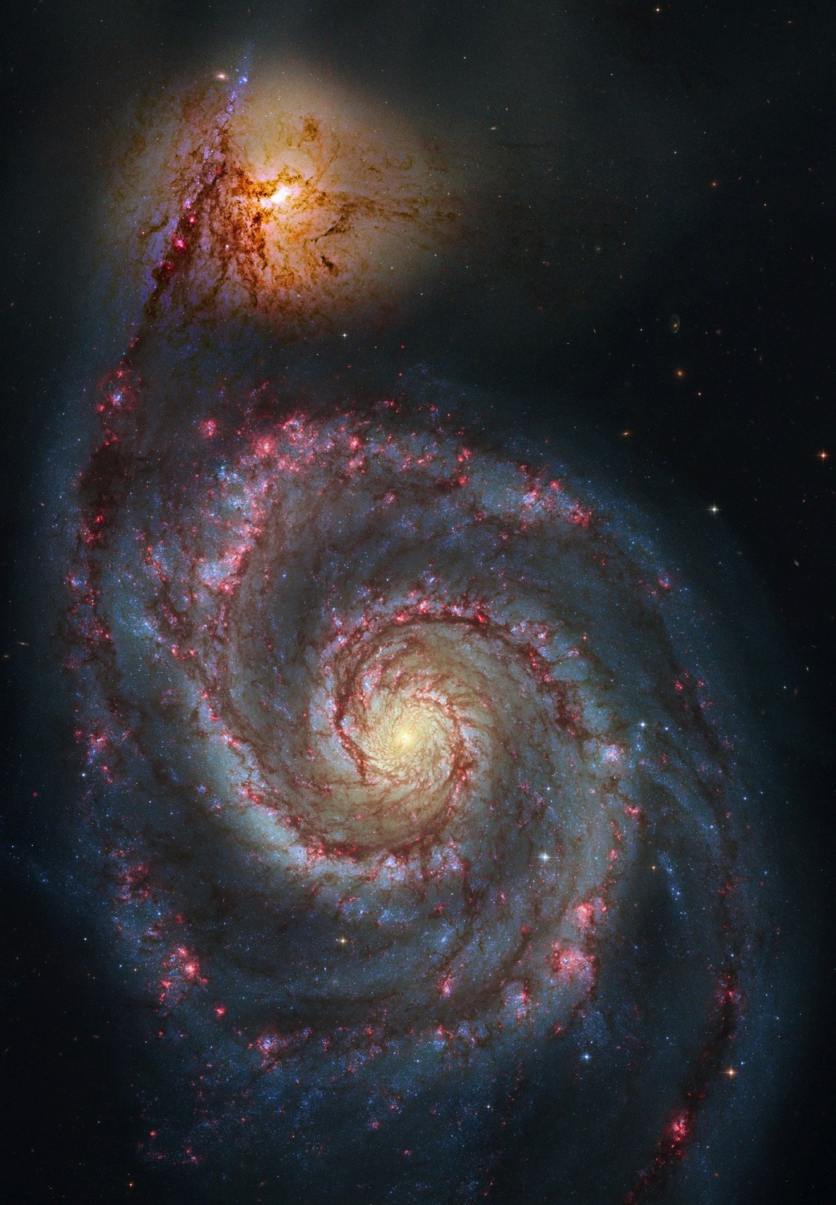
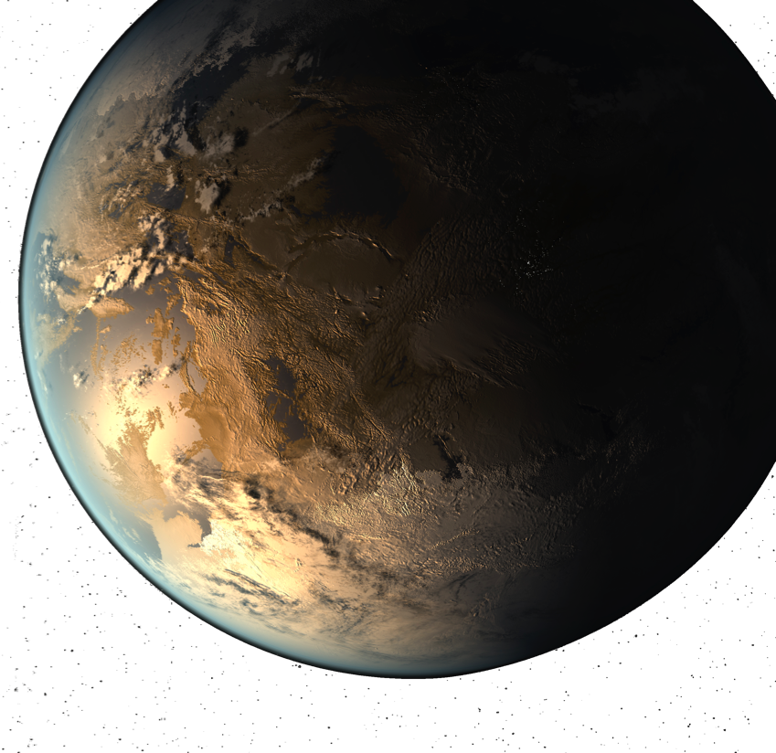
Large UV/Optical/IR Surveyor: Aperture and Instruments
Notes:
NOTE that I am a member of the LUVOIR STDT presenting the structure and progress of the team on behalf of the (community + NASA) study team

Slide 50
To take the next step towards using UV spectroscopy to characterize the structure and composition of planet-forming disks at r < 10 AU, we need higher sensitivities combined with multi-plexed spectroscopy (e.g., a UV multi-object spectrograph or IFU).
A notional two channel instrument would Combine High-resolution and Imaging Spectroscopy:
High-resolution (echelle) point source spectrograph
Multi-object imaging spectrograph, medium- and low-resolution spectral modes.
Notes:
We need 1) higher-sensitivities (we could improve the throughput by maybe a factor of 2-3 with enhanced coatings and detectors, but to make order of magnitude leaps, we need more collecting area), high-sens and high-res, and 2) a way to dramatically reduce the survey time – and this is some sort of a multi-object spectrograph.

Slide 51
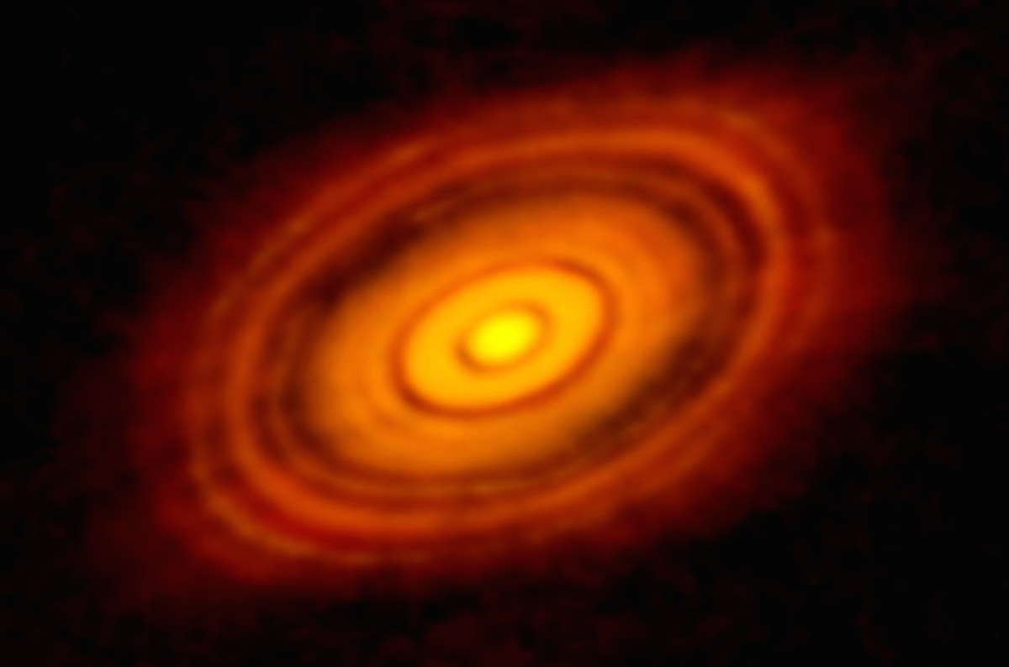
Combined High-resolution and Imaging Spectrograph for LUVOIR
LUVOIR: Characterizing the Exoplanet “Circle of Life”
Composition of planet forming region, connection to eventual bulk composition of exoplanets and their atmospheres.
Notes:
NOTE THAT THE GOAL OF MEASURING THE BIRTHPLACE OF PLANETS IS AN ESSENTIAL PART OF THE LUVOIR STORY TO UNDERSTAND THE ATMOSPHERES OF THE PLANETS
In some sense, circumstellar disks serve as the intersection between COR (IGM->ISM->infall) and EXO (birthplace of planets) science objectives.

Slide 52
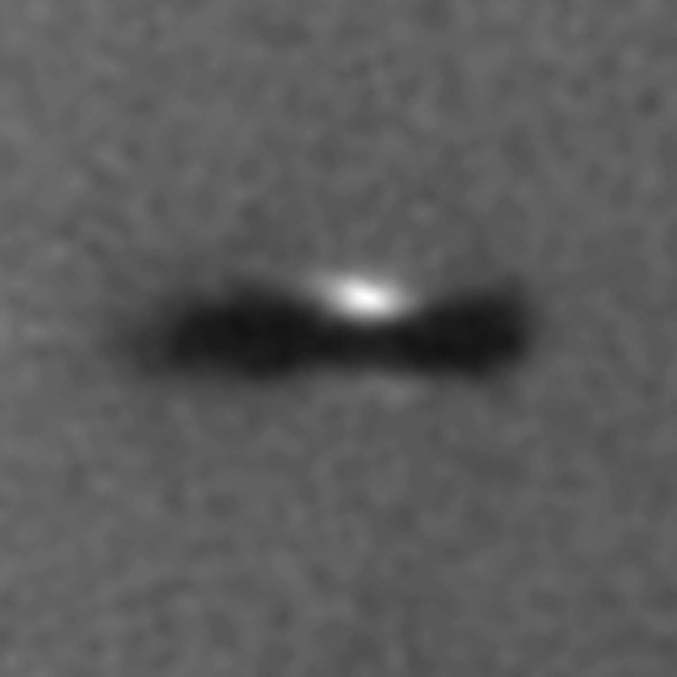
Combined High-resolution and Imaging Spectrograph for LUVOIR
LUVOIR: Characterizing the Exoplanet “Circle of Life”
Composition of planet forming region, connection to eventual bulk composition of exoplanets and their atmospheres.
Notes:
Lets look at another representation of these disks.

Slide 53
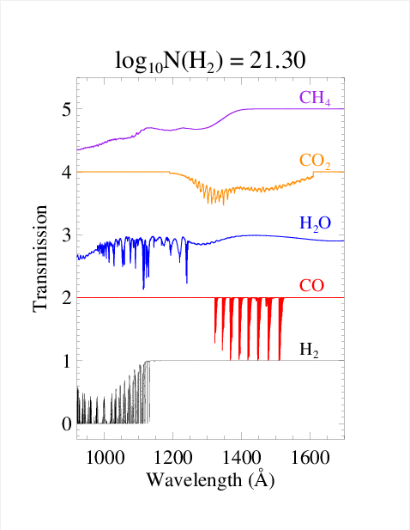
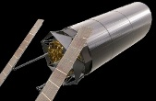
Combined High-resolution and Imaging Spectrograph for LUVOIR
High sensitivity + high-resolution far-UV absorption line spectroscopy of CO, H₂, and H₂O enable quantitative compositional analysis of planet-forming disks
Notes:
I expect LUVOIR will be the next quantum leap the way it was from IUE & STIS to COS. New molecular species show up, the combination of spectral resolution and sensitivity allow to carry out studies we had not really thought of before COS.

Slide 54
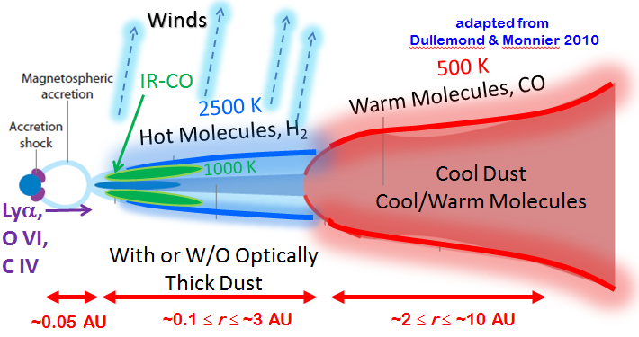
Combined High-resolution and Imaging Spectrograph for LUVOIR
Multi-object + high-sensitivity enables statistical surveys of inclination angle and ages
Notes:
Inclination of a large number of disks can be known from SMA and ALMA
Telescope aperture determines how close to the disk midplane you can probe (current record for UV spectroscopy: A_{V} =7.6)

Slide 55
Combined High-resolution and Imaging Spectrograph for LUVOIR
Photoevaporative wind
h
r
Notes:
Large sample sizes allow you to create statistics of each component of the disk
Probe sightlines through photoevaporative winds (take advantage of all the atomic and molecular resonance lines in the FUV)

Slide 56
Combined High-resolution and Imaging Spectrograph for LUVOIR
Photoevaporative wind
Warm H₂ Atm
h
r
Notes:
Inclination of a large number of disks can be known from SMA and ALMA
Telescope aperture determines how close to the disk midplane you can probe (current record for UV spectroscopy: A_{V} =7.6)

Slide 57
Combined High-resolution and Imaging Spectrograph for LUVOIR
Photoevaporative wind
Warm H₂ Atm
Molec Surface Layer
h
r
Notes:
Inclination of a large number of disks can be known from SMA and ALMA
Telescope aperture determines how close to the disk midplane you can probe (current record for UV spectroscopy: A_{V} =7.6)

Slide 58
Combined High-resolution and Imaging Spectrograph for LUVOIR
Photoevaporative wind
Warm H₂ Atm
Molec Surface Layer
Complex Chemistry
Region and Grain
Growth
h
Distribution of inclination angle and ages allows 4-D mapping of disks [r,h,t,λ]
r
Notes:
Inclination of a large number of disks can be known from SMA and ALMA
Telescope aperture determines how close to the disk midplane you can probe (current record for UV spectroscopy: A_{V} =7.6)

Slide 59
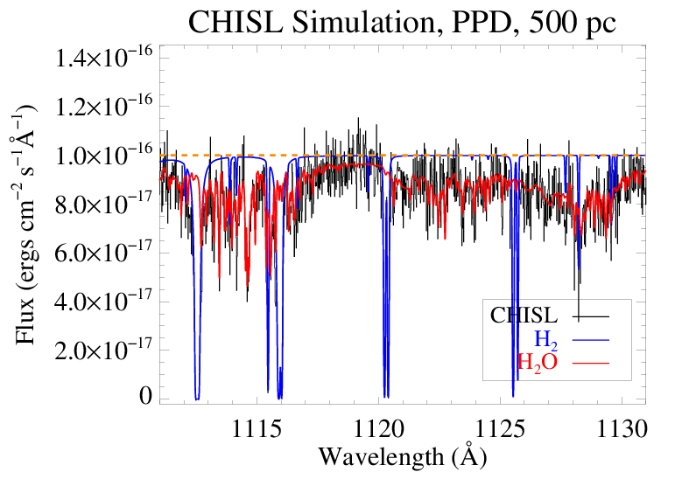
Combined High-resolution and Imaging Spectrograph for LUVOIR
Molecular Surface Layer
Notes:
Simulation using measured H2 column densities from HST, and H2O/H2 ratios from Herschel +++ resolution and sensitivities attainable by 12-m LUVOIR plus UV spectrograph.
This is a tiny snapshot of wavelength space, but intended to show the spectral richness we expect to achieve for average disks.

Slide 60
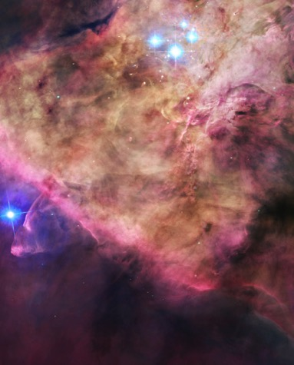
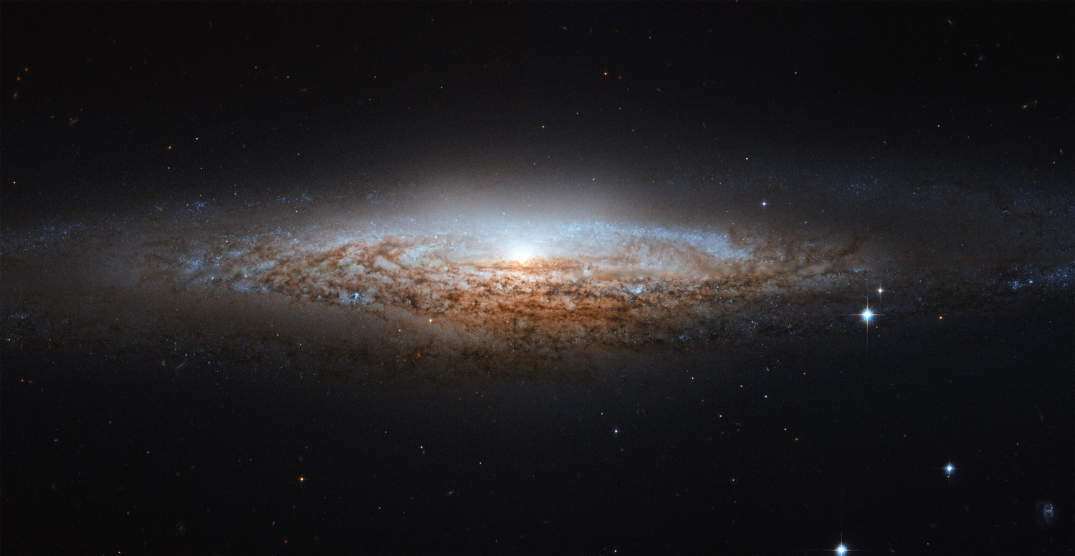
Multi-object observations
PLACE HOLDER
MORE WORDS
Notes:
That material flows into galaxies as the fuel for star-forming regions (like Orion). These star-forming regions are the engines that drive the feedback into the circumgalactic medium -- these are also the places where individual solar-mass stars are forming. Within the circumstellar disks, young planetary systems are coming into being (“proto-solar systems”). LUVOIR will be able to measure the structure and composition of thousands of planet-forming disks in nearby star-forming regions

Slide 61
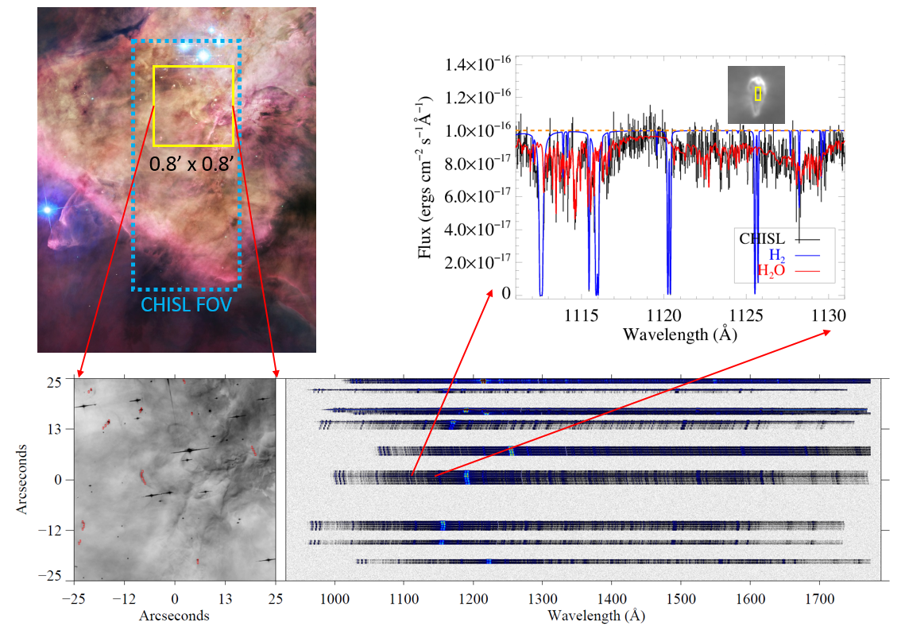
LUVOIR Example Science Theme: The Lifecycle of Baryons Across Cosmic Time
PLACE HOLDER
MORE WORDS
Notes:
Again, multi-object UV spectroscopy.

Slide 62
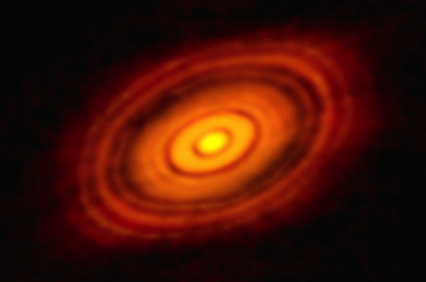
Complementarity with other science instruments for disk and protoplanet science
Composition of planet forming region, connection to bulk composition of protoplanets, exoplanets, and their atmospheres.
10 AU
2 AU
Notes:
Peering into gaps in the protoplanetary disks with high-contrast imaging
NOTE that neither ALMA nor JWST will have the resolution to carry out this experiment (5 – 10 AU resolution, and ALMA is dominated by cool gas and dust) LUVOIR will observe the scattered light profiles directly.

Slide 63
The Combined High-resolution and
Imaging Spectrograph for the
LUVOIR Surveyor (CHISL)
(with Brian Fleming, Keri Hoadley)
Notes:
SO if we only had a UV spectrograph that could do all that! Happily, we took a look at this problem in response to the call for papers in the JATIS special issue on LUVOIR. (published this summer and presented at SPIE in Edinburgh)
Image at left is from 2015 ATLAST study led by GSFC

Slide 64
NOTIONAL LUVOIR INSTRUMENT SUITE
First Generation Science Instruments (*to be defined by STDTs, strictly my own interpretation):
Coronagraph to detect and characterize (potentially inhabited) exoplanets (10⁻¹⁰ contrast ratio – discovery, feeding an R > 70 Vis/NIR spectrometer - characterization)
“Wide field” imager (6’ x 6’; V = 32 in 1 hr)
UV spectrograph (multi-object over > 1’ x 1’ FOV at medium res [R > 25,000]; high-res capability [R ≥ 10⁵])

Slide 65
NOTIONAL LUVOIR INSTRUMENT SUITE
First Generation Science Instruments (*to be defined by STDTs, strictly my own interpretation):
Coronagraph to detect and characterize (potentially inhabited) exoplanets (10⁻¹⁰ contrast ratio – discovery, feeding an R > 70 Vis/NIR spectrometer - characterization)
“Wide field” imager (6’ x 6’; V = 32 in 1 hr)
UV spectrograph (multi-object over > 1’ x 1’ FOV at medium res [R > 25,000]; high-res capability [R ≥ 10⁵])
The Combined High-resolution and Imaging Spectrograph for the LUVOIR surveyor (CHISL)

Slide 66
Combined High-resolution and Imaging Spectrograph for LUVOIR
A two channel instrument :
High-resolution (echelle) point source spectrograph
Multi-object imaging spectrograph, medium- and low-resolution spectral modes.
Notes:
I am going to walk through the layout of the two channels,
then present some performance estimates,
Talk about the science capabilities and
The technical challenges that need to be overcome to realize such an instrument

Slide 67
Combined High-resolution and Imaging Spectrograph for LUVOIR
Optical Telescope Assembly → collimator
TBD -- echelle grating*
Holographically ruled cross-dispersing/focusing grating
NEED: stable advanced coatings (reflectivity ≥ 85% at λ > 1000 Å, large-format detector array (~200mm x 200mm)
Notes:
*need to mention the crappiness of current echelle technology. No significant improvement in more than 30 years.

Slide 68
Combined High-resolution and Imaging Spectrograph for LUVOIR
JWST-like microshutter array (1’ x 2.4’)
Holographic grating
Fold mirror
60” x 144” FOV
NEED: stable advanced coatings, large-format detector arrays (~200mm x 200mm x 2), UV MSAs
Notes:
Walk through raytrace
Note medium (25 – 40 K) and low-res (> 14 K) modes
Imaging < 50 mas at med-res across 1100 – 1500 Ang, < 30 mas across most of FUV in low-res mode

Slide 69
Combined High-resolution and Imaging Spectrograph for LUVOIR
-Quijada et al. 2014;
-Fleming et al. 2016;
-Hennessey et al. 2016
Notes:
Assumes 12m Cassegrain telescopes as the primary fore-optic.
Note that these peak A_effs are 200 to 300 times greater than the high-res (E140H) modes on HST-STIS. (wow!)
The imaging spectroscopy peak A_effs are a factor of 40 higher than HST-COS! (wow!)

Slide 70
3. Combined High-resolution and Imaging Spectrograph for LUVOIR
S/N ~ 15 – 20
at F_{λ} = 10⁻¹⁶
erg/cm²/s/Å
Notes:
Whereas 10^-14 was the natural flux unit for STIS and 10^-15 was the natural flux unit for COS, 10^-16 and even 10^-17 will be the natural flux units for CHISL, at 3 x the resolution of COS.
But we also need multi-object spectroscopy!

Slide 71
Combined High-resolution and Imaging Spectrograph for LUVOIR
Comparison with HST-STIS
Instrument Parameter | STIS G140M | CHISL (Imaging Modes)
Spectral Resolving Power | 10,000 | 16,000 – 40,000
Total Spectral Bandpass | 1140 – 1740 Å | 1000 – 2000 Å
Spectral Bandpass per Exposure | 50 Å | 450 – 1000 Å
Number of Exposures to Cover Spectral Bandpass | 12 | 1 (Low Res) 3 (Med Res)
Imaging Field-of-View | 0.2” x 28′′ | 60” x 144”
Spectrograph Throughput | 1.2% | 11.7%
Notes:
Here is a comparison with the current state-of –the art in medium resolution FUV imaging spectroscopy: bandpass comes from big detectors, throughput comes from gratings and coatings, FOV comes from MSA and control of the grating surfaces
Note that these gains are on top of the factor of 25 increase in collecting area from the OTA

Slide 72
Combined High-resolution and Imaging Spectrograph for LUVOIR
What can we do with LUVOIR + CHISL?
Deep fields will be produced automatic via parallel observations during coronagraphy
Spectroscopic observations of low/intermediate redshift galaxies and CGM/IGM
6’
6’

Slide 73
Combined High-resolution and Imaging Spectrograph for LUVOIR
What can we do with LUVOIR + CHISL?
Spectroscopic observations of low/intermediate redshift galaxies and CGM/IGM
2.4’
6’
1’
6’
Notes:
CHISL FOV, zoom in

Slide 74
Combined High-resolution and Imaging Spectrograph for LUVOIR
What can we do with LUVOIR + CHISL?
3 microshutter arrays, each 20” x 48” FOV
100 x 200 micron slits
< 0.1” spectral imaging across most of FOV
(0.03” – 1.0” spectral imaging across full FOV)
2.4’
1’
Notes:
Walk through the bullets here – all notional and should be optimized once the requirements for the OTA have been more firmly established.
Then say “suppose we wanted to understand the interaction of the IGM, CGM, and star-formation properties of this blue galaxy in the lower left-hand corner…

Slide 75
Combined High-resolution and Imaging Spectrograph for LUVOIR
What can we do with LUVOIR + CHISL?
Notes:
Simultaneously take spectra of the star-forming galaxy, background quasars, and the circumgalactic material

Slide 76
Combined High-resolution and Imaging Spectrograph for LUVOIR
What can we do with LUVOIR + CHISL?
R > 15,000 1000 – 2000 Å spectroscopy of hundreds of objects simultaneously.
Background quasars, numerous galactic regions, circumgalactic halo
Notes:
Composition, temperature, velocity flows, mass, etc for each of these components, SIMULTANEOUSLY.
I noted there are some technology needs to enable an instrument like CHISL: So, how are we going to make an instrument like this a reality??

Slide 77
CHISL Technology – Current Laboratory and Flight Testing
Notes:
But all of this will not be easy!
We need to be doing the precursor work today to mature the technologies and to identify what the tall poles are that require more effort, ingenuity, and/or money.
We are doing this as part of the suborbital rocket program at Colorado.

Slide 78
CHISL Technology – Current Laboratory and Flight Testing
Colorado UV Rocket Program
High-resolution spectroscopy of the local ISM (CHESS); Imaging spectroscopy of nearby galaxies and exoplanet host stars (SISTINE); Ionizing radiation from local OB stars (DEUCE*)
Hardware Development:
High-efficiency UV/visible optical coatings
Large format, high dynamic range UV detectors
Diffraction grating technology
PI – K. France
*PI – J. Green

Slide 79
MCP detector
5 MHz global rate, photon counting, 40cm diam, 8K x 8K pixels
CHESS Payload
Echelle grating: 70% groove efficiency, testing with advanced UV coatings
Cross-disp grating: deformable mirror etching technology
X-strip MCP
Echelle
Cross disperser
Mechanical collimator
France et al. 2012
Hoadley et al. 2014
France et al. 2016
Hoadley et al. 2016
Fleming et al. 2015, 2016
Carbon fiber mechanical structure

Slide 80
Summary: The future
High-res FUV spectroscopy: gas phase abundances at rocky planet radii. Multi-object: statistical analysis of 0.1 – 10 AU gas structure and evolution from 0.5 – 20 Myr.
CHISL: high-resolution (echelle) point source spectrograph, [R ≥ 10⁵]
CHISL: Imaging / multi-object spectrograph, medium- and low-resolution spectral modes. multi-object over 1’ x 2.4’ FOV at medium res [R = 16,000 - 40,000]

Slide 81
Questions?

Slide 82
BREAK

Slide 83
4. CHISL Technology – Current Laboratory and Flight Testing
CHISL Technology Development
CHESS: (see Keri Hoadley’s
poster today/tomorrow, 9905-138) high-resolution (R ≈ 10⁵) echelle spectrograph
Notes:
CHESS: Pathfinder high-res spectgrograph, high-dynamic range MCP detector systems, low-ruling density grating R&D (for echelle and cross-dispersing optics)

Slide 84
CHESS Payload
Cross Disperser (HORIBA Jobin-Yvon):
100 x 100 x 30 mm fused silica substrate
Holographically-ruled, 351 grooves/mm

Slide 85
4. CHISL Technology – Current Laboratory and Flight Testing
CHISL Technology Development
CHESS: (see Keri Hoadley’s poster today/tomorrow, 9905-138)
SISTINE: (see Brian Fleming’s Talk this afternoon, 9905-9). R ≈ 10,000, sub-arcsecond imaging spectrograph, 1000 – 1600 Å
Notes:
SISTINE: Pathfinder imaging specctgrograph, large-format detectors, advanced coatings

Slide 86
Summary – Part 1
1) HST-COS observations have enabled statistical studies of both H₂ and CO in the warm molecular atmospheres of protoplanetary disks for the first time.
2) H₂ fluorescence traces 0.1 – 3 AU (to 10 AU in some transitional disks) while CO fluorescence traces 2 – 10 AU. H₂ disk inner radii increase with dust dissipation and declining mass accretion rate.
3) CO and H₂ absorption line spectroscopy through inclined disks has revealed CO/H₂ ratios ~10⁻⁴, suggesting that little CO chemical processing occurs in the first 2 Myr. H₂O dissociation at ~1 AU is the most likely explanation for the UV molecular continuum in PPD spectra.

Slide 87
AU Mic
Fomalhaut
Kalas et al. 05
A. Roberge et al. 2009 – Astro2010 White Paper

Slide 88
Outline
Circumstellar gas and dust are the building blocks of planetary systems. New molecular disk diagnostics probed using HST-COS
Structure, evolution, and composition of molecular gas at planet-forming radii (r < 10 AU) in protoplanetary environments
High-energy (X-ray through UV) stellar irradiance regulates chemistry and evolution of potentially habitable planets – first panchromatic survey of M and K dwarf host stars (MUSCLES)
Quantifying the high-energy radiation environment, formation of “biosignature” species in Earth-like atmospheres, large UV/X-ray flares on optically inactive stars

Slide 89
The Energetic Radiation Environment in the Habitable Zones Around Low-Mass Exoplanet Host Stars
also starring:
Tom Ayres – CU, Alex Brown – CU, Juan Fontenla - NWRA
Cynthia Froning – Texas, Suzanne Hawley – UW, Lisa Kaltenegger – Harvard/Cornell, Jim Kasting – Penn State
Jeff Linsky- CU, Pablo Mauas – Arg, Yamila Miguel - MPIA
Aki Roberge – NASA/GSFC, Sarah Rugheimer – Harvard/St. Andrews
John Stocke – CU, Feng Tian – LASP/Tsinghua, Mariela Vieytes - Arg
Lucianne Walkowicz – Princeton/Adler

Slide 90
Heating and Chemistry of Planetary Atmospheres

Slide 91
Heating and Chemistry of Planetary Atmospheres

Slide 92
Heating and Chemistry of Planetary Atmospheres
94% O₃
depletion
Segura+, AsBio, 2010

Slide 93
Exoplanet Atmospheres: Exo-Earths
Habitable planet candidates exist today
Segura+, AsBio, 2005
The EUV+FUV+NUV radiation fields of their host stars control the atmospheric heating/ stability and photochemical structure of their atmospheres – including formation of biomarkers (e.g., O₂, O₃, CO₂, CH₄)
However, we have few constraints on the
high-energy irradiance from “typical” (optically inactive) M and K dwarf planet hosts, neither observational nor theoretical
Modeling and interpretation of biomarkers require realistic inputs
GJ 832 c -
(Wittenmyer et al. 2014)
Notes:
We know of super-Earth mass planets in the HZs around M stars within 10 pc today.
To remedy our lack of observational data…we started MUSCLES!

Slide 94
Observational Program
Measurements of the
Ultraviolet
Spectral
Characteristics of
Low-mass
Exoplanetary
Systems
(CU student Sarah LeVine)
PI – France. CU graduate students Allison Youngblood and Parke Loyd

Slide 95
Observational & Modeling Program
Optical & NIR -
North: APO, LCOGT, South: El Leoncito, VLT
FUV (w/ Lyα) & NUV
Hubble Space Telescope, Cycle 22 Treasury
LUV
Far-Ultraviolet Spectroscopic Explorer + models
EUV
Calculation based on new solar/stellar models and observed FUV line emission + EUVE
X-ray
Chandra, XMM-Newton, Swift
X-ray = 0.5 - 10 nm
EUV = 10 – 90 nm
LUV = 91 – 116 nm
FUV = 117 – 170 nm
NUV = 171 – 310 nm
PI – France
Notes:
We have been working to solve ALL of these issues with a large, panchromatic exoplanet host star characterization program ---

Slide 96
MUSCLES
MUSCLES Treasury Survey: 60% of K and M dwarf exoplanet hosts at d < 15 pc.
What is the energetic radiation environment in the habitable zones of low-mass exoplanetary systems?
Flares and activity on typical (`inactive’) K & M dwarfs host stars
Impact on
atmospheric photo-
chemistry and the
production of
molecular tracers

Slide 97
MUSCLES: “typical” M dwarfs
France et al. (ApJ-2016 )
Notes:
Optically inactive.

Slide 98
Compiling X-ray → NIR Stellar Irradiances

Slide 99
M dwarf Lyα
Project MUSCLES: Lyα Reconstruction
Youngblood et al. 2016
see also
France et al. (ApJ-2013)
Wood et al. (ApJ – 2005)
France et al. 2012c – ApJL – in press

Slide 100
EUV Estimates: F(EUV) / F(Lyα)
f(Lyα) ≈ 37 – 75 %
Youngblood et al. 2016
Linsky et al. 2014

Slide 101
5 Å – 5 µm Spectral Irradiance Database
France et al. (ApJ-2016 )
Loyd et al. (ApJ-2016 submitted)
Youngblood et al. (ApJ-2016 astro-ph)
Notes:
Panchrom SED – 12/14/15

Slide 102
https://archive.stsci.edu/prepds/muscles/
Notes:
Panchrom SED – 12/14/15

Slide 103
M dwarf FUV and NUV vs. Solar
Project MUSCLES: GJ 832, UV Spectrum
France et al. (ApJL-2012c, ApJ-2016)

Slide 104
FUV/NUV ratio
FUV
NUV
FUV/NUV – Atmospheric Oxygen Chemistry
Segura+, AsBio, 2010
Tian+, E&PSL, 2014

Slide 105
M -- FUV/NUV ~ 0.2 - 1
Sun -- FUV/NUV ~ 10 ⁻³
Potential abiotic production of O₂ and O₃ leading to “biosignatures imposters”
F(FUV), F(XUV) in HZ
≈ 10 – 70 erg cm⁻² s⁻¹
False Positive Biosignatures around M dwarfs
Segura+, AsBio, 2005; Hu et al. 2012
Tian+, E&PSL, 2014; Gao et al. 2015
Domagal-Goldman+ 2014, Harman+ 2015
France et al. (ApJ-2016 )
Notes:
Rad Field in HZ – 12/14/15

Slide 106
Potential Biomarkers on Exo-Earths
Project MUSCLES: Initial Modeling Results, “Inactive” M dwarf GJ 876
Habitable
Zone
Tian et al. 2014
M4V,
Age ~ 1 – 5 Gyr
Rivera et al. 2010
Tian et al. 2014
Harman et al. 2015

Slide 107
Potential Biomarkers on Exo-Earths
O₂
O₃
O₃
O₂
Alt (km)
Tian, France et al. – 2014
Domagal-Goldman et al. 2014
(Kasting & Catling 2003; Segura et al. 2007)
Abundance [n(x)/n(total)]

Slide 108
Potential Biomarkers on Exo-Earths
Detectable Levels of O₂ and O₃
without an active biosphere
O₂
O₃
O₃
O₂
Alt (km)
Tian, France et al. – 2014
Domagal-Goldman et al. 2014
(Kasting & Catling 2003; Segura et al. 2007)
Abundance [n(x)/n(total)]

Slide 109
Atmospheric Impacts and Potential Biomarkers
Older work: Segura et al. 2005, 2010; Hu et al. 2012
Domagal-Goldman et al. (2014); possible abiotic O₃
Rugheimer et al. (2015); FUV/ NUV irradiances from active/inactive stars vs. stellar models and Earth-like planet spectra
Harman et al. (2015);
prediction of abiotic
O₂ and O₃
More to come!
Notes:
All of this tells a cautionary tale for interpreting biosignatures when they are detected in the next 10 – 20 years. Either planets around mid/late M dwarfs with 30-m class telescopes or direct detection missions under development in the US (LUVOIR and HabEx).
I would argue that the “Know the Star, Know the Planet” mantra is more important now than ever.

Slide 110
UV variability in “inactive” M dwarf exoplanet host stars
Optically Inactive dM4/5 GJ 876.
France et al. (ApJ-2016 )
Loyd et al. (ApJ-2016 submitted)
MUSCLES Treasury, July 07 2015

Slide 111
Velocity Profiles in M dwarf Flares
Loyd et al. (2016 – in prep)
Notes:
dT = 3.5s. V_blue = -60 km/s. V_red = +90 km/s.
The ISM in that direction (GJ832) is -11.3 km/s. v_rad(GJ832) = 4.3 km/s.

Slide 112
UV flare energy/duration distribution
SiIV (T_{form} ≈ 40,000 - 70,000 K) Flare distribution
E(400 - 1700Å) ~ 10³¹ erg about once a day
Loyd & France, ApJS 2014
Loyd et al. (2016 – in prep)
Notes:
NOTES on Fractional UV luminosity in SiIV: 00.11% of total FUV+EUV (300 – 1700A), from Fontenla model 3338, 08/13/15
If total amount of emissivity produced in 40kK – 70kK gas is ~10%, then the total FUV+EUV energy is (TOT/SiIV)*10%
then potential total energy per large flare is E_UV = ~10^31 erg, or roughly 10% L_star (which are all around 10^32 erg/s).
This slope [in these units] is very similar to both solar flares , from SDO/EVE catalog, in comparable transition region emission lines (C III 977) and AD Leo! A 0th order analysis says that the 50,000 - 100,000 K flares are about 100 x times more frequent on the MUSCLES stars, with AD Leo having frequencies a factor of a few larger than the MUSCLES stars. . THE TAKE HOME MESSAGE is that the total flare energy deposition is comparable on ‘inactive’ M stars as on AD Leo and many times larger then the Sun.

Slide 113
Earth-mass Planets around M and K dwarfs: The Production of (and eventual detection of) “Biomarker” Gases
Exo-Earth transits: they have extended atomic atmospheres too…
Kevin France
University of Colorado at Boulder
Notes:
Apollo 16 FUV camera. Note this camera had a LyA blocking filter (probably CaF2, but not sure) so this is almost entirely neutral oxygen emission.

Slide 114
Earth-mass Planets around M and K dwarfs: The Production of (and eventual detection of) “Biomarker” Gases
(R_{planet}/R*) for O₂, O₃, CO, CO_{2,} H₂, and H all peak in the UV, 100 - 400 nm.
O₃ peak at 250 nm, O₂ peak at 160nm: habitable planets around F and A stars. (start discovery now)
NEED: 8+ m primary, facility-class UV spectrograph, large photon-counting UV detectors
2013
Kevin France
University of Colorado at Boulder
Notes:
I think this is the most ambitious application for UV exoplanet science:
Probably around F and A stars.

Slide 115
Summary

Slide 116
Summary – Part 2
1) MUSCLES: First panchromatic survey of the energetic radiation environment around M dwarf exoplanet host stars. High-level data products available on MAST for modeling community.
2) FUV/NUV ~ 0.2 -1 for M dwarfs, important for atmospheric chemistry and the production of possible false-positive “biomarkers”
3) FUV and X-ray flares (50 – 10000% increases on 10² – 10³ second timescales) are present on ≥ half of optically inactive M dwarf exoplanet host stars observed to date. Impacts on atmospheres is work in progress.

Slide 117
Thank you

Slide 118
MUSCLES
Notes:
HD 85512 observations started about…25 minutes ago. XMM and HST will do variability monitoring observations tomorrow night. (03/13/15 JPL talk)
About 40% complete as of today

Slide 119
M dwarf radiation fields: IUE is insufficient

Slide 120
No MUSCLES? No problem.
Correlations between broadband FUV and XUV fluxes and observed line fluxes provide first order irradiance estimates in the absence of complete observations
France et al. (ApJ-2016 astro-ph)
Notes:
Rad Field in HZ – 12/14/15

Slide 121
EUVE M dwarfs: F(EUV) / F(Lyα)
M-dwarf EUV calculations:
Based on EUVE data, M dwarf F(EUV)/F(Lyα) ratios agree with solar model, modulo an empirically constrained offset, e.g.,
log (F(EUV)/F(Lyα))_{M} =
log (F(EUV)/F(Lyα))_{ʘ} + ΔF
ΔF(10 – 20 nm)= +0.37 [16%]
ΔF(20 – 30 nm)= -0.01 [24%]
ΔF(30 – 40 nm)= -0.03 [18%]
Youngblood et al. 2016
Linsky et al. 2014

Slide 122
UV variability in other exoplanet host stars
K-dwarf ε Eri, FUV Flare. L_{FUV} increase ~ 3
HST-COS, Feb 02 2015

Slide 123
UV variability in G, K, and M stars
Stochastic Fluctuations = “excess” noise beyond photometric uncertainties, after removing flares.
Likely microflares or smaller reconnection events
Loyd & France, ApJS 2014

Slide 124
UV variability in G, K, and M stars
Stochastic Fluctuations = “excess” noise beyond photometric uncertainties, likely microflaring events
C⁺, 3 × 10⁴ K
chromosphere
Δt = 60 s
M dwarfs
Stochastic Fluctuations:
5 – 30% on minute timescales
Loyd & France, ApJS 2014

Slide 125
Summary
1) Despite 2 – 3 Myr timescale for the end of accretion, many 1 – 10 Myr protoplanetary disks (CTTS + Herbig Stars) display a
rich molecular layer at planet-forming radii (0.1 – 10 AU)
2) Fundamental band CO studies (λ ~ 4.7 μm) provide the most
detailed constraints on the temperature and kinematics of
the 0.1 – 1.0 AU inner disk, including disk winds
3) H₂O, OH, and organic molecules are common inside 3 AU
4) UV spectroscopy is a promising technique for the characterization of the photoexcitation of the inner disk surface (0.1 – 10 AU). Simultaneous coverage of CO and H₂ set a basis for gas-phase abundance and disk structure studies.

Slide 126
Molecular Gas in the 0.1 – 10 AU
Circumstellar Environments
Around Young Stars
Mahalo

Slide 127
Composition of Protoplanetary Disks: Indirect Observations of H₂O at ~1 AU?
COS enables robust FUV continuum characterization for the first time
Notes:
Sensitivity to observe the continuum, spectral resolution to isolate it from the wealth of spectral lines.

Slide 128
Composition of Protoplanetary Disks: Indirect Observations of H₂O at ~1 AU?
COS enables robust FUV continuum characterization for the first time

Slide 129
Composition of Protoplanetary Disks: Indirect Observations of H₂O at ~1 AU?
“1600Å Bump” Measurement and Correlations
10 – 30% of Lyα pumped H₂ luminosity(!), must tie in to Lyα
Notes:
-Must be related to LyA.
-Previous work where this feature was qualitatively identified called it electron-impact, in analogy to the bright auroral emission on Jupiter
-But I think it is fluorescence from a highly non-thermal H2 population. What non-thermal H2 population best describes the data? Daughter product from LyA-induced WATER DISSOCIATION (van Harravelt & Hemert 2008)

Slide 130
Composition of Protoplanetary Disks: Indirect Observations of H₂O at ~1 AU?
“1600Å Bump” mechanism: H₂O + Lyα -> H₂* + O
H₂* + Lyα -> observed line and continuum spectra
Electron-impact does not fit, Lyα-pumped H₂O fragments do
Notes:
-Must be related to LyA.
-Previous work where this feature was qualitatively identified called it electron-impact, in analogy to the bright auroral emission on Jupiter
-But I think it is fluorescence from a highly non-thermal H2 population. What non-thermal H2 population best describes the data? Daughter product from LyA-induced WATER DISSOCIATION (van Harravelt & Hemert 2008)

Slide 131
Sensitive to
Σ_{gas} < 10⁻⁶ g cm⁻²

Slide 132
DM Tau
Transitional Disk
R_{hole} ~ 3 - 20 AU
Calvet et al. (2005)
Andrews et al. (2011)

Slide 133
S/N ~ 60 per line,
> 10² lines

Slide 134
Molecules at r < 10 AU
λ ~ 4 - 5 μm CO
fundamental emission
High-resolution mid-IR ground-based
spectrographs:
NIRSPEC (R ~ 25,000)
CRIRES (R ~ 90,000)
Salyk et al. 2009

Slide 135
CO Rovibrational Emission
Bast et al. 2011
Inferred Spatial Distributions:
Line Profiles & Astrometry
Temperature Distributions
Keplerian Disk
(requires inclination & M*)
Disk + Wind
(spectroastrometry
desirable)

Slide 136
CO Rovibrational Emission
Rotational Excitation
Diagrams
(optical depth effects)
Isotopic Fractions and
Vibrational Excitation
(UV radiation field,
grain opacities)
Brown et al. 2013
T_{rot} (IR-CO) = 300 – 1500K
(warm molecular layer near/
interior to 1 AU)
Inferred Spatial Distributions:
Line Profiles & Astrometry
Temperature Distributions
Najita et al. 2003
Salyk et al. 2007-2011
Brown et al. 2013

Slide 137
CO Rovibrational Emission
Pontoppidan et al. 2011
Inferred Spatial Distributions:
Line Profiles & Astrometry
Temperature Distributions
Keplerian Disk
(requires inclination & M*)
Disk + Wind
(spectroastrometry
desirable)
Notes:
While many disks can be described by a Keplerian disk, ~half of disk profiles appear to require a second component – Pontipiddan’s disk wind. Details still somewhat unclear, but a wind, possibly a photoevaporative wind driven by the UV field of the central star. Physical conditions not too different from what you get on the edges of PDRs.

Slide 138
Molecules in Protoplanetary Disks: Ultraviolet Emission from the Inner Disk
UV-H₂: Most targets dominated by single, symmetric H₂ line profile at the stellar radial velocity:
Disk surface origin, likely wind component
T_{rot}(UV-H₂) = 2500 ± 1000 K
R_{UV-H2} = 0.1 – 3 AU ; M_{H2}(2500K) ~ 10⁻⁶ – 10⁻⁴ M⊕
UV-CO: Narrower lines, no evidence for broad component
Disk surface origin
T_{rot}(UV-CO) = 400 ± 300 K
R_{UV-CO} = 2.0 – 10 AU ; M_{H2}(500K) ~ 10⁻² – 10⁻¹ M⊕

Slide 139
Molecules in the Inner Disk: Ultraviolet-Infrared Relationship
France et al. (2012b), Salyk et al. (2011), Bast et al. (2011), Brown et al. (2013)

Slide 140
H₂O & organics
Warm, Inner disk origin
Salyk et al. 2008
Carr & Najita et al. 2008

Slide 141
Molecules in Protoplanetary Disks: Ultraviolet Emission from the Inner Disk
10s – 100s of photo-excited
H₂ lines in every gas-rich
disk spectrum
H₂
No hole
< 1AU hole
20 AU hole

Slide 142
UV-H₂ and UV-CO
CO Fluorescence
v = 14
v = 14
v = 14
λ_{o} ~ 1315 Å
~ 1352 Å
~ 1390 Å
λ_{o} ~ 1315 Å
~ 1352 Å
~ 1390 Å
1214.2 < λ ≤ 1220 Å
v = 3, 4, 5
v = 3, 4, 5
v = 0

Slide 143
UV-H₂ and UV-CO
v = 14
Strong detections of photo-excited CO
in ~ 60% of our gas-rich disk targets
λ_{o} ~ 1315 Å
~ 1352 Å
v = 3
v = 4
v = 3 & 4
France et al. (2011b)

Slide 144
UV variability in G, K, and M stars
UV Flare statistics
Loyd & France, ApJS 2014

Slide 145
Hubble’s Ultraviolet View of
Protoplanetary Disks and
Exoplanetary Environments
Kevin France
University of Colorado at Boulder
University of St. Andrews – March 4th 2016

