Slide 1
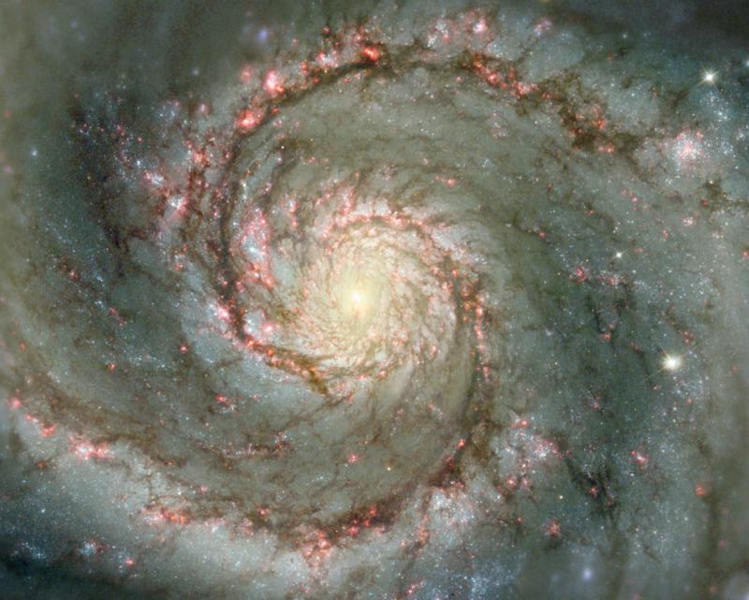
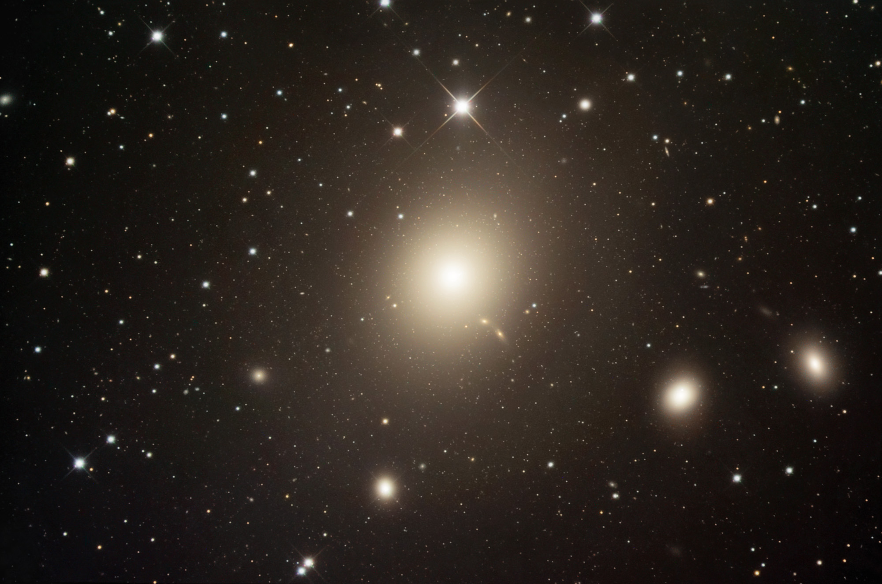
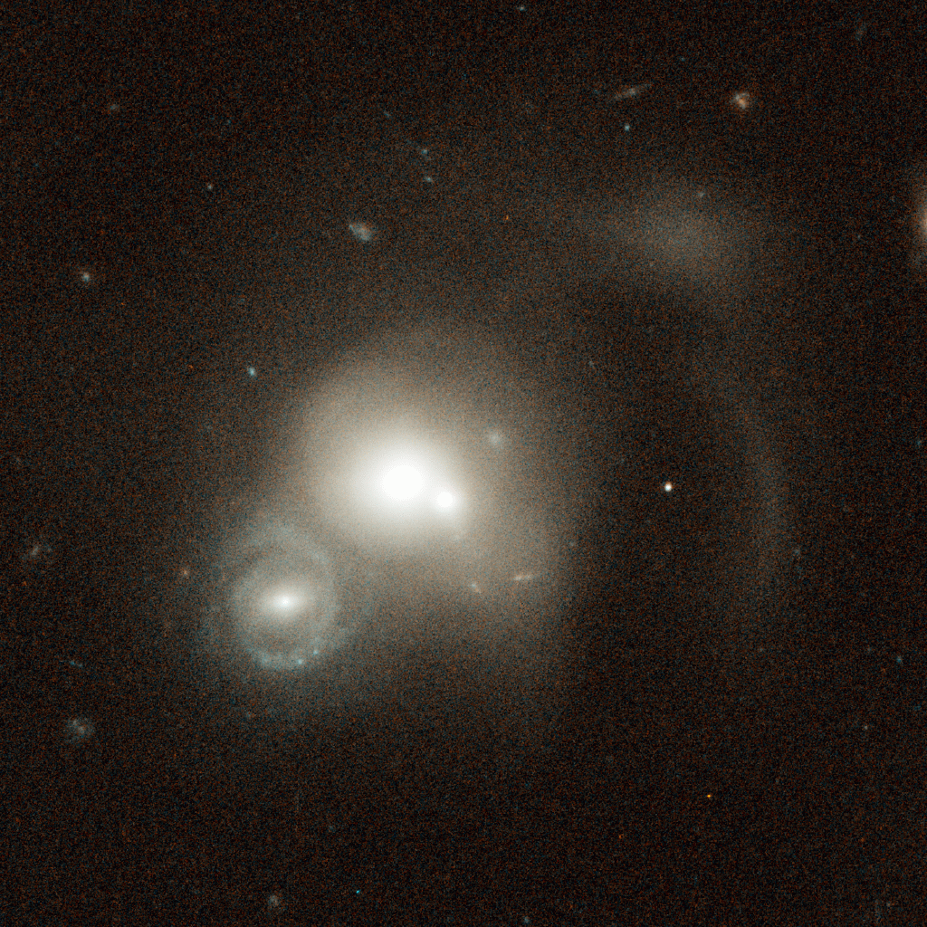
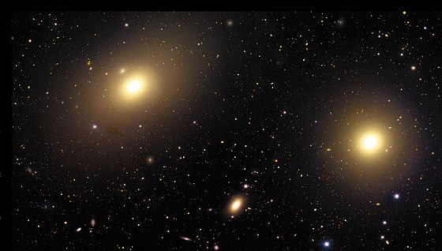
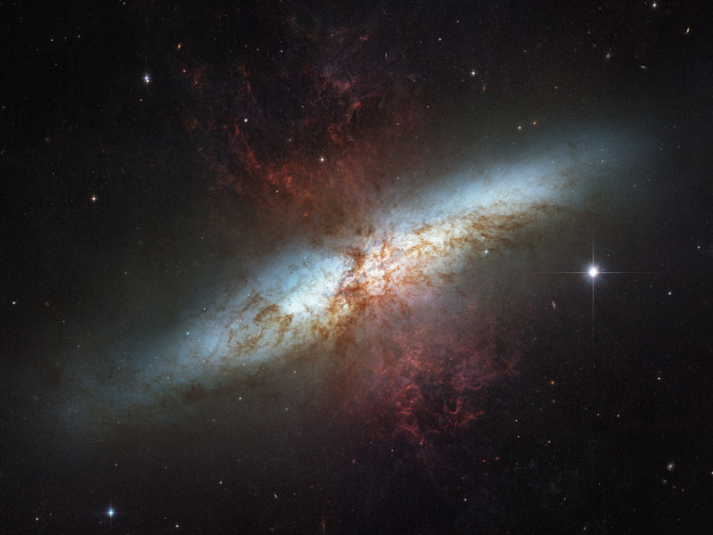
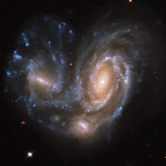
Probing Galaxy Evolution with the Next Generation of UVOIR Telescopes
rachel somerville
Rutgers University

Slide 2
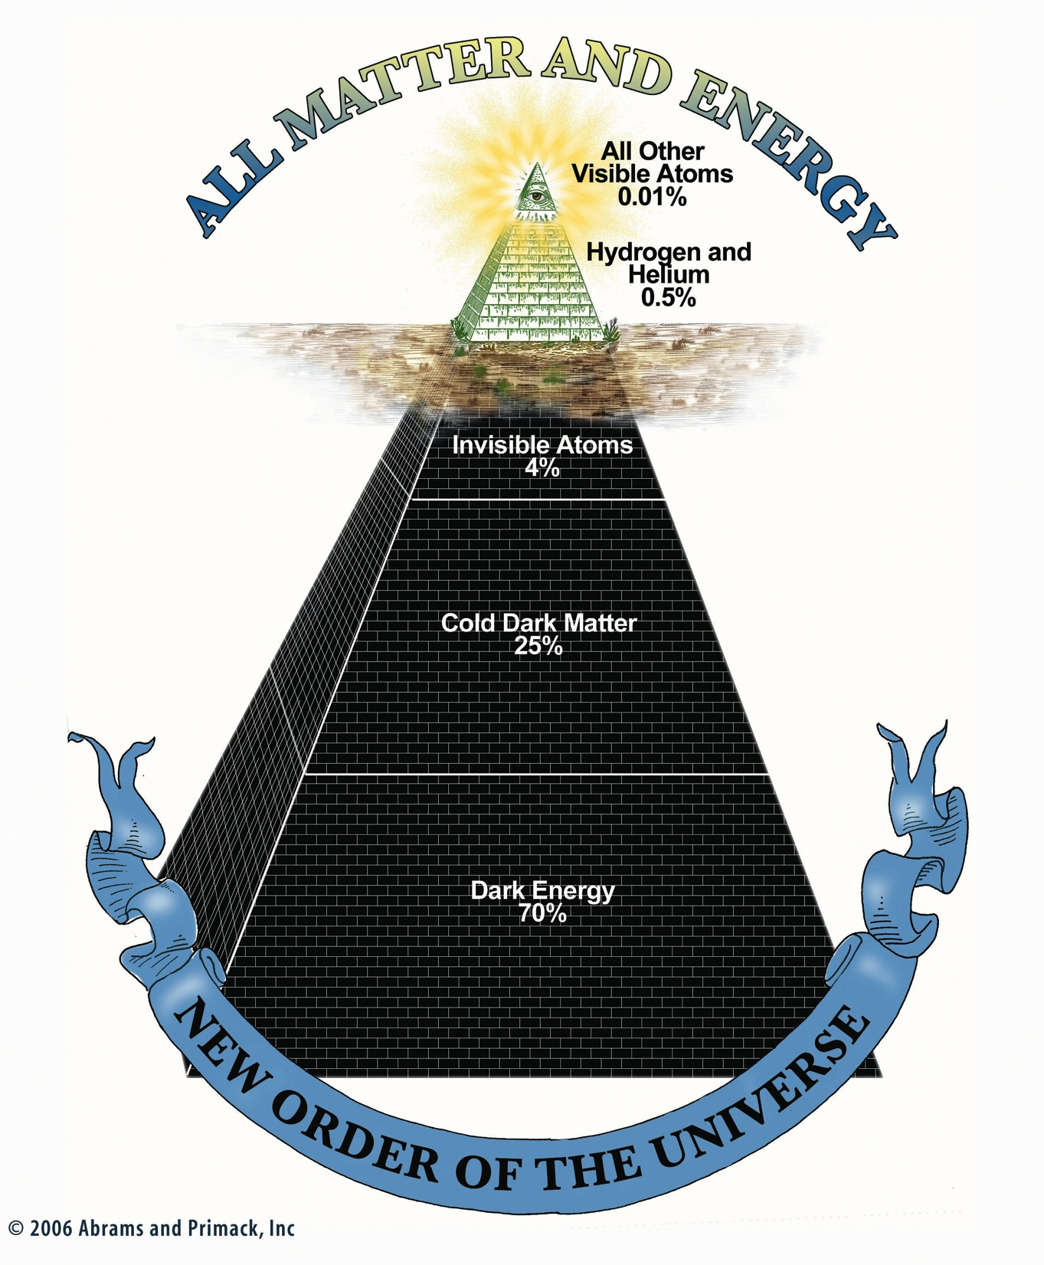

Slide 3
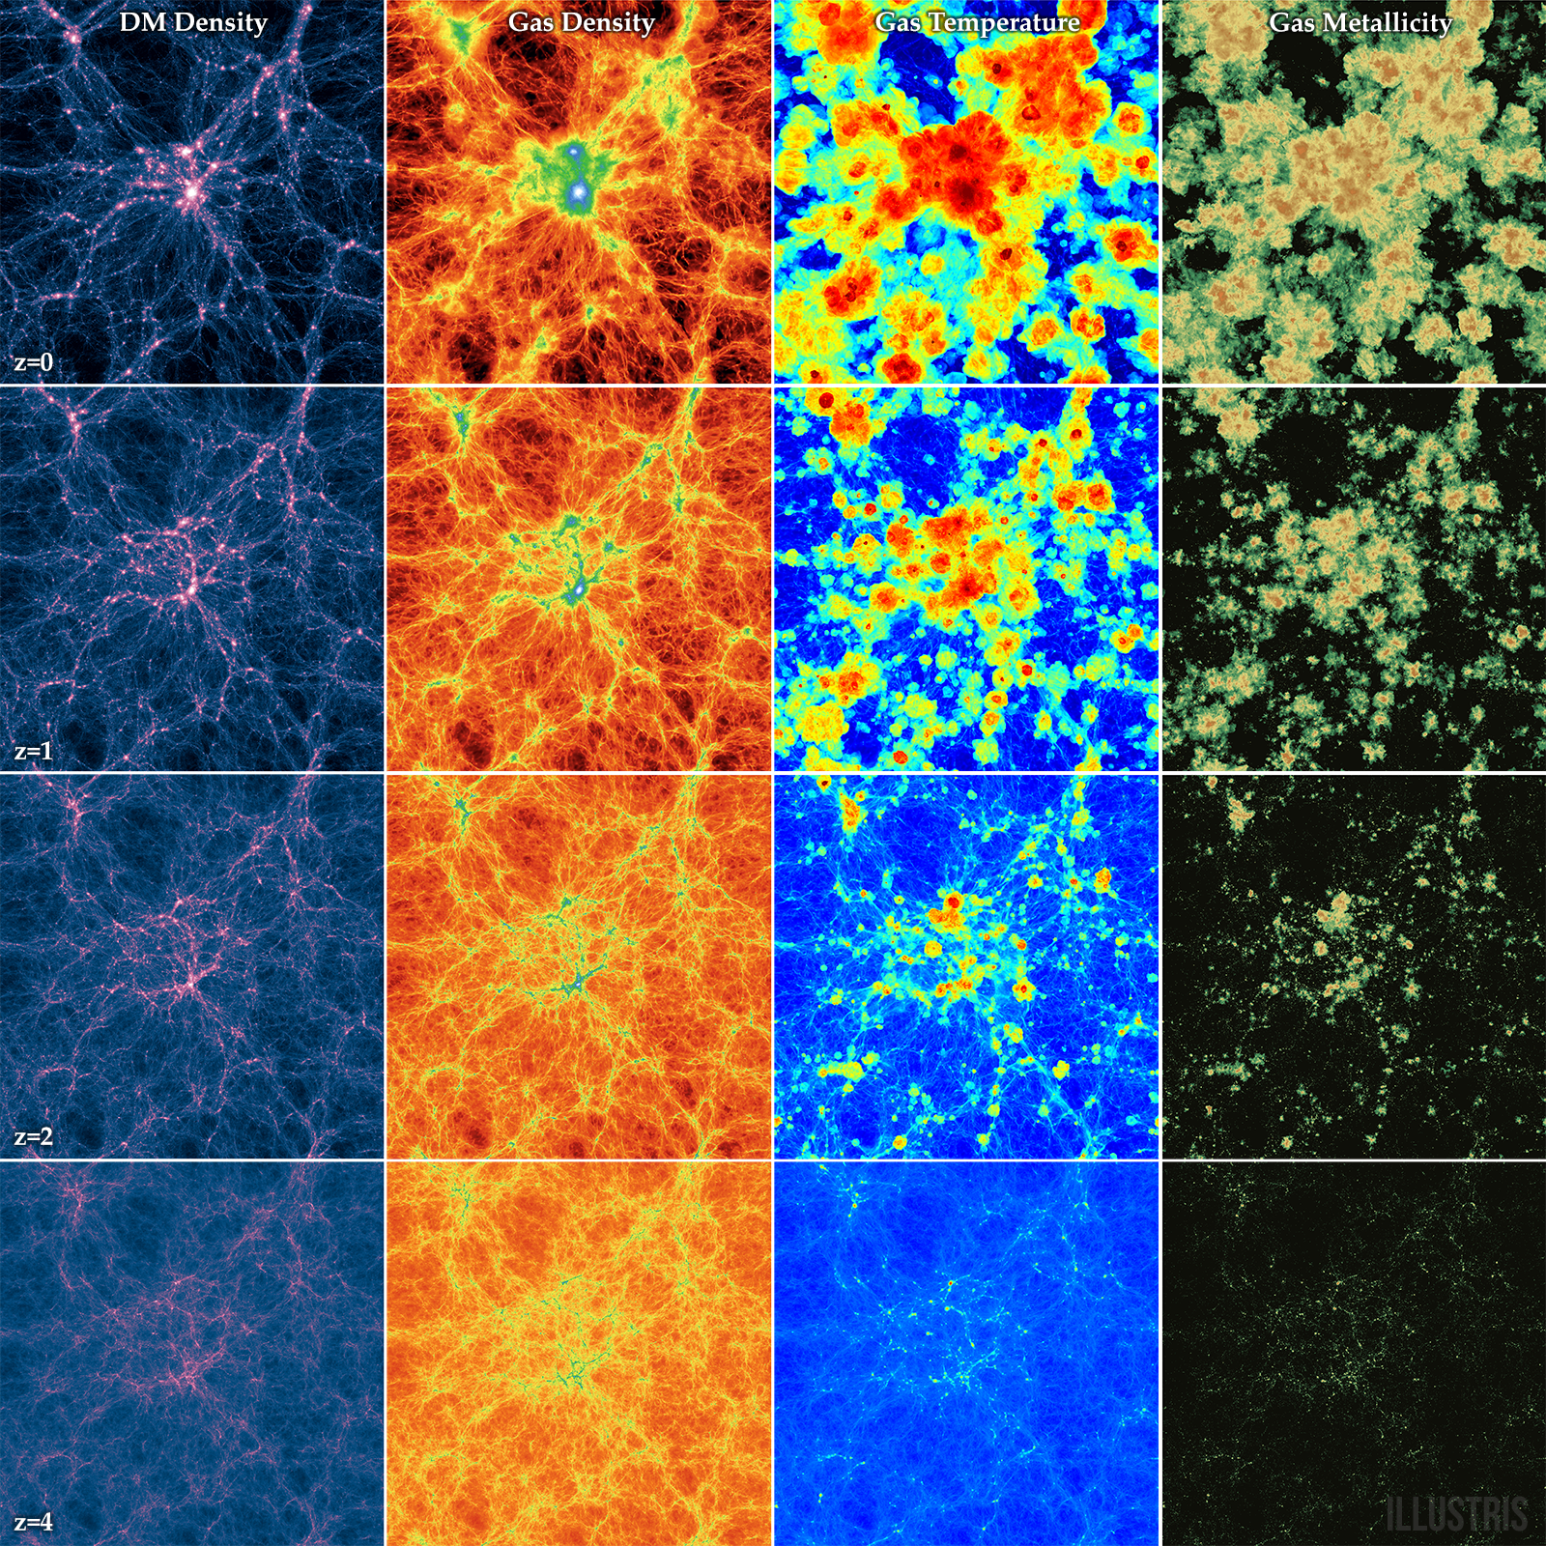
today
~12 Gyr
ago
Illustris simulation
Vogelsberger et al. 2014
Notes:
thickness ~21 cMpc
shows whole illustris box = 106 cMpc

Slide 4
A Theorist’s wish list
high-resolution maps of dark matter, all phases of gas (inside and outside of galaxies), stars, metals, and dust over a representative part of cosmic volume, from ‘cosmic dawn’ to the present day.
spatially resolved kinematics of gas and stars

Slide 5
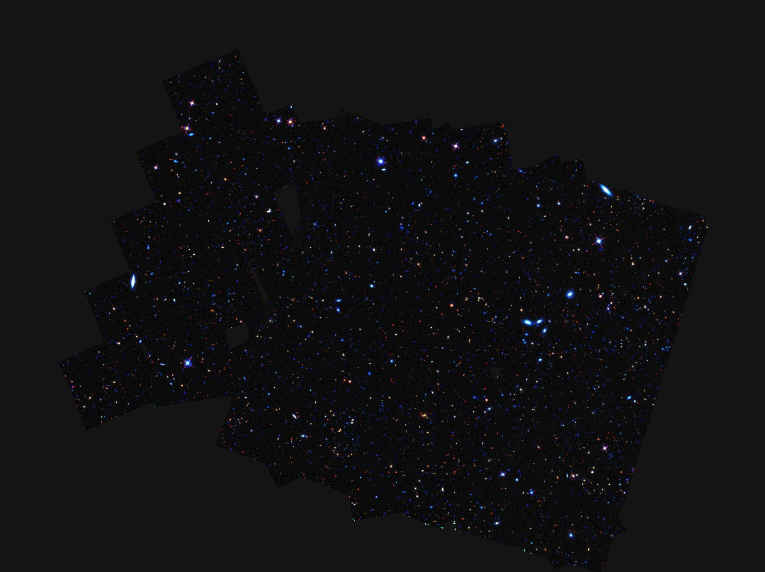
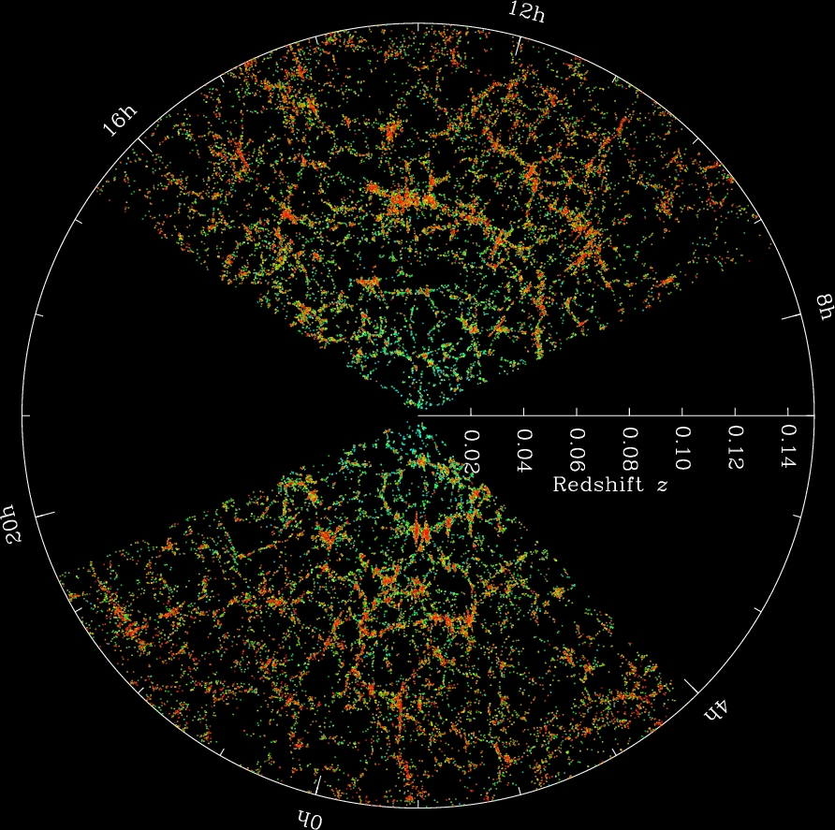
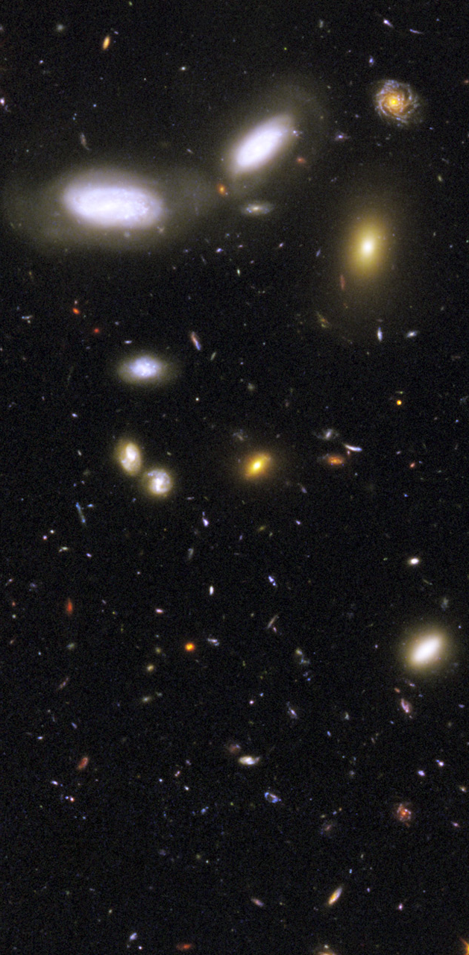
e.g. SDSS, 2dF, GAMA
Hubble Deep Fields, GOODS, GEMS, STAGES, AEGIS, COSMOS
Hubble Ultra-deep Fields, CANDELS, 3D-HST
Notes:
we’ve learned a lot about galaxy properties and their evolution from the past several decades of deep and wide multi-wavelength surveys from the ground and space

Slide 6
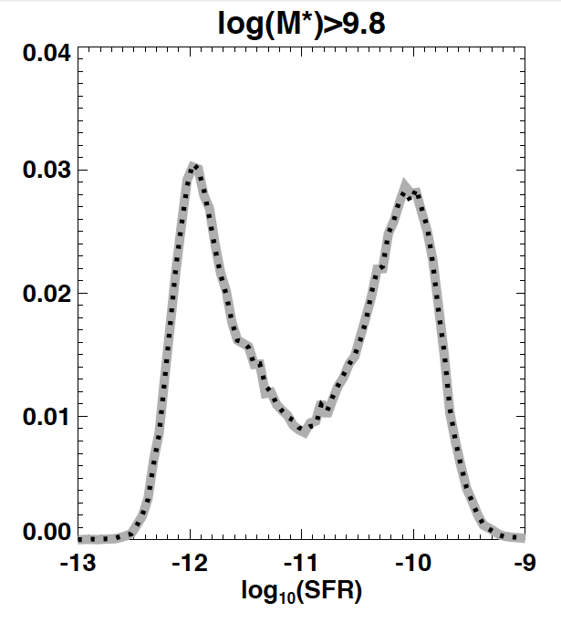
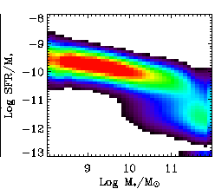
why do we see two populations of galaxies?
z~0 (today)
two distinct populations: star forming and quiescent galaxies (seen up to z~3-4)
SF galaxies live on a surprisingly tight ‘star forming main sequence’ (seen up to z~6)
specific star formation rate
stellar mass
Brinchmann et al. 2003
Kauffmann et al. 2003
Baldry et al. 2004

Slide 7
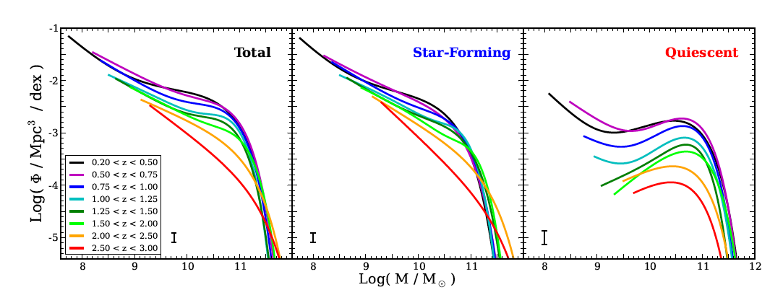
what physical process is responsible for quenching star formation in galaxies?
number/mass in SF
galaxies increases
little or not at all
number/mass of
quiescent galaxies
increases rapidly
→implies SF galaxies must be transformed into
quiescent galaxies (quenching)
Notes:
what physical process is responsible for quenching star formation in these galaxies?

Slide 8
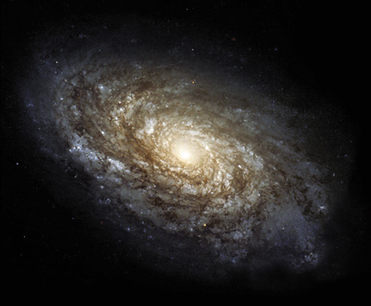
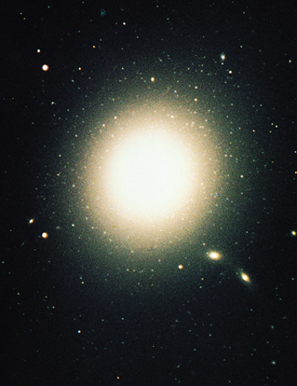
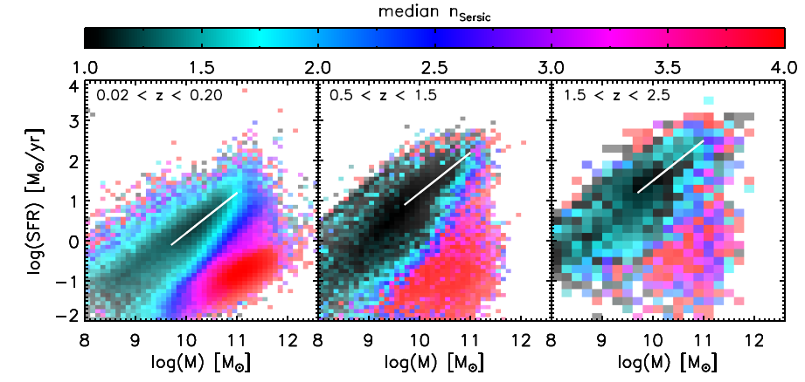
internal structure and quenching are linked -- strong observed correlation between quiescence and bulge fraction or central density
disk-like
spheroid-like
see also Bell et al. 2008, 2012; Cheung+’12; Fang+‘13
Wuyts et al. 2011

Slide 9
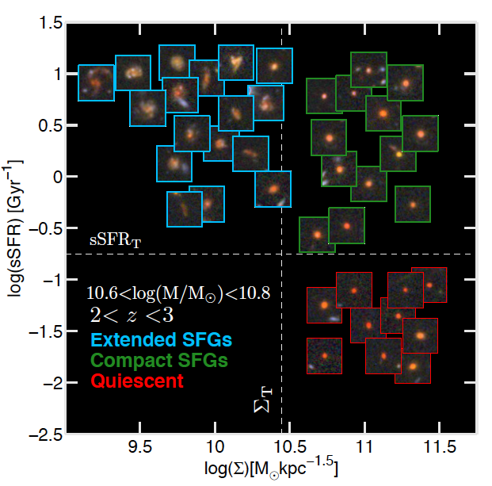
galaxy assembly and transformation since cosmic high noon
galaxies assembled their mass over cosmic time in a `staged’ fashion
build-up of ‘spheroid’-dominated galaxies
star formation quenching
[some] galaxies compactify and then grow in radius
clear link between quenching and internal structure
Barro et al. 2013
‘compactness’
Notes:
here is my super-quick one-slide summary:
*Hubble has allowed us to study this evolution from z~2 to 0 for relatively massive galaxies (1.0E10 Msun)
we would like to push further back in time and to lower mass objects.

Slide 10
compaction
disks
spheroids
star-forming
specific star formation rate
quenching
quiescent
expansion
after
Barro et al. 2013
extended
compact
internal density
Notes:
here is the cartoon summary: some galaxies gradually decrease their SFR and increase their size. these tend to be disk-dominated galaxies.
some galaxies ‘compactify’, become spheroid-dominated, and then quench. quenched galaxies then expand (become fluffier).

Slide 11
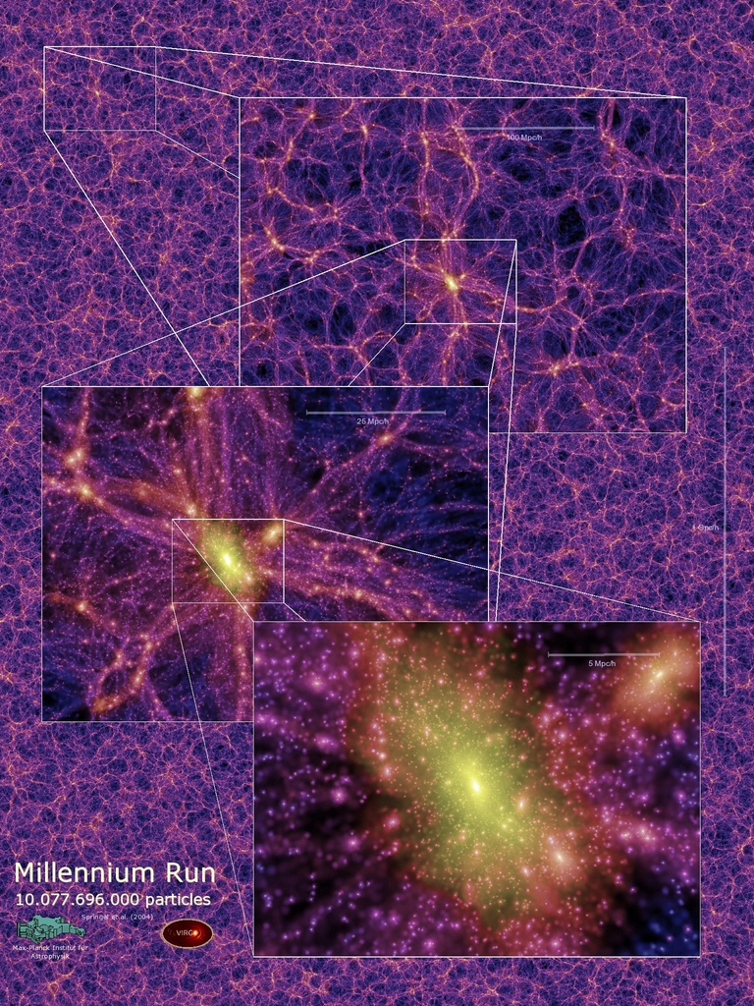
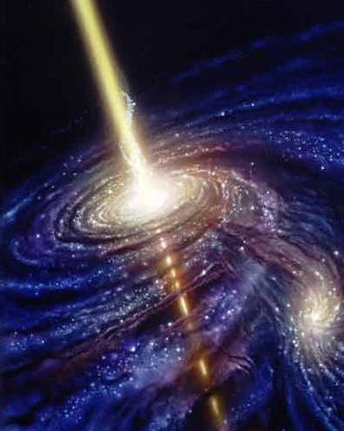
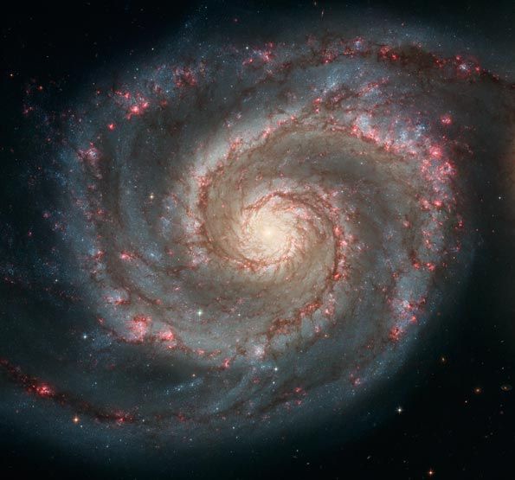
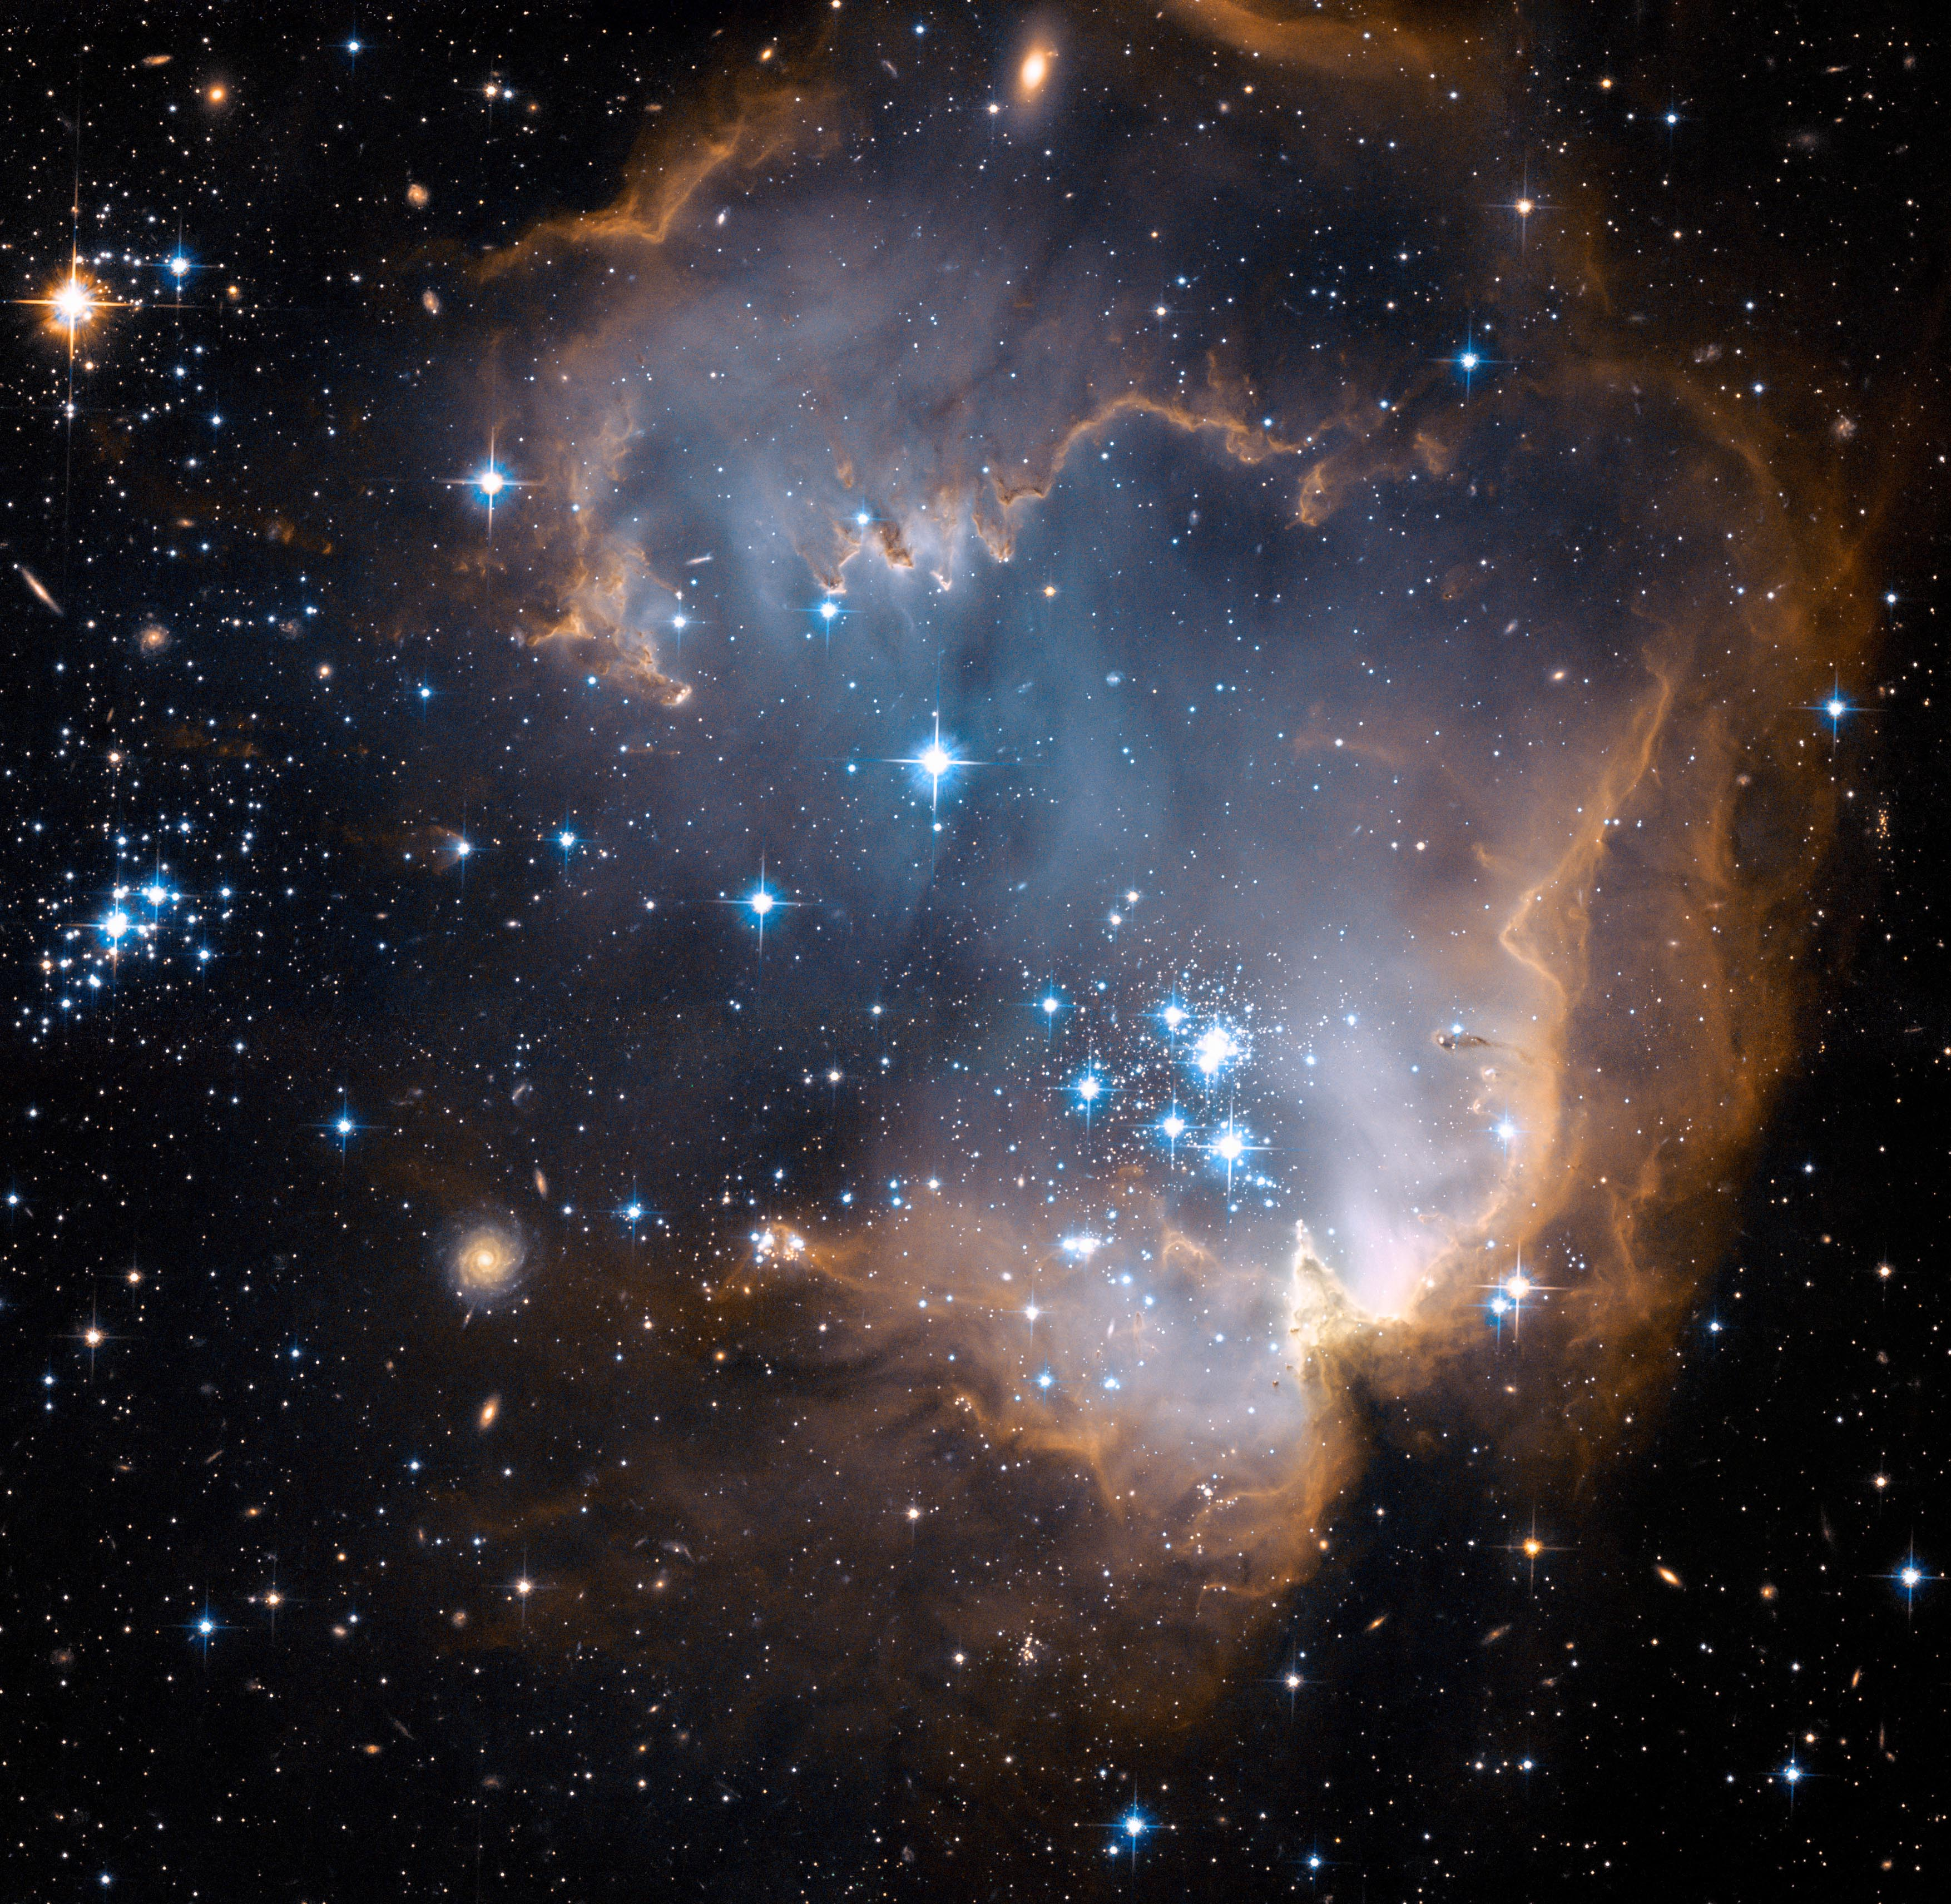
Galaxy Formation: The Grand Challenge
large-scale structure: 100’s of Mpc
galaxy environment: ~1-8 Mpc
galaxy internal structure ~0.1-1 kpc
Giant Molecular clouds: ~10’s of pc
star clusters/SNae: pc/sub-pc
structures associated with supermassive BH: pc/sub-pc
+ diverse array of physical processes
Notes:
so to interpret these observations as well as the ones that are coming, we need detailed models and simulations of how galaxies form and evolve.
as any of you who have ever thought about galaxies know, this is a daunting problem because of the enormous range of scales and physical processes involved, from the sub-pc scales of individual stars and BH to the 100’s of Mpc scales of large scale structure.

Slide 12
Galaxy Formation: The Grand Challenge
as a result, all numerical simulations of
galaxy and SMBH formation in a cosmological context must implement
`sub-grid’ recipes to treat processes that occur on scales smaller than the explicit resolution of the simulation.

Slide 13
Galaxy Formation: The Grand Challenge
as a result, all numerical simulations of
galaxy and SMBH formation in a cosmological context must implement
`sub-grid’ recipes to treat processes that occur on scales smaller than the explicit resolution of the simulation.
can any sub-grid approximation accurately
capture the essential physics for the purposes
of predicting global galaxy properties?
what is the minimal set of physical processes
that we need to include?
what is the minimum scale that we need to
resolve?

Slide 14
http://fire.northwestern.edu/
Notes:
We see the gas (on 200 kpc scales) face-on and edge-on, and the stars as well in the same projections (zoomed-in to the same 50 kpc scales as before).
Magenta is cold molecular/atomic gas (T<1000 K), the stuff that forms stars. Green is warm ionized gas (10^4-10^5 K), most of the stuff cooling onto a galaxy. And red is ‘hot‘ gas (>10^6 K), making up the galaxy halo
looking at the period we are interested in studying with JWST, we see that galaxies are small (these are progenitors of a MW-like galaxy) and are experiencing rapid accretion of gas along filaments, repeated violent merger events, and violent episodes of ‘feedback’ driven by stars and supernovae

Slide 15
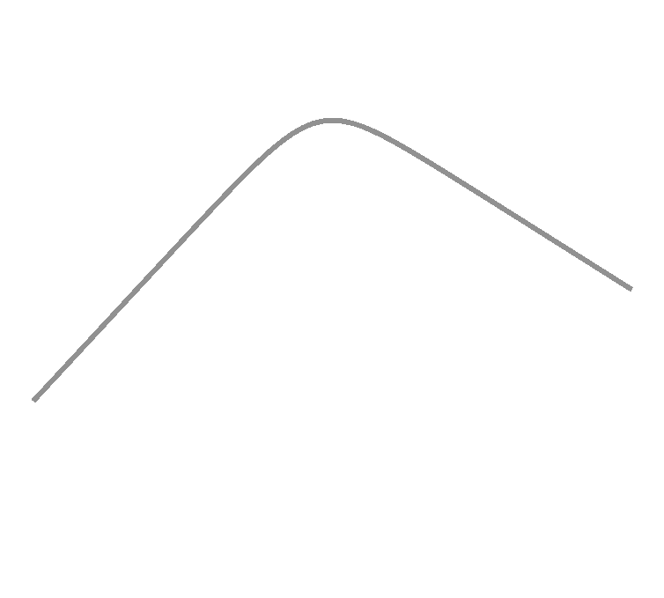
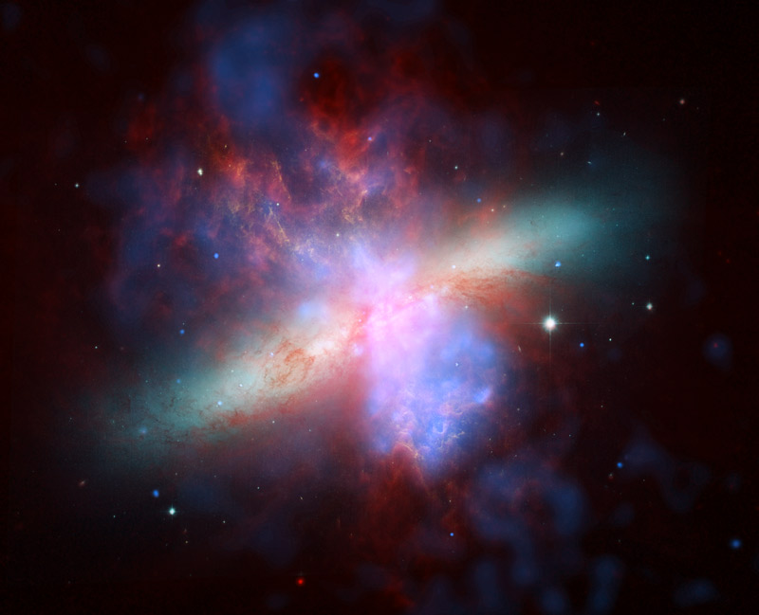
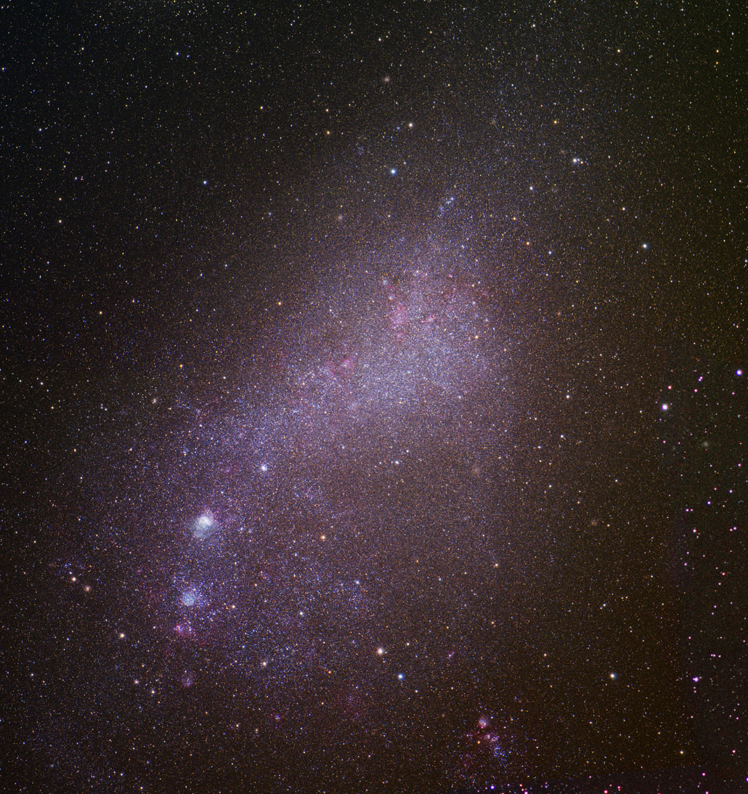
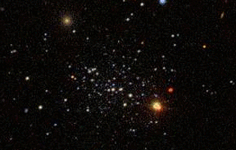
gas accretion
merging
massive stars & SNae
heating and winds
AGN feedback
heating & winds
photoionization/
photoevaporation
gravitational
heating
no HI
cooling
halo mass (M_{sun})
Notes:
although we are still working out the details of many of these processes, there has been progress in at least arriving at a broad consensus about which physical processes are likely to be important for shaping galaxy properties. these include: accretion of gas from the ‘cosmic web’, which dominates the growth of low-mass galaxies, and growth through mergers, which is important for the growth of massive galaxies; heating and winds from stars and supernovae (low-mass), and heating and winds from accreting black holes, important for massive galaxies.

Slide 16
theoretical picture: see discussion in Barro et al. 2013, 2014; also Naab et al.
2009; Hilz et al. 2013; Porter, rss et al. 2014 and references therein
disks
spheroids
star-forming
smooth
gas accretion
wet merger/
disk instabilities
gas removal
(and/or strangulation)
quenching
specific star formation rate
quiescent
dry mergers
extended
internal density
compact
Notes:
the theoretical picture that we’ve built up to explain this is that dissipational processes like wet mergers and disk instabilities cause gas to flow to the center of the galaxy, building a density spheroid and fueling accretion onto a SMBH. the AGN quenches the galaxy, and subsequently dry (mostly minor) mergers puff up the galaxy.

Slide 17
example: stellar feedback
‘sub-grid’
treatment
explicit physical
treatment
galaxy-scale
phenomenological
wind scalings
input of thermal energy
and/or momentum, using
`tricks’ to mimic sub-grid
processes
resolve individual
stars & SNae &
multiphase ISM;
explicitly simulate
all physical processes
semi-analytic models
Oppenheimer & Davé
Illustris
EAGLE
Naab+
GASOLINE
RAMSES
hydro-ART
FIRE
Agertz
& Kravtsov
cosmological
volumes (100-500 Mpc)³
zoom-ins (individual halos)
idealized individual galaxies
Notes:
without getting too technical I just wanted to talk a little bit more about some of what is going on in the trenches of modeling galaxy formation. let’s take stellar feedback as an example. we know that stars and supernova can affect the gas around them through radiation pressure, stellar winds, photoionization, and supernova explosions. the ideal approach would be to resolve individual stars and supernovae and attempt to directly simulate each of those processes. unfortunately this is numerically infeasible, although some groups have made progress on doing this for sub-galactic scale simulations. however, several groups are trying to get as close to this ‘explicit’ modeling of feedback as possible with very high resolution simulations of individual galaxies. the problem is that these simulations are extremely expensive and only a few galaxies can be simulated. for many purposes, we would like to be able to simulate larger volumes, and in this case, it is necessary to either use ‘tricks’ to try to replicate the unresolved physics, or to implement the macro scale processes directly. an example of the kind of trick I’m talking about is to superheat the gas or to turn off cooling after the thermal energy is deposited. an example of the ‘phenomenological’ scalings is to just assume a velocity and mass loading rate for the global outflows from galaxies and kick particles to achieve that.

Slide 18
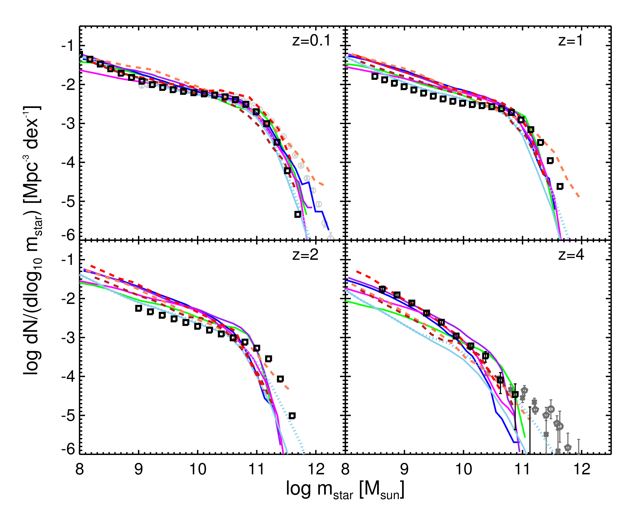
consensus on the main physical processes that shape galaxy evolution?
observational
estimates are shown
by symbols
lines show predictions
from 5 semi-analytic
models (solid)
and 3 numerical
hydrodynamic
simulations (dashed)
Santa Cruz SAM;
GALFORM; MPA
Millennium SAM;
SAGE SAM; Lu SAM
Illustris simulation;
EAGLE simulation;
Oppenheimer & Davé
ezw simulation
Somerville & Davé ARAA, 2015

Slide 19
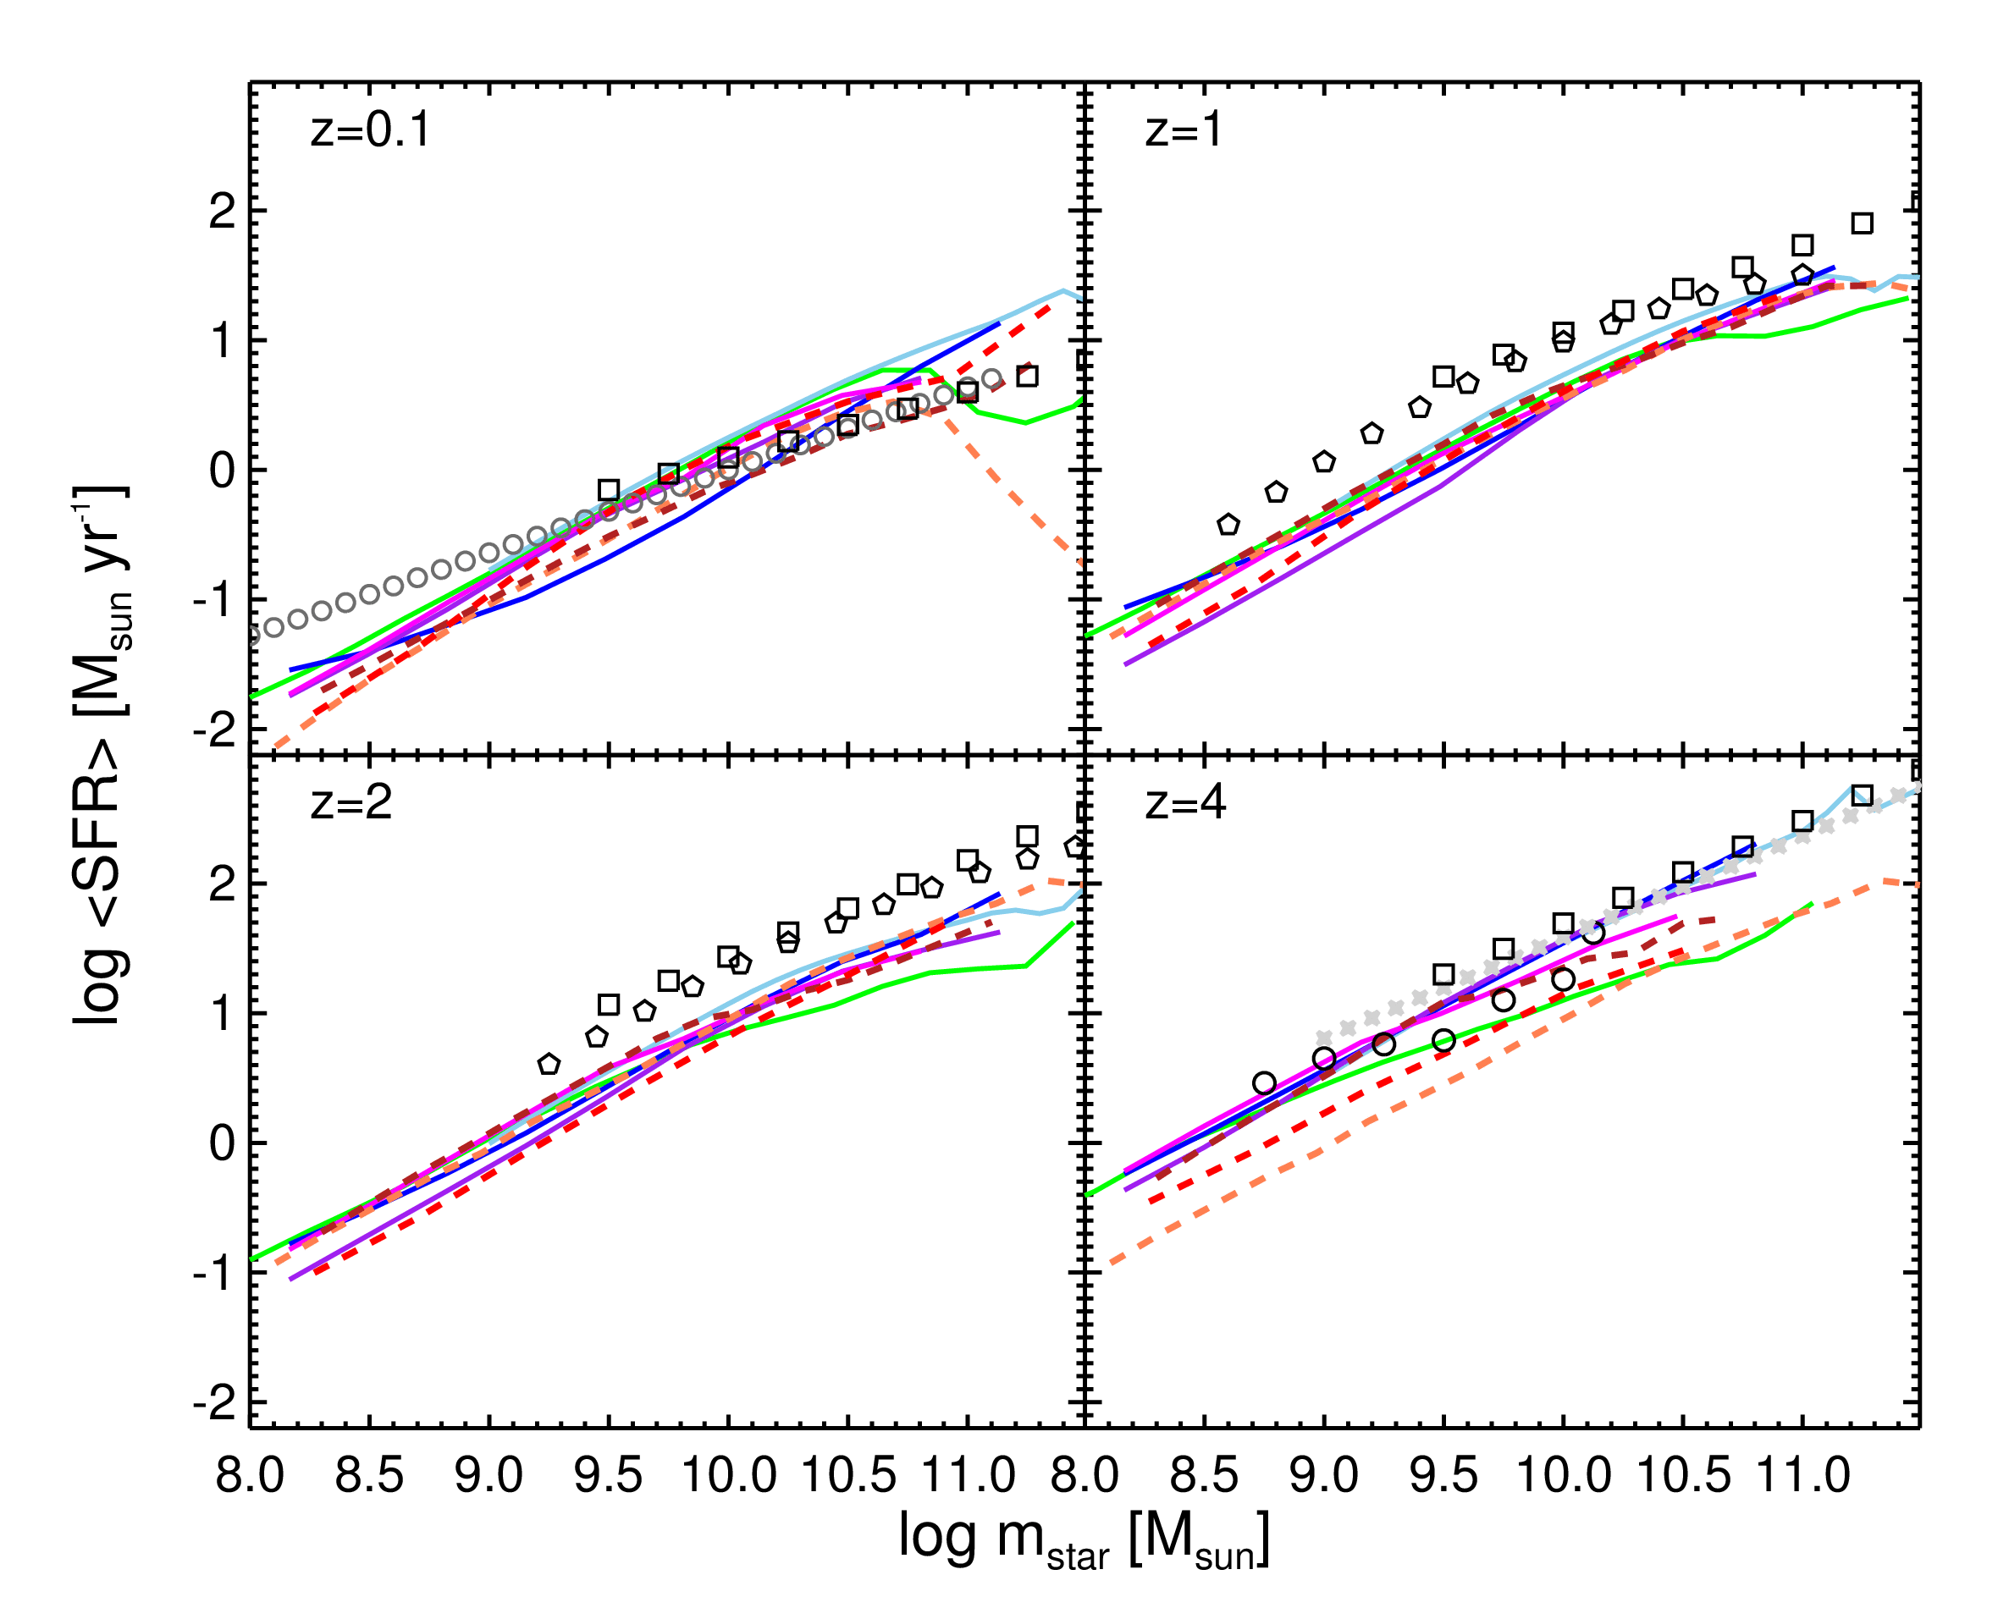
what is the origin of the star forming main sequence?
observational
estimates are shown
by symbols
lines show predictions
from 5 semi-analytic
models (solid)
and 3 numerical
hydrodynamic
simulations (dashed)
behavior can be
explained by a
simple ‘equilibrium’
model)
Somerville & Davé ARAA, 2015

Slide 20
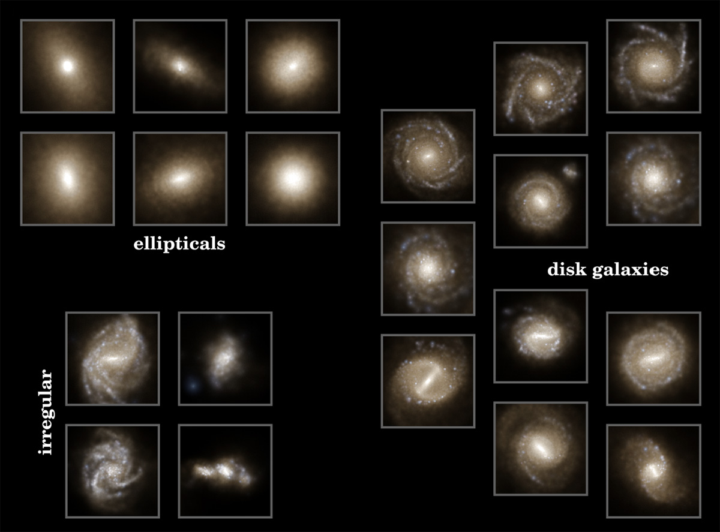
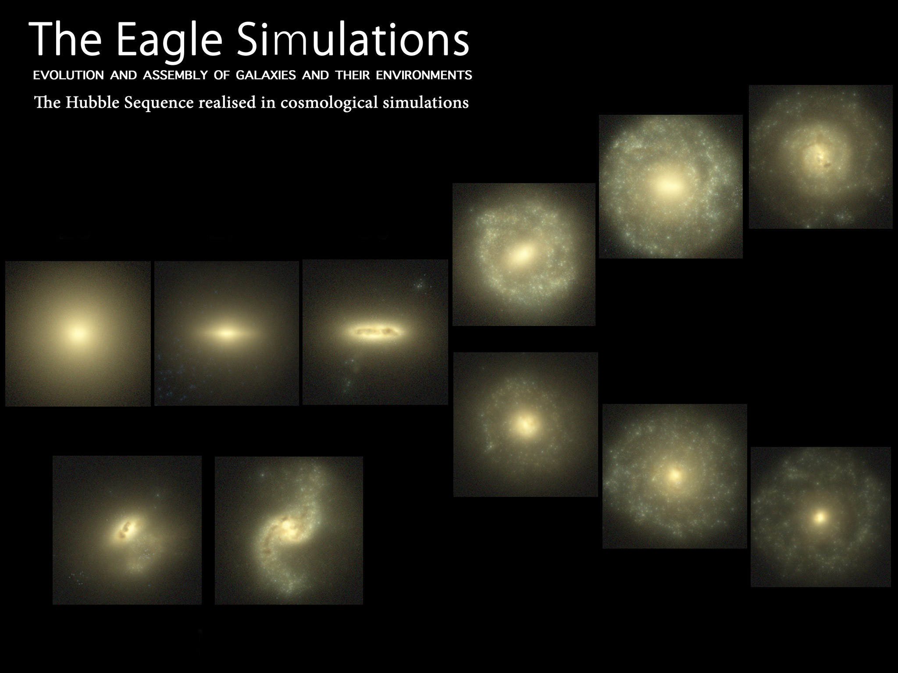
modern simulations produce
a diverse range of galaxy
morphologies
Schaye et al. 2014
Illustris (Vogelsberger et al. 2014)

Slide 21
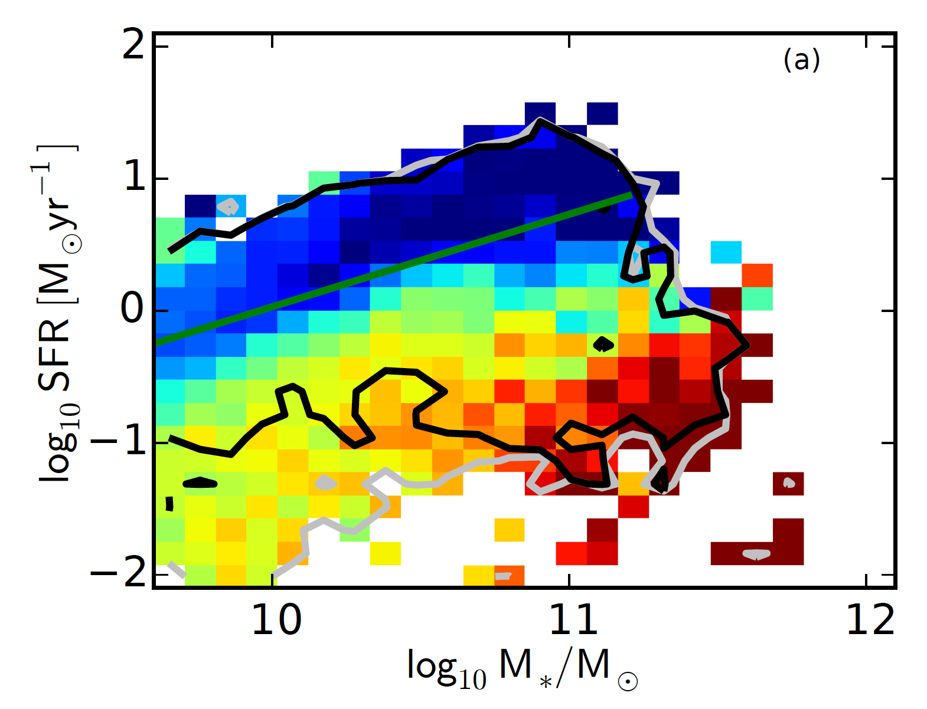
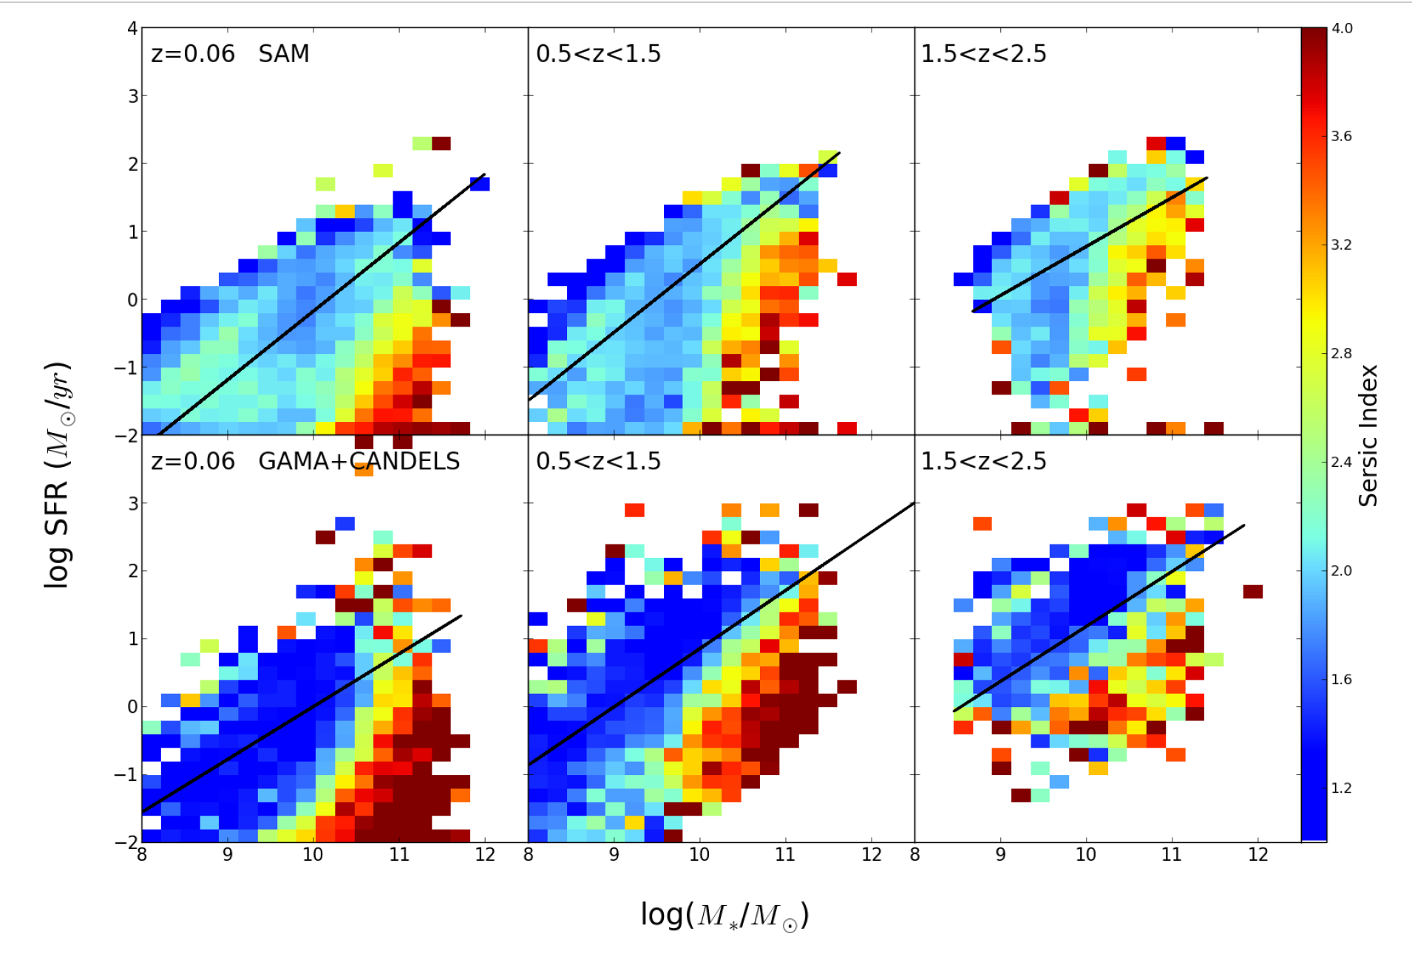
despite the crudeness of current ‘sub-grid’
recipes, simulations qualitatively capture the
observed correlation between quenching
and internal structure
Brennan et al. 2015 semi-analytic model
Snyder et al. 2015
Illustris simulation

Slide 22
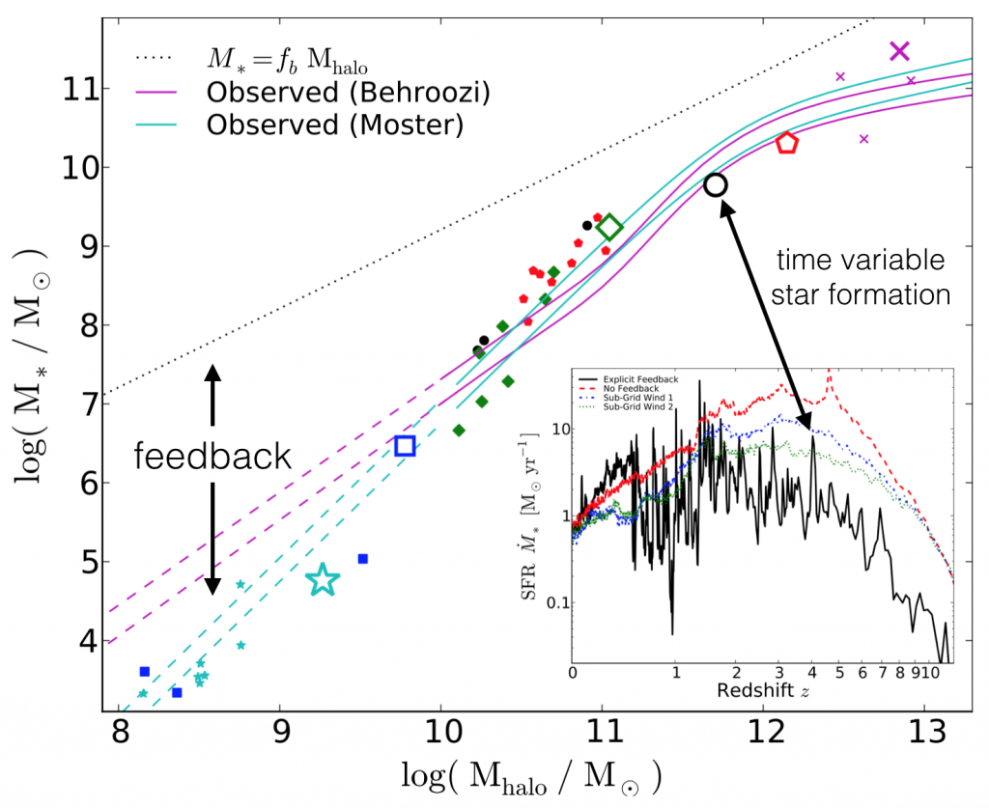
Hopkins et al. 2013
Notes:
here is an example from the FIRE project, which is attempting a very explicit implementation of feedback. the graph shows the mass of the dark matter halo versus the mass of stars that have formed in halos, which is often used as a way to normalize the physical recipes in models. the inset shows the star formation history of a MW-mass galaxy. the red line is a model without feedback, which produces a lot of high redshift star formation. the sub-grid wind models reduce the total mass of stars formed to roughly the right amount, but a different star formation history is predicted by the model with explicit feedback. in particular, this model predicts that star formation should be highly stochastic.

Slide 23
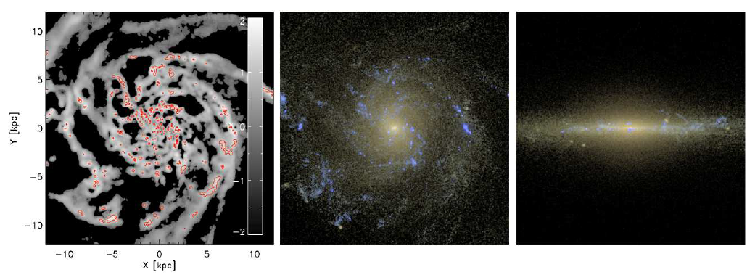
angular momentum catastrophe solved (?) – combination of resolution,
more physical treatment of ISM, star formation, stellar feedback
GASOLINE simulation including metal cooling,
H₂ chemistry & simplified radiative transfer
Christensen et al. 2012
see also Guedes et al. 2011; Brooks et al. 2011; Governato et al. 2010

Slide 24
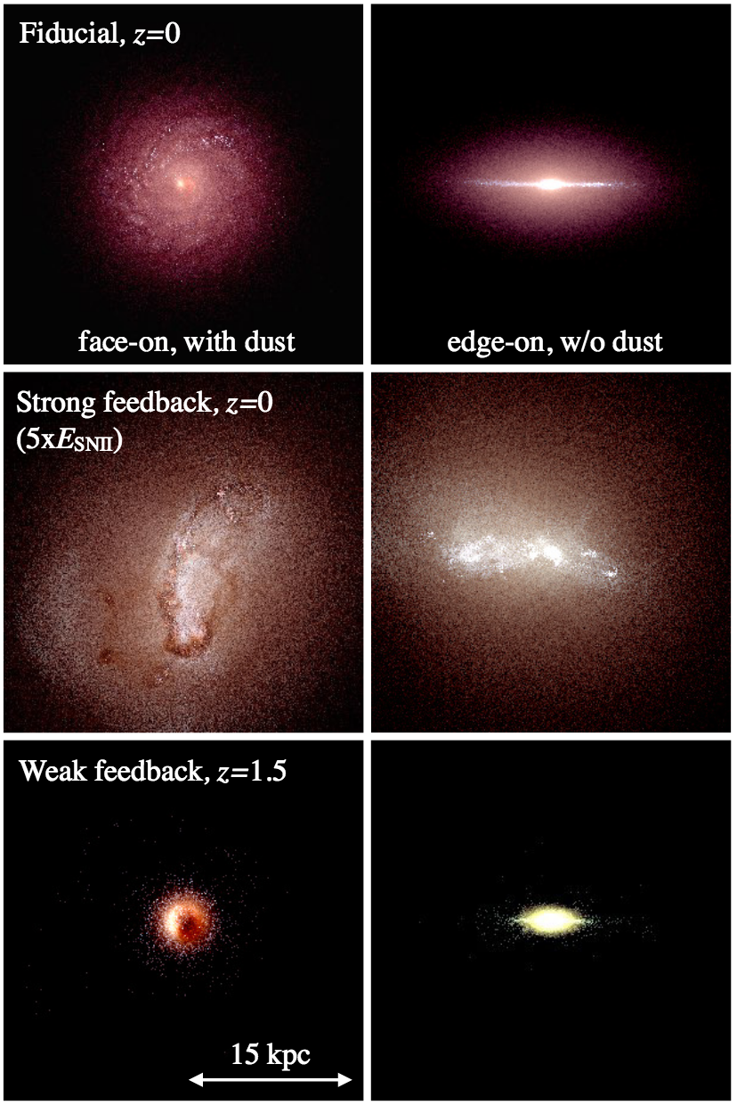
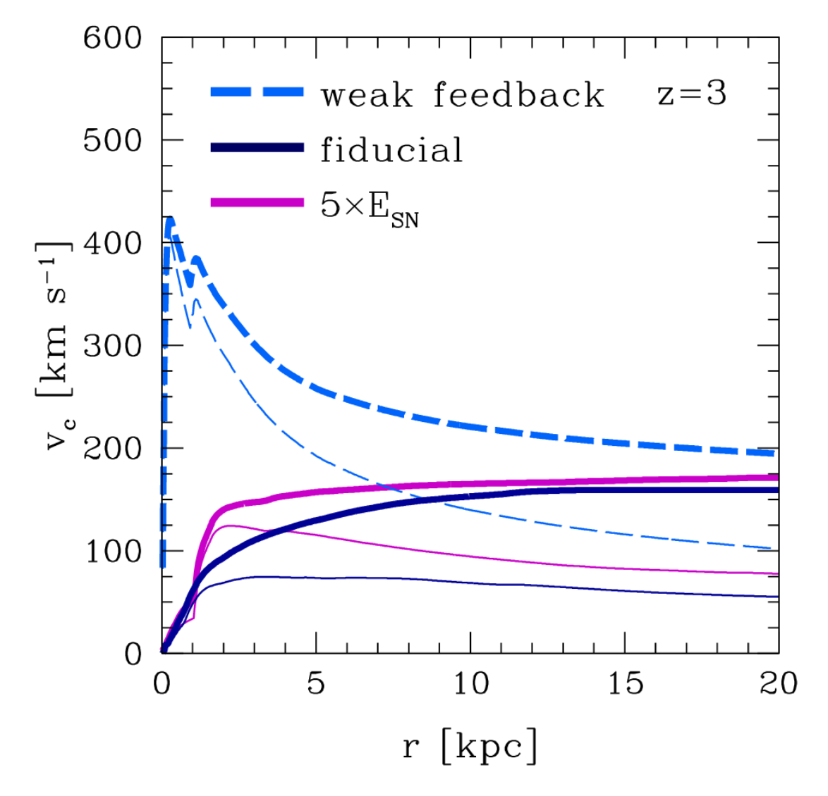
Agertz & Kravtsov 2015

Slide 25
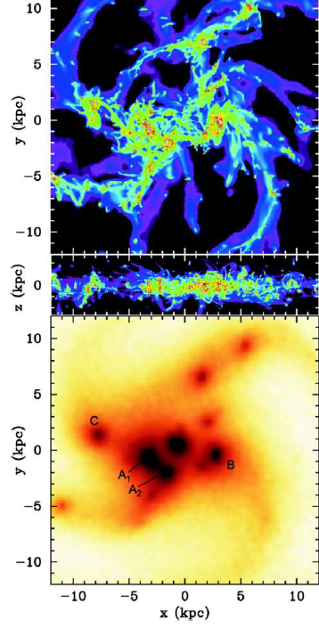
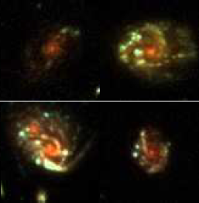
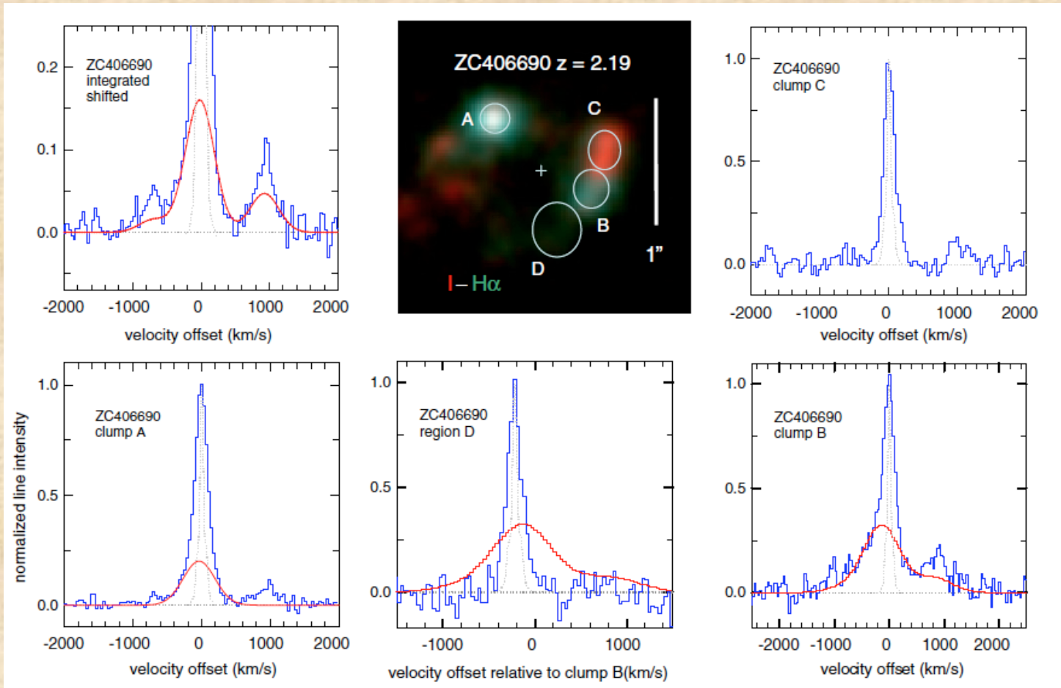
Clumps and Disk Instabilities
internal gravitational instabilities may lead to formation of clumps
these may drive nuclear inflows & migrate to the center, forming a spheroid & feeding the BH
outflows from individual clumps detected (Genzel et al. 2011)
Dekel et al. 2009; Bournaud, Dekel et al. 2011
Y. Guo (CANDELS)

Slide 26
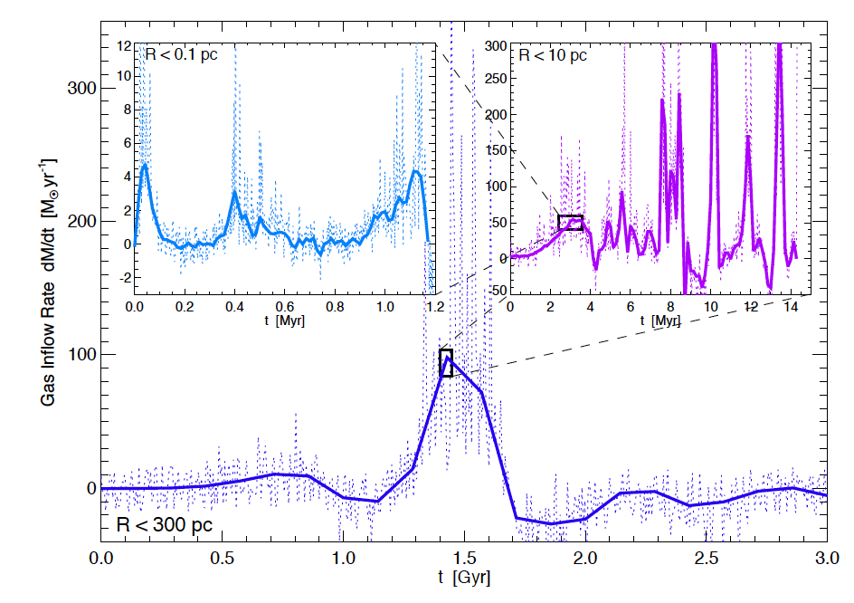
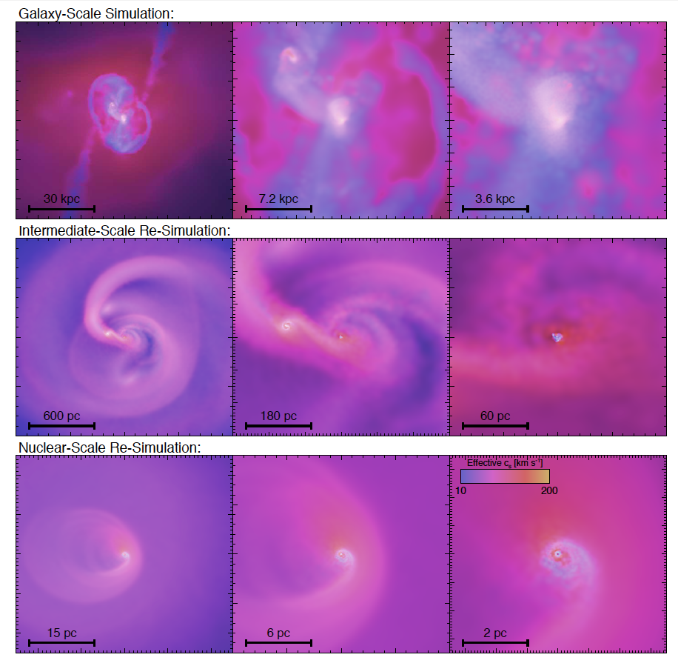
How do black holes accrete?
Why are some BH feasting
while others are starving?
Hopkins & Quataert 2011

Slide 27
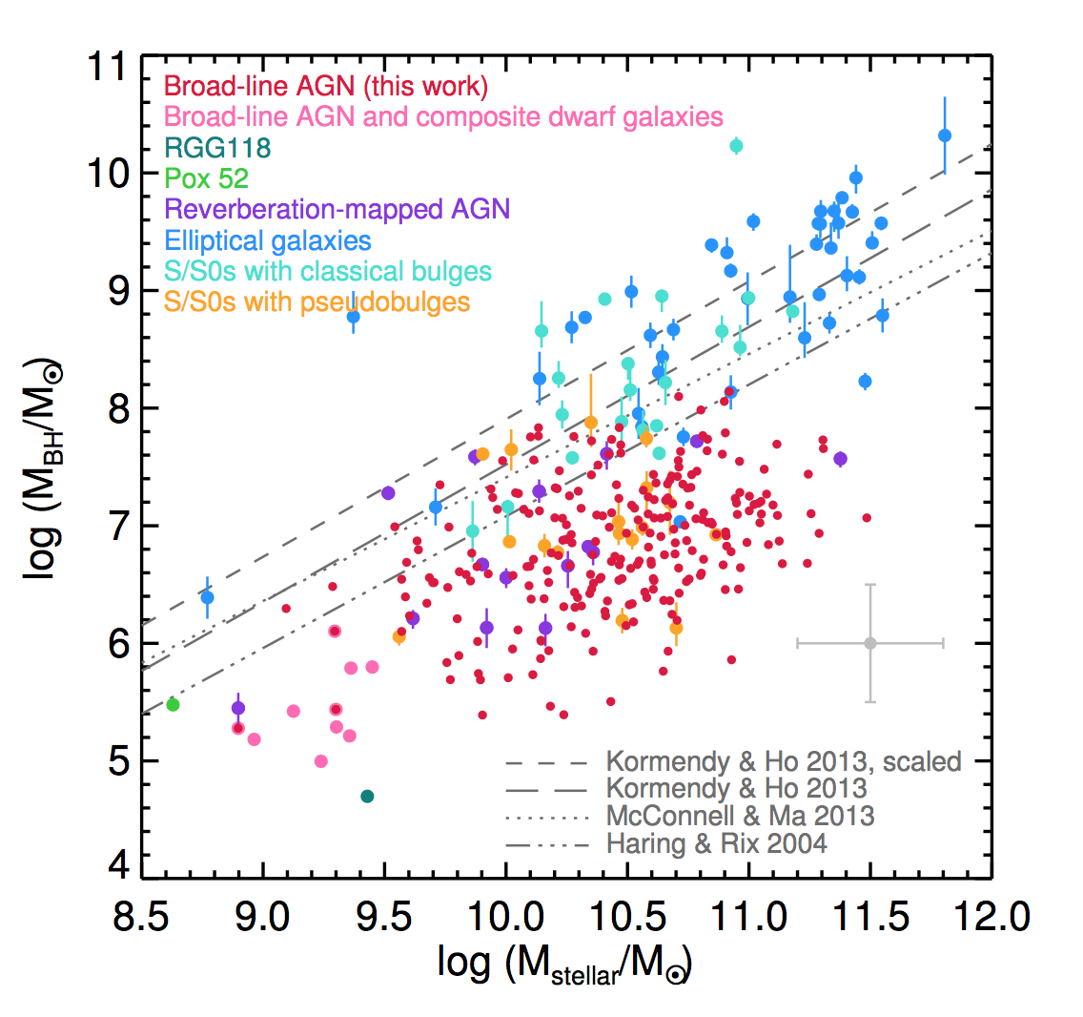
black hole scaling relations
[how often] do low mass galaxies contain black holes?
how do BH scaling relations evolve over cosmic time?
which parameter has the most fundamental correlation with BH mass?
Reines & Volonteri 2015

Slide 28
AGN feedback
radiative mode
heating (Compton, photo-ionization, photo-electric)
winds driven via radiation pressure on spectral lines, free electrons, or dust
ionization and photo-dissociation of gas
jet mode
relativistic jets of charged particles heat diffuse hot gas via sound waves, weak shocks, and viscosity
may also drive outflows of dense, cold material
Notes:
winds may originate in the torus or accretion disk, BLR, larger nuclear scales, or all of the above
kinetic energy in the jets can exceed L_{bol} by orders of magnitude -- plenty of energy to offset cooling if it couples efficiently to a large volume of gas
no cosmological simulations currently include detailed modeling of both modes of AGN FB (radiation and jets)

Slide 29
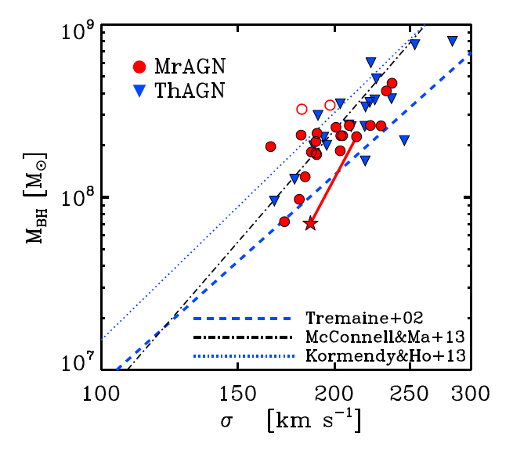
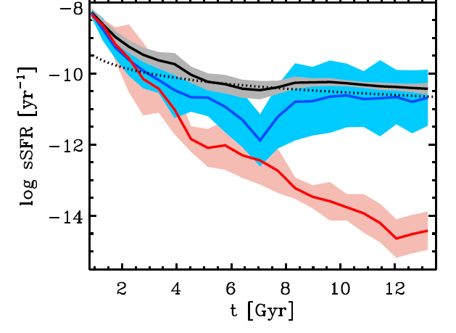
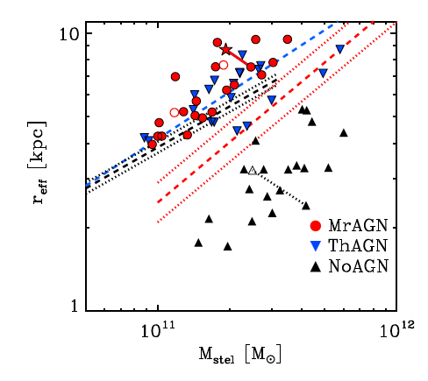
both AGN FB models produce
similar results for global
and structural properties
of galaxies, but model with no
AGN FB produces galaxies that
are too compact
(lines are
observational
estimates;
points are
simulation
predictions)
Choi et al. 2015; see also
di Matteo+05, Springel+05;
Robertson+05; Sijacki+07,11,14

Slide 30
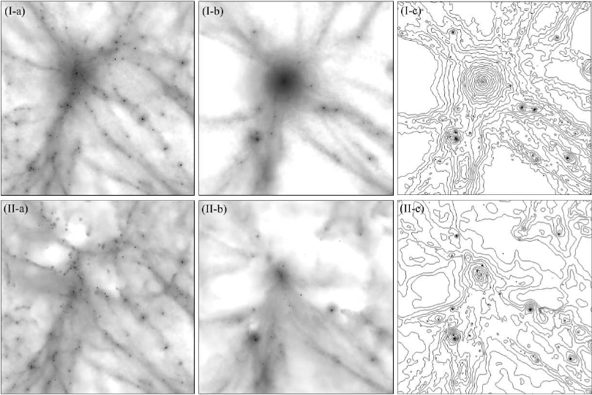
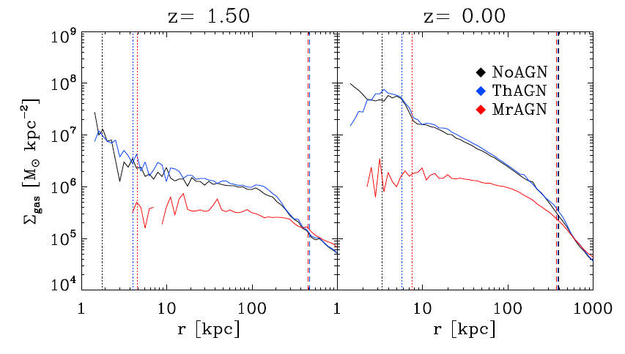
z=1.5
z=0
z=0
Simulations with Momentum
feedback from AGN
thermal only
cosmological zoom-in sims
star and gas particles 6E06 M_{sun}
DM particles 3.6E07 M_{sun}
comoving softening 571 pc
2.3E12<M_{h/}M_{sun}<1.3E13
~10⁶ particles per halo
fixed wind velocity 10,000 km/s
+ radiative feedback
standard ‘thermal’
BH feedback
+momentum
Choi et al. 2014; Choi et al. 2015
w/ J. Ostriker, T. Naab, L. Oser
see also Debuhr et al. 2010, 2011
Notes:
star and gas particles 6E06 M_{sun}
DM particles 3.6E07 M_{sun}
comoving softening 571 pc
halo mass 5E12

Slide 31
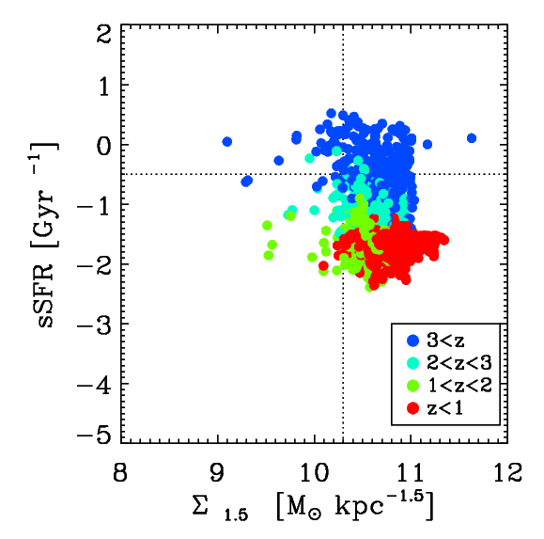
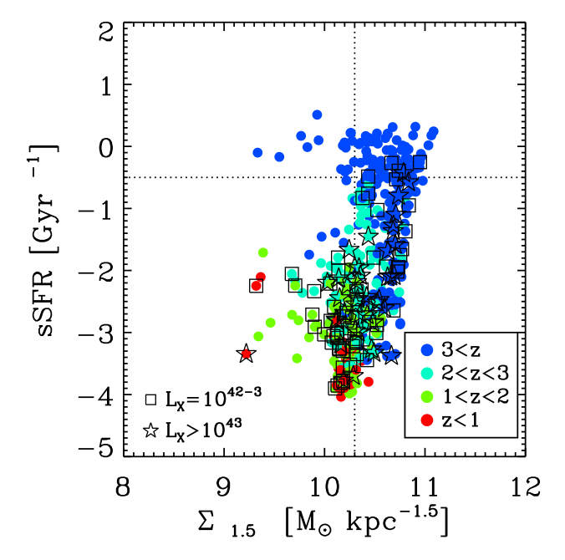
no AGN feedback—
incomplete quenching
indefinite compaction
with AGN-driven winds—
compaction→quenching→
expansion
Choi, rss et al. in prep; rss et al. in prep

Slide 32
Mapping the bulk of the baryons and metals since z~1
theoretical models rely on efficient stellar and AGN-driven winds to get gas out of galaxies
galaxy properties are a blunt tool – CGM should provide much stronger constraints on ‘sub-grid’ physics
many unanswered questions!

Slide 33
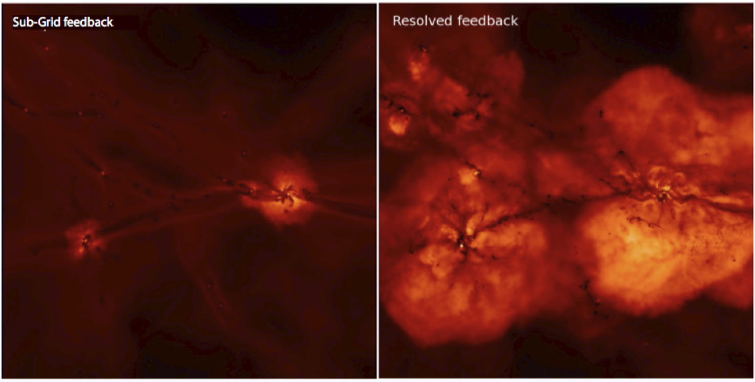
P. Hopkins

Slide 34
COS-halos & COS-dwarfs

Slide 36
CGM lessons and questions
CGM contains a lot of baryons & metals
it also contains a large amount of primordial gas, which may be a signature of accretion
some halos possess gas at ~10⁶ K, which may be the long-sought ‘missing baryons’
quenched galaxies have a lot of gas in their CGM too, begging the question of how they stay quenched over long timescales!
J. Tumlinson, HST whitepaper

Slide 37
Werk et al. 2014
COS-halos: the baryons and
metals in the circumgalactic
medium likely exceed those
in stars and the ISM
Peeples et al. 2014

Slide 38
CGM lessons and questions
what is the dynamical state of the CGM (fraction of primordial accretion, outflowing material, recycled accretion, etc)?
how (in detail) do gas and metals cycle through the CGM?
how do quenched galaxies stay that way while surrounded by lots of gas?
do we finally have a complete census of baryons and metals?
J. Tumlinson, HST whitepaper

Slide 39
Dwarf galaxies as laboratories for fundamental physics:
missing satellites, cusps & cores, & “too big to fail”
discovery of new “ultrafaint”
dwarf galaxies in the Local
Group (satellite count has
tripled in past decade;
SDSS/Segue/DES/DECam/
LSST)
-very high M/L
-pure ancient stellar pop
-fossils of reionization?
Willman et al. 2005; Zucker et al. 2006
Belokurov et al. 2007; Koposov et al. 2015
Bechtol et al. 2015; Kim et al. 2015
slide credit: J. Bullock

Slide 40
highly stochastic star formation and strong stellar winds can convert
cuspy halos into cored halos
Oh et al. 2011; Pontzen & Governato 2012

Slide 42
below a critical mass, halos do not produce enough stars to create cores
(Peñarrubia et al. 2012)
Governato et al. 2012

Slide 43
embarrassingly,
there is a large
parameter space
for ‘non-boring’
variants of dark
matter that is
not ruled out by
current
observations
e.g. self-
interacting DM
(Spergel &
Steinhardt 2000)
range of interaction
cross sections
produce cored
halos
Elbert et al. 2014

Slide 44
spatial resolution
distance to object
FCB2LE

Slide 45
Fig. 4-5,
“From Cosmic Birth to Living Earths”

Slide 46
FCB2LE

Slide 47
summary: Big Questions that a large-aperture UVOIR telescope could help answer!
how are “small scale” physics and global galaxy properties connected?
how does gas cycle in and out of galaxies?
is the dark sector simple or complex?

