Slide 1
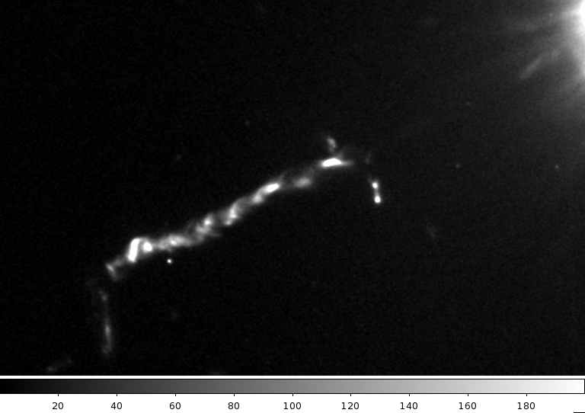
Proper Motions of Jets from Black Holes in the HST Era and Beyond
Eileen Meyer
Postdoctoral Fellow
Space Telescope Science Institute
(→ UMBC this fall)
ATLAST/ULVOIR Symposium, GSFC, 12 August 2015
Bill Sparks (STScI), John Biretta (STScI), Jay Anderson (STScI), Roeland van der Marel (STScI), Tony Sohn (JHU), Marco Chiaberge (STScI), Colin Norman (JHU), Markos Georganopoulos (UMBC)

Slide 2
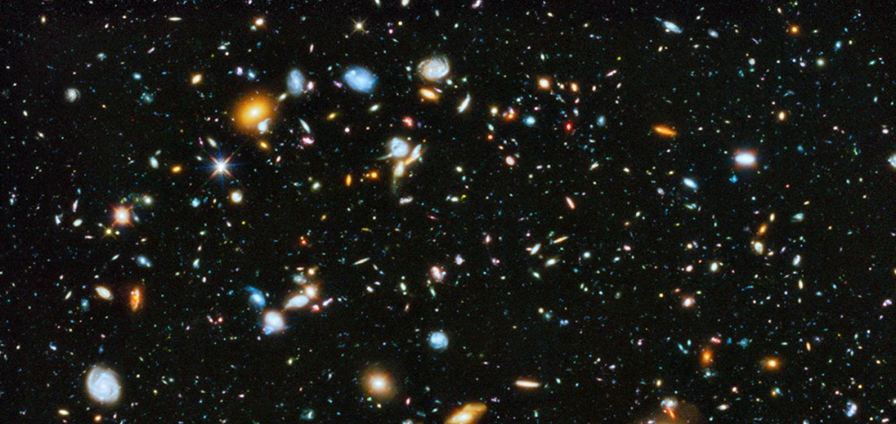
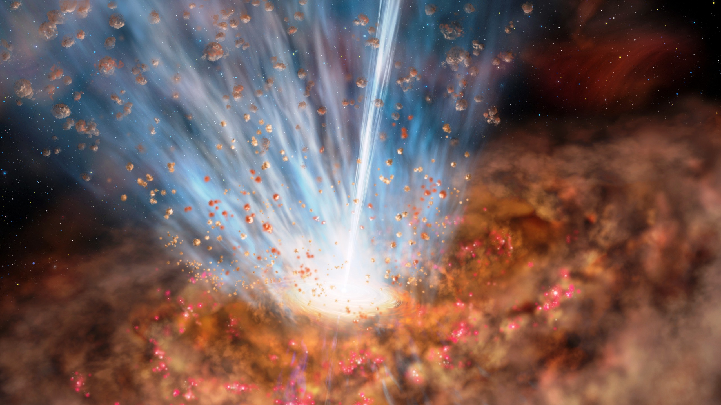
A Super-massive Black Hole (1 million – 1 billion solar masses) at the center of all massive galaxies
A few % of these black holes become “active” by accreting matter
→ Active Galactic Nuclei (AGN)
Luminosities up to 10⁴⁷ erg/s
Massive Winds (3000 solar mass/year!)
Fast Winds (0.3c!)

Slide 3
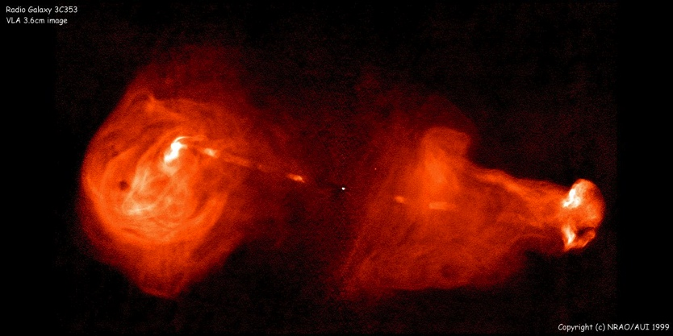
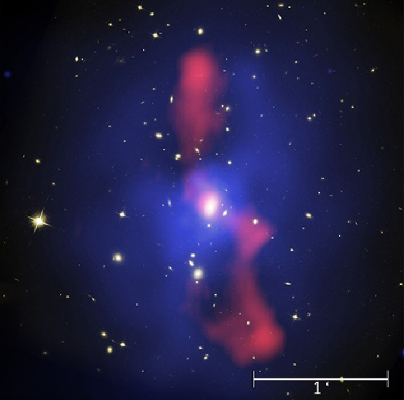
About 10% of AGN have Relativistic Jets
Synchrotron radiation from
Radio to X-rays
3C 353 (NRAO)
Kinetic Powers up to 10⁴⁶ erg s
Lifetimes ~ 10⁷ yr (?)
Jet lengths can reach ~1 Mpc
Heating of the galaxy-scale gas
and cluster medium
MS0735.6 (McNamara et al 2009)

Slide 4
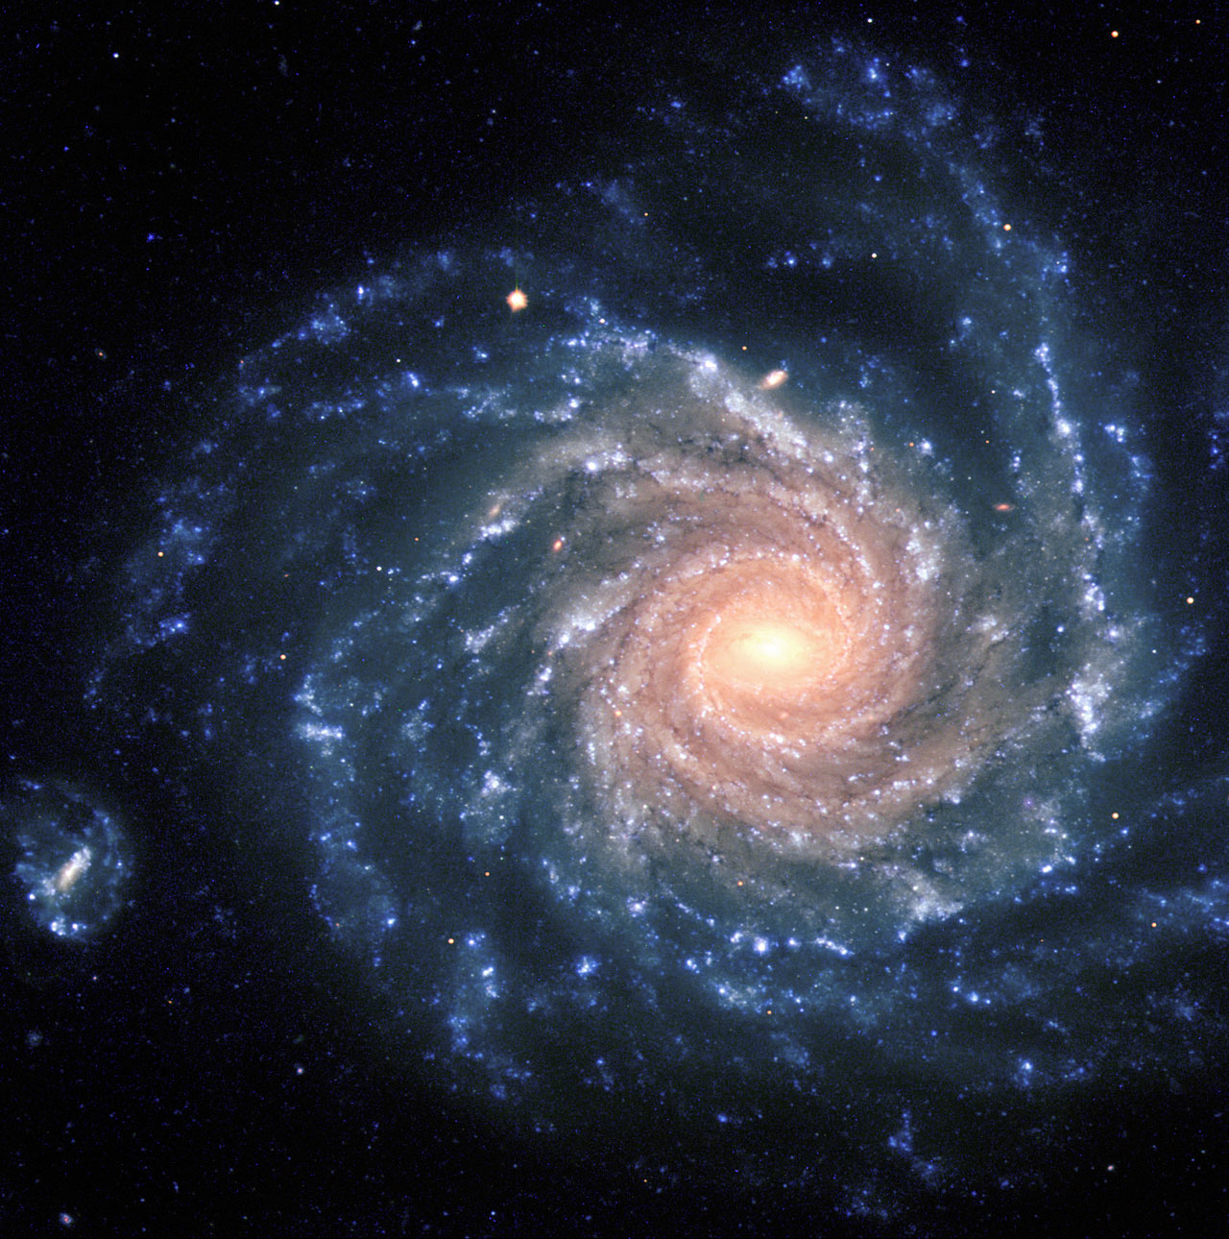
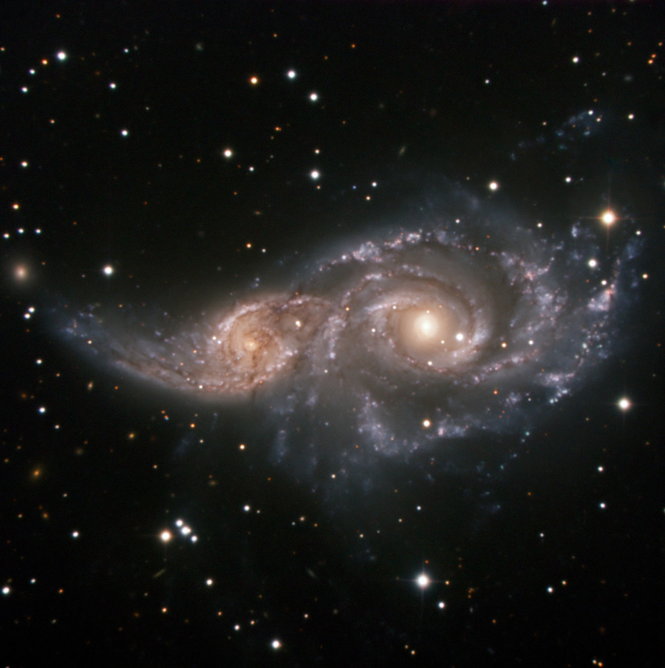
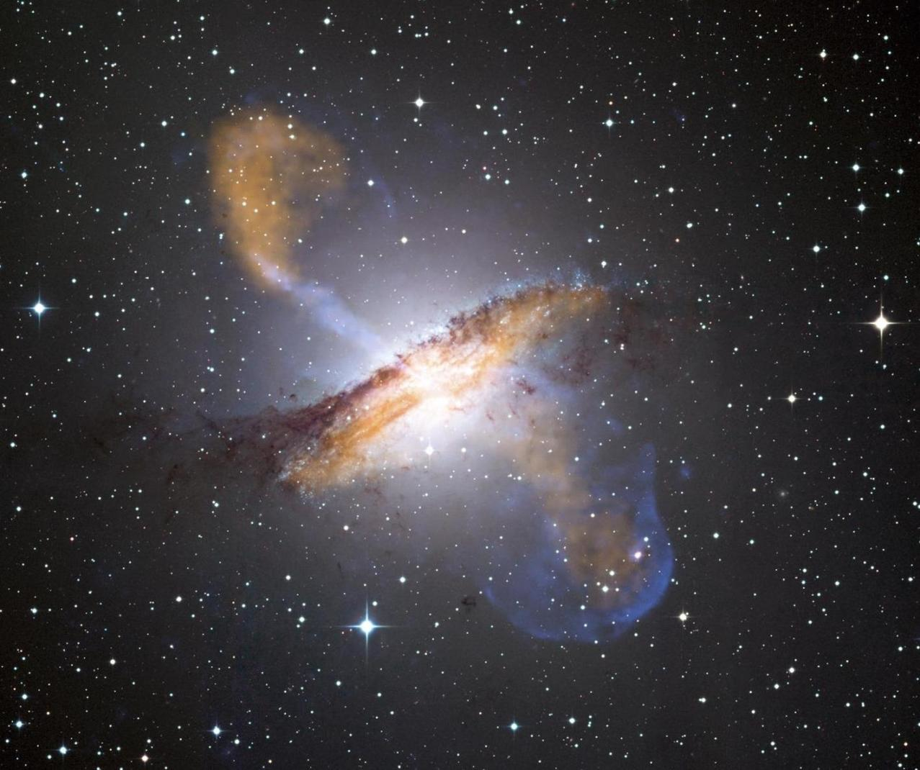
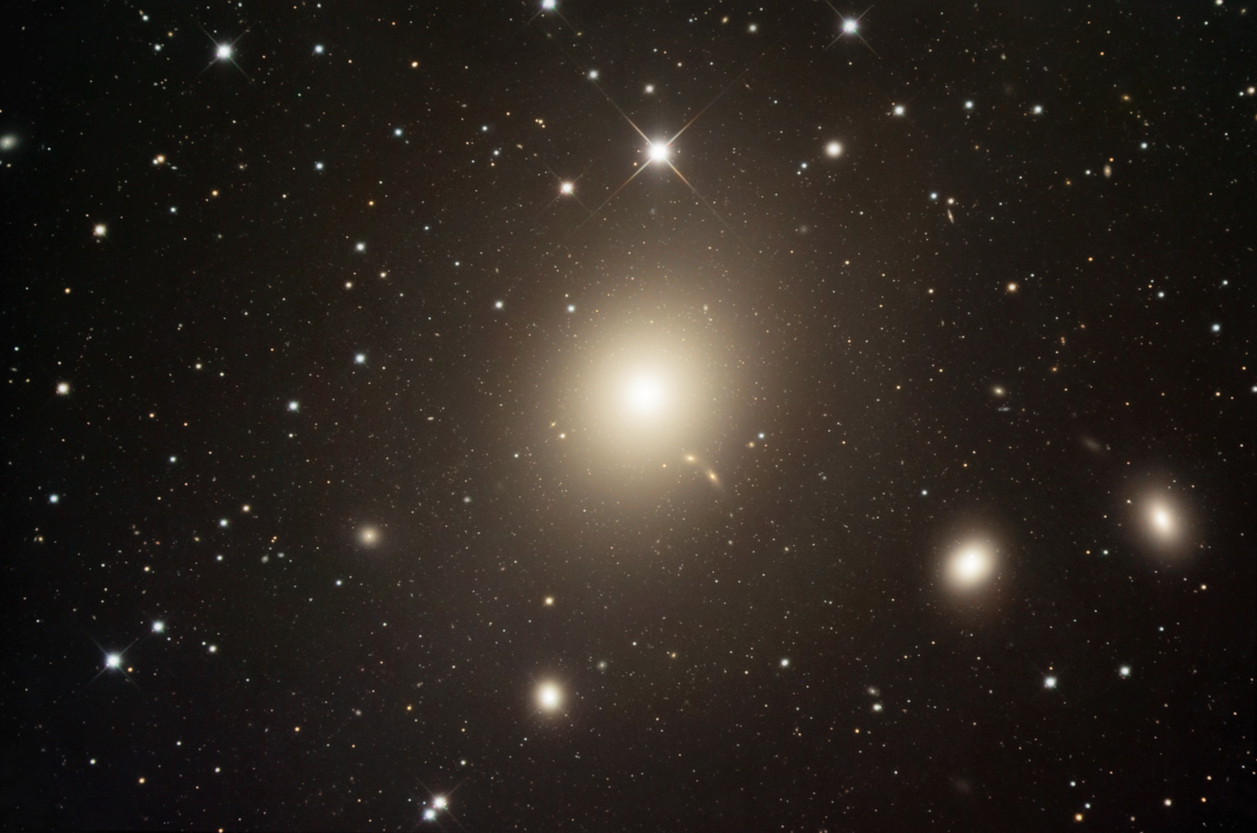
Q: How did galaxies form and evolve to produce the Universe we observe today?

Slide 5
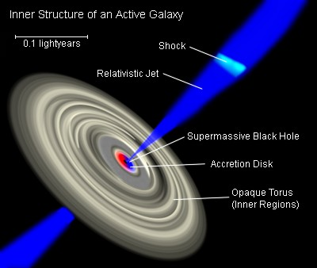
Jetted AGN
AGN as systems
- Why few % of galaxies are active?
- Why 10% of AGN have jets?
- How are Jets formed/launched & connection to the black hole (mass, spin) – what is the `trigger’?
- Energy balance (what is the jet made of)?
- What are the lifetimes/duty cycles of the jet?
AGN jets and “feedback” (the “bigger picture” impact)
- Lots of energy and matter is being `recycled’ on huge scales
- However, quantitatively this is not understood (see above)
- POSSIBLE impacts of jets on galaxy formation, evolution (even altering the makeup of the Universe in terms of types of galaxies produced)
- possible link to reionization

Slide 6
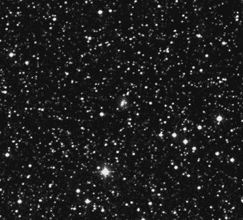
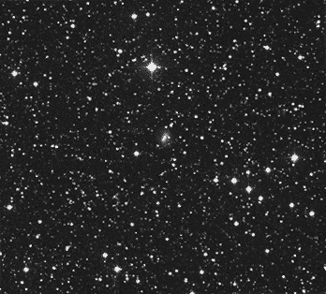
Proper Motions

Slide 7
Proper Motions
Notes:
Barnards star – palomar survey, 50 years apart. 10”/year!

Slide 8
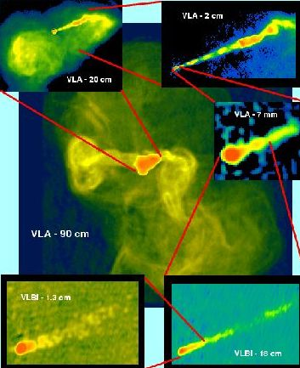
Proper Motions of Jets
M87, one of the archetypical nearby jets
20” (2 kpc)
(Biretta & Junor 1995)
24 mas (2.5 pc)
0.15” (17 pc)
Notes:
Smallest image; A VLBI image of the jet at 1.3 cm (from Biretta & Junor). The length of the visible jet is about 2.5 pc. The physical scale of the innermost jet features, next to the unresolved core source, is about 0.1 pc (1/3 of a light year), about 100 times the size of the black hole which drives the system.

Slide 9
Proper Motions of Jets
Movie Credit: Craig Walker

Slide 10
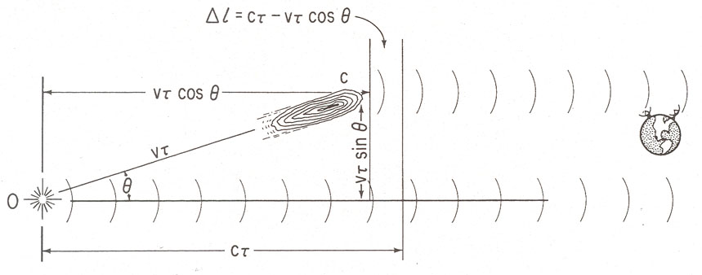
Proper Motions of Jets
Superluminal motion – first predicted in the 1960s, detected soon after and confirmed the relativistic jet at the heart of radio quasars

Slide 11
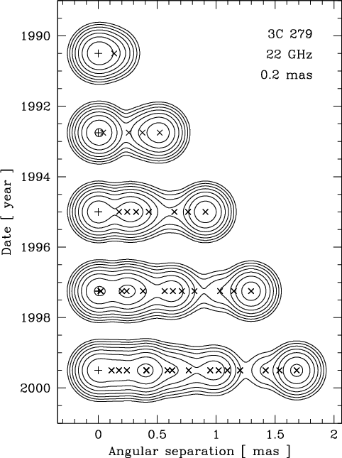
Proper Motions of Jets – in the RADIO
Probing scales close to the black hole (sub-pc to tens of pc)
Relies on a stable core position
Hundreds of sources with measured proper motions (MOJAVE sample, Lister et al. 2009, also Jorstad, Marscher, Piner, many more over decades)
Apparent velocities from sub-luminal up to 50c

Slide 12
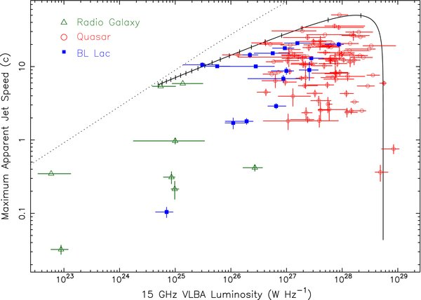
Proper Motions of Jets – in the radio
(from Lister et al. 2009)
Apparent Speed versus radio power
Superluminal Speeds are Common on the parsec and sub-parsec scale near to the black hole

Slide 13
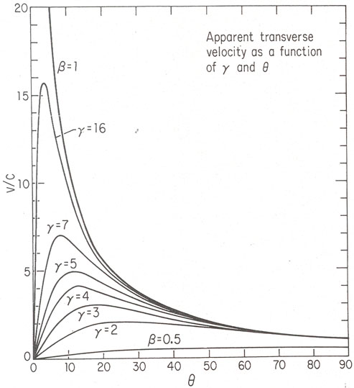
Constraints from Proper Motions

Slide 14
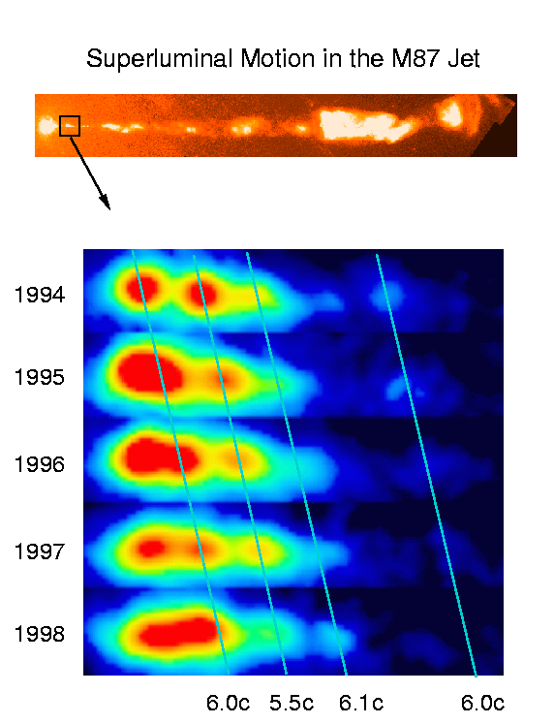
Proper Motions of Jets – with HST
M87: Very nearby, very well-studied jet (19 Mpc)
Biretta et al., 1999
4 years of time-elapsed FOC imaging
First optical proper motions measured in extragalactic jets
Superluminal speeds ~ 6c
This remained the only measurement of proper motions on kpc scales
VLBI gives low speeds (less constraining)

Slide 15
The Present
HST observed the first jets with WFPC2 in the early to mid-1990s
3C 264, 1994
3C 264, 2014
Today: 20+ year baselines
Bill Sparks & John Biretta

Slide 16
The Present
State-of-the-art Astrometry
Easily register images to 5 mas using globular clusters and background galaxies (0.17 mas in M87 study)
In extragalactic jets, we are dominated by the error in measuring the jet components, not the systematics
Tony Sohn
(Johns Hopkins)
Jay Anderson
(STScI)
Roeland Van der Marel
(STScI)

Slide 17
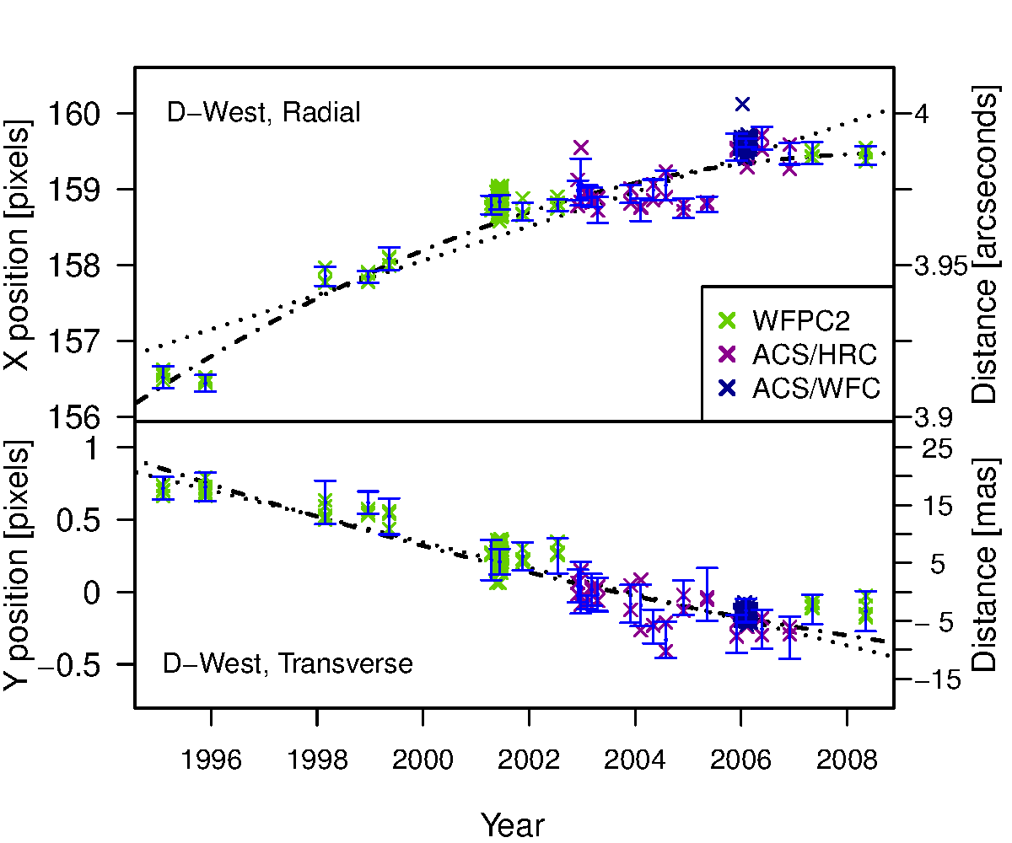
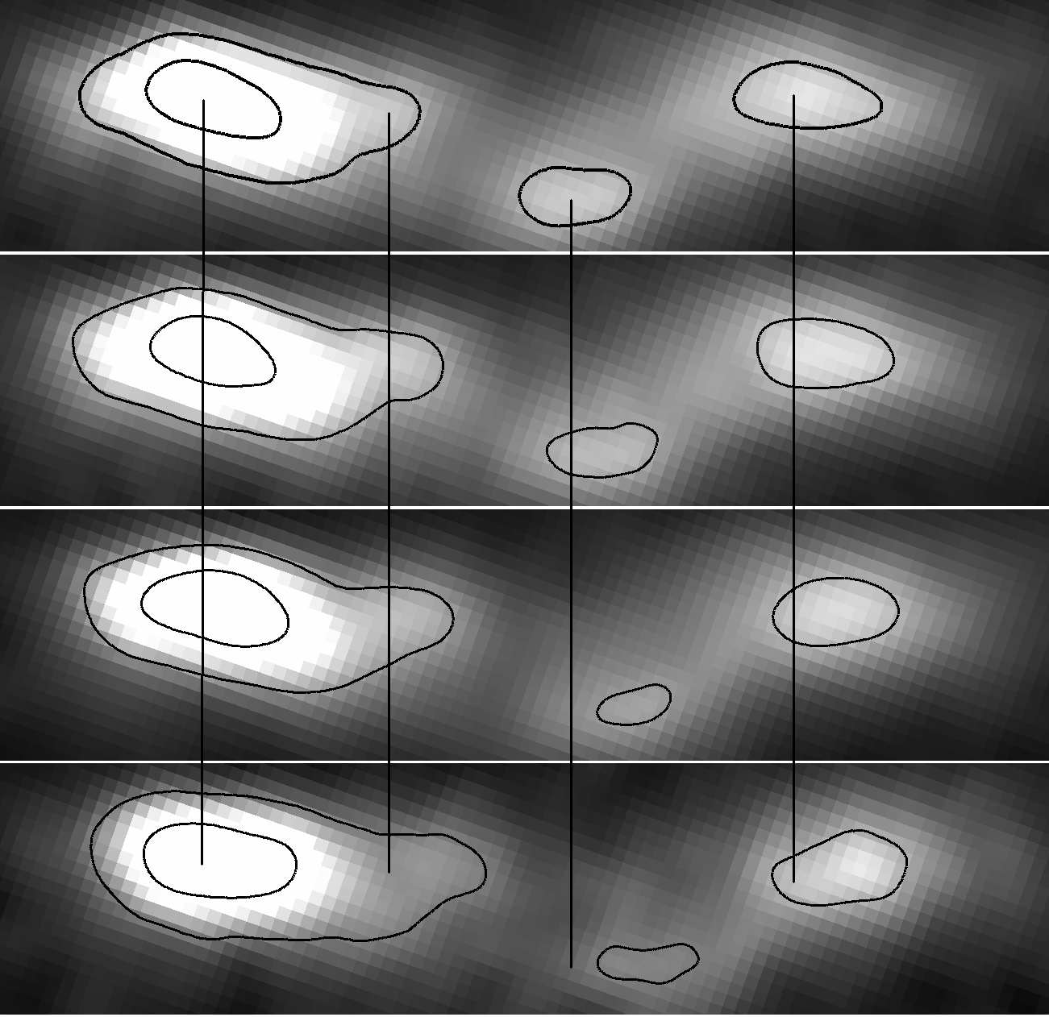
First Test: Back to M87
Nearby: only 16 Mpc away! (106 pc/”)
Meyer et al., 2013 (ApJ, 744 ,L21) Key Results:
Unprecedented accuracy of < 0.1c
Measured deceleration and transverse motions for the first time
Helical pattern in outer knots
Superluminal speeds in the outer knots
D-west
1995
1998
2001
2008
Notes:
For our first attempt to apply high-precision astrometry, we went back to M87…Prefer tip-to-tail image here

Slide 18
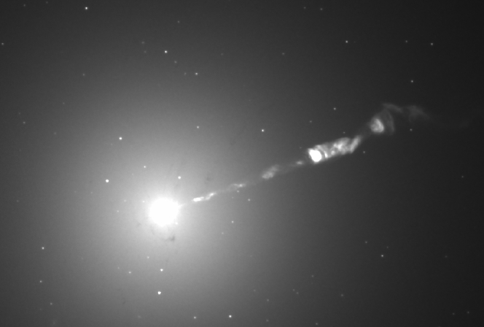
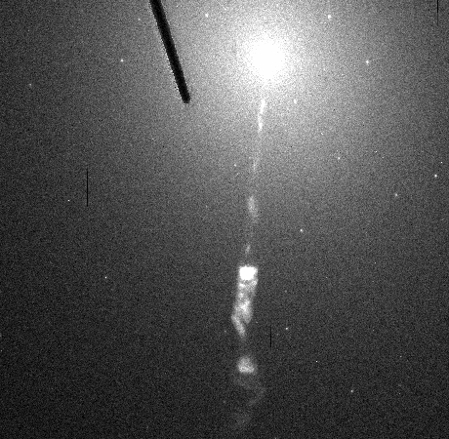

Slide 19
First Test: Back to M87
More M87 movies available at http://www.stsci.edu/~meyer/M87.html
Notes:
Please note that movies are available here

Slide 20
M87 knot D (wide V band)
More M87 movies available at http://www.stsci.edu/~meyer/M87.html

Slide 21
First Test: Back to M87
More M87 movies available at http://www.stsci.edu/~meyer/M87.html

Slide 22
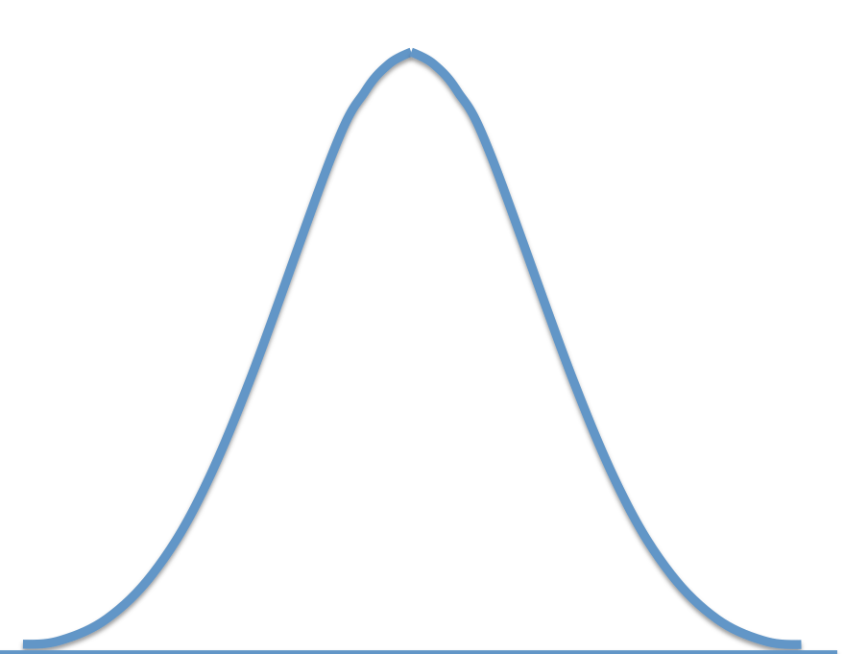
Proper Motions in the HST Era
detection depends on resolution – entering a new era
more distant the target, the faster the velocity for same angular shift
A shift of 1 ACS pixel (50 mas) over 10 years becomes superluminal (faster-than-light) beyond a distance ~ 120 Mpc
LIMITING FACTORS:
- resolution (HST ~< 0.1” )
- sensitivity (WFPC2 is noisy, faint background sources washed out)
- field of view (lesser extent, but important in PC & HRC)
ACS = 202” x 202”
Notes:
Today I’m going to be talking about what we can learn from proper motions of jets. Proper motions are just physical displacements of objects on the sky because they are moving. Now mearing such things requires high angular resolution, and patience in a lot of cases. But we really are entering a new era where telescopes have such resolving power that if you just wait long enough everything moves. Starting from your measurement errors, the speeds you can measure are really dependent on distnace to the target, and how long you wait. If you want to do proper motions of extragalactic targets, of course, it’s basically impossible except for either the very nearby, like companion galaxy M31, or at larger distances, things which move very fast. Note that a shift of 1 ACS pixel, or 50 mas over 10 years becomes equal to the speed of light at 120 Mpc distance, which is very nearby, only a handful of extragalactic jets fall in that volume. So we have to do much better than 1 pixel accuracy, which fortunatley we can. Now I used the speed of light as a metric because this whole field of measuring proper motions of jets is possible because of their extremely relativistic speeds, close to the speed of light. A blob moving with a relativistic speed towards us will feel the doppler effect, and nothing stops the apparent speed from going over c. As I’ll show, at present, given time baselines of 20 years with Hubble at best, we can go out to about 500 Mpc or redshifts of 0.1

Slide 23
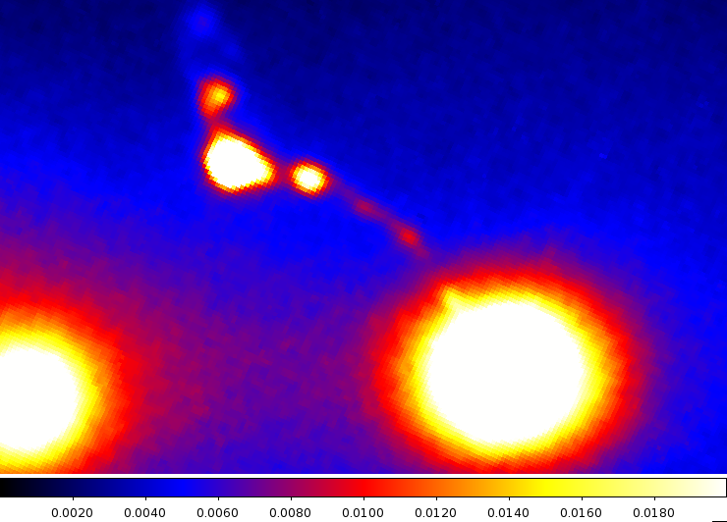
The Present: A New Campaign
20 year baseline + 2 mas accuracy = 1c → 500 Mpc ‘horizon’
3C 273 – powerful quasar jet at 546 Mpc
3C 264, an “M87 analog” at 91 Mpc
3C 346 – unusual ‘bent’ jet in merger system – an FR I/II moderate-power jet at 553 Mpc

Slide 24
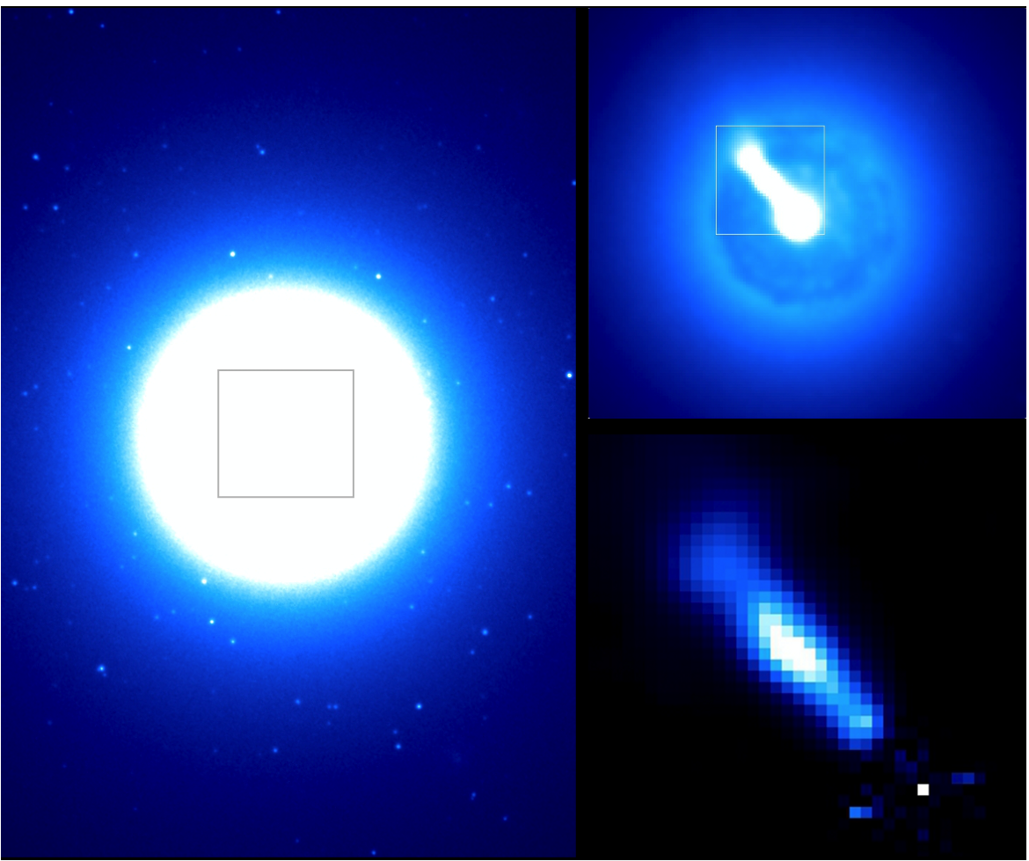
3C 264
Radio (Elliptical) Galaxy
z=0.02 (91 Mpc)
Abell 1367 cluster

Slide 25
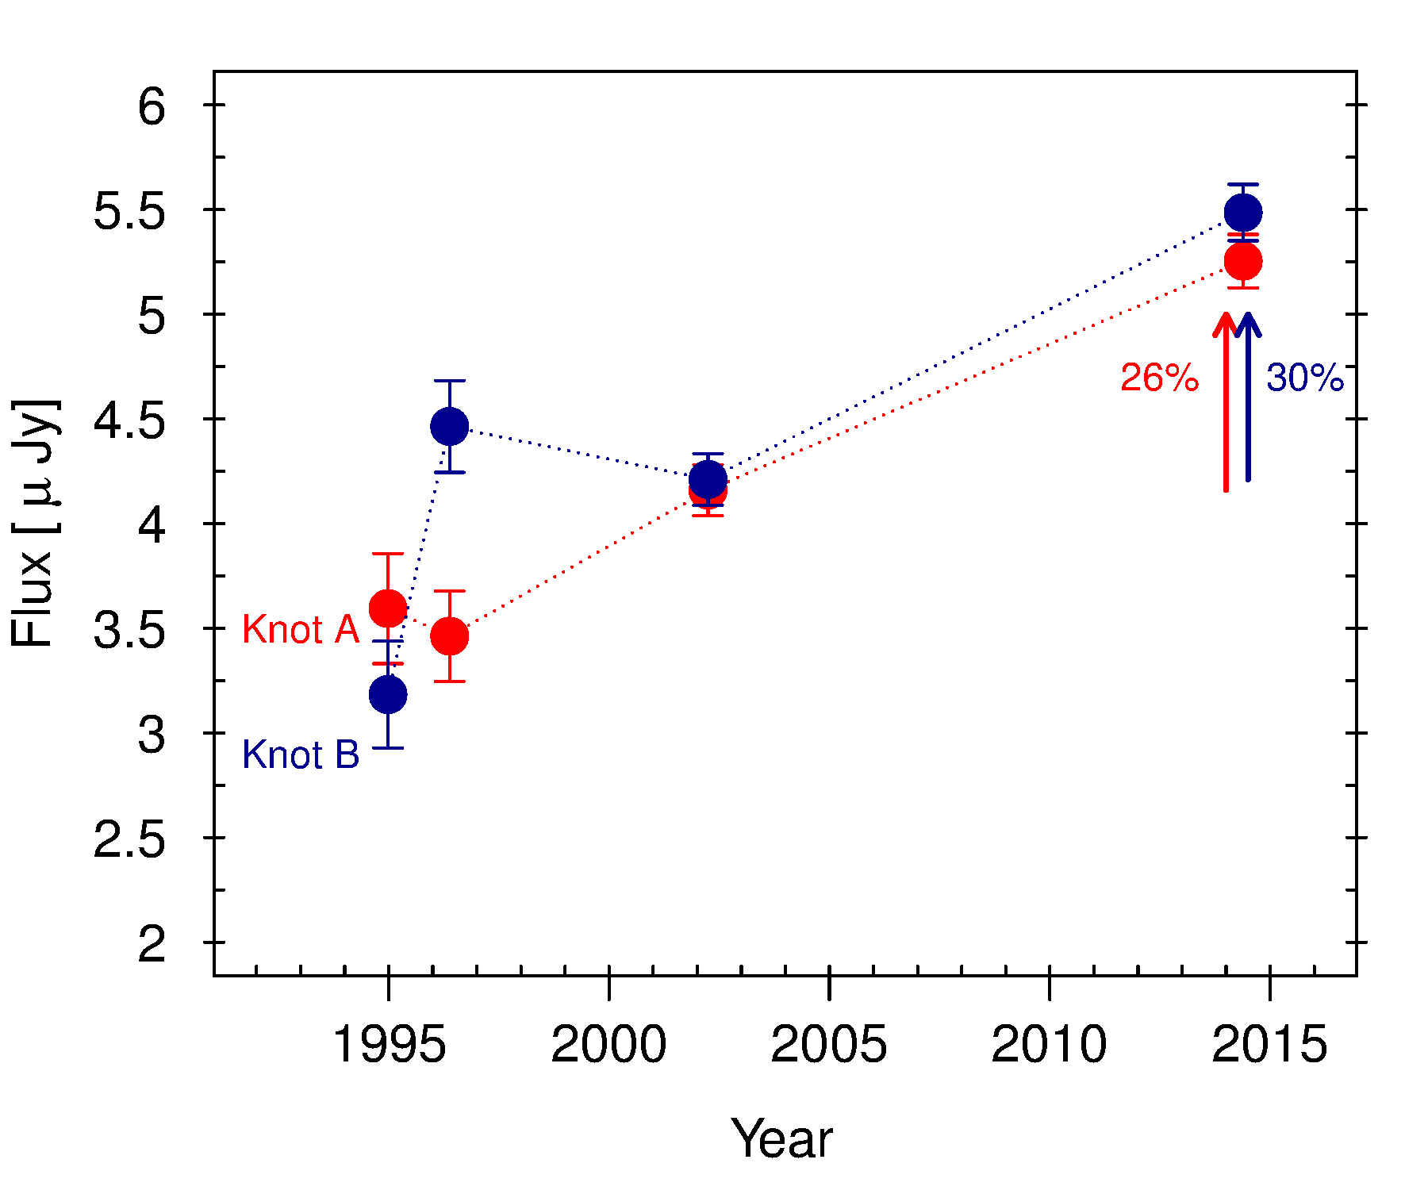
3C 264:First-ever direct evidence for the internal shock model?
3C 264 – 91 Mpc (5x M87 distance)
Jet is 0.4 kpc in length
Knot B has apparent speed of 7+/-0.8 c (highest ever measured at these distances)
Colliding with Knot C in final epoch
Significant Brightening Observed

Slide 26
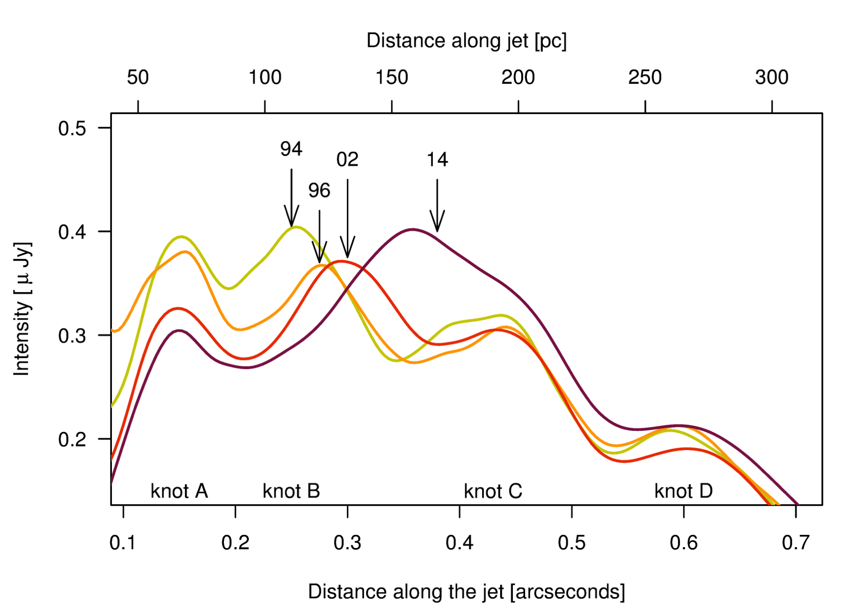

Slide 27
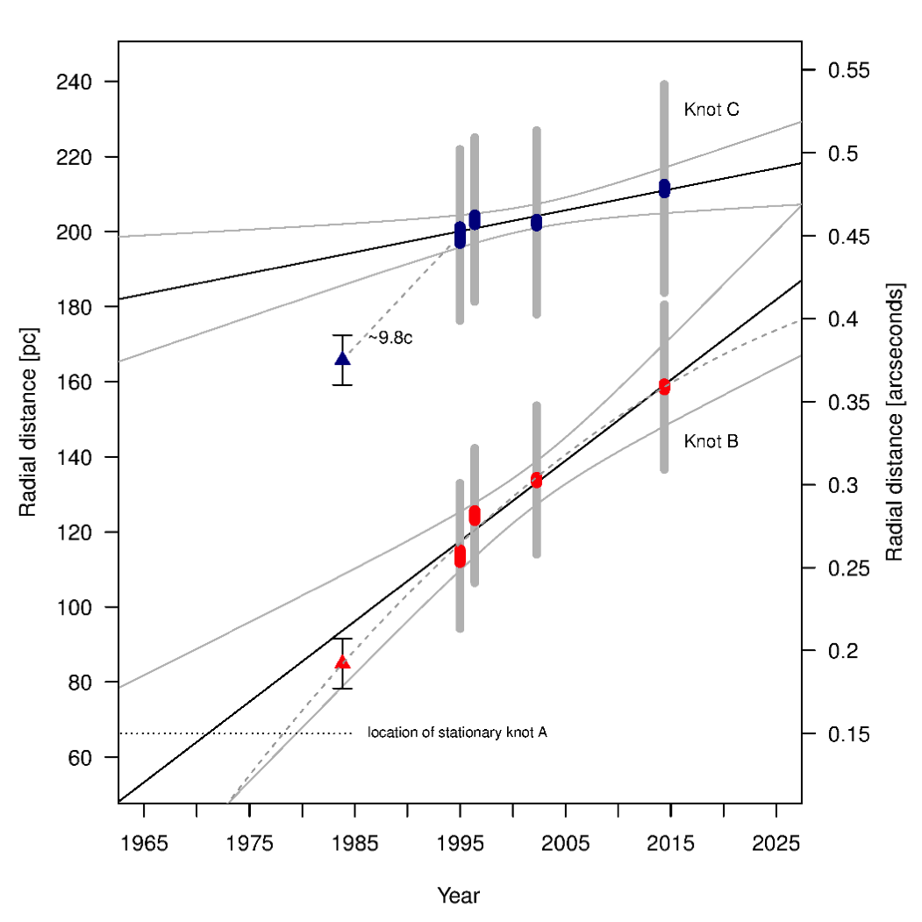

Slide 28
3C 264
(Probable collision timescale ~ 30 years. Ongoing HST monitoring approved!)

Slide 29
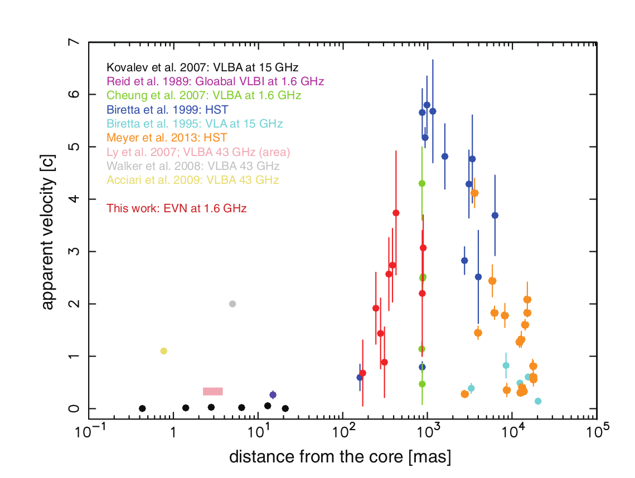
Asada et al., 2014

Slide 30
3C 264 Conclusions
Internal shocks observed in real time
Mass of the knots is only ~ 5% M_{sol}
Timescale is about 30 years to finish colliding
Plan to monitor with HST and VLA
3C 264 looks remarkably like M87, including the presence of a stationary knot ~ 100 pc from the core (aka HST-1 analog)

Slide 31
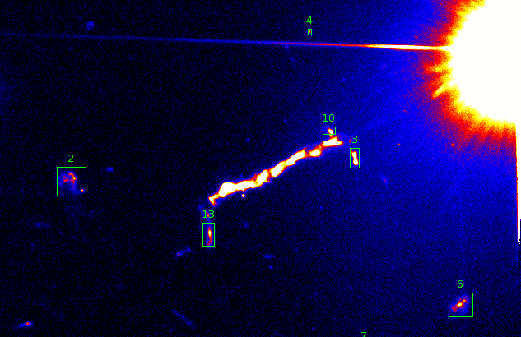
3C 273
Morphology of background galaxies used to register earlier WFPC2/PC exposures

Slide 32
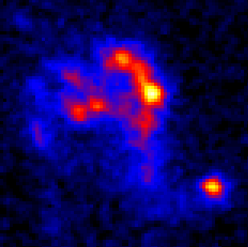
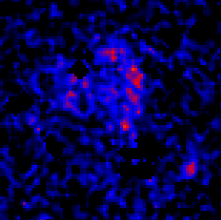
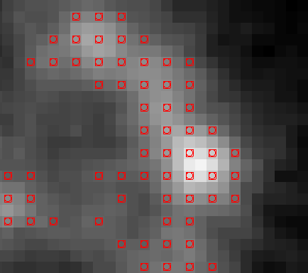
Same galaxy, Single WFPC2 exposure from 1995
2014 ACS/WFC
(deep reference image stack)
Close-up of ‘reference’ pixels as noted by red points
Galaxy positions are determined by finding the optimal overlap over the extent of the galaxy.

Slide 33
3C 273
(submitted to ApJ)
Knot A
The Jet in 1995
The Jet in 2003
The Jet in 2014
The only thing moving is this foreground object!
Results: no apparent proper motions in any knots.
no flux changes (compare to Pictor A, M87, …)
Knot A speed limit of < 2c → RULES OUT IC/CMB X-ray model

Slide 34
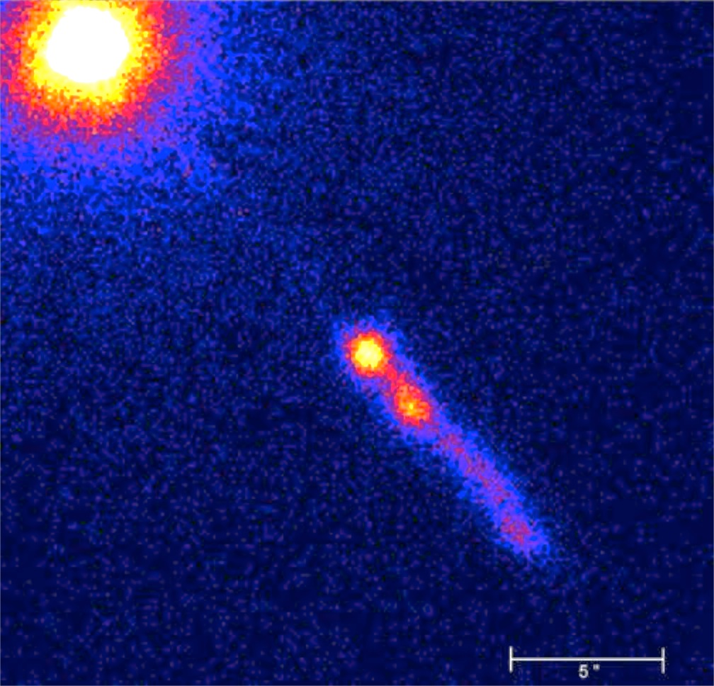
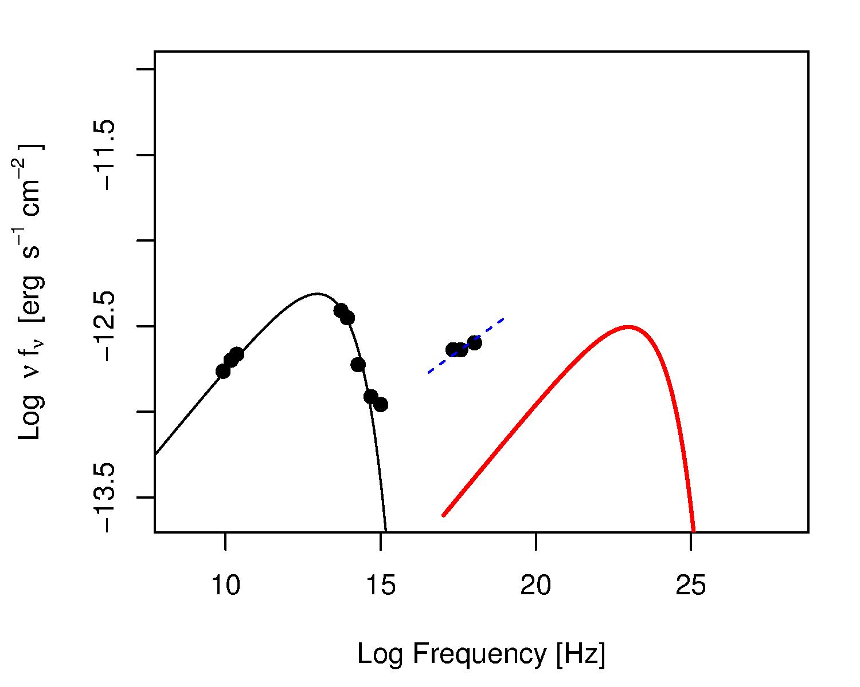
The kpc-scale jet of 3C 273 is very bright in X-rays
X-rays from a second component: inverse Compton or synchrotron?
The popular explanation is that the jet is still highly relativistic (Γ=10)
on kpc scales, so that Doppler-boosted inverse Compton emission from CMB photons can explain the X-rays.
This model explicitly requires that the knots are moving features.
We have thus (independently!) ruled out the IC/CMB model for the X-ray emission in 3C 273.

Slide 35
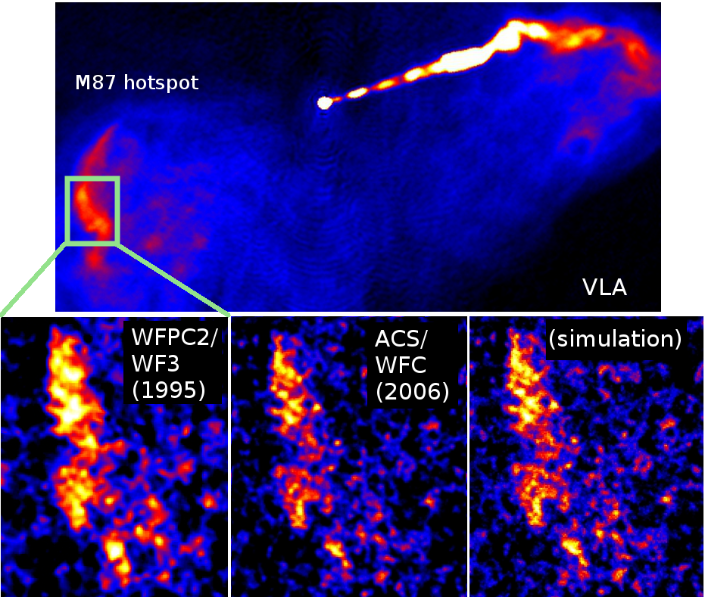
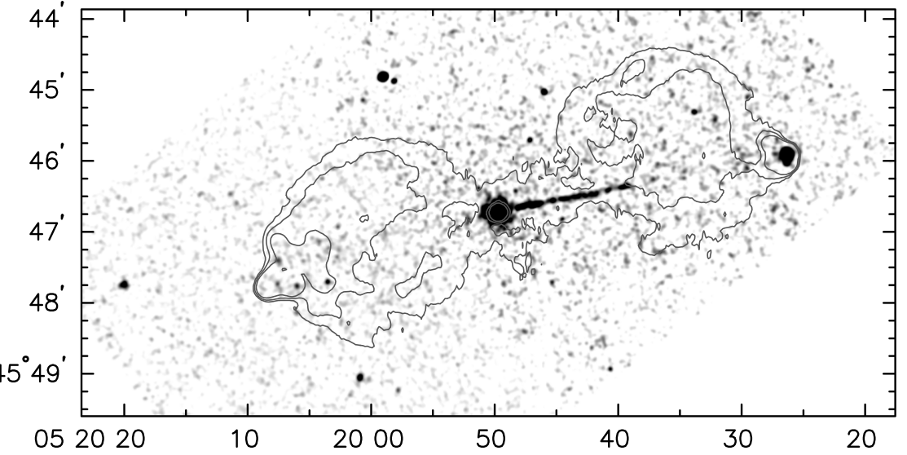
The Future
Analysis of the lensing cluster + jet in 3C 346 ongoing.
“Hotspot” proper motions! → Approved program to measure the advance speed of hotspots in Pictor A and M87

Slide 36
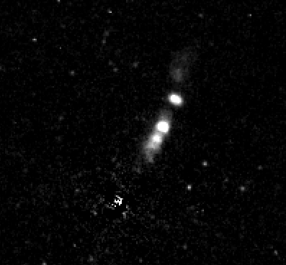
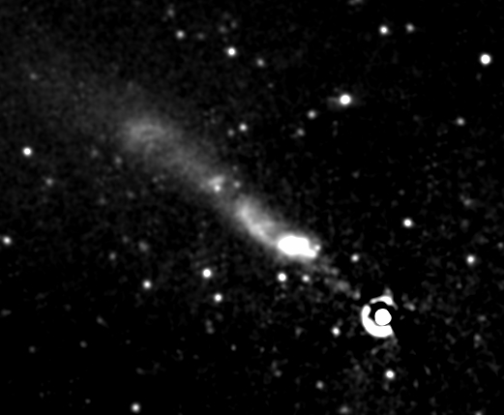
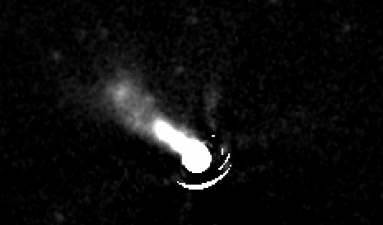
The Future
The remaining 7 jets in the “proper motions sphere” of ~ 500 Mpc – recently approved!
- We require a detection of the optical jet ~ 15 – 20 years ago: usually relies on very short WFPC2 imaging from the 3C snapshot survey
- While 2 baselines is the technical minimum, 3 or more is far better
3C 15 (313 Mpc)
3C 78
(118 Mpc)
3C 66 B (84 Mpc)

Slide 37
The Future
Current & Future Space Observatories
Current list of viable targets:
- Observed by HST < ~ 2000
- Within a z< 0.15
Extending Time Baselines (2 mas over 30 years = 1.8 kpc/” aka z = 0.3
HST – cannot be topped for sensitivity & resolution
JWST
WFIRST
Both can take over -- synchrotron emission doesn’t change much from V-band to R or IR

Slide 38
The Future
From the Ground:
Adaptive Optics? – yes for resolution, ~ for sensitivity
ALMA – changing spectral window to millimeter-wavelengths
Advantage: High Resolution, better compactness of features than VLA, similar long lifetime of instrument (decades)
VLA & ALMA also have issues with needing multiple observations in different configurations to map all scales
However: new techniques (wavelet analysis) may improve the velocity mapping using existing observations

Slide 39
The Future
A New Mission
10-20 times better resolution:
A study that previously took 10-20 years will take 1
No longer reliant on early HST observations!
(prospective, designed studies of individual objects)
Better sensitivity:
There are hundreds of radio jets in the nearby (z<0.1) and nearby-ish
(z<0.3) Universe
Many of these have *not* been detected in the optical, because HST
time is expensive, but almost certainly will be (synchrotron
emission peaks in the optical)
Combined with better resolution, you could complete a massive
survey of jets within z<0.3 very quickly
Plus: Jets and the stationary objects are usually bright (relatively short
exposures, equiv. ½ an orbit with HST)
Bigger Field of View:
More background sources for registration = beat down systematic
errors (but modulo geometric corrections)

Slide 40
A New Mission would allow us to completely map the velocity structure of hundreds of jets from sub-parsec scale near the black hole out to the final deceleration terminus
Very important step towards understanding the actual energetic content of these jets and their structure (note: we still do not know generally what the “knots” in the jets represent)
Critical constraints on the acceleration properties that cannot be probed in any other way.

Slide 42
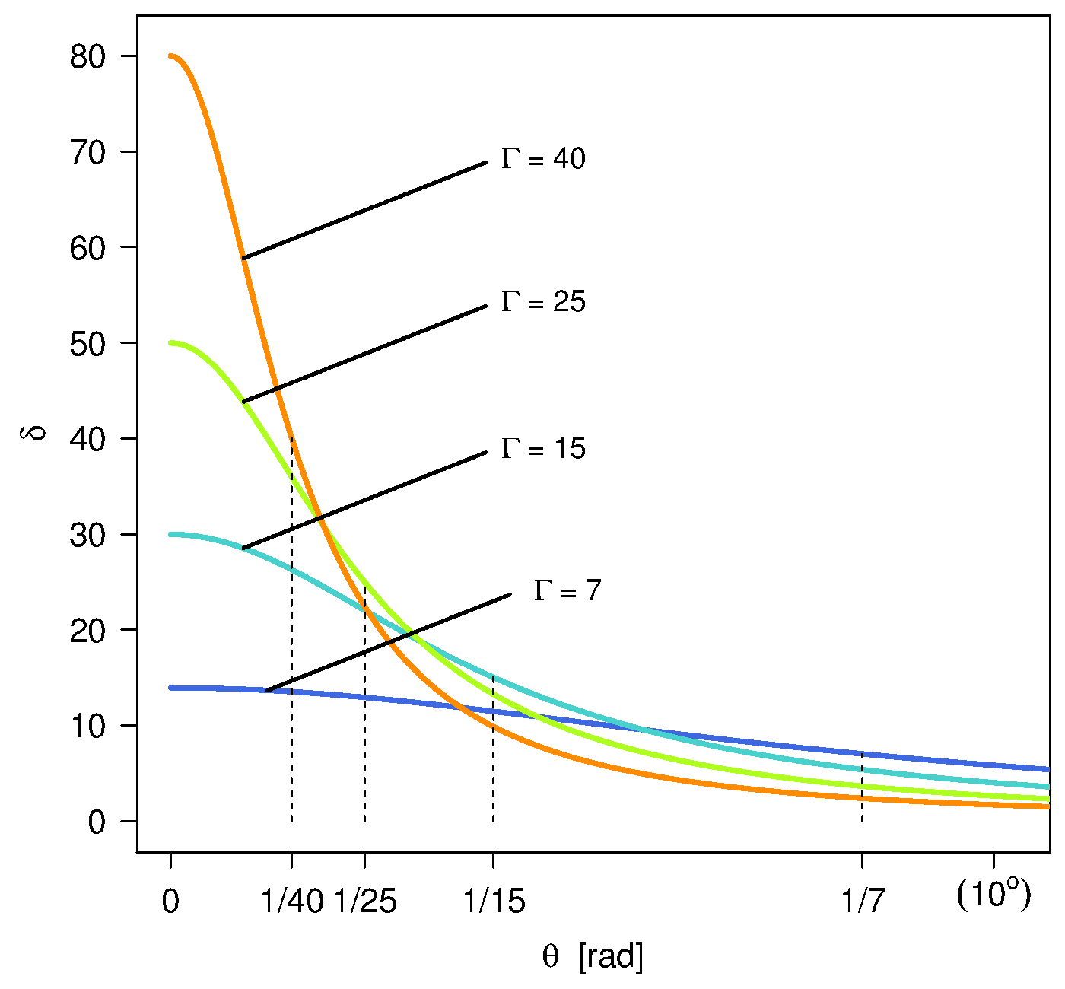
Constraints from Proper Motions
Γ=(1-β²)^{-1/2}
Γ = 2—50

Slide 43
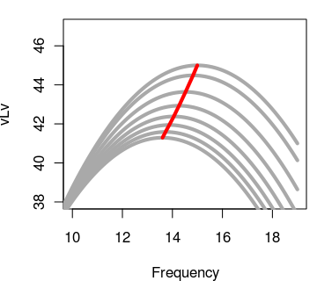
Doppler Boosting of the Apparent Luminosity
and Peak Frequency
ν = δν'

